Slide 1
To easily follow these notes, log on to our Wifi
Wifi: mycci01 p/w: ancientquail060
Go to OrHaOlam.com
Click on downloads, messages, 2017
Notes:
Mtt. 16.24-28 Yeshua's Followers Execution stake
Feb. 25, 2017 5777

Slide 2
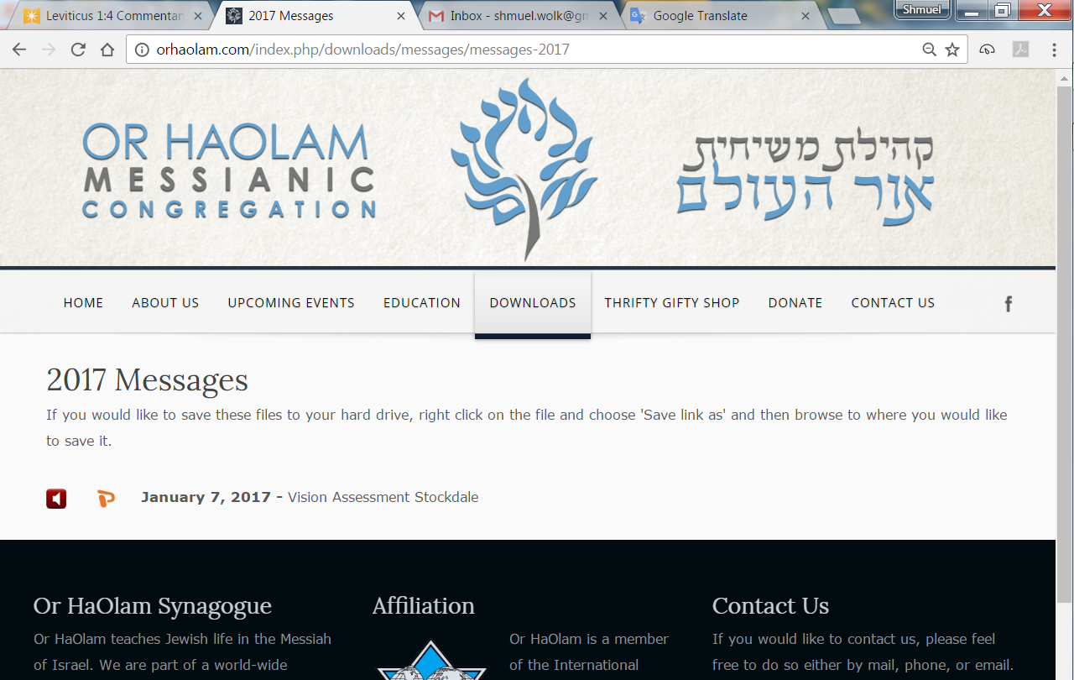
Notes:
Mtt. 16.24-28 Yeshua's Followers Execution stake
Feb. 25, 2017 5777

Slide 3
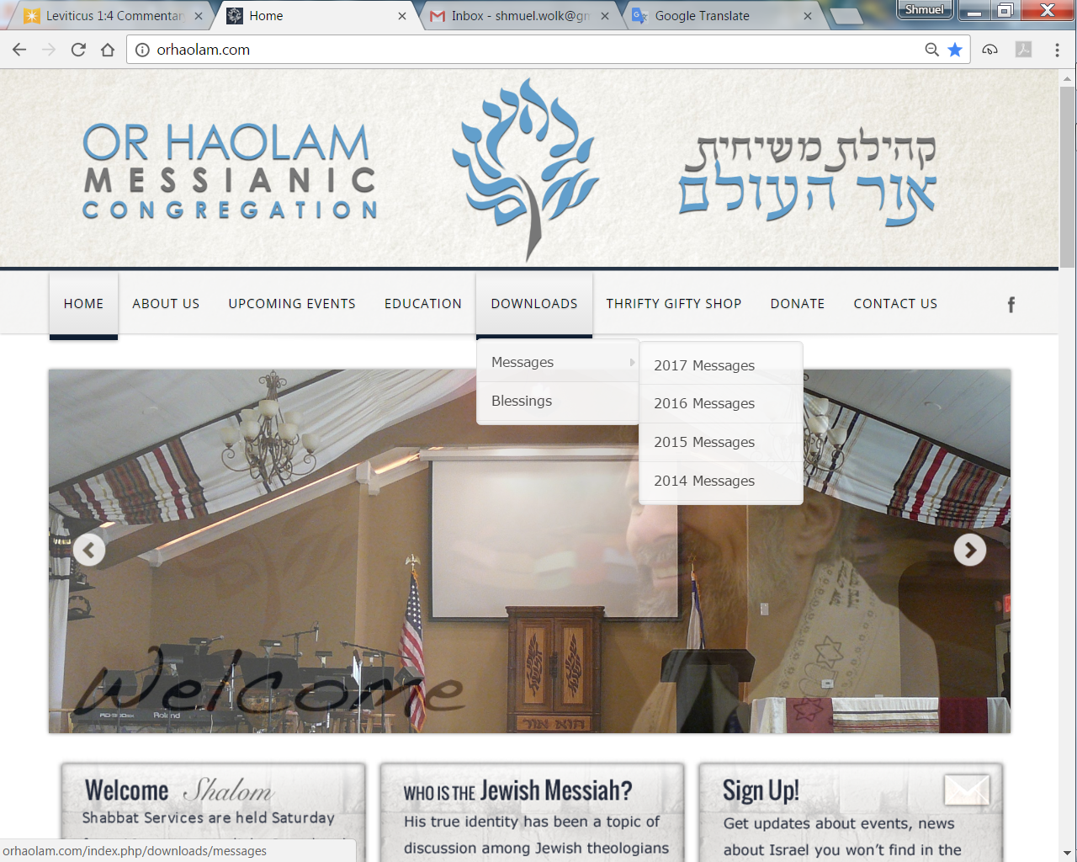
Downloads\messages\
2017 Messages
Notes:
Mtt. 16.24-28 Yeshua's Followers Execution stake
Feb. 25, 2017 5777

Slide 4
In addition to comments on anti-Semitism made by Israel’s PM Netanyahu on 1 March 2017, Yesh Atid chairman Yair Lapid also addressed the issue at the Jewish People Policy Institute conference in Jerusalem saying,
Notes:
Mtt. 16.24-28 Yeshua's Followers Execution stake
Feb. 25, 2017 5777
5 rounds of bomb threats on JCC’s. Monday, Feb 27 on the Jewish Museum in London. The hoax threat came within hours of a similar threat to the Sydney Jewish Museum. Earlier this week, 28 Jewish community centers and Jewish schools, and the San Francisco office of the Anti-Defamation League were evacuated after receiving bomb threats in the fifth wave of such threats since the beginning of the year. (Arutz-7)

Slide 5
“The days in which the Jewish people hid from anti-Semitism are over. We will face it together. Jews “won’t hide anymore, Jews won’t be scared anymore, and we expect the governments of the world to fight anti-Semitism decisively and with all their might”
Notes:
Mtt. 16.24-28 Yeshua's Followers Execution stake
Feb. 25, 2017 5777
5
Jerusalem Post as quoted by Barry & Batya Segal
Our sign proclaims to the world that we are a Jewish synagogue. A Jewish institution. You are here because you are Jewish, or you are standing with Israel. We will NOT be silent. Ultimate reason for March of Remembrance. Clip…

Slide 6
מַתִּתְיָהוּ Mattityahu
(Matthew) 17:1-3
Notes:
Sequence of amazing revelations:
His Deity,
His execution stake death and resurrection,
their execution stake
Now some supernatural strength & comfort
6

Slide 7
Mattityahu (Matthew) 17:1
לְאַחַר שִׁשָּׁה יָמִים לָקַח יֵשׁוּעַ אֶת כֵּיפָא וְאֶת יַעֲקֹב וְאֶת יוֹחָנָן אָחִיו. הוּא הֶעֱלָה אוֹתָם לְהַר גָבוֹהַּ לְבַדָּם
Six days later, Yeshua took Kefa, Ya`akov and his brother Yochanan and led them up a high mountain privately.
Notes:
Six days? Sense of Shabbat?
7

Slide 8
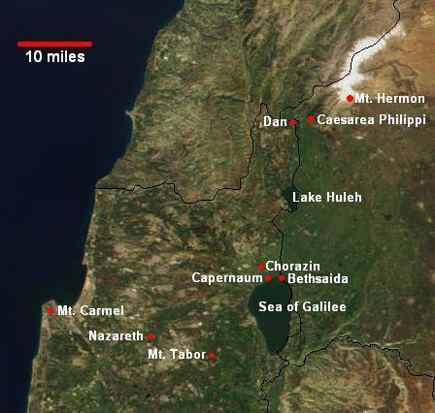
Notes:
8
https://www.google.com/search?q=mt+tabor+israel+map&safe=active&espv=2&biw=1024&bih=679&tbm=isch&imgil=DgovJNTS07MnTM%253A%253B9oxGL3vMNz_9UM%253Bhttps%25253A%25252F%25252Fwww.pinterest.com%25252Fpin%25252F303007881157017465%25252F&source=iu&pf=m&fir=DgovJNTS07MnTM%253A%252C9oxGL3vMNz_9UM%252C_&usg=__qBH5APdDjvWrtiCb1MmQp3-aPnQ%3D&ved=0ahUKEwjatLPzsbvSAhVBRyYKHfEWAREQyjcIKQ&ei=9O65WNrqKMGOmQHxrYSIAQ#q=mt+tabor+israel+map&safe=active&tbm=isch&tbs=rimg:CQ4KLyTU0tOzIjjkxUgKJ8u7vXZ1fA_1eWSSgp0EAQgaxF6DvsoEguKNT7trJMspzrg1gMY8JRmlx4JTJrlO4QjUaZCoSCeTFSAony7u9EU5kUAgd5rTFKhIJdnV8D95ZJKARuMH7FmeASm4qEgmnQQBCBrEXoBFaK7V3ebHX7CoSCe-ygSC4o1PuEQMQT2fR7yyRKhIJ2skyynOuDWARbK8l8_10bfz0qEgkxjwlGaXHglBE2a1DjZm5enSoSCcmuU7hCNRpkEUuka5Rjrgmx&*&imgrc=YhZ2-NKUEHbXDM:
They were at Caesarea Phillippi [Gate of Hell] so mountain
“high mountain privately” Mt. Hermon 9200 ft maybe too rugged, high up, cold.
Mt. Tabor 1900 ft.
Mt. Meron 4000

Slide 9
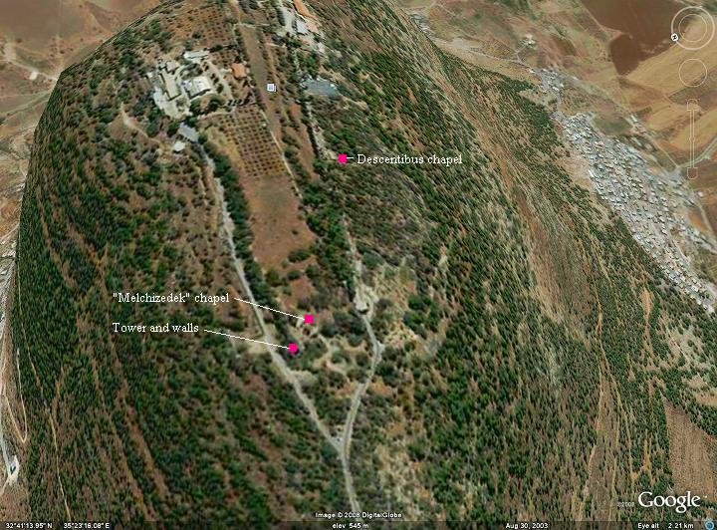
Notes:
Mtt. 16.24-28 Yeshua's Followers Execution stake
Feb. 25, 2017 5777
9

Slide 10
Mattityahu (Matthew) 17:2
וְהִשְׁתַּנָּה לְעֵינֵיהֶם; פָּנָיו זָהֲרוּ כַּשֶּׁמֶשׁ וּבְגָדָיו הִלְבִּינוּ כָּאוֹר.
As they watched, he began to change form — his face shone like the sun, and his clothing became as white as light.
Notes:
Only thing similar in ancient literature is Zeus revealed his heavenly splendor to Semele, but the lightning vaporized her
In Torah history, this has happened before

Slide 11
Blindingly radiant beings
are not new
to Hebrew thought.
Notes:
Mtt. 16.24-28 Yeshua's Followers Execution stake
Feb. 25, 2017 5777
11

Slide 12
^{Daniel 10.4-8} On the twenty-fourth day of the first month, I was on the bank of the great river, the Tigris, when I looked up, and there before me was a man dressed in linen wearing a belt made of fine Ufaz gold. His body was like beryl,
Notes:
Mtt. 16.24-28 Yeshua's Followers Execution stake
Feb. 25, 2017 5777
12

Slide 13
^{Daniel 10.4-6} his face looked like lightning and his eyes like fiery torches; his arms and feet were the color of burnished bronze; and when he spoke, it sounded like the roar of a crowd.
Notes:
Mtt. 16.24-28 Yeshua's Followers Execution stake
Feb. 25, 2017 5777
13

Slide 14
^{Daniel 10.4-8} Only I, Dani’el, saw the vision; the men who were with me did not see the vision; however, a great trembling fell over them; so that they rushed to hide themselves. Thus I was left alone;
Notes:
Mtt. 16.24-28 Yeshua's Followers Execution stake
Feb. 25, 2017 5777
14

Slide 15
^{Daniel 10.4-8} and when I saw this great vision, there was no strength left in me — my face, normally pleasant-looking, became disfigured; and I had no strength.
Notes:
Mtt. 16.24-28 Yeshua's Followers Execution stake
Feb. 25, 2017 5777
15
These angelic beings not sweet and like ceramic figurine.

Slide 16
^{Rev 10.1} Next I saw another mighty angel coming down from heaven. He was dressed in a cloud, with a rainbow over his head; his face was like the sun, his legs like columns of fire;
Notes:
Mtt. 16.24-28 Yeshua's Followers Execution stake
Feb. 25, 2017 5777
16

Slide 17
The righteous after death
Notes:
Mtt. 16.24-28 Yeshua's Followers Execution stake
Feb. 25, 2017 5777
17

Slide 18
^{Daniel 12.2-3} Multitudes who sleep in the dust of the earth will awake—some to everlasting life, and others to shame and everlasting contempt. Those who are wise will shine like the brightness of the heavenly expanse.
Notes:
Mtt. 16.24-28 Yeshua's Followers Execution stake
Feb. 25, 2017 5777
18
Same duration words for righteous and “others”

Slide 19
^{Daniel 12.2-3} And those who turn many to righteousness will be like the stars forever and ever.
Notes:
Mtt. 16.24-28 Yeshua's Followers Execution stake
Feb. 25, 2017 5777
19

Slide 20
^{1 Cor. 15.52-53} For the shofar will sound, and the dead will be raised incorruptible, and we will be changed. For this corruptible must put on incorruptibility, and this mortal must put on immortality.
Notes:
Mtt. 16.24-28 Yeshua's Followers Execution stake
Feb. 25, 2017 5777
20

Slide 21
^{Phil 3.20-21} We expect a Deliverer, the Lord Yeshua the Messiah. He will change the bodies we have in this humble state and make them like his glorious body, using the power which enables him to bring everything under his control.
Notes:
Mtt. 16.24-28 Yeshua's Followers Execution stake
Feb. 25, 2017 5777
21

Slide 22
Visions of G-d Himself
Notes:
Mtt. 16.24-28 Yeshua's Followers Execution stake
Feb. 25, 2017 5777
22

Slide 23
^{Dan 7.9-10} “As I watched, thrones were set in place; and the Ancient One took his seat. His clothing was white as snow, the hair on his head was like pure wool. His throne was fiery flames, with wheels of burning fire.
Notes:
Mtt. 16.24-28 Yeshua's Followers Execution stake
Feb. 25, 2017 5777
23

Slide 24
^{Dan 7.9-10} A stream of fire flowed from his presence; thousands and thousands ministered to him, millions and millions stood before him. Then the court was convened, and the books were opened.
Notes:
Mtt. 16.24-28 Yeshua's Followers Execution stake
Feb. 25, 2017 5777
24

Slide 25
^{2 Thes 1.7-10} Give rest along with us to you who are being troubled, when the Lord Yeshua is revealed from heaven with his mighty angels in a fiery flame. Then he will punish those who don’t know God, that is, those who don’t listen
Notes:
Mtt. 16.24-28 Yeshua's Followers Execution stake
Feb. 25, 2017 5777
25

Slide 26
^{2 Thes 1.7-10} to the Good News of our Lord Yeshua and obey it. They will suffer the just penalty of eternal destruction, far away from the face of the Lord and the glory of his might. On that Day, when he comes to be glorified by his holy people
Notes:
Mtt. 16.24-28 Yeshua's Followers Execution stake
Feb. 25, 2017 5777
26

Slide 27
^{2 Thes 1.7-10} and admired by all who have trusted, you will be among them, because you trusted our witness to you.
Notes:
Mtt. 16.24-28 Yeshua's Followers Execution stake
Feb. 25, 2017 5777
27
Next my favorite.

Slide 28
^{Yeshayahu/Is 6.1-5} In the year of King ‘Uziyahu’s death I saw Adonai sitting on a high, lofty throne! The hem of his robe filled the temple. S’rafim stood over him, each with six wings — two for covering his face, two for covering his feet and two for flying.
Notes:
Mtt. 16.24-28 Yeshua's Followers Execution stake
Feb. 25, 2017 5777
28

Slide 29
^{Yeshayahu/Is 6.1-5} They were crying out to each other, “Holy, holy, holy [more holy than the holiest holiness is Adonai-Tzva’ot!] The whole earth is filled with his glory!”
Notes:
Mtt. 16.24-28 Yeshua's Followers Execution stake
Feb. 25, 2017 5777
29

Slide 30
וְקָרָא זֶה אֶל-זֶה וְאָמַר,
V’kara zeh el zeh v’amar
קָדוֹשׁ קָדוֹשׁ קָדוֹשׁ יְיָ צְבָאוֹת;
Kadosh, Kadosh, Kadosh ADONI Ts’vaot,
מְלֹא כָל-הָאָרֶץ, כְּבוֹדוֹ.
M’lo khawl ha arets c’vodo
Notes:
Mtt. 16.24-28 Yeshua's Followers Execution stake
Feb. 25, 2017 5777
30

Slide 31
^{Yeshayahu/Is 6.1-5} The doorposts shook at the sound of their shouting, and the house was filled with smoke. Then I said,
Notes:
Mtt. 16.24-28 Yeshua's Followers Execution stake
Feb. 25, 2017 5777
31
Maybe surprise effect on the prophet. Instead of enjoying the magnificent vision and special effects…

Slide 32
^{Yeshayahu/Is 6.1-5} “Woe to me! I [too] am doomed! — because I, a man with unclean lips, living among a people with unclean lips, have seen with my own eyes the King, Adonai-Tzva’ot!” …
Notes:
Mtt. 16.24-28 Yeshua's Followers Execution stake
Feb. 25, 2017 5777
32

Slide 33
Application to us: speech
Notes:
Mtt. 16.24-28 Yeshua's Followers Execution stake
Feb. 25, 2017 5777
33

Slide 34
^{Yeshayahu/Is 6.1-5} “Woe to me! I [too] am doomed! — because I, a man with unclean lips, living among a people with unclean lips, have seen with my own eyes the King, Adonai-Tzva’ot!” …
Notes:
Mtt. 16.24-28 Yeshua's Followers Execution stake
Feb. 25, 2017 5777
34

Slide 35
^{Yaakov/Jas 3.5-6} So too the tongue is a tiny part of the body, yet it boasts great things. See how a little fire sets a whole forest ablaze! Yes, the tongue is a fire, a world of wickedness. The tongue is so placed in our body that it defiles every part of it,
Notes:
Mtt. 16.24-28 Yeshua's Followers Execution stake
Feb. 25, 2017 5777
35

Slide 36
^{Yaakov/Jas 3.5-6} setting ablaze the whole of our life; and it is set on fire by Gei-Hinnom itself.
Notes:
Mtt. 16.24-28 Yeshua's Followers Execution stake
Feb. 25, 2017 5777
36

Slide 37
^{Col 4.6} Let your conversation be always full of grace, seasoned with salt, so that you may know how to answer everyone.
Notes:
Mtt. 16.24-28 Yeshua's Followers Execution stake
Feb. 25, 2017 5777
37

Slide 38
Gossip: spreading negative information when the hearer is not part of the problem, nor part of the solution.
Slander: Telling truth with a purpose to hurt.
Notes:
38
https://bible.org/seriespage/lesson-13-have-you-heard-about-gossip-2-samuel-13-15
A congregational bulletin listed the sermon topic for the morning as “Gossip.” Immediately following was the hymn, “I Love to Tell the Story.”

Slide 39
^{Eph 4.29} Let no harmful word come out of your mouth, but only what is beneficial for building others up according to the need, so that it gives grace to those who hear it. Do not grieve the Ruach ha-Kodesh of God.
Notes:
Mtt. 16.24-28 Yeshua's Followers Execution stake
Feb. 25, 2017 5777
39

Slide 40
We may soon have relief from the Johnson Amendment.
Nevertheless, rulers are to be held in highest honor.
Notes:
Mtt. 16.24-28 Yeshua's Followers Execution stake
Feb. 25, 2017 5777
40

Slide 41
Never allowed “Obamination” to be used here.
Praying for Reagan anointing to be on Pres. Trump. State of the Union Address was wonderful.
Notes:
Mtt. 16.24-28 Yeshua's Followers Execution stake
Feb. 25, 2017 5777
41

Slide 42
I can’t compute the term, “I don’t like [name of person]
Can compute “I don’t like [behavior. ]
Notes:
Mtt. 16.24-28 Yeshua's Followers Execution stake
Feb. 25, 2017 5777
42

Slide 43
Application to us:
Theology
Notes:
Mtt. 16.24-28 Yeshua's Followers Execution stake
Feb. 25, 2017 5777
43

Slide 44
Who Was the Person
Seen in Yeshayahu/Is 6?
Notes:
Mtt. 16.24-28 Yeshua's Followers Execution stake
Feb. 25, 2017 5777
44

Slide 45
^{Yeshayahu/Is 6.1-5} …Make the heart of this people [sluggish with] fat, stop up their ears, and shut their eyes. Otherwise, seeing with their eyes, and hearing with their ears,then understanding with their hearts, they might repent and be healed!”
Notes:
Mtt. 16.24-28 Yeshua's Followers Execution stake
Feb. 25, 2017 5777
45

Slide 46
^{Yn 12.37-40} Even though he had performed so many miracles in their presence, they still did not put their trust in him, in order that what Yesha‘yahu the prophet had said might be fulfilled…“He has blinded their eyes and hardened their hearts,
Notes:
Mtt. 16.24-28 Yeshua's Followers Execution stake
Feb. 25, 2017 5777
46

Slide 47
^{Yn 12.37-41} and do t’shuvah,
so that I could heal them.” (Yesha‘yahu said these things because he saw the Sh’khinah of Yeshua and spoke about him.)
Notes:
Mtt. 16.24-28 Yeshua's Followers Execution stake
Feb. 25, 2017 5777
47

Slide 48
^{Yeshayahu/Is 6.1-5} They were crying out to each other, “Holy, holy, holy [more holy than the holiest holiness is Adonai-Tzva’ot!] The whole earth is filled with his glory!”
Notes:
Mtt. 16.24-28 Yeshua's Followers Execution stake
Feb. 25, 2017 5777
48

Slide 49
וְקָרָא זֶה אֶל-זֶה וְאָמַר,
V’kara zeh el zeh v’amar
קָדוֹשׁ קָדוֹשׁ קָדוֹשׁ יְיָ צְבָאוֹת;
Kadosh, Kadosh, Kadosh ADONI Ts’vaot,
מְלֹא כָל-הָאָרֶץ, כְּבוֹדוֹ.
M’lo khawl ha arets c’vodo
Notes:
Mtt. 16.24-28 Yeshua's Followers Execution stake
Feb. 25, 2017 5777
49

Slide 50
Mattityahu (Matthew) 17:3
לְפֶתַע נִרְאוּ אֲלֵיהֶם מֹשֶׁה וְאֵלִיָּהוּ כְּשֶׁהֵם מְדַבְּרִים אִתּוֹ.
Then they looked and saw Moshe and Eliyahu speaking with him.

Slide 51
People in the Presence
Of the glorious G-d
In the Tanakh
Notes:
Mtt. 16.24-28 Yeshua's Followers Execution stake
Feb. 25, 2017 5777
51

Slide 52
^{Shmot / Ex 24.9-11} Moshe, Aharon, Nadav, Avihu and seventy of the leaders went up; and they saw the God of Isra’el. Under his feet was something like a sapphire stone pavement as clear as the sky itself.
Notes:
Mtt. 16.24-28 Yeshua's Followers Execution stake
Feb. 25, 2017 5777
52

Slide 53
^{Shmot / Ex 24.9-11} He did not reach out his hand against these notables of Isra’el; on the contrary, they saw God, even as they were eating and drinking.
Notes:
Mtt. 16.24-28 Yeshua's Followers Execution stake
Feb. 25, 2017 5777
53

Slide 54
^{Shmot/Ex 34.28-29} Moshe was there with Adonai forty days and forty nights, during which time he neither ate food nor drank water. [Adonai] wrote on the tablets the words of the covenant, the Ten Words. When Moshe came down from
Notes:
Mtt. 16.24-28 Yeshua's Followers Execution stake
Feb. 25, 2017 5777
54

Slide 55
^{Shmot/Ex 34.28-29} Mount Sinai with the two tablets of the testimony in his hand, he didn’t realize that the skin of his face was sending out rays of light as a result of his talking with [Adonai]. When Aharon and the people of Isra’el saw Moshe,
Notes:
Mtt. 16.24-28 Yeshua's Followers Execution stake
Feb. 25, 2017 5777
55

Slide 56
^{Shmot/Ex 34.28-29} the skin of his face was shining; and they were afraid to approach him.
Notes:
Mtt. 16.24-28 Yeshua's Followers Execution stake
Feb. 25, 2017 5777
56

Slide 57
^{2 Cor 3.18} But we all, with unveiled face beholding as in a mirror the glory of the Lord, are being transformed into the same image from glory to glory—just as from the Lord, who is the Spirit.
Notes:
Mtt. 16.24-28 Yeshua's Followers Execution stake
Feb. 25, 2017 5777
57

Slide 58
Mattityahu (Matthew) 17:4-5
Kefa said to Yeshua, “It’s good that we’re here, Lord. I’ll put up three shelters if you want — one for you, one for Moshe and one for Eliyahu.” While he was still speaking, a bright cloud enveloped them;
Notes:
Mtt. 16.24-28 Yeshua's Followers Execution stake
Feb. 25, 2017 5777
58

Slide 59
Mattityahu (Matthew 17.4-5)
and a voice from the cloud said, “This is my Son, whom I love, with whom I am well pleased. Listen to him!”
Notes:
Mtt. 16.24-28 Yeshua's Followers Execution stake
Feb. 25, 2017 5777
59

Slide 60
Moshe represented Torah
Eliyahu/Elijah represents the Prophets and the Writings.
Above all, hear Him.
שְׁמַע, יִשְׂרָאֵל יְיָ אֱלֹהֵינוּ יְיָ אֶחָד.
Shma, Yisrael, ADONI Eloheinu, ADONI Ekhad
Notes:
Mtt. 16.24-28 Yeshua's Followers Execution stake
Feb. 25, 2017 5777
60

Slide 61
^{1 Yokhanan 4.1} Dear friends, don’t trust every spirit. On the contrary, test the spirits to see whether they are from God; because many false prophets have gone out into the world.
Notes:
Mtt. 16.24-28 Yeshua's Followers Execution stake
Feb. 25, 2017 5777
61

Slide 62
Very risky to say, “Thus says the L-rd…”
Much better to say, “I think I heard from the L-rd.”
The Enemy can easily imitate the light of G-d’s truth.
Cannot so easily imitate the warmth of G-d love.
Notes:
Mtt. 16.24-28 Yeshua's Followers Execution stake
Feb. 25, 2017 5777
62

Slide 63
Notes:
Mtt. 16.24-28 Yeshua's Followers Execution stake
Feb. 25, 2017 5777
63

