Slide 1
To easily follow these notes, log on to our Wifi
Wifi: mycci01 p/w: ancientquail060
Go to OrHaOlam.com
Click on downloads, messages, 2017

Slide 2
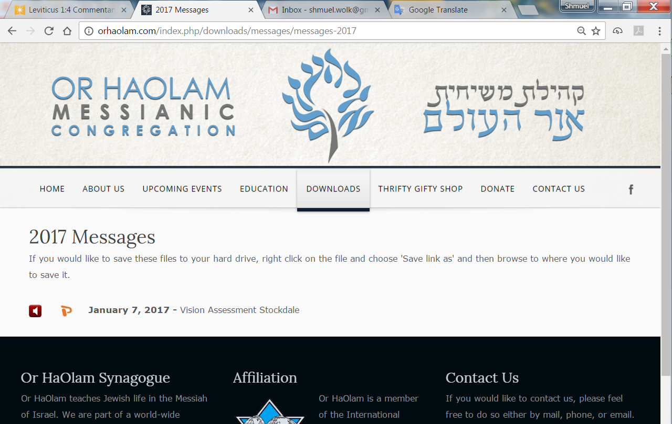

Slide 3
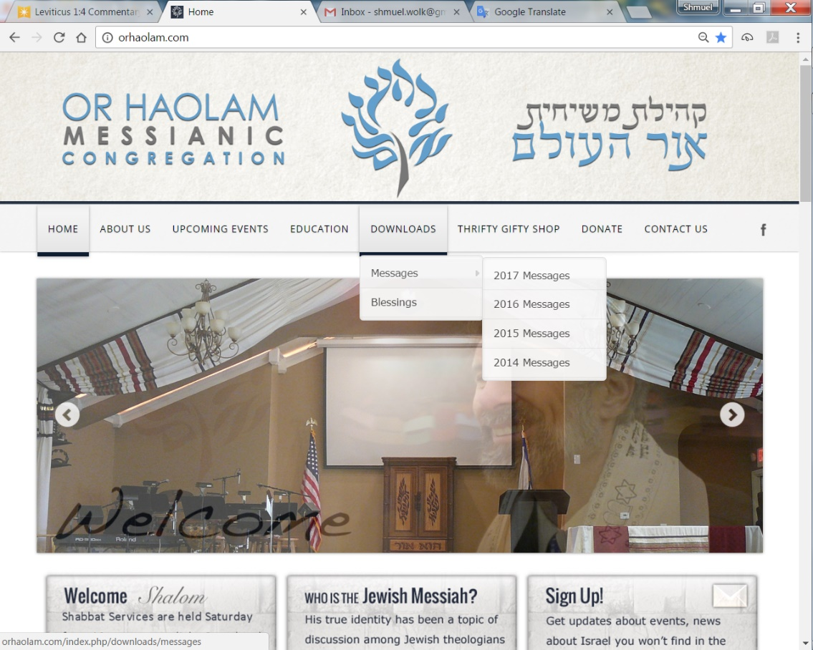
Downloads\messages\
2017 Messages
Notes:
You are likely familiar with the following poem and image. We have a Messianic extension to it.

Slide 4
Notes:
https://blogs.thegospelcoalition.org/evangelical-history/2016/08/19/where-did-the-footprints-poem-come-from/

Slide 5
Notes:
https://blogs.thegospelcoalition.org/evangelical-history/2016/08/19/where-did-the-footprints-poem-come-from/
https://www.pinterest.com/explore/footprints-poem/
Sweet. Good. Soak it in…He carries us.
Here is the Messianic extension.

Slide 6
Notes:
Matt Alford facebook

Slide 7
Notes:
Matt Alford facebook

Slide 8
Our sages have determined that flour from any of five grains - oats, spelt, barley, wheat, rye - that comes into contact with water or moisture will leaven unless fully baked within eighteen minutes. Does the same principle apply to a Rabbi's sermon?
R. Michael Stepakoff Temple New Jerusalem, Dunedin, FL
Notes:
Once we get to the seed of the word, does in leaven in 18 minutes?
Two appropriate answers:

Slide 9
If there is enough fire, the message won’t leaven / get stale in 18 minutes.
The congregation has the once yearly option to call out, after 18 minutes, “Diyaynu! דיינו Enough!”

Slide 10
מַתִּתְיָהוּ Mattityahu
(Matthew) 17:19-20
Notes:
Yeshua and inner 3 leaders descend from the mountain / glory revelation to sea of humanity of sickness, sin, satanic strongholds.

Slide 11
Mattityahu (Matthew) 17:16
הֵבֵאתִי אוֹתוֹ אֶל תַּלְמִידֶיךָ וְהֵם לֹא יָכְלוּ לְרַפְּאוֹ."
I brought him to your talmidim, but they couldn't heal him."
Notes:
Father with a critically sick child!
Distress not solved by Y’s trainees in faith and prayer.

Slide 12
Mattityahu (Matthew) 17:17
הֵשִׁיב יֵשׁוּעַ וְאָמַר: "הוֹי דּוֹר חֲסַר אֱמוּנָה וּמְעַוֵּת דֶּרֶךְ,
Yeshua answered, "Perverted people, without any trust!
Notes:
Yeshua healed the boy, solved the boy’s problem. But the talmidim’s / disciples’ functionality?

Slide 13
Mattityahu (Matthew) 17:19
לְאַחַר מִכֵּן נִגְּשׁוּ הַתַּלְמִידִים אֶל יֵשׁוּעַ לְבַדָּם וְשָׁאֲלוּ: "מַדּוּעַ לֹא יָכֹלְנוּ אֲנַחְנוּ לְגָרֵשׁ אוֹתוֹ?"
Then the talmidim went to him privately and said, "Why couldn't we drive it out?"
Notes:
Why privately? Why not ask right there?
Embarrassed by their failure.
Jewish understanding of Torah has a LOT to say on the theme of embarrassing/humiliating people. Yeshua understood their need for private, non humiliating help with this failure.
Might seem like a rabbit trail, but important.

Slide 14
There is a specific prohibition not to embarrass, that is derived from the Mitzvah of rebuking others. The Torah commands “You shall surely rebuke your friend.” However, the end of the verse: “and you shall not bear iniquity because of him” warns us not to allow the fulfillment
Notes:
http://www.halachipedia.com/index.php?title=Embarrassing_Others
^{Lev 19.17} “Rebuke your neighbor frankly, so that you won't carry sin because of him.

Slide 15
of this commandment to simultaneously cause a transgression of humiliating another.
There is a general prohibition against embarrassing another in any situation.
Notes:
http://www.halachipedia.com/index.php?title=Embarrassing_Others
^{Lev 19.17} “Rebuke your neighbor frankly, so that you won't carry sin because of him.

Slide 16
In addition, anyone who embarrasses another is also failing to fulfil the Mitzvah of [Hebrew] V’ahavta L’reach Kamocha
“Love your neighbor as yourself.”
Rabbinic commentary takes this very strongly. Talmud, etc., not inspired but helpful!
Notes:
http://www.halachipedia.com/index.php?title=Embarrassing_Others

Slide 17
He who publicly shames his neighbor is as though he shed blood.
Verbal wrong is more heinous than monetary wrong.
The pain of shame is even worse than death itself. The Gemara compares embarrassing someone in public to killing them.
Notes:
http://www.halachipedia.com/index.php?title=Embarrassing_Others
Rabbinic: not absolute, but helpful.

Slide 18
As punishment for embarrassing, a person can choose to pay a fine to the victim, or take lashes.
All who descend into Gehenna (hell) eventually leave except for one who publicly shames his neighbor.
Notes:
http://www.halachipedia.com/index.php?title=Embarrassing_Others
Usually justify shaming neighbors.
Rabbinic: not absolute, but helpful.

Slide 19
First acknowledging, then regretting one’s sin.
Privately confessing to God.
Devoting oneself to not committing similar in the future.
Ask for absolute forgiveness from the one you shamed.
Notes:
http://www.halachipedia.com/index.php?title=Embarrassing_Others
Whenever anything goes wrong at Or HaOlam, no matter whose mistake, failure, forgetting, I always say, “I failing to communicate.” “There was a problem.” “Something went wrong.” Never point out the faulty person. At least that’s my plan. “Buck stops here,” in any case. It’s all my fault.

Slide 20
Tamar was willing to be burned rather than shame Yehuda in Genesis 38.
Nobody likes to be embarrassed. In the context of rebuke, it can also make a huge impact on the outcome.
Notes:
https://www.ou.org/torah/mitzvot/taryag/mitzvah240/
There are times of appropriate public rebuke, but less than we imagine.

Slide 21
If properly corrected, a person might change his ways. But if someone is called out in public, he’ll be embarrassed, angry, and resentful.
Notes:
https://www.ou.org/torah/mitzvot/taryag/mitzvah240/
There are times of appropriate public rebuke, but less than we imagine.

Slide 22
He’ll hate the one who rebuked him and probably become more stubborn in his ways out of spite. It’s a bad scene. But even outside the context of rebuke, we must be careful not to shame others.
This mitzvah applies to both men and women in all times and places.
Notes:
https://www.ou.org/torah/mitzvot/taryag/mitzvah240/

Slide 23
Mattityahu (Matthew) 17:19
לְאַחַר מִכֵּן נִגְּשׁוּ הַתַּלְמִידִים אֶל יֵשׁוּעַ לְבַדָּם וְשָׁאֲלוּ: "מַדּוּעַ לֹא יָכֹלְנוּ אֲנַחְנוּ לְגָרֵשׁ אוֹתוֹ?"
Then the talmidim went to him privately and said, "Why couldn't we drive it out?"
Notes:
Yeshua seemed totally in sync with this. Although gave public rebukes, as appropriate. All Matt 23 is a public rebuke, but even then, concluded with hope.
So, He privately addresses their failure…

Slide 24
Mattityahu (Matthew) 17:20
הֵשִׁיב לָהֶם: "בִּגְלַל מִעוּט אֱמוּנַתְכֶם. אָמֵן אוֹמֵר אֲנִי לָכֶם, אִם יֵשׁ לָכֶם אֱמוּנָה כְּגַרְגִּיר הַחַרְדָּל
He said to them, "Because you have such little trust! Yes! I tell you that if you have trust as tiny as a mustard seed,
Notes:
Not none, but little.

Slide 25
Mattityahu (Matthew) 17:20
וְתֹאמְרוּ לָהָר הַזֶּה 'זוּז מִפֹּה לְשָׁם' -- הוּא יָזוּז, וְשׁוּם דָּבָר לֹא יִבָּצֵר מִכֶּם.
You will be able to say to this mountain, 'Move from here to there!' and it will move; indeed, nothing will be impossible for you!"
Notes:
Many of you were here when Bob Weiner was here. Really strong exhortation to me on faith. Bob’s the one whose counsel launched most of our major Messianic leaders: Jon Bernis, Paul Wilbur, Dan Juster, etc. Radically affected me. Since, we’ve bought this facility, my personal outreach at the J, Bernstein coming. Faith.

Slide 26
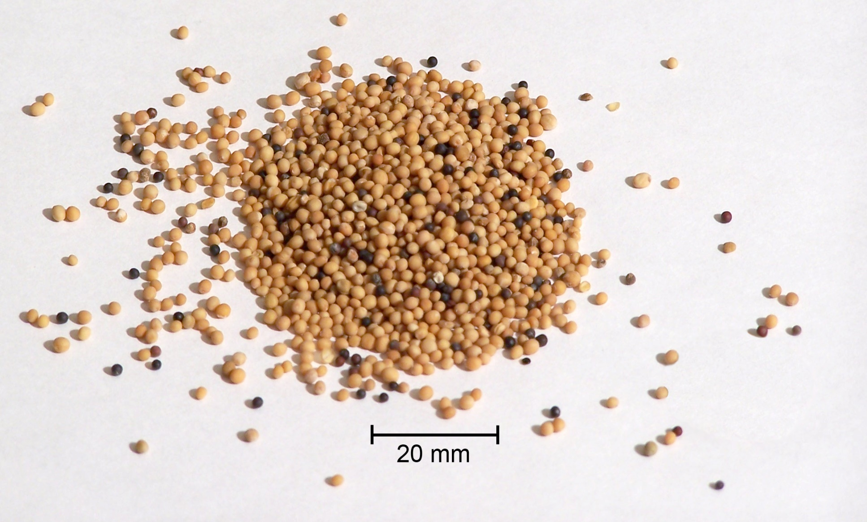
Mustard seeds, about 1/16 in.
Notes:
Not precisely smallest in botanical world, but proverb of the times.

Slide 27
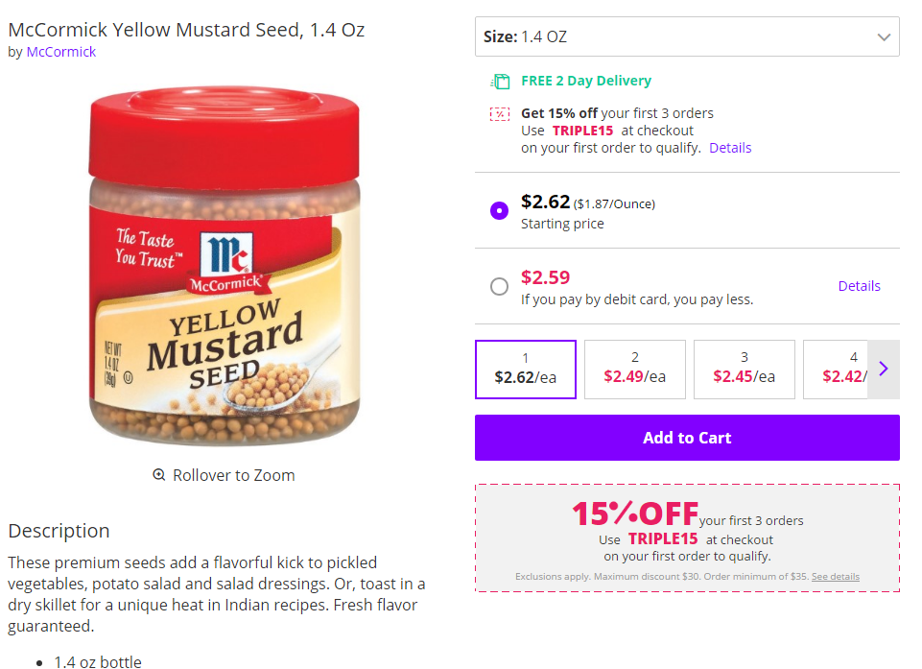
Notes:
$2.62 for 1.4 oz, not expensive

Slide 28
Mattityahu (Matthew) 13:32
אַךְ לְאַחַר צְמִיחָתוֹ גָּדוֹל הוּא מִן הַיְּרָקוֹת
But when it grows up it is larger
than any garden plant.“
lachanōn λαχάνων an herb, garden plant, vegetable: no woody tissue.
Notes:
Keep that in mind «No woody tissue» in a lachanon

Slide 30
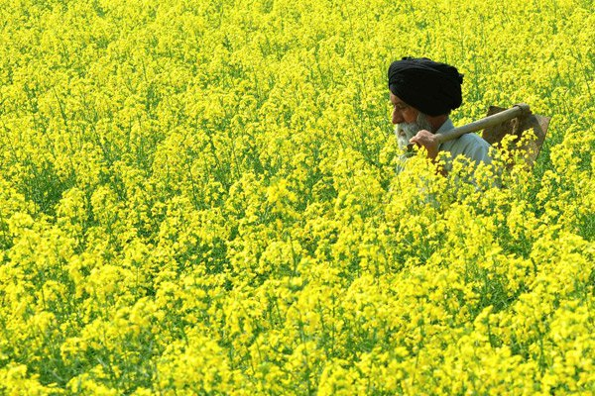
An Indian farmer walks through a mustard field in Baran village
Notes:
It IS a tall herb, but still an herb, not woody.

Slide 31
lachanōn λαχάνων an herb, garden plant, vegetable
no woody tissue
Annual, not perenial. Needs replanting from seed annually.
Notes:
Not rigid or brittle, soft, succulent, with medicinal value. NOT: “My way or the highway” in non-essentials. ^{Eph 4.29-32} Let no harmful word come out of your mouth, but only what is beneficial for building others up according to the need, so that it gives grace to those who hear it. Do not grieve the Ruach ha-Kodesh of God, by whom you were sealed for the day of redemption. Get rid of all bitterness and rage and anger and quarreling and slander, along with all malice. Instead, be kind to one another, compassionate, forgiving each other just as God in Messiah also forgave you. Subtle
Annual: NOT permanent. Dependent on new LIFE in the Ruakh. Effort in prayer to keep life in an organization for many generations. Easy to rigidify.

Slide 32
Mattityahu (Matthew) 17:20
הֵשִׁיב לָהֶם: "בִּגְלַל מִעוּט אֱמוּנַתְכֶם. אָמֵן אוֹמֵר אֲנִי לָכֶם, אִם יֵשׁ לָכֶם אֱמוּנָה כְּגַרְגִּיר הַחַרְדָּל
He said to them, "Because you have such little trust! Yes! I tell you that if you have trust as tiny as a mustard seed,
Notes:
Not none, but little.

Slide 33
Mattityahu (Matthew) 17:20
וְתֹאמְרוּ לָהָר הַזֶּה 'זוּז מִפֹּה לְשָׁם' -- הוּא יָזוּז, וְשׁוּם דָּבָר לֹא יִבָּצֵר מִכֶּם.
You will be able to say to this mountain, 'Move from here to there!' and it will move; indeed, nothing will be impossible for you!"

Slide 34
So, how do we get this mustard seed of faith?

Slide 35
^{Ro 10.16-17} ^{TLV} So faith comes from hearing, and hearing by the word of Messiah.
Notes:
Time in the Word. Daily. Regularly. Deeply. With commentaries or without. Marty Chernoff: all who serve must have a commitment to an hour / day in devotions. Me: encourage, suggest.
What if, “I don’t like to read.”

Slide 36
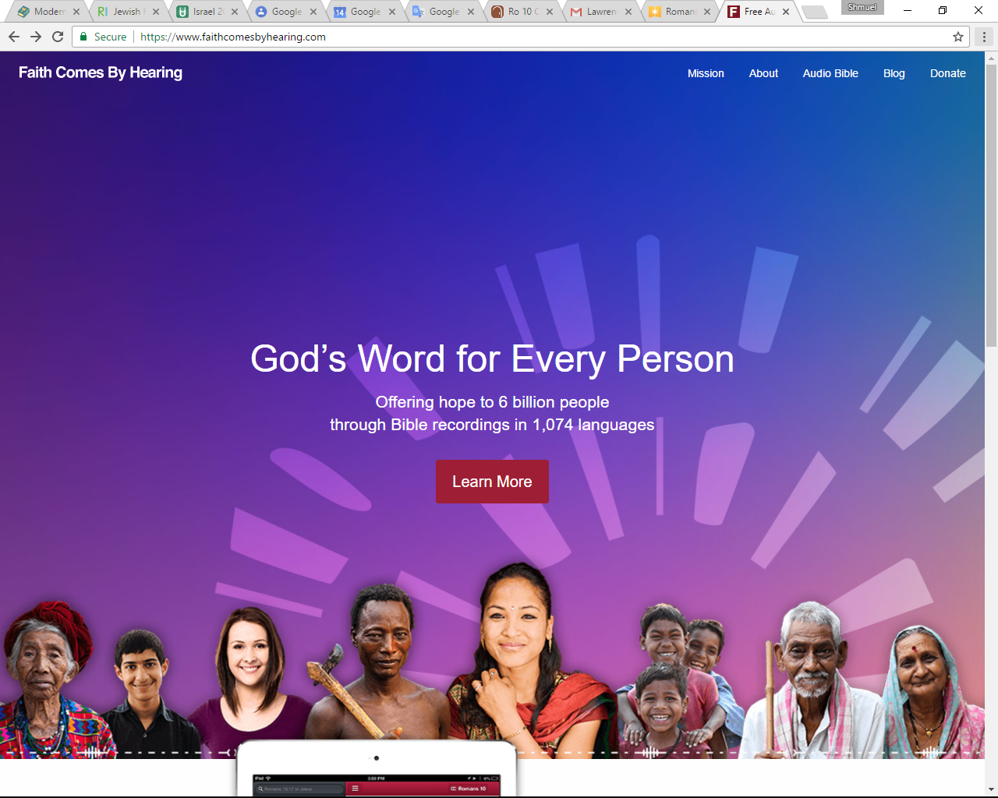

Slide 38
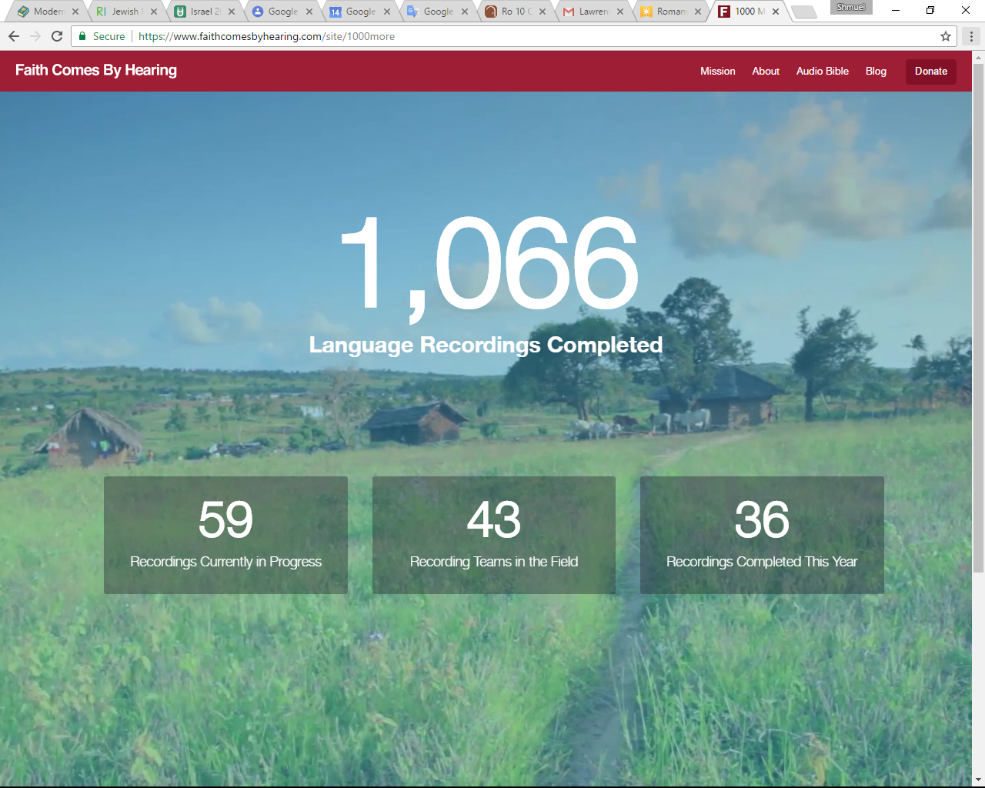
Notes:
https://www.faithcomesbyhearing.com/audio-bibles/resources
Actually, 1307 languages on my phone, as long as I have internet access: hear and read!
https://www.faithcomesbyhearing.com/about/our-story

Slide 39
Notes:
Download to your smartphone in English, Spanish, French, Russian, Hebrew, German, Chinese, Japanese, Indonesian…
And read or listen or both. 1307 languages on my phone!

Slide 40
^{Ro 10.16-17} ^{TLV} So faith comes from hearing, and hearing by the word of Messiah.
Notes:
I don’t like to read. Love letter from your King! Four chapters/most days for me.

Slide 41
^{Eph. 6.16} Always carry the shield of trust, with which you will be able to extinguish all the flaming arrows of the Evil One.
Discouragement
Temptation
Rejection
Bitterness
Notes:
Life’s going to be miserable, but I’ll trust G-d. No, no, no…Life will be GOOD, in His love.
Temptations NOT resisted, rather FLEE.
People are against me, speaking bad of me. Great cure for worrying what people think about you, is that they don’t. But, Yeshua thinks about you ALL the time, thoughts of love and hope and peace.
I’ve been hurt. I’ll serve G-d, but not with THEM. Shield of faith→ “I choose to forgive. Don’t feel like it. And bless, and love.” Feelings will come. May need to process the hurt with the person, but without embarrassing them.

Slide 42
^{Eph. 6.13-16} So take up every piece of war equipment God provides; so that when the evil day comes, you will be able to resist; and when the battle is won, you will still be standing. Therefore, stand! Have the belt of truth buckled around your waist,

Slide 43
Notes:
Belt of truth, “loins girt about with truth” modesty, purity. Truth is from the Word.

Slide 44
^{Eph. 6.13-16} put on righteousness for a breastplate, and wear on your feet the readiness that comes from the Good News of shalom. Always carry the shield of trust, with which you will be able to extinguish all the flaming arrows of the Evil One.
Notes:
Breastplate over heart filled with love = righteousness
Feet = go → serve, speak,

Slide 45
^{Eph 4.25-27 TLV} So lay aside lying and “each one of you speak truth with his neighbor,” for we are members of one another. “Be angry, yet do not sin.” Do not let the sun go down on your anger, nor give the devil a foothold.
Notes:
Commit to TRUST. Decide to trust. Not faith in your faith, your mental energy, but in your Messiah…
Next verse, Yeshua gives grid for faith…

Slide 46
As they were going about together in the Galil, Yeshua said to them, “The Son of Man is about to be betrayed into the hands of people who will put him to death, and on the third day he will be raised.” And they were filled with sadness.
Mattityahu (Matthew) 17:22-23
Notes:
But really, essence of bedrock of faith. Death and resurrection of Messiah…next Shabbat theme.

Slide 47
^{Yeshayahu/Isaiah 53.7-8} Though mistreated, he was submissive — he did not open his mouth. Like a lamb led to be slaughtered, like a sheep silent before its shearers, he did not open his mouth.

Slide 48
^{Yeshayahu/Isaiah 53.7-8} After forcible arrest and sentencing, he was taken away; and none of his generation protested his being cut off from the land of the living for the crimes of my people, who deserved the punishment themselves.

Slide 49
^{Yeshayahu/Isaiah 53.11} As a result of the anguish of His soul He will see it and be satisfied by His knowledge. The Righteous One, My Servant will make many righteous and He will bear their iniquities.
Notes:
An example of trust in effect...[anyone see the movie Faith Like Potatoes?]

Slide 50
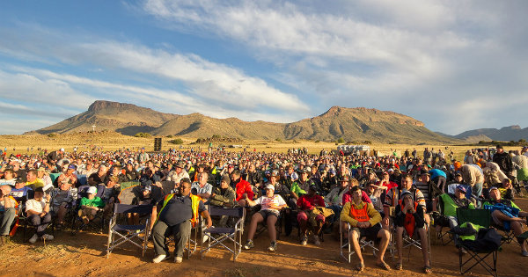
South Africa’s Shalom!
Notes:
http://www.israeltoday.co.il/NewsItem/tabid/178/nid/31409/Default.aspx
A major revival is taking place in South Africa, and a key element is love and support for Israel and the Jewish people.
Who would’ve thought?!

Slide 51
Churches in all parts of South Africa – incorporating black and white as well as English and Afrikaans-speaking – are bursting with new life as they prove a counter-cultural provocation to secularists, humanists and others
Notes:
http://www.israeltoday.co.il/NewsItem/tabid/178/nid/31409/Default.aspx

Slide 52
and especially to a government rife with corruption and virulently opposed to Israel, even to the extent of virtually cutting off diplomatic ties with the Jewish state. This is in spite of the fact that it was Jews who led the resistance to apartheid in the days of the old whites-only Parliament.
Notes:
http://www.israeltoday.co.il/NewsItem/tabid/178/nid/31409/Default.aspx

Slide 53
One man perhaps stands out among the many leaders of this movement for the influence he has had – and that is Angus Buchan, a humble farmer who doubled as an evangelist soon after a dramatic encounter with Messiah in 1979.
Notes:
http://www.israeltoday.co.il/NewsItem/tabid/178/nid/31409/Default.aspx

Slide 54
His campaigns reaped rewards, but then God called him to focus his attention on men – and he has been faithful to this task ever since, drawing both young and old men to weekend camps initially held at Shalom, his KwaZulu-Natal farm, for seven consecutive years.
Notes:
http://www.israeltoday.co.il/NewsItem/tabid/178/nid/31409/Default.aspx

Slide 55
Author of the best-selling Faith Like Potatoes which has been made into a powerful movie, Angus has also led meetings in Israel, where manifestations of the Spirit such as a mighty, rushing wind (see Acts 2.2) have been evident.
Notes:
http://www.israeltoday.co.il/NewsItem/tabid/178/nid/31409/Default.aspx

Slide 56
In South Africa, meanwhile, up to a million people are expected to descend on the central city of Bloemfontein (which, incidentally, translates “flower fountain”) in a fortnight’s time (April 22, 2017) to pray for their nation following a call from the man they have all come to know as Oom (Uncle) Angus!
Notes:
http://www.israeltoday.co.il/NewsItem/tabid/178/nid/31409/Default.aspx

Slide 57
South Africa’s Shalom!
Notes:
http://www.israeltoday.co.il/NewsItem/tabid/178/nid/31409/Default.aspx
A major revival is taking place
in South Africa, and a key
element is love and support for
Israel and the Jewish people

Slide 58
What do you need from G-d?
Repent and BELIEVE.
Forgiveness and peace.
Joy in difficulties.
Family relations.
Financial needs.
Health needs.

Slide 59
Mattityahu (Matthew) 17:20
הֵשִׁיב לָהֶם: "בִּגְלַל מִעוּט אֱמוּנַתְכֶם. אָמֵן אוֹמֵר אֲנִי לָכֶם, אִם יֵשׁ לָכֶם אֱמוּנָה כְּגַרְגִּיר הַחַרְדָּל
He said to them, "Because you have such little trust! Yes! I tell you that if you have trust as tiny as a mustard seed,
Notes:
Not none, but little.

Slide 60
Mattityahu (Matthew) 17:20
וְתֹאמְרוּ לָהָר הַזֶּה 'זוּז מִפֹּה לְשָׁם' -- הוּא יָזוּז, וְשׁוּם דָּבָר לֹא יִבָּצֵר מִכֶּם.
You will be able to say to this mountain, 'Move from here to there!' and it will move; indeed, nothing will be impossible for you!"

Slide 61
As they were going about together in the Galil, Yeshua said to them, “The Son of Man is about to be betrayed into the hands of people who will put him to death, and on the third day he will be raised.” And they were filled with sadness.
Mattityahu (Matthew) 17:22-23
Notes:
Faith through suffering, because of Messiah and His resurrection!

