Slide 1
To easily follow these notes, log on to our Wifi
Wifi: mycci01 p/w: ancientquail060
Go to OrHaOlam.com
Click on downloads, messages, 2017

Slide 2
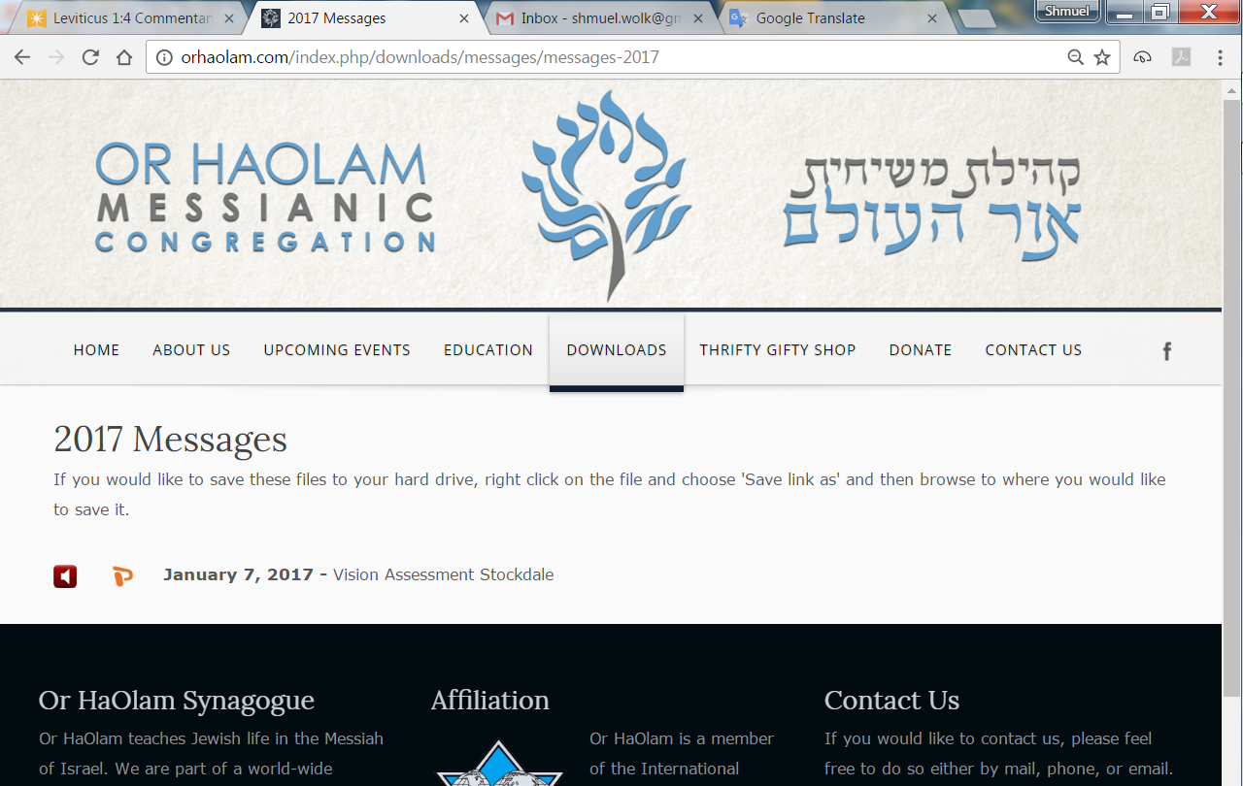

Slide 3
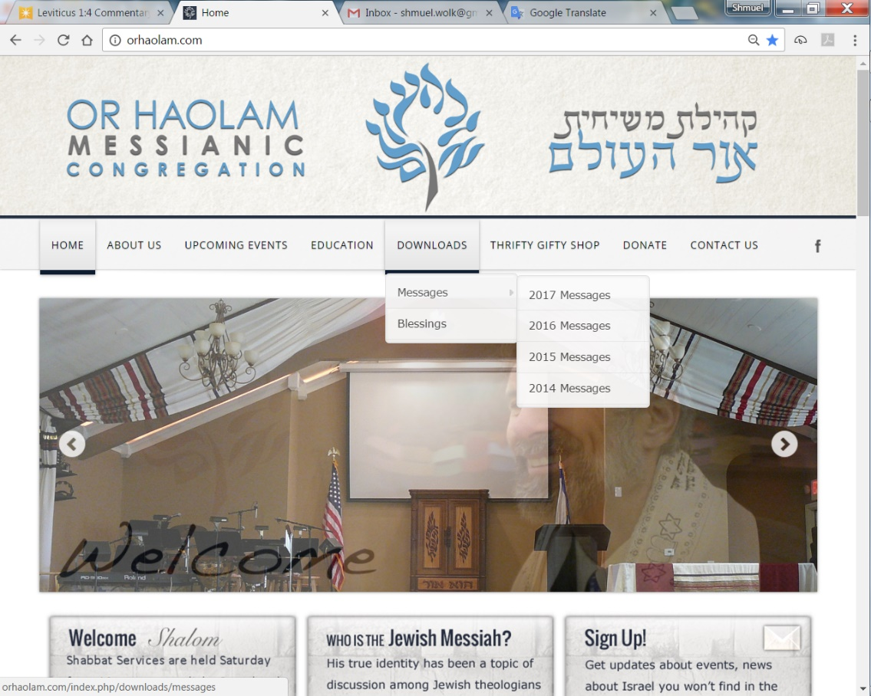
Downloads\messages\
2017 Messages

Slide 4
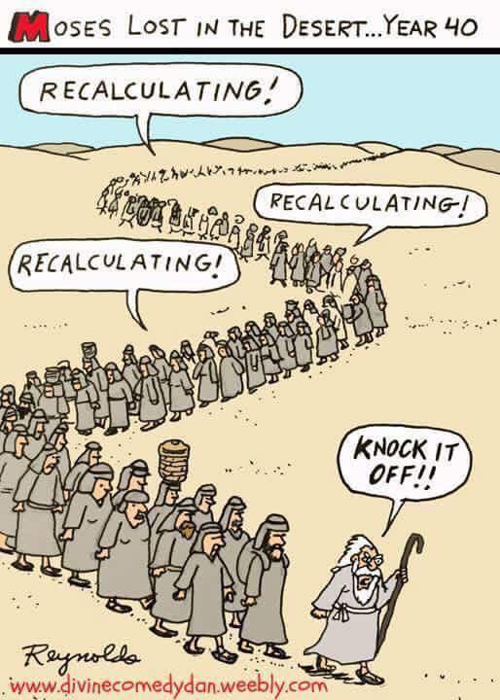
Notes:
Ps 8 When I consider Your heavens…

Slide 5
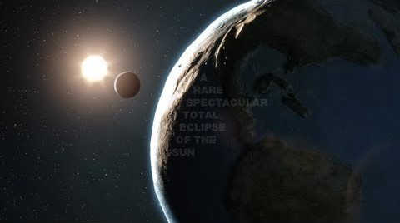
Notes:
http://www.scienceworldreport.com/articles/54882/20161217/total-solar-eclipse-will-occur-august-2017-scientists-gearing-up.htm
Aug. 21, 2017

Slide 6
Total Solar Eclipse
Aug 21, 2017
Notes:
Penumbra → partial eclipse
umbra = totality, small shadow
Every 400 years given location

Slide 7
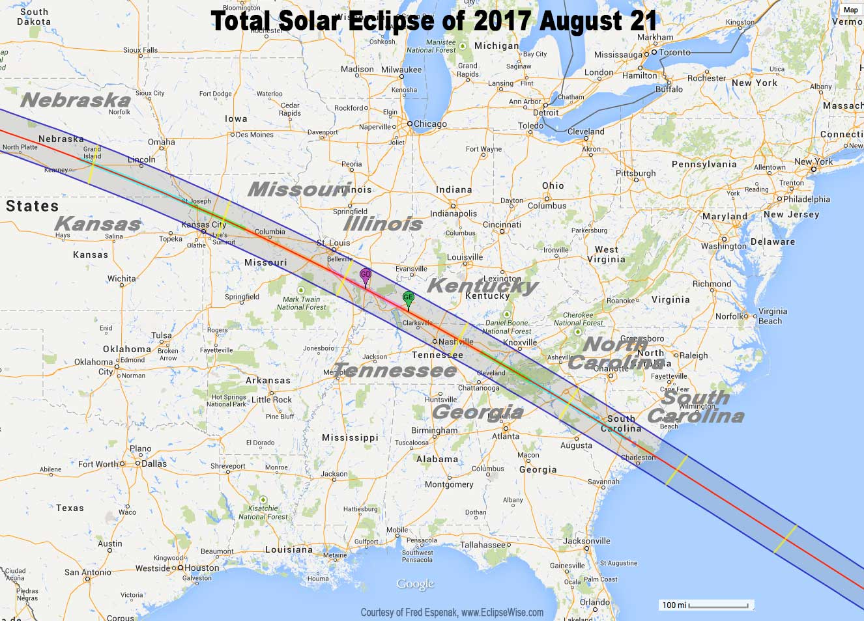
Notes:
Partial eclipse in the blue
Total eclipse on red

Slide 8
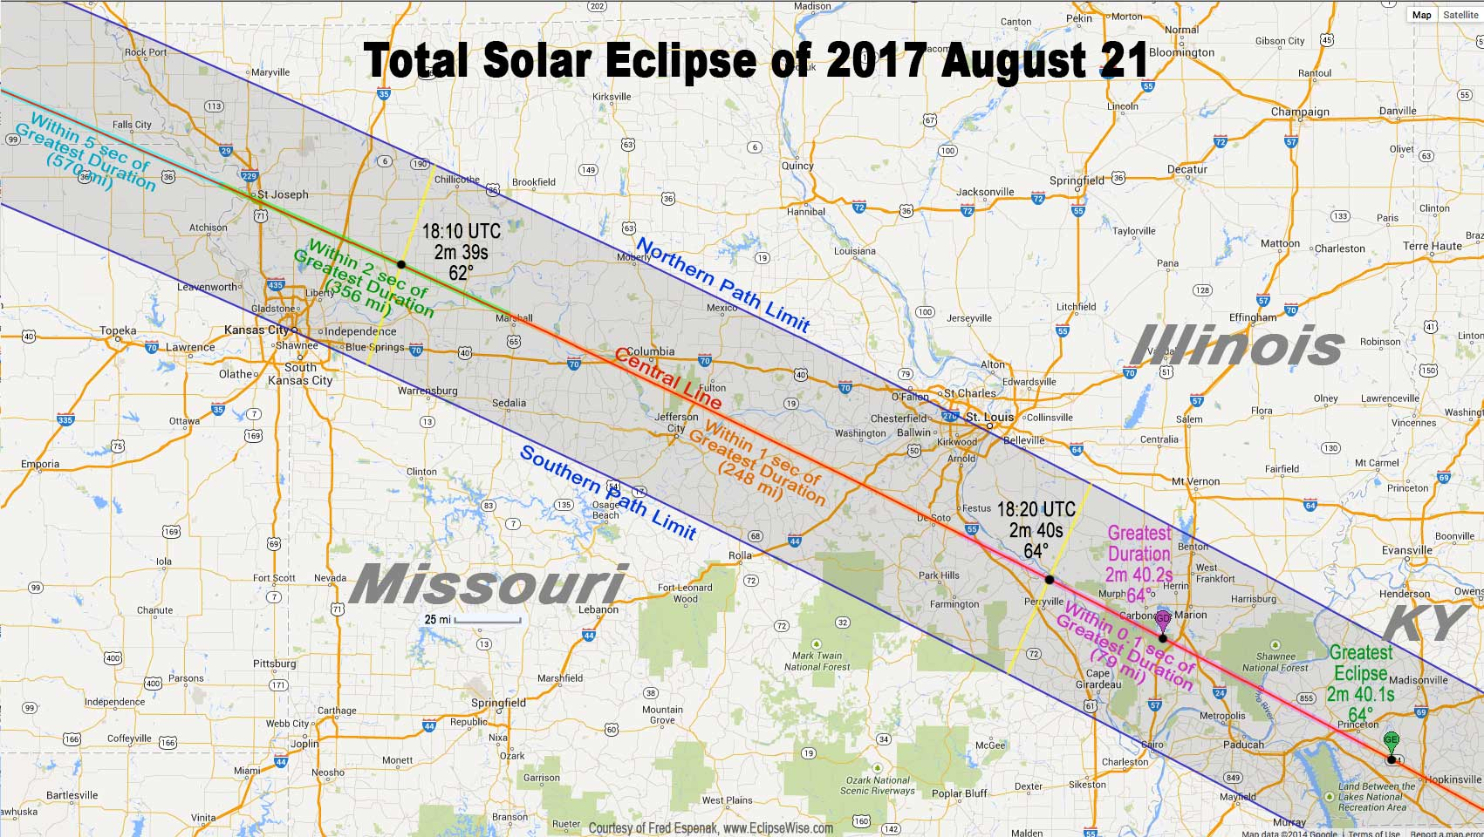
Notes:
Do you live in St. Joe, Marshall?

Slide 9
Notes:
When I consider the heavens…
Maybe an Or HaOlam barbecue if private site

Slide 10
מַתִּתְיָהוּ Mattityahu
(Matthew) 18:1-4
Notes:
Three concepts:
Childlikeness
Joy building
Fasting

Slide 11
Mattityahu (Matthew) 18:1
אוֹתָהּ שָׁעָה נִגְּשׁוּ הַתַּלְמִידִים אֶל יֵשׁוּעַ וְשָׁאֲלוּ: "מִי הוּא הַגָּדוֹל בְּמַלְכוּת הַשָּׁמַיִם?"
At that moment the talmidim came to Yeshua and asked, "Who is the greatest in the Kingdom of Heaven?"
Notes:
At what moment? Just got done with discussion about the Temple tax. Yeshua told Kefa to throw a fishing line into the lake, and find a shekel coin in its mouth. Use for taxes. Tax exemption, exclusion, empowerment!
Also last chapter saw glorified King. Message of death and resurrection apparently a fly by. Exhortation to faith.
Power of tax exemption, power of glory. Maybe getting a bit heady.

Slide 12
In the Scriptures,
Egyptian priests were exempted from taxation by Pharaoh (Gen. 47:26).
Levites, the priestly tribe, actually received something like a tax. The Lord decreed,
Notes:
http://www.christianitytoday.com/history/2008/august/of-church-state-and-taxes.html

Slide 13
"I give to the Levites all the tithes in Israel as their inheritance in return for the work they do while serving at the Tent of Meeting" (Num. 18:21).
Notes:
http://www.christianitytoday.com/history/2008/august/of-church-state-and-taxes.html

Slide 14
^{Ezra 7.24} Moreover, we [the Persian king] herewith proclaim to you that it will be illegal to impose tribute, taxes or tolls on any of the cohanim, L’vi’im, singers, gatekeepers, servants or laborers in this house of God.

Slide 15
By the time of the American Revolution, nine of the original thirteen colonies were giving some kind of tax relief to congregations. Emperor Constantine granted the Christian church a complete exemption from all forms of taxation.

Slide 16
As Chief Justice John Marshall stated back in 1819, "the power to tax involves the power to destroy." Keeping congregations tax exempt removes the temptation from government to interfere with the free exercise of
Notes:
http://www.focusonthefamily.com/socialissues/religious-freedom/religious-freedom-after-the-obergefell-decision/why-are-congregations-and-religious-organizations-tax-exempt#fn1

Slide 17
religion guaranteed by the First Amendment. In 1970, the U.S. Supreme Court held that property tax exemptions for congregations were in keeping with the Establishment Clause of the First Amendment. (Walz v. Tax Commission)
Notes:
http://www.focusonthefamily.com/socialissues/religious-freedom/religious-freedom-after-the-obergefell-decision/why-are-congregations-and-religious-organizations-tax-exempt#fn1

Slide 18
Mattityahu (Matthew) 18:1
אוֹתָהּ שָׁעָה נִגְּשׁוּ הַתַּלְמִידִים אֶל יֵשׁוּעַ וְשָׁאֲלוּ: "מִי הוּא הַגָּדוֹל בְּמַלְכוּת הַשָּׁמַיִם?"
At that moment the talmidim came to Yeshua and asked, "Who is the greatest in the Kingdom of Heaven?"
Notes:
Feeling their power…
Power → arrogance
Yeshua power → servanthood

Slide 19
Mattityahu (Matthew) 18:2
יֵשׁוּעַ קָרָא אֵלָיו יֶלֶד, הֶעֱמִידוֹ בֵּינֵיהֶם
He called a child to him, stood him among them,
Notes:
Could have cited a hero. Instead…

Slide 20
Mattityahu (Matthew) 18:3
וְאָמַר: "אָמֵן אוֹמֵר אֲנִי לָכֶם, אִם לֹא תָּשׁוּבוּ וְתִהְיוּ כִּילָדִים לֹא תִּכָּנְסוּ לְמַלְכוּת הַשָּׁמַיִם.
and said, "Yes! I tell you that unless you change and become like little children, you won't even enter the Kingdom of Heaven!
Notes:
Change: repent, convert, return to G-d

Slide 21
Mattityahu (Matthew) 18:4
לָכֵן מִי שֶׁיַּשְׁפִּיל אֶת עַצְמוֹ לִהְיוֹת כַּיֶּלֶד הַזֶּה הוּא הַגָּדוֹל בְּמַלְכוּת הַשָּׁמַיִם.
So the greatest in the Kingdom is whoever makes himself as humble as this child.
Notes:
What does that mean?

Slide 22
Characteristics of children:
Dependent, powerless, joyful, fragile, loving, believing, uncorrupted, huggy, think parents are WONDERFUL, learners.
Notes:
Main characteristic of childhood…

Slide 23
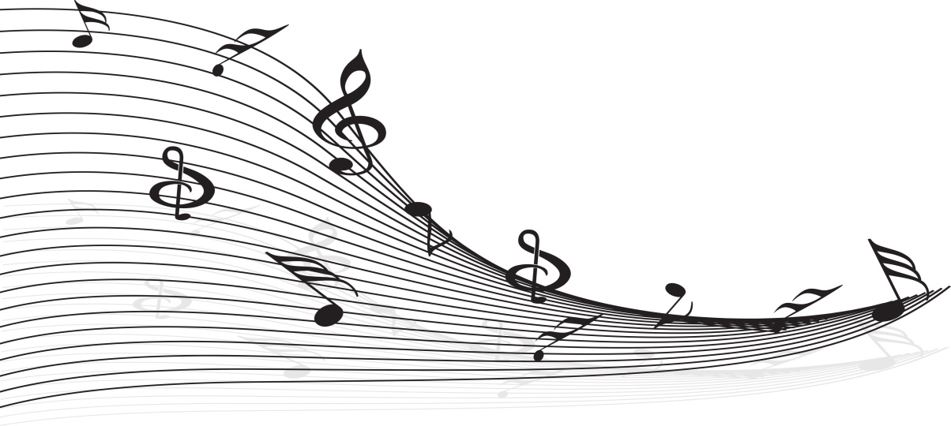
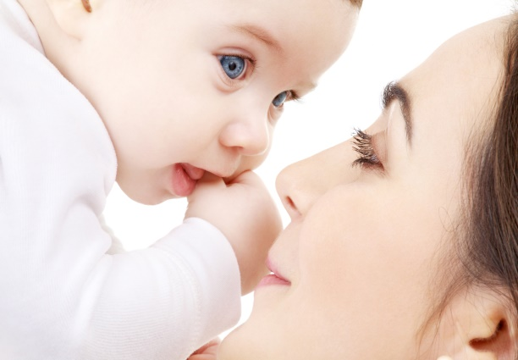
Cycle Of Joy & Quiet
“Joy is also the first emotion infants will seek on their own. Seeking joy is the primary, and perhaps strongest, human motivation.”
(Jim Wilder: Living With Men, p. 13)
At 9 Months, A Child Will Spend Up To 8 Hours A Day Sharing Joy Smiles
Moms Accomplish Little Outside Caring For The Baby
Notes:
Not to condemn working moms, but if possible.
Also helpful to know that there are peak times for growing our prefrontal cortex

Slide 24
Cycle Of Joy & Quiet
Best Illustrated In Interaction With A Small Child
Joy To The Full
Gaze Avert
Child Needs To Rest
Adult Needs To Synchronize To Child
Missing Cues For Rest Is Harmful
Rhythm Of Joy And Quiet Stimulates Growth In Prefrontal Cortex
Notes:
Each individual is born with a void in the front of their brain.
As Ed Khouri so rightly says, “Joy is MiracleGrow for the brain”
And guess what? We really, really like it.

Slide 25
Cycle of Joy
Joy
Level
Notes:
Person A sees Person B and before they are even consciously aware they see person B their brain remembers that they like person B and their brain releases a little dopamine which causes their face, specifically the eye to communicate, “I’m glad to see you.”
When person B

Slide 26
Cycle of Joy
Joy
Level
Notes:
receives that non-verbal, “I’m glad to be with you” message, it triggers a dopamine response in his brain that feels good and raises his joy level

Slide 27
Cycle of Joy
Joy
Level
Notes:
Person B then is “glad to be with their friend also” and reciprocates by sending a “I am glad be with you also” message back.
When person A receives that message it stimulates the pleasure center of his brain to release a little more dopamine and now he is even more glad to see his friend. So guess what he does

Slide 28
Cycle of Joy
Joy
Level
Notes:
He sends another message which feels good to both him and his friend and raises both their joy levels a little more.
And back and forth it goes

Slide 29
Cycle of Joy
Joy
Level
Notes:
And each transmission

Slide 30
Cycle of Joy
Joy
Level
Notes:
builds and amplifies

Slide 31
Cycle of Joy
Joy
Level
Notes:
previous transmissions

Slide 32
Cycle of Joy
Joy
Level
Notes:
And all this happens in 1 second

Slide 33
Cycle Of Joy & Quiet
Peak Times For Growing Prefrontal Cortex (PFC)
Birth to age 2
4 years old
8 years old
15 years old
First Child
First Grandchild
Good news
While optimum time for growing our pre-frontal cortex through joy is early childhood, the process works regardless of our age.

Slide 34
Cycle Of Joy & Quiet
When The Pre-frontal Cortex Doesn’t Develop Properly We Struggle With. . .
Impulse control, addictions, time management, attention span, distractibility, procrastination, poor judgment, problems expressing ourselves and a whole host of other issues.
ADHD
Great News! We Can Grow Our Pre-frontal Cortex Through The Rhythm Of Joy And Quiet
We Have Seen First Hand Evidence Of This In Our Recovery Groups

Slide 35
Childhood is a vital time to develop relational joy.
I am going to propose a revolutionary concept of Kingdom Childlikeness, related to the Omer count.

Slide 36
We are in the season of the counting of the omer, called s’firah, ספירה, counting the days from Passover to Shavuot…
Notes:
Encyclopaedia Judaica

Slide 37
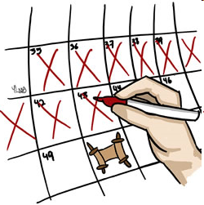
Counting the Omer
S'fee-raht Ha-oh-mehr
סְפִירַת הַעֹמֶר

Slide 38
Lev 23.15-16 "From the day after the day of rest — that is, from the day you bring the sheaf for waving — you are to count seven full weeks, until the day after the seventh week; you are to count fifty days; and then you are to present a new grain offering to ADONI."

Slide 39
During the time encompassed by Sefirah/counting, the grain harvest ripens and it is, therefore, a period of uncertainty -- of hope and prayer that our physical sustenance will be continued in abundance (Abudraham Hashalem, p. 241; B. R. H. 16a).
Notes:
Encyclopaedia Judaica

Slide 40
This uncertainty was due, in particular, to the fact that in Israel, the hot winds that are so harmful to the crops blow between Pesakh and Shavu'ot (Wahrman, Hagei Yisra'el Umo'adaw, p. 171).
Called the khamsin
Notes:
Encyclopaedia Judaica Khamsin

Slide 41
The khamsin usually arrives in April but occasionally can occur between March to May, carrying great quantities of sand and dust from the deserts, with a speed up to 140 kilometers per hour, and a rise of temperatures as much as 20 °C in two hours.
Notes:
https://en.wikipedia.org/wiki/Khamsin

Slide 42
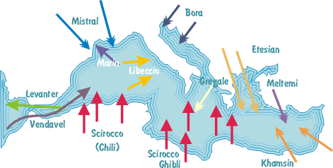

Slide 43
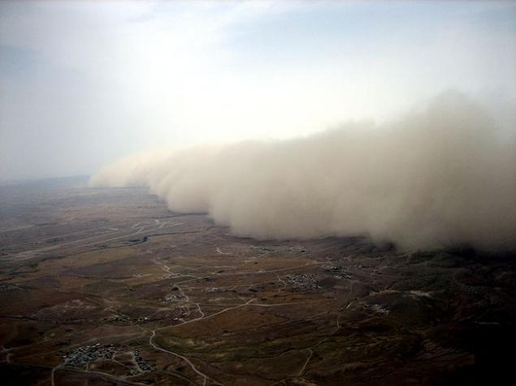
Notes:
http://en.cyplive.com/ru/news/nemnogo-o-hamsin.html

Slide 44
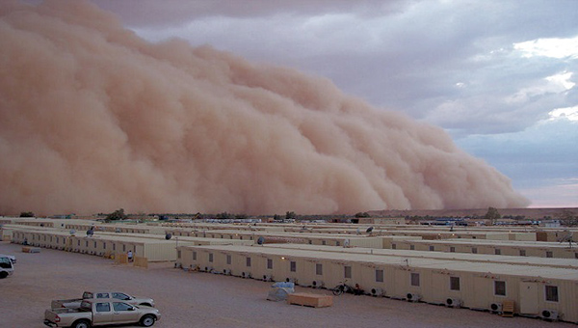
Notes:
http://en.cyplive.com/ru/news/nemnogo-o-hamsin.html

Slide 45
During Napoleon's Egyptian Campaign, the French soldiers…choked and fainted in the blinding, suffocating walls of dust."
Notes:
https://en.wikipedia.org/wiki/Khamsin

Slide 46
During World War II, "allied and German troops were several times forced to halt in mid-battle because of sandstorms caused by khamsin ... Grains of sand whirled by the wind blinded the soldiers and created electrical disturbances that rendered compasses useless."
Notes:
https://en.wikipedia.org/wiki/Khamsin

Slide 47
In Israel, khamsin חמסין‎‎ is known
more formally as sharav שרב
the Biblical term for khamsin is ruaḥ qadīmרוח קדים or "east wind"
Notes:
https://en.wikipedia.org/wiki/Khamsin

Slide 48
Two prevailing winds in Israel. E and W., West is life.
3.5 years wind from E in time of Eliyahu / Elijah
seven ears, thin and blasted by the east wind, sprang up

Slide 49
ADONI caused an east wind to blow on the land all day and all night; and in the morning the east wind brought the locusts
Moshe reached his hand out over the sea, and ADONI caused the sea to go back before a strong east wind all night.
Notes:
Brings plague
http://killacan.com/khamsin/

Slide 50
He made the sea become dry land
Murder was not punishable during the khamsin time
Notes:
Encyclopedia Judaica

Slide 51
Therefore, this counting time is somewhat solemn, for the harvest is at risk. Historically, the omer period has been marked by several tragedies occurring to our people.
Notes:
Encyclopaedia Judaica

Slide 52
The last great deportation to the gas chambers, that of the Jews of Hungary, took place during this Sefirah period.
Notes:
Encyclopaedia Judaica

Slide 53
The Knesset of Israel decided to fix the twenty-seventh of Nisan as Memorial Day for those slaughtered by the Nazis during World War II, called יוֹם הַשּׁוֹאָה Yom HaShoah, Holocaust Memorial Day, and was observed April 23, 2017.
Notes:
Encyclopaedia Judaica

Slide 54
Some communities of faith in the Messiah make it a point to have a time of intercession and protracted fasting in the weeks BEFORE Passover.
Notes:
Lent in Roman Catholic circles.

Slide 55
According to the Jewish understanding of times and seasons, it would be wise to make the days of the Omer to be such a time, fasting and intercession, AFTER Passover.
Harvest time, risky

Slide 56
I’m going to propose a fast that relates to the scripture about childlikeness and joy building.
Fasting from unkindness.

Slide 57
Notes:
http://www.jointhekindnesschallenge.com/

Slide 58
http://shaunti.com/
http://www.jointhekindnesschallenge.com/
We’re not nearly as kind as we think we are!
Notes:
P 32 Highly Happy Marriages

Slide 59
Fast from unkindness for 30 days!
Say NOTHING negative to the person, or about them to others.
Say something positive to them and about them to others.
Notes:
Pick a target person: spouse, in-law, colleague, kid, classmate, teacher, neighbor
What if you think you need to say something negative??
WAIT, pray, and ask the Ruakh
if you really need to say it,
then for wisdom that the information is constructive and encouraging,
WITHOUT A NEGATIVE TONE! No anger, irritation.

Slide 60
3. Do some small act of kindness or generosity.
89% of relationships improved.
Intentional kindness transforms relationships, impacts those around you, and changes YOU.
Notes:
89% of participants saw improvements in their relationships. Documented Kindness Challenge, p 15

Slide 61
A thirty day fast from unkindness
Enables us to be joyful, as Yeshua here teaches. Elicits dopamine in the pre-frontal cortex → joy.
Counts the Omer harvest days
Transforms relationships.
Prepares for Shavuot/Pentecost
Notes:
If you have insecurities → depression, anxiety disorder, paranoia, anger, rage, if your focus is on kindness, it cancels the killer question, “Does he/she like me? Approve of me?” Reverses the focus.
Regarding spouses, to women:

Slide 62
Most men are deeply touched by receiving a simple “Thank you” from their wives. A man’s greatest desire is to do something well– and have it noticed and appreciated. “When she tells me ‘Thank you’ …that simple act does wonders for me.
Notes:
The Surprising Secrets of Highly Happy Couples Shaunti Feldhahn pp 30-32 Most men are insecure in their competence it life. John Eldredge, “Do I have what it takes.”
To Men:

Slide 63
^{1 Cor 16.13-14} Stand firm in the faith! Be men of courage! Be strong! Let all that you do be done in love.
Pull yourself out of bad mood: when depressed, morose, discouraged, grumpy, upset.
Notes:
The Surprising Secrets of Highly Happy Couples Shaunti Feldhahn pp 30-32
Ie, when praying, G-d says, come back later. I’m upset and can’t help you now.
John Eldredge on women: Am I lovely? Worthy of pursuit?

Slide 64
^{T’hillim/Ps 42.12 TLV} Why are you downcast, O my soul? Why are you murmuring within me? Hope in God, for I will yet praise Him, the salvation of my countenance and my God.
FACE SAVER
Notes:
Spirit [inner consciousness] talks to soul [mind, will, emotions.]

Slide 65
Unkindness is the khamsin of relationships, the east wind of death, abetting [not causing] depression, anger, withdrawal.
Notes:
We cause our own sins and misery, but we get help in the downward spiral!
During Omer count, s’firah, reverse the khamsin of death by fasting from unkindness.

Slide 66
A thirty day fast from unkindness

Slide 67
Kindness is a superfood, superpower.
Explosive
Supernatural
Transformational: melts hardness
Notes:
Bulletproof p 20
X-ray vision: p 22
Siege melter p 24

Slide 68
^{Luke 6.35} But love your enemies, do good, and lend expecting nothing back! Your reward will be great, and you will be children of Ha‘Elyon; for he is kind to the ungrateful and the wicked.
Notes:
Most High [not Sacred Name]

Slide 69
We have a library copy of the book.

Slide 70
jointhekindnesschallenge.com/

Slide 71
A S’firah/ Omer counting time fast from unkindness

