Slide 1
To easily follow these notes, log on to our Wifi
Wifi: mycci01 p/w: ancientquail060
Go to OrHaOlam.com
Click on downloads, messages, 2017

Slide 2
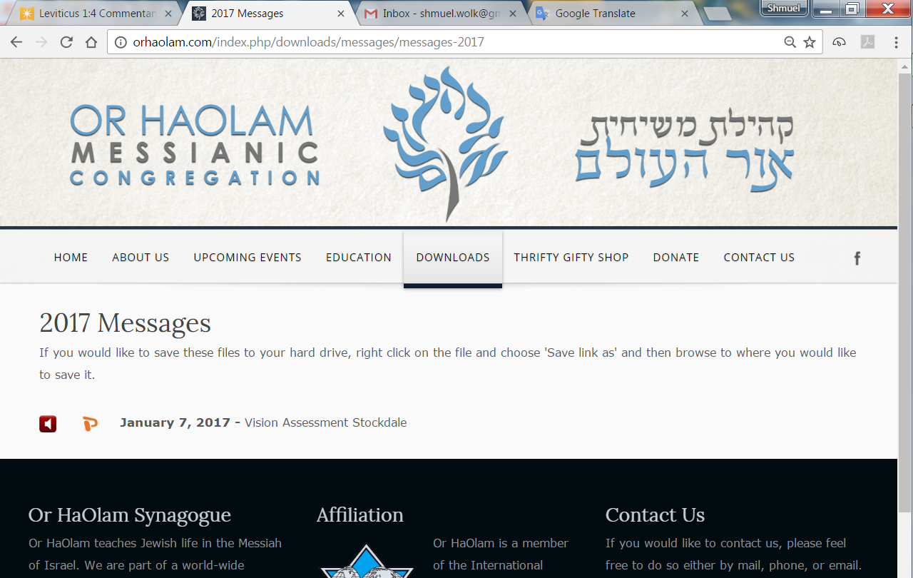

Slide 3
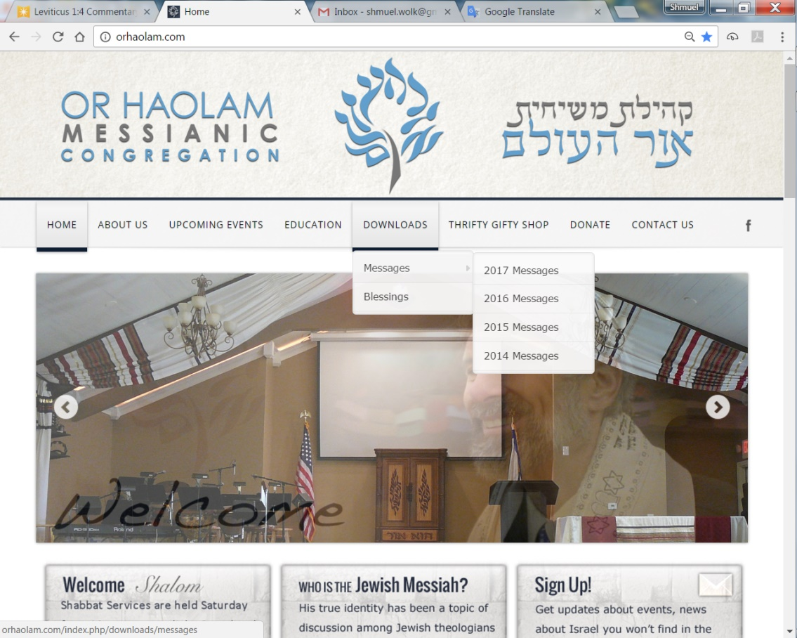
Downloads\messages\
2017 Messages

Slide 4
Total Solar Eclipse
Aug 21, 2017

Slide 5
Or HaOlam has 40 of these. How many? [Show of hands]
Notes:
Special thanks for new Bring and Share Room floor to…

Slide 6
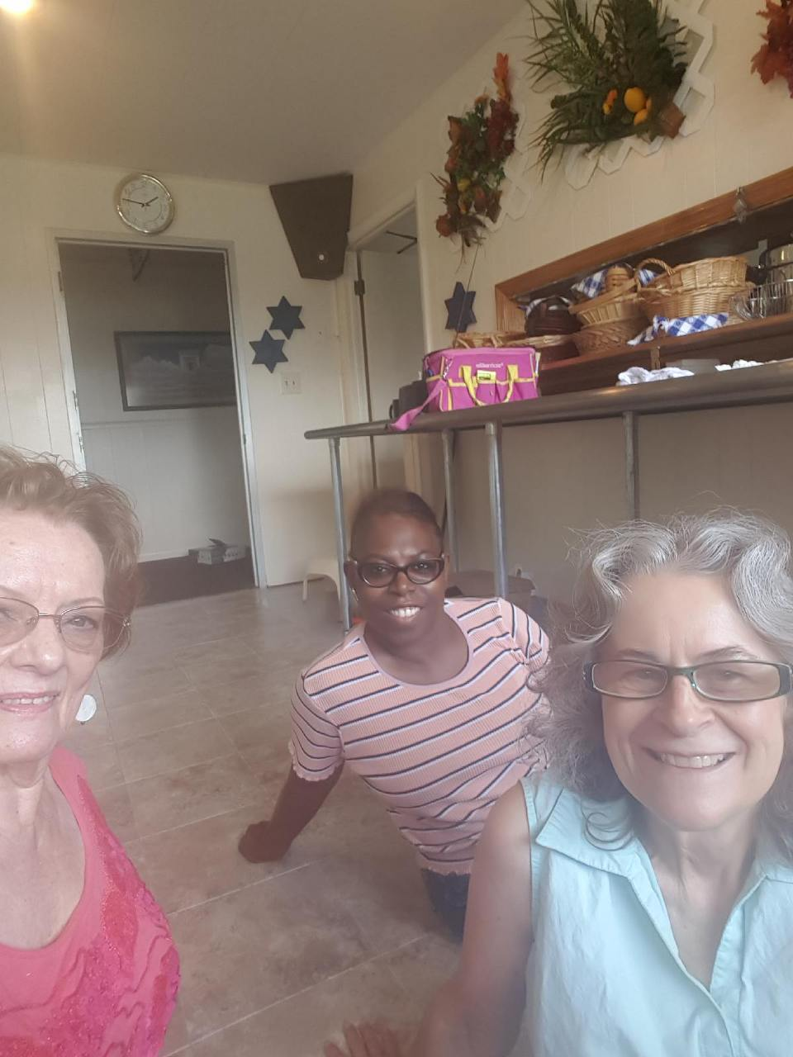

Slide 8
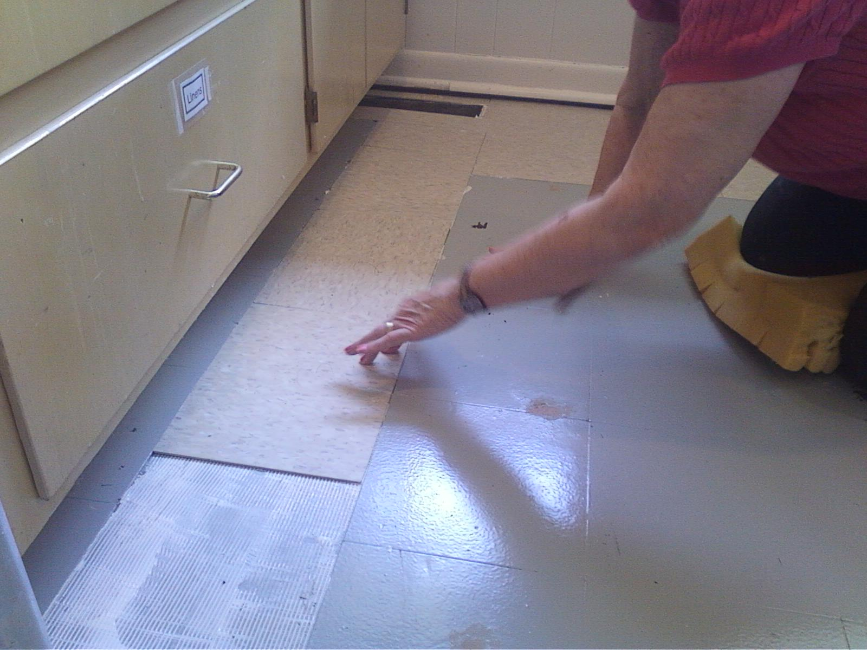
Notes:
Also, need to pause and commemorate, celebrate…

Slide 9
מַתִּתְיָהוּ Mattityahu
(Matthew) 19:16-19
Notes:
Last week about the blessing children. This week about blessing on a grownup, a faithful good man grownup.

Slide 10
Mattityahu (Matthew) 19:16
נִגַּשׁ אֵלָיו אִישׁ אֶחָד וְשָׁאַל:" רַבִּי, אֵיזֶה טוֹב עָלַי לַעֲשׂוֹת כְּדֵי לְהַשִּׂיג חַיֵּי עוֹלָם?"
A man approached Yeshua and said, "Rabbi, what good thing should I do in order to have eternal life?"
Notes:
He was thinking in accordance with Rabbinic Judaism, taking its clue from Vayikra/Lev 18 as Shaul/Paul describes it

Slide 11
^{Ro 10.5} For Moshe writes about the righteousness grounded in the Torah that the person who does these things will attain life through them.
Notes:
Next verses Paul talks about Life/righteousness by faith = received

Slide 12
^{Vayikra /Lev 18.4-5} You are to obey my rulings and laws and live accordingly; I am Adoni your God. You are to observe my laws and rulings; if a person does them, he will have life through them; I am Adoni.
Notes:
Have life by doing. Common Jewish expression is “to merit the blessing…”
As opposed to “receiving eternal life” “receiving the blessing” +/- less active, more gratitude causing

Slide 13
Mattityahu (Matthew) 19:17
אָמַר אֵלָיו: "מַדּוּעַ אַתָּה שׁוֹאֵל אוֹתִי בְּנוֹגֵעַ לַטּוֹב? אֶחָד הוּא הַטּוֹב."
He said to him, "Why are you asking me about good? There is One who is good!
Notes:
Answer a question with a question, typical Jewish repartee.

Slide 14
^{Mark 10.18} “Why do you call Me good?” Yeshua said to him. “No one is good except One—that is God.

Slide 15
David Stern’s commentary:
There are those who take Yeshua's remark to mean, "You should not be calling me good, because only God is good, and I am not God." But it does not say that;
Notes:
http://kifa.kz/eng/bible/stern/stern_mark_10.php

Slide 16
David Stern’s commentary:
rather, it challenges the man to consider who Yeshua really is, whether he may indeed be more than an ordinary human being.
Notes:
http://kifa.kz/eng/bible/stern/stern_mark_10.php

Slide 17
Israel יִשְׂרָאֵל The patriarch Jacob was given the name
"Triumphant with God",
“who prevails with God”
after he wrestled with an angel.
‘God Contended',
'Wrestles with God'
Notes:
https://en.wikipedia.org/wiki/Israel_(name)
Implication: Jews and Bible followers wrestle with Truth. If you have doubts, struggles, G-d is not hurt. Can read as Triumphant because of G-d, not against G-d.
Jews argue, surrender, but it’s a victory. CP

Slide 18
Islam: الإسلام‎‎, is a verbal noun relating to concepts of wholeness, submission, safeness and peace. In a religious context it means "voluntary submission to God". Islām is the verbal noun of the root, and means "submission" or "surrender".
Notes:
https://en.wikipedia.org/wiki/Islam
So, apparently, Yeshua was stirring up a little contention. Why are you asking Me? Who do you think I am? What is the way of the mitzvot, the commandments. Then gives a simple but challenging answer, based on the Torah.

Slide 19
Mattityahu (Matthew) 19:17
, אֲבָל אִם רְצוֹנְךָ לָבוֹא לַחַיִּים, שְׁמֹר אֶת הַמִּצְווֹת
“But if you want to obtain eternal life, observe the mitzvot.”

Slide 20
Mattityahu (Matthew) 19:18
שָׁאַל הָאִישׁ: "אֵיזֶה?" הֵשִׁיב יֵשׁוּעַ: "לֹא תִּרְצַח, לֹא תִּנְאַף, לֹא תִּגְנֹב, לֹא-תַעֲנֶה בְּרֵעֲךָ עֵד שָׁקֶר,
The man asked him, "Which ones?" [!] and Yeshua said, "Don't murder, don't commit adultery, don't steal, don't give false testimony,
Notes:
Murder was previously equated with rage and unforgiveness. Go two miles for your enemies. Said to be the best thing if you have to pay alimony…pay more!
Adultery was previously equated with inner lustful imaginings.
False testimony upgraded to absolute truth telling.

Slide 21
Mattityahu (Matthew) 19:19
כַּבֵּד אֶת-אָבִיךָ וְאֶת-אִמֶּךָ, וְאָהַבְתָּ לְרֵעֲךָ כָּמוֹךָ."
honor father and mother, and love your neighbor as yourself."
Notes:
Neighbor updated to love enemies!!
No where in Torah or commentaries…unique to Yeshua.

Slide 22
Mattityahu (Matthew) 19:20-22
The young man said to him, "I have kept all these; where do I still fall short?"
Notes:
Seems he had really good intentions of the heart, and Yeshua accepted this at face value

Slide 23
^{Mark 10.21} Yeshua, looking at him, felt love for him
Felt the young man was a kindred spirit: loved Torah
David: ^{T’hillim/Ps 119.97-99} How I love your Torah! I meditate on it all day. I am wiser than my foes,
Notes:
There is a notion in the world of followers of the Messiah in the Nations that the Torah is over. It’s history. It’s done for, and the Ruakh is BETTER. Yeshua loved the Torah, the Tanakh. As did David, celebrated it…

Slide 24
^{T’hillim/Ps 119.97-99} because your mitzvot are mine forever. I have more understanding than all my teachers, because I meditate on your instruction.

Slide 25
^{T’hillim/Ps 119.163-165} I hate falsehood, I detest it; but I love your Torah. I praise you seven times a day because of your righteous rulings. Those who love your Torah have great peace; nothing makes them stumble.
Notes:
Yeshua kept Torah. They Loved the Torah p 38
Paul/Shaul is accused, by some Jewish scholars, of being very duplicitous in his keeping of Torah.

Slide 26
^{1 Cor. 9.20-21} That is, with Jews, what I did was put myself in the position of a Jew, in order to win Jews. With people in subjection to a legalistic perversion of the Torah, I put myself in the position of someone under such legalism, in order to win those under this legalism,

Slide 27
^{1 Cor. 9.20-21} even though I myself am not in subjection to a legalistic perversion of the Torah. With those who live outside the framework of Torah, I put myself in the position of someone outside
Notes:
Mark Nanos interp Paul/Shaul was within Judaism. Not superior to it and outside.

Slide 28
^{1 Cor. 9.20-21} the Torah in order to win those outside the Torah - although I myself am not outside the framework of God's Torah but within the framework of Torah as upheld by the Messiah.
Notes:
Mark Nanos and others this was Paul’s TEACHING to the nations, not requiring them, but NOT his lifestyle.

Slide 29
^{Acts 21.20-24} Shaul arrived in Jerusalem, and advised: “You see, brother, how many tens of thousands of believers there are among the Judeans, and they are all zealots for the Torah. Now what they have been told about you is that you are teaching all the Jews

Slide 30
^{Acts 21.20-24} living among the Goyim to apostatize from Moshe, telling them not to have a b’rit-milah for their sons and not to follow the traditions. “What, then, is to be done? They will certainly hear that you have come. So do what we tell you.

Slide 31
^{Acts 21.20-24} We have four men who are under a vow. Take them with you, be purified with them, and pay the expenses connected with having their heads shaved.
Notes:
Conclusion: Shaul/Paul loved and kept Torah!
Even Temple sacrifices long after Yeshua’s death. Why: commemoration/celebration

Slide 32
^{Acts 21.20-24} Then everyone will know that there is nothing to these rumors which they have heard about you; but that, on the contrary, you yourself stay in line and keep the Torah.
Notes:
Torah to the end of time!!

Slide 33
^{Rev 12.17} The dragon was infuriated over the woman and went off to fight the rest of her children, those who obey God's commands and bear witness to Yeshua.

Slide 34
^{Rev 15.2-4} Those defeating the beast, its image and the number of its name were standing by the sea of glass, holding harps which God had given them. They were singing the song of Moshe, the servant of God, and the song of the Lamb: "Great and wonderful are the things

Slide 35
^{Rev 15.2-4} you have done, ADONI, God of heaven's armies! Just and true are your ways, king of the nations! ADONI, who will not fear and glorify your name? because you alone are holy. All nations will come and worship before you, for your righteous deeds have been revealed."
Notes:
But the young man’s heart for Torah wasn’t quite enough…

Slide 36
Mattityahu (Matthew) 19:20-22
Yeshua…said to him, “You’re missing one thing.”
Yeshua said to him, "If you are serious about reaching the goal, go and sell your possessions, give to the poor, and you will have riches in heaven.
Notes:
Typical for teachers to make it hard to enter their circle.

Slide 37
Mattityahu (Matthew) 19:20-22
Then come, follow me!" But when the young man heard this, he went away sad, because he was wealthy.
Notes:
Test. Yeshua did not have a poverty mentality. He had all the wealth in the world. But, He wants ALL of our hearts. ALL. If I clearly heard Y say sell it all, house car, computer, guitar, rental prop, chihuahua, retirement…ALL…I would do.
How do we test… We mostly welcome everyone, but intrinsic in who we are as an Abrahamic Covenantal expression, New Covenant expression…
Yeshua first. Jewish ID, affliction, Tithe and support.

Slide 38
^{Mt. 8.19-20} A Torah-teacher approached and said to him, "Rabbi, I will follow you wherever you go." Yeshua said to him, "The foxes have holes, and the birds flying about have nests, but the Son of Man has no home of his own."
Notes:
We never hear of this guy again. Better answer from Itti to David as fleeing Avshalom’s murderous rebellion.

Slide 39
^{2 Shmuel 15.21} But Ittai answered the king, “As Adoni lives, and as my lord the king lives, wherever my lord the king may be, whether for death or for life, your servant will be there too.”

Slide 40
^{Matityahu/Mt.19.23-26} Then Yeshua said to his talmidim, "Yes. I tell you that it will be very hard for a rich man to enter the Kingdom of Heaven. Furthermore, I tell you that it is easier for a camel to pass through a needle's eye than for a rich man to enter the Kingdom of God."
Notes:
There is debate if eye of a needle is a gate or a real sewing needle. Not the point here. Point is an impossibility.

Slide 41
^{Matityahu/Mt.19.23-26} When the talmidim heard this they were utterly amazed. "Then who," they asked, "can be saved?“ Yeshua looked at them and said, "Humanly, this is impossible; but with God everything is possible."
Notes:
We have to surrender ALL to Yeshua and His kingdom. He may or may not take it all away, but wants ALL of our hearts.

Slide 42
^{Gal 2.20} When the Messiah was executed on the stake as a criminal, I was too; so that my proud ego no longer lives. But the Messiah lives in me, and the life I now live in my body I live by the same trusting faithfulness that the Son of God had, who loved me and gave himself up for me.

Slide 43
^{Gal 6.14} Adonenu, our Lord Yeshua the Messiah! Through him, as far as I am concerned, the world has been put to death on the stake; and through him, as far as the world is concerned, I have been put to death on the stake.

Slide 44
^{Matityahu/Mt.19.23-26} "Humanly, this is impossible; but with God everything is possible."
Notes:
We have to surrender ALL to Yeshua and His kingdom. He may or may not take it all.
That’s the key is DIVINE possibility!!
As part of this tiny Messianic Movement: looked askance by Jews, by most Christians…
Consider a human impossibility that we’ve seen in our time of Or HaOlam…

Slide 45
In ~1997 Joel Chernoff shared that he had an insight/vision from Adoni to import and store goods in Israel to prepare…for Russian immigration. Nothing happened for two or three years.

Slide 46
In 2015, the Joseph Project Israel Relief fund was by far the number one importer of humanitarian aid in Israel. Since its founding the Joseph Project has distributed approximately $100 million in aid to needy Israelis, as well as Arab Christians and Muslims.

Slide 47
Gal Lusky, Israel Flying Aid
Notes:
Up to 1.09
https://www.youtube.com/watch?v=mjszYo8rpAs
Stop audio recording. OK for me to share, just not on internet.

Slide 48
Red and yellow
Majority 75%
Buddhist
Sinhalese
Tamil Hindu
Green

Slide 49
In 2015, the Joseph Project Israel Relief fund was by far the number one importer of humanitarian aid in Israel. Since its founding the Joseph Project has distributed approximately $100 million in aid to needy Israelis, as well as Arab Christians and Muslims.
Notes:
Restart recording
Another story of supernatural aid to Israel.

Slide 51
Thomas Sandell & Calev Myers

Slide 52
European Coalition for Israel
Notes:
https://youtu.be/WwJ5nCVZclY
He started this work as a faith call. No systematic backing from European churches, governments. He didn’t promote. He’s our amazing and only ally in Europe!!
Last week I shared the Rev 12 astronomical phenomenon. Don’t know what it means, but here’s another.

Slide 53
Notes:
http://metrovoicenews.com/kansas-city-archives/

Slide 54
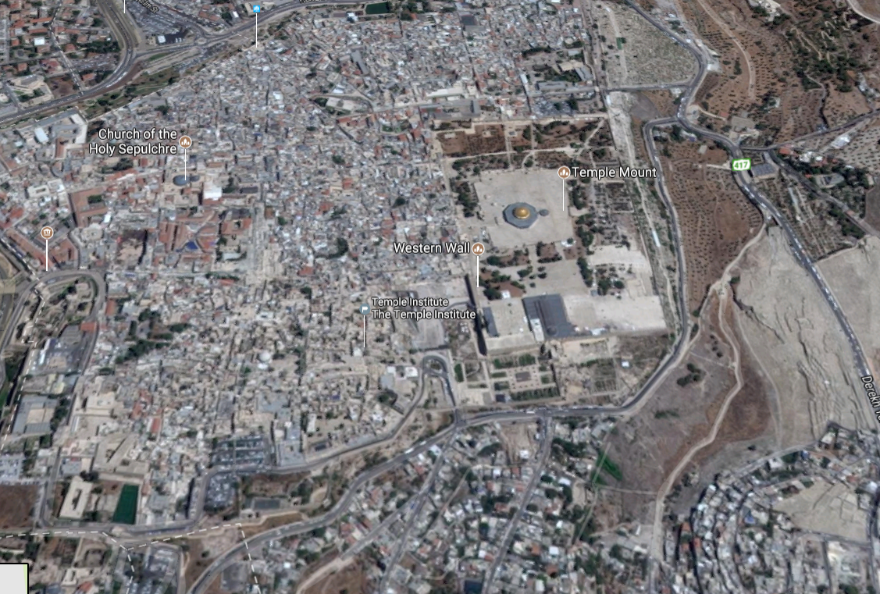

Slide 55
Notes:
During the Second Intifada, approx, 2003, we visited the Temple Institute.
Tourism dead. People thanked us in the hotel elevator. Usually video about the Temple prep, but tourism so low that Chaim Richman in person. Told this story just in the Metro Voice.

Slide 56
The Institute shares a key connection to the battle for Jerusalem. Its founder, Rabbi Yisrael Ariel, served with the 55th Paratroopers Brigade that captured the Temple Mount. After the victory, a Jordanian guide gave them a remarkable tour.
Notes:
http://metrovoicenews.com/kansas-city-archives/

Slide 57
The soldiers were on the Temple Mount and it was just like the first hour or so. And they were approached by a Jordanian fellow in Western dress who explained that he was the official tour guide for the Jordanian parliament and he offered to take the soldiers and to show them the sites on the Temple Mount. [June 1967]
Notes:
http://metrovoicenews.com/kansas-city-archives/

Slide 58
"He takes the soldiers, you know, and the rabbi there, and he says, 'well this is exactly where the sanctuary stood. This is where the altar stood and then this is where the Menorah stood.‘ "He tells them all these things about the history of the Holy Temple …
Notes:
http://metrovoicenews.com/kansas-city-archives/
Israel Ariel, as told by Chaim Richman

Slide 59
Finally, the rabbi asked him, 'why are you telling us all this?‘
And he said, 'well, we have tradition from our fathers [and] they from their fathers that one day the Jews would wage a war and conquer this mountain

Slide 60
and rebuild the Holy Temple, and I assume that you're starting tomorrow. I want this to be my part, my part in helping you,'" he said, according to Rabbi Richman.
Notes:
http://metrovoicenews.com/kansas-city-archives/

Slide 61
CBN News asked Richman what was their reaction to that story. "Well, I guess they were pretty surprised, but the bottom line is in hindsight; it doesn't look like we were ready.“
Gen. Moshe Dayan, gave the Temple Mount to the Waqf!!
Notes:
http://metrovoicenews.com/kansas-city-archives/
Gen. Moshe Dayan, a secular Jew, gave the Temple Mount to the Jordanian Islamic Waqf
Prime Minister Levi Eshkol complied.

Slide 62
Now, 50 years later, that's changed with the Temple Institute preparing blueprints and gathering official temple
elements such as the priestly garments.

Slide 63
All of this means talk of rebuilding the temple is no longer considered a fringe idea.
"Today…“ Richman continued. "There are members of Knesset that actually talk about the rebuilding the Holy Temple.
Notes:
http://metrovoicenews.com/kansas-city-archives/
PAUSE. REBUILDING TEMPLE.
ONE LAST…

Slide 64
Today, the Islamic republic lumbers on as the Soviet Union did during its last years. It professes an ideology that convinces no one. It commands security services that proved unreliable in the 2009 rebellion, causing the regime to deploy the Basij militias because many commanders of the Revolutionary Guards refused to shoot the protesters.
Notes:
The RJC Weekly Newsletter July 6, 2017

Slide 65
The seminaries in the shrine city of Qom appreciate the damage that the government of God has done to Islam as the mosques remain empty even during important religious commemorations. Young men don’t wish to join the clergy, and women don’t want to marry clerics.
Notes:
The RJC Weekly Newsletter July 6, 2017

Slide 66
The system is engulfed by corruption, which is particularly problematic for a regime that bases its power on divine ordinance.
Today, the Islamic republic lumbers on as the Soviet Union did during its last years.
Notes:
The RJC Weekly Newsletter July 6, 2017
How many remember when Russia seemed unstoppable, then suddenly, Gorbechov, perestroika, dissolution of Union of Soviet Socialist Republics. Poland, Ukraine, looking West. Trumps greatest speech in Poland.

Slide 67
Today, the Islamic republic will not be able to manage a succession to the post of the supreme leader as its factions are too divided and its public too disaffected.
Notes:
The RJC Weekly Newsletter July 6, 2017

Slide 68
^{Matityahu/Mt.19.23-26} "Humanly, this is impossible; but with God everything is possible."
Notes:
We have to surrender ALL to Yeshua and His kingdom. He may or may not take it all.

Slide 69
^{Gal 2.20} When the Messiah was executed on the stake as a criminal, I was too; so that my proud ego no longer lives. But the Messiah lives in me, and the life I now live in my body I live by the same trusting faithfulness that the Son of God had, who loved me and gave himself up for me.

Slide 70
^{Gal 6.14} Adonenu, our Lord Yeshua the Messiah! Through him, as far as I am concerned, the world has been put to death on the stake; and through him, as far as the world is concerned, I have been put to death on the stake.

