Slide 1
To easily follow these notes, log on to our Wifi
Wifi: mycci01 p/w: ancientquail060
Go to OrHaOlam.com
Click on downloads, messages, 2017

Slide 2
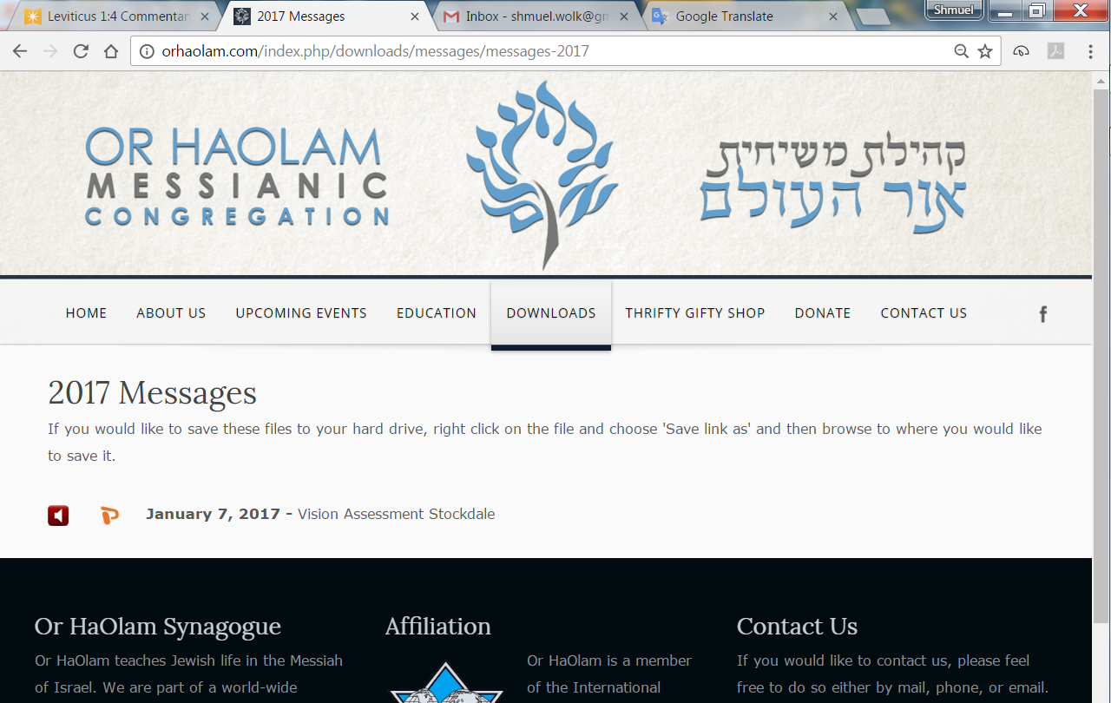

Slide 3
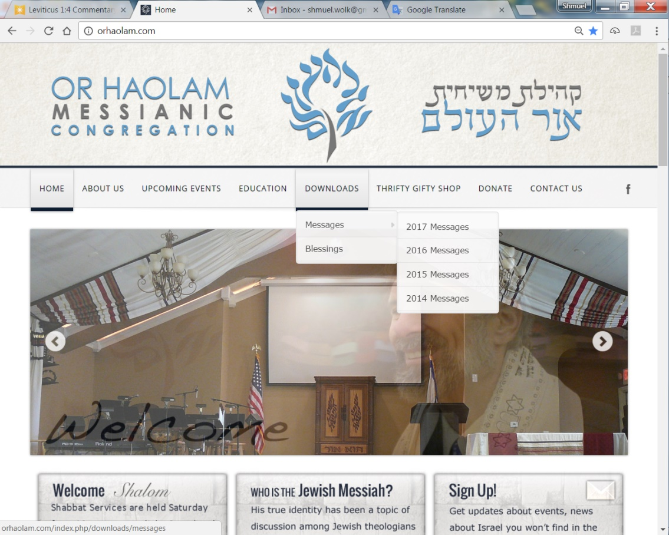
Downloads\messages\
2017 Messages
Notes:
For humor, some bizarre news…

Slide 4
#1. We learned yesterday via the internet news portal, Divuach Rishoni of a Palestinian family demanding that one of its members badly injured in a car accident be transferred to an Israeli hospital. Video footage published online
Notes:
http://www.israeltoday.co.il/NewsItem/tabid/178/nid/32103/Default.aspx

Slide 5
showed officials at the hospital in Jenin refusing the request, and then one of the family members pulling out a gun in order to “persuade” the hospital to send his relative to receive Israeli care.
Notes:
http://www.israeltoday.co.il/NewsItem/tabid/178/nid/32103/Default.aspx

Slide 6
Israeli hospitals routinely accept Palestinians, no matter who they are. Even terrorists who killed Israelis receive life-saving treatment from the very people they would kill given the chance.
Notes:
http://www.israeltoday.co.il/NewsItem/tabid/178/nid/32103/Default.aspx

Slide 7
#2. Early yesterday morning, security forces removed the metal detectors and special cameras installed at the entrances to the Temple Mount. However, in spite of the removal, the majority of those who came to pray still refused to enter.
Notes:
MAOZ ISRAEL INTERCESSORS NETWORK LETTER No. 996 Wednesday, July 26, 2017

Slide 8
Muslims interviewed on Israel’s Channel 2 News claimed that even though metal detectors were gone, special scanners were installed secretly by Israel underground,
Notes:
MAOZ ISRAEL INTERCESSORS NETWORK LETTER No. 996 Wednesday, July 26, 2017

Slide 9
which allow security forces to see people who pass above these scanners as if they were naked in order to check for weapons… (NO, I am not joking…) Last night, riots broke out again after evening prayers.
Notes:
MAOZ ISRAEL INTERCESSORS NETWORK LETTER No. 996 Wednesday, July 26, 2017
Jared Kushner suspects that there is no solution. He’s right unless we do a Munich surrender of 1937 or so.

Slide 10
Total Solar Eclipse
Aug 21, 2017

Slide 11
Or HaOlam has 140 of these. $1

Slide 12
מַתִּתְיָהוּ Mattityahu
(Matthew) 20:1-4
Notes:
Yeshua just got done talking to his talmidim about getting 100-fold reward, after a rich inquirer had turned down Messiah’s conditions of surrender.
Start by introducing a technical, theological term for understanding scripture…

Slide 13
Mattityahu (Matthew) 19:30
But many who are first will be last, and many who are last will be first.
Repeated Mtt. 20.16
Bookend, inclusio
Summary: surprising endings

Slide 14
Mattityahu (Matthew) 20:1
כִּי דּוֹמָה מַלְכוּת הַשָּׁמַיִם לְאִישׁ בַּעַל אֲחֻזָּה שֶׁיָּצָא הַשְׁכֵּם בַּבֹּקֶר לִשְׂכֹּר פּוֹעֲלִים לְכַרְמוֹ,
The Kingdom of Heaven is like a farmer who went out at daybreak to hire workers for his vineyard.
Notes:
No streetlights, got up with the sun.

Slide 15
Mattityahu (Matthew) 20:2
וּלְאַחַר שֶׁהִסְכִּים עִם הַפּוֹעֲלִים עַל שְׂכַר דִּינָר לְיוֹם שָׁלַח אוֹתָם אֶל כַּרְמוֹ.
After agreeing with the workers on a wage of one denarius [the standard daily wage], he sent them off to his vineyard.
Notes:
~covenantal arrangement. Most commentators think first workers are Israel. Later hires are the Gentile Nations.

Slide 16
Mattityahu (Matthew) 20:3
כְּשֶׁיָּצָא בְּשָׁעָה תֵּשַׁע רָאָה אֲחֵרִים עוֹמְדִים בְּטֵלִים בַּשּׁוּק.
Then, on going out at about nine in the morning, he saw more men standing around in the market-square doing nothing,
Notes:
Standing around in the market sounds sort of shiftless. More below.
Even though day began at sunset, hours were reckoned from sunrise. So, Stern translates “third hour” as 9 oclock.
Why farmer go again, and later again and again? Likely this was harvest time, and…

Slide 17
^{Mishlei/Prov 10.4} Idle hands bring poverty; diligent hands bring wealth. A sensible person gathers in summer, but he who sleeps during harvest is an embarrassment.
Notes:
Harvest for grains was in the summer, after the winter rains. For fruits, later till Sukkot. Extra workers needed. Brief and urgent time. Some to guard against thieves and animals, some to reap.

Slide 18
Acts 17.5-6
But some of the Jewish people grew jealous; so they got together some vicious men from the riffraff hanging around in the market square, collected a crowd and started a riot in the city.
Notes:
Riffraff?
Agoraiōn ἀγοραίων
a lounger in the market-place, perhaps with the idea of agitator.
Used to be mall hangout → shuttered Banister mall?
Farmer kept going back for more of these.

Slide 19
Mattityahu (Matthew) 20:4
אָמַר לָהֶם, 'לְכוּ גַּם אַתֶּם אֶל כַּרְמִי וְאֶתֵּן לָכֶם אֶת הַמַּגִּיעַ לָכֶם'. הֵם הָלְכוּ.
and said to them, 'You go to the vineyard too — I'll pay you a fair wage.' So they went.

Slide 20
Mattityahu (Matthew) 20:5-16
At noon, and again around three in the afternoon, he did the same thing. About an hour before sundown, he went out, found still others standing around, and asked them, ‘Why have you been standing here all day, doing nothing?”

Slide 21
Mattityahu (Matthew) 20:5-16
They said to him, ‘Because no one hired us.’ ‘You too,’ he told them, ‘go to the vineyard.’ When evening came, the owner of the vineyard said to his foreman,

Slide 22
Mattityahu (Matthew) 20:5-16
‘Call the workers and pay them their wages, starting with the last ones hired and ending with the first.’
Notes:
I could hold back the wages, and earn interest!!

Slide 23
^{Mishlei/Prov 28.22} He who is greedy rushes after riches, not knowing that want will overtake him.

Slide 24
^{Vayikra/Lev.19.13} Do not oppress or rob your neighbor; specifically, you are not to keep back the wages of a hired worker all night until morning.
Torah had principles of fair labor treatment, BEFORE unions.
Notes:
For our laborers we hire, Dawn and I pay right away, $15/hour.

Slide 25
^{Dvarim/Dt. 24.14-15} “You are not to exploit a hired worker who is poor and needy, whether one of your brothers or a foreigner living in your land in your town. You are to pay him his wages the day he earns them, before sunset;

Slide 26
^{Dvarim/Dt. 24.14-15} for he is poor and looks forward to being paid. Otherwise he will cry out against you to Adoni, and it will be your sin.

Slide 27
Mattityahu (Matthew) 20:5-16
The workers who came an hour before sunset each received a denarius, so the workers who came first expected they would get more, but each of them also received just a denarius. On receiving their wages, they began grumbling to the farmer,

Slide 28
Mattityahu (Matthew) 20:5-16
‘These latecomers have worked only one hour, while we have borne the brunt of the day’s work in the hot sun, yet you have put them on an equal footing with us!’ But he answered one of them, ‘Look, friend, I’m not being unfair with you.
Notes:
Some translations “scorching heat” Persecution? Ie, faithful to G despite opposition.
If apply to Jews first, and persecuted, possible. Still surprising rewards.

Slide 29
Mattityahu (Matthew) 20:5-16
Didn’t you agree to work today for a denarius? Now take your pay and go! I choose to give the last worker as much as I’m giving you.
Notes:
Agree to Torah, to Land promise, to special blessing

Slide 30
Mattityahu (Matthew) 20:5-16
‘Haven’t I the right to do what I want with what belongs to me? Or do you begrudge my generosity?’
^{TLV, literally:} ‘Or is your eye evil because I am good?’
Notes:
They were really not objecting to injustice, but to generosity, to unmerited favor, to grace.

Slide 31
Notes:
https://therealyesua.blogspot.com/2013/10/what-is-evil-eye.html
In the Jewish culture of Yeshua, a person with an evil eye is “a stingy or greedy person who gives his poor needy brother nothing.”

Slide 32
Mattityahu (Matthew) 20:5-16
Thus the last ones will be first and the first last.”
Bookend / inclusio
Summary: surprising rewards.
Notes:
Applications:
Everyone brought into the vineyard is a worker. No spectators.
We who represent the Kingdom, the farmer, need to go out and seek and invite. Active kingdom building.
Things may look placid and prosperous Joco. I go to a neighborhood “Village Fire” prayer meeting once/month. Clint Hall Westbrooke.
Blue Valley has twice the suicide rate of north of I 435.
~500 homeless students in the Shawnee Mission District.

Slide 33
^{1 Cor. 4.1-2} This, then, is how you ought to regard us: as servants of the Messiah and as those entrusted with the mysteries God has revealed. Now it is required that those who have been given a trust must prove faithful.

Slide 34
Faithfulness >> fruitfulness
We or other sow,
We or others water, fertilize,
We or others harvest
We or others process the harvest.
G-d gives the increase…
Notes:
Look around at this precious fellowship. Who built it? Who knocked on your door, explained Yeshua, sin, judgment, eternal life, covenantal identity, to the secrets of your heart?
We’ve sown and sought, but how to be effective…

Slide 35
How did you learn about Or HaOlam?
42%-Knew someone who was attending
26%-Recommended by someone
20%-Was invited by a current member
18%-Attended an event sponsored by Or HaOlam
17%-Visited Or HaOlam’s website
15%-Google search
Notes:
No Passive players, no spectators. If we believe the message of Yeshua is eternal LIFE or death…with great wisdom and love we need to reach out.
One such department has been VERY gratifying to me…

Slide 37
S.S.O.F
Shabbat Souls on Fire

Slide 38
About Us
A Multi-congregational gathering of young people (20s-30s ish).
Cultivating Covenantal identity in bringing Jewish and Gentile believers together into the Abrahamic Covenant.

Slide 39
About Us
We aim to...
Develop friendships among Messianic Young Adults in the Kansas City area
Grow spiritually and relationally
Maintain a Biblical foundation at each gathering
Have representation of each congregation on the leadership/planning team
Have the monthly event hosted by and at each congregation
Serve our community and reach lost

Slide 40
Targeted Spheres of Influence
Jewish
Young Adults
In Kansas City
Messianic Young Adults
Or Ha Olam Young Adults
In Kansas City

Slide 41
SSOF Monthly Gatherings
Held on the 3rd Friday of each month to enter into Shabbat together
Geared toward adults in their 20s-30s, single or married
Provide childcare for younger families so parents can develop community within their age group
Parameters to foster unity at monthly gatherings
We will not discuss relationships and matters regarding those those not present to uphold a culture of honor.
We will not discuss or debate doctrinal opinions or differences unless it is a structured, pre planned event.
Notes:
We sow…G gives the increase.
So, keep sowing. Be encouraged.

Slide 42
I received this from a Messianic rabbi, Steve Sheek,
I would like you to keep Tree of Life Messianic Congregation in Houston in your prayers. The pastor of the church where we were meeting resigned
Notes:
Houston. Daughter Cynthia was at IHOP and here sometimes.

Slide 43
Sunday and now, two days later, the board of the church asked us to leave. They actually said they didn't want a Jewish group using their facility.
Notes:
Houston. Daughter Cynthia was at IHOP and here sometimes.

Slide 44
So now I am on the hunt for a new location. Pray for G-d's favor in finding a location that we can afford. Our congregation is only 18 months old and we have grown from 16 to 40 in that time. We are small, but steadily growing. I know that Hashem will provide.
Steve Sheek www.treeoflifehouston.com
713-206-2680
Notes:
Got this response on the Forum:

Slide 45
Steve [Sheek],
We faced the very same situation a few years ago when we only around 2 years old. We had 12 members including the kids and it seemed very bleak indeed. We began to pray, asking HaShem's favor and when it seemed hopeless we opted to move

Slide 46
into a less than pristine building that you wouldn't invite your dog to eat in. The first Shabbat there only 8 people showed up. One of my people said we should go to the property that we wanted to be housed in (which was an Assembly of God) and sound the shofarot. Now, I don't know if that had any spiritual meaning or not,

Slide 47
but it did catch the attention of the neighbors who asked us who we were. We told them, and they told the Pastor that some "crazy Jews" who believed in Jesus was blowing horns at his church and told him who we were. On Tuesday we got a call from the Pastor wanting to meet with us.

Slide 48
We met on Wednesday and he asked if we were looking for a place to be housed. We told him yes.
For the rest of the story...that congregation never rented or leased to anyone in their 60 years of existence. But they did to us. We grew to a little over 30 there and now 5 years later are running over a hundred and looking to build our first

Slide 49
synagogue in an area where no one thought it possible. We have people from all over the world attending including numerous former Orthodox and Ultra-Orthodox Jews. It's a test my friend...and I know you and your congregation will

Slide 50
come through it and will be amazed at HaShem's handiwork! Beit Shofarot is praying for you guys!
Rabbi Yossi Wentz
Beit Shofarot Messianic Synagogue
Kannapolis, NC
Notes:
Sow, and believe. Effect, reward will surprise you. Blew shofars on a church property to claim it. How bizarre is that?
From meeting yesterday “Village Fire”

Slide 51
I million new believers came to faith in E. Africa in the last 10 years.
300K MBB’s. [Muslim Background Believers]
32,000 new congregations.
Imams coming to faith.
Notes:
Clint Hall told me this, and these E. African pastors [Kenya, Rwanda, Ethiopia] said to him, “Do you want this here?”

Slide 52
Israelis doing Dt 11:24 0.25 to 2:00 Wherever the sole of your foot steps will be yours
Notes:
Wherever the sole of your foot steps will be yours

Slide 53
More than 1,000 Jews braved a searing heat wave Tuesday morning to visit the Temple Mount on Tisha b’Av, the saddest date on the Hebrew calendar, while thousands more sat on the floor – a traditional Jewish sign of mourning – at the Western Wall Plaza
Notes:
https://worldisraelnews.com/times-changing-declares-one-among-1000-jewish-visitors-temple-mount/?utm_source=MadMimi&utm_medium=email&utm_content=Netanyahu+Bans+Israeli-Jordanian+%27Fistfight%27%3B+Supermarket+Terror+Critically+Wounds+Israeli%3B+Nighttime+Roundup+of+Temple+Mount+Rioters&utm_campaign=20170802_m140734905_Netanyahu+Bans+Israeli-Jordanian+%27Fistfight%27%3B+Supermarket+Terror+Critically+Wounds+Israeli%3B+Nighttime+Roundup+of+Temple+Mount+Rioters&utm_term=more_btn_dark_jpg

Slide 54
“Unbelievable! This number is unprecedented! Times are changing,” noted activist Joshua Wander, one of the visitors to the holy site.
Notes:
https://worldisraelnews.com/times-changing-declares-one-among-1000-jewish-visitors-temple-mount/?utm_source=MadMimi&utm_medium=email&utm_content=Netanyahu+Bans+Israeli-Jordanian+%27Fistfight%27%3B+Supermarket+Terror+Critically+Wounds+Israeli%3B+Nighttime+Roundup+of+Temple+Mount+Rioters&utm_campaign=20170802_m140734905_Netanyahu+Bans+Israeli-Jordanian+%27Fistfight%27%3B+Supermarket+Terror+Critically+Wounds+Israeli%3B+Nighttime+Roundup+of+Temple+Mount+Rioters&utm_term=more_btn_dark_jpg

Slide 55
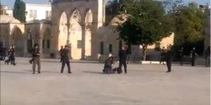
Police surround body of terrorist on Temple Mount
Notes:
https://www.breakingisraelnews.com/92517/first-time-2000-years-jewish-priests-will-learn-lost-laws-holy-holies/#SL5jxlDZWlhE0vDt.99

Slide 56
The July 14 Palestinian terror attack against Israeli police officers that left three dead (including the terrorist), caused the most powerful source of ritual impurity, on the Temple Mount, the holiest site in Judaism. Horrific as the attack was, one Temple activist said it may have served a divine purpose.
Notes:
https://www.breakingisraelnews.com/92517/first-time-2000-years-jewish-priests-will-learn-lost-laws-holy-holies/#SL5jxlDZWlhE0vDt.99

Slide 57
“When the Jewish people are not moving ahead quickly enough, God does something to force it upon us,” Yaakov Hayman, a prominent Temple Mount activist and expert, told Breaking Israel News.
Notes:
https://www.breakingisraelnews.com/92517/first-time-2000-years-jewish-priests-will-learn-lost-laws-holy-holies/#SL5jxlDZWlhE0vDt.99

Slide 58
“When those Arabs did what they did, they created a new situation on the ground. We weren’t preparing for it, so something happened that forced us to deal with it.”
The “new situation on the ground” is that Kohanim, men descended patri-lineally from Aaron the Priest,
Notes:
https://www.breakingisraelnews.com/92517/first-time-2000-years-jewish-priests-will-learn-lost-laws-holy-holies/#SL5jxlDZWlhE0vDt.99

Slide 59
will now be trained for the first time in millennia to enter the area where the Holy of Holies once stood. Their purpose will not be to offer sacrifices or pray for the Jewish people, but to retrieve dead bodies should the need arise again.
Notes:
https://www.breakingisraelnews.com/92517/first-time-2000-years-jewish-priests-will-learn-lost-laws-holy-holies/#SL5jxlDZWlhE0vDt.99

Slide 60
“Har HaBayit (the Temple Mount) is the holiest place and there is a requirement that all ritually impure objects be removed as quickly as possible,” he continued. “So, in this case, the rabbis ruled that it is acceptable for a Kohen to become impure himself to remove something from the Temple Mount.”
Notes:
https://www.breakingisraelnews.com/92517/first-time-2000-years-jewish-priests-will-learn-lost-laws-holy-holies/#SL5jxlDZWlhE0vDt.99

Slide 61
trained for the first time in millennia to enter the area where the Holy of Holies once stood.
Don’t know what that means.
Reclaiming Temple Mount
Training for the Holy of Holies
Rev 12 sign…
Notes:
Rev 12 sign on Sept. 23 read since LOTS of other interesting

Slide 62
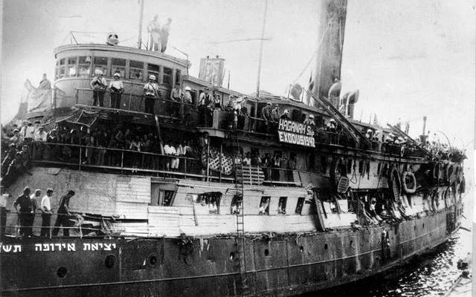

Slide 63
In 1947, 4554 Jewish refugees, mostly Holocaust survivors, sailed towards Israel, then under control of the British Mandate, but were intercepted by British warships. After a bitter struggle, they were turned away and subsequently sent back to Germany.
Notes:
https://unitedwithisrael.org/israel-marks-70-years-since-famed-exodus-voyage/?utm_source=MadMimi&utm_medium=email&utm_content=Rabbi+Muzzled+on+Temple+Mount+for+Victims%27+Prayer%3B+Palestinian+Who+Murdered+Family+Gets+Big+Payoff%3B+Media+Equates+Israeli+Victims+with+Terrorists&utm_campaign=20170725_m140567819_Rabbi+Muzzled+on+Temple+Mount+for+Victims%27+Prayer%3B+Palestinian+Who+Murdered+Family+Gets+Big+Payoff%3B+Media+Equates+Israeli+Victims+with+Terrorists&utm_term=more_btn_dark_jpg

Slide 64
President Rivlin and 12 passengers of the Exodus ship marked seven decades since the crucial events surrounding their voyage to Israel, a milestone towards the establishment of the State of Israel.
Notes:
https://unitedwithisrael.org/israel-marks-70-years-since-famed-exodus-voyage/?utm_source=MadMimi&utm_medium=email&utm_content=Rabbi+Muzzled+on+Temple+Mount+for+Victims%27+Prayer%3B+Palestinian+Who+Murdered+Family+Gets+Big+Payoff%3B+Media+Equates+Israeli+Victims+with+Terrorists&utm_campaign=20170725_m140567819_Rabbi+Muzzled+on+Temple+Mount+for+Victims%27+Prayer%3B+Palestinian+Who+Murdered+Family+Gets+Big+Payoff%3B+Media+Equates+Israeli+Victims+with+Terrorists&utm_term=more_btn_dark_jpg
The events were depicted in the 1958 novel “Exodus” and the 1960 movie of the same name.

Slide 65
There is LOTS for us to do to reach the Jewish people with the love of Messiah. But, it’s all by faithfulness, faith in His power, rewards surprising.

Slide 66
How did you learn about Or HaOlam?
42%-Knew someone who was attending
26%-Recommended by someone
20%-Was invited by a current member
18%-Attended an event sponsored by Or HaOlam
17%-Visited Or HaOlam’s website
15%-Google search
Notes:
No Passive players, no spectators. If we believe the message of Yeshua is eternal LIFE or death…with great wisdom and love

Slide 67
^{1 Cor. 4.1-2} This, then, is how you ought to regard us: as servants of the Messiah and as those entrusted with the mysteries God has revealed. Now it is required that those who have been given a trust must prove faithful.

Slide 68
Faithfulness >> fruitfulness
We or other sow,
We or others water, fertilize,
We or others harvest
We or others process the harvest.
G-d gives the increase…
Notes:
Look around at this precious fellowship. Who built it? Who knocked on your door, explained Yeshua, sin, judgment, eternal life, covenantal identity, to the secrets of your heart?
We’ve sown and sought, but how to be effective…

Slide 69
Mattityahu (Matthew) 20:5-16
Thus the last ones will be first and the first last.”
Bookend / inclusio
Summary: surprising rewards.
Notes:
Applications:
Everyone brought into the vineyard is a worker. No spectators.
We who represent the Kingdom need to go out and seek and invite.
I understand there are some here who have done a prayer drive around the I435 loop. Close before prayer ministry with march around sanctuary with Shofrot?

