Slide 1
e-handout
To have these notes
without taking notes
Go to OrHaOlam.com
Click on downloads,
messages, 2018
Notes:
.

Slide 2
On old tombstones:
Harry Edsel Smith of Albany , New York: Born 1903--Died 1942. Looked up the elevator shaft to see if the car was on the way down. It was.
In a London , England cemetery: Here lies Ann Mann, who lived an old maid, but died an old Mann. Dec. 8, 1767
Notes:
Kathleen Eltrich

Slide 3
In a Ruidoso, New Mexico, cemetery: Here lies Johnny Yeast. Pardon him for not rising.
In a Uniontown, PA, cemetery: Here lies the body of Jonathan Blake, Stepped on the gas instead of the brake.
A lawyer's epitaph in England : Sir John Strange. Here lies an honest lawyer, and that is Strange.
Notes:
Kathleen Eltrich

Slide 5
Last Shabbat the theme was that no one knows the time of Yeshua’s return. There are things in the heavens that point to His coming, but they are for worship. Even a possible Messianic understanding of the signs of the Zodiac! Anything calculable is celebratory.

Slide 6
So, His unknown coming date induces fear of judgment.
But is that all?
Notes:
Is there an upside to the unknown date?

Slide 7
מַתִּתְיָהוּ Mattityahu
(Matthew) 24:45-47

Slide 8
Mattityahu (Matthew) 24:45
”מִי הוּא אֵפוֹא הָעֶבֶד הַנֶּאֱמָן שֶׁהִפְקִידוֹ הָאָדוֹן עַל בְּנֵי בֵּיתוֹ
“Who is the faithful and sensible servant whose master puts him in charge of the household staff,

Slide 9
Mattityahu (Matthew) 24:45
לָתֵת לָהֶם אֶת אָכְלָם בְּעִתּוֹ?
to give them their food at the proper time?

Slide 10
Mattityahu (Matthew) 24:46
אַשְׁרֵי הָעֶבֶד שֶׁיָּבוֹא אֲדוֹנָיו וְיִמְצָא אוֹתוֹ עוֹשֶׂה כֵּן.
“It will go well with that servant if he is found doing his job when his master comes.

Slide 11
Mattityahu (Matthew) 24:47
אָמֵן. אוֹמֵר אֲנִי לָכֶם, הוּא יַפְקִיד אוֹתוֹ עַל כָּל אֲשֶׁר לוֹ.
“Yes, I tell you that he will put him in charge of all he owns.”

Slide 12
^{Matityahu 24.48-51} But if that servant is wicked and says to himself, ‘My master is taking his time’; and he starts beating up his fellow servants and spends his time eating and drinking with drunkards;

Slide 13
^{Matityahu 24.48-51} then his master will come on a day the servant does not expect, at a time he doesn’t know; and he will cut him in two and put him with the hypocrites, where people will wail and grind their teeth!

Slide 14
^{Matityahu 24.48-51} But if that servant is wicked and says to himself, ‘My master is taking his time’; and he starts beating up his fellow servants and spends his time eating and drinking with drunkards;

Slide 15
^{Matityahu 24.48-51} then his master will come on a day the servant does not expect, at a time he doesn’t know; and he will cut him in two and put him with the hypocrites, where people will wail and grind their teeth!

Slide 16
Characteristics of the
end times winner:
Faithful and sensible

Slide 17
Mattityahu (Matthew) 24:45
”מִי הוּא אֵפוֹא הָעֶבֶד הַנֶּאֱמָן שֶׁהִפְקִידוֹ הָאָדוֹן עַל בְּנֵי בֵּיתוֹ
“Who is the faithful and sensible servant whose master puts him in charge of the household staff,
Notes:
One Hebrew word for both.

Slide 18
נֶאֱמָן Neh-eh-man
loyal, faithful, devoted ; reliable, trustworthy ; true to

Slide 19
Faithful:
Definition: faithful, reliable Usage: trustworthy, faithful, believing.
Notes:
https://biblehub.com/interlinear/matthew/24-45.htm

Slide 20
pistós (an adjective, derived from peíthō, "persuaded") – properly, faithful (loyalty to faith; literally, fullness of faith); typically, of believing the faith God imparts.
[The root of pistós, "faithful" and 4100 /pisteúō, "faith," are the same (pist-), referring to persuasion.]
Notes:
https://biblehub.com/greek/4103.htm

Slide 21
^{Ro 4.19-21} His trust [pistei πίστει]
did not waver when he considered his own body — which was as good as dead, since he was about a hundred years old — or when he considered that Sarah’s womb was dead too. He did not by lack of trust decide against God’s promises. On the contrary,
Notes:
Everyone’s trust wavers, if you are honest! Me and Tovia Singer ~1998

Slide 22
^{Mes Jews/Heb 11} Trusting trust [pistei πίστει] is being confident of what we hope for, convinced about things we do not see.
Notes:
Ever drive a long way to a previously unvisited destination, and your GPS says, “Go, turn, go…”
You think: It’s just toooooo long. Can’t me right.
Brian Kaufman, pilot, “Trust your instruments.” apparently works in a 737!
Keep going!
I bought a Garmin, before I upgraded my phone to my Samsung with it’s built in Google maps. Sometime, for re-assurance, I turn both on to a destination. Then they disagree. What shall I believe?
With G-d’s word, it’s not that way. Except sometimes we get unsteady…

Slide 23
^{Ro 4.19-21} by trust [pistei πίστει] he was given power as he gave glory to God, for he was fully convinced that what God had promised he could also accomplish.

Slide 24
^{1 Cor. 4.1-2} So, you should regard us as the Messiah’s servants, as trustees of God’s secret truths. Now the one thing that is asked of a trustee is that he be found trustworthy [pistos πιστός] .

Slide 25
Mattityahu (Matthew) 24:45
”מִי הוּא אֵפוֹא הָעֶבֶד הַנֶּאֱמָן שֶׁהִפְקִידוֹ הָאָדוֹן עַל בְּנֵי בֵּיתוֹ
“Who is the faithful and sensible servant whose master puts him in charge of the household staff,

Slide 26
Sensible:
(fron'-ee-mos) : practically wise, sensible intelligent, prudent φρόνιμος

Slide 27
Characteristics of the
end times winner:
Faithful and sensible

Slide 28
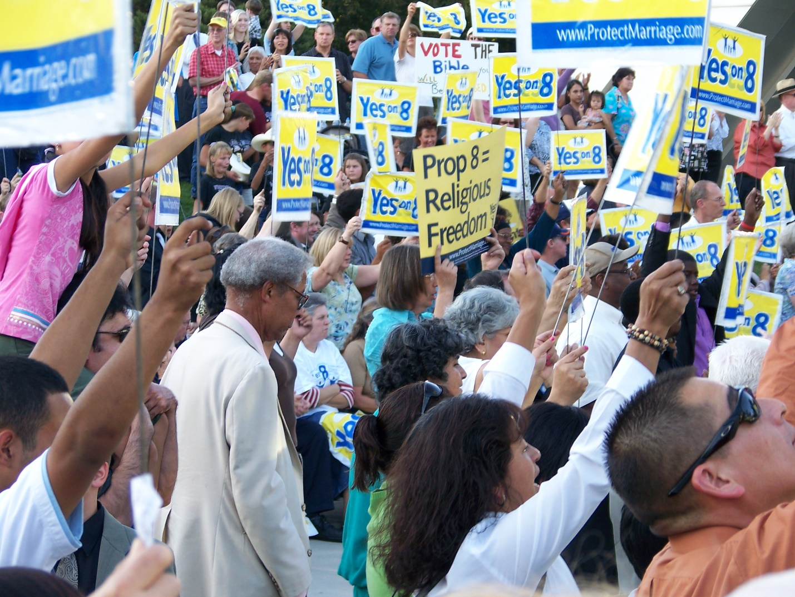
We are in a culture war.
Notes:
Rally for Proposition 8, an item on the 2008 California ballot to ban same-sex marriage

Slide 29
^{Daniel 7.24-25} As for the ten horns, out of this kingdom ten kings will arise. Another will arise after them, but he will be different from the previous ones; he will subdue three kings. He will speak words against the Most High, and will continually harass the kedoshim of the Most High, and will try to change the appointed times and law.

Slide 30
Culture war refers to the conflict between
traditionalist, classical liberal, or conservative values and
social democratic, progressive or social liberal values in the Western world.
Notes:
https://en.wikipedia.org/wiki/Culture_war

Slide 31
October 9, 2018
NEW YORK—Mayor Bill de Blasio today signed a historic piece of legislation into law, creating for the first time a third gender category on New York City birth certificates.
Notes:
https://www1.nyc.gov/office-of-the-mayor/news/501-18/mayor-de-blasio-signs-historic-legislation-adding-third-gender-category-birth-certificates#/0

Slide 32
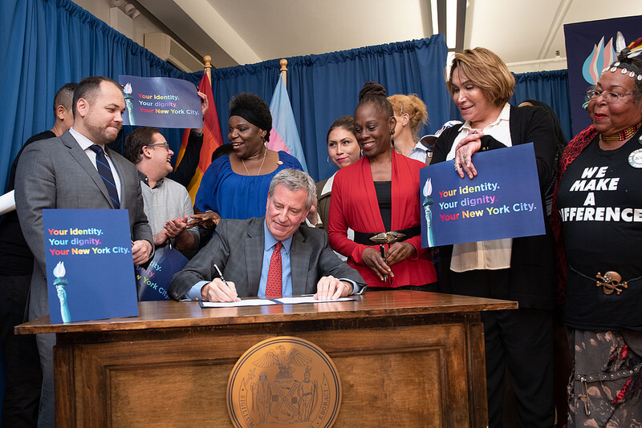
Notes:
https://www1.nyc.gov/office-of-the-mayor/news/501-18/mayor-de-blasio-signs-historic-legislation-adding-third-gender-category-birth-certificates#/0

Slide 33
The Gender Marker Bill (Intro 954-A) was put forward by the openly homosexual speaker of the New York city Council, Corey Johnson, in partnership with the Department of Health and Mental Hygiene.
Notes:
https://www.onenewsnow.com/culture/2018/10/11/nyc-makes-it-official-theres-a-third-gender?utm_source=OneNewsNow&utm_medium=email&utm_term=16792048&utm_content=323193037843968512&utm_campaign=36541

Slide 34
The new law also makes it easier for transgender and gender non-binary people born in the City to amend their birth certificates to more accurately reflect who they are by removing medical and administrative barriers. The law will go into effect on Jan. 1, 2019.
Notes:
https://www1.nyc.gov/office-of-the-mayor/news/501-18/mayor-de-blasio-signs-historic-legislation-adding-third-gender-category-birth-certificates#/0

Slide 35
The law calls for the creation of a third gender to appear on birth certificates issued by the City of New York. In addition to the “male” and “female” designations, birth certificates will also show an “X,” allowing gender non-binary people who identify neither as men nor women to have a birth certificate that more accurately reflects their identities.
Notes:
https://www1.nyc.gov/office-of-the-mayor/news/501-18/mayor-de-blasio-signs-historic-legislation-adding-third-gender-category-birth-certificates#/0

Slide 36
The law also will allow individuals to self-attest their own gender identity on birth certificate applications, removing the current requirement that medical and mental health professionals first attest to an individual’s gender identity before they are permitted to amend the gender marker on their birth certificate.
Notes:
https://www1.nyc.gov/office-of-the-mayor/news/501-18/mayor-de-blasio-signs-historic-legislation-adding-third-gender-category-birth-certificates#/0
I understand that there are people in pain over identity issues. But a major health organization recently described gender transition to minors as a form of abuse.

Slide 37
Your body agrees ~30 trillion times as to what gender you are. XX female or XY male
Notes:
https://www.medicalnewstoday.com/articles/318342.php

Slide 39
Characteristics of the
end times winner:
Faithful and sensible
Faithful = persuaded, following the map
Applies to American history?
Notes:
A rabbi trail??

Slide 40
Since the beginning of time, people have been governed by others, politically and spiritually, usually absolutists.
Emperors
Kings
Tyrants
Roman republic of patricians
Notes:
http://www.drjamesdobson.org/Broadcasts/Broadcast?i=dd10e75d-2af1-46b1-bf22-c7de3c4b1ccf

Slide 42
Evolution of political liberty

Slide 43
Magna Carta is a charter of rights agreed to by King John of England at Runnymede, near Windsor, on 15 June 1215
Notes:
https://en.wikipedia.org/wiki/Montesquieu

Slide 44
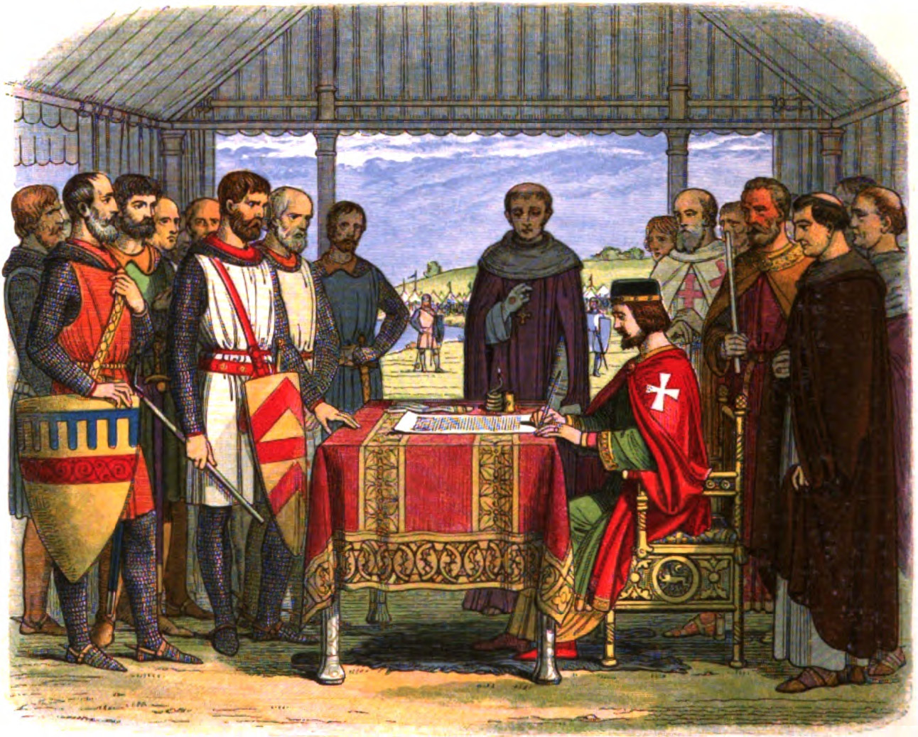
1215,
signing
by
King
John
Notes:
https://www.google.com/search?q=magna+carta&safe=active&source=lnms&tbm=isch&sa=X&ved=0ahUKEwiW_Z6U7IHeAhUPSK0KHW3tDvsQ_AUIESgE&biw=1165&bih=866#imgrc=iTb2dYvG5WkQ7M:

Slide 45
In the early 1600’s, Magna Carta became increasingly important as a political document in arguments over the authority of the English monarchy. James I and Charles I both propounded greater authority for the Crown, justified by the doctrine of the divine right of kings,
Notes:
https://en.wikipedia.org/wiki/Magna_Carta#Magna_Carta's_influence_on_English_medieval_law

Slide 46
and the Magna Carta was cited extensively by their opponents to challenge the monarchy.
Magna Carta, it was argued, recognized and protected the liberty of individual Englishmen, made the King subject to the common law of the land, formed the origin of the trial by jury system
Notes:
https://en.wikipedia.org/wiki/Magna_Carta#Magna_Carta's_influence_on_English_medieval_law

Slide 47
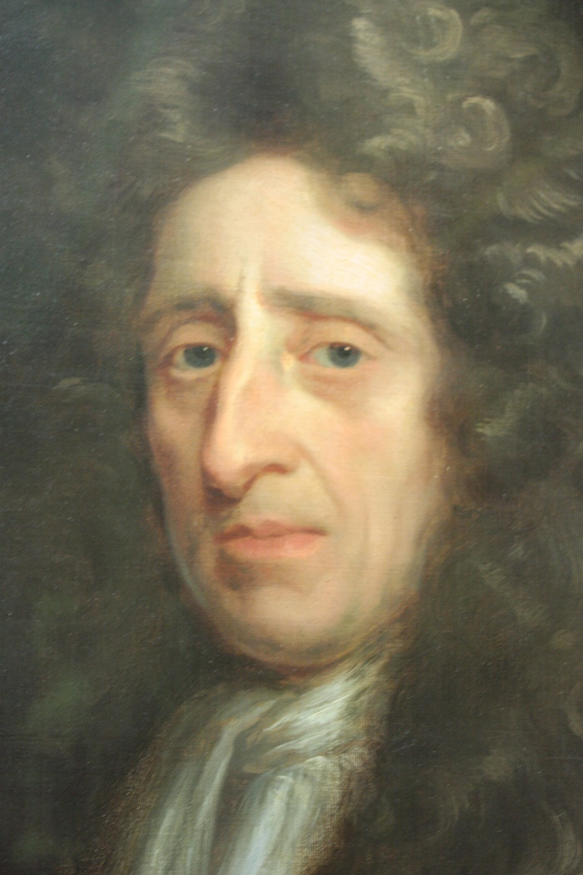
John Locke 1632 –
1704, an English
philosopher and
physician, widely
regarded as one of
the most influential
of Enlightenment
thinkers and
commonly known as the
"Father of Liberalism"
Notes:
Before the American or French Revolution
Liberalism was a good thing then.

Slide 48
Locke's political theory was founded on social contract theory. Social contract arguments typically posit that individuals have consented…to surrender some of their freedoms and submit to the authority of the ruler (or to the decision of a majority) in exchange for protection of their remaining rights.
Notes:
https://en.wikipedia.org/wiki/Social_contract

Slide 49
Locke believed that human nature allowed people to be selfish…In a natural state all people were equal and independent, and everyone had a natural right to defend his "life, health, liberty, or possessions.”
Notes:
https://en.wikipedia.org/wiki/John_Locke

Slide 50
Most scholars trace the phrase "Life, Liberty and the pursuit of Happiness," in the American Declaration of Independence, to Locke's theory of rights.
Notes:
https://en.wikipedia.org/wiki/John_Locke

Slide 51
Locke also advocated governmental separation of powers [executive, legislative, and judicial, no absolute monarchy] and believed that revolution is not only a right but an obligation in some circumstances.
Notes:
https://en.wikipedia.org/wiki/John_Locke

Slide 52
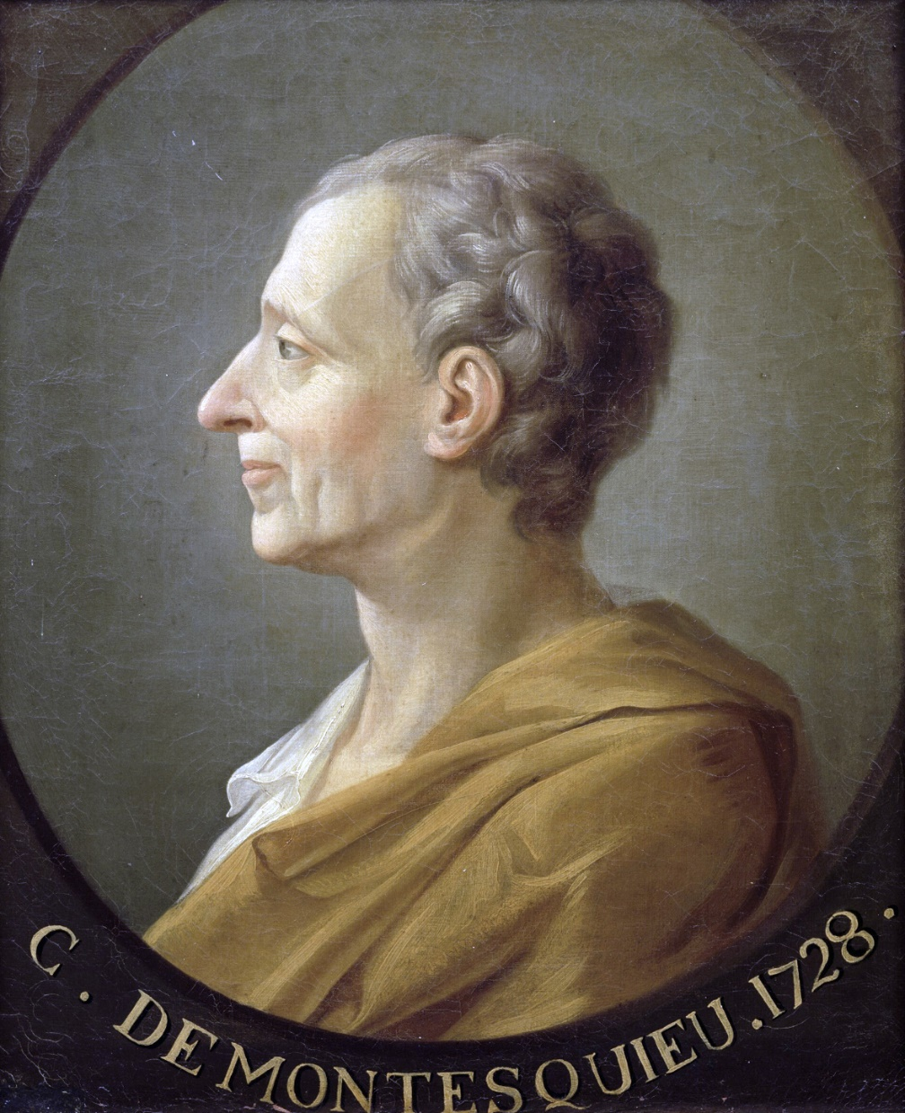
Charles
Montesquieu
1689 -1755, a
French judge,
man of letters,
and political
philosopher.
Notes:
https://en.wikipedia.org/wiki/Montesquieu

Slide 53
He is famous for his articulation of the theory of separation of powers, executive, legislative, judicial; which is implemented in many constitutions throughout the world. He is known for the classification of systems of government based on their principles.
Notes:
https://en.wikipedia.org/wiki/Montesquieu

Slide 54
He is also known for doing more than any other author to secure the place of the word "despotism" in the political lexicon…influencing the Founding Fathers in drafting the United States Constitution.
Notes:
https://en.wikipedia.org/wiki/Montesquieu

Slide 55
Evolution of spiritual liberty

Slide 56
The Protestant Reformation was a widespread theological revolt in Europe against the abuses and totalitarian control of the Roman Catholic Church.
John Wycliffe: 1300’s England, scripture is the standard
Jan Hus (1369–1415) Bohemia/Czech

Slide 57
Martin Luther 1500’s Germany: salvation by faith
Ulrich Zwingli in Switzerland
protested various unbiblical practices of the Catholic Church and promoted a return to sound biblical doctrine.
Notes:
Individual understanding of scripture. Restoration of following the map = faithfulness.

Slide 58
Evolution of political
and spiritual liberty

Slide 59
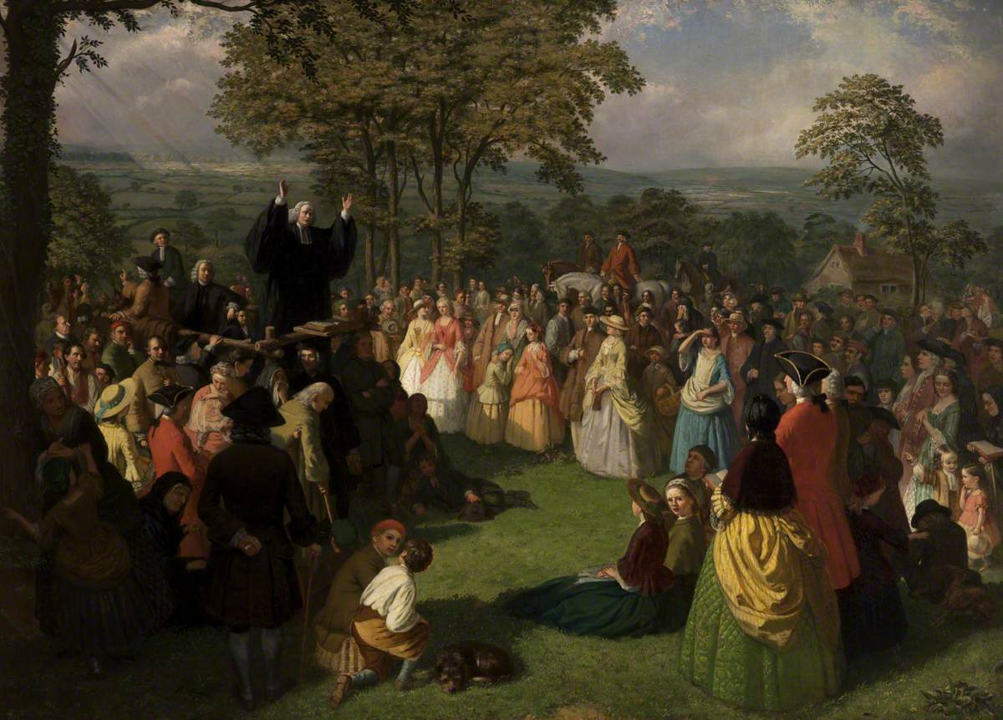
George Whitefield Preaching in
Bolton, UK June 1750

Slide 60
Eric Metaxix on Dobson’s Family Talk: He's preaching the purest kind of gospel of grace and people who'd been used to kind of a moralistic sermons, dour, fatiguing, depressing sermons that tell you what a wretch you are, and you've gotta try harder. He was really delivering the sunshine of the gospel of Yeshua.
Notes:
http://www.drjamesdobson.org/Broadcasts/Broadcast?i=dd10e75d-2af1-46b1-bf22-c7de3c4b1ccf

Slide 61
Thousands would come to hear him. He was preaching four times a day, every single day for decades. Now it's inconceivable to us, thousands would come to hear him and this man did this up and down the 13 colonies all across on horseback for years and years and years and years.
Notes:
http://www.drjamesdobson.org/Broadcasts/Broadcast?i=dd10e75d-2af1-46b1-bf22-c7de3c4b1ccf

Slide 62
So we learn that eventually 80% ... now this is not a typo, and I'm not misspeaking ... 80% of every single person alive in the colonies had heard him in person, not on the radio.
Notes:
http://www.drjamesdobson.org/Broadcasts/Broadcast?i=dd10e75d-2af1-46b1-bf22-c7de3c4b1ccf
The world’s first rock star. Maybe Yeshua was the first.

Slide 63
He wasn't just talking about anything, he was preaching the gospel and at the heart of it, you touched on it before, the message was, we have a direct relationship with the only King, Messiah.
Notes:
http://www.drjamesdobson.org/Broadcasts/Broadcast?i=dd10e75d-2af1-46b1-bf22-c7de3c4b1ccf

Slide 64
And therefore we can question our earthly leaders and if we're being ruled by a tyrant, we can overthrow that tyranny, we have no obligation as believers. Whitefield wasn't talking about Montesquieu and John Locke, he was talking right out of scripture.
Notes:
http://www.drjamesdobson.org/Broadcasts/Broadcast?i=dd10e75d-2af1-46b1-bf22-c7de3c4b1ccf

Slide 65
So when George III despotism got totally intolerable, our founders followed Locke and Montesquieu and scripture.
Notes:
http://www.drjamesdobson.org/Broadcasts/Broadcast?i=dd10e75d-2af1-46b1-bf22-c7de3c4b1ccf
Give me liberty or give me death: Freedom to chose what is right. Spiritual and political freedom.

Slide 66
Evolution of political
and spiritual liberty

Slide 67
We hold these truths to be self-evident, that all men are created equal, that they are endowed by their Creator with certain unalienable Rights, that among these are Life, Liberty and the pursuit of Happiness. — That to secure these rights, Governments are instituted among Men, deriving their just powers from the consent of the governed, —
Notes:
http://www.ushistory.org/declaration/document/

Slide 68
That whenever any Form of Government becomes destructive of these ends, it is the Right of the People to alter or to abolish it, and to institute new Government, laying its foundation on such principles and organizing its powers in such form, as to them shall seem most likely to effect their Safety and Happiness.
Notes:
http://www.ushistory.org/declaration/document/

Slide 69
In 1776, you have a bunch of guys getting together and saying that we're going to take this idea of self-government to the extreme, and we're going to create an entire nation, not a little city state, but an entire nation from Maine to Georgia, and the people will govern themselves. Convention 1787.
Notes:
Http://www.drjamesdobson.org/Broadcasts/Broadcast?i=dd10e75d-2af1-46b1-bf22-c7de3c4b1ccf
Eric Metaxis transcript

Slide 70
The classic 60s definition of freedom as license. It's wrong. Freedom is not freedom to do whatever you like. It's freedom to do what is right.
Notes:
http://www.drjamesdobson.org/Broadcasts/Broadcast?i=dd10e75d-2af1-46b1-bf22-c7de3c4b1ccf
To be faithful, follow the roadmap.

Slide 71
And so the founders created this, I would say, almost miraculous thing in the Constitution. And Benjamin Franklin exhorted them to pray.
Notes:
http://www.drjamesdobson.org/Broadcasts/Broadcast?i=dd10e75d-2af1-46b1-bf22-c7de3c4b1ccf

Slide 72
We think of him as secular. He exhorted them to pray. [Franklin was a great friend of George Whitefield.] So they come up with this thing that allows us to have freedom in the true sense of freedom.
Notes:
http://www.drjamesdobson.org/Broadcasts/Broadcast?i=dd10e75d-2af1-46b1-bf22-c7de3c4b1ccf

Slide 73
Freedom means that I am free to worship God as I see fit, that no one can tell me, no government will tell me what my conscience can tell me. No government will tell me whether to worship God, how to worship God.
Notes:
http://www.drjamesdobson.org/Broadcasts/Broadcast?i=dd10e75d-2af1-46b1-bf22-c7de3c4b1ccf

Slide 74
The idea of democracy, of self-government, not in the history of the world had this ever existed. People always talk about Greece, Greece invented democracy. These were tiny city states. Rome was a republic of the patricians.
Notes:
http://www.drjamesdobson.org/Broadcasts/Broadcast?i=dd10e75d-2af1-46b1-bf22-c7de3c4b1ccf

Slide 75
Os Guiness taught the Golden Triangle of Freedom
freedom requires virtue [or people will elect a Hitler]
virtue requires faith,
and faith, in turn, requires freedom
Notes:
http://www.drjamesdobson.org/Broadcasts/Broadcast?i=dd10e75d-2af1-46b1-bf22-c7de3c4b1ccf
Ravi Zacharias famous line: if morality is relative, give me your wallet.
In the free marketplace of ideas, Biblical truth will stand.

Slide 76
John Adams said, "Our constitution was made only for a moral and religious people. It is wholly inadequate for the government of any other."
Notes:
http://www.drjamesdobson.org/Broadcasts/Broadcast?i=dd10e75d-2af1-46b1-bf22-c7de3c4b1ccf

Slide 77
American exceptionalism is an ideology holding the United States as unique among nations in positive or negative connotations, with respect to its ideas of democracy and personal freedom.
Notes:
https://en.wikipedia.org/wiki/American_exceptionalism

Slide 78
There are some themes common to various conceptions of the idea. One is the history of the United States is different from other nations. In this view, American exceptionalism stems from the American Revolution, becoming what political scientist Seymour Martin Lipset
Notes:
https://en.wikipedia.org/wiki/American_exceptionalism

Slide 79
called "the first new nation" and developing the American ideology of "Americanism", based on liberty, egalitarianism, individualism, republicanism, democracy, and laissez-faire economics.
Notes:
https://en.wikipedia.org/wiki/American_exceptionalism
Story of Ben Franklin and the woman: A republic, if you can keep it. If there is faith → virtue → freedom → faith. Faith will compete well in the market place of ideas.

Slide 80
Characteristics of the
end times winner:
Faithful and sensible
Even in the culture war
Notes:
You can be faithful and sensible in America. It was designed that way. But consider Franklin’s statement. Being a republic is fragile. Virtue → faith → freedom.

Slide 81
Mattityahu (Matthew) 24:45
”מִי הוּא אֵפוֹא הָעֶבֶד הַנֶּאֱמָן שֶׁהִפְקִידוֹ הָאָדוֹן עַל בְּנֵי בֵּיתוֹ
“Who is the faithful and sensible servant whose master puts him in charge of the household staff,
Notes:
One Hebrew word for both.

Slide 82
Mattityahu (Matthew) 24:45
לָתֵת לָהֶם אֶת אָכְלָם בְּעִתּוֹ?
to give them their food at the proper time?
Notes:
A note on HOW to give food.

Slide 83
^{Mishlei/Prov 15.1-2} A gentle response deflects fury, but a harsh word makes tempers rise. The tongue of the wise presents knowledge well
^{Mishlei/Prov 25.15} With patience a ruler may be won over, and a gentle tongue can break bones.
Notes:
We who profess to be GIVING, we need to be so careful of our spirit.

Slide 84
Monday morning quarterback:
If Brett Kavanaugh had said, “Ms. Blasey Ford, I don’t mean to minimize the trauma and pain you’ve experienced. It wasn’t me, but I get it, a bit, the repression of memory, anguish dissociation. I wish you peace.

Slide 85
Similarly, a message some years ago on the Naqba.
A Jew can say to an Arab, “You are the elder son of Abraham. You’re not the covenant son, but you should have gotten a double portion. Instead you’ve had rejection and fatherlessness.

Slide 86
Story told me recently of a man and wife who adopted a baby. As his wife and the baby were crossing a street, some drag racing kid hit and killed both wife and baby.
He sought revenge and death penalty. Consumed him.

Slide 87
Eventually saw the driver in court Murakami met Cabezas for the first time, and was surprised at how clean-cut he was. The young man, now 23, broke down in tears, expressing sympathy and remorse for what happened. He said, “For years I cannot close my eyes without seeing the mother and baby.” I’m so sorry.
Broke the revenge
Notes:
https://abcnews.go.com/GMA/story?id=125847&page=1

Slide 88
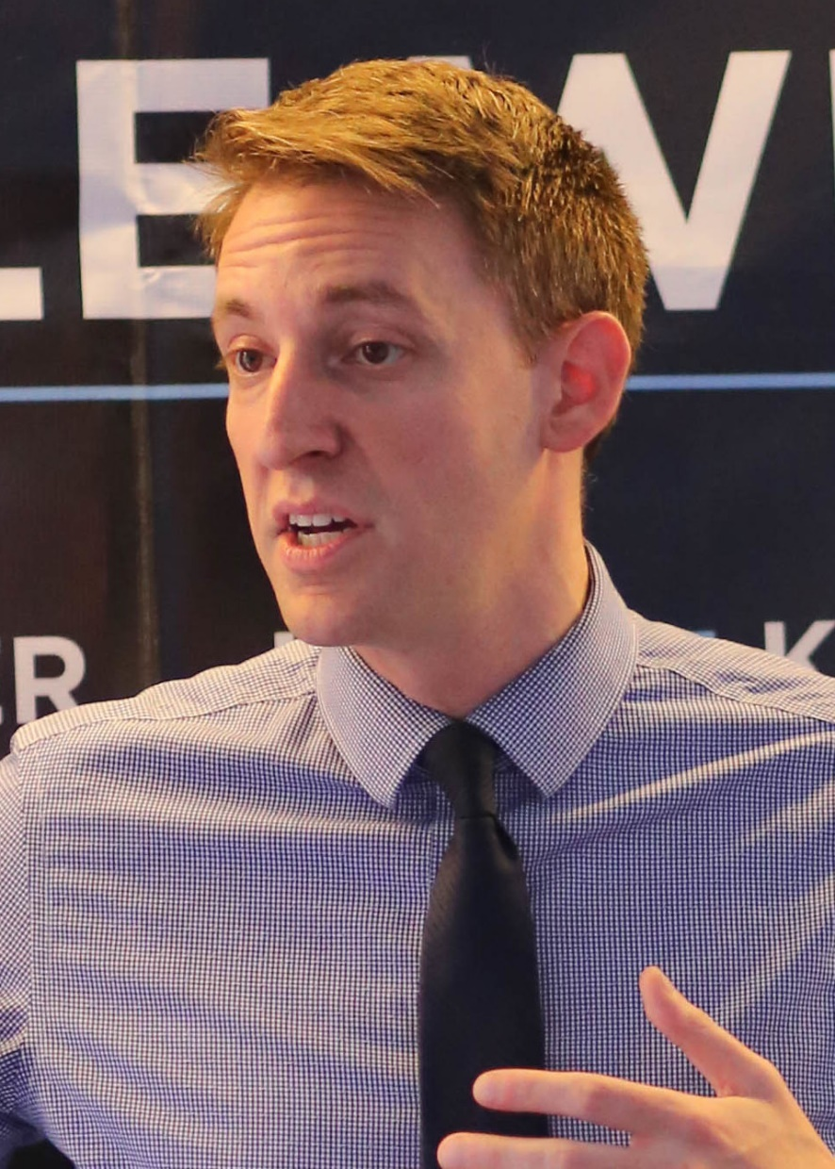
Jason Kander
Born 1981
attorney, author,
combat veteran,
and politician.
Notes:
His father is Jewish, and Kander himself was brought up in a Jewish household which he describes as "Reform but not very observant. 1999 Bishop Miege grad. After the September 11 attacks, he enlisted in the Army National Guard. law degree at Georgetown University, he earned his commission as a second lieutenant through the University's ROTC battalion. After completing his law degree in 2005, he volunteered for a tour in Afghanistan, where he served as an intelligence officer. While serving, his main responsibilities included investigating groups and individuals suspected of corruption, espionage, drug trafficking, and facilitating Al Qaeda and the Taliban
https://en.wikipedia.org/wiki/Jason_Kander

Slide 89
Recently withdrew from KC, MO mayoral race citing PTSD and depression.
Book: Outside the Wire

Slide 90
You live your life with your friends and family, not your accom-plishments.
Democracy requires constant attention, devotion, activism.
Notes:
Jewish Chronicle review of book.

Slide 91
Characteristics of the
end times winner:
Faithful and sensible
giving and serving.

Slide 92
Mattityahu (Matthew) 24:45
”מִי הוּא אֵפוֹא הָעֶבֶד הַנֶּאֱמָן שֶׁהִפְקִידוֹ הָאָדוֹן עַל בְּנֵי בֵּיתוֹ
“Who is the faithful and sensible servant whose master puts him in charge of the household staff,

Slide 93
Mattityahu (Matthew) 24:45
לָתֵת לָהֶם אֶת אָכְלָם בְּעִתּוֹ?
to give them their food at the proper time?

Slide 94
Mattityahu (Matthew) 24:46
אַשְׁרֵי הָעֶבֶד שֶׁיָּבוֹא אֲדוֹנָיו וְיִמְצָא אוֹתוֹ עוֹשֶׂה כֵּן.
“It will go well with that servant if he is found doing his job when his master comes.

Slide 95
Mattityahu (Matthew) 24:47
אָמֵן. אוֹמֵר אֲנִי לָכֶם, הוּא יַפְקִיד אוֹתוֹ עַל כָּל אֲשֶׁר לוֹ.
“Yes, I tell you that he will put him in charge of all he owns.”

Slide 96
give them their food at the proper time
Serve one another.
Share Yeshua
Pray intercede.
Vote

