Slide 1
e-handout
To have these notes
without taking notes
Go to OrHaOlam.com
Click on downloads,
messages, 2018
Notes:
.

Slide 2
Israel news

Slide 3
In February, 2019, the spacecraft recently namedבראשית Beresheet (In the beginning = Genesis), will launch alongside other satellites as a secondary payload on a SpaceX Falcon 9 rocket.

Slide 4
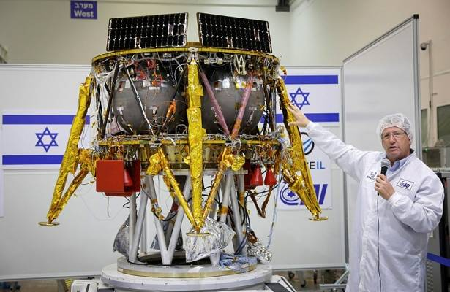
Israelis sending Bible, Israeli
Flag to the Moon
Notes:
The Israeli SpaceIL group and Israel Aerospace Industries (IAI) presented on Monday a time capsule that will travel to the moon with the first Israeli spacecraft. The time capsule consists of three discs, each containing hundreds of digital files, which will launch from Cape Canaveral, Florida, in February. The files traveling to the moon include Israeli national symbols, like Israel’s Declaration of Independence, the Bible, Israel’s national anthem “Hatikvah” and the Israeli flag.

Slide 5
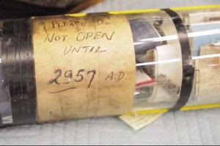
Notes:
The time capsule also includes cultural objects and materials, such as paintings collected from the public over the years for sending to the moon, dictionaries in 27 languages and encyclopedias as an indication of knowledge accumulated by humanity, Israeli songs, books of art and science and Israeli literature, information about Israeli scientific and technological discoveries and developments that influenced the world, and photos Israel’s landscapes and of leading figures in Israeli culture.
On a military/political line…

Slide 6
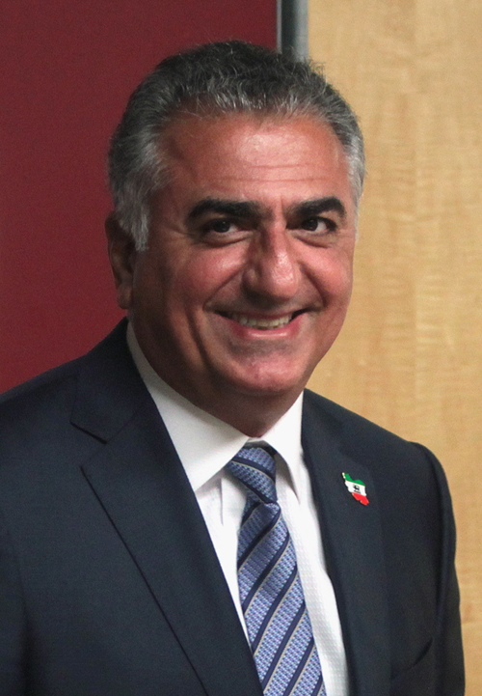
Crown
Prince
Reza
Pahlavi
Pray for
his
success.

Slide 7
Prince Reza Pahlavi, aged 57, son of the late Shah of Iran, has been one of the leading political activists over the past 40 years against the regime that ended his father’s rule in Iran. Recently, he has not only increased his activities in the United States, but he has even attracted unprecedented attention from the American press.
Notes:
https://unitycoalitionforisrael.org/?p=15710045
Was his father, the former Shah of Iran, a righteous ruler? Not exactly. Corruption, political prisoners. From the days when the CIA would change regimes. But, MUCH better than the Ayatollahs who replaced him!

Slide 8
The activities of the pro-Western prince, who is a graduate of top U.S. academic institutions and is fluent in French and English, as well as Farsi, his native language, have increased…
Notes:
https://unitycoalitionforisrael.org/?p=15710045

Slide 9
Hundreds of thousands of young Iranians, in more than 100 cities throughout Iran, shouted slogans in support of the prince, his father Shah Mohammed Reza Pahlavi, and his grandfather Reza Shah.
Notes:
https://unitycoalitionforisrael.org/?p=15710045

Slide 10
The mummified body of the founder of the Pahlavi dynasty, Reza Shah, was discovered at around the same time as the riots, openly causing panic among the leaders of the Islamic regime. [already fearful of discontent about the economy]
Notes:
https://unitycoalitionforisrael.org/?p=15710045

Slide 11
They hid the mummy again in a concealed location to prevent the site from becoming a holy place for the growing number of Reza Pahlavi’s supporters among Iranian youth, who are repudiating the rule of the ayatollahs en masse.
Notes:
https://unitycoalitionforisrael.org/?p=15710045
Pray for the overthrow of the Ayatollahs!!

Slide 12
מַתִּתְיָהוּ Mattityahu
(Matthew) 26:1-2

Slide 13
Mattityahu (Matthew) 26:1
לְאַחַר שֶׁדִּבֵּר יֵשׁוּעַ אֶת כָּל הַדְּבָרִים הָאֵלֶּה אָמַר לְתַלְמִידָיו:
When Yeshua had finished speaking, he said to his talmidim,

Slide 14
Mattityahu (Matthew) 26:2
”אַתֶּם יוֹדְעִים כִּי בְּעוֹד יוֹמַיִם הַפֶּסַח בָּא וּבֶן־הָאָדָם יִמָּסֵר לְהִצָּלֵב.“
“As you know, Pesakh is two days away, and the Son of Man will be handed over to be nailed to the execution-stake.”
Notes:
Might not seem that there is a whole sermon in this verse, but as I was dividing the scriptures for reading, the Ruakh seems to say, this is a message. Really?

Slide 15
Counterpoint: Use of contrasting elements in a work of art.
Notes:
https://www.thefreedictionary.com/counterpoint

Slide 16
What do your think of when hearing the word “Pesakh?”
Redemption
Food
Family gathering
Lot of work
Lamb of G-d

Slide 17
What do your think of when hearing the word “Pesakh?”
Redemption from slavery in Egypt by the blood of the Lamb.

Slide 18
Mattityahu (Matthew) 26:2
”אַתֶּם יוֹדְעִים כִּי בְּעוֹד יוֹמַיִם הַפֶּסַח בָּא וּבֶן־הָאָדָם יִמָּסֵר לְהִצָּלֵב.“
“As you know, Pesakh is two days away, and the Son of Man will be handed over to be nailed to the execution-stake.”
Notes:
Spoke about this, but briefly, last week.

Slide 19
The Son of man
What image is associated
with that phrase?
Notes:
Spoke about this briefly just last week, but need to amplify

Slide 20
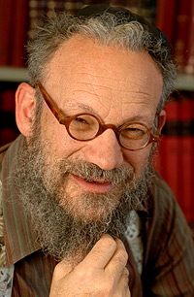
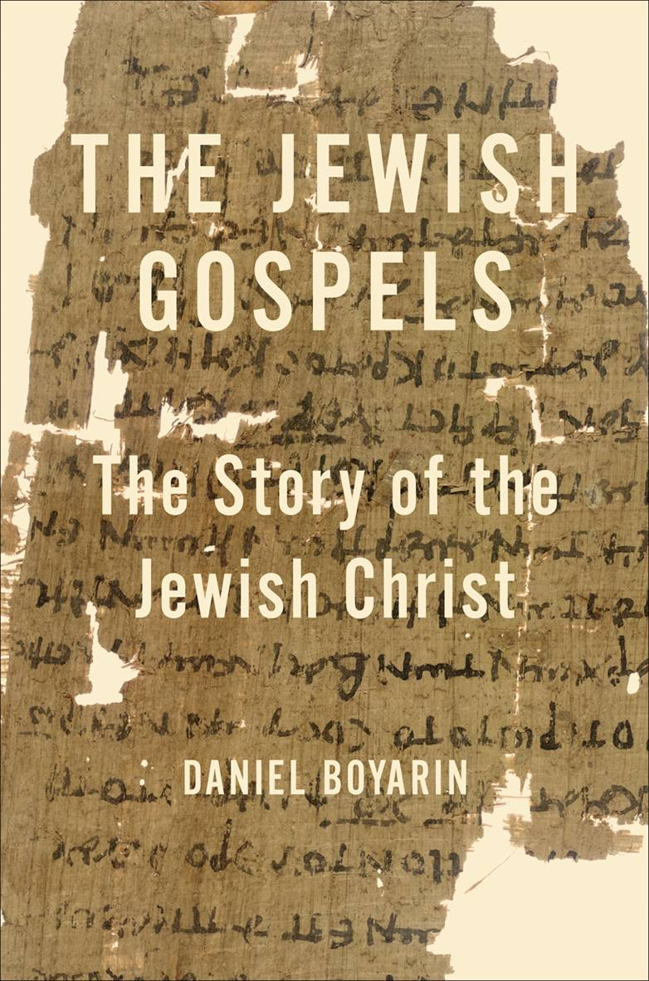
Daniel Boyarin

Slide 21
Daniel Boyarin (born 1946) is a historian of religion. Born in Asbury Park, New Jersey, he holds dual United States and Israeli citizenship. Trained as a Talmudic scholar, in 1990 he was appointed

Slide 22
Professor of Talmudic Culture, Departments of Near Eastern Studies and Rhetoric, University of California, Berkeley, a post which he still holds

Slide 23
Daniel Boyarin, professor of Talmudic Culture at the University of California Berkeley, may be the most influential scholar of ancient Judaism today.
Notes:
Bear with me, he’s speaking as a non-believer about our faith, so uses non-Messianic terminology.
Quotes from p 1-2, 5-6, 25-26

Slide 24
Messiah = Son of G-d in Jewish concepts, but not what you think.
^{1 Shmu 10.1} Then Sh'mu'el took a flask of oil he had prepared and poured it on Sha'ul's head. He kissed him and said, "ADONI has anointed you to be prince over his inheritance.”
משחך m’shakhekha

Slide 25
^{T’hillim 2.6-7} "I myself have installed my king on Tziyon, my holy mountain." "I will proclaim the decree: ADONI said to me, 'You are my son; today I became your father.
Notes:
Later got to have secondary meanings, but at first, simply son of G-d as royal king with divinely appointed authority.

Slide 26
All the kings, priests anointed for service. No hint of deity ~ Pharoah.
^{1 Chron 7. 11-14} When your days come to an end and you go to be with your ancestors, I will establish one of your descendants to

Slide 27
succeed you, one of your own sons; and I will set up his rulership. He will build me a house, and I will establish his throne forever.

Slide 28
^{1 Chron 7. 11-14} I will be a father for him, and he will be a son for me; I will not take my grace away from him, as I took it away from your predecessor.

Slide 29
^{1 Chron 7. 11-14} Rather, I will maintain him in my house and in my kingdom forever; and his throne will be set up forever.'"
The king is special to G-d, a son in authority, but very human.

Slide 30
After the exile, prayer was for a restoration of the Davidic kingdom.
^{Lk 1.31-32} Look! You will become pregnant, you will give birth to a son, and you are to name him Yeshua.
Notes:
Reversal: Son of G-d = divinely appointed king.

Slide 31
^{Lk 1.31-32} He will be great, he will be called Son of Ha`Elyon. ADONI, God, will give him the throne of his forefather David
Focus here primarily Davidic throne
Notes:
Reversal: Son of G-d = divinely appointed king.

Slide 32
In the Tanakh [Hebrew scriptures] and the Messianic scriptures
Son of G-d = human royalty appointed by G-d. Human

Slide 33
Two concepts of
anointed king, Son of God,
divine deliverer, Son of Man
Notes:
Total reversal of traditional Christian teaching.

Slide 34
^{Daniel 7.13-14} "I kept watching the night visions, when I saw, coming with the clouds of heaven, someone like a son of man. He approached the Ancient One and was led into his presence.
Notes:
Coming with clouds Ps 18, and about 70 passages picture of G
In my distress I called to ADONAI; I cried out to my God. Out of his temple he heard my voice; my cry reached his ears. 7 "Then the earth quaked and shook, the foundations of the mountains trembled. They were shaken because he was angry. 8 Smoke arose in his nostrils; out of his mouth came devouring fire; sparks blazed forth from him. 9 He lowered heaven and came down with thick darkness under his feet. 10 He rode on a keruv; he flew, swooping down on the wings of the wind.

Slide 35
^{Daniel 7.13-14} To him was given rulership, glory and a kingdom, so that all peoples, nations and languages should serve him. His rulership is an eternal rulership that will not pass away; and his kingdom is one that will never be destroyed.
Notes:
Coming with clouds Ps 18, and about 70 passages picture of G
In my distress I called to ADONAI; I cried out to my God. Out of his temple he heard my voice; my cry reached his ears. 7 "Then the earth quaked and shook, the foundations of the mountains trembled. They were shaken because he was angry. 8 Smoke arose in his nostrils; out of his mouth came devouring fire; sparks blazed forth from him. 9 He lowered heaven and came down with thick darkness under his feet. 10 He rode on a keruv; he flew, swooping down on the wings of the wind.

Slide 36
Boyarin, Jewish Gospels, p 33
Daniel’s vision of Messiah, son of man
He is divine
He is in human form
Notes:
Exonerate Paul

Slide 37
Boyarin, Jewish Gospels, p 33
He may very well be portrayed as a “younger” appearing divinity
He will be enthroned on high
He is given power on earth.
Notes:
Exonerate Paul

Slide 38
^{Mark 2. 5-11} Seeing their trust, Yeshua said to the paralyzed man, "Son, your sins are forgiven." Some Torah-teachers sitting there thought to themselves, "How can this fellow say such a thing?

Slide 39
^{Mark 2. 5-11} He is blaspheming! Who can forgive sins except God?" But immediately Yeshua, perceiving in his spirit what they were thinking, said to them,

Slide 40
^{Mark 2. 5-11} "Why are you thinking these things? Which is easier to say to the paralyzed man? `Your sins are forgiven'? or `Get up, pick up your stretcher and walk'? But look!
Notes:
Yeshua cites two sources of authority: fact of healing, and Daniel title, quoting Dan 7

Slide 41
^{Mark 2. 5-11} I will prove to you that the Son of Man has authority on earth to forgive sins." He then said to the paralytic, "I say to you: get up, pick up your stretcher and go home!" Dan 7… “To him was given rulership” שלטן
Notes:
Yeshua cites two sources of authority: fact of healing, and Daniel title, quoting Dan 7

Slide 42
^{Mk 2.23-28} One Shabbat Yeshua was passing through some wheat fields; and as they went along, his talmidim began picking heads of grain. The P'rushim said to him,
Notes:
Was Rabbinic context to interpret Shabbat laws Boyarin 63

Slide 43
^{Mk 2.23-28} "Look! Why are they violating Shabbat?" He said to them, "Haven't you ever read what David did when he and those with him were hungry and needed food?
Notes:
Was Rabbinic context to interpret Shabbat laws Boyarin 63

Slide 44
^{Mk 2.23-28} He entered the House of God when Evyatar was cohen gadol and ate the Bread of the Presence," -- which is forbidden for anyone to eat but the cohanim --

Slide 45
^{Mk 2.23-28} "and even gave some to his companions." Then he said to them, "Shabbat was made for mankind, not mankind for Shabbat; So the Son of Man is Lord even of Shabbat."
Notes:
Only G-d can change or lift the Shabbat laws!!

Slide 46
Two concepts of
anointed human king, Son of God,
divine deliverer, Son of Man
began to merge
Notes:
Total reversal of traditional Christian teaching.

Slide 47
The "Son of Man" is a Messianic title that refers to the supra-natural figure from heaven who establishes a kingdom on the earth.
Notes:
http://www.blainerobison.com/bible2-matt/mattnotes25.htm

Slide 48
David Flusser, Orthodox Jewish scholar and professor at Hebrew University, explains,
For first-century Jews the "Son of Man" is Daniel's divine redeemer in human form.
Notes:
http://www.blainerobison.com/bible2-matt/mattnotes25.htm

Slide 49
^{Flusser:} “In all of the sources, the one resembling a man is portrayed in a consistent manner. The Son of Man has a superhuman, heavenly sublimity. He is the cosmic judge at the end of time. Sitting upon the throne of God, judging the entire human race with the aid of the heavenly hosts, he will consign
Notes:
http://www.blainerobison.com/bible2-matt/mattnotes25.htm

Slide 50
^{Flusser:} the just to blessedness and the wicked to the pit of hell. Frequently he is identified with the Messiah, but he can also be identified with Enoch, who was taken up into heaven.”
Notes:
http://www.blainerobison.com/bible2-matt/mattnotes25.htm

Slide 51
^{Daniel 7.13-14} "I kept watching the night visions, when I saw, coming with the clouds of heaven, someone like a son of man. He approached the Ancient One and was led into his presence.
Notes:
Coming with clouds Ps 18, and about 70 passages picture of G
In my distress I called to ADONAI; I cried out to my God. Out of his temple he heard my voice; my cry reached his ears. 7 "Then the earth quaked and shook, the foundations of the mountains trembled. They were shaken because he was angry. 8 Smoke arose in his nostrils; out of his mouth came devouring fire; sparks blazed forth from him. 9 He lowered heaven and came down with thick darkness under his feet. 10 He rode on a keruv; he flew, swooping down on the wings of the wind.

Slide 52
חָזֵה הֲוֵית, בְּחֶזְוֵי לֵילְיָא,
I kept watching the night visions
וַאֲרוּ עִם-עֲנָנֵי שְׁמַיָּא,
when I saw, coming with the clouds of heaven,
כְּבַר אֱנָשׁ אָתֵה הֲוָא;
someone like a son of man.
Notes:
Zipporah Bennett rendition

Slide 53
וְעַד-עַתִּיק יוֹמַיָּא מְטָה,
He approached the Ancient One
וּקְדָמוֹהִי הַקְרְבוּהִי
and was led into his presence.

Slide 54
Mattityahu (Matthew) 26:2
”אַתֶּם יוֹדְעִים כִּי בְּעוֹד יוֹמַיִם הַפֶּסַח בָּא וּבֶן־הָאָדָם יִמָּסֵר לְהִצָּלֵב.“
“As you know, Pesakh is two days away, and the Son of Man will be handed over to be nailed to the execution-stake.”
Notes:
Pesakh = redemption
Son of Man = divine Messiah

Slide 55
Nailed to the execution stake.
What??
Counterpoint: Use of contrasting elements in a work of art.
Son of Man, Divine Messiah, cp Pesakh redemption from slavery by the lamb
Divine Messiah is the Lamb?
Notes:
https://www.thefreedictionary.com/counterpoint

Slide 56
^{T’hillim/Ps 22.17} For dogs have surrounded me. A band of evildoers has closed in on me. They pierced my hands and my feet.
כִּי סְבָבוּנִי, כְּלָבִים: עֲדַת מְרֵעִים, הִקִּיפוּנִי; כָּאֲרִי יָדַי וְרַגְלָי.
Notes:
Michael Brown Answering Jewish Objections p 123-126

Slide 57
^{Yeshayahu/Is 53.5} He was wounded because of our crimes, crushed because of our sins; the disciplining that makes us whole fell on him, and by his bruises we are healed.

Slide 58
^{Zekh 12.10} I will pour out on the house of David and on those living in Yerushalayim a spirit of grace and prayer; and they will look to me, whom they pierced.”
וְהִבִּיטוּ אֵלַי, אֵת אֲשֶׁר-דָּקָרוּ

Slide 59
^{Daniel 7.13-14} To him was given rulership, glory and a kingdom, so that all peoples, nations and languages should serve him. His rulership is an eternal rulership that will not pass away; and his kingdom is one that will never be destroyed.
How given?
Notes:
How was it given?

Slide 60
^{Shmot/Ex 40.13} Within three days Pharaoh will lift up your head and restore you to your office: [cupbearer] יִשָּׂא פַרְעֹה אֶת-רֹאשֶׁךָ
^{Shmot/Ex 40.19} Within three days Pharaoh will lift up your head from off of you — he will hang you on a tree [baker] יִשָּׂא פַרְעֹה אֶת-רֹאשְׁךָ מֵעָלֶיךָ
Notes:
Same wording, entirely different meaning.

Slide 61
Sometimes things are just given to us easily.
Sometimes destruction is just given to us.
Messiah was given the Kingdom, but through the execution stake.

Slide 62
Mattityahu (Matthew) 26:2
”אַתֶּם יוֹדְעִים כִּי בְּעוֹד יוֹמַיִם הַפֶּסַח בָּא וּבֶן־הָאָדָם יִמָּסֵר לְהִצָּלֵב.“
“As you know, Pesakh is two days away, and the Son of Man will be handed over to be nailed to the execution-stake.”
Notes:
Application?

Slide 63
Applications:
Therefore, brothers whom God has set apart, who share in the call from heaven, think carefully about Yeshua, whom we acknowledge publicly as God’s emissary and as cohen gadol [high priest]

Slide 64
^{1 Yn 3.16} The way that we have come to know love is through his having laid down his life for us. And we ought to lay down our lives for the brothers!

Slide 65
Applications:
Lay down /renounce/repent of our sinfulness, repent and trust Yeshua for LIFE
Lay down our selfishness, to serve others, hear others, honor others, upbuild others!
Invite people to LIFE, to congregation. How many 2018?

Slide 67
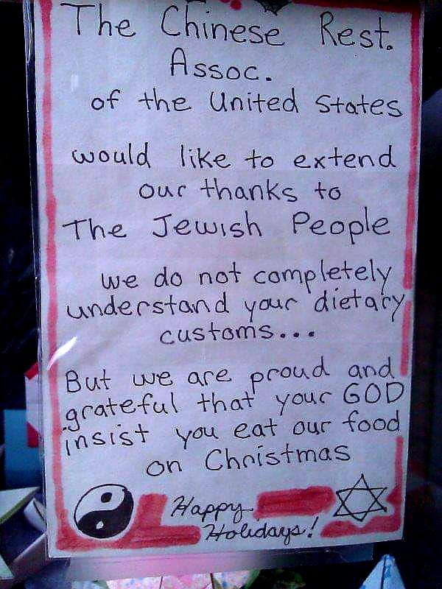
Or HaOlamniks are encouraged to go out for Chinese food Dec 24 or 25.
Notes:
Get eye contact and with a smile on your face say, “You know it is so interesting that while the world is celebrating the birth of a Jewish Rabbi, most of His own people are not and go out to eat Chinese food. Have you ever thought about that?

