Slide 1
If you want to have notes without taking notes,
Go to OrHaOlam.com
WITHOUT WIFI
Click on downloads, messages, 2018 messages
Today’s should be on the top.
Notes:
Like to give big picture of life, grid of events…

Slide 2
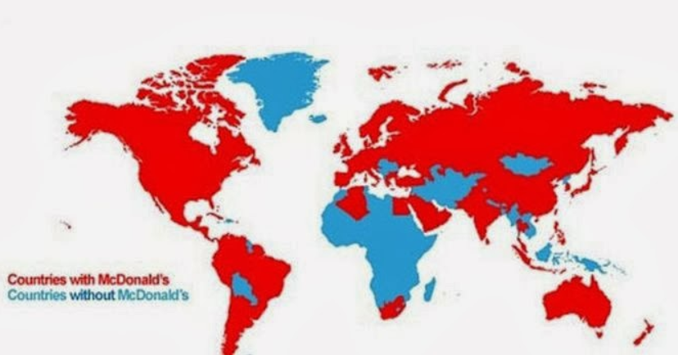
Notes:
All maps from Kathleen Eltrich Feb 12, 2015 at 7:55 PM

Slide 3
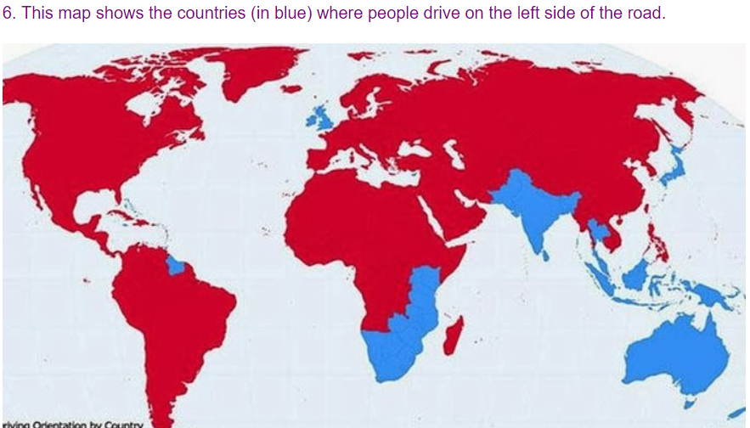

Slide 4
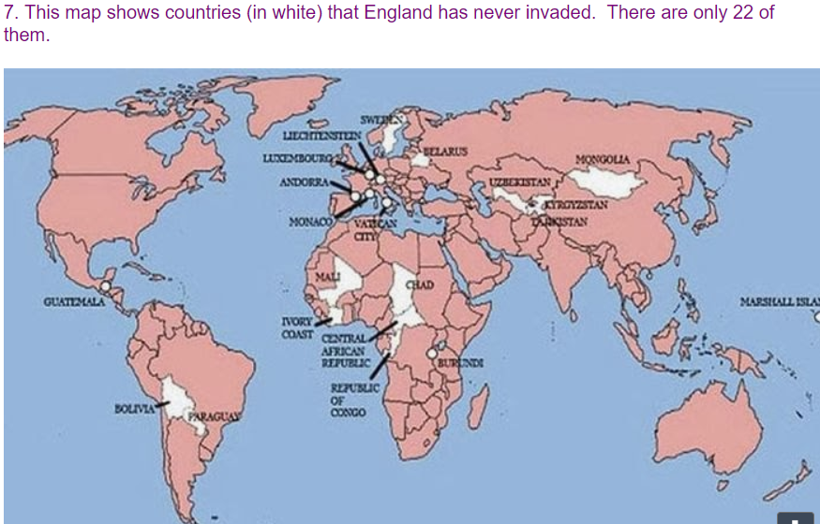

Slide 5
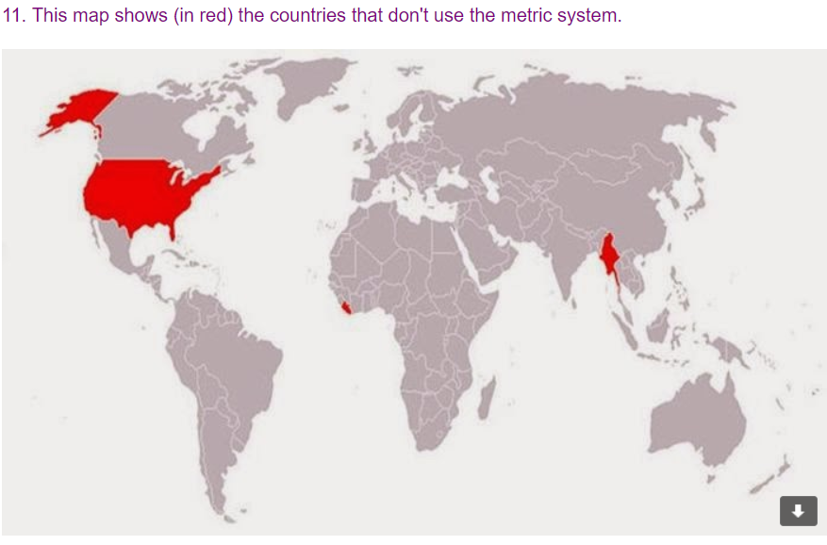

Slide 6
Bat Mitzvah Message for
Louise Ballard
שׁוֹשִׁי בַּת יוֹחֲנָה
Shoshi bat Yokhana
Notes:
http://www.answeringmuslims.com/2017/08/the-psychology-of-islam-part-three.html

Slide 7
G-d intends our lives
to be lived in blessing.

Slide 8
First words ever spoken ^{Beresheet/Gen 1.27} So God created humankind in his own image; in the image of God he created him: male and female he created them. God blessed them: God said to them, “Be fruitful, multiply, fill the earth and subdue it.”
Notes:
Commissioning origination of the Jewish people…

Slide 9
^{Beresheet/Gen. 12.1-3} Then Adoni said to Avram, “Get going out from your land, and from your relatives, and from your father’s house, to the land that I will show you. My heart’s desire is to make you into a great nation, to bless you,

Slide 10
^{Beresheet/Gen. 12.1-3} to make your name great so that you may be a blessing. My desire is to bless those who bless you, but whoever curses you I will curse, and in you all the families of the earth will be blessed.
Notes:
Receiving G-d’s blessing, blessing the Nations, receive blessing from the Nations. A whole exchange and communication of blessing.
Vision for families.

Slide 11
^{T’hillim/Ps 144.11-12} Rescue me, save me from the power of strangers, whose mouths speak worthless words and whose right hands swear false oaths. Our sons in their youth will be like full-grown saplings, our daughters will be like sculptured pillars fit for the corner of a palace.
Notes:
Strong ~pillars, upright, beautiful girls → women.
Yeshua’s own life…

Slide 12
^{Luke 2.25-33} There was in Yerushalayim a man named Shim‘on. This man was a tzaddik, he was devout, he waited eagerly for God to comfort Isra’el, and the Ruakh HaKodesh was upon him. It had been revealed to him by the Ruakh HaKodesh that he would not die before he had seen

Slide 13
^{Luke 2.25-33} the Messiah of Adoni. Prompted by the Spirit, he went into the Temple courts; and when the parents brought in the child Yeshua to do for him what the Torah required, Shim‘on took him in his arms, made a b’rakhah to God, and said,

Slide 14
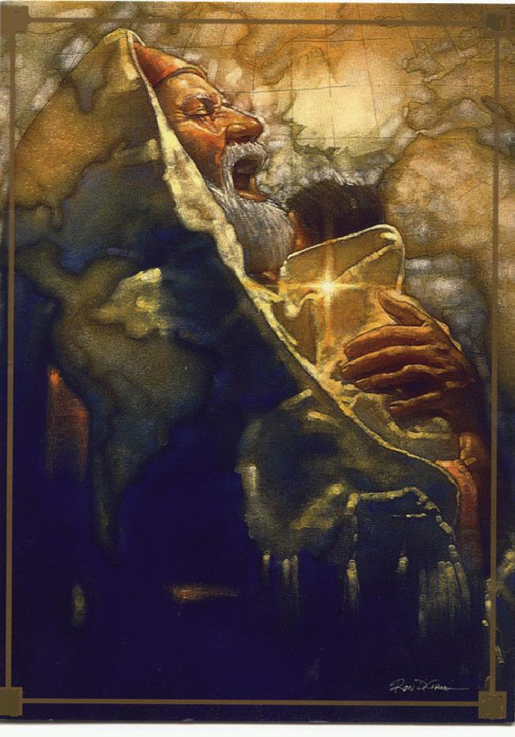
Notes:
Note map of the nations behind

Slide 15
^{Luke 2.25-33} “Now, Adonai, according to your word, your servant is at peace as you let him go; for I have seen with my own eyes your yeshu‘ah [salvation], which you prepared in the presence of all peoples.” Yeshua’s father and mother were marveling at the things Shim‘on was saying about him. Shim‘on blessed them.

Slide 16
^{Mark 10.13-16} People were bringing children to him so that he might touch them…And he took them in his arms, laid his hands on them, and made a b’rakhah over them.
Notes:
So, what is the meaning of this “blessing.”

Slide 17
בֵּרֵךְ bay-rakh
To kneel, bless, greet, congratulate, praise, thank, wish well
Confers identity: Who am I?
Confers destiny: Why am I here?

Slide 18
Or HaOlam
Seminar
Aug. 16-17,
2008

Slide 19
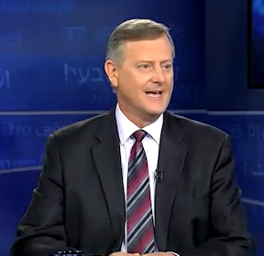
Craig Hill
Video
teacher

Slide 20
Seven Critical Times of Blessing
Conception
Pregnancy
Birth
Infancy
Puberty
Marriage
Older Age
Notes:
Blessing of G-d in “opening the womb” Rachel
A wanted baby. Words of welcome
Brit Milah, Baby Naming.
Acceptance, love, nurturing
Bar/Bat Mitzvah
7 Blessings, taken from Gen 1
Prov 31.28 My aunt Betty at age 84 in the Bronx Bat Mitzvah.

Slide 21
Islam reflects the plague of fatherlessness, lack of the blessing of a father, beginning with Ishmael.

Slide 22
^{Beresheet/Gen 21.9-14} Sarah saw the son of Hagar the Egyptian, whom Hagar had borne to Avraham, making fun of Yitz’chak; so Sarah said to Avraham, “Throw this slave-girl out! And her son! I will not have this slave-girl’s son as your heir along with my son Yitz’chak!”

Slide 23
^{Beresheet/Gen 21.9-14}Avraham became very distressed over this matter of his son. But God said to Avraham, “Don’t be distressed because of the boy and your slave-girl. Listen to everything Sarah says to you, because it is your descendants through Yitz’chak who will be counted…

Slide 24
^{Beresheet/Gen 21.9-14} Avraham got up early in the morning, took bread and a skin of water and gave it to Hagar, putting it on her shoulder, and the child; then he sent her away.
Notes:
Sent out with nothing except contempt and rejection from family.
By contrast…

Slide 25
^{Beresheet/Gen 25.1-6 .}Avraham took another wife, whose name was K’turah. She bore him Zimran, Yokshan, Medan, Midyan, Yishbak; and Shuach. …Avraham gave everything he owned to Yitz’chak. But to the sons of the concubines

Slide 26
^{Beresheet/Gen 25.1-6} he made grants while he was still living and sent them off to the east, to the land of Kedem, away from Yitz’chak his son.
Notes:
Sent out with blessing. Not Ishmael. Firstborn, supposed to have double blessing. Not covenant son, but blessed son.
Millenia later…

Slide 27
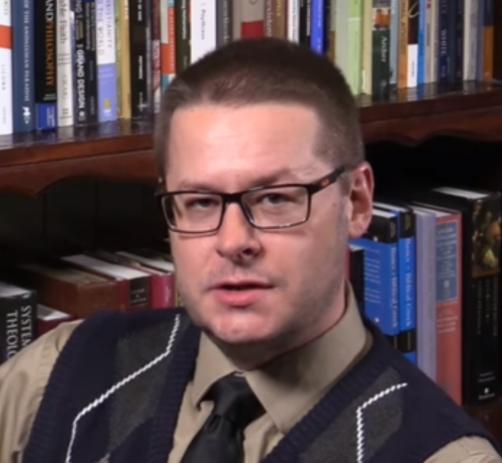
David
Wood
Notes:
http://www.answeringmuslims.com/2017/08/the-psychology-of-islam-part-three.html
Muhammed epitome of fatherlessness.

Slide 28
Muhammed’s father died before he was born
Sent to live with foster family shorly after birth
About age 4 taken from foster family and back to mother
Notes:
http://www.answeringmuslims.com/2017/08/the-psychology-of-islam-part-three.html

Slide 29
Mother died when he was six
Custody then to grandfather who died when Muhammed 8.
With that many broken relationships [lack of blessing], tendency to distrust tradition and authority and rebel.
Notes:
http://www.answeringmuslims.com/2017/08/the-psychology-of-islam-part-three.html

Slide 30
Rebel:
attacked his own people theologically, morally, socially
Subjugated his own tribe & city
View of Father figures
Koran numerous stories about mother of Yeshua, all w/o Yosef
Notes:
http://www.answeringmuslims.com/2017/08/the-psychology-of-islam-part-three.html

Slide 31
Sura 19 taken from pseudo Matthew: Yeshua newborn and Miriaim thirsty. Under palm tree and baby Yeshua speaks, spring appears, tree bends down to give fruit.
Notes:
http://www.answeringmuslims.com/2017/08/the-psychology-of-islam-part-three.html

Slide 32
Notes:
http://www.answeringmuslims.com/2017/08/the-psychology-of-islam-part-three.html
Muslims are NOT children of the Heavenly Father. Not part of their mindset. Fatherlessness…

Slide 33
Notes:
http://www.answeringmuslims.com/2017/08/the-psychology-of-islam-part-three.html
Followers of Allah are slaves. Apparently not voluntary love servants.

Slide 34
Islam reflects the plague of fatherlessness, lack of the blessing of a father, beginning with Ishmael.
We Jewish people haven’t honored our elder brother. Not the covenant brother, but elder nevertheless.
Notes:
Ever get a chance, often GREAT impact to express this to a Muslim, ask forgiveness.

Slide 35
Seven Critical Times of Blessing
Conception
Pregnancy
Birth
Infancy
Puberty
Marriage
Older Age
Notes:
One of the main sources of teen rebellion is perceived lack of blessing. HaSatan, Satan is the accuser, so easy to perceive even with loving parents who are busy, own issues and baggage, limited skill and knowledge.
Communicate blessing.

Slide 36
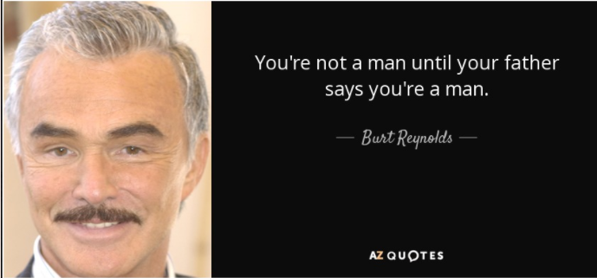
Notes:
http://www.azquotes.com/quote/798976
Applies to women too. Daddy communicates princess identity.

Slide 37
All Dads and daughters, give a hug.
All of us guys…reach out in your spirit.
All women here, particularly Louise, receive this.
Notes:
Maybe a bit corny, but, I like corn…

Slide 38
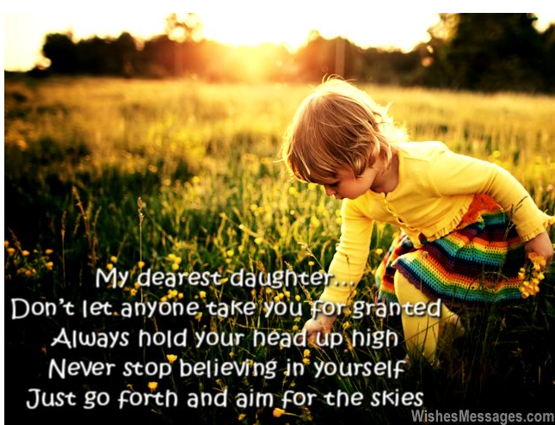
Notes:
https://wishesmessages.com/i-love-you-messages-for-daughter/

Slide 39
You are more priceless than silver, gold or platinum. Not because you are my daughter, but because you are simply awesome.
Notes:
https://wishesmessages.com/i-love-you-messages-for-daughter/

Slide 40
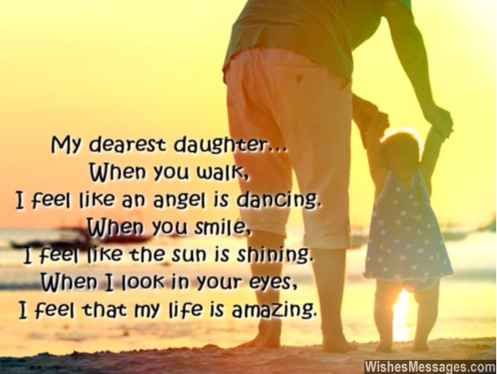
Notes:
https://wishesmessages.com/i-love-you-messages-for-daughter/

Slide 41
She's stubborn, messy, a brat at times, clumsy, loud and silly, but in my eyes she is the definition of perfection and beauty...she is my daughter.
Daughters are flowers that are forever in bloom.
Notes:
https://www.scrapbook.com/quotes/doc/44879/163.html

Slide 42
Do you know how the story of your parents’ lives went from being ordinary to extraordinary? When they became mommy and daddy to a sweet daughter like you.
Notes:
https://wishesmessages.com/i-love-you-messages-for-daughter/

Slide 43
בֵּרֵךְ bay-rakh
To kneel, bless, greet, congratulate, praise, thank, wish well
Confers identity: Who am I?
Confers destiny: Why am I here?
Notes:
Stop. Last slide Clyde. Call up Louise & Vinocurs.

