Slide 1
If you want to have notes without taking notes,
Go to OrHaOlam.com
WITHOUT WIFI
Click on downloads, messages, 2018 messages
Today’s should be on the top.
Notes:
The effects of a looooong Seder

Slide 2
Becky Lee Report

Slide 3
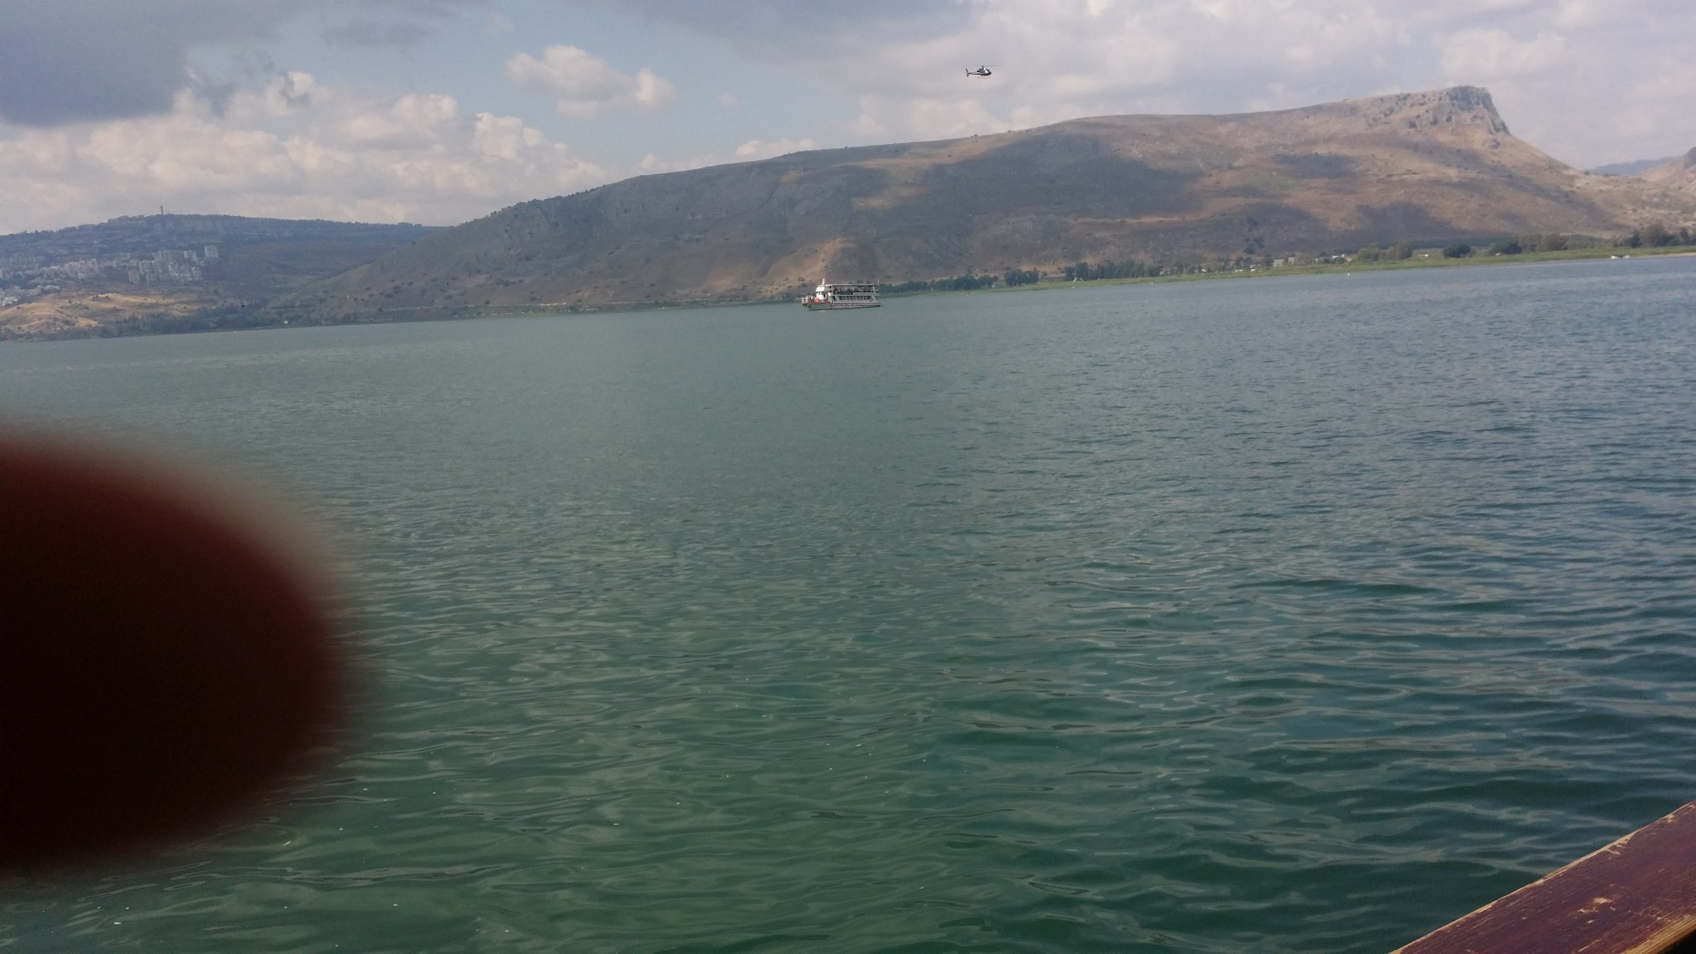

Slide 4
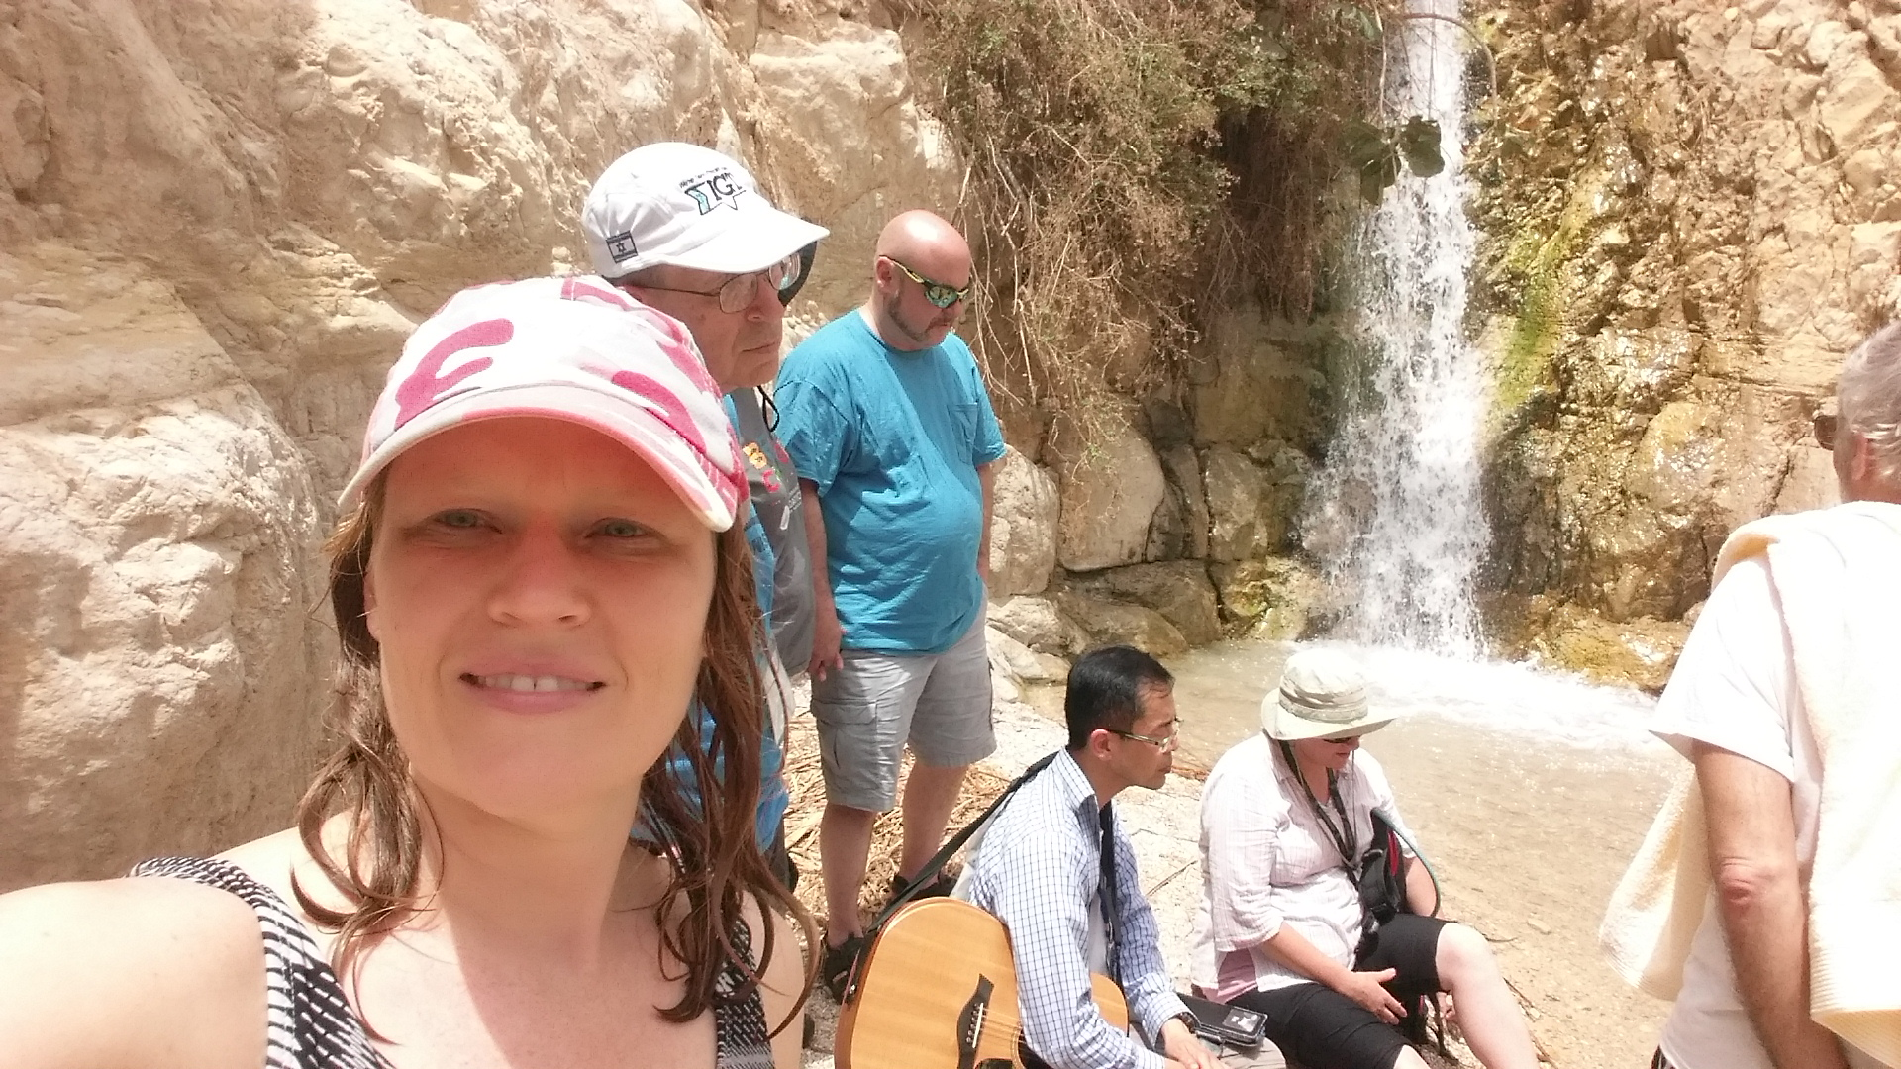

Slide 5
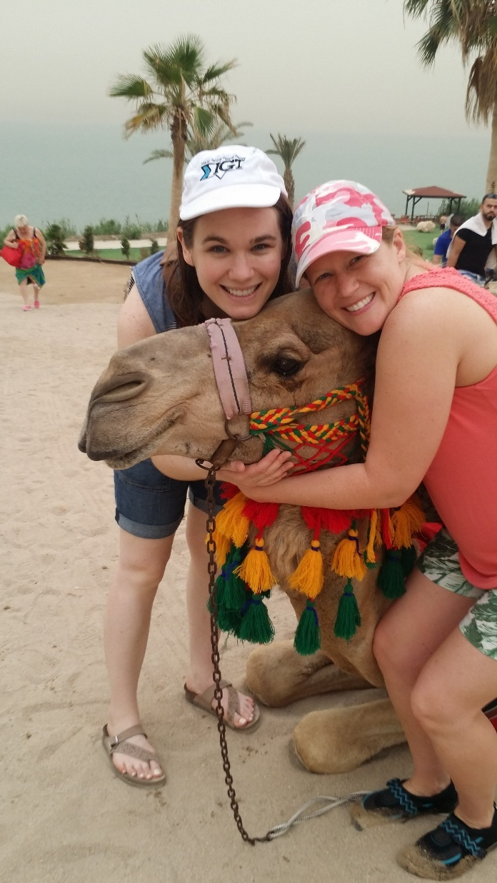

Slide 6
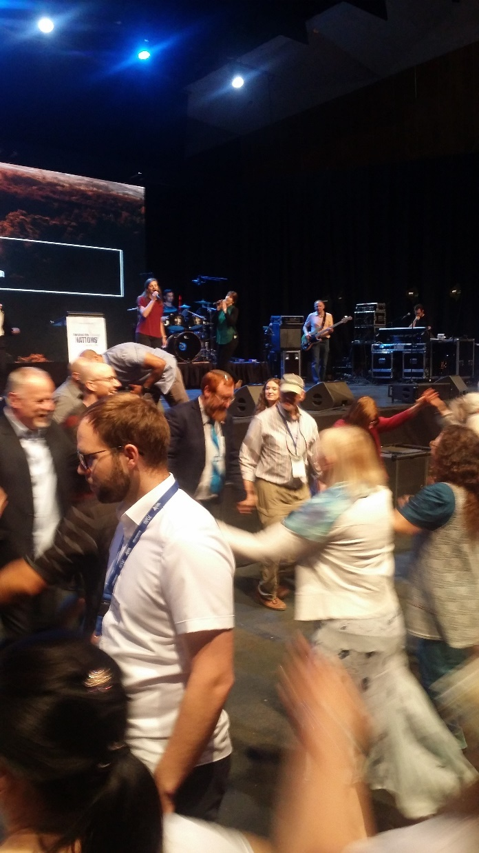

Slide 7
Alan Armfield Report

Slide 8
Israel Presentation
Houses of Prayer

Slide 9
Succat Hallel
Rick Ridings - Director

Slide 10
Nightwatch
Israel Harp & Bowl Team

Slide 11
Jong Kim Report

Slide 12
Nightwatch
Second Team

Slide 13
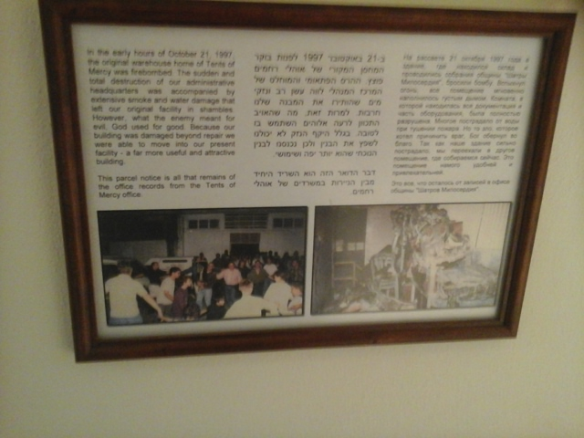
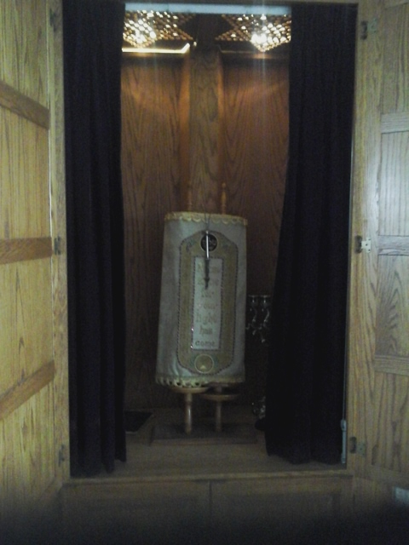
ESV Isaiah 40:8 The grass withers, the flower fades, but the word of our God will stand forever.

Slide 14
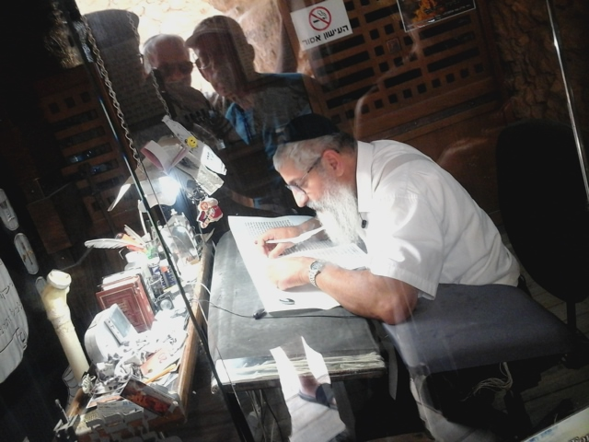
A SCRIBE WRITING THE TORAH SCROLLS
ON TOP OF MASADA

Slide 15
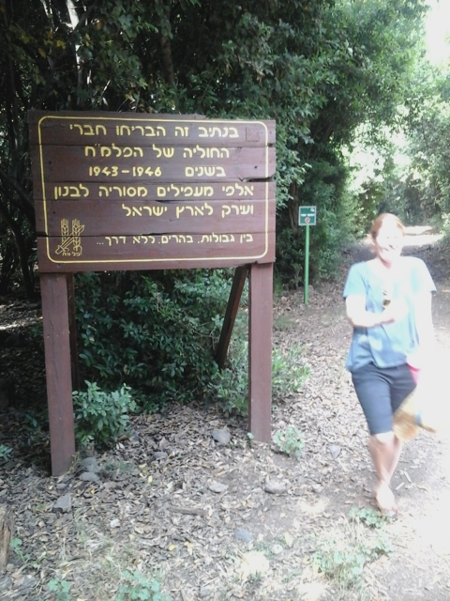
A SIGN REMEMBERING JEWS WHO RISKED THEIR LIVES HELPING OTHER JEWS COME INTO ISRAEL.
On this trail members of the Palmach smuggled, in the years 1943-1946, thousands of Jewish illegal immigrants from Syria, Lebanon and Iraq to Israel.
Notes:
On this trail members of the Palmach band smuggled, in the years 1943-1946, thousands of Jewish illegal immigrants from Syria, Lebanon and Iraq to Israel.

Slide 16
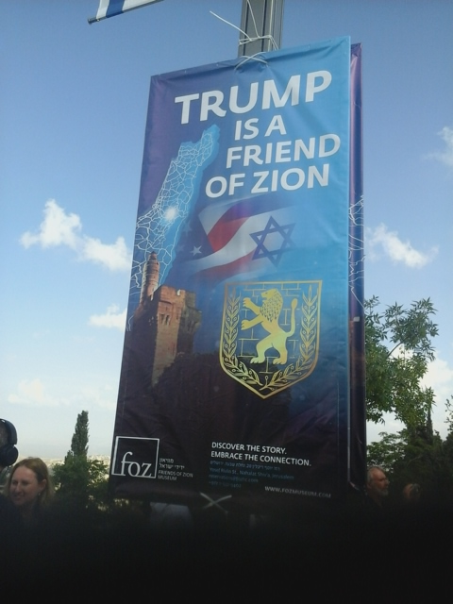
WHO WILL BE FRIENDS OF ZION/ISRAEL?

Slide 17
FRIENDS OF ZION/ISRAEL
FROM THE NATIONS

Slide 18
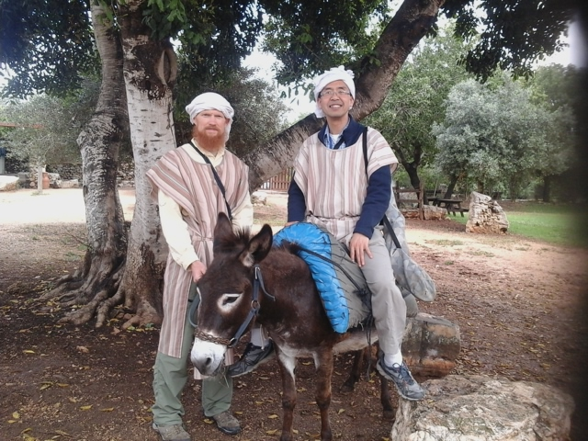
MY LOYAL FRIEND BOB
WHO CAME FOR ME WHEN I GOT LOST

Slide 20
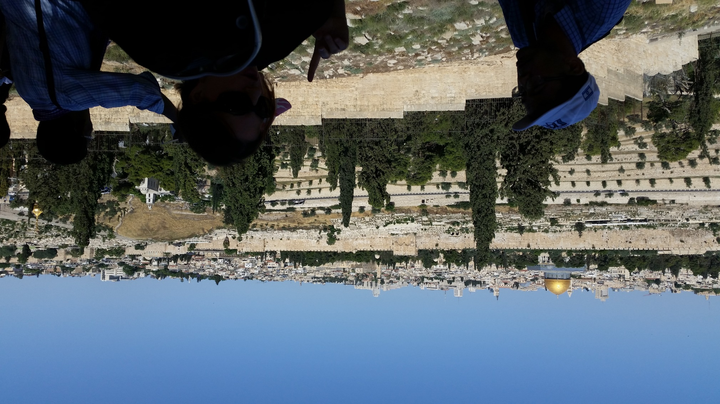
View from Mt. Olives
Notes:
Talmidim/Disciples asking Yeshua:
When will be the end of this age? Seeing as it will happen HERE.
Key lessons prep for this:
Don’t be deceived!
Wars, famines, earthquakes…beginning of birth-pains. I have it on great authority, that birth pains usually start slowly, but never pleasant, and increase.

Slide 21
מַתִּתְיָהוּ Mattityahu
(Matthew) 24:9-10

Slide 22
Mattityahu (Matthew) 24:9
אָז יִמְסְרוּ אֶתְכֶם לָרוֹדְפִים וְיַהַרְגוּ אֶתְכֶם וְתִהְיוּ שְׂנוּאִים עַל כָּל הַגּוֹיִים בִּגְלַל שְׁמִי.
“At that time you will be arrested and handed over to be punished and put to death, and all peoples will hate you because of me.
Notes:
Arrested, punished [jail, flogging], executed, hated.
Yeshua spoke of this at other times…

Slide 23
^{Yn 15.18-21} “If the world hates you, know that it has hated Me before you. If you were of the world, the world would love you as its own. But you are not of the world, since I have chosen you out of the world;

Slide 24
^{Yn 15.18-21} since I have chosen you out of the world; therefore the world hates you. “Remember the word I spoke to you: ‘A servant is not greater than his master.’ If they persecuted Me, they will persecute you also.

Slide 25
^{Yn 15.18-21} If they kept My word, they will keep yours also.
“But all these things they will do to you for the sake of My name, because they do not know the One who sent Me.*
Arrested, punished, executed…
Notes:
*Knowing Him is really the purpose of living, and our work. To know the Jewish Divine Messiah King, and revel/worship/love in His Presence
Makes it worth it all, besides escaping righteous wrath.

Slide 26
The Center for the Study of Global Christianity [Gordon Conwell Seminary] estimates that more than 70 million believers have been martyred over the last two millennia. More than half of these were in the 20th century under fascist and communist regimes.
Notes:
http://www.gordonconwell.edu/resources/documents/csgc_Christian_martyrs.pdf

Slide 27
For the early 21st century, we estimate that 1 million were killed over the 10-year period from 2000–2010, an average of approximately 100,000 believers killed each year.
Notes:
http://www.gordonconwell.edu/resources/documents/csgc_Christian_martyrs.pdf

Slide 28
According to Daniel Boyarin, …martyrdom…originated in Judaism and Christian martyrdom as a continuation of that practice. Judaism [is characterized ] as "a religion of martyrdom”
Notes:
https://en.wikipedia.org/wiki/Christian_martyrs

Slide 29
"In the first two centuries C.E. there was a living…tradition of self-sacrifice for a cause, a preparedness if necessary to defy an unjust ruler.
Notes:
https://en.wikipedia.org/wiki/Christian_martyrs

Slide 30
It is believed that the concept of voluntary death for God developed out of the conflict between King Antiochus Epiphanes IV and the Jewish people. 1 Maccabees and 2 Maccabees recount numerous martyrdoms suffered by Jews
Notes:
https://en.wikipedia.org/wiki/Christian_martyrs

Slide 31
resisting the Hellenizing of their Seleucid overlords, being executed for such crimes as observing the Sabbath, circumcising their children or refusing to eat pork or meat sacrificed to foreign gods.
Notes:
https://en.wikipedia.org/wiki/Christian_martyrs

Slide 32
Tertullian, one of the 2nd century Patriarchs, wrote that “the blood of martyrs is the seed of the faith,” implying that the martyrs' willing sacrifice of their lives leads to the conversion of others.
Notes:
https://en.wikipedia.org/wiki/Christian_martyrs
This is not in our American psyche. We are used to safety and comfort. But we still get overwhelmed. We have suffering.

Slide 33
^{Yer 12.5 NIV} “If you have raced with men on foot and they have worn you out, how can you compete with horses? If you stumble in safe country, how will you manage in the [overflowing of the] thickets by the Jordan?
Notes:
That is, if in calm times we have gotten exhausted and stumbled, how will we face adversity…when the Jordan river overflows in the Spring, and the lions come out of the thickets?

Slide 34
Believers on trial for our faith
Jack Phillips, Masterpiece Cakeshop [SCOTUS]
Kim Davis
Dinesh D’Souza?
Andrew Brunson [Turkey]
Notes:
https://www.christianitytoday.com/news/2017/december/supreme-court-masterpiece-cakeshop-christians-gay-weddings.html

Slide 35
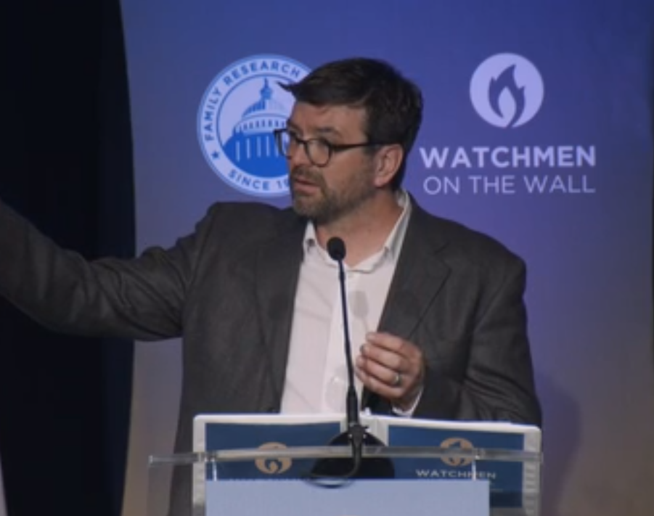
Pastor Jeremy Schossau, Detroit
Notes:
https://www.frc.org/get.cfm?i=WA18F03&f=WU18F01
Pastor Jeremy Schossau, [the leader of Detroit's Metro City Church.] Had a small group study for 12 girls with parents permission or presence on gender identity, etc. Advertised in on Facebook. 8 pm he in FL on vacation and 100’s emails. Death threats started streaming into the congregation office -- on Facebook, Twitter, and Metro City's phone lines. Angry activists threatened to burn the building down or shoot members of the staff . Legislative investigation threatened.
Tony Perkins awarded him “Watchman on the Wall” commendation, with a shofar. “What do with?”

Slide 36
Arrest, death, jail.
Wurmbrand method…
Side note on reprieve.

Slide 37
If there was anyone more surprised than Donald Trump by his come-from-behind 2016 win, it was the person he was succeeding: Barack Obama. In a new book, The World as It Is, former advisor Ben Rhodes says Trump's predecessor couldn't seem to come to grips with the results, wondering, "What if we were wrong?"
Notes:
https://www.frc.org/get.cfm?i=WA18F02&f=WU18F01

Slide 38
Still, President Obama was “shell-shocked,” “Obama told aides, according to the memoir. “Maybe we pushed too far...” For once, he was right. What we witnessed in 2016 was the revenge of the "deplorables," who, after a decade of being mocked and maligned, finally said, “enough!”
Notes:
https://www.frc.org/get.cfm?i=WA18F02&f=WU18F01
We don’t know how long the reprieve will last, but ours to enjoy and labor. Continuing..

Slide 39
Mattityahu (Matthew) 24:10
רַבִּים יִכָּשְׁלוּ בְּאוֹתָהּ עֵת וְיַסְגִּירוּ זֶה אֶת זֶה וְיִשְׂנְאוּ זֶה אֶת זֶה.
“At that time many will be trapped into betraying and hating each other.”

Slide 40
Lot’s of scriptures with the phrase “each other”
“one another”

Slide 41
^{Ro. 12.10} Love each other devotedly and with brotherly love; and set examples for each other in showing respect.
^{Ro 12.16} Be sensitive to each other’s needs — don’t think yourselves better than others.

Slide 42
^{Ro. 15.7} Be sensitive to each other’s needs — don’t think yourselves better than others.
Notes:
I feel it’s a vital theme from Messiah King to develop this.
Some of you were at the Darrel Brazell teaching…

Slide 43
What Is Joy?
Defined
“Being with someone who is glad as glad can be to be with me.”
Impact
Feels good
Dopamine released in both brains
Always relational—distinguishing it from “pleasure.”
Transmission
Non-verbal
Authentic
Cycles 6 complete transactions per second
Notes:
Defined
ADVANCE “Being with someone who is glad as glad can be to be with me.”
ADVANCE Impact
ADVANCE Feels good
ADVANCE Dopamine released in both brains
ADVANCE Always relational—distinguishing it from “pleasure.”
ADVANCE Transmission
Non-verbal
Authentic
Cycles 6 complete transactions per second and looks something like this:

Slide 44
Cycle of Joy
Joy
Level
Notes:
Person A sees Person B and before they are even consciously aware they see person B their brain remembers that they like person B and their brain releases a little dopamine which causes their face, specifically the eye to communicate, “I’m glad to see you.”
When person B

Slide 45
Cycle of Joy
Joy
Level
Notes:
receives that non-verbal, “I’m glad to be with you” message, it triggers a dopamine response in his brain that feels good and raises his joy level

Slide 46
Cycle of Joy
Joy
Level
Notes:
Person B then is “glad to be with their friend also” and reciprocates by sending a “I am glad be with you also” message back.
When person A receives that message it stimulates the pleasure center of his brain to release a little more dopamine and now he is even more glad to see his friend. So guess what he does

Slide 47
Cycle of Joy
Joy
Level
Notes:
He sends another message which feels good to both him and his friend and raises both their joy levels a little more.
And back and forth it goes

Slide 48
Cycle of Joy
Joy
Level
Notes:
And each transmission

Slide 49
Cycle of Joy
Joy
Level
Notes:
builds and amplifies

Slide 50
Cycle of Joy
Joy
Level
Notes:
previous transmissions

Slide 51
Cycle of Joy
Joy
Level
Notes:
And all this

Slide 52
Cycle of Joy
Joy
Level
Notes:
Happens

Slide 53
Cycle of Joy
Joy
Level
Notes:
At a rate

Slide 54
Cycle of Joy
Joy
Level
Notes:
of 6 complete cycles per second

Slide 55
Cycle of Joy
Joy
Level
6 Complete Cycles Per Second
Notes:
so what just took me two minutes and 11 PowerPoint slides to explain happens 6 times each and every second you are with someone who is glad to be with you.
That is one of the reasons it is always authentic. You can’t fake something that happens before you are even aware you are doing anything.
Fake it til you make it doesn’t work with joy. Or much else for that matter but we don’t have time for that discussion.
Best illustrated not with Darrell’s goofy blue faces but with a small child.

Slide 56
Dopamine…activates oxytocin production in your hypothalamus and hippocampus
Notes:
Darrel Brazell Power of Joy lectures.

Slide 57
A special chemical in your body, called oxytocin, helps to create the feeling of falling in love. Oxytocin naturally enhances a sense of:
Optimism, Trust, Mastery, Self-esteem
Notes:
https://bodyecology.com/articles/this-bliss-hormone-can-heal-your-body-the-many-benefits-of-oxytocin

Slide 58
In the study, scientists were able to prove the hormone oxytocin plays a vital role toward the sentiment of trust, even after a betrayal. The ability of human beings to live in societies is based on trust. Whether in love or politics, in family or business life,
Notes:
https://psychcentral.com/news/2008/05/23/biochemical-effects-of-betrayal/2347.html

Slide 59
trust always plays an important role. The interest was correspondingly high when researchers at the University of Zurich discovered three years ago that oxytocin promotes a feeling of trust.
Notes:
https://psychcentral.com/news/2008/05/23/biochemical-effects-of-betrayal/2347.html

Slide 60
So, what does all this have to do with Yeshua’s words on “betraying and hating each other”?

Slide 61
The most common forms of betrayal are harmful disclosures of confidential information, disloyalty, infidelity, dishonesty. They can be traumatic and cause considerable distress. The effects of betrayal include shock, loss and grief, morbid pre-occupation, damaged self-esteem, self-doubting, anger.
Notes:
https://www.ncbi.nlm.nih.gov/pubmed/20035927

Slide 62
The effects of a catastrophic betrayal are most relevant for anxiety disorders, and OCD and PTSD in particular.
It’s coming.
Notes:
https://www.ncbi.nlm.nih.gov/pubmed/20035927

Slide 63
^{Stern’s Commentary:} Similarly, according to the Talmud, "Our rabbis taught, ‘For Adoni will vindicate his people and have compassion on his servants when he sees that their power is gone ^{Dt, 32:36}.’ The Son of David will not come until there are many denouncers." ^{Sanhedrin 97a}

Slide 64
^{Stern’s Commentary:} The phrase, "...when he sees that their power is gone," is here understood to mean that the people of Israel will be at the mercy of informers.

Slide 65
^{Stern’s Commentary:} It is then that God will vindicate his people and have compassion on his servants by redeeming them through the Messiah, the Son of David.

Slide 66
We are not yet regularly facing people “betraying and hating” us. But, Israel faces daily lies. It’s in the spiritual environment…

Slide 67
Gaza's Islamist rulers Hamas and an allied terrorist group claimed joint responsibility on Tues. 29 May 2018, for dozens of mortar rounds and rockets fired at Israel throughout the day.
Notes:
(INN) from Barry & Batya Segal

Slide 68
The military wings of Hamas and Islamic Jihad announced in a rare joint statement their "joint responsibility for the striking of military positions and Zionist settlements surrounding the Gaza Strip."
Yet the world’s media…
Notes:
(INN) from Barry & Batya Segal

Slide 69
One of dozens of rockets launched Tues. 29 May 2018, by terrorists from the Gaza Strip, hit facilities supplying electricity to the Gaza Strip. Due to the damage to the facilities, three lines supplying electricity to the southern Gaza Strip were stopped. The electricity company said it would take several
Notes:
Barry & Batya Segal

Slide 70
days to repair the equipment for a regular supply of electricity. Israel’s Energy Minister Yuval Steinitz instructed the Israel Electricity Company (IEC) not to endanger its employees and to repair the problem only after a lull. (Arutz-7)
Notes:
Barry & Batya Segal

Slide 71
Targets IDF struck in Gaza 1:06

Slide 72
Mattityahu (Matthew) 24:10
רַבִּים יִכָּשְׁלוּ בְּאוֹתָהּ עֵת וְיַסְגִּירוּ זֶה אֶת זֶה וְיִשְׂנְאוּ זֶה אֶת זֶה.
“At that time many will be trapped into betraying and hating each other.”
Notes:
Fracture of a fellowship. Never had a split at Or HaOlam. Some difficult partings of individuals or a few. Even that painful.

Slide 73
How do we prepare for arrest, imprisonment, death, betrayal, hatred?
Make sure your heart’s joy is NOT dependent on circumstances, or even on people. Know Him!

Slide 74
Remember those in prison and being mistreated, as if you were in prison with them and undergoing their torture yourselves. ^{Mes Jews 12.3}
Practice reaching out, wisely and lovingly, beyond your comfort zone, even if opposition.

Slide 75
Don’t resist the evils of life unduly. ^{Mt 5.39-42} But I tell you, do not resist an evildoer. But whoever slaps you on your right cheek, turn to him also the other. And the one wanting to sue you and to take your shirt, let him also have your coat.
Notes:
Love suffers long.

Slide 76
Don’t resist the evils of life unduly. ^{Mt 5.39-42} Whoever forces you to go one mile, go with him two. Give to the one who asks of you, and do not turn away from the one who wants to borrow from you.
Notes:
Practice a little suffering.
You’ll NEVER fix all your relational problems. Some you have to suffer, with joy. Get used to it!

Slide 77
^{Phil 2.5-9} Let your attitude toward one another be governed by your being in union with the Messiah Yeshua: Though he was in the form of God, he did not regard equality with God something to be possessed by force.

Slide 78
^{Phil 2.5-9} On the contrary, he emptied himself, in that he took the form of a slave by becoming like human beings are. And when he appeared as a human being, he humbled himself still more

Slide 79
^{Phil 2.5-9} by becoming obedient even to death — death on a stake as a criminal! Therefore God raised him to the highest place and gave him the name above every name.
Notes:
Last slide Clyde.

