Slide 1
If you want to have notes without taking notes,
Go to OrHaOlam.com
WITHOUT WIFI
Click on downloads, messages, 2018 messages
Today’s should be on the top.

Slide 2
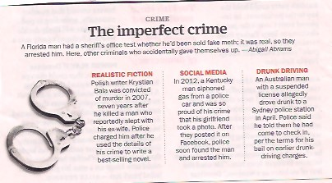
Notes:
Time Magazine, June 23, 2018 or so.
Some serious news, not much or at all in the media.

Slide 3
According to Iran’s meteorological center, 96 percent of Iranians suffer from some degree of drought, while up to 50 million may be forced to leave their homes as a result of the environmental damage.
Notes:
https://unitedwithisrael.org/israel-shares-lifesaving-water-expertise-with-iranians/?utm_source=MadMimi&utm_medium=email&utm_content=Netanyahu+Hails+Trump%27s+N_+Korea+Summit%3B+French+Anti-Israel+Bias+Exposed%3B+Palestinians+Steal+Medical+Helium+for+Terror+Balloons&utm_campaign=20180612_m145835027_Netanyahu+Hails+Trump%27s+N_+Korea+Summit%3B+French+Anti-Israel+Bias+Exposed%3B+Palestinians+Steal+Medical+Helium+for+Terror+Balloons&utm_term=F100113MS26-250x170_jpg

Slide 4
The year 2018 was the driest in Iran over the past 67 years. This trend has continued for over 30 years, and the constant decline in precipitation indicates that drought will continue and even get worse.
Notes:
https://unitedwithisrael.org/israel-shares-lifesaving-water-expertise-with-iranians/?utm_source=MadMimi&utm_medium=email&utm_content=Netanyahu+Hails+Trump%27s+N_+Korea+Summit%3B+French+Anti-Israel+Bias+Exposed%3B+Palestinians+Steal+Medical+Helium+for+Terror+Balloons&utm_campaign=20180612_m145835027_Netanyahu+Hails+Trump%27s+N_+Korea+Summit%3B+French+Anti-Israel+Bias+Exposed%3B+Palestinians+Steal+Medical+Helium+for+Terror+Balloons&utm_term=F100113MS26-250x170_jpg

Slide 5
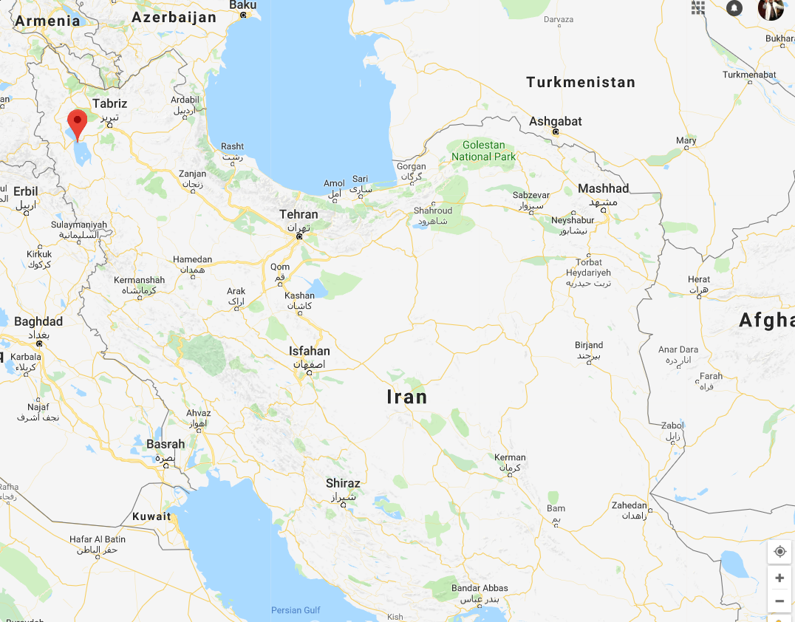
Urmia
Lake

Slide 6
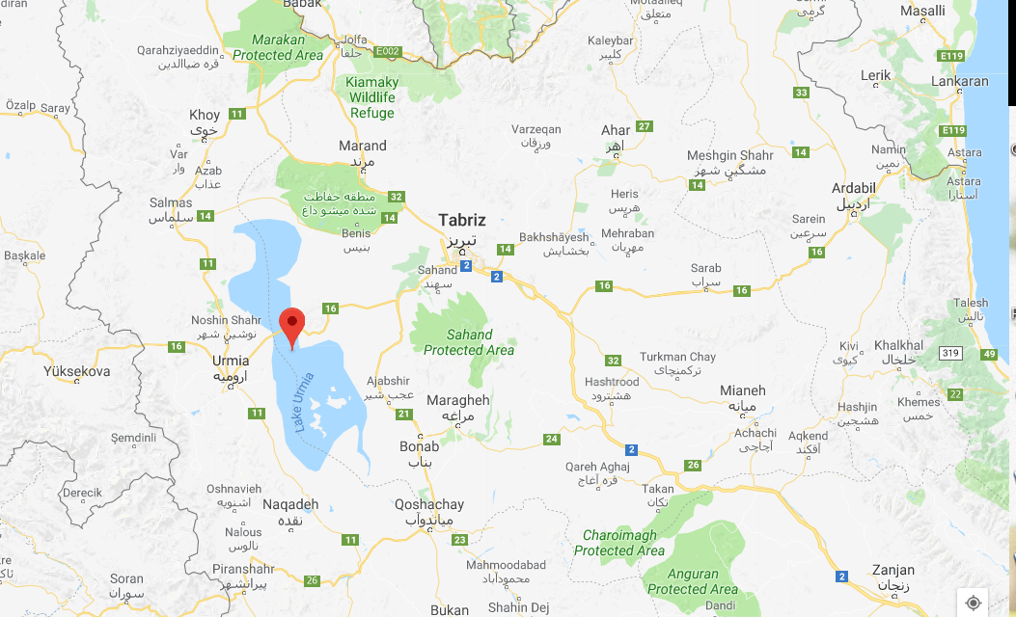

Slide 7
https://upload.wikimedia.org/wikipedia/commons/c/c6/Urmia_lake_drought.gif
Notes:
https://www.tabletmag.com/jewish-news-and-politics/193549/iran-water-crisis
The background history to this is not widely known, and is even more amazing.

Slide 8
Up until 1962 Iran’s most fertile agricultural valley was Qazvin with water from an ancient Persian system, 2700 years old, called qanats. The 1962 earthquake killed 20,000 Iranians and destroyed the qanat system. The Shah brought in Israeli
Notes:
https://www.tabletmag.com/jewish-news-and-politics/193549/iran-water-crisis

Slide 9
hydrologists who dug modern deep wells, taught conservation, trained Iranian engineers, built desalination plants.
Notes:
https://www.tabletmag.com/jewish-news-and-politics/193549/iran-water-crisis

Slide 10
By the mid- to late 1960s, so many Israelis had arrived in Qazvin with their families that a local building was converted into a school in which Hebrew was the language of instruction for the sixty Israeli children who studied there under Israeli teachers.
Notes:
https://www.tabletmag.com/jewish-news-and-politics/193549/iran-water-crisis

Slide 11
The shopkeepers in Qazvin learned Hebrew to better engage with their new customers. One Israeli Ph.D. remembers most of his local interactions with the merchants being in Hebrew.
All that ended when the ayatollahs took over in 1969.
Notes:
https://www.tabletmag.com/jewish-news-and-politics/193549/iran-water-crisis
Restaurants served Israeli food, in Hebrew.
The Ayatollahs hated Israel, and so all Jew were expelled. America’s embassy seized.

Slide 12
Good news from Israel
Notes:
A message in Farsi to Iran over social media, from Benjamin Netanyahu…

Slide 13
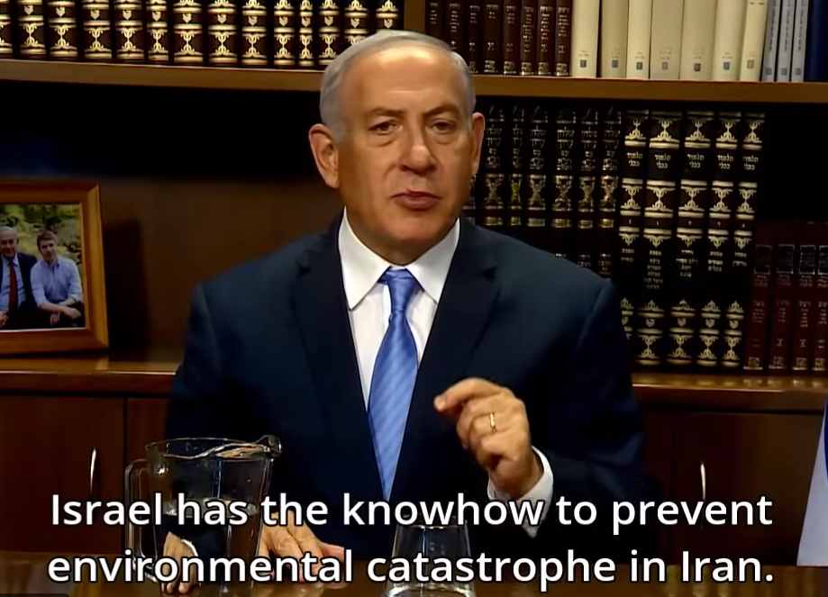
Notes:
Again.
Apparently, Bibi choosing not to flaunt the history of Israeli engineering superiority.

Slide 14
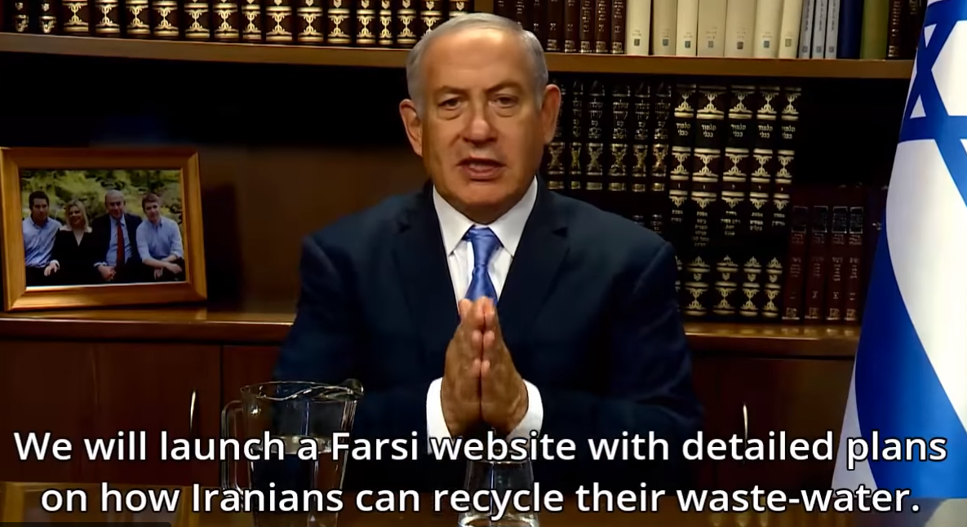
Notes:
Israel recycles 86% of their waste water. Closest second in the world is Spain, with about 30%

Slide 15
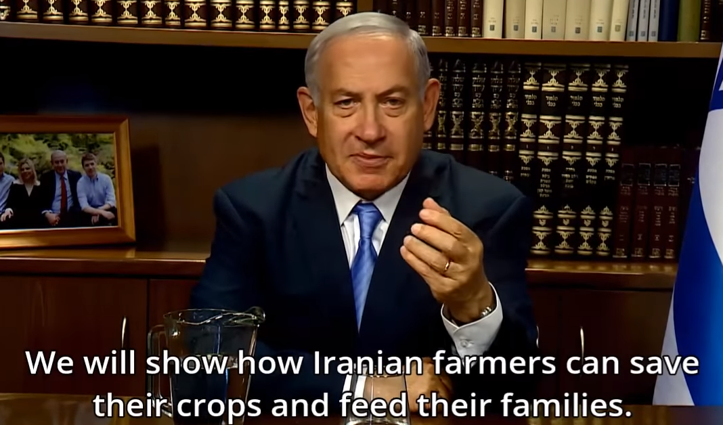
Notes:
Israel can save Iran, again. We’ll see what Iranian leaders do while their country collapses. It’s a lot like the failed communism of the Soviet Union in the 1980s.

Slide 16
Notes:
To return to our Mattityahu series…

Slide 17
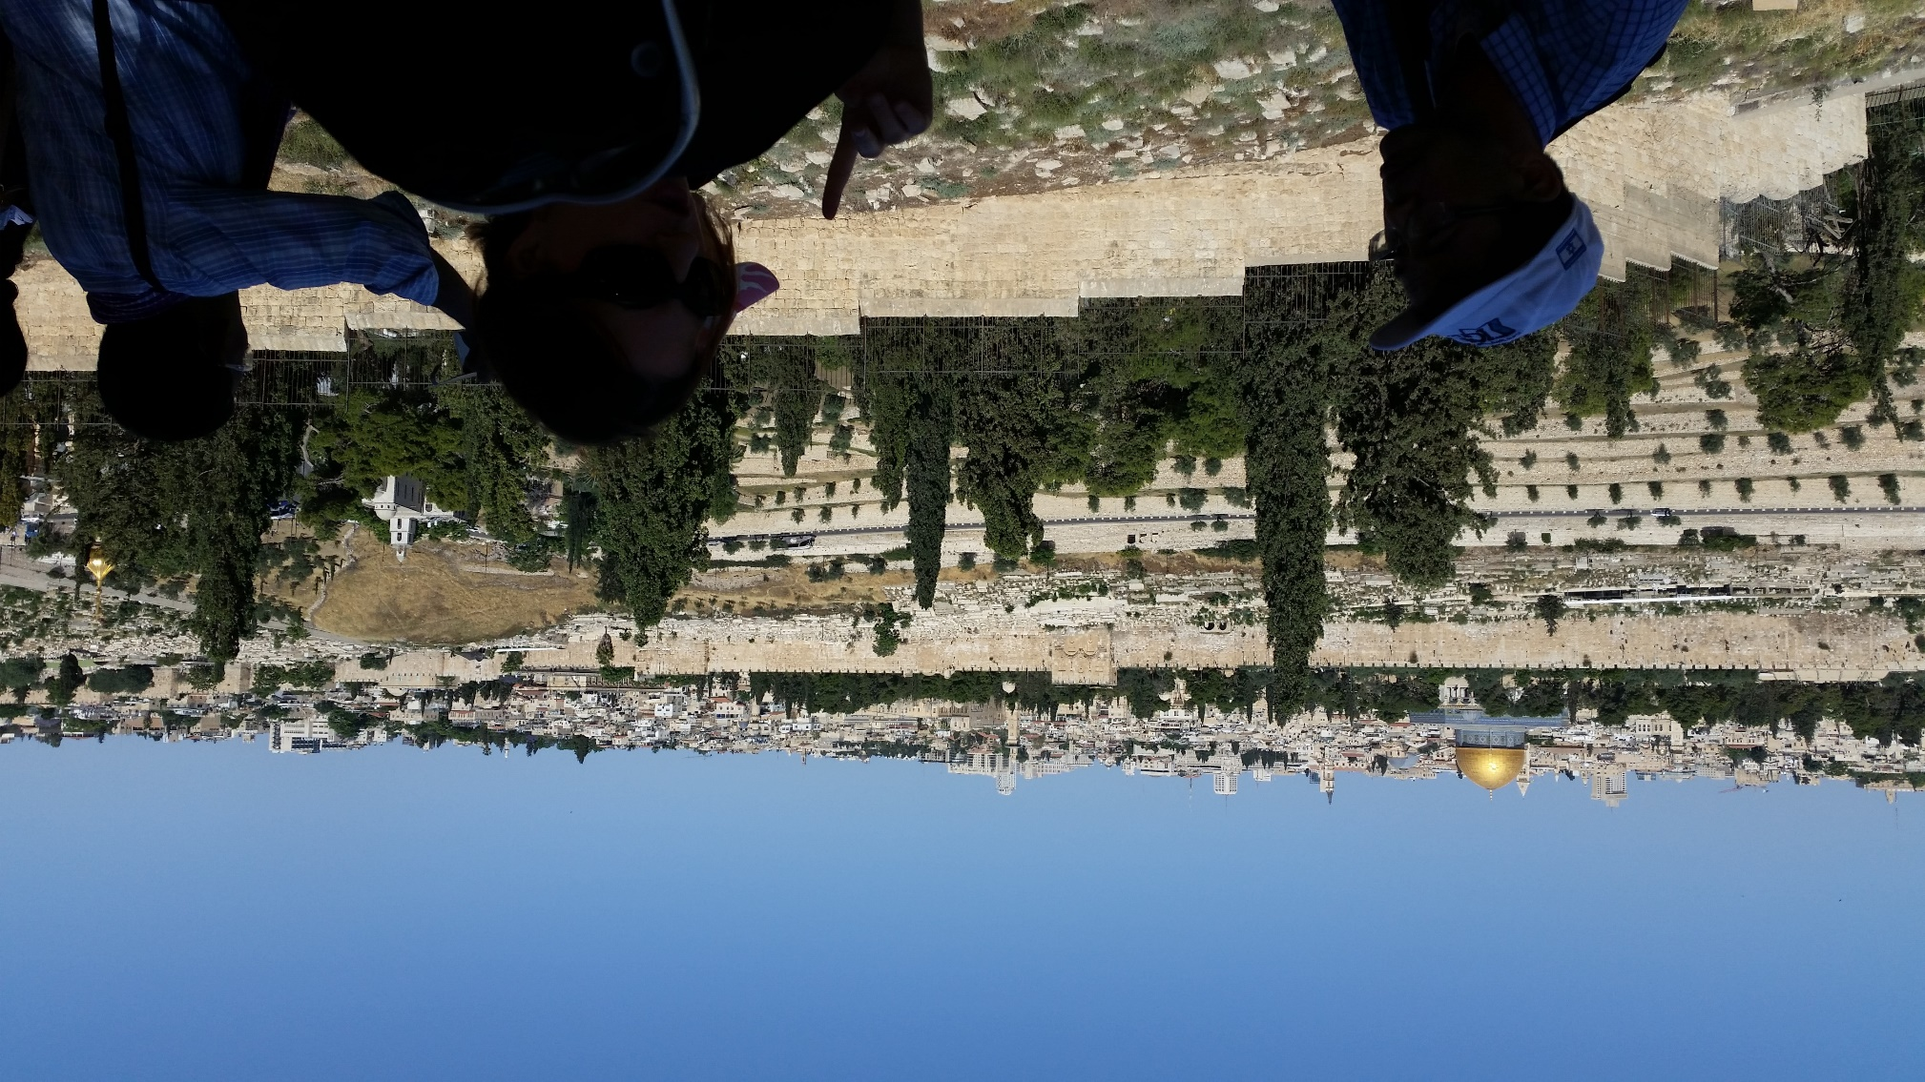
View from Mt. Olives

Slide 18
Matityahu ch 24 On Mt. Olives
Talmidim/Disciples asking Yeshua:
When will be the end of this age? Seeing as it will happen HERE.
Key lessons so far in this chapter to prep for the end:

Slide 19
Don’t be deceived! Many in My Name.
Wars, famines, earthquakes …beginning of birth-pains.
Imprisoned, hated, executed, betrayed
False prophets within, without
Love grow cold
Notes:
Next descriptor of end times…

Slide 20
מַתִּתְיָהוּ Mattityahu
(Matthew) 24:13

Slide 21
Mattityahu (Matthew) 24:13
‏ ‏ אֲבָל הַמַּחֲזִיק מַעֲמָד עַד קֵץ הוּא יִוָּשַׁע.
“But whoever endures till the end will be delivered.”
Notes:
Endure!!
USB Hebrew translation of Greek: to hold on, hold the stand

Slide 22
Endurance
Endurance importance
Endurance builders
Endurance blockers
Notes:
Outline of this message

Slide 23
Endurance Importance
Notes:
I have to give the big picture to intro the topic. Some theological considerations, and varying views here.

Slide 24
Two major schools of thought among Yeshua believers, and much in between.
Calvinism: believers will endure, cannot be lost.
Arminianism: believers must will to endure, can fail.
David Stern: Messianic Judaism an easier fit in Arminianism.
Notes:
Varieties of above, these are the basics
Scriptures to flesh this out…

Slide 25
^{Yekhezkel/Ezk 33.7, 12, 13, 18} “You, son of man, I have set you as a watchman for the house of Israel. When you hear the word from My mouth, warn them from Me… “You, son of man, say to the children of your people: ‘The righteousness of the righteous person will not deliver him

Slide 26
^{Yekhezkel/Ezk 33.7, 12, 13, 18} “in the day of his sins…When I tell the righteous that he will surely live, but he trusts in his own righteousness and commits iniquity, none of his righteous deeds will be remembered. But in his iniquity that he has committed, he will die…

Slide 27
^{Yekhezkel/Ezk 33.7, 12, 13, 18} When a righteous person turns from his righteousness and commits iniquity, he will die in it. When a wicked person turns from his wickedness and does what is just and right, he will live by it.
Notes:
Doesn’t specifically mention eternity, but seems implied to me!

Slide 28
^{2 Kefa/Pet 2. 20-22} Indeed, if they have once escaped the pollutions of the world through knowing our Lord and Deliverer, Yeshua the Messiah, and then have again become entangled and defeated by them, their latter condition has become worse than their former.
Notes:
Proverbs 26:11

Slide 29
^{2 Kefa/Pet 2. 20-22} It would have been better for them not to have known the Way of righteousness than, fully knowing, to turn from the holy command delivered to them.
Endurance is all important!!
Notes:
Proverbs 26:11

Slide 30
Endurance builders:
Knowing Messiah
Notes:
More significant than success

Slide 31
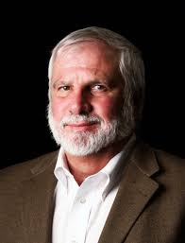
Notes:
P 213 Fictionalized conversation with Paul by a visitor there.
There is no more important responsibility that I have compared to helping you live so as to see you on the other side…in eternity.

Slide 32
Endurance builders:
Will power
Notes:
Self?

Slide 33
ὑπό hypó +μένω menó

Slide 34
ὑπό hypó
properly, under, often meaning "under authority" of someone working directly as a subordinate (under someone/something else).
μένω menó remain, abide, stay, wait; with

Slide 35
So Greek meaning of Endure…
remain behind,
stand my ground, show endurance,
endure, bear up against, persevere.
Notes:
Captain goes down with the ship
Devil dogs How many have heard that title? According to United States Marine Corps legend, the moniker was used by German soldiers to describe U.S. Marines who fought in the Battle of Belleau Wood in 1918. The Marines fought with such ferocity that they were likened to "Dogs from Hell." German: Höllenhunde. Story likely not exactly historic, but the term "Devil Dog" is a very common nickname for all Marines. Marines mascot…

Slide 36
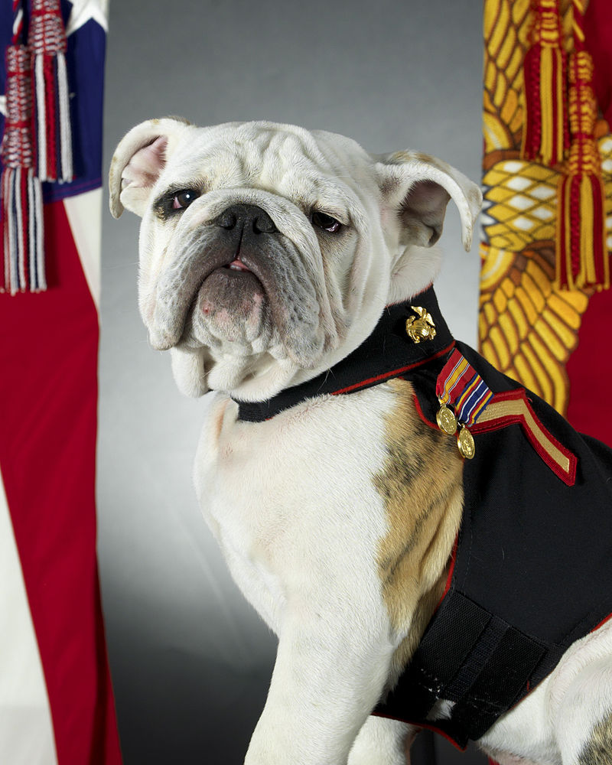
The Bulldog
is the US
Marine Corps
mascot
Notes:
By Adrian R. Rowan http://www.defenseimagery.mil/imageRetrieve.action?guid=eb13aff4a296176b7031260fd19eeacafc5a1bcf&t=2, Public Domain, https://commons.wikimedia.org/w/index.php?curid=26443720
In Marine dress blues. Our son served as a Marine, has dress blues. We need to have a bulldog tenacity to our faith, our hold on Yeshua! Holding on to eternal life!!
^{Hebrews 10:23} Let us hold fast the unwavering confession of hope, for He who promised is faithful.

Slide 37
Original Word: σῴζω sózó

Slide 38
sṓzō (from sōs, "safe, rescued") – properly, deliver out of danger and into safety; used principally of God rescuing believers from the penalty and power of sin – and into His provisions (safety). heal, preserve, rescue
Notes:
Saved in spirit: worship without distraction process
Saved in soul: mind, will emotions Shrek doctrine
Saved in body: eternity
Endure to the END, so you will be saved.

Slide 39
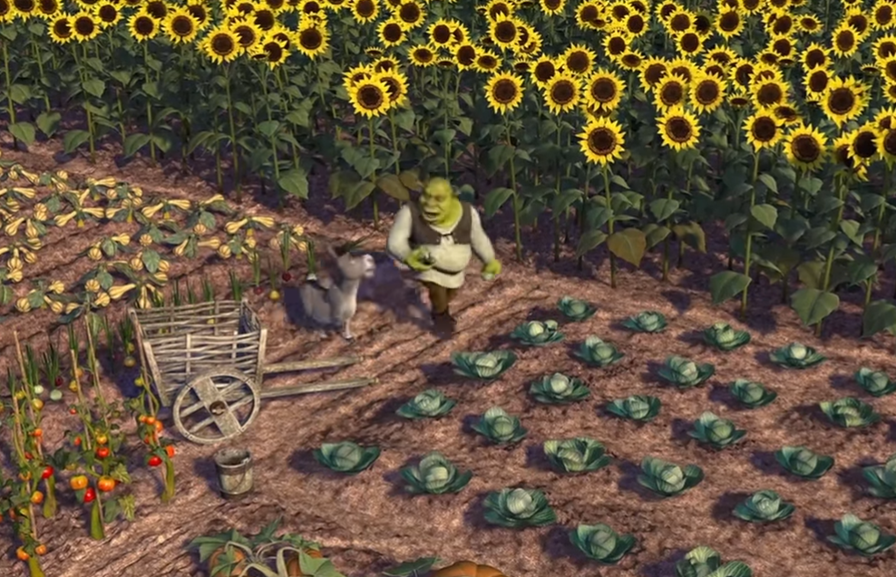
https://youtu.be/_bMcXVe8zIs
Notes:
You and I have layers: woundings, pain, strength, corruption.
You have to work at it to get your soul right: mind, will emotions.
Sozo,
RTF [maybe again in November],
Life Model [maybe Chris Coursey back in March],
Ancient Paths

Slide 40
Endurance builders:
Community /
Comraderie

Slide 41
^{Kohelet/Eccles 4.9-10} Two are better than one, in that their cooperative efforts yield this advantage: if one of them falls, the other will help his partner up — woe to him who is alone when he falls and has no one to help him up.
Notes:
Loneliness Time Mag., Northern Youth

Slide 42
kishkas
Definitions: Intestines, gut
“Something's wrong--I feel it in my kishkes.”
Yiddishקישקעס
kishkes “innards”
Notes:
http://www.jewish-languages.org/jewish-english-lexicon/words/268
Who do you have who knows your guts, your kishkas?
Your spouse? Sibling? Friend [same gender]? Mentor?
Are you heard?
Do you hear? Time Mag: one in four no one. “All the lonely people…”

Slide 43
^{1 Yokhanan 1.6-7} If we say we have fellowship with Him and keep walking in the darkness, we are lying and do not practice the truth. But if we walk in the light as He Himself is in the light, we have fellowship with one another and the blood of His Son Yeshua purifies us from all sin.

Slide 44
Keep “short accounts”
Clear with others
Clear with Messiah

Slide 45
^{Yeshayahu/Is 2.5} Come descendants of Ya‘akov, let us walk in the light of Adoni.

Slide 46
Endurance builders:
Commitment to children,
Pass the torch

Slide 47
^{T’hillim/Ps 144.9-12} God, I will sing a new song to you; sing praises to you with a ten-stringed harp. You give kings their victories; you save your servant David from the cruel sword. Rescue me, save me from the power of strangers,

Slide 48
^{T’hillim/Ps 144.9-12} whose mouths speak worthless words and whose right hands swear false oaths. Our sons in their youth will be like full-grown saplings,
our daughters will be like sculptured pillars fit for the corner of a palace.
Notes:
Even if your children are NOT walking with Yeshua, keep true as an exemplar for them. The ARE watching.
^{Thillim Ps 90.16} Let Your work appear to Your servants, and Your glory on their children.

Slide 49
Endurance breakers:
Pleasures of Things, $
Notes:
Story of Balaam, this week’s parasha…

Slide 50
^{Bamidbar/Nu 21-22:} Balak king of Moav recruits Balaam
^{Bamidbar/Nu 23-25} Blessing instead of curse
^{Bamidbar/Nu 24.25} Then Balaam got up and went and returned to his own place, and Balak went on his way.
Notes:
Seems like an abortive mission, then he went home. Missed G-d’s will to go, but it all turned to good.

Slide 51
^{Bamidbar 23.9-10} “From the top of the rocks I see them, from the hills I behold them — yes, a people that will dwell alone and not think itself one of the nations. “Who has counted the dust of Ya‘akov or numbered the ashes of Isra’el? May I die as the righteous die! May my end be like theirs!”
Notes:
Endurance was a passion to him when said this!
Great prophetic rhapsody somewhere in this time..

Slide 52
^{Mikhah 6.5} O My people, remember, please: What did Balak, king of Moab, propose? What did Balaam son of Beor answer him? From Shittim as far as Gilgal, so that you might acknowledge the righteous acts of Adoni.”

Slide 53
^{Mikhah 6.6-8} With what shall I come before Adoni? With what shall I bow myself before God on high? Shall I present Him with burnt offerings, with year-old calves? Will Adoni be pleased with thousands of rams, with hordes of rivers of oil?

Slide 54
^{Mikhah 6.6-8} Shall I offer my firstborn for my transgression, the fruit of my belly for the sin of my soul? He has told you, humanity, what is good, and what Adoni is seeking from you: Only to practice justice, to love mercy, and to walk humbly with your God.
Notes:
Then, he apparently reconsidered…

Slide 55
^{Bamidbar/Nu 25.1-2} While Israel was staying in Shittim, the people began to have immoral sexual relations with women from Moab. Then they invited the people to the sacrifices of their gods, so the people were eating, and bowing down before their gods.
Notes:
Balaam came back and apparently connived this.
Couldn’t curse them with words, maybe words of witchcraft mixed with prophetic utterance?
Couldn’t curse them with words
Could corrupt them with wantonness, lewdness, licentiousness,

Slide 56
^{Bamidbar/Nu 31.7-8} They fought Midian just as Adoni had commanded Moses…they also killed the Midianite kings…the five kings of Midian. They also killed Balaam son of Beor with the sword.
Notes:
Great prophetic speaker, vacillated,
went with Balak,
kept true,
started home,
came back and connived,
and died in connivance.

Slide 57
^{2 Kefa Peter 2:15} They have abandoned the straight way. They have gone astray. They have followed the way of Balaam the son of Beor, who loved the wages of wickedness.
Notes:
Apparently Balaam knew G-d, but didn’t end well.

Slide 58
Endurance breaker [above]:
Pleasures of Things, $
Notes:
You will likely be similarly tempted: great opportunity with corruption.

Slide 59
Endurance builders:
Hope to Accomplish
Kingdom Building

Slide 60
Barna surveyed American adults to gauge how they discuss faith online. Their research found that 28 percent of believing respondents reported sharing their faith with nonbelievers on social media, as well as 58 percent of non-believing respondents reporting that someone shared their faith with them on social media.
Notes:
https://www.christianpost.com/news/nearly-30-percent-christians-share-faith-social-media-barna-225438/
Reach out, seek to expand the Kingdom of the King, do exploits. We’re not just barely holding on.
“Hold the fort for I am coming…”
Some truth to that song, but if a life mentality, makes me ill.
We are serving the One Who is the Truth, and He will prevail!!

Slide 61
Endurance builders:
Vision of the End

Slide 62
^{2 Tim. 4. 6-8} For I am already being poured out like a drink offering, and the time of my departure has come. I have fought the good fight, I have finished the course, I have kept the faith. In the future there is reserved for me a crown of righteousness,
Notes:
Implies possibility of not keeping the faith, not getting the crown or worse.

Slide 63
^{2 Tim. 4. 6-8} which the Lord, the righteous Judge, will award to me on that day—and not to me only, but also to everyone who has longed for His appearing.

Slide 64
^{Mes Jews/Heb 12.1-2} Keep running with endurance in the contest set before us, looking away to the Initiator and Completer of that trusting, Yeshua — who, in exchange for obtaining the joy set before him, endured execution on a stake as a criminal, scorning the shame, and has sat down at the right hand of the throne of God.

Slide 65
Endurance
Endurance importance
Endurance blockers: $, things
Endurance builders
Knowing Messiah
Will power
Community
Children
Hope to accomplish
Notes:
Outline of this message

Slide 66
Mattityahu (Matthew) 24:13
‏ ‏ אֲבָל הַמַּחֲזִיק מַעֲמָד עַד קֵץ הוּא יִוָּשַׁע.
“But whoever endures till the end will be delivered.”

