Slide 1
Good news from Israel:
Two items

Slide 2
Israeli technology key to rescue of Thai soccer team boys
A sophisticated Israeli communication system was donated to the rescue effort by Maxtech in Israel. The lack of reliable communication tools hampered earlier rescue attempts.
Notes:
https://www.jpost.com/Israel-News/Israeli-technology-to-the-rescue-for-cave-trapped-Thai-boys-561806

Slide 3
Because of the distance and depth – MaxTech’s devices communicate wirelessly between one another – one link at a time. It’s akin to beacons being lit one hilltop after another, gradually sending a message in a type of relay league.
Notes:
https://www.jpost.com/Israel-News/Israeli-technology-to-the-rescue-for-cave-trapped-Thai-boys-561806
Secondly

Slide 4
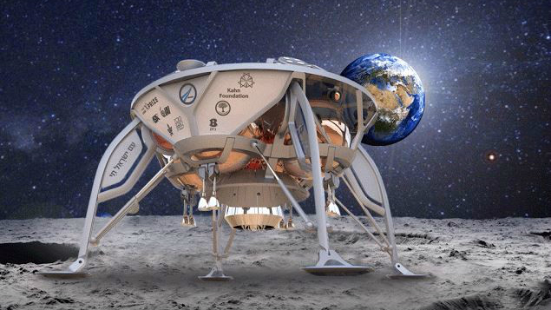
An artist’s rendering of
Israel’s SpaceIL lunar spacecraft.
Notes:
https://www.timesofisrael.com/in-first-israeli-spacecraft-set-for-trip-to-the-moon/

Slide 5
The SpaceIL organization announced Tuesday that it will be sending a small, unmanned spacecraft to the moon in December, with an expected landing date of February 13, 2019.
Notes:
https://worldisraelnews.com/israelis-plan-to-launch-unmanned-spacecraft-to-moon-by-end-of-year/?utm_source=MadMimi&utm_medium=email&utm_content=Israel+Will+Act+%27Aggressively%27+Against+Iran%3B+Israelis+Set+to+Land+on+Moon%3B+Obama+Shocked+by+Jewish+Settlement+Maps&utm_campaign=20180710_m146205916_Israel+Will+Act+%27Aggressively%27+Against+Iran%3B+Israelis+Set+to+Land+on+Moon%3B+Obama+Shocked+by+Jewish+Settlement+Maps&utm_term=_0D_0A_09_09_09_09_09_09_09_09_09_09Read+Now_0D_0A_09_09_09_09_09_09_09_09_09

Slide 6
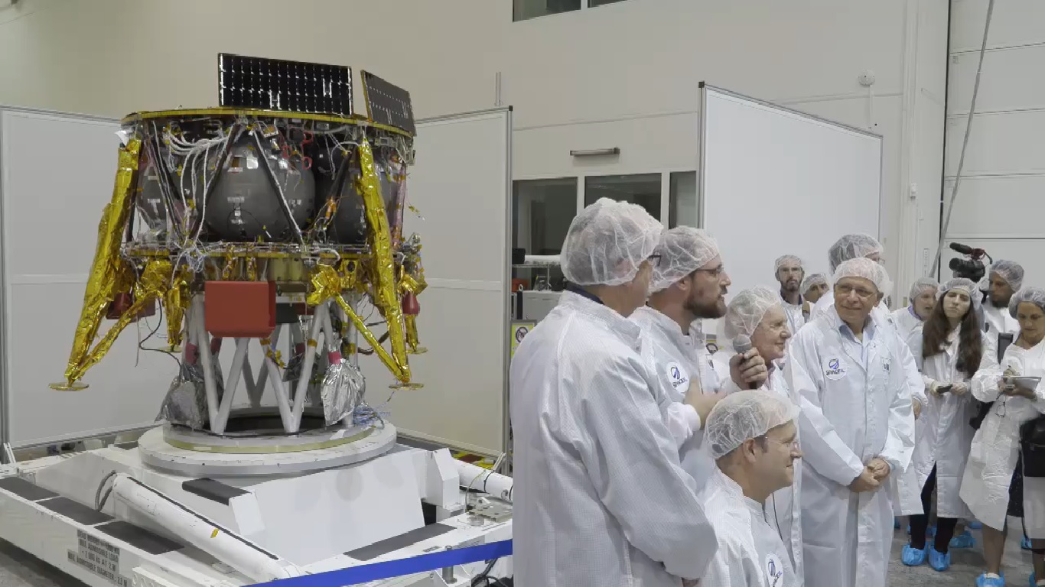
Notes:
Screen capture from video of a press conference displaying the SpaceIL moon craft, July 10, 2018. (Facebook)

Slide 7
It will be launched on a SpaceX missile from Cape Canaveral. The spaceship will go around the Earth in an ever-widening, elliptical orbit that will eventually enable it to cross paths with the moon.
Notes:
https://worldisraelnews.com/israelis-plan-to-launch-unmanned-spacecraft-to-moon-by-end-of-year/?utm_source=MadMimi&utm_medium=email&utm_content=Israel+Will+Act+%27Aggressively%27+Against+Iran%3B+Israelis+Set+to+Land+on+Moon%3B+Obama+Shocked+by+Jewish+Settlement+Maps&utm_campaign=20180710_m146205916_Israel+Will+Act+%27Aggressively%27+Against+Iran%3B+Israelis+Set+to+Land+on+Moon%3B+Obama+Shocked+by+Jewish+Settlement+Maps&utm_term=_0D_0A_09_09_09_09_09_09_09_09_09_09Read+Now_0D_0A_09_09_09_09_09_09_09_09_09

Slide 8
At that point, it is supposed to fire its engines in order to slow down and get into a lunar orbit, eventually landing gently on the rocky surface.
Its first task will be to plant an Israeli flag on the surface and then take still pictures and video. It is expected that the “mission” will wrap up in a mere two days.
Notes:
https://worldisraelnews.com/israelis-plan-to-launch-unmanned-spacecraft-to-moon-by-end-of-year/?utm_source=MadMimi&utm_medium=email&utm_content=Israel+Will+Act+%27Aggressively%27+Against+Iran%3B+Israelis+Set+to+Land+on+Moon%3B+Obama+Shocked+by+Jewish+Settlement+Maps&utm_campaign=20180710_m146205916_Israel+Will+Act+%27Aggressively%27+Against+Iran%3B+Israelis+Set+to+Land+on+Moon%3B+Obama+Shocked+by+Jewish+Settlement+Maps&utm_term=_0D_0A_09_09_09_09_09_09_09_09_09_09Read+Now_0D_0A_09_09_09_09_09_09_09_09_09

Slide 9
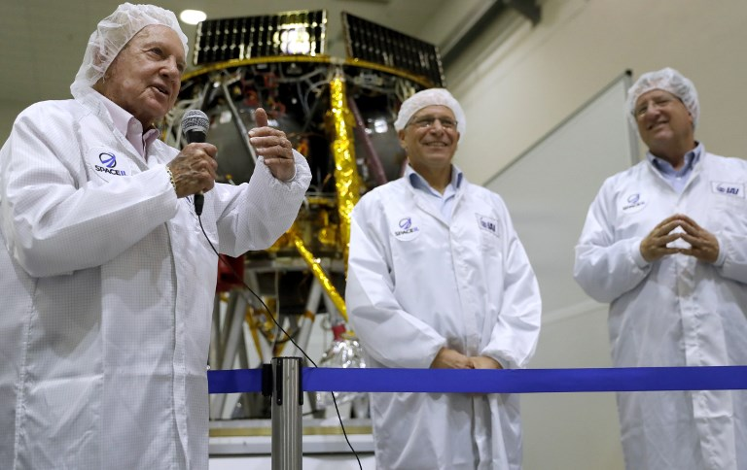
Notes:
I’m sure someone will say that the Israelis are stealing the land from…
Israeli billionaire and investor Morris Kahn (L) speaks to journalists in front of a Israeli Aerospace Industries spacecraft during a press conference to announce its launch to the moon, in Yehud, near Tel Aviv, on July 10, 2018. (AFP PHOTO / THOMAS COEX)

Slide 10
מַתִּתְיָהוּ Mattityahu
(Matthew) 24:14-16
Notes:
I need to particularly comment on last week’s B’sorah reading.

Slide 11
Mattityahu (Matthew) 24:14
This Good News of the kingdom shall be proclaimed in the whole world as a testimony to all the nations, and then the end will come.
Notes:
How will that happen?

Slide 12
Mattityahu (Matthew) 24:15
‏ ”לָכֵן כַּאֲשֶׁר תִּרְאוּ אֶת הַשִּׁקּוּץ הַמְּשֹׁמֵם, כַּנֶּאֱמַר בְּפִי דָּנִיאֵל הַנָּבִיא,
“So when you see the abomination that causes devastation spoken about through the prophet Dani’el

Slide 13
Mattityahu (Matthew) 24:15
‏ ”עוֹמֵד בְּמָקוֹם קָדוֹשׁ — עַל הַקּוֹרֵא לְהָבִין -
”standing in the Holy Place” (let the reader understand the allusion),

Slide 14
Mattityahu (Matthew) 24:16
‏ אֲזַי הַנִּמְצָאִים בִּיהוּדָה, שֶׁיָּנוּסוּ אֶל הֶהָרִים:
“that will be the time for those in Y’hudah to escape to the hills.”
Notes:
The end: outreach and abomination.

Slide 15
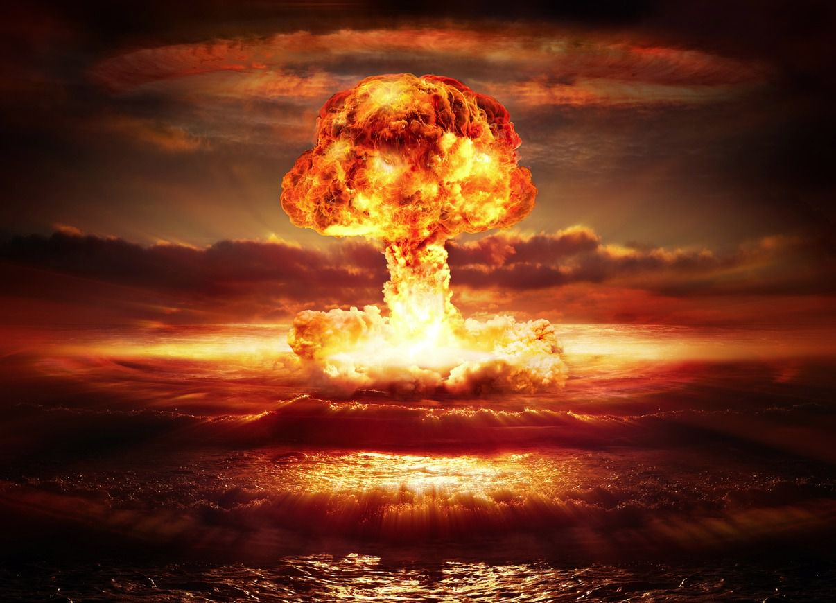
Atomic bomb detonation
Notes:
https://www.google.com/search?q=atomic+bomb&safe=active&source=lnms&tbm=isch&sa=X&ved=0ahUKEwj374-nq5zcAhUIR6wKHQWpAK4Q_AUICigB&biw=1151&bih=848#imgrc=XNjflTrnCTGxmM:
July 16, 1945, in the desert north of Alamogordo, New Mexico, the first nuclear test took place, released energy equivalent to 19,000 tons of TNT, far more powerful than any weapon ever used before.
2 lbs of TNT can obliterate a small car.
https://en.wikipedia.org/wiki/TNT_equivalent
This was 19 million x a car’s worth of TNT.

Slide 16
On August 6, 1945, a uranium-based weapon, Little Boy, was detonated above the Japanese city of Hiroshima, and three days later, another weapon, Fat Man, was detonated above the Japanese city of Nagasaki. On August 15,1945, Japanese Emperor Hirohito announced Japan's surrender.

Slide 17
Power, a whole new form
and level of power
for outreach before the end..

Slide 18
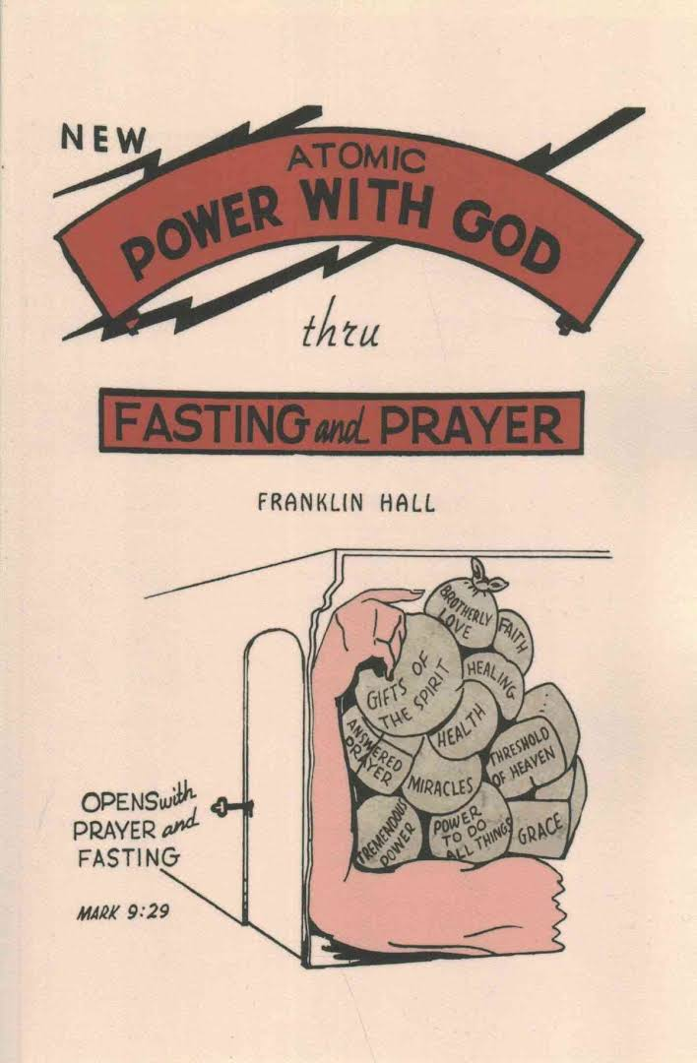
published
1946
Atomic Power
with God
Fasting
movement
in response
Notes:
2016 Reprint of 1950 Edition. Along with many others of the depression era Franklin Hall grew up in rural poverty and was deeply religious. During the depression and World War II he travelled as an independent evangelist. In 1946, he published a brief book entitled "Atomic Power with God through Prayer and Fasting." The book, which provided detailed information on the methods and benefits of fasting, was an immediate success and brought Hall considerable fame. According to Hall, all of the major evangelists began following his fasting regime and miracles erupted everywhere. Many observers of the early revival years agreed, as one said, "Every one of these men down through the years followed Franklin Hall's method of fasting."

Slide 19
Then in 1947-1952 the great healing revival broke out with men like William Branham, Oral Roberts, and T.L. Osborne
Big Tent
Notes:
https://www.christianity.ca/page.aspx?pid=10891
https://www.youtube.com/watch?v=fL85daR2nBI
Do I endorse all these? Not wholly. However, birth is messy. [Been there?] Revival is messy. The Messianic movement is messy: Orthodox Rabbinical Messianics, anti-Orthodox Messianics, charismatic Messianics, anti-charismatic Messianics. Hyper charismatics. Hyper anti charismatics. Big tent guy, to see LIFE in Yeshua where there is life. Big heart, big filter. Sift, keep baby; throw out bathwater. Secret:
I can pray in tongues. Don’t do it much. Sweet.
I can pray in T’fillin. Don’t do it much either. T’fillin and tongues. Dan Juster told me that there was a message on that at the UMJC Conference one year.

Slide 20
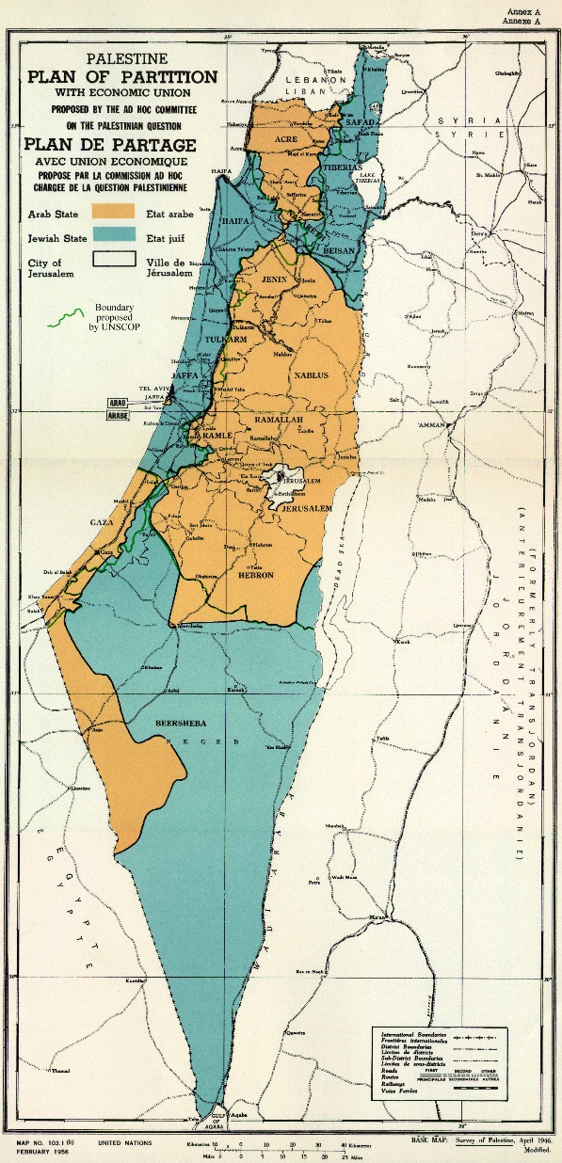
1947 Partition plan
Jewish state blue
Arab state orange
Jerusalem white
internationalized
Needed 2/3 majority
in UN Gen’l Assembly
Notes:
https://en.wikipedia.org/wiki/United_Nations_Partition_Plan_for_Palestine
Context, breakthrough practice of fasting for the Kingdom before the end! The end: outreach and abomination.

Slide 21
On 29 November 1947, the United Nations General Assembly voted 33 to 13, with 10 abstentions and 1 absent, in favor of the modified Partition Plan. All Soviet republics voted FOR. [To antagonize the British.]
Diplomatic miracle.
Notes:
https://en.wikipedia.org/wiki/United_Nations_Partition_Plan_for_Palestine
Very difficult to get the votes. Lots of Arab states opposed.

Slide 22
In 1948 the "Latter Rain" outpouring hit North Battleford, Canada, and swept into the United States.
Notes:
https://www.christianity.ca/page.aspx?pid=10891
https://www.youtube.com/watch?v=fL85daR2nBI

Slide 23
In 1948 Bill Bright saw a vision of college campus awakenings,
Billy Graham's ministry was released in 1949
The Asbury College revival, along with many others, commenced in 1950.
Notes:
https://www.christianity.ca/page.aspx?pid=10891
https://www.youtube.com/watch?v=fL85daR2nBI
These are some leaders most of us would agree was great, good, powerful.

Slide 24
Atomic Power
with God
published
1946
Fasting
movement in
response→ revival
Notes:
Context, breakthrough practice of fasting for the Kingdom before the end! The end: outreach and abomination.
Repeated theme at the Messiah Conference…

Slide 25
Notes:
I don’t remember whose presentation this slide was.

Slide 26
Five major leaders spoke of Messianic Jewish breakthrough
Paul Wilbur
Frank Lowinger – Buffalo
Jason Soebel -- Los Angeles
David Chernoff – Philadelphia
Jeff Forman – Toronto
Notes:
I’ll be presenting these, at least some of them.

Slide 27
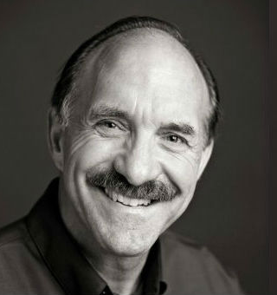
Lou Engle,
this year’s
Messiah
Conference
invitee from
the church
world.
Notes:
Conference has been making a practice of one such/year. Ruth Graham Lotz one year.

Slide 28
Lou Engle 8th Gen preacher. His ancestor was the original settler who founded Brethren in Christ, Messiah Bible College their school. He played bball on this floor, adapted as our sanctuary.

Slide 29
Louis Engle Messiah College Basketball statistics:
122 games
1975-1976
total points: 1576
Target of evangelistic club; least likely to be reached

Slide 30
^{Mtt. 9.37-38} Then he said to his talmidim, “The harvest is rich, but the workers are few. Pray that the Lord of the harvest will send out workers to gather in his harvest.”

Slide 31
throw (cast, put) out; banish; bring forth, produce, hurl
Notes:
David Chernoff tells his story.
Lou now hurled into ministry.

Slide 32
^{Yeshayahu/Is. 44. 3-5} For I will pour water on the thirsty land and streams on the dry ground; I will pour my Spirit on your descendants, my blessing on your offspring…One will say, ‘I belong to Adoni.’ Another will be called by the name of Ya‘akov. Yet another will write that he belongs to Adoni and adopt the surname Isra’el.”
Notes:
Hurled into ministry.
Context, breakthrough practice of fasting for the Kingdom before the end! The end: outreach and abomination.
Do we want to see our children, siblings, neighbors, friends, neighbors, won to Yeshua??

Slide 33
Lou Engle
Believes the first followers of Yeshua/ talmidim studying Yoel 2 and saw themselves. Former rain
Like Yokhanan saw self in Isaiah 40. “Voice of one crying…”
Notes:
Do we see ourselves as Ro. 11…?

Slide 34
^{Ro. 11.12,15} Now if their transgression leads to riches for the world, and their loss riches for the Gentiles, then how much greater riches will Isra’el in its fullness bring them!!...For if their rejection leads to the reconciliation of the world, what will their acceptance be but life from the dead?
Notes:
Is it our time, for US to convey the MUCH GREATER RICHES, the LIFE FROM THE DEAD?

Slide 35
Mattityahu (Matthew) 24:14
This Good News of the kingdom shall be proclaimed in the whole world as a testimony to all the nations, and then the end will come.

Slide 36
Lou Engle Rev 12 warfare against Jews already started. Michael & angels warring. It is time.
40 day fast of Yeshua not anomaly, rather prototype.

Slide 37
Jeff Forman – Toronto Are we making impact on our people or just making noise? 140 IAMCS Congregations.

Slide 38
Jeff at 800 pastors conference Heard said G about to remove you from the side street to the main street of the Jewish world. Shifting from stronghold of Rabbinic Judaism. Yeshua was irrelevant to Jeff until he saw Y in Jewish environment.

Slide 39
^{Yekhezkael/Ezk. 12.26-28} The word of Adoni came to me saying: “Son of man, behold, the house of Israel says, ‘The vision that he sees is for many days from now. He prophesies about times that are far off.’

Slide 40
^{Yekhezkael/Ezk. 12.26-28} Therefore say to them, thus says Adoni Elohim, ‘None of My words will be delayed anymore, but the word that I speak will be fulfilled.’” It is a declaration of Adoni.

Slide 41
The norm in the Kingdom is that breakthroughs happen in response to fasting and prayer.
Forty days of fasting and prayer.
Atomic power…

Slide 42
Lou Engle
Elisha out of cave~Messianic movement. 40 days ~40 weeks gestation
Death of Billy Graham ~Elisha double portion

Slide 43
Moshe Shmot/Ex 24.18
After 10 commandments Ex 20 and dozens detailed commandments Ex 20-24,
Presence Party Shmot/Ex 24
Before revelation of Mishkan/Tabernacle place of redemption. 40 days fasting!!
Notes:
Midrash:
forty fasting Moshe face illuminated. May happen if don’t complain!
Moshe 40 x 3 = 120 He lived till 120!
Why midrash? Rabbinics helpful, not authoritative.

Slide 44
Eliyahu ^{1 K 19.8-9} So he arose and ate and drank, and in the strength of that meal forty days and forty nights went to Horeb, the mountain of God. There he went into a cave.

Slide 45
Eliyahu recovering from depletion from battle with prophets of Baal, with drought, 40 days fasting.
^{1 K 19.11} Go outside צֵא
^{1 K 19.12} quiet, subdued voice
קוֹל דְּמָמָה דַקָּה
Then appointed Elisha, Kings…

Slide 46
^{Mtt. 4.1-2} Then Yeshua was led by the Ruakh into the wilderness to be tempted by the devil. After He had fasted for forty days and forty nights, He was hungry.

Slide 47
The norm in the Kingdom is that breakthroughs happen in response to fasting and prayer.
Forty days of fasting and prayer.
Atomic power…
I feel that it’s time.
Notes:
Context, breakthrough practice of fasting for the Kingdom before the end! The end: outreach and abomination.

Slide 48
Proposal:
Starting July 21 evening Tisha B’Av till approximately Labor Day.
What level?:

Slide 49
A total fast is without water. Ester fast. Don't go beyond three days.
A water-only fast is very difficult, but very effective. Depending on your weight and metabolism, you can go 40 days on water.
Notes:
https://www.christianity.ca/page.aspx?pid=10891

Slide 50
A juice fast allows you to enter into the Spirit of fasting but still gives energy. Most people can do a 40-day juice fast.
Notes:
https://www.christianity.ca/page.aspx?pid=10891

Slide 51
A Daniel fast with vegetables and water is good for those employed in manual labor or those carrying a heavy workload (like moms).
A milk-shake fast isn't really a fast!
Notes:
https://www.christianity.ca/page.aspx?pid=10891

Slide 52
How organized?
Pray this week about your level of participation in
Extra prayer
Fasting level
We will have an online or paper sign up sheet.

Slide 53
Fasting hazards: martyr, grouch
^{Matityahu 6.16-18} “Now when you fast, don’t go around looking miserable, like the hypocrites. They make sour faces so that people will know they are fasting. Yes! I tell you, they have their reward already! But you, when you fast,
Notes:
“I’m sooooo spiritual!!” Do less. Sleep more!

Slide 54
^{Matityahu 6.16-18} “wash your face and groom yourself, so that no one will know you are fasting — except your Father, who is with you in secret. Your Father, who sees what is done in secret, will reward you.”

Slide 55
1. THE KEY TO PERSONAL, FAMILY , NATIONAL, ISRAEL REVIVAL IS UNITED FASTING AND PRAYING. 2. JOEL 2 UNITED FASTING AND PRAYING LEADS TO ACTS 2 OUTPOURING OF THE SPIRIT.

Slide 56
NKJ Joel 2:12 " Now, therefore," says the LORD, "Turn to Me with all your heart, With fasting, with weeping, and with mourning." 13 So rend your heart, and not your garments; Return to the LORD your God, For He is gracious and merciful, Slow to anger, and of great kindness; And He relents from doing harm.

Slide 57
KJ Acts 2:16 "But this is what was spoken by the prophet Joel: 17 'And it shall come to pass in the last days, says God, That I will pour out of My Spirit on all flesh; Your sons and your daughters shall prophesy, Your young men shall see visions, Your old men shall dream dreams….21 And it shall come to pass That whoever calls on the name of the LORD Shall be saved.'

Slide 58
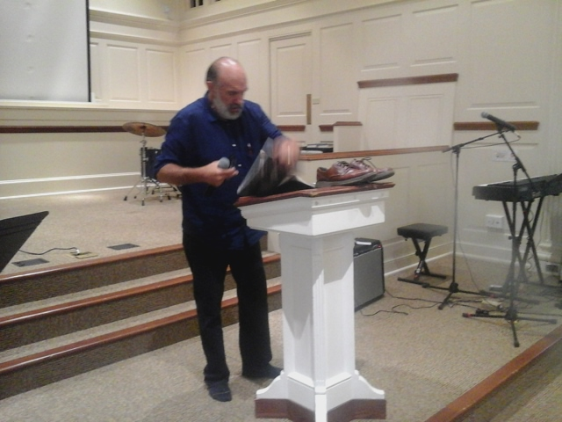
LOU ENGLE CALLS THE MESSIANICS TO BE LEADERS OF FASTING AND PRAYING UNTO THE HARVEST REVIVAL UNTO THE RETURN AND REIGN OF MESSAH.

Slide 59
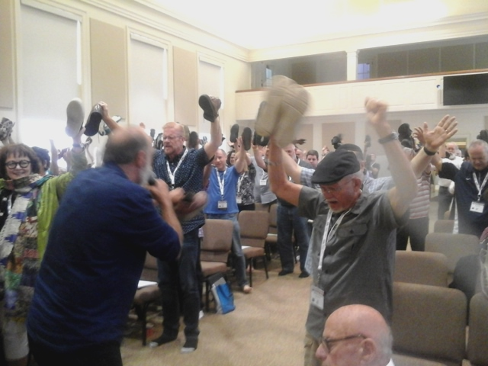
LOU ENGLE CALLS THE MESSIANICS TO THE HARVEST FIELD

Slide 60
RABBI SHMUEL: FAITHFUL MAN OF G-D
WHO REGULARLY FASTS AND PRAYS

Slide 61
Messiah 2018
Morning prayer sessions

Slide 62
Morning prayer group
This is the morning prayer group. We met every morning of the conference, starting Monday 7/1/2018. It was an effective, glorious session each morning.

Slide 63
Morning prayer dancing
One morning, as we sang “Hine ma tov”, we spontaneously began to dance in a circle! We were very joyful, because G-D answered our prayers, even then! And He filled us with His joy in our innermost being!

Slide 64
Jason Soebel
book with Kathy
Lee Lewis?
Messianic
Movement
coming out of
obscurity.

Slide 65
Frank Lowinger Nov 1739 preacher George Whitefield welcomed b 4k. Great Awakening. We MJ are to the world what Whitefield was to America.

Slide 66
Guy praying over Hudson River and complaints disturbing the peace. Told police praying over gangs. Keep on. That night AG preacher in PA reading Life Magazine Dave Wilkerson millions saved intercessors share reward

Slide 67
Chernoff: Angel offered leader infinite wisdom, beauty, money. Instantly took wisdom.....all looked at him to speak. “I should have taken the money.” Mikhah הפורץ breaker 2 Sam G-d broke out. Ch 2. Breaker anointing Break through - unrighteousness -Mt 11 violent take it by force

Slide 68
Lead by humility: Jewish repentance cf church

Slide 69
Extra time
Do less
Devotions
Private
Couple
family

Slide 70
SW testimony and fasting.
Jason Gardiner stats.
40% less attendance than 2000
Not at all reaching immigrants
4-9% Americans attend regularly.
Statistical increase: prayer movement.

