Slide 1
e-handout
To have these notes
without taking notes
Go to OrHaOlam.com
Click on downloads,
messages, 2020

Slide 2
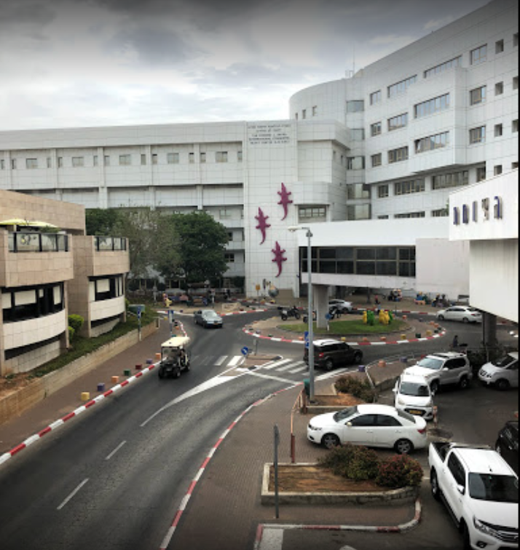
Good news from Israel
Sheba שיבא Medical Center
Notes:
Enrique Saldivar
https://www.google.com/maps/uv?hl=en&pb=!1s0x151d4af57a9329a1%3A0x81d1075dcacc6c30!3m1!7e115!4shttps%3A%2F%2Flh5.googleusercontent.com%2Fp%2FAF1QipOmajqmEhKIxLdcDY1TtxA_1IBF4yVfcsgh4p6-%3Dw286-h200-k-no!5s%E2%80%9CSheba%20Medical%20Center%20-%20Google%20Search!15sCAQ&imagekey=!1e10!2sAF1QipOWtEFsaOvr0mBC1FhHT5Ekxd72likN_wnGDSYH&sa=X&ved=2ahUKEwj3w7S4jfvnAhUH2qwKHURFATwQoiowEnoECCEQBg

Slide 3
Sheba is ranked #10 in the world!
“Sheba Medical Center—or Tel HaShomer Hospital—in Tel Aviv is a leader in medical science and biotechnical innovation, both in the Middle East and worldwide. The center’s collaborations with international parties have advanced innovative medical practices, hospital systems, and biotechnology.

Slide 4
Scientists at Israel's MIGAL Research Institute say they are 8-10 weeks away from a vaccine.
Notes:
https://vfinews.com/en/news/march-13-2020/hold-off-on-boycotting-israel?subscribed=true&mc_cid=25677e84d1&mc_eid=[UNIQID]

Slide 6
New standard of affectionate
greeting

Slide 7
Notes:
From Marc Richardson, and one other
Seriously, we have a handout, ushers will distribute while I show these.

Slide 14
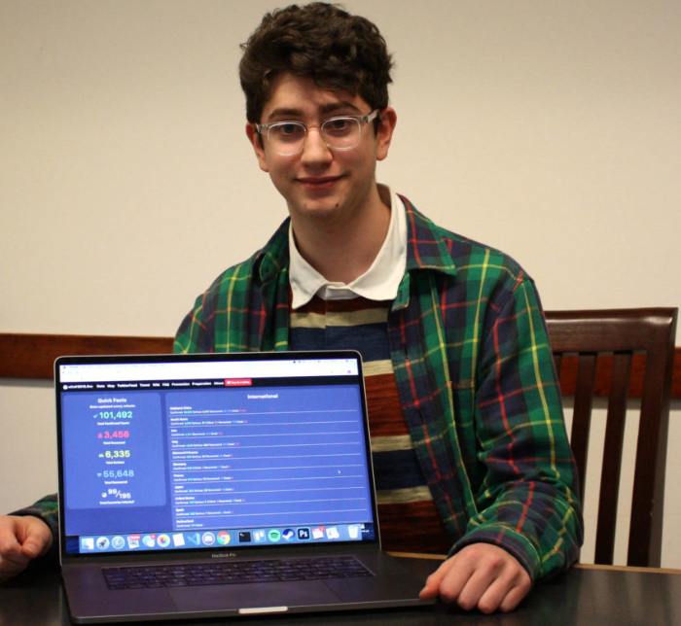
Jewish 17 year old from Seattle creates corona virus tracker https://ncov2019.live/data

Slide 15
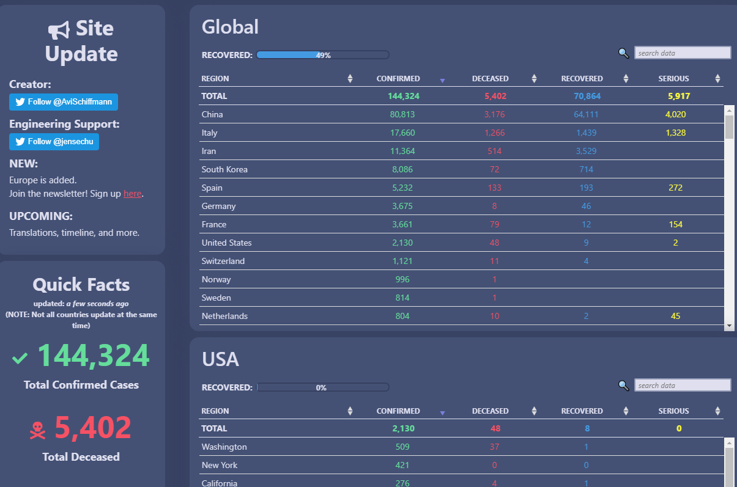
Notes:
As of Friday night ~9 pm

Slide 16
Continuing series in MJ, [Letter to the Messianic Jew, Hebrews]
Overcoming him who has the power of death.
Are we facing a death threat now??

Slide 17
Summary: MJ 2.1-12
The human race had it ALL. Ps 8
Not exactly have it all now. Ps 8
Yeshua voluntarily left glory. Ps 8
Regained it all, sovereignty over creation by His death. Ps 22
We can return to glory. Ps 22

Slide 18
Messiah, the Divine Cohen/priest
Notes:
Previously considered evidence that Messiah is the Son of G-d = G-d the Son,
now Messiah Son of Man, one of us!

Slide 19
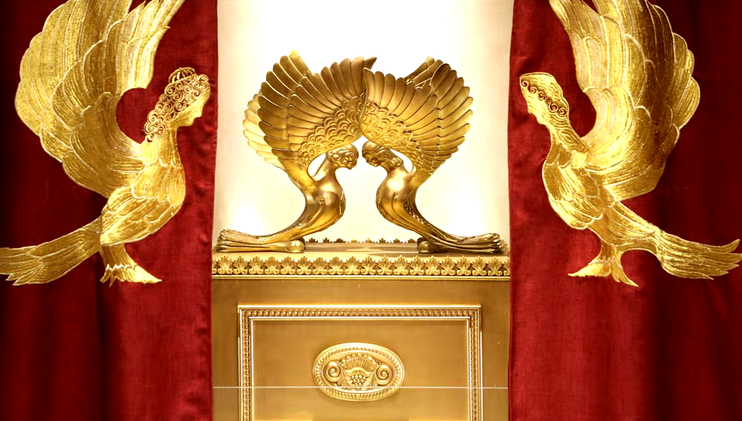
Letter to the Messianic Jews [Hebrews] MJ 2.13-17
Notes:
https://www.templeinstitute.org/new-location.htm

Slide 20
^{MJ 2.13-18} Also, “I will put my trust in him, . . .”

Slide 21
^{MJ 2.13-18} and then it goes on, “Here I am, along with the children God has given me.” Therefore, since the children share a common physical nature as human beings,

Slide 22
^{MJ 2.13-18} he became like them and shared that same human nature; so that by his death he might render ineffective the one who had power over death (that is, the Adversary) and thus set free those who had been in bondage all their lives because of their fear of death.

Slide 23
^{MJ 2.13-18} Indeed, it is obvious that he does not take hold of angels to help them; on the contrary, “He takes hold of the seed of Avraham.” This is why he had to become like his brothers in every respect — so that he might become a merciful and faithful

Slide 24
^{MJ 2.13-18} cohen gadol in the service of God, making an atonement / kapparah for the sins of the people. For since he himself suffered death when he was put to the test, he is able to help those who are being tested now.

Slide 25
Let’s go back through the text and unpack it the way 1st century, the original hearers and readers, perceived it.

Slide 26
Reminder: When Jewish hearers in Yeshua’s day were told a phrase of scripture, many or most would think of the whole chapter.
We still do that.
That’s one small step…

Slide 27
^{MJ 2.13-18} Also, “I will put my trust in him, . . .”
^{T’hillim/Ps 18.2} Adoni is my rock, my fortress and my deliverer. My God, my rock, in Him I take refuge, אֵלִי צוּרִי, אֶחֱסֶה-בּוֹ;
Psalm 18 has many references to Messiah.

Slide 28
^{T’hillim/Ps 18.5-8} Cords of death entangled me. Torrents of Belial overwhelmed me. Cords of Sheol coiled around me. Snares of death came before me. In my distress I called on Adoni, and cried to my God for help.

Slide 29
^{T’hillim/Ps 18.5-8} From His Temple He heard my voice, my cry before Him came into His ears. Then the earth rocked and quaked.
Notes:
Maybe a metaphor in general, but literal in the case of Messiah Yeshua

Slide 30
Targum rendering of Ps 18.31-32
For because of the miracle and deliverance that you will perform for your Messiah, and for the remnants of your people who will remain, all the Gentiles, nations, and tongues will confess and say,
Notes:
http://www.targum.info/pss/ps1.htm
Ancient Aramaic language translation, really paraphrase

Slide 31
Targum rendering of Ps 18.31-32
There is no God but the Lord, for there is none besides you; and your people will say, There is none mighty except our God.
Notes:
http://www.targum.info/pss/ps1.htm

Slide 32
^{T’hillim/Ps 18.44-45} You free me from quarrels of my people. You set me as head of the nations —people I did not know are serving me. As soon as they hear, they obey me.

Slide 33
^{T’hillim/Ps 18.50(49)-51(50)} “So I give thanks to you, Adoni, among the nations; I sing praises to your name. Great salvation he gives to his king; he displays grace to his anointed, to David
לִמְשִׁיחוֹ--לְדָוִד and his descendants forever.”

Slide 35
^{MJ 2.13-18} and then it goes on, “Here I am, along with the children God has given me.” quoted from:
^{Isaiah 8:18} Meanwhile, I and the children whom Adoni has given me will become for Isra’el signs and wonders from Adoni-Tzva’ot living on Mount Tziyon.
Notes:
Keep in mind, about the prophet Yeshyahu/Isaiah

Slide 36
Context: spiritual failure of King Akhaz, so Judah was subject to a brutal Assyrian invasion.
Power of death…

Slide 37
^{Yeshayahu/Is 8.1-4} Adoni said to me, “Take a large tablet, and write on it in easily readable letters; ‘Maher shalal, hash baz [the spoil hurries, the prey speeds along].’” I had it witnessed for me by reliable witnesses… Then I had sexual relations with my wife;

Slide 38
^{Yeshayahu/Is 8.1-4} she became pregnant and gave birth to a son; and Adoni said to me, “Name him Maher Shalal Hash Baz; because before the child knows how to cry, ‘Abba!’ and ‘Eema!’, the riches of Dammesek and the spoil of Shomron will be carried off and given to the king of Ashur.”

Slide 39
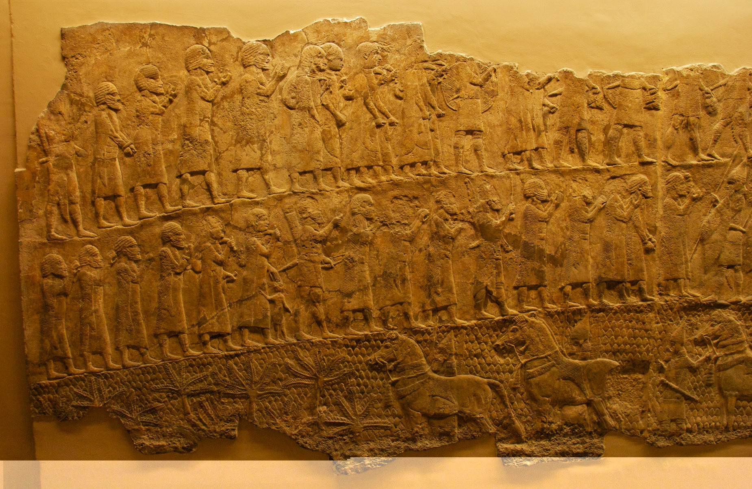
Seige of Lakhish
Notes:
Assyrians were famous for piles of skulls. Dreadfully cruel. Ancient depiction, perspective of siege ramps. Relief picture of the battle now in the British museum.
https://en.wikipedia.org/wiki/Siege_of_Lachish#/media/File:Lachish_Relief,_British_Museum.jpg

Slide 40
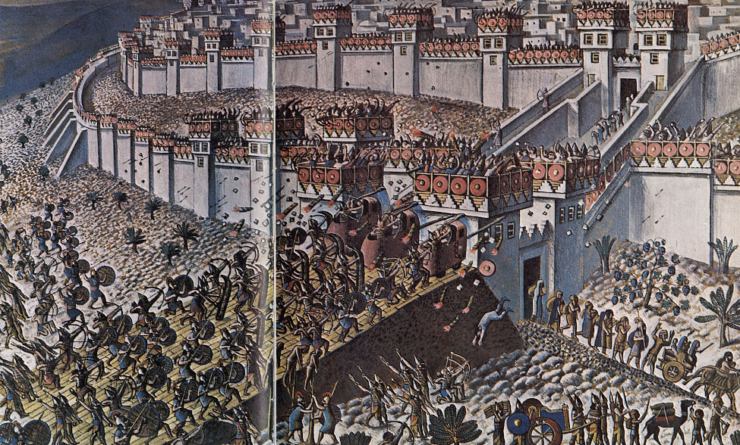
Seige of Lakhish

Slide 41
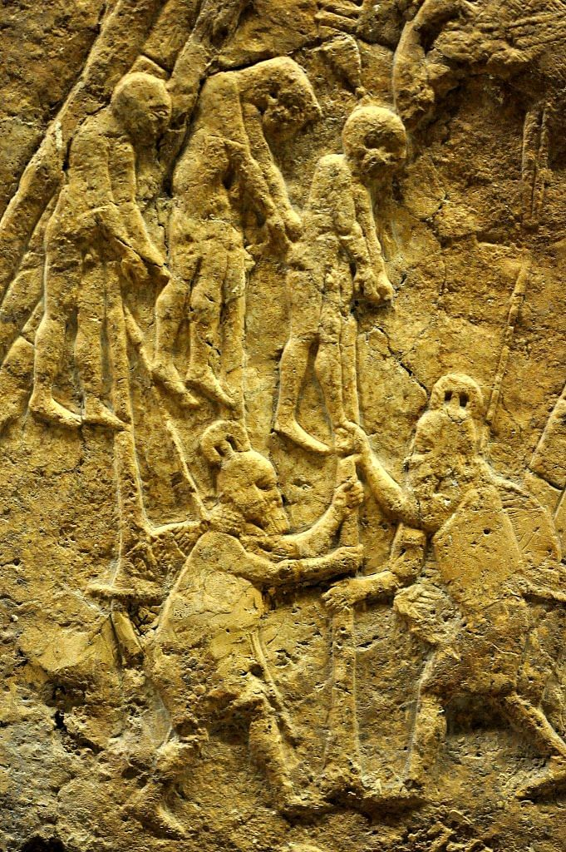
Notes:
Impaled prisoners
https://www.google.com/search?q=assyrian+siege+of+lachish&safe=active&sxsrf=ALeKk01b_H88BAAXsVwfvKctOtv0NxpEtQ:1584163983486&tbm=isch&source=iu&ictx=1&fir=f7bg4bZM9wPfGM%253A%252CWTAlhaErfZ2hAM%252C%252Fm%252F02x2j13&vet=1&usg=AI4_-kQm4XjXRbgBwxY7SXi-g_m2vDBBqA&sa=X&ved=2ahUKEwjEq4HcnpnoAhXIla0KHbVrDq0Q_B0wHHoECAsQAw#imgrc=XedHHBrHiESJeM

Slide 42
^{Isaiah 7.13-14} Then he said, “Hear now, house of David! Is it a small thing for you to weary men? Will you also weary my God? Therefore Adoni Himself will give you a sign: Behold, the virgin will conceive. When she is giving birth to a son, she will call his name Immanuel.

Slide 43
^{Yesh/Is 9.5} For a child is born to us, a son is given to us; dominion will rest on his shoulders, and he will be given the name Pele-Yo‘etz El Gibbor Avi-‘Ad Sar-Shalom [Wonder of a Counselor, Mighty God, Father of Eternity, Prince of Peace],

Slide 44
Summary so far
Psalm 18 about great heavenly warfare
Isaiah about Assyrian invasion disaster and overcoming by the power of G-d.

Slide 45
^{MJ 2.13-18} Therefore, since the children share a common physical nature as human beings,

Slide 46
^{MJ 2.13-18} he became like them and shared that same human nature; so that by his death he might render ineffective the one who had power over death (that is, the Adversary) and thus set free those who had been in bondage all their lives because of their fear of death.
Notes:
Power of death because the human race had forfeited our sovereignty

Slide 47
^{MJ 2.13-18} Indeed, it is obvious that he does not take hold of angels to help them; on the contrary, “He takes hold of the seed of Avraham.” Isaiah 41:8–9

Slide 48
^{Yeshayahu/Is 41.8-9} “But you, Isra’el, my servant; Ya‘akov, whom I have chosen, descendants of Avraham my friend,I have taken you from the ends of the earth, summoned you from its most distant parts and said to you, ‘You are my servant’ — I have chosen you, not rejected you

Slide 49
^{MJ 2.13-18} This is why he had to become like his brothers in every respect — so that he might become a merciful and faithful cohen gadol in the service of God,

Slide 50
^{MJ 2.13-18} making a kapparah for the sins of the people. For since he himself suffered death when he was put to the test, he is able to help those who are being tested now.

Slide 51
Are we being tested now?
Is the power of death around us?

Slide 52
Rabbi Hylan Slobodkin
Beit Tikvah Messianic Congregation
7935 136th Ave SE
Newcastle, WA 98059
www.BeitTikvah.us

Slide 53
We are taking it online! Shabbat service will be offered in a live online format. No audience in the sanctuary. We encourage you to enter into a time of worship and rest as we gather together virtually online. In addition to our regular streamed service, we have several other interactive sessions throughout the day.

Slide 54
Messianic Rabbi Joel Liberman, Tree of Life Messianic Jewish San Diego, CA
Personally, our state (California) has banned mass gatherings of more than 250 people until the end of March and for those gatherings that are currently less than 250, there must be 6-feet of social distancing, which,

Slide 55
for all intents and purposes, shuts down all congregations in our city for the safety of everyone. We are unable to meet in our facility until April (at least!) All of the congregations in our city are in the same boat.

Slide 56
^{MJ 2.13-18} he became like them and shared that same human nature; so that by his death he might render ineffective the one who had power over death (that is, the Adversary) and thus set free those who had been in bondage all their lives because of their fear of death.

Slide 57
Other difficulties:

Slide 58
According to a recent survey taken by the Action and Protection League, roughly 40 percent of people surveyed in 16 European countries said a secret network of Jews is influencing the world’s political and economic affairs.
Notes:
https://www.jerusalemonline.com/survey-alarming-number-of-europeans-believe-jews-control-the-world/

Slide 59
Thirty-nine percent of those polled agreed with the statement “There is a secret Jewish network that influences political and economic affairs in the world,” and fifty-one percent of them agreed with the statement that “Jews are more inclined than most to use shady practices to achieve their goals.”
Notes:
https://www.jerusalemonline.com/survey-alarming-number-of-europeans-believe-jews-control-the-world/

Slide 60
Notes:
This whole corona virus thing could turn into an anti-Semitic crusade.
https://www.jerusalemonline.com/survey-alarming-number-of-europeans-believe-jews-control-the-world/

Slide 61
Kids Suffering over Climate Fears
British children have been so immersed in news about the supposedly imminent climate apocalypse that nearly a fifth of them are losing sleep and having nightmares about it, according to a survey conducted by the BBC’s Newsround, a television news program for children.
Notes:
https://www.endtime.com/prophecy-news/kids-suffering-nightmares-lost-sleep-over-climate-fears/?utm_source=Endtime+Newsletter&utm_campaign=bfa6fd0f65-19ENEWS+-+NEWSLETTER&utm_medium=email&utm_term=0_5ded71173e-bfa6fd0f65-54179837&mc_cid=bfa6fd0f65&mc_eid=59df1cdf24

Slide 62
Nineteen percent of those surveyed said they’d had a bad dream about climate change, while 17 percent said their concerns have affected their sleeping and eating habits.
Notes:
https://www.endtime.com/prophecy-news/kids-suffering-nightmares-lost-sleep-over-climate-fears/?utm_source=Endtime+Newsletter&utm_campaign=bfa6fd0f65-19ENEWS+-+NEWSLETTER&utm_medium=email&utm_term=0_5ded71173e-bfa6fd0f65-54179837&mc_cid=bfa6fd0f65&mc_eid=59df1cdf24

Slide 63
Israel Eighth Most Expensive Country in the World
According to CEO World Magazine, the Jewish state is the eighth-most expensive place in the world to live. High rents, high prices, and high transport costs placed Israel close to the top of the countries with the highest cost of living. Using “notoriously expensive” New York City as a benchmark.
Notes:
https://vfinews.com/en/news/march-3-2020/israel-eighth-most-expensive-country-in-the-world?subscribed=true&mc_cid=217cebaddd&mc_eid=[UNIQID]

Slide 64
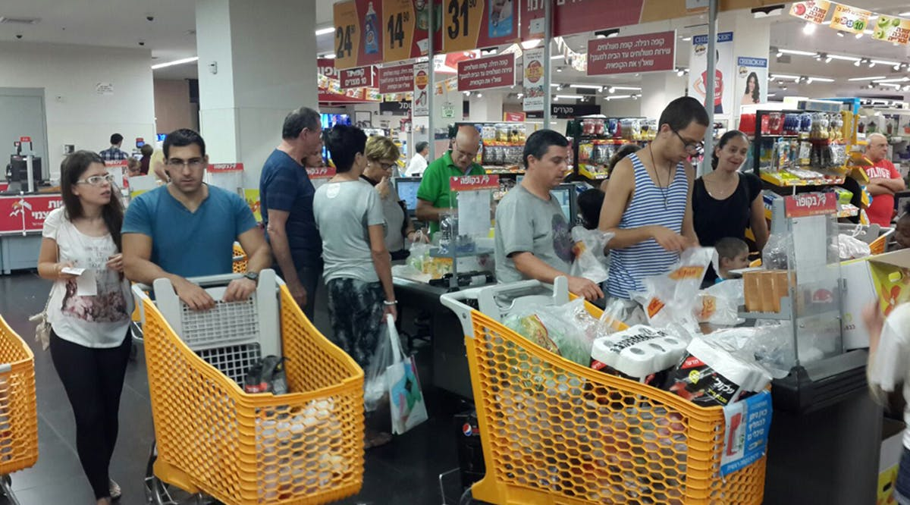
Notes:
https://vfinews.com/en/news/march-3-2020/israel-eighth-most-expensive-country-in-the-world?subscribed=true&mc_cid=217cebaddd&mc_eid=[UNIQID]

Slide 65
Based on that, Israel’s cost of living was about 80% of New York’s. Those looking for an inexpensive lifestyle should check out Pakistan or Afghanistan, which ranked as the two least expensive countries for almost every metric. (VFI News)
Notes:
https://vfinews.com/en/news/march-3-2020/israel-eighth-most-expensive-country-in-the-world?subscribed=true&mc_cid=217cebaddd&mc_eid=[UNIQID]

Slide 66
So, how do we live:

Slide 67
Ron Cantor: I want to encourage you as we face this pandemic together. Panic is not from God. Elana and I were watching the news the other day, and we could both feel this sense of fear and dread coming on us. The next morning we prayed to break the spirit of panic. The word “Panic” means, “pertaining to Pan.”
Notes:
Ron Cantor

Slide 68
Who is Pan? A mythical god who would let out a demonic scream each afternoon that would produce fear in all who heard it. When you panic, it is giving in to irrational fear. Instead, let’s obey God’s wisdom. Yeshua said when we see these things happening, "see to it that you are not alarmed." (Matt. 24:6) Be of good courage—your name is written in heaven!
Notes:
Ron Cantor

Slide 69
Rabbi Hylan “Make the most of every opportunity because the days are evil.” Ephesians 5:16. This is the perfect time for the people of God to rise up and let our light shine. We demonstrate faith, not fear; hope, not despair; love, not hate; peace,

Slide 70
not anxiety nor confusion. Romans 8:28 applies here, “And we know that God causes all things to work together for good to those who love God, to those who are called according to His purpose.”

Slide 71
From Shaunti Feldhahn
Two millennia ago, in A.D. 165 and 251, two great plagues swept the Roman Empire. Where pagans tried to avoid all contact with the sick, believers in Messiah put themselves at risk in order to succor those sick and dying, caring for those who had always treated them with contempt.
Notes:
https://religionnews.com/2020/03/13/christian-love-in-a-time-of-coronavirus/

Slide 72
But with the love of Messiah in their hearts, how could they not step forward when so many were hurting and in need?
Many paid the ultimate price. But as Rodney Stark concluded in his 1996 book "The Rise of Christianity,"

Slide 73
From Shaunti Feldhahn
this visible love so overwhelmed the reigning philosophies of the day — it so showed Yeshua ­— that it was one of the most important factors behind the explosion of our faith to every corner of the empire and beyond.
Notes:
https://religionnews.com/2020/03/13/christian-love-in-a-time-of-coronavirus/

Slide 74
Surprising working of G-d?

Slide 75
Iran's leadership has been hit especially hard by the coronavirus, as the Islamic Republic predicts that 40% of residents in its capital of Tehran will be infected by the spreading virus within two weeks.
Notes:
https://www.worthynews.com/47660-irans-leadership-falls-prey-to-coronavirus?utm_source=Worthy+Brief&utm_campaign=76a32520c6-EMAIL_CAMPAIGN_2020_03_10_03_03&utm_medium=email&utm_term=0_d1151ee7ea-76a32520c6-104018657

Slide 76
Friday prayers across major Iranian cities, and all prayers across the nation last Friday, were canceled or limited as the government indefinitely postponed open parliamentary sessions.
Notes:
https://www.worthynews.com/47660-irans-leadership-falls-prey-to-coronavirus?utm_source=Worthy+Brief&utm_campaign=76a32520c6-EMAIL_CAMPAIGN_2020_03_10_03_03&utm_medium=email&utm_term=0_d1151ee7ea-76a32520c6-104018657

Slide 77
Major figures of the Iranian hostage crisis Hossein Shekholeslam, an English-speaking Iranian student who interrogated the 52 U.S. diplomats taken captive at the U.S. Embassy in 1979, and Muhammad Hajj Abulqasmi, commander of the Basij militia in Tehran
Notes:
https://www.worthynews.com/47660-irans-leadership-falls-prey-to-coronavirus?utm_source=Worthy+Brief&utm_campaign=76a32520c6-EMAIL_CAMPAIGN_2020_03_10_03_03&utm_medium=email&utm_term=0_d1151ee7ea-76a32520c6-104018657

Slide 78
known as the "butcher of Tehran" for his work in suppressing domestic resistance to the regime, both died of the virus on Thursday.
Notes:
https://www.worthynews.com/47660-irans-leadership-falls-prey-to-coronavirus?utm_source=Worthy+Brief&utm_campaign=76a32520c6-EMAIL_CAMPAIGN_2020_03_10_03_03&utm_medium=email&utm_term=0_d1151ee7ea-76a32520c6-104018657

Slide 79
Of Iran's 290-member "Majlis" or parliament, 23 lawmakers have contracted the coronavirus, including the deputy health minister and one vice president, comprising 8% of its government leadership.
Notes:
https://www.worthynews.com/47660-irans-leadership-falls-prey-to-coronavirus?utm_source=Worthy+Brief&utm_campaign=76a32520c6-EMAIL_CAMPAIGN_2020_03_10_03_03&utm_medium=email&utm_term=0_d1151ee7ea-76a32520c6-104018657

Slide 80
Iran is number nine on Open Doors USA's World Watch List for the persecution of Christians, though it has a flourishing house church movement, with the number of secret believers having nearly doubled since 2016, according to the watchdog group.
Notes:
https://www.worthynews.com/47660-irans-leadership-falls-prey-to-coronavirus?utm_source=Worthy+Brief&utm_campaign=76a32520c6-EMAIL_CAMPAIGN_2020_03_10_03_03&utm_medium=email&utm_term=0_d1151ee7ea-76a32520c6-104018657

Slide 81
In addition to the virus that has hit thousands in the Islamic Republic, massive swarms of desert locusts have been arriving in Iran’s southern regions. Government officials say the invasion is too huge to counter except with the use of pesticides.
Notes:
https://vfinews.com/en/news/march-10-2020/iran-plagued-with-plagues?subscribed=true&mc_cid=fd2757b8e0&mc_eid=[UNIQID]

Slide 82
“The density of locusts in the swarms is so high that a 10-15 centimeter layer of dead locusts forms on the ground after spraying pesticides,” he said. (VFI News)
Notes:
https://vfinews.com/en/news/march-10-2020/iran-plagued-with-plagues?subscribed=true&mc_cid=fd2757b8e0&mc_eid=[UNIQID]

Slide 83
Notes:
From Kolene Evans’ Facebook

Slide 84
Israel Pochtar’s cong in Ashdod
Notes:
He is the guest speaker Tuesday Mar 24 at IHOPKC, so I’m lifting Teersoh so we can hear him.

Slide 86
From Angela Schear: He even invited me to come see the sanctuary (is that what it is called?) and took my contact info because he is interested in partnering in political action. At the end, he said a blessing over me. Like a dove carrying an olive branch, I felt I had accomplished my mission.

Slide 87
Richard and I [Luanne] dropped off the Purim letter packet at a drop box for the synagogue. I spoke to a woman & explained that I wanted to drop off letters of support of the Jewish community from Christians in the greater KC area. She received the message very kindly and expressed “Oh, that is so nice of you!”. Later, I spoke to a man at the synagogue.

Slide 88
There was sincere appreciation in his voice when he said this was very thoughtful of us and greatly appreciated. I never sensed any intent from either to merely placate me but, quite the contrary, I sensed both were sincerely touched that we knew it was Purim and we had taken the time to gather letters of support. “Pleasant astonishment” is how I’d describe the response when I said there were around 1,100 signatures.

Slide 89
From a Messianic rabbi, sent to Jonathan Cahn: I was there as many of us were when you delivered the Harbinger message at the Messiah Conference perhaps twelve years ago? I must confess it was the only CD I ever listened to twice

Slide 90
on the way home from conference. Keep on truckin, chazak v’nit chazak, I can only imagine the attack you face spiritually as we all do, and yet I’m sure you have quite an army of intercessors.

Slide 91
I was once having supper with Bruce Wilkinson (Prayer of Jabez and Secrets of the Vine), he told us of all the really cool things the Lord had done after he wrote those books, then I asked him about the spiritual attack and he turned white and said he didn’t want to talk about it. Our hostess that night insisted that he tell, so he did. It’s not as easy a road as many would assume I gather.

Slide 92
Jon Cahn’s response:
Yes, the first time I shared any of these things outside of Beth Israel was at the Messiah Conference. And yes, the spiritual attack is always very great at the time of the release, and often on the day of the release

Slide 93
and often on the day of the release (including being paralyzed in the hospital on one release day, in emergency surgery on another, a hurricane flooding our ministry on another, etc.) My wife said “Do you have to keep writing books?” J
All the more I so appreciate all of your prayers Blessings! Jonathan

Slide 94
^{MJ 2.13-18} he became like them and shared that same human nature; so that by his death he might render ineffective the one who had power over death (that is, the Adversary) and thus set free those who had been in bondage all their lives because of their fear of death.

