Slide 1
e-handout
To have these notes
without taking notes
Go to OrHaOlam.com
Click on downloads,
messages, 2020

Slide 2
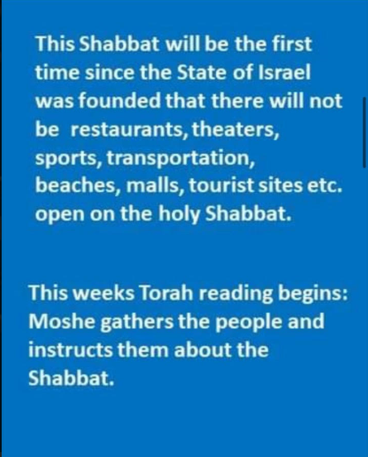
Notes:
From Cathryn Billings

Slide 3
Notes:
From Cathryn Billings

Slide 4
Since we’re in quarantine now, I guess we will have more insider jokes.
Notes:
Jai Cohen Smith

Slide 5
A Minyan מִנְיָן is the quorum of ten Jewish adults required for certain public prayers.
Notes:
https://en.wikipedia.org/wiki/Minyan

Slide 6
A minyan in Israel with social distancing!

Slide 7
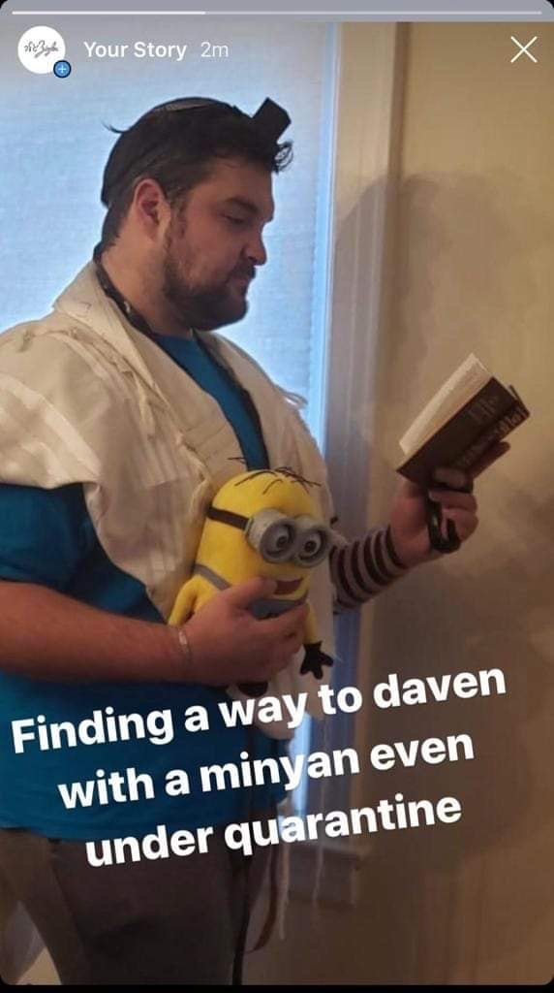

Slide 8
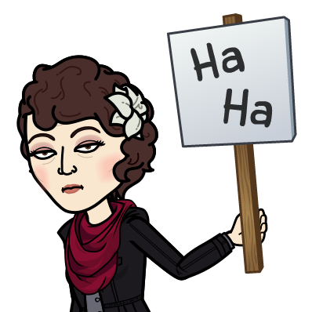

Slide 9
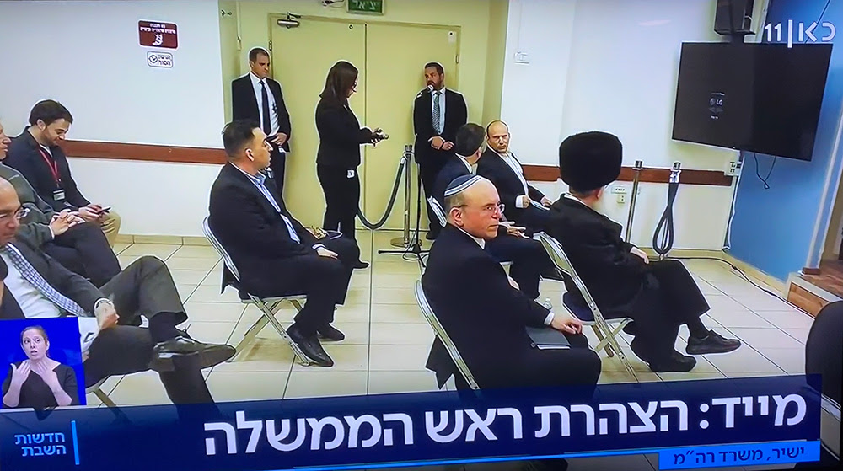
Israeli officials, waiting to hear
Prime Minister Netanyahu issue
new directives, spread chairs out
to demonstrate new social
distancing standards

Slide 10
What wisdom does G-d have for us in this Corona crisis?

Slide 11
T’hillim/Ps 43
Vs 1-2 Gloom, discouragement
Vs 3 Prayer for uplift
Vs 4 Pursuit of uplift
Vs 5 Conclusion of faith.

Slide 12
T’hillim/Ps 43 Judge me, God, and plead my cause against a faithless nation. Rescue me from those who deceive and from those who are unjust. ² For you are the God of my strength; why have you thrust me aside? Why must I go about mourning, under pressure by the enemy?
Notes:
Vs 1-2 Gloom, discouragement

Slide 13
^{T’hillim/Ps 43 3} Send out your light and your truth; let them be my guide; let them lead me to your holy mountain, to the places where you live. ⁴ Then I will go to the altar of God, to God, my joy and delight; I will praise you on the lyre, God, my God.
Notes:
Vs 3 Prayer for uplift
Vs 4 Pursuit of uplift

Slide 14
^{T’hillim/Ps 43 5} My soul, why are you so downcast? Why are you groaning inside me? Hope in God, since I will praise him again for being my Savior and God.
Notes:
Vs 1-2 Gloom, discouragement
Vs 3 Prayer for uplift
Vs 4 Pursuit of uplift
Vs 5 Conclusion of faith.

Slide 15
Back through the psalm and unpack it.

Slide 16
^{Ps 43.1} Judge me, God, and plead my cause against a faithless nation.
שָׁפְטֵנִי אֱלֹהִים, וְרִיבָה רִיבִי--מִגּוֹי לֹא-חָסִידrighteous, pious, kind khasid
חֶסֶד khesed grace, goodness, love mercy, kindness, benevolence
Notes:
A khasid could be considered “one with khesed” My interpretation. Not all Hasidim are so necessarily.
Warm, loving, community, people who read your BEST motives and heart. 6x/sec exchange. Somewhat equivalent to the Greek work Agape.
Key attribute of the nature of G-d as self defined to Moshe at Sinai:

Slide 17
יְיָ יְיָ אֵל רַחוּם וְחַנּוּן
Adoni, Adoni, El ra-khoom v'kha-noon
אֶֽרֶךְ אַפַּֽיִם, וְרַב חֶֽסֶד
Eh-rekh a-pi-yeem, v'rav khe-sed
ADONI, ADONI is G-d, merciful and compassionate, slow to anger and rich in grace
Notes:
Hence, G-d is love. Special love. Redeeming love. Uplifting love. Re-enforcing empowering, convicting, transforming. Love through and in Yeshua to make us whole, forgiven, blessed, joyful in difficulties!
Psalmist is saying that I’m in a world without Khesed חסד

Slide 18
מֵאִישׁ מִרְמָה וְעַוְלָה תְפַלְּטֵנִי.
^{Ps 43.1} Rescue me from those who deceive and from those who are unjust.
מִרְמָהmirma deceit, fraud, falsehood
עַוְלָה injustice, wrong, crook avlah
Notes:
Shaul, Philistines,or Avshalom Implacable

Slide 19
^{Ps 43.2} For you are the God of my strength; why have you thrust me aside? Why must I go about mourning, under pressure by the enemy?
כִּי-אַתָּה, אֱלֹהֵי מָעוּזִּי--לָמָה זְנַחְתָּנִי: לָמָּה-קֹדֵר אֶתְהַלֵּךְ, בְּלַחַץ אוֹיֵב. קֹדֵר mournful, gloomy, sad koder
Notes:
לַחַץ lakhatz pressure, stress
Ever feel stressed?
Are we stressed now? Danger, death?, job loss, financial loss. Stock market back to value before current bull market.

Slide 20
^{Ps 43.3} Send out your light and your truth; let them be my guide; let them lead me to your holy mountain, to the places where you live.
שְׁלַח-אוֹרְךָ וַאֲמִתְּךָ, הֵמָּה יַנְחוּנִי; יְבִיאוּנִי אֶל-הַר-קָדְשְׁךָ, וְאֶל-מִשְׁכְּנוֹתֶיךָ.
Notes:
But where is that. Holy mountain?

Slide 21
^{Ps 43.4} Then I will go to the altar of God, to God, my joy and delight; I will praise you on the lyre, God, my God.
וְאָבוֹאָה, אֶל-מִזְבַּח אֱלֹהִים-- אֶל-אֵל, שִׂמְחַת גִּילִי:
Notes:
Another geographic reference. Where is His altar?

Slide 22
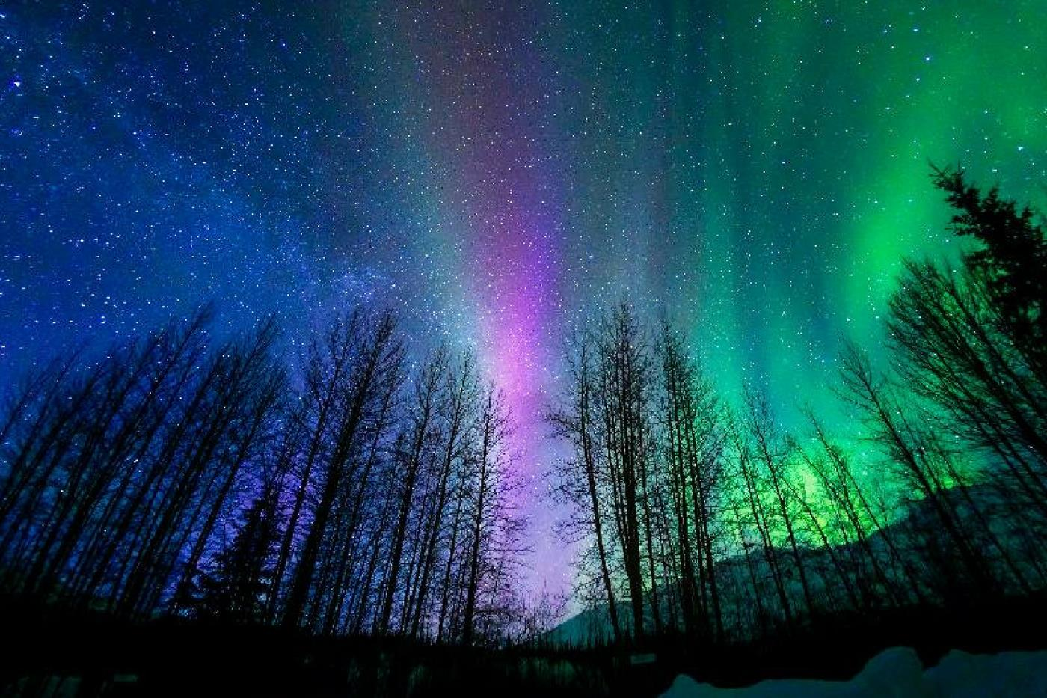
^{Ps 43.4} אָבוֹא אֶל מִזְבֵּחַ אֱלֹהִים
אֶל אֵל שִׂמְחַת גִּילִי
Avo el mizbakh Elohim el El simkhat gili
אַקְרִיב פְּרִי שְׂפָתַי לְפָנֶיךָ
Akriv pri sfati lefaneikha
[I will come to the altar of G-d,
to G-d my exceeding joy
I will bring the fruit of my lips]
Notes:
Physical first: literal Jerusalem Then spiritual
One basic difference Messianics and much of the church world. If skip the literal כי sloppiness, or כי denial rejection of Israel
You have to make an altar in your mind, heart. Sometimes a place in your home where prayer frequent.
Ps 51.17 fruit of my lips. Adoni, open my lips; then my mouth will praise you.

Slide 23
וְאַזְכּוֹר מַה גְּדוֹלוֹת עָשִׂיתָ עֲבוּרִי
Ve’ezkor mah g’dolot asita avori
I will remember the great things
You have done for me.
Notes:
Another place in the Word, but something about singing the Word. Psalms and hymns… Ps 71.19
Ps 103.2 Bless Adoni, O my soul, and forget none of His benefits:
Great things: Yeshua, death and resurrection.
Israel. Your family. This Or HaOlam family. G-d always sends people. Scene in Star Wars last minute rescue?

Slide 24
הַלְלוּיָהּ כִּי מָלַךְ אֲדֹנָי אֱלֹהֵינוּ
Halleluyah ki malakh Adoni Elohinu
Halleluyah, for Adoni our G-d reigns!
הַלְלוּיָהּ כִּי מָלַךְ אֱלֹהֵי צְבָאוֹת
Halleluyah ki malakh Elohei Tsava’ot
Halleluyah, for Adoni of armies reigns!
Notes:
PROCLAMATION!!

Slide 26
הנֵּה מִשְׁכָּן אֱלֹהִים עִם בְּנֵי אָדָם
Hineh mishkan Elohim im b’nei adam
הֵמָּה יִהְיוּ לוֹ לָעָם
Hema yihyu lo le’am
[Behold, the tabernacle of G-d is with men
They shall be His people]

Slide 27
הוּא יִמְחֶה כָּל דִּמְעָה מֵעֵינָם
Hu yimkheh kol dimah me’einam
וּמָוֶת, כְּאֵב וּזְעָקָה לֹא יִהְיוּ עוֹד
Umavet, ke’ev veze’akah lo yihu od
[He will wipe away every tear from their eyes
There shall be no more death, pain, nor crying]

Slide 28
^{T’hillim /Psalm 48.1-2}גָּדוֹל אֲדֹנָי וּמְהֻלָּל מְאוֹד
Gadol Adoni um’hulal meod
בָּעִיר אֱלֹהֵינוּ, בָּהָר קָדְשׁוֹ
B’ir Elohaynu, b’har kodsho
[Great is the L-rd and greatly to be praised]
[In the city of our G-d, In His holy mountain]

Slide 29
הַלְלוּיָהּ כִּי מָלַךְ אֲדֹנָי אֱלֹהֵינוּ
Halleluyah ki malakh Adoni Elohinu
Halleluyah, for Adoni our G-d reigns!
הַלְלוּיָהּ כִּי מָלַךְ אֱלֹהֵי צְבָאוֹת
Halleluyah ki malakh Elohei Tsava’ot
Halleluyah, for Adoni of armies reigns!

Slide 30
נָגִילָה וְנִשְׂמְּחָה וְנִתַּן לוֹ כָּבוֹד
Nagila v’nis’mekha V’nitan lo kavod
נָגִילָה וְנִשְׂמְּחָה וְנִתַּן לוֹ כָּבוֹד
Nagila v’nis’mekha V’nitan lo kavod
[Come and rejoice and give Him glory]

Slide 31
^{Ps 43.5} My soul, why are you so downcast? Why are you groaning inside me? Hope in God, since I will praise him again for being my Savior and God.

Slide 32
Great is the L-rd
and greatly to be praised
In the city of our G-d
in His Holy place

Slide 33
גָּדוֹל אֲדֹנָי וּמְהֻלָּל מְאוֹד
Gadol Adoni um’hulal meod
בָּעִיר אֱלֹהֵינוּ, בָּהָר קָדְשׁוֹ
B’ir Elohaynu, b’har kodsho
[Great is the L-rd and greatly to be praised]
[In the city of our G-d, In His holy mountain]

Slide 34
Perspective…
This is not the first plague on our land or on the world.

Slide 37
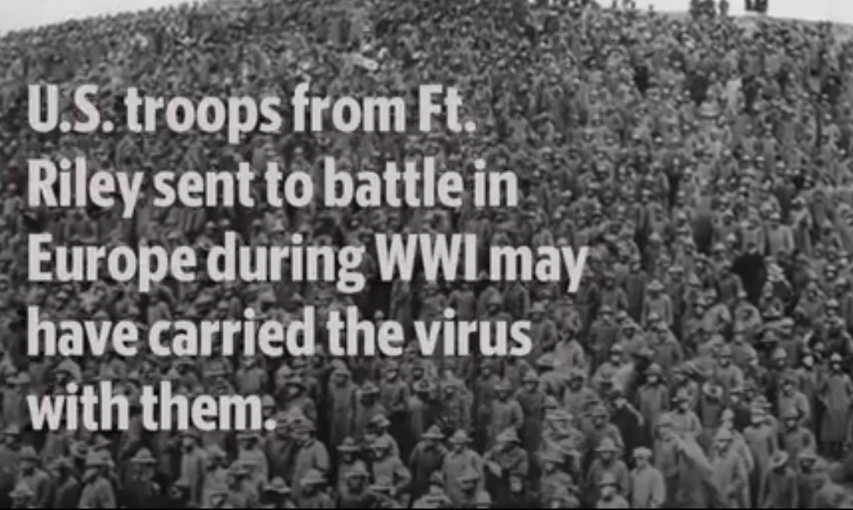

Slide 38
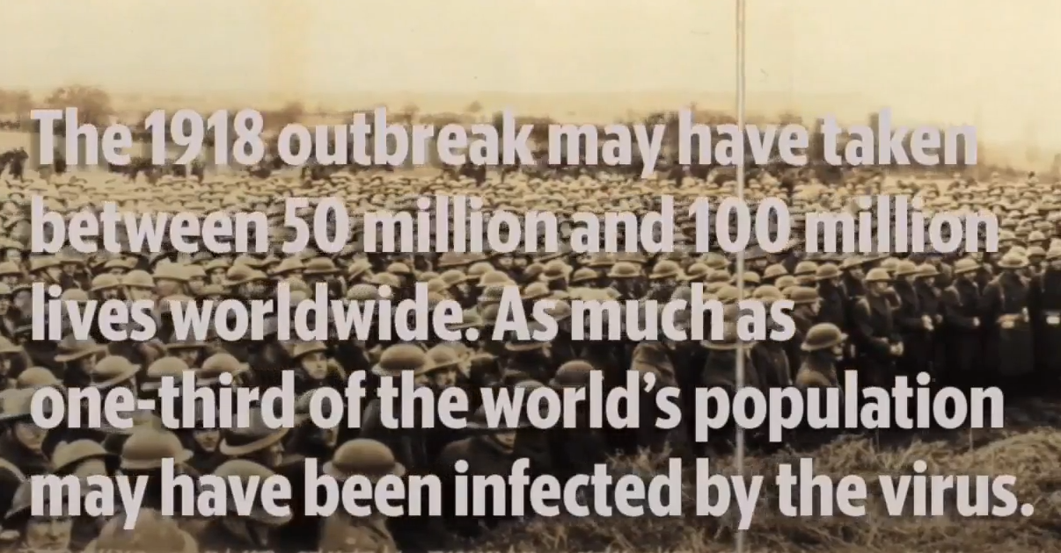

Slide 39
“A DRASTIC BAN IS ON,” shouted the bold headline of The Kansas City Star, on Oct. 17, 1918. So-called Spanish influenza had been ravaging the city since late September. Hundreds in town were sick and dying of “the purple death.”
Notes:
https://www.kansascity.com/news/business/health-care/article241058181.html

Slide 40
Over the next 27 weeks, the flu would kill an estimated 2,300 people in Kansas City, giving it a mortality rate greater than New York, Chicago, Cleveland, Detroit and even St. Louis, a city with more than 2.5 times Kansas City’s population at the time.
Notes:
https://www.kansascity.com/news/business/health-care/article241058181.html

Slide 41
The reason — standing perhaps as a cautionary tale in the face of the spread of the global coronavirus pandemic — is that Kansas City failed in spectacular fashion to responsibly deal with the contagion when it had the chance, experts say now.
Notes:
https://www.kansascity.com/news/business/health-care/article241058181.html

Slide 42
In the end, the town of some 250,000 people would emerge from the epidemic with a death rate of 718 people per 100,000 population — the 17th worst among 50 large American cities.
Notes:
https://www.kansascity.com/news/business/health-care/article241058181.html

Slide 43
The actual worst, Pittsburgh, would log a rate of 1,240 per 100,000. But Cleveland would have a rate of 590, New York at 582, St. Louis at 536 with Chicago, Cleveland and Detroit even lower.
Notes:
https://www.kansascity.com/news/business/health-care/article241058181.html

Slide 44
“Effective at once, to remain in effect indefinitely,” The Star’s story continued. Then came the list of closings: All theaters and motion picture shows. All schools. All churches. Public gatherings of 20 or more persons, including dances, parties, weddings, funerals.
Notes:
https://www.kansascity.com/news/business/health-care/article241058181.html

Slide 45
Crowding in stores was forbidden, restricted to no more than 25 persons. Music or amusements in hotels, bars and restaurants: forbidden. Streetcars could carry no more than 20 standing passengers.
Notes:
https://www.kansascity.com/news/business/health-care/article241058181.html

Slide 46
All elevators and streetcars would be sterilized daily; telephone booths would be sterilized twice a day; streets would be deluged in water.
Notes:
https://www.kansascity.com/news/business/health-care/article241058181.html

Slide 47
The exact source of the Spanish flu is unclear, but some have come to believe that it should have been called the Kansas flu. It’s thought to have taken root in early March 1918 among World War I soldiers at Camp Funston, part of Fort Riley in Geary and Riley counties.
Notes:
https://www.kansascity.com/news/business/health-care/article241058181.html

Slide 48
April, 2018 Hundreds of schoolchildren in Mexico, Missouri, near Columbia, had been flattened for days by a mysterious bug. Doctors suspected it was some form of flu, but speculated that recent rains had “ended the epidemic.”
Notes:
https://www.kansascity.com/news/business/health-care/article241058181.html

Slide 49
In the surrounding weeks, several thousand soldiers at Camp Funston would also be treated for a flu that killed 38 men.
Notes:
https://www.kansascity.com/news/business/health-care/article241058181.html

Slide 50
“Six to eight months later,” said John Barry, author of “The Great Influenza: The Epic Story of the Deadliest Plague in History,” “it exploded simultaneously on three continents: Europe, Africa and the United States.”
Notes:
https://www.kansascity.com/news/business/health-care/article241058181.html

Slide 51
“This influenza was violent. … This influenza killed,” Barry wrote.
No mere cold, the flu caused a swift and wrenching death, with a killing rate 25 times higher than milder forms. In hours, healthy individuals could go from having what seemed like a cough to developing pneumonia that engorged the lungs with fluid, then blood.
Notes:
https://www.kansascity.com/news/business/health-care/article241058181.html

Slide 52
Violent hacking contorted bodies as victims struggled to breathe. With lungs filled to uselessness, oxygen disappeared and victims quickly turned blue, the “purple death.” First the mahogany patches rose near the cheekbones and ears; then they spread across the face.
Notes:
https://www.kansascity.com/news/business/health-care/article241058181.html

Slide 53
People turned so dark near death, reported one Army physician in the day’s vernacular, “it became hard to distinguish the coloured men from the white.”
Notes:
https://www.kansascity.com/news/business/health-care/article241058181.html

Slide 54
Sept. 27, p.m.: “Grip Doubles Death Rate.”
Then the flu hit town, often afflicting healthy people — between 15 and 35 — first and hardest. The youngest and oldest came later.
Notes:
https://www.kansascity.com/news/business/health-care/article241058181.html

Slide 55
The first cases, the McKinseys note, were reported in the last week of September at the Sweeney Automobile and Tractor School, a private building at 24th Street and Baltimore Avenue, that had been converted for military use.
“Within a week 800 fell ill,” the McKinsey paper notes.
Notes:
https://www.kansascity.com/news/business/health-care/article241058181.html
Read Fighting with Pendergast

Slide 56
Fighting with Pendergast…
Star article
What does scripture say?

Slide 57
Isaiah 26.20, with it’s timely instruction:
“Come, my people, enter your rooms, & shut your doors behind you. Hide yourselves for a little while until the wrath is past.”

Slide 58
For this time I will send all my plagues on you yourself, and on your servants and your people, so that you may know that there is none like me in all the earth.
– Exodus 9:14

Slide 59
As long as they have the disease they remain unclean. They must live alone… – Leviticus 13:46

Slide 60
“A man’s spirit will sustain him in sickness (machalahoe), but who can support a broken spirit?” (Proverbs 18:14).
The Aramaic translation by Jonathan Ben Uziel translates the word machalahoe into coranei (which is Aramaic forCorona, or Crown).
Rashi, according to the blogger, said that the cure for this illness is as follows:
“Someone with a healthy attitude, that tries to lead a happy life and he does not allow worries to affect him, no power, including illness (such as corona) will be able to consume him.”
Notes:
https://www.israeltoday.co.il/read/analysis-corona-israel-and-the-world-apocalypse-now/

Slide 61
From Julia Roberts Instagram…
Notes:
https://www.kansascity.com/news/business/health-care/article241058181.html

Slide 62
Notes:
From Julia Roberts Instagram

Slide 63
Notes:
From Julia Roberts Instagram

Slide 64
Massive experession of support for health care workers.

Slide 65
The Iranian regime speaks of an official death toll of 1,046, but opposition sources say the number is at least 4 times higher.
Notes:
https://www.israeltoday.co.il/read/analysis-corona-israel-and-the-world-apocalypse-now/

Slide 66
Dr. Afruz Eslami, an Iranian physician who is also a journalist warns that at least 110,000 Iranians will die from the virus. He further cautioned that if the healthcare system in Iran collapses that number could rise to 3.5 million people.
Notes:
https://www.israeltoday.co.il/read/analysis-corona-israel-and-the-world-apocalypse-now/

Slide 67
Iran’s already battered economy will further collapse as a result of the Corona crisis and this is good news for Israel, which has been repeatedly threatened with annihilation by the fanatical regime in the Islamic Republic.
Notes:
https://www.israeltoday.co.il/read/analysis-corona-israel-and-the-world-apocalypse-now/

Slide 68
Iran won’t have the funds anymore to finance its drive to build-up a Shiite Crescent in the Middle East and to give support to terrorist groups that threaten Israel’s existence.
Notes:
https://www.israeltoday.co.il/read/analysis-corona-israel-and-the-world-apocalypse-now/

Slide 69
Shaunti Feldhahn reminds us that since we will be alone with each other lots, take the Kindness Challenge again.
Notes:
https://www.kansascity.com/news/business/health-care/article241058181.html

Slide 70
For 30 days, you will:
Say nothing negative about your person—either to them or about them to someone else. If you must provide negative feedback (for example, to discipline a child or correct a subordinate’s mistake), be constructive and encouraging without a negative tone.
Every day, find one thing that you can sincerely praise or affirm about your person and tell them—and tell someone else.
Every day, do one small act of kindness or generosity for them.

Slide 71
Across Africa and Asia, millions of people in historically unengaged people groups are now in rapidly growing Disciple Making Movements. In 2000 there were 6 such movements, today there are now 1,035!
Notes:
https://www.christianpost.com/voices/christianity-is-growing-faster-than-any-time-in-history-why-is-the-church-in-europe-america-declining.html

Slide 72
Many thousands of former Muslim clerics have left Islam to become fearless disciples of Yeshua. Growth in Africa and Asia is explosive. On average, between 2000 to 2020, (7,300 days):
Africa had 37,825 new Messiah Followers every day over the last 20 years
Latin America had 16,988
Asia had 13,443
North America had 1,999
Oceania had 473
Europe had 8
Notes:
https://www.christianpost.com/voices/christianity-is-growing-faster-than-any-time-in-history-why-is-the-church-in-europe-america-declining.html

Slide 73
What is it that the congregations of the Global South are doing that makes so much difference?
1. Abundant, and Bold Prayer
2. Discipling to Conversion
3. Obedience-Based Discipleship
4. Empowering Ordinary People for Ministry
Notes:
https://www.christianpost.com/voices/christianity-is-growing-faster-than-any-time-in-history-why-is-the-church-in-europe-america-declining.html

Slide 74
5. Make Replicating Disciples, not Converts
6. Never Ending Leadership Training for All
Notes:
https://www.christianpost.com/voices/christianity-is-growing-faster-than-any-time-in-history-why-is-the-church-in-europe-america-declining.html

Slide 75
Jonathan Cahn

Slide 76
^{Ps 43.5} My soul, why are you so downcast? Why are you groaning inside me? Hope in God, since I will praise him again for being my Savior and God.

Slide 77
הַלְלוּיָהּ כִּי מָלַךְ אֲדֹנָי אֱלֹהֵינוּ
Halleluyah ki malakh Adoni Elohinu
Halleluyah, for Adoni our G-d reigns!
הַלְלוּיָהּ כִּי מָלַךְ אֱלֹהֵי צְבָאוֹת
Halleluyah ki malakh Elohei Tsava’ot
Halleluyah, for Adoni of armies reigns!

Slide 78
נָגִילָה וְנִשְׂמְּחָה וְנִתַּן לוֹ כָּבוֹד
Nagila v’nis’mekha V’nitan lo kavod
נָגִילָה וְנִשְׂמְּחָה וְנִתַּן לוֹ כָּבוֹד
Nagila v’nis’mekha V’nitan lo kavod
[Come and rejoice and give Him glory]

