Slide 1
e-handout
To have these notes
without taking notes
Go to OrHaOlam.com
Click on downloads,
messages, 2020

Slide 2
Introducing….
The Bat coin!

Slide 3
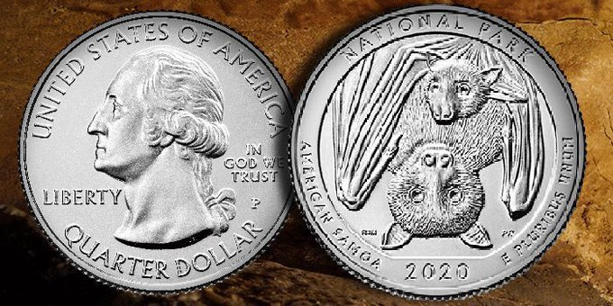
Notes:
https://www.huffpost.com/entry/fruit-bat-quarter-american-samoa-coin_l_5e160afcc5b66361cb5e5788

Slide 4
As part of its America the Beautiful Quarters Program that launched in 2010, the U.S. Mint releases five new quarter designs per year, each depicting national parks and sites.

Slide 5
The 2020 set is scheduled for release on Feb. 3 and will include the National Park of American Samoa quarter, which features a Samoan fruit bat hanging from a tree and holding her pup.

Slide 6
Notes:
https://www.huffpost.com/entry/fruit-bat-quarter-american-samoa-coin_l_5e160afcc5b66361cb5e5788

Slide 7
Samoan fruit bat. Also known as “flying foxes,” these bats are big guys, with wings that span up to 3 feet, and are active day and night. They can only be found in the Samoan Islands and Fiji.
Notes:
https://www.cincinnati.com/story/news/2020/01/10/u-s-mint-samoan-fruit-bat-new-quarter-2020/4430593002/

Slide 8
The current COVID-19 crisis was possibly born out of people who worked and shopped at a “wet market” in Wuhan, China. A wet market sells live and dead animals —including fish, birds, badgers, bats, pangolins (scaly anteaters), and turtles — for human consumption.
Notes:
https://thehill.com/opinion/international/490528-china-must-close-down-wet-markets-now

Slide 9
Water splashes over the sides of open tubs filled with live sea animals that will inevitably be killed; countertops and floors are streaked red with the insides of gutted fish and the blood of slaughtered animals.
Bat quarter, coming to your pocket soon!
Notes:
https://thehill.com/opinion/international/490528-china-must-close-down-wet-markets-now

Slide 10
How do we live with this?
How do we do Passover
with this?

Slide 11
A lesson in religious presumption…
Israel is the top place in the world for coronavirus health safety, according to the think tank of a Hong Kong-based venture capital fund.
Notes:
Judith Kaufman
https://worldisraelnews.com/israel-ranked-first-for-corona-safety-by-hong-kong-think-tank-that-caught-netanyahus-eye/?utm_source=MadMimi&utm_medium=email&utm_content=Israel%27s+Top+Leaders+in+Quarantine%3B+Bnei+Brak+Declared+%E2%80%98Restricted+Zone%E2%80%99%2C+Thousands+Evacuated%3B+Arabs+Riot+in+Jaffa%3B+Biden+Urges+Trump+to+Ease+Iran+Sanctions&utm_campaign=20200403_m157711985_Israel%27s+Top+Leaders+in+Quarantine%3B+Bnei+Brak+Declared+%E2%80%98Restricted+Zone%E2%80%99%2C+Thousands+Evacuated%3B+Arabs+Riot+in+Jaffa%3B+Biden+Urges+Trump+to+Ease+Iran+Sanctions&utm_term=_0D_0A_09_09_09_09_09_09_09_09_09_09Read+Now_0D_0A_09_09_09_09_09_09_09_09_09

Slide 12
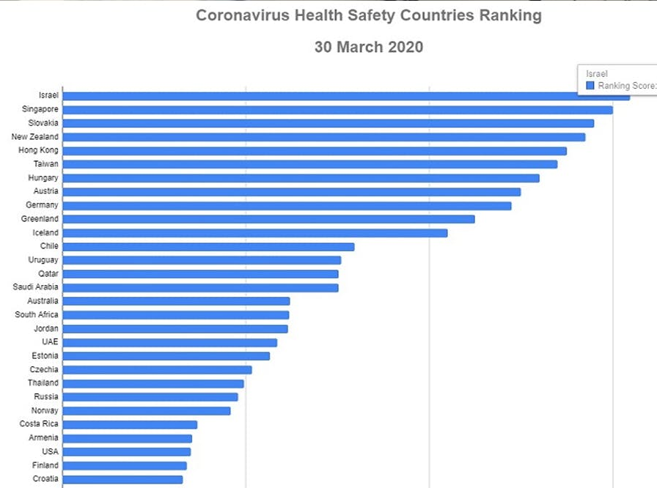
Notes:
https://vfinews.com/en/news/april-3-2020/israel-rated-the-highest-in-coronavirus-safety?subscribed=true&mc_cid=f54ee11144&mc_eid=[UNIQID]

Slide 13
The study by Deep Knowledge Ventures (DKV) looked at 200 data points for fifty countries to compare not just the infections, but what they said is a deep analysis including transparency,
Notes:
https://worldisraelnews.com/israel-ranked-first-for-corona-safety-by-hong-kong-think-tank-that-caught-netanyahus-eye/?utm_source=MadMimi&utm_medium=email&utm_content=Israel%27s+Top+Leaders+in+Quarantine%3B+Bnei+Brak+Declared+%E2%80%98Restricted+Zone%E2%80%99%2C+Thousands+Evacuated%3B+Arabs+Riot+in+Jaffa%3B+Biden+Urges+Trump+to+Ease+Iran+Sanctions&utm_campaign=20200403_m157711985_Israel%27s+Top+Leaders+in+Quarantine%3B+Bnei+Brak+Declared+%E2%80%98Restricted+Zone%E2%80%99%2C+Thousands+Evacuated%3B+Arabs+Riot+in+Jaffa%3B+Biden+Urges+Trump+to+Ease+Iran+Sanctions&utm_term=_0D_0A_09_09_09_09_09_09_09_09_09_09Read+Now_0D_0A_09_09_09_09_09_09_09_09_09

Slide 14
the state of the healthcare system, medical profession and hospitals, the mobilization of the military and the resilience and discipline of the population.
Notes:
https://worldisraelnews.com/israel-ranked-first-for-corona-safety-by-hong-kong-think-tank-that-caught-netanyahus-eye/?utm_source=MadMimi&utm_medium=email&utm_content=Israel%27s+Top+Leaders+in+Quarantine%3B+Bnei+Brak+Declared+%E2%80%98Restricted+Zone%E2%80%99%2C+Thousands+Evacuated%3B+Arabs+Riot+in+Jaffa%3B+Biden+Urges+Trump+to+Ease+Iran+Sanctions&utm_campaign=20200403_m157711985_Israel%27s+Top+Leaders+in+Quarantine%3B+Bnei+Brak+Declared+%E2%80%98Restricted+Zone%E2%80%99%2C+Thousands+Evacuated%3B+Arabs+Riot+in+Jaffa%3B+Biden+Urges+Trump+to+Ease+Iran+Sanctions&utm_term=_0D_0A_09_09_09_09_09_09_09_09_09_09Read+Now_0D_0A_09_09_09_09_09_09_09_09_09

Slide 15
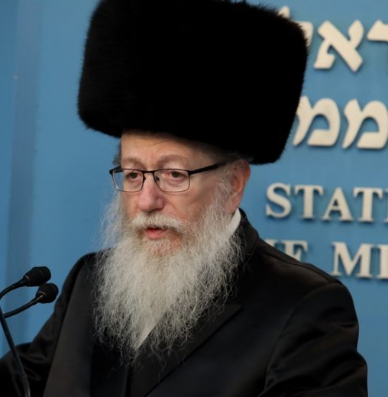
Israeli Health Minister Yaakov Litzman

Slide 16
Israel’s Minister of Health, Mar. 31, 2020, said,
“I am sure that the Messiah will come by Passover and save us the same way God saved us during the Exodus and we were freed. The Moshiach will come and save us all.”
Notes:
Keep that date in mind.
https://www.israeltoday.co.il/read/messiah-will-come-by-passover-says-israel-health-minister/

Slide 17
4/03/2020
Notes:
Combination of Israeli confidence and religious fervor?
http://thejewishvoice.com/2020/04/netanyahu-senior-officials-quarantined-after-israels-health-minister-tests-positive-for-coronavirus/

Slide 18
Israeli Prime Minister Benjamin Netanyahu,
Mossad chief Yossi Cohen,
National Security head Meir Ben-Shabbat,
Health Ministry director Moshe Bar Siman-Tov,
head of Hadassah-University Medical Center professor Zev Rotstein
Notes:
http://thejewishvoice.com/2020/04/netanyahu-senior-officials-quarantined-after-israels-health-minister-tests-positive-for-coronavirus/

Slide 19
all entered self-quarantine on Thursday, after Israeli Health Minister Yaakov Litzman tested positive for coronavirus.
Litzman, 71, whose wife Chava also tested positive for coronavirus, was reported to be in good condition.
Notes:
http://thejewishvoice.com/2020/04/netanyahu-senior-officials-quarantined-after-israels-health-minister-tests-positive-for-coronavirus/

Slide 20
None of the other leaders were yet reporting symptoms, and many were set to be quarantined in their offices so they could continue their work on behalf of the country
Notes:
http://thejewishvoice.com/2020/04/netanyahu-senior-officials-quarantined-after-israels-health-minister-tests-positive-for-coronavirus/

Slide 21
Perspective: the Big Picture

Slide 22
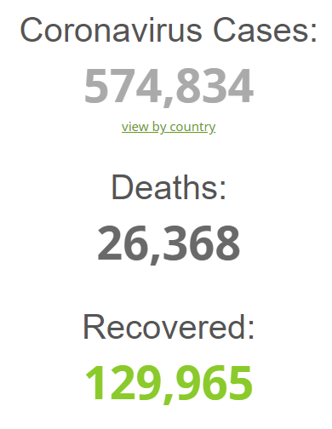
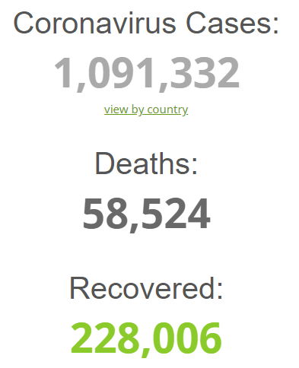
Friday, April 4, 2020 4 p.m.
Friday, Mar. 27
2020 noon
Notes:
Nearly doubled in a week!
https://www.worldometers.info/coronavirus/

Slide 23
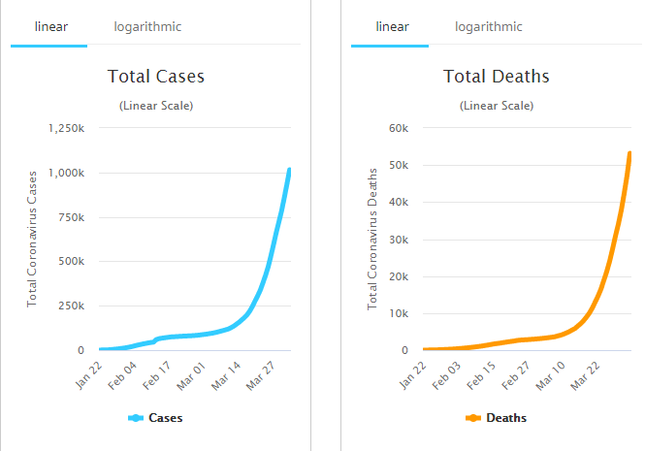
Friday, April 4, 2020 4 p.m.
Notes:
https://www.worldometers.info/coronavirus/

Slide 24
Johnson County…
Sun., Mar. 29 108 cases 2 deaths.
Mon., Mar. 30 116 cases 2 deaths.
Tues., Mar. 31 127 cases 3 deaths.
Wed., Apr. 1 144 cases 3 deaths.
Thurs.,Apr. 2 159 cases 4 deaths.
Friday, Apr. 3 172 cases 7 deaths.
Notes:
Currently, to most if not all of us here, this worldwide plague is a bit of a phantasm, a scary issue far away and almost a bad dream. We have zero congregants or extended families of congregants who are infected. I have zero siblings, cousins, etc., afflicted.
But, what about when it gets to our doors. What about when a loved one dies?
In Ecuador, health system so overrun that dead bodies are accumulating in the street.
Johnson County Government communications@jocogov.org

Slide 25
Chaos in Ecuador:
The body was wrapped in a plastic tarp, swollen, already attracting flies. He had been a neighbor, a man Rosangelys Valdiviezo passed while walking home from work.
Notes:
https://www.washingtonpost.com/world/the_americas/coronavirus-guayaquil-ecuador-bodies-corpses-streets/2020/04/03/79c786c8-7522-11ea-ad9b-254ec99993bc_story.html

Slide 26
Now he lay in front of his home, one of an untold number of bodies cast out in the streets of Guayaquil, Ecuador, a sweltering South American city ­being ravaged by the novel coronavirus. The body had been out in the tropical heat for six days.
Notes:
https://www.washingtonpost.com/world/the_americas/coronavirus-guayaquil-ecuador-bodies-corpses-streets/2020/04/03/79c786c8-7522-11ea-ad9b-254ec99993bc_story.html

Slide 27
How do we live with this?
How do we do Passover
with this?

Slide 28
Concerning the very first Passover in Egypt, G-d said,
^{Ex 12.22-23} None of you is to go out the door of his house until morning. For Adoni will pass through to kill the Egyptians; but when he sees the blood on the top and on the two sides,
Notes:
[Dawn pointed this out to me.]

Slide 29
^{Ex 12.22-23} Adoni will pass over the door and will not allow the angel of death to enter your houses and kill you.
Notes:
[Dawn pointed this out to me.]

Slide 30
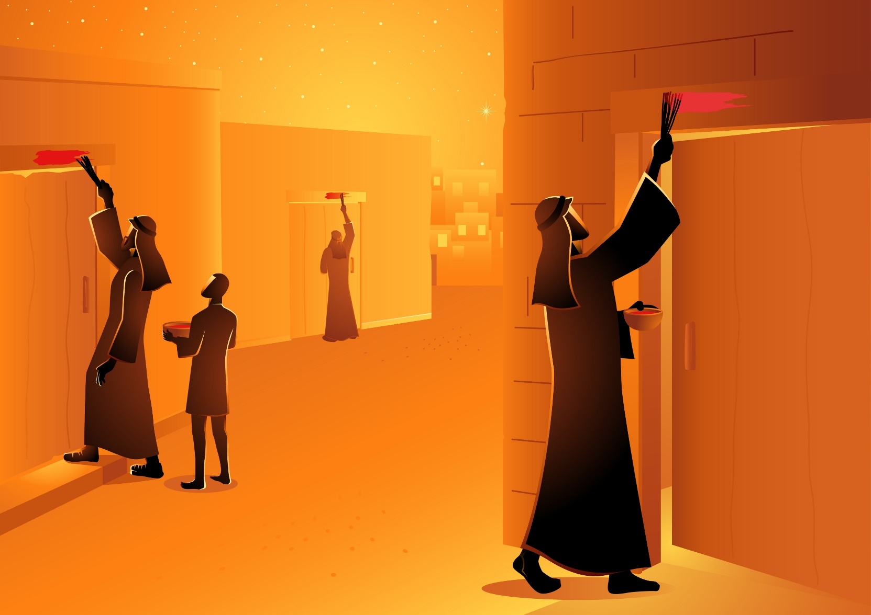

Slide 31
So, there is sort of an angel of death stalking the land, and the advice to stay in our homes seems to be in force again. Actually, even in Israel:

Slide 32
Israel’s govt has forbidden anyone from having a Seder with people from another home. Friends and family members isolating elsewhere must connect online only.

Slide 33
Notes:
https://worldisraelnews.com/watch-israeli-police-promise-passover-patrols-to-prevent-family-get-togethers/?utm_source=MadMimi&utm_medium=email&utm_content=%27Bnei+Brak+Like+Italy%27%3A+Israeli+Health+Minister+Calls+for+Full+Lockdown%3B+Quarantine+Lapse+at+Ben-Gurion+Airport%3B+Israel+Promises+Passover+Patrols&utm_campaign=20200401_m157676914_%27Bnei+Brak+Like+Italy%27%3A+Israeli+Health+Minister+Calls+for+Full+Lockdown%3B+Quarantine+Lapse+at+Ben-Gurion+Airport%3B+Israel+Promises+Passover+Patrols&utm_term=F200401TN15-600x315_jpg

Slide 34
Notes:
https://worldisraelnews.com/watch-israeli-police-promise-passover-patrols-to-prevent-family-get-togethers/?utm_source=MadMimi&utm_medium=email&utm_content=%27Bnei+Brak+Like+Italy%27%3A+Israeli+Health+Minister+Calls+for+Full+Lockdown%3B+Quarantine+Lapse+at+Ben-Gurion+Airport%3B+Israel+Promises+Passover+Patrols&utm_campaign=20200401_m157676914_%27Bnei+Brak+Like+Italy%27%3A+Israeli+Health+Minister+Calls+for+Full+Lockdown%3B+Quarantine+Lapse+at+Ben-Gurion+Airport%3B+Israel+Promises+Passover+Patrols&utm_term=F200401TN15-600x315_jpg

Slide 35
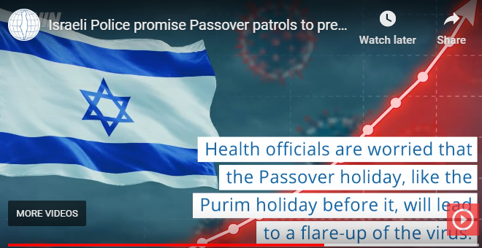
Notes:
https://worldisraelnews.com/watch-israeli-police-promise-passover-patrols-to-prevent-family-get-togethers/?utm_source=MadMimi&utm_medium=email&utm_content=%27Bnei+Brak+Like+Italy%27%3A+Israeli+Health+Minister+Calls+for+Full+Lockdown%3B+Quarantine+Lapse+at+Ben-Gurion+Airport%3B+Israel+Promises+Passover+Patrols&utm_campaign=20200401_m157676914_%27Bnei+Brak+Like+Italy%27%3A+Israeli+Health+Minister+Calls+for+Full+Lockdown%3B+Quarantine+Lapse+at+Ben-Gurion+Airport%3B+Israel+Promises+Passover+Patrols&utm_term=F200401TN15-600x315_jpg

Slide 37
So we will do Seders at home.
On the OrHaOlam.com website
https://orhaolam.com/index.php/education/jewish-life-cycle
There is a 30 minute Haggadah [booklet] and a YouTube class from that Haggadah
Thursday, April 9, 6.30 p.m. join me for a Zoom Seder. p/w coming with invitation. Zoombombing.

Slide 38
A practical note…
Notes:
Leaven, leavened food, confusing. Need the Hebrew…

Slide 39
^{Shmot/Ex 12.15} For seven days you are to eat matzah — on the first day remove the leaven [s’or] from your houses. For whoever eats hametz from the first to the seventh day is to be cut off from Isra’el.
שִׁבְעַת יָמִים, מַצּוֹת תֹּאכֵלוּ-אַךְ בַּיּוֹם הָרִאשׁוֹן, תַּשְׁבִּיתוּ שְּׂאֹר מִבָּתֵּיכֶם: כִּי כָּל-אֹכֵל חָמֵץ, וְנִכְרְתָה הַנֶּפֶשׁ הַהִוא מִיִּשְׂרָאֵל--מִיּוֹם הָרִאשֹׁן, עַד-יוֹם הַשְּׁבִעִי.

Slide 40
Passover cleansing particulars…
Notes:
Leaven, leavened food, confusing. Need the Hebrew…

Slide 41
חָמֵץ leavened food khametz
שְׂאֹר s’or
Khametz is a product that is both made from one of five types of grain and has been combined with water and left to stand raw for longer than eighteen minutes and becomes leavened.
Notes:
Khametz is the more commonly known word. Essentially, they are synonyms. In previous years, I had taught that s’or was yeast or the leavening agent. Correction!
https://en.wikipedia.org/wiki/Chametz

Slide 42
חִטָּה Wheat Ḥitta,
כֻּסְמִין Spelt Kusmin,
שְׂעוֹרָה barley Se’orah,
שִׁבֹּלֶת שׁוּעָל oats Shibbolet shual,
שִׁיפוֹן rye shifon
Notes:
https://en.wikipedia.org/wiki/Chametz
fox = שׁוּעָל

Slide 43
Leavening agents, such as yeast or baking soda, are not themselves khametz. Rather, it is the fermented grains. Thus yeast may be used in making wine, and kefir.
Notes:
https://en.wikipedia.org/wiki/Chametz
Also Kefir

Slide 44
Similarly, baking soda may be used in Passover baked goods made with matzoh meal and in matzoh balls. Since the matzoh meal used in those foods is already baked, the grain will not ferment.
Notes:
https://en.wikipedia.org/wiki/Chametz
Also Kefir

Slide 45
So if you want to have a Pesakik home: no khametz: leavened grain products.
No: Bread, crackers [except matzah], pasta, cakes, cookies.

Slide 46
What about rice, corn, lentils, beans, and peanuts?
They don’t leaven, but may appear to. So, Ashkenazic Jews forbid, called kitnayot.
Sephardic Jewish communities they are OK.
Or HaOlam follows the Sephardi.
Notes:
https://www.thoughtco.com/passover-forbidden-foods-2076548
Sephardi more Biblical, less add ons. Great music too.

Slide 47
Torah's description of Matza as "Lekhem Oni" – לחם עוני
the bread of affliction, poverty.
Alternatively, it could mean the bread over which a person answers.
Notes:
https://www.ulpanor.com/category/newletter/
But personally, I like matzah, the bread of affliction.

Slide 48
So it’s a practice in observant Jewish homes to do a THOROUGH Spring cleaning! Get ALL the khametz out of every corner.
Burn the crumbs
And then a prayer of covering.
Notes:
This practice and similar is what spared our people during past plagues, particularly the 1348 Black Plague that decimated Europe. Of course, then the Jews were blamed, as we are now!

Slide 49
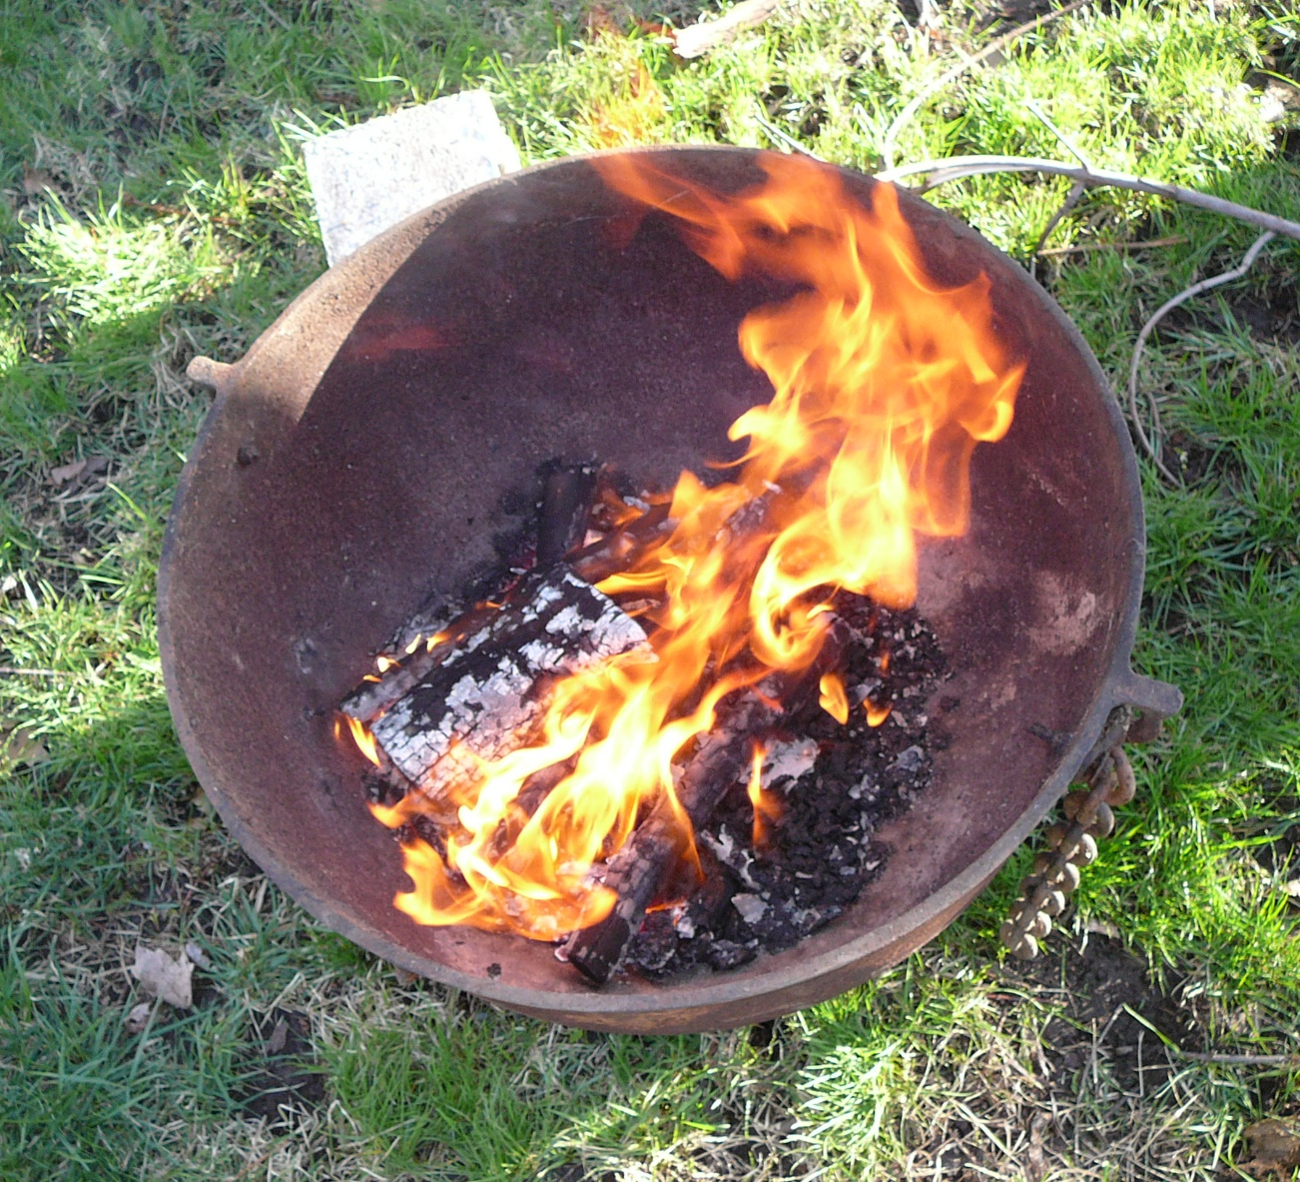
Khametz burn barrel

Slide 50
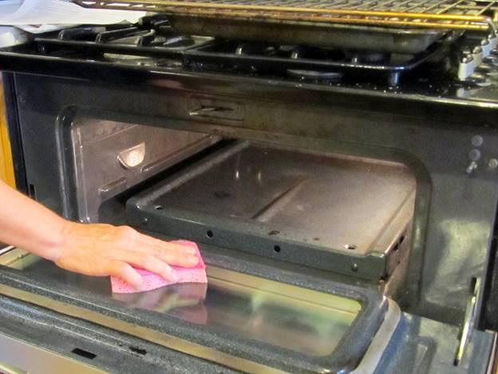

Slide 51
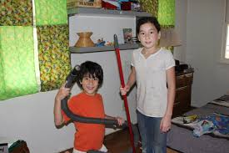

Slide 52
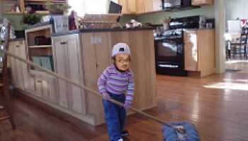
Notes:
https://www.google.com/search?q=chametz+burning&safe=active&tbm=isch&tbs=rimg:CXGR7-dDLk5BIjg1IMGltlriQnD5c6B2s6UdbVpRCvMgvCD5eE9MM8tiLT6XdlbuvnKoOO-5WSZnkZtz2ub3eWX4TyoSCTUgwaW2WuJCEWAR8_1Sg2G0sKhIJcPlzoHazpR0RiWrzQiq97U8qEgltWlEK8yC8IBEIpVnCqYqZzSoSCfl4T0wzy2ItET70tzS7UCuxKhIJPpd2Vu6-cqgRoFDs8WYCBXEqEgk477lZJmeRmxGgUOzxZgIFcSoSCXPa5vd5ZfhPEaBQ7PFmAgVx&tbo=u&sa=X&ved=2ahUKEwjFwo7F3YPaAhWKqlMKHVlIAzMQ9C96BAgAEBs&biw=1282&bih=884&dpr=1#imgrc=yXlZZUKJdFanwM:
A new Israeli military version, getting out the impurities, corruptions..

Slide 53
Notes:
From Checho Rojas’ Facebook.
After we’ve cleaned all, we burn the leftovers.

Slide 54
How do we live with this?
How do we do Passover
with this?

Slide 55
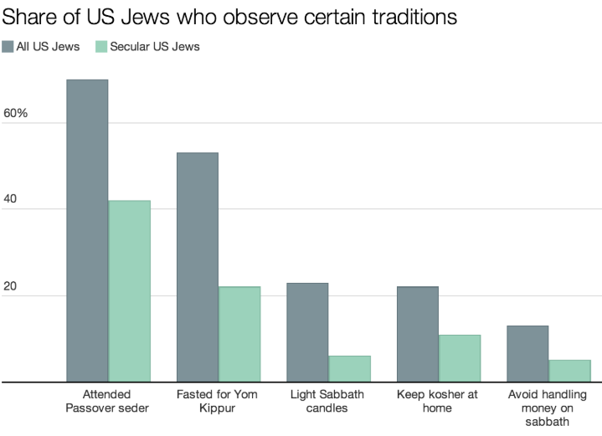
93% of Israeli Jews attend a Pesakh seder
Notes:
Why is it soooooo important?
I know a Russian lady my age, grew up in militantly atheistic communism. Knew nothing of her Jewish identity, except every Spring her dad would buy “holiday crackers.” Unexplained.
Didn’t know Jewish till passport for college admission. [ignore underlining]
https://www.vox.com/2014/4/14/5613562/why-passover-is-such-a-big-deal-for-american-jews-in-one-chart

Slide 56
What did HaMashiakh Yeshua think and feel about Seder Pesakh?
^{Luke 22.14-15} When the time came, Yeshua and the emissaries reclined at the table, and he said to them, “I have really wanted so much to celebrate this Seder with you before I die!”

Slide 57
epithumia: desire, eagerness for, inordinate desire, lust.
Epithumeó: long for, covet, lust after, set the heart upon

Slide 58
“really wanted so much to celebrate”
Five degrees of emphasis
wanted
really wanted
really wanted much
really wanted so much
really wanted so much to celebrate

Slide 59
What was the big deal?
This Seder
With you.
Before I suffer
With you:
^{Nekhemyah 8.10} The joy of ADONI is your strength
^{T’hilim/Ps 43.4} Then I will go to the altar of G-d , to G-d, my joy and delight;
אֶל-אֵל, שִׂמְחַת גִּילִי:
Notes:
Answer: Community. Family. Relationships

Slide 60
We were designed to live centered in joy.
Birth through age three: we learn that joy is the normal emotional state. [?]
The “joy center” exists in the right orbital pre-frontal cortex of the brain.

Slide 63
“Joy means someone is delighted to be with me, and I like it!”
Yeshua understood the communication of JOY “WITH YOU”
Joy means Someone is delighted to be with me, and I like it!”
Notes:
Passover is the pre-eminent family time. My parents would fly me home from Cincinnati for our Seder.

Slide 64
Cycle of Joy
Joy
Level
6 Complete Cycles Per Second
Notes:
Best illustrated not with goofy blue faces but with a small child.

Slide 65
“this Seder with you”
Yeshua’s sense of a Seder:
^{1 Cor. 5.7-8} Get rid of the old hametz, so that you can be a new batch of dough, because in reality you are unleavened. For our Pesakh lamb, the Messiah, has been sacrificed. So let us celebrate the Seder not with leftover hametz, the hametz of wickedness and evil, but with the matzah of purity and truth.

Slide 66
Get rid of the old hametz, of wickedness and evil
You can be a new batch, of purity and truth.
For our Pesakh lamb, the Messiah, has been sacrificed
So let us celebrate
Notes:
Are there any divisions in your families, among us??
Find the point where you can humble yourself, with ONLY I statements. I was wrong in ….
NO you statements.
EXCEPT very tentatively, with grief. I could be mistaken but it seems [very specific]

Slide 67
^{1 Thes 5.16-18} Always be joyful. Pray regularly. In everything give thanks, for this is what God wants from you who are united with the Messiah Yeshua
^{Gal 5.20} the fruit of the Spirit is love, joy

Slide 68
Before I suffer
Makes this joy of fellowship possible with My sacrifice.
^{MJ 12.2} Yeshua — who, in exchange for obtaining the joy set before him, endured execution on a stake as a criminal, scorning the shame, and has sat down at the right hand of the throne of God.

Slide 69
So, consider those you can serve: family, friends, congregants, neighbors, strangers. Look left and right, and smile and humble yourself and bless!
Notes:
You don’t know…

Slide 70
How do we live with this?
How do we do Passover
with this?

Slide 71
Micheal Brown: the biggest question for us is this: What does God want to accomplish through this crisis?
It's just like the man born blind. Yeshua didn't see his blindness as the direct result of personal sin, even though in the Bible, sin and sickness are often connected.
Notes:
https://www.charismanews.com/opinion/in-the-line-of-fire/80603-getting-god-s-perspective-on-the-current-crisis?utm_source=In%20the%20Line%20of%20Fire&utm_medium=email&utm_content=subscriber_id:5194514&utm_campaign=Blogger%20-%20Michael%20Brown%20-%202020-04-03

Slide 72
^{Micheal Brown:} And Yeshua never explained directly why the man was born blind. He only stated that this was a divine opportunity. The blindness was an opportunity for healing.
Notes:
https://www.charismanews.com/opinion/in-the-line-of-fire/80603-getting-god-s-perspective-on-the-current-crisis?utm_source=In%20the%20Line%20of%20Fire&utm_medium=email&utm_content=subscriber_id:5194514&utm_campaign=Blogger%20-%20Michael%20Brown%20-%202020-04-03

Slide 73
David Wilkerson in 1986
"I see a plague coming on the world, and the bars, churches and government will shut down. The plague will hit New York City and shake it like it has never been shaken. The plague is going to force prayerless believers into radical prayer and into their Bibles

Slide 74
and repentance will be the cry from the man of God in the pulpit. And out of it will come a third Great Awakening that will sweep America and the world." -David Wilkerson in 1986

Slide 75
Avner Boskey: Messiah Yeshua spoke of the Last Days, the birth pangs prior to His return. These Last Days will be marked by unusual events including plagues:
^{Lk 21:11} “And there will be great earthquakes, and in various places plagues and famines. And there will be terrors and great signs from heaven”.
Notes:
https://davidstent.org/passover-plagues-and-the-god-of-the-hebrews/

Slide 76
The point here is not to be blown away by such occurrences, but to stay on track while looking forward to the amazing return of Messiah. “And there shall be . . . distress of nations upon the earth, with perplexity, . . .
Notes:
https://davidstent.org/passover-plagues-and-the-god-of-the-hebrews/

Slide 77
^{Lk 21:25-28} men’s hearts failing them for fear, and for looking after those things which are coming on the earth. For the powers of heaven shall be shaken . . . And when these things begin to come to pass, then look up, and lift up your heads, for your redemption draws near”
Notes:
https://davidstent.org/passover-plagues-and-the-god-of-the-hebrews/

Slide 78
Joel Rosenberg: Corona virus wake up call
Notes:
https://worldisraelnews.com/watch-nearly-3-in-10-americans-say-coronavirus-is-wake-up-call-from-god-and-sign-of-biblical-last-days/?utm_source=MadMimi&utm_medium=email&utm_content=Netanyahu+Back+in+Quarantine%3B+Bnei+Brak+Finally+Fears+Virus%3B+Israeli+Health+Minister+Tests+Positive%3B+China+Blasts+Trump%3B+Corona+Fueling+Anti-Semitism&utm_campaign=20200402_m157693566_Netanyahu+Back+in+Quarantine%3B+Bnei+Brak+Finally+Fears+Virus%3B+Israeli+Health+Minister+Tests+Positive%3B+China+Blasts+Trump%3B+Corona+Fueling+Anti-Semitism&utm_term=shutterstock_1023661171-600x315_jpg

Slide 79
I know it sounds like an April Fools' headline. But it is not. On Mar. 30, MSNBC host Craig Melvin asked Rev. T. D. Jakes to pray for America in the midst of the coronavirus scare. Melvin even bowed his head as Jakes prayed. This is a sign of the times. Americans are turning to God.
Notes:
https://charismamail.com/ga/webviews/4-5194514-58-34149-35436-83825-ba1db0f9f6

Slide 80
Jakes responded immediately with this prayer: "Our Father and our God, we bow our heads to You in humility, understanding that we are not competent in and of ourselves to handle this kind of global calamity. We look to You, Lord, to be the source, the strength, the help, the light that we need.
Notes:
https://charismamail.com/ga/webviews/4-5194514-58-34149-35436-83825-ba1db0f9f6

Slide 81
Notes:
https://charismamail.com/ga/webviews/4-5194514-58-34149-35436-83825-ba1db0f9f6

Slide 82
Strengthen our first responders, strengthen even our broadcast people, strengthen all of us whose lives have been devastated and disrupted, and give us the peace that passes all understanding. In Messiah’s name we pray, amen."
Yes, this happened live on MSNBC

Slide 83
Get a schedule. Out of PJs
Get moving: exercise. Endorphins
Stay connected.
Don’t obsess about the news.
Music and dance.
Start something new.
Notes:
https://unitedwithisrael.org/watch-top-5-ways-to-stay-positive-and-productive-during-crisis/?utm_source=MadMimi&utm_medium=email&utm_content=Israel%27s+Corona+Vaccine+Testing+on+the+Way%27%3B+Google+and+Apple+MUST+Ban+App+Spreading+Anti-Semitic+Corona+Conspiracies%3B+Stop+Blaming+Others+for+Corona%21&utm_campaign=20200403_m157709882_Israel%27s+Corona+Vaccine+Testing+on+the+Way%27%3B+Google+and+Apple+MUST+Ban+App+Spreading+Anti-Semitic+Corona+Conspiracies%3B+Stop+Blaming+Others+for+Corona%21&utm_term=shutterstock_1276178860-209x139_jpg

Slide 84
The Palestinian Media Watch (PMW) has noted that "instead of the monies that the PA is spending on compensation for terrorists during Mar. 2020, it could have purchased 387,143 coronavirus test kits, or 465 ventilators."
Notes:
https://vfinews.com/en/news/april-3-2020/ongoing-pa-incitement?subscribed=true&mc_cid=f54ee11144&mc_eid=[UNIQID]

Slide 85
Michael W. Smith encouragment
Notes:
Till 3.42

Slide 86
An unexpected hazard!

Slide 87
CARES Act “Coronavirus Aid, Relief, and Economic Security Act” Great act of compassion, but…
The relief package of 2 trillion dollars is ENTIRELY money that the US does NOT have. Further debt.

Slide 88
Your personal $1200 grant will come unsolicited. Fine.
But Or HaOlam has the opportunity to borrow, maybe forgivable, but…

Slide 89
From https://www.usdebtclock.org/
The government is offering Or HaOlam money it doesn’t have, and the U.S. Government must further borrow.

Slide 90
^{Ro 13.8} Owe to no man anything.
^{Proverbs 22:7} וְעֶבֶד לֹוֶה, לְאִישׁ מַלְוֶה.
The borrower is a slave to the lender.

Slide 91
Further, the Chinese have been the great creditor nation with assets to buy our debts. This may be the greatest loss of this COVID-19 virus, that the Chinese will further own us!

Slide 92
So, Or HaOlam will avoid this blood money and debt. No CARES loan.
Rely on G-d, and our faithful, tithing people.
Dave Ramsey gave a great talk on this, that you can still hear on https://www.daveramsey.com/

Slide 93
Rely on G-d, and yourself. There are jobs that are continuing and safe.
Rely on Yeshua!
Setting up a phone tree for our congregants.

Slide 94
A new idea
Notes:
Lori Wilson revelation

Slide 95
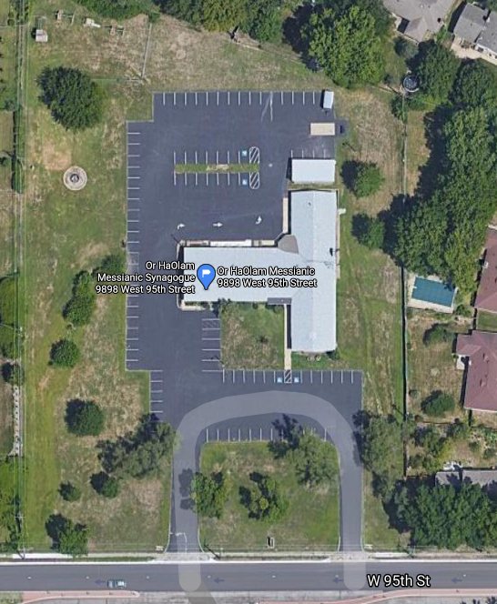
Notes:
Google maps of our synagogue. Anything surprising? Janette’s trailer.

Slide 96
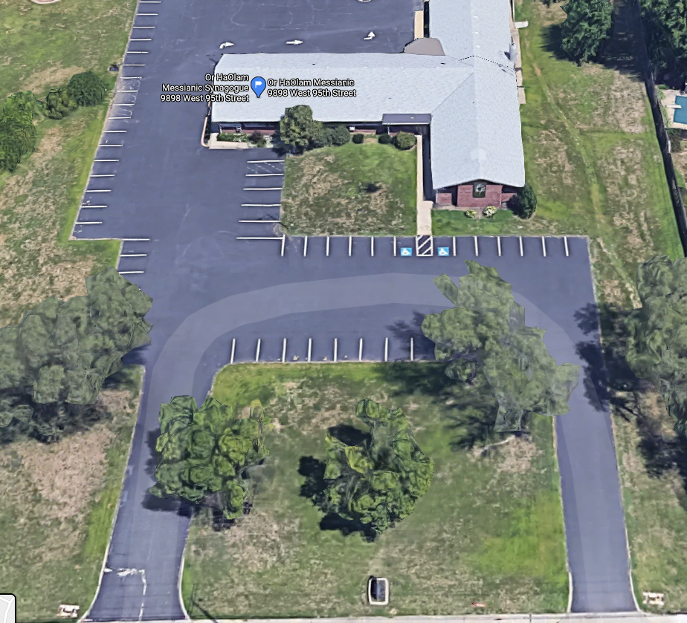
Tentative: Drive in prayer!
Car here
Sign here with removable
“Prayer partner is in.”
Notes:
Table next to car for social distancing.
From the website of Curé of Ars Catholic Church, 9401 Mission Road, Leawood:
Drive up confessions will be available on Saturdays from 2:30 -3:30 pm. Father will be in a marked car with a table next to his car to insure a 6-foot distance is maintained. You will be able to pull up to the marked spot on the far side of the table.

Slide 97
As yet tentative.
If you would like to be part of a two person
“Prayer Partner” team, email admin@orhaolam.com

Slide 98
Above all,
Trust Yeshua,
Seek Him
Ask Him to examine your heart
Repent of any wrongdoing

Slide 99
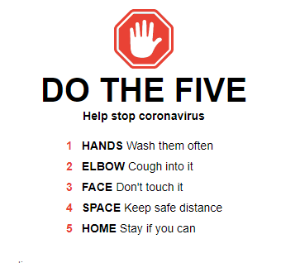
Notes:
https://www.google.com/search?q=coronavirus+tips&fbx=dothefive

Slide 100
MIQEDEM - PS 23 - Quarantine Version

