Slide 1
e-handout
To have these notes
without taking notes
Go to OrHaOlam.com
Click on downloads,
messages, 2020

Slide 2
Notes:
Strange title.
Father’s Day investment mandate!

Slide 3
There are many who are foretelling impending doom and disaster

Slide 4
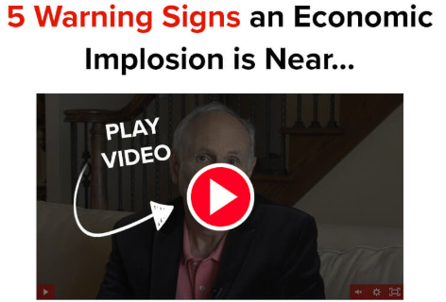
Notes:
I don’t have the link because I’m not endorsing any of these, just making a wake up call.

Slide 5
Martin Weiss
Notes:
Martin Weiss

Slide 7
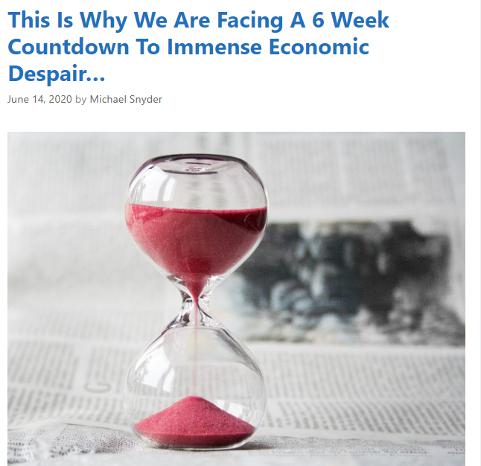

Slide 8
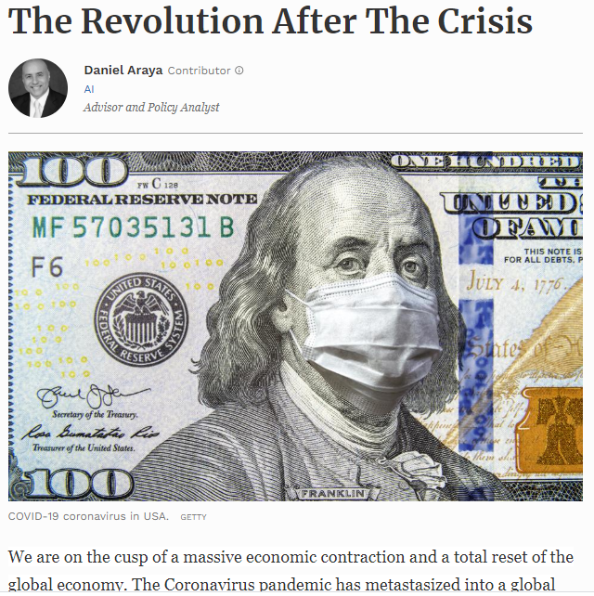
crisis that experts predict will very likely kill millions and unleash a worldwide economic depression
Notes:
https://www.forbes.com/sites/danielaraya/2020/03/31/the-revolution-after-the-crisis/#5caf7f0a101e

Slide 9
Generally, they are selling an investment plan, strategy, book, or product.
Should we panic? I don’t think so.
Will they work?
I don’t guarantee any.
But there is a scriptural investment mandate keyed to fatherhood:

Slide 11
^{2 Cor.12.14-15} Children are not supposed to save up for their parents, but parents for their children. And as for me, I will most gladly spend everything I have and be spent myself too for your sakes. If I love you more, am I to be loved less?
Notes:
Pray

Slide 12
A father is the prototype giver, builder, lover.

Slide 13
We are expected to invest in our children.
Relationships among persons are the central meaning of existence. Dan Juster Relational Leadership p 5
Fathering is a type of talmidut/Discipleship, grooming someone to be your closest friend. Asher Intrater Covenant Relationships p 44
Notes:
Relationships >> performance. People are all that counts.
Doesn’t mean poor performance. Sloppy agape. Look left and right, [ev other person.]
Conundrum: need excellent performance, ministry is extremely important, and a HUGE task.
Get caught up in the task and it undermines the real task.

Slide 14
^{Bamidbar/Nu. 11.11.12} So Moshe asked Adoni, “Why have You brought trouble on Your servant? Haven’t I found favor in Your eyes—that You laid the burden of all these people on me?
Notes:
Moshe’s view >> teaching, sacrifices burdern

Slide 15
^{Bamidbar/Nu. 11.11-12} Did I conceive all these people, or did I give birth to them, that You should say to me, ‘Carry them in your bosom just as the nurse carries an infant’

Slide 16
כִּי-תֹאמַר אֵלַי שָׂאֵהוּ בְחֵיקֶךָ, כַּאֲשֶׁר יִשָּׂא הָאֹמֵן אֶת-הַיֹּנֵק
trainer, educator, tutor, foster father
Notes:
How Moshe viewed himself.

Slide 17
^{1 Cor. 4.15} For though you may have ten thousand guardians in Messiah, yet you do not have many fathers. For in Messiah Yeshua, I became your father through the Good News.
Notes:
How Shaul/Paul viewed himself.

Slide 18
^{2 Cor.11.28} And besides these external matters, there is the daily pressure of my anxious concern for all the congregations.

Slide 19
^{Eph 6.4} Fathers, do not provoke your children to anger, but bring them up in the discipline and instruction of the Lord.

Slide 20
^{T’hillim/Ps 78.4-7} We will tell the generation to come the praises of Adonai and his strength, the wonders that he has performed. He raised up a testimony in Ya‘akov and established a Torah in Isra’el.

Slide 21
^{T’hillim/Ps 78.4-7} He commanded our ancestors to make this known to their children, so that the next generation would know it, the children not yet born, who would themselves arise and tell their own children, who could then put their confidence in God.
Notes:
We did that, maybe somewhat imperfectly, but the results are not what we expected.

Slide 22
^{Mishlei/Prov 22:6} Train a child in the way he [should] go; and, even when old, he will not swerve from it.
חֲנֹךְ לַנַּעַר עַל-פִּי דַרְכּוֹ גַּם כִּי-יַזְקִין, לֹא-יָסוּר מִמֶּנָּה.
Notes:
We did that, maybe somewhat imperfectly, but the results are not what we expected.

Slide 23
How do we give/ invest in our children? Does it end at adulthood?
Time
Love
Impartation of JOY!
Knowledge of them
Notes:
John Gill: parents not only care for their children, bring them up, and provide for them food and raiment; but as they are blessed by Providence, lay up treasures for them for tithe to come, and not children for their parents;

Slide 24
1. To a Child Love is Spelled TIME
Notes:
James Dobson says pursue, relentlessly, in love
https://vimeo.com/94658986

Slide 25
2. Love: ^{1 Cor 13. 4-8} Love is patient and kind, not jealous, not boastful, not proud, rude or selfish, not easily angered, and it keeps no record of wrongs. Love does not gloat over other people’s sins but takes its delight in the truth. Love always bears up, always trusts, always hopes, always endures. Love never ends;
Notes:
Reading from Founder Reflections NYP

Slide 26
Original Word: παροξύνω
Translit: paroxunó to sharpen, to stimulate, to provoke, Usage: I arouse anger, provoke, irritate.
Notes:
https://biblehub.com/greek/3947.htm

Slide 27
^{Eph 6.4} Fathers, do not provoke your children to anger, but bring them up in the discipline and instruction of the Lord.

Slide 28
Ways to provoke to anger:
Children are commanded to obey and honor us.
^{Eph 6.1-3 quoting Ex 20} Children, obey your parents in the Lord, for this is right. “Honor your father and mother” (which is the first commandment with a promise), “so that it may be well with you, and you may live long on the earth.”

Slide 29
If and when they don’t honor/obey how do we deal.

Slide 30
^{T’hillim/Ps 119.165} Great peace have they which love your Torah: and nothing shall offend them.
שָׁלוֹם רָב לְאֹהֲבֵי תוֹרָתֶךָ וְאֵין-לָמוֹ מִכְשׁוֹל . obstacle; stumbling-block, hindrance
To live an unoffendable life…
Notes:
Can only do if living…

Slide 31
^{T’hillim / Ps 23.5-6} You prepare a table before me in the presence of my enemies. You have anointed my head with oil, my cup overflows. Surely [Only] goodness and mercy will follow me all the days of my life,
Notes:
Similarly, in the Sarah Liberman song we presented recently…

Slide 32
^{Ps 29.3-4} The voice of Adoni is over the waters. Over mighty waters. The voice of Adoni is powerful. The God of glory thunders | קוֹל יְיָ עַל-הַמָּיִם: עַל-מַיִם רַבִּים. קוֹל-יְיָ בַּכֹּחַ; אֵל-הַכָּבוֹד הִרְעִים;

Slide 33
^{Yn 7.38} He who thirsts come and drink water abundantly Let him who will hear come and know Living waters given freely Living waters given freely | הצָּמֵא יָבוֹא וְיִשְׁתֶּה מַיִם בשפע! מִי שֶׁישמע יָבוֹא וידע מַיִם חַיִּים חנם מַיִם חַיִּים חנם

Slide 34
^{Ps 36.8} How dear is Your love, my G-d Those who find You trust You, Adoni Oases will be revealed to us in the desert ^{Ps 36.8} For those who fear Him lack nothing | כמַה-יָּקָר חַסְדְּךָ, אֱלֹוה מוצאיך יבטחו בך אדוני נְאַת מִדְבָּר יגלו לפניני כִּי-אֵין מַחְסוֹר לִירֵאָיו.

Slide 35
^{Rev 22.1} There is a river that flows from His throne ^{Ps 118.24} We will rejoice and be glad in it. | יש נְהַר שיוֹצֵא מִכִּסֵּא נִשְׂמְחָה וְנָגִילָה בוֹ.

Slide 36
You have to be living in the place of abundant water, to not be offended, but lovingly deal with dishonor.
THAT is Messiah’s way.
Joy is what we need to invest in our children!!
401K for Father’s day.
Joy to every girl and boy!

Slide 37
^{1 Cor. 10.31-33} Therefore, whether you eat or drink or whatever you do, do all to the glory of God. Give no offense either to Jewish or Greek people or to God’s community—just as I also try to please everyone in everything, not seeking my own benefit but the benefit of many, so that they may be saved.

Slide 39
Somewhat similar to domestic dishonor, is civil unrest. There has been a lot of discussion on the Rabbi’s Forum about the current civil unrest. One rabbi wrote:

Slide 40
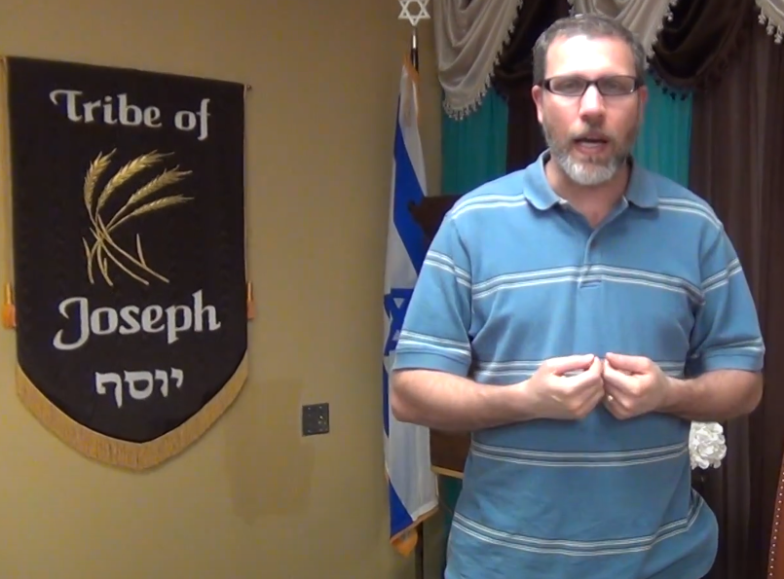
Rabbi Joshua Lessard Tikvat Ami Messianic Synagogue Tallahassee, FL
Notes:
Actually endorsing Oxana’s music and ministry in this clip
https://www.youtube.com/watch?v=DKQws7LAexM

Slide 41
Messianic Rabbi Josh Lessard:
Recently, I got up from my computer and walked out into my living room where I saw one of my foster children eating on the couch (after I had just told them not to eat on the couch). I sprang into Dad mode and took their electronics for an hour.
Notes:
Shared with permission

Slide 42
I congratulated myself on administering a consequence without losing my cool and went back to my office. But this time, instead of opening up YouTube or the news, I spent time in prayer. It was in prayer that I realized what had happened in regard to my child. It's true that I delivered a consequence without anger, but there was also no love behind it.

Slide 43
My response wasn't harsh, but neither could I categorize it as gentle instruction that reaffirmed my love. I honored a black and white approach to rule keeping above connecting with this child who's been through some really traumatic things.
Notes:
A foster child…

Slide 44
And then I started to realize that my approach to my child was an extension of the mindset I appropriated from listening to [news] commentators. Instead of approaching the situation as a follower of Yeshua and looking for a way to bring love into the situation, I was looking for a right and a wrong.

Slide 45
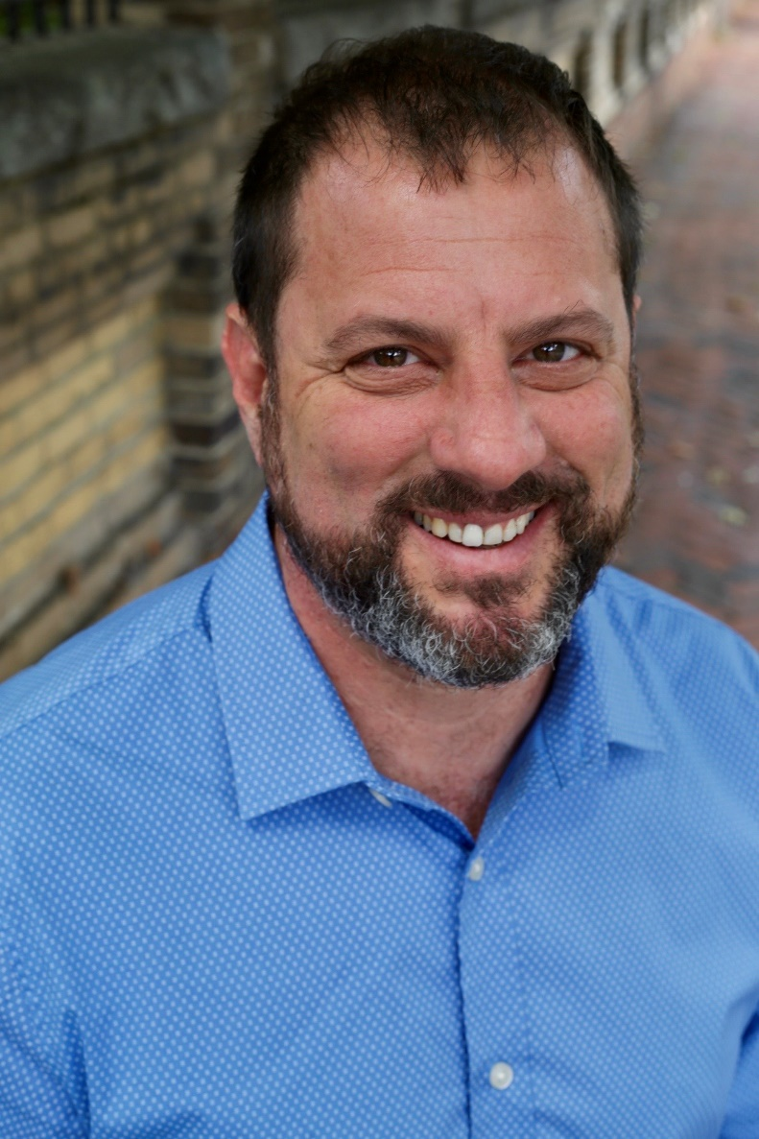
Ron Cantor, with Tikkun, Israel

Slide 46
Ron Cantor Tikkun felt an inspired word as if from Adoni. Not normative, but dramatic…
“The key to the revival that you in the ‘white believers’ seek, is reaching out to the black community with my love, healing power and practical help…[such as listening and serving, and if possible, mentoring and tutoring]—I am calling you to share your lives with them.

Slide 47
“I will deal with the looters and criminals through the criminal justice system, yet even they have a purpose just as I used Assyria to judge Israel. (Is. 10:5-6) In the end, I judged Assyria for her actions.

Slide 48
“But I want you to look deeper and bring my healing touch to black America. There is no other answer. Hear my voice, ‘THERE IS NO OTHER ANSWER!’ Will you be my body? Will you be my hands? My heart breaks for them; does yours?

Slide 49
^{2 Cor.12.14-15} Children are not supposed to save up for their parents, but parents for their children. And as for me, I will most gladly spend everything I have and be spent myself too for your sakes. If I love you more, am I to be loved less?
Notes:
John Gill: parents not only care for their children, bring them up, and provide for them food and raiment; but as they are blessed by Providence, lay up treasures for them for tithe to come, and not children for their parents;

Slide 50
A father is the prototype giver, builder, lover.

Slide 51
We are expected to invest in our children.
Relationships among persons are the central meaning of existence. Dan Juster Relational Leadership p 5
Fathering is a type of talmidut/Discipleship, grooming someone to be your closest friend. Asher Intrater Covenant Relationships p 44
Notes:
Relationships >> performance. People are all that counts.
Doesn’t mean poor performance. Sloppy agape. Look left and right, [ev other person.]
Conundrum: need excellent performance, ministry is extremely important, and a HUGE task.
Get caught up in the task and it undermines the real task.

Slide 52
How do we give/ invest in our children? Does it end at adulthood?
Time
Love
Impartation of JOY!
Knowledge of them

Slide 53
The wife is the most important recipient of your love; disciple. [Pour into her life, build her up] Children need to see her loved and honored or will take up her insecurity, offense. Children need to see a joyful spousal relationship!
Notes:
Asher Covenant Relationships p 187

Slide 54
[from the movie Honey, I Blew up the Kids]
There's one thing every little kid knows. Daddies mean fun; mommies mean business.
Notes:
https://www.quotes.net/mquote/43998

Slide 55
How do we give/ invest in our children? Does it end at adulthood?
Time
Love
Impartation of JOY!
Knowledge of them

Slide 56
^{Mishlei/Prov 22:6} Train a child in the way he [should] go; and, even when old, he will not swerve from it.
חֲנֹךְ לַנַּעַר עַל-פִּי דַרְכּוֹ גַּם כִּי-יַזְקִין, לֹא-יָסוּר מִמֶּנָּה.
Notes:
We did that, maybe somewhat imperfectly, but the results are not what we expected.

Slide 57
As we develop relational intimacy in our families and in our congregation, we will be GREATLY strengthened. By His wounds חבורתו khavurato fellowship we are healed!
150 wall
Divorce protection!
Mike Boatright at outreach Zoom meeting.
No one falls through the cracks!
Notes:
Dan Juster, 10 years of home group networking intimacy, NOT one divorce.

Slide 58
^{2 Cor. 6.4-13} But as God’s servants, we are commending ourselves in every way—in great endurance, in afflictions, in hardships, in distresses, 5 in beatings, in imprisonments, in riots, in troubles, in sleeplessness, in hunger; 6 in purity, in knowledge, in patience, in kindness, in the Ruach ha-Kodesh, in genuine love, 7 in truthful speech, in the power of God; with the weapons of righteousness in the right hand and in the left; 8 through honor and dishonor, through evil report and good report. We are regarded as deceivers and yet true; 9 as unknown and yet well-known; as dying, yet behold, we live; as disciplined yet not put to death; [b] 10 as grieving yet always rejoicing; as poor yet enriching many; as having nothing yet possessing everything. We have spoken openly to you, O Corinthians; our heart is open wide! 12 You are not restricted by us, yet you are restricted in your own feelings. 13 Now in return—I speak as to my children—open wide to us also.

Slide 59
You may say, “But I did all of that, not perfectly, but the best I could.” What then??
Here is a promise, specifically for Messianic Jews and Gentiles.

Slide 60
^{Yeshayahu/Is 44.1-2} “Now listen, Ya‘akov my servant, Isra’el whom I have chosen: Thus says Adoni, who made you, formed you in the womb, and will help you: Don’t be afraid, Ya‘akov my servant, Yeshurun, whom I have chosen

Slide 61
As I pour water on thirsty land
And streams upon dry ground
I will pour my Spirit on your children
And my blessing upon your descendants.

Slide 62
They will sprout up like grass seedlings
As willows by the river's edge
One will boast, "I am Adoni's"
Another will name himself Yaakov
Still another will write with his hand "Adoni"
And will take the name of Yisrael.

Slide 63
סֵפֶר ישעיהוּ פֶּרֶק מדYeshayahu [Is.] 44: 3-5
כִּי אֶצָּק מַיִם עַל צָמֵא וְנוֹזְלִים עַל יַבָּשָׁה 2x
Kee eh-tsok miyeem al tsa-may
V'noz-leem al ya-ba-sha 2x
אֶצֹּק רוּחִי עַל זַרְעֶךָ וּבִרְכָתִי עַל צֶאֱצָאֶֽיךָ: 2x
Eh-tsok roo-khee al zar-eh-kha
Oo-veer-kha-tee al
tseh-eh-tsa-eh-kha 2x

Slide 64
וְצָֽמְחוּ בְּבֵין חָצִיר כַּֽעֲרָבִים עַל יִבְלֵי מָֽיִם: 2x
V'tsam-khoo b'vayn kha-tseer,
Ka-a-ra-veem al yeev-lay mi-yeem 2x
זֶה יֹאמַר לַֽייָ אָנִי וְזֶה יִקְרָא בְשֵׁם יַֽעֲקֹב
Zeh yo-mar l'Adoni anee,
V'zeh yeek-rah v'shaym Ya-a-kov
וְזֶה יִכְתֹּב יָדוֹ לַֽייָ וּבְשֵׁם יִשְרָאֵל יְכַנֶּֽה:
V'zeh yeekh-tov yado l'Adoni
Oov-shaym Yees-ra-ayl Y'kha-neh.

Slide 66
Moreover, the covenantal promises of fatherhood and of the peoplehood of Israel were set into a prayer in the time of Nekhemyah / Nehemiah. The Great Assembly. Considered “The Prayer” of Jewish liturgy. Celebrates FATHERHOOD. Don’t despair.

Slide 67
שְׁמוֹנֶה עֶשּׂרֵה Sh'moneh Esray [Eighteen Blessings]
Traditional, Public Domain
Notes:
Do as a liturgical prayer, but with pause after many slides for comment.

Slide 68
בָּרוּךְ אַתָּה יְיָ
[בָּרוּךְ הוּא וּבָּרוּךְ שְּׁמוֹ]
Ba-rukh a-tah Ah-do-ni
[Ba-rukh hu u-ba-rukh sh’mo]
[Blessed are You Adoni
Blessed is He and Blessed is His Name]

Slide 69
אֱלהֵינוּ וֵאלהֵי אֲבוֹתֵינוּ
E-lo-hay-nu vay-lo-hay avo-tay-nu
אֱלהֵי אַבְרָהָם אֱלהֵי יִצְחָק
וֵאלהֵי יַעֲקב
Eh-lo-hay Av-rah-am Eh-lo-hay Yits-khak
Vay-lo-hay Ya-a-kov
[Our G-d and the G-d of our Fathers, the G-d of Avraham, the G-d of Yitzkhak, the G-d of Yaakov]
Notes:
Avot: patriarchs, FAMILY blessing. Put your name in there!

Slide 70
הָאֵל הַגָּדוֹל הַגִּבּוֹר וְהַנּוֹרָא אֵל עֶלְיוֹן
Ha-El Ha-ga-dol Ha-gee-bor v'ha-no-ra
El El-yon
גּוֹמֵל חֲסָדִים טוֹבִים וְקוֹנֵה הַכּל
Go-mayl kha-sa-deem to-veem
v'ko-nay ha-kol
[The Great G-d, the Mighty, the dreadful G-d Most High, Who bestows lovingkindness and goodness, and sustains all]

Slide 71
וְזוֹכֵר חַסְדֵי אָבוֹת
וּמֵבִיא גּוֹאֵל לִבְנֵי בְנֵיהֶם
V'zo-khayr khas-day a-voht
oo-may-vee go-ayl lee-v'nay
v'nay-hem
[and remembers the piety
of the fathers and brings the Redeemer
to their childrens' children ]
Notes:
Remembers…4000 years remembered. When I first had occasion to attend a synagogue service in 1969, shocked to realize that this prayer was about the then current Messianic Jewish awakening.
If G-d remembers the piety = worship of Avraham, He will remember Your faithfulness and bring the Redeemer to YOUR children!

Slide 72
לְמַעַן שְׁמוֹ בְּאַהֲבָה
L'ma-an sh'mo b'a-ha-va
מֶלֶךְ עוֹזֵר וּמוֹשִׁיעַ וּמָגֵן
Me-lekh o-zayr
oo-mo-she-a u-ma-gayn
[for the sake of His name, in love
King, Helper, Savior, and Shield]
Notes:
His Name. His reputation. [not pronunciation]

Slide 73
בָּרוּךְ אַתָּה יְיָ
[בָּרוּךְ הוּא וּבָּרוּךְ שְּׁמוֹ]
Ba-rukh a-tah Ah-do-ni
[Ba-rukh hu u-ba-rukh sh'mo]
מָגֵן אַבְרָהָם
Ma-gayn Av-ra-ham
Blessed are You, ADONI [Blessed is He and bless His Name] the shield of Abraham

Slide 74
Blessed be ADONI our G-d
and the G-d of our forefathers
The G-d of Av-ra-ham
The G-d of Yits-khak
and the G-d of Ya-a-kov
The great G-d, the mighty, the dreaded
G-d Most High, Who bestows lovingkindness and goodness

Slide 75
And sustains all
and remembers the piety
of the fathers
and brings the Redeemer
to their childrens' children
for the sake of His name, in love
King, Helper, Savior, and Shield
Blessed are You, ADONI
the shield of Abraham

Slide 76
אַתָּה גִּבּוֹר לְעוֹלָם אֲדנָי
A-tah gee-bor l'olam Ah-doni
מְחַיֵּה מֵתִים אַֽתָּה רַב לְהוֹשִׁיעַ
M'khi-yay may-teem a-tah [X2]
Rav l'ho-shee-ah
[You are the mighty One forever, O L-rd
You raise the dead sleeping in their graves
You are mighty to save ]

Slide 77
מְכַלְכֵּל חַיִּים בְּחֶסֶד
M'khal-kayl khi-yeem b'khesed
מְחַיֵּה מֵתִים בְּרַחֲמִים רַבִּים
M'khi-ay may-teem
B'ra-kha-meem ra-beem
[He sustains life in love
He revives the dead
With great mercies]

Slide 78
סוֹמֵךְ נוֹפְלִים וְרוֹפֵא חוֹלִים
So-maykh no-fleem
V'ro-fay kho-leem
וּמַתִּיר אֲסוּרִים
[He supports the falling
And heals the sick
And frees the prisoners]

Slide 79
וּמְקַיֵּם אֱמוּנָתוֹ לִישֵׁנֵי עָפָר
U-m'ka-yeem e-mu-na-to
Lee-shay-nay a-far
[And establishes his faithfulness
With those that sleep in the dust]
Notes:
Death does not stop the covenant faithfulness to Israel, to YOU, Dads and Moms!

Slide 80
מִי כָמֽוֹךָ בַּעַל גְּבוּרוֹת
Mee kha-mokha ba-al g'vu-rot
וּמִי דּֽוֹמֶה לָּךְ מֶלֶךְ מֵמִית
U-mee do-meh lakh Melekh ma-meet
[Who is like you The Master of Power
And who resembles You
O King who controls death]

Slide 81
וּמְחַיֶּה וּמַצְמִֽיחַ יְשׁוּעָה
U-m'kha-yeh u-mats-mee-akh
Y'shu-ah
And gives life
And causes salvation
to spring forth

Slide 82
וְנֶאֱמָן אַתָּה לְהַחֲיוֹת מֵתִים
V’neh-eh-mahn a-tah
L’ha-khay-oht meh-teem
[And you are faithful to
Resurrect the dead]

Slide 83
בָּרוּךְ אַתָּה יְיָ
[בָּרוּךְ הוּא וּבָּרוּךְ שְּׁמוֹ]
Ba-rukh a-tah Ah-do-ni
[Ba-rukh hu u-ba-rukh sh'mo]
מְחַיֶּה הַמֵּתִים
M’kha-yeh ha-meh-teem
Blessed are You, ADONI Who resurrects the dead

Slide 84
He sustains life in love
He revives the dead
With great mercies
He supports the falling
And heals the sick
And frees the prisoners
And establishes his faithfulness
With those that sleep in the dust

Slide 85
Who is like you
The Master of Power
And who resembles You
O King who controls death
And gives life
And causes salvation
to spring forth

Slide 86
And you are faithful to
Resurrect the dead
Blessed are You, ADONI
Who resurrects the dead

Slide 88
This ancient prayer about the covenant of the fathers was joyfully set to music by modern sons and daughters of the covenant, recorded by modern Messianic Jewish Israeli young adults!! Am Yisrael Khi.
The covenant people of Israel live!

Slide 90
David Loden Shmoneh Esray
Notes:
https://www.youtube.com/watch?v=0VLEva3jZjM

Slide 91
David Loden Amidah Avot/Patriarchs https://www.youtube.com/watch?v=0VLEva3jZjM
Notes:
https://www.youtube.com/watch?v=0VLEva3jZjM

Slide 92
בָּרוּךְ אַתָּה יְיָ אֱלהֵינוּ
Ba-rukh a-tah Ah-do-ni Eh-lo-hay-nu
בָּרוּךְ אַתָּה אלהֵי אֲבוֹתֵינוּ
Ba-rukh a-tah Elohay avotenu
[Blessed are you, Adoni, our G-d
[Blessed are you, G-d of our forefathers.]

Slide 93
בָּרוּךְ אַתָּה יְיָ אֱלהֵינוּ
Ba-rukh a-tah Ah-do-ni Eh-lo-hay-nu
בָּרוּךְ אַתָּה אלהֵי אֲבוֹתֵינוּ
Ba-rukh a-tah Elohay avotenu
[Blessed are you, Adoni, our G-d
[Blessed are you, G-d of our forefathers.]

Slide 94
אֱלהֵי אַבְרָהָם יִצְחָק וֵיַעֲקב
Eh-lo-hay Av-rah-am,
Yits-khak Ya-a-kov
הָאֵל הַגָּדוֹל הַגִּבּוֹר וְהַנּוֹרָא
Ha-El Ha-ga-dol Ha-gee-bor v'ha-no-ra
The G-d of Avraham, Yitskhak/Isaac, and Yaakv
The great G-d, the Mighty, the Dreadful.

Slide 95
בָּרוּךְ אַתָּה יְיָ אֱלהֵינוּ
Ba-rukh a-tah Ah-do-ni Eh-lo-hay-nu
בָּרוּךְ אַתָּה אלהֵי אֲבוֹתֵינוּ
Ba-rukh a-tah Elohay avotenu
[Blessed are you, Adoni, our G-d
[Blessed are you, G-d of our forefathers.]

Slide 96
אֵל עֶלְיוֹן El El-yon
גּוֹמֵל חֲסָדִים טוֹבִים קוֹנֵה הַכּל
Go-mayl kha-sa-deem to-veem ko-nay ha-kol
זוֹכֵר חַסְדֵי אָבוֹת
V'zo-khayr khas-day a-voht
G-d most High, Who bestows lovingkindness and goodness, and sustains all, and remembers the piety of the Fathers]

Slide 97
בָּרוּךְ אַתָּה יְיָ אֱלהֵינוּ
Ba-rukh a-tah Ah-do-ni Eh-lo-hay-nu
בָּרוּךְ אַתָּה אלהֵי אֲבוֹתֵינוּ
Ba-rukh a-tah Elohay avotenu
[Blessed are you, Adoni, our G-d
[Blessed are you, G-d of our forefathers.]

Slide 98
בָּרוּךְ אַתָּה יְיָ אֱלהֵינוּ
Ba-rukh a-tah Ah-do-ni Eh-lo-hay-nu
בָּרוּךְ אַתָּה אלהֵי אֲבוֹתֵינוּ
Ba-rukh a-tah Elohay avotenu
[Blessed are you, Adoni, our G-d
[Blessed are you, G-d of our forefathers.]

Slide 99
וּמֵבִיא גּוֹאֵל לִבְנֵי בְנֵיהֶם
oo-may-vee go-ayl lee-v'nay
v'nay-hem
לְמַעַן, לְמַעַן שְׁמוֹ בְּאַהֲבָה
L'ma-an, L'ma-an
sh'mo b'a-ha-va
And brings the redeemer to their children’s children for the sake of His Name, in love

Slide 100
בָּרוּךְ אַתָּה יְיָ אֱלהֵינוּ
Ba-rukh a-tah Ah-do-ni Eh-lo-hay-nu
בָּרוּךְ אַתָּה אלהֵי אֲבוֹתֵינוּ
Ba-rukh a-tah Elohay avotenu
[Blessed are you, Adoni, our G-d
[Blessed are you, G-d of our forefathers.]

Slide 101
מֶלֶךְ עוֹזֵר וּמוֹשִׁיעַ וּמָגֵן
Me-lekh o-zayr u-mo-she-a
U-ma-gayn
בָּרוּךְ אַתָּה יְיָ מָגֵן אַבְרָהָם
Ba-rukh a-tah Ah-doni [X2]
Ma-gayn Avraham
King Helper Savior and Shield
Blessed are you the shield of Avraham

Slide 102
בָּרוּךְ אַתָּה יְיָ אֱלהֵינוּ
Ba-rukh a-tah Ah-do-ni Eh-lo-hay-nu
בָּרוּךְ אַתָּה אלהֵי אֲבוֹתֵינוּ
Ba-rukh a-tah Elohay avotenu
[Blessed are you, Adoni, our G-d
[Blessed are you, G-d of our forefathers.]

Slide 103
בָּרוּךְ אַתָּה יְיָ אֱלהֵינוּ
Ba-rukh a-tah Ah-do-ni Eh-lo-hay-nu
בָּרוּךְ אַתָּה אלהֵי אֲבוֹתֵינוּ
Ba-rukh a-tah Elohay avotenu
[Blessed are you, Adoni, our G-d
[Blessed are you, G-d of our forefathers.]

Slide 104
מְכַלְכֵּל חַיִּים בְּחֶסֶד
M'khal-kayl khi-yeem b'khesed
מְחַיֵּה מֵתִים בְּרַחֲמִים רַבִּים
M'khi-ay may-teem
B'ra-kha-meem ra-beem
[He sustains life in love
He revives the dead
With great mercies]

Slide 105
בָּרוּךְ אַתָּה יְיָ אֱלהֵינוּ
Ba-rukh a-tah Ah-do-ni Eh-lo-hay-nu
בָּרוּךְ אַתָּה אלהֵי אֲבוֹתֵינוּ
Ba-rukh a-tah Elohay avotenu
[Blessed are you, Adoni, our G-d
[Blessed are you, G-d of our forefathers.]

Slide 106
אַתָּה גִּבּוֹר A-tah gee-bor
אַֽתָּה מְחַיֵּה מֵתִים
אַתָּה יְיָ רַב לְהוֹשִׁיעַ
M'khi-yay may-teem a-tah
Rav l'ho-shee-ah
[You are Mighty, Your revive the dead,
You are might to save]

Slide 107
בָּרוּךְ אַתָּה יְיָ אֱלהֵינוּ
Ba-rukh a-tah Ah-do-ni Eh-lo-hay-nu
בָּרוּךְ אַתָּה אלהֵי אֲבוֹתֵינוּ
Ba-rukh a-tah Elohay avotenu
[Blessed are you, Adoni, our G-d
[Blessed are you, G-d of our forefathers.]

Slide 108
בָּרוּךְ אַתָּה יְיָ אֱלהֵינוּ
Ba-rukh a-tah Ah-do-ni Eh-lo-hay-nu
בָּרוּךְ אַתָּה אלהֵי אֲבוֹתֵינוּ
Ba-rukh a-tah Elohay avotenu
[Blessed are you, Adoni, our G-d
[Blessed are you, G-d of our forefathers.]

Slide 109
סוֹמֵךְ נוֹפְלִים וְרוֹפֵא חוֹלִים
So-maykh no-fleem
V'ro-fay kho-leem
[He supports the falling
And heals the sick]

Slide 110
וְרוֹפֵא חוֹלִים וּמַתִּיר אֲסוּרִים
וּמְקַיֵּם אֱמוּנָתוֹ לִישֵׁנֵי עָפָר
Rofeh kholeem U-ma-teer a-su-reem
U-m'ka-yeem e-mu-na-to
Lee-shay-nay a-far
He heals the sick and frees the prisoners, and remembers His faithfulness to those who sleep in the dust.

Slide 111
בָּרוּךְ אַתָּה יְיָ אֱלהֵינוּ
Ba-rukh a-tah Ah-do-ni Eh-lo-hay-nu
בָּרוּךְ אַתָּה אלהֵי אֲבוֹתֵינוּ
Ba-rukh a-tah Elohay avotenu
[Blessed are you, Adoni, our G-d
[Blessed are you, G-d of our forefathers.]

Slide 112
בָּרוּךְ אַתָּה יְיָ אֱלהֵינוּ
Ba-rukh a-tah Ah-do-ni Eh-lo-hay-nu
בָּרוּךְ אַתָּה אלהֵי אֲבוֹתֵינוּ
Ba-rukh a-tah Elohay avotenu
[Blessed are you, Adoni, our G-d
[Blessed are you, G-d of our forefathers.]

Slide 113
בָּרוּךְ אַתָּה יְיָ אֱלהֵינוּ
Ba-rukh a-tah Ah-do-ni Eh-lo-hay-nu
בָּרוּךְ אַתָּה אלהֵי אֲבוֹתֵינוּ
Ba-rukh a-tah Elohay avotenu
[Blessed are you, Adoni, our G-d
[Blessed are you, G-d of our forefathers.]

Slide 114
בָּרוּךְ אַתָּה יְיָ אֱלהֵינוּ
Ba-rukh a-tah Ah-do-ni Eh-lo-hay-nu
בָּרוּךְ אַתָּה אלהֵי אֲבוֹתֵינוּ
Ba-rukh a-tah Elohay avotenu
[Blessed are you, Adoni, our G-d
[Blessed are you, G-d of our forefathers.]

Slide 115
Dads, please come up front for blessing and gift.

