Slide 1
e-handout
To have these notes
without taking notes
Go to OrHaOlam.com
Click on downloads,
messages, 2020

Slide 2
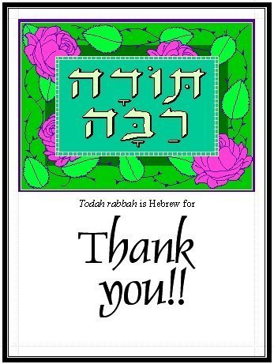
Notes:
Thanks to YOU made it possible. What was it like? What did I gain? It is said that Jewish people are like everyone else, only more so. My sabbatical was like my regular life, only more so. I.e., if you take out errands, most emails, all admin tasks: left with the nectar of life: devotions, exercise, some email, read, pray, walk with G-d which to me is Hebrew music worship. Give you a taste of all in this message!
Inner healing: Sozo, RTF, Ancient Paths, Joy Starts here, Life Model, Shaunti Feldhan, all realy כי I needed it. Found epitome of help with phobias, insecurities, toxicities, is to quote “The blood of Yeshua the Messiah His Son, purifies us from all sin. But, more anointed, personal, powerful to me if וְדַם יֵשׁוּעַ הַמָּשִׁיחַ בְּנוֹ מְטַהֵר אוֹתָנוּ מִכָּל חֵטְא Time with Dawn, periodicals, see my desk, filing. Shalom Thanks for ongoing…

Slide 3
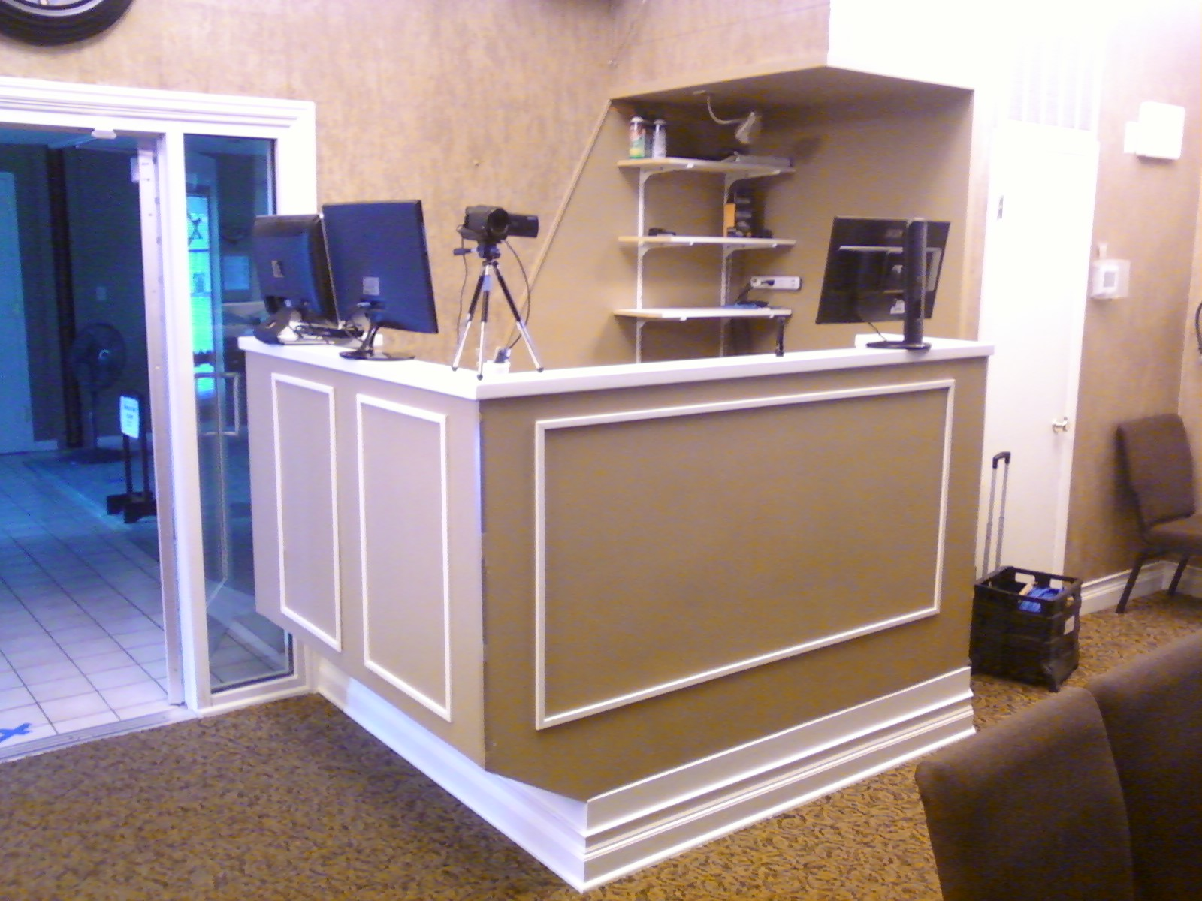
New sound booth
Notes:
Steve Kline’s creative skills. Livestream can’t see this כי in back.

Slide 4
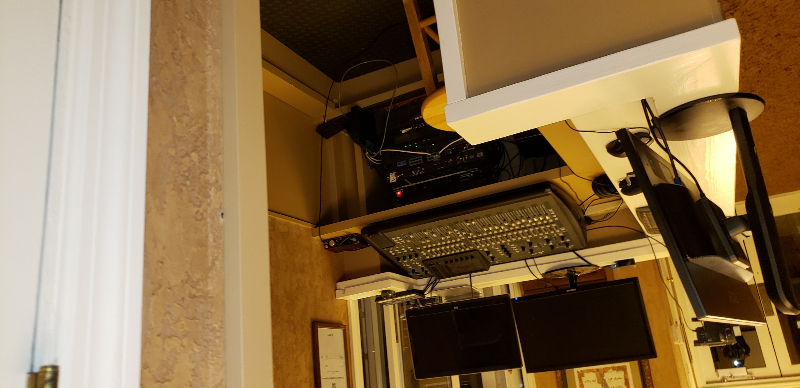
Inside the new sound booth

Slide 5
Repaired chimney by the Men’s group under Steve Kline’s direction, other repairs

Slide 6
Livestream subtitles = “lower third”
Better than Messiah Conf
Notes:
Upgrade to ProPresenter done BETTER than Messiah Conf. Real Hebrew with vowels, not just transliteration! Brett.
Plus a light consultant and we are removing front two chandeliers and getting professional platform lights for $4000. This sanctuary was well designed for 1980’s. No thought of studio for broadcast then. Back wall may need new color.

Slide 7
Drive-In Prayer
report from Tammy Silva:
“We had a number of quality conversations (with) more than one car at a time lined up for prayer. All in all, it was a precious time.”

Slide 8
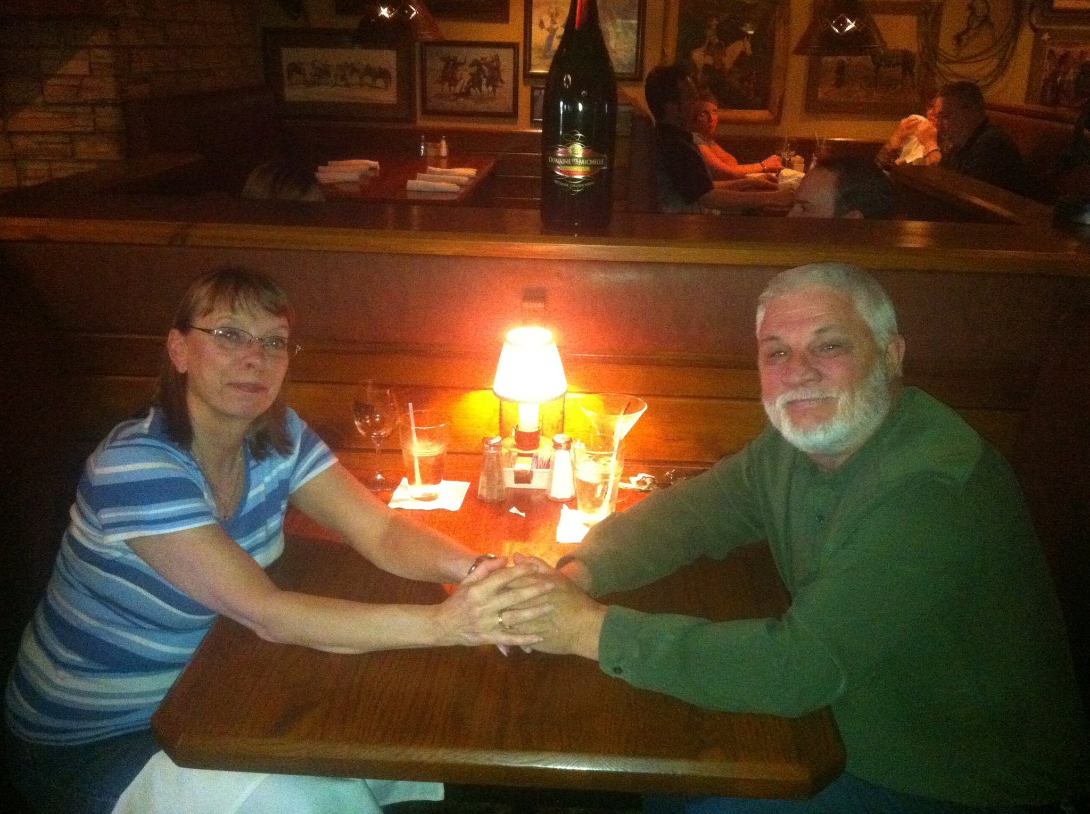
Gavriel & Jan Rennels

Slide 9
Good news from Israel:
Israeli innovations

Slide 10
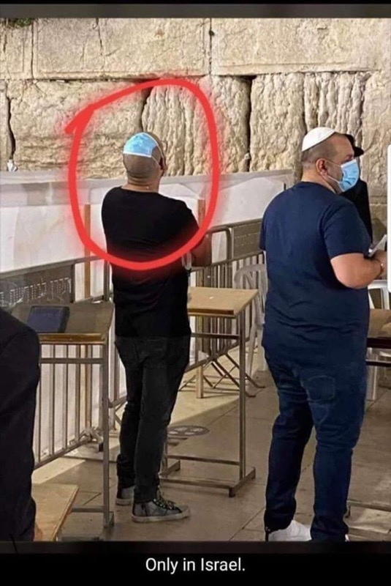
Maskkippah
Notes:
From Hylan Slobodkin

Slide 11
New Israeli health food. חַרְגּוֹל
Notes:
https://youtu.be/sHcI7dfrpoY
Yokhanan the Immerser, John

Slide 12
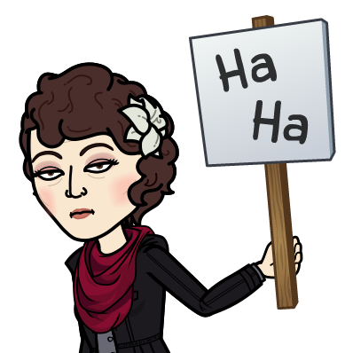
Notes:
Continuing our series in Messianic Jews, Hebrews, MJ

Slide 14
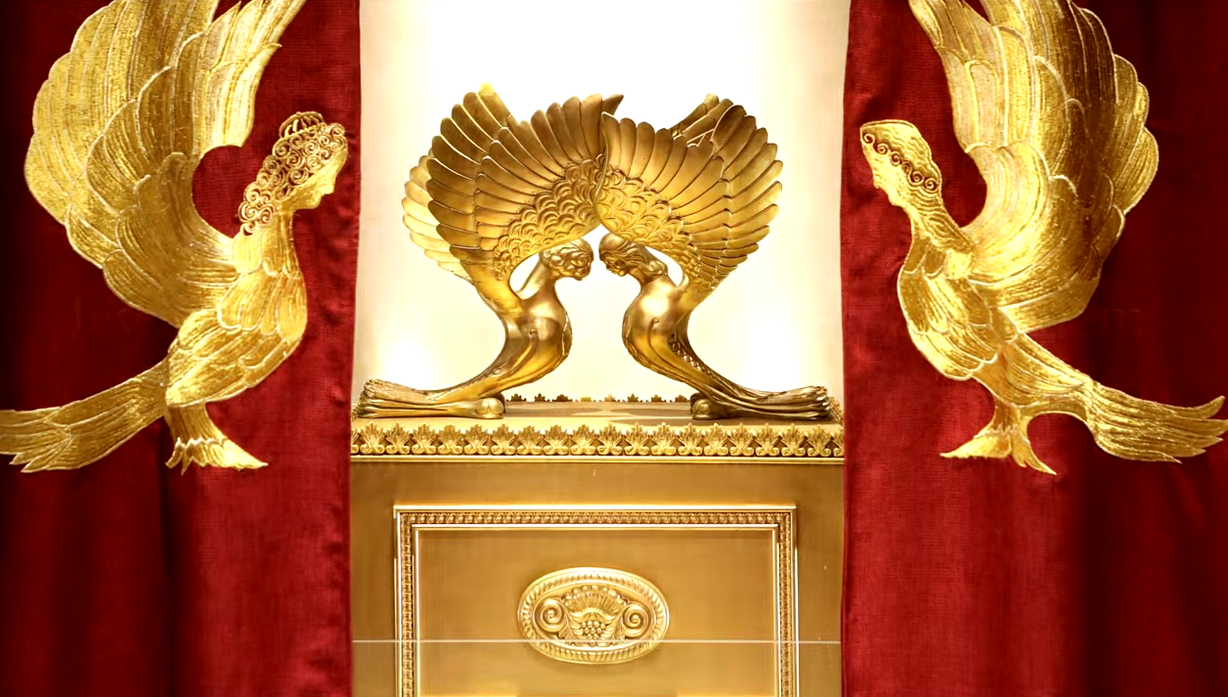
Letter to the Messianic Jews [Hebrews] MJ 4.9-14
DIY Hazards
Notes:
https://www.templeinstitute.org/new-location.htm

Slide 15
^{MJ 4.9-14} So there remains a Shabbat rest for the people of God. For the one who has entered God’s rest has also ceased from his own work, just as God did from His. Let us, therefore, make every effort to enter that rest, so that no one may fall through the same pattern of disobedience.

Slide 16
^{MJ 4.9-14} For the word of God is living and active and sharper than any two-edged sword—piercing right through to a separation of soul and spirit, joints and marrow, and able to judge the thoughts and intentions of the heart.

Slide 17
^{MJ 4.9-14} No creature is hidden from Him, but all are naked and exposed to the eyes of Him to whom we must give account, Yeshua, our Compassionate Kohen Gadol. Therefore, since we have a great Kohen Gadol who has passed through the heavens, Yeshua Ben-Elohim, let us hold firmly to our confessed allegiance.

Slide 18
How many times are we exhorted to enter into rest in Ch 3 and 4 of MJ?
^{3.8,11} Today…enter into rest
^{3.13} Today…that none of you will become hardened
^{3.15} Today, if you hear God’s voice
Notes:
Words “today” “rest” “hear” all Tanakhic quote triggers. Ps 95

Slide 19
^{3.18} God [was] disgusted for forty years? [Who] would not enter his rest?
^{3.19} unable to enter because of lack of trust
^{4.3} we who have trusted are entering into that rest
Notes:
Words “today” “rest” “hear” “enter” all Tanakhic quote triggers Ps 95.

Slide 20
^{4.5} “They shall never enter My rest.”
^{4.7} Today, if you hear God’s voice, don’t harden your hearts.
^{4.10} For the one who has entered God’s rest has also ceased from his own work

Slide 21
Reminder: When Jewish hearers in Yeshua’s day were told a phrase of scripture, many or most would think of the whole chapter. T’hillim/Ps 95 here.

Slide 22
10. ^{4.11} Therefore, let us do our best to enter that rest.

Slide 23
How many times do we have to be exhorted to do something, before we do it?
Like a mother telling her child, “Go to bed!”

Slide 24
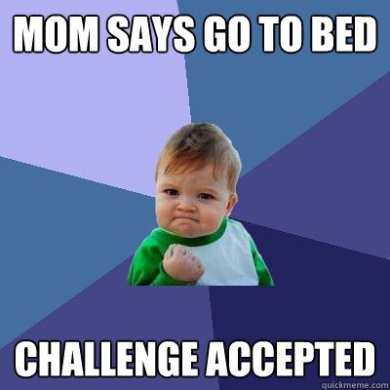
Notes:
https://www.google.com/url?sa=i&url=http%3A%2F%2Fwww.quickmeme.com%2Fmeme%2F1io8&psig=AOvVaw32Wy_4vvlqgCxL4noOqMwG&ust=1591469357122000&source=images&cd=vfe&ved=0CAIQjRxqFwoTCNC94cSr6-kCFQAAAAAdAAAAABAT

Slide 25
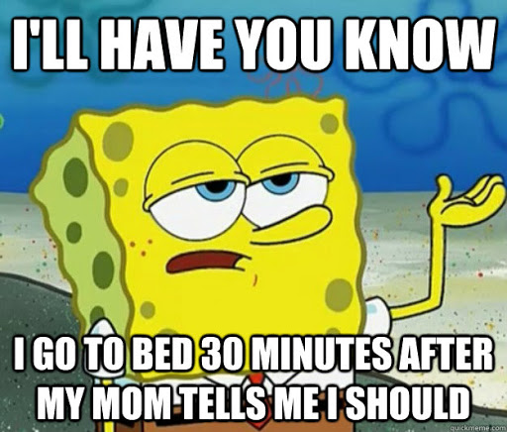
Notes:
https://www.google.com/url?sa=i&url=http%3A%2F%2Fwww.quickmeme.com%2Fmeme%2F3qqex8&psig=AOvVaw32Wy_4vvlqgCxL4noOqMwG&ust=1591469357122000&source=images&cd=vfe&ved=0CAIQjRxqFwoTCNC94cSr6-kCFQAAAAAdAAAAABAO

Slide 26
What does it mean spiritually to enter His rest? [Go to bed!]
Why is it soooo important?
10x or more exhortations in 2 chapters!
4 meanings of rest [Go to bed!]

Slide 27
Ceased [rested] from his own work
DIY hazards
4 types of works
we can claim as our own
Notes:
Pray after ‘own work’
These are the works we can claim.

Slide 28
Ceased [rested] from his own work DIY hazard #1
Carnal works of the flesh
Our own works of righteousness, no need for Messiah.
Our own working for Messiah: lone soldier.
Messiah’s works, but in our own strength.
Notes:
These are the works we can claim.

Slide 29
1. Carnal works of the flesh
^{Gal. 5.19-21} Now the deeds/works of the flesh are clear: sexual immorality, impurity, indecency, idolatry, witchcraft, hostility, strife, jealousy, rage, selfish ambition,
Notes:
When we do these, we bear full responsibility. Can be comfort from hurt, but evil comfort.
Examine your heart and life. Are any of these part of your mindset or practice?

Slide 30
1. Carnal works of the flesh
^{Gal. 5.19-21} dissension, factions, envy, drunkenness, carousing, and things like these. I am warning you, just as I warned you before, that those who do such things will not inherit God’s kingdom.
Notes:
It doesn’t matter how religious you are, or powerful you are

Slide 31
^{Mtt. 7.21-23} Not everyone who says to me, ‘Lord, Lord!’ will enter the Kingdom of Heaven, only those who do what my Father in heaven wants. On that Day, many will say to me, ‘Lord, Lord! Didn’t we prophesy in your name?

Slide 32
^{Mtt. 7.21-23} Didn’t we expel demons in your name? Didn’t we perform many miracles in your name?’ Then I will tell them to their faces, ‘I never knew you! Get away from me, you workers of lawlessness!’
Notes:
Yeshua the King wants a Holy, joyful, loving, humble people.

Slide 33
Ceased [rested] from his own work DIY hazard #2
Carnal works of the flesh
Our own righteousness, no need for Yeshua.

Slide 34
^{Ro 10.1-5} Brothers, my heart’s deepest desire and my prayer to God for Isra’el is for their salvation; for I can testify to their zeal for God. But it is not based on correct understanding; for, since they are unaware of God’s way of making people righteous and instead seek to set up their own,

Slide 35
^{Ro 10.1-5} they have not submitted themselves to God’s way of making people righteous. For the goal at which the Torah aims is the Messiah, who offers righteousness to everyone who trusts.

Slide 36
^{Ro 10.1-5} For Moshe writes about the righteousness grounded in the Torah that ”The person who does these things will attain life through them.” ^{Vayikra/Lev. 18:5}

Slide 37
Some Jewish people, immersed in Torah and seeking to obey, will find the power and forgiveness offered by Messiah Yeshua, PERFECT and liberating. Others will find it a threat to their own kingdom.
One writer said that the unsaved will be judged by “A spirit of faith and a purpose of righteousness.”
Notes:
That is, one has to acknowledge the Yom Kippur prayer, Salakh lanu, makhal lanu, caper alenu. Forgive us, release us, atone for us. Then Messiah brings all three by His atoning death and T’khiyah/resurrection!

Slide 38
But, if one is threatened by the “gift of righteousness” requiring humble receiving, they could end up as Rabbi Shaul / Paul before revelation of Messiah…

Slide 39
^{Acts 26.9-11} “I used to think it was my duty to do all I could to combat the name of Yeshua from Natzeret…Often I went from one synagogue to another, punishing them and trying to make them blaspheme;

Slide 40
^{Acts 26.9-11}and in my wild fury against them, I even went so far as to persecute them in cities outside the country.
Notes:
Why such hostility? We are just offering LIFE!! Those who trust in their own righteousness can feel threatened.

Slide 41
Ceased [rested] from his own work DIY hazard #3
Carnal works of the flesh
Our own righteousness, no need for Messiah Yeshua.
Our own working for Messiah: lone soldier
Notes:
There are some who receive Messiah, and His love, joy peace, and labor for Him. But they do so in social isolation…before social distancing.
Here’s the prototype of community working…

Slide 42
^{2 Tim 2.1-2} So then, [#2] you, [#1] my son, be empowered by the grace that comes from the Messiah Yeshua. And the things you heard from [#1] me, which were supported by many witnesses, these things commit to [#3] faithful people, such as will be competent to teach [#4] others also
Notes:
Note the generational numbers

Slide 43
Each of us needs
An accountability person or persons who know you, your strengths, weakness, struggles, victories. Strength from upward
A person you are mentoring. Strength passed downward.

Slide 44
Who knows you?
Whom do you know?
Best done, most easily done through small groups.
Everyone should be in a weekly or bi-weekly home group.
Caring for others, being cared for.
No loners!
Notes:
Dan Juster Relational Leadership p 30-35.
Said before concerning phobias, insecurities, toxicities, is to quote “The blood of Yeshua the Messiah His Son, purifies us from all sin. But, more anointed, personal, powerful to me if וְדַם יֵשׁוּעַ הַמָּשִׁיחַ בְּנוֹ מְטַהֵר אוֹתָנוּ מִכָּל חֵטְא
Previous phrase:
אֲבָל אִם נִתְהַלֵּךְ בָּאוֹר, כְּמוֹ שֶׁהוּא בָּאוֹר, כִּי אָז הִתְחַבַּרְנוּ זֶה עִם זֶה
But if we walk in the Light, as He is in the light, we have fellowship with one another, and the Blood…
Covenantal Relationships: Everything is fellowship p 5, 8

Slide 45
Along the lines of
community caring…

Slide 47
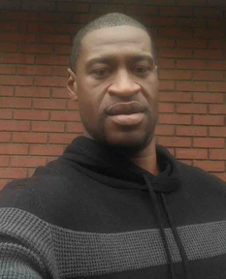
George Floyd
1974 -- May 25, 2020
Restaurant security guard, father of a 6 year old girl
Notes:
https://www.instagram.com/p/CArQqmrl-IH/?utm_source=ig_embed
Rebuilding his life.

Slide 49
Notes:
The first African slaves in what would become the present day United States of America arrived in 1526 with Lucas Vázquez de Ayllón
The first recorded Africans in Virginia arrived in late August 1619.
https://en.wikipedia.org/wiki/Slavery_in_the_colonial_United_States

Slide 50
Eric Garner, Michael Brown, Freddie Gray, Breonna Taylor, George Floyd…

Slide 51
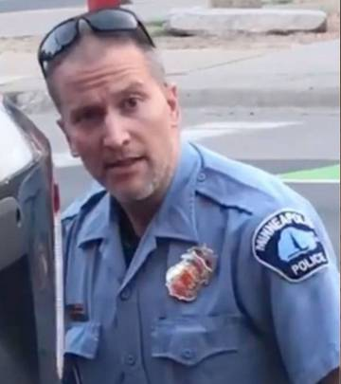
Derek Chauvin, the former Minneapolis cop who has been charged with murder in the death of George Floyd, has had a spotty career with the police department, including at least 17 investigations into him and 12 complaints.
On the home front, Chauvin's life was also in disarray, with a failing marriage and financial woes.
Notes:
Tony Perkins: Derek Chauvin was no saint. That much was known long before his knee crushed the life out of George Floyd. After racking up 17 complaints in 19 years, the question most people have is -- what was he still doing on the police force anyway? If we can stand the answer, it would go a long way to getting some of these bad people off the beat. But it would also mean taking a long hard look at the power of unions in this country. And for some people, that's a bridge too far.

Slide 52
There is a very traditional Jewish prayer, similar poetic genre to the Sermon on the Mount, that lifts our heart to worship G-d for His inscrutable purposes in times of tragedy, and as an expression of community with our Afro-American brothers. .

Slide 53
We’d like to pray this prayer of comfort for the family and friends of George Floyd. Daniel Hall consented to represent the Afro-American people.

Slide 54
קָדֶשׁ Kaddish (The Sanctification)
Public Domain

Slide 55
Magnified and sanctified
be His great name
in the world
which He has created
according to His will.
May He establish His kingdom during your life and
during your days,

Slide 56
and cause His salvation to sprout, and bring near His Messiah, during the life of all the house of Israel, even speedily
and at a near time.
And all say, "A-mayn."

Slide 57
Let His great name be blessed forever and to all eternity.
[Ee-yov [Job] 1:21, Dan 2:20, Tehillim 113:2]
Blessed, praised, and glorified, exalted, extolled, and honored, magnified, and lauded
be the name of the Holy One,
blessed be He;

Slide 58
though He be high above all the blessings and hymns,
praises and consolations,
which are uttered in the world;
and all say, "A-mayn."

Slide 59
May there be abundant
peace from heaven,
and a happy life for us
and for all Israel;
and all say, "A-mayn."

Slide 60
He who makes peace
in His high places,
[Ee-yov [Job] 25:2]
may He in His mercy
make peace for us
and for all Israel;
and all say, "A-mayn."

Slide 61
יִתְגַּדַּל Yeet-ga-dal
וְיִתְקַדַּשׁ V'yeet-ka-dash
שְׁמֵהּ רַבָּא. Sh'mayh ra-ba.
[Y'khezkel 38:23, Ee-yov [Job] 1:21]

Slide 62
בְּעָלְמָא דִּי בְרָא כִרְעוּתֵהּ,
B'al-ma dee v'ra kheer-u-tayh
וְיַמְלִיךְ מַלְכוּתֵהּ
V'yam-leekh mal-khu-tayh

Slide 63
וְיַצְמַח פּוּרְקַּנֶה
V'yats-makh pur-ka-neh
וִיְקַּרֵב מְשִׁיחֵה
Veey-ka-rayv M'shee-khay
בְּחַיֵּיכוֹן וּבְיוֹמֵיכוֹן
B'khi-yay-khon uv-yo-may-khon

Slide 64
וּבְחַיֵּי דְכָל בֵּית יִשְׂרָאֵל.
uv-khi-yay d'khawl bayt Yees-ra-ayl
בַּעֲגָלָא וּבִזְמַן קָרִיב
B'ah-ga-la u-veez-man ka-reev
[Congregation:]
וְאִמְרוּ אָמֵן: V'eem-ru a-mayn

Slide 65
יְהֵא שְׁמֵהּ רַבָּא מְבָרַךְ
לְעָלַם וּלְעָלְמֵי עָלְמַיָּא: יִתְבָּרַךְ...
Y'hay sh'may ra-ba m'va-rakh
[Ee-yov [Job] 25:2, Dan 2:20]
L'a-lam ul-al-may al-may-a.
Yeet ba-rakh.

Slide 66
[Leader:]
יִתְבָּרַךְ וְיִשְׁתַּבַּח,
Yeet-bar-akh v'yeesh-ta-bakh
וְיִתְפָּאַר וְיִתְרוֹמַם וְיִתְנַשֵּׂא
V'yeet-pa-ar v'yeet-ro-mam
V'yeet-na-say

Slide 67
וְיִתְעַלֶּה וְיִתְהַלָּל וְיִתְהַדָּר
v'yeet-ha-dar
V'yeet-a-lay v'yeet-ha-lal
שְׁמֵהּ דְּקֻדְשָׁא
Sh'may d'kud'sha
[Congregation:]
בְּרִיךְ הוּא B'reekh hu

Slide 68
[Leader:]
לְעֵלָּא מִכָּל בִּרְכָתָא
L'ay-lah mee-kawl beer-kha-ta
וְשִׁירָתָא,
V'shee-ra-ta

Slide 69
תֻּשְׁבְּחָתָא וְנֶחֱמָתָא,
Tush-b'kha-ta v'neh-kheh-ma-tah
דַּאֲמִירָן בְּעָלְמָא,
Da-a-mee-ran b'al-ma
וְאִמְרוּ אָמֵן:
V'eem'ru a-mayn

Slide 70
יְהֵא שְׁלָמָא רַבָּא מִן שְׁמַיָּא
Y'hay sh'la-ma ra-ba meen sh’mi-ya
וְחַיִּים עָלֵינוּ וְעַל כָּל יִשְׂרָאֵל,
וְאִמְרוּ אָמֵן:
v'khi-yeem a-lay-nu v'al kawl
Yees-ra-ayl, v'eem'ru a-mayn.

Slide 71
עשֶׂה שָׁלוֹם Oseh shalom (Make Peace)
Public Domain
Based on Ee-yov [Job] 25:2

Slide 72
עשֶׂה שָׁלוֹם בִּמְרוֹמָיו
הוּא יַעֲשֶׂה שָּׁלוֹם עָלֵינוּ
O-seh sha-lom beem-ro-mav
Hu ya-a-seh sha-lom a-lay-nu
וְעַל כָּל יִשְׂרָאֵל, וְאִמְרוּ, וְאִמְרוּ אָמֵן:
V'al kawl Yis-ra-el, V'eem-ru,
V'eem-ru, A-mayn [repeat]

Slide 73
יַעֲשֶׂה שָּׁלוֹם, יַעֲשֶׂה שָּׁלוֹם
Ya-a-seh sha-lom. (x2)
שָּׁלוֹם עָלֵינוּ וְעַל כָּל יִשְׂרָאֵל
Sha-lom a-lay-nu,
V'al kawl Yis-ra-el
[repeat all]
[May He Who makes peace in the heavenlies (Eph. 4: 10)
Make peace for us, and for all Israel. (Matt. 16: 19) ]

Slide 74
עשֶׂה שָׁלוֹם בִּמְרוֹמָיו
הוּא יַעֲשֶׂה שָּׁלוֹם עָלֵינוּ
O-seh sha-lom beem-ro-mav
Hu ya-a-seh sha-lom a-lay-nu
וְעַל כָּל יִשְׂרָאֵל, וְאִמְרוּ, וְאִמְרוּ אָמֵן:
V'al kawl Yis-ra-el, V'eem-ru,
V'eem-ru, A-mayn [repeat]

Slide 75
Review: four varieties of “our own works”

Slide 76
Ceased [rested] from his own work DIY hazard #4
Carnal works of the flesh
Our own righteousness, no need for Yeshua.
Our own working: lone soldier
Messiah’s works, but in our own strength, without joy of worship.
Notes:
Sarah Liberman song that I entered into this Sabbatical epitomizes doing this right!

Slide 77
One more species of “our own works”…
Working for Messiah, without joy! Bucket load in the following…

Slide 78
Sarah Liberman
Living Waters
Mayim Hayim מים חיים
panoply, rich collection scriptures

Slide 79
^{Ps 29.3-4} The voice of Adoni is over the waters. Over mighty waters. The voice of Adoni is powerful. The God of glory thunders | קוֹל יְיָ עַל-הַמָּיִם: עַל-מַיִם רַבִּים. קוֹל-יְיָ בַּכֹּחַ; אֵל-הַכָּבוֹד הִרְעִים;

Slide 80
^{Yn 7.38} He who thirsts come and drink water abundantly Let him who will hear come and know Living waters given freely Living waters given freely | הצָּמֵא יָבוֹא וְיִשְׁתֶּה מַיִם בשפע! מִי שֶׁישמע יָבוֹא וידע מַיִם חַיִּים חנם מַיִם חַיִּים חנם

Slide 81
^{Ps 36.8} How dear is Your love, my G-d Those who find You trust You, Adoni Oases will be revealed to us in the desert ^{Ps 36.8} For those who fear Him lack nothing | כמַה-יָּקָר חַסְדְּךָ, אֱלֹוה מוצאיך יבטחו בך אדוני נְאַת מִדְבָּר יגלו לפניני כִּי-אֵין מַחְסוֹר לִירֵאָיו.

Slide 82
^{Rev 22.1} There is a river that flows from His throne ^{Ps 118.24} We will rejoice and be glad in it. | יש נְהַר שיוֹצֵא מִכִּסֵּא נִשְׂמְחָה וְנָגִילָה בוֹ.

Slide 83
^{Ps 36.8} How dear is Your love, my G-d Those who find You trust You, Adoni ^{Yn 7.38} Rivers of living water will burst forth from within us ^{Ps 36.8} For those who fear Him lack nothing | כמַה-יָּקָר חַסְדְּךָ, אֱלֹוה מוצאיך יבטחו בך אדוני ונְהָרוֹת יפרצו מתוכנו כִּי-אֵין מַחְסוֹר לִירֵאָיו.

Slide 84
Living Water Sarah Liberman Mayim Hayim מים חיים
Notes:
https://youtu.be/IDiGvC5-m28

Slide 85
Ceased [rested] from his own work DIY hazards
Carnal works of the flesh
Our own righteousness, no need for Yeshua.
Our own working: lone soldier
Messiah’s works, but in our own strength, without joy of worship.

Slide 86
The life of a disciple is a beautiful life because it is disciplined, and increasing in the consciousness of God. Sobriety isn't dull or boring or religious; it's sharp and focused and intentional. Actually, it's more like a race car driver on the Autobahn, who must keep exquisite focus and concentration to enjoy the speed and avoid the dangers...can you imagine a race car driver texting?
Notes:
George Whitten May 5, 2020

Slide 87
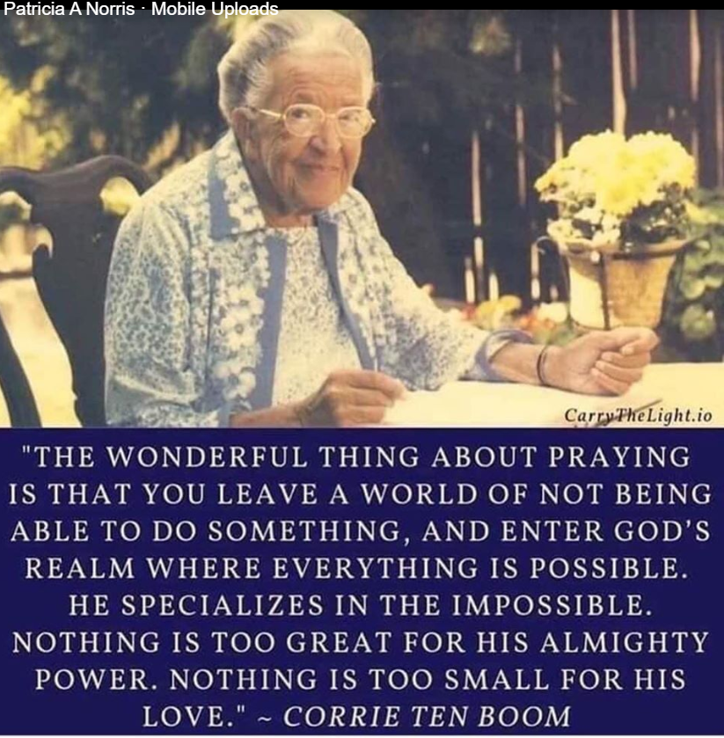
Notes:
Just found out that when Taysir Abu Saada left Gaza 108 believers, then reduced to 76 now 230, some ministering around the world!

