Slide 1
e-handout
To have these notes
without taking notes
Go to OrHaOlam.com
Click on downloads,
messages, 2020

Slide 2
Review: Rosh Hashanna greetings
Shana Tovah שָׁנָה טוֹבָה
[Have a] Good Year
שָׁנָה טוֹבָה וּמְתוּקָה
Shana Tova oo-m’tukah
[Have a] Good and sweet year
Notes:
In traditional Jewry, Rosh HaShannah is celebrated two days. Uncertainty when new moon was..

Slide 3
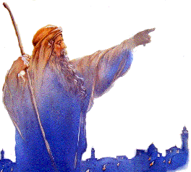
Yirmeyahuיִרְמְיָה
(Jeremiah) 31:10-13

Slide 4
The ancient rabbis chose these verses, actually Yermiyahu /Jer 31.1-19, as the Rosh HaShannah reading, because they are about the promise of redemption to Israel.
Context:

Slide 5
^{Yermihahu/ Jer 31} Thus says Adoni: “The people surviving the sword found grace in the wilderness— where I gave Israel rest.” “From afar Adoni appeared to me.” “Yes, I have loved you with an everlasting love. Therefore I have drawn you with lovingkindness.
Notes:
Holocaust
And redemption of Yeshua the Messiah. Everlasting love and redemption.

Slide 6
^{Yermihahu/ Jer 31} For there will be a day when watchmen will call out in the hill country of Ephraim, ‘Arise, let us go up to Zion, to Adonai our God.’” For thus says Adoni : “Sing aloud with joy for Jacob! Shout with the chief of the nations! Proclaim, give praise, and say: ‘Adoni, save your people, the remnant of Israel!’

Slide 7
^{Yermihahu/ Jer 31} Behold, I will bring them from the north country, and I will gather them from the ends of the earth— among them the blind and the lame, the pregnant together with she who is in labor with child. A great throng will return here. With weeping and supplications they will come. I will bring them,

Slide 8
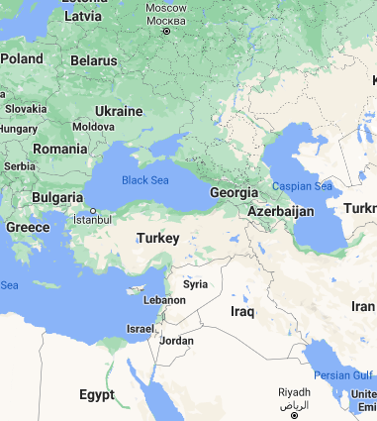
Due NORTH of Israel is Russia / Magog

Slide 9
^{Yermihahu/ Jer 31.9} Hear the word of Adoni, O nations, and declare it in the distant islands, and say: ‘He who scattered Israel will gather and watch over him, as a shepherd does his flock.’

Slide 10
Yirmeyahu (Jeremiah) 31:10 (CJB)
ג כִּי שֵׁם יְהוָה אֶקְרָא ס הָבוּ גֹדֶל לֵאלֹהֵינוּ׃
כִּֽי־פָדָ֥ה יְיָ אֶֽת־יַעֲקֹ֑ב וּגְאָל֕וֹ מִיַּ֖ד חָזָ֥ק מִמֶּֽנּוּ׃
For Adoni has ransomed Ya‘akov, redeemed him from hands too strong for him.
Notes:
Another Holocaust reference

Slide 11
Yirmeyahu (Jeremiah) 31:11 (CJB)
ג כִּי שֵׁם יְהוָה אֶקְרָא ס הָבוּ גֹדֶל לֵאלֹהֵינוּ׃
וּבָאוּ֮ וְרִנְּנ֣וּ בִמְרוֹם־צִיּוֹן֒ וְנָהֲר֞וּ אֶל־ט֣וּב יְיָ עַל־דָּגָן֙ וְעַל־תִּירֹ֣שׁ וְעַל־יִצְהָ֔ר וְעַל־בְּנֵי־צֹ֖אן וּבָקָ֑ר וְהָיְתָ֤ה נַפְשָׁם֙ כְּגַ֣ן רָוֶ֔ה וְלֹא־יוֹסִ֥יפוּ לְדַאֲבָ֖ה עֽוֹד׃
They will come and sing on the heights of Tziyon, streaming to the goodness of Adoni, to the grain, the wine, the olive oil, and the young of the flock and the herd. They themselves will be like a well-watered garden, never to languish again.

Slide 12
Yirmeyahu (Jeremiah) 31:12 (CJB)
ג כִּי שֵׁם יְהוָה אֶקְרָא ס הָבוּ גֹדֶל לֵאלֹהֵינוּ׃
אָ֣ז תִּשְׂמַ֤ח בְּתוּלָה֙ בְּמָח֔וֹל וּבַחֻרִ֥ים וּזְקֵנִ֖ים יַחְדָּ֑ו וְהָפַכְתִּ֨י אֶבְלָ֤ם לְשָׂשׂוֹן֙ וְנִ֣חַמְתִּ֔ים וְשִׂמַּחְתִּ֖ים מִיגוֹנָֽם׃
“Then the virgin will dance for joy, young men and old men together; for I will turn their mourning into joy, comfort and gladden them after their sorrow.
Notes:
No dancing in Jewish worship anywhere till Messianics re-started it from Temple times till about 1980, under Murray Silberling at Beit Emunah, I believe, in Seattle, WA
Together: Messianic dance is typically in lines, circles. NOT individual, כי celebration of peoplehood covenant.

Slide 13
Yirmeyahu (Jeremiah) 31:13 (CJB)
ג כִּי שֵׁם יְהוָה אֶקְרָא ס הָבוּ גֹדֶל לֵאלֹהֵינוּ׃
וְרִוֵּיתִ֛י נֶ֥פֶשׁ הַכֹּהֲנִ֖ים דָּ֑שֶׁן וְעַמִּ֛י אֶת־טוּבִ֥י יִשְׂבָּ֖עוּ נְאֻם־יְיָ
“ I will give the cohanim their fill of rich food, and my people will be satisfied with my bounty,” says Adoni.

Slide 14
But, we are not quite at the point of celebration.
Continuing from last night…

Slide 16
The day, Yom T’ruah, יוֹם תְּרוּעָה
Has a connotation of judgment.
Right now, America is under judgement.
Plague, fires, riots, storms
Will we respond?

Slide 17
The 2020 Atlantic hurricane season is an ongoing tropical cyclone season that has featured tropical cyclone formations at an unprecedented rate. So far, it has featured a total of 24 tropical cyclones,
Notes:
https://en.wikipedia.org/wiki/2020_Atlantic_hurricane_season

Slide 18
23 named storms, eight hurricanes, and two major hurricanes.[nb 1] With 23 named storms, it is the second most active Atlantic hurricane season on record, behind only the 2005
Notes:
https://en.wikipedia.org/wiki/2020_Atlantic_hurricane_season

Slide 19
^{Yeshayahu/Is 28.2} Behold, Adoni is strong and mighty, like a hailstorm, a destructive tempest, like a downpour of overflowing water, He hurls it down to earth with His hand.

Slide 20
America’s sins
Sexual impurity and redefinition
Aborting/murdering babies.
Disrespect of G-d and worship.
Racial bias, baseless hatred
Rioting from unforgiveness.
Notes:
Historical context review last night…

Slide 21
American exceptionalism
a uniquely American ideology based on liberty, equality before the law, individual responsibility, republicanism, representative democracy, and laissez-faire economics.
the idea that America has a mission to transform the world
Notes:
https://en.wikipedia.org/wiki/American_exceptionalism#:~:text=American%20exceptionalism%20is%20a%20European,called%20%22the%20first%20new%20nation%22

Slide 22
The essence of the protests is that America rather was founded on
genocide of the indigenous people
slavery
Greedy exploitative capitalism.
and should be abolished.

Slide 23
This 244 year old republic could be at its end.
Freedom to live and preach Biblically may be viewed as hateful.
Defense of our nation may be viewed as imperialism.

Slide 24
Defund the military as now some police departments are being defunded.
Totally open borders.
Nationalize industries [~Cuba or Russia or Venezuala]
Universal housing, healthcare, salary…

Slide 25
Historical context

Slide 26
Pax Britannica (Latin for "British Peace", modelled after Pax Romana) was the period of relative peace between the Great Powers during which the British Empire became the global hegemonic power and adopted the role of a "global policeman".

Slide 27
Between 1815 and 1914, a period referred to as Britain's "imperial century", around 10,000,000 square miles of territory and roughly 400 million people were added to the British Empire. Victory over Napoleonic France left the British without any serious international rival,

Slide 28
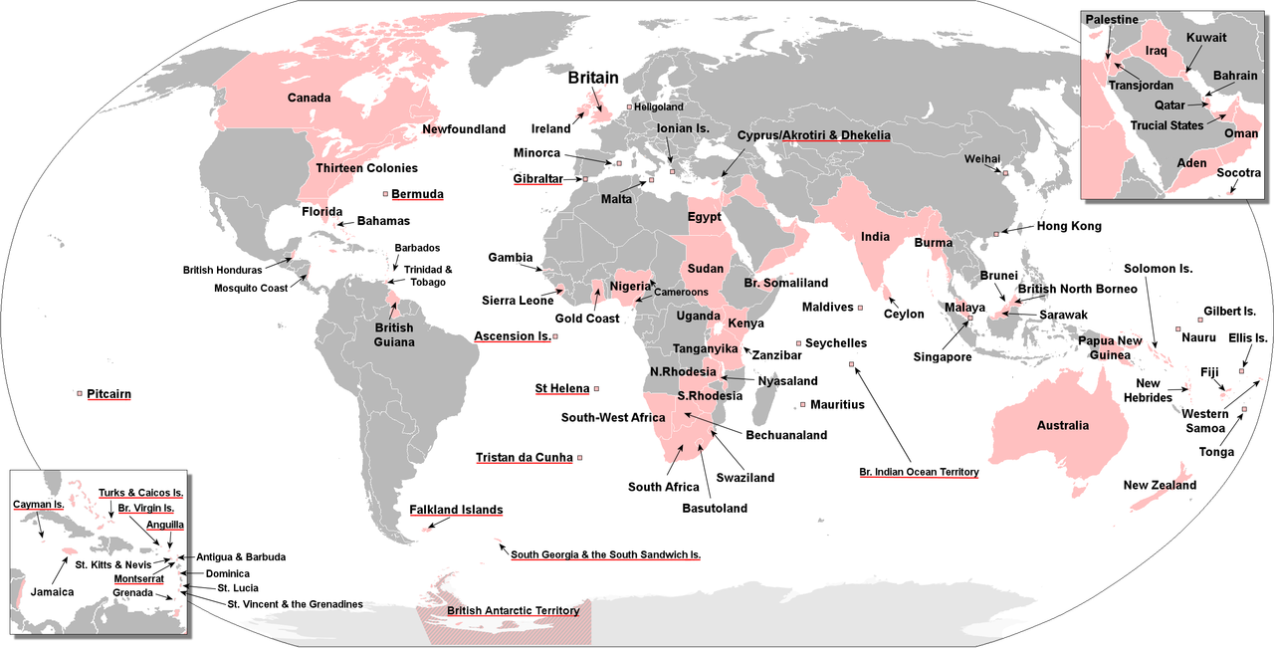
Notes:
Britannia rules the waves.
The sun never sets on the British Empire.
The British lost this all right after WW II. Many reasons. At least one is that they reneged on their promise to provide a homeland in Turkish province of Palestine for the Jewish people, and turned them back for the sake of Arab oil. 6 million perished.

Slide 29
Pax Americana (Latin for "American Peace", is a term applied to the concept of relative peace in the Western Hemisphere and later the world beginning around the middle of the 20th century, thought to be caused by the preponderance of power enjoyed by the United States.
Notes:
https://en.wikipedia.org/wiki/Pax_Americana
So we are used to America being respected, our dollar as the international currency. Necessary? No, but nice.

Slide 30
Hegemony: leadership or dominance, especially by one country or social group over others.
America has had a benevolent hegemony over the world since WW II.
Notes:
We hoped, assumed our model of democracy and freedom would be copied. Iraq!?

Slide 31
There are enemies who desire that hegemony / leadership, and which would not be so benevolent.
Chinese Communists
Mutilation of Uighar Muslims
Hostile takeover of Hong Kong

Slide 32
Notes:
Oil and gas wealth.

Slide 33
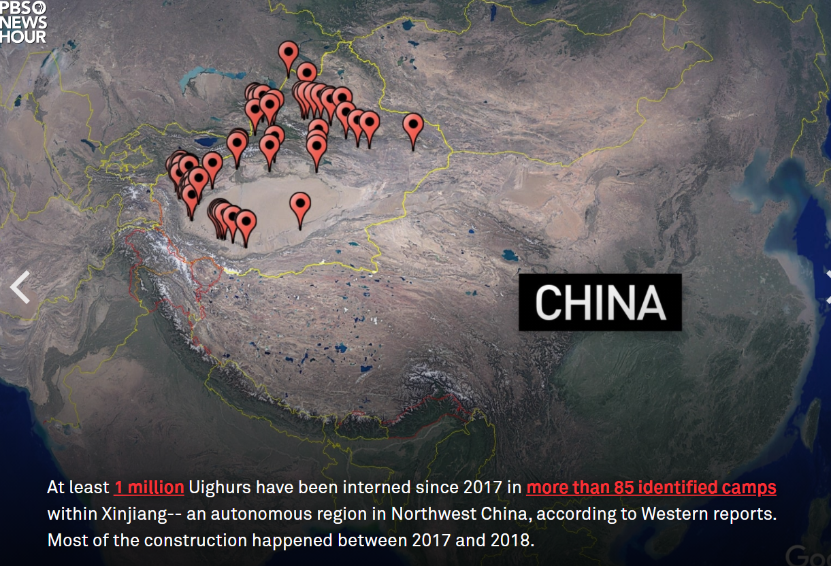
Notes:
https://www.pbs.org/newshour/features/uighurs/

Slide 34
Notes:
https://www.pbs.org/newshour/features/uighurs/

Slide 35
Notes:
https://www.youtube.com/watch?v=_hCoh2snUgw

Slide 36
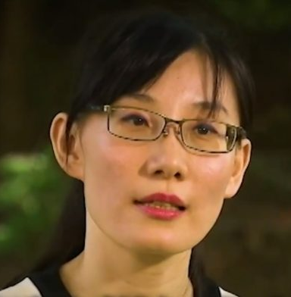
Li-Meng Yan, Chinese virologist who claims that SARS-CoV-2 was made in a lab
Notes:
traditional Chinese: 閆麗夢) or Yan Limeng, is a Chinese virologist who claims that SARS-CoV-2 was made in a lab and that the Chinese government and the World Health Organization knew about person-to-person transmission of COVID-19 much earlier than reported.
One prophetic voice on Sid Roth’s program said that more such plagues are coming!
Plus torture of Falun Gong practitioners. Tony Perkins conveyed confessions of Chinese doctors

Slide 37
Shia Muslims in Iran desire to impose Sharia on the world, defeat the great Satan, the USA, and the little Satan, Israel

Slide 38
A recent example of successful benevolent American hegemony.

Slide 39
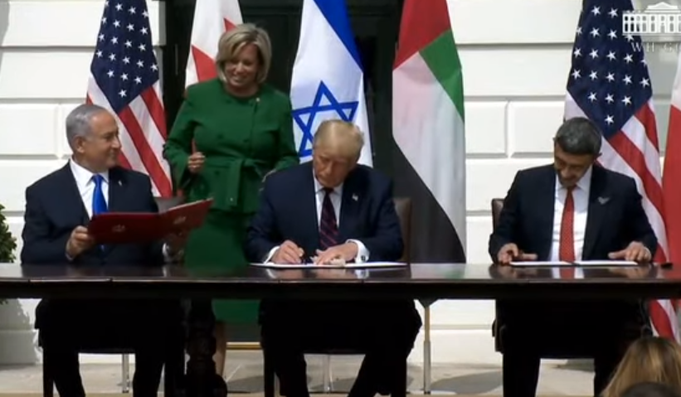
Notes:
https://unitedwithisrael.org/watch-historic-israel-uae-bahrain-peace-deal-signing-at-white-house/

Slide 40
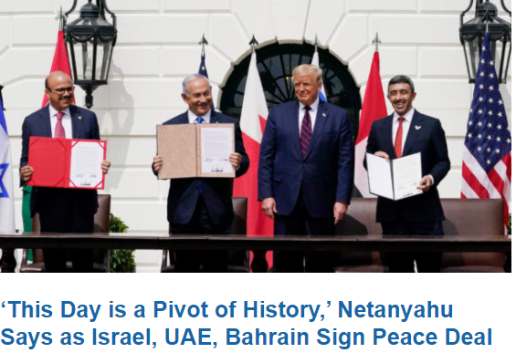

Slide 41
Prophetic significance:
^{Ezek 38.1-6} The word of Adoni came to me saying: “Son of man, set your face toward Gog of the land of Magog, chief prince of Meshech and Tubal. Prophesy against him and say, thus says Adoni Elohim: ‘Behold, I am against you, Gog,

Slide 42
Prophetic significance:
^{Ezek 38.1-6} chief prince of Meshech and Tubal…With them will be Persia, Cush and Put, all of them with shield and helmet, Gomer and all his troops, the house of Togarmah

Slide 43
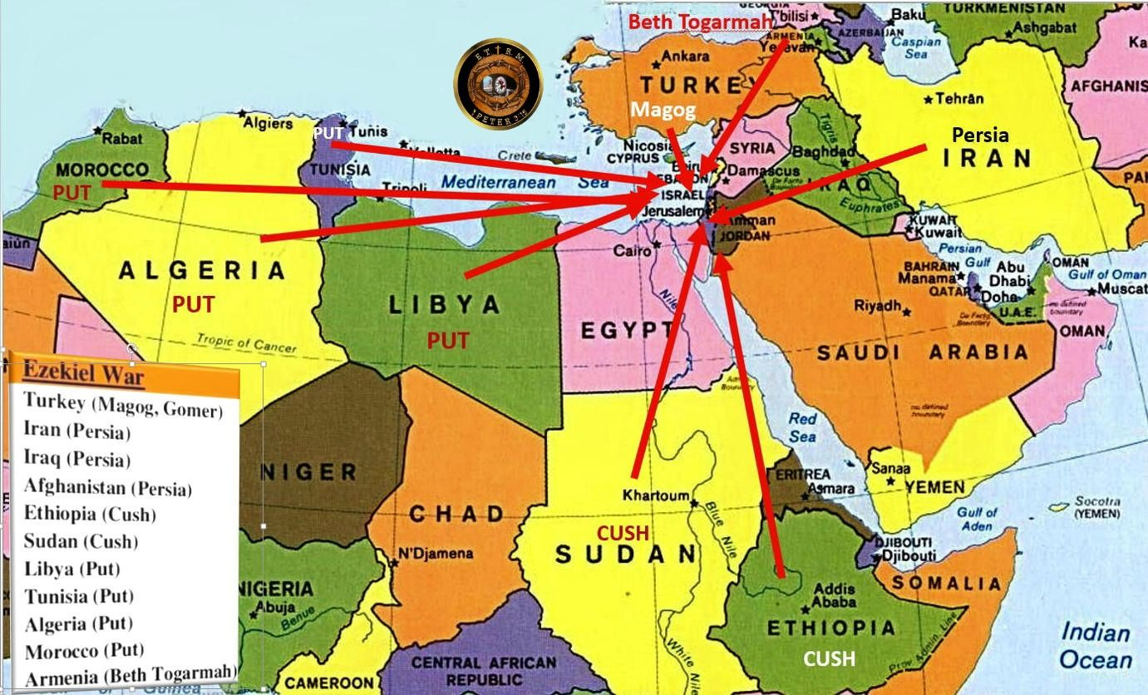
Notes:
https://www.google.com/url?sa=i&url=https%3A%2F%2Fwww.pinterest.com%2Fpin%2F528328600021758808%2F&psig=AOvVaw0_7RkKGYh8XXT0NJNNs-Wp&ust=1600581860421000&source=images&cd=vfe&ved=0CAIQjRxqFwoTCJjbuajG9OsCFQAAAAAdAAAAABAO
This excludes the countries that are in the recent Abrahmic Accords! Previously GREAT enemies of Israel. Stage is now better set for Ezek 38

Slide 44
Daniel Pipes: In the wake of the exhilarating joint UAE-Israel statement, that old sourpuss, Hanan Ashrawi, emerged from her hole to pronounce that "There is an erroneous assumption that the Palestinians are defeated,
Notes:
Copyright © 2020 Daniel Pipes, All rights reserved.
Palestinians are focused on destruction of Israel, and not building. The other Arab nations are wanting economic life, and fear of Iran is overcoming their preoccupation with destruction of Israel.

Slide 45
and they have to accept the fact of their defeat." No, she insisted, "The Palestinians are willing, generation after generation, to continue their struggle."
Notes:
Copyright © 2020 Daniel Pipes, All rights reserved.
Palestinians are focused on destruction of Israel, and not building. The other Arab nations are wanting economic life, and fear of Iran is overcoming their preoccupation with destruction of Israel.

Slide 46
The realistic view – now dominant in Israel – holds that Palestinians never reconciled themselves to Israel's existence. To be sure, Palestinians acknowledged their weakness in 1993 by making empty promises. But, as Mrs. Ashrawi reiterates, they never abandoned the goal of eliminating Israel.
Notes:
Copyright © 2020 Daniel Pipes, All rights reserved.
Abba Eban: The Palestinians never miss an opportunity to miss and opportunity.
Jared Kushner’s brilliance in pulling this off was realizing that peace can come with nations, without the Palestinians.

Slide 47
This is UAE Israel Accord / Abrahamic Covenant is relatively minor. Doesn’t address the dangers within and without.
What will really shape history, save America from our enemies internal and external?
Notes:
Wesley’s England.
Burning Heart, p 9
Then, 1738 p 59

Slide 49
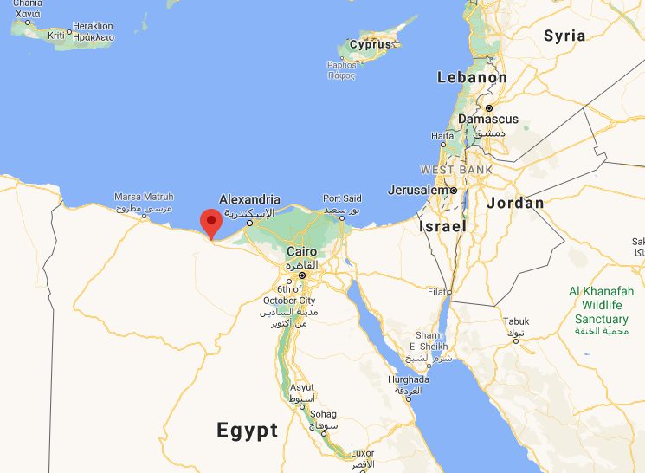
Notes:
Germans Nazis under Rommel were moving from the West, toward the Suez Canal, toward ~600,000 Zionist returnees in then British Palestine.

Slide 50
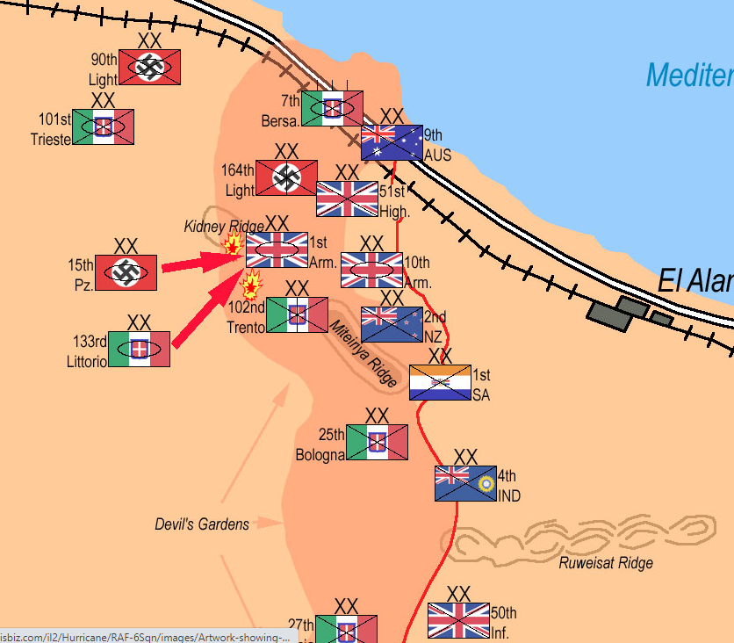

Slide 51
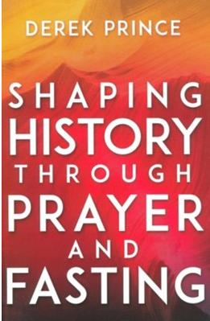
Derek Prince was a British soldier in N. Africa, and describes the 700 mile retreat because of the poor British morale, dissolute officers.
Notes:
http://allmyways.blogspot.com/2008/10/prayer-for-leadership-in-our-country.html

Slide 52
“Lord, give us leaders such that it will be for Your glory to give us victory through them.” I continued praying this prayer every day. In due course, the British government decided to relieve the commander of their forces in the desert and to replace him with another man. The man whom they chose was a general named W.H.E. “Strafer”:Gott.
Notes:
http://allmyways.blogspot.com/2008/10/prayer-for-leadership-in-our-country.html

Slide 53
He was flown to Cairo to take over command, but he was killed when his plane was shot down. At this critical juncture the British forces in this major theater of the war were left without a commander. Winston Churchill, then Prime Minister of Britain, proceeded to act largely on his own initiative. He appointed a more-or-less unknown officer, named B. L. Montgomery, who was hastily flown out from Britain.
Notes:
http://allmyways.blogspot.com/2008/10/prayer-for-leadership-in-our-country.html

Slide 54
Montgomery was the son of an evangelical Anglican bishop. He was a man who very definitely fulfilled god’s two requirements in a leader of men. He was just and god-fearing. He was also a man of tremendous discipline. Within two months, he had instilled a totally new sense of discipline into his officers and had thus restored the confidence of the men in their leaders.
Notes:
http://allmyways.blogspot.com/2008/10/prayer-for-leadership-in-our-country.html

Slide 55
Notes:
First victory against the Nazis in all the war!
Revivals, Laws and Leaders p 40

Slide 56
Shaking
Repentance and return
Awakening and revival
Message of Messiah more viral than COVID
Harvest Jews and the Nations
Healing of the land.
Notes:
From Stewart Winograd

Slide 57
^{1 Kefa/Peter 3.21-22} The water of immersion, which is not the removal of dirt from the body, but one’s pledge to keep a good conscience toward God, through the resurrection of Yeshua the Messiah. He has gone into heaven and is at the right hand of God, with angels, authorities and powers subject to him.
Notes:
We had a little taste of this…

Slide 58
Trella Trometer immersion 9/13/2020

Slide 59
Trella Trometer immersion 9/13/2020

Slide 60
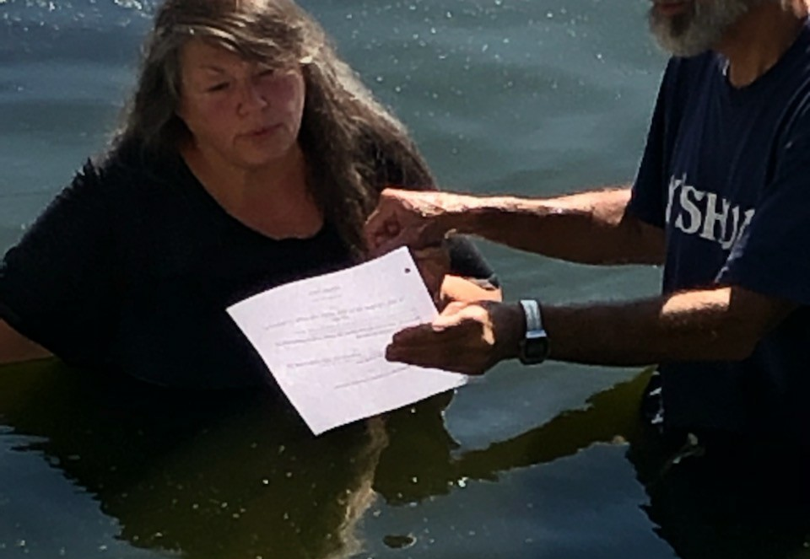
Rhonda Weaver immersion 9/13/2020

Slide 61
Yirmeyahu (Jeremiah) 31:10 (CJB)
ג כִּי שֵׁם יְהוָה אֶקְרָא ס הָבוּ גֹדֶל לֵאלֹהֵינוּ׃
כִּֽי־פָדָ֥ה יְיָ אֶֽת־יַעֲקֹ֑ב וּגְאָל֕וֹ מִיַּ֖ד חָזָ֥ק מִמֶּֽנּוּ׃
For Adoni has ransomed Ya‘akov, redeemed him from hands too strong for him.

Slide 62
Yirmeyahu (Jeremiah) 31:11 (CJB)
ג כִּי שֵׁם יְהוָה אֶקְרָא ס הָבוּ גֹדֶל לֵאלֹהֵינוּ׃
וּבָאוּ֮ וְרִנְּנ֣וּ בִמְרוֹם־צִיּוֹן֒ וְנָהֲר֞וּ אֶל־ט֣וּב יְיָ עַל־דָּגָן֙ וְעַל־תִּירֹ֣שׁ וְעַל־יִצְהָ֔ר וְעַל־בְּנֵי־צֹ֖אן וּבָקָ֑ר וְהָיְתָ֤ה נַפְשָׁם֙ כְּגַ֣ן רָוֶ֔ה וְלֹא־יוֹסִ֥יפוּ לְדַאֲבָ֖ה עֽוֹד׃
They will come and sing on the heights of Tziyon, streaming to the goodness of Adoni, to the grain, the wine, the olive oil, and the young of the flock and the herd. They themselves will be like a well-watered garden, never to languish again.

Slide 63
Yirmeyahu (Jeremiah) 31:12 (CJB)
ג כִּי שֵׁם יְהוָה אֶקְרָא ס הָבוּ גֹדֶל לֵאלֹהֵינוּ׃
אָ֣ז תִּשְׂמַ֤ח בְּתוּלָה֙ בְּמָח֔וֹל וּבַחֻרִ֥ים וּזְקֵנִ֖ים יַחְדָּ֑ו וְהָפַכְתִּ֨י אֶבְלָ֤ם לְשָׂשׂוֹן֙ וְנִ֣חַמְתִּ֔ים וְשִׂמַּחְתִּ֖ים מִיגוֹנָֽם׃
“Then the virgin will dance for joy, young men and old men together; for I will turn their mourning into joy, comfort and gladden them after their sorrow.

Slide 64
Yirmeyahu (Jeremiah) 31:13 (CJB)
ג כִּי שֵׁם יְהוָה אֶקְרָא ס הָבוּ גֹדֶל לֵאלֹהֵינוּ׃
וְרִוֵּיתִ֛י נֶ֥פֶשׁ הַכֹּהֲנִ֖ים דָּ֑שֶׁן וְעַמִּ֛י אֶת־טוּבִ֥י יִשְׂבָּ֖עוּ נְאֻם־יְיָ
“ I will give the cohanim their fill of rich food, and my people will be satisfied with my bounty,” says Adoni.

Slide 65
^{Yeshayau /Is 43.1-3} But now this is what Adonai says, he who created you, Ya‘akov, he who formed you, Isra’el: “Don’t be afraid, for I have redeemed you; I am calling you by your name; you are mine. When you pass through water,

Slide 66
^{Yeshayau /Is 43.1-3} I will be with you; when you pass through rivers, they will not overwhelm you; when you walk through fire, you will not be scorched — the flame will not burn you. For I am Adonai, your God, the Holy One of Isra’el, your Savior —

Slide 67
The words of Abraham Lincoln, at another crisis time in American history: It is rather for us to be here dedicated to the great task remaining before us—that from these honored dead we take increased devotion to that cause for which they gave the last full measure of devotion—that we here highly resolve that…

Slide 68
this nation, under God, shall have a new birth of freedom—and that government of the people, by the people, for the people, shall not perish from the earth.

Slide 69
^{1K 8.38} when prayer or supplication is made by anyone or by all Your people Israel—each knowing the plague of his own heart

Slide 70
^{Divrei Yamin ב /2 Chron 713-14} If I shut up the sky, so that there is no rain; or if I order locusts to devour the land; or if I send an epidemic of sickness among my people; then, if my people, who bear my name, will humble themselves, pray, seek my face and turn from their evil ways, I will hear from heaven, forgive their sin and heal their land.

Slide 71
^{Yoel 2.12-14} “Yet even now,” says Adoni, “turn to me with all your heart, with fasting, weeping and lamenting.” Tear your heart, not your garments; and turn to Adoni your God. For he is merciful and compassionate, slow to anger, rich in grace,

Slide 72
^{Yoel 2.12-14} and willing to change his mind about disaster. Who knows? He may turn, change his mind and leave a blessing behind him.

Slide 73
The election will not save us. We need a culture change, only by a spiritual renewal. Such transformation has happened before in history: Wesley, Fiji Islands, Hebrides, Yeshua movement 1970’s.
By intercession… continued tomorrow. Hear the shofar call…

Slide 74
The day, Yom T’ruah, יוֹם תְּרוּעָה
Has a connotation of judgment.
Right now, America is under judgement.
Will we respond?

Slide 76
