Slide 1
e-handout
To have these notes
without taking notes
Go to OrHaOlam.com
Click on downloads,
messages, 2020

Slide 2
While most puns make me feel numb,
Notes:
Lori Wilson

Slide 3
While most puns make me feel numb,
mathematics puns make me feel number.
Notes:
Lori Wilson
What is a mathematics pun?

Slide 4
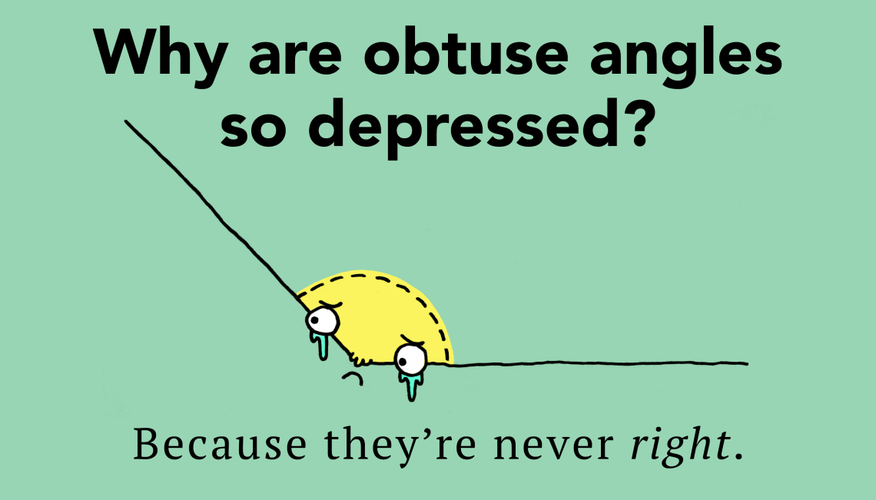
Notes:
https://www.google.com/url?sa=i&url=https%3A%2F%2Fthoughtcatalog.com%2Fjanuary-nelson%2F2018%2F04%2F39-math-jokes-and-puns-that-will-make-you-smile-easy-as-pi%2F&psig=AOvVaw0ePkJfG92ziSwZBpWaYsxY&ust=1611469970089000&source=images&cd=vfe&ved=0CAIQjRxqFwoTCICkscu3se4CFQAAAAAdAAAAABAN

Slide 5
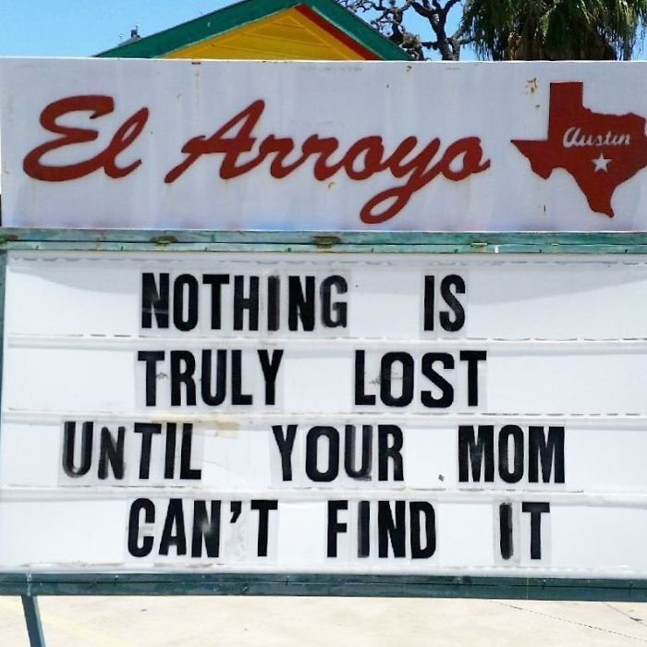
Notes:
Or your wife.

Slide 6
Notes:
Be careful how you communicate…

Slide 9
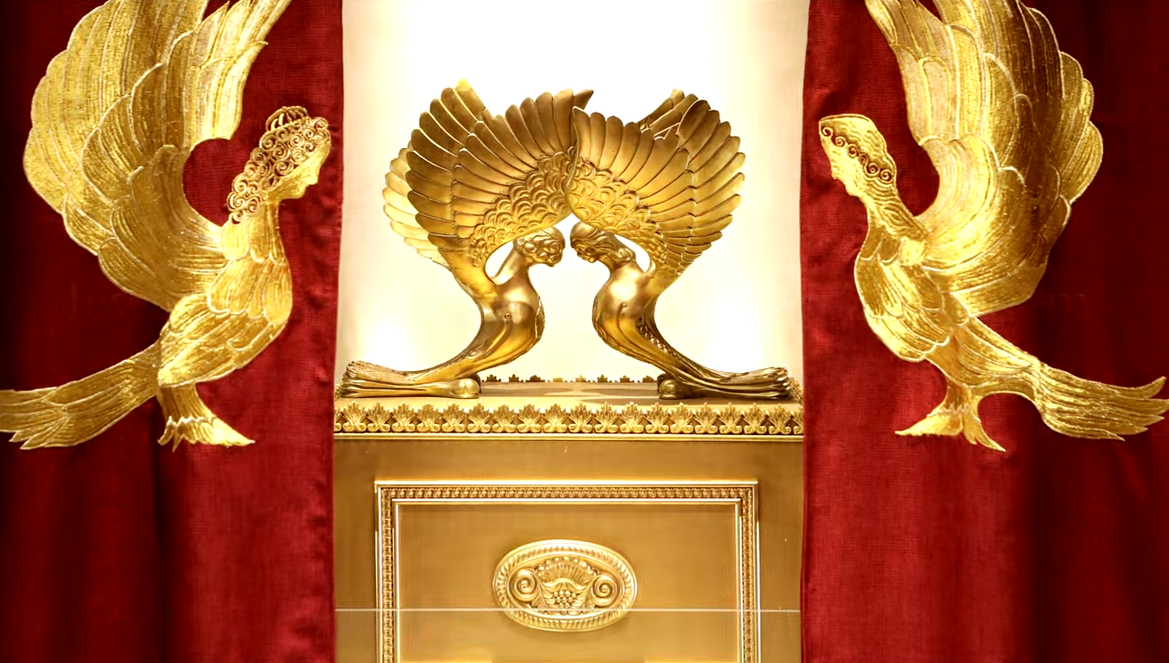
Letter to the Messianic Jews
MJ.8.3 Something To offer
Notes:
https://www.templeinstitute.org/new-location.htm

Slide 10
^{MJ 8.3} For every cohen gadol [High Priest] is appointed to offer both gifts and sacrifices; so this cohen gadol too has to have something he can offer.
Notes:
He was not from the tribe of Levi, so couldn’t officiate, give animal sacrifices in the Temple.
“something to offer” was the Holy Spirit download line to me.

Slide 11
Outline
Yeshua was the Cohen Gadol/ High Priest ~ Melkitsedek
A Cohen has to have an offering. What was His offering?

Slide 12
We are called to be Cohanim/ priests.
A Cohen has to have an offering. What is our offering?

Slide 13
Outline
Yeshua was the Cohen Gadol/ High Priest ~ Melkitsedek
A Cohen has to have an offering. What was His offering?

Slide 14
In the B’sorot Gospels, Yeshua never uses the term that He is our sacrifice or offering.
Other terms were used, since the Torah forbad human sacrifice.
Notes:
Brett pointed out

Slide 15
^{Mtt 20.28} For the Son of Man did not come to be served, but to serve — and to give his life as a ransom for many.”

Slide 16
^{Yn 1.29} The next day, Yochanan [John] saw Yeshua coming toward him and said, “Look! God’s lamb! The one who is taking away the sin of the world!
Notes:
Later, in the writings of Shaul/Paul…

Slide 17
^{1 Cor. 5.7} Get rid of the old hametz [leaven], so that you can be a new batch of dough, because in reality you are unleavened. For our Pesakh lamb, the Messiah, has been sacrificed.

Slide 18
^{MJ 9.13-14} The blood of the Messiah, who, through the eternal Spirit, offered himself to God as a sacrifice without blemish, will purify our conscience from works that lead to death, so that we can serve the living God!

Slide 19
^{Eph.5.1-2} Therefore be imitators of God, as dearly loved children; and walk in love, just as Messiah also loved us and gave Himself up for us as an offering and sacrifice to God for a fragrant aroma.

Slide 20
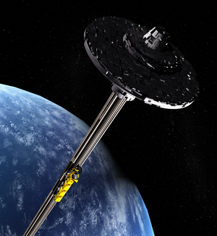
Resurrection
Spiritual
“Space”
Elevator
Like Jacob’s vision of a ladder
Notes:
Jim Templer’s observation
Yeshua Himself, His body, His Life, was the sacrifice He gave for us.

Slide 21
Outline
Yeshua was the Cohen Gadol/ High Priest ~ Melkitsedek
A Cohen has to have an offering. What was His offering? He was the offering.

Slide 22
We are called to be Cohanim/ priests.

Slide 23
^{1 Kefa/Peter 2.5} You yourselves…are being built into a spiritual house to be cohanim set apart for God to offer spiritual sacrifices acceptable to him through Yeshua the Messiah.

Slide 24
^{Eph.5.1-2} Therefore be imitators of God, as dearly loved children; and walk in love, just as Messiah also loved us and gave Himself up for us as an offering and sacrifice to God for a fragrant aroma.

Slide 25
Outline
Yeshua was the Cohen Gadol/ High Priest ~ Melkitsedek
A Cohen has to have an offering. What was His offering? He was the offering.

Slide 26
We are called to be Cohanim/ priests.
A Cohen has to have an offering. What is our offering?
Notes:
This is actually the download line from the Ruakh, the Spirit for me.
His offering gives us the power to make our offering.

Slide 27
^{Micah 5.6-7} With what shall I come before Adoni? With what shall I bow myself before God on high? Shall I present Him with burnt offerings, with year-old calves? Will Adoni be pleased with thousands of rams, with hordes of rivers of oil?
Notes:
Great money donations?

Slide 28
^{Micah 5.6-7} Shall I offer my firstborn for my transgression, the fruit of my belly for the sin of my soul? He has told you, humanity, what is good, and what Adoni is seeking from you: Only to practice justice, to love mercy, and to walk humbly with your God.
Notes:
Do Justice: precise justice on ourselves
Love Mercy: mercy on others

Slide 29
^{Ro 12.1} I exhort you, therefore, brothers, in view of God’s mercies, to offer yourselves as a sacrifice, living and set apart for God. This will please him; it is the logical “Temple worship” for you.
Notes:
Our bodies belong to G-d, to be used for His purposes and in His ways. Self care spiritually and physically.
His offering gives us the power to make our offering.

Slide 30
^{Eph.5.1-2} Therefore be imitators of God, as dearly loved children; and walk in love, just as Messiah also loved us and gave Himself up for us as an offering and sacrifice to God for a fragrant aroma.

Slide 31
^{1 Yn 3.16} The way that we have come to know love is through his having laid down his life for us. And we ought to lay down our lives for the brothers!

Slide 32
^{Col. 2.1-2} I want you to know how great a struggle I have for you and for those in Laodicea. My purpose is that their hearts, joined together in love, may be encouraged. May they have all the riches of the full assurance of understanding, leading to a true knowledge of the mystery of God—that is, Messiah.

Slide 33
^{Phil 2.17-18} Indeed, even if my lifeblood is poured out as a drink offering over the sacrifice and service of your faith, I will still be glad and rejoice with you all. Likewise, you too should be glad and rejoice with me.

Slide 34
Optional exercise:
Look at someone and say, I will sacrifice my life for you.
Notes:
I’ve had two people say this to me. Gentiles.
“I’d take a bullet for you.”

Slide 35
Optional exercise:
Look at someone and say, I will suffer whatever it takes to build you up in the Kingdom.
Notes:
Usually those closest to us.

Slide 36
Not optional exercise:
Look at G-d, in your spirit, and say, I will suffer whatever it takes to advance Your Kingdom.

Slide 37
^{John 15.18-20} “If the world hates you, understand that it hated me first. If you belonged to the world, the world would have loved its own. But because you do not belong to the world — on the contrary, I have picked you out of the world

Slide 38
^{John 15.18-20} “— therefore the world hates you. Remember what I told you, ‘A slave is not greater than his master.’ If they persecuted me, they will persecute you too; if they kept my word, they will keep yours too.

Slide 39
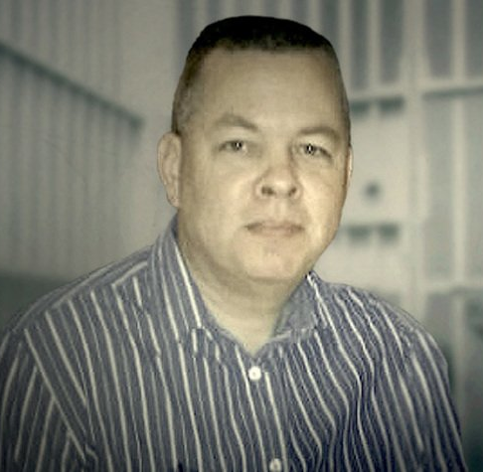
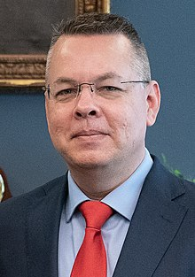

Slide 40
Andrew Brunson is originally from Black Mountain, North Carolina. He is married and has three children. Brunson lived in Turkey for 23 years where he served as pastor of the Izmir Resurrection Church. Pastor Brunson “…thought I'd be in Turkey the rest of my life doing church planting.“
Notes:
https://www.frc.org/get.cfm?i=WA21A30&f=WU21A09
https://en.wikipedia.org/wiki/Andrew_Brunson
We love outreach here. Not so successful yet but a bit. Essence of what the enemy hates.

Slide 41
Brunson, was imprisoned on October 7, 2016 as part of the purges that followed the failed 2016 coup attempt. His wife, Norine, was initially arrested alongside him, but was released after 13 days. For a time Brunson was held with 21 others in a cell that was made for eight prisoners.
Notes:
https://www.frc.org/get.cfm?i=WA21A30&f=WU21A09
https://en.wikipedia.org/wiki/Andrew_Brunson

Slide 42
Indictment The Turkish government primarily claimed that Brunson was a member of the Gülen movement, but also claimed that he worked with the banned Kurdistan Workers' Party (PKK), and claimed that he was involved with American espionage, among other things.
Notes:
https://www.frc.org/get.cfm?i=WA21A30&f=WU21A09
https://en.wikipedia.org/wiki/Andrew_Brunson
Always a reason. The persecuted are a threat to society.

Slide 43
"I thought I'd be in Turkey the rest of my life doing church planting," he admitted on "Washington Watch." God had other plans. When Andrew was wrongfully charged and sentenced to life behind bars, he's pretty candid: it broke him.
Notes:
https://www.frc.org/get.cfm?i=WA21A30&f=WU21A09

Slide 44
Nothing, he said, equipped him for the kind of persecution he experienced. “I had counted the cost for some pressure, but certainly not for prison.”
Notes:
https://www.frc.org/get.cfm?i=WA21A30&f=WU21A09

Slide 45
Over time, Andrew says, the despair broke him. "And every time I broke, I had to get up again and learn perseverance at a deeper level." But there was a purpose to the pain. "God allowed me to be broken like that so that I could be an encouragement to other people who are going to face persecution."
Notes:
https://www.frc.org/get.cfm?i=WA21A30&f=WU21A09

Slide 46
On October 12, 2018, Brunson was convicted, by Turkish authorities, on the charge of aiding terrorism, but sentenced to time served. He was released from Turkish custody and immediately returned to the United States.
Notes:
https://www.frc.org/get.cfm?i=WA21A30&f=WU21A09
https://en.wikipedia.org/wiki/Andrew_Brunson
Two years and 5 days.

Slide 47
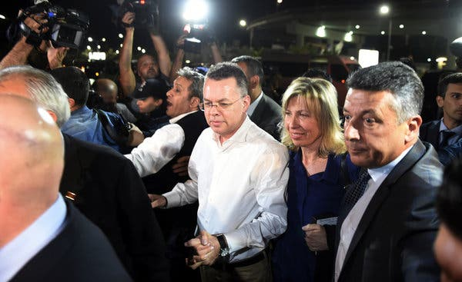
Notes:
Andrew Brunson arriving at a Turkish airport on Friday. He was to fly to Germany, and then the U.S.
Credit...Emre Tazegul/Associated Press
https://www.nytimes.com/2018/10/12/world/europe/turkey-us-pastor-andrew-brunson.html

Slide 48
"One thing I want to underline from my experience is that those who persecute [are] going to justify it by saying that we're hate groups, that we have a message of hate."
Notes:
https://www.frc.org/get.cfm?i=WA21A30&f=WU21A09

Slide 49
Your views make people unsafe. You can't use social media. You can't use your bank account, your credit cards, things like that.
Notes:
https://www.frc.org/get.cfm?i=WA21A30&f=WU21A09

Slide 50
"There's a real sea change taking place in our country and this generation... The hostility toward followers of Messiah is going to rise," he warned.
Notes:
https://www.frc.org/get.cfm?i=WA21A30&f=WU21A09

Slide 51
How to prepare for our offering, the sacrifice of suffering for the Kingdom, and persevering…

Slide 52
Talk about persecution
For starters, Andrew says, be aware that people have suffered -- and are suffering -- persecution in many countries.

Slide 53
1. Talk about persecution Americans have been spared from that fate because, despite the sins of our country, generations were still faithful to God.

Slide 54
2. Pursue Intimacy with God
Cultivating a love for God doesn't necessarily come naturally, Andrew says. We have to grow it. "This is the number one thing that fueled my perseverance."
Notes:
https://www.frc.org/get.cfm?i=WA21A30&f=WU21A09

Slide 55
3. Develop the Right Perspective: Fear of God, Not Man
“Yeshua said very clearly: 'Don't fear those who kill the body but cannot kill the soul; rather fear Him who can destroy both soul and body and in hell.'
Notes:
https://www.frc.org/get.cfm?i=WA21A30&f=WU21A09

Slide 56
3. Develop the Right Perspective: Fear of God, Not Man
“That wasn't empty rhetoric," Andrew insists. “He was saying this to his disciples, and most of them were killed for their faithfulness to Yeshua.
Notes:
https://www.frc.org/get.cfm?i=WA21A30&f=WU21A09

Slide 57
4. Determine ahead of Time to Follow Yeshua
"If we make the decisions now, then we're more likely to have an anchor to hold on to when the winds come, when the storm comes.
Notes:
https://www.frc.org/get.cfm?i=WA21A30&f=WU21A09

Slide 58
4. Determine ahead of Time to Follow Yeshua
Whereas if we don't make those decisions now, then when we are under pressure, we may not have the strength to make them. So you have to decide ahead of time.
Notes:
https://www.frc.org/get.cfm?i=WA21A30&f=WU21A09
Practice it in stressful situations now.

Slide 59
5. Stand on the Word
"We need to make the decision that we won't compromise the word of God, even if it costs us," Andrew urges. Of course, to do that, we have to know what the word of God says.
Notes:
https://www.frc.org/get.cfm?i=WA21A30&f=WU21A09

Slide 60
5. Stand on the Word
"That means we've got to be in the word of God. One of the things lacking most in the believing community today is biblical literacy.”
Notes:
https://www.frc.org/get.cfm?i=WA21A30&f=WU21A09

Slide 61
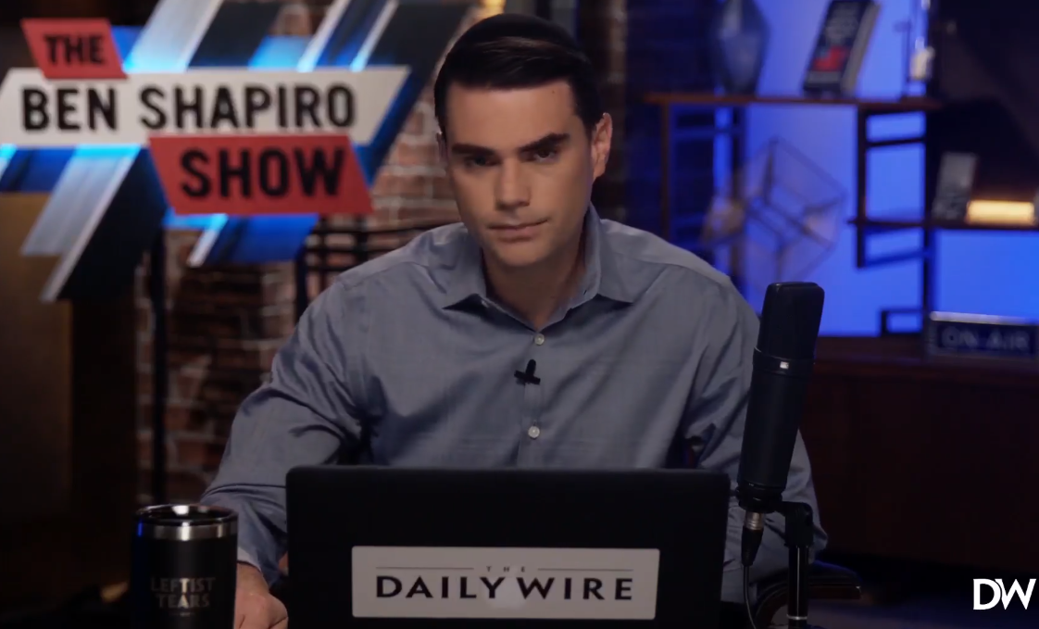
Notes:
https://www.dailywire.com/news/on-day-one-joe-bidens-transgender-executive-order-destroys-womens-rights?utm_campaign=dw_newsletter&utm_medium=email&_hsmi=107649078&_hsenc=p2ANqtz-8-mHpjQ_6Mb9UXNHWsPKIQI6C2sZleykDFTJ6JQZK79zu38ZkwiVd7xNDjPy118wAh3pOR3aapgxFB5If7I_C5vc6phw&utm_content=non_insiders&utm_source=housefile

Slide 62
17 Executive orders the first day: The first paragraph of one order contains the following: “Children should be able to learn without worrying about whether they will be denied access to the restroom, the locker room, or school sports.”
Notes:
https://www.dailywire.com/news/on-day-one-joe-bidens-transgender-executive-order-destroys-womens-rights?utm_campaign=dw_newsletter&utm_medium=email&_hsmi=107649078&_hsenc=p2ANqtz-8-mHpjQ_6Mb9UXNHWsPKIQI6C2sZleykDFTJ6JQZK79zu38ZkwiVd7xNDjPy118wAh3pOR3aapgxFB5If7I_C5vc6phw&utm_content=non_insiders&utm_source=housefile

Slide 63
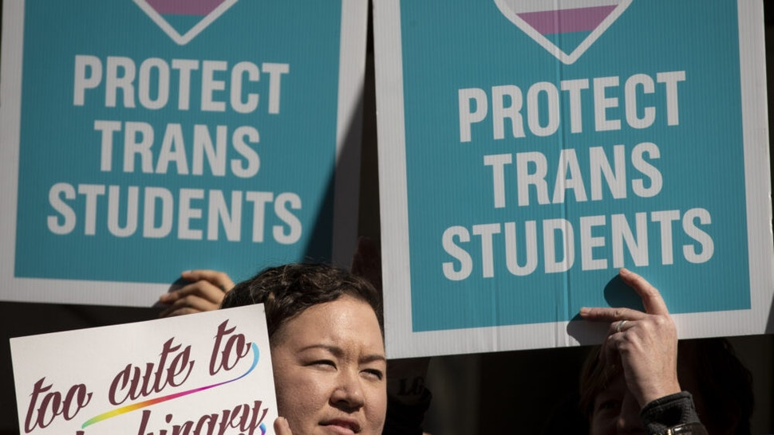
Notes:
https://www.dailywire.com/news/on-day-one-joe-bidens-transgender-executive-order-destroys-womens-rights?utm_campaign=dw_newsletter&utm_medium=email&_hsmi=107649078&_hsenc=p2ANqtz-8-mHpjQ_6Mb9UXNHWsPKIQI6C2sZleykDFTJ6JQZK79zu38ZkwiVd7xNDjPy118wAh3pOR3aapgxFB5If7I_C5vc6phw&utm_content=non_insiders&utm_source=housefile

Slide 64
So, what does this mean? This means that children — defined by the federal government by anyone who is younger than age 18 or who is not an emancipated minor — have the “right” to decide which restroom or locker room they use. What does this mean, in raw actuality?
Notes:
https://www.dailywire.com/news/on-day-one-joe-bidens-transgender-executive-order-destroys-womens-rights?utm_campaign=dw_newsletter&utm_medium=email&_hsmi=107649078&_hsenc=p2ANqtz-8-mHpjQ_6Mb9UXNHWsPKIQI6C2sZleykDFTJ6JQZK79zu38ZkwiVd7xNDjPy118wAh3pOR3aapgxFB5If7I_C5vc6phw&utm_content=non_insiders&utm_source=housefile

Slide 65
Girls who believe they are boys can enter bathrooms and locker rooms designated for boys and, more worryingly, boys who believe they are girls can enter bathrooms and locker rooms designated for girls. Don’t like it? Too bad.
Notes:
https://www.dailywire.com/news/on-day-one-joe-bidens-transgender-executive-order-destroys-womens-rights?utm_campaign=dw_newsletter&utm_medium=email&_hsmi=107649078&_hsenc=p2ANqtz-8-mHpjQ_6Mb9UXNHWsPKIQI6C2sZleykDFTJ6JQZK79zu38ZkwiVd7xNDjPy118wAh3pOR3aapgxFB5If7I_C5vc6phw&utm_content=non_insiders&utm_source=housefile

Slide 66
Cutting through the vague and evasive language of the executive order, this means that — just by claiming that they are a girl — boys will have access to an enclosed and previously private space where girls can undress.
Notes:
https://www.dailywire.com/news/on-day-one-joe-bidens-transgender-executive-order-destroys-womens-rights?utm_campaign=dw_newsletter&utm_medium=email&_hsmi=107649078&_hsenc=p2ANqtz-8-mHpjQ_6Mb9UXNHWsPKIQI6C2sZleykDFTJ6JQZK79zu38ZkwiVd7xNDjPy118wAh3pOR3aapgxFB5If7I_C5vc6phw&utm_content=non_insiders&utm_source=housefile

Slide 67
Not only that, they will have the supposed right to undress in front of these girls, forcing them into — at best — an uncomfortable situation, and — at worst — a dangerous one.
Notes:
https://www.dailywire.com/news/on-day-one-joe-bidens-transgender-executive-order-destroys-womens-rights?utm_campaign=dw_newsletter&utm_medium=email&_hsmi=107649078&_hsenc=p2ANqtz-8-mHpjQ_6Mb9UXNHWsPKIQI6C2sZleykDFTJ6JQZK79zu38ZkwiVd7xNDjPy118wAh3pOR3aapgxFB5If7I_C5vc6phw&utm_content=non_insiders&utm_source=housefile

Slide 68
10 Spirit-Filled Ways to Respond Right Now
1. Pray for revival as never before.
Notes:
https://www.charismanews.com/us/84094-10-spirit-filled-ways-for-never-biden-voters-to-respond-right-now?utm_source=Charisma%20News%20Daily&utm_medium=email&utm_content=subscriber_id:5160390&utm_campaign=CNO%20daily%20-%202021-01-21

Slide 69
 | Midnight | 1 a.m. | 2 a.m. | 3 a.m.
Sunday | Louise Warfare children | Kathi Joy, music | Shmuel Sweet reality | Greg
Monday | Cathy A | Ramona | Amy Stewart | Amy Richardson
Notes:
- Password protected Joomla page with short registration form
- Staff can change the password at any time. Notify users of the new password.
- Staff can edit notes, instructions, messages shown to the users.
- Calendar of the week shown with the ability for any user to sign up for a 1/2 - 1 hour block
- Users can edit / delete their entry at any time
- Users may also optionally indicate that they are "attending" the event
- After the time has passed, the user can submit a short report
- Users can look backwards or forward through the calendar, either to review past signups, or to volunteer for times in the future

Slide 70
10 Spirit-Filled Ways to Respond Right Now
2. Immerse our new president in prayer.
3. Resist fear, anger and hopelessness.
Notes:
https://www.charismanews.com/us/84094-10-spirit-filled-ways-for-never-biden-voters-to-respond-right-now?utm_source=Charisma%20News%20Daily&utm_medium=email&utm_content=subscriber_id:5160390&utm_campaign=CNO%20daily%20-%202021-01-21

Slide 71
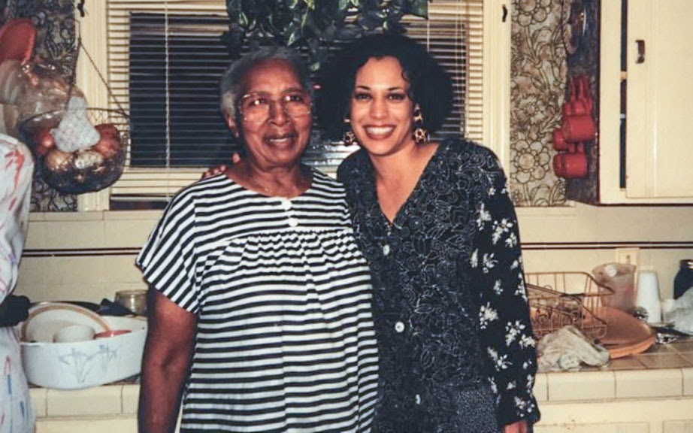
From Gary Kendall, local pastor
Kamala Harris and “my second
Mom,” Regina Shelton, a neighbor
who lived two doors down.
Notes:
Mrs. Shelton would take her neighbors to church at the 23rd Avenue Church of God, where they learned of a loving God, so she borrowed Regina’s Bible and used it as a support on which to lay her hand as she promised to uphold the office of Vice-President.
Copyright © 2021 Love KC, All rights reserved. Love KC 12417 Ellsworth St Olathe, KS 666062

Slide 72
10 Spirit-Filled Ways to Respond Right Now
4. Trust God and lean not on our own understanding.
5. Remember that we are citizens of the kingdom of God—a kingdom that cannot be shaken. We are just passing through.
Notes:
https://www.charismanews.com/us/84094-10-spirit-filled-ways-for-never-biden-voters-to-respond-right-now?utm_source=Charisma%20News%20Daily&utm_medium=email&utm_content=subscriber_id:5160390&utm_campaign=CNO%20daily%20-%202021-01-21

Slide 73
10 Spirit-Filled Ways to Respond Right Now
6. Walk in love and be peacemakers to everyone around us—on both sides of the aisle.
7. Repent for any part we played in letting politics divide the congregation and any negative rhetoric in which we took part.
Notes:
https://www.charismanews.com/us/84094-10-spirit-filled-ways-for-never-biden-voters-to-respond-right-now?utm_source=Charisma%20News%20Daily&utm_medium=email&utm_content=subscriber_id:5160390&utm_campaign=CNO%20daily%20-%202021-01-21
Discord about masks, election validity

Slide 74
10 Spirit-Filled Ways to Respond Right Now
8. Remember that God is sovereign, in complete control and holds the universe in the palm of His hand.
9. Get our priorities back in order from the distractions of this election and be about the business of the kingdom.
Notes:
https://www.charismanews.com/us/84094-10-spirit-filled-ways-for-never-biden-voters-to-respond-right-now?utm_source=Charisma%20News%20Daily&utm_medium=email&utm_content=subscriber_id:5160390&utm_campaign=CNO%20daily%20-%202021-01-21
Dr. Jamie Morgan is lead pastor of Life Church (Assemblies of God) in Williamstown, New Jersey. She graduated with her Doctor of Ministry from the Assemblies of God Theological Seminary. Morgan is the author of A Journey to Ministry: Discover Your Calling, Purpose and Destiny. Her website is JamieMorgan.com.

Slide 75
10 Spirit-Filled Ways to Respond Right Now
10. Become as articulate in explaining the message of Messiah to the lost as we were in explaining the election.
Notes:
https://www.charismanews.com/us/84094-10-spirit-filled-ways-for-never-biden-voters-to-respond-right-now?utm_source=Charisma%20News%20Daily&utm_medium=email&utm_content=subscriber_id:5160390&utm_campaign=CNO%20daily%20-%202021-01-21
Dr. Jamie Morgan is lead pastor of Life Church (Assemblies of God) in Williamstown, New Jersey. She graduated with her Doctor of Ministry from the Assemblies of God Theological Seminary. Morgan is the author of A Journey to Ministry: Discover Your Calling, Purpose and Destiny. Her website is JamieMorgan.com.

Slide 76
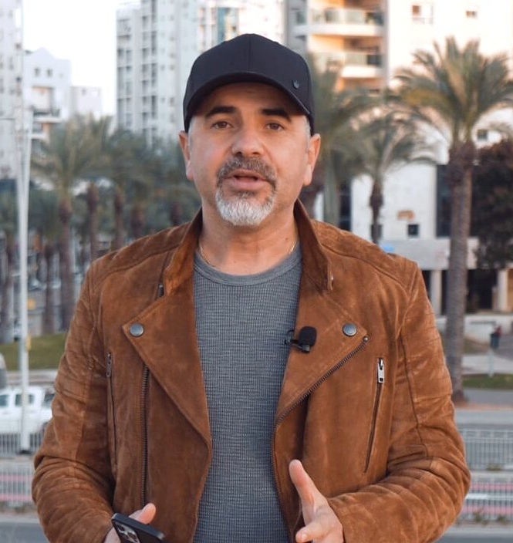
Israel Pochtar
Ashdod, Israel Congregation
Notes:
He’s the one that I’ve met at Messiah Conf., and helped us give the $1000 to a congregation in Beiruit, Lebanon in the name of Yeshua.
https://vojisrael.org/2021/01/12/mayan-eilat-congregation-denounced-lgbt-propaganda-in-local-schools/

Slide 77
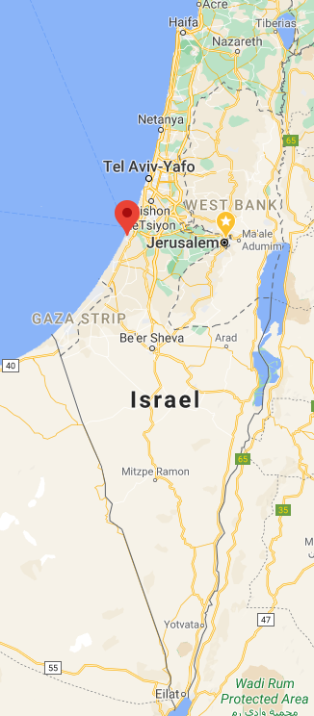
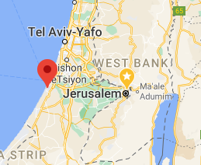

Slide 78
Recently our daughter congregation in Eilat was faced with the reality that the LGBT community was granted free pass by the Eilat municipality to propagate their lifestyle in local schools to underage kids.
Notes:
https://vojisrael.org/2021/01/12/mayan-eilat-congregation-denounced-lgbt-propaganda-in-local-schools/

Slide 79
Pastor Ariel actively denounced such agenda, and obviously was also faced with backlash calling his actions “hateful”, when in actual fact he was bold enough to stand up on behalf of dozens of other parents who were outraged at such blatant disregard for the parents right to chose what their child is exposed to, at home or at school.
Notes:
https://vojisrael.org/2021/01/12/mayan-eilat-congregation-denounced-lgbt-propaganda-in-local-schools/
So, STAND for right. Stand

Slide 80
Hebrew Alphabet insight on suffering: Aleph is the only totally silent letter of the 22 consonants composing the Hebrew alphabet - it represents the unrevealed, infinite spiritual.
Note that the letters of the name of the letter 'Aleph', read backwards become the word 'Peleh'.
Notes:
From Ulpan Or

Slide 81
אלף פלא
which means an inexplicable wonder - the wonder of the infinite spiritual is silent, being manifested within the finite physical!!

Slide 82
^{Yeshayahu/Isaiah 9.6} For a child is born to us, a son is given to us; dominion will rest on his shoulders, and he will be given the name Wonder of a Counselor, Mighty God, Father of Eternity, Prince of Peace

Slide 83
Pele-Yo‘etz El Gibbor, Avi-‘Ad, Sar-Shalom
[Wonder of a Counselor, Mighty God, Father of Eternity, Prince of Peace]
וַיִּקְרָא שְׁמוֹ פֶּלֶא יוֹעֵץ, אֵל גִּבּוֹר, אֲבִי-עַד,
שַׂר-שָׁלוֹם.

Slide 84
Alef is silence. Alef ~ Fele
Silence in which we find the wonder, the mystery, the majesty of G-d.
Notes:
Prince of Egypt: Many times we prayed, not knowing anyone could hear.

Slide 85
Alef is silence. Alef ~ Fele
Silence in which we find the wonder, the mystery, the majesty of G-d.
G-d seems silent in suffering, but we make our sacrifice there.

Slide 86
Not optional exercise:
Look at G-d, in your spirit, and say, I will suffer whatever it takes to advance Your Kingdom.

Slide 87
Two earthquakes

Slide 88
^{Acts 16.23-26} After giving them a severe beating, they threw them in prison, charging the jailer to guard them securely. Upon receiving such an order, he threw them into the inner cell and clamped their feet securely between heavy blocks of wood.

Slide 89
^{Acts 16.23-26} Around midnight, Sha’ul and Sila were praying and singing hymns to God, while the other prisoners listened attentively. Suddenly there was a violent earthquake which shook the prison to its foundations. All the doors flew open and everyone’s chains came loose.
Notes:
Actually two earthquakes, one caused the other.
After the beating and imprisonment: praying and singing. Violent in the Ruakh.
Not a natural earthquake.
No one killed or even hurt.
Prison doors opened and shackles opened.

Slide 90
Not optional exercise:
Look at G-d, in your spirit, and say, I will suffer whatever it takes to advance Your Kingdom.

Slide 91
Outline
Yeshua was the Cohen Gadol/ High Priest ~ Melkitsedek
A Cohen has to have an offering. What was His offering? He was the offering.

Slide 92
We are called to be Cohanim/ priests.
A Cohen has to have an offering. What is our offering? Our suffering, from our adversaries, for each other, for the lost. Love suffers long.
Notes:
His offering gives us the power to make our offering.
I was told that your unbelieving children will be more touched by your response to suffering than by your success. I’d rather touch them with success.

Slide 93
^{Mark 12.32-33} “Well said, Rabbi; you speak the truth when you say that he is one, and that there is no other besides him; and that loving him with all one’s heart, understanding and strength, and loving one’s neighbor as oneself, mean more than all the burnt offerings and sacrifices.”

Slide 95
