Slide 1
e-handout
To have these notes
without taking notes
Go to OrHaOlam.com
Click on downloads,
messages, 2021

Slide 2
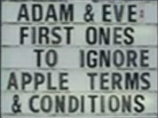

Slide 3
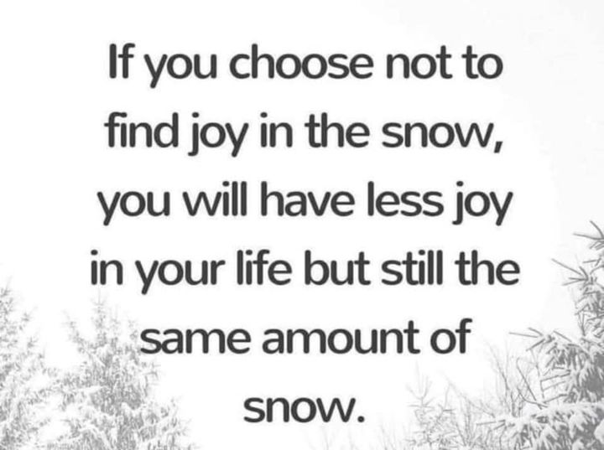
Notes:
From Yisraela Hiatt

Slide 4
Would you eat at:
Sam & Ella’s Chicken Palace
419 N Muskogee Ave, Tahlequah, OK 74464
918-456-1411
https://www.facebook.com/pages/Sam-and-Ellas/148737295248710

Slide 7
Outline: Purpose Despite Peril
Why observe Purim
What observe? Like Yom Kippur
Risk by Ester ~ death
Resurrection Power
Risks by others

Slide 8
^{Shmot/Ex 17.9-16} Then ‘Amalek came and fought with Isra’el at Refidim… Adoni said to Moshe, “Write this in a book to be remembered, and tell it to Y’hoshua: I will completely blot out any memory of ‘Amalek from under heaven.”...Adoni will fight ‘Amalek generation after generation.”
Notes:
Fresh out of Egypt Ex 15 Reed Sea crossing.
Every generation there will be an Amalek.
To destroy the Jewish people. Genocide
To Destroy all people of faith in G-d.
Every generation there will be supernatural victory by Adoni Himself.

Slide 9
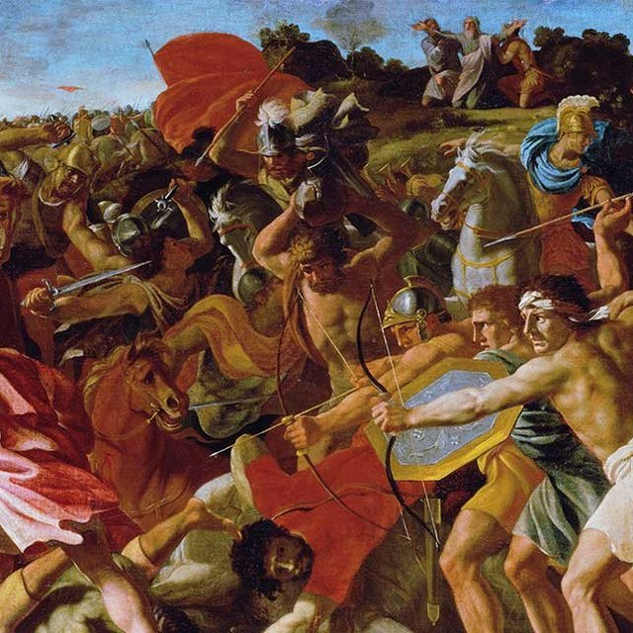
When Moshe raised his hand, Isra’el prevailed; but when he let it down, Amalek prevailed…Moshe’s hands grew heavy; so they took a stone and put it under him, and he sat on it. Aharon and Hur held up his hands.
Notes:
https://ffoz.org/discover/assets_c/2016/03/wm-poussin-nicolas-victory-of-joshua-thumb-640x640-3965.jpg

Slide 10
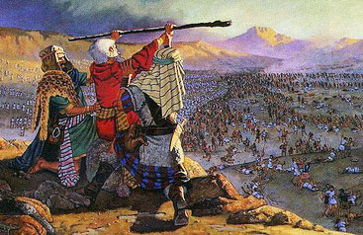
Notes:
http://www.swordofthespirit.net/bulwark/moses-amalekites02.jpg

Slide 11
BDS activists trumpet their claim to support “freedom, justice and equality” for the Palestinian people. They are less open about their desire to eradicate the Jewish State for fear they would lose backing.
Notes:
https://worldisraelnews.com/opinion-why-bds-is-winning-even-when-it-seems-it-isnt/?utm_source=newsletters_worldisraelnews_com&utm_medium=email&utm_content=Netanyahu%27s+Biblical+Warning+to+Iran%3B+Civil+Rights+Advocate%27s+Outrageous+Accusation+Against+Orthodox+Jews%3B+Trump%27s+2024+Run%3B+Israel+Shocked+by+Deaths+of+Young+Mother%2C+Fetus&utm_campaign=20210223_m162151369_Netanyahu%27s+Biblical+Warning+to+Iran%3B+Civil+Rights+Advocate%27s+Outrageous+Accusation+Against+Orthodox+Jews%3B+Trump%27s+2024+Run%3B+Israel+Shocked+by+Deaths+of+Young+Mother%2C+Fetus&utm_term=_0D_0A_09_09_09_09_09_09_09_09_09_09Read+Now_0D_0A_09_09_09_09_09_09_09_09_09

Slide 12
Qatar-born Omar Barghouti, founder of BDS, has repeatedly rejected a two-state solution, instead advocating one state: “Definitely, most definitely, we oppose a Jewish state in any part of Palestine.” He makes clear that his definition of “Palestine” includes the entirety of the State of Israel.
Notes:
https://worldisraelnews.com/opinion-why-bds-is-winning-even-when-it-seems-it-isnt/?utm_source=newsletters_worldisraelnews_com&utm_medium=email&utm_content=Netanyahu%27s+Biblical+Warning+to+Iran%3B+Civil+Rights+Advocate%27s+Outrageous+Accusation+Against+Orthodox+Jews%3B+Trump%27s+2024+Run%3B+Israel+Shocked+by+Deaths+of+Young+Mother%2C+Fetus&utm_campaign=20210223_m162151369_Netanyahu%27s+Biblical+Warning+to+Iran%3B+Civil+Rights+Advocate%27s+Outrageous+Accusation+Against+Orthodox+Jews%3B+Trump%27s+2024+Run%3B+Israel+Shocked+by+Deaths+of+Young+Mother%2C+Fetus&utm_term=_0D_0A_09_09_09_09_09_09_09_09_09_09Read+Now_0D_0A_09_09_09_09_09_09_09_09_09

Slide 13
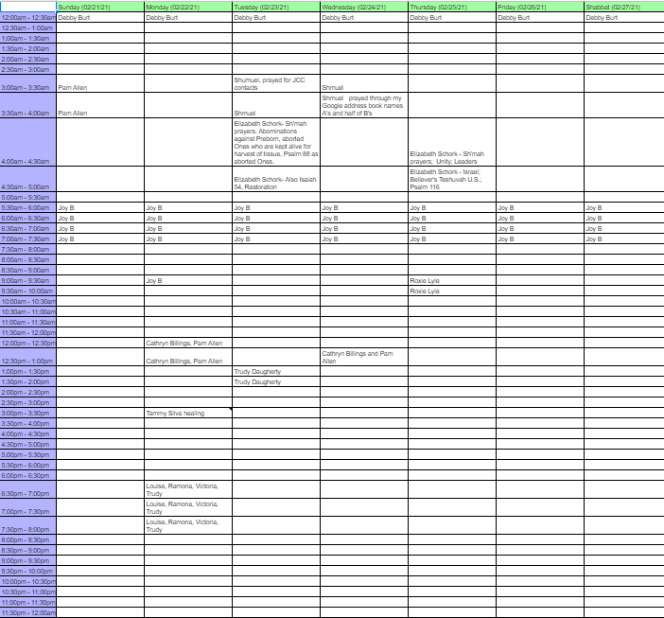
The 24/7 Cyber Prayer room is operating!
Send your day and time pref to admin@orhaolam.com
Notes:
You can join.
Jim Garlow’s prayer meeting is still going Wed and Sunday nights.
JB has started a prayer room, at first just a few leaders, now expanding. More info coming.

Slide 14
^{Dvarim/Dt. 25.17-19} “Remember what ‘Amalek did to you on the road as you were coming out of Egypt, how he met you by the road, attacked those in the rear, those who were exhausted and straggling behind when you were tired and weary. He did not fear God.

Slide 15
^{Dvarim/Dt. 25.17-19} “Therefore, when Adoni your God has given you rest from all your surrounding enemies in the land Adoni your God is giving you as your inheritance to possess, you are to blot out all memory of ‘Amalek from under heaven. Don’t forget!
Notes:
Blot out, but don’t forget. Seems contradictory.
Israel failed to do it. Let Amalek continue.
Lesson to us, what secret inner sins have we allowed to continue: bitterness, lust, love of praise/ lack of servant heart/pride, jealousy?
All Agags descendants of Amalek!

Slide 16
^{1 Shmuel 15.7-9} Then Sha’ul attacked ‘Amalek, starting at Havilah and continuing toward Shur, at the border of Egypt. He took Agag the king of ‘Amalek alive…Sha’ul and the people spared Agag, along with the best of the sheep and cattle, and even the second best, also the lambs, and everything that was good.
Notes:
Later the prophet Shmuel executed Agag as they had been told

Slide 17
^{Ester 3.1} Some time later King Akhashverosh began to single out Haman the son of Hamdata the Agagi for advancement; eventually he gave him precedence over all his fellow officers.
Notes:
Both the Targums [ancient translations into Aramaic] construe Agag to be of the stock or family of Agag, the common name of the kings of Amalek; and so Josephus [John Gill commentary]

Slide 18
Ch 3: Genocide conceived by Haman.
Ch 4: Ester called a fast and committed to risk her life appealing to the king
Ch 5 Haman builds 75 ft gallows for Mordekhi. יַעֲשׂוּ-עֵץ
Ch 6: Haman’s downfall predicted.
Ch 7: Haman’s downfall & death.
Ch 8-9 Jewish victory celebration.
Notes:
Ch 5, John Gill: that the person hanged thereon might be seen at a distance, and so be a greater reproach to him, and a terror to others, to take care they were not guilty of the same offence:

Slide 19
^{Ester 9.1-2} The time approached for the king’s order and decree to be carried out, the day when the enemies of the Jews hoped to overpower them. But, as it turned out, the opposite took place — the Jews overpowered those who hated them

Slide 20
^{Ester 9.1-2} Thus, on the 13th day... the month of Adar, the Jews assembled in their cities throughout all the provinces of King Akhashverosh to attack anyone who tried to do them harm.
Notes:
Keep that in mind, the 13 day of Adar, which this year was Thursday

Slide 21
^{Ester 9.1-2} and no one was able to withstand them; because all the peoples were afraid of them.

Slide 22
^{Ester 9.18} However, the Jews of Shushan assembled on both the thirteenth and fourteenth days of Adar, so it was on the fifteenth that they rested and made it a holiday for celebrating and rejoicing.

Slide 23
When the holiday of Purim was set for the 14th of Adar, the sages instituted that Shushan residents perpetually observe Purim on the 15th of Adar—the day when the Shushanite Jews celebrated.
Notes:
https://www.chabad.org/holidays/purim/article_cdo/aid/645278/jewish/Shushan-Purim.htm

Slide 24
The 15th of Adar is hence known as “Shushan Purim.” Along with Shushan (which is located in modern-day southwestern Iran),
Notes:
https://www.chabad.org/holidays/purim/article_cdo/aid/645278/jewish/Shushan-Purim.htm

Slide 25
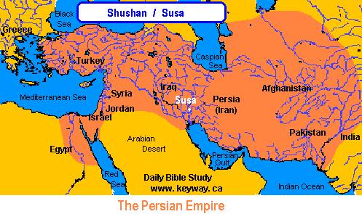
Notes:
https://www.blackhistoryinthebible.com/wp-content/uploads/2018/02/susa.gif

Slide 26
All cities that were walled at the time when the Israelites, under the leadership of Joshua, entered Canaan, observe Purim on the 15th.
Today, the only city that we are certain had walls in Joshua’s times is Jerusalem. And indeed, in the holy city, Purim is festively celebrated one day after all other cities.
Notes:
https://www.chabad.org/holidays/purim/article_cdo/aid/645278/jewish/Shushan-Purim.htm

Slide 27
Shushan Purim / שׁוּשָׁן פּוּרִים
Shushan Purim (Purim celebrated in Jerusalem and walled cities) for Hebrew Year 5781 begins at sundown on Saturday, 27 February 2021 and ends at nightfall on Sunday, 28 February 2021.
Notes:
https://www.hebcal.com/holidays/shushan-purim
So, tomorrow, you can greet one another with Happy Shushan Purim!!

Slide 28
That is why our Purim Party is tomorrow Sunday. We are following the practice of the walled city of Jerusalem in what is called “Shushan Purim.”
Celebrating the ancient and ongoing victory over Amalek.

Slide 30
Outline: Purpose Despite Peril
Why observe Purim
What observe? Like Yom Kippur
Risk by Ester ~ death
Resurrection Power
Risks by others

Slide 31
The true name for Yom Kippur is “Yom Hakipurim.” יום הכפורים
While both terms are translated as the Day of Atonement, the latter, “Yom Hakipurim,” which is used in scripture, can actually be translated as “the Day that is like Purim” (Kipurim = like Purim).

Slide 32
Why? Ester faced risk of death and won LIFE for her people!!
Won life by intercession, fasting, wise and attractive strategy, faced death, humility → victory and celebration.

Slide 33
With this in mind, we can even suggest that Purim is holier than Yom Kippur! Why? Because Yom Kippur is “like” Purim…but Purim is the REAL holy day!

Slide 34
Ester is a Yeshua figure.
^{Yeshayahu/Is 53.2} He had no form or majesty that we should look at Him, nor beauty that we should desire Him.

Slide 35
Ester is a Yeshua figure.
^{T’hillim/Ps 45.3-4} You are the most handsome of the sons of men. Grace pours from your lips. Therefore God has blessed you forever. Gird your sword on your thigh, O mighty one, in your splendor and your majesty.

Slide 36
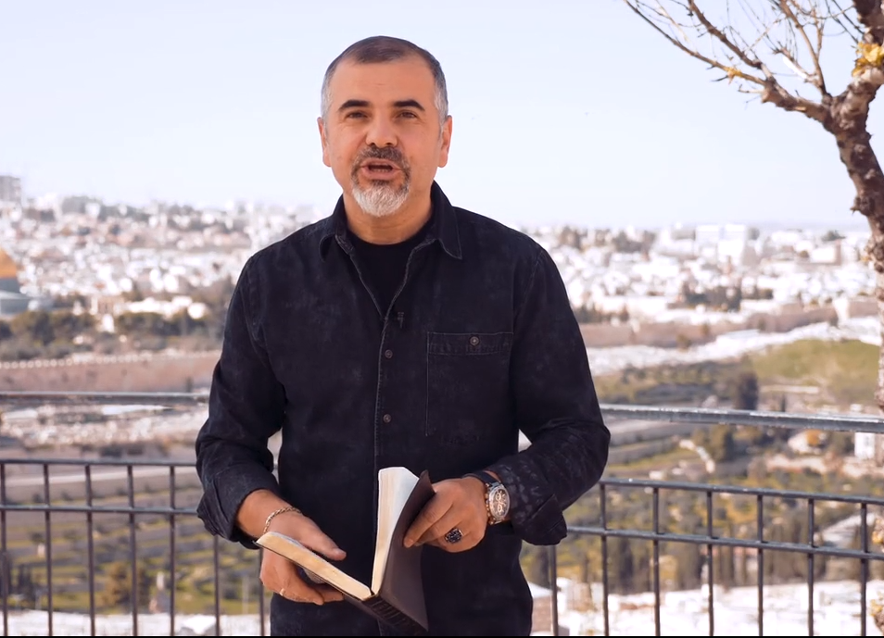
An Ester message from Israel Pochtar of Asdod, Israel
Notes:
Russian Hebrew accented English
Congregational leader of the largest Messianic Cong in Israel.
https://vojisrael.org/2021/02/19/purims-lessons-part-2-responding-to-gods-calling-unafraid/

Slide 38
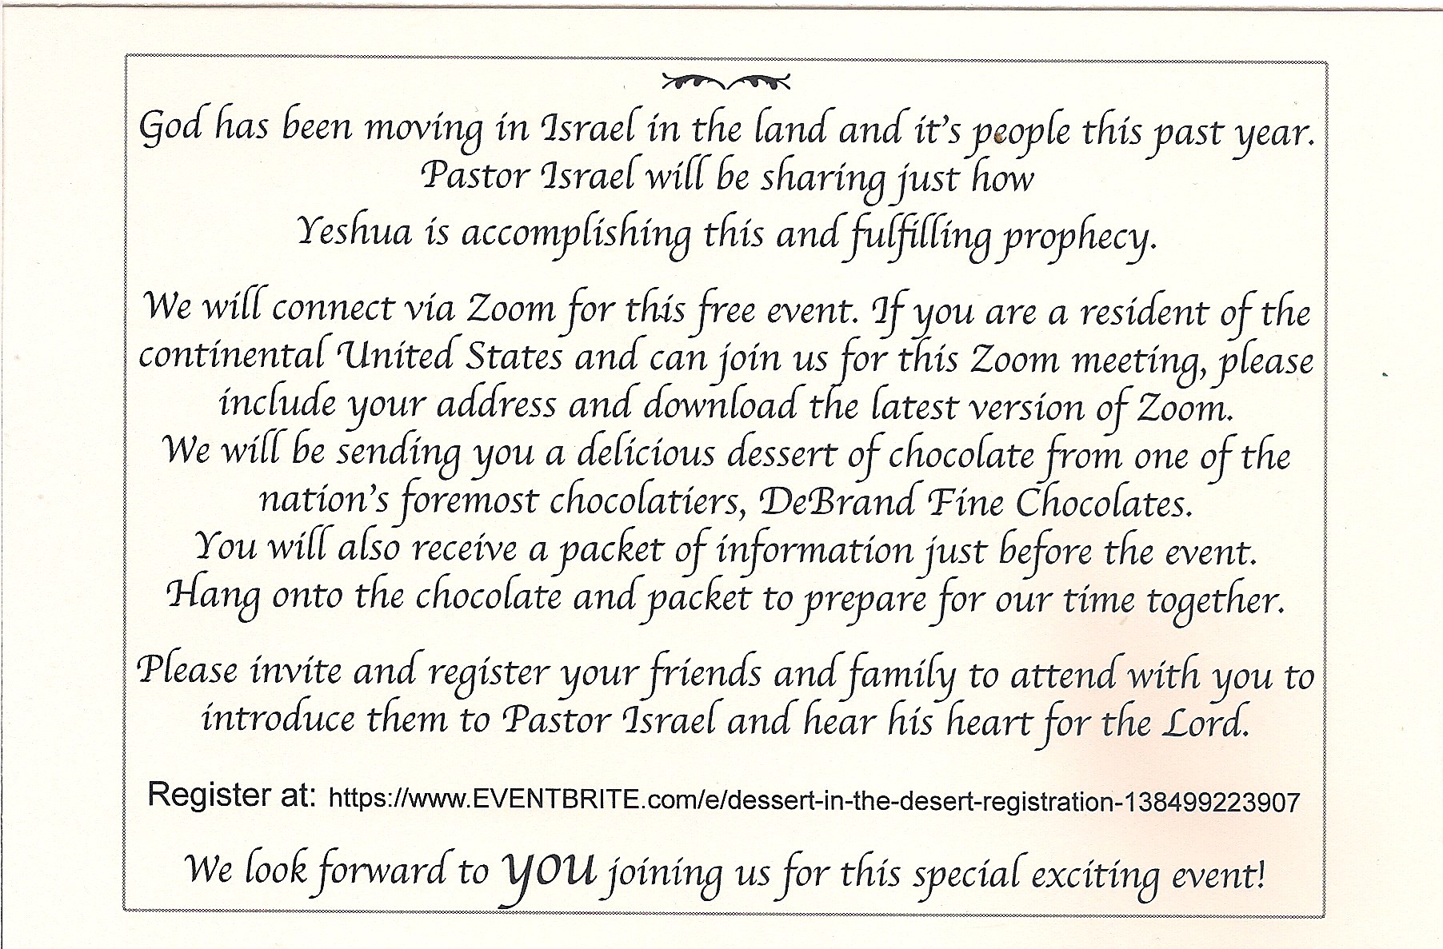

Slide 39
Outline: Purpose Despite Peril
Why observe Purim
What observe? Like Yom Kippur
Risk by Ester ~ death
Resurrection Power
Risks by others

Slide 40
^{Ester 9.26-28} The Jews resolved and took upon themselves, their descendants and all who might join them that without fail they would observe these two days in accordance with what was written in [this letter] and at the appointed time, every year;

Slide 41
^{Ester 9.26-28} and that these days would be remembered and observed throughout every generation, every family, every province and every city; and that these days of Purim would never cease among the Jews or their memory be lost by their descendants.

Slide 42
^{Ester 9.20-22} Mordekhi recorded these events and sent letters to all the Jews in all the provinces of King Akhashverosh, both near and far [to commemorate] the days on which the Jews obtained rest from their enemies and the month which for them was turned from sorrow into gladness and from mourning into a holiday;
Notes:
What sorrows do you have in your life: family, finance, marriage, kids, health?
Resurrection Power of Messiah Yeshua: turned my mourning into dancing, as we TRUST.

Slide 43
Outline: Purpose Despite Peril
Why observe Purim
What observe? Like Yom Kippur
Risk by Ester ~ death
Resurrection Power
Risks by others

Slide 44
^{Ester 9.20-22} they were to make them days of celebrating and rejoicing, sending portions [of food] to each other and giving gifts to the poor.

Slide 45
Notes:
https://mail.google.com/mail/u/0/#inbox/FMfcgxwLsdHTNGxzSZQcCgvfkzLZnmhP
Video clip of Israelis stealing in stores, minor amounts. Caught on security cameras, but let go כי need!
Tomorrow, special Purim offering for impoverished in Israel!

Slide 46
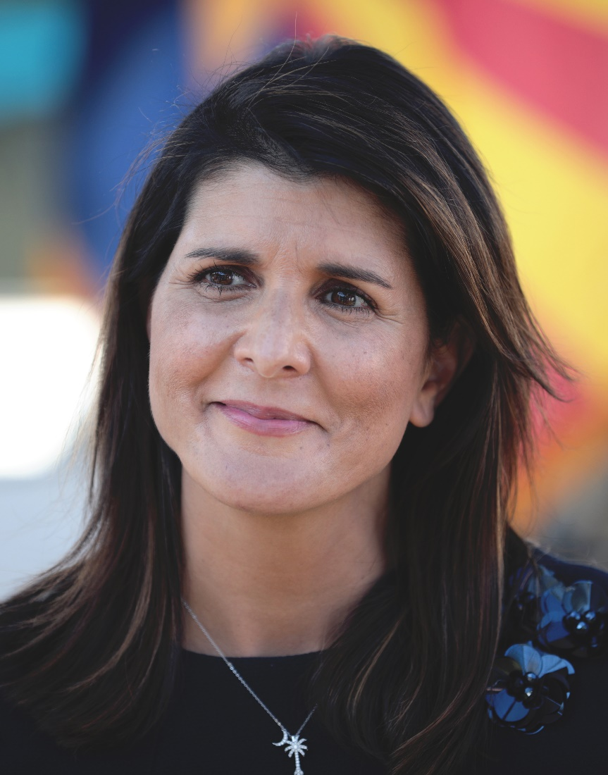
Nimrata Nikki (née Randhawa) Haley; born 1972
Gov S. Carolina
UN Ambassador
Notes:
You may be aware that New Yorkers love ethnic issues. I love Thai food, Mexican, Indian, Chinese, Japanese.
So here’s a story.
Her father, Ajit Singh Randhawa, and her mother, Raj Kaur Randhawa, immigrated to the United States from Amritsar District, Punjab, India. Her father was formerly a professor at Punjab Agricultural University, and her mother received her law degree from the University of Delhi.

Slide 47
Age 5-year-old she and her older sister were entered into a pageant in which they historically crowned one white girl winner and one black girl winner.
Notes:
https://www.nytimes.com/2011/03/06/magazine/06talk-t.html

Slide 48
Right after I got through singing “This Land Is Your Land,” the judges called my parents to the back and said, “If we put them in one category, then one group will be mad, and if we put them in the other category, the other group will be mad.” They basically disqualified me and gave me a beach ball and sent me on my way.
Notes:
https://www.nytimes.com/2011/03/06/magazine/06talk-t.html

Slide 49
I know that to people outside the state, it sounds like something that’s really terrible. But what I want people to understand is that Bamberg, SC, is the same small town that stopped segregating the princesses after that,
Notes:
https://www.nytimes.com/2011/03/06/magazine/06talk-t.html

Slide 50
that took black girls and white girls in the Girl Scouts and that allowed me on the tennis team. I wanted the takeaway not to be that I was disqualified from the pageant but what the town did after the pageant.
Notes:
https://www.nytimes.com/2011/03/06/magazine/06talk-t.html

Slide 51
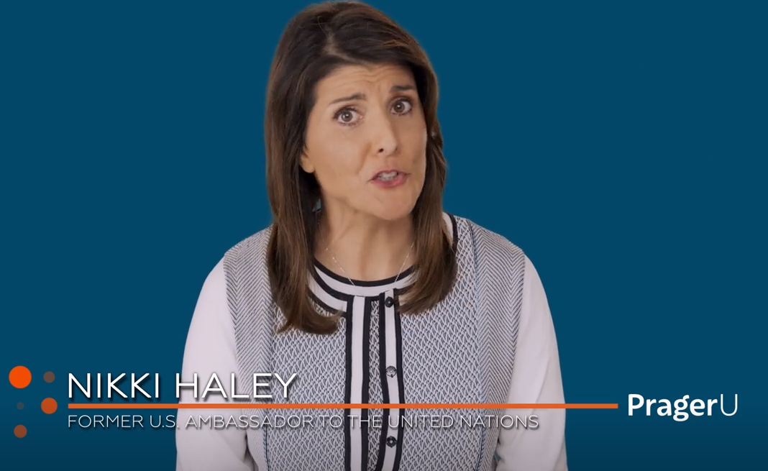
Notes:
https://www.prageru.com/video/capitalism-wins/?utm_source=Main+Mailing+List&utm_campaign=e987838263-EMAIL_CAMPAIGN_2020_04_09_06_29_COPY_01&utm_medium=email&utm_term=0_f90832343d-e987838263-164356353

Slide 53
Outline: Purpose Despite Peril
Why observe Purim
What observe? Like Yom Kippur
Risk by Ester ~ death
Resurrection Power
Risks by others
Notes:
This illustration may seem disconnected, but wait.

Slide 54
Katherine Johnson was an American mathematician whose calculations of orbital mechanics as a NASA employee were critical to the success of the first and subsequent U.S. crewed spaceflights.
Notes:
https://duckduckgo.com/?q=Katherine+Johnson&ia=web
I taught Algebra 2, Trigonometry, Calculus for 11 years. Mostly female students. Won awards. Chris Meyer’s wife Melanie one of my BEST.

Slide 55
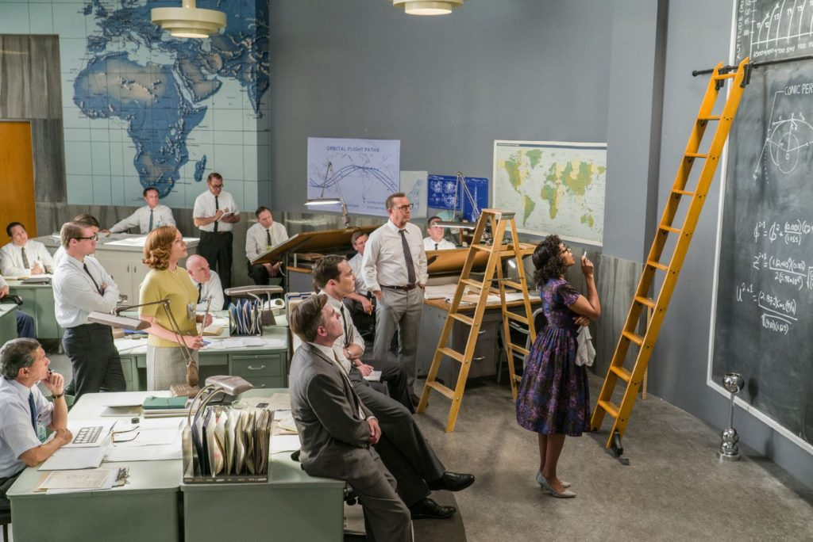
Notes:
http://behindthelensonline.net/site/wp-content/uploads/2017/01/hidden-figures-1-1024x684.jpg

Slide 56
During her 35-year career at NASA and its predecessor, she earned a reputation for mastering complex manual calculations and helped pioneer the use of computers to perform the tasks.
Notes:
John Glenn chose her calculations over the inconsistent results of the new IBM computer.
https://en.wikipedia.org/wiki/Katherine_Johnson

Slide 57
The Gates Foundation is the only donor mentioned on the homepage of A Pathway to Equitable Math Instruction, a group of 25 education organizations whose curriculum states that asking students to show their work and find the right answer is an inherently racist practice.
Notes:
https://thejewishvoice.com/2021/02/bill-and-melinda-gates-foundation-behind-anti-racist-math-push/

Slide 58
We stand for what is right, speaking the truth always in love, we may be so far out of the new normal of our culture that people will think we have been living under a rock. No matter…we stand on Yeshua’s resurrection power! Trust Him! Seek Him!

Slide 60
Outline: Purpose Despite Peril
Why observe Purim
What observe? Like Yom Kippur
Risk by Ester ~ death
Risks by others
Resurrection Power

Slide 61
^{Ester 4:16}“Go, assemble all the Jews to be found in Shushan, and have them fast for me, neither eating nor drinking for three days, night and day; also I and the girls attending me will fast the same way. Then I will go in to the king, which is against the law; and if I perish, I perish.” וְכַאֲשֶׁ֥ר אָבַ֖דְתִּי אָבָֽדְתִּי׃

Slide 62
The 24/7 Cyber Prayer room is operating!
Send your day and time pref to admin@orhaolam.com
Notes:
You can join.

Slide 63
Do you KNOW Him and the assurance of sins forgiven?
Are you surrendered to Him, body, soul, spirit? Destroy EVERY Agag?
Are you filled with His Spirit, transforming your life?

