Slide 1
e-handout
To have these notes
without taking notes
Go to OrHaOlam.com
Click on downloads,
messages, 2021
Notes:
It was always intuitively a good idea to open with a joke, but now I’ve learned why. As I said last week…

Slide 2
Notes:
Release endorphins in you and recipient.
Promote trustworthiness.
Increase longevity
Helps marriage.
Gives you space to pray over an uncomfortable situation.
So, there is some advantage to the mask mandate! If Eliyahu / Elijah is required to wear a mask to show up at our Seder…

Slide 3
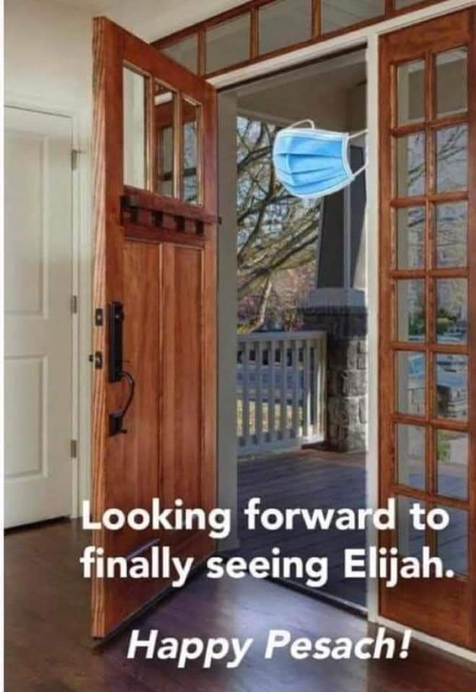
Notes:
Jim Adler

Slide 4
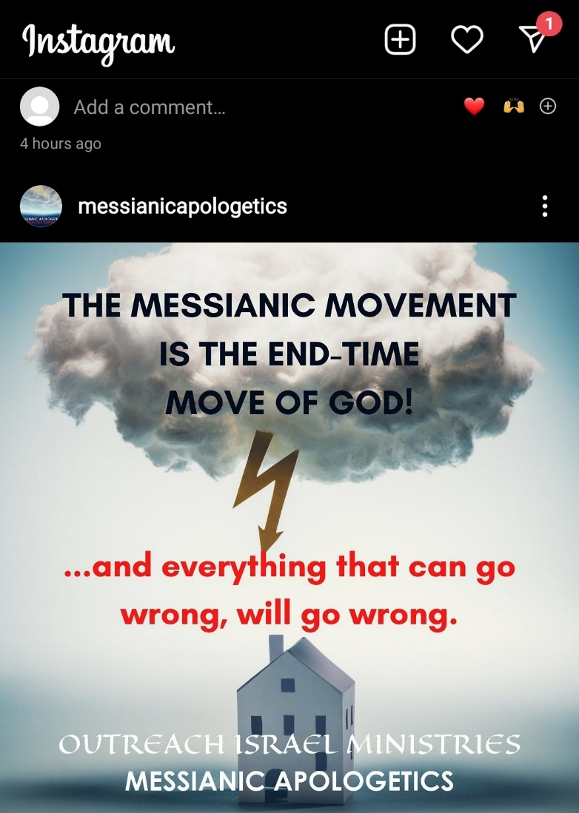
Notes:
Plowing concrete. Raleigh Washington

Slide 5
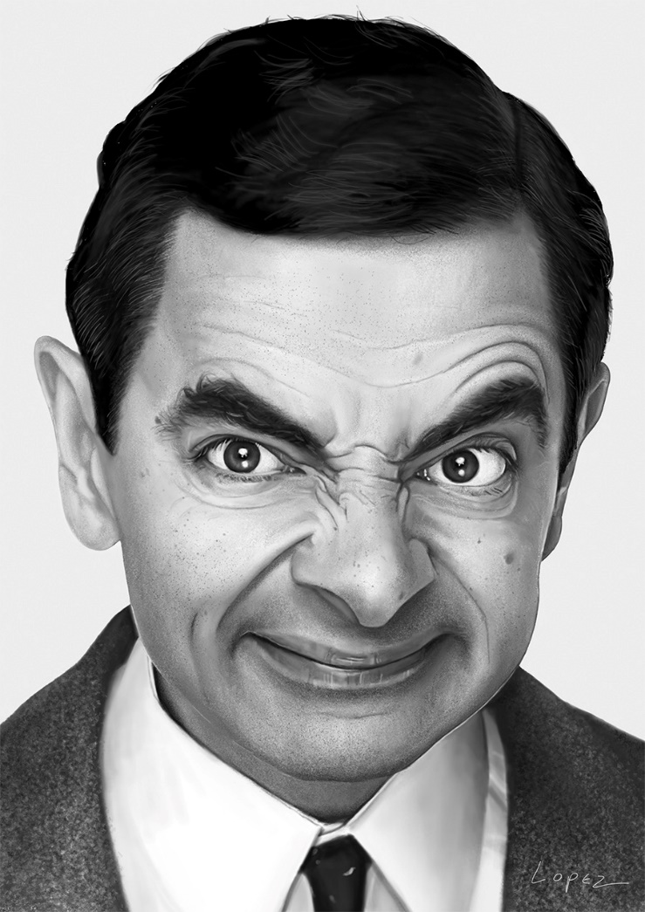
Mr. Bean meets Albert Einstein. As they are talking Einstein mentions he's considered the smartest man in the world. Mr. Bean say’s, “OK, If you ask me a question and I can't answer it, I have to pay you a dollar.”

Slide 6
If I ask you a question and you can't answer it, you have to pay me $1000. Einstein thinks about it a moment and finally says, OK. Einstein askes, " What does MC squared equal?". Mr Bean thinks for a moment, says he doesn't know and hands Einstein $1.
Notes:
Gavriel Rennels

Slide 7
Mr. Bean askes Einstein, "What animal crosses the road with 4 legs, crosses back with 2 and then crosses back again with 5?" Einstein thinks about this for a long time and finally says, "I don't know, here is your $1000."
Notes:
Gavriel Rennels

Slide 8
Einstein asks, "Now tell me what animals is that?" Me. Bean hand's Einstein $1.00.
Notes:
Gavriel Rennels

Slide 9
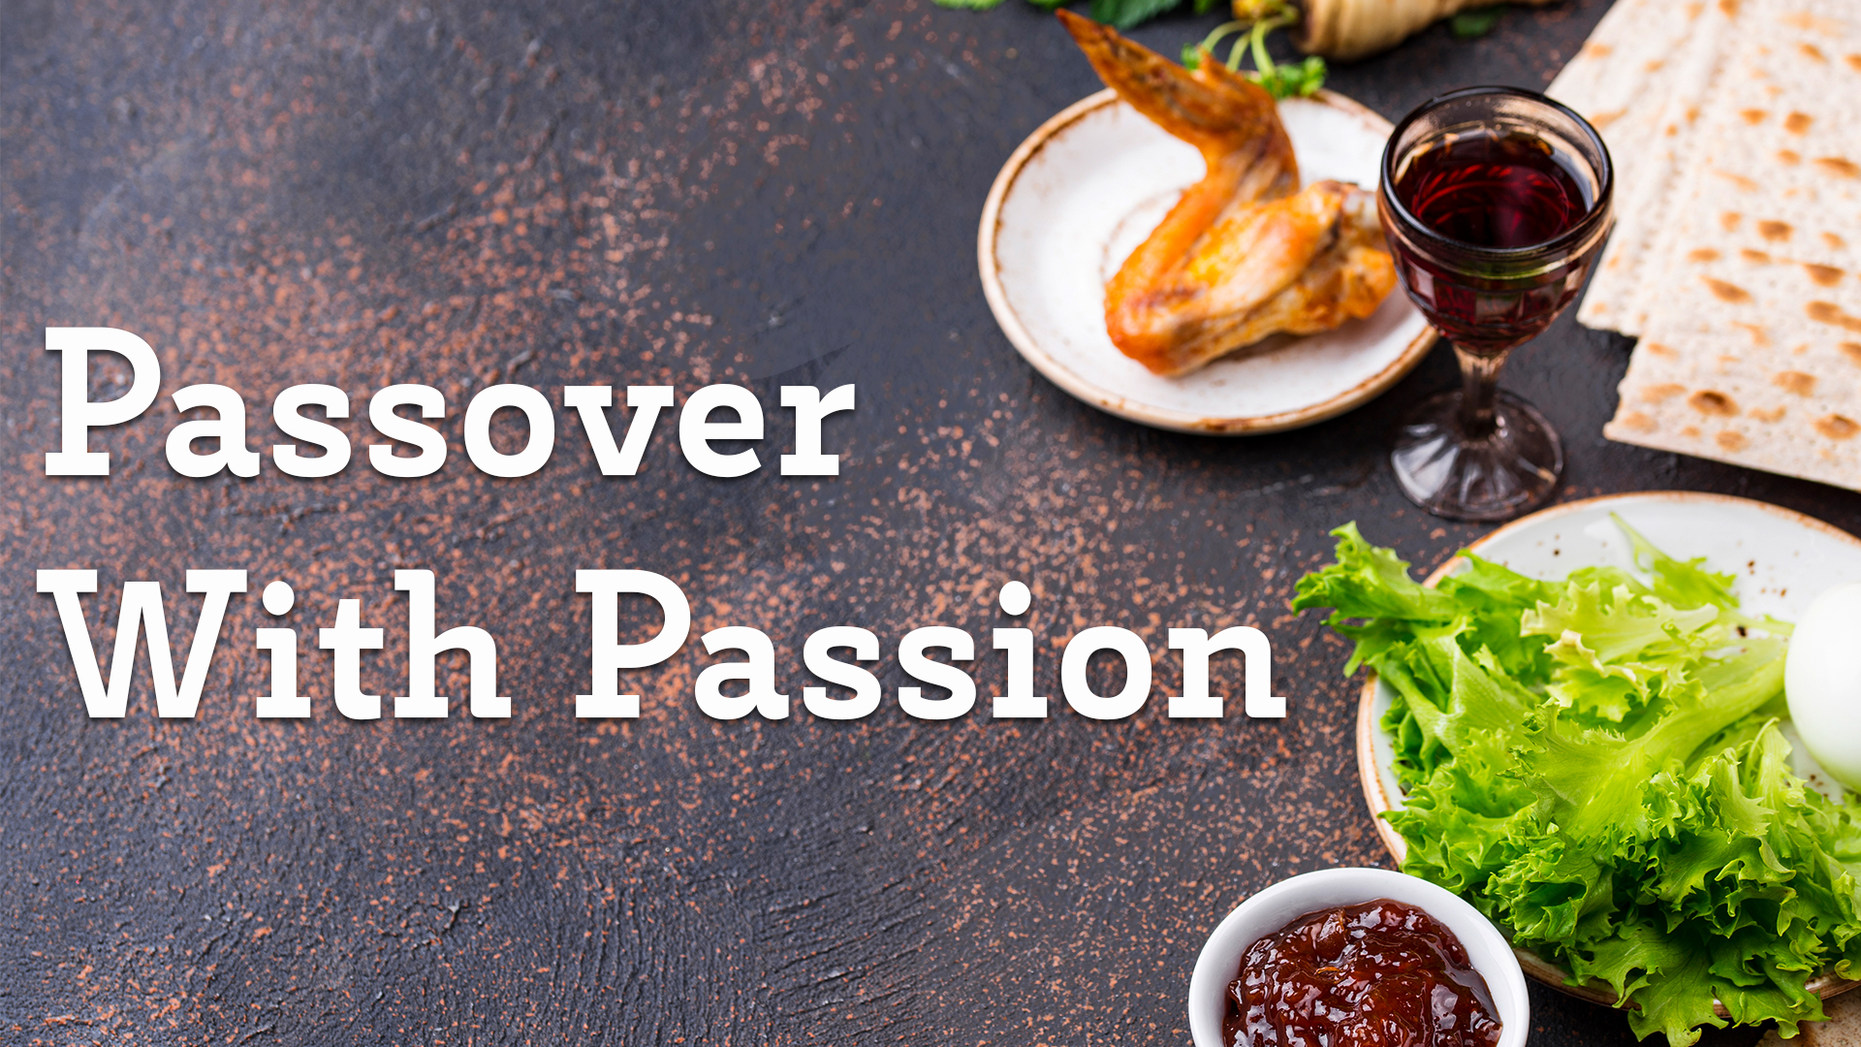
^{Lk 22.14-19 Part 2}

Slide 10
^{Lk 22.14-15} When the time came, Yeshua and the emissaries reclined at the table, and he said to them, "I have really wanted so much to celebrate this Seder with you before I die!
Notes:
78% secular Jews in US attend a Seder,
90% secular Jews in Israel JFJ Issues vol 23-05 p 24

Slide 11
Passover is relational “with you.”
Love expressed in interaction
Love expressed in ritual: Leaven
Love expressed in confession

Slide 12
^{Yn 15.9-11}“Just as my Father has loved me, I too have loved you; so stay in my love. If you keep my commands, you will stay in my love — just as I have kept my Father’s commands and stay in his love. I have said this to you so that my joy may be in you, and your joy be complete.
Notes:
Yeshua really liked these guys. “With YOU” Rowdy unruly bunch, nevertheless. Passover fellowship was His final community expression to them of love.
If you love someone, or like them, express affection, appreciation.
Exercise:
I like you, I love you, I appreciate you, I welcome you.

Slide 13
^{Eph. 3.16-17} I pray that from the treasures of his glory he will empower you with inner strength by his Spirit, so that the Messiah may live in your hearts through your trusting. Also I pray that you will be rooted and founded in love,

Slide 14
^{Eph. 3.18-19} so that you, with all God’s people, will be given strength to grasp the breadth, length, height and depth of the Messiah’s love, yes, to know it, even though it is beyond all knowing, so that you will be filled with all the fullness of God.
Notes:
This congregation is about us, Jews and the Nations, receiving the atoning love of Messiah and the experience of His forgiveness. If you’ve never asked Yeshua into you life, or to be L-rd of your life, you can do so today, even now.
All sin, iniquity, lack of character, comes from a sense of want, of need, of deprivation. → ungratefulness, anger, bitterness, false satisfaction. Two thanksgiving messages came from this theme of thankfulness and ungratefulness. The flip side, the positive side, is focus on the love of G-d in Messiah!
Are you fulfilled in Him, or needy, scratching and clawing for recognition, satisfaction, survival?

Slide 15
Passover lesson in having fulness.
The Ten
Plagues

Slide 16
דָּם Blood [Dam]
צְפַרְדֵּֽעַ Frogs [Tsfar-day-ah]
כִּנִּים Vermin [Kee-neem]
עָרוֹב Wild animals [A-rov]
דֶּֽבֶר Cattle disease [De-ver]

Slide 17
שְׁחִין Boils [Sh'kheen]
בָּרָד Hail [Ba-rad]
אַרְבֶּה Locusts [Ar-beh]
חֹֽשֶׁךְ Darkness [Kho-shkh]
מַכַּת בְּכוֹרוֹת Death of the firstborn [Ma-kat b'kho-rot]

Slide 18
DI-YAY-NOO דַּיֵנוּ
It would have
been enough

Slide 19
אִלּוּ אִלּוּ הוֹצִיאָֽנוּ, הוֹצִיאָֽנוּ מִמִּצְרַֽיִם,
Ee loo, ee-loo ho-tsee-ah-noo,
ho-tsee-ah-noo mee-Meets-ri-eem,
הוֹצִיאָֽנוּ מִמִּצְרַֽיִם,
ho-tsee-ah-noo mee-Meets-ri-eem, דַּיֵּנוּ: Di-yay-nu
[Had He brought us out of Egypt,
It would have been enough.]

Slide 20
Expression of Gratefulness for healing:
Linda Elser testimony

Slide 21
^{Lk 22.14-19 Part 2}

Slide 22
^{Lk 22.14-15} When the time came, Yeshua and the emissaries reclined at the table, and he said to them, "I have really wanted so much to celebrate this Seder with you before I die!
Notes:
78% secular Jews in US attend a Seder,
90% secular Jews in Israel JFJ Issues vol 23-05 p 24

Slide 23
Passover is relational “with you.”
Love expressed in interaction
Love expressed in ritual: Leaven
Love expressed in confession

Slide 24
Passover cleansing particulars…
Notes:
Leaven, leavened food, confusing. Need the Hebrew…

Slide 25
שְׂאֹר leavening agents s’or
חָמֵץ leavened food khametz
Khametz is a product that is both made from one of five types of grain and has been combined with water and left to stand raw for longer than eighteen minutes and becomes leavened.
Notes:
https://en.wikipedia.org/wiki/Chametz
https://en.wikipedia.org/wiki/Passover

Slide 26
חִטָּה Wheat Ḥittim,
כֻּסְמִין Spelt Kusmin,
שְׂעוֹרָה barley Se’orah,
שִׁבֹּלֶת שׁוּעָל oats Shibbolet shual,
שִׁיפוֹן rye shifon
Notes:
https://en.wikipedia.org/wiki/Chametz
fox = שׁוּעָל

Slide 27
Leavening agents, such as yeast or baking soda, are not themselves khametz. Rather, it is the fermented grains. Thus yeast may be used in making wine, and kefir.
Notes:
https://en.wikipedia.org/wiki/Chametz
Also Kefir

Slide 28
Similarly, baking soda may be used in Passover baked goods made with matzoh meal and in matzoh balls. Since the matzoh meal used in those foods is already baked, the grain will not ferment.
Notes:
https://en.wikipedia.org/wiki/Chametz
Also Kefir

Slide 29
This applies to April 3 Oneg. Please, no khametz: leavened grain products.
No: Bread, crackers [except matzah], pasta, cakes, cookies.
Noon, Friday, Sept 26, leaven burning bonfire.

Slide 30
What about rice, corn, lentils, beans, and peanuts?
They don’t leaven, but may appear to. So, Ashkenazic Jews forbid, called kitnayot.
Sephardic Jewish communities they are OK.
Or HaOlam follows the Sephardi.
Notes:
https://www.thoughtco.com/passover-forbidden-foods-2076548
Sephardi more Biblical, less add ons. Great music too.

Slide 31
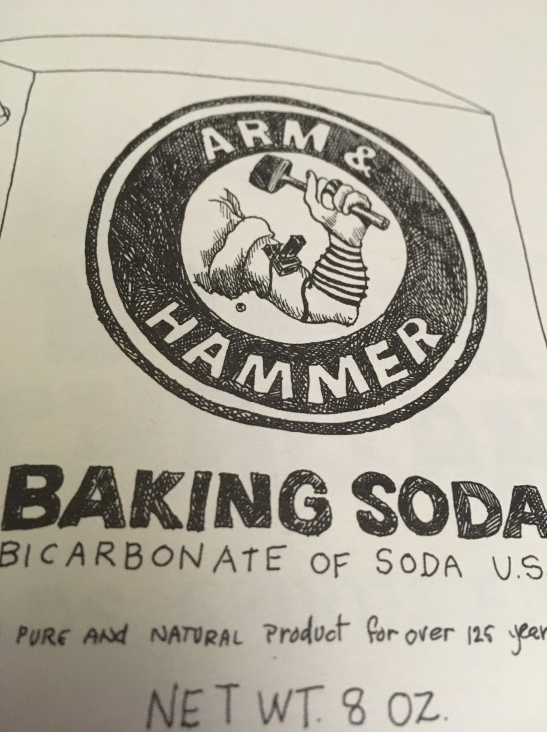
Notes:
From Brett Clear

Slide 32
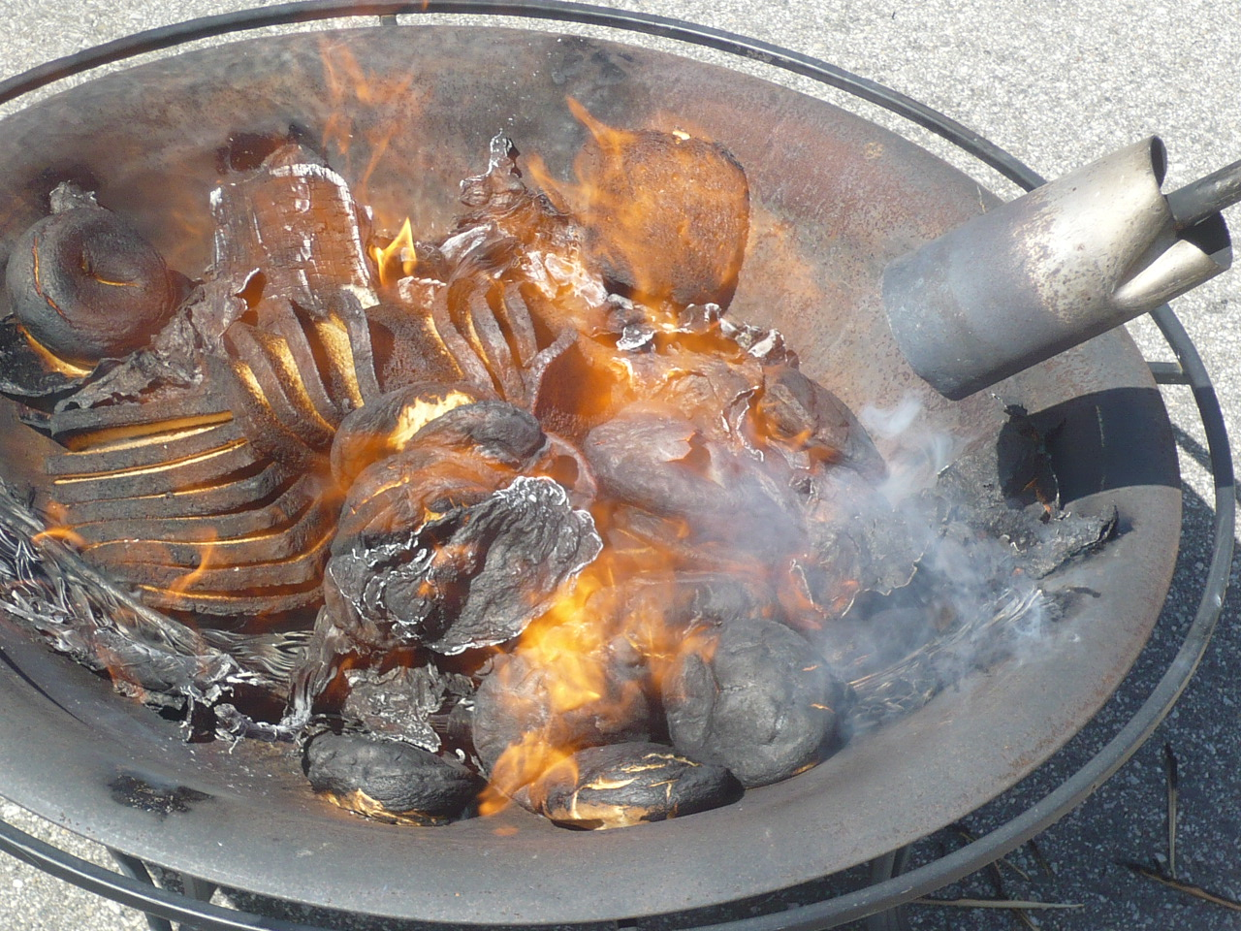
Burning hametz on the morning before Passover,
For us noon Fri. Mar. 26
Notes:
https://upload.wikimedia.org/wikipedia/commons/7/74/BiurChametz2010.jpg
We have a weed burner, otherwise known as a flame thrower, for hametz use if needed.

Slide 33
^{Lk 22.14-15}

Slide 34
^{Lk 22.14-15} When the time came, Yeshua and the emissaries reclined at the table, and he said to them, "I have really wanted so much to celebrate this Seder with you before I die!

Slide 35
Passover is relational “with you.”
Love expressed in interaction
Love expressed in ritual: Leaven
Love expressed in spiritual cleansing

Slide 36
^{1 Cor. 5. 6-8} Your boasting is no good. Don’t you know that a little hametz leavens the whole batch of dough? Get rid of the old hametz, so you may be a new batch, just as you are unleavened—for Messiah, our Passover Lamb,

Slide 37
^{1 Cor. 5. 6-8} has been sacrificed. Therefore let us celebrate the feast not with old hametz, the hametz of malice and wickedness, but with unleavened bread—the matzah of sincerity and truth.

Slide 38
ONE Getting out the leaven of false narratives of history, that the Jews are colonial occupants of the Land. Rather, they are the ancient indigenous population, returning!

Slide 39
Notes:
https://youtu.be/PVNQ5JkHDHc

Slide 40
TWO Getting out the leaven of false narratives of history,
new California Ethnic Studies Curriculum

Slide 41
California Ethnic Studies Curriculum, another false narrative
Children are taught that Christian settlers committed "theocide" against the Native Americans by "murdering" their gods and replacing them with the Christian God. This, the curriculum's authors insist, is what led to
Notes:
Tony Perkins https://www.frc.org/get.cfm?i=WA21C45&f=WU21C14

Slide 42
“coloniality, dehumanization, and genocide,” and the “explicit erasure and replacement of holistic Indigeneity and humanity.” To help reverse that trend and create a new “social order,” children are encouraged to cry out to Aztec gods and right this wrong.
Notes:
Tony Perkins https://www.frc.org/get.cfm?i=WA21C45&f=WU21C14

Slide 43
Of course, as plenty of legal scholars have pointed out, the forced practice of religion is a real violation of the Establishment Clause. If Christians can't pray, then surely a coerced class of pagan incantation is unconstitutional.
Notes:
Tony Perkins https://www.frc.org/get.cfm?i=WA21C45&f=WU21C14

Slide 44
THREE Getting out the leaven of the idea that our walk with G-d is in isolation.

Slide 45
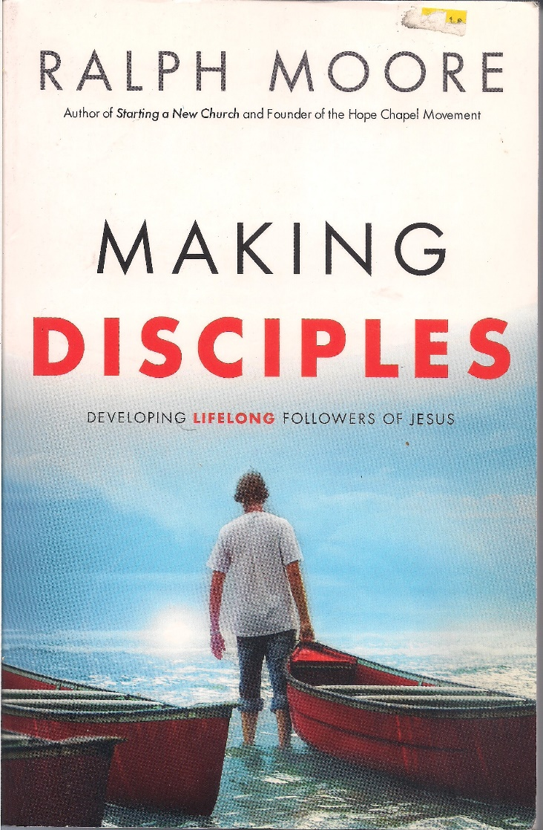
The essence of discipleship is relational.

Slide 46
How are you doing?
What is G-d showing you in the Bible [Shma שמע]?
What are you doing with what G-d is showing you?
How are your disciples doing in their ministry?
Notes:
Is there someone of whom you are asking these questions? Is someone asking you these questions?

Slide 47
Does anyone know what’s going on in your life?
Does anyone care, or express caring?
Passover is a time to connect with G-d and each other.

Slide 48
FOUR Getting out the leaven of the inroads of the enemy to literally and spiritually kill, steal, and destroy.

Slide 49
Notes:
https://youtu.be/7hFVvkqpptw

Slide 50
FIVE Getting out the leaven of misunderstaning.
Clarification from last week…

Slide 51
A subtle difference Jews and Nations-Gentiles:
A. ^{Acts 15.10} So why are you putting God to the test now by placing a yoke on the neck of the talmidim which neither our fathers nor we have had the strength to bear?

Slide 52
B. ^{Acts 15.19} We should not put obstacles in the way of the Goyim who are turning to God.
C. ^{Acts 15.28} For it seemed good to the Ruach HaKodesh and to us not to lay any heavier burden

Slide 53
D. ^{Acts 21.25} “However, in regard to the Goyim who have come to trust in Yeshua, we all joined in writing them a letter with our decision

Slide 54
Four words of differentiation of Jews and the Nations/Gentiles
Yoke, obstacles, heavier burden, decision.
These words were never defined in scripture in terms of practice.

Slide 55
Yoke, obstacles, heavier burden, decision.
These words were defined in scripture in terms of effect.

Slide 56
^{Ro. 11.12} Now if their transgression leads to riches for the world, and their loss riches for the Gentiles, then how much more their fullness!

Slide 57
^{Ro.11.15} For if their rejection leads to the reconciliation of the world, what will their acceptance be but life from the dead?

Slide 58
If you are not of Jewish ancestry you keep Torah because
it is the right and blessed way to live.
It provokes Jewish people to jealousy.

Slide 59
If you are of Jewish ancestry you keep Torah because
it is the right and blessed way to live.
It brings life from the dead and greater riches to the Nations!

Slide 60
SIX Getting out the leaven of sin.
^{1Yn 1.7-9} But if we are walking in the light, as he is in the light, then we have fellowship with each other, and the blood of his Son Yeshua purifies us from all sin.

Slide 61
^{1Yn 1.7-9} If we claim not to have sin, we are deceiving ourselves, and the truth is not in us. If we acknowledge our sins, then, since he is trustworthy and just, he will forgive them and purify us from all wrongdoing.

Slide 62
^{Yn. 17.21-23} That they may all be one. Just as you, Father, are united with me and I with you, I pray that they may be united with us, so that the world may believe that you sent me. The glory which you have given to me, I have given to them;

Slide 63
^{Yn. 17.21-23} so that they may be one, just as we are one — I united with them and you with me, so that they may be completely one, and the world thus realize that you sent me, and that you have loved them just as you have loved me.

Slide 64
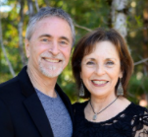
From Hylan Slobodkin, rabbi of Beit Tikvah since 1996, near Seattle, WA
Applied to leaven.

Slide 65
Revival is in the air once again Many are praying for revival. While states legalize marijuana and grow rich on the tax revenue, brokenness abounds in our culture. Substance abuse and immoral lifestyles abound.
Notes:
Hylan Slobodkin Rabbi of Beit Tikvah, Seattle WA

Slide 66
We have over 2.2 million people incarcerated, more than any other country in the world. Our illiteracy rate, which is almost 25% of the total U.S. population, has crippling effects on our society
Notes:
Hylan Slobodkin Rabbi of Beit Tikvah, Seattle WA

Slide 67
I could list all the ills of our nation, but it would only make you depressed. In some ways, it seems like we’ve passed the point of no return. But Someone is going to return, a second time, to those who eagerly await Him. Many wonder if there is hope for a culture in such deep darkness?
Notes:
Hylan Slobodkin Rabbi of Beit Tikvah, Seattle WA

Slide 68
^{2 Timothy 3:1-4} But realize this, that in the last days difficult times will come. For people will be lovers of self, lovers of money, boastful, arrogant, slanderers, disobedient to parents, ungrateful, unholy,
Notes:
Hylan Slobodkin Rabbi of Beit Tikvah, Seattle WA

Slide 69
^{2 Timothy 3:1-4} unloving, irreconcilable, malicious gossips, without self-control, brutal, haters of good, treacherous, reckless, conceited, lovers of pleasure rather than lovers of God,
Notes:
Hylan Slobodkin Rabbi of Beit Tikvah, Seattle WA

Slide 70
^{2 Timothy 3:13-15} But evil people and impostors will proceed from bad to worse, deceiving and being deceived. You, however, continue in the things you have learned and become convinced of, knowing from whom
Notes:
Hylan Slobodkin Rabbi of Beit Tikvah, Seattle WA

Slide 71
^{2 Timothy 3:13-15} you have learned them, and that from childhood you have known the sacred writings which are able to give you the wisdom that leads to salvation through faith which is in Messiah Yeshua
Notes:
Hylan Slobodkin Rabbi of Beit Tikvah, Seattle WA

Slide 72
In 18th century England [1700’s] , poverty was widespread and endemic. The nation was on the verge of revolution. Many women had turned to prostitution. Thousands died from syphilis and gonorrhea.
Notes:
Hylan Slobodkin Rabbi of Beit Tikvah, Seattle WA

Slide 73
Crime abounded, seemingly unabated. Slavery in the British Empire was widespread and brutal. Was there hope for England?
Notes:
Hylan Slobodkin Rabbi of Beit Tikvah, Seattle WA

Slide 74
Within this darkness, the Wesleyan revival broke out. John Wesley began with small groups meeting in homes and offices and the universityies around London. They called them bands. This is from The Radical Wesley, by Howard Snyder:
Notes:
Hylan Slobodkin Rabbi of Beit Tikvah, Seattle WA

Slide 75
Band members were expected to abstain from doing evil, to be zealous in good works, including giving to the poor, and to use all the means of grace. The design of our meeting is to obey that command of God: “Confess your faults one to another, and pray for one another, that ye may be healed.”
Notes:
Hylan Slobodkin Rabbi of Beit Tikvah, Seattle WA

Slide 76
To this end, we intend,
To meet once a week, at the least.
To come punctually at the hour appointed, without some extraordinary reason.
To begin (those of us who are present) exactly at the hour, with singing or prayer.
Notes:
Hylan Slobodkin Rabbi of Beit Tikvah, Seattle WA

Slide 77
To speak each of us in order, freely and plainly, the true state of our souls, with the faults we have committed in thought, word, or deed, and the temptations we have felt, since our last meeting.
To end every meeting with prayer, suited to the state of each person present.
Notes:
Hylan Slobodkin Rabbi of Beit Tikvah, Seattle WA
This is related to Passover and the removal of leaven.

Slide 78
To desire some person among us to speak his own state first, and then to ask the rest, in order, as many and as searching questions as may be, concerning their state, sins, and temptations.
Notes:
Hylan Slobodkin Rabbi of Beit Tikvah, Seattle WA

Slide 79
Questions to be asked each week were:
What known sins have you committed since our last meeting?
What temptations have you met with?
How were you delivered?
Notes:
Hylan Slobodkin Rabbi of Beit Tikvah, Seattle WA

Slide 80
What have you thought, said, or done, of which you doubt whether it be sin or not?
The resulting Wesleyan 1700’s revival was so dramatic, many historians credit them with ushering in the Victorian age,
Notes:
Hylan Slobodkin Rabbi of Beit Tikvah, Seattle WA

Slide 81
a time when the poor began to matter and “doing the right thing” became the norm. A time when the social order was restored, crime was dramatically reduced, and the future began to look hopeful.
Notes:
Hylan Slobodkin Rabbi of Beit Tikvah, Seattle WA

Slide 82
Bars closed and jails closed, as there were few people to arrest. When he died, Wesley left 129,000 Methodists behind. As the flames of revival broke out in what was once darkness, historians marvel at how the movement of revival was sustained for 100 years.
Notes:
Hylan Slobodkin Rabbi of Beit Tikvah, Seattle WA

Slide 83
G-d spoke thru the prophet Isaiah:
^{Isaiah 60:2} For behold, darkness will cover the earth, and deep darkness the peoples, but the Lord will rise upon you and His glory will appear upon you.
Notes:
Hylan Slobodkin Rabbi of Beit Tikvah, Seattle WA

Slide 84
Things are shaking all around us, but we serve a God whose Kingdom cannot be shaken. God allows things to happen to get our attention, to make changes in nations, in communities, and in us personally.
Notes:
Hylan Slobodkin Rabbi of Beit Tikvah, Seattle WA

Slide 85
JB Bernstein: I love hearing about the moves of God in the past but what about now? I long for the second Mezuzah Street Revival!

Slide 86
^{Lk 22.14-15}

Slide 87
^{Lk 22.14-15} When the time came, Yeshua and the emissaries reclined at the table, and he said to them, "I have really wanted so much to celebrate this Seder with you before I die!
Notes:
78% secular Jews in US attend a Seder,
90% secular Jews in Israel JFJ Issues vol 23-05 p 24

Slide 88
Passover is relational “with you.”
Love expressed in interaction
Love expressed in ritual: Leaven
Love expressed in spiritual cleansing

Slide 89
Conclusion:

Slide 90
Do you KNOW Him and the assurance of sins forgiven?
Are you surrendered to Him, body, soul, spirit? Leaven out, walking in relational love, confessing?
Are you filled with His Spirit, transforming your life?
Notes:
Who are you discipling, building up?4

