Slide 1
e-handout
To have these notes
without taking notes
Go to OrHaOlam.com
Click on downloads,
messages, 2021

Slide 2
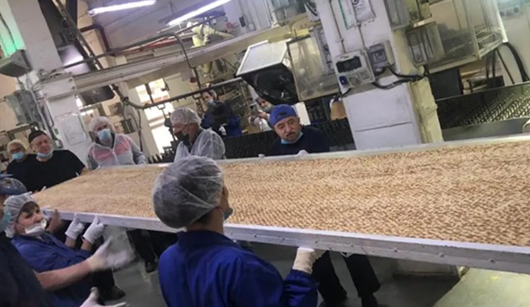
The World's Largest Matzah, ever
Notes:
In honor of the Passover festival, the Matzot Aviv factory in Bnei Brak in Central Israel baked the world's largest matzah.

Slide 3
Weighing in at 13.2 pounds, the massive matzah was nearly 20 feet long, 3.5 feet wide, and 0.16 inches thick.
The recipe for the record-breaking matzah included 15.4 pounds of flour and a half gallon of water.

Slide 4
It had a total of 119,000 holes across its surface.
The Matzot Aviv bakery was founded in 1887 by the Wolf family in Neve Tzedek and sells matzot, cookies, and other baked goods to over 30 countries around the world. (INN / VFI News)
Notes:
Another matzah factoid…

Slide 5
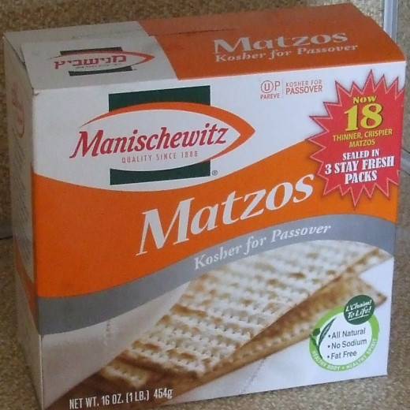
Russians eat 2.4 lbs /person
Easy to do in the worst days of Soviet atheism.
Deliverance from slavery
Notes:
2 ½ boxes per person
Story of Alla Landa

Slide 6
Wedding planning
Dates are important…
Notes:
KC Star Sunday April 4, 2021

Slide 7
Wedding planning
4/3/21 -- 700 couples
KC Star Sunday April 4, 2021
Notes:
KC Star Sunday April 4, 2021

Slide 8
Wedding planning
4/3/21 -- 700 couples
12/13/14 -- 1,800 couples
Notes:
KC Star Sunday April 4, 2021

Slide 9
Wedding planning
4/3/21 -- 700 couples
12/13/14 -- 1,800 couples
10/10/10 -- 2,700 couples
Notes:
KC Star Sunday April 4, 2021

Slide 10
Wedding planning
4/3/21 -- 700 couples
12/13/14 -- 1,800 couples
10/10/10 -- 2,700 couples
11/11/11 -- 3,125 couples
Notes:
KC Star Sunday April 4, 2021

Slide 11
Wedding planning
4/3/21 -- 700 couples
12/13/14 -- 1,800 couples
10/10/10 -- 2,700 couples
11/11/11 -- 3,125 couples
12/12/12 -- 1,800+ couples
Notes:
Grand finale….
KC Star Sunday April 4, 2021

Slide 12
Wedding planning
4/3/21 -- 700 couples
12/13/14 -- 1,800 couples
10/10/10 -- 2,700 couples
11/11/11 -- 3,125 couples
12/12/12 -- 1,800+ couples
7/7/7 -- 4,492
Notes:
KC Star Sunday April 4, 2021
Plan your marriage >> than this! Books, programs, consultations, Shalom Arush, Prepare Enrich.

Slide 14
Dates are important…

Slide 15
Outline of this message
Signs of the end
Deception
Restoration of Israel amidst war
G-d’s interventions

Slide 16
Mattityahu (Matthew) 24:3
ככַּאֲשֶׁר יָשַׁב עַל הַר הַזֵּיתִים נִגְּשׁוּ אֵלָיו הַתַּלְמִידִים לְבַדָּם וְאָמְרוּ:
When he was sitting on the Mount of Olives, the talmidim came to him privately. “Tell us,” they said,

Slide 17
Mattityahu (Matthew) 24:3
”הַגֵּד נָא לָנוּ מָתַי יִהְיֶה הַדָּבָר הַזֶּה וּמַה הוּא אוֹת בּוֹאֲךָ וְקֵץ הָעוֹלָם?“
“when will these things happen? And what will be the sign that you are coming, and that the ‘olam hazeh is ending?”

Slide 18
When, oh L-rd?
How long, Adoni?
How will we know?
Greatest sign…

Slide 19
With all My heart and all My soul
I will in truth plant them in this land.
Notes:
But first…

Slide 20
Outline of this message
Signs of the end
Deception
Restoration of Israel amidst war
G-d’s interventions

Slide 21
Mattityahu (Matthew) 24:4
הֵשִׁיב יֵשׁוּעַ וְאָמַר לָהֶם: ”הִזָּהֲרוּ שֶׁלֹּא יַתְעֶה אֶתְכֶם אִישׁ,
Yeshua replied: “Watch out! Don’t let anyone fool you!
πλανάω planaó
lead astray, deceive, cause to wander
Notes:
Significant problem in the Kingdom, from beginning until now. Especially now.

Slide 22
^{Acts 20.29-30} I know that after my departure, savage wolves will come in among you, not sparing the flock. Even from among yourselves will arise men speaking perversions, to draw the disciples away after themselves.

Slide 23
^{1 Tim. 3.13} Evil people and impostors will go from bad to worse, deceiving others and being deceived themselves.
Notes:
Jim Garlow newsletter 38 deceptions or traumas 2020-2021
One GREAT deception of our day, the supposed difference between
Personal gender identity and
Biological sexual identity.

Slide 24
‘Men Are Coming’: 255 California Prison Inmates Have Requested Transfer to Women’s Prisons Since January. Democratic California Gov. Gavin Newsom signed S.B. 132 into law in January, a bill that requires the California Department of Corrections and Rehabilitation (CDCR) to ask every individual
Notes:
https://www.theepochtimes.com/mkt_breakingnews/men-are-coming-255-california-prison-inmates-have-requested-transfer-to-womens-prisons-since-january_3764385.html?&utm_source=News&utm_medium=email&utm_campaign=breaking-2021-04-06-2&mktids=7502b26275e1f2ec99ea4baed9763e40&est=fB9PcDfb40RVRFFEIkjxdUIBCk68oioqc4Waf6CPmvPUK9K8R529ygQXqdKEfcsRZg%3D%3D

Slide 25
entering the department’s custody to specify their pronouns, their gender identity, and whether they identify as transgender, nonbinary, or intersex. Prison inmates at Chowchilla told the Los Angeles Times that “men are coming” and that the prisoners should anticipate sexual violence.
Notes:
https://www.theepochtimes.com/mkt_breakingnews/men-are-coming-255-california-prison-inmates-have-requested-transfer-to-womens-prisons-since-january_3764385.html?&utm_source=News&utm_medium=email&utm_campaign=breaking-2021-04-06-2&mktids=7502b26275e1f2ec99ea4baed9763e40&est=fB9PcDfb40RVRFFEIkjxdUIBCk68oioqc4Waf6CPmvPUK9K8R529ygQXqdKEfcsRZg%3D%3D

Slide 26
“That if we think it’s bad now, be prepared for the worst…“They say we’re going to need a facility that’s going to be like a maternity ward. They say we’re going to have an inmate program where inmates become nannies.”
Notes:
https://www.theepochtimes.com/mkt_breakingnews/men-are-coming-255-california-prison-inmates-have-requested-transfer-to-womens-prisons-since-january_3764385.html?&utm_source=News&utm_medium=email&utm_campaign=breaking-2021-04-06-2&mktids=7502b26275e1f2ec99ea4baed9763e40&est=fB9PcDfb40RVRFFEIkjxdUIBCk68oioqc4Waf6CPmvPUK9K8R529ygQXqdKEfcsRZg%3D%3D

Slide 27
^{1 Tim. 4.1} The Spirit expressly states that in the akharit hayamim, end of days, some people will apostatize from the faith by paying attention to deceiving spirits and things taught by demons.
Notes:
Deceit and false religion endemic in last days!

Slide 28
Mattityahu (Matthew) 24:5
כִּי רַבִּים יָבוֹאוּ בִּשְׁמִי וְיֹאמְרוּ ’אֲנִי הַמָּשִׁיחַ‘ וְיַתְעוּ רַבִּים.
For many will come in my name, saying, ‘I am the Messiah!’ and they will lead many astray.

Slide 29
When, oh L-rd?
How long, Adoni?
How will we know?

Slide 30
Outline of this message
Signs of the end
Deception
Restoration of Israel amidst war
G-d’s interventions

Slide 31
^{Yekhezkael / Ezk 37.1-3} The hand of Adoni was upon me. The Ruakh Adoni carried me out and set me down in the middle of the valley. It was full of bones. He led me all around them. Behold, there were very many on the floor of the valley. Behold, they were very dry. Then He said to me, “Son of man, can these bones live?”

Slide 32
Dry
Bones
Notes:
https://www.youtube.com/watch?v=ZVUUpwt0IQQ

Slide 33
^{Yekhezkael / Ezk 37.11-14} “Son of man, these bones are the whole house of Israel. Behold, they say: ‘Our bones are dried up;
our hope is lost;
אָבְדָה תִקְוָתֵנוּ
Avdah tikvatenu
Notes:
I saw this movie on 16mm in the apartment of Shira Lindsay in 1969 with the granddaughter of Eliezer ben Yehuda. Shira Lindsay became Shira Sorko Ram, wife of Ari, leader of Maoz. Shared this movie with Golda Meir.
From the Hatikvah, that we sang, the national anthem of Israel.

Slide 35
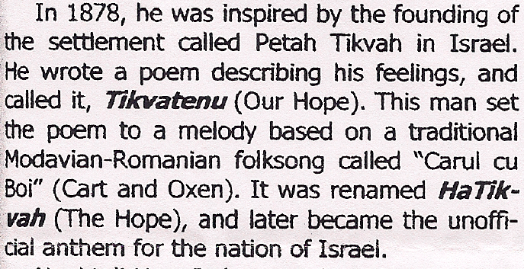
Notes:
Went to America in 1892. Wrote poems, translated “The Rubaiyat” of Omar Khayyam, and some tractates of the Talmud. Died in poverty in 1909 in NYC. Sung May 14, 1948 at the ceremony of the declaration of the State of Israel.
Remember when you sing the Hatikvah, it’s a Messianic song!!

Slide 36
^{Yekhezkael / Ezk 37.11-14} we are cut off—by ourselves.’ Therefore prophesy and say to them, thus says Adoni Elohim: ‘Behold, I will open your graves. I will bring you up out of your graves, My people. I will bring you back to the land of Israel. You will know that I am Adoni,

Slide 37
^{Yekhezkael / Ezk 37.11-14} when I have opened your graves and brought you up out of your graves, My people. I will put My Ruakh in you and you will live. I will place you in your own land. Then you will know that I, Adoni, have spoken and that I have done it.” It is a declaration of Adoni.

Slide 38
^{Matt 24:5} “Now let the fig tree teach you its lesson: when its branches begin to sprout and leaves appear, you know that summer is approaching.
Notes:
Israel is described as a fig tree.

Slide 39
^{Hosea 9:10} Like grapes in the wilderness I found Israel. Like early fruit on a fig tree in its first season I saw your fathers.

Slide 40
^{Yoel 1.6-7} For a mighty and numberless nation has invaded my land. His teeth are lion’s teeth; his fangs are those of a lioness. He has reduced my vines to waste, my fig trees to splinters.

Slide 41
^{Yermiyahu/Jer. 32.37-41} “See, I will gather them out of all the countries, where I have driven them in My anger, My fury, and great wrath, and I will bring them back to this place and cause them to dwell securely. They will be My people, and I will be their God.

Slide 42
^{Yermiyahu/Jer. 32.37-41} I will give them one heart and one way, so they may fear Me forever; for their good and for their children after them. I will make an everlasting covenant with them: I will never turn away from doing good for them.

Slide 43
^{Yermiyahu/Jer. 32.37-41} I will put My fear in their hearts, so that they will not depart from Me. “Yes, I will delight in doing good for them, and with all My heart and all My soul I will in truth plant them in this land.” בְּכָל-לִבִּי וּבְכָל-נַפְשִׁי.
Notes:
Never said of anything else in scripture…that G-d would do with all His heart and soul.
When I was first a believer, and preaching in churches, I used to say that I you are not right with G-d, it should be frightening to see me here.
Now I can say, if you aren’t right with G-d, it should be frightening to see US here, the re-awakening of Israel.
Also…wars not over. Continuing restoration of Israel in the midst of war…

Slide 44
With all My heart and all My soul
I will in truth plant them in this land.

Slide 45
^{Zekh 14.1-2} Behold, a day of Adoni is coming when your plunder will be divided in your midst. I will gather all the nations against Jerusalem to wage war.
Verse was nonsense 100 years ago
No one to gather against
No way to gather

Slide 46
War against Israel is currently heating up…
Ezek 38 does not include the Abrahamic Accord nations in the enemy list
Paras = ? Persia = Iran IS listed.

Slide 47
According to a report in The Wall Street Journal on 12 March, since the end of 2019, 12 Iranian oil tankers on their way to Syria were attacked by Israel. Meanwhile, Israel claims two of its cargo ships were targeted:
Notes:
https://english.ahram.org.eg/NewsContent/2/8/408791/World/Region/Analysis-Saviz-attack-a-significant-shift-in-war-o.aspx

Slide 48
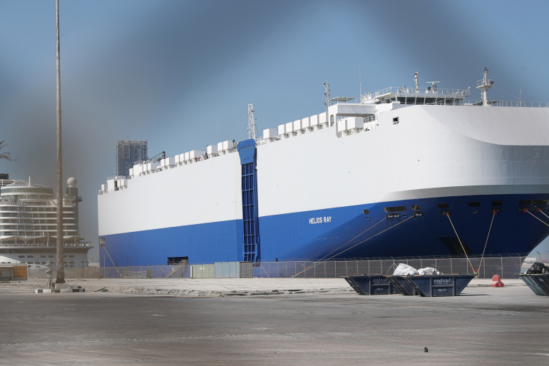
Israeli-owned Helios Ray docked in Dubai after mysterious explosion Feb 26, 2021
Notes:
https://www.aljazeera.com/wp-content/uploads/2021/02/h_56728790.jpg?resize=770%2C513

Slide 49
MV Helios Ray on 25 February 2021 in the Gulf of Oman, and one month later on 25 March a ship owned by XT Management was targeted with an Iranian missile in the Arabian Sea.
Notes:
https://english.ahram.org.eg/NewsContent/2/8/408791/World/Region/Analysis-Saviz-attack-a-significant-shift-in-war-o.aspx

Slide 50
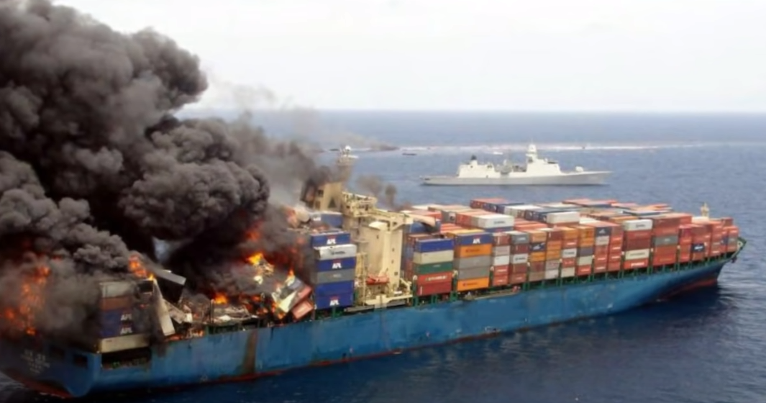
Iranian Missile Hits Israeli-owned
Cargo Ship in Arabian Sea
Mar 26, 2021
Notes:
The ship – owned by XT Management, which is chaired by Israeli Udi Angel – carried on to its destination amid the damage it suffered. , it appears that Israel struck several dozen Iranian oil tankers, which caused Iran cumulative damage of billions of dollars, amid a high rate of success in disrupting its shipping.

Slide 51
An Iranian military ship, the Saviz, was struck by an explosion April 6 in the Red Sea, off the coast of Yemen. The blast reportedly was caused by a mine planted by Israel on the ship’s hull as retaliation for recent Iranian attacks against Israeli shipping.

Slide 52
Photo of SAVIZ
Notes:
https://img3.fleetmon.com/thumbnails/saviz_9167253_594838.570x1140.jpg

Slide 53
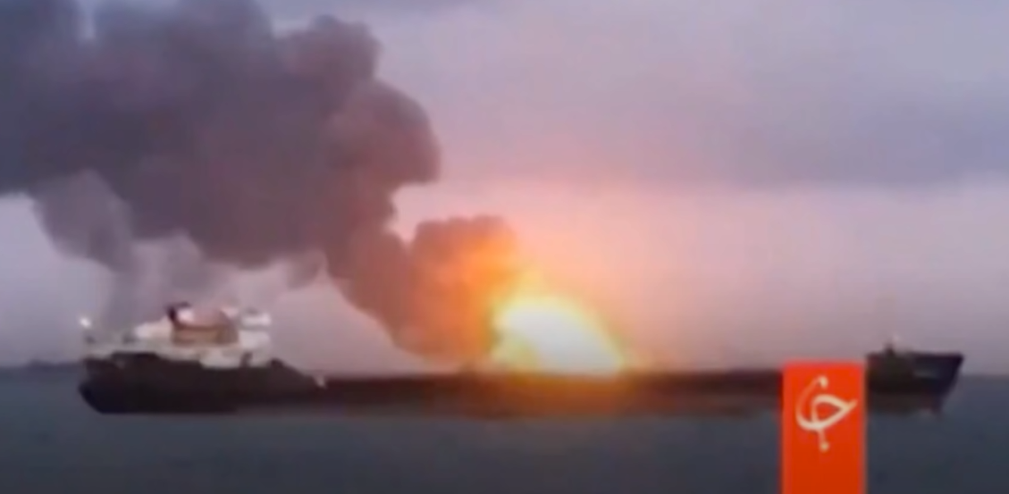
6 Apr 2021
Notes:
https://thejewishvoice.com/2021/04/israel-strikes-iranian-mother-ship-as-shadow-war-at-sea-heats-up/

Slide 54
And the Saviz is no ordinary ship–it is reportedly an Iranian Revolutionary Guards Corps “Mother Ship” that has provided support to the Iran-backed Houthi rebels in Yemen.
Notes:
Previous wars Israel and proxies of Lebanon: Hezbollah, Hamas, Syrians. This is direct.

Slide 55
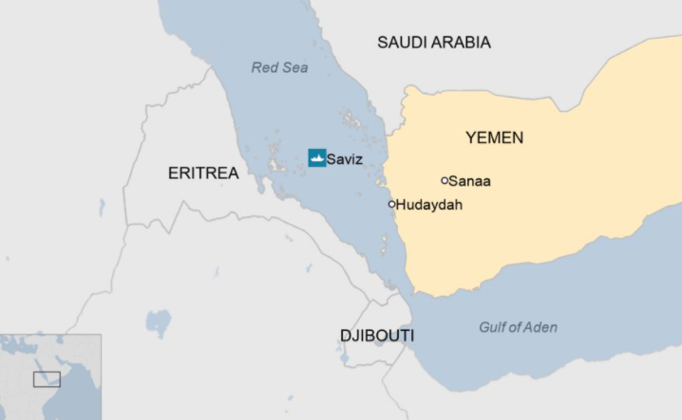
Notes:
https://www.bbc.com/news/world-middle-east-56661069

Slide 57
Nearly Half of Israelis Fear a Second Holocaust
There is a moderate-to high chance of the Jewish people facing another attempt to exterminate them in the future, according to 43 percent of Israelis.
Notes:
https://www.israeltoday.co.il/read/nearly-half-of-israelis-fear-a-second-holocaust-2/?utm_source=acfs&utm_medium=email&utm_term=all&utm_campaign=newsletter-2021-04-08

Slide 58
The facts on the ground are just a few items of what will take place. The next war against us will be a multi-front attack from potentially the following: Iran, Hezbollah in Lebanon, Syria, the Houthis in Yemen,
Notes:
Barry and Batya Segal

Slide 59
pro-Iranian militias in Iraq, Hamas and Islamic Jihad in the Gaza Strip—and add to that the unknown possibilities of Turkey and Russia’s involvement.
Notes:
Barry and Batya Segal

Slide 60
This war will be devastating in many respects since Israel’s present enemies claim to have an arsenal of around 150,000 missiles, both short and long-range, not to mention the new generation of drones used in warfare. It is reported by Israel’s generals that between 1,000 to 2,000 missiles will be launched against Israel daily.
Notes:
Barry and Batya Segal
And back to the theme of deception. Anti Israel. What is the closing line of the Passover Seder?

Slide 61
Notes:
In a Disney Channel program last week devoted to Passover, the network replaced the festive meal’s key declaration “Next Year in Jerusalem” with the phrase “Next Year in the Holy Land.”
https://unitedwithisrael.org/act-now-demand-disney-stop-erasing-jewish-history/?utm_source=newsletters_unitedwithisrael_org&utm_medium=email&utm_content=1500+Rabbis+Warn%3A+Biden+is+Funding+Terror%3B+Last+Known+Jew+in+This+Country+Moves+to+Israel%3B+Demand+Disney+Stop+Erasing+Jewish+History%3B+IDF+Has+Herd+Immunity%21&utm_campaign=20210409_m162772847_1500+Rabbis+Warn%3A+Biden+is+Funding+Terror%3B+Last+Known+Jew+in+This+Country+Moves+to+Israel%3B+Demand+Disney+Stop+Erasing+Jewish+History%3B+IDF+Has+Herd+Immunity%21&utm_term=more_btn_light_png
Answer?

Slide 62
Outline of this message
Signs of the end
Deception
Restoration of Israel amidst war
G-d’s interventions

Slide 63
G-d does things in inconceivably creative ways.
Humans now are making intelligent life: AI
Not gendered
Not reproducing
Notes:
Male and female robots reproducing?

Slide 64
Humans have made nations. [USA]
G-d made a nation: Called a man
Then enslaved. [Pharoah]
Then given land. [Joshua]
Then exiled. [Babylonians]
Then restored. [Ezra]
Then exiled. [Romans, Hitler]
Then restored. [Herzl]
Then all nations attack [Messiah]

Slide 65
This Season of the year
Pesakh
Barley Firstfruits—Resurrection
Counting the Omer 50 Days: sorrow relieve by Israel Ind. Day
Wheat Firstfruits—Torah and Ruakh
Notes:
Mar 27 & 28 evenings
Mar 29 or Apr. 4 We did as community Apr. 3
During the 50 days:
Holocaust Memorial April 8 & 11
Israel Memorial April 13 evening
Israel Independence day.
May 16 evening all night or late night.

Slide 66
3. During the 50 counting days:
a. Holocaust Memorial 4/11
b. Israel Memorial eve. Apr 13
c. Israel Independence day April 14 - 15.
d. This is the season for intercession.

Slide 67
This Season of the year
Pesakh
Barley Firstfruits—Resurrection
Counting the Omer 50 Days: sorrow relieve by Israel Ind. Day
Wheat Firstfruits—Torah and Ruakh We don’t begin to know His power.
Notes:
Mar 27 & 28 evenings
Mar 29 or Apr. 4 We did as community Apr. 3
During the 50 days:
Holocaust Memorial April 8 & 11
Israel Memorial April 13 evening
Israel Independence day.
May 16 evening all night or late night.

Slide 68
Notes:
https://www.favorintl.org/about/our-story/founder-carole-ward/

Slide 69
Grew up with missionary parents in the Philippines Isis territory. Father got daily instructions how to travel.

Slide 70
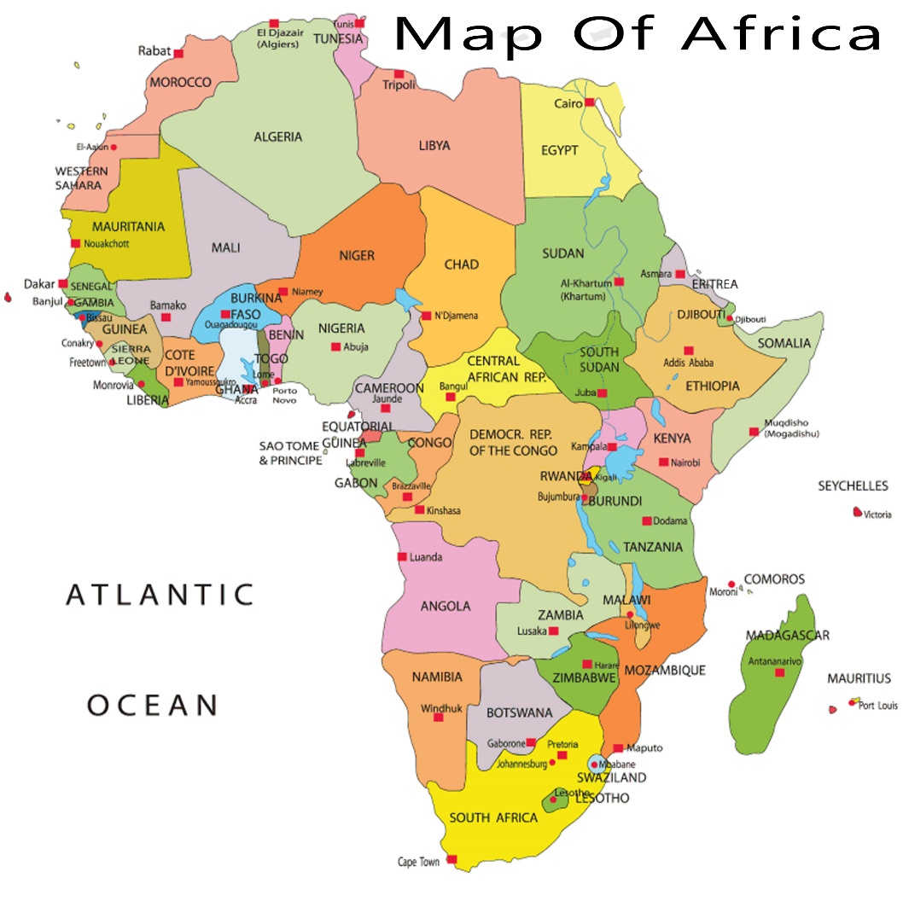
Lots of stories of prayer and fasting. She said to her Board, send me where no one wants to go. To border area Uganda and South Sudan.

Slide 71
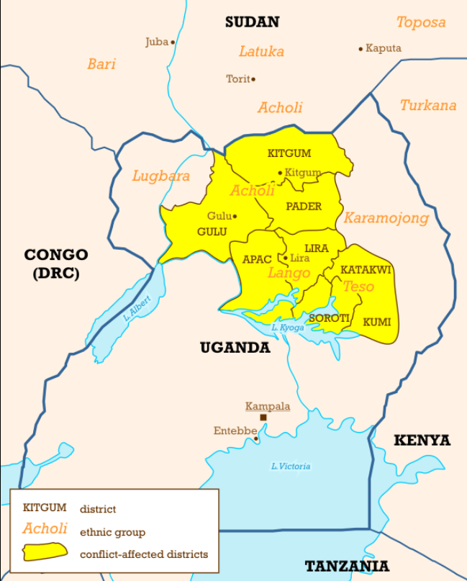
Joseph Kony, leader of The Lord's Resistance Army, , who had trained thirty thousand of them to be used as soldiers, sent out on killing rampages against their own people.
Notes:
To hear her presentation in our Zoom prayer meeting go to
https://us02web.zoom.us/rec/share/MZRvxjaWFMV5ozIbweTOWwPbImfeWbzWko6srjllsP5Cix1ZJ0DONqCAGtPAPaBV.d948jzRkW_Wvu6dw
Passcode: &a1hhjg9

Slide 73
The verse that describes how God took us out of Egypt is in Exodus 19:4:
אַתֶּם רְאִיתֶם, אֲשֶׁר עָשִׂיתִי לְמִצְרָיִם; וָאֶשָּׂא אֶתְכֶם עַל-כַּנְפֵי נְשָׁרִים, וָאָבִא אֶתְכֶם אֵלָי
You have seen what I did unto the Egyptians, and how I bore you on eagles' wings, and brought you unto Myself.
Notes:
www.ulpanor.com

Slide 74
The bird, eagle is unique. While other birds carry their young in their talons because they fear of other birds of pray, that soar above them, the eagle carries its young on its wings.
Notes:
www.ulpanor.com

Slide 75
As the bird that flies higher than any other, it has no fear of attack from above. All it fears are the arrows of man from below. This is how God protects us. We cling to Him, safe in the knowledge that we are protected from above.
Notes:
www.ulpanor.com

Slide 76
^{Dvarim / Dt 7.6-8} “It is not because you are more numerous than all the peoples that Adoni set His love on you and chose you—for you are the least of all peoples. Rather, because of His love for you and His keeping the oath He swore to your fathers,

Slide 77
^{Dvarim / Dt 7.6-8} Adoni brought you out with a mighty hand and redeemed you from the house of slavery, from the hand of Pharaoh king of Egypt.

Slide 78
Praise Adoni, all you nations!
Glorify Him, all you peoples.
For great is His lovingkindness toward us,
and Adoni’s truth endures forever. Halleluyah!
Notes:
Avner Boskey: All nations rejoice in G-d’s love and faithfulness to Israel.

Slide 79
(All figures below come from George Barna.)
There are approximately 364,000 worship facilities in the U.S.
Approximately 20,000 of them are Muslim, Buddhist, Hindu, Sikh, and other groups, which leaves 344,000 that are Christian.
Notes:
Dr. Jim Garlow CEO/Co-Founder
& Rosemary Schindler Garlow Co-Founder

Slide 80
Approximately 20,000 of those are Catholic, leaving around 324,000 Protestant congregations.
Approximately 72% of these Protestant churches are not committed to Scripture. That is, they are liberal, left wing, “progressive” congregations.

Slide 81
That leaves approximately 28% (less than 100,000) that are committed to Scripture, that is, Biblical.
But only about 10% of those (10,000 or so) evangelicals have a distinctively biblical worldview, that is, the application of Scriptural truth to all of life, including the governmental-political.

Slide 82
Outline of this message
Signs of the end
Deception
Restoration of Israel amidst war
G-d’s interventions

Slide 83
Do you KNOW Him and the assurance of sins forgiven?
Are you surrendered to Him, body, soul, spirit? Walking in relational love, confessing?
Are you filled with His Spirit, transforming your life?
Notes:
Who are you discipling, building up?4

Slide 84
Are you inviting people [Jewish people!] to Messiah or to our meetings, and following up?

