Slide 1
e-handout
To have these notes
without taking notes
Go to OrHaOlam.com
Click on downloads,
messages, 2021

Slide 3
Good news from Israel

Slide 4
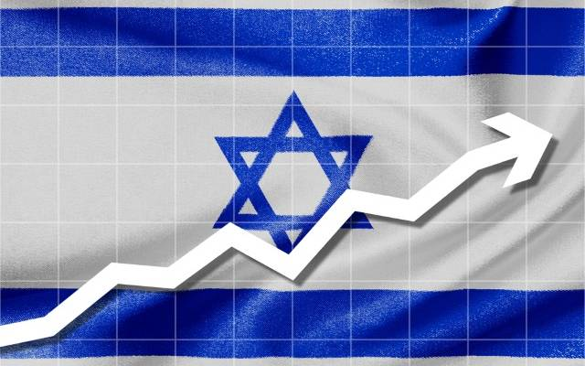
Despite Pandemic, Israel Joins World’s Top 20 GDP Per Capita
Notes:
https://unitedwithisrael.org/despite-pandemic-israel-joins-worlds-top-20-gdp-per-capita/?utm_source=newsletters_unitedwithisrael_org&utm_medium=email&utm_content=%E2%80%98Shark+Tank%E2%80%99+Star+Praises+Farrakhan%3B+What+Did+Ex-Obama+Official+Tell+Iran+About+Israel%3F+Jewish+War+Hero+Who+Fought+Nazis+Honored+in+Canada&utm_campaign=20210427_m163004076_%E2%80%98Shark+Tank%E2%80%99+Star+Praises+Farrakhan%3B+What+Did+Ex-Obama+Official+Tell+Iran+About+Israel%3F+Jewish+War+Hero+Who+Fought+Nazis+Honored+in+Canada&utm_term=more_btn_dark_jpg

Slide 5
By Yakir Benzion, United With Israel
The latest data compiled by the Israeli edition of one of the world’s leading business magazines, Forbes, shows that Israel is in 19th place in the world based on GDP per capita, the magazine reported recently.
Notes:
https://unitedwithisrael.org/despite-pandemic-israel-joins-worlds-top-20-gdp-per-capita/?utm_source=newsletters_unitedwithisrael_org&utm_medium=email&utm_content=%E2%80%98Shark+Tank%E2%80%99+Star+Praises+Farrakhan%3B+What+Did+Ex-Obama+Official+Tell+Iran+About+Israel%3F+Jewish+War+Hero+Who+Fought+Nazis+Honored+in+Canada&utm_campaign=20210427_m163004076_%E2%80%98Shark+Tank%E2%80%99+Star+Praises+Farrakhan%3B+What+Did+Ex-Obama+Official+Tell+Iran+About+Israel%3F+Jewish+War+Hero+Who+Fought+Nazis+Honored+in+Canada&utm_term=more_btn_dark_jpg

Slide 6
Led by Luxembourg, which ranks first with a whopping $116,021 per capita, Israel is up there with the best, including the US in 6th place, with $63,416 per capita, Singapore in 8th at $58,902, and Qatar – the only Arab country in the top 20 – in 11th place at $52,144.
Notes:
https://unitedwithisrael.org/despite-pandemic-israel-joins-worlds-top-20-gdp-per-capita/?utm_source=newsletters_unitedwithisrael_org&utm_medium=email&utm_content=%E2%80%98Shark+Tank%E2%80%99+Star+Praises+Farrakhan%3B+What+Did+Ex-Obama+Official+Tell+Iran+About+Israel%3F+Jewish+War+Hero+Who+Fought+Nazis+Honored+in+Canada&utm_campaign=20210427_m163004076_%E2%80%98Shark+Tank%E2%80%99+Star+Praises+Farrakhan%3B+What+Did+Ex-Obama+Official+Tell+Iran+About+Israel%3F+Jewish+War+Hero+Who+Fought+Nazis+Honored+in+Canada&utm_term=more_btn_dark_jpg

Slide 7
Israel is still considered one of the most expensive countries in the world,” the report said, with the OECD noting that prices in Israel today are about 25% higher than the average of all the countries in the organization.
Notes:
https://unitedwithisrael.org/despite-pandemic-israel-joins-worlds-top-20-gdp-per-capita/?utm_source=newsletters_unitedwithisrael_org&utm_medium=email&utm_content=%E2%80%98Shark+Tank%E2%80%99+Star+Praises+Farrakhan%3B+What+Did+Ex-Obama+Official+Tell+Iran+About+Israel%3F+Jewish+War+Hero+Who+Fought+Nazis+Honored+in+Canada&utm_campaign=20210427_m163004076_%E2%80%98Shark+Tank%E2%80%99+Star+Praises+Farrakhan%3B+What+Did+Ex-Obama+Official+Tell+Iran+About+Israel%3F+Jewish+War+Hero+Who+Fought+Nazis+Honored+in+Canada&utm_term=more_btn_dark_jpg

Slide 8
Thus, while in terms of per capita income Israel is in 19th place, which is very respectable, in terms of the actual purchasing power of consumers Israel is ranked only 35th in the world.
Notes:
https://unitedwithisrael.org/despite-pandemic-israel-joins-worlds-top-20-gdp-per-capita/?utm_source=newsletters_unitedwithisrael_org&utm_medium=email&utm_content=%E2%80%98Shark+Tank%E2%80%99+Star+Praises+Farrakhan%3B+What+Did+Ex-Obama+Official+Tell+Iran+About+Israel%3F+Jewish+War+Hero+Who+Fought+Nazis+Honored+in+Canada&utm_campaign=20210427_m163004076_%E2%80%98Shark+Tank%E2%80%99+Star+Praises+Farrakhan%3B+What+Did+Ex-Obama+Official+Tell+Iran+About+Israel%3F+Jewish+War+Hero+Who+Fought+Nazis+Honored+in+Canada&utm_term=more_btn_dark_jpg

Slide 10
REAL Motherhood
Word study on motherhood
Physical application
Spiritual application

Slide 11
^{Beresheet/Gen 3.20} The man called his wife Havah [Eve] [life], because she was the mother of all living.
וַיִּקְרָא הָאָדָם שֵׁם אִשְׁתּוֹ חַוָּה: כִּי הִוא הָיְתָה, אֵם כָּל-חָי.
Motherhood = source of life.
Prophetic label, before any childbirth.
Notes:
Not at all obvious in the English Eve.
Phonetically spell Havah or Khavah.
Theme of message, think about Khavah = Motherhood = Source of Life

Slide 12
Two possible roots to Khava: Khayah חיה and Khavah חווה.
Words structurally related to Khavah:
Notes:
Could be both, or ambivalent, so use both. Certain things in scripture not clear, so use both meanings.

Slide 13
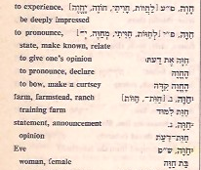
Complete Hebrew
Dictionary Reuben
Alcalay 1974
experience,
pronounce,
farm
Notes:
[Two possible roots to her name. Khayah חיה and חווה.
Store in Tiberias, on Lake Kinneret = Sea of Galilee sold Judaica חוית גליל Khviyat Galil = Galilee Experience

Slide 14
Modern Hebrew words structurally related to Khavah summary:
To give life
To experience,
To pronounce, express opinion,
To farm
Notes:
Physical motherhood
Women experience things often more intensely, right brain perception, spatial perception
Women have a quicker, more intuitive opinion

Slide 15
from “Khayah, to live”
Adam’s prophetic word of what she would be; that he and his wife should not die immediately for the offence they had committed, but should live and propagate their species, as well as be partakers of spiritual and eternal life, from her.
Notes:
https://www.biblestudytools.com/commentaries/gills-exposition-of-the-bible/genesis-3-20.html

Slide 16
She would also be the mother of Him that should bring life and immortality to light. Previous verse:
^{Beresheet/Gen 3.14-15} Adoni Elohim said to the serpent…“Because you did this, I will put animosity between you and the woman—between your seed and her seed. He will crush your head, and you will crush his heel.
Notes:
https://www.biblestudytools.com/commentaries/gills-exposition-of-the-bible/genesis-3-20.html

Slide 17
^{Ro. 16.20} Now the God of shalom will soon crush satan under your feet. May the grace of our Lord Yeshua be with you.
This message is practical/ relational, but theological/ spiritual underpinnings is Atonement of Messiah.
Notes:
All about Messiah Yeshua, ultimately!
When we worship dance, arguable that we invoke this crushing of satan.
https://www.biblestudytools.com/commentaries/gills-exposition-of-the-bible/genesis-3-20.html

Slide 18
REAL Motherhood=Source of LIFE
Word study on motherhood
Physical application
Spiritual application

Slide 19
More than a “birthing person”.
Motherhood and the dignity of
the source of life.
Notes:
https://www.frcaction.org/get.cfm?i=WA21E15&f=WU21E01

Slide 20
Protection of the source of life: Mothers [and all women] RECEIVING protection

Slide 21
Principles of touching.
Private areas are inviolate outside marriage.
The shoulder is the place of public contact.
Hold the door open, ladies first
Notes:
Annie Schumacher teaching.

Slide 22
A Prayer That Left Me Gloriously Ruined
By Gary Thomas
I was a young husband, and during an intense time of prayer, I sensed God telling me very directly that Lisa wasn’t just my wife,
Notes:
https://www.patheos.com/blogs/askshaunti/2021/04/a-prayer-that-left-me-gloriously-ruined/?mc_cid=f0a31771ae&mc_eid=fec1a78175
From Shaunti Feldhan

Slide 23
but she was also His daughter and I was to treat her accordingly. It was an intense application of 1 John 3:1: “See what kind of love the Father has given to us, that we should be called children of God.”
Notes:
https://www.patheos.com/blogs/askshaunti/2021/04/a-prayer-that-left-me-gloriously-ruined/?mc_cid=f0a31771ae&mc_eid=fec1a78175

Slide 24
So when I realized I was married to God’s daughter—and that you, women, are married to God’s sons—everything about how I viewed marriage changed. God feels about my wife—His daughter—in an even holier and more passionate way than I feel about my own daughters.
Notes:
https://www.patheos.com/blogs/askshaunti/2021/04/a-prayer-that-left-me-gloriously-ruined/?mc_cid=f0a31771ae&mc_eid=fec1a78175

Slide 25
Suddenly, my marriage was no longer about just me and one other person; it was very much a relationship with a passionately interested third partner. I realized one of my primary forms of worship throughout the rest of my life would be honoring God by taking care of a woman who would always be, in His divine mind, “His little girl.”
Notes:
https://www.patheos.com/blogs/askshaunti/2021/04/a-prayer-that-left-me-gloriously-ruined/?mc_cid=f0a31771ae&mc_eid=fec1a78175
Let that sink in. Commitment by all men and boys.
How have us guys been?
“Me first.”
“I’m offended.”
“My problems.”
Love her as Messiah loved the congregation. Die for her!

Slide 26
REAL Motherhood=Source of LIFE
Word study on motherhood
Physical application
Spiritual application

Slide 27
Protection of the source of life: Mothers [and all women] GIVING protection.

Slide 28
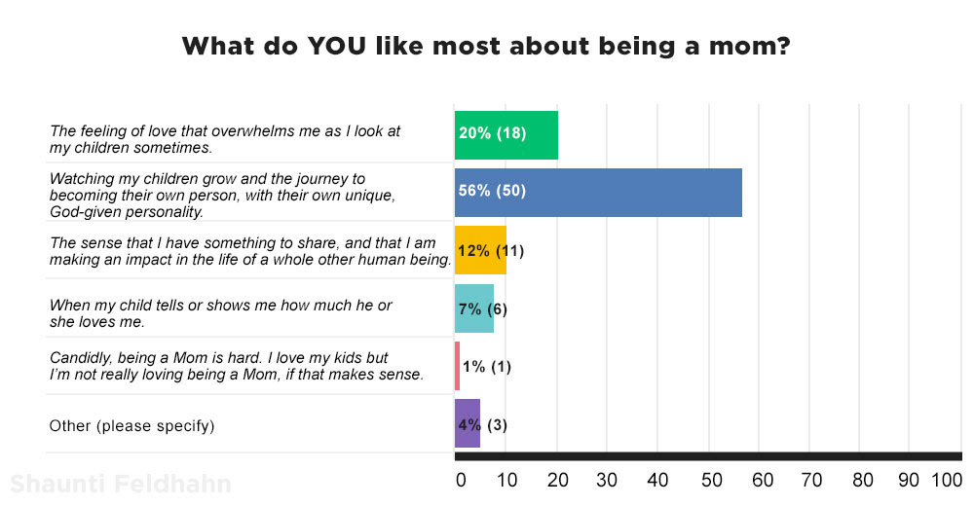
Notes:
https://www.patheos.com/blogs/askshaunti/2021/05/all-the-mommy-ladies-what-you-said-about-being-a-mom/?mc_cid=209e9f1590&mc_eid=fec1a78175
Shaunti Feldhan

Slide 29
^{Mishlei/Prov 31.10} Who can find a capable wife? Her value is far beyond that of pearls.
אֵשֶׁת-חַיִל מִי יִמְצָא; וְרָחֹק מִפְּנִינִים מִכְרָהּ.
חַיִל khiyil (military) corps; army; strength, success

Slide 31
^{Mishlei/Prov 17.12} Better to meet a bear robbed of her cubs than to deal with a fool in his folly.
Notes:
Illustration of the severity of a momma bear protecting her cubs.

Slide 32
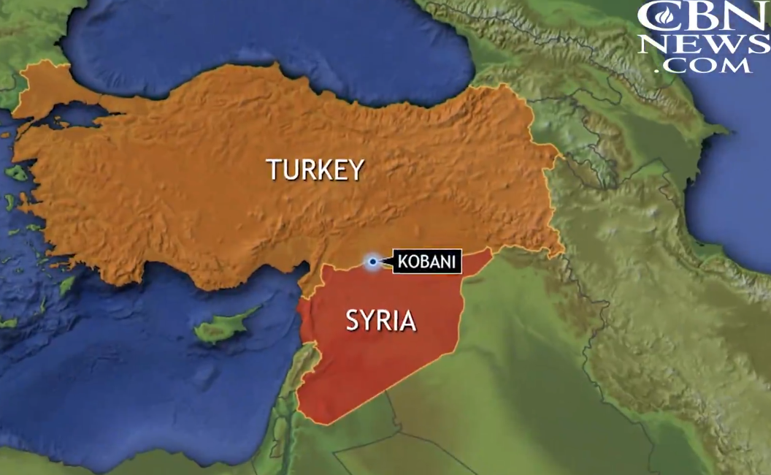
Notes:
https://www1.cbn.com/cbnnews/world/2021/march/isiss-worst-nightmare-the-daughters-of-kobani-nbsp

Slide 33
In 2014, The Islamic State had swept across much of Syria, overtaking cities and spreading terror as civil war raged all around it. As ISIS approached a town called Kobani, a group of Kurdish female fighters,
Notes:
https://www1.cbn.com/cbnnews/world/2021/march/isiss-worst-nightmare-the-daughters-of-kobani-nbsp

Slide 34
armed with AK-47s and a lot of courage, were determined not to let ISIS take their town, homes, or their families. And although they had braided hair and painted fingernails, when it came to fighting ISIS they were as fierce as any male army.
Notes:
https://www1.cbn.com/cbnnews/world/2021/march/isiss-worst-nightmare-the-daughters-of-kobani-nbsp

Slide 35
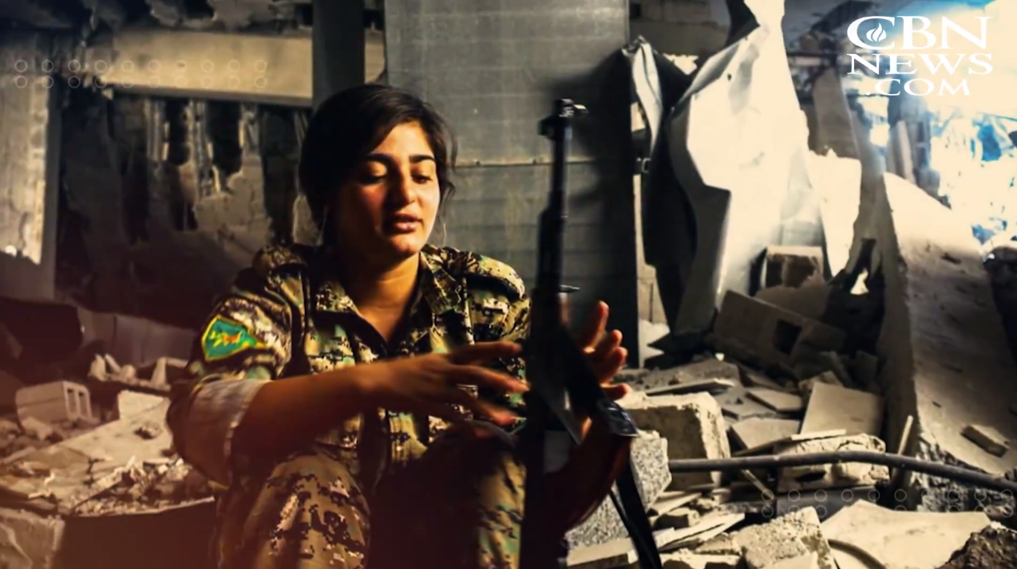
Notes:
https://www1.cbn.com/cbnnews/world/2021/march/isiss-worst-nightmare-the-daughters-of-kobani-nbsp

Slide 36
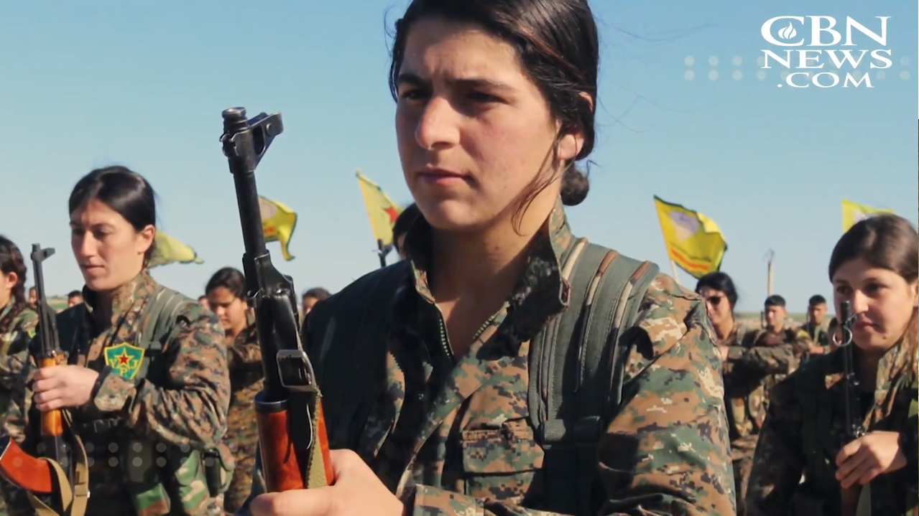
Notes:
https://www1.cbn.com/cbnnews/world/2021/march/isiss-worst-nightmare-the-daughters-of-kobani-nbsp

Slide 37
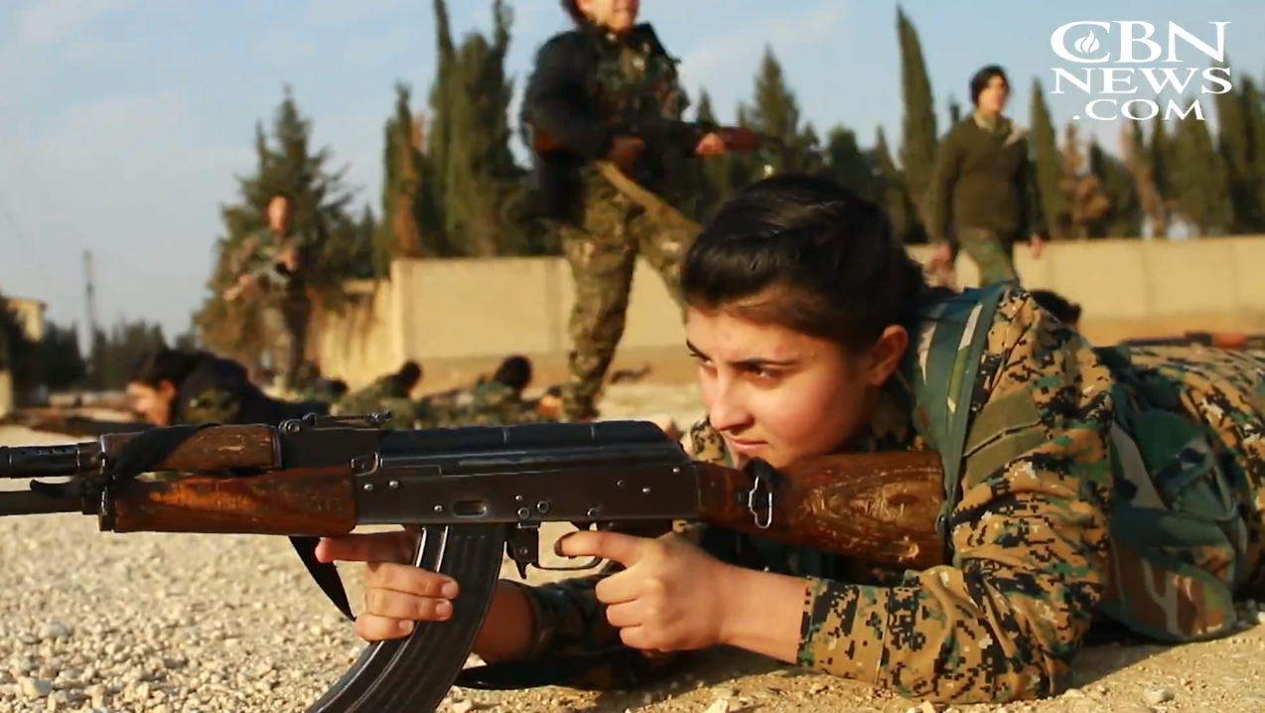
Notes:
https://www1.cbn.com/cbnnews/world/2021/march/isiss-worst-nightmare-the-daughters-of-kobani-nbsp

Slide 38
Mothers and all women:
You deserve to be protected.
If not, G-d WILL STIL be there to help you protect yourself. Emotionally, spiritually, physically. FIGHT RIGHTEOUSLY!

Slide 39
REAL Motherhood=Source of LIFE
Word study on motherhood
Physical application
Spiritual application

Slide 40
Spiritual warfare can be MUCH BIGGER than physical warfare.

Slide 41
Notes:
https://www.youtube.com/watch?v=ktvB21Jnxi4&t=157s
From 2.35 to 2.49

Slide 42
^{Shmot/Ex.35.22} Both men and women came, as many as had willing hearts; they brought nose-rings, earrings, signet-rings, belts, all kinds of gold jewelry — everyone bringing an offering of gold to Adonai.

Slide 43
^{Shmot/Ex.35.26} Also all the women who were wise-hearted spun with their hands, and brought what they had woven—the blue, purple, scarlet and fine linen.
Notes:
Women were more intense givers for the Mishkan, the Tabernacle of Moshe.

Slide 44
^{Shmot/Ex.38.8} He [B’tzal’el] made the basin of bronze with its base of bronze from the mirrors of the women serving at the entrance to the tent of meeting.

Slide 45
^{Shmot/Ex 32.2-3} Aharon said to them, “Have your wives, sons and daughters strip off their gold earrings; and bring them to me.” The people stripped off their gold earrings and brought them to Aharon.
Notes:
This is the story of the making of the golden calf. Rashi says that there is an implication here that the women would NOT easily give up their jewelry, and so the idolatry would be delayed by Aharon’s request, till Moshe got back. Nevertheless, the men got the earrings.

Slide 46
The women refused to give up their gold, the husbands found other ways to get gold for the Golden Calf. So much for that idea, but at least the women were proven righteous.
Therefore Rosh Khodesh can be celebrated as a monthly Women’s Day.
Notes:
https://unitedwithisrael.org/living-torah-how-orthodox-judaism-views-women/?utm_source=newsletters_unitedwithisrael_org&utm_medium=email&utm_content=Obama+Must+Correct+Lies+About+Israel%3B+IDF+is+First+Army+in+World+to+Defeat+Corona%3B+Israel+to+the+Rescue+After+Disaster+Strikes+Tiny+Nation%3B+Making+Shabbat+Holy%21&utm_campaign=20210312_m162398063_Obama+Must+Correct+Lies+About+Israel%3B+IDF+is+First+Army+in+World+to+Defeat+Corona%3B+Israel+to+the+Rescue+After+Disaster+Strikes+Tiny+Nation%3B+Making+Shabbat+Holy%21&utm_term=How+Torah+Judaism+Views+Women

Slide 47
A Life Giver.

Slide 48
^{1 Shmuel 1.5-10} Hannah…Adoni had closed her womb. Her rival would taunt her bitterly to provoke her, because Adoni had closed her womb. So it was year after year, whenever she went up to the House of Adoni, that she would provoke her; so she wept and would not eat… While her soul was bitter, she prayed to Adoni and wept.

Slide 49
^{1 Shmuel 1.11-12} Then she took a vow; she said, “Adoni-Tzva’ot, if you will notice how humiliated your servant is, if you will remember me and not forget your servant but will give your servant a male child, then I will give him to Adoni for as long as he lives; and no razor will ever come on his head.” She prayed for a long time before Adoni.
Notes:
Prophet Shmuel. Brought revival to Israel. Guided them into a Kingdom.

Slide 50
Another Life Giver.

Slide 51
^{Lk 2.36-38} There was also a prophetess named Hannah Bat-P’nu’el, of the tribe of Asher. She was a very old woman — she had lived with her husband seven years after her marriage and had remained a widow ever since; now she was eighty-four.

Slide 52
^{Lk 2.36-38} She never left the Temple grounds but worshipped there night and day, fasting and praying. She came by at that moment and began thanking God and speaking about the child to everyone who was waiting for Yerushalayim to be liberated.
Notes:
Exhortation to mothers, and all women: welcomed the Messiah to ancient Jerusalem. Maybe key to His coming? Welcome Him now!!

Slide 53
Another Life Giver.

Slide 54
^{Gal. 4.19} My dear children, I am suffering the pains of giving birth to you all over again — and this will go on until the Messiah takes shape in you.
Zion travailed

Slide 55
^{Yeshayahu/Is 66.7-8} Before going into labor, she gave birth; before her pains came, she delivered a male child. Who ever heard of such a thing? Who has ever seen such things? Is a country born in one day? Is a nation brought forth all at once? For as soon as Tziyon went into labor, she brought forth her children.

Slide 56
Are there spiritual issues to fight for?
Some with political overtones!

Slide 57
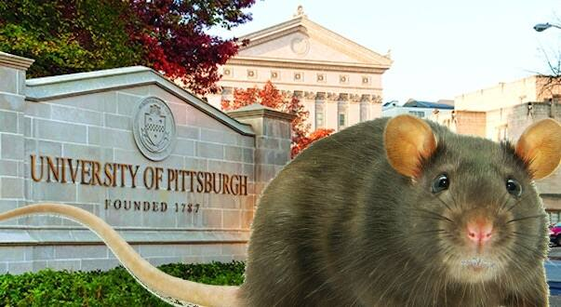
Transplanting scalps of aborted
babies onto rodents raises ethical
concerns.
Notes:
https://metrovoicenews.com/transplanting-scalps-of-aborted-babies-onto-rodents-raises-ethical-concerns/

Slide 58
Notes:
https://metrovoicenews.com/transplanting-scalps-of-aborted-babies-onto-rodents-raises-ethical-concerns/

Slide 59
The Pennsylvania Family Institute letter :
“We call on the University of Pittsburgh to stop all experimentation on aborted babies and the inhumane practice of grafting their skin and body parts onto rodents,” it says.
Notes:
https://metrovoicenews.com/transplanting-scalps-of-aborted-babies-onto-rodents-raises-ethical-concerns/

Slide 60
They urged the state legislature to conduct a full investigation of the university, Planned Parenthood and other groups involved in the experiments. “This ghastly finding is a product of Pitt’s systemic practices of using aborted babies for inhumane research,” they wrote.
Notes:
https://metrovoicenews.com/transplanting-scalps-of-aborted-babies-onto-rodents-raises-ethical-concerns/

Slide 61
“Pitt has been involved in hundreds of fetal kidneys and other organs from aborted babies being distributed for research as part of a project funded by the National Institute of Health. Pitt has also had scientists harvesting fetal livers ‘in vivo’ from fetuses delivered via labor induction.”
Notes:
https://metrovoicenews.com/transplanting-scalps-of-aborted-babies-onto-rodents-raises-ethical-concerns/
More info on U Pitt experiments at
https://youtu.be/c-JUzqswKZs

Slide 62
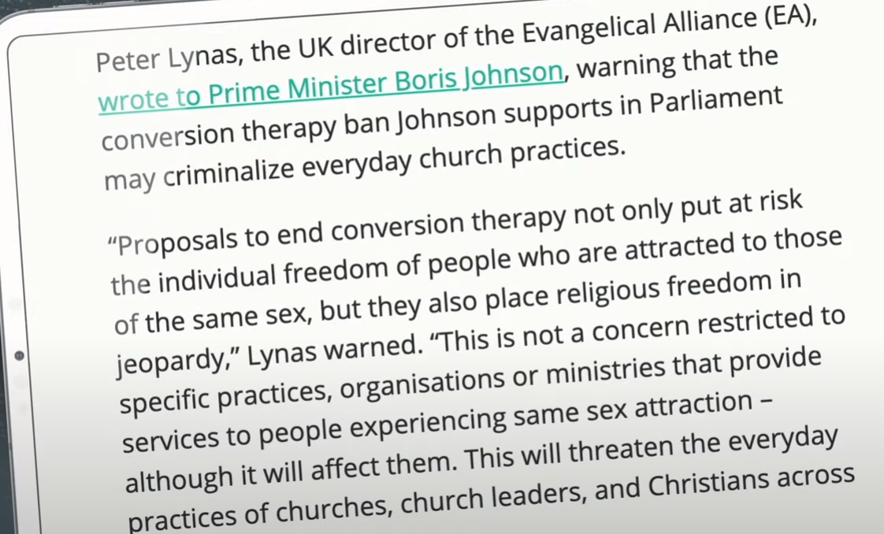
Notes:
https://www.youtube.com/watch?v=S0SDIK0LKaY

Slide 63
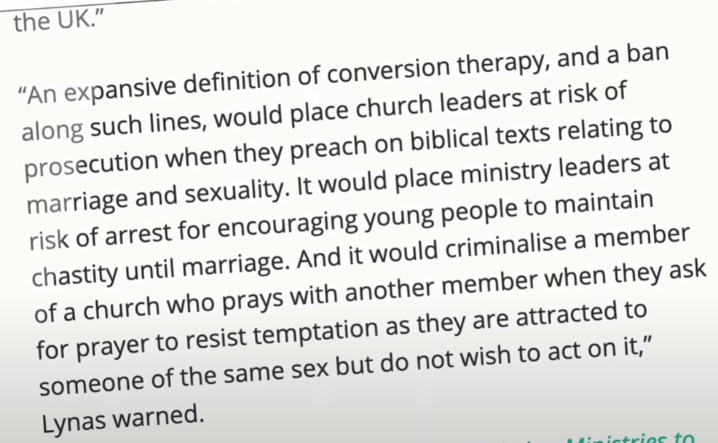
Notes:
https://www.youtube.com/watch?v=S0SDIK0LKaY

Slide 64
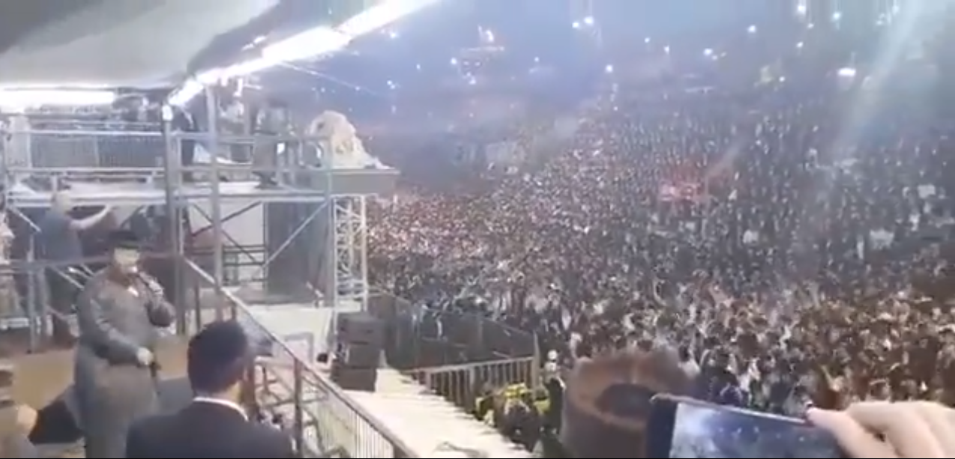
The worshipers at Mt. Meron
Notes:
https://twitter.com/i/status/1387889426412544014
It helps us to pray by the grave of Rabbi Shimon bar Yokhai

Slide 65
The worshipers at Mt. Meron
Notes:
https://twitter.com/i/status/1387889426412544014

Slide 66
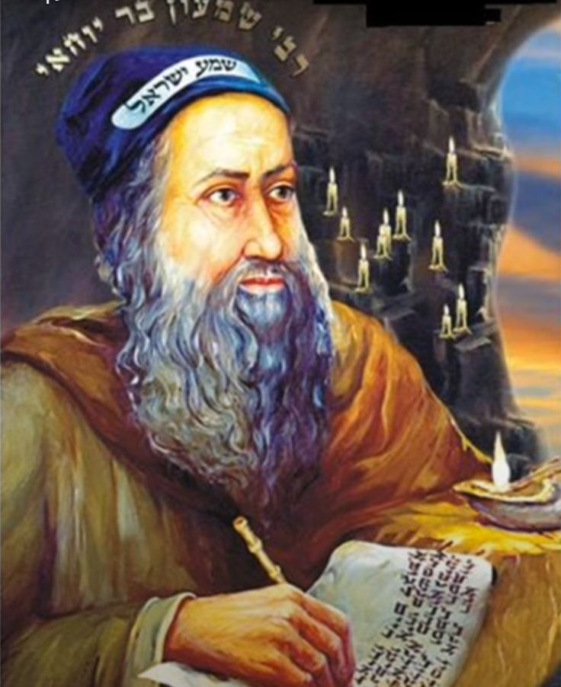

Slide 67
REAL Motherhood=Source of LIFE
Word study on motherhood
Physical application
Spiritual application

Slide 68
The Yeshua Fast
Notes:
https://www.youtube.com/watch?v=Q7SxUO6kiZ4 beginning to 1.33
Lou Engle had a paradigm shift ~pray-adigm shift. He was told your lion is abortion, your bear gay marriage, your Goliath Jerusalem.
In 2004 a woman named Christy Brent had a dream that there would be a pandemic, then a surge in homelessness, then economic decline and loss, social unrest, the storming of the US Capitol, and the president be silenced. After that would be a GREAT harvest.
Calling for a fast leading up to Shavuot. Some Messianic leaders participating. Wed. Thu. Fri.
Shavuot-nik = Pentecostal

Slide 69
Do you KNOW Him and the assurance of sins forgiven?
Are you surrendered to Him, body, soul, spirit? Walking in relational love, confessing?
Are you filled with His Spirit, transforming your life?
Notes:
Who are you discipling, building up?4

Slide 70
Rebbitzin Dawn will honor Moms
Notes:
If you are single, or childless, we are not unaware of your pain. Please try to focus on blessing moms.

