Slide 1
e-handout
To have these notes
without taking notes
Go to OrHaOlam.com
Click on downloads,
messages, 2021

Slide 2
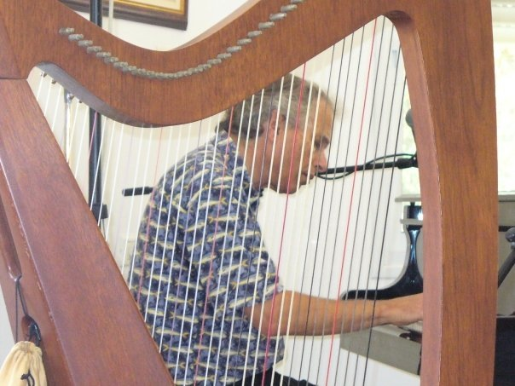
Steve Gelbart, our first worship leader

Slide 3
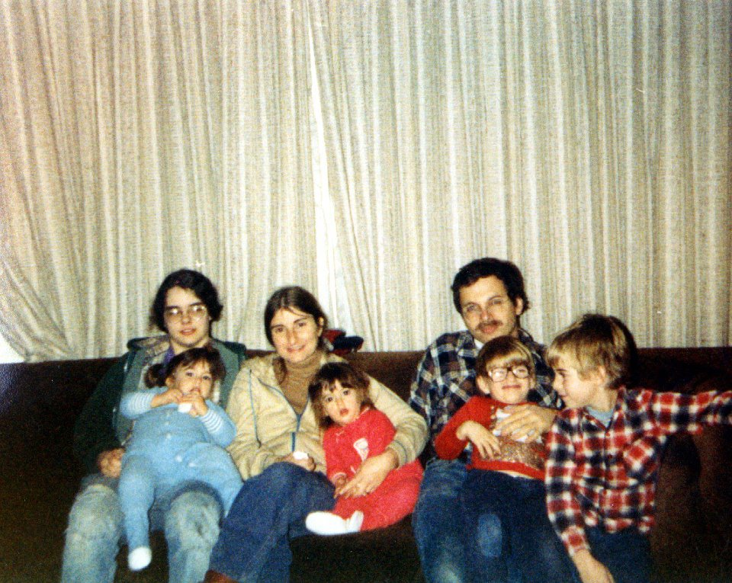
Gelbart family ~1980
Steve, Jeanie, Asher, Michael, Elise, Ilana and ?

Slide 4
Greetings from Israel by one of our founders, and dance meisters, Jeanie Gelbart

Slide 5
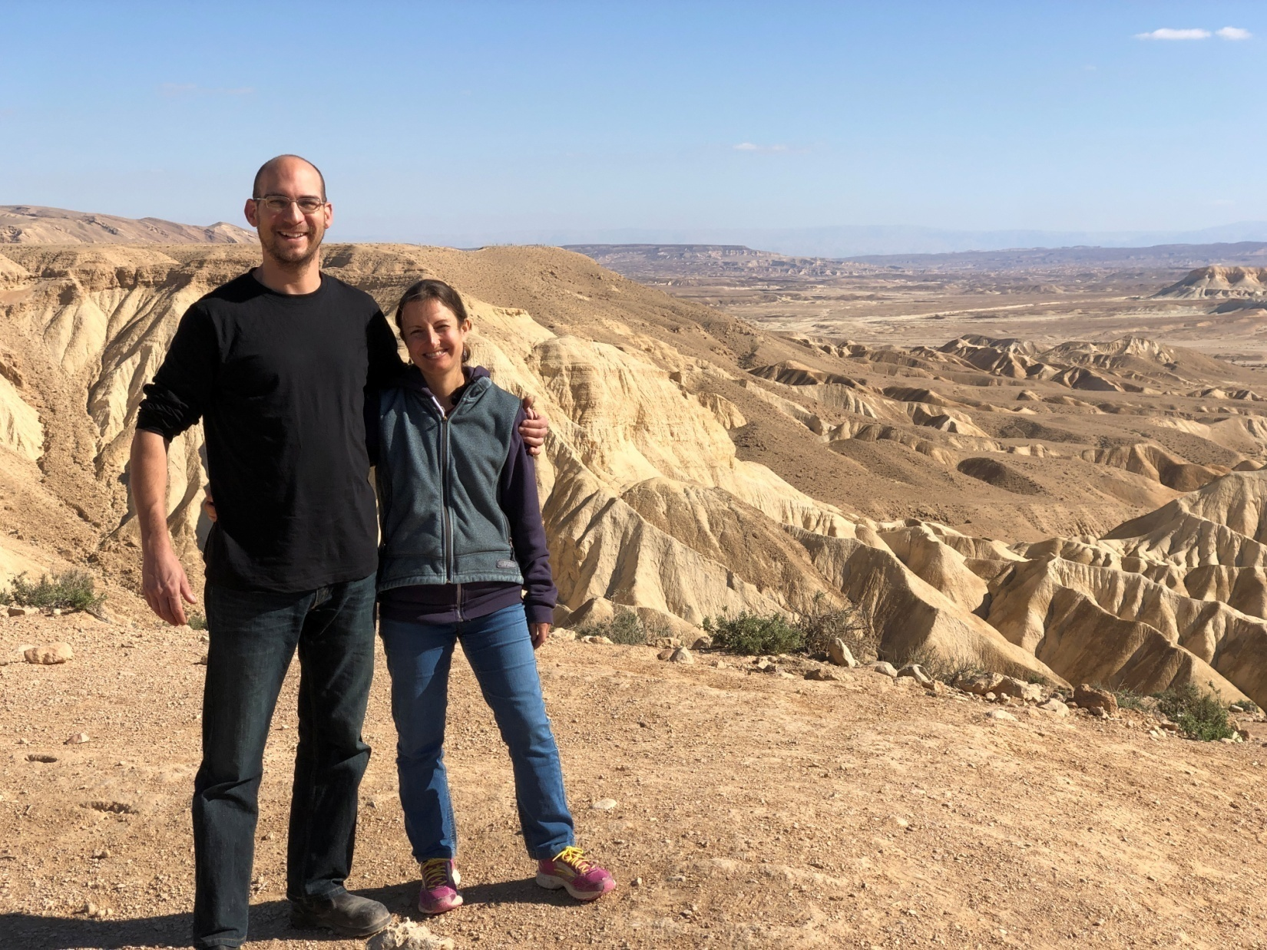

Slide 6
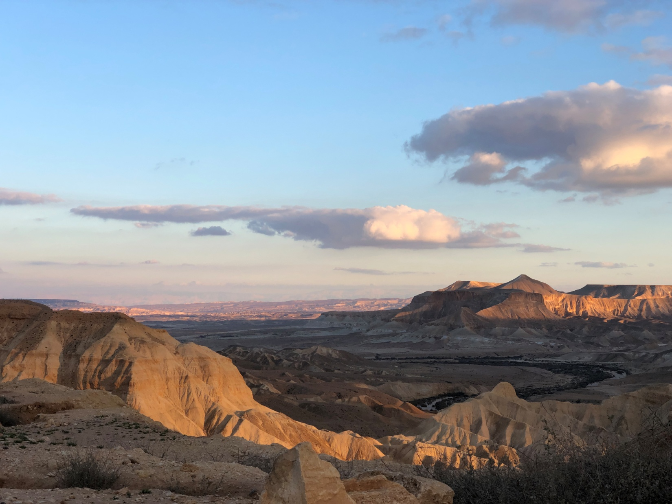

Slide 7
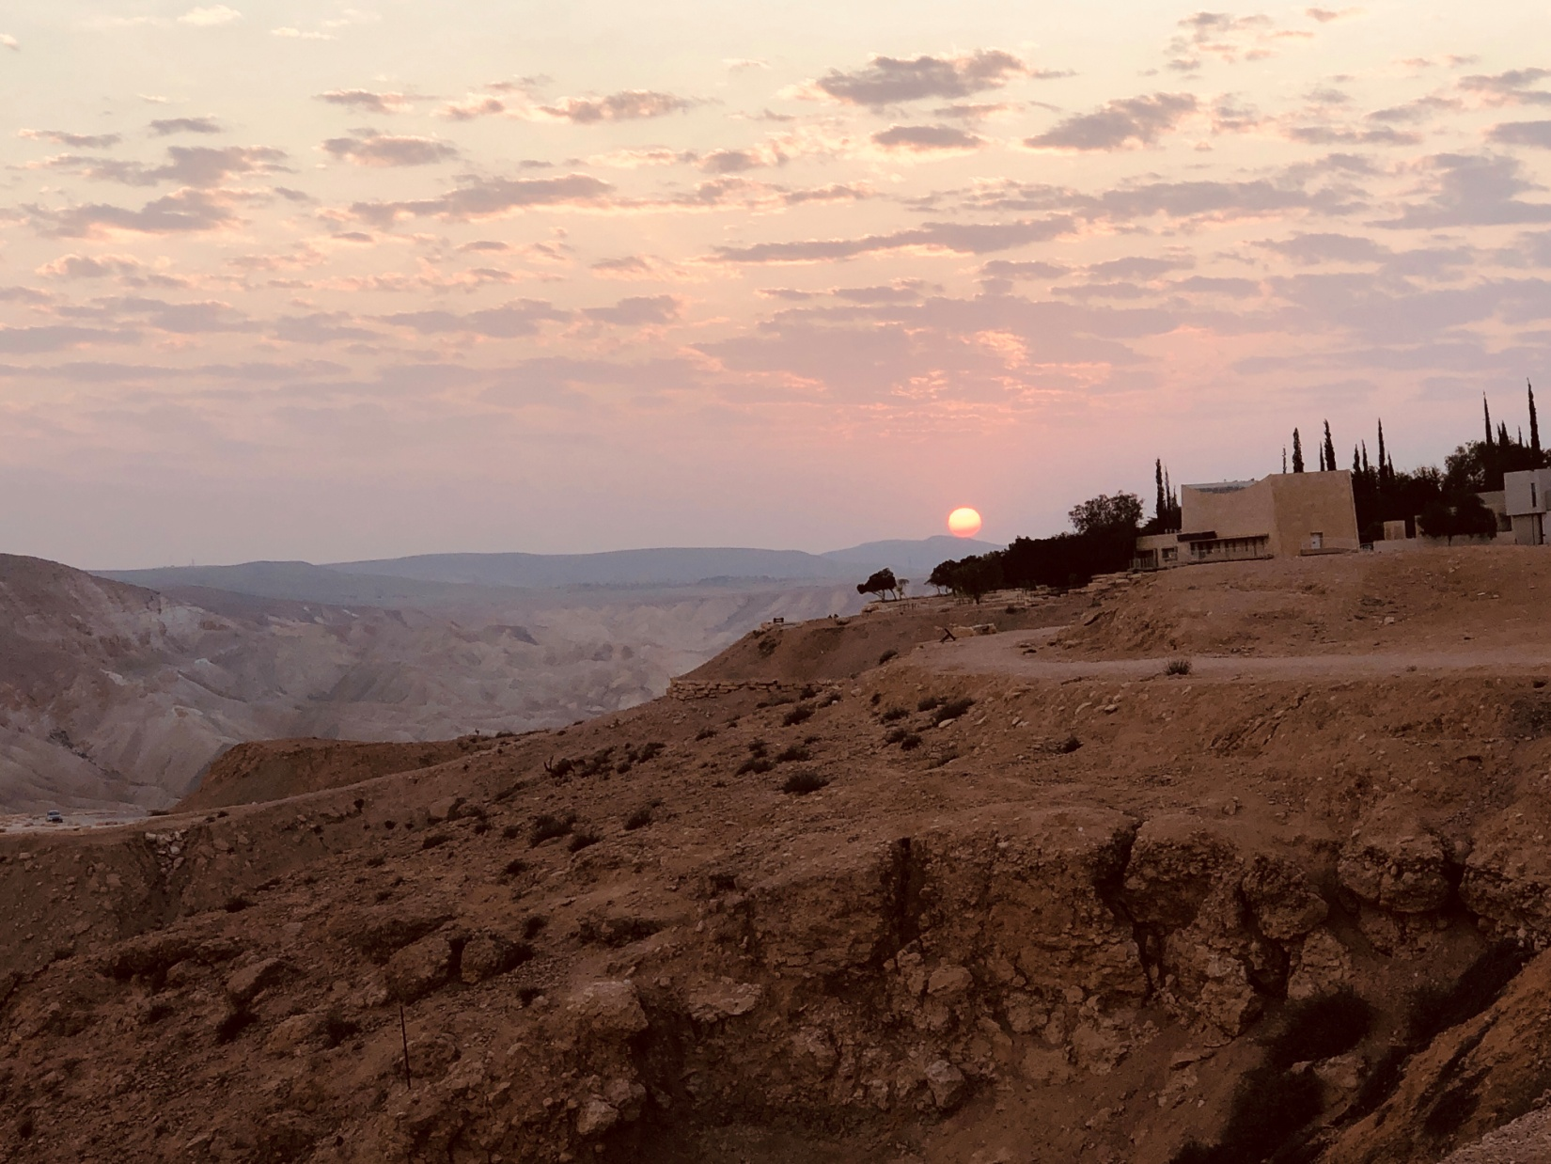
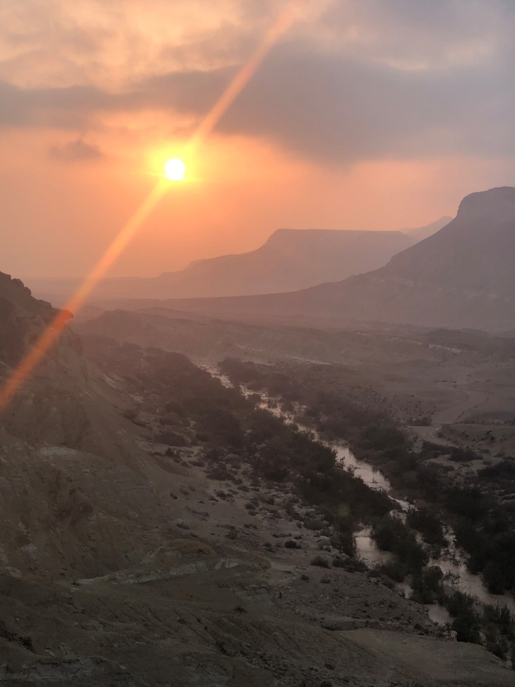

Slide 8
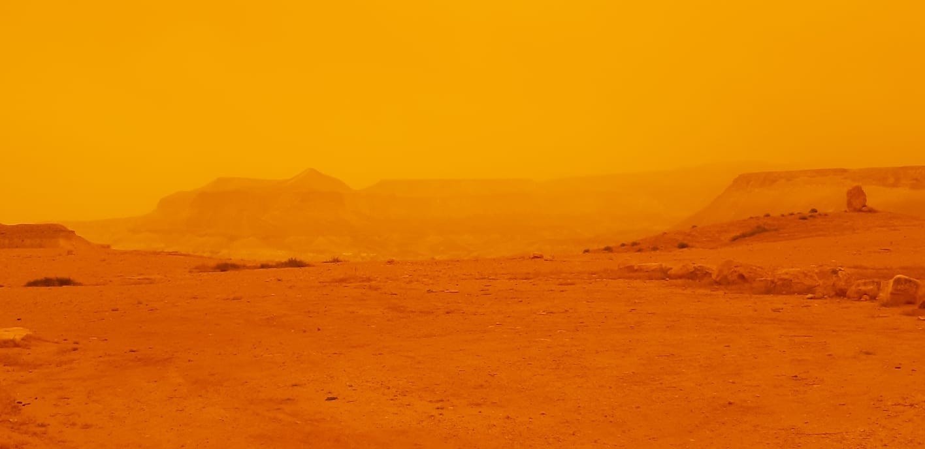

Slide 9
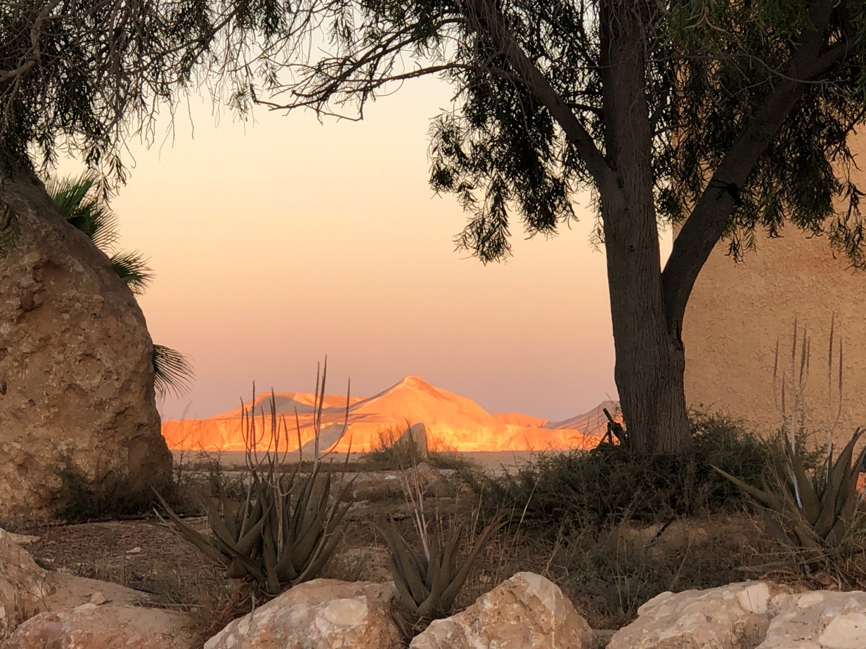

Slide 10
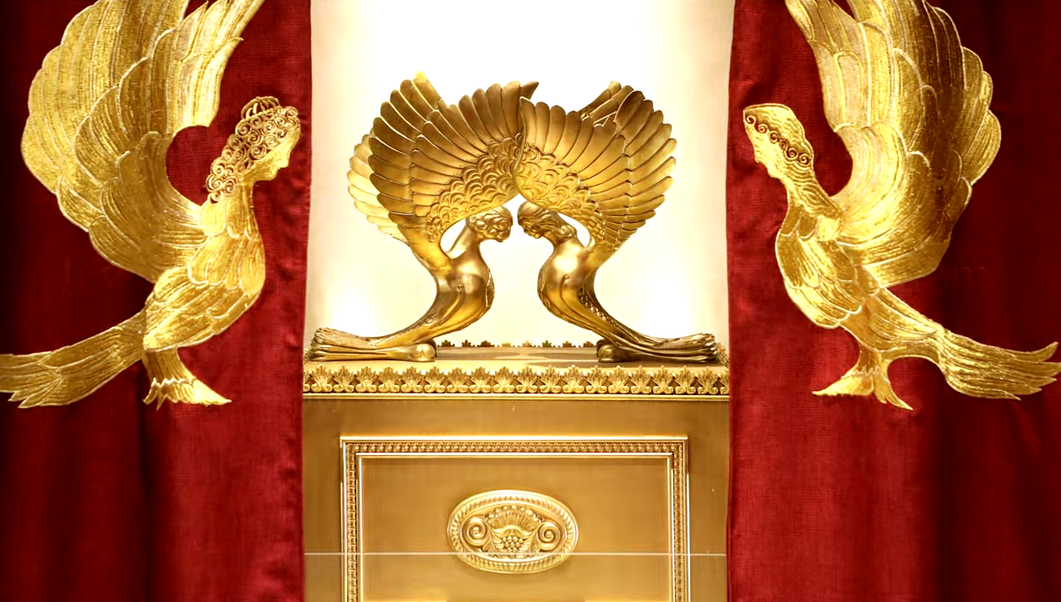
Letter to the Messianic Jews
MJ 9.3-5 The Holy of Holies
Notes:
https://www.templeinstitute.org/new-location.htm

Slide 11
Israel news
The Holy of Holies
The Ark of the Covenant
Jar of mahn מָן
Aharon’s sprouted rod
Tablets
Applications

Slide 12
Hamas using armed child soldiers
Notes:
https://twitter.com/i/status/1400556197212610560

Slide 13
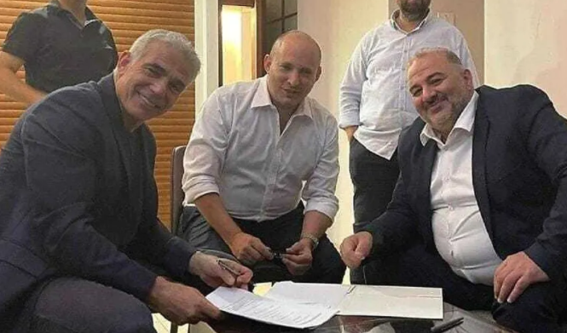
Yair Lapid Naphtali Bennet, Mansour Abbas
Notes:
Ra’am leader Mansour Abbas threw his support behind the would-be government late on Wednesday night, setting up his Islamist party to be the first majority Arab party in decades to be part of a ruling coalition.

Slide 14
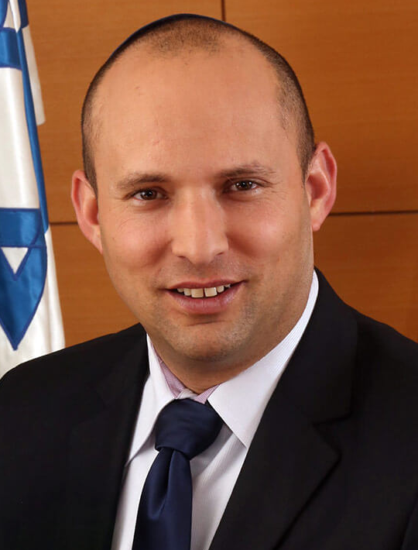
Naphtali Bennet
Born in Haifa of American parents imparted Modern Orthodox Judaism. They made aliya before he was born. His family then spent several years of his childhood in the U.S. before returning to Israel.
Notes:
He served in combat operations as an officer in Israel’s special forces. Bennett went on to create several highly-successful software companies and sold them for about $300 million. He entered politics in 2006 serving as Chief of Staff for PM Netanyahu. He opposes the creation of a Palestinian state. He is for investing in building roads for Palestinians so they can travel in their own areas without checkpoints. His plans include creating joint industrial zones for Jewish and Arab workers because, he says, “Peace grows from below—through people in daily life.”

Slide 15
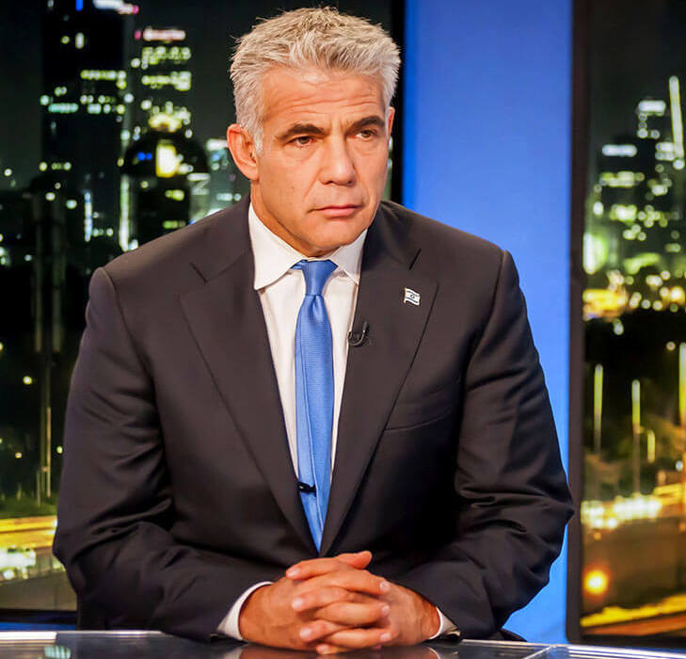
Yair Lapid
Yesh Atid
יש עתיד
“There is a Future.”
Notes:
His father was a Holocaust survivor and a politician who was a strong enemy of the ultra-Orthodox. The son is less extreme, but as prime minister his platform includes passing a law that insists ultra-Orthodox men must serve in the army. Lapid is left-leaning on the peace process. He would be ready to halt construction in Israeli settlements. He is willing to seek a Palestinian state if the Palestinians will stop their violence.

Slide 16
Mansour Abbas, leader of the Islamist party Ra’am, which shares the vision of Yasser Arafat and the PLO. Following what many now refer to as the “2021 Pogroms” for example, Abbas said the burning of synagogues, homes, cars, shops and so on, fall into the category of “legal and legitimate protests.” Abbas, to clarify, does not refer to himself as an Israeli Arab, but as a Palestinian citizen of Israel.
Notes:
https://www.israeltoday.co.il/read/is-israels-new-government-wholesaling-the-jewish-state/?utm_source=acfs&utm_medium=email&utm_term=all&utm_campaign=newsletter-2021-06-10

Slide 17
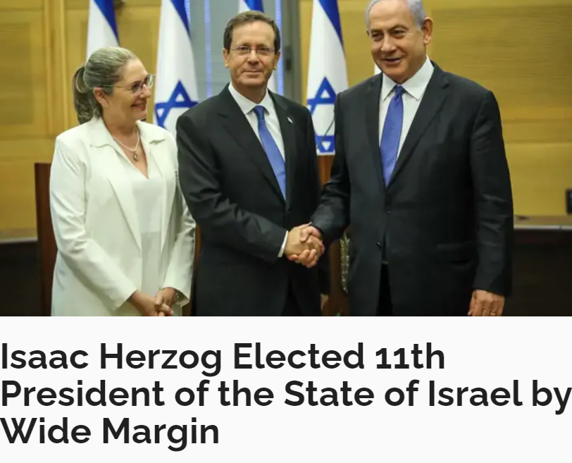
Notes:
The son of former Israeli President Chaim Herzog, he is a lawyer by profession
His paternal grandfather, Rabbi Yitzhak HaLevi Herzog, was the first Chief Rabbi of Ireland from 1922 to 1935 and Ashkenazi Chief Rabbi of Israel from 1936 to 1959.
member of the Knesset from 2003 to 2018.
Formerly the chairman of the Labor Party 2013 -2017
Herzog met with Palestinian President Mahmoud Abbas to pledge his support for the two-state solution.

Slide 18
Letter to the Messianic Jews
MJ 9.3-5 The Holy of Holies
Notes:
https://www.templeinstitute.org/new-location.htm

Slide 19
^{MJ 9.3-4} Behind the second parokhet was a tent called the Holiest Place, which had the golden altar for burning incense and the Ark of the Covenant, entirely covered with gold. In the Ark were the gold jar containing the man,

Slide 20
^{MJ 9.3-4} Aharon’s rod that sprouted and the stone Tablets of the Covenant; and above it were the k’ruvim representing the Sh’khinah, casting their shadow on the lid of the Ark.

Slide 21
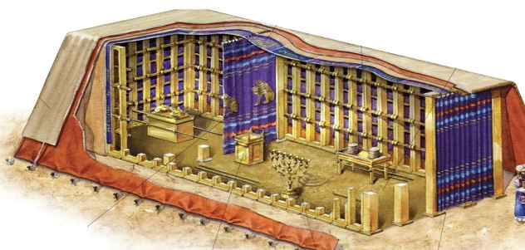
Notes:
http://www.messengerofthename.com/wp-content/uploads/2015/03/Tabernacle1.png
This rendering has a simple table, and simple loaves. One interpretation.

Slide 22
Israel news
In the Holy of Holies:
The Ark of the Covenant
Jar of mahn מָן
Aharon’s sprouted rod
Tablets
Applications

Slide 23
^{Shmot/Ex} ^{25.17} “You are to make a cover for the ark out of pure gold; it is to be three-and-three-quarters feet long and two-and-a-quarter feet high.
וְעָשִׂיתָ כַפֹּרֶת זָהָב טָהוֹר
V’aseeta kaporet
Notes:
Solid gold slab. About 3” thick.

Slide 24
^{Shmot/Ex 25.22} There I will meet with you. I will speak with you from above the ark-cover, from between the two k’ruvim which are on the ark for the testimony, about all the orders I am giving you for the people of Isra’el.
Notes:
Holiest place in the Jewish universe.
I heard about such as a child in Hebrew school. But not told more. Longing stirred. Thought maybe it was behind the Torah cabinet.

Slide 26
^{Vayikra/Lev 16.2} Adoni said to Moshe, “Tell your brother Aharon not to come at just any time into the Holy Place beyond the curtain, in front of the ark-cover which is on the ark, so that he will not die; because I appear in the cloud over the ark-cover. אֶל-פְּנֵי הַכַּפֹּרֶת אֲשֶׁר עַל-הָאָרֹן
Notes:
Kaporet key phrase.

Slide 27
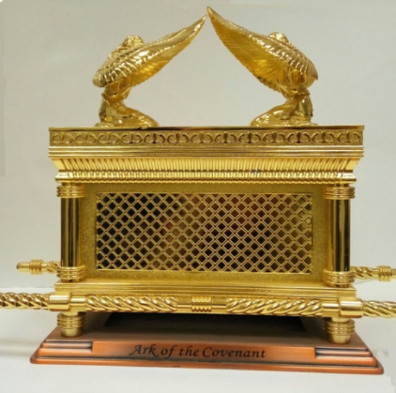
Notes:
https://static.wixstatic.com/media/3ba141_b77acd4032b540f1a27a2bea286a01da~mv2.jpg/v1/fit/w_500,h_500,q_90/file.jpg

Slide 28
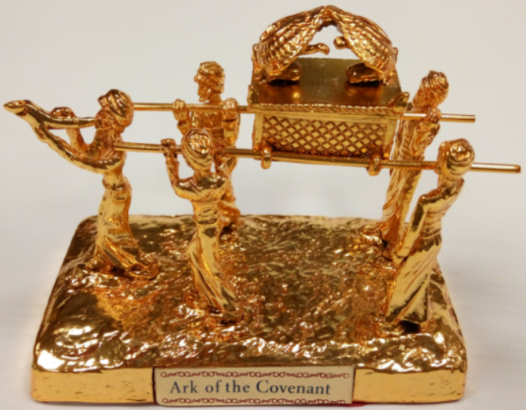
Notes:
https://static.wixstatic.com/media/3ba141_5232b66231dd4da9bd32a64d17a90e07~mv2_d_3202_2530_s_4_2.jpg/v1/fill/w_3202,h_2530,al_c,q_85/3ba141_5232b66231dd4da9bd32a64d17a90e07~mv2_d_3202_2530_s_4_2.jpg
Looks wonderful, dancing, shofar, but bogus. Aron/Ark was covered when carried.

Slide 29
The lid of the Ark was also known as the "mercy seat" (Hebrew kapporet), meaning the physical place where Adoni met the cohen hagadol on Yom Kippur and from which, in his mercy, he forgave the sins of the people of Israel.
Notes:
https://kifakz.github.io/eng/bible/stern/stern_evreyam_09.html

Slide 30
^{Ro 3.25} God put Yeshua forward as the kapparah for sin through his faithfulness in respect to his bloody sacrificial death.

Slide 31
hilastḗrion – the place of propitiation; the lid of the golden ark (the mercy-seat) where the blood of a vicarious sacrifice appeased God's wrath on sin.

Slide 32
(a) a sin offering, by which the wrath of the deity shall be appeased; a means of propitiation,
(b) the covering of the ark, which was sprinkled with the atoning blood on the Day of Atonement.

Slide 33
Messiah
Yeshua’s
Atonement
is represented
by the solid
gold plate.
Notes:
https://static.wixstatic.com/media/3ba141_b77acd4032b540f1a27a2bea286a01da~mv2.jpg/v1/fit/w_500,h_500,q_90/file.jpg

Slide 34
There was no menorah, no window, no other light source in the Holy of Holies.
Only the Shekhinah.

Slide 35
^{2 Cor.3.18} So all of us, with faces unveiled, see as in a mirror the glory of the Lord; and we are being changed into his very image, from one degree of glory to the next, by Adoni the Spirit.

Slide 36
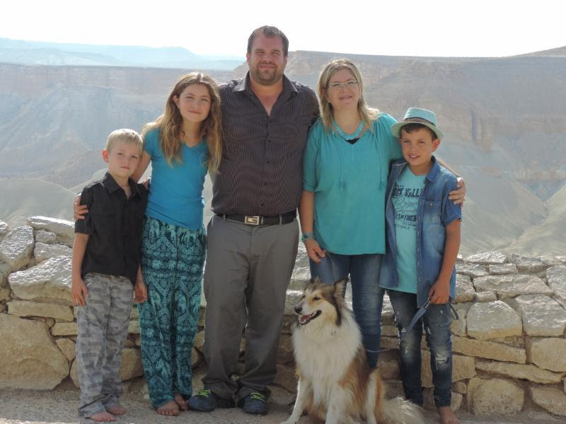
Sean & Ayelet Steck-beck and Maayan, two bros.
Notes:
Ayelet was traumatized by the death of her brother in war in Israel, and entered a yeshiva for women to try to find meaning and Shalom. There a visiting rabbi spoke on this verse...

Slide 37
^{Shmot/Ex 25.2} Tell the people of Isra’el…to make me a sanctuary, so that I may live among them.
וְשָׁכַנְתִּי בְּתוֹכָם.
inside; within, in; בתוכו - internally, inside oneself
Notes:
The Rabbi taught that it didn’t just mean “in the tent, mishkan. Rather inside each of us, our inner being, our heart. But only a few are worthy.” Ayelet determined to be among that few. Eventually came to faith in Yeshua WHILE a yeshiva student!

Slide 38
^{2 Cor. 4.6} For God, who said, “Let light shine out of darkness,” is the One who has shone in our hearts, to give the light of the knowledge of the glory of God in the face of Messiah Yeshua.

Slide 41
What was it like
in the Holy of Holies?

Slide 42
^{T’hillim 8.1-3} Adoni! Our Lord! How glorious is your name throughout the earth! The fame of your majesty spreads even above the heavens! …you established strength because of your foes, in order that you might silence the enemy and the avenger.

Slide 43
^{Rev. 12.10-11}Then I heard a loud voice in heaven saying, “Now have come the salvation and the power and the kingdom of our God and the authority of His Anointed One, for the accuser of our brothers and sisters—
Notes:
Do you suffer accusations,
false guilt from the enemy internally?
Real guilt from the past?
False or real accusations and condemnation from people?
Suspicions and accusations of other people?

Slide 44
^{Rev. 12.10-11} the one who accuses them before our God day and night—has been thrown out. They overcame him by the blood of the Lamb and by the word of their testimony, and they did not love their lives even in the face of death.
Notes:
When you are in the thick of accusations, internally or from people or toward people: Overcame…

Slide 45
Does Yeshua have
any specifics about Himself
and the Holy of Holies

Slide 46
^{Yn 17.5, 22-24} You have loved them just as you have loved me. Father, I want those you have given me to be with me where I am; so that they may see my glory, which you have given me because you loved me before the creation of the world.

Slide 47
^{Yn 17.5, 22-24} Give me the same glory I had with you before the world existed... The glory which you have given to me, I have given to them; so that they may be one, just as we are one — I united with them and you with me, so that they may be completely one, and the world thus realize that you sent me,

Slide 48
^{Yeshahyahu/Is 6.1-4} In the year of King Uzziah’s death, I saw Adoni sitting on a throne, high and lifted up, and the train of His robe filled the Temple. Seraphim were standing above Him. Each had six wings: with two he covered his face and with two he covered his feet, and with two he flew.

Slide 49
^{Yeshahyahu/Is 6.1-4} One called out to another, and said: “Holy, holy, holy, is Adoni-Tzva’ot! The whole earth is full of His glory.” Then the posts of the door trembled at the voice of those who called, and the House was filled with smoke.

Slide 50
^{Yokhanan/Jn 12 39-41}Yesha‘yahu/Is said elsewhere — “He has blinded their eyes and hardened their hearts, so that they do not see with their eyes, understand with their hearts, and do t’shuvah, so that I could heal them.” (Yesha‘yahu said these things because he saw the Sh’khinah of Yeshua and spoke about him.)
Notes:
Yeshua is the One seated on the throne, before Whom the seraphim cry out “Holy”

Slide 51
^{T’hillim /Ps 110} Adoni declares to my Lord: “Sit at My right hand until I make your enemies a footstool for Your feet.”

Slide 52
^{Acts 7.55-56} But Stephen, full of the Ruakh ha-Kodesh, gazed into heaven and saw the glory of God—and Yeshua standing at the right hand of God. And he said, “Look, I see the heavens opened and the Son of Man standing at the right hand of God!”

Slide 53
Where is the Aron HaBrit,
the Ark of the Covenant, today?

Slide 54
Some say,
it was carried away by Nebuchadnezzar into Babylon,
others say, that Jeremiah the prophet took it, and hid it in a cave on Mount Nebo; but
Notes:
T. Bab. Yoma, fol. 53. 2. Seder Olam Rabba, c. 25. T. Hieros. Shekalim, fol. 49. 3.
Joseph ben Gorion, l. 1. c. 17. 2 Maccab. ii. 4, 5.
T. Hieros. Sota, fol. 22. 3. T. Bab. Ceritot, fol. 5. 2. Maimon. Beth Habbechira, c. 4. sect. 1.

Slide 55
the more generally received opinion is, that it was hid by King Josiah in some hidden and deep place, which Solomon had built for that purpose under ground, knowing, that the temple would be destroyed; and it is often said, that it was hid under the pavement of a room in the temple, called "the wood room.”
Notes:
T. Bab. Yoma, fol. 53. 2. Seder Olam Rabba, c. 25. T. Hieros. Shekalim, fol. 49. 3.
Joseph ben Gorion, l. 1. c. 17. 2 Maccab. ii. 4, 5.
T. Hieros. Sota, fol. 22. 3. T. Bab. Ceritot, fol. 5. 2. Maimon. Beth Habbechira, c. 4. sect. 1.

Slide 56
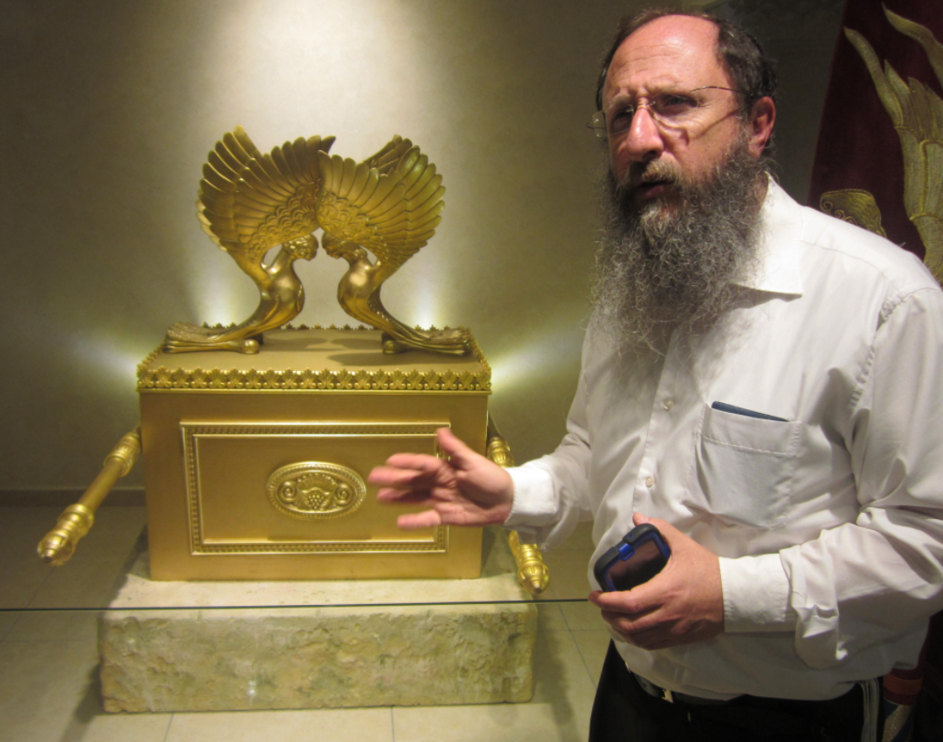
Chaim
Richman
co-founder
Temple
Institute
with Israel
Ariel
Notes:
I heard him say on a tour that there was a crew that determined the location under the Temple Mount, Har HaBayit, and they started to excavate from the west, but some of the laborers were Arab Muslim, and reported the digging to the Waqf, which brought in concrete trucks to block it. BUT the Ark, Aron, is safe. If it’s found, it’s a political bomb. Can’t be stored in just a warehouse, must build the Temple.
Also Ethiopia, France, Dead Sea caves, Turkey, S. Egypt, Japan, Scotland
https://listverse.com/2020/06/16/top-10-possible-locations-of-the-ark-of-the-covenant/

Slide 57
^{Rev 11.19} Then the Temple of God in heaven was opened, and the Ark of the Covenant was seen in his Temple; and there were flashes of lightning, voices, peals of thunder, an earthquake and violent hail.

Slide 58
Letter to the Messianic Jews
MJ 9.3-5 The Holy of Holies
Notes:
https://www.templeinstitute.org/new-location.htm

Slide 59
Israel news
The Holy of Holies
The Ark of the Covenant
Jar of mahn מָן
Aharon’s sprouted rod
Tablets
Applications

Slide 60
^{Bamidbar 16.1-2} Now Korach the son of Yitz’har, the son of K’hat, the son of Levi, along with Datan and Aviram…rebelled against Moshe. Siding with them were 250 men of Isra’el, leaders of the community, key members of the council, men of reputation.

Slide 61
^{Bamidbar 16.1-2} They assembled themselves against Moshe and Aharon and said to them, “You take too much on yourselves! After all, the entire community is holy, every one of them, and Adonai is among them. So why do you lift yourselves up above Adonai’s assembly?”

Slide 62
Moshe’s first strategy:
[Prayer]
^{BaMidbar/Nu.16.4} When Moshe heard this he fell on his face.
Notes:
Moshe’s greatest strength as a leader is his dependence on G-d. On prayer to G-d . On the reality of G-d’s moving in ישראל
Teerosh
Cyber prayer
Not really Jewish? התבודד

Slide 63
Moshe’s second strategy: [Censer test, revelation in prayer?]
^{Bamidbar/Nu 16.6-7} Do this: take censers, Korach and all your group; put fire in them; and put incense in them before Adoni tomorrow. The one whom Adoni chooses will be the one who is holy! It is you, you sons of Levi, who are taking too much on yourselves!"
Notes:
All your group, only cohanim supposed to burn incense.
V 17 Each of you take his fire pan and put incense in it; every one of you, bring before ADONAI his fire pan, 250 fire pans, you too, and Aharon - each one his fire pan."
Sort of trial by ordeal, see what happens.
³⁵ And fire came out from the Lord and consumed the 250 men who were offering the incense.

Slide 64
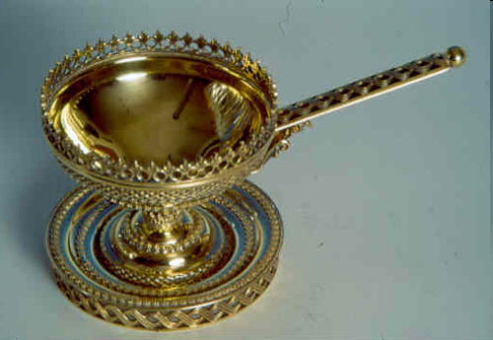
ADONI
ADONI
ADONI
ADONI
incense chalice
מַחְתָּה
Incense chalice, firepan, מַחְתָּה
Notes:
The incense chalice, which holds "half a portion" (approx. 200 grams), of the incense offering ingredients.
However, this one gold, 250 had brass

Slide 65
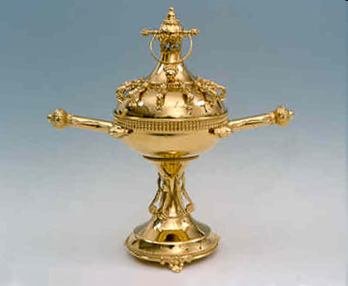
ADONI
ADONI
ADONI
ADONI
Incense chalice, firepan, מַחְתָּה
Notes:
½ oz of incense.
The chalice is carried into the Sanctuary of the Temple, where the golden incense altar stands. Upon entering the Sanctuary the priest sounds the small ring-shaped bell seen on the top of the chalice cover.

Slide 66
Notes:
Yom Kippur use

Slide 67
¹⁹ When Korah had gathered all his followers in opposition to them at the entrance to the tent of meeting, the glory of the Lord appeared to the entire assembly. ³⁵ And fire came out from Adoni and consumed the 250 men who were offering the incense.

Slide 68
Moshe’s Third strategy: [Judgment]
Moshe got up and went to Datan and Aviram, and the leaders of Isra'el followed him. There he said to the assembly, "Leave the tents of these wicked men! Don't touch anything that belongs to them, or you may be swept away in all their sins."
Notes:
Really G-d’s strategy

Slide 69
Notes:
HEY: sometimes radically surprising things happen

Slide 71
Notes:
Guatemala, also Florida sinkholes
YOU Sometimes our lives seem collapse
Visible
Hidden
BREAK POWER SINK HOLES

Slide 72
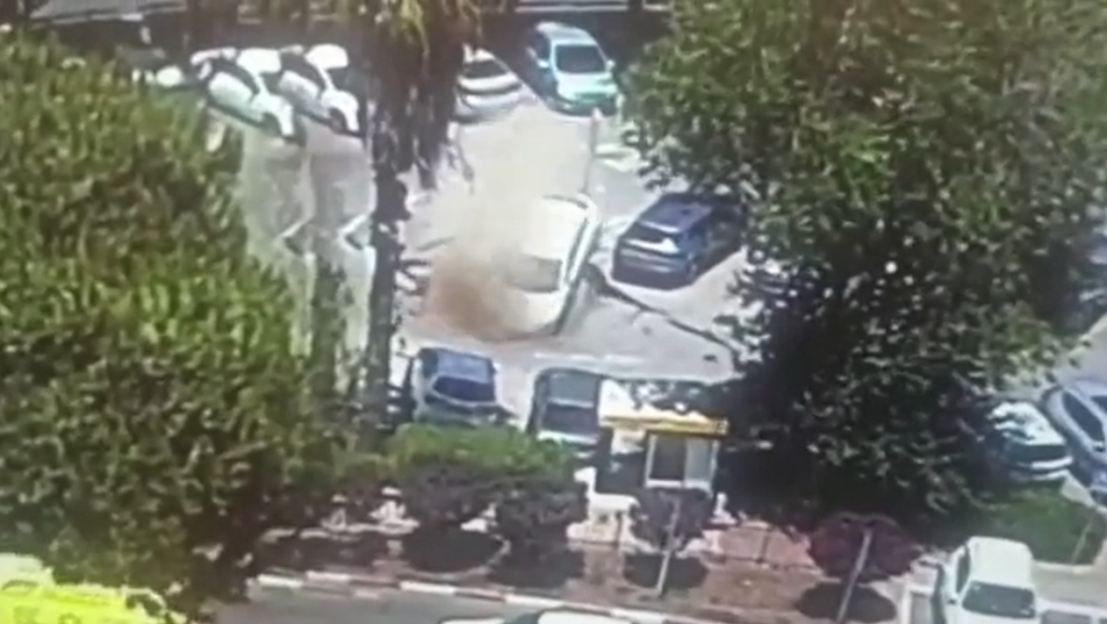
Jerusalem sinkhole swallows up
parked cars Mon, June 7, 2021,
10:41 AM Shaare Zedek
Medical Center
Notes:
https://news.yahoo.com/jerusalem-sinkhole-swallows-parked-cars-154133135.html 0 to 22 sec

Slide 73
Response of Israel:
^{Bamidbar/Nu 17.6} But the very next day, the whole community of the people of Isra’el complained against Moshe and Aharon: “You have killed Adoni’s people!”

Slide 74
^{Nu 17.21-28} Moshe spoke to the people of Isra’el, and all their leaders gave him staffs, one for each leader, according to their ancestral tribes, twelve staffs. Aharon’s staff was among their staffs… The next day Moshe went into the tent of the testimony, and there he saw that Aharon’s staff for the house of Levi

Slide 75
^{Nu 17.21-28} had budded — it had sprouted not only buds but flowers and ripe almonds as well… But the people of Isra’el said to Moshe, “Oh no! We’re dead men! Lost! We’re all lost! Whenever anyone approaches the tabernacle of Adonai, he dies! Will we all perish?”

Slide 76
What couldn’t affect Israel by fire, by fissure, was won by flowers and fruitfulness.
That is apparently why Aharon’s rod was in the Aron/Ark.

Slide 77
I enter the Holy of Holies
I enter through the blood of the Lamb
I enter to worship You only
I enter to honor I am

Slide 78
Lord I worship You, I worship You
For Your name is Holy, Holy Lord
Let the weight of Your glory cover us
Let the life of Your river flow
Let the truth of Your kingdom reign in us

Slide 79
Let the weight of Your glory
Let the weight of Your glory fall
For Your name is Holy, Holy Lord

Slide 80
We may be on the wrong side of history with our views, but we are on the right side of eternity.
Jim Garlow

Slide 81
Letter to the Messianic Jews
MJ 9.3-5 The Holy of Holies
Notes:
https://www.templeinstitute.org/new-location.htm

Slide 82
Israel news
The Holy of Holies
The Ark of the Covenant
Jar of mahn מָן
Aharon’s sprouted rod
Tablets
Applications: power of prayer

Slide 83
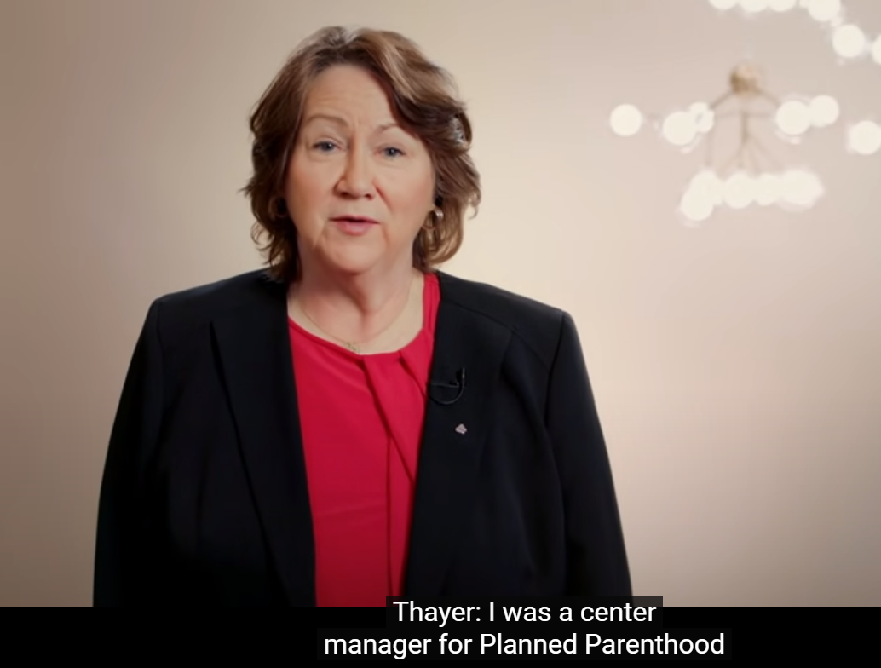
Sue Thayer, center manager for Planned Parent-hood 18 years
Notes:
https://www.youtube.com/watch?app=desktop&v=e67UKZEUDWo&feature=share
3.10 to 5.13

Slide 84
Passion of every believer
Yn 17. unity, humility, forgiveness.

Slide 86
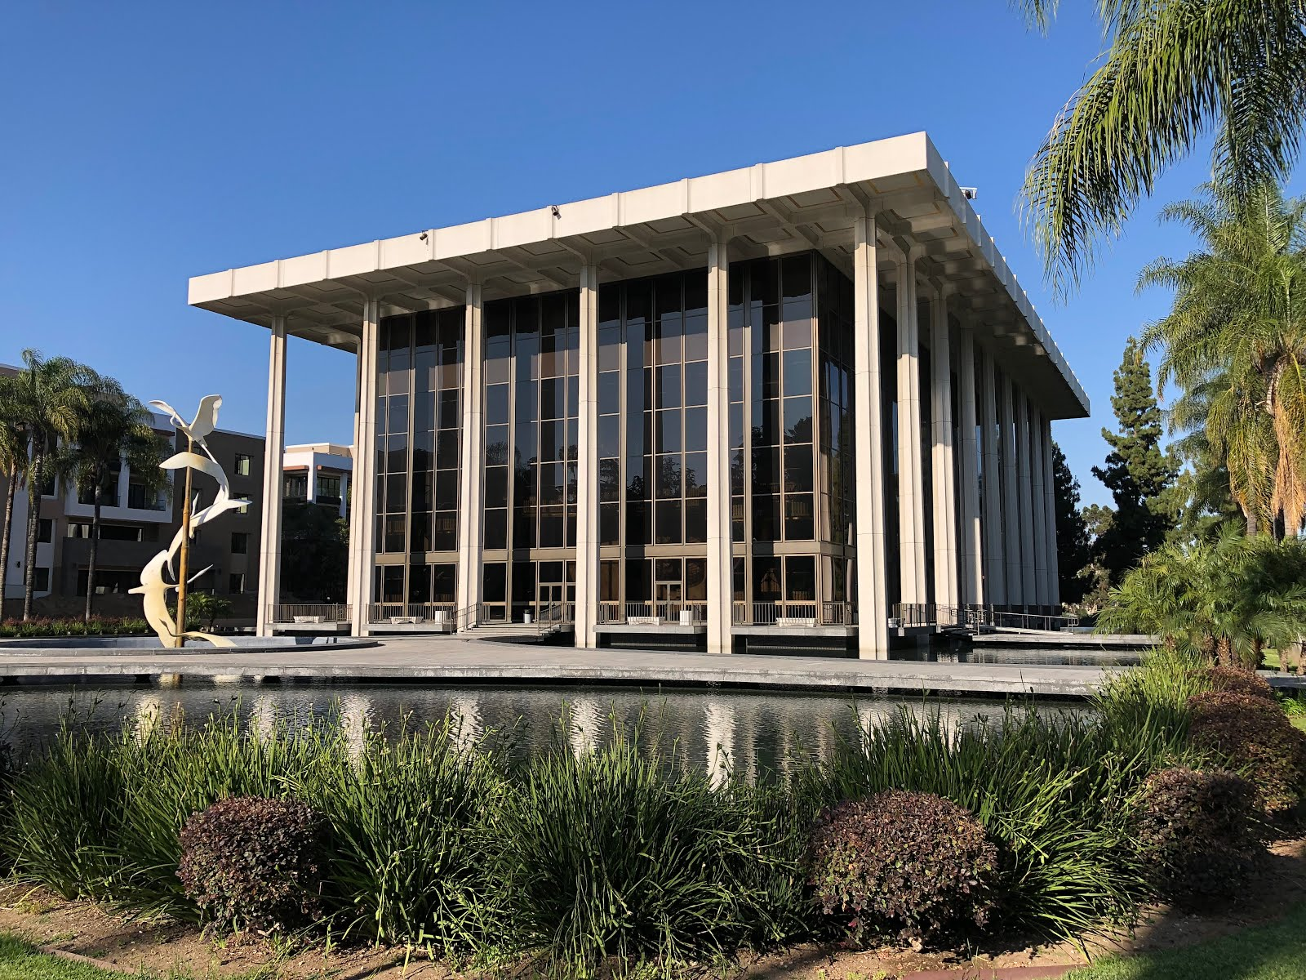

Slide 87
Liberty Counsel, a Christian legal organization that defends religious freedom, filed the lawsuit on behalf of Pastor Che Ahn. Atty Matt Staver recounted that Pastor Ahn "got a letter from the Pasadena criminal prosecutor, threatening him, his staff.”
Notes:
https://www.frc.org/get.cfm?i=WA21E37&f=WU21E12

Slide 88
The letter threatened any churchgoer with "criminal charges, up to one year in prison, and daily fines of a thousand dollars. And so [Pastor Ahn] had to tell his church members" that they could face criminal charges for coming to church.
Notes:
https://www.frc.org/get.cfm?i=WA21E37&f=WU21E12

Slide 89
Pastor Ahn worried that many people would refrain from coming to church. Yet, the opposite turned out to be the case. Most of the congregation continued attending services, and other Christians looking for a church and even non-believers who were interested starting attending Harvest Rock Church.
Notes:
https://www.frc.org/get.cfm?i=WA21E37&f=WU21E12

Slide 90
Staver says that other pastors who stood up to unfair coronavirus restrictions are experiencing similar growth. Churches that "stood up against this adversity, this persecution, they're seeing revival happening in their communities.“
Notes:
https://www.frc.org/get.cfm?i=WA21E37&f=WU21E12

Slide 91
Governor Newsom's yearlong COVID-19 restrictions on churches were so strict that Californians were even banned from participating in Bible studies in private homes and singing. With the new permanent statewide injunction, this will never be allowed to happen in California again.
Notes:
https://www.frc.org/get.cfm?i=WA21E37&f=WU21E12

Slide 92
Notes:
https://www.youtube.com/watch?v=L9hd9AIgmL4&t=7s
13.13 to 13.44 and 29.23 to 31.02

Slide 93
Do you KNOW Yeshua and the assurance of sins forgiven?
Are you surrendered to Messiah, body, soul, spirit? Walking in relational love, confessing, entering the Holy Place?
Are you filled with His Spirit, transforming your life?
Who are you discipling, building up?

