Slide 1
e-handout
To have these notes
without taking notes
Go to OrHaOlam.com
Click on downloads,
messages, 2021

Slide 6
Tisha B’Av 9th of Av
[Hebrew calendar]
July 17 evening, 2021
Part 2

Slide 7
Tisha B’Av commemorates the pattern of sin and wrath, and is the paramount expression of repentance.
Notes:
Last Shabbat:

Slide 8
Outline Tisha B’Av part 2
Conquest → famine
Hope
Means to Hope
Prayer
Repentance
Some victories, with opposition

Slide 9
^{Vayikra/Lev 26.27-29} “Yet if in spite of this you will not listen to Me but walk contrary to Me, then I will walk contrary to you in wrath. So I will chastise you seven times for your sins. You will eat the flesh of your sons and you will eat the flesh of your daughters.
7 x 7 x 7 x 7 = 7⁴ = 2401 fold
Notes:
Starvation → cannibalism of one’s own kids would seem to be the 2401 fold.

Slide 10
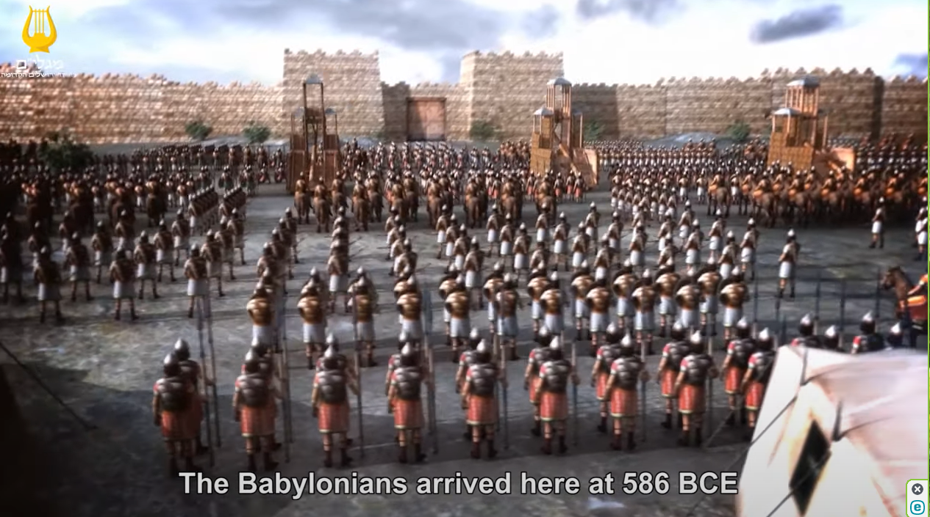
Tisha B’Av destruction
Notes:
https://youtu.be/Z5Wqhf_8itA
Picture, it wasn’t a quick conquest, but a siege. No garden market, no food. No mercy.

Slide 11
^{Eikhah/ Lam. 4.10-11} With their own hands compassionate women have cooked their own children; their children became their food when the daughter of my people was destroyed.

Slide 12
^{Eikhah/ Lam. 4.10-11} Adoni has finished with his fury, he has poured out his blazing wrath; he kindled a fire in Tziyon that consumed its very foundations.

Slide 13
This is no figure of speech, starvation leading to cannibalism has happened several times in human history.
Bolshevism’s beginnings
Donner Party
Uruguayan rugby team

Slide 14
Russian communist revolutionary Vladimir Ilyich Ulyanov, better known as Lenin, had been in charge of the country since 1917. Lenin’s Bolsheviks party believed peasants were actively trying to undermine the war effort and by taking their food away it reduced their strength.
Notes:
https://strangesounds.org/2020/05/famine-picture-cannibalism-russia-history.html
Cannibalism became a marketable means of survival!

Slide 15
The famine was able to take root with ease due to the economic problems caused by World War I, five years of civil war, and a drought in 1921 which led to 30 million Russians becoming malnourished.
Notes:
https://strangesounds.org/2020/05/famine-picture-cannibalism-russia-history.html

Slide 16
As Lenin declared ‘let the peasants starve,’ the result was to force them to resort to trading human flesh on the black market. The starving peasants were even seen digging up recently buried corpses to retrieve their flesh,

Slide 17
as well as eating grass and animals that were previously considered pets. More than five million people died during the catastrophe, which began in 1921 and lasted through 1922.
Notes:
https://strangesounds.org/2020/05/famine-picture-cannibalism-russia-history.html
So if you support socialism and /or communism, this is the natural outgrowth. Note the current Cuban protesters.

Slide 18
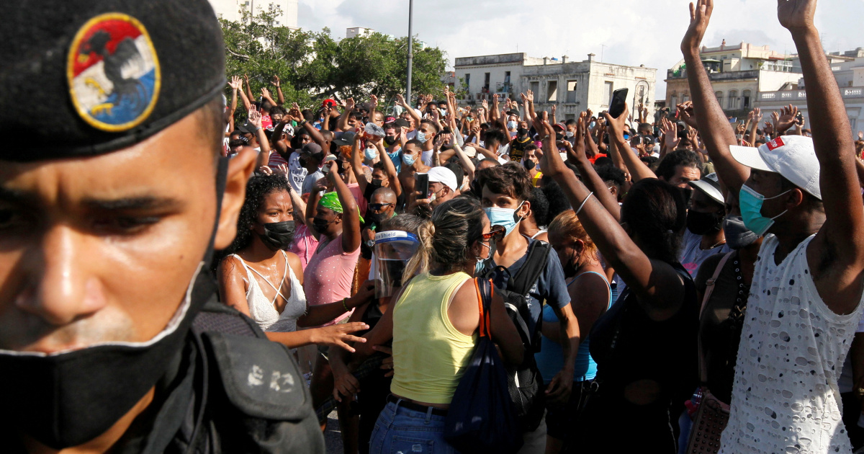
An anti-government protest on
Monday on the outskirts of Havana
Notes:
News commentator pointed out that the people protesting are thin. Little food. Socialism.
12 Jul 2021 Thousands of Cubans marched on Havana’s Malecon promenade and elsewhere on the island to protest against food shortages and high prices
https://unfoxnews.com/man-dies-in-anti-government-protest-in-cuba-interior-ministry/

Slide 19
The Donner Party was a group of American pioneers who migrated to California in a wagon train from the Midwest. Delayed by a multitude of mishaps, they spent the winter of 1846–1847 snowbound in the Sierra Nevada mountain range. Some of the migrants resorted to cannibalism to survive, eating the bodies of those who had succumbed to starvation, sickness and extreme cold.
Notes:
https://en.wikipedia.org/wiki/Donner_Party

Slide 20
Uruguayan Air Force Flight 571 flies over the Andes on October 13, 1972. The raucous rugby players and a few of their relatives and friends are eagerly looking forward to an upcoming match in Chile. Upon emerging from clouds, the plane encounters turbulence and collides with a mountain.
Notes:
https://en.wikipedia.org/wiki/Alive_(1993_film)

Slide 21
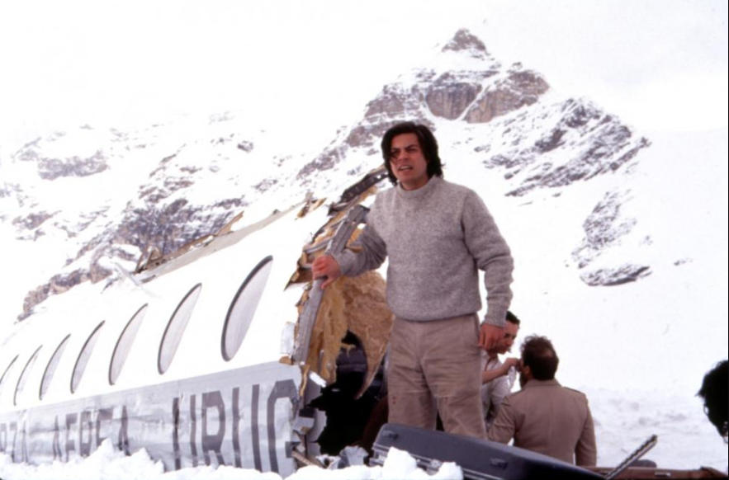
From the movie Alive!

Slide 22
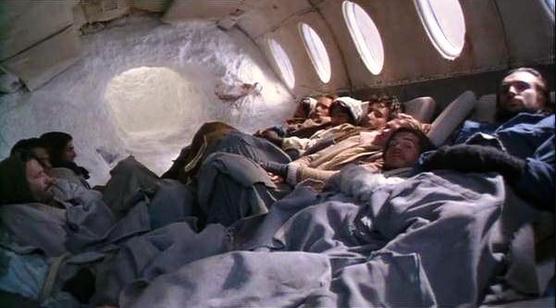

Slide 23
During the next 72 days, the remaining crash survivors suffered exposure, starvation, and an avalanche. Some of the survivors resorted to cannibalism.
29 deceased and 16 survivors
Notes:
https://en.wikipedia.org/wiki/Uruguayan_Air_Force_Flight_571

Slide 24
^{Yermiyahu/Jer. 16.17-18} For I see all their ways; they are not hidden from me; their crimes are not concealed from my eyes. First, I will pay them back double for their crimes and sins; because they have defiled the land which is mine; they have filled my heritage with the corpses of their horrors and abominations.’”

Slide 25
^{Eikhah/ Lam. 5.21} הֲשִׁיבֵנוּ Hashivenu
Part 2

Slide 26
Outline Tisha B’Av part 2
Conquest → famine
Hope
Means to Hope
Prayer
Repentance
Some victories, with opposition

Slide 27
In the midst of this worst of horrors, is there hope?

Slide 28
^{Havakkuk 3.3} Adoni, I have heard the report about You and I have come to fear. Adoni, revive Your work throughout the years, throughout the years make it known, in wrath remember compassion.

Slide 29
רֹגֶזrogez
Rage, thunder, turmoil, wrath
רַחֵם rakhem
[from the word for womb]
Compassion, pity, love, mercy, pity

Slide 30
^{Yeshayahu/Is 51.3} For Adoni will comfort Tziyon, will comfort all her ruined places, will make her desert like ‘Eden, her ‘Aravah like the garden of Adoni. Joy and gladness will be there, thanksgiving and the sound of music.
Notes:
I think we can make an application to our beloved and apostate culture in America, in the Western world generally.
1970’s

Slide 31
^{Yeshayahu/Is 40.1-2} “Comfort, comfort My people,” says your God. Speak kindly to the heart of Jerusalem and proclaim to her that her warfare has ended, that her iniquity has been removed. For she has received from Adoni’s hand double for all her sins.
Double comfort for 2401x punishment?
Notes:
Two exiles

Slide 32
“Double for all her sins,” does not mean that God has punished the nation twice what their sins required. This is a reference to an Eastern custom. If a man owed a debt he could not pay, his creditor would write the amount of the debt on a paper and nail it to the front
Notes:
https://www.raystedman.org/daily-devotions/isaiah/true-comfort

Slide 33
door of the man's house so that everyone passing would see that here was a man who had not paid his debts. But if someone paid the debt for him, then the creditor would double the paper over and nail it to the door as a testimony that the debt had been fully paid.
Notes:
https://www.raystedman.org/daily-devotions/isaiah/true-comfort
If someone paid the debt…

Slide 34
^{Zekharyah 1.16-17} “Therefore,” thus says Adoni, “I will return to Jerusalem with compassion. My House will be built there,” declares Adoni-Tzva’ot…Again cry out, saying, thus says Adoni-Tzva’ot, “My cities will again overflow with prosperity and Adoni will again comfort Zion and will again choose Jerusalem.’”

Slide 35
Targum: G-d’s consolation was as great as if she had suffered double what she [Zion] actually had.

Slide 36
^{Eikhah/ Lam. 5.21} הֲשִׁיבֵנוּ Hashivenu
Part 2

Slide 37
Outline Tisha B’Av part 2
Conquest → famine
Hope
Means to Hope
Prayer
Repentance
Some victories, with opposition

Slide 38
What is the prophet Yermiyahu/Jerimiah counselling us to do, to move from wrath to comfort?

Slide 39
^{Eikhah/Lamentations 2.18-19} Their hearts cried out to Adoni, “Wall of the daughter of Tziyon! [ref to 2.8]
^{Eikhah/Lamentations 2.8} Adoni resolved to destroy the wall of the daughter of Tziyon. He measured it with his line and did not stay his hand until it was all in ruins. He brought grief to rampart and wall; together they lie dejected.
Notes:
This is the prophet’s remedy. Only a broken wall standing, some remains and ruins of that.
Can apply to our universities, our public education, Hollywood, Netflix.

Slide 40
^{2.18-19} Let your tears stream down like a torrent, day and night! Give yourself no respite, give your eyes no rest! “Get up! Cry out in the night, at the beginning of every watch!
Notes:
Prayer this afternoon, then 7-11. Cyber prayer enrollment.

Slide 41
^{2.18-19} Pour your heart out like water before the face of Adoni! Lift up your hands to him for the lives of your babies, who are fainting away from hunger at every street corner.”
Notes:
This is no analogy, but reality before his eyes.
That is the solution, just prayer?
Not just prayer, but begins with that.

Slide 42
Kiev, Ukraine
Boris Grisenko founding Senior Rabbi
Notes:
Approx.
2,000 - 3,000 who gather in home groups
1,000 - 2,000 on Shabbat services

Slide 43
Notes:
https://www.facebook.com/watch/?v=521743988960154

Slide 44
We can’t ONLY pray. Like warfare with air power, eventually the ground troops.
Umar Mulinde: Can’t marry a woman just by praying, you have to court her and ask her! Go! Mtt. 28
Huge cadre of servants: Oneg, ushers, musicians, all involved!

Slide 45
^{Eikhah/ Lam. 5.21} הֲשִׁיבֵנוּ Hashivenu
Part 2

Slide 46
Outline Tisha B’Av part 2
Conquest → famine
Hope
Means to Hope
Prayer
Repentance
Some victories, with opposition

Slide 47
^{3.21-32} This I recall to my heart— therefore I have hope: Because of the mercies of Adoni we will not be consumed, for His compassions never fail. They are new every morning! Great is Your faithfulness. “Adoni is my portion,” says my soul, “therefore I will hope in Him.”
Notes:
In the midst of this darkness and despair!
Believing in the sovereign love of Adoni in Messiah!
Read this in unison.
What is your point of plague?

Slide 48
^{3.21-32} Adoni is good to those who wait for Him, to the soul that seeks Him. It is good to wait quietly for the salvation of Adoni. It is good for a man to bear the yoke in his youth. Let him sit alone and be silent, since He has laid it upon him.
Notes:
Time: love is spelled time.
Bear the yoke…learn of me. Casting care upon Him. He shares the yoke.
^{Mtt 11.29-30} Take My yoke upon you and learn from Me, for I am gentle and humble in heart, and ‘you will find rest for your souls.’ For My yoke is easy and My burden is light.”
What would Yeshua do? Do I handle situations as He did? Patience, purity, joy?
Do I let Him give me His strength to work out situations, inner issues?
P 23 Wesley Duewel Revival Fire

Slide 49
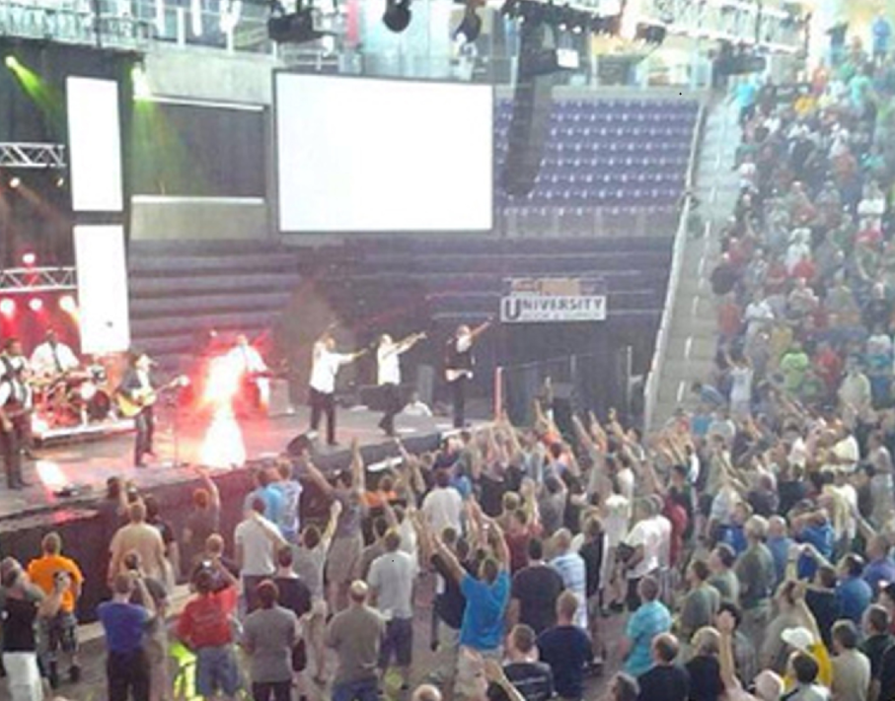
Fire angel at PromiseKeepersConcertDec., 2013

Slide 50
^{3.21-32} Let him put his mouth in the dust— there may yet be hope. Let him offer his cheek to the one who strikes him. Let him have his fill of disgrace. For Adoni will not reject forever. For though He has caused grief, yet He will have compassion according to His abundant mercies.
Notes:
Babylonians? Contextually
Us? Who has struck you? Wesley Deuwel 260

Slide 51
I received an anonymous email: “Visited your congregation, sat on side with distancing Unfavorable experience with 3 different individuals who displayed quite cavalier attitude

Slide 52
re. a) distancing b) masking [3rd even made disparaging comment of assumed superiority re having been vaccinated) Good worship & message but from now on will attend online.”
Notes:
Are we people of grace, even with those that disagree?
For example…

Slide 53
The Squad
Rashida Tlaib of Michigan
Ilhan Omar of Minnesota,
Alexandria Ocasio-Cortez of New York,
Ayanna Pressley of Massachusetts
Notes:
https://external-content.duckduckgo.com/iu/?u=https%3A%2F%2Ftse4.mm.bing.net%2Fth%3Fid%3DOIP.ZVwMkEnOFwhTnbQjsAjr6gHaE7%26pid%3DApi&f=1
These are women, and now joined by two men Jamaal Bowman of New York and Cori Bush of Missouri, who are unreasonably, vitriolically hateful of Jews and Israel. Do we hate and mock them? Never lead anyone to repentance and faith that you are mocking. We need to grieve over them.

Slide 54
^{3.38-42} Don’t both bad things and good proceed from the mouth of the Most High? Why should anyone alive complain, even a strong man, about the punishment for his sins? Let us examine and test our ways and return to Adoni.
Notes:
Yermiyahu, experienced horrific siege and destruction of Yerushalayim, saying this!!
Are we complaining?

Slide 55
^{3.38-42} Let us lift up our hearts and our hands to God in heaven and say, “We, for our part, have transgressed and rebelled; you, for your part, have not forgiven.
Notes:
This is from Yermiyahu/Jeremiah, overlooking the ruins of Yerushaliyim.
Examine our hearts: personal, 95% right, 5% wrong, yet you are 100% responsible for that 5%
also identificational repentance.
Our cultural ruins…

Slide 56
Dr Dobson: Middle school students recently brought a flyer home from school explaining that 11-year-olds can legally have sex with someone up to two years older. And can obtain an abortion without their parent's knowledge.
Notes:
https://www.drjamesdobson.org/news/planned-parenthood-pushes-11-year-olds-toward-sex?utm_campaign=2021%20Public%20Policy&utm_medium=email&_hsmi=139096655&_hsenc=p2ANqtz-9C0IEmqwiPov044veqa2fGzADSzrtYHBxQxKWLb6_o6QXgz8G0qoRfmPBkeZlNO_glznEA4FRI5pX41gyUojcUqgO8TQ&utm_content=139096655&utm_source=hs_email

Slide 57
The source of the flyer was none other than abortion giant Planned Parenthood. This happened at a school in Tacoma and, not surprisingly, parents in Washington were furious. School officials dismissed their concerns by apologizing for "the error."
Notes:
https://www.drjamesdobson.org/news/planned-parenthood-pushes-11-year-olds-toward-sex?utm_campaign=2021%20Public%20Policy&utm_medium=email&_hsmi=139096655&_hsenc=p2ANqtz-9C0IEmqwiPov044veqa2fGzADSzrtYHBxQxKWLb6_o6QXgz8G0qoRfmPBkeZlNO_glznEA4FRI5pX41gyUojcUqgO8TQ&utm_content=139096655&utm_source=hs_email

Slide 58
In the early 1800s, Charles Finney was at the forefront of the great move of God sweeping across New York. If you didn't know, Daniel Nash, unseen by man, would be praying for days by himself before Finney ever came into town.

Slide 59
The prayers of Nash were plowing and getting the soil ready for the seed God would deposit through Finney. The plowing and planting go hand in hand.

Slide 60
Henry Ward Beecher wrote, “It is defeat that turns bone to flint; it is defeat that turns gristle to muscle; it is defeat that makes men invincible. Do not then be afraid of defeat. You are never so near to victory as when defeated in a good cause.”
Notes:
Sent by drjimgarlow@wellversednews.com

Slide 61
F. B. Meyer once wrote, “We never test the resources of God until we attempt the impossible.” Restoring our nation may look impossible. But do not give up. Persevere.
Notes:
Sent by drjimgarlow@wellversednews.com

Slide 62
^{5.21} Cause us to return You, Adoni, and we will return. Renew our days as of old.
הֲשִׁיבֵנוּ יְיָ אֵלֶיךָ וְנָשׁוּבָה, חַדֵּשׁ יָמֵינוּ כְּקֶדֶם.
Hashivenu, hashivenu, Adoni eilekha, v’nashuva.
Khadesh, khadesh, yamenu k’kedem
Notes:
This pattern hasn’t stopped. There is yet unmitigated, unreasonable, implacable destructive hatred for righteousness, for Jews and Israel.

Slide 63
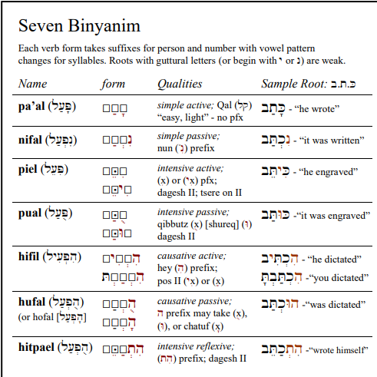
Seven verb forms in Hebrew grammar, each has past, present, future

Slide 65
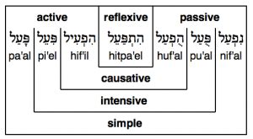
Notes:
https://www.frathwiki.com/images/thumb/b/b8/Binyanim.png/300px-Binyanim.png

Slide 66
^{5.21} Cause us to return You, Adoni, and we will return. Renew our days as of old.
הֲשִׁיבֵנוּ יְיָ אֵלֶיךָ וְנָשׁוּבָה, חַדֵּשׁ יָמֵינוּ כְּקֶדֶם.
Hashivenu, hashivenu, Adoni eilekha, v’nashuva.
Khadesh, khadesh, yamenu k’kedem
Notes:
Cause us to return, change, soften transform our hearts, even for the ones that are the worst.

Slide 67
^{Eikhah/ Lam. 5.21} הֲשִׁיבֵנוּ Hashivenu
Part 2

Slide 68
Outline Tisha B’Av part 2
Conquest → famine
Hope
Means to Hope
Prayer
Repentance
Some victories, with opposition

Slide 69
Some Tisha B’Av related good news!

Slide 70
The Church of England has confirmed it will officially apologize for the church’s involvement in the expulsion of Jews from medieval England, the Telegraph reports. Jewish groups have welcomed the move.
Notes:
by Karen Faulkner, Worthy News Correspondent
https://www.worthynews.com/59978-church-of-england-confirms-it-will-apologize-for-centuries-of-supporting-anti-semitism-in-england

Slide 71
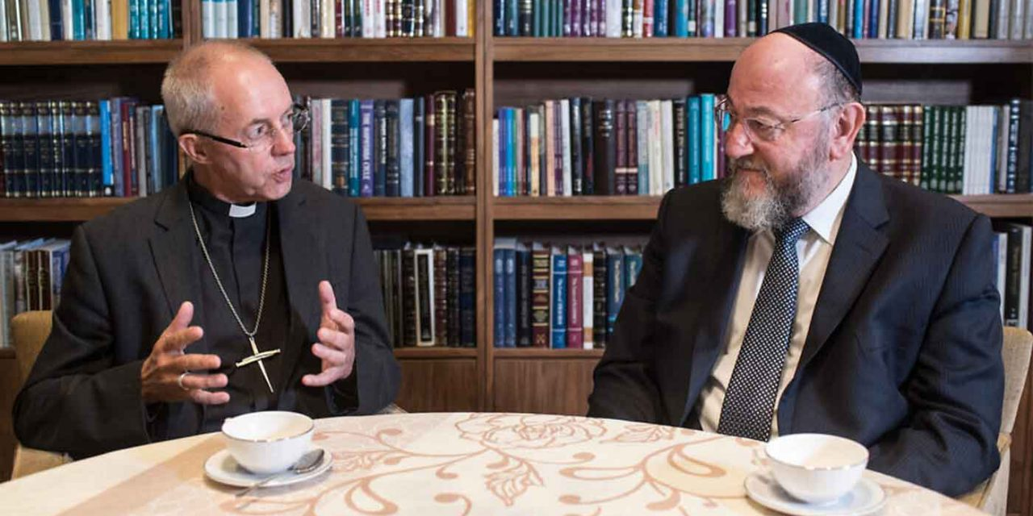
Notes:
https://external-content.duckduckgo.com/iu/?u=https%3A%2F%2Fwww.cufi.org.uk%2Fwp-content%2Fuploads%2F2019%2F11%2FWelby-mirvis-1280x640.jpg&f=1&nofb=1

Slide 72
The church’s General Synod legislative body said on Monday it is planning to offer an “act of repentance” for supporting historic anti-semitic legislation such as forcing Jews to wear identification badges and barring them from certain professions,
Notes:
by Karen Faulkner, Worthy News Correspondent
https://www.worthynews.com/59978-church-of-england-confirms-it-will-apologize-for-centuries-of-supporting-anti-semitism-in-england

Slide 73
the Telegraph reports. These laws ultimately led to the expulsion of Jews from England on July 18, 1290, Tisha B’Av
Notes:
by Karen Faulkner, Worthy News Correspondent
https://www.worthynews.com/59978-church-of-england-confirms-it-will-apologize-for-centuries-of-supporting-anti-semitism-in-england

Slide 74
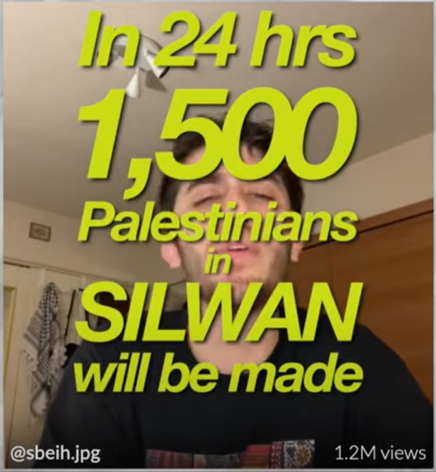
The truth about the Silwan evictions that allegedly started the recent Gaza War.

Slide 75
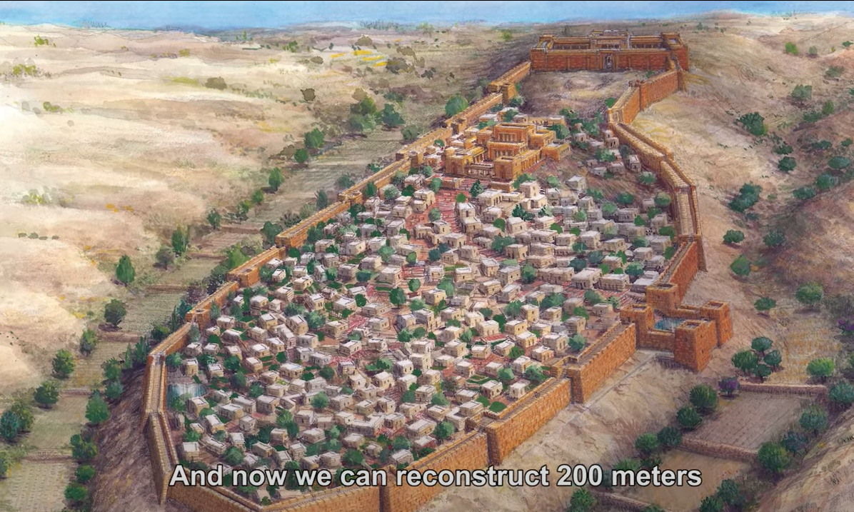
Notes:
Note Gei Hinnom, Kidron, Temple
https://youtu.be/WP-S7tR8HYc

Slide 76
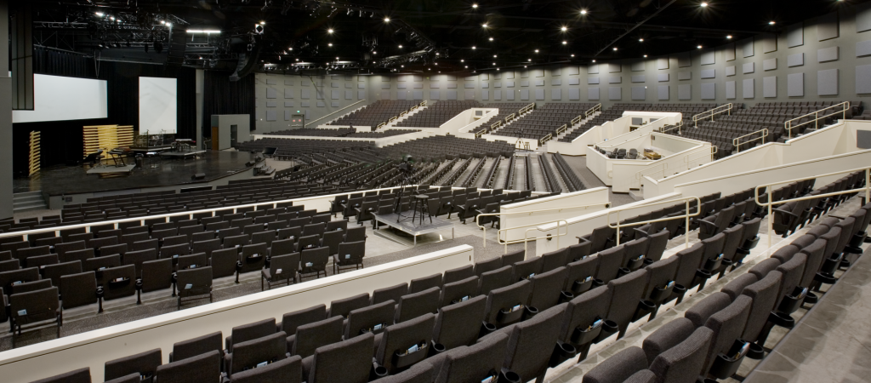
Skyline Church, San Diego
Notes:
https://www.eastcountymagazine.org/sites/eastcountymagazine.org/files/Worship-Center_0.jpg

Slide 77
Rosemary Schindler Garlow & Dr. Jim Garlow
Notes:
On of the most Messianic friendly leaders, some of you been in his Wednesday and Sunday prayer. Gave free rent to Joel Liberman’s Messianic Cong. Can a husband charge his wife rent?
When they went to build the building you see…

Slide 78
The bird: Environmentalists claimed that there were two birds (not two species) – California Black Tailed Gnatcatchers – that were on the property and were endangered. Later it was admitted that they were not endangered,
Notes:
Sent by drjimgarlow@wellversednews.com

Slide 79
Later it was admitted that they were not endangered, but rather governmental officials had only counted the ones on the US side of the border, not those on the Mexico side, where most of the birds lived. The two birds cost us millions of dollars.
Notes:
Sent by drjimgarlow@wellversednews.com

Slide 80
The bush: There were laws that we could not build where the coastal sage bush was growing, or as one person stated it, “might someday grow.” That halted our building extensively.
Notes:
Sent by drjimgarlow@wellversednews.com

Slide 81
The road: A state highway was slated to someday run through the property. It took years to get this plan changed.
Notes:
Sent by drjimgarlow@wellversednews.com

Slide 82
The rock: A darkened rock, in the minds of some, that some native American’s had started a bonfire 6,000 years ago. This “darkened” rock required us to hire 29 archeological digs – with spoons and toothbrushes – the last of which cost $29,000.
Notes:
Sent by drjimgarlow@wellversednews.com

Slide 83
The shard: A pottery shard the size of a thumbnail was found, convincing some bureaucrats that there had evidently been Jamacha Indians living on this land possibly 1,000 years ago. Therefore, we had to put down a “geo-mat” and a “soil cap” over this area (in case there might be more shards down there) and we lost – for perpetuity the right to have a parking lot over those areas.
Notes:
Sent by drjimgarlow@wellversednews.com

Slide 84
The light: Our light poles in the parking lot were to be anywhere from fourteen to twenty feet tall. However, it was claimed that we would create “light pollution” for an observatory, located over 50 miles away. The bureaucrats insisted that we make our light poles three feet tall. That might work great if your cars are six inches tall!
Notes:
Sent by drjimgarlow@wellversednews.com

Slide 85
The expansion: We were required by the State of California to widen highway 94 in front of our property and pay for traffic lights. Widening: $2,000,000. Traffic lights: $25,000.
Notes:
Sent by drjimgarlow@wellversednews.com

Slide 86
The design: Earthquake laws changed on January 1 of that year, before we could get construction underway. Additional steel required: $856,000.
Notes:
Sent by drjimgarlow@wellversednews.com

Slide 87
The truck: In order for the Fire Department to sign off on our building, we had to make a “voluntary” contribution to the purchase of a new fire truck, amounting to $12,000. This “voluntary” practice was later stopped.
Notes:
Sent by drjimgarlow@wellversednews.com

Slide 88
The tragedy: With all the changes, and with all the litigation issues, we had a project manager who was managing our property. He did great work. But unknown to us, he had deep personal problems in his private life and took his life. We were stunned.
Notes:
Sent by drjimgarlow@weSent by drjimgarlow@wellversednews.com
llversednews.com

Slide 89
May I ask you to make a declaration? Here it is: “I can persevere. Our nation can be turned. I will not give up on America. I will never give up. Nothing will dissuade me from doing that which God has called me to be or to do. I will persevere for my country.”
Notes:
Sent by drjimgarlow@wellversednews.com

Slide 90
^{5.21} Cause us to return You, Adoni, and we will return. Renew our days as of old.
הֲשִׁיבֵנוּ יְיָ אֵלֶיךָ וְנָשׁוּבָה, חַדֵּשׁ יָמֵינוּ כְּקֶדֶם.
Hashivenu, hashivenu, Adoni eilekha, v’nashuva.
Khadesh, khadesh, yamenu k’kedem
Notes:
This pattern hasn’t stopped. There is yet unmitigated, unreasonable, implacable destructive hatred for Jews and Israel.

Slide 91
Do you KNOW Yeshua and the assurance of sins forgiven?
Are you hearing daily from His Word?
How are you applying what you heard?
Are you asking this of another?
Notes:
Who are you discipling, building up?

Slide 93
