Slide 1
e-handout
To have these notes
without taking notes
Go to OrHaOlam.com
Click on downloads,
messages, 2021

Slide 2
Yom Kippur greeting
צום קל
Tsom Kal
Easy Fast
Notes:
An aside coming…

Slide 7
Jewish people have had the Scriptures for ~3500 years.
Seeking meaning and application, many opinions. Li-drosh לִדְרוֹשׁ to seek, to search for; (biblical) to seek higher guidance, to turn to powerful forces; to demand; to require, to need;

Slide 8
Many amplifications
Kol Nidre is one of them
Notes:
An aside coming…

Slide 9
Disclaimer for tomorrow’s message on ^{Vayikra/Lev 23.27} “Yom Kippur… you are to afflict yourselves.” Rabbis’ five ways of affliction. Some are amplifications. Don’t stress out tomorrow over doing all.
Notes:
And that I didn’t tell you to do all this.
Teaser for tomorrow. Back to Kol Nidre.

Slide 10
Why Kol Nidre?
Renunciation of Vows?
And why on Erev Yom Kippur?
Translation of Traditional text…

Slide 11
"All vows [Kol Nidre כל נדרי], obligations, oaths, and anathemas, whether called 'ḳonam,' 'ḳonas,' or by any other name, which we may vow, or swear, or pledge, or whereby we may be bound, from this Day of Atonement until the next (whose happy coming we await)
Notes:
http://www.jewishencyclopedia.com/articles/9443-kol-nidre

Slide 12
we do repent. May they be deemed absolved, forgiven, annulled, and void, and made of no effect; they shall not bind us nor have power over us. The vows shall not be reckoned vows; the obligations shall not be obligatory; nor the oaths be oaths."
Notes:
http://www.jewishencyclopedia.com/articles/9443-kol-nidre
Why have such a prayer, and why does it strike such a chord in Jewish hearts?

Slide 13
Why Kol Nidre?
Renunciation of Vows?
And why on Erev Yom Kippur?

Slide 14
Outline:
Scripturally: no easy release from our words.
Rabbinic complex religious formula for release.
Kol Nidre poetic release.

Slide 15
Accusations from Jews and Gentiles that this is too easy.
Reasons for enduring Kol Nidre.
Yeshua’s release.

Slide 16
Hebrew scriptures about vows:

Slide 18
^{Dvarim/Dt 23.21-23} "When you make a vow to ADONI your God, you are not to delay in fulfilling it, for ADONI your God will certainly demand it of you…if a vow passes your lips, you must take care to perform it according to what you

Slide 19
^{Dvarim/Dt 23.21-23} voluntarily vowed to ADONI your God, what you promised in words spoken aloud.

Slide 20
^{Kohelet/ Eccles 5.4-6} If you make a vow to God, don't delay in discharging it. For God takes no pleasure in fools, so discharge your vow! Better not to make a vow than to make a vow and not discharge it. Don't let your words make you guilty, and don't tell the

Slide 21
^{Kohelet/ Eccles 5.4-6} temple official that you made the vow by mistake. Why give God reason to be angry at what you say and destroy what you have accomplished?

Slide 22
^{T’hillim/Ps 15} Adoni, who may dwell in Your tent? Who may live on Your holy mountain? The one who walks with integrity, who does what is right, and speaks truth in his heart who does not slander with his tongue…who keeps his oath even when it hurts, and does not change. One who does these things will never be shaken.

Slide 23
Yeshua commented:
^{Mtt 5.33-37} “Again, you have heard that our fathers were told, ‘Do not break your oath,’ and ‘Keep your vows to Adoni…Just let your ‘Yes’ be a simple ‘Yes,’ and your ‘No’ a simple ‘No’; anything more than this has its origin in evil.

Slide 24
By your words you shall be justified…

Slide 25
Our words are binding. Irretrievable.
Notes:
You can’t unsay it. Unring the bell. Regather the feathers.

Slide 26
We can’t un-ring a bell.
We can’t unsay a statement, if it was heard by others, and repeated. Contact tracing?
Notes:
That’s why we have weddings, to make public vows.

Slide 27
The main theme of Yom Kippur?
Hurtful, wrong words, = vows.
Words born of pressure, words of fear, of passion, of anger, of hurt.
Notes:
Why we do the Boskey paraphrase, NOT the original.
I’ll NEVER be like my mother….

Slide 28
Outline:
Scripturally: no easy release from our words.
Rabbinic complex religious formula for release.
Kol Nidre poetic release.

Slide 29
Accusations from Jews and Gentiles that this is too easy.
Reasons for enduring Kol Nidre.
Yeshua’s release.

Slide 30
Rabbinic complex religious formula for release.

Slide 31
^{Vayikra/Lev 16.21} Aharon is to lay both his hands on the head of the live goat and confess over it all the transgressions, crimes and sins of the people of Isra'el; he is to put them on the head of the goat and then send it away into the desert with a man appointed for the purpose. [Broken vows??]
Notes:
ALL
But, vows seem unpardonable.
So, how to resolve??

Slide 32
This gave rise to the rite of absolution from a vow ("hattarat nedarim" הַתָּרָת נדרים) which might be performed only by a scholar or an expert (mumḥeh מֻמְחֶה) on the one hand, or by a board of three laymen on the other. What??
Notes:
http://www.jewishencyclopedia.com/articles/9443-kol-nidre
Who determined that??
Who had that authority?
Someone, a long time ago, nearly to Yeshua's day.
Whole section of the Talmud on Vows, Ndarim 11 chapters

Slide 33
Hence, the Kol Nidre.
The date of the composition of the declaration and its author are alike unknown; but it was in existence at the Geonic period (589–1038 CE).
Known by controversies it engendered then.
Notes:
https://en.wikipedia.org/wiki/Kol_Nidre
Idelsohn, Abraham Z., Jewish Liturgy and its Development (1932, NY, Henry Holt) pages 227-228; Davidson, Israel, "Kol Nidre", The American Jewish Year Book: 5684, vol. 25 (1923, Philadelphia, Jewish Public'n Soc.) pages 186-187.

Slide 34
Outline:
Scripturally: no release from our words.
Rabbinic complex religious formula for release.
Kol Nidre poetic release.

Slide 35
Accusations from Jews and Gentiles that this is too easy.
Reasons for enduring Kol Nidre.
Yeshua’s release.

Slide 36
Kol Nidre poetic release.

Slide 37
Complexity of rabbinic release from vows helped lead to this simpler, melodic, Kol Nidre expression of release.

Slide 38
Judah the Pious in the 1200’s, "chant your supplications to God in a melody that makes the heart weep, and your praises of Him in one that will make it sing. Thus you will be filled with love and joy for Him that seeth the heart
Notes:
https://en.wikipedia.org/wiki/Kol_Nidre#The_Ashkenazi_melody

Slide 39
Its fame has spread far beyond the synagogue. A noted non-Jewish poet declared" "Such a mysterious song, redolent of a People's suffering, can hardly have been composed by one brain, however much inspired."
Notes:
https://en.wikipedia.org/wiki/Kol_Nidre#The_Ashkenazi_melody

Slide 40
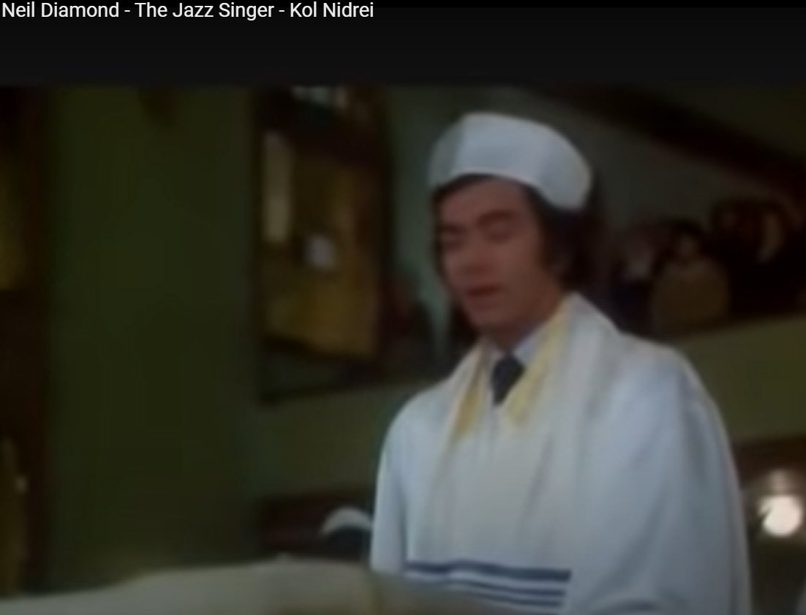
Notes:
https://www.youtube.com/watch?v=-IEDLZayfdU&list=RD-IEDLZayfdU&start_radio=1

Slide 41
Howie Rubin 8 years ago I have seen the movie at least 30 times, and this scene still brings tears to my eyes.
Mike Bouck 2 years ago I'm not Jewish but this scene still makes me cry like a baby
Notes:
https://www.youtube.com/watch?v=-IEDLZayfdU&list=RD-IEDLZayfdU&start_radio=1

Slide 42
For many contemporary Jews, attendance at Kol Nidre is one of only a handful of non-negotiable Jewish acts. One Brooklyn anecdote:
Notes:
http://www.tabletmag.com/jewish-life-and-religion/112181/kol-nidre-conundrum

Slide 43
The past few years, I've prayed on the High Holidays in a wonderful and homey synagogue in the Park Slope neighborhood of Brooklyn, NY.
Notes:
http://www.chabad.org/holidays/JewishNewYear/template_cdo/aid/752989/jewish/The-Ultimate-Yom-Kippur-Jew.htm

Slide 44
There's always a flurry of activity as I walk into the sanctuary before the Kol Nidre prayers; some devoted volunteers finishing off the last minute preparations, setting up the extra chairs for the anticipated overflow crowd.
Notes:
http://www.chabad.org/holidays/JewishNewYear/template_cdo/aid/752989/jewish/The-Ultimate-Yom-Kippur-Jew.htm

Slide 45
The scores of men and women who invariably wander in for their requisite once-a-year synagogue service.
In this inviting congregation, these people are kindly greeted as they enter, handed prayer-books (and kippahs for the men)
Notes:
http://www.chabad.org/holidays/JewishNewYear/template_cdo/aid/752989/jewish/The-Ultimate-Yom-Kippur-Jew.htm
Kol Nidre in the mind of a Jewish person analogous to Easter Service, or Thanksgiving meal. Participation is how you proclaim, minimally, who you are. Sort of absolute minimum.

Slide 46
and shown to an unreserved seat. But despite the warm atmosphere, their self-consciousness is plainly evident, as they constantly cast not-so-furtive glances at the experienced congregants to make sure that they are doing the right thing.
Notes:
http://www.chabad.org/holidays/JewishNewYear/template_cdo/aid/752989/jewish/The-Ultimate-Yom-Kippur-Jew.htm

Slide 47
I've often wondered, who are these people? And what motivates them to come to the synagogue on Yom Kippur? If they believe in G‑d and seek atonement, if their Judaism is meaningful to them, where are they the rest of the year?
Notes:
http://www.chabad.org/holidays/JewishNewYear/template_cdo/aid/752989/jewish/The-Ultimate-Yom-Kippur-Jew.htm
So, why does Kol Nidre endure, and have this magnetic authority?
As I mentioned…

Slide 48
Outline:
Scripturally: no release from our words.
Rabbinic complex religious formula for release.
Kol Nidre poetic release.

Slide 49
Accusations from Jews and Gentiles that this is too easy.
Reasons for enduring Kol Nidre.
Yeshua’s release.

Slide 50
Accusations from Jews and Gentiles that this is too easy.

Slide 51
The readiness with which vows were made and the facility with which they were annulled by the scribes gave the Karaites an opportunity to attack the Rabbinites, the Geonim גאונים [Jewish leaders and scholars] at Constantinople in 1148
Notes:
http://www.jewishencyclopedia.com/articles/9443-kol-nidre
[a Jewish group only accepted the Tanakh/Old Testament as authoritative, not the Talmud, etc.]

Slide 52
Yehudai Gaon of Sura (760), went so far as to forbid any study whatsoever of Nedarim, the Talmudic treatise on oaths. Thus the "Kol Nidre" was discredited in both of the Babylonian academies
Notes:
http://www.jewishencyclopedia.com/articles/9443-kol-nidre

Slide 53
and was not accepted by the geonim Naṭronai (853-856) and Hai Bar Naḥshon (889-896
Kol Nidre attacked and rejected in the 700’s, 800’s
Notes:
http://www.jewishencyclopedia.com/articles/9443-kol-nidre

Slide 54
In addition, outsiders have made the "Kol Nidre" one of the means widely used by Jewish apostates and by enemies of the Jews to cast suspicion on the trustworthiness of an oath taken by a Jew.
Notes:
http://www.jewishencyclopedia.com/articles/9443-kol-nidre
https://www.jewishencyclopedia.com/articles/9443-kol-nidre
Jewish testimony in courts was suspect in some places.

Slide 55
Frum Reporter 8 years ago Many German judges refused to allow [Jewish people] to take an oath, basing their objections chiefly on this prayer. As early as 1240 in the Disputation of Paris, Yechiel of Paris was obliged to defend Kol Nidrei against these charges.
Notes:
https://www.youtube.com/watch?v=-IEDLZayfdU&list=RD-IEDLZayfdU&start_radio=1
https://www.jewishencyclopedia.com/articles/9443-kol-nidre

Slide 56
The Russian government, in 1857, decreed that the prayerbooks must include, as an introduction to Kol Nidrei, a Hebrew explanation to the readers of the limited nature of the vows that could be released by this ceremony.
Notes:
https://www.youtube.com/watch?v=-IEDLZayfdU&list=RD-IEDLZayfdU&start_radio=1
https://www.jewishencyclopedia.com/articles/9443-kol-nidre

Slide 57
Yielding to the numerous accusations and complaints brought against the "Kol Nidre" in the course of centuries, the Reform rabbinical conference held at Brunswick, Germany, in 1844 decided unanimously
Notes:
http://www.jewishencyclopedia.com/articles/9443-kol-nidre

Slide 58
that the Kol Nidre was not essential, and that the members of the convention should exert their influence toward securing its speedy abolition.
Notes:
http://www.jewishencyclopedia.com/articles/9443-kol-nidre

Slide 59
Outline:
Scripturally: no easy release from our words.
Rabbinic complex religious formula for release.
Kol Nidre poetic release.

Slide 60
Accusations from Jews and Gentiles that this is too easy.
Reasons for enduring Kol Nidre.
Yeshua’s release.

Slide 61
Reasons for enduring Kol Nidre.

Slide 62
A Jewish historical motivation to make forced vows, use wrong words.

Slide 63
For Paul the cross had represented victory--God's victory over the grip of death and evil. Lost now was the Pauline insight that the victory of the cross came through vulnerability. The cross of the Constantinian era symbolized only triumph.
Notes:
http://www.crosscurrents.org/boys-cross.htm

Slide 64
Christians in their history have made it a sign of conquering hate rather than sacrificial love.
Notes:
http://www.crosscurrents.org/boys-cross.htm

Slide 65
Eusebius of Caesarea (ca. 260-339) described the vision inspiring Constantine's order:
He said that about noon…he saw with his own eyes the trophy of a cross of light in the heavens, above the sun, and bearing the inscription, CONQUER BY THIS.
Notes:
http://www.crosscurrents.org/boys-cross.htm

Slide 66
In the 11th century the victory motif began to be dramatized in a new and terrible way in the Crusades, so called because of the cross emblazoned on the tunic of each crusader. Here the cross became a clarion call to liberate the "Holy Land" from "infidels," the Muslims.
Notes:
http://www.crosscurrents.org/boys-cross.htm

Slide 67
In violation of papal policy, however, the baser elements among the crusaders raped, and pillaged, and murdered "infidels" closer to home, i.e., the Jews.
Notes:
http://www.crosscurrents.org/boys-cross.htm

Slide 68
As Marc Saperstein comments, "the cross, the symbol in which the massacres were perpetrated, acquired powerful negative associations for Jews that linger to this day.
Notes:
http://www.crosscurrents.org/boys-cross.htm

Slide 69
For a Jew, the cross is inextricably linked with those ancient charges of being Christ-killers.
Notes:
http://www.crosscurrents.org/boys-cross.htm

Slide 70
In our heavily Christian communities, Catholic funeral processions were always led by a young boy holding a long metal sceptre with a cross on top. Behind the child the priest would march, reading the prayers.
Notes:
http://www.crosscurrents.org/boys-cross.htm

Slide 71
Any Christian passer-by meeting the procession would remove his hat, bend his knee and bow to the cross. Jewish adults knew how to handle this situation, sometimes seeking shelter in doorways to avoid confronting the cross.
Notes:
http://www.crosscurrents.org/boys-cross.htm

Slide 72
Children were less experienced, and were occasionally beaten when the procession passed by and they did not bend their knee before the cross.
Notes:
http://www.crosscurrents.org/boys-cross.htm

Slide 73
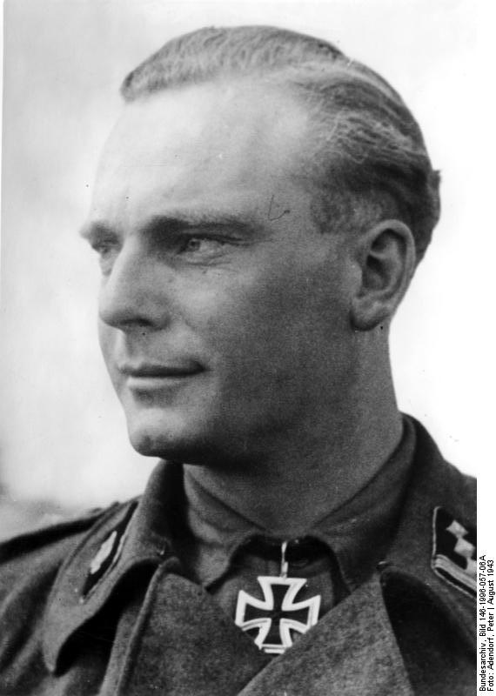
Notes:
https://en.wikipedia.org/wiki/Iron_Cross#Pilots
Adolf Hitler restored the Iron Cross in 1939 as a German decoration

Slide 74
A Jewish tradition that dates from at least the 19th century is to write plus using a symbol like an inverted T. This practice was adopted into Israeli schools and is still commonplace today in elementary schools (including secular schools) but in fewer secondary schools.
Notes:
https://en.wikipedia.org/wiki/Plus_and_minus_signs

Slide 75
The usual explanation for this practice is that it avoids the writing of a symbol "+" that looks like a Christian cross. Unicode: U+FB29 ﬩ HEBREW LETTER ALTERNATIVE PLUS SIGN
Headset volume control
on El Al flights
Notes:
https://en.wikipedia.org/wiki/Plus_and_minus_signs

Slide 76
Medieval Christians received the message on Good Friday that the Jews who lived in their midst were the enemies of Christians who killed their savior and needed to either convert to Christianity or face divine punishment.
Notes:
https://theconversation.com/why-good-friday-was-dangerous-for-jews-in-the-middle-ages-and-how-that-changed-114896

Slide 77
This language about Jews in the medieval Good Friday liturgy often carried over into physical violence toward local Jewish communities. It was common for Jewish houses to be attacked with stones. Often these attacks were led by the clergy.
Notes:
https://theconversation.com/why-good-friday-was-dangerous-for-jews-in-the-middle-ages-and-how-that-changed-114896

Slide 78
Passion plays, originating in Europe in the 12th century, have a long history of virulent anti-Judaism. These theatrical performances of Jesus's Passion were often filled with medieval anti-Jewish tropes, depicting the Jews of the first century
Notes:
https://www.ajc.org/OberammergauPassionPlay

Slide 79
as greedy, bloodthirsty, devilish (including with horns), and exclusively concerned with the legalistic elements of religion.
Notes:
https://www.ajc.org/OberammergauPassionPlay

Slide 80
A notable attendee of the Oberammergau Passion Play was Adolf Hitler, who saw the play in 1930 and 1934, during its 300th year anniversary season. Following the play’s 1934 performance, Hitler proclaimed, “Never has the menace of Jewry been so convincingly portrayed.”
Notes:
https://www.ajc.org/OberammergauPassionPlay
Story of Edgar Mortara
http://en.wikipedia.org/wiki/Edgardo_Mortara
Age 7 baptized by his nurse, then kidnapped by RC church. Pope Pius IX most of popes hostile to the Jews in one way or another
1846-1878 one of longest papacy

Slide 81
There was a common theory that it commenced during and because of a period of extreme persecution, in which Jews were forced at sword's point to convert (either to Christianity or Islam) and that Kol Nidre was supposed to nullify that forced conversion
Notes:
https://en.wikipedia.org/wiki/Kol_Nidre
Idelsohn, Abraham Z., Jewish Liturgy and its Development (1932, NY, Henry Holt) pages 227-228; Davidson, Israel, "Kol Nidre", The American Jewish Year Book: 5684, vol. 25 (1923, Philadelphia, Jewish Public'n Soc.) pages 186-187.
Existed probably before such, but found a deep resonance because of forced vows.
So, some examples of that, particularly for those who didn’t grow up with this consciousness, that Christians are dangerous, that the cross is a sign of a threat.

Slide 82
So, the Kol Nidre seems to be, for Jewish people, a release from the wrongful speech generally, assimilation to the culture, and from taint and corruption.

Slide 84
Kol Nidre has three sources of enduring significance.
a legal component relative to conscientiousness
an emotional component relative to forced conversionist vows
A visceral melodic enchantment

Slide 85
The melody that stirs the heart of Ashkenazic Jews is of unknown origin, but is part of a body of music known as מסני " MiSinai melodies" that emerged in Germany between the 11th and 15th centuries. "MiSinai" literally means "from Sinai."

Slide 86
Kol Nidre is ultimately a melodic affirmation of life, forgiveness, shalom, in spite of our hopelessly broken vows, in spite of our enemies.
It hints at the spiritual, ultimate affirmation…

Slide 87
But, is the Kol Nidre really the answer to vows we cannot keep, or did not keep, or will not keep?

Slide 88
First, Kol Nidre was never intended to be applied to contracts and business relations.

Slide 89
Rabbis have always pointed out that the dispensation from vows in Kol Nidre refers only to those an individual voluntarily assumes for himself alone and in which no other persons or their interests are involved.
Notes:
https://en.wikipedia.org/wiki/Kol_Nidre#The_Ashkenazi_melody

Slide 90
The first verse ends with a qualifier for all the forms of pledges and vows being annulled עַל נַפְשָׁתָֽנָא regarding ourselves by which this formula is limited to annulling only those vows that would affect only ourselves but not vows that would affect any other person.
Notes:
https://en.wikipedia.org/wiki/Kol_Nidre#The_Ashkenazi_melody

Slide 91
Second, there are scriptural mechanisms by which a vow can be redeemed.

Slide 92
^{Lev 27.14-15} When a person consecrates [vows] his house to be holy for Adoni, the cohen is to set a value on it in relation to its good and bad points; the value set by the cohen will stand. If the consecrator wishes to redeem his house, he must add one-fifth to the value you have set on it; and it will revert to him.

Slide 93
^{Mishlei/Prov. 6.1-5} My son, if you have put up security for your friend, if you committed yourself on behalf of another; you have been snared by the words of your mouth, caught by the words of your own mouth. Do this now, my son,

Slide 94
^{Mishlei/Prov. 6.1-5} and extricate yourself, since you put yourself in your friend’s power: go, humble yourself, and pester your friend; give your eyes no sleep, give your eyelids no rest; break free, like a gazelle from the [hunter’s] trap, like a bird from the grip of the fowler.

Slide 95
Outline:
Scripturally: no easy release from our words.
Rabbinic complex religious formula for release.
Kol Nidre poetic release.

Slide 96
Accusations from Jews and Gentiles that this is too easy.
Reasons for enduring Kol Nidre.
Yeshua’s release.

Slide 97
Yeshua commented on vows: ^{Mtt. 5.33-37} “Again, you have heard that our fathers were told, ‘Do not break your oath,’ and ‘Keep your vows to Adoni.’ But I tell you not to swear at all — not ‘by heaven,’

Slide 98
^{Mtt. 5.33-37} because it is God’s throne; not ‘by the earth,’ because it is his footstool; and not ‘by Yerushalayim,’ because it is the city of the Great King. And don’t swear by your head, because you can’t make a single hair white or black.

Slide 99
^{Mtt. 5.33-37} Just let your ‘Yes’ be a simple ‘Yes,’ and your ‘No’ a simple ‘No’; anything more than this has its origin in evil.
Notes:
We should be known as people who preeminently keep our word. If you say you’ll be somewhere at 3 pm, what if you’re 5 minutes late?
Jewish time?
Indian time?
There is mercy! I hope.

Slide 100
^{Acts 13.38-39} “Therefore, brothers, let it be known to you that through this man is proclaimed forgiveness of sins! That is, God clears everyone who puts his trust in this man, even in regard to all the things concerning which you could not be cleared by the Torah of Moshe.
Notes:
Could not be forgiven of broken vows by the Torah of Moshe…so this invented. By Yeshua, all can be forgiven.
So, let’s be people of integrity for ourselves, and mercy for others. And mercy for ourselves.

Slide 101
According to the Mishna, "There are thirty-six transgressions for which the Torah specifies the punishment of karet" that is, being "cut off' from Israel (K'ritot 1:1). For these the Torah provides no "clearing": no sacrifice or punishment named in the Torah provides atonement or restores fellowship.

Slide 102
These transgressions include the prohibited sexual unions of Leviticus 18, blasphemy (Numbers 15:30), idolatry, necromancy (Leviticus 20:6), profaning Shabbat (Exodus 31:14), certain violations of ritual purity laws, eating chametz during Pesach and eating or working on Yom-Kippur.

Slide 103
^{Vayikra/Lev 16.21} Aharon is to lay both his hands on the head of the live goat and confess over it all the transgressions, crimes and sins of the people of Isra'el; he is to put them on the head of the goat and then send it away into the desert with a man appointed for the purpose.
Notes:
ALL
But, vows seem unpardonable.
So, how to resolve??

Slide 104
^{1 Yn 1.7-9} If we are walking in the light, as he is in the light, then we have fellowship with each other, and the blood of his Son Yeshua purifies us from all sin...If we acknowledge our sins, then, since he is trustworthy and just, he will forgive them and purify us from all wrongdoing.

