Slide 1
e-handout
To have these notes
without taking notes
Go to OrHaOlam.com
Click on downloads,
messages, 2021

Slide 2
Notes:
https://i.ytimg.com/vi/1nHDOQh853E/maxresdefault.jpg

Slide 3
^{Lk 21.24} Jerusalem will be trampled by the Gentiles until the times of the Gentiles are fulfilled

Slide 4
“The Wall was before us. I trembled. There it was as I had known it—immense, mighty, in all its splendor...overcome, I bowed my head in silence.” –General Uzi Narkiss, Head of Central Command during the Six Day War
Notes:
http://www.sixdaywar.org/content/ReunificationJerusalem.asp

Slide 5
In the 1960’s and 70’s, the liberation of Jerusalem was so breathtaking that we all had our seatbelts fastened, expecting Yeshua momentarily.
Notes:
Heady days. I scared my sister with talk of how I might disappear while driving the car.
Often preached…till we were jaded.
Since turned to how to live life. How to please G-d, bring up a family. Discern Torah commands.
It might be time to revisit.

Slide 8
Yesha’yahu (Isaiah) 27:13
ג כִּי שֵׁם יְהוָה אֶקְרָא ס הָבוּ גֹדֶל לֵאלֹהֵינוּ׃
ג כִּי שֵׁם יְהוָה אֶקְרָא ס הָבוּ גֹדֶל לֵאלֹהֵינוּ׃
וְהָיָ֣ה ׀ בַּיּ֣וֹם הַה֗וּא יִתָּקַע֮ בְּשׁוֹפָ֣ר גָּדוֹל֒ וּבָ֗אוּ הָאֹֽבְדִים֙ בְּאֶ֣רֶץ אַשּׁ֔וּר
On that day a great shofar will sound. Those lost in the land of Ashur will come,

Slide 9
Yesha’yahu (Isaiah) 27:13
ג כִּי שֵׁם יְהוָה אֶקְרָא ס הָבוּ גֹדֶל לֵאלֹהֵינוּ׃
ג כִּי שֵׁם יְהוָה אֶקְרָא ס הָבוּ גֹדֶל לֵאלֹהֵינוּ׃
וְהַנִּדָּחִ֖ים בְּאֶ֣רֶץ מִצְרָ֑יִם וְהִשְׁתַּחֲו֧וּ לַֽיְיָ בְּהַ֥ר הַקֹּ֖דֶשׁ בִּירוּשָׁלָֽ͏ִם׃
also those scattered through the land of Egypt; and they will worship Adoni on the holy mountain in Yerushalayim.
Notes:
The Shofar was used for gathering the people in the Torah, back to the time of Moshe’s travelling in Sinai.

Slide 10
The Shofar call was
for gathering the community.

Slide 11
^{Bamidbar/Nu 10.2-4} “Make two trumpets of hammered silver for yourself. They are for summoning the community and having the camps set out. Whenever both are sounded, the whole community is to gather

Slide 12
^{Bamidbar/Nu 10.2-4} toward you at the entrance of the Tent of Meeting. But if only one is sounded, the princes—the heads of the tribes of Israel—are to gather toward you.

Slide 13
Yeshua picked up on this verse

Slide 14
^{Mtt 24.30-31} He will send out his angels with a great shofar; and they will gather together his chosen people from the four winds, from one end of heaven to the other.
Notes:
Maybe implies space colonies: believers on the Moon and Mars colonists. Elon Musk talks about it.

Slide 15
^{Mtt 24.30-31} and they will see the Son of Man coming on the clouds of heaven with tremendous power and glory.
Quoting Daniel…

Slide 16
^{Daniel 7:13–14} “I kept watching the night visions, when I saw, coming with the clouds of heaven, someone like a son of man. He approached the Ancient One and was led into his presence. To him was given Rulership,

Slide 17
^{Daniel 7:13–14} glory and a kingdom, so that all peoples, nations and languages should serve him. His rulership is an eternal rulership that will not pass away; and his kingdom is one that will never be destroyed.

Slide 18
^{Mtt 24.30-31} “Then the sign of the Son of Man will appear in the sky, all the tribes of the Land will mourn,
Quoting Zekharyah
Notes:
Not all nations here, all Israel

Slide 19
^{Zekh 12.10-14} and I will pour out on the house of David and on those living in Yerushalayim a spirit of grace and prayer; and they will look to me, whom they pierced.” They will mourn for him as one mourns for an only son;

Slide 20
^{Zekh 12.10-14} they will be in bitterness on his behalf like the bitterness for a firstborn son. When that day comes, there will be great mourning in Yerushalayim, mourning like that for Hadad-Rimmon in the Megiddo Valley.

Slide 21
^{Zekh 12.10-14} Then the land will mourn, each family by itself — the family of the house of David by itself, and their wives by themselves;

Slide 22
^{Mtt. 24.6-14} The end is yet to come. For peoples will fight each other, nations will fight each other,

Slide 23
CCP, Chinese communist genocidal aggression,
Iranian Caliphate Mahdi returning genocidal aggression
Renewed Russian ambitions

Slide 24
^{Mtt. 24.6-14} and there will be famines and earthquakes in various parts of the world; all this is but the beginning of the ‘birth-pains.’

Slide 25
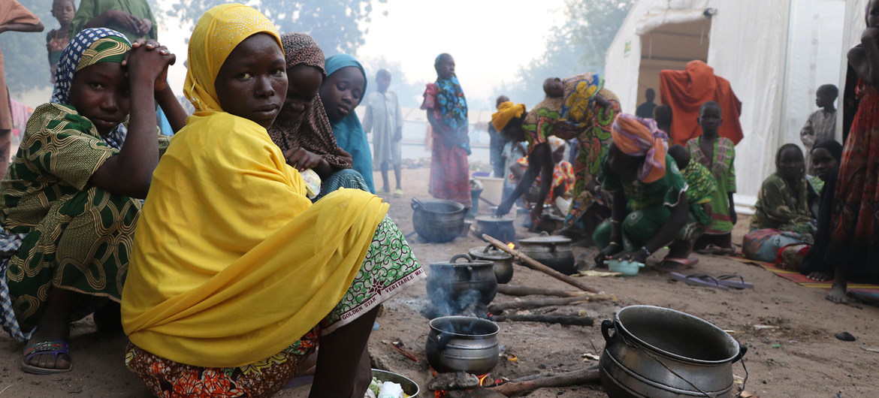
WFP says 41 million people around the world, including in Nigeria (pictured) are at imminent risk of famine.
Notes:
https://news.un.org/en/story/2021/06/1094472

Slide 26
“In Somalia in 2011, 260,000 people died of hunger – and by the time the famine was actually declared – half of that number had already died,” Mr. Beasley recalled. “We can’t debate the numbers to death when people need our help now.”
Notes:
https://news.un.org/en/story/2021/06/1094472

Slide 27
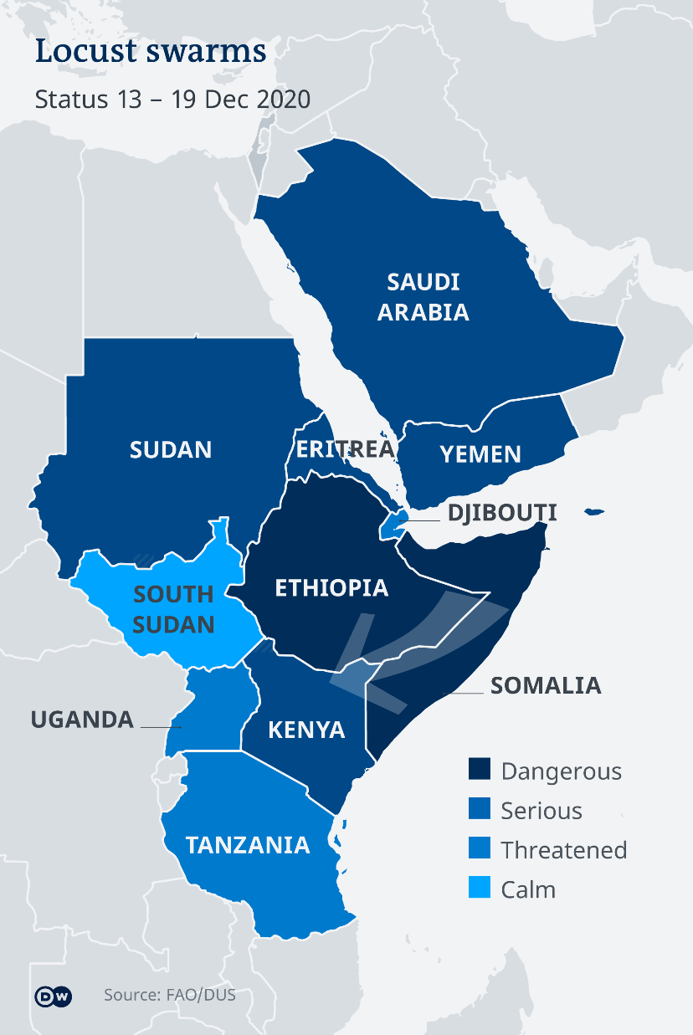
East Africa braces for a return of the locusts
Notes:
https://www.dw.com/en/east-africa-braces-for-a-return-of-the-locusts/a-56133496?maca=en-rss-en-all-1573-xml-mrss

Slide 28
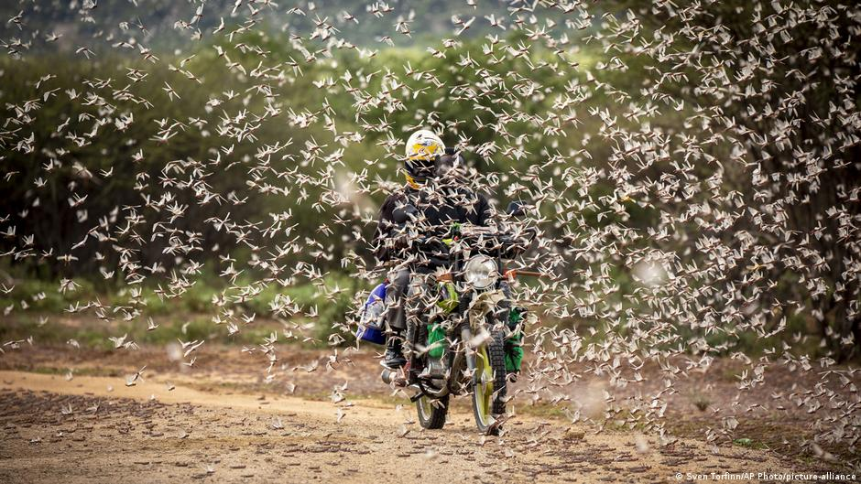
The locust invasion in East Africa
has deprived many farmers of their
livelihood
Notes:
https://www.dw.com/en/east-africa-braces-for-a-return-of-the-locusts/a-56133496?maca=en-rss-en-all-1573-xml-mrss

Slide 29
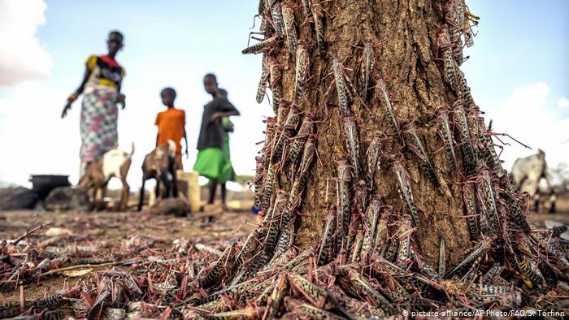
East Africa has seen the worst
locust plague in decades
Notes:
https://www.dw.com/en/east-africa-braces-for-a-return-of-the-locusts/a-56133496?maca=en-rss-en-all-1573-xml-mrss

Slide 30
^{Mtt. 24.6-14} At that time you will be arrested and handed over to be punished and put to death, and all peoples will hate you because of me.

Slide 31
Social media are acting as the voice of authority, and our message is being limited.
Speaking about heterosexual sexual purity may become a hate crime.

Slide 32
^{Mtt. 24.6-14} At that time many will be trapped into betraying and hating each other, many false prophets will appear and fool many people;

Slide 33
^{Mtt. 24.6-14} and many people’s love will grow cold because of increased distance from Torah.

Slide 34
Love one another with a pure heart fervently.
“Love suffers loooooooooooong.”
Doctrinal differences
Science differences: severity of COVID-19, masks, vaccination?
Notes:
People feel welcomed. Big tent. Families bitterly divided.
PreTrip, Post Trib, speaking in tongues is glorious or Satanic, eternal security or lose salvation
Can you bless someone unvaccinated? Can you bless the vaccinated. Many Messianic leaders, almost all in Israel, are vaccinated. Deeply dividing families.

Slide 35
Love one another with a pure heart fervently.
“Love suffers loooooooooooong.”
Doctrinal differences
Science differences: mask, vax, severity of COVID-19?
Political differences?
Notes:
People feel welcomed. Big tent. Families bitterly divided.
PreTrip, Post Trib, speaking in tongues is glorious or Satanic, eternal security or lose salvation
Can you bless someone unvaxed? Many Messianic leaders, almost all in Israel, are vaxed.
Election steal? I’m NOT so concerned about the Nov., 2020 election. I’m concerned about the eternal 2020 vision election. It’s more important that we are not overcome, even if overrun. More important is our relationship with G-d and people than our candidate.

Slide 36
Big tent ⛺
In non-salvation issues.
I could lose money! Lose safety!
Lose unity in the Spirit!?

Slide 37
^{Eph. 4.2-3} Always be humble, gentle and patient, bearing with one another in love, and making every effort to preserve the unity the Spirit gives through the binding power of shalom.

Slide 38
^{Mtt. 24.6-14} But whoever holds out till the end will be delivered. And this Good News about the Kingdom will be announced throughout the whole world as a witness to all the Goyim. It is then that the end will come.
Notes:
That’s part of the reason we are doing outreach, expedite His coming.

Slide 39
^{Yeshayahu/ Is 11.12} He will lift up a banner for the nations, and assemble the dispersed of Israel, and gather the scattered of Y’hudah/Judah from the four corners of the earth

Slide 40
A prophetic grid…

Slide 42
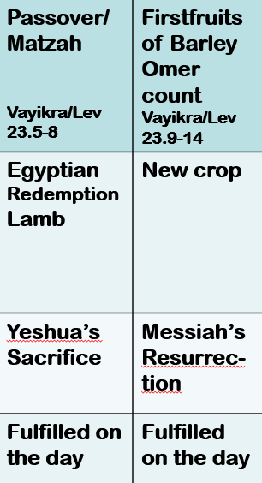

Slide 43
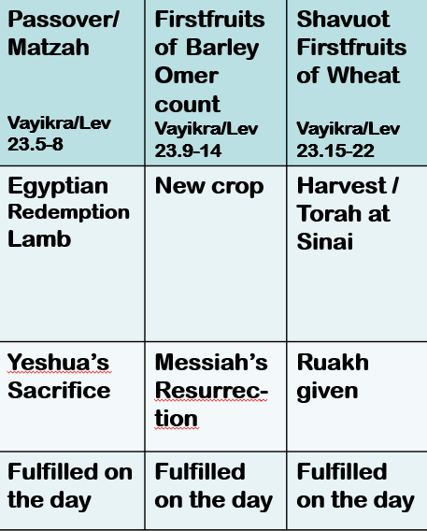

Slide 44
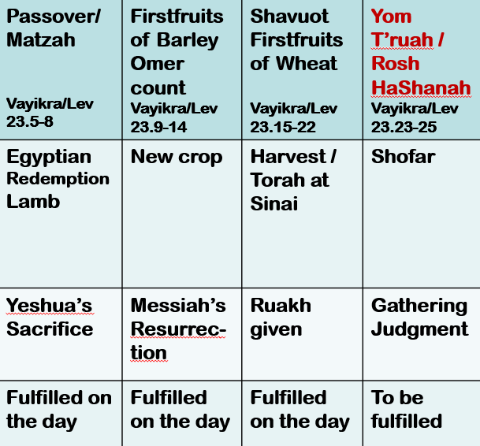

Slide 45
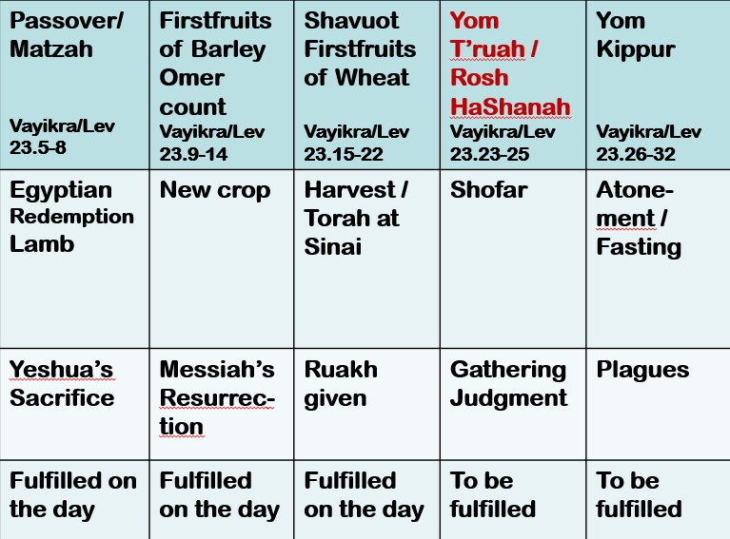

Slide 46
Passover/ Matzah Vayikra/Lev 23.5-8 | Firstfruits of Barley Omer count Vayikra/Lev 23.9-14 | Shavuot Firstfruits of Wheat Vayikra/Lev 23.15-22 | Yom T’ruah / Rosh HaShanah Vayikra/Lev 23.23-25 | Yom Kippur Vayikra/Lev 23.26-32 | Sukkot Vayikra/Lev 23.33-43
Egyptian Redemption Lamb | New crop | Harvest / Torah at Sinai | Shofar | Atone-ment / Fasting | Celebrate Eat in Sukkah Wave 4 species
Yeshua’s Sacrifice | Messiah’s Resurrec-tion | Ruakh given | Gathering Judgment | Plagues | Celebrate Kingdom!
Fulfilled on the day | Fulfilled on the day | Fulfilled on the day | To be fulfilled | To be fulfilled | To be fulfilled

Slide 47
Will Messiah Yeshua return today [Monday night to Wednesay = Yom Sheni יום שני in Hebrew reckoning.]
Apparently, it’s up to us, at least in part!

Slide 48
^{2 Kefa/Peter 3.10-14} However, the Day of the Lord will come “like a thief.” On that Day the heavens will disappear with a roar, the elements will melt and disintegrate, and the earth and everything in it will be burned up.

Slide 49
^{2 Kefa/Peter 3.10-14} Since everything is going to be destroyed like this, what kind of people should you be? You should lead holy and godly lives, as you wait for the Day of God and work to hasten its coming. That Day will bring on the destruction of the heavens by fire,

Slide 50
^{2 Kefa/Peter 3.10-14} and the elements will melt from the heat; but we, following along with his promise, wait for new heavens and a new earth, in which righteousness will be at home. Therefore, dear friends, as you look for these things,

Slide 51
^{2 Kefa/Peter 3.10-14} do everything you can to be found by him without spot or defect and at peace.
“as you wait for the Day of God and work to hasten its coming.”
Hasten??

Slide 52
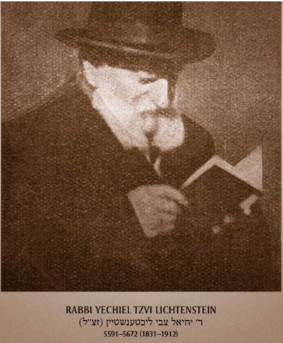
Notes:
https://ffoz.org/discover/messianic-luminaries/the-old-rebbe-yechiel-tzvi-lichtenstein.html

Slide 53
19th century Messianic Jewish luminary and scholar, Rabbi Yechiel Tzvi Lichtenstein, born into a Chasidic family in 1831 Bessarabia (Moldavia)...He purchased a Hebrew edition of the New Testament,
Notes:
https://ffoz.org/discover/messianic-luminaries/the-old-rebbe-yechiel-tzvi-lichtenstein.html

Slide 54
became convinced about Yeshua, and persuaded a small circle of young men to join him.
On the present verse Yechiel Lichtenstein writes: "Kefa says the believers can hasten the Day.
Notes:
https://ffoz.org/discover/messianic-luminaries/the-old-rebbe-yechiel-tzvi-lichtenstein.html

Slide 55
In the Talmud compare Sanhedrin 98a, which applies Isaiah 60:22 ('I, Adonai, will hasten it in its time') to the Messiah's coming: God means, “If they deserve him, I will hasten it: but if they do not deserve him, his coming will be in its time.”””

Slide 56
David Stern quotes a number of Hasidic legends about expediting the coming of Messiah.
And finally, again the Talmud: "Rav said, 'All the forecast dates [for redemption] have come and gone. Now the matter [of when the Messiah will come] depends only on repentance and good deeds.’” (Sanhedrin 97b). ﻿

Slide 57
“as you wait for the Day of God and work to hasten its coming.”
We can hasten [by implication delay] the return of Messiah.

Slide 58
Will Messiah Yeshua return today [Monday night to Wednesday = Yom Sheni יום שני in Hebrew reckoning.]
Apparently, it’s up to us, at least in part.

Slide 59
Applications:
Every time you click on that licentious image on screen, you delay his coming.

Slide 60
Frequent type
of sidebar in
news articles:
Curious?
~Woodstock
~WW II
Notes:
Other forms of fornication of the eyes or in fact, intoxication

Slide 61
2. Every generous act of giving, tithing, blessing hastens His coming.

Slide 62
3. Every kind, unselfish deed and word done to others, especially needy or difficult people, expedites His return.
4. Every act of service to the community, oneg food, cleanup, ushering, hastens His return.

Slide 63
5. Every time you follow a Ruakh prompt to share your redemptive faith in Messiah, you hasten his coming. So, our people will say, “Barukh HaBa b’Shem Adoni!”
ברוך הבא בשם ד"

Slide 64
6. When you vote for righteous leadership in government.
7. When you spend time in prayer and in His word, you purify your soul, expedite His Return!

Slide 65
Will Messiah Yeshua return today, or soon?
Apparently, it’s up to us, at least in part?

Slide 66
^{1 Thes 3.12-13} And as for you, may the Lord make you increase and overflow in love toward each other, indeed, toward everyone, just as we do toward you; so that he may give you the inner strength to be blameless, by reason of your holiness, when you stand before God our Father at the coming of our Lord Yeshua with all his angels.

Slide 68
Do you KNOW Yeshua and the assurance of sins forgiven?
Are you hearing daily from His Word?
How are you applying what you heard?
Are you asking this of another?
Notes:
Who are you discipling, building up?4

