Slide 1
e-handout
To have these notes
without taking notes
Go to OrHaOlam.com
Click on Messages tab,
2022 Messages
Notes:
You may notice that I’m slowing down in my rate of speech. This is because we may be getting language translation equipment for simultaneous translation. Media room is now painted, new floor almost finished, monitor installed.

Slide 2
Notes:
Whose?

Slide 3
Why consider Messiah’s Birth today?
a. ^{Luke 1.5} There was a cohen/priest named Z’kharyah who belonged to the Aviyah division.
b. The cohainim /priests were partitioned into 24 divisions, the names at I Chr 24:7-18.

Slide 4
The Aviyah division was the eighth, counting from Nisan 1 . Each served for a week at a time; thus the members of a division did Temple duty 2x/year.
c. Zekhariah served at Shavuot/ Pentecost. Count [6+9] 15 months till birth Messiah → during Sukkot.
Notes:
It’s not exactly Sukkot anymore, but since we’re guessing anyhow, we’re moved it forward for a B’not Mitzvah.

Slide 6
Outline
The Corruption of this World
Yeshua entered our world, our life chemistry
Water is LIFE
Yeshua is the Water of Life

Slide 7
^{1 Yn 5.5} Who is it that overcomes the world?
This is our goal!

Slide 9
Outline
The Corruption of this World
Yeshua really entered our life chemistry
Water is LIFE
Yeshua is the Water of Life

Slide 10
Gender Transition Surgeries
on Minors Accelerating,
Most Covered by Insurance
Notes:
https://washingtonstand.com/commentary/study-gender-transition-surgeries-on-minors-accelerating-most-covered-by-insurance
Find out if your health insurer does this. Reason for Samaritan, Medishare,

Slide 11
Over 1,100 adolescents underwent gender transition surgery between 2016-2019, according to a new study published in the Journal of the American Medical Association (JAMA) Pediatrics.
Notes:
https://washingtonstand.com/commentary/study-gender-transition-surgeries-on-minors-accelerating-most-covered-by-insurance

Slide 12
100 gender transition surgeries on adolescents in 2016,
over 200 in 2017,
over 300 in 2018,
and 489 in 2019
“Nearly all were masculinizing, 1.4% feminizing.” ± $30,000 cost
Notes:
https://washingtonstand.com/commentary/study-gender-transition-surgeries-on-minors-accelerating-most-covered-by-insurance

Slide 13
238 “top” surgeries (double mastectomies) on minors in 2019
61.1% covered by private insurance,
16.5% were covered by public health insurance,
15.8% were self-paid
Notes:
https://washingtonstand.com/commentary/study-gender-transition-surgeries-on-minors-accelerating-most-covered-by-insurance
Find out from your agent. In EU, Canada, Israel Health Ins socialized. No recourse. Americans still do!

Slide 14
Notes:
https://www.drjamesdobson.org/hubfs/%23ChasedAway_1920X1200.jpg
I have a warm feeling for the Chase Manhattan Bank on every corner, it seemed in NYC. I think it’s futile as having a warm feeling for the local rhinoceros at the zoo. Not reciprocated. Nevertheless, I was shocked and disappointed…

Slide 15
The National Committee for Religious Freedom (NCRF) is a non-partisan, faith-based, non-profit organization, dedicated to defending the right of everyone in America to the freedom of religion.
Notes:
https://www.drjamesdobson.org/articles/chased-away

Slide 16
Its chairman is Sam Brownback, previously US Ambassador-at-Large for International Religious Freedom. He was elected as governor of Kansas and before that he served 14 years in the U.S. Senate.
Notes:
https://www.drjamesdobson.org/articles/chased-away

Slide 17
After the founding of NCRF, the organization opened a bank account at J.P. Morgan Chase & Company. So far, so good. But three weeks later they received a letter notifying them that Chase had decided to “end their relationship” with NCRF. The account was immediately closed by the bank.
Notes:
https://www.drjamesdobson.org/articles/chased-away

Slide 18
Chase employees refused to tell Brownback why his group that defends our constitutional right to religious freedom had their bank account cancelled.
Notes:
https://www.drjamesdobson.org/articles/chased-away

Slide 19
Chase finally reached out to NCRF with an outrageous request. They would be willing to reconsider opening the account if NCRF provided their donor list, a list of candidates they intended to endorse, and what criteria they would use to make those endorsements.
Notes:
https://www.drjamesdobson.org/articles/chased-away

Slide 20
Notes:
https://www.drjamesdobson.org/hubfs/Gary-Bauer_Public-Policy_1200x630.jpg

Slide 21
^{2 Tim 3.1} But know this, that in the last days perilous times [times of stress] will come:

Slide 23
Outline
The Corruption of this World
Yeshua entered our world, our life chemistry
Water is LIFE
Yeshua is the Water of Life

Slide 24
^{1 Yn 5.5} Who is it that overcomes the world?

Slide 25
^{1 Yn 5.5} Who is it that overcomes the world, if not the one who believes that Yeshua is Ben-Elohim /Son of G-d?

Slide 26
^{1 Yn 5.6-9} He is the one who came by means of water and blood, Yeshua the Messiah — not with water only, but with the water and the blood. And the Spirit bears witness, because the Spirit is the truth.
Notes:
Water and blood?
Many believers: immersion and Seder of Messiah [baptism and communion]

Slide 27
^{1 Yn 5.6-9} There are three witnesses — the Spirit, the water and the blood — and these three are in agreement. If we accept human witness, God’s witness is stronger, because it is the witness which God has given about his Son.

Slide 28
Why the phrase twice “came by means of water and blood”??
Context: Yokhanan was dealing with Gnostic teachers. γνωστικός, gnōstikós, 'having knowledge’
Notes:
BTW, this is my Messiah’s Birthday message, that He really was born among us, fully human, fully G-d.
Too theological? “I want shepherds and angels!” Sorry, not today…but maybe more significant!

Slide 29
Gnostic teaching: Messiah is seen as a divine being which has taken human form in order to lead humanity back to recognition of its own divine nature. Messiahship came on Yeshua at immersion and left at Gethsemane.
Notes:
https://en.wikipedia.org/wiki/Gnosticism

Slide 30
^{1 Cor 8.1-3} “knowledge” puffs a person up with pride; whereas love builds up. The person who thinks he “knows” something doesn’t yet know in the way he ought to know. However, if someone loves God, God knows him.

Slide 31
Some ancient cults denied the full dual nature of Yeshua:
not 50% G-d, 50% human
Rather: 100% G-d, 100% human
Yeshua was fully human. 46 chromosomes: 23 from Miriam, 23 supernatural.

Slide 32
Docetist any teaching that claims that Yeshua’s body was either absent or illusory
In one version, as in Marcionism, Messiah was so divine that he could not have been human, since God lacked a material body, which therefore could not physically suffer. Yeshua only appeared to be a flesh-and-blood man; his body was a phantasm.
Notes:
https://en.wikipedia.org/wiki/Docetism

Slide 33
Other groups who were accused of docetism held that Yeshua was a man in the flesh, but Messiahship was a separate entity who entered Yeshua' body in the form of a dove at his immersion, empowered him to perform miracles, and abandoned him upon his death on the cross.
Notes:
https://en.wikipedia.org/wiki/Docetism

Slide 34
Monophysite Some taught that in Messiah the human nature was completely absorbed by the divine, leaving only a divine nature, like a drop of vinegar in the ocean.
Notes:
https://en.wikipedia.org/wiki/Monophysitism

Slide 35
^{MJ 4.15} For we do not have a Cohen Gadol unable to empathize with our weaknesses; since in every respect he was tempted just as we are, the only difference being that he did not sin.
Evidence of full humanity of Messiah…

Slide 36
grew in wisdom as a child ^{(Lk 2:40, 52),}
was weary ^{(John 4:6),}
was hungry ^{(Matthew 4:4),}
was thirsty ^{(John 19:28),}
was tempted by the devil ^{(Mt 4:1–11),}
was sorrowful ^{(Matthew 26:38a),}
Notes:
https://answersingenesis.org/Yeshua/why-did-Yeshua-take-on-a-human-nature/

Slide 37
Yeshua was a “lamb without blemish and without spot” ^{(1 Peter 1:19)}.
Yeshua’s sinless [human] life qualifies Him to be a sacrifice for the sins of others ^{(Isaiah 53:7–10).}
Notes:
https://answersingenesis.org/jesus/why-did-jesus-take-on-a-human-nature/

Slide 38
Yeshua did not sin, not because his divine nature overpowered his human nature, keeping him from sinning, but because he utilized all of the resources given to him in his humanity. He loved and meditated on God’s Word . . . he prayed to his Father; he trusted in the wisdom and rightness of his Father’s will and Word Yeshua did not sin,
Notes:
https://answersingenesis.org/jesus/why-did-jesus-take-on-a-human-nature/

Slide 39
not because his divine nature overpowered his human nature, keeping him from sinning, but because he utilized all of the resources given to him in his humanity. He loved and meditated on God’s Word . . . he prayed to his Father; he trusted in the wisdom and rightness of his Father’s will and Word; and,
Notes:
https://answersingenesis.org/jesus/why-did-jesus-take-on-a-human-nature/

Slide 40
very significantly, he relied on the supernatural power of the Spirit to strengthen him to do all that he was called upon to do.; and, very significantly, he relied on the supernatural power of the Spirit to strengthen him to do all that he was called upon to do.
Notes:
https://answersingenesis.org/jesus/why-did-jesus-take-on-a-human-nature/
Also, He was not corrupted with a sin nature. He had life with His Father.

Slide 41
^{1 Yn 5.6} came by means of water and blood
Atonement by natural human birth / incarnation, and by bloody death.

Slide 42
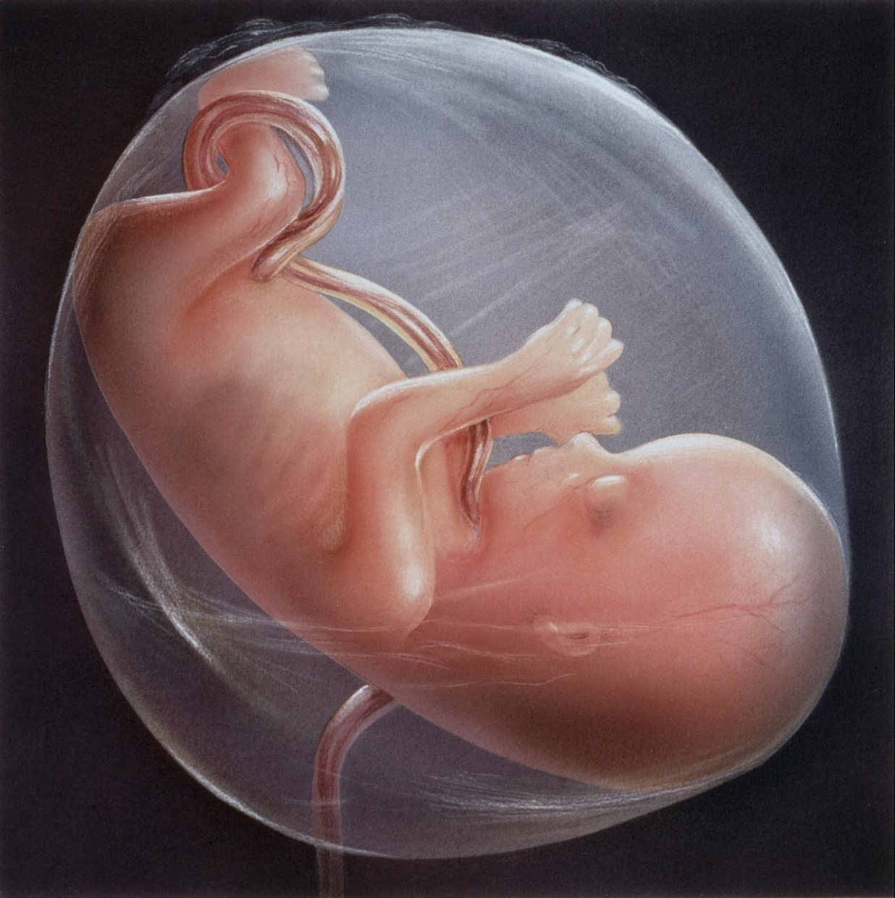
^{Yn 3.5} Yeshua answered, “Yes, indeed, I tell you that unless a person is born from water and the Spirit, he cannot enter the Kingdom of God.
Notes:
http://www.longlonglife.org/wp-content/uploads/2017/01/Amniotic-fluid-reverses-ageing-bones.jpg
Most commentators view this “water” as either immersion or a parallelism for the Spirit. But look at the next verse.

Slide 43
^{Yn 3.6-7} What is born of the flesh is flesh, and what is born of the Spirit is spirit. Do not be surprised that I said to you, ‘You all must be born from above.’
Notes:
~of water and of the Spirit

Slide 44
^{Phil 2.6-7} He was in the form of God,
he did not regard equality with God
something to be possessed by force.
On the contrary, he emptied himself,
in that he took the form of a slave
by becoming like human beings are.
He entered into this world of matter, of water, to give life.

Slide 46
Outline
The Corruption of this World
Yeshua entered our world, our life chemistry
Water is LIFE
Yeshua is the Water of Life

Slide 47
In our physical world,
water is LIFE.
This is an object lesson of the LIFE Messiah gave and gives us.
Notes:
Special Sukkot meaning, that we didn’t give enough attention to.

Slide 48
Water is essential for life.
We are “born of water.” Babies in the womb are encased in water.
Yeshua was the water of life, as fully human, fully divine.

Slide 49
Water makes up 60-75% of human body weight. A loss of just 4% of total body water leads to dehydration, and a loss of 15% can be fatal. Likewise, a person could survive a month without food but wouldn’t survive 3 days without water.
Notes:
https://sitn.hms.harvard.edu/uncategorized/2019/biological-roles-of-water-why-is-water-necessary-for-life/
How long can you survive/thrive without Messiah’s presence? Do you notice? Do you get thirsty?

Slide 50
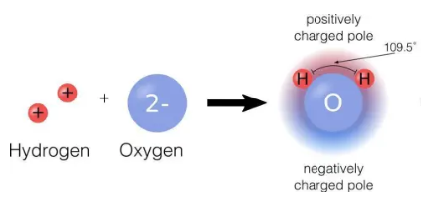
Notes:
https://sitn.hms.harvard.edu/uncategorized/2019/biological-roles-of-water-why-is-water-necessary-for-life/
Water is a polar molecule.

Slide 51
As a polar molecule, water interacts best with other polar molecules, such as itself.
Importantly, this bonding makes water molecules stick together in a property called cohesion. The cohesion of water molecules helps plants take up water at their roots
Notes:
https://sitn.hms.harvard.edu/uncategorized/2019/biological-roles-of-water-why-is-water-necessary-for-life/
If we have Yeshua, we’ll have more cohesion as a body.

Slide 52
Cohesion also contributes to water’s high boiling point, which helps animals regulate body temperature.
Water’s extensive capability to dissolve a variety of molecules has earned it the designation of “universal solvent,” and it is this ability that makes water such an invaluable life-sustaining force. Helps cells transport and use substances like oxygen or nutrients.
Notes:
https://sitn.hms.harvard.edu/uncategorized/2019/biological-roles-of-water-why-is-water-necessary-for-life/

Slide 53
Water allows everything inside cells to have the right shape at the molecular level. As shape is critical for biochemical processes, this is also one of water’s most important roles.
Notes:
https://sitn.hms.harvard.edu/uncategorized/2019/biological-roles-of-water-why-is-water-necessary-for-life/

Slide 54
Proteins are produced as a long chain of building blocks called amino acids and need to fold into a specific shape to function correctly. Water drives the folding of amino acid chains as different types of amino acids seek and avoid interacting with water.
Notes:
We grow and unfold in His presence!!

Slide 55
Additionally, water buffers cells from the dangerous effects of acids and bases.

Slide 56
Isaiah 26:3 You will keep him in perfect peace, whose mind is stayed on you: because he trusts in you.
The captain of a submarine was once asked, "How did the terrible storm last night affect you?" The officer looked at him in surprise and exclaimed, "Storm? We didn't even know there was one!"
Notes:
George Whitten

Slide 57
There is an area beneath the surface of the ocean known to sailors as the "cushion of the sea". In this place, although the ocean may be raging terribly above, the waters here are never stirred.
Notes:
George Whitten

Slide 58
I think you know where I'm going with this. There is a place, a wonderful place, we can go to find refuge during the frightening storms raging above us -- a place where we don't feel a thing -- no fear, no worry for tomorrow.
Notes:
George Whitten

Slide 60
Outline
The Corruption of this World
Yeshua really entered our life chemistry
Water is LIFE
Yeshua is the Water of Life

Slide 61
^{Yn 4.13-14} Yeshua answered, “Everyone who drinks this water will get thirsty again, but whoever drinks the water I will give him will never be thirsty again! On the contrary, the water I give him will become a spring of water inside him, welling up into eternal life!”
Notes:
She wanted it, but what was the price? Full confession, and repentance.

Slide 62
^{Yn 2.7-9} Yeshua told them, “Fill the jars with water,” and they filled them to the brim. He said, “Now draw some out, and take it to the man in charge of the banquet”; and they took it. The man in charge tasted the water; it had now turned into [the best] wine!

Slide 63
1st Day | Sukkot | holy convo-cation מִקְרָא-קֹדֶשׁ mikra kodesh 4 species
7th Day | Hoshannah Rabba Water drawing
8th Day | Shemini Atseret | Mikra kodesh PLUS a solemn assembly= עֲצֶרֶת atseret The stop day | Combined in Israel, and by others in the diaspora, us.
9th Day | Simkhat Torah = Rejoicing in the Torah | Rewinding the scroll, dancing
Notes:
We combined 7, 8 and 9th days. We emphasized the one of these three that is specifically in the Bible, but observing, at least in a measure, the other two.

Slide 64
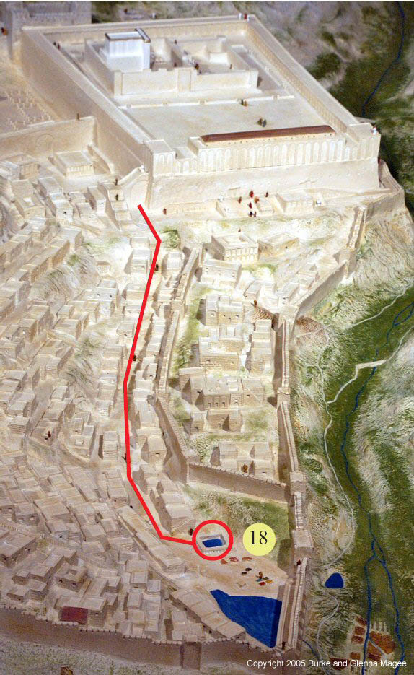
The walk from the Temple Mount to the pool of Shiloakh / Siloam for water drawing.
Notes:
https://www.returntogod.com/jerusalem/images/PoolOfSiloam.jpg

Slide 65
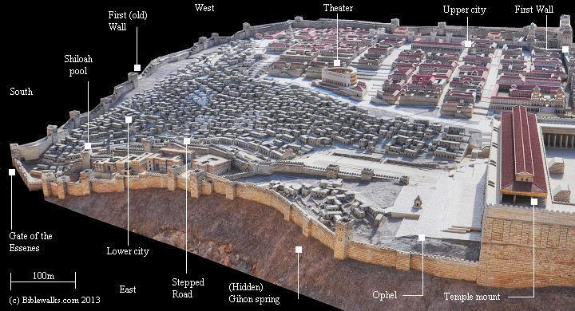
Notes:
https://www.biblewalks.com/Photos105/SouthJerusalemModelS.jpg

Slide 66
Notes:
https://youtu.be/z-yRqd6w0n8

Slide 67
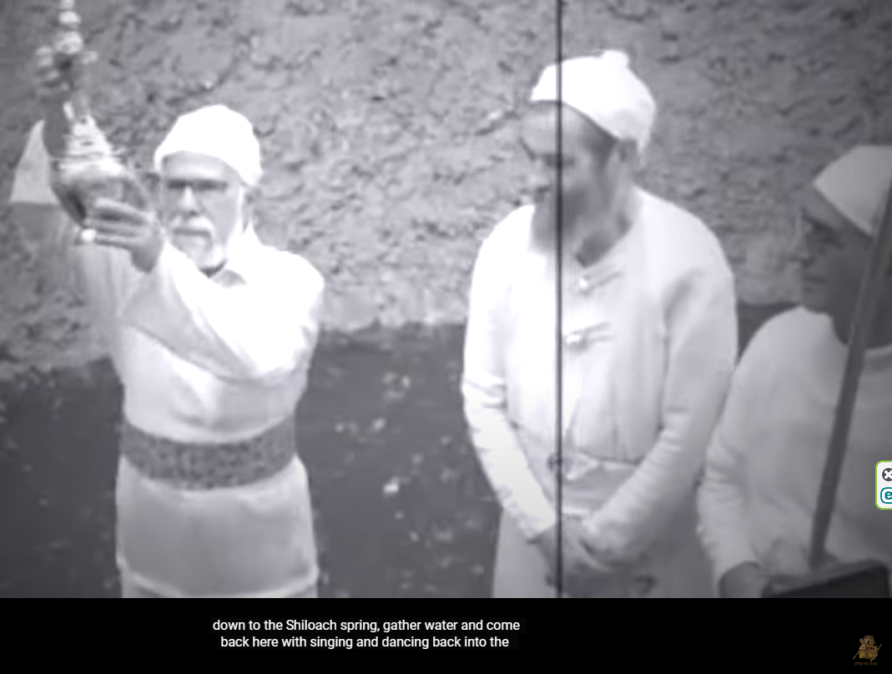
Notes:
https://youtu.be/z-yRqd6w0n8

Slide 68
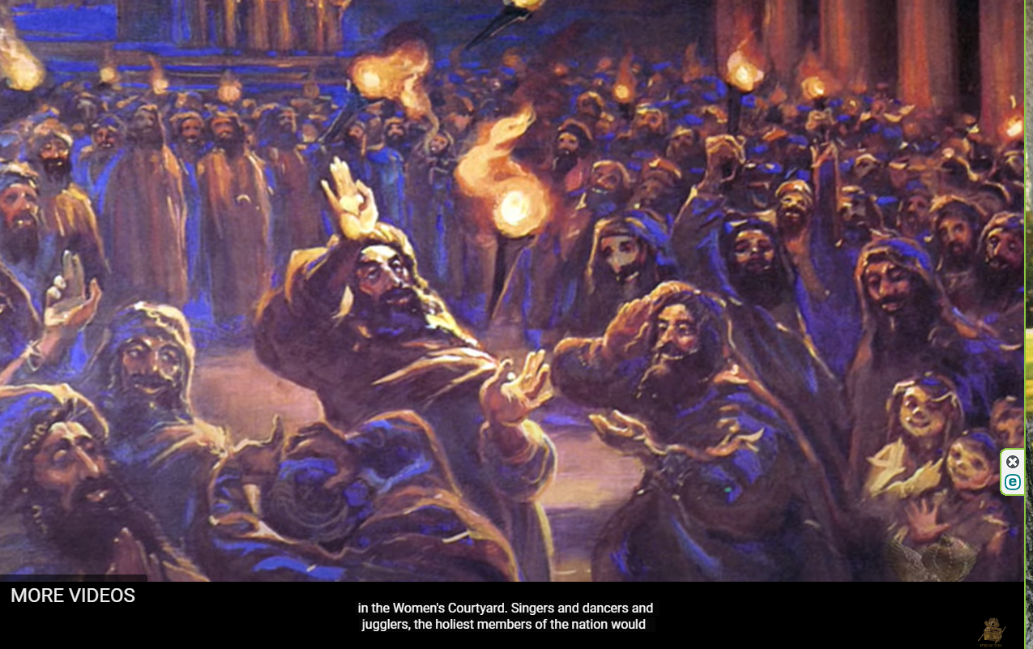
Notes:
https://youtu.be/z-yRqd6w0n8

Slide 69
Notes:
https://youtu.be/z-yRqd6w0n8

Slide 70
It was related of Rabban Shimon ben Gamliel that when he was rejoicing with the joy of the Water-Drawing he would take eight burning torches in one hand and toss them upwards; he tossed one and caught one, and never did one touch the other.
Notes:
https://en.wikipedia.org/wiki/Simchat_Beit_HaShoeivah

Slide 71
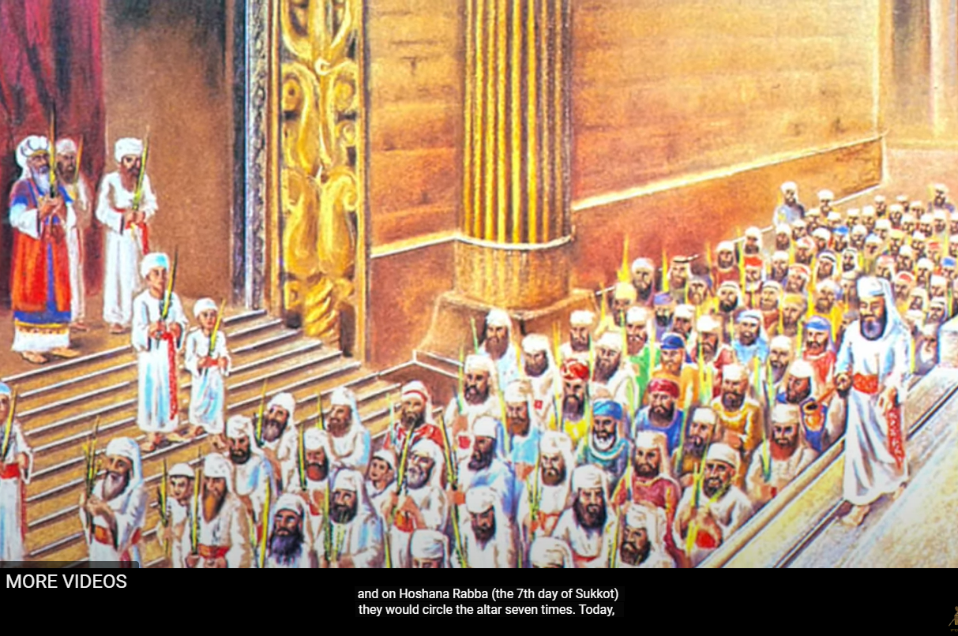
Notes:
https://youtu.be/z-yRqd6w0n8

Slide 72
The seventh day:
^{Yn 7.33-39} Now on the last day of the festival, Hoshana Rabbah, Yeshua stood and cried out, “If anyone is thirsty, let him keep coming to me and drinking! Whoever puts his trust in me, as the Scripture says,

Slide 73
The seventh day:
^{Yn 7.33-39} rivers of living water will flow from his inmost being!” (Now he said this about the Spirit, whom those who trusted in him were to receive later — the Spirit had not yet been given, because Yeshua had not yet been glorified.)
Notes:
Are you drinking the rivers, and being a source to others? Love, joy, peace? Or knowledge?

Slide 74
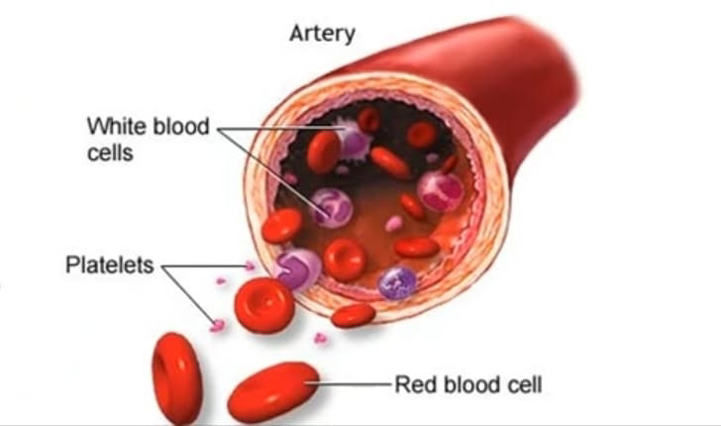
Notes:
https://lh3.googleusercontent.com/-9Ln5RPQD8pg/YbM2ZNE6NKI/AAAAAAAAAro/TonqYJITfIYNAN0hegR7xNVjut6rCv5vQCNcBGAsYHQ/s1600/1639134816914829-0.png
Supply of oxygen lung to tissues (bound to haemoglobin, which is carried in red blood cells).
Removal of waste such as carbon dioxide, urea, and Uric acid.
Supply of nutrients such as glucose, amino acids, and fatty acids (dissolved in the blood or bound to plasma proteins).
Immunological functions, including circulation of white blood cells, and detection of foreign material by antibodies.
Coagulation, the response to a broken blood vessel, the conversion of blood from a liquid to a semisolid gel to stop bleeding.
Messenger functions, including the transport of hormones and the signaling of tissue damage.
Maintains body temperature, Acid-Base balance and balance of water level.

Slide 75
^{Yn 19.33-35} When they got to Yeshua and saw that he was already dead, they didn’t break his legs. However, one of the soldiers stabbed his side with a spear, and at once blood and water flowed out. The man who saw it has testified about it, and his testimony is true. And he knows that he tells the truth, so you too can trust.
Notes:
The decreased oxygen (due to the difficulty in exhaling) causes damage to the tissues and the capillaries begin leaking watery fluid from the blood into the tissues. This results in a build-up of fluid around the heart (pericardial effusion) and lungs (pleural effusion). The collapsing lungs, failing heart, dehydration, and the inability to get sufficient oxygen to the tissues essentially suffocate the victim.⁵ The decreased oxygen also damages the heart itself (myocardial infarction) which leads to cardiac arrest. In severe cases of cardiac stress, the heart can even burst, a process known as cardiac rupture.
“blood and water came out” (John 19:34), referring to the watery fluid surrounding the heart and lungs.
https://www.apu.edu/articles/the-science-of-the-crucifixion/#:~:text=Instead%2C%20the%20soldiers%20pierced%20His,surrounding%20the%20heart%20and%20lungs.

Slide 77
Outline
The Corruption of this World
Yeshua entered our world, our life chemistry
Water is LIFE
Yeshua is the Water of Life
Notes:
And getting worse. Be sure to vote! Check your insurance company!
He knows our afflictions.
He has life that fits us exactly!

Slide 78
Do you KNOW Yeshua and drinking the water of LIFE?
Are you hearing daily from His Word?
How are you applying what you heard?
Are you offering that water of life to anyone?

