Slide 1
e-handout
To have these notes
without taking notes
Go to OrHaOlam.com
Click on Messages tab,
2022 Messages
Notes:
You may notice that I’m slowing down in my rate of speech. This is because we may be getting language translation equipment for simultaneous translation.

Slide 2
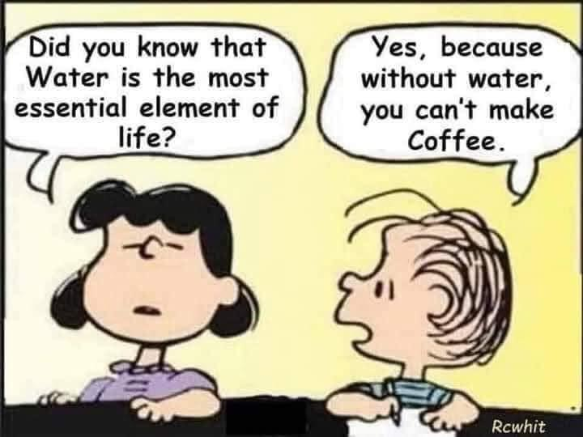
Notes:
Scott Hahn

Slide 3
Notes:
Scott Hahn

Slide 4
Notes:
I love archeology…
Lori Wilson

Slide 5
Adam
Notes:
Lori Wilson

Slide 6
Hava/
Eve
Notes:
Lori Wilson

Slide 8
Give Thanks!
Exhortation to give thanks!
Benefits of Giving Thanks.
Practicing giving thanks.

Slide 9
Give Thanks!
Exhortation to give thanks!
Benefits of Giving Thanks.
Practicing giving thanks.

Slide 10
^{1 Thes 5. 16-19} Always be joyful, pray constantly, in everything give thanks; for this is God’s will for you in Messiah Yeshua. Do not quench the Spirit.
What does “this” refer to?
Notes:
“This” means everything is the will of G-d?
“This” means giving thanks is the will of G-d?

Slide 11
Two interpretation:
Everything is the will of G-d in Messiah Yeshua.

Slide 12
Two interpretation:
Everything is the will of G-d in Messiah Yeshua.
Giving thanks is the will of G-d in Messiah Yeshua.

Slide 13
Two interpretation:
Everything is the will of G-d in Messiah Yeshua.
Giving thanks is the will of G-d in Messiah Yeshua.
Tevye’s interpretation.

Slide 14
It doesn’t look like everything is the will of G-d!!
^{Yn. 16.33} “I have said these things to you so that, united with me, you may have shalom. In the world, you have tsuris. But be brave! I have conquered the world!”
Notes:
Doesn’t matter. That physical ailment, financial distress, relational distress, estranged loved one…He has conquered!

Slide 15
Believe that everything is for the best.
Notes:
Arush 122, 121

Slide 16
Believe that everything is for the best.
Express gratitude – say “Thank you!” to Messiah Yeshua.
Notes:
Arush 122, 121

Slide 17
Believe that everything is for the best.
Express gratitude – say “Thank you!” to Messiah Yeshua.
Do teshuva תשובה
Notes:
Arush 122, 121

Slide 18
^{Rev. 5.13} I heard every creature in heaven, on earth, under the earth and on the sea — yes, everything in them — saying, “To the One sitting on the throne and to the Lamb belong praise, honor, glory and power forever and ever!”

Slide 19
“You are worthy to take the scroll and break its seals; because you were slaughtered; at the cost of blood you ransomed for God persons from every tribe, language, people and nation. You made them into a kingdom for God to rule, cohanim to serve him;and they will rule over the earth.”

Slide 20
^{T’hillim 136.1-3} Give thanks to Adoni, for he is good, for his lovingkindness continues forever.
Ki l’olam khasdo. כִּי לְעוֹלָם חַסְדּוֹ.
Notes:
Practice כי לעולם חסדו

Slide 21
^{T’hillim 136.1-3} Give thanks to the God of gods, for his lovingkindness continues forever.
Ki l’olam khasdo. כִּי לְעוֹלָם חַסְדּוֹ.

Slide 22
^{T’hillim 136.1-3} Give thanks to the Lord of lords, for his lovingkindness continues forever;
Ki l’olam khasdo. כִּי לְעוֹלָם חַסְדּוֹ.
Continues for a total of 26 verses!
Receive and celebrate Yeshua’s victory!

Slide 23
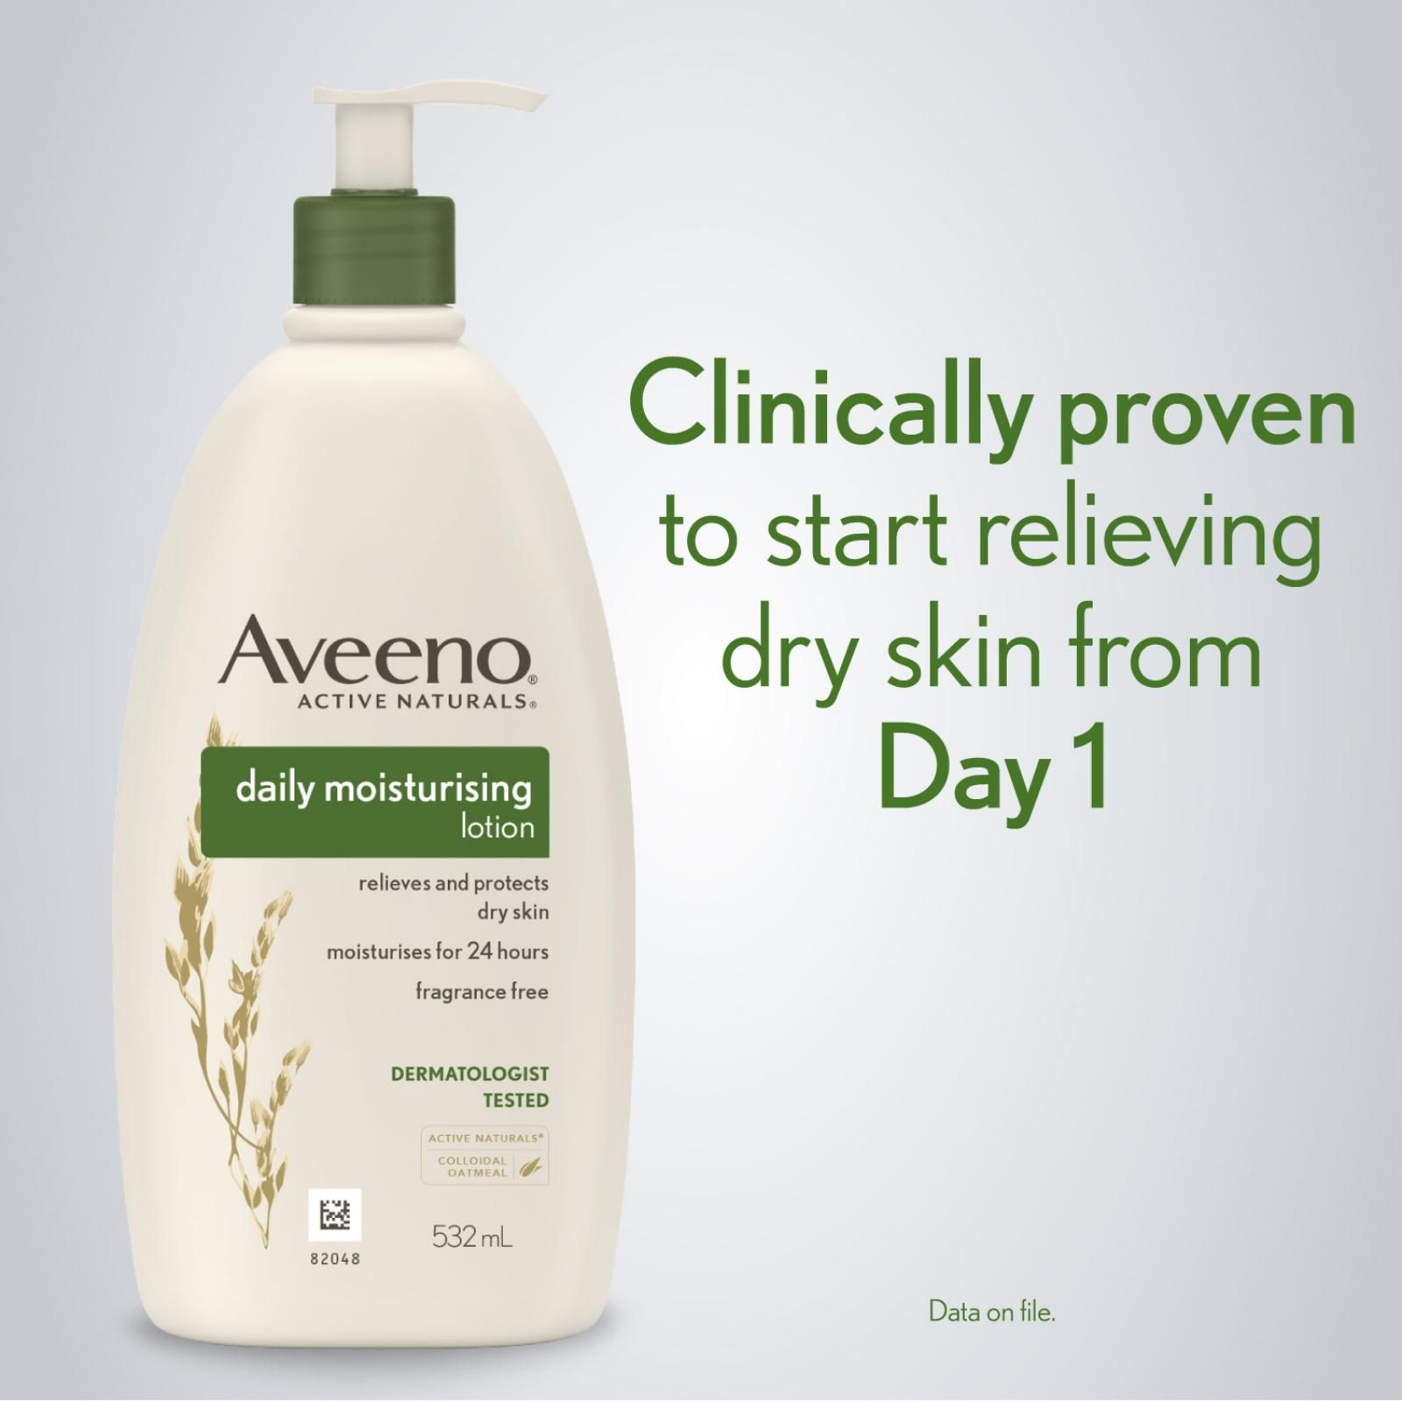
Notes:
https://external-content.duckduckgo.com/iu/?u=https%3A%2F%2Fwww.yourdiscountchemist.com.au%2Fmedia%2Fcatalog%2Fproduct%2Fcache%2Fa8d9900800ed5d8e3ea1ce145bf58b44%2F3%2F8%2F381857-3.jpg&f=1&nofb=1&ipt=b390504136d9195ff18a5a1fcebab9764820249a9619c1a39664a956d73c587f&ipo=images

Slide 24
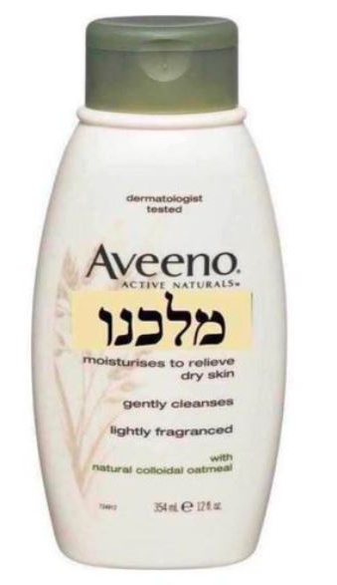
Clinically and Biblically proven to relieve dryness of spirit from day 1!
Notes:
From Rukhel

Slide 26
Give Thanks!
Exhortation to give thanks!
Benefits of Giving Thanks.
Practicing giving thanks.

Slide 27
We have 30 trillion cells, each cell with 46 chromosome in 23 pairs
Each of the chromosomes have telomeres at the ends.
Cells don’t live forever, they divide and multiply and the new cells can have shortened telomeres.

Slide 28
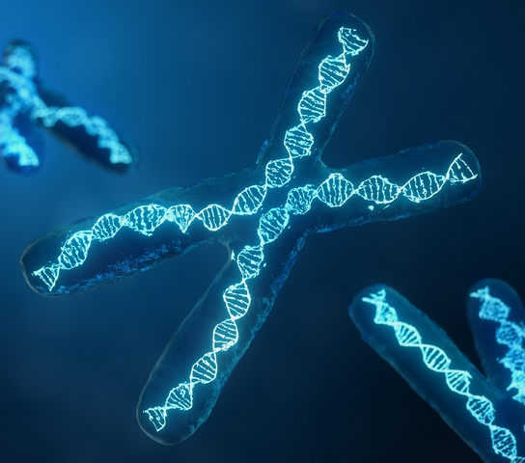
Double helix DNA inside the chromosome
Tip is the telomere
Notes:
https://external-content.duckduckgo.com/iu/?u=https%3A%2F%2Fwww.wakingscience.com%2Fwp-content%2Fuploads%2F2019%2F11%2F0.jpg&f=1&nofb=1&ipt=c4b43feeb3069a2437434cca88da638a01e90d2192971e75451f56653e0262ef&ipo=images

Slide 29
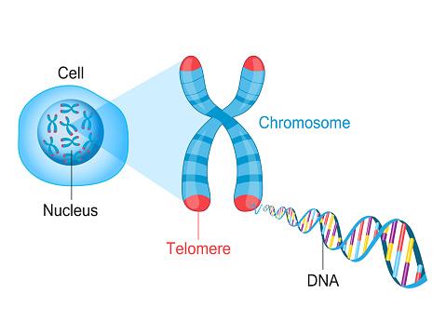
Notes:
https://external-content.duckduckgo.com/iu/?u=https%3A%2F%2Fmedia.istockphoto.com%2Fvectors%2Ftelomere-chromosome-and-dna-vector-id961320764%3Fk%3D6%26m%3D961320764%26s%3D170667a%26w%3D0%26h%3DXigZgjP3ymxPgu4229n-QKAQZLwmXLaCPX46DihOnmA%3D&f=1&nofb=1&ipt=5901f61dbc602f7a57d6f14181db755ff05426de0ee40635daf17f548ef1f781&ipo=images

Slide 30
As telomeres shorten, we age.
Scientists call telomeres the
biological clock.
Notes:
https://www.theepochtimes.com/nobel-prize-winner-5-things-that-speed-up-aging-and-1-anti-aging-secret_4381285.html?est=yoV2YqXdtz1wCVBIEG7BVBPSdi8X5mUmI%2BPVS9APnTVsXj%2BrgTF9PJCbs399CettgA%3D%3D

Slide 31
Notes:
https://youtu.be/U0fRAr-ZHCo

Slide 32
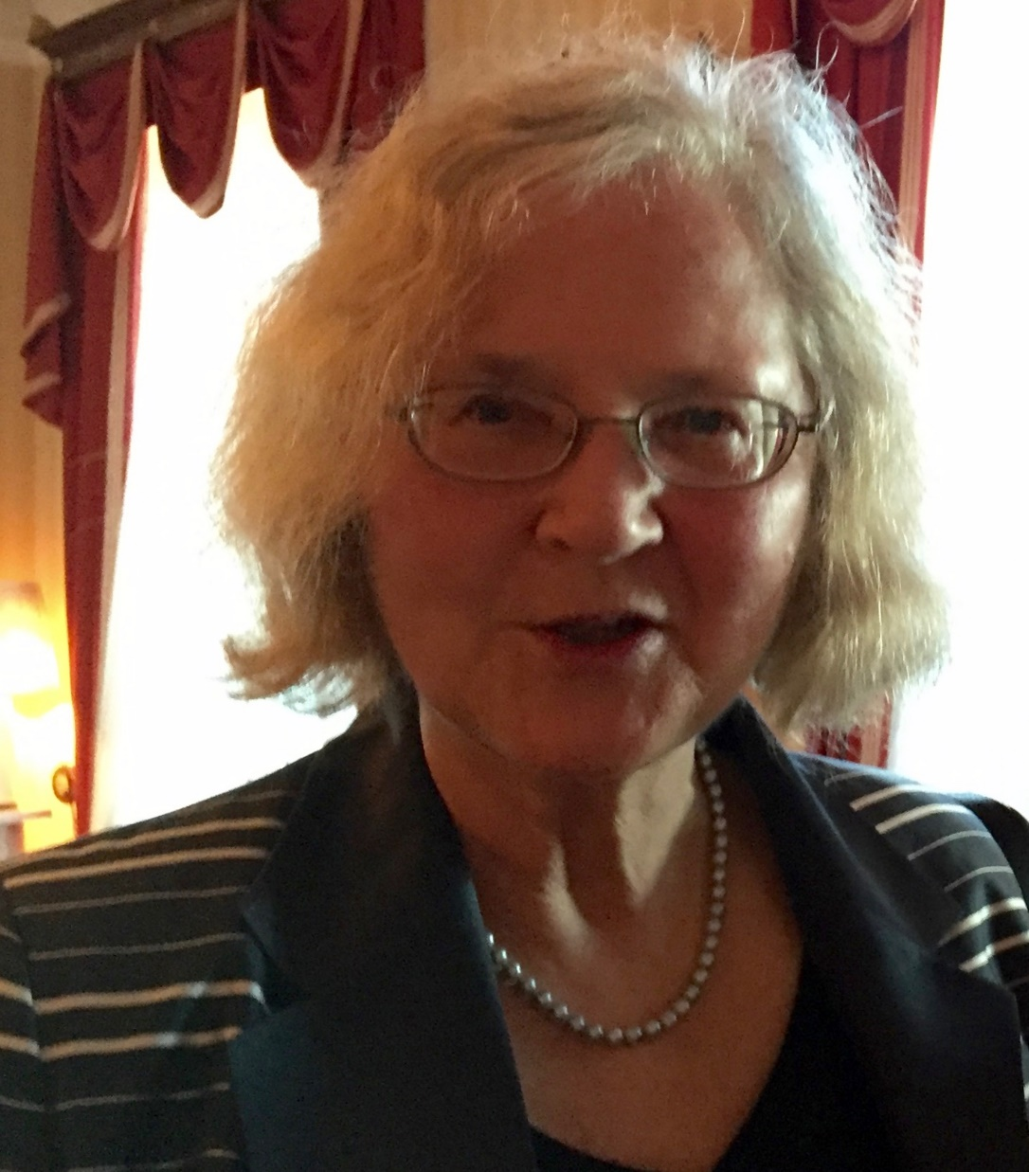
Elizabeth Blackburn, PhD, won the Nobel Prize in Physiology / Medicine in 2009 for discovering the
Notes:
https://en.wikipedia.org/wiki/Elizabeth_Blackburn
https://upload.wikimedia.org/wikipedia/commons/2/24/Elizabeth_Blackburn_CHF_Heritage_Day_2012_Rush_001.JPG

Slide 33
molecular nature of telomeres, the ends of chromosomes that serve as protective caps essential for preserving genetic information, and for co-discovering telomerase, an enzyme that maintains telomere ends.
Notes:
https://www.theepochtimes.com/nobel-prize-winner-5-things-that-speed-up-aging-and-1-anti-aging-secret_4381285.html?est=yoV2YqXdtz1wCVBIEG7BVBPSdi8X5mUmI%2BPVS9APnTVsXj%2BrgTF9PJCbs399CettgA%3D%3D

Slide 34
We now know there are harmful thinking patterns that can actually damage our telomeres, but are there ways to correct the process?
Notes:
https://www.theepochtimes.com/nobel-prize-winner-5-things-that-speed-up-aging-and-1-anti-aging-secret_4381285.html?est=yoV2YqXdtz1wCVBIEG7BVBPSdi8X5mUmI%2BPVS9APnTVsXj%2BrgTF9PJCbs399CettgA%3D%3D

Slide 35
“Telomeres listen to you, they listen to your behaviors, they listen to your state of mind,” Blackburn, president of the Salk Institute for Biological Studies in La Jolla, California told StatNews.
Notes:
https://www.theepochtimes.com/nobel-prize-winner-5-things-that-speed-up-aging-and-1-anti-aging-secret_4381285.html?est=yoV2YqXdtz1wCVBIEG7BVBPSdi8X5mUmI%2BPVS9APnTVsXj%2BrgTF9PJCbs399CettgA%3D%3D

Slide 36
Based on reviews of thousands of studies, Blackburn concluded that you can actually lengthen your telomeres, and in effect, perhaps lengthen your life. Men who scored high on measures of cynic hostility had shorter telomeres than men whose hostility scores were low.”
Notes:
https://www.theepochtimes.com/nobel-prize-winner-5-things-that-speed-up-aging-and-1-anti-aging-secret_4381285.html?est=yoV2YqXdtz1wCVBIEG7BVBPSdi8X5mUmI%2BPVS9APnTVsXj%2BrgTF9PJCbs399CettgA%3D%3D

Slide 37
Cynical hostility is defined by high anger and frequent thoughts that other people cannot be trusted.
Notes:
“Someone with hostility doesn’t just think, “I hate to stand in long lines at the grocery store”; they think, “That other shopper deliberately sped up and beat me to my rightful position in the line!”—and then they seethe.”
IF you are always thinking, political conspiracy, instead of praise…
https://www.theepochtimes.com/nobel-prize-winner-5-things-that-speed-up-aging-and-1-anti-aging-secret_4381285.html?est=yoV2YqXdtz1wCVBIEG7BVBPSdi8X5mUmI%2BPVS9APnTVsXj%2BrgTF9PJCbs399CettgA%3D%3D

Slide 38
In a smaller study, of about 35 women, Blackburn found that women scored high in pessimism had shorter telomeres.
Notes:
https://www.theepochtimes.com/nobel-prize-winner-5-things-that-speed-up-aging-and-1-anti-aging-secret_4381285.html?est=yoV2YqXdtz1wCVBIEG7BVBPSdi8X5mUmI%2BPVS9APnTVsXj%2BrgTF9PJCbs399CettgA%3D%3D

Slide 39
A study of over 1,000 men also found that pessimism was a risk factor for poor health. When pessimists suffer from aging-related diseases, such as cancer or heart disease, the disease tends to progress faster, and in general pessimists tend to die earlier.
Notes:
https://www.theepochtimes.com/nobel-prize-winner-5-things-that-speed-up-aging-and-1-anti-aging-secret_4381285.html?est=yoV2YqXdtz1wCVBIEG7BVBPSdi8X5mUmI%2BPVS9APnTVsXj%2BrgTF9PJCbs399CettgA%3D%3D

Slide 40
Obsession with these lingering conflicts between family members and individuals can also affect the body’s immune cells and shorten telomeres.
A lot of conflicts are just poor hearing, or inattention.
Notes:
https://www.theepochtimes.com/nobel-prize-winner-5-things-that-speed-up-aging-and-1-anti-aging-secret_4381285.html?est=yoV2YqXdtz1wCVBIEG7BVBPSdi8X5mUmI%2BPVS9APnTVsXj%2BrgTF9PJCbs399CettgA%3D%3D

Slide 41
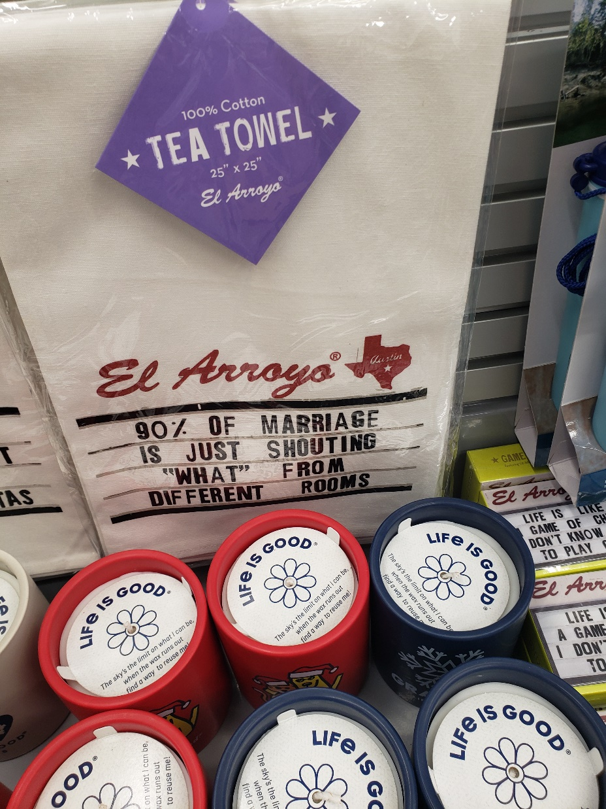

Slide 43
People with more negative thoughts on the past or negative mind wandering (rumination) tended to have more clinical depression and anxiety disorders, which is also associated with shorter telomeres.
Notes:
https://www.theepochtimes.com/nobel-prize-winner-5-things-that-speed-up-aging-and-1-anti-aging-secret_4381285.html?est=yoV2YqXdtz1wCVBIEG7BVBPSdi8X5mUmI%2BPVS9APnTVsXj%2BrgTF9PJCbs399CettgA%3D%3D

Slide 44
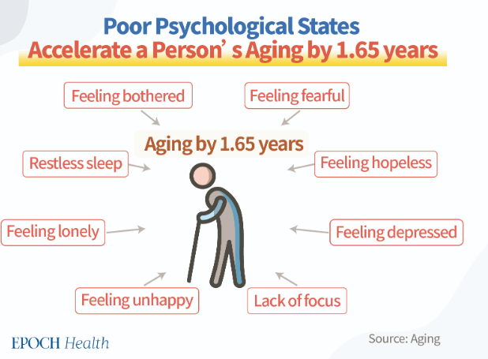
Notes:
https://www.theepochtimes.com/health/one-way-to-beat-the-culprit-behind-aging_4820739.html

Slide 45
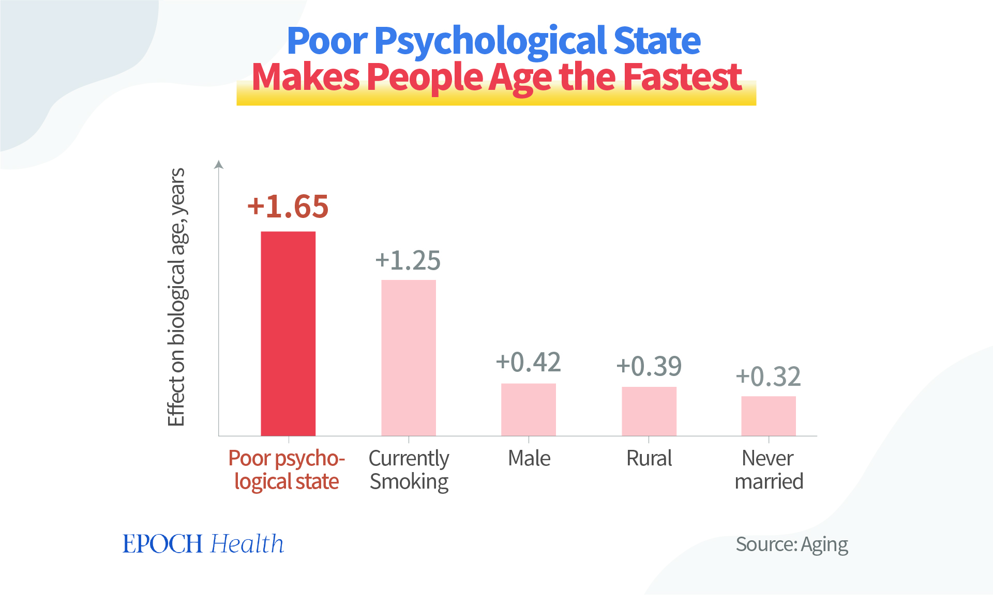
Notes:
https://img.theepochtimes.com/assets/uploads/2022/10/26/1-2.jpg

Slide 46
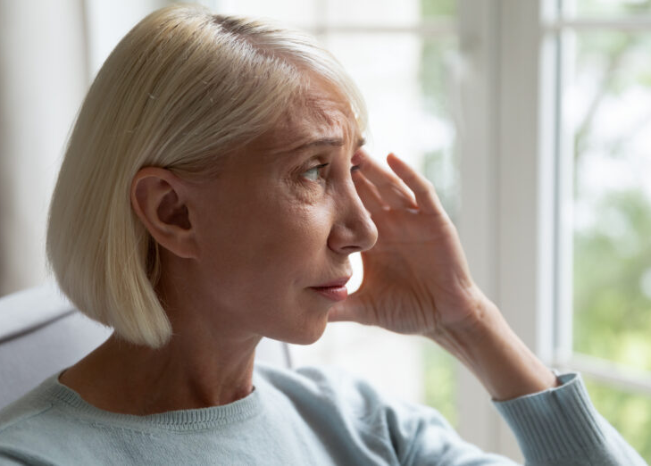
Stress and depression
can contribute to
accelerated aging
while also increasing
the risk for chronic
disease. fizkes/Shutterstock
Notes:
I’m NOT saying that depression is a sin, but not fighting it, just wallowing in it and the stressors without praise and joy, is hurtful.
https://www.theepochtimes.com/health/one-way-to-beat-the-culprit-behind-aging_4820739.html

Slide 47
When people are unable to concentrate and focus on the present, it also affects the length of telomeres.
Notes:
So, when you come to worship, focus. Put away your phone. Offer your worship to Messiah.
When you talk to someone, focus on them. Eye contact. Repeat, rephrase what they said, charitably.
https://www.theepochtimes.com/nobel-prize-winner-5-things-that-speed-up-aging-and-1-anti-aging-secret_4381285.html?est=yoV2YqXdtz1wCVBIEG7BVBPSdi8X5mUmI%2BPVS9APnTVsXj%2BrgTF9PJCbs399CettgA%3D%3D

Slide 48
We don’t need to believe everything our thoughts tell us. Being aware of our own thoughts, and where we are negatively biased, can help let go and stop the negative spiral.
Notes:
https://www.theepochtimes.com/nobel-prize-winner-5-things-that-speed-up-aging-and-1-anti-aging-secret_4381285.html?est=yoV2YqXdtz1wCVBIEG7BVBPSdi8X5mUmI%2BPVS9APnTVsXj%2BrgTF9PJCbs399CettgA%3D%3D

Slide 49
The authors recommended activities like meditation and other similar mind-body exercises like long distance running, which has a meditative effect, because these exercises promote better thought awareness. With practice, we can cease thinking ourselves towards unhappiness
Notes:
Meditation, or praise, meditation on G-d and His love and goodness.
https://www.theepochtimes.com/nobel-prize-winner-5-things-that-speed-up-aging-and-1-anti-aging-secret_4381285.html?est=yoV2YqXdtz1wCVBIEG7BVBPSdi8X5mUmI%2BPVS9APnTVsXj%2BrgTF9PJCbs399CettgA%3D%3D

Slide 50
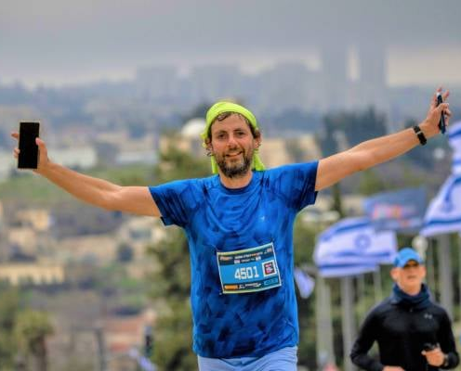
Intense aerobic exercise can reduce the risk of metastatic [spreading] cancer by 72 percent, according to study leaders Prof. Carmit Levy (TAU department of human genetics and biochemistry) and Yftach Gepner (TAU School of Public Health and Sylvan Adams Sports Institute).
Notes:
https://unitedwithisrael.org/israeli-discovery-doing-this-slashes-risk-of-cancer-metastasis-by-72/

Slide 51
They discovered it’s because an intense aerobic workout increases the glucose (sugar) consumption of internal organs, thereby starving the tumor of energy to spread.
Sweat is the elixir of youth.
Notes:
https://unitedwithisrael.org/israeli-discovery-doing-this-slashes-risk-of-cancer-metastasis-by-72/

Slide 52
Dr. Henry Cloud: Isolation is one of the worst things that can happen to a person. This isn't just simple aloneness, or a preference for solitude. This is exile from the love and care of others.
People with unresolved issues related to bonding, connection, and attachment may often find that as adults, they struggle to find their people.
Notes:
Sent by Dr. Henry Cloud's Boundaries.MePO Box 6031 • Irvine, California • 92616

Slide 53
Dr. Henry Cloud: They may wind up feeling empty, fearful, anxious, or live with perpetual seeming sadness.
Love is food. When you are not fed, you feel empty.
Notes:
Sent by Dr. Henry Cloud's Boundaries.MePO Box 6031 • Irvine, California • 92616

Slide 54
Dr. Henry Cloud: This situation can result from unresolved traumas that get triggered. The fear that you will get left or let down again. It can also arise due to distortions in our thinking.
This can lead to thoughts like:
People don't care about me.
Notes:
Sent by Dr. Henry Cloud's Boundaries.MePO Box 6031 • Irvine, California • 92616

Slide 55
^{T’hillim /Ps 136.1-3} Give thanks to Adoni, for he is good, to him who alone has done great wonders, for his lovingkindness continues forever.
Ki l’olam khasdo. כִּי לְעוֹלָם חַסְדּוֹ.

Slide 56
^{T’hillim /Ps 136.1-3} Give thanks to Adoni, for he is good, to him who made the great lights, for his lovingkindness continues forever.
Ki l’olam khasdo. כִּי לְעוֹלָם חַסְדּוֹ.

Slide 57
^{T’hillim /Ps 136.} the sun to rule the day, the moon and stars to rule the night
for his lovingkindness continues forever.
Ki l’olam khasdo. כִּי לְעוֹלָם חַסְדּוֹ.

Slide 58
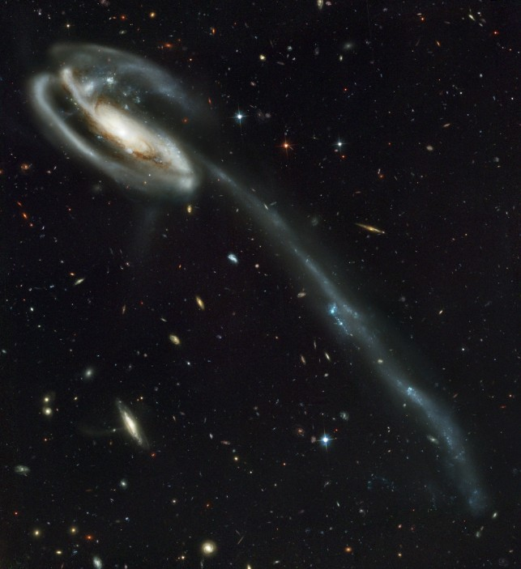
Tadpole galaxy
Notes:
Credit: NASA/ESA/Hubble SM4 ERO Team https://www.nature.com/articles/nature.2015.17345

Slide 59
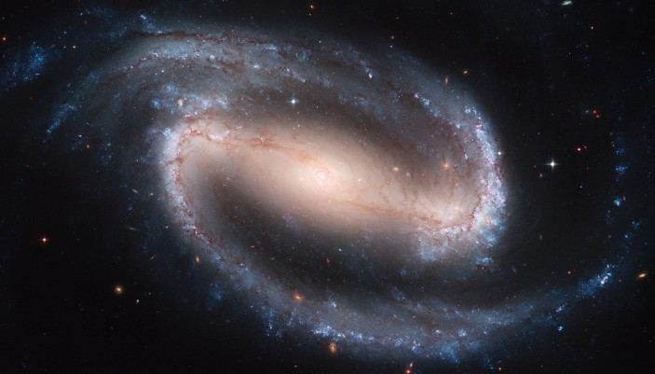
GALAXY NGC1300
Notes:
Credit: NASA/ESA/Hubble SM4 ERO Team https://www.nature.com/articles/nature.2015.17345

Slide 60
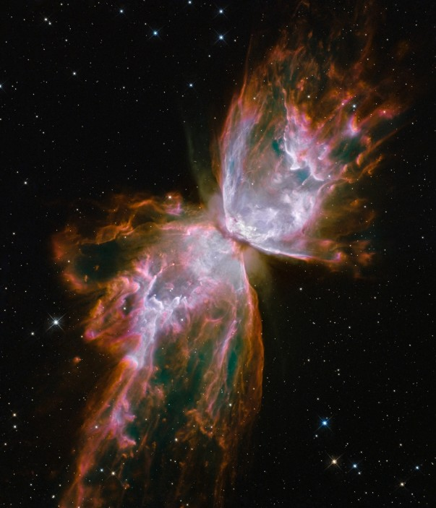
The Butterfly Nebula shows what happens to a star at the end of its life, when it loses all of its gas and dust to its surroundings.
Notes:
Credit: NASA/ESA/Hubble SM4 ERO Team https://www.nature.com/articles/nature.2015.17345

Slide 61
^{T’hillim /Ps 136} to him who struck down Egypt’s firstborn, and brought Isra’el out from among them,
for his lovingkindness continues forever.
Ki l’olam khasdo. כִּי לְעוֹלָם חַסְדּוֹ.

Slide 62
^{T’hillim /Ps 136} to him who led his people through the desert,
to him who struck down great kings,
for his lovingkindness continues forever.
Ki l’olam khasdo. כִּי לְעוֹלָם חַסְדּוֹ.

Slide 63
^{T’hillim /Ps 136} who remembers us whenever we are brought low, and rescues us from our enemies,
for his lovingkindness continues forever.
Ki l’olam khasdo. כִּי לְעוֹלָם חַסְדּוֹ.

Slide 64
^{T’hillim /Ps 136} who provides food for every living creature,
for his lovingkindness continues forever.
Ki l’olam khasdo. כִּי לְעוֹלָם חַסְדּוֹ.

Slide 65
Notes:
https://ci5.googleusercontent.com/proxy/I_M3_ZzGm41Ux8InhhEUR0jXqVgq9hDfGX_SbfnXJWk883POeJgHJKCf_q7akynNvRhleLNILM6YIjITyXR5Og6JEgaMSwXoLUQuqGiKNfI0D6eX0zZ-2kOKLJoICUDRAr8gtXQ7FIOg26P5eb-hthiW=s0-d-e1-ft#https://files.constantcontact.com/7aacec83201/9041b872-bcdf-4f9c-83c6-d417a68f4a07.png?rdr=true

Slide 66
Gratitude is associated with some pretty powerful effects, such as lower stress, higher resilience, and greater happiness overall. Research has found that these benefits extend to marriage as well, fostering positive feelings and stronger connection between spouses. Who wouldn’t want that?
Notes:
https://www.prepare-enrich.com/blog/cultivating-a-mindset-of-gratitude/

Slide 67
Start noticing the little things. A beautiful sunset. The kids laughing in the next room. Practice being fully present in these moments. When you’re more mindful of the things that you tend to take for granted,
Notes:
https://www.prepare-enrich.com/blog/cultivating-a-mindset-of-gratitude/

Slide 68
whether in your marriage or other areas of your life, you begin to develop a sense of muscle memory in appreciating them.
Notes:
https://www.prepare-enrich.com/blog/cultivating-a-mindset-of-gratitude/

Slide 69
Lean into gratitude during difficult times. When you’re going through a rough time, it’s easy to get wrapped up in the negative. You start focusing on what’s gone wrong, losing sight of the bigger picture. Learning to look through the lens of gratitude helps you gain a fuller perspective.
Notes:
https://www.prepare-enrich.com/blog/cultivating-a-mindset-of-gratitude/

Slide 70
This doesn’t mean you have to ignore or minimize negative emotions. You can experience and acknowledge those feelings and feel grateful. You have a choice in where you invest your emotional energy. Be intentional about investing in the things that inspire gratitude.
Notes:
https://www.prepare-enrich.com/blog/cultivating-a-mindset-of-gratitude/

Slide 72
Give Thanks!
Exhortation to give thanks!
Benefits of Giving Thanks.
Practicing giving thanks.

Slide 73
Notes:
https://ci3.googleusercontent.com/proxy/IM0YjyxWDfS3zu0Bu2hfitKJxkyHiwv2BLVO3k_5w2LAi0TyWqDY0YA3UzFgm34QvR8fcYTKDj2zMpyA3VTBq0x077z8WzpJX3JVnjgzlQc6FrQMmR2jOfQIdE4HJSe4wDYg3gGi6N8_UCaM9KD9mO8lGy1VBZIqTWj7bA=s0-d-e1-ft#https://mcusercontent.com/03685a5d5189468afea969fde/_compresseds/5ca2e2a7-36d8-8835-01a2-ba5ff089f294.jpg

Slide 74
Clinically and Biblically proven to relieve dryness of spirit from day 1!
Notes:
From Rukhel

Slide 75
From Sheila Schwartz Phillips: As you know, I have been very sick the past few weeks & have missed the last two Shabbats with all of you. Nevertheless I want you to know how grateful to Adonai I am for having Him bring me to Or Ha Olam. So grateful to have recovered my Covenantal Identity & made so many new friends in a town where I knew no one but my son & his family.

Slide 76
If I am able to be there this Shabbat, I would love to tell everyone how grateful I am to Yeshua, my family & all of you for having loved me & cared for me & taught me so much. I have a ticket to fly to Malibu, CA. for Thanksgiving, to be with my other son & his family.

Slide 77
If I can’t be at Shul this Shabbat, I will have to cancel my trip. I am still so grateful for all the L-ord has done for me these past 4 years. It will be 4 years Dec.3 when my husband went to be with the Lord & 3 months later I discovered all of you. This is my Year of Jubilee, 50 years with Yeshua & I would love to testify as to His faithfulness & goodness to me.

Slide 78
Even if I don’t get to do it, this needs to be said. Thank you for allowing me to “say so”. Respectfully, Sheila (Shana)

Slide 79
Louise
Amy: ​I would like to give a statement of thanks for my mishpokha at the shul and for renewed relationships with our family. Thankful for the worship team members who make music every week that I get to work with and grow in faith with.

Slide 80
Notes:
https://www.youtube.com/watch?v=YC4bzxN0n-0

Slide 81
Miranda and Rachel would like to do this. We would like to give thanks to Jimmy as a husband and father who braves being out in the elements and physical work so we can be able to be at home to do school. I would also like to give thanks to our community there at OrHaolam especially since coming back after being gone for awhile for the love and support you, Dawn and many others gave us when we walked through a season of unknown. And of course our beloved father for guiding us here to kc and transforming our lives to walk with him closer in our messianic faith
I can’t promise I won’t cry during this

Slide 82
Roxie Lyle:
Includes thankful for people & privileges in my life…while knowing not everyone can enjoy that. But some blessings are universal in the lives of believers, including Adonai’s illogical logic….

Slide 83
I’m thankful for something on our upcoming tour…

Slide 84
from Aaron Lipkin, our
Wed., Aug. 30, special tour guide.
Notes:
https://www.lipkintours.com/files/catalog/item/thumb/Aaron_Lipkin___Bio.jpg
https://www.lipkintours.com/index.php?dir=site&page=content&cs=3370&langpage=eng

Slide 85
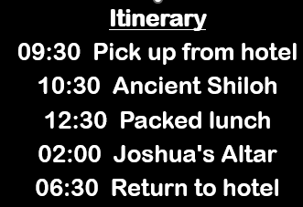
Wed., Aug. 30:

Slide 86
Notes:
https://external-content.duckduckgo.com/iu/?u=https%3A%2F%2Fwww.lipkintours.com%2Ffiles%2Fcatalog%2Fitem%2FEBAL_LECTURES_800.jpg&f=1&nofb=1&ipt=b7346db4d1a8728b0a0297940378d1533d33a2afee31768d82195ea868a88879&ipo=images

Slide 87
I always asked myself, why are the Cohanim - Priests standing like that? Where in the Bible do we have such a commandment to stand with two hands in the air? I always answered myself that this is an ancient tradition from Sinai that we will never understand....
Notes:
https://www.lipkintours.com/index.php?dir=site&page=content&cs=3370&langpage=eng

Slide 88
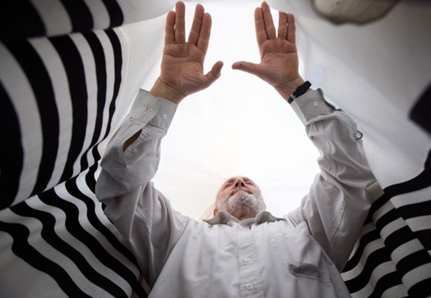
Notes:
https://www.lipkintours.com/index.php?dir=site&page=content&cs=3370&langpage=eng

Slide 89
^{Bamidbar/Nu 6.23-27} Again Adoni spoke to Moses saying, “Speak to Aaron and to his sons saying: Thus you are to bless the people of Israel, by saying to them: ‘Adoni bless you and keep you! Adoni make His face to shine on you

Slide 90
^{Bamidbar/Nu 6.23-27} and be gracious to you! Adoni turn His face toward you and grant you shalom!’ In this way they are to place My Name over the people of Israel, and so I will bless them.”

Slide 91
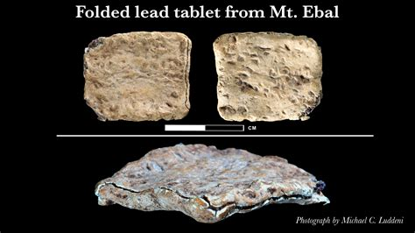
Notes:
https://external-content.duckduckgo.com/iu/?u=https%3A%2F%2Ftse2.mm.bing.net%2Fth%3Fid%3DOIP.3ghy8pe51kWtSPKN1yT6EwHaEK%26pid%3DApi&f=1&ipt=59adc09e9b790c992922ef15c277c59892161dba033a1209a6ce546bf6ab8e69&ipo=images

Slide 92
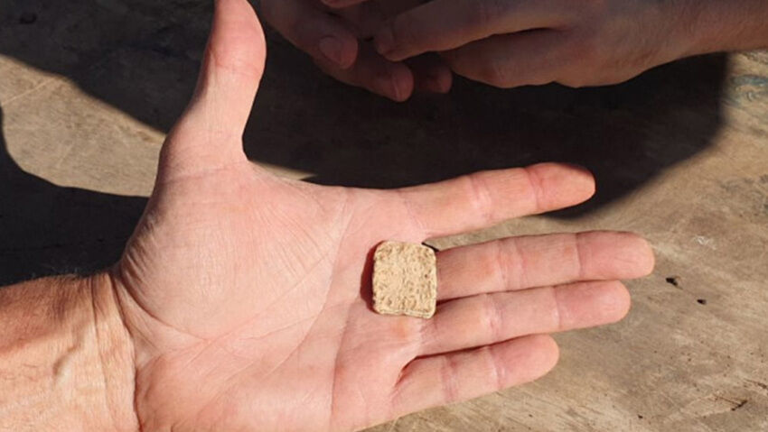
Notes:
https://external-content.duckduckgo.com/iu/?u=https%3A%2F%2Ftse1.mm.bing.net%2Fth%3Fid%3DOIP.Iq2cFu1pmYPi7gcBSRqXYQHaEL%26pid%3DApi&f=1&ipt=001905f46138f9d911e3bfe788d1ca19ff07a170f0104999303c9ab699c6f31c&ipo=images

Slide 93
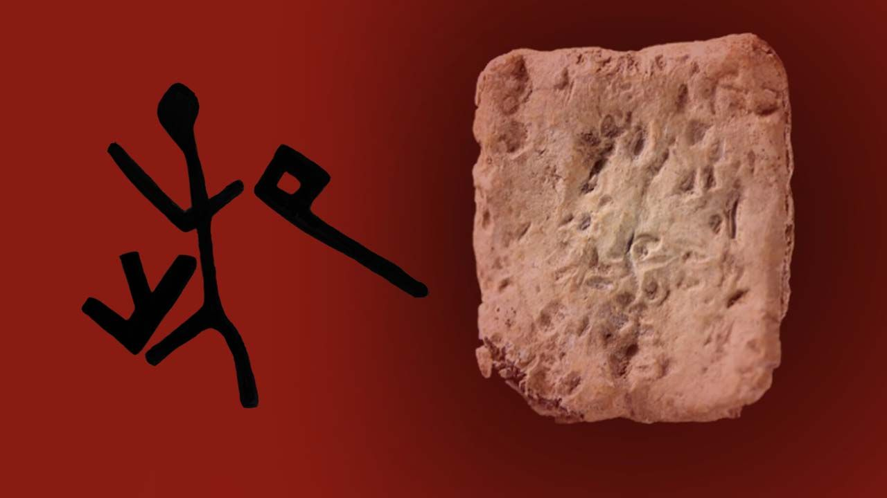
The Name in proto-Hebraic
Notes:
https://external-content.duckduckgo.com/iu/?u=https%3A%2F%2Fwww.pshir.com%2Fcontent%2Fimages%2F2022%2F06%2FInsc1.jpg&f=1&nofb=1&ipt=884175decffeb7f958b3e6105be58c5a5d6a35f24c425df66fed999aeb8c17a5&ipo=images

Slide 94
Notes:
https://external-content.duckduckgo.com/iu/?u=http%3A%2F%2Fviewzone.com%2Fnegev-hebrew.gif&f=1&nofb=1&ipt=51f6f623658173cd71529aa3568e224af175e45fa5dfb18a66e76dec6d4ef5af&ipo=images

Slide 95
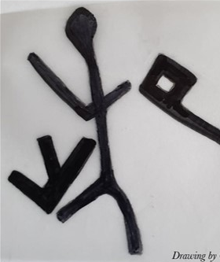
The divine name appears in its 3 letter form AND the middle letter is a person standing with
his hands high.
Notes:
https://www.lipkintours.com/index.php?dir=site&page=content&cs=3370&langpage=eng

Slide 96
Their hands in the air resemble the middle letter. A special shape in both of their hands signifying a letter from each side of the middle letter, the Y and the W.
Notes:
https://www.lipkintours.com/index.php?dir=site&page=content&cs=3370&langpage=eng

Slide 97
Is it possible that the priests are embodying Gods name and literally PUTTING it on the Israelites....?
Notes:
https://www.lipkintours.com/index.php?dir=site&page=content&cs=3370&langpage=eng

Slide 98
^{Bamidbar/Nu 6.23-27} In this way they are to place My Name over the people of Israel, and so I will bless them.”

Slide 99
Do you KNOW Yeshua and the thankfulness of being forgiven?
Are you hearing daily from His Word?
How are you applying what you heard?
Are you offering that water of life to anyone?

