Slide 1
e-handout
To have these notes
without taking notes
Go to OrHaOlam.com
Click on Messages tab,
2022 Messages

Slide 2
Cathy Adler’s bio: Kind, loving and hilarious Stephanie. Wise and patient. Incredibly creative. She was a woman who impacted her family and friends in immeasurable ways. Her heart was big, adventurous and golden, her faith contagious and her smile and laugh joyfully infectious.

Slide 3
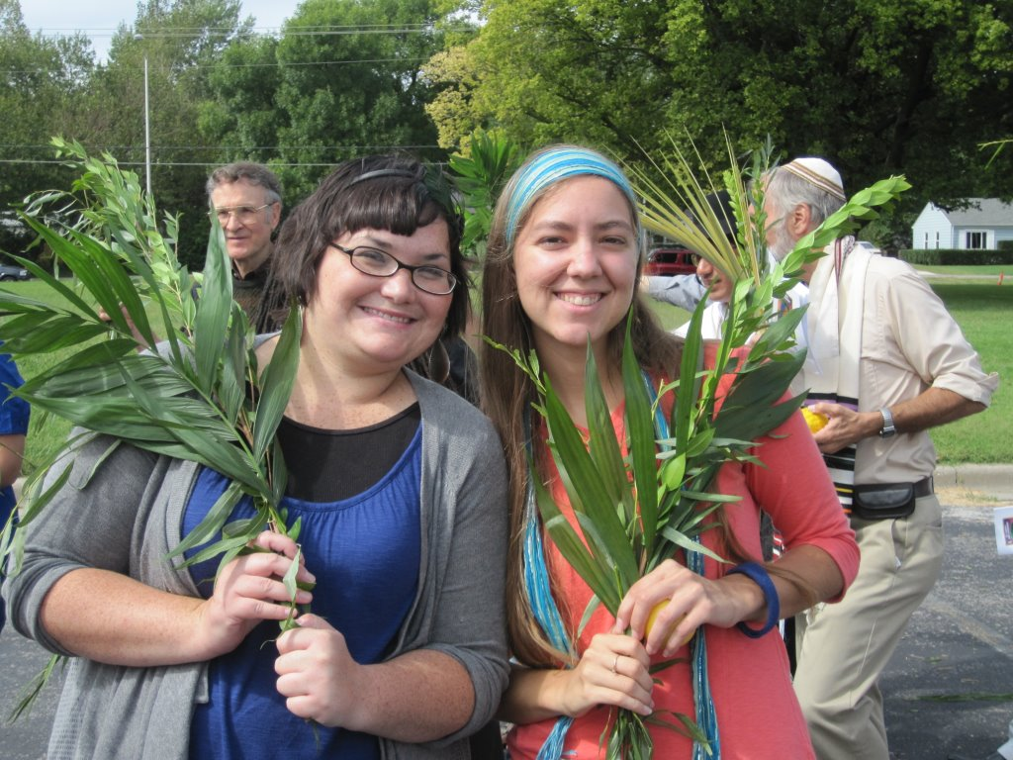

Slide 4
October 13, 2010
To whom it may concern,
I have known Stephanie Miller for at least 5 years. She served as Assistant Youth Leader in our congregation, and also a children’s teacher. She is of exemplary character and spirit, and we are very delighted to count her as an
an Or HaOlamnik. אור העולמ-ניק

Slide 5
She has a wonderful spirit of service, loyalty, diligence, faithfulness to the task and the group. She is warm, friendly, supportive, and sociable. The young adults, and the children that she ministered to, loved her greatly. She roomed in our home with my wife and me, and she was easy to get along with and pleasant. We considered her a daughter, and still do!

Slide 6
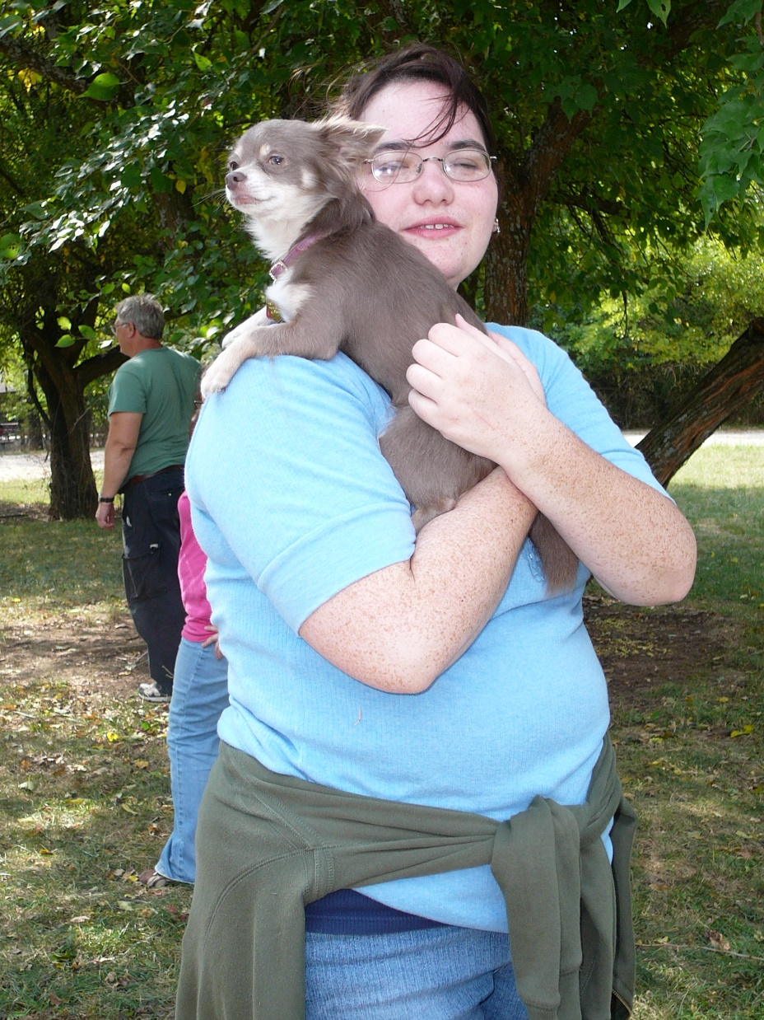
Stephanie with our chihuahua Kaspeet at a Sukkot campout

Slide 7
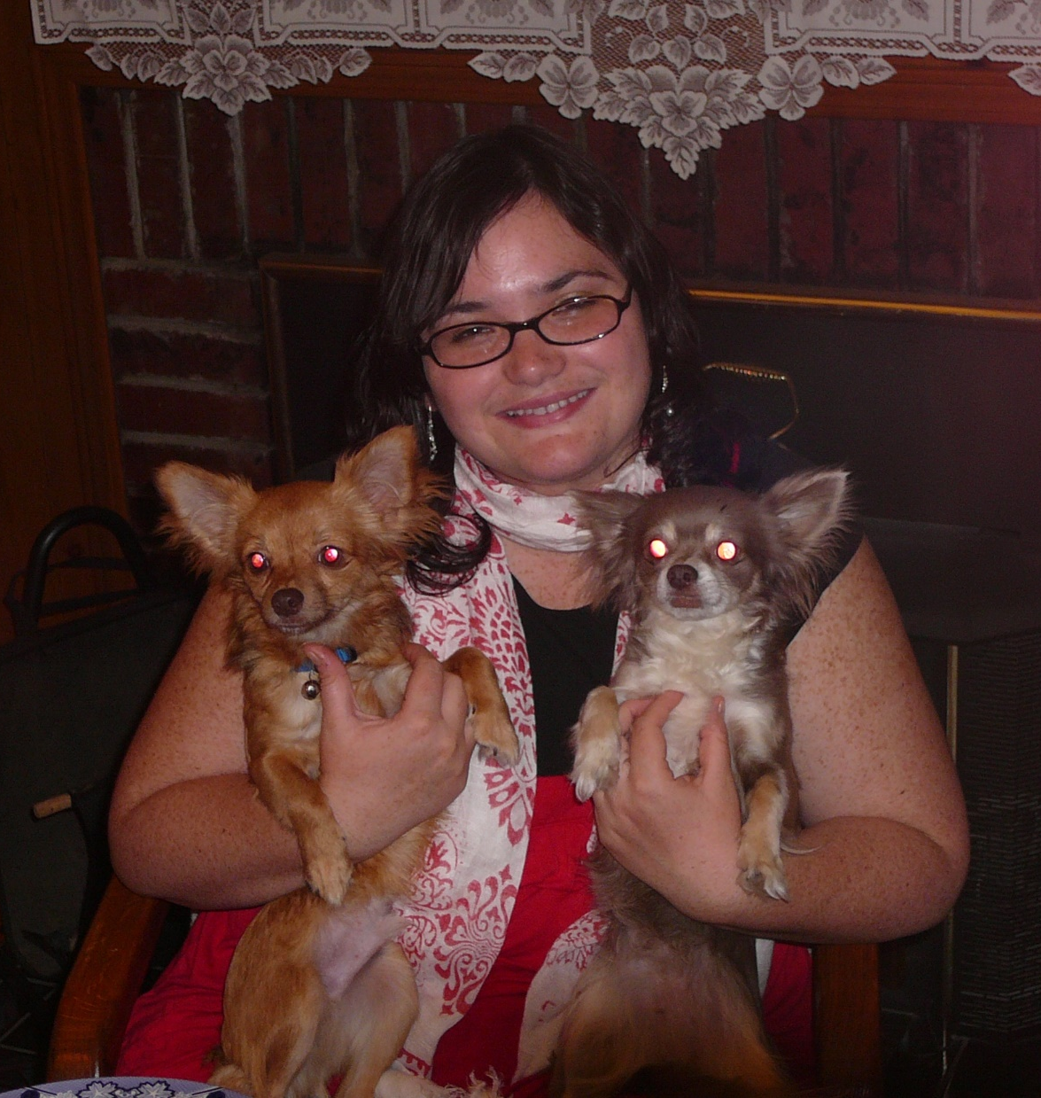
Stephanie with Kaspeet and
Perpie

Slide 8
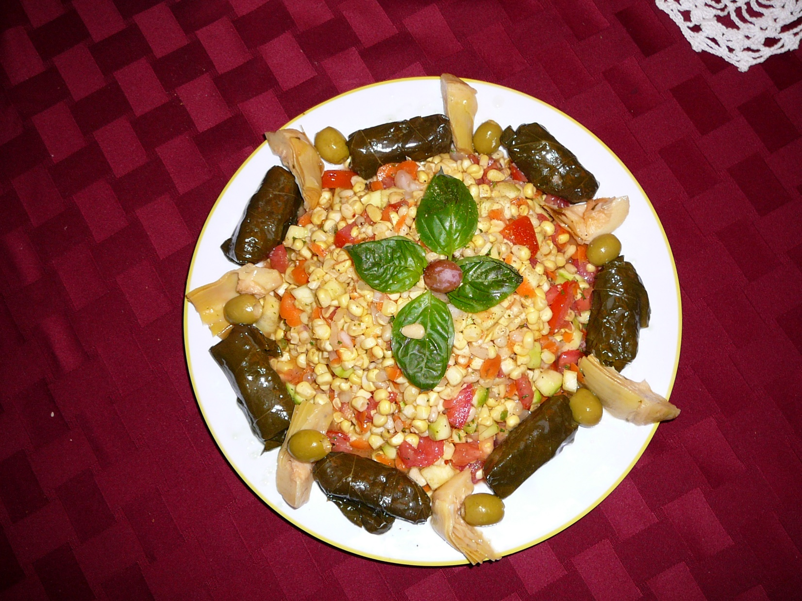
Raw food Shabbat dinner

Slide 9
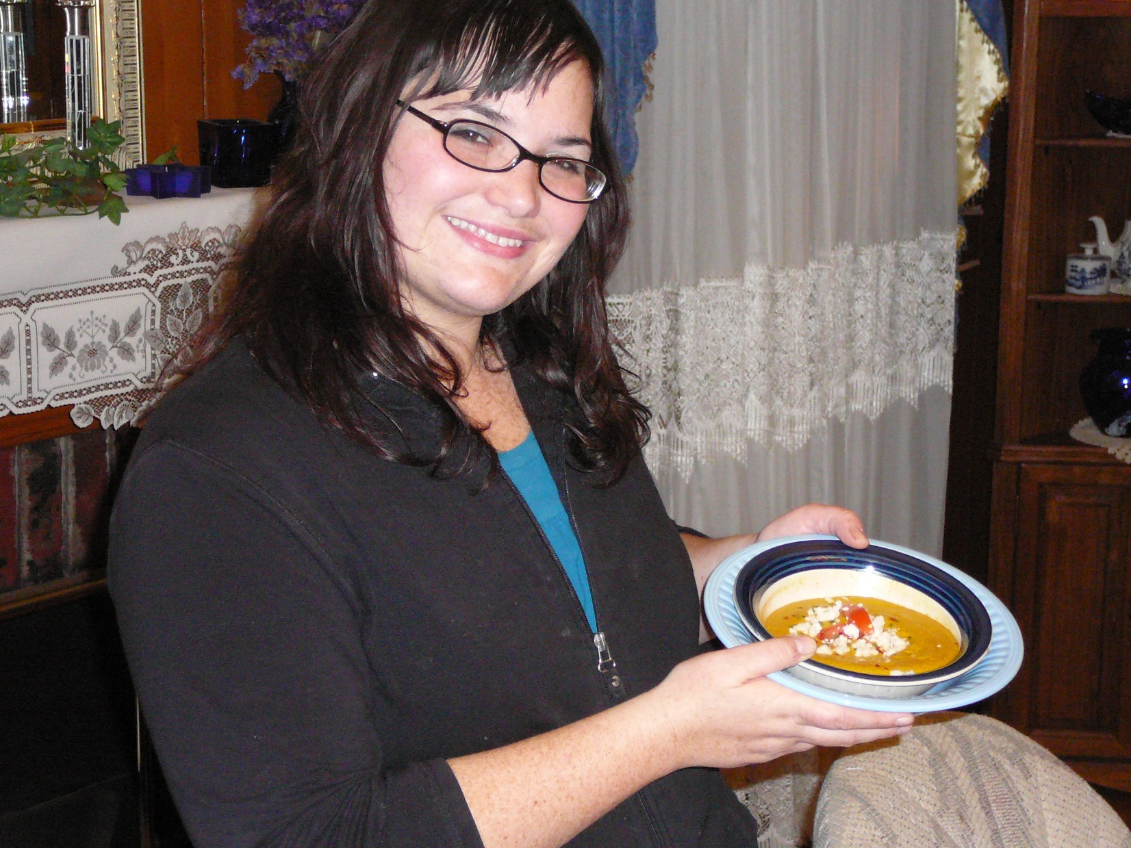

Slide 10
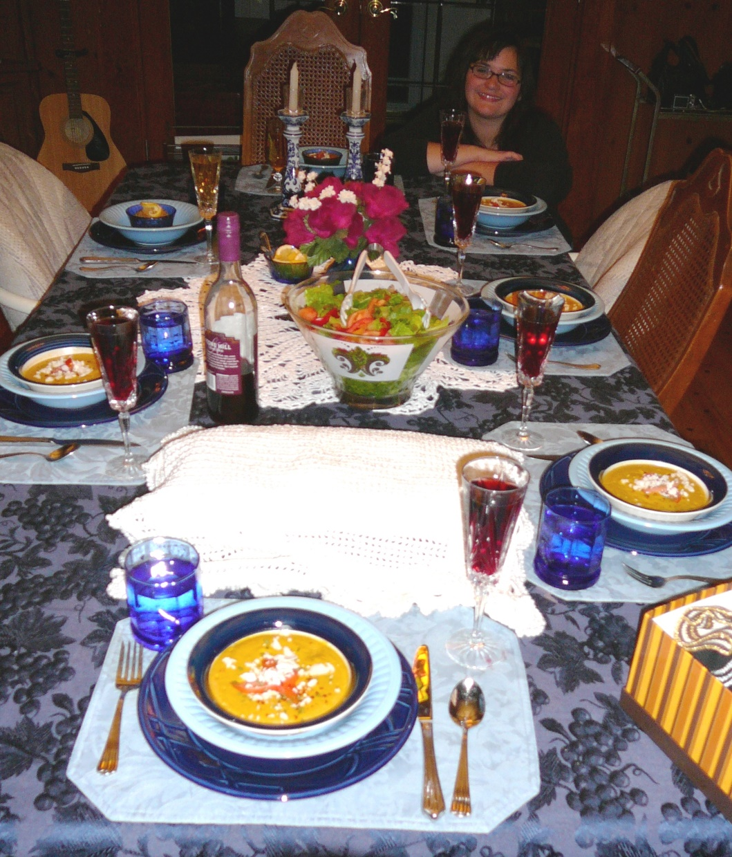
Notes:
It was wonderful in its way, but Saturday night after Shabbat I had some errand to run back to the old location of the synagogue on 74th St., and I stopped at Fuddruckers and got a beef hot dog.

Slide 11
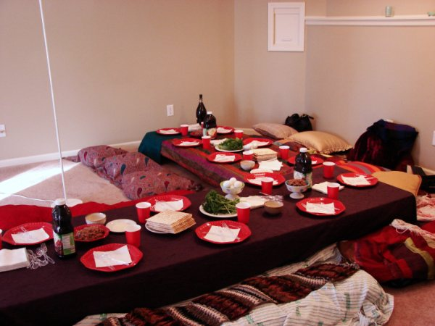

Slide 12
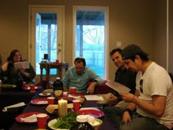

Slide 13
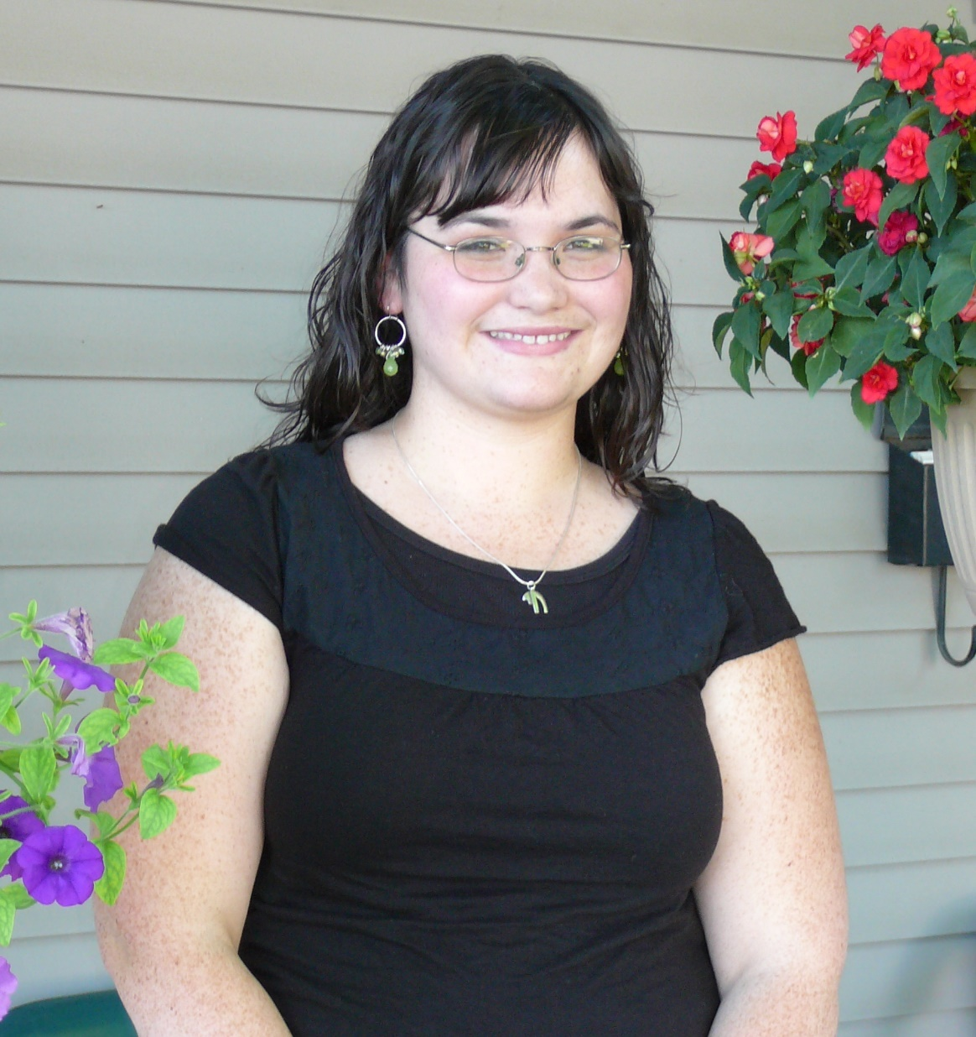
Stephanie at her Bat Mitzvah June 9, 2007
Aviel bat Sarah
אביאל בת שרה
Nu.15.37-41
Joshua 2.16-24
Notes:
Re-did parasha June 20, 2009 and June 5, 2010
Asst Youth Leader and lived in our basement then and had the whole youth group in a basement meeting while Dawn and I had an Elders / Zakenim meeting in my study. It was a happening time on Hadley St that night.

Slide 14
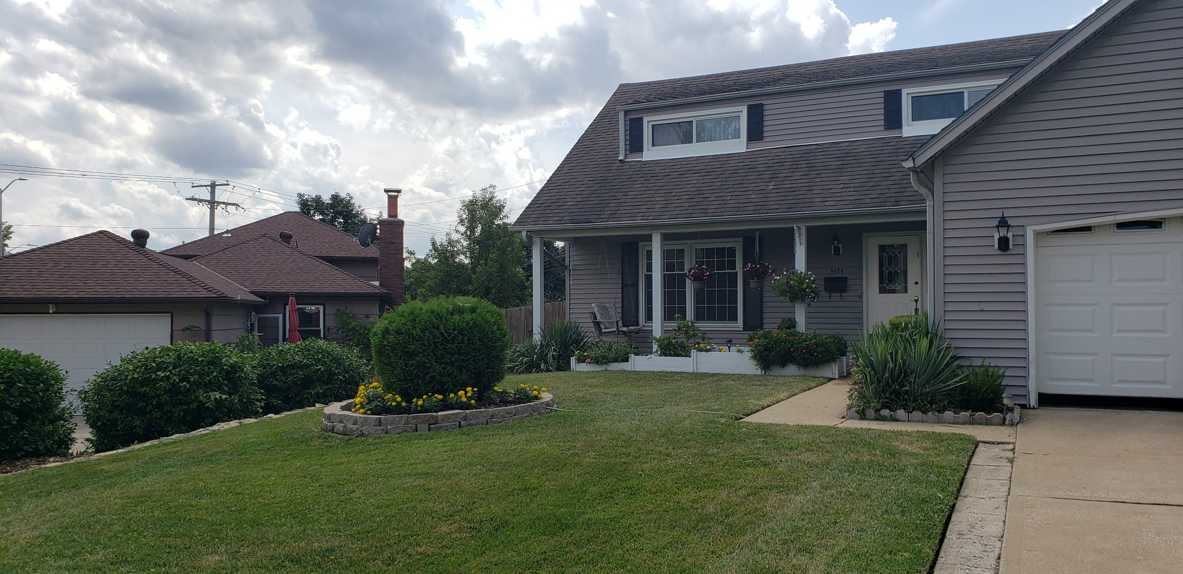

Slide 15
Notes:
We installed this porch swing for Stephanie because she wanted a place she could visit with her intended, with complete accountability, but complete privacy. So the plan was that I could see out my study window, but not hear!
One night knocking on our bedroom door at about 3 a.m. saying that rain was coming in her window. I checked the roof, and our west half of the house had flat pitch with roll roofing that had blown back in the windstorm. I kicked it down amidst the lightning, and then the rain started to deluge. If Stephanie hadn’t awoken me to kick down the roll roof, and the rain deluge had hit the plywood directly, we might have lost house.

Slide 16
Stephanie, Vernon, and Oliver
Notes:
She found Vernon without the help of my swing, but I think they sat on it once or twice.

Slide 17
T’hillim/ Psalm 13 For the music director, a psalm of David.
How long, Adoni? Will You forget me forever? How long will You hide Your face from me? How long must I have cares in my soul and daily sorrow in my heart? How long will my enemy triumph over me?

Slide 18
Look at me and answer, Adoni my God. Light up my eyes, or I will sleep in death. Or else my enemy will say: “I have overcome him!” and my foes will rejoice because I am shaken.

Slide 19
But I trust in Your lovingkindness, my heart rejoices in Your salvation. I will sing to Adoni, because He has been good to me.
Notes:
Faith or trust doesn’t seem like much of an answer, but it’s all we have. In sorrow, Yeshua is still with us.

Slide 20
^{Havakkuk 3.17-18} Though the fig tree does not blossom, and there is no yield on the vines, Though the olive crop fail, and the fields produce no food, the flock is cut off from the fold, and there is no cattle in the stalls. Yet will I triumph in Adoni, I will rejoice in the God of my salvation!

Slide 21
^{Habakkuk 2.4} The righteous will live by his trust.

