Slide 1
e-handout
To have these notes
without taking notes
Go to OrHaOlam.com
Click on Messages tab,
2022 Messages

Slide 2
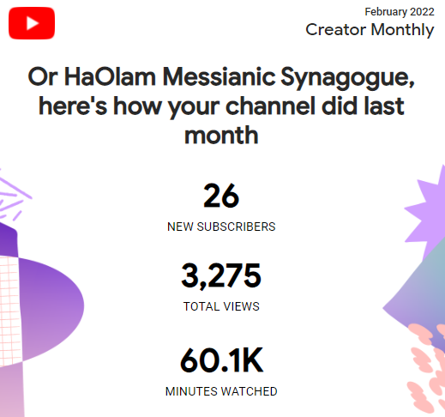
Or HaOlam YouTube results for February, 2022
Notes:
~800/week

Slide 3
Finding a Jewish Zebra

Slide 5
I was hunting big game deep in Kruger National Park in the wilds of South Africa. This was a one-in-a-million photo op.

Slide 6
I was hunting big game deep in Kruger National Park in the wilds of South Africa. This was a one-in-a-million photo op.
Ooops. I meant photo shop.

Slide 7
A new Israeli invention

Slide 8
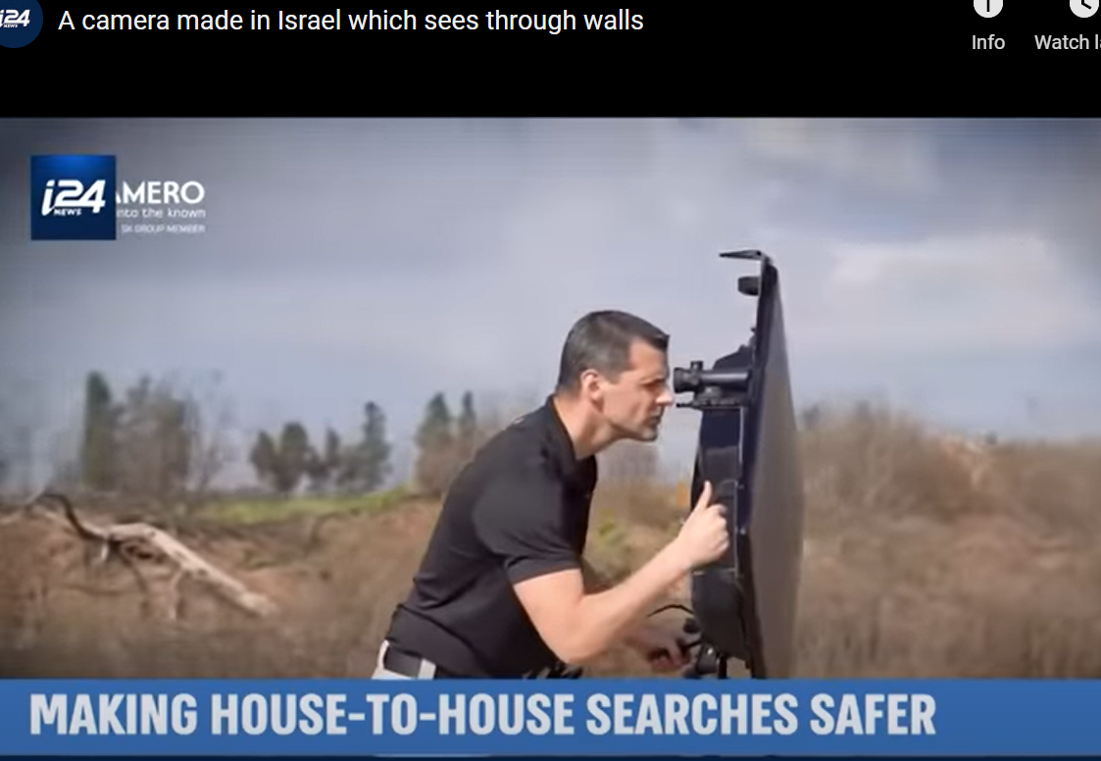

Slide 9
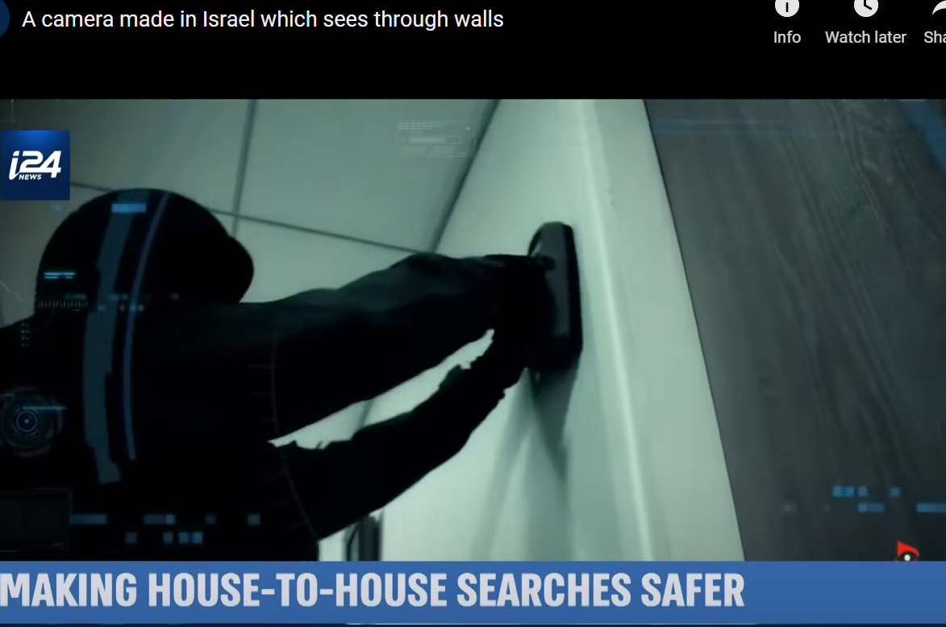
Notes:
https://youtu.be/8wDVwwuBAss

Slide 10
The future is like that.
We don’t know what’s coming, what’s on the other side of the wall of time.
Notes:
Danger, doom, prosperity, health, love…

Slide 11
The present is like that.
We don’t know WHY things are happening, what purpose.
We don’t know what is in people’s minds; why people do what they do, or how to love them in a way that will be received.
Notes:
Their minds and hearts are walled off to us.
Life’s purposes are veiled to us.

Slide 12
MJ 10 closes with the exhortation:
So don’t throw away that courage of yours, which carries with it such a great reward. For you need to hold out; so that, by having done what God wills, you may receive what he has promised… The person who is righteous will live his life by trusting.

Slide 13
Hebrew/Tanakhic source:
^{Hab 2.2.4} “the righteous shall live by Emunah אמונה Faith.”
צַדִּיק בֶּאֱמוּנָתוֹ יִחְיֶה.
Tsadeek beh-emunato yikhyeh
Faith is G-d’s mode for us to see into life: past, present, future.
Notes:
Originally written by when questioning the horrific Babylonian conquest and destruction and exile.

Slide 14
^{Ro.1.16-17} For in it [the message of Yeshua] is revealed how God makes people righteous in his sight; and from beginning to end it is through trust — as the Tanakh puts it, “But the person who is righteous will live his life by trust.”
Notes:
Shaul quotes this as the foundational concept of faith in presenting salvation to Israel and the Nations.

Slide 15
^{Gal 3.10-11} For all who rely on the deeds of Torah are under a curse—for the Scriptures say, “Cursed is everyone who does not keep doing everything written in the scroll of the Torah.” It is clear that no one is set right before God by Torah, for “the righteous shall live by Emunah אמונה Faith.”
Notes:
Here it is the decisive concept to keep us from legalism.

Slide 16
,

Slide 17
^{Mes Jews/Hebrews 11.01-03} Now faith is the substance of things hoped for, the evidence of realities not seen. For by it the elders received commendation. By faith we understand that the universe was created by the word of God, so that what is seen did not come from anything visible.
Notes:
Amy Jill Levine: Faith carries overtones of endurance, trust, and insight into spiritual reality. Insight into invisible things, beyond the walls.

Slide 18
“The righteous shall live by Emunah אמונה Faith.”
צַדִּיק בֶּאֱמוּנָתוֹ יִחְיֶה.
Tsadeek beh-emunato yikhyeh
Notes:
Faith is the means by which we see through the walls of time and circumstances.
Righteous: saved eternally, righteous in community
By his faith: not by himself, his strength, by his social and family support, but by faith in the atoning death and resurrection of the Messiah Yeshua
Live: strength, joy, dependence GIVE not from spouse, from kids, from community,
Consider the Greek…

Slide 19
Faith/pistis is always a gift from God, and never something that can be produced by people…It is "God's divine persuasion" –
and therefore
distinct from human
belief (confidence),
yet involving it.
Notes:
https://biblehub.com/greek/5287.htm That is, we exercise it, but G-d by the Ruakh responds and empowers it. So, penetrates time and circumstances.

Slide 20
hupostasis: a support, substance, steadiness, hence assurance (lit: an underlying), (a) confidence, assurance, (b) a giving substance (or reality) to, or a guaranteeing, “title of possession” evidence
Notes:
https://biblehub.com/greek/5287.htm

Slide 21
to see, observe suggests “to see something physical, with spiritual results (perception).” It carries what is seen into the non-physical (immaterial) realm so a person can take the needed action (respond, beware, be alert).
Notes:
We don’t see the purpose in this difficulty!!!
Involves surrender. We’d like to understand, to control. By faith.

Slide 22
^{Mes Jews/Hebrews 11.01-02} Now faith is the substance of things hoped for, the evidence of realities not seen. For by it the elders received commendation.

Slide 23
“The righteous shall live by Emunah אמונה Faith.”
צַדִּיק בֶּאֱמוּנָתוֹ יִחְיֶה.
Tsadeek beh-emunato yikhyeh
Notes:
Stop here with application.
If you have uncertainty, fear about eternal life, you receive it by repentance and faith in the resurrected Messiah.
If you have fears about finances, government, sickness, people, family [say each time.]

Slide 24
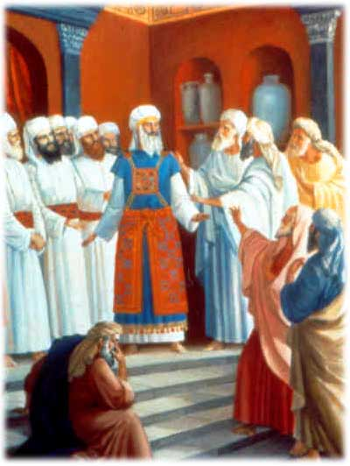
Notes:
In the Temple and Mishkan/Tabernacle, ornate robes except all cohnanim/priests barefoot.

Slide 26
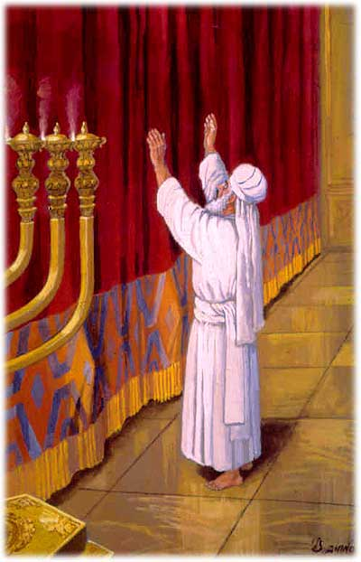
Why barefoot?
Perhaps ~Moshe before the bush. Surrender our control, our power.
Notes:
Comfort and protection of footwear.
Yom Kippur Day of Atonement whites
Human interest rabbi trail…

Slide 27
Pulse ups
Notes:
I had cold feet, literally, and couldn’t ever wear sandals, until I started doing an exercise. This is the exercise. No guarantees that it will help your cold feet, but it should help your abs.

Slide 28
tricepts
Notes:
Also difficult on, therefore good for, your triceps also.

Slide 29
Ultimately, faith is NOT about us and our needs. It’s about the mystery of the Holy One, and our barefoot (self abandoning) surrender to HIM.
Messiah say about such absolute surrender?
Notes:
To see beyond the wall of life’s mystery

Slide 30
^{Mtt 10.29-32} Aren't sparrows sold for next to nothing, two for an assarion? Yet not one of them will fall to the ground without your Father's consent. As for you, every hair on your head has been counted.
Notes:
a very small coin; according to them it contained four grains of silver; was the ninety sixth part of a "sela", or shilling Maimon. in Misn. Peah, c. 8. sect. 1.
not one of them is taken in a snare, or killed with a stone, or shot flying, or sitting, but by the will of God: from whence it may be strongly concluded, that nothing comes by chance; that there is no such thing as contingency with respect to God, though there is to men, with respect to second causes; that all things are firmly ordained by the purpose of God, and are wisely ordered by his providence:
Just like we can’t grasp the HOLINESS of G, we can’t grasp his purposes in all things. But we can worship!! In ALL circumstances!!

Slide 31
^{Mtt 10.29-32} So do not be afraid, you are worth more than many sparrows. Whoever acknowledges me in the presence of others I will also acknowledge in the presence of my Father in heaven.

Slide 32
^{Ro 8.28-29} Furthermore, we know that God causes everything to work together for the good of those who love God and are called in accordance with His purpose; because those whom he knew in advance,
Notes:
The whole purpose of life is to Know G-d, revealed in Yeshua. If we ignore a message, and choose to complain, whine, get bitter, rather than praise Messiah and grow, He sends a louder one. Our task to discern Yeshua’s loving message to us, Not to sink into frustration, anger, depression!!

Slide 33
^{Ro 8.28-29} he also determined in advance would be conformed to the pattern of his Son, so that he might be the firstborn among many brothers
Notes:
Hebrew term is Tikkun, soul correction, to correct ourselves!!

Slide 34
^{Yn 16.33} "I have said these things to you so that, united with me, you may have shalom. In the world, you have tsuris. But be brave! I have conquered the world!"
Notes:
Tsuris: Trouble; aggravation. A Yiddish phrase for worries, stress, or hassle.
Does it look like it’s conquered?
Everyone has troubles.
Robin Hood is based on lack of understanding the ways of G-d. If we have faith, poor and rich are by the will of G-d. So is Marxism. Confiscatory taxes in UK.
How has He conquered? Joy IF we trust HIM!! Don’t like rejection, disputes, shortfalls, health problems.

Slide 35
^{T’hillim Ps 25.4-5} Make me know your ways, ADONI, teach me your paths. Guide me in your truth, and teach me; for you are the God who saves me, my hope is in you all day long.
Notes:
My truth is to have life easy. YOUR truth is to perfect me through all.

Slide 36
^{T’hillim Ps 73.21-25} When I had a sour attitude and felt stung by pained emotions, I was too stupid to understand; I was like a brute beast with you. Nevertheless, I am always with you; you hold my right hand.
Notes:
Moshe took off his sandals to worship the holy. We need to take off our self protection, defensiveness, justification, woundedness, revenge, accusation, anger, walls, and instead: worship. Worship Him who does all things well. Thank him for the worst. Not that the worst is not so bad, but the HE is working through it. Even when we don’t see it…No second causes.
If someone sins, it’s wrong. But the effect on US is processed by Divine providence. Wrong to them, right to us!!
If we sin, it’s wrong. But consequences of our sin are processed by Divine providence. So we can repent and still praise!! Get irritable? Provoke reaction? Repent, and praise G for the reaction!

Slide 37
^{T’hillim Ps 73.21-25} You will guide me with your advice; and afterwards, you will receive me with honor. Whom do I have in heaven but you? And with you, I lack nothing on earth.

Slide 38
Notes:
A word of disclaimer on Shalom Arush’s book. His concepts and interp of scripture is EXCELLENT. Some of his illustrations are from Kabbalah, some about reincarnation. I am NOT endorsing those illustrations. Men’s group remember we had to filter some things.
Why use? Marriage book that we did in Men’s Group called men to a deeper level of the crucified life than Dobson, Trent, Smalley, etc. Not use that terminology.
This book calls us to an amazing level of faith. Those who remember David Dreiling, highly endorsed.

Slide 39
Forms of doubt
Doubt that the minutest details of our lives are the providence of a loving G-d and for our redemption.
Doubt that we can speak effectively to G-d about every circumstance, in surrender → praise, and prayer.
Notes:
A midrash, a fanciful story to interpret scripture. Not necessarily true. Maybe, but illustrative. Moshe prayed 515 times to enter the promised land. Then G-d told him to stop. One more prayer and He’d have to reverse.
Don’t really think it happened, but it’s an illustration that shows the power of prayer.

Slide 40
Forms of doubt
Doubt that He loves us, and desires to help us, especially when we talk to Him
Doubt that G-d has power, mercy, and compassion that are limitless to work wonders.

Slide 41
^{T’hillim Ps 147.10-12} He takes no delight in the strength of a horse, no pleasure in a runner's speed. ADONI takes pleasure in those who fear him, in those who wait for his grace. Glorify ADONI, Yerushalayim! Praise your God, Tziyon!
Notes:
It’s NOT our abs, or figure, or impressive skills and knowledge, or financial resources that give G-d pleasure. It’s glorifying G-d in all. This is VERY liberating.

Slide 42
Levels of living faith.
אֱמוּנָה Emunah
faith, trust, confidence
Active faith.

Slide 43
Basic level Emuna: firm belief that EVERYTHING comes from Adoni by way of perfect Divine providence. No secondary causes.
Intermediate level: belief that everything that comes from Adoni is for the very best. All troubles have their purpose. Therefore PRAISE. Without understanding the purpose.
Notes:
Like holiness. We accept G-d goodness, and praise.
We fall before His Holiness. We praise ALL His works. ALL. Gan Emuna 21, 22
We talk about Sozo ministry, which involves finding the lies about life and G-d that we’ve received, renouncing, and asking G-d for revelation of truth.
This is generalized Sozo, כי the basic lie is that life/G-d is mean, against us.
We commit to praise in everything. Even the consequences of our and others failures. Still in His hands.

Slide 44
Upper level: Belief that our joyful task is to discern the message to us in EVERY trouble.
Notes:
Message NOT = punishment. Iyov/Job was not punished, but called to go higher. Tho He slay me, yet will I trust Him.
Torah re curses:

Slide 45
^{Dvarim 28.45-46} "All these curses will come on you, pursuing you and overtaking you until you are destroyed, because you didn't pay attention to what ADONI your God said, observing his mitzvot and regulations that he gave you. These curses will be on you and your descendants as a sign and a wonder forever. WHY sooo intense??

Slide 46
^{Dvarim 28. 47-48} Because you didn’t serve Adoni your God with joy and gladness in your heart when you had such an abundance of everything; Adoni will send your enemy against you; and you will serve him when you are hungry, thirsty, poorly clothed and lacking everything; he will put a yoke of iron on your neck until he destroys you.
Notes:
Here it is: it’s not just obeying.
OK, won’t steal, fornicate, pornicate, prevaricate, pontificate (pride), rage, the forbidden ate (all the dietary laws)
It would be nice, but NOT good enough

Slide 47
^{T’hillim/Ps 32.9-11} Don't be like a horse or mule that has no understanding, that has to be curbed with bit and bridle, or else it won't come near you. Many are the torments of the wicked, but grace surrounds those who trust in ADONI. Be glad in ADONI; rejoice, you righteous! Shout for joy, all you upright in heart!
Notes:
Some of us have bit and bridle religion. Horseback riding is really fun.
What about when we fail, and don’t rejoice, and get angry and depressed, and blow it?
We can still come before Him, repent, and praise Him that He will work even our failure for good. Trust Him in all.

Slide 48
^{Phil. 3.8-10} Because of Him…I gave up everything and regard it all as garbage, in order to gain the Messiah, and be found in union with Him, not having any righteousness of my own based on legalism, but having that righteousness which comes through the Messiah's faithfulness, the righteousness from God based on trust.
Notes:
Here’s where Messianics have a different foundation from others that keep Torah. We keep Torah as an expression of our faith and joy, and the power of the Blood of Yeshua, and if we’re Jewish, of our covenant with G.
Torah earns us NOTHING.

Slide 49
^{Phil. 3.8-10} Yes, I gave it all up in order to know him, that is, to know the power of his resurrection and the fellowship of his sufferings as I am being conformed to his death,
Notes:
I can handle sufferings that I understand the purpose. I can praise in that…

Slide 50
^{1 Thes. 5. 16-22} Always be joyful. Pray regularly. In everything give thanks, for this is what God wants from you who are united with the Messiah Yeshua. Don't quench the Spirit... May the God of shalom make you completely holy - may your entire spirit, soul and body be kept blameless for the coming of our Lord Yeshua the Messiah.
Notes:
Weird idea. Always be happy. Only if have active faith, Emuna about life.
NOT talking about Alfred E Newman. What, me worry?

Slide 52
Two NotesBy Asher Intrater
Rabbi Menahem Mendel Morgenstern of Kutsk (1787 - 1859) is known to have said, "Every man should have a note in one pocket saying, 'The whole world was created for me,' and a note in the other pocket saying, 'I'm nothing but dirt and ashes.'" Let's compare verses from Genesis 1, 2, and 3.Genesis 1:26 – And God said,
Notes:
Note NAR recent vindication.
Shmuel Birnbaum’s son submitted resolution to NOT resolve.

Slide 53
"Let us make man in our image, as our likeness, he will rule over the fish of the sea... and all the earth. "In a certain way, we are "like" God. He created the earth for us and commanded us to take dominion over it.

Slide 54
All the world was indeed created for us. On the other hand we are simply created beings. He created us out of the dirt. Mankind dies and goes back to being simply dirt. ^{Genesis 3:19} until you return to the earth for from it you were taken, for you are dust and to the dust you will return.

Slide 55
This is a paradox, a double truth that seems contradictory. It takes great faith to see ourselves "like God" and sharing in His divine nature ^{(II Peter 1:4).} It takes great humility to see ourselves as mere dirt. We are a combination of the creator and the created. We are "half-God" and "half-mud."

Slide 56
^{Genesis 2:7} – YHVH God formed man, dust from the earth, and blew into his nostrils the breath of life.God blew into us of His own spirit to give us life. (Yeshua blows into us the Holy Spirit again to give us eternal life – ^{John 20:22}) By revelation, we need to be aware of our lowliness and our highness. In years of walking with the Lord, we understand more and more how lowly we are without Him,

Slide 57
and how high He wants to bring us. ^{2 Cor. 4:7} – This treasure is given to us in vessels of clay in order that the excellency of the power may be of God and not of us. Discipleship is a process of being both humbled down low and lifted up high.

Slide 58
Why cover one’s eyes with the right hand when saying the Shma?
The simple answer is that doing so allows one to concentrate properly without visual distractions.
It is crucial to have the proper intention when reciting the first verse of Shema, even more so than during other parts of prayer. As we say the words, we focus not just on the meaning of the words, but also hearing from Messiah, and on accepting the yoke of heaven.
Notes:
https://www.chabad.org/library/article_cdo/aid/705353/jewish/The-Shema.htm Modified

Slide 59
,

Slide 60
So, we can win in history. Derek Prince's Changing History Through Prayer and Fasting

Slide 61
15 Fasting Benefits for Miraculous Breakthrough
- Renews spiritual vision
- Brings a holy brokenness
- Purifies our hearts
- Humbles our souls
Notes:
https://www.charismanews.com/opinion/heres-the-deal/88404-larry-tomczak-discover-these-15-fasting-benefits-for-miraculous-breakthrough?utm_source=Charisma%20News%20Daily&utm_medium=email&utm_content=subscriber_id:5160390&utm_campaign=CNO%20daily%20-%202022-02-18

Slide 62
- Releases spiritual guidance
- Subdues our flesh
- Heightens spiritual awareness
- Deepens communion with God
- Clears our minds to hear God
- Bring supernatural refreshing
Notes:
https://www.charismanews.com/opinion/heres-the-deal/88404-larry-tomczak-discover-these-15-fasting-benefits-for-miraculous-breakthrough?utm_source=Charisma%20News%20Daily&utm_medium=email&utm_content=subscriber_id:5160390&utm_campaign=CNO%20daily%20-%202022-02-18

Slide 63
- Adds power to prayer
- Brings deliverance
- Enables greater fruitfulness
- Facilitates breakthroughs
- Cleanses the physical body
Notes:
https://www.charismanews.com/opinion/heres-the-deal/88404-larry-tomczak-discover-these-15-fasting-benefits-for-miraculous-breakthrough?utm_source=Charisma%20News%20Daily&utm_medium=email&utm_content=subscriber_id:5160390&utm_campaign=CNO%20daily%20-%202022-02-18

Slide 64
My vision and plan for Or HaOlam
Fast, pray, labor, innovate, love, sacrifice until we see Jewish people, and those of the Nations, won to new LIFE in Yeshua.
My passion in preaching and living.
Every department is a department of outreach!!

Slide 65
,

Slide 66
A stellar contemporary
example of faith in action.

Slide 67
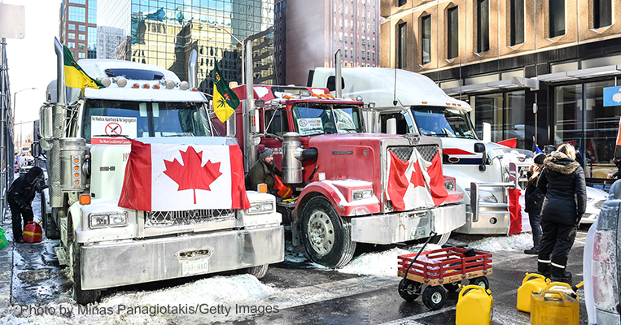
Notes:
https://www.frc.org/get.cfm?i=WA22B38&f=WU22B13&utm_medium=email&utm_source=washingtonupdate&utm_campaign=wa22b38

Slide 68
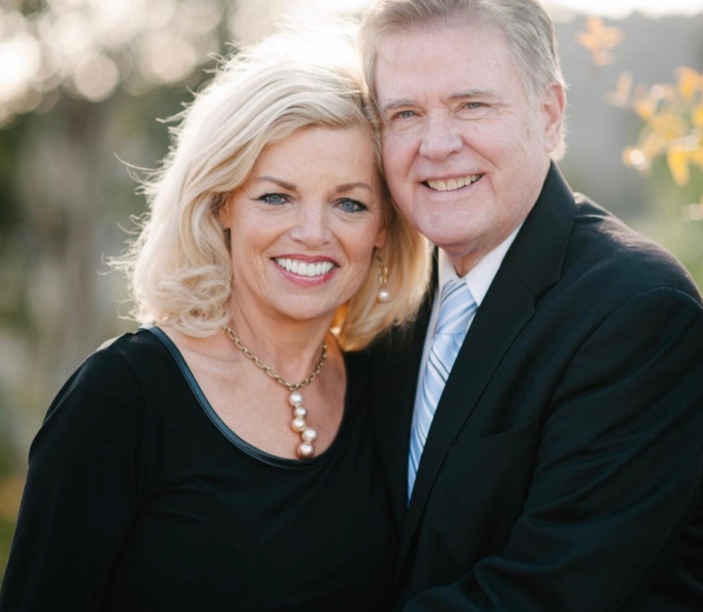
﻿Dr. Jim Garlow,
& Rosemary Schindler Garlow,
Founder and co-Founder-Well Versed

Slide 69
In 1978, God looked down on America and could not find enough bold pastors to stand up, so He said, "I am going to find an associate clinical professor of pediatrics at the University of Southern California School of Medicine,
Notes:
https://www.charismanews.com/opinion/88401-when-god-couldn-t-find-enough-bold-pastors-he-called-the-truckers

Slide 70
with a Ph.D. in child development, and I am going to prepare him to do what I need done." So God raised a young Dr. James Dobson to a position of national and international influence for righteousness.
Notes:
https://www.charismanews.com/opinion/88401-when-god-couldn-t-find-enough-bold-pastors-he-called-the-truckers

Slide 71
In 1980, God looked down on America and could not find enough bold pastors to stand up, so He said, "I am going to find a Hollywood actor who has been divorced, once a liberal, and I am going to prepare him to do what I need done." So God raised Ronald Reagan to a national and international position of influence for righteousness.
Notes:
https://www.charismanews.com/opinion/88401-when-god-couldn-t-find-enough-bold-pastors-he-called-the-truckers

Slide 72
In 1990, God looked down on America and could not find enough bold pastors to stand up, so He said, "I am going to find a football coach at the University of Colorado, Boulder, and he is going to launch a movement for men called "Promise Keepers."
Notes:
https://www.charismanews.com/opinion/88401-when-god-couldn-t-find-enough-bold-pastors-he-called-the-truckers

Slide 73
So God raised Bill McCartney and Raleigh Washington to a position of national and international influence for righteousness.
Notes:
https://www.charismanews.com/opinion/88401-when-god-couldn-t-find-enough-bold-pastors-he-called-the-truckers
Next one I read from Jim Garlow with a bit of a disclaimer. Some will be offended, some will love.

Slide 74
In 2016, God looked down on America and could not find enough bold pastors to stand up, so He said, "I am going to find a braggadocious New York City billionaire who has owned casinos, has been a playboy,
Notes:
https://www.charismanews.com/opinion/88401-when-god-couldn-t-find-enough-bold-pastors-he-called-the-truckers

Slide 75
is in his third marriage and tweets too much, and I am going to prepare him to do what I need done." So God raised up Donald Trump to a position of national and international influence for righteousness.
Notes:
https://www.charismanews.com/opinion/88401-when-god-couldn-t-find-enough-bold-pastors-he-called-the-truckers

Slide 76
In 2022, God looked down on all of North America and could not find enough bold pastors to stand up, so He said, "I am going to find a group of truckers in Canada who care about freedom and liberty, who hate tyranny and despotic rule,
Notes:
https://www.charismanews.com/opinion/88401-when-god-couldn-t-find-enough-bold-pastors-he-called-the-truckers

Slide 77
socialism and medical coercion, and I am going to bring them to Ottawa, Ontario to do what I need done." So God raised up the truckers who congregated in Canada's capital city to a position of national and international influence for righteousness.
Notes:
https://www.charismanews.com/opinion/88401-when-god-couldn-t-find-enough-bold-pastors-he-called-the-truckers

Slide 78
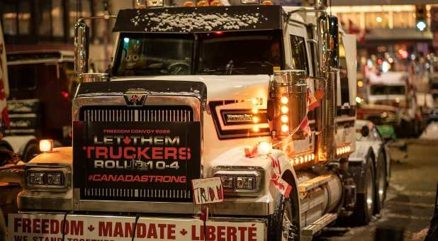
Notes:
https://www.charismanews.com/opinion/88401-when-god-couldn-t-find-enough-bold-pastors-he-called-the-truckers
Interview with Faytene Grasseschi
https://app.videosquirrel.app/watch/2081
Fifty-nine percent of Americans support the convoy's crusade, a new Rasmussen Report announces -- including 42 percent who "strongly support" it. Oh, and in case the AP was wondering, that includes "majorities of every racial category -- 55 percent of whites, 55 percent of black voters, and 70 percent of other minorities.“
https://www.frc.org/get.cfm?i=WA22B39&f=WU22B14&utm_medium=email&utm_source=washingtonupdate&utm_campaign=wa22b39

Slide 79
How do you view the Canadian truckers event? A protest? A blockade? OK, maybe it includes that. But it is so much more. Could it be a spiritual renewal? Or a revival? Or at least a "pre-revival," a precursor to an awakening? Quite possibly.
Notes:
https://www.charismanews.com/opinion/88401-when-god-couldn-t-find-enough-bold-pastors-he-called-the-truckers

Slide 80
Some might think that truckers are an unlikely place for God to look. However, there are so many examples throughout history where God used the "unlikelies." God tends to work with those who will say yes to Him and then obey. The truckers did exactly that.
Notes:
https://www.charismanews.com/opinion/88401-when-god-couldn-t-find-enough-bold-pastors-he-called-the-truckers

Slide 81
I have talked with some of the Canadian truck drivers. They are peaceful and committed to nonviolence. In fact, according to interviews with people on the ground, their event has a family-friendly atmosphere. Crime has dropped to zero in Ottawa.
Notes:
https://www.charismanews.com/opinion/88401-when-god-couldn-t-find-enough-bold-pastors-he-called-the-truckers

Slide 82
A practical matter of faith…

Slide 83
From the By-laws of Or HaOlam:
If there is need to find a successor to the position of Rabbi, they [the local Z’kaynim / Elders] are to act as a Leadership search committee, and shall recommend rabbinical candidates

Slide 84
to the membership and to the Directors. After consultation with the members and Directors, and prayer, two thirds majority of the Directors and the Z’kaynim (although ideally the call should be unanimous)

Slide 85
shall constitute an offer to a candidate to be the Rabbi of this congregation for a one year probationary period. After the one year, continued agreement of the two thirds majority of the Directors and the Z’kayneem shall constitute tenure

Slide 86
From the Director’s Minutes, 2021
Tim Gustafson brought up a discussion about Shmuel’s plan of succession. He proposed that Stewart be the immediate interim guy to fill in so that Or HaOlam can be taken care of until a replacement be found.

Slide 87
^{Messianic Jew/Heb 13.12-15} Through him, therefore, let us offer God a sacrifice of praise continually. For this is the natural product of lips that acknowledge his name.
Notes:
.

Slide 88
,

Slide 89
“the righteous shall live by Emunah אמונה Faith.”
צַדִּיק בֶּאֱמוּנָתוֹ יִחְיֶה.
Tsadeek beh-emunato yikhyeh

Slide 90
^{Mes Jews/Hebrews 11.01-13} Now faith is the substance of things hoped for, the evidence of realities not seen. For by it the elders received commendation.
Notes:
We see through the walls…

Slide 91
Do you KNOW Yeshua and the assurance of sins forgiven?
Are you hearing daily from His Word?
How are you applying what you heard?
Are you asking this of another?
Notes:
Who are you discipling, building up?4

Slide 93
