Slide 1
e-handout
To have these notes
without taking notes
Go to OrHaOlam.com
Click on Messages tab,
2022 Messages

Slide 2
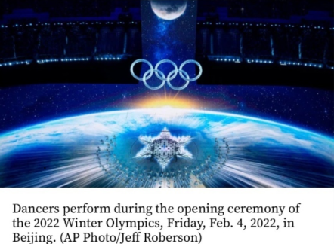
Notes:
Not that I’m endorsing the CCP Olympics, but, pretty beautiful.

Slide 3
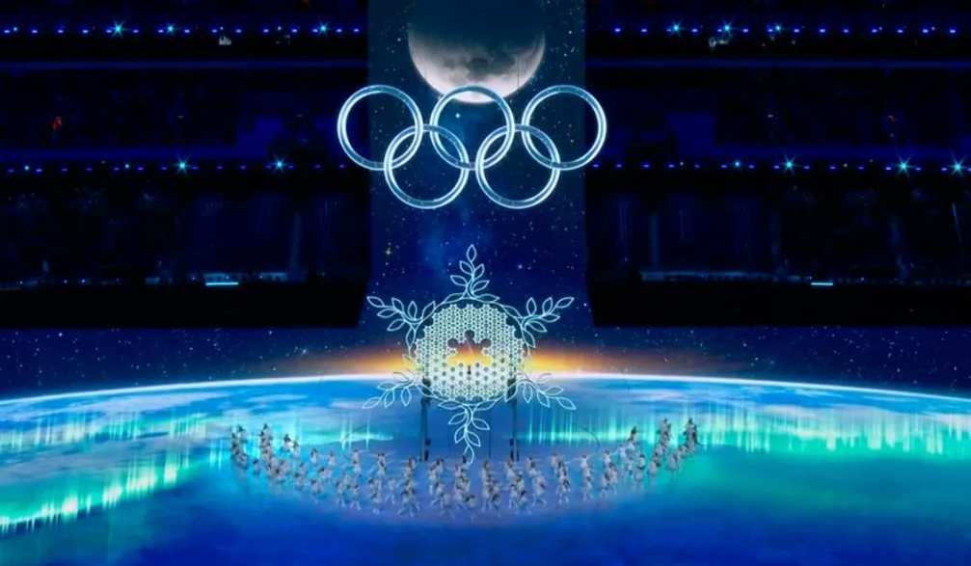
Notes:
https://i0.wp.com/tvtonight.com.au/wp-content/uploads/Screen-Shot-2022-02-05-at-12-1.jpeg?fit=1040%2C700&ssl=1

Slide 4
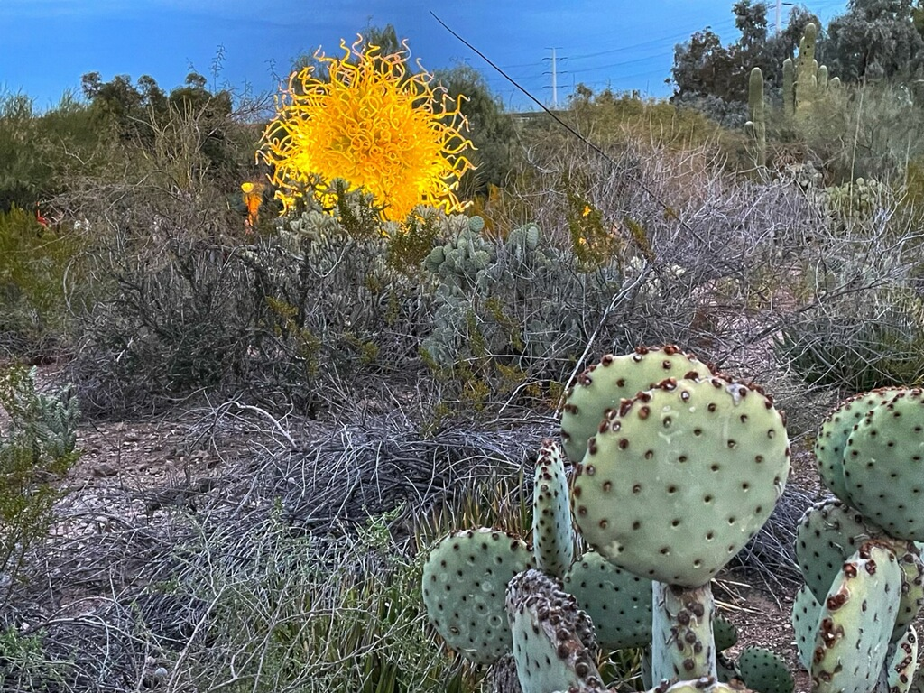
From Richard & Luann:
Moses isn’t the only one to find a burning bush in the desert. This one didn’t talk though.
Notes:
Here’s what the bush said to Moshe:

Slide 5
^{Shmot/Ex 2.24, 3.7-8} God heard their sobbing and remembered His covenant with Abraham, Isaac, and Jacob…“I have surely seen the affliction of My people who are in Egypt, and have heard their cry because of their slave masters,
Notes:
The burning bush is about COVENANT!

Slide 6
^{Shmot/Ex 2.24, 3.7-8} for I know their pains. So I have come down to deliver them out of the hand of the Egyptians, to bring them up out of that land into a good and large land, a land flowing with milk and honey.”

Slide 7
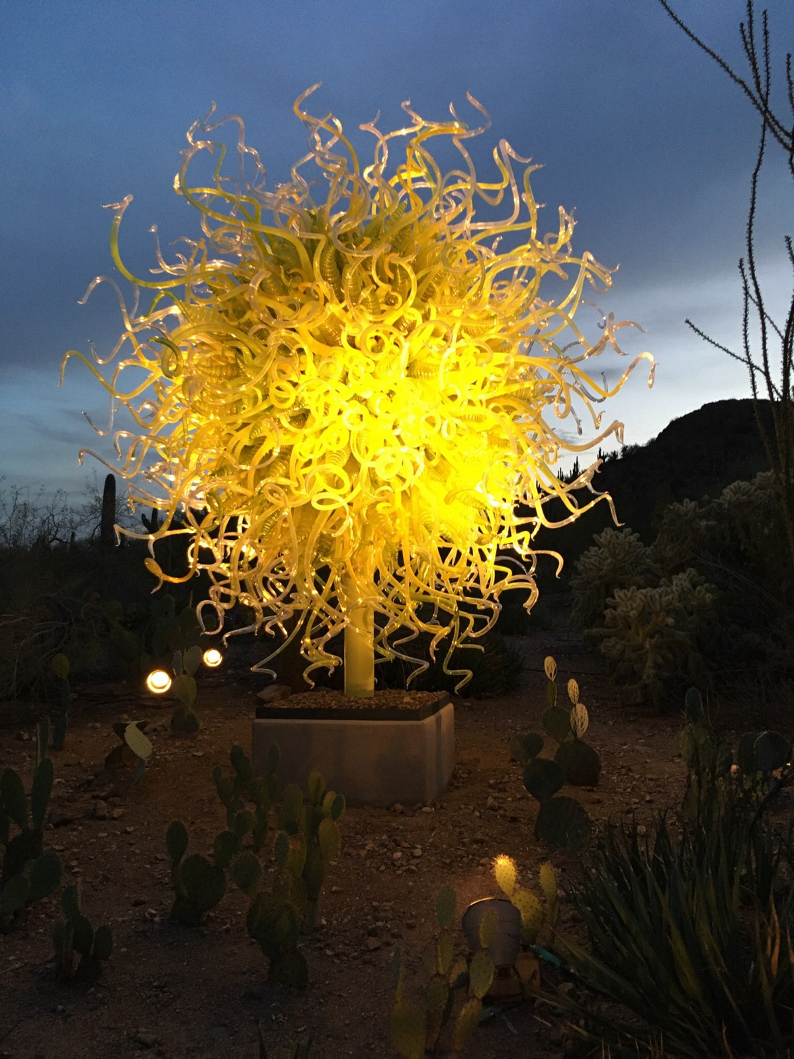
It’s a glass sculpture in the Phoenix Desert Botanical Garden
Notes:
.

Slide 8
Fire of covenant
Last time…

Slide 9
Outline Jan. 22: Heb/ MJ 10:15-25 Covenant and Community
Meaning of covenant בְּרִית Brit
History of covenant 8 of them
Current active covenant
Application of covenant
Notes:
All the covenants are with the Son, the Word, Davar Adoni, Logos.
Last one, Yeshua claims particularly: ^{Lk 22.20} He did the same with the cup after the meal, saying, “This cup is the New Covenant, ratified by my blood, which is being poured out for you.

Slide 10
בְּרִית Brit [breet]
treaty, alliance, pact, league:
constitution, ordinance, between monarch and subjects

Slide 12
Today: MJ 10:24-31 Covenant and Catastrophe
Vs 24-25 Covenant Community
Vs 26-31 Covenant Catastrophe
Notes:
After discussion of the 8th Covenant, the New Covenant, our great Cohen Gadol, High Priest, Yeshua the Messiah, and our access to the Holy of Holies, it discusses community and catastrophe.
Community is the positive application of the 8th, the new covenant.
Then it discusses catastrophe, judgement.
Catastrophe and Judgment is the negative application of the 8th, the new covenant.

Slide 13
^{Messianic Jews 10.24-31} And let us keep paying attention to one another, not neglecting our own congregational meetings, as some have made a practice of doing, but, rather, encouraging each other. And let us do this all the more as you see the Day approaching.

Slide 14
^{Messianic Jews 10.24-31} For if we deliberately continue to sin after receiving the knowledge of the truth, there no longer remains a sacrifice for sins, but only the terrifying prospect of Judgment, of raging fire that will consume the enemies.

Slide 15
^{Messianic Jews 10.24-31} Someone who disregards the Torah of Moshe is put to death without mercy on the word of two or three witnesses. Think how much worse will be the punishment deserved by someone who has trampled underfoot the Son of God; who has treated as something common the blood of the covenant

Slide 16
^{Messianic Jews 10.24-31} which made him holy; and who has insulted the Spirit, giver of God’s grace! For the One we know is the One who said, “Vengeance is my responsibility; I will repay,” and then said, “Adoni will judge his people.” It is a terrifying thing to fall into the hands of the living God!
Notes:
Let’s go back and unpack this 9 verse text.

Slide 18
Today: MJ 10:24-31 Covenant and Catastrophe
Vs 24-25 Covenant Community
Vs 26-31 Covenant Catastrophe

Slide 19
^{Messianic Jews 10.24} And let us keep paying attention to one another
to take note of, perceive, consider carefully, discern, detect, make account of.
Notes:
Note absences, facial expressions of distress or joy.
“I’m just hear to worship and learn and serve” Very important. Need more servants. More focused worship. During worship time, the rest of the building is closed. Not then time for visiting.
However, you are also here for community. “How are you doing?”
One writer: plenty of considering faults, merciless criticism. “Speaking the truth in love” Being bonded. Is there anyone that really knows you, whom you know their joys and struggles, they know yours.

Slide 20
^{Yn 13.34-35} “I am giving you a new command: that you keep on loving each other. In the same way that I have loved you, you are also to keep on loving each other. Everyone will know that you are my talmidim by the fact that you have love for each other.”
Notes:
Greg had a great message on love while Dawn and I were in AZ with our son and fam.

Slide 21
^{1 Yn 3.10} Here is how one can distinguish clearly between God’s children and those of the Adversary: everyone who does not continue doing what is right is not from God. Likewise, anyone who fails to keep loving his brother is not from God.

Slide 22
^{1 Yn 3.14} We know that we have passed from death to life, because we love our brothers and sisters. The one who does not love remains in death.

Slide 23
^{1 Yn 3.18} Children, let us love not with words and talk, but with actions and in reality!

Slide 24
^{1 Yn 4.7-8} Loved ones, let us love one another, for love is from God. Everyone who loves is born of God and knows God. The one who does not love does not know God, for God is love

Slide 25
David Stern: The emphasis in the Tanakh is on the common historical destiny of God's people and their need to treat each other with justice and mercy. The Messianic Scriptures/NT is no less concerned with the group; it commands believers to love each other in real,
Notes:
https://kifakz.github.io/eng/bible/stern/stern_evreyam_10.html

Slide 26
practical ways and to build up the Body of the Messiah. This necessitates personal involvement, relationship, communication and working together for the Kingdom of God; and these are impossible challenges unless God's people meet together often.
Notes:
https://kifakz.github.io/eng/bible/stern/stern_evreyam_10.html

Slide 27
Extreme forms of individualism spawned in the secular world have infected the Messianic Community and produced efforts to discredit the importance of believers' meeting together.
Notes:
https://kifakz.github.io/eng/bible/stern/stern_evreyam_10.html
Ayn Rand and Robert Ringgren
Plus general distaste for organized religion and its mandates.

Slide 28
From 2009 to 2019 those who have disaffiliated (marked “none” for a religious affiliation) rose from just under 15% to 20% of the U.S. population. A significant majority of this group that marks down “none” still believes a divine being exists or that there is some type of spiritual
Notes:
https://witness.lcms.org/2022/nones-the-spirituality-of-the-unaffiliated/

Slide 29
existence. In 2012: Two-thirds of say they believe in God (68%). More than half say they often feel a deep connection with nature and the earth (58%), while more than a third classify themselves as “spiritual” but not “religious” (37%), and one-in-five (21%) say they pray every day.
Notes:
https://witness.lcms.org/2022/nones-the-spirituality-of-the-unaffiliated/

Slide 30
"Living stones being built into a spiritual house" (1 Ke 2:5) do not flit about. The time has come for God's people to understand that spirituality means what Dietrich Bonhoeffer called, in the title of his book. Life Together.
Notes:
The body of Messiah is generally understood as the specific house community. If you are part of a body, you don’t amputate and transfer. You draw life together.
Of course, you that are here are here. But this is an exhortation to build friendship, community!

Slide 31
Oneg, Shabbat meals together, Home groups, Men’s group, Women’s Havurah, Teerosh, coffee,are avenues of building community.
Messianic worship dance is even defined by lines and circles, “together.”

Slide 32
^{Yer 31.1, 10, 12} “The people escaping the sword found favor in the desert — I have brought Isra’el to its rest…For Adoni has ransomed Ya‘akov, redeemed him from hands too strong for him…“Then the virgin will dance for joy, young men and old men together; for I will turn their mourning into joy.

Slide 34
^{Messianic Jews 10.24} And let us keep paying attention to one another
in order to spur each other on to love and good deeds
stimulation, provocation, irritation, angry dispute.

Slide 35
^{Messianic Jews 10.24} in order to spur each other on to love and good deeds
Paroxysm [Am Heritage dic.]
A sudden outburst of emotion or action.
A sudden attack, recurrence, or intensification of a disease.
A spasm or fit; a convulsion.
Notes:
Sort of opposite way the word is commonly used: an outburst of love!!

Slide 36
^{Messianic Jews 10.25a} not neglecting our own congregational meetings, as some have made a practice of doing,
Notes:
Our own speaks of particular community.
In the time of this writing, “synagogue” was NOT an endemically Jewish term, just a gathering.

Slide 37
^{Messianic Jews 10.25a} not neglecting our own congregational meetings, as some have made a practice of doing,
Stern: Greek episunagdgen; one could render the phrase, "not neglecting to synagogue ourselves together"). "Hillel said, 'Do not separate yourself from the community."'(Avot 2:4)

Slide 38
^{Messianic Jews 10.25b} but, rather, encouraging each other.
Notes:
I have a few thoughts of personal encouragement.
Some may seem disconnected…

Slide 39
Is it possible to get some community / spiritual / encouraging advice from Audrey Hepburn?
^{Lk 16.8} The sons of this age are smarter when dealing with their own generation than the sons of light.
Notes:
From Epoch Times, so…

Slide 40
Notes:
https://img.theepochtimes.com/assets/uploads/2022/01/25/hepburn-1200x904.jpg
In 2006, 29 years after the Hollywood icon’s passing, Audrey Hepburn was voted the most beautiful woman of all time by the British magazine New Woman.

Slide 41
Time-Tested Beauty Tips
For attractive lips, speak words of kindness.
For lovely eyes, seek out the good in people.
For a slim figure, share your food with the hungry.
Notes:
https://img.theepochtimes.com/assets/uploads/2022/01/25/hepburn-1200x904.jpg

Slide 42
For beautiful hair, let a baby run his fingers through it once a day.
For poise, walk with the knowledge you’ll never walk alone.
The tender loving care of human beings will never become obsolete.
Notes:
https://img.theepochtimes.com/assets/uploads/2022/01/25/hepburn-1200x904.jpg
https://womenswisdom.net/beauty-tips-by-audrey-hepburn/

Slide 43
People even more than things have to be restored, renewed, revived, reclaimed, and redeemed and redeemed and redeemed.
Never throw out anybody. [cancel]
Remember, if you ever need a helping hand, you’ll find one at the end of your arm.
Notes:
https://img.theepochtimes.com/assets/uploads/2022/01/25/hepburn-1200x904.jpg
https://womenswisdom.net/beauty-tips-by-audrey-hepburn/

Slide 44
As you grow older, you will discover that you have two hands: one for helping yourself, the other for helping others.
Your “good old days” are still ahead of you. May you have many of them.

Slide 45
The beauty of a woman is not in the clothes she wears, the figure that she carries, or the way she combs her hair. The beauty of a woman must be seen from in her eyes, because that is the doorway to her heart, the place where love resides.
Notes:
https://womenswisdom.net/beauty-tips-by-audrey-hepburn/

Slide 46
The beauty of a woman is not in a facial mode, but the true beauty in a woman is reflected in her soul. It is the caring that she lovingly gives the passion that she shows.
The beauty of a woman grows with the passing years.
Notes:
https://womenswisdom.net/beauty-tips-by-audrey-hepburn/
An example of G-d’s covenant faithfulness, from last week’s message on covenants…

Slide 47
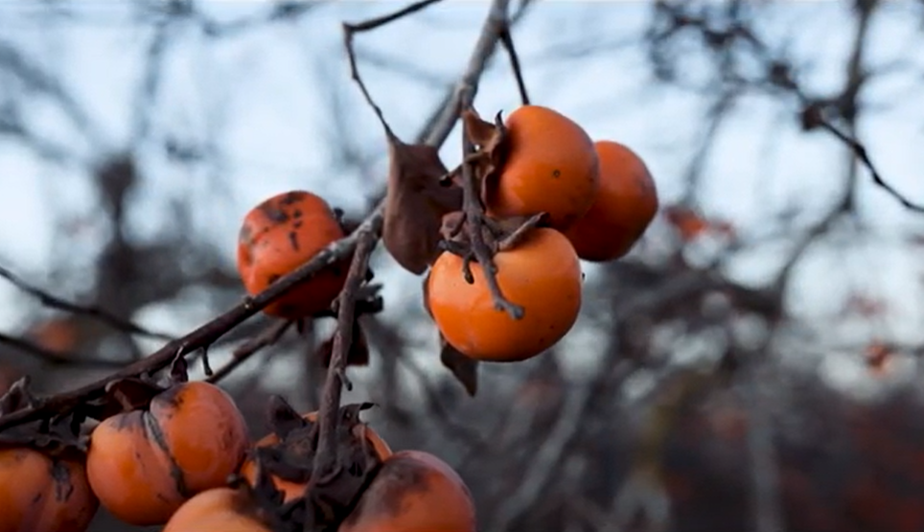
Shmittah שמיטה
Year of Release
Notes:
https://youtu.be/oapFzSmUo4k to 4.01 Shmittah Israel Pochtar

Slide 48
Another bit of community advice and exhortation…

Slide 49
Human Muscle Fights Inflammation
All by Itself
Notes:
https://www.theepochtimes.com/human-muscle-fights-inflammation-all-by-itself_4241371.html?utm_source=healthnoe&utm_campaign=health-2022-01-28&utm_medium=email&est=qnzdrkJJ0rUC6sxlFdclBqC5MpJcVNeyXvMI%2Bw2yGtNZZs%2FOhO%2BUeuK2FiJJbwqsjQ%3D%3D

Slide 50
Human muscle has an innate ability to ward off the damaging effects of chronic inflammation when exercised, according to a new study…“When exercising, the muscle cells themselves were directly opposing the pro-inflammatory signal.”
Notes:
https://www.theepochtimes.com/human-muscle-fights-inflammation-all-by-itself_4241371.html?utm_source=healthnoe&utm_campaign=health-2022-01-28&utm_medium=email&est=qnzdrkJJ0rUC6sxlFdclBqC5MpJcVNeyXvMI%2Bw2yGtNZZs%2FOhO%2BUeuK2FiJJbwqsjQ%3D%3D

Slide 51
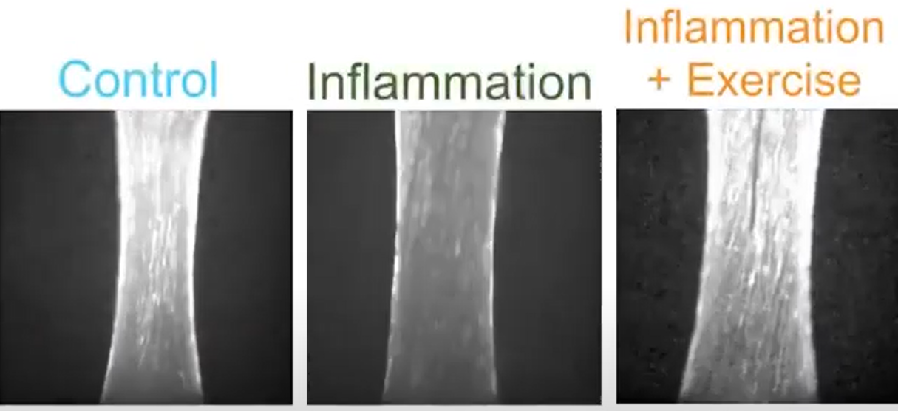
Notes:
https://www.theepochtimes.com/human-muscle-fights-inflammation-all-by-itself_4241371.html?utm_source=healthnoe&utm_campaign=health-2022-01-28&utm_medium=email&est=qnzdrkJJ0rUC6sxlFdclBqC5MpJcVNeyXvMI%2Bw2yGtNZZs%2FOhO%2BUeuK2FiJJbwqsjQ%3D%3D

Slide 52
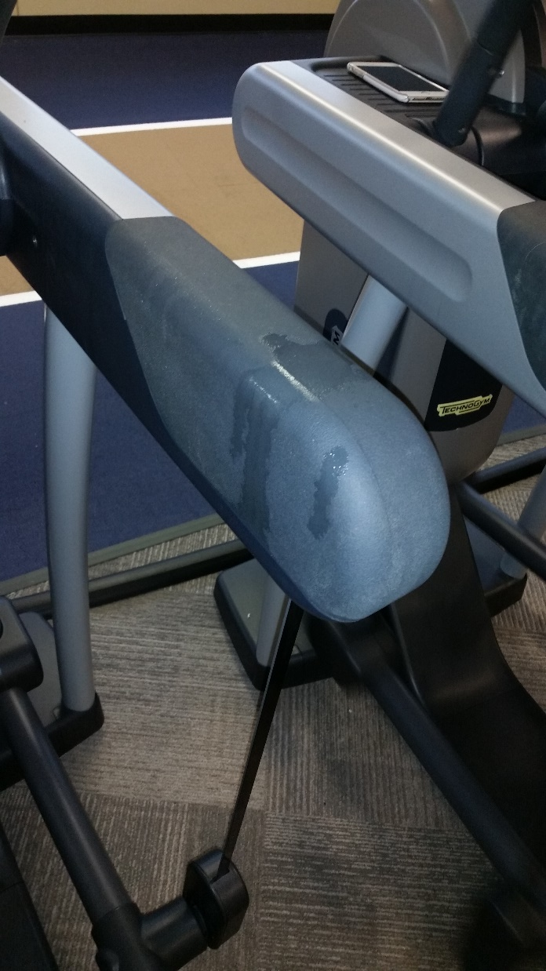
Elixir of youth
and health.
Notes:
Do fitness together!!

Slide 53
^{Messianic Jews 10.25b} And let us do this all the more as you see the Day approaching. What day?
^{2 Tim 3.1-2} But know this, that in the last days perilous times [times of stress] will come: For men will be lovers of themselves…
Notes:
We need each other, for prayer, encouragement!

Slide 54
Perilous times [times of stress]
Illustration #1

Slide 55
A Finnish member of parliament, Päivi Räsänen, physician, mother of 5, pastor’s wife
Notes:
The first charge concerns a 2019 tweet in which Räsänen questioned the decision of the Evangelical Lutheran Church of Finland (her own denomination) to partner with Helsinki's gay pride parade; this tweet also featured an image of Romans 1:24-27. Räsänen had moved on and forgotten about this tweet -- until she learned that the police were investigating her over it.

Slide 56
Päivi Räsänen, is facing trial for three counts of "ethnic agitation" -- a hate speech provision in Finland's criminal code -- simply for expressing widely held biblical beliefs.
Notes:
https://frc.org/PrayForPaivi

Slide 57
Päivi was invited to the police station. She was interrogated, asked about her Christian beliefs, asked about what the Bible taught. For these acts, Päivi, a soft-spoken 62-year-old mother of 5 and grandmother and trained medical doctor, could end up spending two years in jail, with the trial concluding Monday, February 14, 2022.
Notes:
https://frc.org/PrayForPaivi

Slide 58
Perilous times [times of stress]
Illustration #2

Slide 59
Notes:
Lia Thomas (born 1998/1999)[1] is a swimmer and a University of Pennsylvania student
https://ca.style.yahoo.com/16-penn-swimmers-trans-teammate-184726977.html

Slide 60
Lia Thomas’ UPenn [female] teammate tells how the trans swimmer doesn’t always cover up her male genitals when changing and their concerns go ignored by their coach.”
Seriously? Her male genitals? What kind of madness is this?!
Notes:
https://askdrbrown.org/library/i-will-stop-crying-out-when-transanity-stops
Bigger lungs, heart, skeleton, less fat, more muscle than the women.

Slide 61
And the fact that a biological male with male plumbing (who, by the way, is attracted to females), shares a locker room with women – where they disrobe and shower – is absolute insanity, not to mention terribly unfair.
In fact, it is outright abusive.
Notes:
https://askdrbrown.org/library/i-will-stop-crying-out-when-transanity-stops

Slide 62
Perilous times [times of stress]
Illustration #3

Slide 63
NAMBLA (the North American Man Boy Love Association) has more advocates than we could care to imagine. As quoted, “The Dutch lawyer Edward Brongersma wrote an article sympathetic to man-boy love. He cites a report that ‘gives several examples of social workers achieving miracles with apparently incorrigible young delinquents – not by preaching to them, but by sleeping with them..."
Notes:
https://askdrbrown.org/library/i-will-stop-crying-out-when-transanity-stops

Slide 65
Today: MJ 10:24-31 Covenant and Catastrophe
Vs 24-25 Covenant Community
Vs 26-31 Covenant Catastrophe

Slide 66
^{Messianic Jews 10.26-31} For if we deliberately continue to sin after receiving the knowledge of the truth, there no longer remains a sacrifice for sins, but only the terrifying prospect of Judgment, of raging fire that will consume the enemies.
Notes:
Not different from the Hebrew Tanakh

Slide 67
^{Zeph 1.14-17} The great day of Adoni is near— near and coming very quickly! The sound of the day of Adoni is bitter— the shouting of the warrior is there. That day is a day of wrath a day of trouble and distress, a day of devastating storm and desolation

Slide 68
^{Zeph 1.14-17} a day of darkness and gloom, a day of clouds and thick darkness, a day of shofar and alarm. I will bring such distress upon mankind that they will walk like the blind— for they have sinned against Adoni.

Slide 69
^{Messianic Jews 10.28-31} Someone who disregards the Torah of Moshe is put to death without mercy on the word of two or three witnesses. Think how much worse will be the punishment deserved by someone who has trampled underfoot the Son of God; who has treated as something common the blood of the covenant

Slide 70
^{Messianic Jews 10.29-31} which made him holy; and who has insulted the Spirit, giver of God’s grace! For the One we know is the One who said, “Vengeance is my responsibility; I will repay,” and then said, “Adoni will judge his people.” It is a terrifying thing to fall into the hands of the living God!

Slide 71
Rejecting the blood of Yeshua is a fearsome undertaking, for it is shutting off the only source of mercy.
The way of righteous judgment in the Tanakh is the same under the
New Covenant, neither more or less severe

Slide 72
David Stern: The modern tendency is to bowdlerize fear of God into "reverence for God" or minimize it by exalting love of God as a higher motivation for right behavior than fear of him.
Notes:
https://kifakz.github.io/eng/bible/stern/stern_evreyam_10.html

Slide 73
But doing so blunts the impact which the prospect of judgment ought to make. There is a right reason for fearing God; there is such a thing as "holy fear" (11:7). "The fear of Adoni is the beginning of wisdom" (Proverbs 9:10).
Notes:
https://kifakz.github.io/eng/bible/stern/stern_evreyam_10.html

Slide 74
^{Yeshayahu/Is 66.15} For — look! — Adoni will come in fire, and his chariots will be like the whirlwind, to render his anger furiously, his rebuke with blazing fire. For Adoni will judge all humanity with fire and with the sword, and those slain by Adoni will be many.

Slide 76
Today: MJ 10:24-31 Covenant and Catastrophe
Vs 24-25 Covenant Community
Vs 26-31 Covenant Catastrophe

Slide 77
A Purim Prayer challenge

Slide 78
Rania Sayegh, is a Christian Arab ministry leader
HOPE - House Of Prayer & Exploits
Nazareth, Israel
Notes:
The lady below, ​Rania Sayegh, is a Christian Arab who lives in Nazareth and loves Israel and the Jewish people. She made a gracious personal apology to me once at IHOP prayer room just as she was a representative of the Palestinian Arab people. Rosemary Schindler was there. I reciprocated with an apology for the sins of Israel and the Jewish people, like I did with Taysir Abu Saada.

Slide 79
Feb. 4 newsletter:
Iran threatens Israel with genocide, leads ME terrorism
In Nov., 2021 Iran hit with 6.4 magnitude earthquake Hormozgan province

Slide 80
She felt inclined to Is 64.1-4
Dec. 2021 lecture by Israeli historian Mordechai Kedar “Will the Iranian regime collapse in 2022?” many reasons: economy, water system, ethnic fracture, US sanctions

Slide 81
Iranian New Year = Noroz
Wednesday preceding is called Char Chambi Sori” in Farsi which means “the Wednesday of fire.”

Slide 82
everyone comes out onto the streets and lights fires. The day is known for chaos! Therefore these groups would most likely choose such a day to make an organized effort to come out onto the streets in an attempt to oppose the government.

Slide 83
This year, “the Wednesday of Fire” falls on March the 16th.
Purim is March 16.
Year 2022, consider 2x 22 = 44
Fast from 2/2/2022 to Mar. 14 is 44 days.
This year Islamic Republic 44 years old.

Slide 84
I knew that the Lord was speaking to me, that we are to ask Him to rend the heaven and come down over Iran and shake the regime and give courage and faith to the people of Iran to rise up and stand against this evil structure that has been threatening all the Middle East and especially the existence of Israel

Slide 85
After receiving this revelation from the Lord, I asked Him what He wanted us to do. He showed me that He wants the intercessors to unite globally and begin to roar His decrees over Iran and speak deliverance to her people.

Slide 86
The Lion of the Tribe of Judah is about to roar from Zion and bring vengeance over the Haman spirit that is moving in the land. Enough is enough, Aslan is on the move!
This is the decree to be released on Purim 16/3/2022!

Slide 87
^{Joel 3:16} The Lord will roar from Zion and thunder from Jerusalem; the earth and the heavens will tremble. But the Lord will be a refuge for his people, a stronghold for the people of Israel.

Slide 88
Iran = Persia = Elam
^{Yer/Jer 49.32-39} ‘Behold, I will break the bow of Elam,
The foremost of their might.
Against Elam I will bring the four winds
From the four quarters of heaven,
And scatter them toward all those winds;
There shall be no nations where the outcasts of Elam will not go.

Slide 89
Iran = Persia = Elam
^{Yer/Jer 49.32-39} For I will cause Elam to be dismayed before their enemies And before those who seek their life.
I will bring disaster upon them,
My fierce anger,’ says the Lord;
‘And I will send the sword after them
Until I have consumed them.

Slide 90
Iran = Persia = Elam
^{Yer/Jer 49.32-39} I will set My throne in Elam, And will destroy from there the king and the princes,’ says the Lord.
‘But it shall come to pass in the latter days:
I will bring back the captives of Elam,’ says the Lord.."

Slide 91
Rania Sayegh, is a Christian Arab ministry leader
HOPE - House Of Prayer & Exploits
Nazareth, Israel

Slide 93
Today: MJ 10:24-31 Covenant and Catastrophe
Vs 24-25 Covenant Community
Vs 26-31 Covenant Catastrophe

Slide 94
Considering the covenant keeping G-d, let’s consider special fasting and prayer, now till Purim for breakthrough in Iran!

Slide 95
Do you KNOW Yeshua and the assurance of sins forgiven?
Are you hearing daily from His Word?
How are you applying what you heard?
Are you asking this of another?
Notes:
Who are you discipling, building up?4

