Slide 1
e-handout
To have these notes
without taking notes
Go to OrHaOlam.com
Click on Messages tab,
2022 Messages

Slide 2
I went to buy some camouflage trousers yesterday,

Slide 3
I went to buy some camouflage trousers yesterday, but couldn't find any.

Slide 4
What do you call a bee that can’t make up its mind?

Slide 5
What do you call a bee that can’t make up its mind? A maybe.

Slide 6
I tried to sue the airline for losing my luggage.

Slide 7
I tried to sue the airline for losing my luggage. I lost my case.

Slide 8
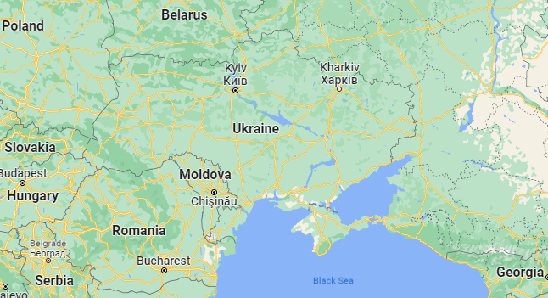
Notes:
Note:
Ukraine war,
Belarus friends, Stewart’s ministry,
Poland NATO,
Romania,
Georgia safe

Slide 9
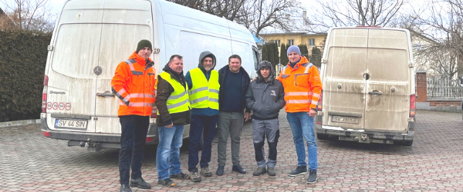
I am standing in the company of heroes!
These brave men are driving vans from
Romania into some of the most dangerous
areas of Ukraine including Kyiv and Kharkiv,
to bring food, medicine, and other vital supplies.
Notes:
Stewart and Chantal in Romania

Slide 11
Notes:
https://www.cnn.com/2022/03/09/world/ukrainian-refugee-aid-poland-border-trnd/index.html
Train station in Poland: “You are safe.”

Slide 12
Notes:
https://youtu.be/mIDKJu6mie0

Slide 13
A lieutenant in the Ukrainian army, called and said his men were sitting in hiding and looking out to see where an enemy attack would come from," Zelfimein said. "He said, 'all of a sudden, I felt the urgency to pray.' He heard God speaking to him, 'Take your men and leave this place, this very location.'
Notes:
https://www.charismanews.com/world/88572-ukrainian-pastor-tells-sid-roth-god-is-sending-angels-to-protect-us?utm_source=Charisma%20News%20Daily&utm_medium=email&utm_content=subscriber_id:5160390&utm_campaign=CNO%20daily%20-%202022-03-09

Slide 14
"As soon as he and his men relocated to a different place, rockets and fire opened on that spot where they were. That very spot was bombed and destroyed…now they are praying and asking the Lord to come into their lives."
Notes:
https://www.charismanews.com/world/88572-ukrainian-pastor-tells-sid-roth-god-is-sending-angels-to-protect-us?utm_source=Charisma%20News%20Daily&utm_medium=email&utm_content=subscriber_id:5160390&utm_campaign=CNO%20daily%20-%202022-03-09

Slide 15
Notes:
The van for rescuing war refugees, bought by Reach Initiative. Last week’s and Purim offering.

Slide 16
Notes:
Van purchased by Reach/Stewart Winograd

Slide 18
We are in a war for truth.

Slide 19
^{Yeshayahu 59.14} And judgment is turned away backward, and justice stands afar off: for truth is fallen in the street.
Notes:
Battle used to be “What is truth?”
Now question is “Is there truth?”

Slide 21
^{Mes. Jews/Hebrew 11: 3} By trusting, we understand that the universe was created through a spoken word of God, so that what is seen did not come into being out of existing phenomena.
Notes:
Ex nihilo
Not out of matter, space, time.
Hebrew term is צימצום tsimtsum reduction of G-d Himself

Slide 22
^{T’hillim/Ps 33.6} By the word of Adoni the heavens were made, and their whole host by a breath from his mouth.

Slide 23
^{2 Kefa/Peter 3.5} It was by God’s Word that long ago there were heavens, and there was land which arose out of water and existed between the waters.
Notes:
Implications:
Science can discover present patterns of uniformity but can say nothing about whether God might suddenly change them. Stern
So we presume that the laws of physics are the same in the next galaxy, Andromeda, as they are in the Milky Way. But we don’t know.
If there is a Divine order, then there will be a divine ordering of things out of order.
Intelligent creation implies
purpose to the universe,
accountability from the created beings.

Slide 24
^{2 Kefa/Peter 3.7} It is by that same Word that the present heavens and earth, having been preserved, are being kept for fire until the Day of Judgment, when ungodly people will be destroyed.

Slide 25
David Stern: The Bible disagrees with the philosophy of materialism; that we only are physical beings.
Notes:
Stern’s commentary.

Slide 26
Incidentally, so does the “Big Bang” theory, which says that the entire universe began in an unimaginably great explosion some fifteen billion years ago, before which there was nothing (or, in terms of the theory itself, “before” which the concepts of time and matter are…undefined).
Notes:
Stern’s commentary.

Slide 27
A number of materialistic and atheistic scientists have confessed inability to cope emotionally and spiritually with these consequences of their own theory. ﻿
Notes:
Stern’s commentary.

Slide 28
In 2010 there was a decision by the Texas State Board of Education to require textbooks to present the weaknesses, as well as the strengths, of Darwin's theory. Dr. Joseph A. Kuhn argued that the three limitationsof Darwin's theory:
Notes:
https://www.ncbi.nlm.nih.gov/pmc/articles/PMC3246855/#:~:text=The%20three%20limitations%20of%20Darwin's,evolution%20to%20an%20alternative%20explanation.
That’s how I used to teach it as a biology teacher in a Christian school.

Slide 29
the origin of DNA,
the irreducible complexity of the cell,
and the paucity of transitional species.
Notes:
https://www.ncbi.nlm.nih.gov/pmc/articles/PMC3246855/#:~:text=The%20three%20limitations%20of%20Darwin's,evolution%20to%20an%20alternative%20explanation.

Slide 30
Because of these limitations, the author predicts a paradigm shift away from evolution to an alternative explanation.
Notes:
https://www.ncbi.nlm.nih.gov/pmc/articles/PMC3246855/#:~:text=The%20three%20limitations%20of%20Darwin's,evolution%20to%20an%20alternative%20explanation.

Slide 31
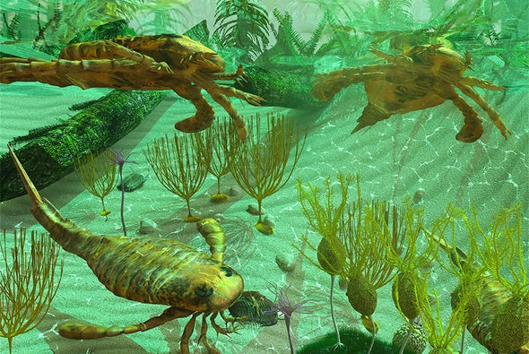
The Cambrian
Explosion
Notes:
https://www.scientificamerican.com/article/what-sparked-the-cambrian-explosion1/

Slide 32
Cambrian explosion or The Biological Big Bang refers to an interval of time in the Cambrian Period when practically all major animal phyla started appearing in the fossil record.
[No intermediate forms]
Notes:
https://en.wikipedia.org/wiki/Cambrian_explosion

Slide 33
Before early Cambrian diversification, most organisms were relatively simple, composed of individual cells, or small multicellular organisms, occasionally organized into colonies.
Notes:
https://en.wikipedia.org/wiki/Cambrian_explosion
If you can’t remember a lot of technical issues, remember “Cambrian Explosion.”

Slide 34
As the rate of diversification subsequently accelerated, the variety of life became much more complex, and began to resemble that of today. Almost all present-day animal phyla appeared during this period
Notes:
https://en.wikipedia.org/wiki/Cambrian_explosion

Slide 35
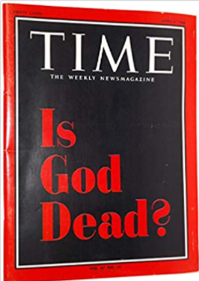
April 8, 1966 Time Magazine cover asked, “Is God Dead?
Notes:
Eric Metaxas recently wrote…

Slide 37
Dennis Prager has this to say about Is Atheism Dead? This latest book features Metaxas versus atheism, and it's not a fair fight.
Notes:
Next slides are Metaxas’ presentation on Dobson’s Family Talk.

Slide 38
Hugh Ross
Reasons.org
How many people are familiar with the concept of the fine-tuned universe?
Notes:
https://familytalk.widen.net/view/pdf/xvgkmz97gm/03072022ISATHEISMDEAD1.pdf?u=c3crpv

Slide 39
If Earth’s gravity were stronger, our atmosphere would contain too much methane and ammonia. If our planet’s gravity were weaker, Earth wouldn’t be able to retain enough atmosphere, particularly water.
Notes:
https://coldcasechristianity.com/writings/four-ways-the-earth-is-fine-tuned-for-life/

Slide 40
As it is, Earth’s atmosphere has a finely calibrated ratio of oxygen to nitrogen—just enough carbon dioxide and adequate water vapor levels to promote advanced life, allow photosynthesis (without an excessive greenhouse effect), and to allow for sufficient rainfall.
Notes:
https://coldcasechristianity.com/writings/four-ways-the-earth-is-fine-tuned-for-life/

Slide 41
If the earth were a little bit smaller, it wouldn't be strong enough to give us the magnetosphere to protect us from Cosmic rays.
Notes:
https://familytalk.widen.net/view/pdf/xvgkmz97gm/03072022ISATHEISMDEAD1.pdf?u=c3crpv
you can look at Mars.

Slide 42
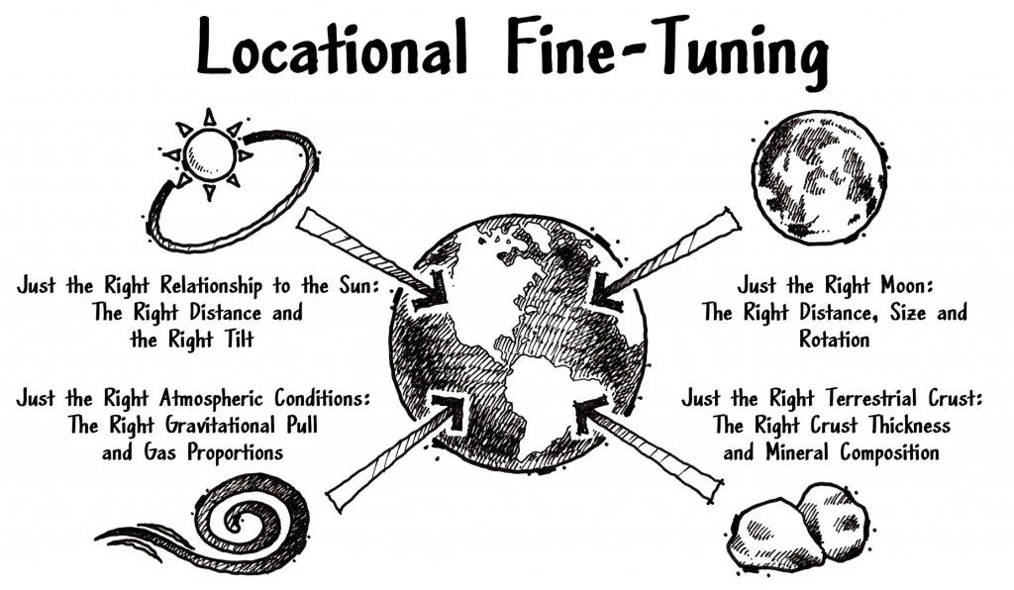
Notes:
https://coldcasechristianity.com/writings/four-ways-the-earth-is-fine-tuned-for-life/
“Goldilocks zone”

Slide 43
We all watched Star Trek. You just assume anything could be anything. We could have a planet a billion times, bigger billion times, what does it matter? Well, science has discovered, fairly recently, again, this is the irony.
Notes:
https://familytalk.widen.net/view/pdf/xvgkmz97gm/03072022ISATHEISMDEAD1.pdf?u=c3crpv

Slide 44
Because remember, there was a narrative that science is at odds with faith, mostly since Darwin, but in the last 150 years. Science has discovered that every single thing has to be the way it is.
Notes:
https://familytalk.widen.net/view/pdf/xvgkmz97gm/03072022ISATHEISMDEAD1.pdf?u=c3crpv

Slide 45
In 1961, physicist Robert H. Dicke claimed that certain forces in physics, such as gravity and electromagnetism, must be perfectly fine-tuned for life to exist in the universe.
Notes:
https://en.wikipedia.org/wiki/Fine-tuned_universe

Slide 46
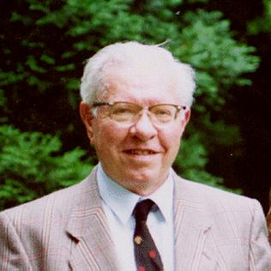
Fred Hoyle also argued for a fine-tuned universe in his 1984 book The Intelligent Universe. "The list of apparent accidents of a non-biological nature without which carbon-based and hence human life could not exist, is large and impressive",
Notes:
https://en.wikipedia.org/wiki/Fine-tuned_universe

Slide 47
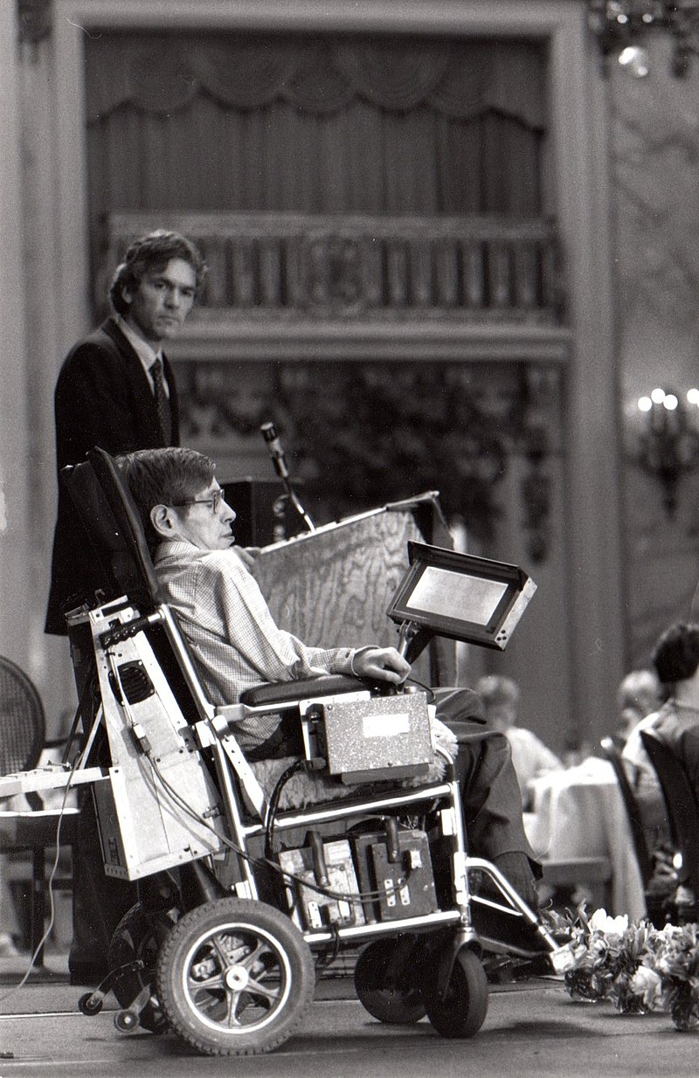
As Stephen Hawking has noted, "The laws of science, as we know them at present, contain many fundamental numbers, like the size of the electric charge of the electron and the ratio of the masses of the proton and the electron… these numbers seem to have been very finely adjusted to make possible the development of life.
Notes:
https://en.wikipedia.org/wiki/Fine-tuned_universe

Slide 48
Martin Rees formulates the fine-tuning of the universe in terms of the six dimensionless physical constants.
Notes:
https://en.wikipedia.org/wiki/Fine-tuned_universe

Slide 49
N, the ratio of the electromagnetic force to the gravitational force between a pair of protons, is approximately 10³⁶. According to Rees, if it were significantly smaller, only a small and short-lived universe could exist
Notes:
https://en.wikipedia.org/wiki/Fine-tuned_universe
5 others

Slide 50
If, for example, the strong nuclear force were 2% stronger than it is (i.e. if the coupling constant representing its strength were 2% larger) while the other constants were left unchanged, diprotons would be stable; according to Davies, hydrogen would fuse into them instead of deuterium and helium
Notes:
https://en.wikipedia.org/wiki/Fine-tuned_universe
5 others

Slide 51
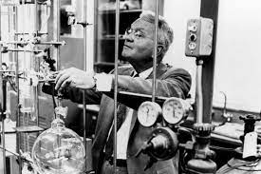
Miller Urey
Notes:
My biology teacher, Mr Unger told us…

Slide 52
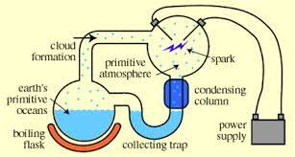
water, ammonia,
hydrogen and
methane
Notes:
Did surprisingly produce some amino acids, the building block of proteins

Slide 53
The influential Miller-Urey experiment showed that with just water, ammonia, hydrogen and methane – and electric sparks to mimic lightning – you could form several of the protein precursors necessary for life on Earth. Stanley Miller and Harold Urey's aim was to recreate the chemical conditions of early Earth.

Slide 54
The famous Miller-Urey experiment 1952, published in '53, that was the beginning, and it's only a matter of time before we find out how the amino acids become proteins and how we get carbohydrates and then we get single cells.
Notes:
https://familytalk.widen.net/view/pdf/xvgkmz97gm/03072022ISATHEISMDEAD1.pdf?u=c3crpv

Slide 55
James Tour. He's a nano scientist, probably the top nano scientist on planet Earth, Jewish, believer in Messiah, wonderfully brilliant.
https://www.oneforisrael.org
Notes:
https://familytalk.widen.net/view/pdf/xvgkmz97gm/03072022ISATHEISMDEAD1.pdf?u=c3crpv

Slide 57
Jim Tour, the genius nano scientist, says to me [Eric Metaxas], "That was seven decades ago. We have not moved that ball forward one millimeter."
Notes:
https://familytalk.widen.net/view/pdf/xvgkmz97gm/03072022ISATHEISMDEAD1.pdf?u=c3crpv

Slide 58
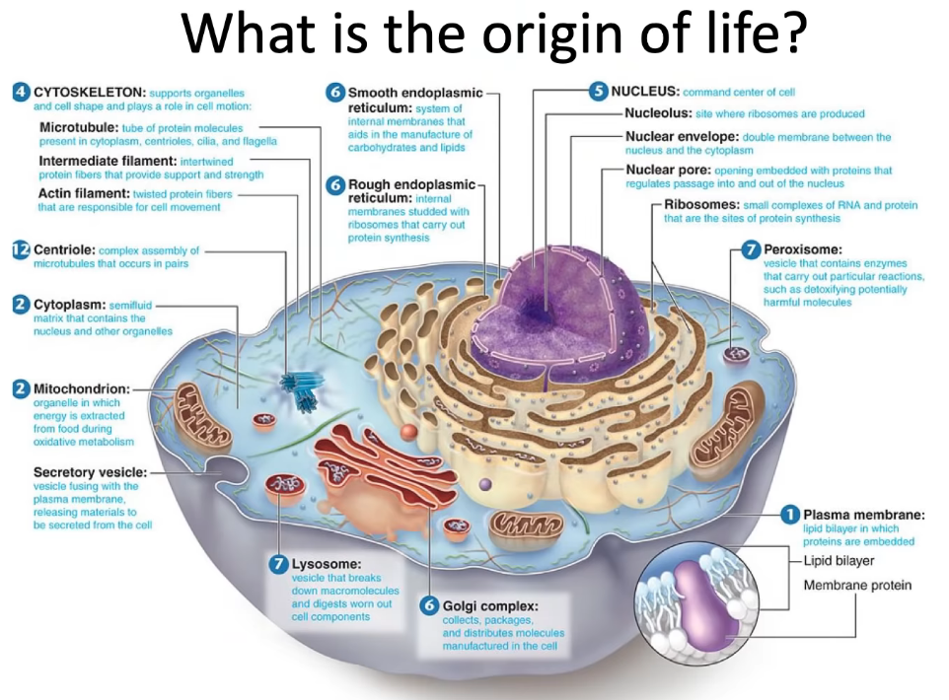

Slide 59
And it's like discovering a bit of plastic and saying, "Any day now we're going to have a flat screen TV, just wait
Notes:
https://familytalk.widen.net/view/pdf/xvgkmz97gm/03072022ISATHEISMDEAD1.pdf?u=c3crpv

Slide 60
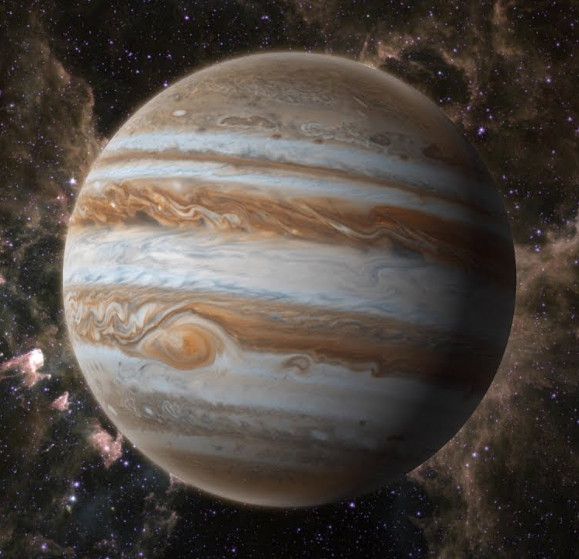
Notes:
https://i.ytimg.com/vi/PtkqwslbLY8/maxresdefault.jpg

Slide 61
Science now tells us that if Jupiter weren't there with its tremendous size and tremendous gravity, we wouldn't be here. Why?
Notes:
https://familytalk.widen.net/view/pdf/xvgkmz97gm/03072022ISATHEISMDEAD1.pdf?u=c3crpv

Slide 62
Because it has so much gravity that it pulls away the asteroids and the meteorites and the comets sufficiently that we are not bombarded with them every day. Asteroids, we're hit by them all the time, but they're fairly small and it's fairly rare.
Notes:
https://familytalk.widen.net/view/pdf/xvgkmz97gm/03072022ISATHEISMDEAD1.pdf?u=c3crpv

Slide 63
But one of them hit Tunguska, Siberia, 1908, it was ~180 feet. And it instantly flattened 80 million trees instantly with the explosive power of 1000 Hiroshima bombs.
Notes:
https://familytalk.widen.net/view/pdf/xvgkmz97gm/03072022ISATHEISMDEAD1.pdf?u=c3crpv

Slide 64
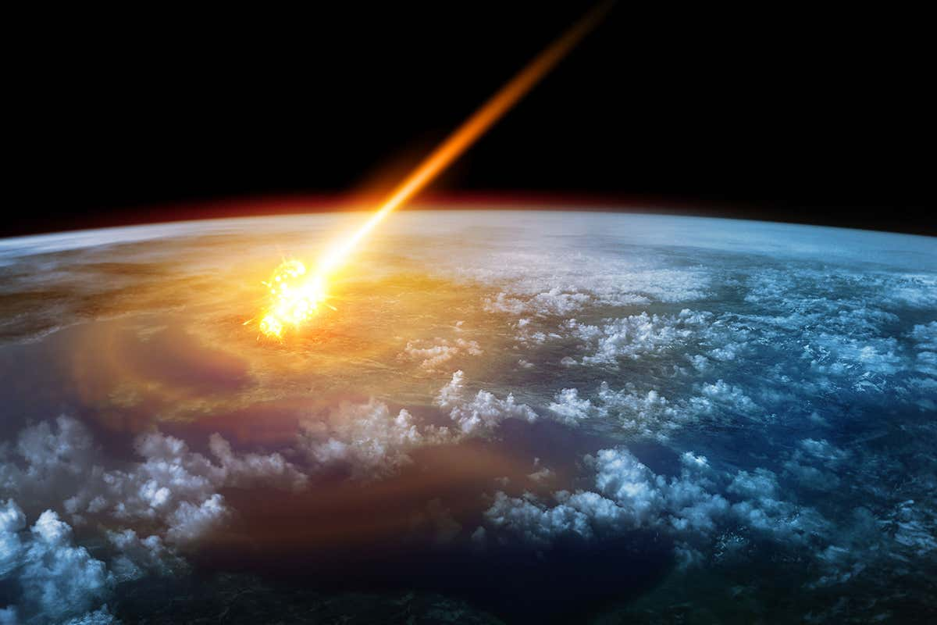

Slide 65
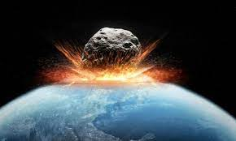
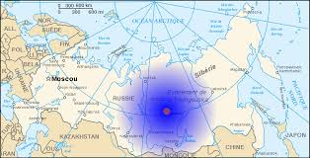
flattened 80 million trees instantly with the explosive power of 1000 Hiroshima bombs.
Notes:
https://encrypted-tbn0.gstatic.com/images?q=tbn:ANd9GcQhLe_cRFUzljVMYRaNjAoNZOWth0SOvPa3Bir0o-3ahVWFIYHxuWP-7zHa-RYDFdGeKMY&usqp=CAU
https://encrypted-tbn0.gstatic.com/images?q=tbn:ANd9GcQx4Lg2ovsFaLQeYhgF2UNBs4iYm7qRZnLa2Q&usqp=CAU

Slide 66
If there's no God, and you evolved out of the primordial soup, your life has no more value than a cockroach or a rat or a rock. And you understand that, right? And they'd say, “Well, I create my own meaning.”
Notes:
https://familytalk.widen.net/view/pdf/xvgkmz97gm/03072022ISATHEISMDEAD1.pdf?u=c3crpv

Slide 67
So even people who say there's no God, they almost never follow it to the end because it would mean there's literally no meaning in the universe. In other words, if there's no God, and we all evolved out of the primordial soup, out of nothing, by random chance, it literally would mean what is ultimately incomprehensible to us.
Notes:
https://familytalk.widen.net/view/pdf/xvgkmz97gm/03072022ISATHEISMDEAD1.pdf?u=c3crpv
it's impossible, if I said, try really hard to think about a square circle,

Slide 68
The love you have for your parents and your children and your spouse, that's not transcendent, that's just chemicals. So materialists don't talk about it.
Notes:
https://familytalk.widen.net/view/pdf/xvgkmz97gm/03072022ISATHEISMDEAD1.pdf?u=c3crpv

Slide 70
Another example

Slide 71
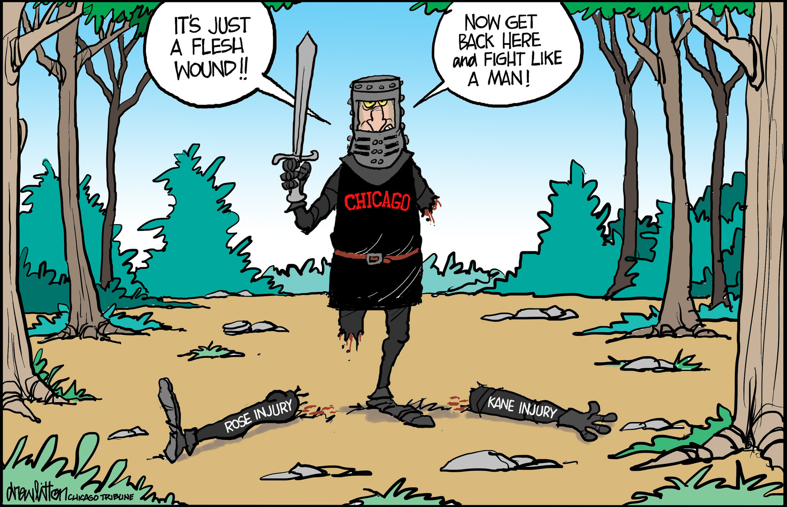
Notes:
Monty Python

Slide 72
It requires a sequential chain reaction of enzymes to bind up a wound when the skin is cut. Each one has a special duty but, if just one is removed, healing will not work. And yet it clots only the wounded area rather than the heart or brain, which would be fatal.
Notes:
https://www.israeltoday.co.il/read/evolution-exposed/?utm_source=acfs&utm_medium=email&utm_term=all&utm_campaign=newsletter-en-2022-03-11

Slide 73
Microbiologist Dr Michael Behe, that there was no way it could have come about through evolution.
Notes:
https://www.israeltoday.co.il/read/evolution-exposed/?utm_source=acfs&utm_medium=email&utm_term=all&utm_campaign=newsletter-en-2022-03-11

Slide 74
Evolution is the gradual increase of genetic information over time. But if all the enzymes are not present from day one, the blood cannot function and life cannot exist. Evolutionary theory provides no satisfactory evidence for how blood came about. It cannot possibly have evolved, so must have been created by a super-intelligent mind. This is why the Bible says that ‘life is in the blood’ (Lev 17:11).
Notes:
https://www.israeltoday.co.il/read/evolution-exposed/?utm_source=acfs&utm_medium=email&utm_term=all&utm_campaign=newsletter-en-2022-03-11

Slide 75
Another example

Slide 76
Dr. Steven Collins ia the archeologist who discovered biblical Sodom.
Notes:
https://familytalk.widen.net/view/pdf/xvgkmz97gm/03072022ISATHEISMDEAD1.pdf?u=c3crpv

Slide 77
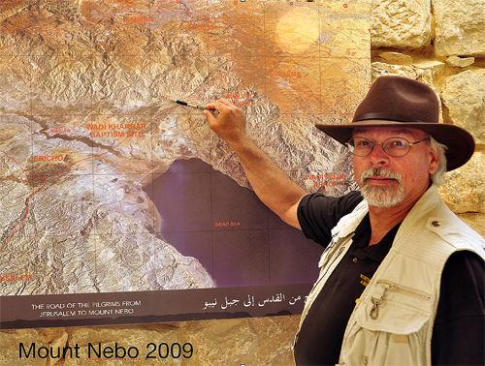
Dr. Steven Collins
pointing to the site of
Tall el-Hammam
Notes:
https://www.ritmeyer.com/wp-content/uploads/2015/05/SC.jpg
Dr. Steven Collins pointing to the site of Tall el-Hammam on an aerial photograph displayed on Mount Nebo in 2009. Photo: Leen Ritmeyer

Slide 78
They excavated, around 2005 down to the level of 1700 BC. He's a ceramic typologist, which means he can just look at something and tell you the date. They dig down a 1700 BC and they find a layer of ash, which is unlike anything anyone's ever seen. It couldn't be caused by an earthquake, couldn't be caused by a fire.
Notes:
https://familytalk.widen.net/view/pdf/xvgkmz97gm/03072022ISATHEISMDEAD1.pdf?u=c3crpv

Slide 79
Pithos Jar
Notes:
https://rumblemuseumobjectaday.files.wordpress.com/2020/05/4428fb4e463147a74bdfaf59db9d97c6.jpg
https://rumblemuseumobjectaday.wordpress.com/2020/05/14/day-33-pithos-jar/

Slide 80
Instantly he knows. He knows even what the part of the shoulder of a large pithoi jar. He knows, instantly of the era.
Notes:
https://familytalk.widen.net/view/pdf/xvgkmz97gm/03072022ISATHEISMDEAD1.pdf?u=c3crpv

Slide 81
He finds it and sees that it has a glassy green glaze on it. Well, now he's got a problem because he says the technology for glaze or glass was not invented until the eighth century AD, that's 24 centuries after. He's very confused. So he takes it to a lab among with other things in New Mexico and they tell him that the woman who takes it to look at it says
Notes:
https://familytalk.widen.net/view/pdf/xvgkmz97gm/03072022ISATHEISMDEAD1.pdf?u=c3crpv

Slide 82
"Oh, a nice piece of trinitite." Now, when he found it in Jordan where he was digging and he looked at it and handed it up to a guy, that guy was also from New Mexico, and that guy said, "Oh, nice piece of trinitite." Or, "It looks like trinitite." When the atom bombs were being tested in the desert of New Mexico, Oppenheimer the physicist named it Trinity site for various reasons.
Notes:
https://familytalk.widen.net/view/pdf/xvgkmz97gm/03072022ISATHEISMDEAD1.pdf?u=c3crpv

Slide 83
Science tells us that the only way this piece of pottery could have what it has on it is that this is melted. And the temperature had to be 5,000 degrees Fahrenheit for 20 or 30 seconds.
Notes:
https://familytalk.widen.net/view/pdf/xvgkmz97gm/03072022ISATHEISMDEAD1.pdf?u=c3crpv

Slide 84
There's no fire that can do that. The ash had distributed in it, it was about five feet in depth across this whole vast, huge city of that era, huge city. And all through it, they found little tiny bits of charred human bone, melted bits of brick, things that nobody had ever seen.
Notes:
https://familytalk.widen.net/view/pdf/xvgkmz97gm/03072022ISATHEISMDEAD1.pdf?u=c3crpv

Slide 85
And it was churned so much that they called it the cuisine art effect. They said, "We've never seen a destruction matrix like this. This just was unheard of. What is this?" So all the scientists pour over this stuff and I mean, all kinds of scientists, and they say,
Notes:
https://familytalk.widen.net/view/pdf/xvgkmz97gm/03072022ISATHEISMDEAD1.pdf?u=c3crpv

Slide 86
"There's only one thing that could have caused everything that we see here. It's very simple. We call that a cosmic airburst event." What is that? That is when a meteor comes from far away, comes into our atmosphere at about 35,000 miles an hour and explodes from the heat, maybe five miles above the surface of the earth
Notes:
https://familytalk.widen.net/view/pdf/xvgkmz97gm/03072022ISATHEISMDEAD1.pdf?u=c3crpv

Slide 87
Now this happened, as I said in Tunguska, Siberia in 1908. So we can know what that does exactly. It creates winds of 700 miles an hour. The temperature of the initial explosion is something like 300,000 degrees Fahrenheit. I mean, the temperature of the sun is like 10,000 degrees Fahrenheit.
Notes:
https://familytalk.widen.net/view/pdf/xvgkmz97gm/03072022ISATHEISMDEAD1.pdf?u=c3crpv

Slide 88
So they know the only thing that could have caused what happened at this spot was a cosmic airburst event about the same size, 180 feet maybe in diameter, meteor comes down, explodes, vaporizes every human, vaporizes every building, including bricks, brick walls 12 feet deep, thick, just nothing.
Notes:
https://familytalk.widen.net/view/pdf/xvgkmz97gm/03072022ISATHEISMDEAD1.pdf?u=c3crpv

Slide 89
Above the level of 1700 BC, for seven centuries they find absolutely nothing. For seven centuries no human beings settled on this spot because it was so obliterated and I would think haunted in the minds of people. Such an example of horror, unprecedented horror.
Notes:
https://familytalk.widen.net/view/pdf/xvgkmz97gm/03072022ISATHEISMDEAD1.pdf?u=c3crpv

Slide 90
The grand excuse

Slide 91
They go to something called the multiverse theory. Have you heard that? There's zero evidence for it. But they said, "Well look, if this universe is perfect in every way, there's probably a zillion other universes and we just happen to be in the one that has Arizona.
Notes:
https://familytalk.widen.net/view/pdf/xvgkmz97gm/03072022ISATHEISMDEAD1.pdf?u=c3crpv

Slide 92
The Scripture, when the enemy comes in like a flood, the spirit of God will raise up a standard against him. Now you understand a standard, I don't mean like a standard, like I have my standards. We mean a standard like a battle standard, a battle flag.
Notes:
https://familytalk.widen.net/view/pdf/xvgkmz97gm/03072022ISATHEISMDEAD1.pdf?u=c3crpv

Slide 93
Woody Allen, if you've ever heard him in interviews, when he talks about there's no God and that means the universe is absurd.
Notes:
https://familytalk.widen.net/view/pdf/xvgkmz97gm/03072022ISATHEISMDEAD1.pdf?u=c3crpv

Slide 94
Dylan Thomas the poet claimed to be an atheist, but in his famous poem, most of you've heard, “Do not go gentle in to that good night, but rage, rage against the dying of the light.” His father is dying and even though he claims to be an atheist, he knows there is something worth raging against that death is not ... If we were nothing, dying is nothing, but he's telling his father rage, rage against the dying of the light.
Notes:
https://familytalk.widen.net/view/pdf/xvgkmz97gm/03072022ISATHEISMDEAD1.pdf?u=c3crpv

Slide 95
John-Paul Sartre and Albert Camus, who the premier philosophers of the 20th century, they were deadly serious about atheism and they were not happy about it.
Notes:
https://familytalk.widen.net/view/pdf/xvgkmz97gm/03072022ISATHEISMDEAD1.pdf?u=c3crpv
I grew up on Albert Camus The Stranger

Slide 96
Camus and Sartre, these are the two most famous atheist practically of the 20th century. They looked more deeply into the abyss of meaninglessness than anybody and they tried to come up with an ethical system in a world without God.
Notes:
https://familytalk.widen.net/view/pdf/xvgkmz97gm/03072022ISATHEISMDEAD1.pdf?u=c3crpv

Slide 97
These two famous atheists who were not buddies, they died 20 years apart. Camus was killed in a car crash at age 47 around 1960. Sarte died in about 1980. He was about '80. Both of them, totally independently of each other came to believe in God.
Notes:
https://familytalk.widen.net/view/pdf/xvgkmz97gm/03072022ISATHEISMDEAD1.pdf?u=c3crpv

Slide 98
Bonhoeffer went to the gallows, he didn't hope he was going to the presence of God. I'm telling you, he didn't hope. Because if you just hope that you're going to the presence of God, you never would've lived in a way that led you to those gallows. When you know whose you are and who died for you, when you know these things are true, they're not a truth, they're not nice ideas, they're true.
Notes:
https://familytalk.widen.net/view/pdf/xvgkmz97gm/03072022ISATHEISMDEAD1.pdf?u=c3crpv

Slide 99
The Lord wants us to fight to win. He doesn't want us to fight in the flesh. He wants us to fight on our knees and prayer, but He also wants us to fight by getting involved in school boards, getting involved politically, giving as much money as the government still allows you to have for God's purposes. Because if you don't all use all your bullets now, they may be confiscated five years from now.
Notes:
https://familytalk.widen.net/view/pdf/xvgkmz97gm/03072022ISATHEISMDEAD1.pdf?u=c3crpv
All this also means that if you got into the Kingdom for comfort, for grand schemes of world influence, which were partially my motives, this is NO OPTION. This is just reality.

Slide 100
^{Yeshayahu 59.115-17} Adoni saw it, and it displeased him that there was no justice. He saw that there was no one, was amazed that no one interceded. Therefore his own arm brought him salvation, and his own righteousness sustained him. He put on righteousness as his breastplate, salvation as a helmet on his head.

Slide 102
^{Mes. Jews/Hebrew 11: 3} By trusting, we understand that the universe was created through a spoken word of God, so that what is seen did not come into being out of existing phenomena.

Slide 103
So, the is not just info. Actionable!
Realize we are sinners and repent before G-d’s holiness.
Believe and receive the Son, the Messiah.
Immerse yourself in His word! Shma שמע and do!
Lead someone else
Notes:
What did you hear in His word today? What are you doing with what you heard?

