Slide 1
e-handout
To have these notes
without taking notes
Go to OrHaOlam.com
Click on Messages tab,
2022 Messages

Slide 2
What’s the difference between a hippo and a zippo?

Slide 3
What’s the difference between a hippo and a zippo? One is really heavy and the other is a little lighter.

Slide 4
Two windmills are standing in a wind farm. One asks, “What’s your favorite kind of music?

Slide 5
Two windmills are standing in a wind farm. One asks, “What’s your favorite kind of music?
The other says, “I’m a big metal fan.”

Slide 6
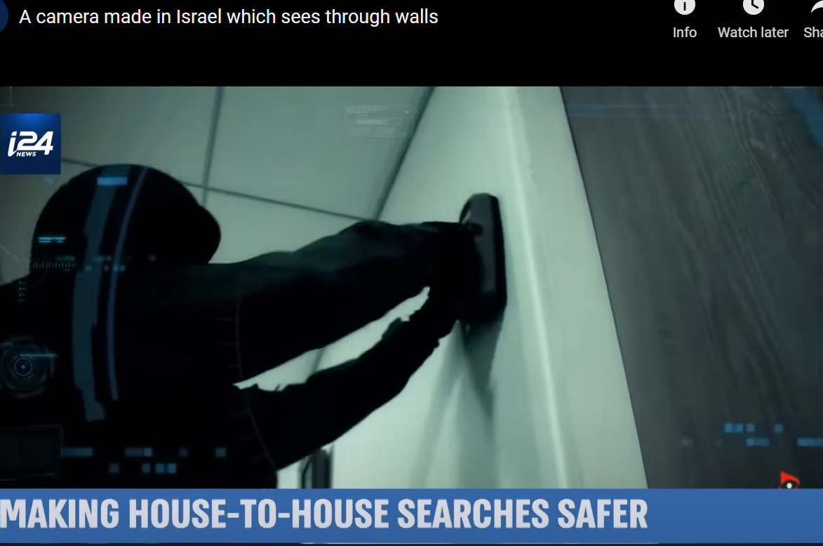
Notes:
https://youtu.be/8wDVwwuBAss
Last time we spoke of an Israeli security invention that can see through walls.

Slide 7
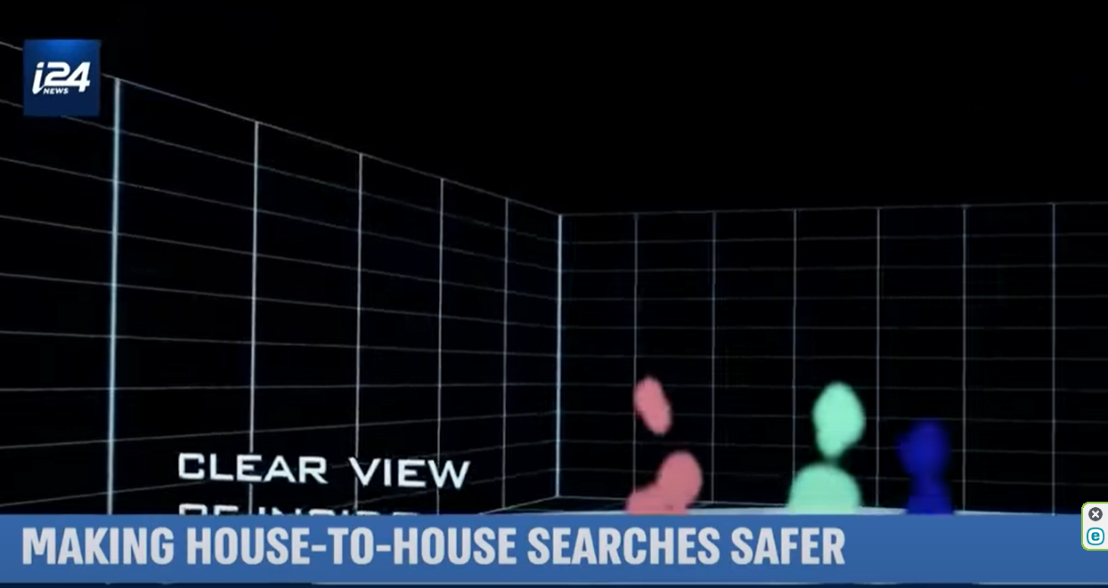
Notes:
https://youtu.be/8wDVwwuBAss

Slide 8
The future is like that.
We don’t know what’s coming, what’s on the other side of the wall of time.
Notes:
Danger, doom, prosperity, health, love, rejection…

Slide 9
The present is like that.
We don’t know WHY things are happening, what purpose.
We don’t know what is in people’s minds; why people do what they do, or how to love them in a way that will be received.
Notes:
Their minds and hearts are walled off to us.
Life’s purposes are veiled to us.

Slide 10
Faith in the atoning death, resurrection, and life in us and for us, of Yeshua the Messiah, is our way of “seeing” and dealing with the unknown present and future.
Notes:
Danger, doom, prosperity, health, love, rejection…

Slide 11
MJ 10 closes with the exhortation:
So don’t throw away that courage of yours, which carries with it such a great reward. For you need to hold out; so that, by having done what God wills, you may receive what he has promised… The person who is righteous will live his life by trusting.

Slide 12
Hebrew/Tanakhic source:
^{Hab 2.2.4} “the righteous shall live by Emunah אמונה Faith.”
צַדִּיק בֶּאֱמוּנָתוֹ יִחְיֶה.
Tsadeek beh-emunato yikhyeh
Faith is G-d’s mode for us to see into life: past, present, future.
Notes:
Originally written by when questioning the horrific Babylonian conquest and destruction and exile.
Did you have to invoke this, this week? I did. Reversals!!

Slide 13
,
Part 2

Slide 14
^{Mes Jews/Hebrews 11.01-03} Now faith is the substance of things hoped for, the evidence of realities not seen. For by it the elders received commendation. By faith we understand that the universe was created by the word of God, so that what is seen did not come from anything visible.
Notes:
Amy Jill Levine: Faith carries overtones of endurance, trust, and insight into spiritual reality. Insight into invisible things, beyond the walls.

Slide 15
We don’t know what the outcome of the Russian invasion of Ukraine will be.

Slide 16
Ukrainian Experts Suggest 5 Potential Outcomes For the Russian Invasion
Scenario 1: Attempted Blitz A quick defeat and surrender by Ukraine was something the Russian president’s generals failed to deliver.
Notes:
https://www.theepochtimes.com/ukrainian-experts-suggest-5-potential-outcomes-for-the-russian-invasion_4314868.html
Putin thought he would be welcomed, and had broken treaties to justify it.

Slide 17
Historians who argue that the Soviets were led to believe that NATO would not expand farther to the east. No binding, legal agreement ever codified the terms that Putin’s camp now say were violated.
Notes:
https://www.theguardian.com/world/2022/jan/12/russias-belief-in-nato-betrayal-and-why-it-matters-today

Slide 18
Scenario 2: Shades of Syria
like the protracted conflict in Syria that began in 2011. Or like Afghanistan.
Notes:
Afghanistan, they take credit for the demise of the Soviet Union. We credit Reagan, if anyone.
https://www.theepochtimes.com/ukrainian-experts-suggest-5-potential-outcomes-for-the-russian-invasion_4314868.html

Slide 19
Scenario 3: World War III
Ukraine and the rest of the world held their breath on Feb. 27 after Putin ordered his country’s nuclear forces to be on “high alert.” Putin would lose everything. Anyone involved in this [a nuclear strike] will be judged by history forever.

Slide 20
Scenario 4: Diplomacy Prevails
Diplomacy is still possible due to a combination of enormous pressure from the West and Russia’s economy imploding from heavy sanctions. People have lost their entire life savings in just a few days.” This includes the $11 billion Nord Stream 2 pipeline project.
Notes:
https://www.theepochtimes.com/ukrainian-experts-suggest-5-potential-outcomes-for-the-russian-invasion_4314868.html

Slide 21
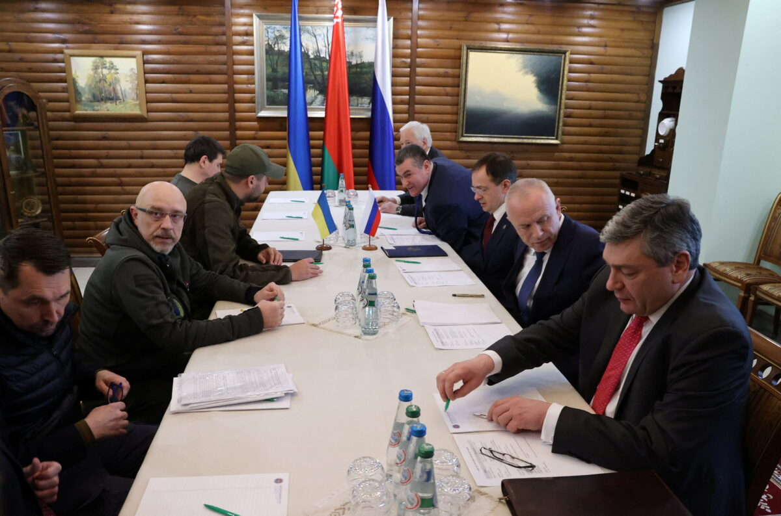
Russian and Ukrainian officials in talks in
the Brest region, Belarus, on March 3, 2022.
(Maxim Guchek/BelTA via Reuters)
Notes:
https://www.theepochtimes.com/ukrainian-experts-suggest-5-potential-outcomes-for-the-russian-invasion_4314868.html

Slide 22
Scenario 5: Rebellion From Within
Some analysts believe the crippling effect of the sanctions and heavy losses of Russian soldiers in Ukraine could snowball into a rebellion too big to stop, leading Putin’s people to remove him from power.

Slide 23
Russian Law enforcement agents have arrested 7,678 protesters in dozens of Russian cities for demanding a halt to the invasion of Ukraine.

Slide 24
Notes:
https://youtu.be/l7CfoDByXso

Slide 25
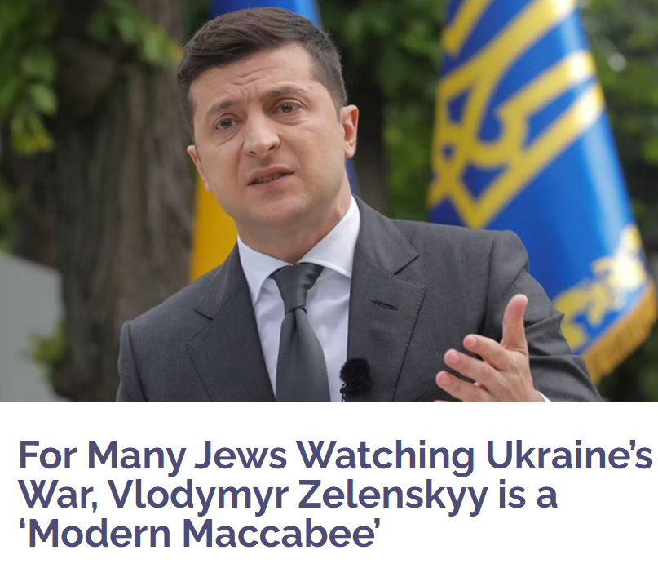
Notes:
https://vfinews.com/news/russia-strikes-babyn-yar-holocaust-memorial-site-in/for-many-jews-watching-ukraines-war-vlodymyr-zelenskyy
We just don’t know.

Slide 26
,
Part 2

Slide 27
^{Mes Jews/Hebrews 11.01-02} Now faith is the substance of things hoped for, the evidence of realities not seen. For by it the elders received commendation.
1. Faith in Yeshua to LIVE

Slide 28
Faith/pistis is always a gift from God, and never something that can be produced by people…It is "God's divine persuasion" –
and therefore
distinct from human
belief (confidence),
yet involving it.
Notes:
https://biblehub.com/greek/5287.htm That is, we exercise it, but G-d by the Ruakh responds and empowers it. So, penetrates time and circumstances.

Slide 29
hupostasis: a support, substance, steadiness, hence assurance (lit: an underlying), (a) confidence, assurance, (b) a giving substance (or reality) to, or a guaranteeing, “title of possession” evidence
Notes:
https://biblehub.com/greek/5287.htm

Slide 30
elegchos: a proof, test, that by which a thing is proved or tested
You just know that you know that you know. Sometimes decide.
Notes:
Decide what to believe. Lies and accusations and discouragement of the Enemy, or the Promises of G-d
https://biblehub.com/greek/5287.htm

Slide 31
“The righteous shall live by Emunah אמונה Faith.”
צַדִּיק בֶּאֱמוּנָתוֹ יִחְיֶה.
Tsadeek beh-emunato yikhyeh
Notes:
Faith is the means by which we see through the walls of time and circumstances.
Righteous: saved eternally, righteous in community
By his faith: not by himself, his strength, by his social and family support, but by faith in the atoning death and resurrection of the Messiah Yeshua
Live: strength, joy, dependence GIVE not from spouse, from kids, from community.

Slide 32
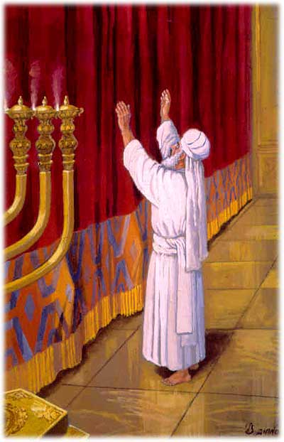
Why barefoot?
Perhaps ~Moshe before the bush. Surrender our control, our power.
Notes:
Comfort and protection of footwear.
Yom Kippur Day of Atonement whites

Slide 33
Ultimately, faith is NOT about us and our needs. It’s about the mystery of the Holy One, and our barefoot (self abandoning) surrender to HIM.
Messiah say about such absolute surrender?
Notes:
To see beyond the wall of life’s mystery

Slide 34
^{Mtt 10.29-32} Aren't sparrows sold for next to nothing, two for an assarion? Yet not one of them will fall to the ground without your Father's consent. As for you, every hair on your head has been counted.
Notes:
a very small coin; according to them it contained four grains of silver; was the ninety sixth part of a "sela", or shilling Maimon. in Misn. Peah, c. 8. sect. 1.
not one of them is taken in a snare, or killed with a stone, or shot flying, or sitting, but by the will of God: from whence it may be strongly concluded, that nothing comes by chance; that there is no such thing as contingency with respect to God, though there is to men, with respect to second causes; that all things are firmly ordained by the purpose of God, and are wisely ordered by his providence:
Just like we can’t grasp the HOLINESS of G, we can’t grasp his purposes in all things. But we can worship!! In ALL circumstances!!

Slide 35
^{Mtt 10.29-32} So do not be afraid, you are worth more than many sparrows. Whoever acknowledges me in the presence of others I will also acknowledge in the presence of my Father in heaven.

Slide 36
^{T’hillim Ps 73.21-25} When I had a sour attitude and felt stung by pained emotions, I was too stupid to understand; I was like a brute beast with you. Nevertheless, I am always with you; you hold my right hand.
Notes:
Moshe took off his sandals to worship the holy. We need to take off our self protection, defensiveness, justification, woundedness, revenge, accusation, anger, walls, and instead: worship. Worship Him who does all things well. Thank him for the worst. Not that the worst is not so bad, but the HE is working through it. Even when we don’t see it…No second causes.
If someone sins, it’s wrong. But the effect on US is processed by Divine providence. Wrong to them, right to us!!
If we sin, it’s wrong. But consequences of our sin are processed by Divine providence. So we can repent and still praise!! Get irritable? Provoke reaction? Repent, and praise G for the reaction!

Slide 37
^{T’hillim Ps 73.21-25} You will guide me with your advice; and afterwards, you will receive me with honor. Whom do I have in heaven but you? And with you, I lack nothing on earth.

Slide 38
Notes:
A word of disclaimer on Shalom Arush’s book. His concepts and interp of scripture is EXCELLENT. Some of his illustrations are from Kabbalah, some about reincarnation. I am NOT endorsing those illustrations. Men’s group remember we had to filter some things.
Why use? Marriage book that we did in Men’s Group called men to a deeper level of the crucified life than Dobson, Trent, Smalley, etc. Not use that terminology.
This book calls us to an amazing level of faith. Those who remember David Dreiling, highly endorsed.

Slide 39
Forms of doubt
Doubt that the minutest details of our lives are the providence of a loving G-d and for our redemption.

Slide 40
Forms of doubt
Doubt that the minutest details of our lives are the providence of a loving G-d and for our redemption.
Doubt that we can speak effectively to G-d about every circumstance, in surrender → praise, and prayer.
Notes:
A midrash, a fanciful story to interpret scripture. Not necessarily true. Maybe, but illustrative. Moshe prayed 515 times to enter the promised land. Then G-d told him to stop. One more prayer and He’d have to reverse.
Don’t really think it happened, but it’s an illustration that shows the power of prayer.

Slide 41
Forms of doubt
Doubt that He loves us, and desires to help us, especially when we talk to Him
Doubt that G-d has power, mercy, and compassion that are limitless to work wonders.

Slide 42
^{T’hillim Ps 147.10-12} He takes no delight in the strength of a horse, no pleasure in a runner's speed. ADONI takes pleasure in those who fear him, in those who wait for his grace. Glorify ADONI, Yerushalayim! Praise your God, Tziyon!
Notes:
It’s NOT our abs, or figure, or impressive skills and knowledge, or financial resources that give G-d pleasure. It’s glorifying G-d in all. This is VERY liberating.

Slide 43
Levels of living faith in Messiah.
אֱמוּנָה Emunah
faith, trust, confidence
Active faith.

Slide 44
“The righteous shall live by Emunah אמונה Faith.”
צַדִּיק בֶּאֱמוּנָתוֹ יִחְיֶה.
Tsadeek beh-emunato yikhyeh
Notes:
Faith is the means by which we see through the walls of time and circumstances.
Righteous: saved eternally, righteous in community
By his faith: not by himself, his strength, by his social and family support, but by faith in the atoning death and resurrection of the Messiah Yeshua
Live: strength, joy, dependence GIVE not from spouse, from kids, from community,
Consider the Greek…

Slide 45
Basic level Emuna: firm belief that EVERYTHING comes from Adoni by way of perfect Divine providence. No secondary causes.
Notes:
Like holiness. We accept G-d goodness, and praise.
We fall before His Holiness. We praise ALL His works. ALL. Gan Emuna 21, 22
We talk about Sozo ministry, which involves finding the lies about life and G-d that we’ve received, renouncing, and asking G-d for revelation of truth.
This is generalized Sozo, כי the basic lie is that life/G-d is mean, against us.
We commit to praise in everything. Even the consequences of our and others failures. Still in His hands.

Slide 46
Intermediate level: belief that everything that comes from Adoni is for the very best. All troubles have their purpose. Therefore PRAISE. Without understanding the purpose.
Notes:
Like holiness. We accept G-d goodness, and praise.
We fall before His Holiness. We praise ALL His works. ALL. Gan Emuna 21, 22
We talk about Sozo ministry, which involves finding the lies about life and G-d that we’ve received, renouncing, and asking G-d for revelation of truth.
This is generalized Sozo, כי the basic lie is that life/G-d is mean, against us.
We commit to praise in everything. Even the consequences of our and others failures. Still in His hands.

Slide 47
Upper level: Belief that our joyful task is to discern the message to us in EVERY trouble.
Notes:
Message NOT = punishment. Iyov/Job was not punished, but called to go higher. Tho He slay me, yet will I trust Him.
Torah re curses:

Slide 48
^{Dvarim 28.45-46} "All these curses will come on you, pursuing you and overtaking you until you are destroyed, because you didn't pay attention to what ADONI your God said, observing his mitzvot and regulations that he gave you. These curses will be on you and your descendants as a sign and a wonder forever. WHY sooo intense??

Slide 49
^{Dvarim 28. 47-48} Because you didn’t serve Adoni your God with joy and gladness in your heart when you had such an abundance of everything; Adoni will send your enemy against you; and you will serve him when you are hungry, thirsty, poorly clothed and lacking everything; he will put a yoke of iron on your neck until he destroys you.
Notes:
Here it is: it’s not just obeying.
OK, won’t steal, fornicate, pornicate, prevaricate, pontificate (pride), rage, the forbidden ate (all the dietary laws)
It would be nice, but NOT good enough

Slide 50
^{T’hillim/Ps 32.9-11} Don't be like a horse or mule that has no understanding, that has to be curbed with bit and bridle, or else it won't come near you. Many are the torments of the wicked, but grace surrounds those who trust in ADONI. Be glad in ADONI; rejoice, you righteous! Shout for joy, all you upright in heart!
Notes:
Some of us have bit and bridle religion. Horseback riding is really fun.
What about when we fail, and don’t rejoice, and get angry and depressed, and blow it?
We can still come before Him, repent, and praise Him that He will work even our failure for good. Trust Him in all.

Slide 51
^{Phil. 3.8-10} Because of Him…I gave up everything and regard it all as garbage, in order to gain the Messiah, and be found in union with Him, not having any righteousness of my own based on legalism,

Slide 52
^{Phil. 3.8-10} but having that righteousness which comes through the Messiah's faithfulness, the righteousness from God based on trust.
Notes:
Here’s where Messianics have a different foundation from others that keep Torah. We keep Torah as an expression of our faith and joy, and the power of the Blood of Yeshua, and if we’re Jewish, of our covenant with G.
Torah earns us NOTHING.

Slide 53
^{Phil. 3.8-10} Yes, I gave it all up in order to know him, that is, to know the power of his resurrection and the fellowship of his sufferings as I am being conformed to his death.
Notes:
I can handle sufferings that I understand the purpose. I can praise in that…

Slide 54
^{1 Thes. 5. 16-22} Always be joyful. Pray regularly. In everything give thanks, for this is what God wants from you who are united with the Messiah Yeshua. Don't quench the Spirit...

Slide 55
^{1 Thes. 5. 16-22} May the God of shalom make you completely holy - may your entire spirit, soul and body be kept blameless for the coming of our Lord Yeshua the Messiah.
Notes:
Weird idea. Always be happy. Only if have active faith, Emuna about life.
NOT talking about Alfred E Newman. What, me worry?

Slide 58
^{Mes Jews/Hebrews 11.01-02} Now faith is the substance of things hoped for, the evidence of realities not seen. For by it the elders received commendation.
2. Faith for Yeshua: His will, His expression of life

Slide 59
So, Rabbi, you may ask, what is your “things hoped for” for life, for Or HaOlam.
Notes:
Here is where my faith lives…
Love G-d with all our hearts.

Slide 60
So, Rabbi, you may ask, what is your “things hoped for” for life, for Or HaOlam.
Mystery of the revelation of the Glory of G-d in Messiah.
Notes:
Here is where my faith lives…
Love G-d with all our hearts.

Slide 61
Why do some cover their eyes with the right hand when saying the Shma?
The simple answer is that doing so allows one to concentrate properly without visual distractions.
Notes:
https://www.chabad.org/library/article_cdo/aid/705353/jewish/The-Shema.htm Modified

Slide 62
It is crucial to have the proper intention when reciting the first verse of Shema, even more so than during other parts of prayer. As we say the words, we focus not just on the meaning of the words, but also hearing from visualizing the Messiah, and on accepting the yoke of heaven.
Notes:
https://www.chabad.org/library/article_cdo/aid/705353/jewish/The-Shema.htm Modified

Slide 63
שְׁמַע יִשְׂרָאֵל
יְיָ אֱלהֵינוּ יְיָ אֶחָד
Sh’ma Yis-ra-ayl Ah-do-ni E-lo-hay-nu
Ah-do-ni eh-khad
בָּרוּךְ שֵׁם כְּבוֹד מַלְכוּתוֹ לְעוֹלָם וָעֶד
Ba-rukh shaym k’vod Mal-khu-to l’o-lam va-ed

Slide 64
Hear O Israel
ADONI is our G-d
ADONI is one
Blessed is the name of
His glorious kingdom
forevermore

Slide 65
יֵשׁוּעַ מִנַצֶרֶת הוּא הַמָשִׁיחַ
וְהוּא יְיָ
Yeshua mee-Na-tse-ret
Hoo ha-Ma-shi-akh
v’Hoo Ah-do-ni
Yeshua of Natseret
He is the Messiah
and He is ADONI

Slide 66
2. And the second is like it…

Slide 67
וְאָהַבְתָּ לְרֵעֲךָ כָּמוֹךָ
V’a-hav-tah l’rey-ah-kha kha-mo-kha
And you shall love your neighbor as yourself
Notes:
Not just passively, as a good feeling, “I feel love”

Slide 68
^{Eph 3.8-13} To bring to light the plan of the mystery… and to make all see what is the fellowship of the mystery,…In union with him, through his faithfulness, we have boldness and confidence when we approach God.

Slide 69
^{Gal. 5.13} Brothers and sisters, you were called to freedom—only do not let your freedom become an opportunity for the flesh, but through love serve one another.

Slide 70
Conception >> consumption
Healthy married bodies usually reproduce. [exceptions]
Functioning hospital has ob-gyn, or community has midwives!
Yeshua doesn’t call us to feast for it’s own sake.

Slide 71
^{Mtt. 11.28-30} Come to Me, all who are weary and burdened, and I will give you rest.
Notes:
See there. Just a call to R&R.

Slide 72
^{Mtt. 11.28-30} Come to Me, all who are weary and burdened, and I will give you rest. Take My yoke upon you and learn from Me, for I am gentle and humble in heart, and ‘you will find rest for your souls.’ For My yoke is easy and My burden is light.”
Notes:
Bait and switch??
Deepest rest is serving in love.

Slide 73
^{Mt 16.24-25} Then Yeshua told his talmidim, “If anyone wants to come after me, let him say ‘No’ to himself, take up his execution-stake, and keep following me. For whoever wants to save his own life will destroy it, but whoever destroys his life for my sake will find it.

Slide 74
^{Mtt. 4.19} Yeshua said to them, “Come after me, and I will make you fishers for men!”

Slide 75
^{Mtt 10.38-39} And anyone who does not take up his execution-stake and follow me is not worthy of me. Whoever finds his own life will lose it, but the person who loses his life for my sake will find it.

Slide 76
Chris Hodges: If you are looking for a community in which to be blessed, think again.
If you are looking for a community to receive then GIVE blessing, you found it.
Notes:
What about the Jewish dimension?

Slide 77
^{Beresheet 12. 1-3} Now Adoni said to Avram, “Get yourself out of your country, away from your kinsmen and away from your father’s house, and go to the land that I will show you. I will make of you a great nation,

Slide 78
^{Beresheet 12. 1-3} I will bless you, and I will make your name great; and you are to be a blessing. I will bless those who bless you, but I will curse anyone who curses you; and by you all the families of the earth will be blessed.”

Slide 79
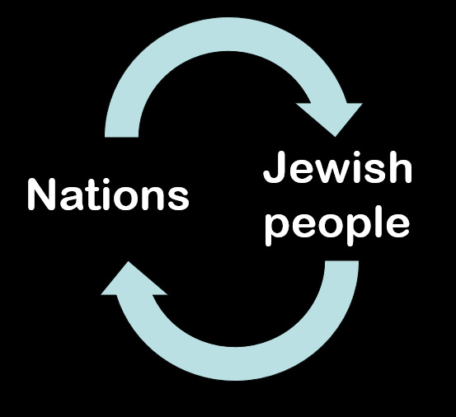
blessing
G-d blesses Jews;
Jews bless Nations;
Nations bless Jewish people
blessing
Notes:
Not exclusively, but inclusively. We DON’T stick just to our own.
Why is the Jewish communication of blessing upside down? Hebrew is right to left. All things a bit disorienting at first.

Slide 80
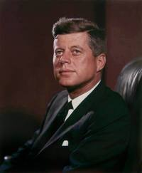
Pres. John F. Kennedy: “Ask not what your country can do for you; ask what you can do for your country.”

Slide 81
A culture of חֶסֶד Khesed kindness, benevolence; goodness, charity, grace; favor, grace;
[92 x in the Hebrew scriptures]
Notes:
Like the Greekk Agape

Slide 82
Hag Purim, the holiday of Purim, is coming up, celebrating the fact that in the ancient Persian Empire [now Iran], about 450 years before the Messiah came to Israel, the government made a plan to murder all the Jewish people.

Slide 83
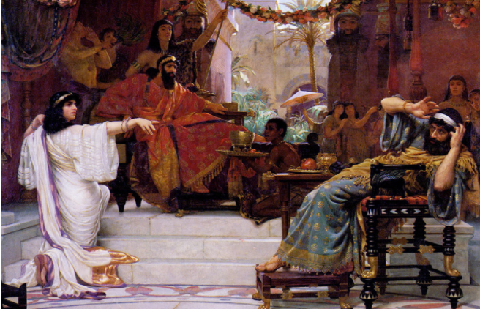
Esther unmasking Haman

Slide 84
An unknown beautiful young woman of faith thwarted the plan, and turned the course of the Empire’s history. Modern history is still filled with horrific threats by tyrants, but Purim is about G-d’s power to bring true liberation and peace!

Slide 85
As a result, an edict was issued then “to commemorate the days on which the Jews obtained rest from their enemies…they were to make them days of celebrating and rejoicing, sending presents of food to their neighbors. ^{Esther 9.22}
מִשְׁלֹחַ מָנוֹת misloakh manot
Notes:
Packing today, distributing tomorrow.

Slide 86
A culture of חֶסֶד Khesed kindness, benevolence; goodness, charity, grace; (flowery) favor, grace;
[92 x in the Hebrew scriptures]
Today we pack. May 12 we distribute. May 20 we welcome.
Notes:
Pack today, deliver next week.
Prepare for visitors. Practice on one another.
Like the Greek Agape

Slide 87
Let people know that THEY are important. Their history and connections are significant. LISTEN to promptings from the Ruakh to communicate their value to G-d, and how to segue to G-d's plan for them, as much as is suitable. Have fun with the people and express love.
Notes:
Packing today, distributing tomorrow.

Slide 88
Schmoozer starters:
Is there anything I can get you? [ice for water, coffee, creamer, sugar, tea]
Notes:
I don’t do this at home. I don’t do this with regular congregants. I don’t care about anyone except my friends and family

Slide 89
Are you from around here? Did you grow up here?
Notes:
This is a very safe and non-invasive question. Whatever they say, play geography with them. If local, talk about KC legendary barbecue, or the Chiefs, or the Truman legacy, or the notorious Pendergast legacy, etc. If East Coast, West Coast, Europe, Latin America, Israel, Asia, Mars, etc., discuss what is interesting and important about that area.

Slide 90
What is your spiritual background? What kind of faith did you grow up in?
Notes:
This will tell you where they are coming from. Whatever their connection, it is significant. Even if they grew up JW's, the JW's are wonderful at outreach.

Slide 91
So, how did you connect with us?
Notes:
This is the most important one, as it tells you what their spiritual direction is. Try to discern if they are saved, or looking for Hebrew roots. If Hebrew roots, try to work in that we love Jewish people and Israel, not just Jewish things. If they are Jewish and looking for connection with G-d, point them to the Jewish Messiah, as Malachi says, the messenger of the covenant, and salvation.

Slide 92
Ask them what their prayer requests might be.

Slide 93
,
Part 2

Slide 94
^{Mes Jews/Hebrews 11.01-02} Now faith is the substance of things hoped for, the evidence of realities not seen. For by it the elders received commendation.
3. Faith in Yeshua in difficulties

Slide 95
What about difficulties?
Sickness
Divisions, oppositions
War

Slide 96
"Andrey spoke with Boris in Kyiv, his cong. had Shabbat services and all-night prayers Friday! All the Christians and Jews are coming together, the Holy Spirit is falling on them in Revival!!! Bringing His entire Body together! Please pray that Revival would breakout in Israel and around the world!
Notes:
From Ron Cantor

Slide 97
(Rabbi Boris in Kyiv has been a dear friend for 20 years and leads the largest Messianic congregation in the world.) And one more testimony from a partner of the gentlemen who sent it to me who is in Lviv. Pastor Igor said: “Please tell your people, because of their prayers, God really fights our battles.
Notes:
From Ron Cantor

Slide 98
The rockets disappear in the air without reaching our homes and no one knows where they go, enemy tanks run out of fuel, Russian troops get lost and ask for directions—
Notes:
From Ron Cantor

Slide 99
that is definitely God because we are dealing with the second strongest army in the world. And this morning Kyiv and other major cities are still free and we in Lviv did not have to run to the basements.”
Notes:
From Ron Cantor

Slide 100
,
Part 2

Slide 101
Faith in Yeshua for LIFE
Faith for Yeshua to serve
Faith in Yeshua in difficulties.

Slide 102
So, we can win in history. Derek Prince's Changing History Through Prayer and Fasting

Slide 103
15 Fasting Benefits for Miraculous Breakthrough
- Renews spiritual vision
- Brings a holy brokenness
- Purifies our hearts
- Humbles our souls
Notes:
https://www.charismanews.com/opinion/heres-the-deal/88404-larry-tomczak-discover-these-15-fasting-benefits-for-miraculous-breakthrough?utm_source=Charisma%20News%20Daily&utm_medium=email&utm_content=subscriber_id:5160390&utm_campaign=CNO%20daily%20-%202022-02-18

Slide 104
- Releases spiritual guidance
- Subdues our flesh
- Heightens spiritual awareness
- Deepens communion with God
- Clears our minds to hear God
- Bring supernatural refreshing
Notes:
https://www.charismanews.com/opinion/heres-the-deal/88404-larry-tomczak-discover-these-15-fasting-benefits-for-miraculous-breakthrough?utm_source=Charisma%20News%20Daily&utm_medium=email&utm_content=subscriber_id:5160390&utm_campaign=CNO%20daily%20-%202022-02-18

Slide 105
- Adds power to prayer
- Brings deliverance
- Enables greater fruitfulness
- Facilitates breakthroughs
- Cleanses the physical body
Notes:
https://www.charismanews.com/opinion/heres-the-deal/88404-larry-tomczak-discover-these-15-fasting-benefits-for-miraculous-breakthrough?utm_source=Charisma%20News%20Daily&utm_medium=email&utm_content=subscriber_id:5160390&utm_campaign=CNO%20daily%20-%202022-02-18

Slide 106
My vision and plan for Or HaOlam
Fast, pray, labor, innovate, love, sacrifice until we see Jewish people, and those of the Nations, won to new LIFE in Yeshua.
My passion in preaching and living.
Every department is a department of outreach!!

Slide 107
,

Slide 108
^{Messianic Jew/Heb 13.12-15} Through him, therefore, let us offer God a sacrifice of praise continually. For this is the natural product of lips that acknowledge his name.
Notes:
.

Slide 109
“the righteous shall live by Emunah אמונה Faith.”
צַדִּיק בֶּאֱמוּנָתוֹ יִחְיֶה.
Tsadeek beh-emunato yikhyeh

Slide 110
^{Mes Jews/Hebrews 11.01-13} Now faith is the substance of things hoped for, the evidence of realities not seen. For by it the elders received commendation.
Notes:
We see through the walls…

Slide 111
Faith in Yeshua for LIFE
Faith for Yeshua to serve
Faith in Yeshua in difficulties.

Slide 112
Do you KNOW Yeshua and the assurance of sins forgiven?
Are you hearing daily from His Word?
How are you applying what you heard?
Are you asking this of another?
Notes:
Who are you discipling, building up?4

