Slide 1
e-handout
To have these notes
without taking notes
Go to OrHaOlam.com
Click on Messages tab,
2022 Messages
Notes:
You may notice that I’m slowing down in my rate of speech. This is because we may be getting language translation equipment for simultaneous translation.

Slide 2
A rabbi, lawyer and doctor all go moose hunting. After 4 days of seeing nothing, on the 5th day the all three crest a hill and see a prize bull moose. The rabbi and the lawyer fire at the same time and the moose drops. The rabbi exclaims, "I got it."
Notes:
From Gavriel Rennels

Slide 3
The Lawyer says, "No I got it." as they begin to argue, the doctor says, OK I can tell you who got it if I examine the moose. After a short examination the doctor says, “The Rabbi got it."
Notes:
From Gavriel Rennels

Slide 4
The lawyer wants to know what evidence the doctor used to determine that the rabbi got the moose.
Notes:
From Gavriel Rennels

Slide 5
The doctor said, " Simple the bullet went in one ear and out the other."
Notes:
From Gavriel Rennels

Slide 8
Passover is soon.
First night Friday, April 15
Synagogue Seder Sunday, April 17
No leavened foods April 15 - 22

Slide 9
Why do we all do Passover / Khag Hamatsot [Holiday of Unleavened bread]?
What does G-d have for us in it?
Notes:
I know that it’s a Bible command, but what does G-d intend?
Your friends, family, schoolmates response?

Slide 11
Liberation Passover:
From Khamets
From sin
From lies of the culture

Slide 12
Liberation Passover:
From Khamets
From sin
From lies of the culture
Notes:
Some definitions…

Slide 13
שְׂאֹר leavening agents s’or
חָמֵץ leavened food khametz
Khametz is a product that is both made from one of five types of grain and has been combined with water and left to stand raw for longer than eighteen minutes and becomes leavened.
Notes:
https://en.wikipedia.org/wiki/Chametz

Slide 14
חִטָּה Wheat Ḥittah
כֻּסְמִין Spelt Kusmin
שְׂעוֹרָה barley Se’orah
שִׁבֹּלֶת שׁוּעָל oats Shibbolet shual
שִׁיפוֹן rye sheefon
Notes:
https://en.wikipedia.org/wiki/Chametz
fox = שׁוּעָל
שִׁבֹּלֶת ear (of corn), stalk (of grain)=

Slide 15
Leavening agents, such as yeast or baking soda, are not themselves khametz. Rather, it is the five fermented grains. Thus yeast may be used in making wine, and kefir.
Notes:
https://en.wikipedia.org/wiki/Chametz
Also Kefir
I wondered about Memuhah: Sephardic Jews have bread fest on the night of the 7th day. Ashkenaz still on matzah. How do they get the yeast so quickly?
A: they always had it.

Slide 16
So it’s a practice in observant Jewish homes to do a THOROUGH Spring cleaning! Get ALL the khametz out of every corner.
Burn the crumbs
And then a prayer of covering.
Notes:
Of course, the best is to eat it all before Passover/

Slide 17
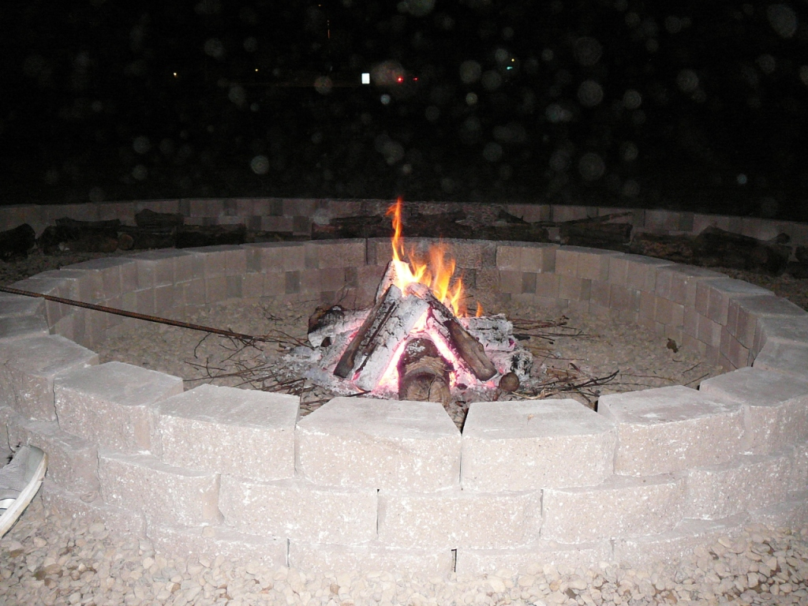

Slide 18
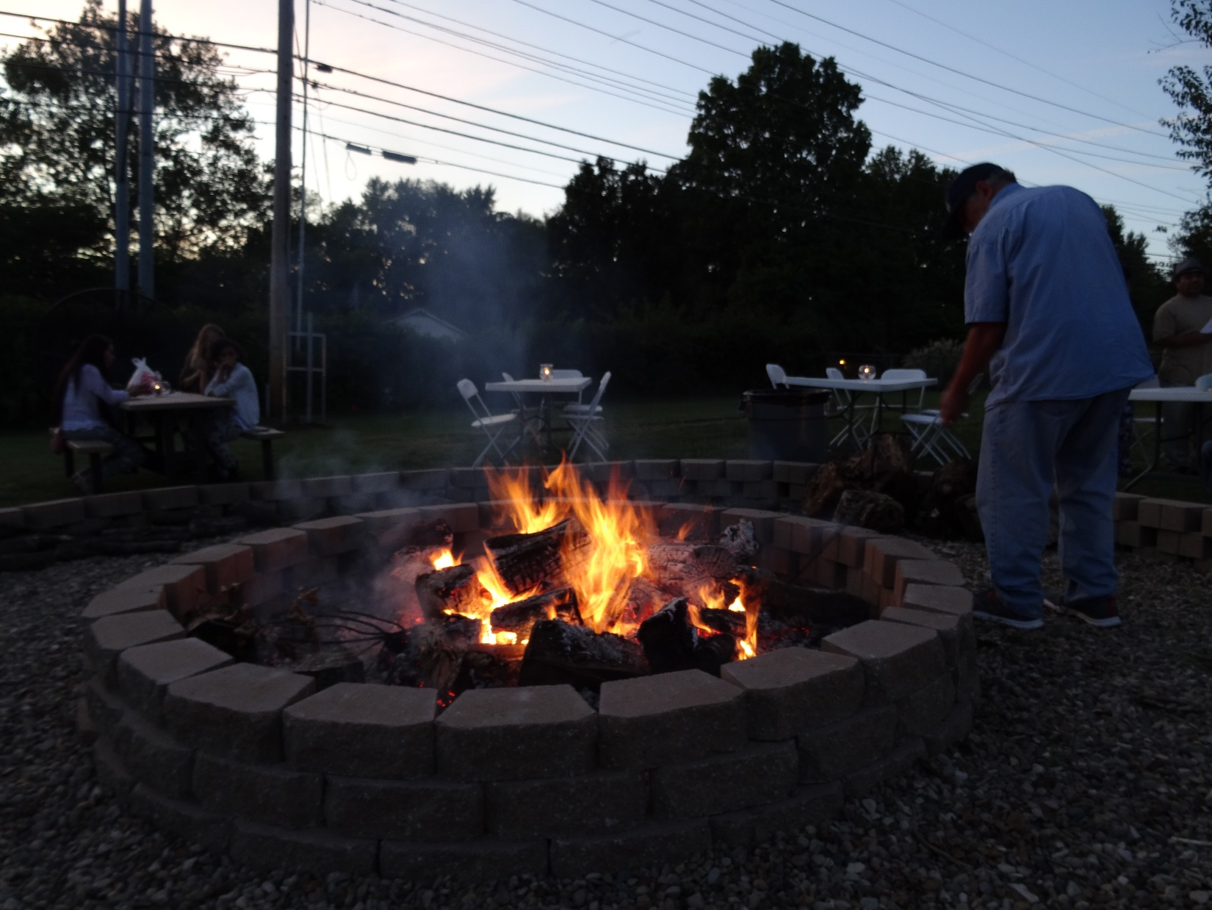
Notes:
Or you could hire a cleaning service…

Slide 19
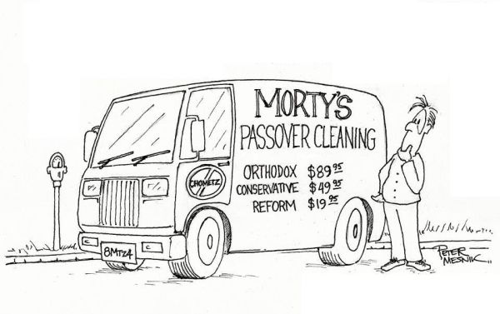
Notes:
https://i.pinimg.com/originals/00/02/ef/0002efad19eea4493078b482c3707d9c.jpg

Slide 20
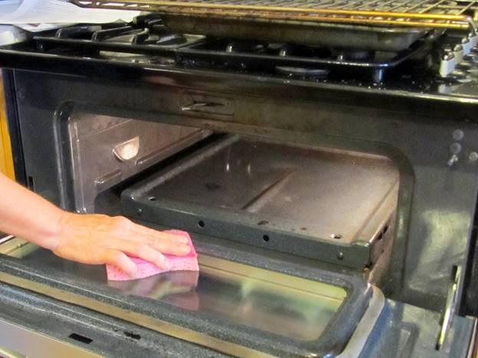

Slide 21
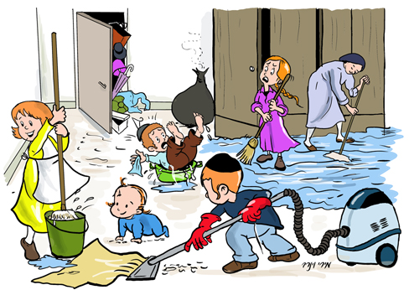
Notes:
http://jewishmom.com/wp-content/uploads/passover-cleaning.jpg

Slide 22
What is the motivation and meaning for believers in the Messiah Yeshua?

Slide 24
Liberation Passover:
From Khamets
From sin
From lies of the culture

Slide 25
^{1 Cor 5.6-8} Your boasting is no good. Don’t you know that a little hametz [yeast] leavens the whole batch of dough? Get rid of the old hametz, so you may be a new batch, just as you are unleavened — for Messiah, our Passover Lamb, has been sacrificed.

Slide 26
^{1 Cor 5.6-8} Therefore let us celebrate the feast not with old hametz, the hametz of malice and wickedness, but with unleavened bread—the matzah of sincerity and truth.
Notes:
Get the leaven out. More than just the physical house cleaning?
Who was this letter addressed to?

Slide 27
Who was this written to ?

Slide 28
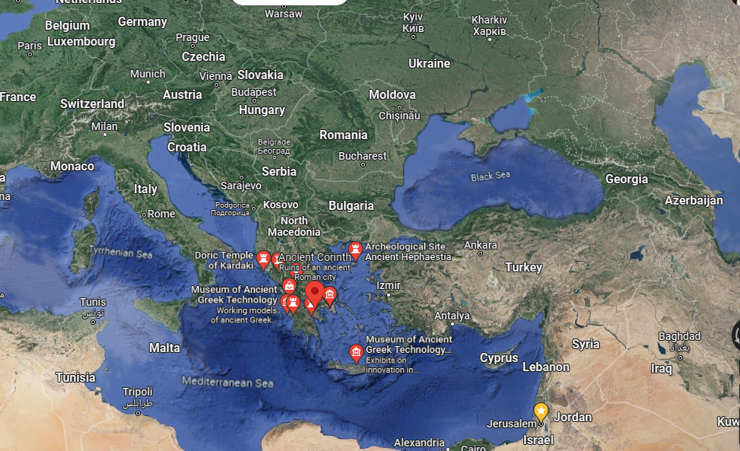
Notes:
Does anyone like landing from outer space.

Slide 29
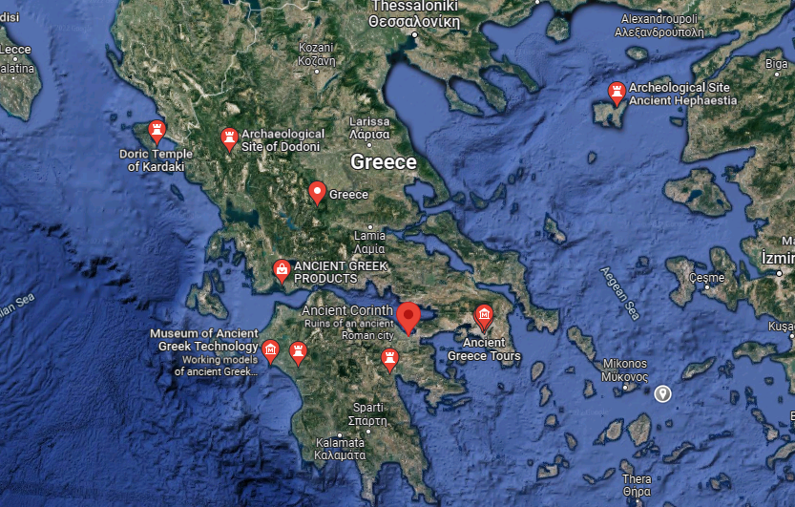
Notes:
Corinth was a Greek city. Rather a wild place. Told to keep Passover. Comparing it to Haight-Ashbury circa 1969. The city was built around two ports and attracted sailors.
Temple of Aphrodite with 2000 prostitutes. Aristophanes coined the verb korinthiazesthai, “to fornicate” (Fr. 354).
https://readingacts.com/2011/10/25/corinth-as-sin-city-2/

Slide 30
^{1 Cor 5.6-8} Therefore let us celebrate the feast.

Slide 33
Notes:
https://www.prageru.com/video/why-you-should-care-about-passover

Slide 34
Themes of Passover in this clip?
Freedom from slavery for Israel
Not just freedom for Jews.
A theme of freedom, exemplified in Harriet Tubman, the Black Moshe.
Notes:
Holiday is called זמן חרותינו zman khayrutenu Season of Our Freedom

Slide 35
Notes:
13 till 50

Slide 36
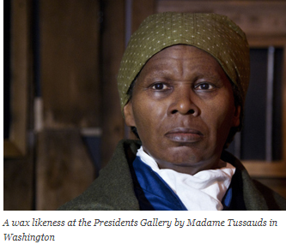
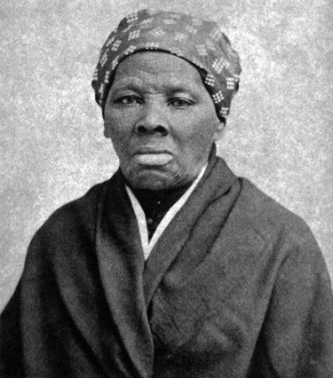
1822-1913

Slide 37
She started work as a housemaid when she was five, enduring whippings and even starvation. As a teenager, during a trip to a dry goods store, she happened to be nearby as an overseer was trying to capture an enslaved person that had left his labor camp without permission.
Notes:
https://www.godreports.com/2016/04/harriet-tubman-she-followed-the-voice-of-god/

Slide 38
The man threw a two-pound weight at the runaway and hit Harriet instead. Part of her skull was crushed, and her very life hung in the balance for days.
Notes:
https://www.godreports.com/2016/04/harriet-tubman-she-followed-the-voice-of-god/

Slide 39
Bleeding and unconscious, she was carried back to her owner’s house and laid on the seat of a loom, where she remained without medical care for two days.
Notes:
https://www.godreports.com/2016/04/harriet-tubman-she-followed-the-voice-of-god/

Slide 40
Then she was sent back into the fields to work. As she bent over the crops, blood and sweat rolled down her face until she couldn’t see and could work no more.
Notes:
https://www.godreports.com/2016/04/harriet-tubman-she-followed-the-voice-of-god/

Slide 41
Tubman began having seizures in the weeks and months that followed her injury and she would fall asleep at irregular times without warning. Her slave master recognized her diminished capacity and tried unsuccessfully to sell her.
Notes:
https://www.godreports.com/2016/04/harriet-tubman-she-followed-the-voice-of-god/

Slide 42
She may have suffered from temporal lobe epilepsy as a result of the damage to her skull, which stayed with Tubman the rest of her life.
Notes:
https://www.godreports.com/2016/04/harriet-tubman-she-followed-the-voice-of-god/

Slide 43
While Tubman never learned to read, she had a phenomenal memory and memorized long passages of Scripture that informed her captivating oratory later in life.
Notes:
https://www.godreports.com/2016/04/harriet-tubman-she-followed-the-voice-of-god/

Slide 44
One day she learned that she would be sent to a chain gang in the far south – considered a terrible fate for any slave. The tone of her prayers shifted, and began to mimic the imprecatory prayers of David. “Lord, if you ain’t never going to change that man’s heart, kill him Lord, and take him out of the way, so he won’t do no more mischief.”
Notes:
Last week in our 3rd hour prayer, Mike Boatright prayed some of the imprecatory prayers. Russian loses have been astounding.
https://www.godreports.com/2016/04/harriet-tubman-she-followed-the-voice-of-god/

Slide 45
The prayer proved prophetic. Tubman’s master died suddenly shortly after the prayer and she was filled with remorse. “Oh, I would give the world full of silver and gold if I had it to bring that poor soul back; I would give everything! But he was gone, I couldn’t pray for him no more.”
Notes:
https://www.godreports.com/2016/04/harriet-tubman-she-followed-the-voice-of-god/

Slide 46
In 1849, when Tubman was in her late twenties, she felt she heard the Lord’s voice urging her to flee northward. After an initial attempt with her two brothers that failed, she set out again by herself, hiding during daylight hours and traveling by night, fixing her eyes on the North Star for direction.
Notes:
https://www.godreports.com/2016/04/harriet-tubman-she-followed-the-voice-of-god/

Slide 47
When Tubman crossed into Pennsylvania’s free soil she felt like she had been born again: “I looked at my hands to see if I was the same person now (that) I was free. There was such a glory over everything, the sun came like gold through the trees and over the fields, and I felt like I was in heaven.”
Notes:
https://www.godreports.com/2016/04/harriet-tubman-she-followed-the-voice-of-god/

Slide 48
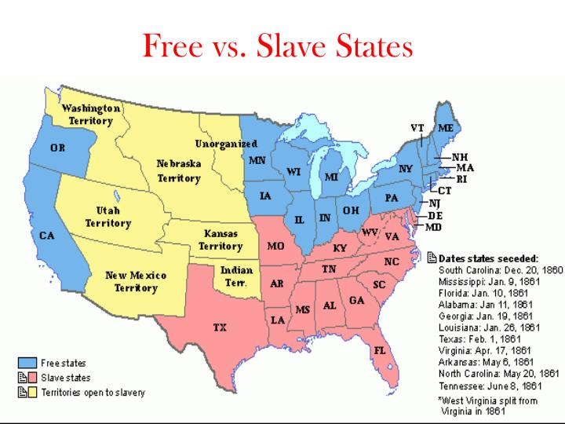
Notes:
https://image1.slideserve.com/2807422/free-vs-slave-states-n.jpg
Five states: MO, KY, W. VA, MD, DEL though slave, stayed in the Union, though slavery was allowed.
[The Confederacy later accepted the slave states of Missouri and Kentucky as members, they were never substantially controlled by Confederate forces, despite the efforts of Confederate shadow governments, which were eventually expelled.]

Slide 49
With God’s help and her newfound connections with abolitionists, she found odd jobs and saved a little money. When she learned her niece and two children would be sold in Maryland the year after her own escape, she made her way back to Baltimore and hid until she could make arrangements for their escape. Tubman was able to bring them with her to Philadelphia.
Notes:
We have people now campaigning to end abortion, the great legal crime in our nation. Federal overspending, overreach. COS. Always a fight.
160 years ago, Americans were campaigning and fighting to end the similarly great legal crime of slavery: of one person owning and able to abuse and kill another. It’s a blight on our history that believers fought against.
https://www.godreports.com/2016/04/harriet-tubman-she-followed-the-voice-of-god/

Slide 50
The following spring, she went to Maryland again to aid her brother’s escape, along with two other slaves.
Notes:
https://www.godreports.com/2016/04/harriet-tubman-she-followed-the-voice-of-god/

Slide 51
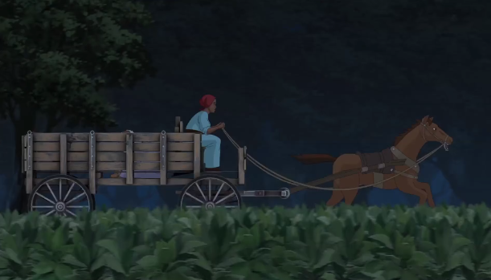
Notes:
https://vimeo.com/251813872 From 13 till 50
The slaveowners had a $40,000 reward for capturing or killing her.
https://www.godreports.com/2016/04/harriet-tubman-she-followed-the-voice-of-god/

Slide 52
Over 11 years, Tubman personally rescued at least 70 slaves in about 13 expeditions, including her three other brothers, Henry, Ben, and Robert, their wives and some of their children. She also assisted and directed 50 to 60 additional slaves who escaped to the north. Some have estimated she was ultimately responsible for liberating as many as 300 slaves. That’s why she was called the black Moshe.
Notes:
https://www.godreports.com/2016/04/harriet-tubman-she-followed-the-voice-of-god/

Slide 53
In one instance God warned her she must turn aside from the path she was on and cross a rushing river immediately. Not knowing the depth, the men with her hesitated. Harriet stepped boldly into the current, and found it never rose above her chin, according to an account on Christianity.com by Dan Graves.
Notes:
https://www.godreports.com/2016/04/harriet-tubman-she-followed-the-voice-of-god/

Slide 54
When the men saw she was safely across, they followed her. Later Harriet learned that a group of desperate men had been waiting on the path they were traveling and planned to seize them. If she had not responded to God’s ‘still small voice,’ they would have been captured.
Notes:
https://www.godreports.com/2016/04/harriet-tubman-she-followed-the-voice-of-god/

Slide 55
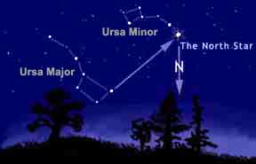

Slide 56
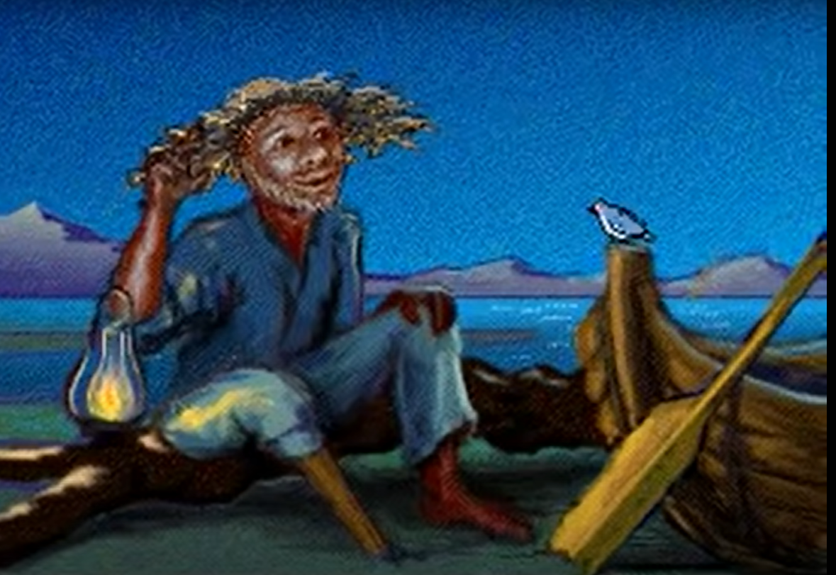
Peg Leg Joe
Notes:
https://www.youtube.com/watch?v=pw6N_eTZP2U
Folklore has it that enslaved people in the United States used it as a point of reference so they would not get lost. According to legend, the song was used by a conductor of the Underground Railroad, called Peg Leg Joe, to guide some fugitive slaves. The song ostensibly encodes escape instructions and a map from Mobile, Alabama up the Tombigbee River, over the divide to the Tennessee River, then downriver to where the Tennessee and Ohio rivers meet in Paducah, Kentucky.

Slide 57
What Passover freedom lessons can we learn from Harriet Tubman’s life?

Slide 58
1.Trust G-d in impossible circumstances. Head injury.
Notes:
By His wounds we are healed.

Slide 59
1.Trust G-d in impossible circumstances. Head injury.
2. America is the land of opportunity, though sometimes with GREAT difficulty.

Slide 60
1.Trust G-d in impossible circumstances. Head injury.
2. America is the land of opportunity, though sometimes with GREAT difficulty.
3. Memorize scripture. It’s a weapon.

Slide 61
4. Rescue those enslaved. Spiritually and physically enslaved.
Notes:
4. If you came here to be blessed and have your needs met, we are glad to serve. But that’s not really our end game. We are here to serve, win the lost, transform the culture! We are at war, in the spirit!

Slide 62
^{Mishlei/Prov 24.10-12} Rescue those being dragged off to death, hold back those stumbling to slaughter. If you say, “Look, we didn’t know this.” Won’t He who weighs hearts perceive it? Won’t He who guards your soul know it?

Slide 63
4. Rescue those enslaved. Spiritually and physically enslaved.
5. Pray about opposition.

Slide 64
4. Rescue those enslaved. Spiritually and physically enslaved.
5. Pray about opposition.
6. Work hard and save money.
Notes:
6. Pay OFF that mortgage! Reset or not.

Slide 65
4. Rescue those enslaved. Spiritually and physically enslaved.
5. Pray about opposition.
6. Work hard and save money.
7. G-d loves the oppressed.

Slide 66
“The land of the free, and the home of the brave.”

Slide 67
Notes:
passover the time of our freedom - Bing images

Slide 68
Notes:
https://w3.chabad.org/media/images/1086/BYuJ10869964.jpg
What does that mean? Sin, Satan, Society, LOVE to destroy you. Yeshua is the GREATER Moshe to lead us out of sin.
Do we whine and complain and sin? Repent

Slide 69
^{Yn 8.31-36} Then Yeshua said to the Judeans who had trusted Him, “If you stay in My word, then you are truly My followers. You will know the truth, and the truth will set you free!” They answered Him, “We are Abraham’s children and have never been slaves to anyone!
Notes:
How does the truth set us free? Directions. Whenever Ulises house, I always get turned around. Which way? Fortunately, the GPS corrects if you start in the wrong direction.

Slide 70
^{Yn 8.31-36} How can you say, ‘You will become free’?” Yeshua answered them, “For sure, I tell you, everyone who sins is a slave to sin. Now the slave does not remain in the household forever; the son abides forever. So if the Son sets you free, you will be really free!
Notes:
Slave to sin. Means? Anger, language, pornography,
Really free. Means? From fear. Fear of people? Of condemnation for wrong.

Slide 71
Freedom
Is NOT the liberty to do anything we want
It is the power to do what we should
Freedom is the power to love.
Notes:
Serve >> control
Purity >> power
Give honor >> receive honor

Slide 72
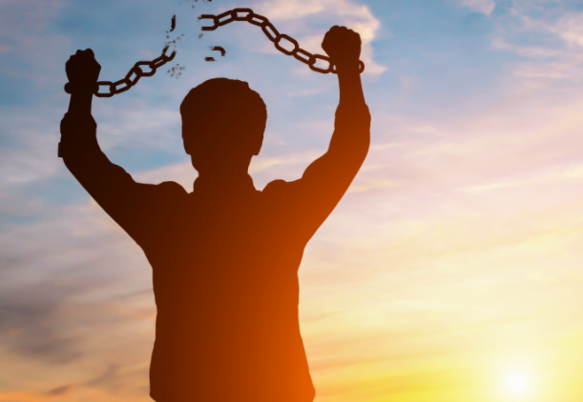
Notes:
https://www.taxsystems.com/sites/default/files/styles/feature_image/public/2019-09/spreadsheets_and_automation_-_how_to_make_tax_reporting_more_efficient.jpg?itok=QNlOujMm

Slide 73
“The truth will set you free!”

Slide 75
Liberation Passover:
From Khamets
From sin
From lies of the culture

Slide 76
Recently, there was one of the greatest discoveries to ever come out of the Holy Land. The ramifications will shake debates over when the Bible was first written, literacy in early Israel, and the authenticity of the Conquest narrative.
Notes:
https://patternsofevidence.com/2022/04/01/hebrew-tablet-deciphered-mentions-israels-god/?utm_source=Email%20List%20-%20120%20day%20engaged&utm_medium=email&utm_campaign=Thinker%20Update-%20NEWS%20ALERT%20-%20Hebrew%20Curse%20Tablet%20Deciphered%20-%20Mentions%20Israel%27s%20God%21%20%28Vw6uq2%29&triplesource=klaviyo&_kx=mCLlu5nEAHXBShgdv2P2Ei2SG7GJ9e-LxXTCNVtmwHo%3D.WEfJdA
Aaron Lipkin: Archeological earthquake

Slide 77
^{Dvarim/Dt 27.1-3} Moshe and the elders of Israel commanded the people, saying, “…On the day when you cross over the Yarden to the land that Adoni your God is giving you, you are to set up large stones for yourself and coat them with plaster. Then you are to write on them all the words of this Torah when you cross over…
Notes:
Note the plaster instruction.

Slide 78
^{Dvarim/Dt 27.12-15} “When you have crossed over the Yarden, these are to stand on Mount Gerizim to bless the people: Simeon…For the curse these are to stand on Mount Ebal: Reuben…“Then the Levites are to answer and say with a loud voice to every man of Israel: ‘Cursed is the one who makes a carved or molten image…

Slide 79
^{Yehoshua/Josh 8.30-32} Then Joshua built an altar to Adoni, God of Israel, on Mount Ebal, as Moshe the servant of Adoni had commanded Yisrael, as written in the scroll of the Torah of Moshe, an altar of uncut stones on which no man had wielded any iron tool…There on the stones he wrote a copy of the Torah of Moses, which he had written, in the presence of Yisrael.

Slide 80
^{Yehoshua/Josh 8.33-34} Half of them stood in front of Mount Gerizim and half of them in front of Mount Ebal—just as Moshe the servant of Adoni had commanded before—in order to bless the people of Israel. Then afterward he read all the words of the Torah—the blessing and the curse—according to all that is written in the book of the Torah.

Slide 81
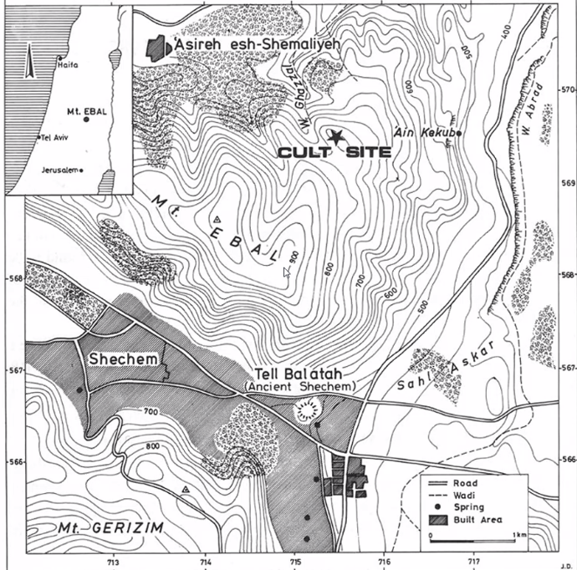
Foreign researhers examined the peak, 1920s. Israelis, under Zertal here, surveyed all.
Notes:
Aaron Lipkin lecture

Slide 82
Notes:
Aaron Lipkin lectures

Slide 84
1400 BCE ceremony at Ebal round altar one time use.
Notes:
Aaron Lipkin lecture

Slide 85
1400 BCE ceremony at Ebal round altar one time
1400 to 1250 BCE Aron/Ark at Shiloh and nothing at Ebal.
Notes:
Aaron Lipkin lecture

Slide 86
1400 BCE ceremony at Ebal round altar one time
1400 to 1250 BCE Aron/Ark at Shiloh and nothing at Ebal.
1250 BCE rectangular altar at Ebal, gap at Shiloh 1250 to 1150
Notes:
Aaron Lipkin lecture

Slide 87
1150 BCE Ebal buried and Shiloh activity returns. Eli, Hannah, Samuel then.
Notes:
Aaron Lipkin lecture. Covering an altar was the ancient way of decommissioning it. I saw similar at Arad in the south of Israel.

Slide 88
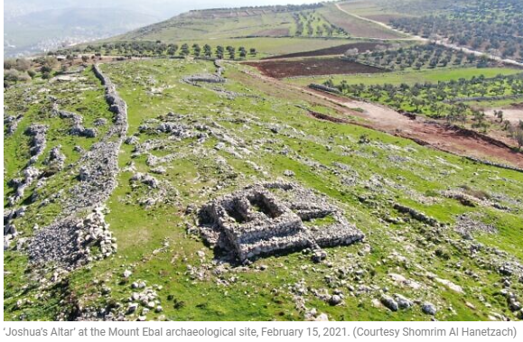
1250 to 1150
rectangular altar
at Ebal
Notes:
https://www.timesofisrael.com/archaeologist-claims-to-find-oldest-hebrew-text-in-israel-including-the-name-of-god/

Slide 89
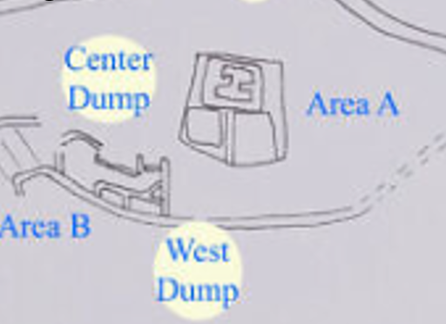
Dry sifting by Zertal
in 1980s. Wet sifting
By Scott Stripling
2010s
Notes:
https://www.timesofisrael.com/archaeologist-claims-to-find-oldest-hebrew-text-in-israel-including-the-name-of-god/

Slide 90
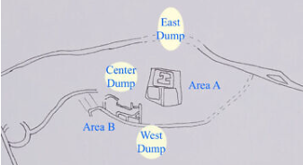
Artist’s rendering of the Mt. Ebal archaeological site and the dump piles sifted by Dr. Scott Stripling and his team
in 2019
Notes:
Aaron Lipkin lecture https://www.timesofisrael.com/archaeologist-claims-to-find-oldest-hebrew-text-in-israel-including-the-name-of-god/

Slide 91
The late University of Haifa professor Zertal excavated the site in the 1980s, including a large rectangular altar that was apparently constructed over an earlier round altar. Stripling said the tablet came from earth originally excavated from this round altar.
Notes:
https://www.timesofisrael.com/archaeologist-claims-to-find-oldest-hebrew-text-in-israel-including-the-name-of-god/

Slide 92
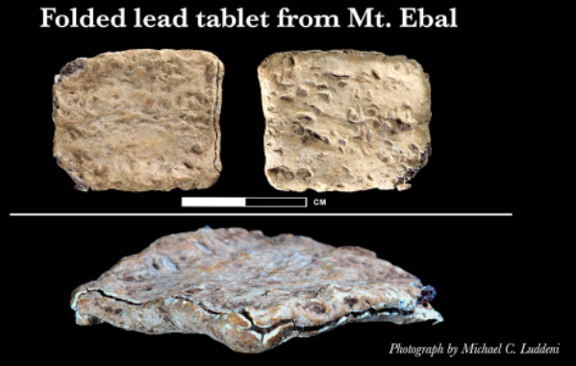
Notes:
https://patternsofevidence.com/2022/04/01/hebrew-tablet-deciphered-mentions-israels-god/?utm_source=Email%20List%20-%20120%20day%20engaged&utm_medium=email&utm_campaign=Thinker%20Update-%20NEWS%20ALERT%20-%20Hebrew%20Curse%20Tablet%20Deciphered%20-%20Mentions%20Israel%27s%20God%21%20%28Vw6uq2%29&triplesource=klaviyo&_kx=mCLlu5nEAHXBShgdv2P2Ei2SG7GJ9e-LxXTCNVtmwHo%3D.WEfJdA

Slide 93
Four scientists from the Academy of Sciences of the Czech Republic did the advanced imaging (tomographic scans) of the tablet to recover the hidden text.
Notes:
https://patternsofevidence.com/2022/04/01/hebrew-tablet-deciphered-mentions-israels-god/?utm_source=Email%20List%20-%20120%20day%20engaged&utm_medium=email&utm_campaign=Thinker%20Update-%20NEWS%20ALERT%20-%20Hebrew%20Curse%20Tablet%20Deciphered%20-%20Mentions%20Israel%27s%20God%21%20%28Vw6uq2%29&triplesource=klaviyo&_kx=mCLlu5nEAHXBShgdv2P2Ei2SG7GJ9e-LxXTCNVtmwHo%3D.WEfJdA

Slide 94
Notes:
https://www.timesofisrael.com/archaeologist-claims-to-find-oldest-hebrew-text-in-israel-including-the-name-of-god/

Slide 95
Chiastic structure, or chiastic pattern, is a literary technique in narrative motifs and other textual passages. An example of chiastic structure would be two ideas, A and B, together with variants A’ and B’, being presented as A,B,B’,A’.
Notes:
https://www.cravencountryjamboree.com/other/what-is-chiastic-parallelism/

Slide 96
Examples can be found in Biblical scripture (“But many that are first / Shall be last, / And many that are last / Shall be first”; Matthew 19:30).
Notes:
https://www.cravencountryjamboree.com/other/what-is-chiastic-parallelism/

Slide 97
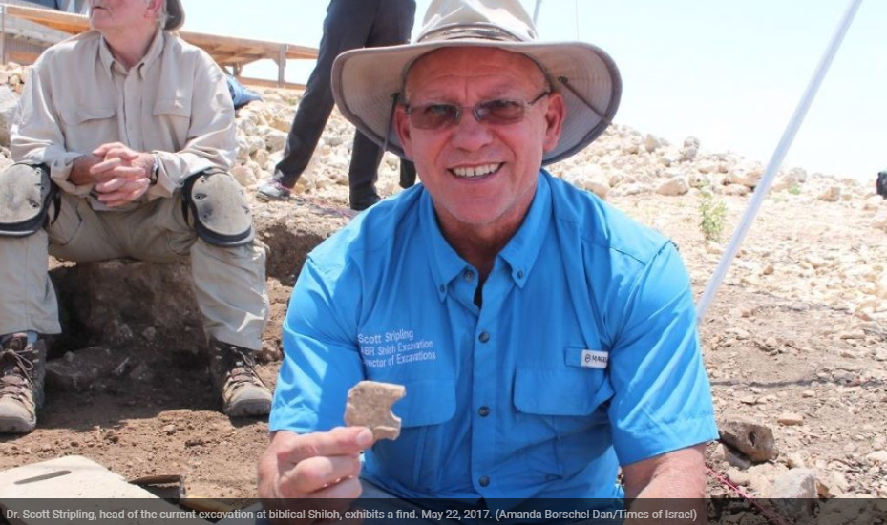
Notes:
https://patternsofevidence.com/2022/04/01/hebrew-tablet-deciphered-mentions-israels-god/?utm_source=Email%20List%20-%20120%20day%20engaged&utm_medium=email&utm_campaign=Thinker%20Update-%20NEWS%20ALERT%20-%20Hebrew%20Curse%20Tablet%20Deciphered%20-%20Mentions%20Israel%27s%20God%21%20%28Vw6uq2%29&triplesource=klaviyo&_kx=mCLlu5nEAHXBShgdv2P2Ei2SG7GJ9e-LxXTCNVtmwHo%3D.WEfJdA

Slide 98
Notes:
https://patternsofevidence.com/2022/04/01/hebrew-tablet-deciphered-mentions-israels-god/?utm_source=Email%20List%20-%20120%20day%20engaged&utm_medium=email&utm_campaign=Thinker%20Update-%20NEWS%20ALERT%20-%20Hebrew%20Curse%20Tablet%20Deciphered%20-%20Mentions%20Israel%27s%20God%21%20%28Vw6uq2%29&triplesource=klaviyo&_kx=mCLlu5nEAHXBShgdv2P2Ei2SG7GJ9e-LxXTCNVtmwHo%3D.WEfJdA

Slide 99
Notes:
https://external-content.duckduckgo.com/iu/?u=https%3A%2F%2Fi.pinimg.com%2Foriginals%2F0a%2F2e%2Fd2%2F0a2ed202914f085615ef1e6b5696a8fa.jpg&f=1&nofb=1
text is largely written in an archaic proto-Canaanite script, with some letters coming from hieroglyphs.
https://www.timesofisrael.com/archaeologist-claims-to-find-oldest-hebrew-text-in-israel-including-the-name-of-god/

Slide 100
The ramifications will shake debates over when the Bible was first written, literacy in early Israel, and the authenticity of the Conquest narrative.
Notes:
https://patternsofevidence.com/2022/04/01/hebrew-tablet-deciphered-mentions-israels-god/?utm_source=Email%20List%20-%20120%20day%20engaged&utm_medium=email&utm_campaign=Thinker%20Update-%20NEWS%20ALERT%20-%20Hebrew%20Curse%20Tablet%20Deciphered%20-%20Mentions%20Israel%27s%20God%21%20%28Vw6uq2%29&triplesource=klaviyo&_kx=mCLlu5nEAHXBShgdv2P2Ei2SG7GJ9e-LxXTCNVtmwHo%3D.WEfJdA

Slide 101
“The truth will set you free!”

Slide 103
Liberation Passover:
From Khamets
From sin
From lies of the culture

Slide 104
^{1 Yn 4.18-21} There is no fear in love. On the contrary, love that is mature gets rid of fear, because fear has to do with punishment; the person who keeps fearing has not been brought to maturity in regard to love. We ourselves love now because he loved us first.
Notes:
Some people are intimidating. Put downs, sarcasm.

Slide 105
^{1 Yn 4.18-21} If anyone says, “I love God,” and hates his brother, he is a liar. For if a person does not love his brother, whom he has seen, then he cannot love God, whom he has not seen. Yes, this is the command we have from him: whoever loves God must love his brother too.
Notes:
Love G and hates…religious person. Angry religion.

Slide 106
^{1 Yn 4.7-10} Beloved friends, let us love one another; because love is from God; and everyone who loves has God as his Father and knows God. Those who do not love, do not know God; because God is love.

Slide 107
^{1 Yn 4.7-10} Here is how God showed his love among us: God sent his only Son into the world, so that through him we might have life. Here is what love is: not that we have loved God, but that he loved us and sent his Son to be the kapparah/atonement for our sins.

Slide 108
^{Mes Jews 2.14-15} Through death He might break the power of the one who had the power of death (that is, the devil) and free those who by fear of death were in bondage all their lives.
Notes:
Fear of death…and judgment after.

Slide 109
^{Ro 815-16} For you did not receive the spirit of slavery to fall again into fear; rather, you received the Spirit of adoption, by whom we cry, “Abba! Father!” The Ruach Himself bears witness with our spirit that we are children of God.
Notes:
Me and April 13, 1969

Slide 110
^{1 Tim. 1.7} For God has not given us a spirit of timidity, but of power and love and self-discipline.

Slide 111
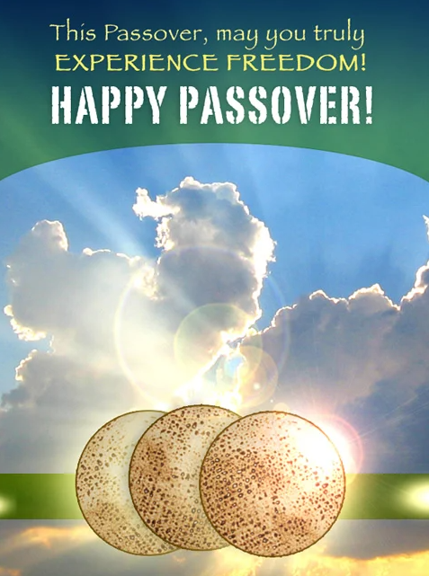
Notes:
https://w3.chabad.org/media/images/284/MCHE2848836.jpg

Slide 112
Do you KNOW Yeshua and the assurance of sins forgiven?
Are you hearing daily from His Word?
How are you applying what you heard?
Are you asking this of another?
Notes:
Passover FREEDOM! Exodus
Passover guidance ~ pillar of clod
Walking behind the pillar
Who are you liberating? discipling, building up?

