Slide 1
e-handout
To have these notes
without taking notes
Go to OrHaOlam.com
Click on Messages tab,
2022 Messages
Notes:
You may notice that I’m slowing down in my rate of speech. This is because we may be getting language translation equipment for simultaneous translation.

Slide 2
I broke my finger last week.

Slide 3
I broke my finger last week.
On the other hand, I’m okay.

Slide 4
Don't spell part backwards.

Slide 5
Don't spell part backwards.
It's a trap.

Slide 6
Did you hear about the guy who got hit in the head with a can of soda?

Slide 7
Did you hear about the guy who got hit in the head with a can of soda?
He was lucky it was a soft drink.

Slide 10
Victory as it appeared early on. [was]
Victory as we persevered. [is]
Victory in renewal. [is to come]
Notes:
That is, we are preparing for victory: success, growth

Slide 11
^{Mes Jews 12.1-2} Therefore, since we have such a great cloud of witnesses surrounding us, let us also get rid of every weight and entangling sin. Let us run with endurance the race set before us, focusing on Yeshua, the initiator and perfecter of faith.

Slide 12
^{Mes Jews 12.1-2} For the joy set before Him, He endured the cross, disregarding its shame; and He has taken His seat at the right hand of the throne of God.
Notes:
This is the key to all the running, the power and presence of Yeshua through faith in His death and resurrection and ascended power!

Slide 13
My personal journey: I came to faith in April 1969, less than two years after the Israelis liberated Jerusalem.

Slide 14
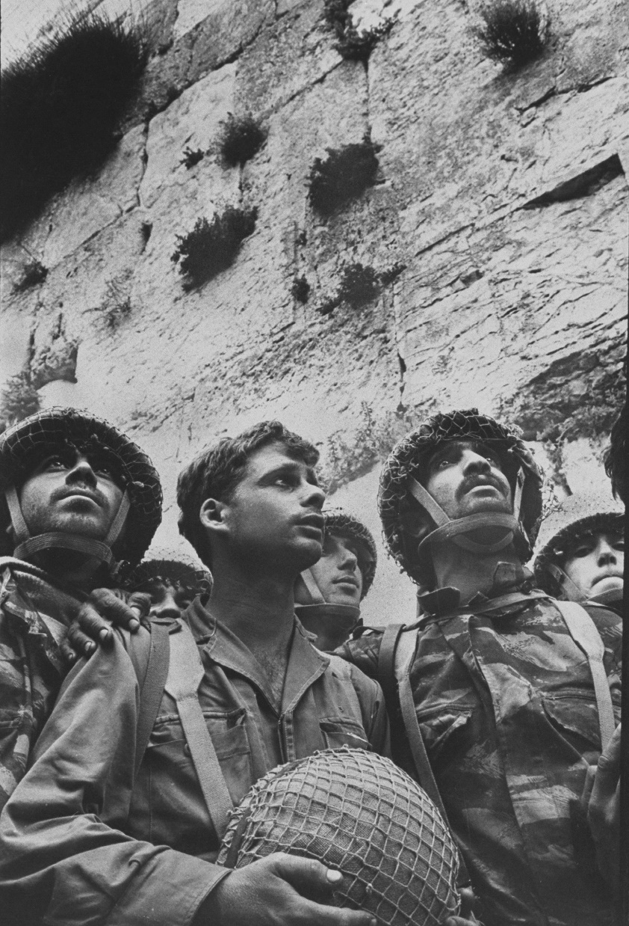
7 June 1967
(28 Iyar 5727),
Israel liberation of the Old City of Jerusalem.
Notes:
I was in Mrs. Gluck’s English class. News blackout. We didn’t know if there would be an Israel after the war. Richard came in said Israelis winning on all front.

Slide 15
Notes:
https://youtu.be/u_rJvuqvQlk
from 1.21 to the end

Slide 16
It was a common understanding then, among Bible believers, that the church age was over, and the Kingdom was imminent.
“We’re back in the Land, the time is at hand, so G-d fall upon us now.”
Notes:
Univ of Cinti shock of Arab Muslim young woman, “Jews representing Messiah! This is the End!”
In Israel, sense of optimism and shalom. Terrorists in fear. It was safe.

Slide 17
^{Luke 21.24 TLB} Some will fall by the edge of the sword and be led away captive into all the nations. Jerusalem will be trampled by the Gentiles until the times of the Gentiles are fulfilled.

Slide 18
^{Luke 21.24 CJB} until the age of the Goyim has run its course.

Slide 19
Many reasons for believing it was the end of time
Jerusalem back in Jewish hands.
Kings of the East.
Gog and Magog from the North.
Notes:
Jews were back in Israel and surviving!

Slide 20
2. Kings from the East

Slide 21
^{Rev 9.14-16} It said to the sixth angel who had the trumpet, “Release the four angels who are bound at the great river Euphrates.” And the four angels who had been kept ready for this very hour and day and month and year

Slide 22
^{Rev 9.14-16} were released to kill a third of mankind. The number of the mounted troops was twice ten thousand times ten thousand [two hundred million]. I heard their number.

Slide 23
^{Rev 16.12} The sixth angel poured out his bowl over the great river Euphrates; and its water was dried up, to prepare the way for the kings from the east.
Notes:
Note: 200 million, from the East, crossing the Euphrates.

Slide 24
In 2011 China boasted they now have an army of 200 million soldiers.
Notes:
https://comfortoneanother.com/2021/08/31/how-will-a-200-million-man-chinese-army-get-to-israel/
Or it could be an alliance of Russians and Chinese and Iranians.

Slide 25
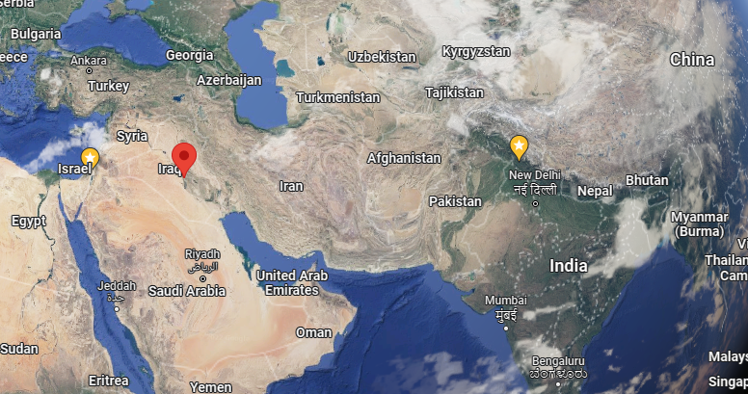
Notes:
Doesn’t show the Euphrates.

Slide 26
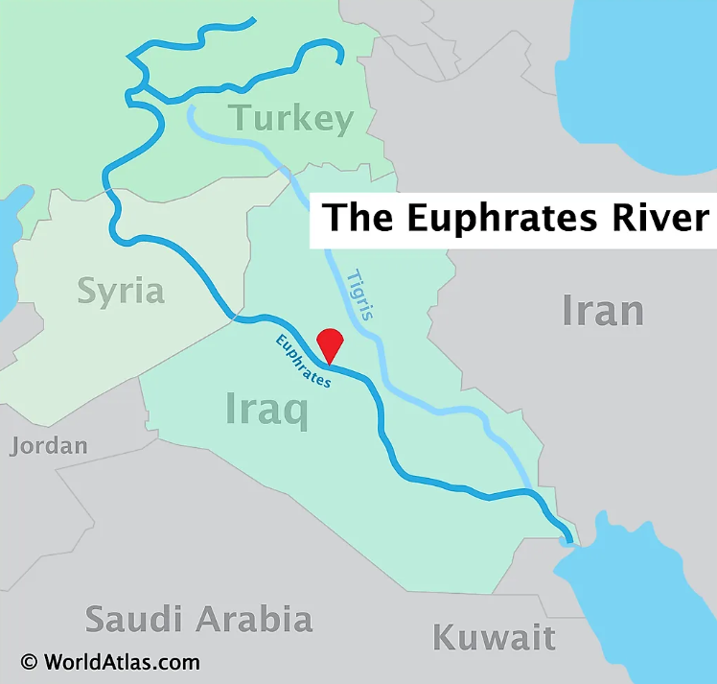

Slide 27
Notes:
Chinese army has to cross the Euphrates to invade Israel.

Slide 28
^{Rev 16.12} The sixth angel poured out his bowl over the great river Euphrates; and its water was dried up, to prepare the way for the kings from the east.
[two hundred million]
Notes:
Note: 200 million, from the East, crossing the Euphrates.
That was major reason #2 that that was the end of time.

Slide 29
3. Gog and Magog

Slide 30
^{Ezek 38.3-6} Thus says Adoni Elohim: ‘I am against you, Gog, chief prince of Meshech and Tubal. I will turn you about and put hooks into your jaws. I will bring you out, with all your army, horses and horsemen—all of them splendidly dressed—a vast assembly with breastplate and shield, all of them wielding swords.
Notes:
Moscow

Slide 31
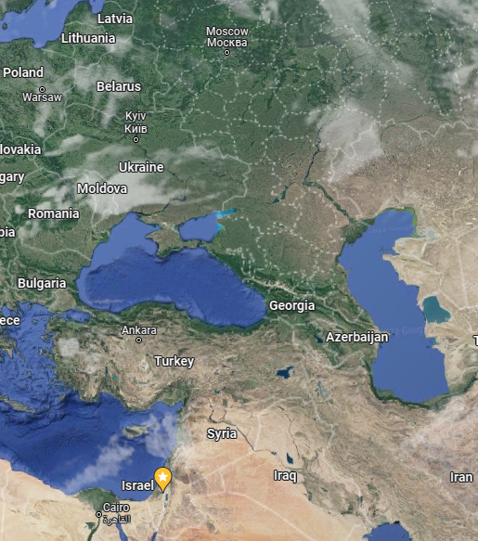
^{Ezek 38.3-6} With them will be Persia [Iran], Cush [Ethiopia] and Put [Libya], all of them with shield and helmet, Gomer and all his troops, the house of Togarmah [Turkey] from the extreme north and all his troops—many peoples with you.
Russia
Notes:
Still expected. Just didn’t happen yet.

Slide 32
We waited excitedly for the END, the Return, the Awakening!
Saw the beginning of the “birth pains.”
Other reasons for excitedly waiting:

Slide 33
^{Mark 13.7-8} When you hear of wars and rumors of wars, do not be alarmed, for this must happen but it is not yet the end…These things are only the beginning of birth pains.
Notes:
Earthquakes, famines, deception

Slide 34
^{Mark 13.10-13} The Good News must first be proclaimed to all the nations. When they arrest you and hand you over, do not worry…Brother will betray brother to death, and a father his child.
Notes:
Worldwide proclamation with technology, betrayal.

Slide 35
^{Mark 13.10-13} And children will rise up against parents and have them put to death. And you will be hated by all because of My name, but the one who endures to the end will be saved.”
Notes:
There was an expectancy, a zeal, a confidence.
1960’s, 70’s, 80’s, 90’s, 2000’s, 2010’s. We didn’t lose faith…but energy?
After the decades, excited expectancy → enduring expectancy

Slide 37
Victory as it appeared early on. [was]
Victory as we persevered. [is]
Victory in renewal. [is to come]
Notes:
focusing on Yeshua, the initiator and perfecter of faith.

Slide 38
^{2 Tim 312-13} All who want to live a godly life united with the Messiah Yeshua will be persecuted, while evil people and impostors will go from bad to worse, deceiving others and being deceived themselves.

Slide 39
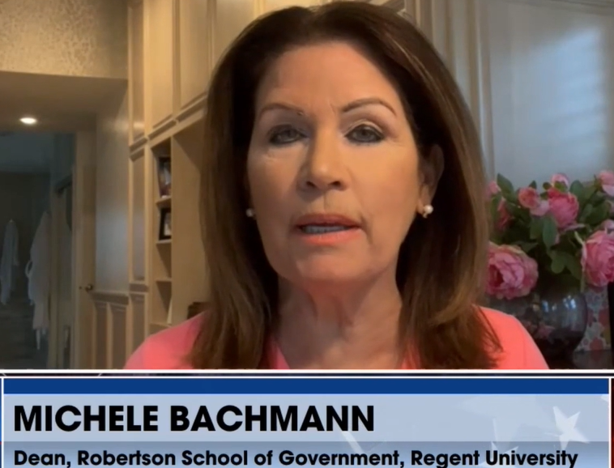
former Congresswoman warns that the World Health Organization (WHO) is set to vote on a provision that could give this organization control of the health directives of 193 countries around the world.
Notes:
https://www.drjamesdobson.org/articles/is-the-us-giving-sovereignty-over-to-the-who?utm_campaign=2022%20Public%20Policy&utm_medium=email&_hsenc=p2ANqtz-_rRp3FhNWHunk70AOg0F5C8A0NHYHh6YTAqIFlXsuuk3VVGzQdXMwS9bnJlseQHCRjLn_L59FqeXGFugy_ce3W0pKOQA&_hsmi=213052080&utm_content=213052080&utm_source=hs_email&hsCtaTracking=2129107e-33e2-4226-88af-d5005118d7fa%7Cb18a8b56-f03f-415d-bae2-b1fc9b75121e

Slide 40
It would grant extraordinary authority to WHO’s Director-General, Tedros Ghebreyesus, to declare “public health emergencies of international concern” and what must be done in response to such 'emergencies.'
Notes:
Please act today. Now. Go to oga.rsvp@hhs.gov and send your short email.
Dr. Jim Garlow,
CEO/Founder-Well Versed
& Rosemary Schindler Garlow,
﻿Co-Founder-Well Versed

Slide 41
According to a study by the World Zionist Organization and the Jewish Agency, 2021 was the most antisemitic year worldwide in the last decade. Ten antisemitic incidents of physical and verbal violence occurred on average every day.
Notes:
March of Remembrance P.O. Box 20051, New York, NY 10017 phone: +1 - 917-833-0482 www.marchofremembrance.org info@marchofremembrance.org

Slide 42
At the same time, conspiracy theories based on age-old antisemitic prejudices flood social media. Many see Jews as the authors and profiteers of the pandemic. Education and enlightenment are only of limited help.
Notes:
March of Remembrance P.O. Box 20051, New York, NY 10017 phone: +1 - 917-833-0482 www.marchofremembrance.org info@marchofremembrance.org

Slide 43
The California state legislature is currently debating a bill—AB 2223—that will effectively legalize infanticide by legalizing abortion until as many as 28 days after a baby is born.
Notes:
https://www.charismanews.com/us/88953-spirit-filled-pastors-rail-against-immoral-california-bill-that-would-legalize-infanticide?utm_source=Charisma%20News%20Daily&utm_medium=email&utm_content=subscriber_id:5160390&utm_campaign=CNO%20daily%20-%202022-04-21

Slide 44
^{T’hillim/Ps 13.1-4} How long, Adoni? Will you forget me forever? How long will you hide your face from me? How long must I keep asking myself what to do, with sorrow in my heart every day?

Slide 45
^{T’hillim/Ps 13.1-4} How long must my enemy dominate me? Look, and answer me, Adoni my God! Give light to my eyes, or I will sleep the sleep of death.

Slide 47
Victory as it appeared early on. [was]
Victory as we persevered. [is]
Victory in renewal. [is to come]
Notes:
focusing on Yeshua, the initiator and perfecter of faith.

Slide 48
Meanwhile, a back story…

Slide 49
I [Mike Bickle] met Bob Jones on March 7, 1983. He said, “You are an intercessor and youth pastor. You will lead a worldwide youth movement of singers and musicians who will be used in power evangelism that will mobilize prayer for Israel and receive abundant grace in the prophetic and intercession.”
Notes:
https://mikebickle.org/resource
Mike was at that point in his life a pretty successful 27 year old senior pastor in OP. Professionals, Chiefs players in his congregation, on fire for Yeshua, outreach. No Israel piece in his theology.

Slide 50
“The Lord will place you next to Harry Truman’s property in Grandview as a sign and wonder. Truman was a political intercessor for Israel (God used him in Israel becoming a nation in 1948). This youth movement will be spiritual intercessors for Israel.”
Notes:
https://mikebickle.org/resource

Slide 51
Bob told me we would have a great connection with believers throughout all Asia. On unplugged TV sets (??), they would see our singers worshipping on Harry Truman’s property.
Notes:
https://mikebickle.org/resource
(??) = Smart phones 1983 who knew?

Slide 52
January 27, 1958 Harry Truman sold his family farm to developers, Jewish realtors named Intrater.

Slide 53
In 2007, a man named Gary Cooper came into Mike Bickle’s office and said, “I had the strangest conversation with the city leaders. It’s just developed out of nowhere that Harry S Truman sold his property in Grandview Missouri to a Jewish family.

Slide 54
This Jewish couple died, and their children now have it.” The children came to us and were willing to sell it to us at one fraction of the cost of what it’s worth. They brought it way down.
Notes:
Grandview City officials aren’t developers, didn’t want it.

Slide 55
They came to visit IHOP–KC, and what struck this Jewish family was this: “Our parents always wanted this property to do something that would bless Grandview. They always loved Grandview. We think that all these young couples and all these young people with these bright spirits will bless Grandview,

Slide 56
so we’re going to bring the price way down. We want to sell it to you. We want you guys to have it.’”
All of this happened in late September and early October, but they needed to wait until the first of the new year for tax reasons, so it happened that our closing date was January 27, 2008,

Slide 57
which was exactly fifty years to the day that Harry S Truman sold it to this Jewish family. He sold it on January 27, 1958. Gary got the paper and it said, “Harry S Truman closing date.” It was exactly fifty years to the date.

Slide 58
A certain man who wishes to remain anonymous—flew into Kansas City and said, “I want to pay every single dollar to buy this property. I want to pay the closing costs. I want to pay for everything. It’s a matter of principle. I want it to be debt free for IHOP–KC.”
Notes:
It seems it was about $1-2 million .

Slide 59
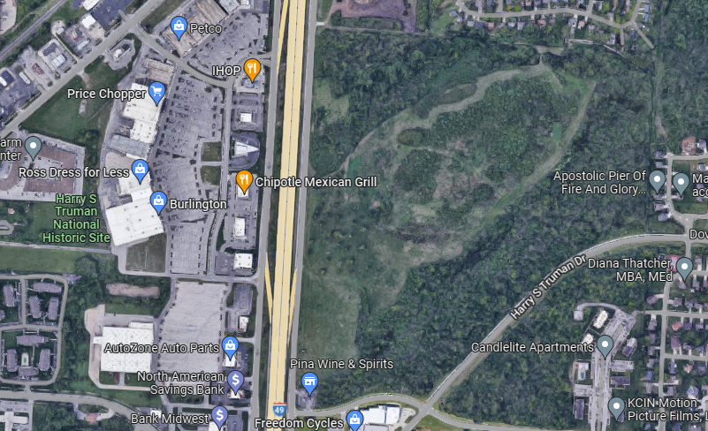
Truman Farm
Notes:
Truman Farm House, farmland to the east [before Highway built] IHOP—Pancake house.

Slide 60
The developers never developed this apparently prime Grandview real estate, and 50 years to the day [ יובלYovel / Jubilee] they approached IHOPKC about selling it under market, for the youth ministry! Return to original purpose! Intercession for Israel!

Slide 61
IHOP has done nothing substantial with the property from 2008 till this month.

Slide 62
Notes:
Will You Be 1 of 100 Million Intercessors for Israel? www.i49wall.com
https://youtu.be/57A43lmeeCY
BUT only beginning to 1.12 then 2.11 to the end.

Slide 63
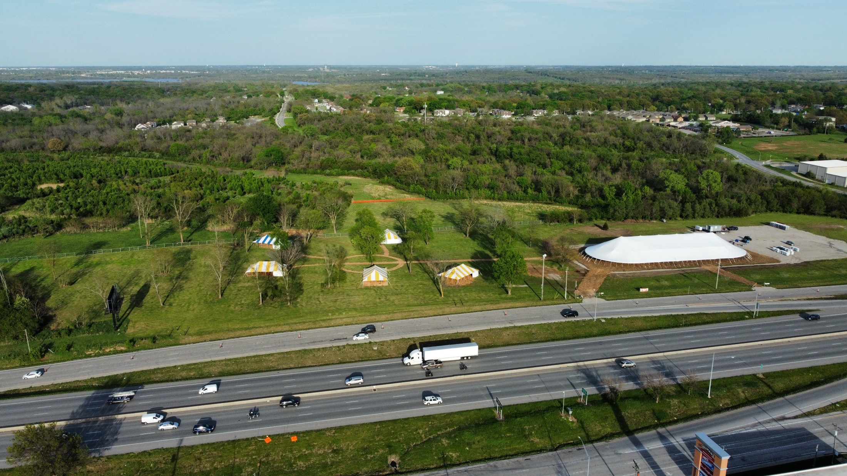

Slide 64
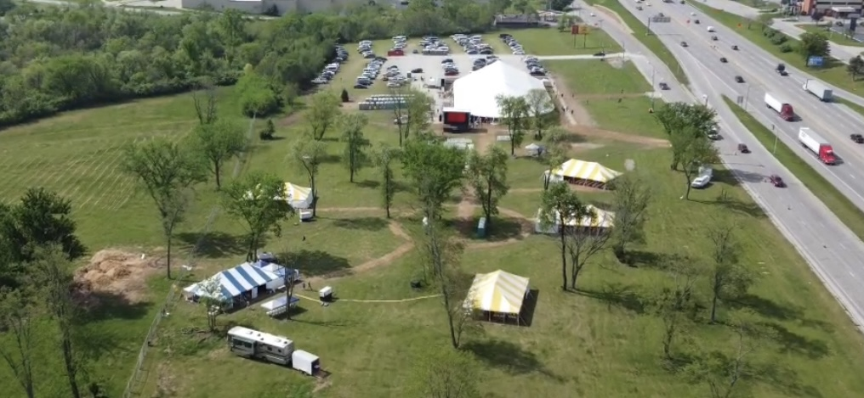

Slide 65
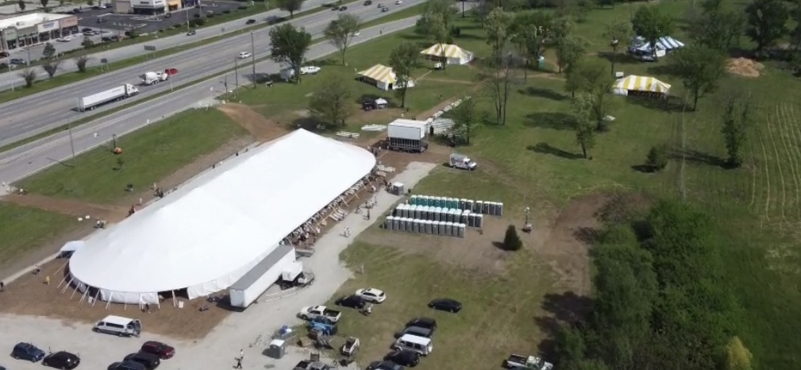

Slide 67
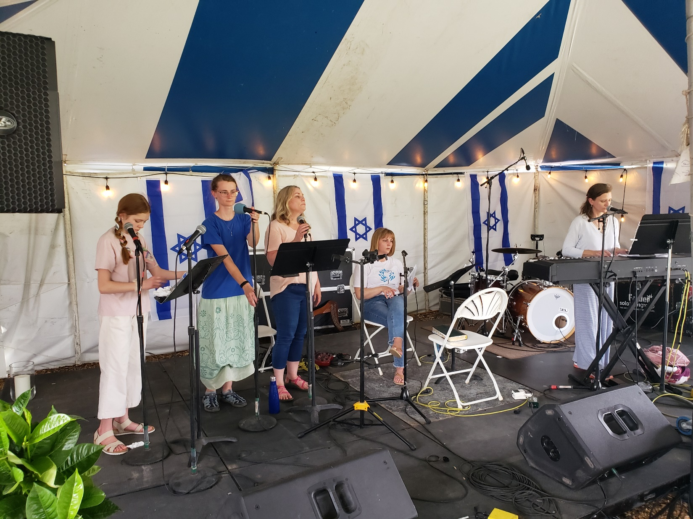

Slide 68
^{Yeshayahu/Is 60.22b} I, Adoni, when the right time comes, will quickly bring it about.”

Slide 69
^{T’hillim/Ps 102.13-14} You will arise and take pity on Tziyon, for the set time has come to have mercy on her; the set time has come. For your servants love her very stones; they take pity even on her dust.

Slide 71
Victory as it appeared early on. [was]
Victory as we persevered. [is]
Victory in renewal. [is to come]
Notes:
That is, this message is about getting ready for renewal.

Slide 72
If G-d really brings awakening, it means [prototype awakening in Acts]:
^{15.3} Great joy -- New people will find LIFE in Messiah. ++++.
New people will need to be discipled and grow…
Notes:
doesn’t mean things will be easier.
Family issues. Doctrinal issues. Health, inner healing.

Slide 73
^{Acts 14.21-22} After proclaiming the Good News in that city and making many people into talmidim/disciples, they returned to Lystra, Iconium and Antioch, strengthening the talmidim, encouraging them to remain true to the faith, and reminding them that it is through many hardships that we must enter the Kingdom of God.

Slide 74
^{15.2} much contentious debate… New disagreements are possible.
^{15.39} sharp contention in strategy between Shaul and Bar-Naba
Notes:
Revival is messy. Book of Acts was premier, protype revival, transformed Roman Empire. Smooth and perfect?
Antioch in Syria, just north of Israel. Acts 11 major revival. Yet first major anti Judaic replacement theology teacher. First century. Died 110 CE The letters condemn two sets of heretics: the Judaizers, who insisted that Christians continue to follow Jewish law

Slide 75
Notes:
https://www.drjamesdobson.org/marriage-parenting/error-or-opportunity-beelers-episode-9

Slide 77
^{Mes Jews 12.1-2} Therefore, since we have such a great cloud of witnesses surrounding us, let us also get rid of every weight and entangling sin. Let us run with endurance the race set before us, focusing on Yeshua, the initiator and perfecter of faith.

Slide 78
^{Mes Jews 12.1-2} For the joy set before Him, He endured the cross, disregarding its shame; and He has taken His seat at the right hand of the throne of God.

Slide 79
Victory as it appeared early on. [was]
Victory as we persevered. [is]
Victory in renewal. [is to come]

Slide 80
Do you KNOW Yeshua and the assurance of sins forgiven?
Are you hearing daily from His Word?
How are you applying what you heard?
Are you asking this of another?
Notes:
Who are you discipling, building up?4

