Slide 1
e-handout
To have these notes
without taking notes
Go to OrHaOlam.com
Click on Messages tab,
2022 Messages
Notes:
You may notice that I’m slowing down in my rate of speech. This is because we may be getting language translation equipment for simultaneous translation.

Slide 2
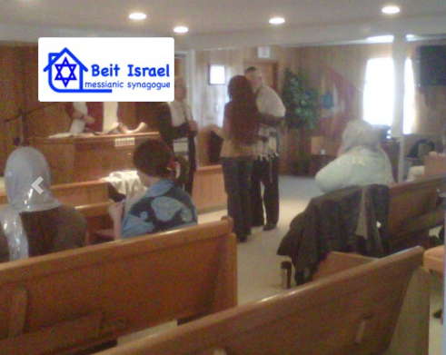
Mazel Tov to Rabbi Paul and Sally Collins and Beit Israel on paying off their synagogue mortgage this week!!!
Notes:
Bayou la Batre, AL 36509
From Rabbi David Tokajer, Congregation Mayim Chayim
Thu, Jun 16, 2022, 6:33 PM
https://www.messianic.org/congregations/congregation-beit-Israel
http://shalommobile.com/home

Slide 3
Notes:
https://external-content.duckduckgo.com/iu/?u=https%3A%2F%2Fwww.thoughtco.com%2Fthmb%2FZ28Fq5EaiUS3ykb4w65-LPiCE9c%3D%2F3685x2261%2Ffilters%3Afill(auto%2C1)%2Fhalf-full-and-empty-157672090-57a8f6553df78cf45952581a.jpg&f=1&nofb=1

Slide 4
Notes:
https://external-content.duckduckgo.com/iu/?u=https%3A%2F%2Fwww.thoughtco.com%2Fthmb%2FZ28Fq5EaiUS3ykb4w65-LPiCE9c%3D%2F3685x2261%2Ffilters%3Afill(auto%2C1)%2Fhalf-full-and-empty-157672090-57a8f6553df78cf45952581a.jpg&f=1&nofb=1
What’s the difference?

Slide 5
Notes:
https://external-content.duckduckgo.com/iu/?u=https%3A%2F%2Fwww.thoughtco.com%2Fthmb%2FZ28Fq5EaiUS3ykb4w65-LPiCE9c%3D%2F3685x2261%2Ffilters%3Afill(auto%2C1)%2Fhalf-full-and-empty-157672090-57a8f6553df78cf45952581a.jpg&f=1&nofb=1

Slide 6
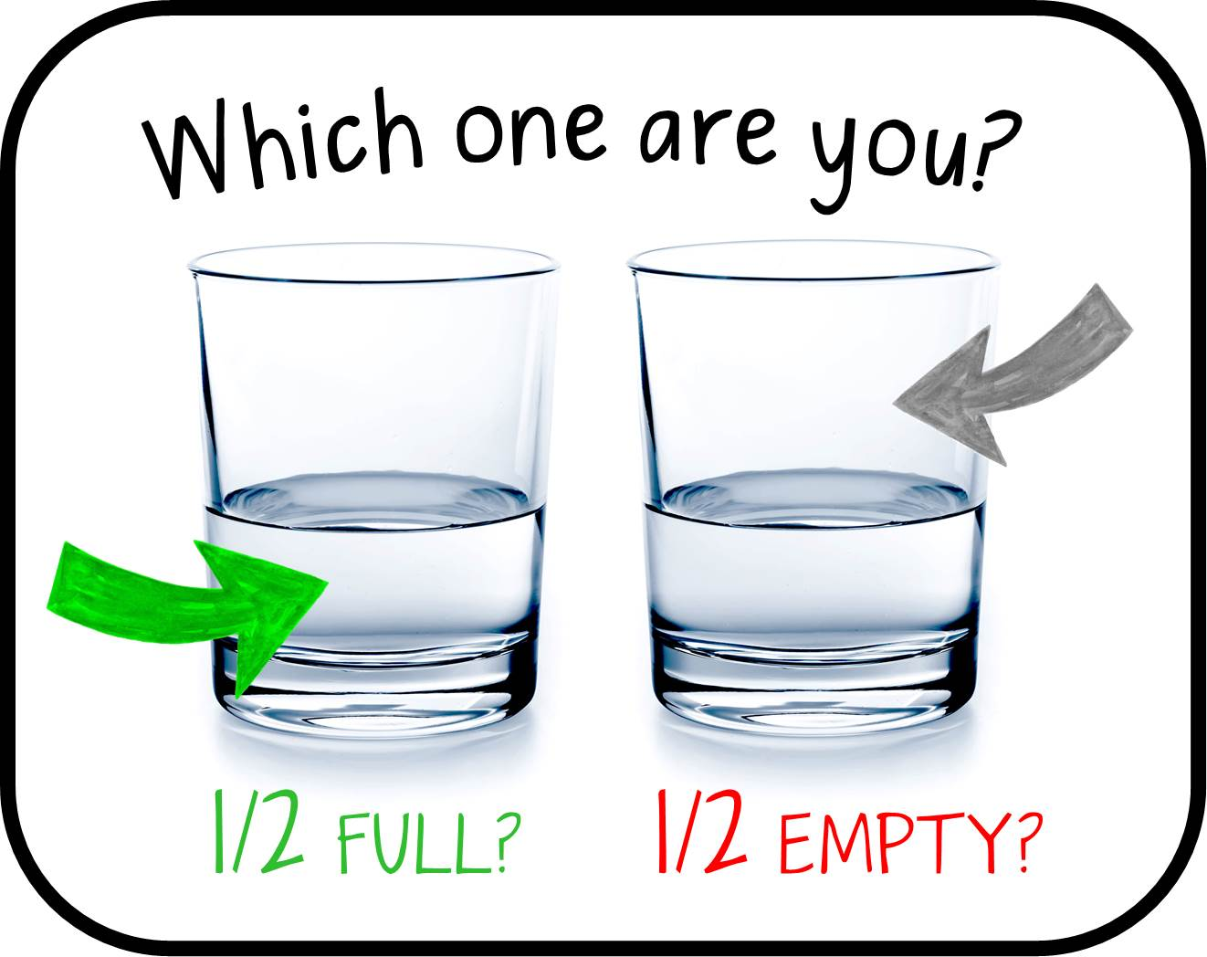
Notes:
https://external-content.duckduckgo.com/iu/?u=http%3A%2F%2Fwww.savvyrealestateinvestor.com%2Fwp-content%2Fuploads%2F2016%2F12%2Fglass-half-empty.jpg&f=1&nofb=1

Slide 8
במדברB’midbar
(Numbers) 11:1-3
(from) Beha’alotcha / when you set up בְּהַעֲלֹתְךָ

Slide 10
Father’s Day Message Outline
Complaining
Fatherhood response
Some illustrations

Slide 11
B’midbar (Numbers) 11:1
ג כִּי שֵׁם יְהוָה אֶקְרָא ס הָבוּ גֹדֶל לֵאלֹהֵינוּ׃
ג כִּי שֵׁם יְהוָה אֶקְרָא ס הָבוּ גֹדֶל לֵאלֹהֵינוּ׃
וַיְהִ֤י הָעָם֙ כְּמִתְאֹ֣נְנִ֔ים רַ֖ע בְּאׇזְנֵ֣י יְיָ
וַיִּשְׁמַ֤ע יְיָ
But the people began complaining about their hardships to Adoni. When Adoni heard it,
Notes:
Reflexive form of the verb, spins around and saturates
מִתְאֹ֣נְנִ֔ים mitonenim pl from
מִתְאֹ֣נְנן singular
Complaining, protesting, rebellious,
אנן From anan:
mourn, bewail, be sorry for, lament, grumble
Me: one of my primary gifts is mercy. So when I hear a complaint: commiserate, sympathize, help, fix, comfort.
These people in desolate desert, cf Egypt civ., panic, frantic, Ramban: humanly, right to complain!
Opening verb ויהי indicates ongoing
G-d hear with mercy? Two ways to read רַע: G-d heard their hardships OR G-d found it evil

Slide 12
B’midbar (Numbers) 11:1
ג כִּי שֵׁם יְהוָה אֶקְרָא ס הָבוּ גֹדֶל לֵאלֹהֵינוּ׃
ג כִּי שֵׁם יְהוָה אֶקְרָא ס הָבוּ גֹדֶל לֵאלֹהֵינוּ׃
וַיִּ֣חַר אַפּ֔וֹ וַתִּבְעַר־בָּם֙ אֵ֣שׁ יְיָ וַתֹּ֖אכַל בִּקְצֵ֥ה הַֽמַּחֲנֶֽה׃
His anger flared up, so that fire from Adoni broke out against them and consumed the outskirts of the camp.
Notes:
Most times, hardship stirs up G-d’s compassion.
Not this time.
Fire: lightning strike, miraculous outburst [Nadav and Avihu], or just conflagration.
This just one year after Exodus from Egypt not decades.

Slide 13
This week, we see the catalyst for the dramatic downfall of an entire generation.
Forty years of wandering. Why?
Complaining.
Aren’t we all guilty of it?
Notes:
Rabbi Fohrman
A project of the Hoffberger Fund for Biblical Studies, LTD PO BOX 8 Lombardy St. #40833 Newark, NJ 07102

Slide 14
“I can’t stand my boss! When am I going to get a better job?”
“How long do we have to wait for the right house, already?”
“Ugh, did someone have to rear-end me? I didn’t need this.”
“When is God going to send me more money?”
Notes:
A project of the Hoffberger Fund for Biblical Studies, LTD PO BOX 8 Lombardy St. #40833 Newark, NJ 07102

Slide 15
God gives gifts. A job. A spouse. A car. An income.
But then we come along and try to exert our control over it. Like we don’t trust that it’s good enough without our intervention.
Notes:
A project of the Hoffberger Fund for Biblical Studies, LTD PO BOX 8 Lombardy St. #40833 Newark, NJ 07102

Slide 16
It draws to mind another instance in which God gave a gift, and we thought we knew better.
The parallels between the Mitonenim, the complainers, and the rejection of God’s permitted fruit in the Garden of Eden are striking.
Notes:
A project of the Hoffberger Fund for Biblical Studies, LTD PO BOX 8 Lombardy St. #40833 Newark, NJ 07102

Slide 17
B’midbar (Numbers) 11:2
ג כִּי שֵׁם יְהוָה אֶקְרָא ס הָבוּ גֹדֶל לֵאלֹהֵינוּ׃
ג כִּי שֵׁם יְהוָה אֶקְרָא ס הָבוּ גֹדֶל לֵאלֹהֵינוּ׃
וַיִּצְעַ֥ק הָעָ֖ם אֶל־מֹשֶׁ֑ה וַיִּתְפַּלֵּ֤ל מֹשֶׁה֙ אֶל־יְיָ וַתִּשְׁקַ֖ע הָאֵֽשׁ׃
Then the people cried to Moshe, Moshe prayed to Adoni, and the fire abated.
Notes:
Why didn’t they cry out to G-d??
Had just deeply offended Him. Moshe intermediary.
שָׁקַע shaka
to sink; to become submerged; to become engrossed; to decline, to deteriorate; (said of the sun) to set

Slide 18
B’midbar (Numbers) 11:3
ג כִּי שֵׁם יְהוָה אֶקְרָא ס הָבוּ גֹדֶל לֵאלֹהֵינוּ׃
ג כִּי שֵׁם יְהוָה אֶקְרָא ס הָבוּ גֹדֶל לֵאלֹהֵינוּ׃
וַיִּקְרָ֛א שֵֽׁם־הַמָּק֥וֹם הַה֖וּא תַּבְעֵרָ֑ה כִּֽי־בָעֲרָ֥ה בָ֖ם אֵ֥שׁ יְיָ
That place was called Tav‘erah [burning] because Adoni’s fire broke out against them.
Notes:
Complaining is a GREAT sin.
Can be construed as the fundamental sin.
Opposite of gratefulness and faith.
The righteous shall live by his faith [in the death and resurrection and Ruakh care of Messiah.]
צדיק באמונתו יחיהTsakik b’emunato y’khiyeh

Slide 19
What was the complaining about?
Not directly known, but several subsequent events described:
^{Bamidbar/Nu 11.4} Next, the mixed crowd that was with them began to have cravings, so Bnei-Yisrael began to wail repeatedly..
Notes:
They brought along the converts from the Egyptians, but they didn’t have generations of teaching on their covenantal identity: Avraham, Yitskhak, Yaakov, Abe, Isaac, Jacob…so infected the whole nation.
Important to reach out to the world, but hazardous.
A predecessor Messianic rabbi here in KC, about 40 years ago, studied Kabbala with a local rabbi…left Yeshua, left his wife.
We become the company we keep, unless…
Yeshua talks about four responses to His message. Consider three:

Slide 20
^{Mtt13.19-23} When anyone hears the word of the kingdom and doesn’t understand it, the evil one comes and snatches away what was sown in his heart. This is the one having been sown along the road.

Slide 21
^{Mtt13.19-23} “The one sown on rocky ground, this is the one who hears the word and immediately receives it with joy. Yet he has no root himself but lasts only a short while; and when trouble or persecution comes because of the word, immediately he falls away.
Notes:
Egyptians who didn’t have generations of teaching, but this whole thing of plagues, and Reed Sea, Sinai Revelation…amazing.
No root in themselves. Personal repentance, devotion, relation to G-d!
Trouble: family opposition. Division. Contention. Hostility.
Societal opposition: media, employment: vax, global warming, LGBTQI+,
Do we have root in ourselves?

Slide 22
^{Mtt13.19-23} “Now the one sown on the good soil, this is the one who hears the word and understands. He indeed bears fruit, yielding a hundredfold, some sixty, some thirty times what was sown.”
Notes:
Bears fruit:
people,
actions,
effects,
MOST importantly, internal: Fruit of the Ruakh/Spirit

Slide 23
2. ^{Bamidbar/Nu 11.4-6} The grumblers among them began to have cravings, so Bnei-Yisrael began to wail repeatedly, saying, “If we could just eat some meat!

Slide 24
^{Bamidbar/Nu 11.4-6} We remember the fish we used to eat in Egypt — it cost us nothing! — and the cucumbers, the melons, the leeks, the onions, the garlic! But now we’re withering away, we have nothing to look at but this man.”
Notes:
Both were complaining, newbies and Israelites. So, when you hear complaints, What do you do?
Join, rebuke, praise.

Slide 25
What was the man, manna?

Slide 26
Book of Exodus, manna is described as being "a fine, flake-like thing" like the frost on the ground. It is described in the Book of Numbers as arriving with the dew during the night. Exodus adds that it had to be collected before it was melted by the heat of the sun, and that it was like a coriander seed in size but white in color.
Notes:
https://en.wikipedia.org/wiki/Manna

Slide 27
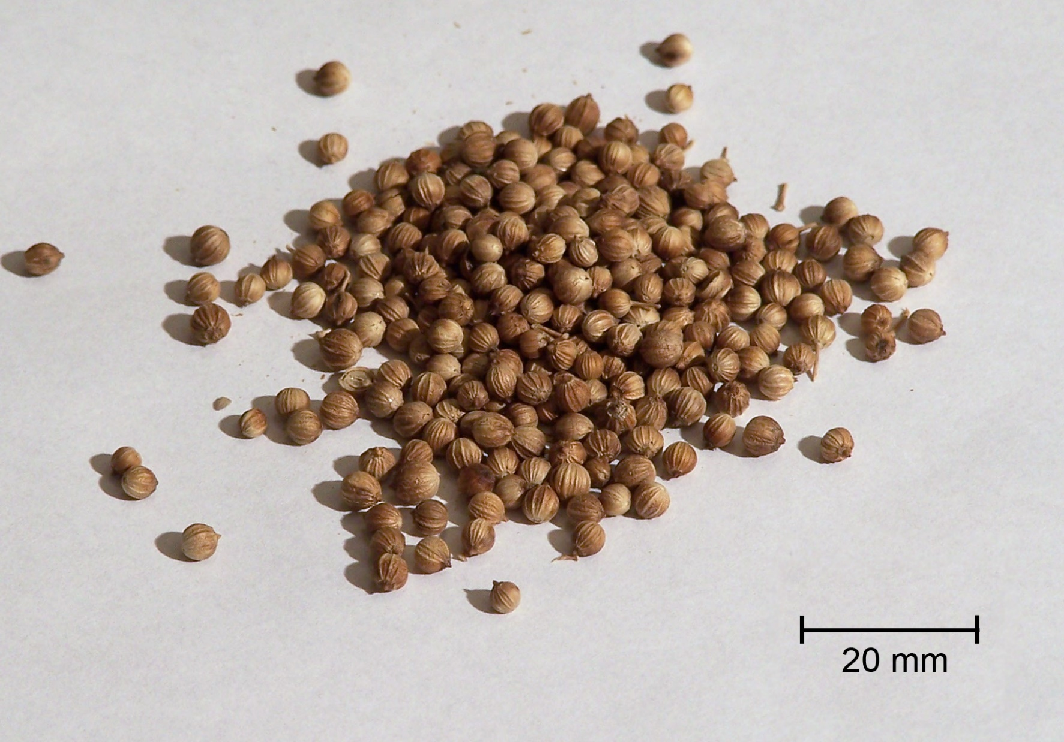
~.75 in
Notes:
https://en.wikipedia.org/wiki/Manna

Slide 28
3. ^{Bamidbar/Nu 11.10} Moshe heard the people crying, family after family, each person at the entrance to his tent; the anger of Adoni flared up violently; and Moshe too was displeased.
Basic distrust.
Notes:
On thing to lust after forbidden items, but to want to go back to Egypt: sensual idolatry, wholesale reject of G-d and holiness.
Ovadia Sforno, Italian commentator of the 1500s, “Parents often have children who are in sharp conflict with them, but at least there is a certain basic trust that their parents love them and mean their good. But this nation had displayed no such trust in Moshe, and were constantly testing to see how he would react.

Slide 29
^{Bamidbar/Nu 11.11-15} So Moshe asked Adoni, “Why have You brought trouble on Your servant? Haven’t I found favor in Your eyes—that You laid the burden of all these people on me? Did I conceive all these people,

Slide 30
^{Bamidbar/Nu 11.11-15} or did I give birth to them, that You should say to me, ‘Carry them in your bosom just as the nurse carries an infant’—to the land You promised to their fathers?

Slide 31
^{Bamidbar/Nu 11.11-15} Where can I get meat for all these people?…I am not able to carry all these people by myself! The load is too heavy for me! If this is how You are treating me, kill me now! If I have found favor in Your eyes, kill me please—don’t let me see my own misery!”
Notes:
Father load just too heavy!!

Slide 32
Here is the heart of the Father’s Day message; the challenge of an overwhelmed father!

Slide 34
Father’s Day Message Outline
Complaining
Fatherhood response
Some illustrations

Slide 35
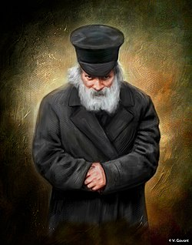
Rabbi Yisrael Meir Kagan is the Chafetz Chaim,
חָפֵץ חַיִּים “Desirer of Life”, Belarussian rabbi 1800’s. *
He drew from this that parents have no
Notes:
Come, children, hearken to me; I will teach you the fear of the Lord. Who is the man who desires life (“Khafetz khaim"), who loves days to see goodness? Guard your tongue from evil and your lips from speaking deceitfully. Shun evil and do good, seek peace and pursue it. ^{Psalm 34:12–15}

Slide 36
right to shirk responsibility for their children, no matter how difficult their lot.
Never give up. Never give up.

Slide 37
Notes:
https://external-content.duckduckgo.com/iu/?u=https%3A%2F%2Fpbs.twimg.com%2Fmedia%2FDOknQhSW0AEDp0t.jpg%3Alarge&f=1&nofb=1

Slide 38
^{2 Cor.12.5-7} About myself I will not boast, except in regard to my weaknesses. For if I should want to boast, I would not be foolish—for I will speak the truth. But I refrain, so that no one may think more of me than what he sees in me or hears from me— even in the extraordinary quality of the revelations.

Slide 39
^{2 Cor 12.14-15} Look, I am ready to come to you this third time, and I will not burden you—for I seek not your possessions, but you! For the children are not obliged to save up for the parents, but the parents for the children. I will most gladly spend and be spent for your souls. If I love you more, am I to be loved less?

Slide 41
Father’s Day Message Outline
Complaining
Fatherhood response
Some illustrations

Slide 42
Ted Gonder — who’s the co-founder of Moneythinkand has been named on the Forbes 30 under 30 list.
He posted a potent letter
to his pre-fatherhood self.
Notes:
https://img.theepochtimes.com/assets/uploads/2022/03/21/the-Gonder-family-3.jpg

Slide 43
“Wifey carried baby IN her belly for 9 months. So you carry baby ON your belly for 9 months every chance you get.” “Tell her she is beautiful…” “Remind her she is a superhero. She literally just moved all her organs around and gained 20 kilograms (44 pounds) to give you a child that will be a gift to you for the rest of your life.”
Notes:
https://www.theepochtimes.com/dads-letter-to-his-childless-self-inspires-gender-role-talks-between-couples_4350735.html?utm_source=brightnoe&utm_campaign=bright-2022-06-16&utm_medium=email&est=JKqJ8QaYulbynEsYgJQwxcgU3D%2F%2BjN9oQZsiqhK2f5DxiM2FyWloaI3wJIWxy%2FuVaA%3D%3D

Slide 44
“…change EVERY diaper you can. From diaper #1 onward. You will get over the grossness fast…” “…when all your wife’s friends are complaining about how absent and unsupportive their husbands are, your wife will be bragging about you.”
Notes:
https://www.theepochtimes.com/dads-letter-to-his-childless-self-inspires-gender-role-talks-between-couples_4350735.html?utm_source=brightnoe&utm_campaign=bright-2022-06-16&utm_medium=email&est=JKqJ8QaYulbynEsYgJQwxcgU3D%2F%2BjN9oQZsiqhK2f5DxiM2FyWloaI3wJIWxy%2FuVaA%3D%3D

Slide 45
“Take the heat. Hormones are crazy, both pre and post birth. She won’t seem like herself every day and sometimes she will say things she wouldn’t say if she didn’t feel like she was hungover, caffeinated, and on steroids every day…”
Notes:
https://www.theepochtimes.com/dads-letter-to-his-childless-self-inspires-gender-role-talks-between-couples_4350735.html?utm_source=brightnoe&utm_campaign=bright-2022-06-16&utm_medium=email&est=JKqJ8QaYulbynEsYgJQwxcgU3D%2F%2BjN9oQZsiqhK2f5DxiM2FyWloaI3wJIWxy%2FuVaA%3D%3D

Slide 46
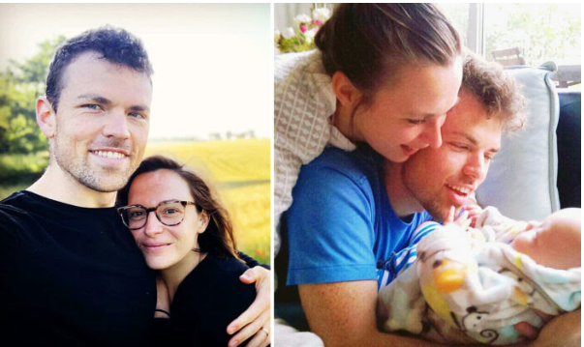

Slide 47
“The hardest part of becoming a dad for me was how all of a sudden I went from having total control over my schedule and routines to now having to design my life around another person’s life. I became much more grounded, caring, empathetic, calm, and clearheaded after becoming a parent.”
“Becoming a parent starved my ego but fed my soul,” Gonder added.
Notes:
https://www.theepochtimes.com/dads-letter-to-his-childless-self-inspires-gender-role-talks-between-couples_4350735.html?utm_source=brightnoe&utm_campaign=bright-2022-06-16&utm_medium=email&est=JKqJ8QaYulbynEsYgJQwxcgU3D%2F%2BjN9oQZsiqhK2f5DxiM2FyWloaI3wJIWxy%2FuVaA%3D%3D

Slide 48
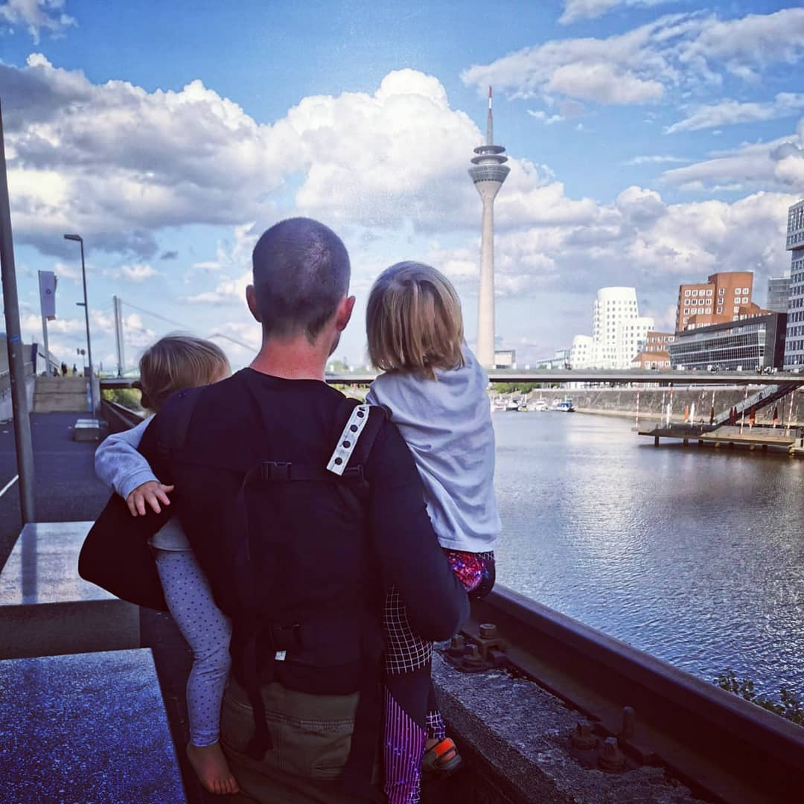
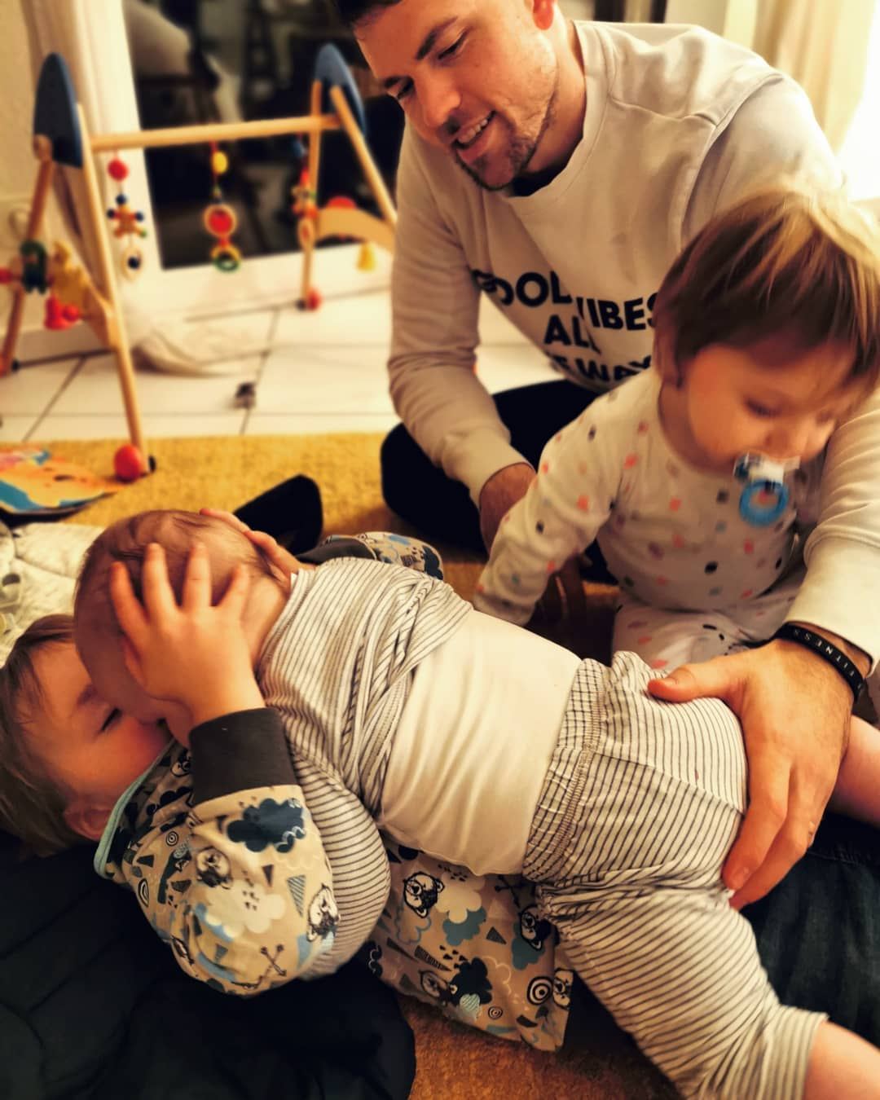
Notes:
https://img.theepochtimes.com/assets/uploads/2022/03/21/the-Gonder-family-7.jpg
https://img.theepochtimes.com/assets/uploads/2022/03/21/the-Gonder-family-5.jpg

Slide 49
Advising young couples before they embark on their journey to parenthood, Gonder says, “It’s time to graduate from boy psychology to man psychology.” He believes that it is wise to build a fitness habit to prepare oneself for all of the carrying,
Notes:
https://www.theepochtimes.com/dads-letter-to-his-childless-self-inspires-gender-role-talks-between-couples_4350735.html?utm_source=brightnoe&utm_campaign=bright-2022-06-16&utm_medium=email&est=JKqJ8QaYulbynEsYgJQwxcgU3D%2F%2BjN9oQZsiqhK2f5DxiM2FyWloaI3wJIWxy%2FuVaA%3D%3D

Slide 50
twisting, crawling, sleeping in odd positions, and being on the feet more than one is used to, apart from planning “a couple’s retreat with your wife to create a ‘family vision’ and turn it into a manifesto.”
Notes:
https://www.theepochtimes.com/dads-letter-to-his-childless-self-inspires-gender-role-talks-between-couples_4350735.html?utm_source=brightnoe&utm_campaign=bright-2022-06-16&utm_medium=email&est=JKqJ8QaYulbynEsYgJQwxcgU3D%2F%2BjN9oQZsiqhK2f5DxiM2FyWloaI3wJIWxy%2FuVaA%3D%3D

Slide 51
And last but not the least, he says, remember to “remind your loving wife how beautiful she is, and that she’s enough!”
Notes:
https://www.theepochtimes.com/dads-letter-to-his-childless-self-inspires-gender-role-talks-between-couples_4350735.html?utm_source=brightnoe&utm_campaign=bright-2022-06-16&utm_medium=email&est=JKqJ8QaYulbynEsYgJQwxcgU3D%2F%2BjN9oQZsiqhK2f5DxiM2FyWloaI3wJIWxy%2FuVaA%3D%3D

Slide 52
We call God "our Father," and it's no coincidence. The way He loves, protects and provides for us is the same role He has graciously given us—the role of loving, protecting and providing for those we love.
Notes:
https://www.charismanews.com/culture/89461-matthew-barnett-fatherhood-can-be-joyous-but-it-isn-t-for-the-fainthearted?utm_source=Charisma%20News%20Daily&utm_medium=email&utm_content=subscriber_id:5160390&utm_campaign=CNO%20daily%20-%202022-06-17
`

Slide 53
With God as our example, we will find new ways to be the dads our families need. We must be willing to be vessels of God's love, a patient and sacrificial love. Be willing to look beyond the four walls of your own home and reach those in our communities who desperately need a father.
Notes:
https://www.charismanews.com/culture/89461-matthew-barnett-fatherhood-can-be-joyous-but-it-isn-t-for-the-fainthearted?utm_source=Charisma%20News%20Daily&utm_medium=email&utm_content=subscriber_id:5160390&utm_campaign=CNO%20daily%20-%202022-06-17

Slide 54
Gay Pride events began with a day then a weekend then a week and then Obama with his
"fundamental transformation of America" made his proclamation establishing June as "Lesbian, Gay, Bisexual and Transgender Pride Month."
Notes:
We are told that "transgender affirmative healthcare" is now a human right and we are to guard against "dangerous" legislation opposed to it

Slide 55
As Father's Day approaches, remember that multitudes drift into the LGBTQ lifestyle because of fatherlessness and neglect or abuse from a dad. Those ensnared in this lifestyle represent a major mission field
Notes:
https://www.charismanews.com/opinion/heres-the-deal/89457-father-s-day-feedback-pride-events-feature-drag-queens-satanist-pornographer?utm_source=Charisma%20News%20Daily&utm_medium=email&utm_content=subscriber_id:5160390&utm_campaign=CNO%20daily%20-%202022-06-17

Slide 56
of hurting people searching and desperate for relationship with the living God. A woman in our former Atlanta congregation lived as a lesbian for 42 years until she heard the gospel; now she reaches out to multitudes.
Notes:
https://www.charismanews.com/opinion/heres-the-deal/89457-father-s-day-feedback-pride-events-feature-drag-queens-satanist-pornographer?utm_source=Charisma%20News%20Daily&utm_medium=email&utm_content=subscriber_id:5160390&utm_campaign=CNO%20daily%20-%202022-06-17

Slide 57
There are five mitzvot or commandments that address a father’s obligation toward his sons specifically. According to the Talmud ^{(in Kiddushin 1)}: “A father is obligated with regard to his [Jewish] son to circumcise him,
Notes:
Fatherhood _ Judaica WebStore Blog.pdf

Slide 58
and to redeem him if he is a firstborn son, and to teach him Torah, and to marry him to a woman, and to teach him a trade. And some say: A father is also obligated to teach his son to swim.”
Notes:
Fatherhood _ Judaica WebStore Blog.pdf
Talmudic era, swim = survival ki ship travel

Slide 59
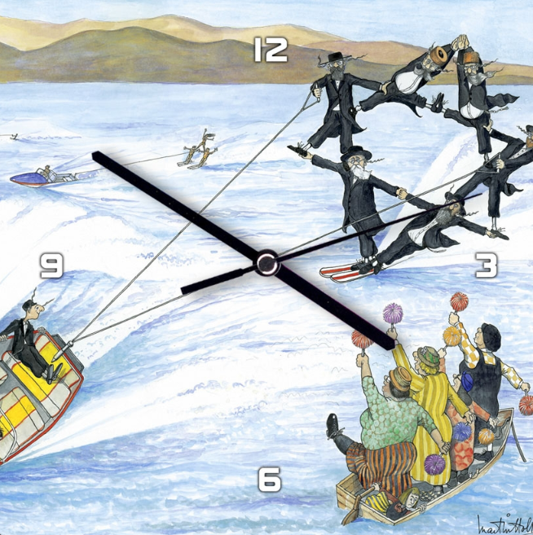
Notes:
https://www.judaicawebstore.com/martin-holt-jewish-humor-wall-clock-water-ski?refSrc=121421&nosto=nosto-page-product1-desktop

Slide 60
The Torah’s first dialogue between a father and son occurs in Genesis 22, between Abraham and Isaac. Isaac cries out, “Where are you, my father?” and Abraham replies, “Here I am.” Many rabbis and Jewish thinkers have gathered from that verse that the most important thing a father can be is present.
Notes:
Fatherhood _ Judaica WebStore Blog.pdf

Slide 61
Notes:
https://external-content.duckduckgo.com/iu/?u=https%3A%2F%2F2.bp.blogspot.com%2F-xqej4ajeXJg%2FVxk3WzPrWDI%2FAAAAAAAAIsc%2FJVte5KKdXLoB4X1ZGzwaH4YykGSJZ-1PQCLcB%2Fs640%2FMotivational-and-inspirational-Quotes.jpg&f=1&nofb=1

Slide 63
Father’s Day Message Outline
Complaining
Fatherhood response
Some illustrations

Slide 64
Do you KNOW Yeshua and the assurance of sins forgiven?
Are you hearing daily from His Word?
How are you applying what you heard?
Are you asking this of another?
Notes:
Who are you discipling, building up?4

Slide 65
Father’s Day Message Outline
Complaining
Fatherhood response
Some illustrations

