Slide 1
From the Messiah Conference:

Slide 2
Rabbi to counsellor: How can you tell if someone is mentally competent?
Counsellor: Ask the person a thoughtful question. For example, Captain Cook took three trips around the world. He died on one of them. Which one?
Notes:
David Chernoff?

Slide 3
From the Messiah Conference:
Rabbi Jeff Forman:
I was going to make a vax joke, but I was afraid people wouldn’t get it.

Slide 4
From the Messiah Conference:
Rabbi Jeff Forman:
I gave it a shot.

Slide 5
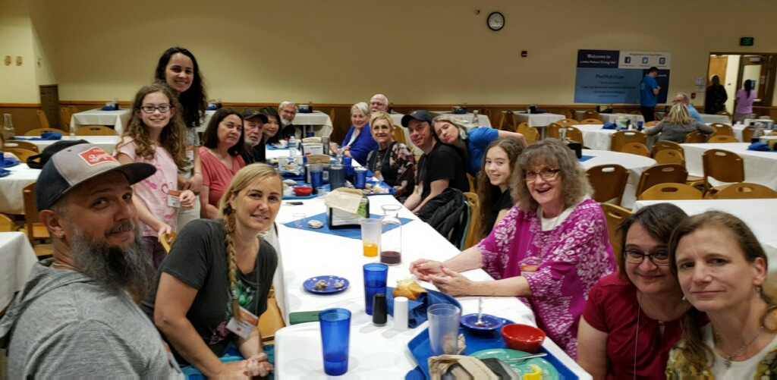

Slide 6
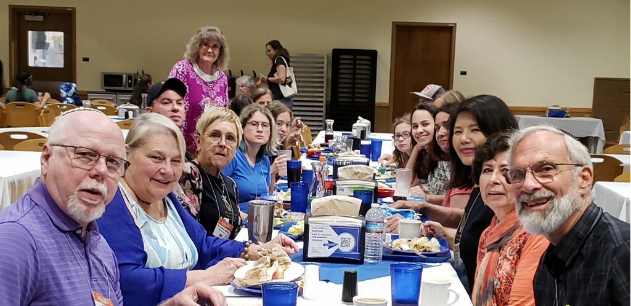

Slide 7
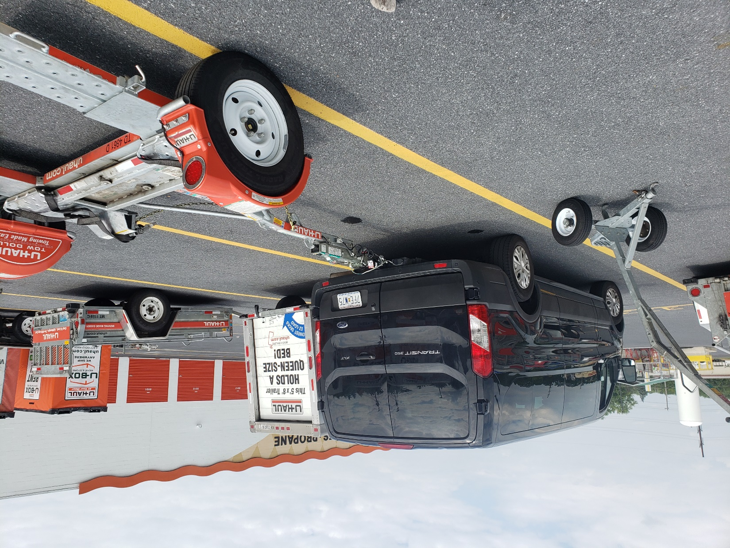

Slide 8
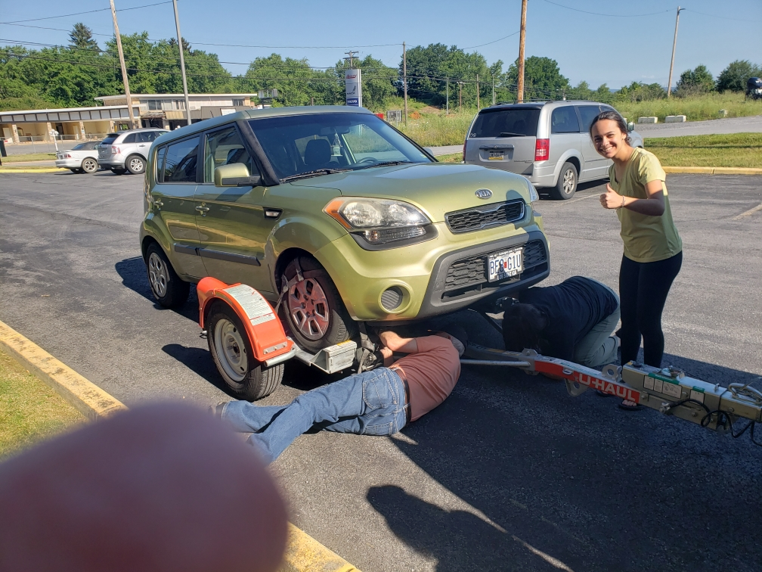

Slide 9
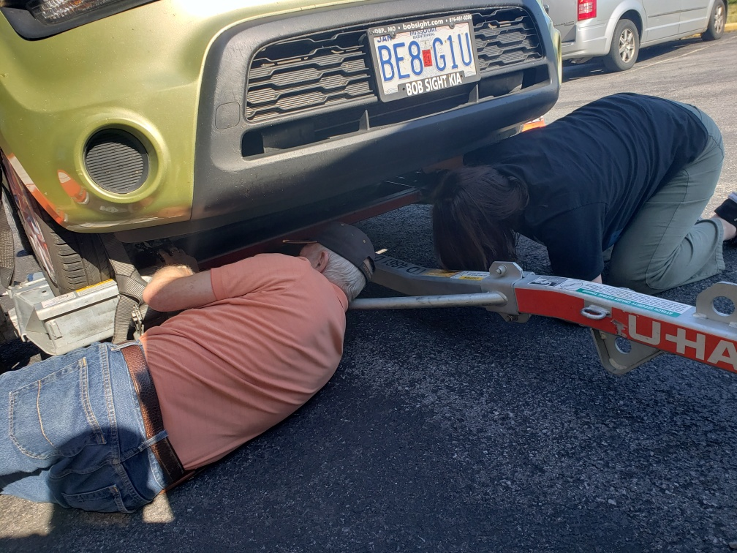

Slide 10
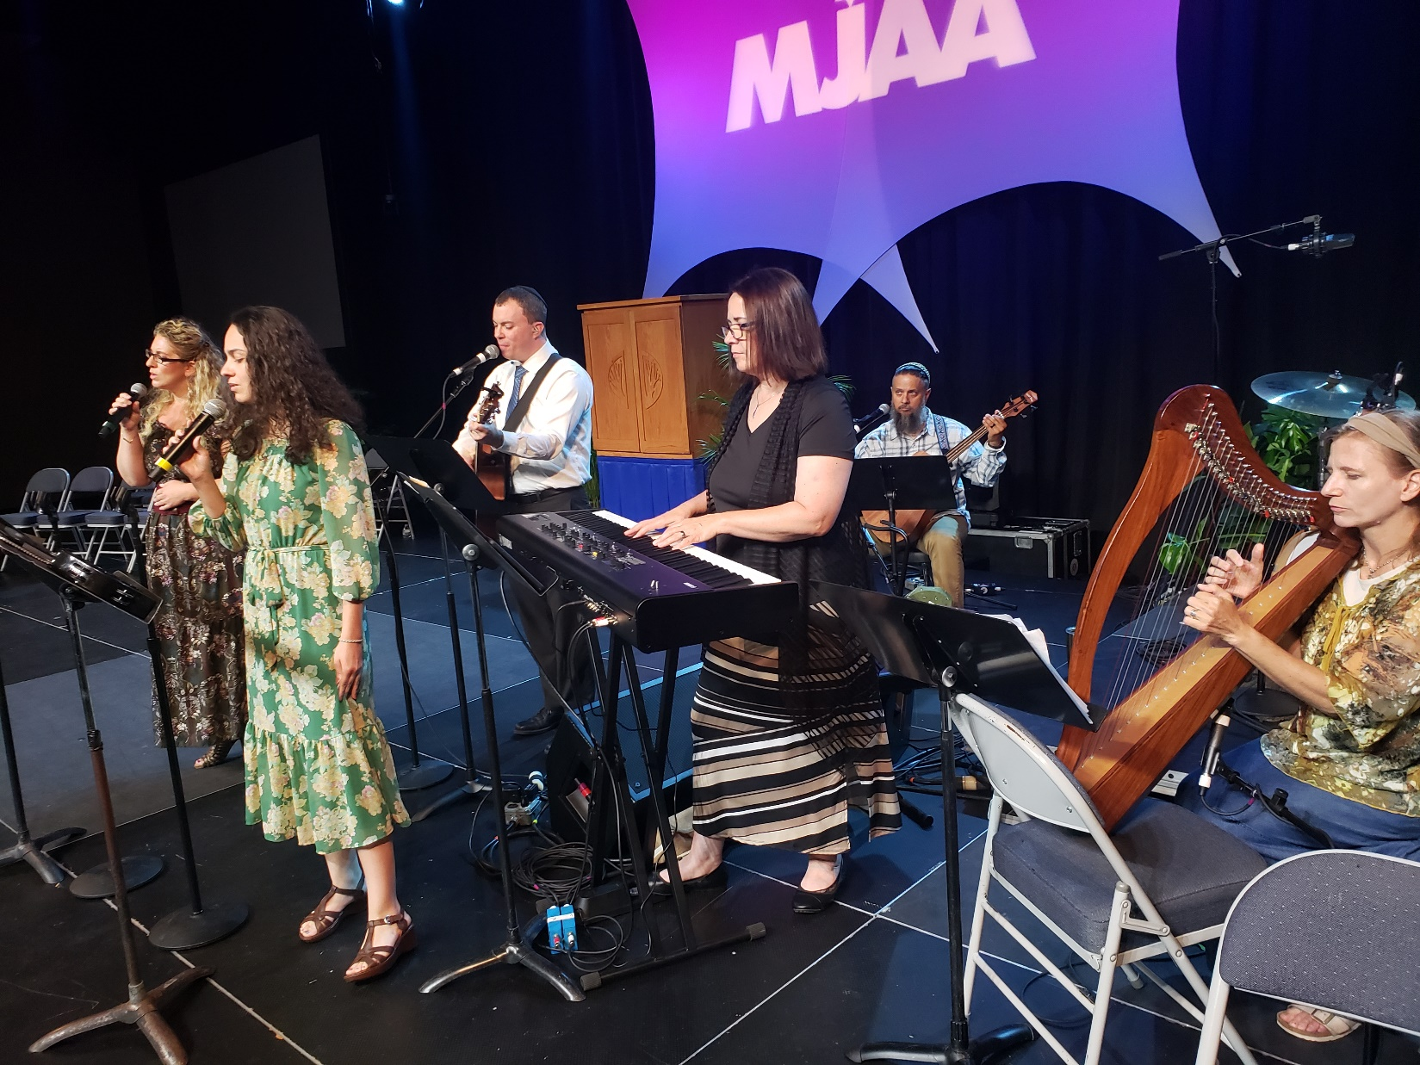
Notes:
High point of the Conference!

Slide 11
Two Minute Testimonies

Slide 12
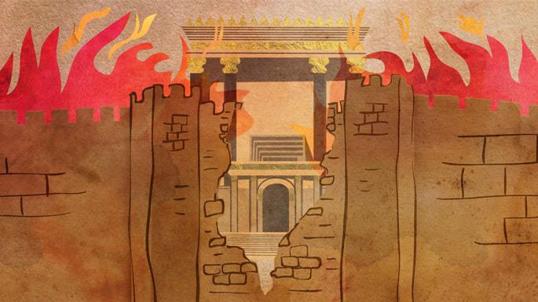
Fast of 17 Tammuz, Today
שבעה עשר בתמוז Shivah Asar b'Tammuz
Notes:
https://www.chabad.org/library/article_cdo/aid/5571741/jewish/11-Facts-About-the-17-Tammuz-Fast-Day.htm#utm_medium=email&utm_source=1_chabad.org_magazine_en&utm_campaign=en&utm_content=content

Slide 13
Fasts in the Hebrew Scriptures
Fasting in the Messianic Scriptures
Desperate times
Some dramatic accomplishments

Slide 14
Fasts in the Hebrew Scriptures
Fasting in the Messianic Scriptures
Desperate times
Some dramatic accomplishments

Slide 15
Fast days fall into three main categories:
fasts decreed in the Bible or instituted to commemorate biblical events;
fasts decreed by the rabbis;
private fasts.
Notes:
https://www.jewishvirtuallibrary.org/fasting-and-fast-days

Slide 16
Sept. 3. 2021
The 3 Tishri, called Tsom Gedalyah (the Fast of Gedaliah), in memory of the slaying of Gedaliah and his associates ^{(Jer. 41:1–2; II K 25:25).}
Notes:
https://www.jewishvirtuallibrary.org/fasting-and-fast-days

Slide 17
Sept. 16, 2021
The Day of Atonement (Yom Kippur) on which it is commanded "Ye shall afflict your souls" so that the individual may be cleansed from sins (Lev. 16:29–31; 23:27–32; Num. 29:7ff.); this is the only fast ordained in the Pentateuch.
Notes:
https://www.jewishvirtuallibrary.org/fasting-and-fast-days

Slide 18
Dec. 14, 2021
The Tenth of Tevet, in memory of the siege of Jerusalem by Nebuchadnezzar , king of Babylon (II Kings 25:1–2, Jer. 52:4ff.; Ezek. 24:1–2).
Notes:
https://www.jewishvirtuallibrary.org/fasting-and-fast-days

Slide 19
Mar. 16, 2022
The Fast of Esther (Ta'anit Ester) on the 13th of Adar, the day before Purim ^{(Esth. 4:16).}
Notes:
https://www.jewishvirtuallibrary.org/fasting-and-fast-days

Slide 20
July 17, 2022
The 17th of Tammuz, in commemoration of the breaching of the walls of Jerusalem in the First Temple period (Jer. 39:2 where the date is the 9th) and Titus breaching the walls of Jerusalem, and of other calamities which befell the Jewish people (Ta'an. 4:6, Ta'an. 28b, also Sh. Ar., OḤ, 549:2).
Notes:
https://www.jewishvirtuallibrary.org/fasting-and-fast-days

Slide 21
Aug. 7, 2022
The Ninth of Av (Tishah be-Av), a day of mourning for the destruction of the First and Second Temples (see Jer. 52:12–13), and other calamitous occasions.
Notes:
https://www.jewishvirtuallibrary.org/fasting-and-fast-days

Slide 22
Six fasts with Biblical basis
Plus rabbinic fasts
Plus personal fasts
Why so many?

Slide 23
^{Yoel 2. 11-15} Great is the Day of Adoni, fearsome, terrifying! Who can endure it? “Yet even now,” says Adoni, “turn to me with all your heart, with fasting, weeping and lamenting.” Tear your heart, not your garments; and turn to Adoni your God.

Slide 24
^{Yoel 2. 11-15} Who knows? He may turn, change his mind and leave a blessing behind him, [enough for] grain offerings and drink offerings to present to Adoni your God. “Blow the shofar in Tziyon! Proclaim a holy fast, call for a solemn assembly.”
Notes:
Study on cong. Growth. Many strategies. All in common that the leadership, and maybe others, fasted lots. I do, but if I tell you it nullifies them. “You have your reward already.”

Slide 25
Fast of 17 Tammuz, Today
שבעה עשר בתמוז Shivah Asar b'Tammuz
Notes:
https://www.chabad.org/library/article_cdo/aid/5571741/jewish/11-Facts-About-the-17-Tammuz-Fast-Day.htm#utm_medium=email&utm_source=1_chabad.org_magazine_en&utm_campaign=en&utm_content=content

Slide 26
Fasts in the Hebrew Scriptures
Fasting in the Messianic Scriptures
Desperate times
Some dramatic accomplishments

Slide 27
^{Mt. 9.15} And Yeshua said to them, “The guests of the bridegroom cannot mourn while the bridegroom is with them, can they? But the days will come when the bridegroom is taken away from them, and then they will fast.

Slide 28
^{Luke 6.32} Now Hanna, a daughter of Phanuel of the tribe of Asher, was a prophetess. She was well advanced in age…eighty-four. She never left the Temple, serving night and day with fasting and prayers.

Slide 29
^{Acts 13.2} One time when they were worshipping the Lord and fasting, the Ruakh HaKodesh said to them…
^{Acts 13.3} Then after fasting, praying, and laying hands on them, they sent them off

Slide 30
^{Acts 14.23} When they had handpicked elders for them in every community, and prayed with fasting, they placed them in the care of the Lord—in whom they had put their trust.

Slide 31
^{Acts 20.33-37} Just before daybreak, Sha’ul urged them all to eat, saying, “Today is the fourteenth day you have been in suspense, going hungry, eating nothing. Therefore I advise you to take some food; you need it for your own survival…

Slide 32
^{Acts 20.33-37} When he had said this, he took bread, said the b’rakhah…broke it and began to eat. With courage restored, they all ate some food themselves. Altogether there were 276 of us on board the ship.

Slide 33
^{2 Cor. 6.4-5} As God’s servants, we are commending ourselves in every way—in great endurance, in afflictions, in hardships, in distresses, in beatings, in imprisonments, in riots, in troubles, in sleeplessness, in hunger…

Slide 34
in sleeplessness, in hunger…

Slide 35
^{2 Cor. 11.27} in labor and hardship, through many sleepless nights, in hunger and thirst, often without food, in cold and exposure.
^{KJV} In weariness and painfulness, in watchings often, in hunger and thirst, in fastings often, in cold and nakedness.

Slide 36
There is a passion to prayer and worship that is activated by fasting.
Notes:
https://www.jewishvirtuallibrary.org/fasting-and-fast-days
I heard that lawyers will fast before arguing a big case. Some lawyers here. Can verify or not?
I know if I eat a meal, especially meat, I go into a “food coma.” Lasts ~15 minutes. But really heavy.
Fasting energizes. Sometimes stupefies since no energy. Fasting fog. Juice, grapes, watermelon.

Slide 37
Fast of 17 Tammuz, Today
שבעה עשר בתמוז Shivah Asar b'Tammuz
Notes:
https://www.chabad.org/library/article_cdo/aid/5571741/jewish/11-Facts-About-the-17-Tammuz-Fast-Day.htm#utm_medium=email&utm_source=1_chabad.org_magazine_en&utm_campaign=en&utm_content=content

Slide 38
Fasts in the Hebrew Scriptures
Fasting in the Messianic Scriptures
Desperate times: ~today 17 Tammuz
Some dramatic accomplishments

Slide 39
Traditionally, when a fast day is on Shabbat, it is postponed till Sunday. Except Yom Kippur. However, we feel the urgency of fasting and intercession, and haven’t followed that custom.

Slide 40
The ancient rabbinic chronology, Seder Olam Rabbah, tells us that…on 17 Tammuz, Noah sent out the dove, who also returned since he could find no terra firma on which to land. The dove was sent out again seven days later, and this time returned with an olive leaf in his beak.
Notes:
https://www.chabad.org/library/article_cdo/aid/5571741/jewish/11-Facts-About-the-17-Tammuz-Fast-Day.htm#utm_medium=email&utm_source=1_chabad.org_magazine_en&utm_campaign=en&utm_content=content

Slide 41
On 16 Tammuz, the people became antsy and crafted a Golden Calf, which they worshipped the following day, Tammuz 17. Upon seeing their disastrous actions, Moshe shattered the Tablets and begged G‑d for forgiveness.
Notes:
https://www.chabad.org/library/article_cdo/aid/5571741/jewish/11-Facts-About-the-17-Tammuz-Fast-Day.htm#utm_medium=email&utm_source=1_chabad.org_magazine_en&utm_campaign=en&utm_content=content

Slide 42
During the time when the Hasmonean dynasty ruled Judea, Hyrcanus II (who served as High Priest) was briefly crowned king. His brother, Aristobulus II, rose in rebellion. Hyrcanus took refuge in Jerusalem, and Aristobulus besieged Jerusalem, only allowing the daily lambs. But this stopped on 17 Tammuz.
Notes:
https://www.chabad.org/library/article_cdo/aid/5571741/jewish/11-Facts-About-the-17-Tammuz-Fast-Day.htm#utm_medium=email&utm_source=1_chabad.org_magazine_en&utm_campaign=en&utm_content=content
Family war. Brother murdering brother. No wonder Jews lost to Romans.

Slide 43
The Jerusalem Talmud… maintains that the 17th of Tammuz was the date that the Babylonians breached the walls of Jerusalem (in 423 BCE) on their way to destroy the first Temple.
Notes:
https://www.chabad.org/library/article_cdo/aid/5571741/jewish/11-Facts-About-the-17-Tammuz-Fast-Day.htm#utm_medium=email&utm_source=1_chabad.org_magazine_en&utm_campaign=en&utm_content=content

Slide 44
In 69 CE, the Roman destroyers breached the walls of Jerusalem and began a period of burning, looting, murder, and mayham, which culminated with the Temple complex burning on 9 Av, three weeks later.
Notes:
https://www.chabad.org/library/article_cdo/aid/5571741/jewish/11-Facts-About-the-17-Tammuz-Fast-Day.htm#utm_medium=email&utm_source=1_chabad.org_magazine_en&utm_campaign=en&utm_content=content
So, the next three weeks are called “Between the Walls” Bein haMetsarim. Orthodox Jewish people do not hold weddings, enjoy music, or cut their hair.

Slide 45
^{Zekh 8.18-19} This word of Adoni-Tzva’ot came to me: “Adoni-Tzva’ot says, ‘The fast days of the fourth, fifth, seventh and tenth months are to become times of joy, gladness and cheer for the house of Y’hudah. Therefore, love truth and peace.’

Slide 46
^{Zekh 8.18-19} This word of Adoni-Tzva’ot came to me: “Adoni-Tzva’ot says, ‘The fast days of
fourth, 17 of Tammuz
fifth, 9 of Av
seventh 10 of Tishri Yom Kippur!!
and tenth 10 of Tevet

Slide 47
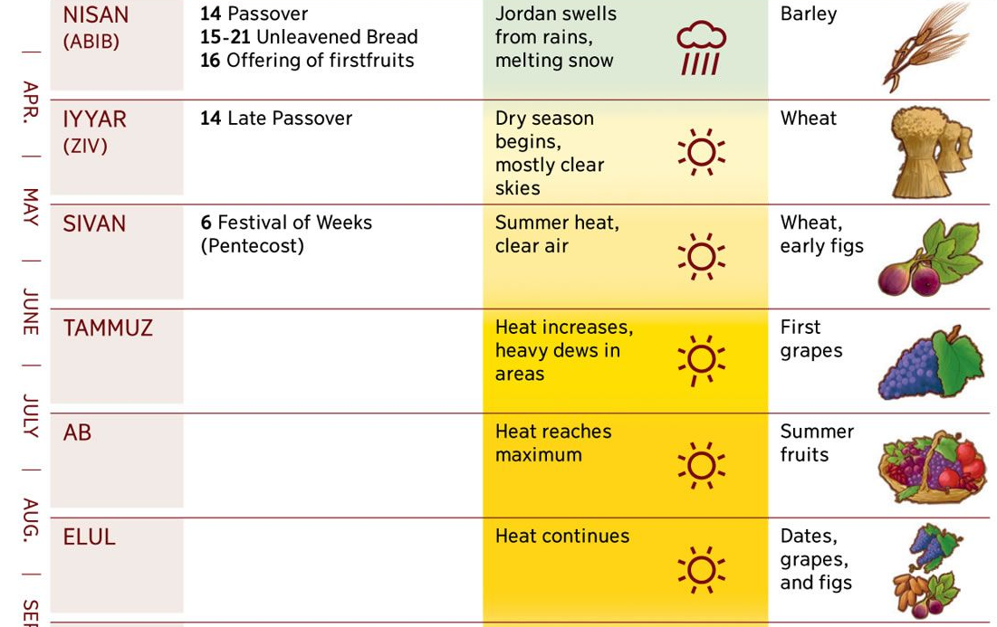
1
2
3
4
5
6
Notes:
https://external-content.duckduckgo.com/iu/?u=https%3A%2F%2Fs-media-cache-ak0.pinimg.com%2Foriginals%2F56%2F63%2F5d%2F56635d4e1293a70436cdeb3fd995aa63.jpg&f=1&nofb=1

Slide 48
7
8
Notes:
https://external-content.duckduckgo.com/iu/?u=https%3A%2F%2Fs-media-cache-ak0.pinimg.com%2Foriginals%2F56%2F63%2F5d%2F56635d4e1293a70436cdeb3fd995aa63.jpg&f=1&nofb=1

Slide 49
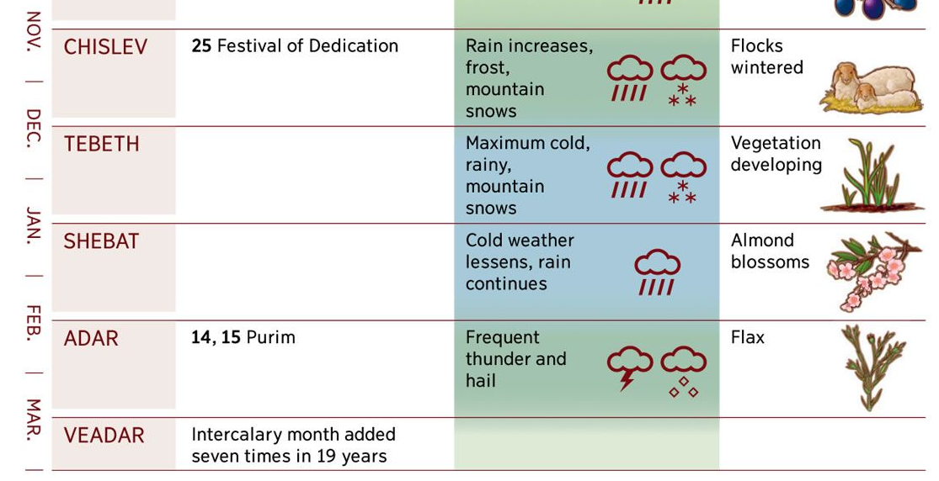
9
10
11
12
13
Notes:
https://i.pinimg.com/originals/56/63/5d/56635d4e1293a70436cdeb3fd995aa63.jpg

Slide 50
^{Zekh. 8.19} are to become times of joy, gladness and cheer for the house of Y’hudah. Therefore, love truth and peace.’

Slide 51
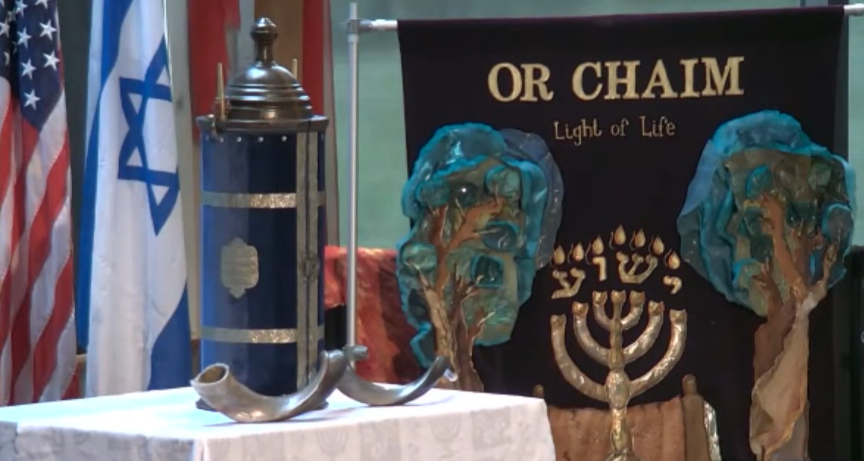
Golden, CO

Slide 52
July 14, 2022, Thursday night, there was a fire in the Sanctuary at Gateway on Mt. Zion, 166 S Lookout Mountain Rd, Golden, CO. No one was in the building at the time so thankfully there were no injuries or worse. Of course, we are all stunned. Investigating for arson.
Stewart and Millie Lieberman.

Slide 53
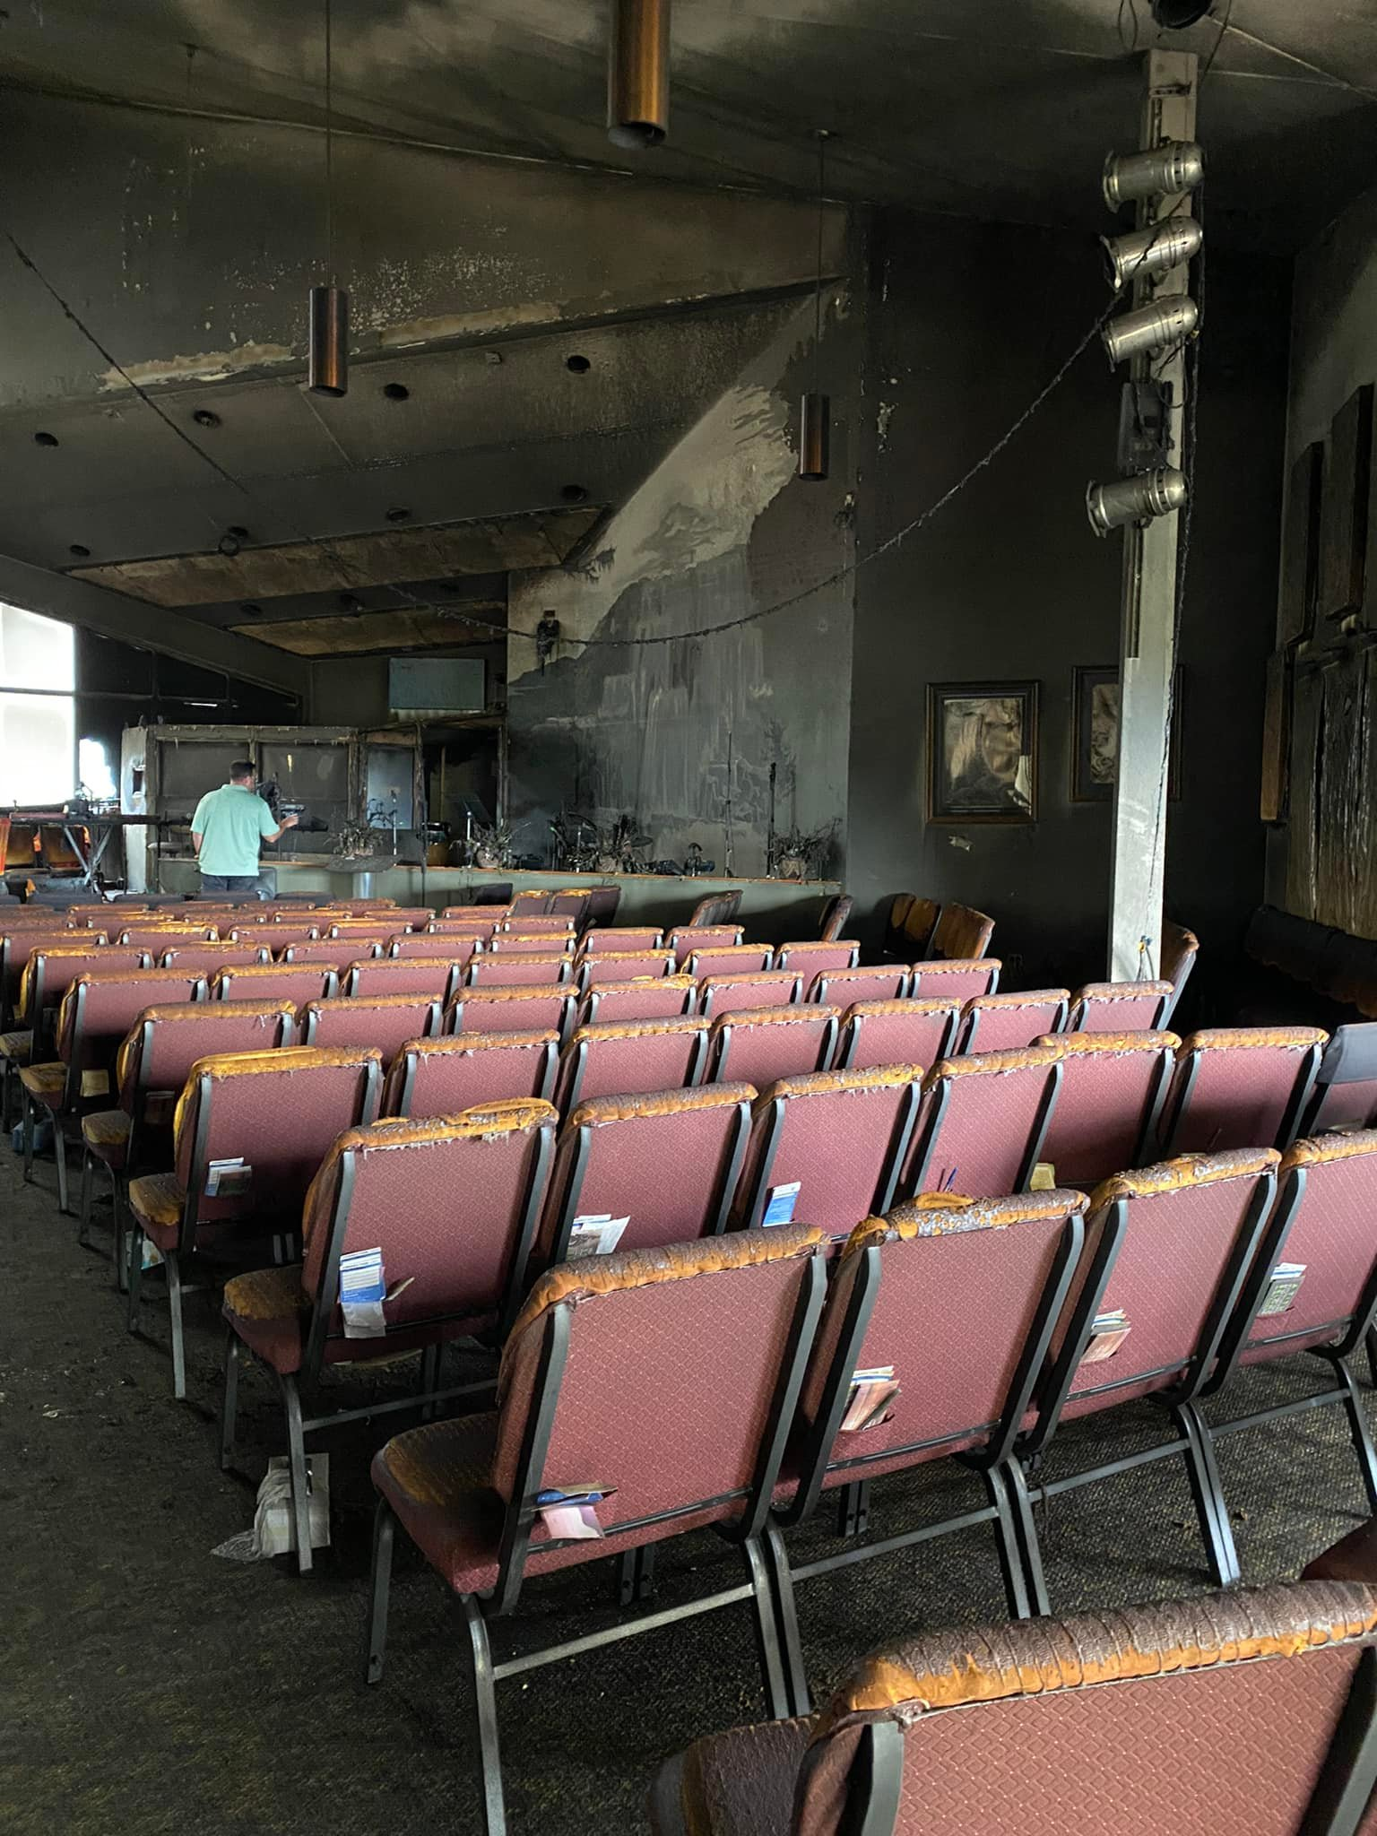
Notes:
https://www.facebook.com/OrChaim.org/photos/pcb.4896196693819367/4896190193820017

Slide 54
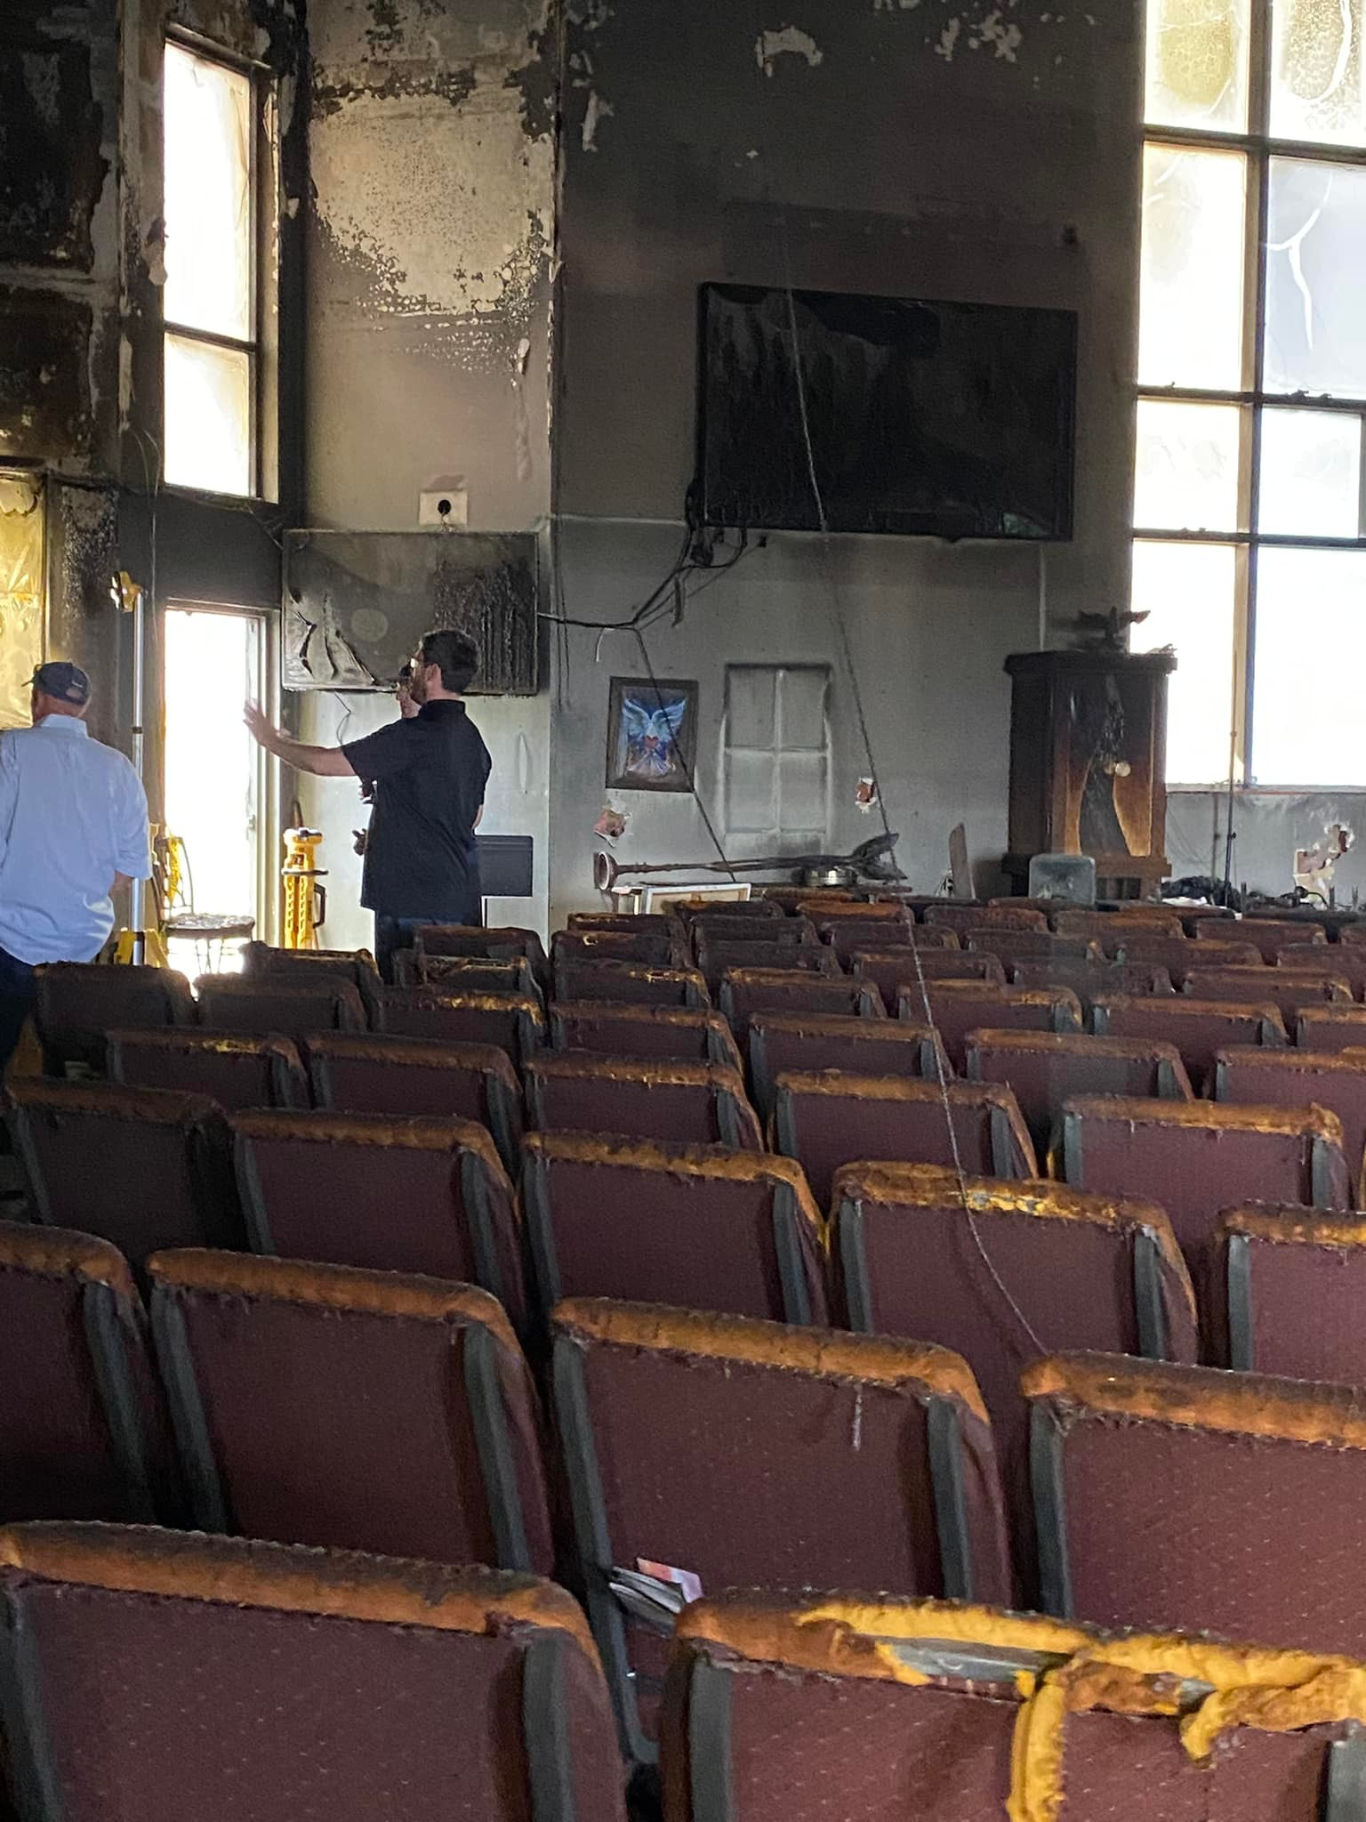
Notes:
https://www.facebook.com/OrChaim.org/photos/pcb.4896196693819367/4896190160486687

Slide 55
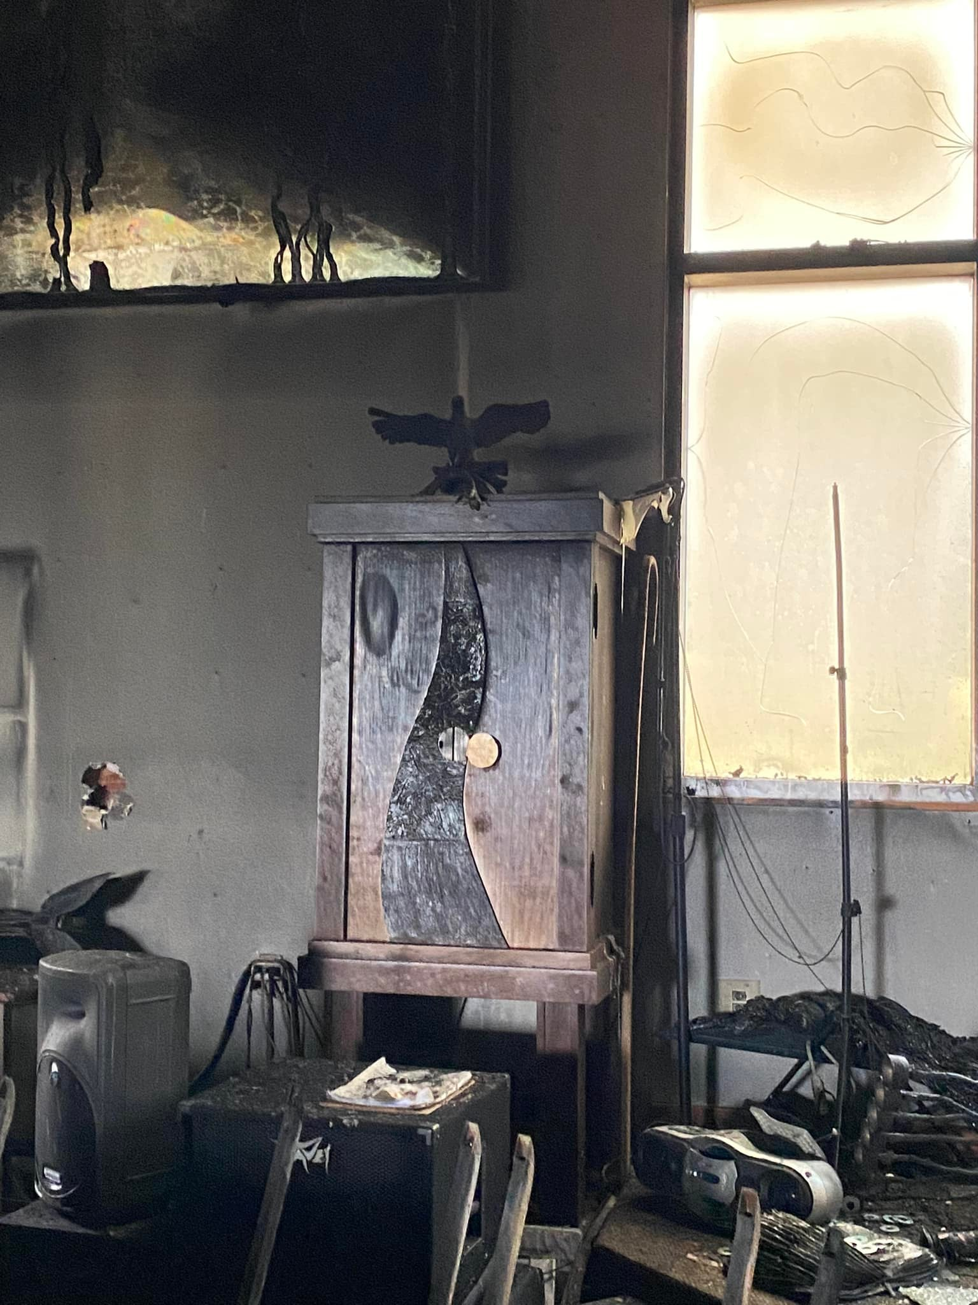
Notes:
https://www.facebook.com/OrChaim.org/photos/pcb.4896196693819367/4896189747153395

Slide 56
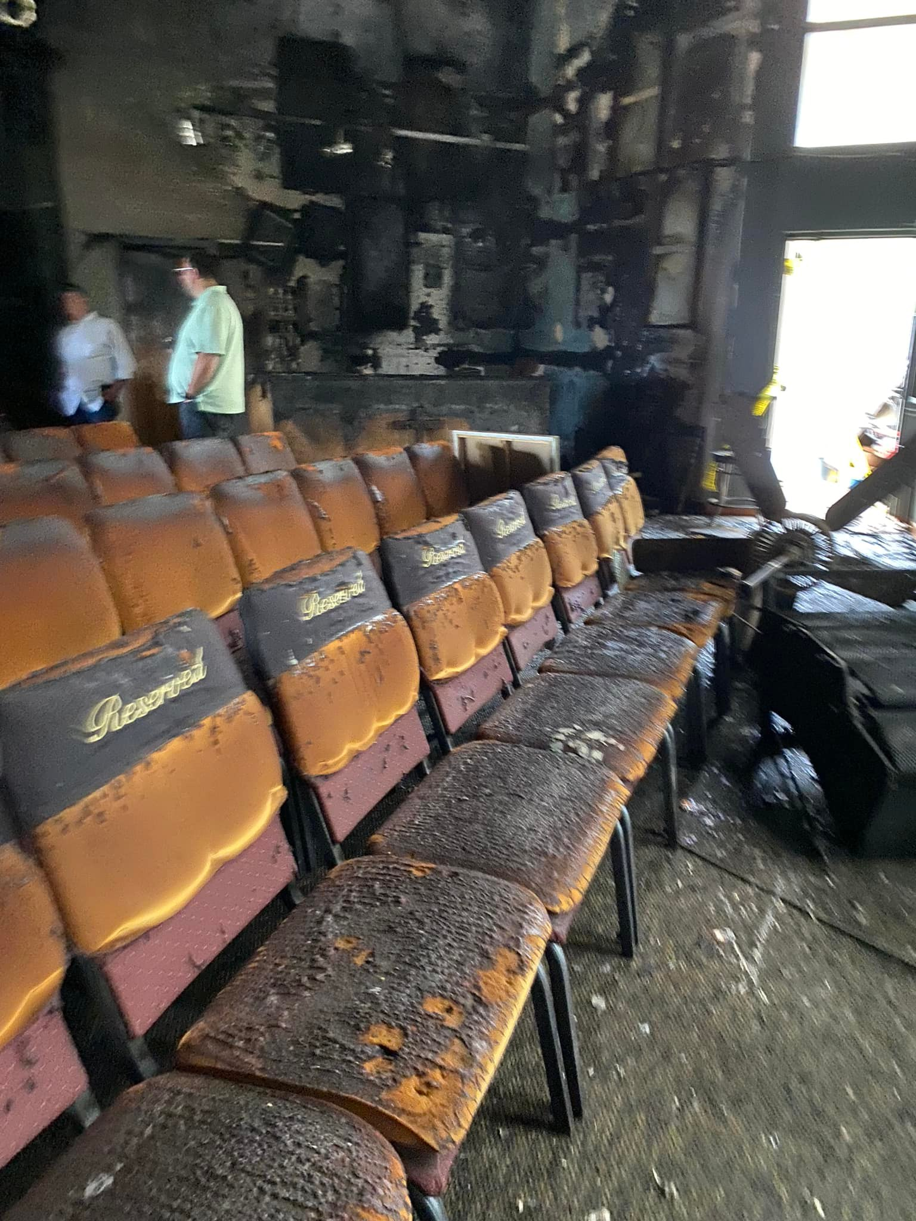

Slide 57
Fast of 17 Tammuz, Today
שבעה עשר בתמוז Shivah Asar b'Tammuz
Notes:
https://www.chabad.org/library/article_cdo/aid/5571741/jewish/11-Facts-About-the-17-Tammuz-Fast-Day.htm#utm_medium=email&utm_source=1_chabad.org_magazine_en&utm_campaign=en&utm_content=content

Slide 58
Fasts in the Hebrew Scriptures
Fasting in the Messianic Scriptures
Desperate times
Some dramatic accomplishments

Slide 59
Does fasting and intercession work?

Slide 60
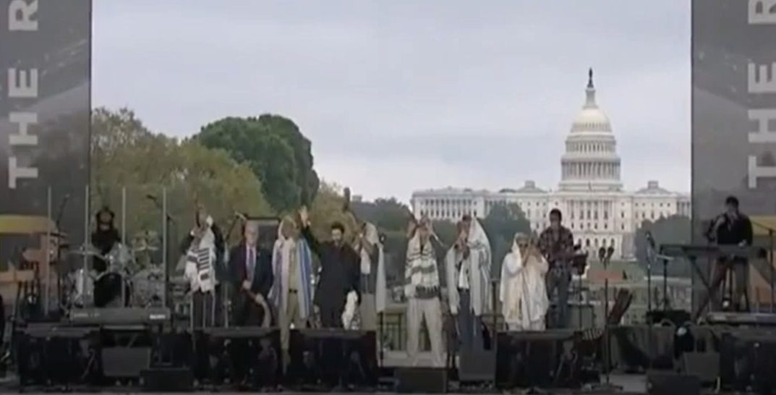
Saturday, Sept. 26, 2020
Shabbat Shuva
Notes:
We drove, fasted, prayed, worshipped. Avail for anything?

Slide 61
FIRST Jonathan Cahn told us that as the shofars were sounding on the day, the moment of the Return,, 5:04 p.m., Saturday, Sept. 26, 2020 Shabbat Shuva, Amy Coney Barrett was nominated as Supreme Ct. Justice.
Notes:
https://youtu.be/_TXPE1Hx4ro?t=8866

Slide 62
SECOND ^{Yeshayahu/Is 51.11} Now the ransomed of Adoni will return, and come to Zion with singing. Everlasting joy will be upon their heads. They will obtain gladness and joy, and sorrow and sighing will flee away.
Notes:
But the ransomed cannot return according to Israeli law. Believers disallowed.
1989 Gary and Shirley Beresford, Jewish people from S. Africa

Slide 63
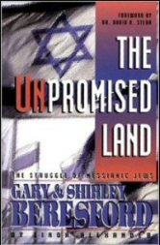
1989 a S. African Jewish couple tried to make Aliyah, but Israeli Supreme Ct. Justice Aharon Barak ruled against them, that they were not Jewish anymore.
Notes:
https://en.wikipedia.org/wiki/Aharon_Barak

Slide 64
^{Yekhez/Ezk 39.28} They will know that I am Adoni their God, since it was I who caused them to go into exile among the nations, and it was I who regathered them to their own land. I will leave none of them there any more, and I will no longer hide my face from them, for I have poured out my Spirit on the house of Isra’el,’ says Adoni Elohim.”

Slide 65
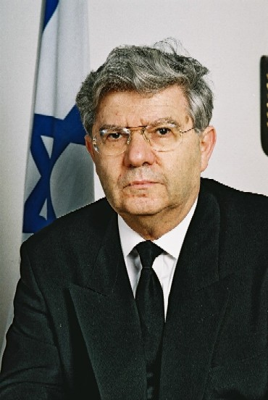
Justice Barak ruled that the perception of the “man in the street” is that Jewish believers in Messiah are Christian. If that changes…
Notes:
https://en.wikipedia.org/wiki/Aharon_Barak

Slide 66
^{1 Kefa/P 2.15} For it is God’s will that your doing good should silence the ignorant talk of foolish people.
Notes:
1999 Paul Liberman and Joel Chernoff in Paul’s appt. Joel had Joseph Project vision. Nothing happened for 4 years.

Slide 67
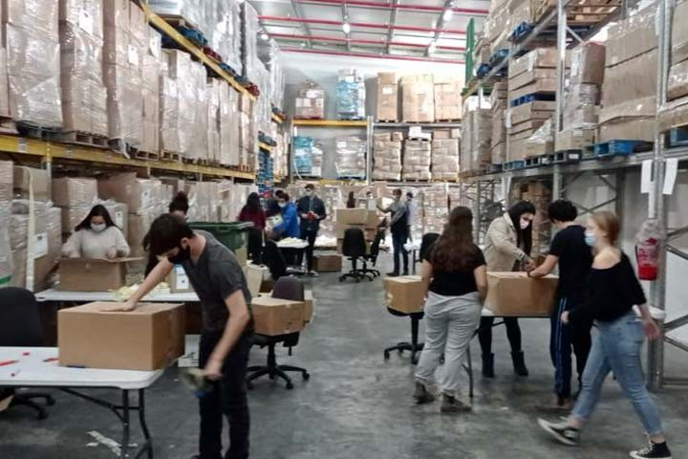
Joseph Project warehouse

Slide 68
Our Logistics Center is strategically located in the heart of the country, adjacent to highways connecting Israel's southern and northern-most points, allowing our logistics team the ability to offer relief on a nation-wide scale, and making our warehouse uniquely equipped to provide humanitarian aid during times of national crisis.

Slide 69
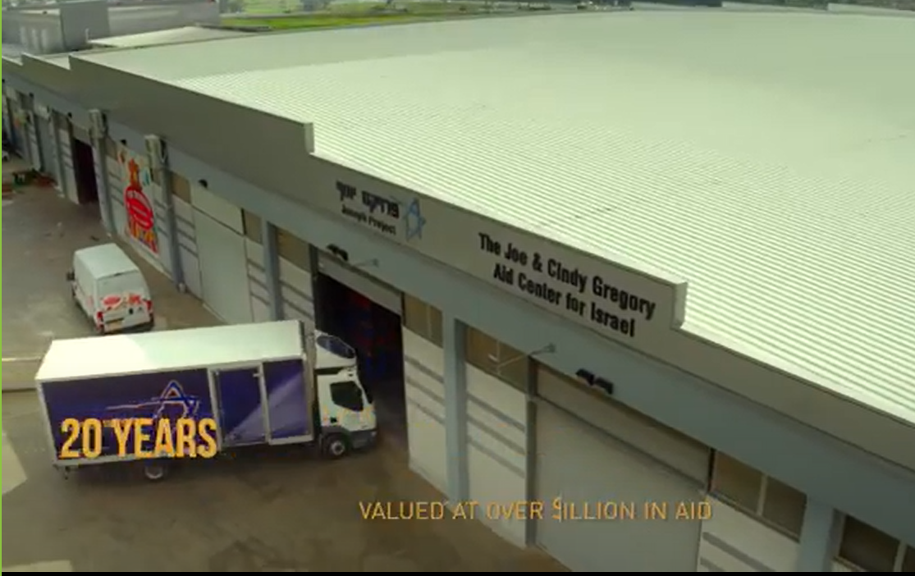
Notes:
$120 million in aid

Slide 70
Three signs are posted saying that during the distribution of aid, no matters of faith can be discussed: in Hebrew, Russian, English.
“But come back at 5 p.m.” People did and congregations started.

Slide 71
30 distribution points
100 major Israeli corp.
Joseph Project is the leading importer of humanitarian aid
23 distribution points in Ukraine.
CHANGING the perception of the “man in the street.” so the redeemed can return!

Slide 72
THIRD

Slide 73
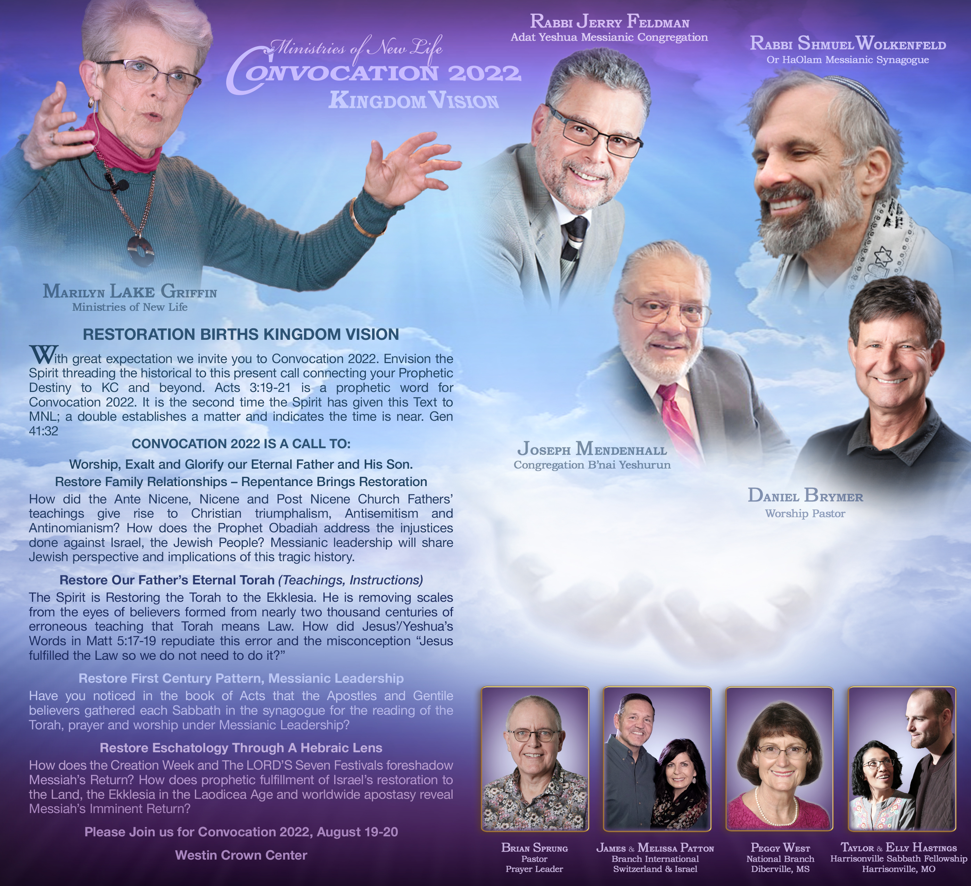
Convocation Location
Westin Crown Center
1 E Perishing Rd
Kansas City, MO 64108
Ballroom A
Registration covers: Convocation packet, morning coffee & refreshments,
plated lunch - Friday & Sabbath
*Registration secured when full payment is received in MNL office with contact information.
(postal registration due by Aug 15
& online registration by Aug 18)

Slide 74
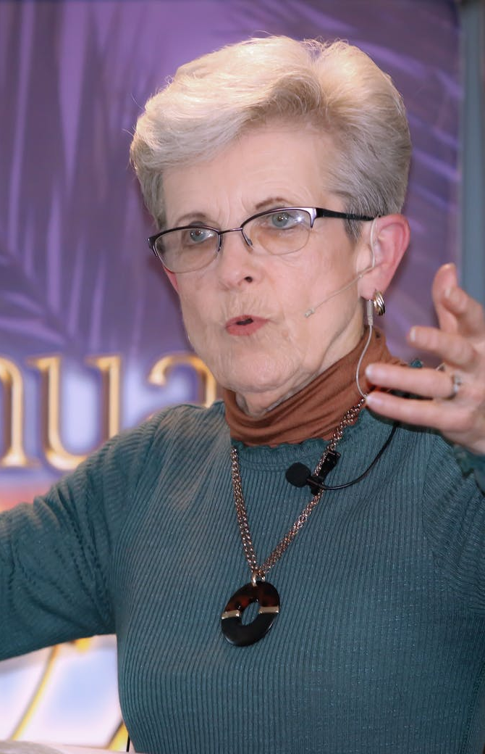
Marilyn Griffin, a
spiritual matriarch
in Kansas City.
Notes:
https://mnewlife.org/about

Slide 75
1987 started the City Wide Prayer movement.
Midwest Minister’s Fellowship
Renunciation of the dedication of Kansas City to Pallas Athena 9/29/1886 -- 9/29/2000

Slide 76
A new Kansas City tradition emerged on October 13, 1887 with the first Priests of Pallas parade. President Grover Cleveland and his new bride, Frances, were on hand to witness the spectacle that would begin after nightfall.
Notes:
https://kchistory.org/week-kansas-city-history/we-play-pallas

Slide 77
A crowd waited at the gates of the "Priests' Den," a warehouse where all of the horse-drawn floats were staged. As the doors swung open, fireworks lit the path of mounted and armored guards, the robed Priests of Pallas, and a float bearing the queen Athena, or rather, an elaborately-costumed performer.
Notes:
https://kchistory.org/week-kansas-city-history/we-play-pallas

Slide 78
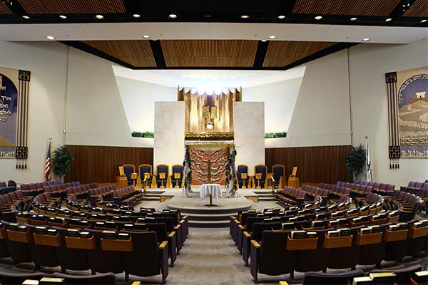
Kehilath Israel Synagogue
Notes:
https://external-content.duckduckgo.com/iu/?u=https%3A%2F%2Fkisyn.org%2Fsites%2Fdefault%2Ffiles%2Fstyles%2Fmikvah_slideshow__600x400_%2Fpublic%2FWWA_HistoryofKI_Slideshow_ALL-16.png%3Fitok%3DEe5NivCo&f=1&nofb=1

Slide 79
2008, May 13 Marilyn orchestrated a public repentance service at Kehilath Israel Synagogue.
The mayor of Leawood apologized to the Jewish community for deed restrictions barring Jews.
Notes:
Going back to J.C. Nichols

Slide 80
The president of the St. Lukes Hospital System apologized for a hiring prohibition of Jewish doctors at St. Lukes.

Slide 81
Convocation Location
Westin Crown Center
1 E Perishing Rd
Kansas City, MO 64108
Ballroom A
Registration covers: Convocation packet, morning coffee & refreshments,
plated lunch - Friday & Sabbath
*Registration secured when full payment is received in MNL office with contact information.
(postal registration due by Aug 15
& online registration by Aug 18)

Slide 82
We have a very special Friday morning planned at Convocation 22. The entire morning will be dedicated to helping Gentile believers understand the grievous history of total disregard in recognizing and supporting the Messianic Body, causing a great divide and much pain. Marilyn Griffin will begin by laying a historical foundation, followed by Rabbi Shmuel Wolkenfeld sharing the Messianic perspective regarding this most crucial topic. A dedicated time will be set aside for repentance to the Messianic Brethren. We believe this will bring a mighty breakthrough from the Courts of Heaven, releasing deep healing and restoration.
Another crucial point that will be covered in this years Convocation is the invitation that Torah is for all set-apart believers in Messiah Yeshua. One Messiah and One Torah for all, different covenantal relationship.
Other essential topics will be covered at Convocation 22 restoring Kingdom Vision to the entire Body of Messiah.
Please join us!

Slide 85
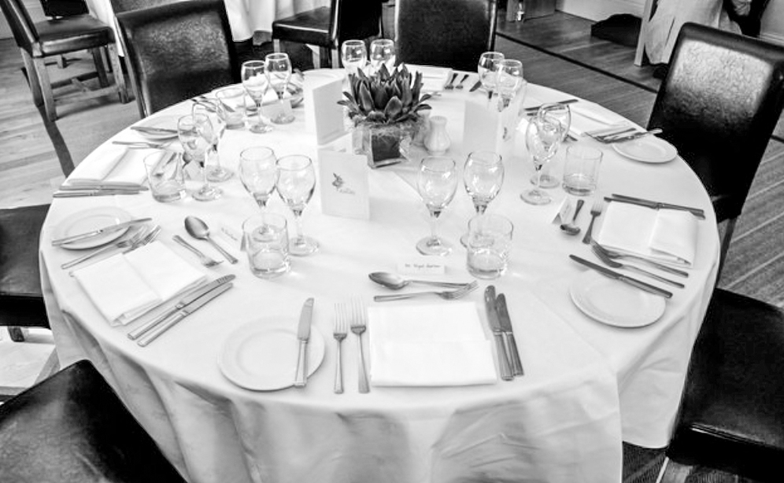
Personalize Your Tables and promote
Or HaOlam Messianic Congregation
Early Registration Pricing through Aug. 9th:
Table of 8 – $400
Table of 10 – $500
Be sure to register your space for Convocation 2022!

Slide 86
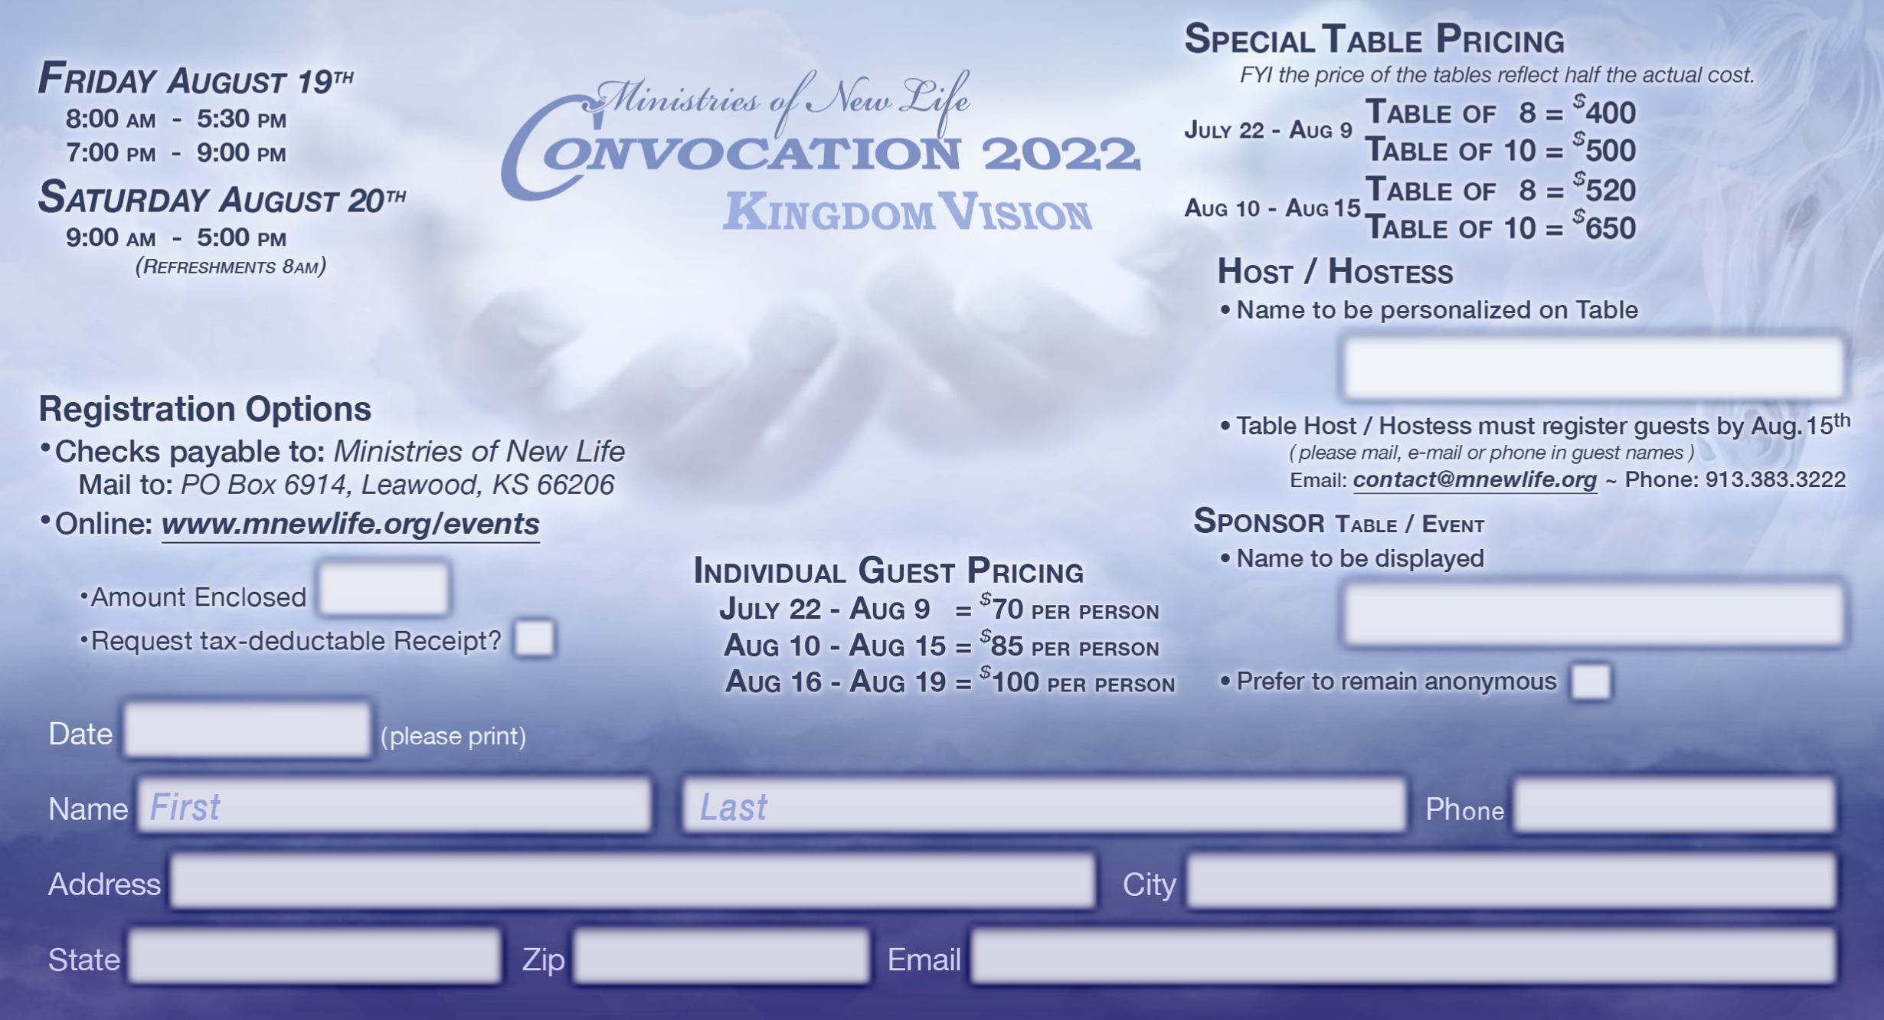

Slide 87
Parking
On-Site Parking
Daily: $23
MNL Voucher Parking
Daily: $11
Voucher may be purchased from MNL
Entrance to Parking in located at main entrance of the Westin Hotel

Slide 88
^{Acts 3.19-21} Repent, therefore, and return—so your sins might be blotted out, so times of relief might come from the presence of Adonai and He might send Yeshua, the Messiah appointed for you. Heaven must receive Him, until the time of the restoration of all the things that God spoke about long ago through the mouth of His holy prophets.

Slide 89
Summary and prayer points:
Fasts in the Hebrew Scriptures
Fasting in the Messianic Scriptures spirit of intercession
Desperate times: arson, VTB
Some dramatic accomplishments: Joseph Project in Ukraine, Convocation

