Slide 1
Notes:
Lori Wilson

Slide 2
Notes:
Late to school…of fish.

Slide 5
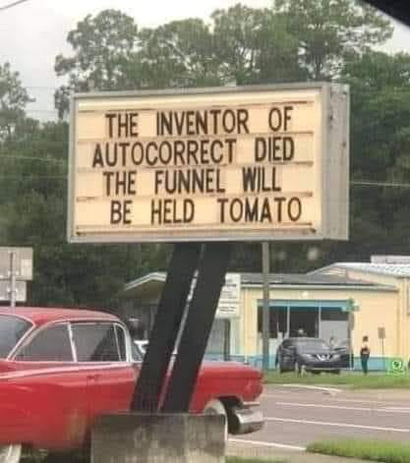

Slide 7
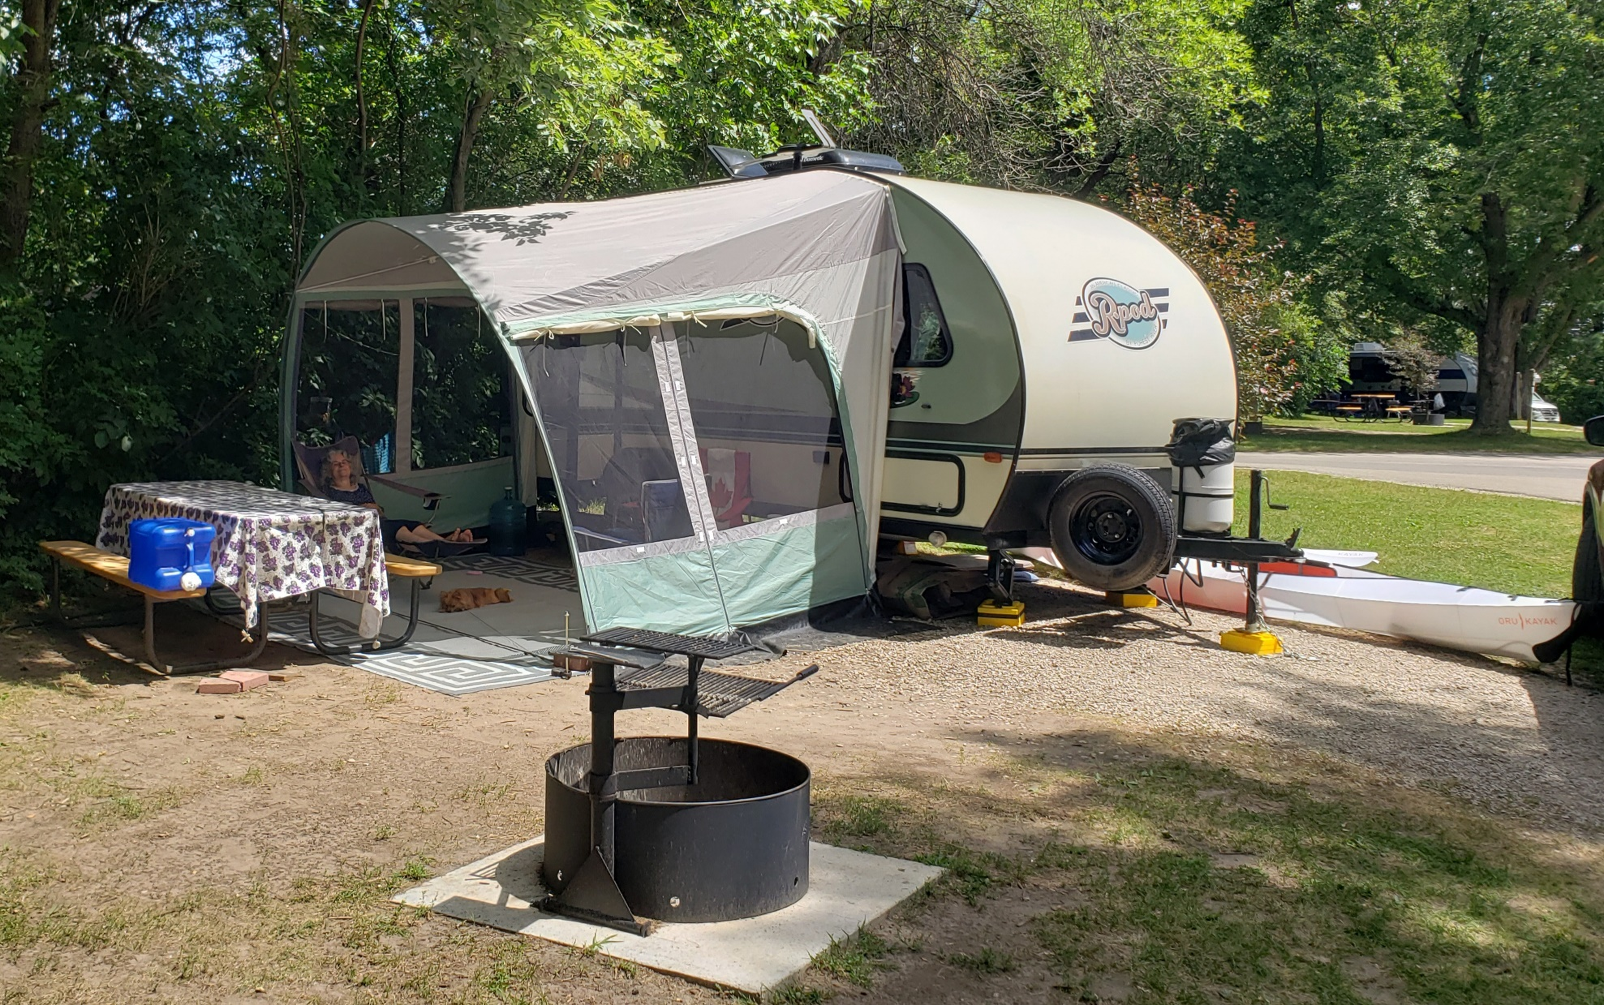
Our campsite, Clear Lake, Iowa
Notes:
No responsibilities. Just rest and relaxation!

Slide 9
מְנוּחָה M’nukha
rest, respite; quiet, calm, serenity, resting place, repose, peace, ease, tranquility
65x in Hebrew scriptures
Notes:
Topical message.

Slide 10
What מְנוּחָה M’nukha is not:
Everything pleasing: money, health, plans
Everyone agreeing and blessing

Slide 11
Broadway song from Oklahoma
Oh, What a beautiful mornin’,
Oh, What a beautiful day.
I got a beautiful feelin' Ev'erything's goin' my way.
Deeper than that!
Notes:
Written by: Oscar Hammerstein, Richard Rodgers from the Broadway play Oklahoma
Lyrics © CONCORD MUSIC PUBLISHING LLC
Lyrics Licensed & Provided by LyricFind
https://www.lyrics.com/lyric/348197/Rodgers+%26+Hammerstein/Oh%2C+What+a+Beautiful+Morning

Slide 12
Difference between most men and most women.
If a husband is expecting to be honored for his spiritual connection…
Notes:
I though I was the only one to deal with this!
https://www.instagram.com/reel/Cf4--l3Jf3O/?igshid=MDJmNzVkMjY=
https://www.instagram.com/reel/Cf4--l3Jf3O/?igshid=MDJmNzVkMjY%3D

Slide 13
What מְנוּחָה M’nukha is:

Slide 14
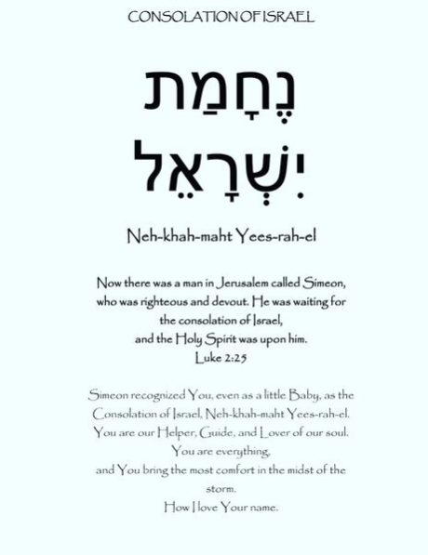
Notes:
Barri Seif’s instagram

Slide 15
Notes:
Barri Seif’s instagram

Slide 16
Notes:
Barri Seif’s instagram

Slide 17
Yeshua is the source and essence of מְנוּחָה M’nukha Deep Rest

Slide 18
^{Mtt. 11.28-30} Come to Me, all who are weary and burdened, and I will give you rest מְנוּחָה m’nukha .
Notes:
In 1969, first verse I really GOT.
As we come to Him in repentance of our sins and faith in His atoning death and resurrection, we experience rest מְנוּחָה m’nukha

Slide 19
^{Mtt. 11.28-30} Come to Me, all who are weary and burdened, and I will give you rest. Take My yoke upon you and learn from Me, for I am gentle and humble in heart, and ‘you will find rest for your souls.’ For My yoke is easy and My burden is light.”
Notes:
Bait and switch??
Deepest rest is serving in love.

Slide 20
מְנוּחָה M’nukha
Sometimes thought synonymous with שַׁבָּת Shabbat,
But שַׁבָּת = cease, to strike, to stop working
Notes:
Interesting connection in the two words.

Slide 21
We read in the Book of Genesis that G‑d created the world in six days and rested on the seventh. The sages say that on that day, G‑d created m’nukhah, מְנוּחָה rest, without which sustained creativity would be impossible.
Notes:
https://www.chabad.org/library/article_cdo/aid/633659/jewish/What-Is-Shabbat.htm

Slide 22
^{Shmot/Ex 20.11} For in six days Adoni made heaven and earth, the sea, and all that is in them, and
rested וַיָּנַח on the seventh day. Thus Adoni blessed Yom Shabbat, and made it holy.
Notes:
Two different Hebrew words: rest, and cease.

Slide 23
Abraham Joshua Heschel, “Shabbat is an island in time.”
Notes:
If we enter it in the right spirit Shabbat is a time of deep m’nukhah.
https://www.chabad.org/library/article_cdo/aid/253215/jewish/Shabbat.htm
https://rs.tiofnatick.org/2015/10/22/shabbat-is-an-island-in-time/

Slide 24
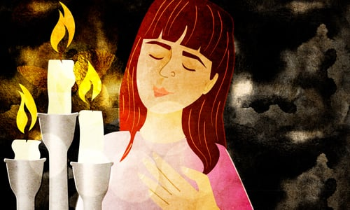
According to the Talmud, Shabbat is equal to all the other command-ments.
Notes:
https://www.chabad.org/library/article_cdo/aid/633659/jewish/What-Is-Shabbat.htm
What I was taught as a kid in Hebrew school. It’s the first listed in Vayikra/Lev. 23.
Appreciated Brett’s message on Shabbat, and NOT bashing Sunday Christians.
However, one practical advantage of the Jewish interpretation is that Sunday Sabbath begins at midnight, ends at midnight. Hopefully you are sleeping!
Jewish Shabbat begins Friday sunset with a celebration of Kiddush, ends with celebration of Havdalah. Neither ceremony is commanded per se, but wonderful

Slide 25
Hebrew word structure:
מְנוּחָה noun M’nukha
נוֹחַ adjective noakh
comfortable; easy; convenient; easy-going
נָחto rest verb nakh
מְ and ה are weak letters. Structural filler. Key root letters ח and נ

Slide 26
^{Ber/Gen 6.8} But Noah וְֹנחַ found favor in Adoni’s eyes.
Notes:
the grace he found was not on account of his own merit, but on account of the mercy of God: and this shows that he was not without sin, or he would have stood in no need of the mercy and grace of God to save him
Relationship rest and grace. Noakh was a man of rest because of grace.

Slide 27
^{Ber/Gen 8.4} The ark came to וַתָּנַח rest in the seventh month, on the seventeenth day of the month, upon the mountains of Ararat.

Slide 28
כִּי כֹה-אָמַר אֲדֹנָי יְיָ קְדוֹשׁ יִשְׂרָאֵל, בְּשׁוּבָה וָנַחַת תִּוָּשֵׁעוּן--בְּהַשְׁקֵט וּבְבִטְחָה, תִּהְיֶה גְּבוּרַתְכֶם
^{Isaiah 30:15} For thus says Adoni Elohim, the Holy One of Israel: “By repentance and rest נַחַת
you are saved, in quietness and trust is your strength.”
Notes:
A verse about Messiah, indeed!! Let’s take a moment to do!!

Slide 29
^{Psalm 116.7} My soul, return to your rest! ִמְנוּחָיְכִי
For Adoni has been generous toward you.
שׁוּבִי נַפְשִׁי, לִמְנוּחָיְכִי: כִּי-יְיָ, גָּמַל עָלָיְכִי.

Slide 30
Our campsite, Clear Lake, Iowa
The theme of the message:
repentance and trust →
deep rest in Yeshua.

Slide 31
“the righteous shall live by Emunah אמונה Faith.”
צַדִּיק בֶּאֱמוּנָתוֹ יִחְיֶה.
Tsadeek beh-emunato yikhyeh

Slide 33
^{Phil. 4.6-7} Don’t worry about anything; on the contrary, make your requests known to God by prayer and petition, with thanksgiving. Then God’s shalom, passing all understanding, will keep your hearts and minds safe in union with the Messiah Yeshua.

Slide 34
^{Jeremiah 6:16} Here is what Adoni says: “Stand at the crossroads and look; ask about the ancient paths, ‘Which one is the good way?’ Take it, and you will find rest for your souls.
כֹּה אָמַר יְיָ עִמְדוּ עַל-דְּרָכִים וּרְאוּ וְשַׁאֲלוּ לִנְתִבוֹת עוֹלָם, אֵי-זֶה דֶרֶךְ הַטּוֹב וּלְכוּ-בָהּ, וּמִצְאוּ מַרְגּוֹעַ לְנַפְשְׁכֶם

Slide 35
מַרְגּוֹעַ margoa
rest, peace, relaxation, serenity

Slide 36
^{Proverbs 29:17} Correct your son and he will give you rest. He will bring delight to your soul.
יַסֵּר בִּנְךָ וִינִיחֶךָ; וְיִתֵּן מַעֲדַנִּים לְנַפְשֶׁךָ.
Notes:
https://jewishjournal.com/commentary/opinion/126273/

Slide 37
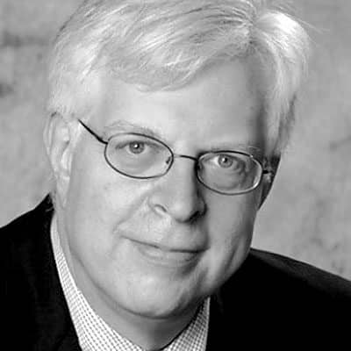
The traditional wish that Jews offer fellow Jews is “May you have nachas from your children.” Nachas is understood to be pride and joy. And for most Jews, pride and joy from their children is the greatest blessing in life.
Notes:
https://jewishjournal.com/commentary/opinion/126273/
Think about it. It may sound great to have nachas from your child as your greatest wish. But it may not sound as great to your child. The purpose of one’s life has to be something beyond being a source of nachas to one’s parents.

Slide 38
Intercession, spiritual warfare, is a form of rest:
^{1 Peter 5:7} Throw all your anxieties upon him, because he cares about you.

Slide 39
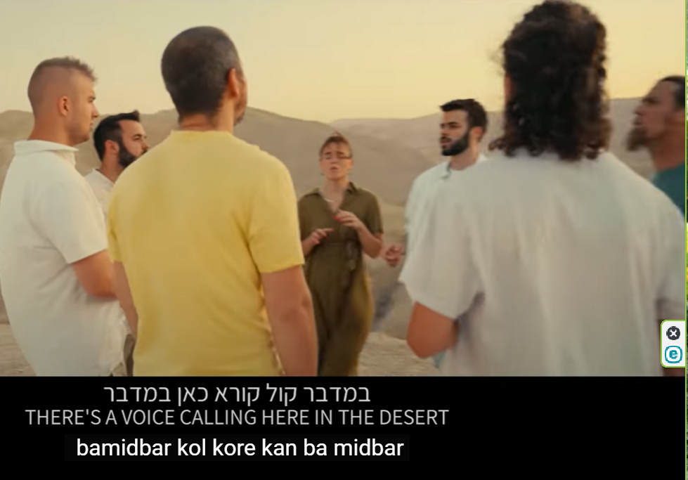
Notes:
https://www.youtube.com/watch?v=cHn1POJovZA
One of the great mistakes in my life was to not make Aliyah in my early 20’s, when my folks sent me to Israel to revert me in 1971. I could have had some of my kids among these. So I am adopting them!

Slide 40
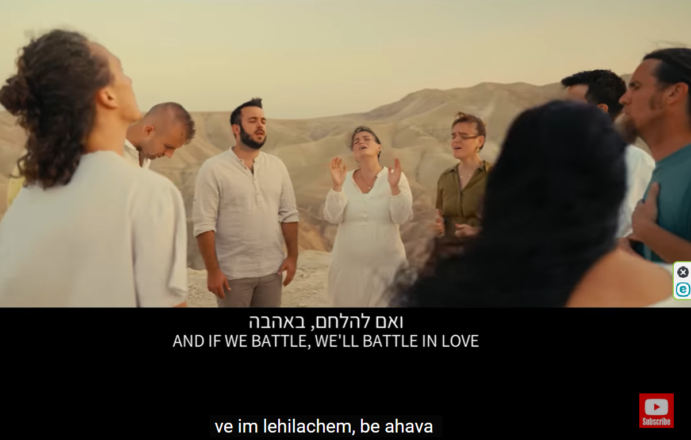
Love, and rest, in war!!
Notes:
https://www.youtube.com/watch?v=cHn1POJovZA

Slide 41
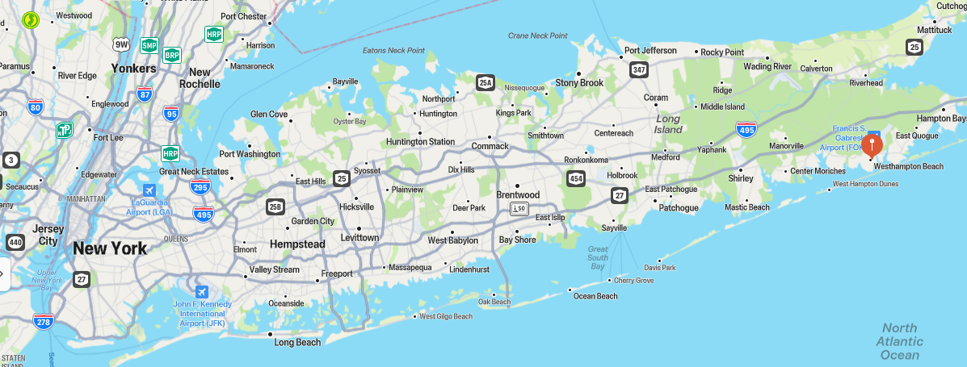

Slide 43
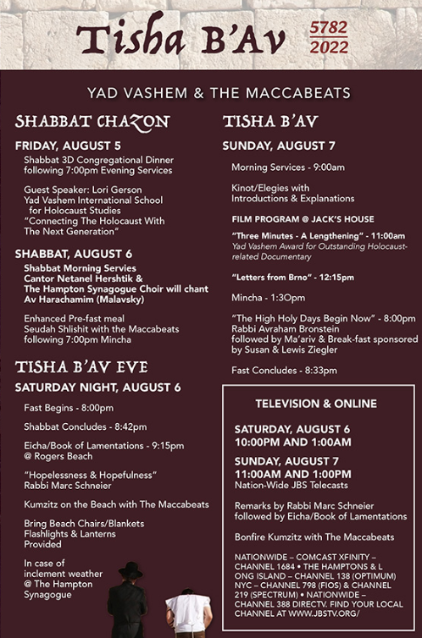

Slide 44
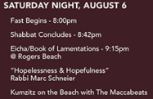
Notes:
Kumzits (קומזיץ) is used to describe a musical gathering that Jews partake in. Everyone sits together, be it on the floor or on chairs, and sings spiritually moving songs. In order to establish a certain ambiance the lighting is often low and candles are primarily used, or if taking place outdoors it is usually around a campfire. ...

Slide 46
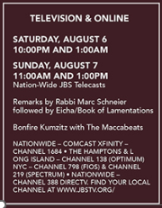

Slide 47
Intercession, spiritual warfare, is a form of rest:
^{1 Peter 5:7} Throw all your anxieties upon him, because he cares about you.

Slide 48
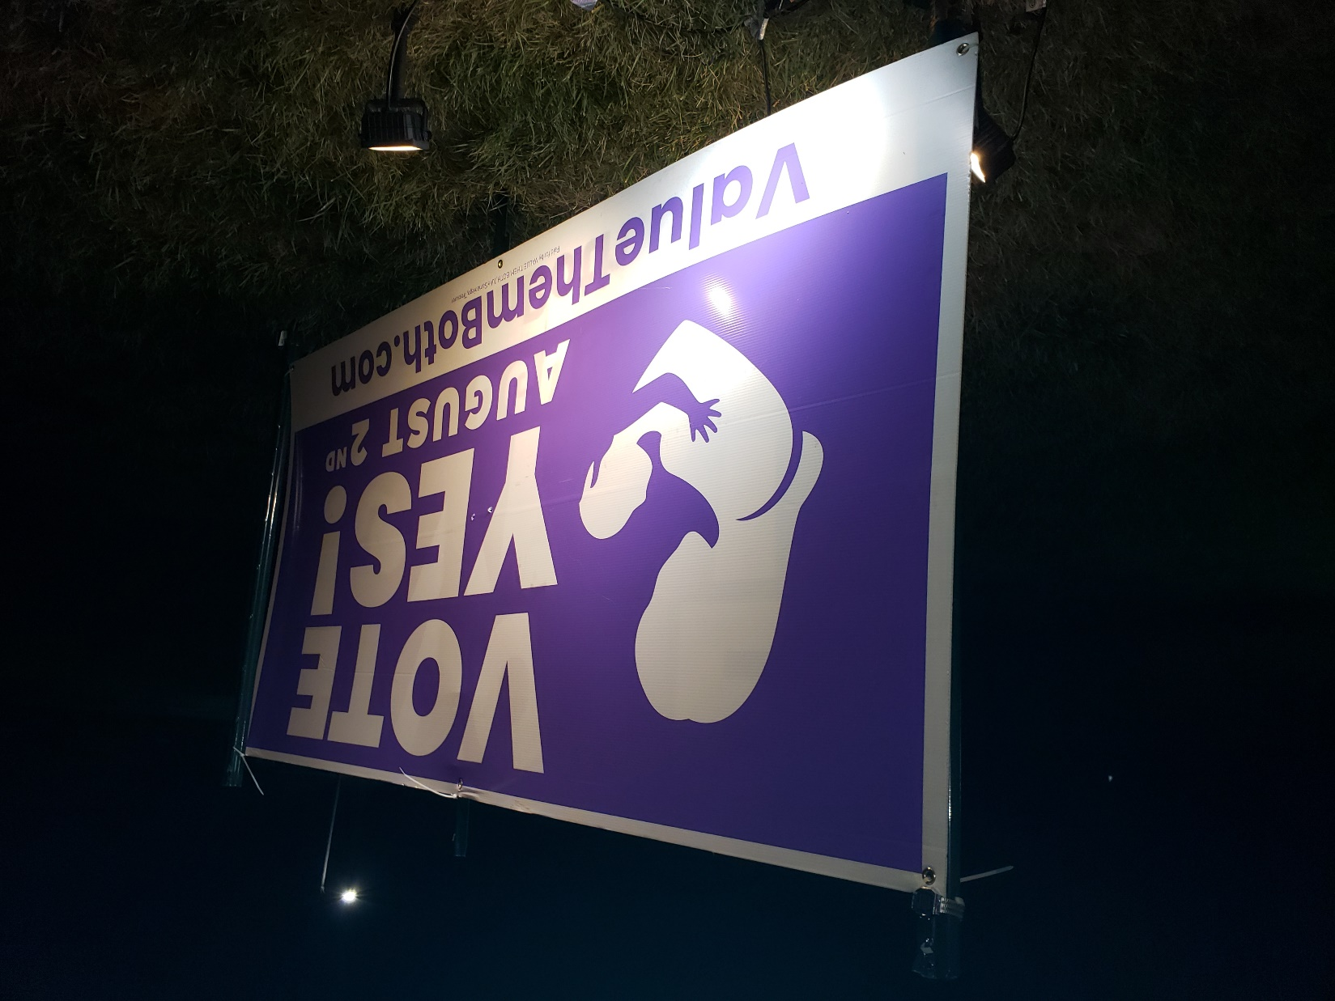
Notes:
When Dawn and I came home from our camping trip, E on 95th St. ~ 10 pm the sign down
~12 a.m. I went W passed synagogue to return DVDs to the Oak Park library, sign up.
~12:15 a.m. returning E on 95th St. sign was down again. Stopped just strings or zip ties cut. Went home to get some.
12:30 putting sign up and car pulled up with headlights on me. Thought, here comes a fight. Then realized about 6 headlights. This a police car.

Slide 49
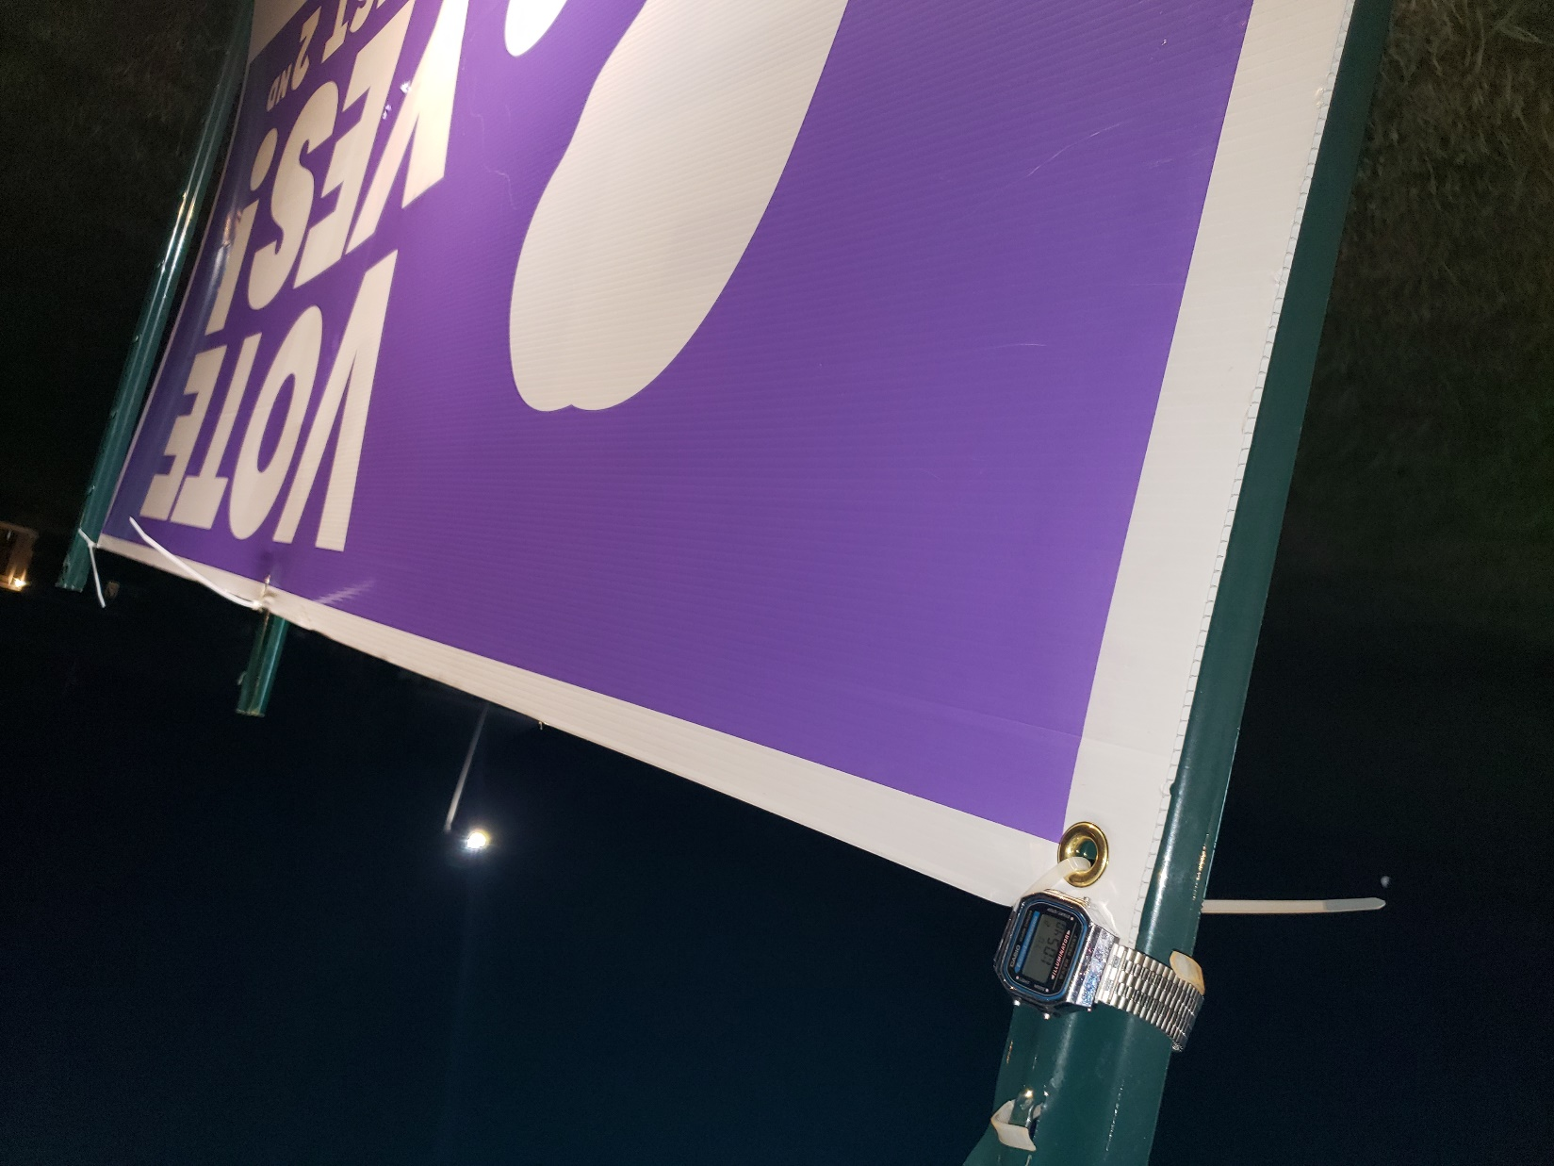

Slide 51
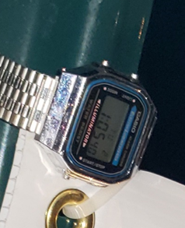
Notes:
Sign back up.
Lost election, nevertheless.

Slide 52
Tyler Lussi
Jaelene Daniels
Notes:
https://washingtonstand.com/commentary/soccer-star-deserted-by-courage-but-still-standing-for-it

Slide 53
On Jaelene Daniels’s Twitter page, there’s a single pinned tweet. It says, “If you live for people’s acceptance, you’ll die from their rejection.” “Unashamed,” she added below. The post is from 2016, a year before the soccer star made coast-to-coast headlines for refusing to wear an LGBT pride jersey.
Notes:
https://washingtonstand.com/commentary/soccer-star-deserted-by-courage-but-still-standing-for-it

Slide 54
It was a decision that cost Jaelene a spot on the U.S. Women’s National team — ending a longtime dream. “I just felt so convicted in my spirit that it wasn’t my job to wear this jersey,” she said. Five years later, that conviction hasn’t changed.
Notes:
https://washingtonstand.com/commentary/soccer-star-deserted-by-courage-but-still-standing-for-it

Slide 55
Intercession and warfare is a form of rest:
^{1 Peter 5:7} Throw all your anxieties upon him, because he cares about you.
Notes:
Shalom Arush stories #14 p 57, #25 p 83 #39 p107

Slide 56
Many tragic events for the people of Israel occurred on the Ninth of Av.
Both Holy Temples Were Destroyed
The Battle at Betar Was Lost
The Romans Plowed the second Temple
The Jews Were Expelled from England
The Jews Were Banished from Spain
Both World Wars Began
Notes:
https://www.ulpanor.com/category/blog/

Slide 57
Our sages tell us that to rectify the world that had formed after the period of baseless hatred:
שנאת חינם - sin’at khinam
We have to get to a level of baseless love:
אהבת חינם – ahavat khinam
The Baseless Love
Notes:
https://www.ulpanor.com/category/blog/

Slide 58
Our campsite, Clear Lake, Iowa
Repentance and trust →
deep rest in Yeshua.

