Slide 1
e-handout
To have these notes
without taking notes
Go to OrHaOlam.com
Click on Messages tab,
2022 Messages
Notes:
You may notice that I’m slowing down in my rate of speech. This is because we may be getting language translation equipment for simultaneous translation.

Slide 2
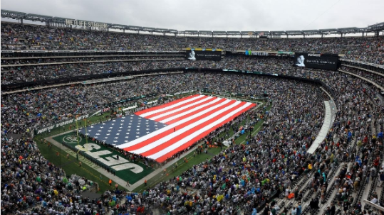
Fans Sing National Anthem
Along With NYPD Officer At
Jets-Ravens Game
12:02 PM · Sept. 11, 2022
Notes:
At MetLife Stadium

Slide 3
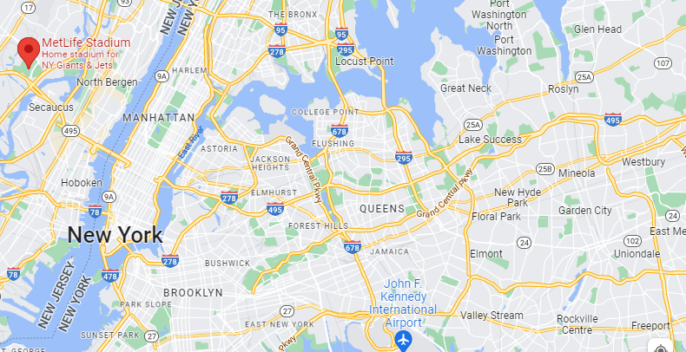
Notes:
NYC, for all its corruption, yet
29th St., my father’s business
Jamaica: my elementary years
Flushing Meadows Park, World’s Fair, UN vote 1947

Slide 4
Fans Sing National Anthem
Along With NYPD Officer At
Jets-Ravens Game
12:02 PM · Sept. 11, 2022
Notes:
At MetLife Stadium
https://twitter.com/i/status/1569008604467929090

Slide 5
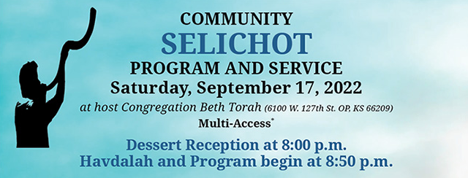
Notes:
3 aspects to this event: dessert, Havdalah, program

Slide 6
Notes:
4th aspect, siddur prayer service, in three locations!

Slide 7
Why is Slikhot such a big deal?
Fourfold event?
Not a Biblical holiday.

Slide 8
Why is Slikhot such a big deal?
Fourfold event?
Not a Biblical holiday.
“Prepare for the approaching of Rosh HaShanah and the
Days of Awe”

Slide 9
סְלִיחות
Notes:
Varying transliteration: Selikhot, Selichot

Slide 10
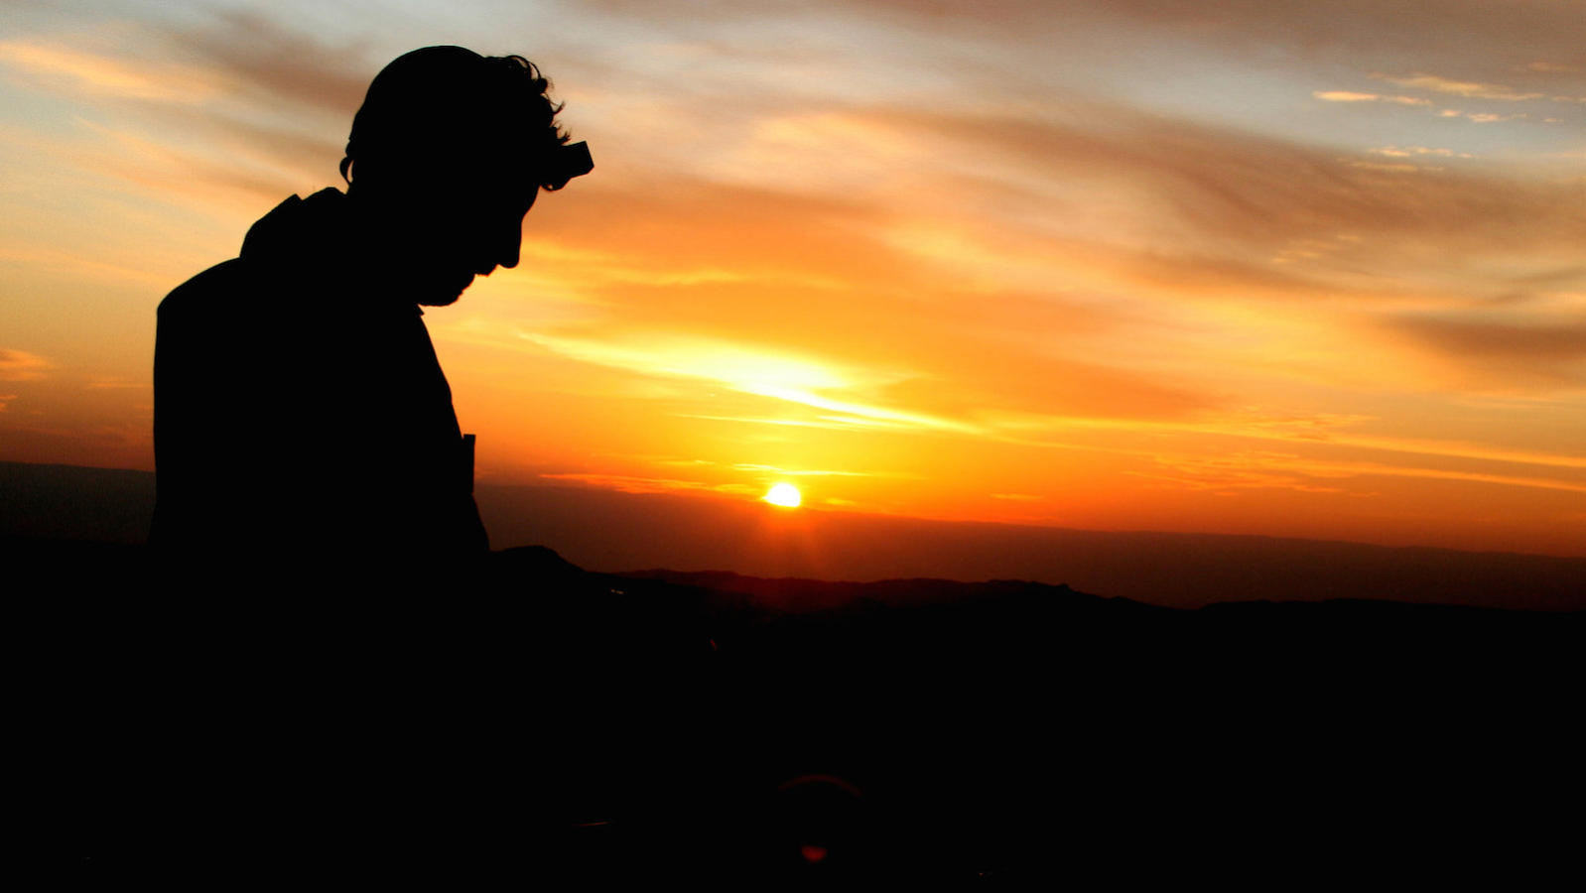
Slikhot outline:
Biblical basis Slikhot
Slikhot today: Perishing
Resistance to Slikhot

Slide 11
Slikhot outline:
Biblical basis Slikhot
Slikhot today: Perishing
Resistance to Slikhot

Slide 12
What is the Biblical meaning
of Rosh HaShanah?
Notes:
We are a Bible people. That’s our source!

Slide 13
^{Vayikra/Lev 23.24} ‘In the seventh month, the first of the month is to be for you a day of complete rest for remembering, a holy gathering announced with blasts. זִכְרוֹן תְּרוּעָה
shout, cry; blast
Notes:
Blasts, not necessarily shofar. Shout, cry out! Great noise.

Slide 14
^{Vayikra/Lev 23.24} ‘In the seventh month, the first of the month is to be for you a day of complete rest for remembering, a holy gathering announced with blasts. זִכְרוֹן תְּרוּעָה
shout, cry; blast
Notes:
Cry out remembering…what? with a blast, a shout?
Shout of judgement
Remembering our sins before G-d!

Slide 15
So, it is also called Yom Hadin,
יוֹם הַדִּין which means “the day of judgment”. It is the day on which Jews believe God starts to judge our actions of the past year.
Notes:
https://www.tallahassee.com/story/life/faith/2017/09/15/reconnecting-god-hebrew-words-high-holy-days/670378001/
Scripturally reasonable conclusion from “Remember with a great sound.”

Slide 16
Slikhot is to prepare us for Rosh HaShanah and Days of Awe, a time of self examination and Tshuvah, repentance!
Notes:
But I’ve already repented and received Messiah. Enough! No…not even enough for your own purification.

Slide 17
The objective of Selikhot is not only to pray about one’s individual life, the main intention is to pray for Clal Yisrael, all of the Jews – to awaken to teshuva (repentance), to beg God to forgive us for our sins and have mercy on His people in their exile and tribulations.
Notes:
https://www.israelnationalnews.com/news/342366
I pray that all of you, Jews, and people of the Nations, can identify in with this. Mercy on G-d’s people Israel, the Jewish people, AND America!!
Daniel prayed a repentance prayer for his nation.

Slide 18
Selichotסְלִיחוֹת are Jewish penitential poems and prayers, especially those said in the period leading up to the High Holidays. The Thirteen Attributes of Mercy are a central theme throughout these prayers. In the Ashkenazic tradition, it begins on the Saturday night before Rosh Hashanah.
Notes:
https://en.wikipedia.org/wiki/Selichot
So, tonight.

Slide 19
Since the times of the Geonim (589-1038),Jews have had the custom of rising in the early hours of the morning during the Ten Days of Repentance to recite Selikhot penitential poems and prayers.
Notes:
https://www.israelnationalnews.com/news/342366

Slide 21
Prophetic Origins
In times of trouble, the Prophets aroused Israel to gather in fasting and prayer, begging God to spare His people and land, as it is written:
Notes:
https://www.israelnationalnews.com/news/342366
Urge us to fast from RH to YK! Extra prayer?

Slide 22
^{Yoel 2.15-17} Blow the shofar in Zion! Sanctify a fast; proclaim an assembly. Gather the people; sanctify the congregation; assemble the elders; gather the children, even those nursing at breasts.

Slide 23
^{Yoel 2.15-17} Let the bridegroom come out from his bedroom and the bride from her chamber. Between the porch and the altar let the kohanim, ministers of Adoni, weep, and let them say: “Have pity, Adoni, on Your people. Don’t make Your heritage a scorn, a byword among the nations. Why should the peoples say, ‘Where is their God?’
Notes:
Are believers scorned and mocked in the culture. Israel in the UN, believers on TV.

Slide 24
^{Daniel 9.8-11} I, Daniel…prayed to Adoni and confessed…Adoni, shame covers our face—our kings, our leaders, our fathers—because we have sinned against you. Adoni our God is compassionate and forgiving, even though we have rebelled against Him.

Slide 25
^{Daniel 9.8-11} We have not obeyed the voice of Adoni Eloheinu by walking in His Torah that He set before us through His servants the prophets. Yes, all Israel has transgressed Your Torah and has turned away—not obeying Your voice.

Slide 26
Russ Resnik encountered Yeshua as Lord and Messiah in the early 70s as a young radical in the mountains of northern New Mexico.
Notes:
https://www.messianicjewish.net/pages/rabbi-russell-Resnik
Later, he was drawn into the Messianic Jewish movement and founded Adat Yeshua, a Messianic congregation in Albuquerque, NM, which he led for nearly 20 years. Later president of the UMJC.

Slide 27
סְלִיחות

Slide 28
Slikhot outline:
Biblical basis Slikhot
Slikhot today: Perishing
Resistance to Slikhot

Slide 29
As a well-worn saying goes, it’s the preacher’s job to comfort the afflicted and afflict the comfortable. They’re both challenging tasks, which is why Jewish tradition devotes, not just a day or two, but a whole season to affliction and comfort.
Notes:
That is why I start with jokes, to warm you up for the affliction, telling you your sins.
Rabbi Russ Resnik
https://www.umjc.org/commentary/2022/9/14/its-time-for-a-spiritual-u-turn?utm_source=UMJC+News&utm_campaign=b88721f923-EMAIL_CAMPAIGN_2020_12_10_08_42_COPY_01&utm_medium=email&utm_term=0_cd802052fa-b88721f923-203688328

Slide 30
For three weeks leading up to Tisha B’Av we read the Haftarot of Affliction, and for seven weeks afterwards the Haftarot of Comfort.
Notes:
Such as today, Isaiah 60
Rabbi Russ Resnik
https://www.umjc.org/commentary/2022/9/14/its-time-for-a-spiritual-u-turn?utm_source=UMJC+News&utm_campaign=b88721f923-EMAIL_CAMPAIGN_2020_12_10_08_42_COPY_01&utm_medium=email&utm_term=0_cd802052fa-b88721f923-203688328

Slide 31
The most important text for Selikhot, is the Thirteen Attributes of Mercy from Shmot / Exodus 34:6–7. Moshe is speaking with Hashem after the incident of the golden calf.
Notes:
Israel about to perish, as are we, our culture in judgement.

Slide 32
^{Shmot/Ex 32.9-10} Adoni said to Moshe, “I have seen this people, and behold, it is a stiff-necked people. Now therefore, leave Me alone, so My wrath may burn hot against them, and so I may consume them — and make from you a great nation!”

Slide 33
^{Shmot/Ex 32.31-32} Moshe went back to Adoni and said, “Please! These people have committed a terrible sin: they have made themselves a god out of gold. Now, if you will just forgive their sin! But if you won’t, then, I beg you, blot me out of your book which you have written!”

Slide 34
Paul writes similarly:
^{Ro. 9.1-3} I tell the truth in Messiah—I do not lie, my conscience assuring me in the Ruakh ha-Kodesh — that my sorrow is great and the anguish in my heart unending.

Slide 35
Paul writes similarly:
^{Ro. 9.1-3} For I would pray that I myself were cursed, banished from Messiah for the sake of my people — my own flesh and blood,

Slide 36
^{Shmot/Ex 33.17-18} Adoni said to Moshe, “I will also do what you have asked me to do, because you have found favor in my sight, and I know you by name.”

Slide 37
^{Shmot/Ex 33.17} Adoni said to Moshe, “I will also do what you have asked me to do, because you have found favor in my sight, and I know you by name.”

Slide 38
^{Shmot/Ex 33.18} But Moshe said, “I beg you to show me your glory!” ^{Shmot/Ex 34.5-6} Adoni descended in the cloud, stood with him there and pronounced the name of Adoni. Adoni passed before him and proclaimed:

Slide 39
The Thirteen Attributes of ADONI
[Sh’mot (Exodus) 34: 6-7]

Slide 40
יְיָ יְיָ אֵל רַחוּם וְחַנּוּן
Adoni, Adoni, El ra-khum v'kha-nun
אֶֽרֶךְ אַפַּֽיִם, וְרַב חֶֽסֶד וְאֶמֶת
Eh-rekh a-pi-yeem, v'rav
khe-sed v'eh-met
ADONI, ADONI is G-d, merciful and compassionate, slow to anger
and rich in grace and truth,

Slide 41
נֹצֵר חֶֽסֶד לָאֲלָפִים
נֹשֵׂא עָוֹן וָפֶֽשַׁע וְחַטָּאָה
No-tsayr khe-sed a-ah-la-feem,
no-say ah-von v'feh-shah v'kha-ta-ah
Showing grace to the thousandth generation, forgiving offenses, crimes, and sins,

Slide 42
וְנַקֵּה לֹא יְנַקֶּה
V'nah-kay lo y'nah-keh
Yet not exonerating the guilty.

Slide 43
פֹּקֵד עֲוֺן אָבוֹת עַל-בָּנִים
Poked avon avot al banim
וְעַל-בְּנֵי בָנִים,
V’al bn’ay vanim
But causing the negative effects of the parents’ offenses to be experienced by their children and grandchildren,

Slide 44
עַל-שִׁלֵּשִׁים וְעַל-רִבֵּעִים.
Al shilesheem v’al riba-eem
and even by the third
and fourth generations.”

Slide 45
ADONI, ADONI is G-d, merciful and compassionate, slow to anger and rich in grace and truth,
showing grace to the thousandth generation, forgiving offenses, crimes, and sins, yet not exonerating the guilty.

Slide 46
but causing the negative effects of the parents’ offenses to be experienced by their children and grandchildren, and even by the third and fourth generations.”

Slide 47
In this ultimate moment of divine self-revelation, God’s “glory” is not a visual display, but a verbal declaration of mercy and compassion.

Slide 48
נֹצֵר חֶֽסֶד לָאֲלָפִים
נֹשֵׂא עָוֹן וָפֶֽשַׁע וְחַטָּאָה
No-tsayr khe-sed a-ah-la-feem,
no-say ah-von v'feh-shah v'kha-ta-ah
Showing grace to the thousandth generation, forgiving offenses, crimes, and sins,
Notes:
Forgiving offenses (nosei avon) Avon refers to intentional sin, which God forgives if the sinner turns back to him.
Crimes (pesha)—Pesha is sin with malicious intent, rebellion against God. God allows teshuva, turning back, leading to forgiveness even for this.
And sins (v’hata’ah)—And God forgives sins committed out of carelessness, thoughtlessness, or apathy.

Slide 49
These attributes call for teshuva, a U-turn from our own ways and back to God.
Notes:
https://www.umjc.org/commentary/2022/9/14/its-time-for-a-spiritual-u-turn?utm_source=UMJC+News&utm_campaign=b88721f923-EMAIL_CAMPAIGN_2020_12_10_08_42_COPY_01&utm_medium=email&utm_term=0_cd802052fa-b88721f923-203688328

Slide 50
פֹּקֵד עֲוֺן אָבוֹת עַל-בָּנִים
Poked avon avot al banim
וְעַל-בְּנֵי בָנִים,
V’al bn’ay vanim
But causing the negative effects of the parents’ offenses to be experienced by their children and grandchildren,

Slide 51
עַל-שִׁלֵּשִׁים וְעַל-רִבֵּעִים.
Al shilesheem v’al riba-eem
and even by the third
and fourth generations.”
Notes:
Epigenetics.

Slide 52
Some say that sin is inherited.
Half truth.
G-d doesn’t punish the next generation, but the sins continue.
The consequences continue.
[Science illustration and digression]

Slide 53
Epigenetics
Genetics is the study of DNA sequences. 4 nucleic acids are the alphabet of life:
C A T G
Cytosine, adenine, thyamine, guanine

Slide 54
Genetics, DNA cannot be changed by behavior. But the molecules surrounding it [epi] can be changed.
Notes:
http://en.wikipedia.org/wiki/Behavioral_epigenetics

Slide 55
Environmental stress [and sin] has been shown to increase the risk of substance use. In an attempt to cope with stress, alcohol and drugs can be used as an escape. Once substance use commences, however, epigenetic alterations may further exacerbate the biological
Notes:
http://en.wikipedia.org/wiki/Behavioral_epigenetics
Once aberrant behavior, hormonal activity occurs, epigenetic alterations may exacerbate the biological. So it SEEMS to be a genetic tendency,but

Slide 56
and behavioral changes associated with addiction.
Even short-term substance use can produce long-lasting epigenetic changes in the brain of rodents, via DNA methylation and histone modification
Notes:
http://en.wikipedia.org/wiki/Behavioral_epigenetics

Slide 57
epigentic methyl group
Epigenetics is affected by behavior.
Notes:
Four colors are the four nucleic acids, guanine, cytosine, adenine, thiamine. Controlling components, alphabet of life. Determines if an organism is a fish or an elephant. All have the same DNA alphabet.
Epigentics doesn’t change the underlying guanine, cytosine, adenine, thiamine. But DOES affect expressions: on/off switch. Behavior of past generations affects your tendency to behave a certain way. TENDENCY.
Sins of our ancestors can make a proclivity in us. BUT, ancestors added it on by willful behavior, we can overcome by willful choices.

Slide 58
Notes:
In biology, and specifically genetics, epigenetics is the study of inherited changes in phenotype (appearance) or gene expression caused by mechanisms other than changes in the underlying DNA sequence, hence the name epi- (Greek: επί- over, above) -genetics. These changes may remain through cell divisions for the remainder of the cell's life and may also last for multiple generations.
“third or fourth generation…”

Slide 59
So someone can appear to be genetically prone to sin: alcoholism, homosexuality, drugs.
But they are only epigenetically prone to the sin.
Notes:
We can bring the epigenetic tendencies in, we can bring them out. Gone in 3 or 4 generations!

Slide 61
נֹצֵר חֶֽסֶד לָאֲלָפִים
נֹשֵׂא עָוֹן וָפֶֽשַׁע וְחַטָּאָה
No-tsayr khe-sed a-ah-la-feem,
no-say ah-von v'feh-shah v'kha-ta-ah
Showing grace to the thousandth generation, forgiving offenses, crimes, and sins,
Notes:
Forgiving offenses (nosei avon) Avon refers to intentional sin, which God forgives if the sinner turns back to him.
Crimes (pesha)—Pesha is sin with malicious intent, rebellion against God. God allows teshuva, turning back, leading to forgiveness even for this.
And sins (v’hata’ah)—And God forgives sins committed out of carelessness, thoughtlessness, or apathy.

Slide 62
These attributes call for teshuva, a U-turn from our own ways and back to God.
Notes:
https://www.umjc.org/commentary/2022/9/14/its-time-for-a-spiritual-u-turn?utm_source=UMJC+News&utm_campaign=b88721f923-EMAIL_CAMPAIGN_2020_12_10_08_42_COPY_01&utm_medium=email&utm_term=0_cd802052fa-b88721f923-203688328

Slide 63
סְלִיחות

Slide 64
Slikhot outline:
Biblical basis Slikhot
Slikhot today: Perishing
Resistance to Slikhot

Slide 65
But something within our human nature resists the sort of change that teshuva entails. We love routine and the status quo—especially when it comes to inward things. We might like to try out new experiences, new flavors and colors and places,
Notes:
https://www.umjc.org/commentary/2022/9/14/its-time-for-a-spiritual-u-turn?utm_source=UMJC+News&utm_campaign=b88721f923-EMAIL_CAMPAIGN_2020_12_10_08_42_COPY_01&utm_medium=email&utm_term=0_cd802052fa-b88721f923-203688328

Slide 66
but when it comes to changing the things closest to ourselves, we’re most likely to resist. Just ask anyone—including yourself—who’s tried to exercise more or eat less or phase out some unhealthy habit. We resist change.
Notes:
https://www.umjc.org/commentary/2022/9/14/its-time-for-a-spiritual-u-turn?utm_source=UMJC+News&utm_campaign=b88721f923-EMAIL_CAMPAIGN_2020_12_10_08_42_COPY_01&utm_medium=email&utm_term=0_cd802052fa-b88721f923-203688328

Slide 67
Remember my job description: To comfort the afflicted and afflict the comfortable. Yes, we emphasize teshuva during this whole season, because genuine comfort only comes after affliction.
Notes:
https://www.umjc.org/commentary/2022/9/14/its-time-for-a-spiritual-u-turn?utm_source=UMJC+News&utm_campaign=b88721f923-EMAIL_CAMPAIGN_2020_12_10_08_42_COPY_01&utm_medium=email&utm_term=0_cd802052fa-b88721f923-203688328

Slide 68
Our tradition provides lengthy prayers of remorse and confession through the Days of Awe. We might end up like Moshe, who “bowed his head down to the earth and worshiped” after hearing the Thirteen Attributes ^{(Ex 34:8),} seeing not only who God was, but who he himself was too.
Notes:
https://www.umjc.org/commentary/2022/9/14/its-time-for-a-spiritual-u-turn?utm_source=UMJC+News&utm_campaign=b88721f923-EMAIL_CAMPAIGN_2020_12_10_08_42_COPY_01&utm_medium=email&utm_term=0_cd802052fa-b88721f923-203688328

Slide 69
But we’re unlikely to respond like Moshe amid our entertainment, distraction, and info-glutted lives, so let’s prepare ourselves during this season with practices like these:
Notes:
https://www.umjc.org/commentary/2022/9/14/its-time-for-a-spiritual-u-turn?utm_source=UMJC+News&utm_campaign=b88721f923-EMAIL_CAMPAIGN_2020_12_10_08_42_COPY_01&utm_medium=email&utm_term=0_cd802052fa-b88721f923-203688328

Slide 71
Distraction entertainment, and information inflation
Looking at our screens during prayer
Talking to someone and texting
Sitting in service and texting
Notes:
https://www.umjc.org/commentary/2022/9/14/its-time-for-a-spiritual-u-turn?utm_source=UMJC+News&utm_campaign=b88721f923-EMAIL_CAMPAIGN_2020_12_10_08_42_COPY_01&utm_medium=email&utm_term=0_cd802052fa-b88721f923-203688328

Slide 72
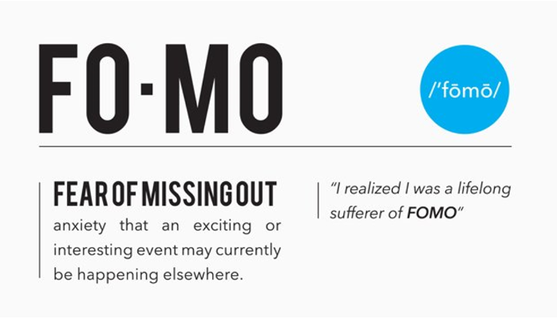

Slide 73
Ignorance of news
Notes:
https://institute.careerguide.com/fomo-fear-of-missing-out/

Slide 74
Monotasking. We all know that you can’t really multitask, as in doing two or three things at the same time, but we keep trying. Let’s refrain for a while and instead give full attention to one thing at a time, hour by hour and day by day. So can really repent!
Notes:
When my wife walks into my study I take my hands OFF the keyboard and look her in the eye and smile,
or say just one moment…
https://www.umjc.org/commentary/2022/9/14/its-time-for-a-spiritual-u-turn?utm_source=UMJC+News&utm_campaign=b88721f923-EMAIL_CAMPAIGN_2020_12_10_08_42_COPY_01&utm_medium=email&utm_term=0_cd802052fa-b88721f923-203688328

Slide 75
Shabbat focus
No commercial activity: easy
Spare the Oneg staff:
Bring in your oneg ie., salad food cut, sliced, prepped
plug in crock pots right temp
Notes:
^{Shmot Ex 12.16} The first day is to be a holy assembly for you as well as the seventh day. No manner of work is to be done on those days, except what is to be eaten by every person—that alone may be prepared by you.

Slide 76
Hesed-casting Give someone close to you a genuine, but unexpected, word of affirmation or encouragement. Decide not to criticize or minimize the efforts of someone else, even if you think they deserve it. Give relational freebies—and enjoy doing it!
Notes:
https://www.umjc.org/commentary/2022/9/14/its-time-for-a-spiritual-u-turn?utm_source=UMJC+News&utm_campaign=b88721f923-EMAIL_CAMPAIGN_2020_12_10_08_42_COPY_01&utm_medium=email&utm_term=0_cd802052fa-b88721f923-203688328

Slide 77
ADONI, ADONI is G-d, merciful and compassionate, slow to anger and rich in grace and truth,
showing grace to the thousandth generation, forgiving offenses, crimes, and sins, yet not exonerating the guilty.
Notes:
Similar to the invitation and focus of Yeshua, inviting us to repentance and obedience.

Slide 78
^{Yn 14.15-16} “If you love me, you will keep my commands; and I will ask the Father, and he will give you another comforting Counselor like me, the Spirit of Truth, to be with you forever.

Slide 79
A slikhot help…

Slide 81
10days.net/virtual-2022

Slide 82
Monday, Sept. 25, 2022:
6 pm Kevin Jessup
10 pm Grant Berry

Slide 83
During the Days of Awe (Sept 25 - Oct 5), we will have 24/10 prayer with a teaching time at Noon Eastern (7pm Israel).
To find out more, please visit: https://www.10days.net/virtual-2022
The accompanying prayer guide is available at: https://www.10days.net/10daysresources

Slide 84
Our teaching and prayer times are focused on the following Biblical topics:
Personal Repentance and Transformation
The Salvation of all Nations (The Harvest)
Notes:
https://www.eventbrite.co.uk/e/10-days-of-prayer-2022-tickets-412034194367

Slide 85
Supernatural Unity in the Body of Messiah (John 17)
The Outpouring of the Holy Spirit
The Salvation of the Jewish People
The Preparation of the Bride for the Lord's Return
The Lord's Return
Notes:
https://www.eventbrite.co.uk/e/10-days-of-prayer-2022-tickets-412034194367

Slide 86
Our vision is to see thousands of cities simultaneously and continually seeking God’s face for 10 Days in unity and to see individuals taking time off from work, fasting food, taking days off from social media, and devoting themselves to prayer with other believers.
Notes:
https://www.10days.net/about10days

Slide 87
Together, we are forming a global upper room (Acts 1-2) as an act of intercession so that entire cities and regions may come to repentance (Jonah 1-4) and be transformed.
Notes:
https://www.10days.net/about10days

Slide 88
A new danger and Slikhot distraction
in the culture war:

Slide 89
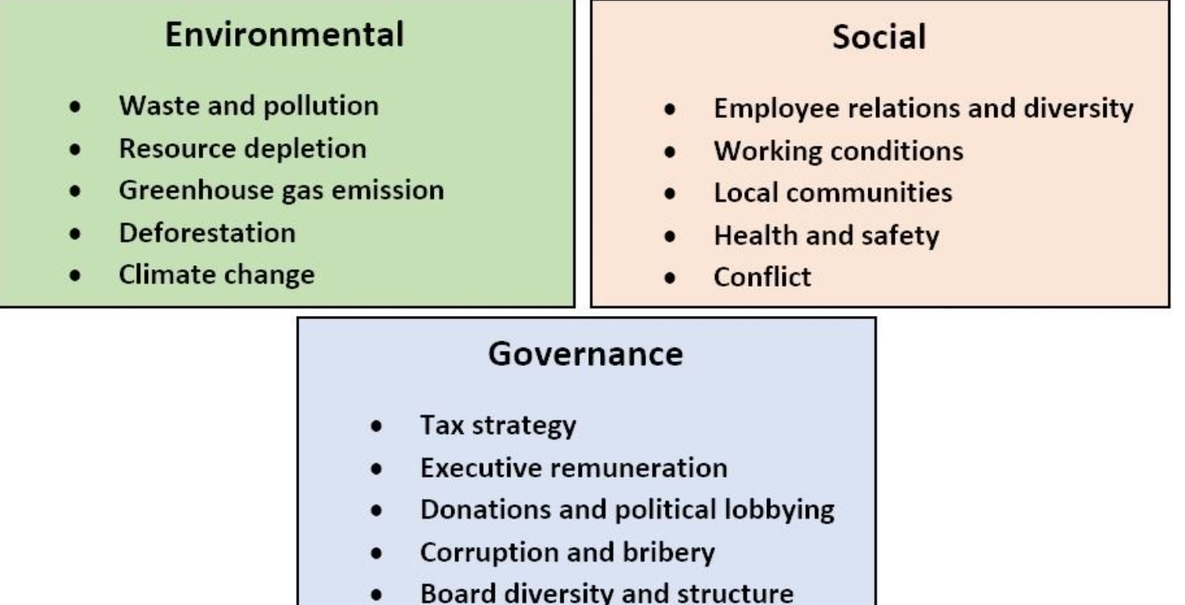
Notes:
Evalutating employment, contracting, loan applications

Slide 90
We’ll repeat the Thirteen Attributes in our prayers from the night of Selichot through Yom Kippur. They provide the essential backdrop for all our confessions of sin.
Notes:
https://www.umjc.org/commentary/2022/9/14/its-time-for-a-spiritual-u-turn?utm_source=UMJC+News&utm_campaign=b88721f923-EMAIL_CAMPAIGN_2020_12_10_08_42_COPY_01&utm_medium=email&utm_term=0_cd802052fa-b88721f923-203688328

Slide 91
ADONI, ADONI is G-d, merciful and compassionate, slow to anger and rich in grace and truth,
showing grace to the thousandth generation, forgiving offenses, crimes, and sins, yet not exonerating the guilty.

Slide 92
^{Yn 14.15-16} “If you love me, you will keep my commands; and I will ask the Father, and he will give you another comforting Counselor like me, the Spirit of Truth, to be with you forever.

Slide 93
סְלִיחות

Slide 94
Slikhot outline:
Biblical basis Slikhot
Slikhot today: Perishing
Resistance to Slikhot

Slide 95
Prayer points Slikhot tshuvah
Individual tshuvah
Community tshuvah
Cultural tshuvah

