Slide 1
e-handout
To have these notes
without taking notes
Go to OrHaOlam.com
Click on Messages tab,
2024 Messages

Slide 2
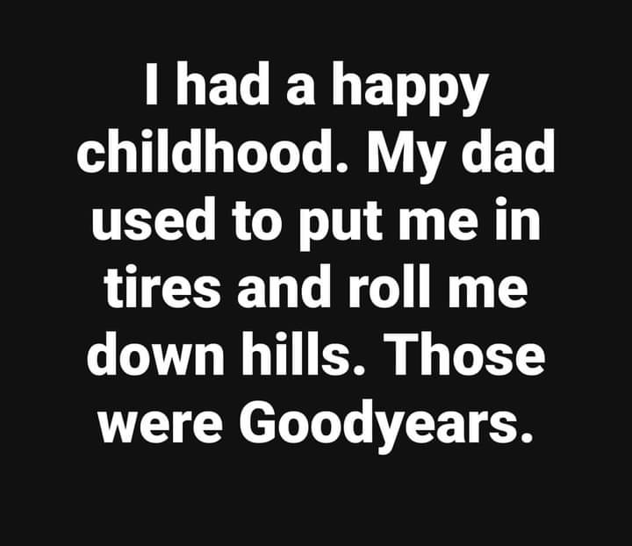
An eclipse from above, in the ISS
Notes:
Scott Hahn

Slide 3
An eclipse from above, in the ISS
Notes:
Scott Hahn

Slide 4
There is a US Military Base that is off-limits for Passover
An eclipse from above, in the ISS
Notes:
Shay Weber

Slide 5
There is a US Military Base that is off-limits for Passover
Fort Leavenworth.
An eclipse from above, in the ISS
Notes:
Shay Weber

Slide 6
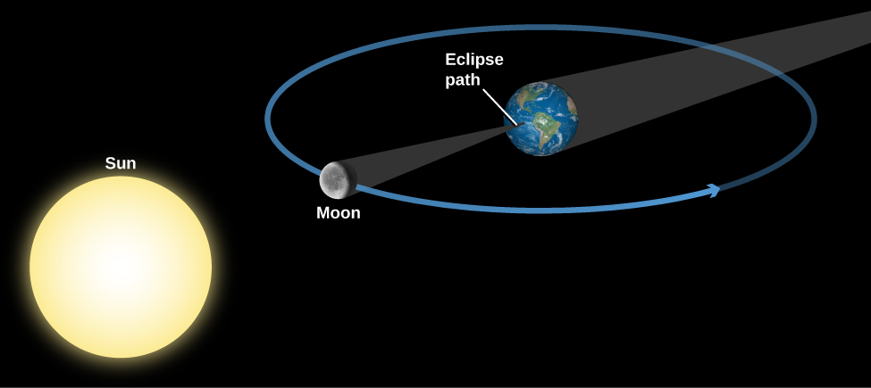
Monday, April 8, 2024
Sun moon earth for solar eclipse

Slide 7
An eclipse from above, in the ISS
Notes:
Time Mag

Slide 8
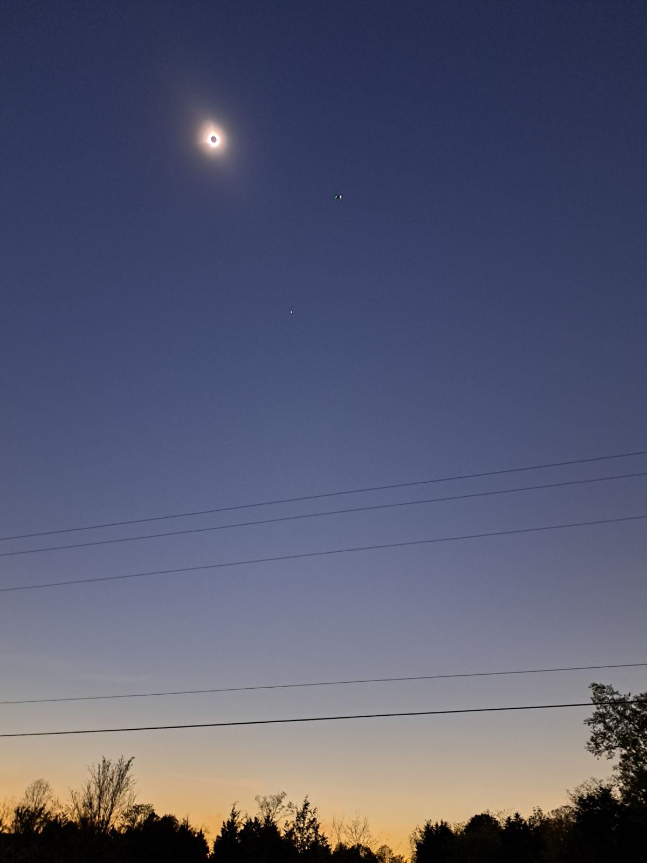
Solar eclipse
April 8, 2024
An eclipse from above, in the ISS
Notes:
From Jim Templer in Mt Pleasant Arkansas.
Zoom in on the photo…

Slide 9
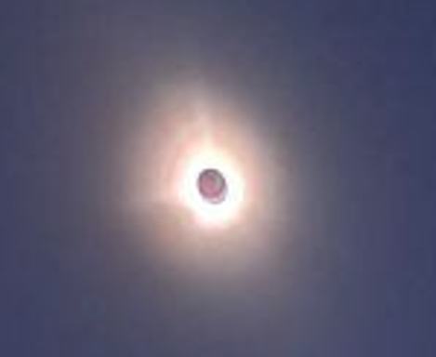
An eclipse from above, in the ISS
Notes:
From Jim Templer in Mt Pleasant Arkansas. Granddaughter promised me she'd set up my birthday party for the next one on August 12, 2044. Jim will be 91.
A solar eclipse can only happen at the beginning of a lunar / Hebrew calendar month.

Slide 10
Sun moon earth for solar eclipse

Slide 11
Sun moon earth for solar eclipse
15 days later…
Sun earth moon for lunar eclipse, Passover full moon

Slide 12
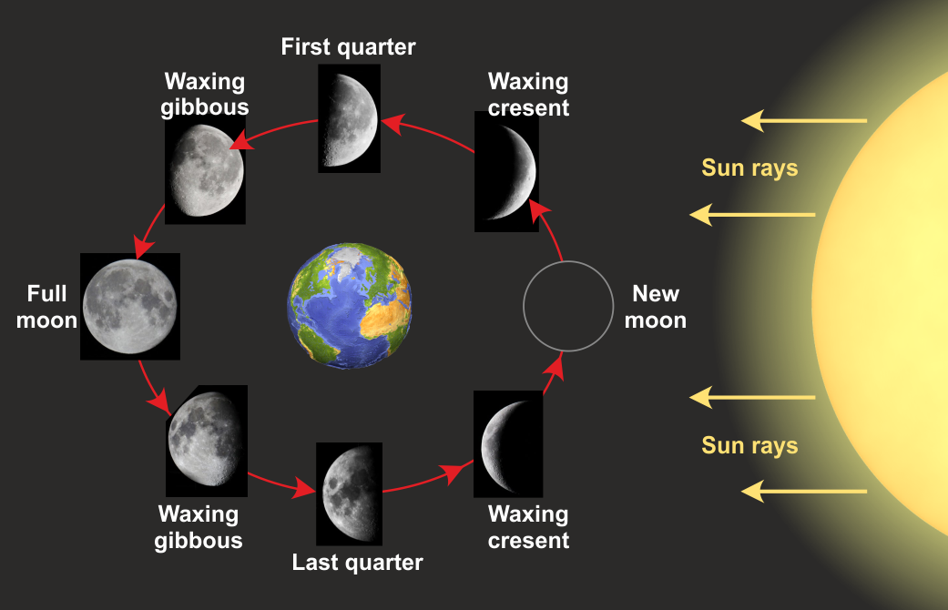
Sun earth moon for Passover
Passover 15 Nisan full moon
Notes:
April 22
https://external-content.duckduckgo.com/iu/?u=https%3A%2F%2Ftse4.mm.bing.net%2Fth%3Fid%3DOIP.eSKTTsvR9MClt512Zo4WQgHaEx%26pid%3DApi&f=1&ipt=158d2da9d5eb3ef260a10243015e82af463b9b0374ff8161ead0294ea2391f0e&ipo=images
Solar system moves counter clockwise as viewed from above the North Pole

Slide 13
^{Shmot/ Ex 12.3,6} ‘On the tenth day of this month, each man is to take a lamb or kid for his family, one per household…You are to keep it until the fourteenth day of the month, and then the entire assembly of the community of Isra’el will slaughter it at dusk. [15th day, April 22]

Slide 14
^{Shmot/Ex 12.11} “‘Here is how you are to eat it: with your belt fastened, your shoes on your feet and your staff in your hand.
Notes:
Is there a deeper meaning to these instructions? I seem to have something maybe strange, from the Ruakh, to present today.
[pray]

Slide 15
An eclipse from above, in the ISS
Notes:
Four weeks ago, Mar 16, 2024
A Real Mensch מענטש Ephesians 4.11-13
That is, Pesakh / Passover should make us MORE menschy!

Slide 16
A Passover Mensch מענטש
Passover Parallel Exodus
Passover Personal SW history
Passover Maturity
An eclipse from above, in the ISS
Notes:
Exoduses? Exodusim Exodusi

Slide 17
Eat it ready to go!

Slide 18
^{Shmot/ Ex 12.6-7} “‘On the tenth day of this month, each man is to take a lamb or kid for his family. You are to keep it until the fourteenth day of the month, and then the entire assembly of the community of Isra’el will slaughter it at dusk.

Slide 19
^{Shmot/ Ex 12.6-7} “‘They are to take some of the blood and smear it on the two sides and top of the door-frame at the entrance of the house in which they eat it.

Slide 20
^{Shmot/Ex 12.11-13} “‘Here is how you are to eat it: with your belt fastened, your shoes on your feet and your staff in your hand; and you are to eat it hurriedly. It is Adoni’s Pesakh [Passover]. For that night, I will pass through the land of Egypt and kill all the firstborn in the land of Egypt,

Slide 21
^{Shmot/Ex 12.11-13} both men and animals; and I will execute judgment against all the gods of Egypt; I am Adoni. The blood will serve you as a sign marking the houses where you are; when I see the blood, I will pass over [פסח pasakh] you — when I strike the land of Egypt, the death blow will not strike you.

Slide 22
^{Shmot/Ex 12.14} “‘This will be a day for you to remember and celebrate as a festival to Adoni; from generation to generation you are to celebrate it by a perpetual regulation.
Notes:
It is the most observed holiday among the Jewish people, even seculars, assimilating.
Spirit of the Seder…

Slide 23
Eat the Seder as a model of family redemption!
Hebrews to be out of slavery in Egypt, by the blood of a lamb.
We all are to be out of slavery to sin, by the blood of the Lamb!

Slide 24
Eat the Seder as a model of family redemption!
ready to separate from the corrupted splendor of the pagan world.
Ready to see judgement on the gods of this world.

Slide 25
Eat the Seder as a model of family redemption!
Ready to TRUST the power of G-d, blood of redemption / angel of death to selectively destroy.
Ready to TRUST the power of G-d, blood of redemption / angel of death to liberate.

Slide 26
Eat the Seder as a model of family redemption!
Ready to mark this as an annual celebration for 4000 years
Ready to rejoice with each other in family redemption!

Slide 27
An eclipse from above, in the ISS
Notes:
Ephesians 4.11-13.
A Real Mensch מענטש
Mar 16, 2024

Slide 28
A Passover Mensch מענטש
Passover Parallel Exodus
Passover Personal SW history
Passover Maturity
An eclipse from above, in the ISS

Slide 29
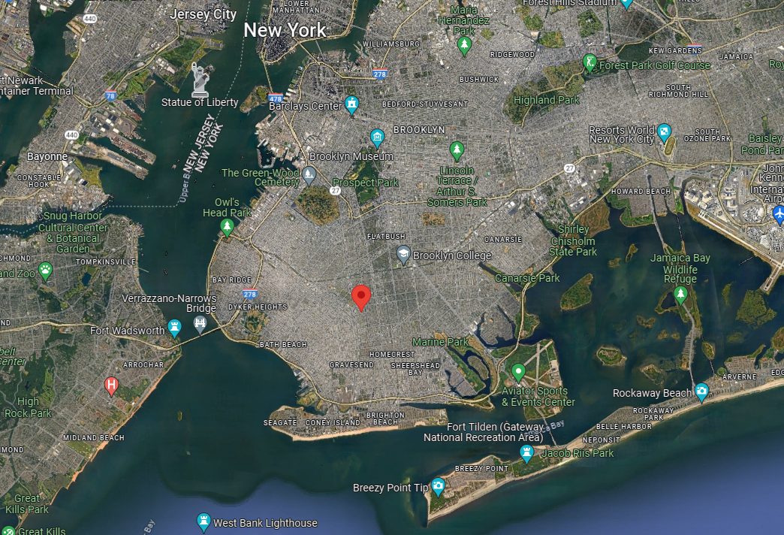
An eclipse from above, in the ISS
Notes:
Home of Max & Rose Levy, my now deceased maternal grandparents
1449 E 4th St, Brooklyn, NY 11230

Slide 30
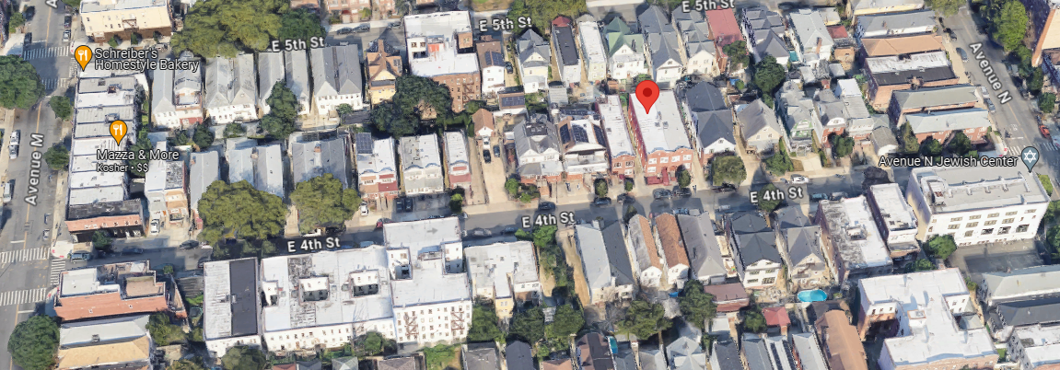
Home of Max & Rose Levy, my now deceased maternal grandparents
1449 E 4th St, Brooklyn, NY 11230
An eclipse from above, in the ISS
Notes:
Note Ave N Jewish Center on right, Grandpa’s tailor shop on left, candy store on left. Grandpa give my cousin Isabel and me a quarter each to walk down there and buy candy before Shabbat dinner.

Slide 31
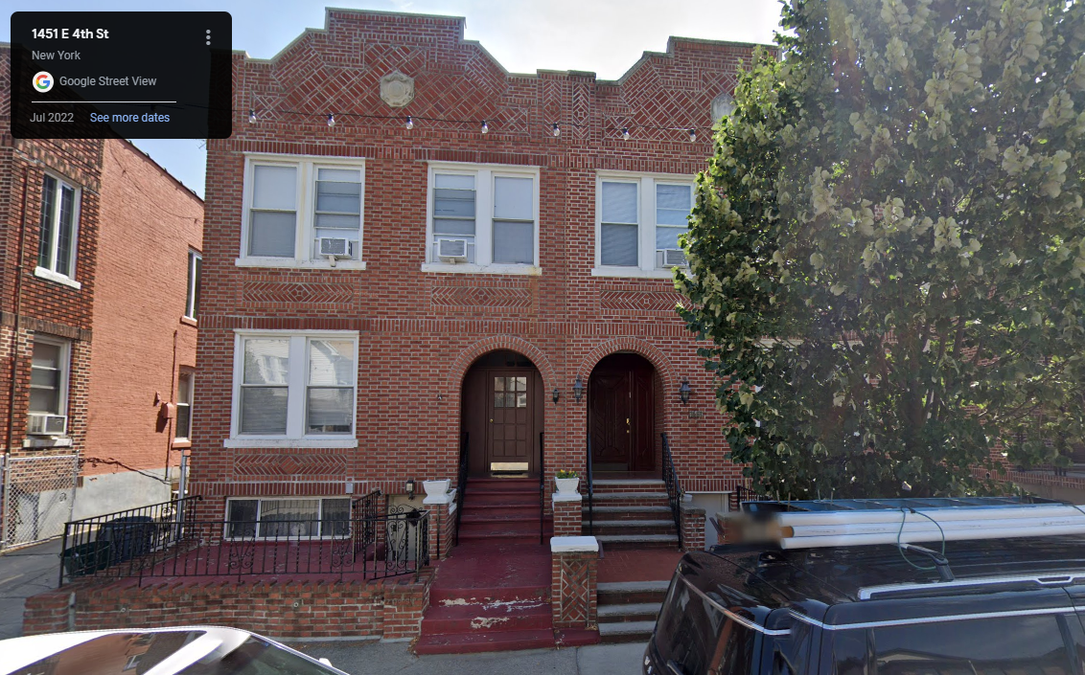
An eclipse from above, in the ISS
Notes:
Where I had my first glass of Manischewitz or Mogen David sweet wine, and Passover horse radish. These are the steps where I would go down from 2nd floor apt go to see if Eliyahu/ Elijah the prophet had come to introduce the Messiah to the Jewish people and the world!
.

Slide 32
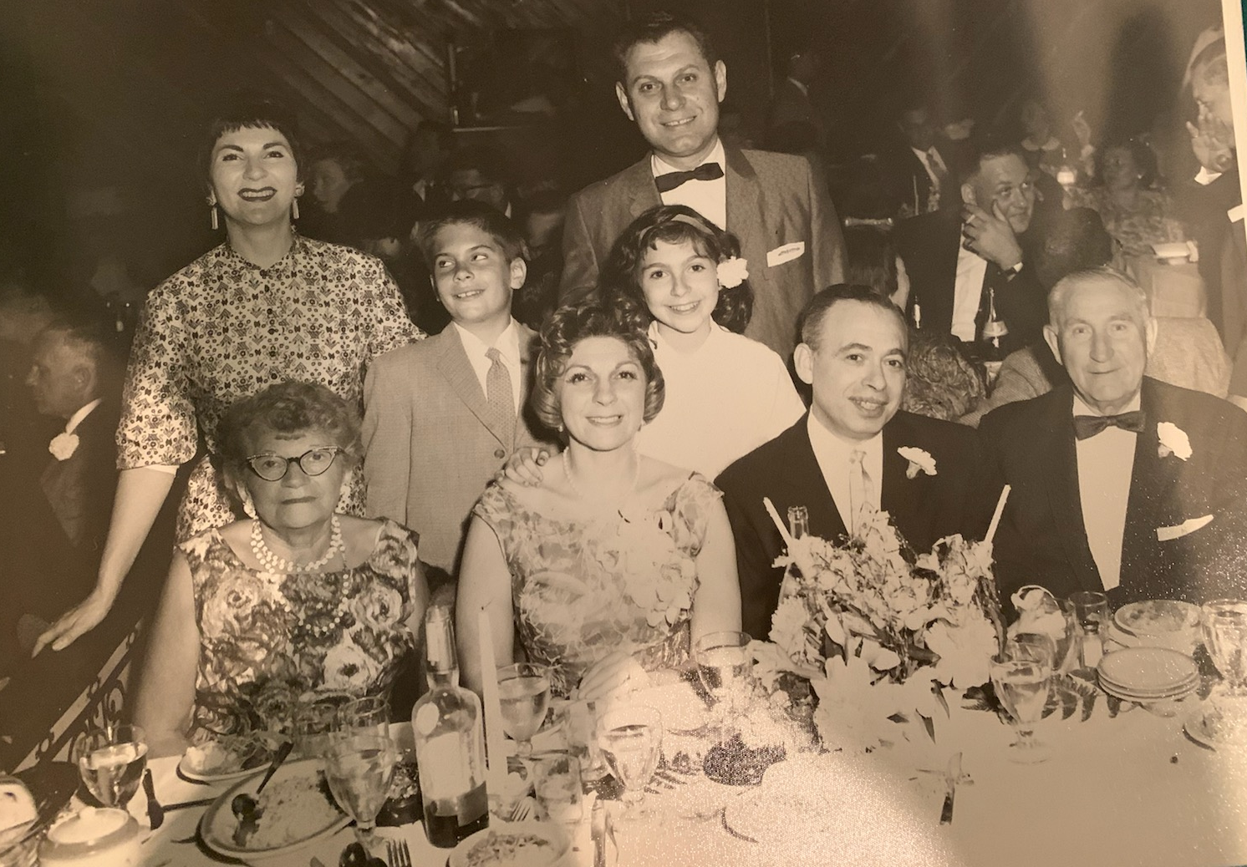
An eclipse from above, in the ISS
Notes:
Mom Miriam, me, cousin Isabel, Dad Irving
Grandma Rose Levy, Aunt Francis, Uncle Murray, [Isabel’s parents] Grandpa Max Levy the tailor.

Slide 33
An eclipse from above, in the ISS
Notes:
When we were having our Seders there, all was right with the world. Age 10 or so. Grandpa, Grandma, Dad, Mom, Aunts, Uncles, cousins. A Seder is a place of redemptive refuge. One of the happiest memories of my childhood.
Build that culture into Or HaOlam families, Jewish and Gentile grafted it.
.

Slide 34
^{Shmot/Ex 12.3} Speak to all the assembly of Isra’el and say, ‘On the tenth day of this month, each man is to take a lamb or kid for his family, one per household, except that if the household is too small for a whole lamb or kid, then he and his next-door neighbor should share one, dividing it in proportion to the number of people eating it.
Notes:
Family redemption

Slide 35
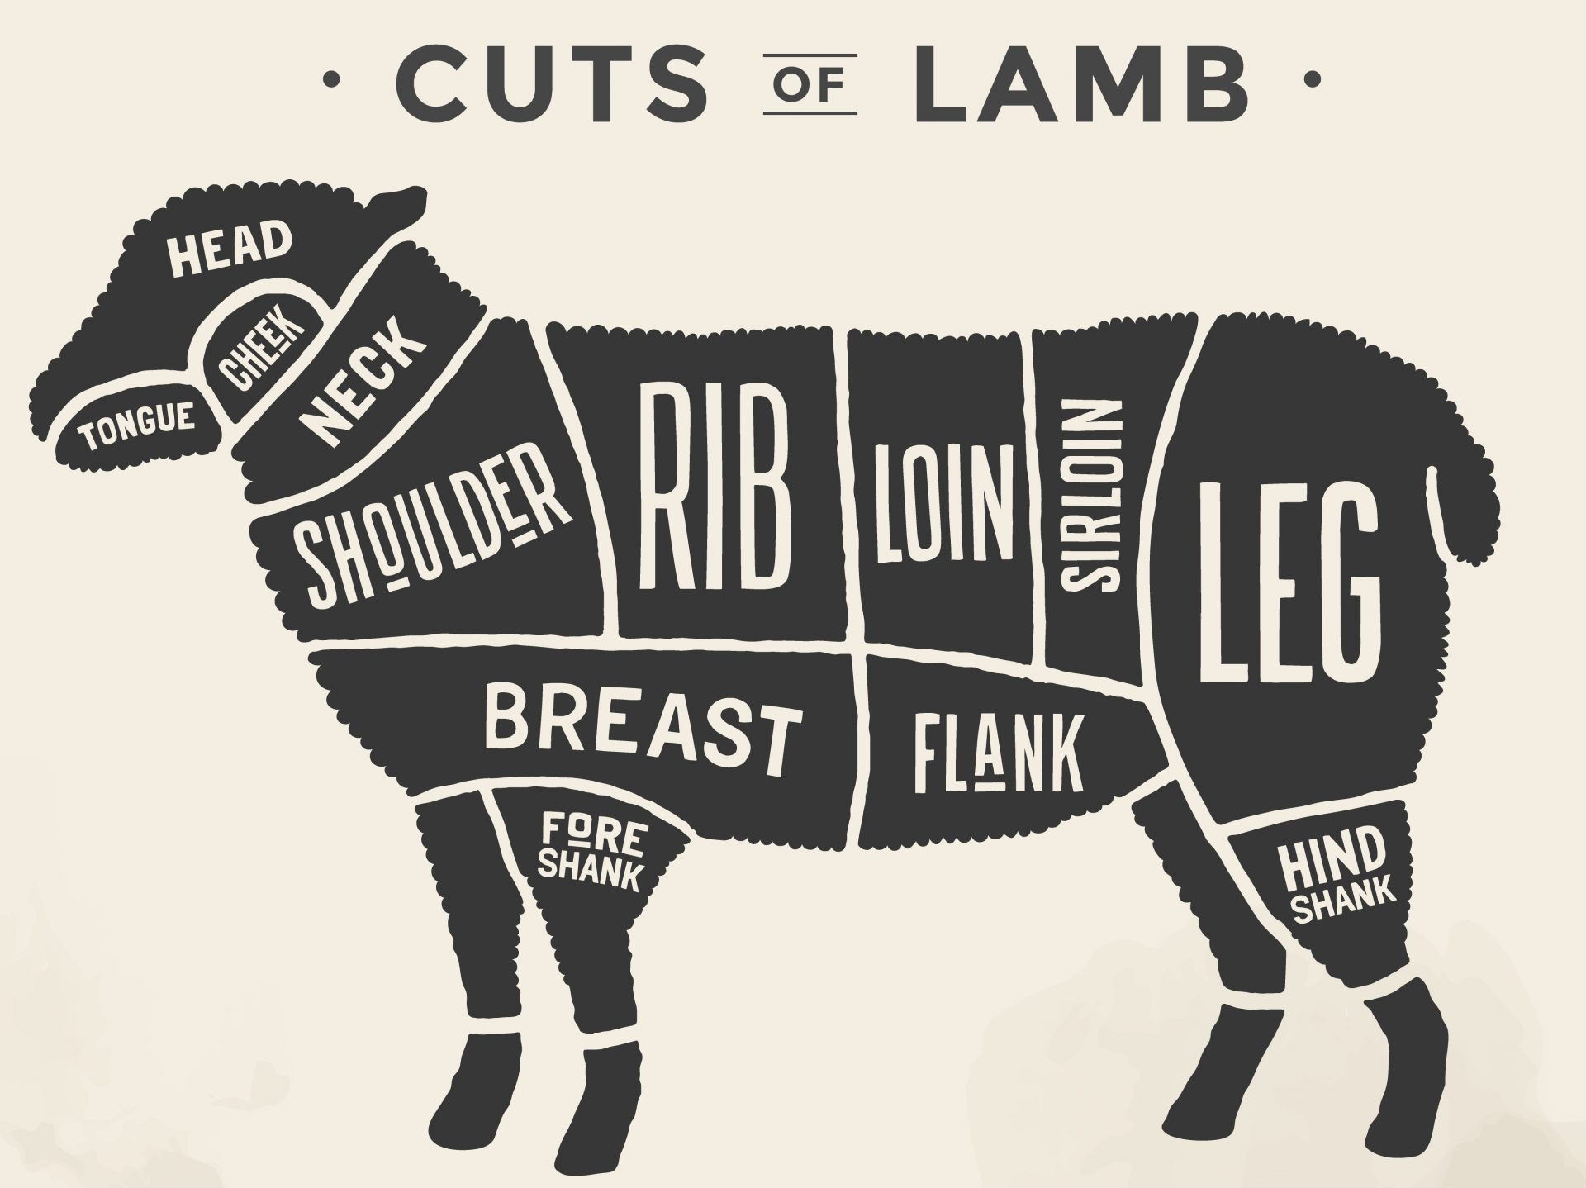
An eclipse from above, in the ISS
Notes:
https://external-content.duckduckgo.com/iu/?u=https%3A%2F%2Fkitchenteller.com%2Fwp-content%2Fuploads%2F2021%2F09%2FLamb-cuts-chart-diagram.jpeg&f=1&nofb=1&ipt=4fec82f27a0af9eed1d1255a264216ceb196b558f09bc949d7c6cc3034ff937f&ipo=images

Slide 36
As a general rule of thumb, plan for about ½ to ¾ pound of bone-in lamb per person. 30-35 people
Notes:
With the help of our Chef John Stewart
https://images.squarespace-cdn.com/content/v1/57a100f7e4fcb592ee30586c/1531879631530-MPOLMQ4CTYN3JGA4OLYL/ke17ZwdGBToddI8pDm48kCaV558uD8AygXjJj_awbU8UqsxRUqqbr1mOJYKfIPR7LoDQ9mXPOjoJoqy81S2I8N_N4V1vUb5AoIIIbLZhVYxCRW4BPu10St3TBAUQYVKcFtRpSW8rpPJTjxekQxbGl2zHaCVY1W0eYyReGKb0BibeEvFP2jVY73SMrwGb4vO8/Screen+Shot+2018-07-17+at+9.06.48+PM.png

Slide 37
^{Shmot/Ex 12.11} “‘Here is how you are to eat it: with your belt fastened, your shoes on your feet and your staff in your hand.
Ready to GO, follow G-d, OUT of Egypt.
Notes:
Even if some of the OH next gen not walking in Messiah’s redemption, it is still TRUE!

Slide 38
An eclipse from above, in the ISS

Slide 39
A Passover Mensch מענטש
Passover Parallel Exodus
Passover Personal SW history
Passover Maturity
An eclipse from above, in the ISS

Slide 40
^{Shmot/Ex 12.11} “‘Here is how you are to eat it: with your belt fastened, your shoes on your feet and your staff in your hand.
Ready to GO, follow G-d, OUT of Egypt.
Notes:
Segue to the Messianic Scriptures book of Ephesians, my current series.

Slide 41
^{Eph 6.14} Therefore, stand! Have the belt of truth buckled around your waist, put on righteousness for a breastplate.
Passover is NOT a religious event, but a righteous, fun event!

Slide 42
^{Yeshayahu / Isaiah 60.18-20} Violence will no longer be heard in your land, desolation or destruction within your borders; instead, you will call your walls Salvation and your gates Praise.
Notes:
Every one of our rules should be praise and salvation!

Slide 43
^{Yeshayahu / Isaiah 60.18-20} “No more will the sun be your light by day, nor will moonlight shine on you; instead Adoni will be your light forever and your God your glory.
This is why the music and dance time is so important, really prophetic.
Notes:
Last week’s unfinished message:

Slide 44
[from April 6] The Elite Rescue /LiberationTeam
Emissaries
Prophets
Proclaimers of the Good News,
Shepherds and teachers
Notes:
David Stern: Because the Greek is ambiguous, some take the two terms "shepherds" (pastors) and "teachers" to be speaking of one office — "shepherd-teachers." Pastoring and teaching are overlapping yet distinguishable skills.

Slide 45
Instruction in
The Word
Worship
Community
Mission and vision
Doctrine
Torah Practice

Slide 46
^{T’hillim Ps 23} Adoni is my shepherd; I lack nothing. He has me lie down in grassy pastures, he leads me by quiet water, he restores my inner person. He guides me in right paths for the sake of his own name. Even if I pass through death-dark ravines, I will fear no disaster; for you are with me; your rod and staff reassure me.
Notes:
7 major conflicts 2024. More than I ever remember.
Are you in any conflict, with anyone? Not reconciled. Some things can’t be reconciled, must be forgiven and WAITED.
Especially settle all conflicts BEFORE Passover.

Slide 47
Shepherd
The Babylonian Talmud TB Gittin 56a, describes Jerusalem of 68-70 A.D. just before its destruction, when the Romans were besieging the city and various Jewish political-religious parties were fighting amongst each other:
Notes:
Avner Boskey

Slide 48
Rome sent Vespasian Caesar against the Jews. He came and laid siege to Jerusalem for three years. There were at that time in Jerusalem these three wealthy people: Nakdimon [i.e., Nicodemus] ben Gurion, ben Kalba Savua, and ben Tzitzit HaKesat . . .
Notes:
Copyright © 2024 Final Frontier Ministries, All rights reserved.

Slide 49
These three wealthy men had between them enough commodities to sustain the besieged [populace] for twenty-one years. There were certain Zealots among the people of Jerusalem . . . In order to force the residents of the city to engage in battle, the Zealots arose and burned down these storehouses of wheat and barley, and there was a general famine.
Notes:
Copyright © 2024 Final Frontier Ministries, All rights reserved.

Slide 50
Modern Israelis make use of a phrase from that day –
לשרוף את האסמים
lisrof et ha’asamim
[‘to burn down the warehouses ‘]
Are we burning the warehouses?
Notes:
Copyright © 2024 Final Frontier Ministries, All rights reserved.
https://davidstent.org/in-a-wilderness-of-mirrors/
7 major conflicts 2024

Slide 51
Avner Boskey concerning Israel: Our last newsletter went out on March 15, 2023. A lot has happened in the past two weeks. The Saturday night demonstrations in Tel Aviv’s Habimah Square have grown from approximately 100,000 people to close to 200,000 in attendance.
Notes:
Avner Boskey

Slide 52
These have escalated, blocking Tel Aviv’s central freeway for hours, and closing down main municipal arteries. Eventually mounted police, stun grenades and water cannons have been deployed, and multiple arrests followed. Kaplan St. protests
Notes:
Avner Boskey

Slide 53
A Passover Mensch מענטש
Passover Parallel Exodus
Passover Personal SW history
Passover Maturity
An eclipse from above, in the ISS

Slide 54
^{Ephesians 4.14-16} We will then no longer be infants tossed about by the waves and blown along by every wind of teaching, at the mercy of people clever in devising ways to deceive. Instead, speaking the truth in love, we will in every respect grow up into him who is the head, the Messiah.
Notes:
Words that harm, Telushkin.
Do we speak the truth in love?

Slide 55
^{Ephesians 4.14-16} Under his control, the whole body is being fitted and held together by the support of every joint, with each part working to fulfill its function; this is how the body grows and builds itself up in love.
Notes:
Are we building up?

Slide 56
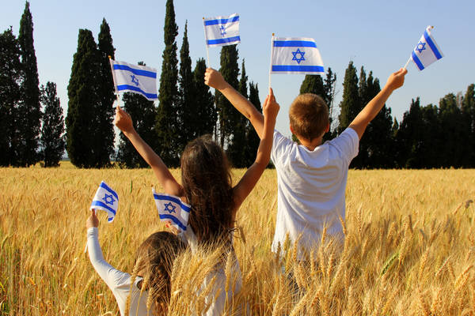
Israel ranked 5th in the most recent World Happiness Index in spite of the recent war
whereas the United States fell from 20 to 23.
Notes:
https://unitedwithisrael.org/an-american-historian-explains-why-israelis-are-so-happy/

Slide 57
In a Wall Street Journal Op-Ed, historian Gil Troy attributed Israel’s high happiness rating on a feeling of social cohesiveness, family ties and a sense of tradition and history.
Notes:
https://unitedwithisrael.org/an-american-historian-explains-why-israelis-are-so-happy/

Slide 58
“Israelis pursue happiness through family and community, by feeling rooted and having a sense of purpose,” he wrote. He added, “Amid unspeakable suffering, Israelis have found comfort in one another and a higher calling. Too many Americans feel lonely and lost.”
Notes:
Troy added, “They feel part of a bigger story, Jews’ historical saga reaching back 3,500 years. The pain punctuating this story helps transcend passing traumas.”
https://unitedwithisrael.org/an-american-historian-explains-why-israelis-are-so-happy/

Slide 59
In addition, in spite of demonstrations and passionate disagreements, as witnessed during anti-government demonstrations, Israelis nevertheless “live in an intimate society that runs on trust and generates hope. Israelis feel they’re never alone, and that their relatives and friends will never abandon them.”
Notes:
https://unitedwithisrael.org/an-american-historian-explains-why-israelis-are-so-happy/

Slide 60
Troy quoted the Father of Political Zionism, Theodor Herzl, and wrote “Israelis don’t count in days and decades but in millennia and eternity.”
Notes:
https://unitedwithisrael.org/an-american-historian-explains-why-israelis-are-so-happy/

Slide 61
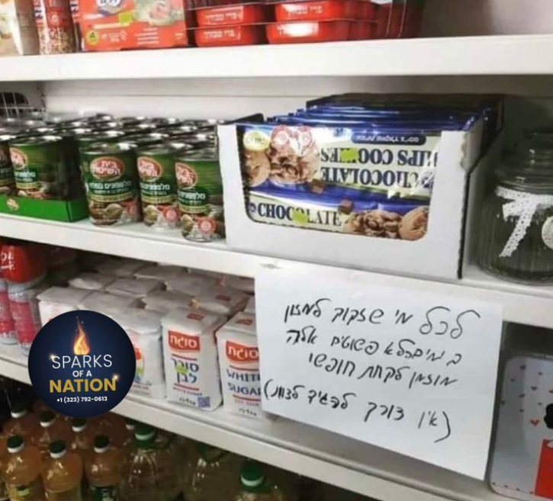
“If you’re going through a tough financial time, you need not pay. Take it and go.”
Notes:
https://www.instagram.com/p/C5SPkvvtnN0/

Slide 62
Do we always speak the truth in love?
Are our spiritual practices, Passover, unleavened bread, Shabbat expressions of family joy and unity, or rigidity?
Do we celebrate life?

Slide 63
אזור חופשי לשון הרע
Azor khofshi
Lashon HaRa
Defamation free zone

Slide 64
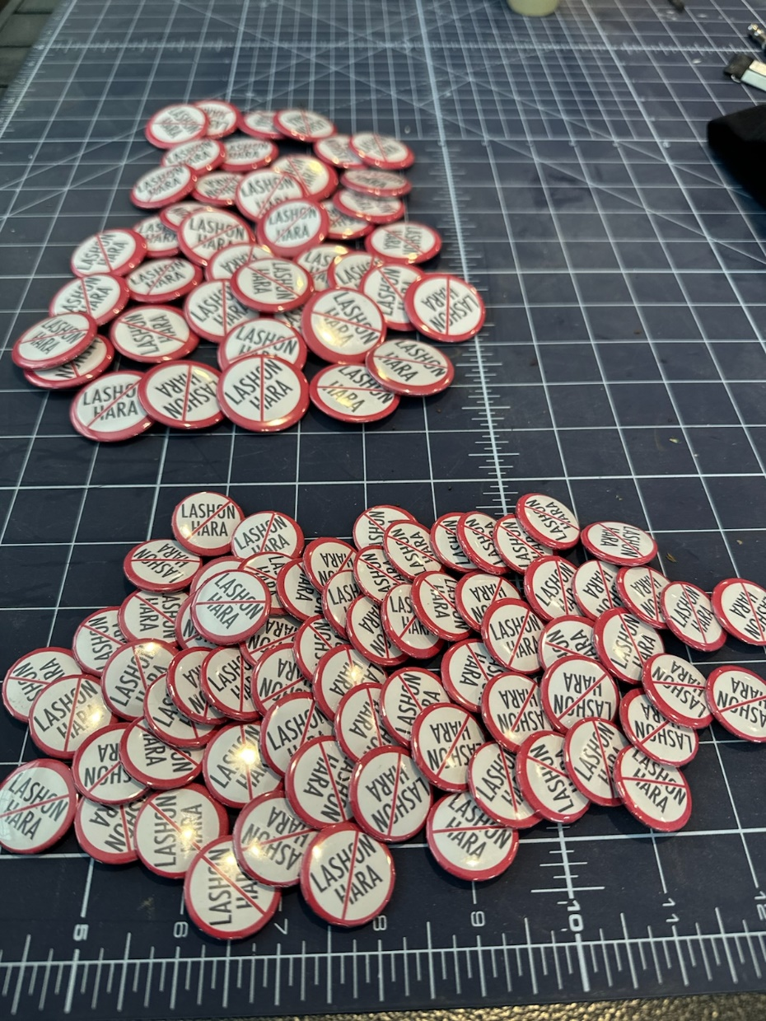
Notes:
Nature Illustration of LIFE.

Slide 65
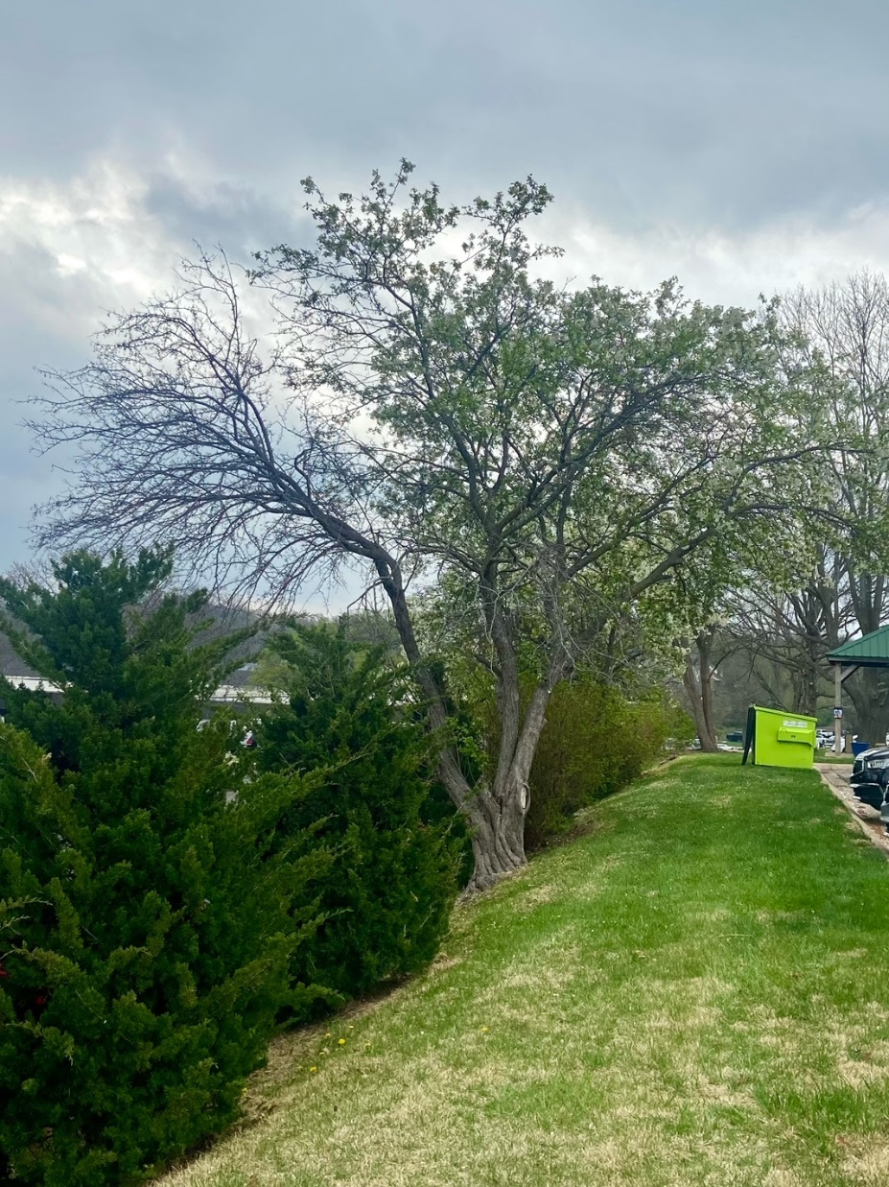
That tree grows on the property where Advice & Aid Pregnancy Center resides at 10901 Granada Lane in Overland Park, Kansas.

Slide 66
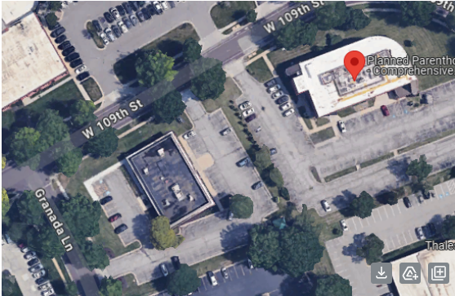
Planned
Parenthood
Advice & Aid
An eclipse from above, in the ISS
Notes:
Hi. The tree would be one of the ones in front of the blue looking car on our parking lot

Slide 67
Many of you have been to our center and know that on the other side of those evergreens is the largest abortion facility in the Kansas City Metro which serves women from Kansas, Missouri, and neighboring states. This picture represents what is happening in this corner of Overland Park.

Slide 68
As you can see, the branches that hang above the Advice & Aid property are filled with green leaves, they have life; while the branches that are over the abortion clinic side are lifeless, nothing really is growing there.

Slide 69
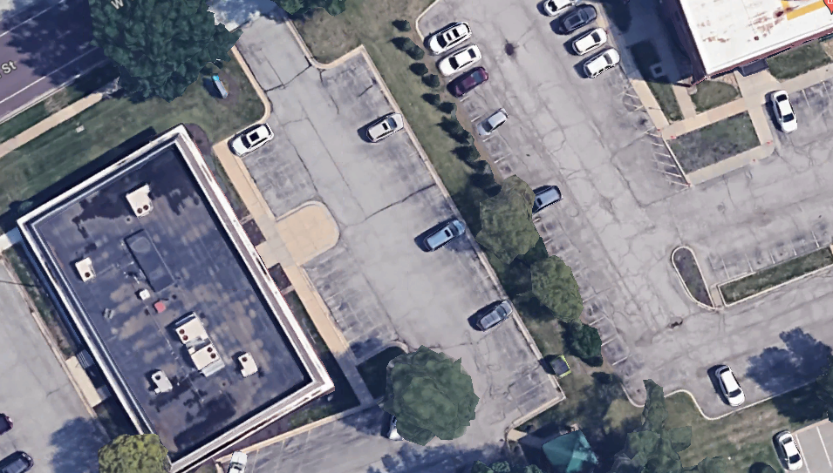
An eclipse from above, in the ISS
Notes:
We HAVE life. Sometimes it might seem that the world is prospering, but note, in Yeshua we have LIFE!! Even the tree knew.

Slide 70
For our congregational Seder Wednesday, April 24, we have open seating. So, newcomers and visitors may be isolated unless YOU scope them out and befriend them. Plan to share LIFE.

Slide 71
Wokeness
and
depression
Notes:
https://youtu.be/wt091XiILmw

Slide 72
Some more good news
about living in LIFE

Slide 73
An eclipse from above, in the ISS
Notes:
https://www.fdd.org/analysis/2024/04/09/hamas-run-gaza-health-ministry-admits-to-flaws-in-casualty-data/

Slide 74
BREAKING - Gaza Health Ministry has now 𝗮𝗱𝗺𝗶𝘁𝘁𝗲𝗱 that the TOTAL death count in Gaza stands at 𝟮𝟭,𝟳𝟮𝟬. An estimated 13,000 of those militant deaths from IDF estimates. Which means that 𝗼𝗻𝗹𝘆 𝟴,𝟳𝟮𝟬 𝗵𝗮𝘃𝗲 𝗯𝗲𝗲𝗻 𝗰𝗶𝘃𝗶𝗹𝗶𝗮𝗻 𝗱𝗲𝗮𝘁𝗵𝘀.Combatant to civilian ratio stands as 𝘂𝗻𝗱𝗲𝗿 𝟭:𝟭
Notes:
https://www.fdd.org/analysis/2024/04/09/hamas-run-gaza-health-ministry-admits-to-flaws-in-casualty-data/
https://www.tabletmag.com/sections/news/articles/how-gaza-health-ministry-fakes-casualty-numbers
https://allisrael.com/renowned-statistics-professor-explains-how-hamas-exaggerates-distorts-civilian-death-toll-in-gaza

Slide 75
We have never seen that before in any war in Modern History. 𝙐𝙨𝙪𝙖𝙡 𝙨𝙩𝙖𝙣𝙙𝙖𝙧𝙙𝙨: According to the UN, civilians usually make up around 90 percent of casualties in war. That’s a 1:9 ratio. Compared to the IDF’s 1:1
Notes:
https://www.fdd.org/analysis/2024/04/09/hamas-run-gaza-health-ministry-admits-to-flaws-in-casualty-data/
https://www.tabletmag.com/sections/news/articles/how-gaza-health-ministry-fakes-casualty-numbers
https://allisrael.com/renowned-statistics-professor-explains-how-hamas-exaggerates-distorts-civilian-death-toll-in-gaza

Slide 76
We have never seen a war with such a precise ratio. The IDF are also operating in an Urban War environment where Hamas hide amongst the civilian population. What they are pulling off is just next level.
Notes:
https://www.fdd.org/analysis/2024/04/09/hamas-run-gaza-health-ministry-admits-to-flaws-in-casualty-data/
https://www.tabletmag.com/sections/news/articles/how-gaza-health-ministry-fakes-casualty-numbers
https://allisrael.com/renowned-statistics-professor-explains-how-hamas-exaggerates-distorts-civilian-death-toll-in-gaza

Slide 78
^{Ephesians 4.14-16} We will then no longer be infants tossed about by the waves and blown along by every wind of teaching, at the mercy of people clever in devising ways to deceive. Instead, speaking the truth in love, we will in every respect grow up into him who is the head, the Messiah.
Notes:
Words that harm, Telushkin.
Do we speak the truth in love?

Slide 79
^{Ephesians 4.14-16} Under his control, the whole body is being fitted and held together by the support of every joint, with each part working to fulfill its function; this is how the body grows and builds itself up in love.
Notes:
Are we building up?

Slide 80
We live in the immediate risk of attack and disaster, and need to esteem and value each other all the more!

Slide 81
Former U.S. Central Command
Commander Gen. Frank McKenzie
Notes:
just days before the Moscow attack that ISIS-K, ‘retains the capability and will to attack U.S. and Western interests abroad in as little as six months and with little or no warning’,” “In Afghanistan, we have almost no ability to see into that country and almost no ability to strike into that country. And so, ISIS there is able to grow unabated.
https://www.dailywire.com/news/ex-centcom-commander-isis-threat-to-u-s-becoming-serious-because-of-bidens-foreign-policy

Slide 82
“And so, I think the threat is growing,” he continued. “It began to grow as soon as we left Afghanistan, took pressure off ISIS-K. So I think we should expect further attempts of this nature against the United States as well as our partners and other nations abroad. I think this is inevitable.”

Slide 83
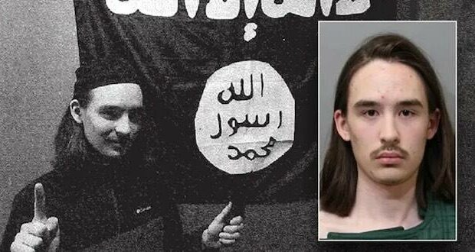
Alexander Mercurio
Notes:
https://metrovoicenews.com/fbi-details-idaho-mans-isis-plot-against-churches/

Slide 84
In a release, the Department of Justice (DOJ) said Alexander Mercurio was plotting to incapacitate his father with a pipe, handcuff him and restrain him, steal his guns and other weapons, and attack churches in Coeur d’Alene, Idaho, on Sunday.
Notes:
https://metrovoicenews.com/fbi-details-idaho-mans-isis-plot-against-churches/

Slide 85
The defendant allegedly pledged loyalty to ISIS and sought to attack people attending churches in Idaho.
Notes:
https://vfinews.com/news/hamas-wont-release-40-hostages-netanyahu-is-determ/fbi-arrests-idaho-18-year-old-for-violent-plot-to-

Slide 86
FBI Director Christopher Wray said Tuesday that the defendant swore devotion to ISIS “and sought to attack people attending churches in Idaho, a truly horrific plan which was detected and thwarted by the FBI’s Joint Terrorism Task Force.”
Notes:
https://metrovoicenews.com/fbi-details-idaho-mans-isis-plot-against-churches/

Slide 87
We live in the immediate risk of attack and disaster, and need to esteem and value each other all the more!

Slide 88
Some action you can take if you have an Amazon account.

Slide 89
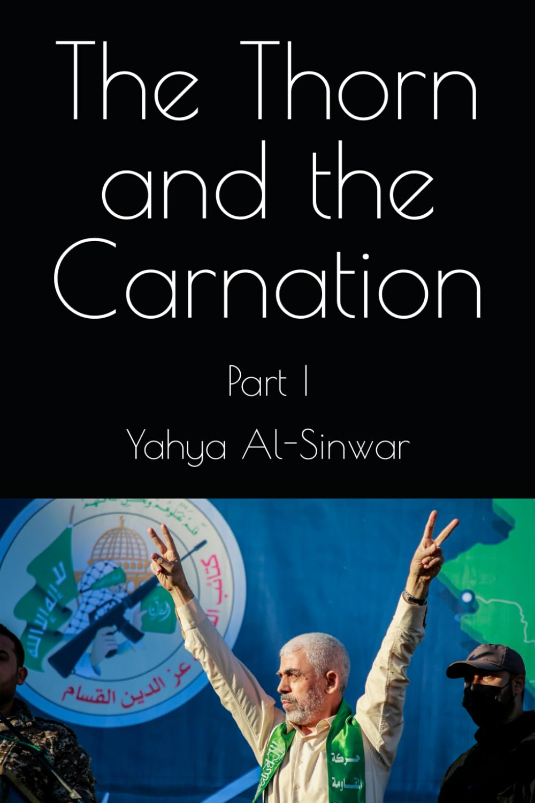
Set against the backdrop of the occupied territories of Palestine, "The Thorn and the Carnation" is a narrative that delves deep into the heart of Gaza's resilience and the Palestinian spirit of endurance.
Notes:
https://www.amazon.com/Thorn-Carnation-Yahya-Al-Sinwar/dp/B0CPCPLQZX?language=en_US

Slide 90
Authored by Yahya Al-Sinwar during his time in Israeli detention, this work offers a poignant exploration of the human condition under the shadows of the Israeli occupation.
Notes:
https://www.amazon.com/Thorn-Carnation-Yahya-Al-Sinwar/dp/B0CPCPLQZX?language=en_US

Slide 91
Go to your Amazon account, and to this book The Thorn and the Carnation, and then
Notes:
https://www.amazon.com/Thorn-Carnation-Yahya-Al-Sinwar/dp/B0CPCPLQZX?language=en_US

Slide 92
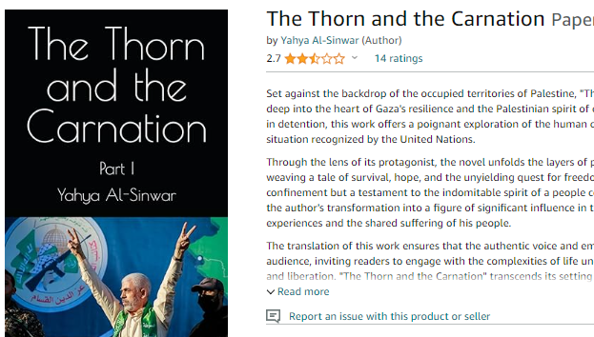

Slide 93
Jewish Israeli-American filmmaker Dan Gordon
Notes:
https://cmsedit.cbn.com/cbnnews/israel/2024/april/documentary-filmmaker-explains-why-christians-must-understand-what-led-to-hamas-massacre-christians-role-in-israels-founding

Slide 94
U.S. intelligence warned on Wednesday that a major strike against Israel to be carried out by Iran or one of its proxies using missiles or drones was “imminent,” Bloomberg reported.
Notes:
https://www.meforum.org/65766/iran-four-options-for-revenge-against-israel?goal=0_086cfd423c-3736f7e6e3-33765913&mc_cid=3736f7e6e3&mc_eid=2515d15785
https://allisrael.com/us-intel-warns-iranian-attack-on-israel-imminent-centcom-commander-to-visit-israel

Slide 95
Four options
Iran usually favors using proxies over staging direct attacks. In an unkind formulation common in Israel, Teheran is prepared to 'fight to the last Arab'. (Iranians are obviously Persian, unlike their Arab proxies.)
Notes:
https://www.meforum.org/65766/iran-four-options-for-revenge-against-israel?goal=0_086cfd423c-3736f7e6e3-33765913&mc_cid=3736f7e6e3&mc_eid=2515d15785

Slide 96
Yesterday marked the 1st day of Nissan, the beginning of the year on the Hebrew calendar. Nissan is known as the "month of miracles", derived from the Hebrew word, "nissim", which means "miracles". Israel finally and miraculously left Egypt in the month of Nissan after hundreds of years of slavery. God orchestrated their escape, "nus" in Hebrew, (which some say is connected to Nissan),
Notes:
George Whitten

Slide 97
displaying His power over the Egyptian gods and His sovereignty over every pantheon. Nissan may also be related to the Hebrew word "nitzan", which means "to bud" or "to start fresh and anew", reflecting the seasonal advent of new life and new beginnings...springtime.
Notes:
George Whitten

Slide 98
While I don't wish to diminish the gravity of attacks against Israel by Hamas, the Houthis in the south, or Hezbollah's missiles from the north, Iran poses a threat of an entirely different magnitude. Yet even in the face of this menace, I firmly believe in Israel's ability to defend itself. More than that, I am confident that if Iran decides to attack, Israel will deliver a devastating counterstrike.
Notes:
Gregg Roman Director Middle East Forum Copyright © 2024 Middle East Forum, All rights reserved.

Slide 99
Jonathan Feldstein President Genesis 123 Foundation
The army has canceled the leave for combat soldiers, more reservists are being called up again, public bomb shelters are open (we have one in our home as do many Israelis), the air force is on high alert,
Notes:
https://genesis123.co/

Slide 100
and GPS is being jammed as far south as Tel Aviv because Hezbollah has many (tens or hundreds of) thousands of precision GPS guided missiles that can hit most everywhere here.
Notes:
https://genesis123.co/

Slide 101
Last week I was driving in northern Israel and my GPS kept saying I was in Beirut. Yesterday, amid rocket fire from Gaza (still) and Lebanon (dozens a day), big news here was the GPS jamming created huge traffic problems.
Notes:
https://genesis123.co/

Slide 102
^{Yn 17.22-23} The glory which you have given to me, I have given to them; so that they may be one, just as we are one — I united with them and you with me, so that they may be completely one, and the world thus realize that you sent me, and that you have loved them just as you have loved me.

Slide 103
^{2 Cor 4.6} For it is the God who once said, “Let light shine out of darkness,” who has made his light shine in our hearts, the light of the knowledge of God’s glory shining in the face of the Messiah Yeshua.

Slide 104
^{2 Cor 3.18} All of us, with faces unveiled, see as in a mirror the glory of the Lord; and we are being changed into his very image, from one degree of glory to the next, by Adoni the Spirit.

Slide 105
An eclipse from above, in the ISS

Slide 106
A Passover Mensch מענטש
Passover Parallel Exodus
Passover Personal SW history
Passover Maturity
An eclipse from above, in the ISS

Slide 107
Do you KNOW Yeshua and drinking the water of LIFE?
Are you hearing daily from His Word?
How are you applying what you heard?
Are you offering that water of life to anyone?

