Slide 1
To easily follow these notes, log on to our Wifi
Wifi: mycci01
p/w: ancientquail060
Go to OrHaOlam.com
Click on downloads, messages, 2017

Slide 2
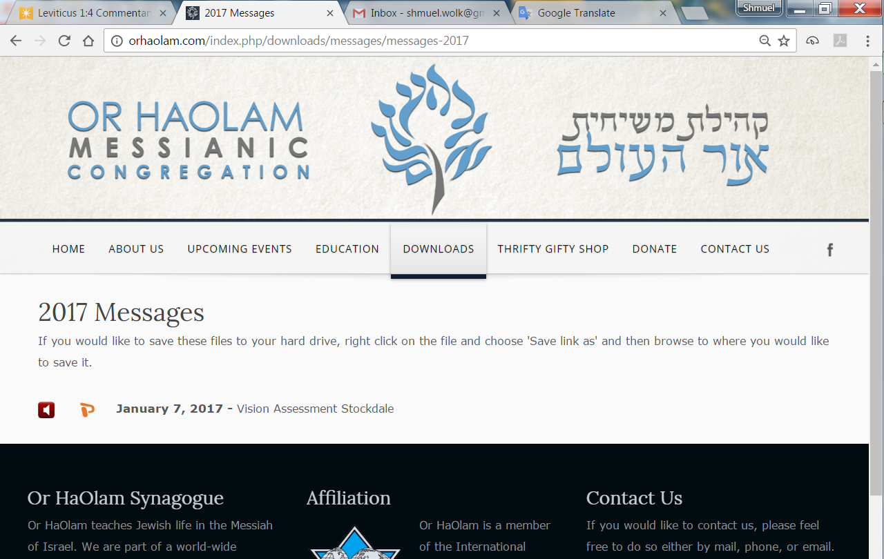

Slide 3
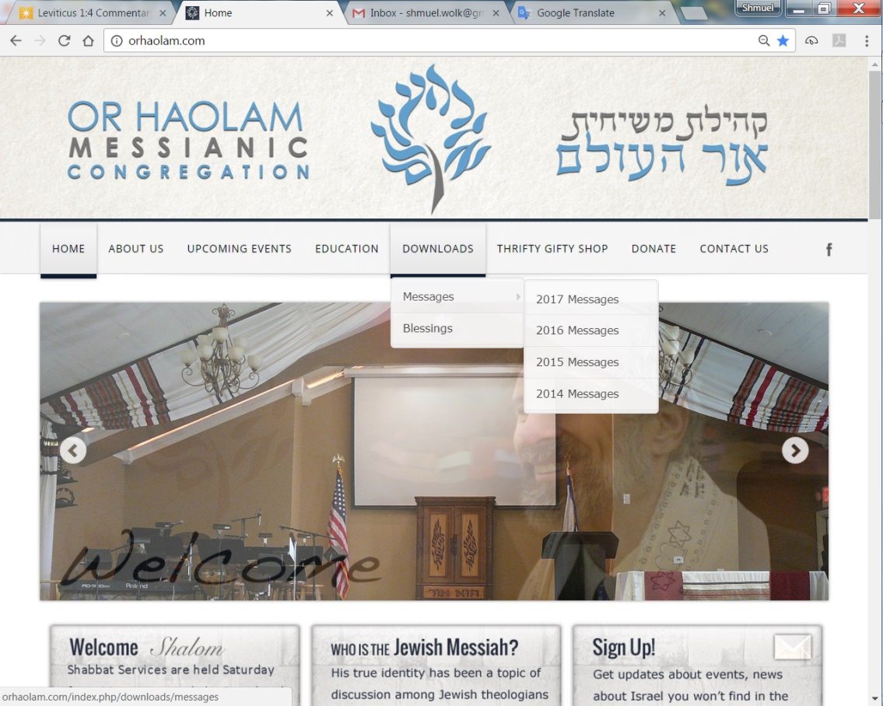
Downloads\messages\
2017 Messages

Slide 4
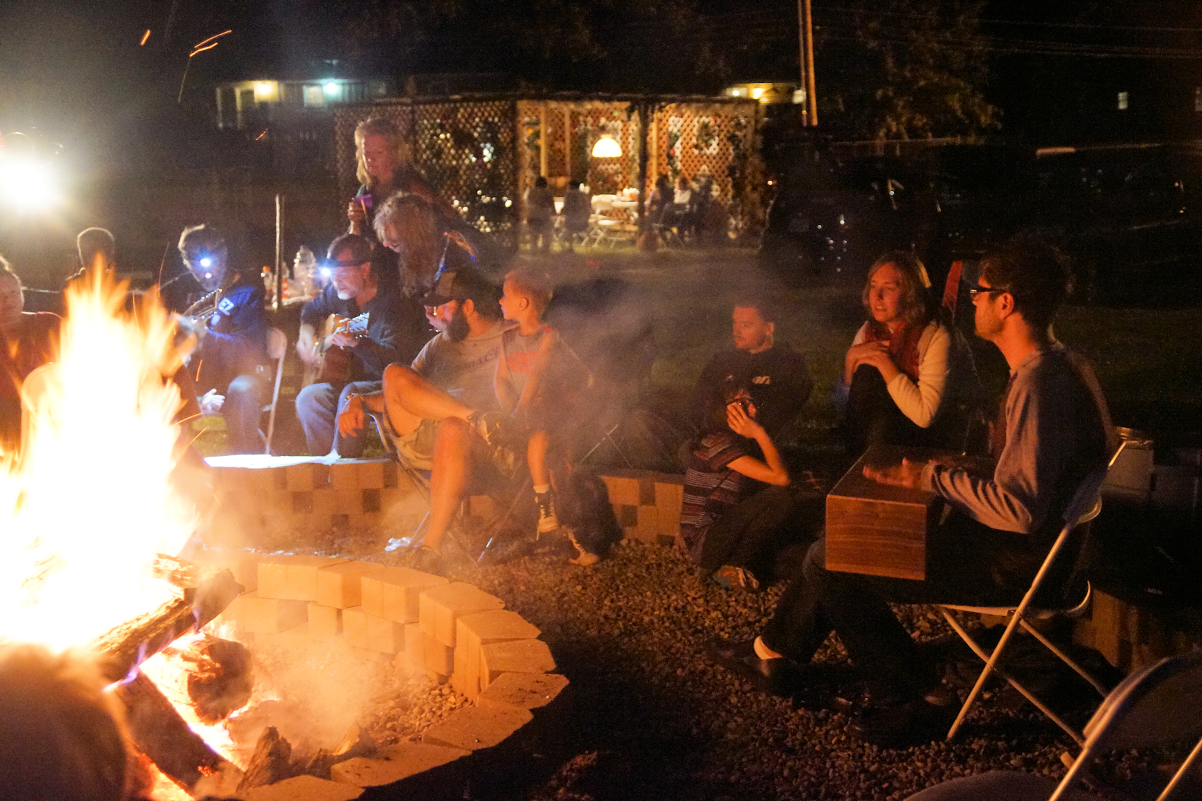
Sukkot Havdalah Oct. 7, 2017
Notes:
Beautiful picture one of sweetest moments of my life, in community!
The joy of an anointed, joyful evening! Kudos to
-my wife, whose idea and labor of love built the firepit,
-Sergio and Gerardo and the men who designed and built the beautiful Sukkah,
-Steve and Michael, the anointed musicians of the evening,
-Steve who hustled to get the electric installed,
-all of YOU worshipers!
Great evening that GREATLY impacted my grandson!! This picture will be on the re-formatted OH website. It’s really cool, but if you don’t want your mug there, let me know.

Slide 5
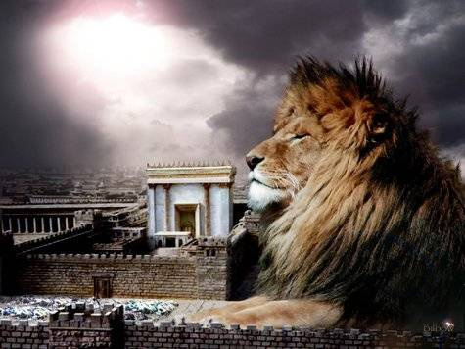
מַתִּתְיָהוּ Mattityahu
(Matthew) 21:12-13
Notes:
Yeshua just had done what is called the “Triumphal Entry” to Jerusalem. Celebrated and honored.

Slide 6
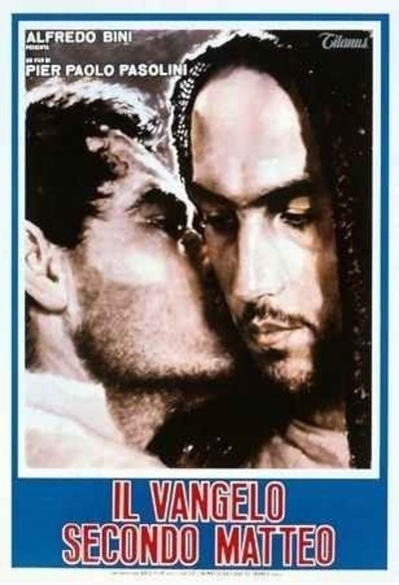
The Gospel
According to
St. Matthew
(1964), which was
filmed mostly in
the poor, desolate
Italian district of
Basilicata
Notes:
http://www.rogerebert.com/reviews/great-movie-gospel-according-to-st-matthew-1964
Arts movie at my college. I perceived an angry Yeshua. I saw it in 1969 uncomfortably as a secular Jewish unbeliever, but squirmed at the angry Yeshua. I said so to the only believer I knew, who went to the movie.
Director Pier Paolo Pasolini, atheist, Marxist, homosexual, decided to produce a film literally from the Gospel of Matthew. One angry scene in Y life.
(Forty years later, Mel Gibson would film The Passion of the Christ on the very same Italian impoverished locations.)

Slide 7
Mattityahu (Matthew) 21:12
יֵשׁוּעַ נִכְנַס לְבֵית הַמִּקְדָּשׁ וְגֵרֵשׁ אֶת כָּל הַמּוֹכְרִים וְהַקּוֹנִים בְּבֵית הַמִּקְדָּשׁ
Yeshua entered the Temple grounds and drove out those who were doing business there, both the merchants and their customers.
Notes:
Keep in mind that it’s Passover week.

Slide 8
Mattityahu (Matthew) 21:12
וְהָפַךְ אֶת שֻׁלְחֲנוֹת הַחַלְּפָנִים וְאֶת כִּסְאוֹת מוֹכְרֵי הַיּוֹנִים.
He upset the desks of the money-changers and knocked over the benches of those who were selling pigeons [doves].

Slide 9
Mattityahu (Matthew) 21:13
אָמַר לָהֶם: "הֵן כָּתוּב, 'בֵּיתִי בֵּית-תְּפִלָּה יִקָּרֵא', אַךְ אַתֶּם הוֹפְכִים אוֹתוֹ לִמְעָרַת פָּרִיצִים."
He said to them, "It has been written, 'My house will be called a house of prayer.' But you are making it into a den of robbers!"

Slide 10
Similar but 3 years earlier: Yn 2.13-17 The Jewish feast of Passover was near, so Yeshua went up to Jerusalem. In the Temple, He found the merchants selling oxen, sheep, and doves; also the moneychangers sitting there. Then He made a whip of cords and drove them all out of the Temple,
Notes:
Passover, so note similar chronology. More Temple sacrificial animals listed here, but probably no different event.

Slide 11
Similar but 3 years earlier: Yn 2.13-17 both the sheep and oxen. He dumped out the coins of the moneychangers and overturned their tables. To those selling doves, He said, “Get these things out of here! Stop making My Father’s house a marketplace!” His disciples remembered that it is written, “Zeal for your House will consume Me!”
Notes:
Artist’s rendering, bit of a cariature…

Slide 12
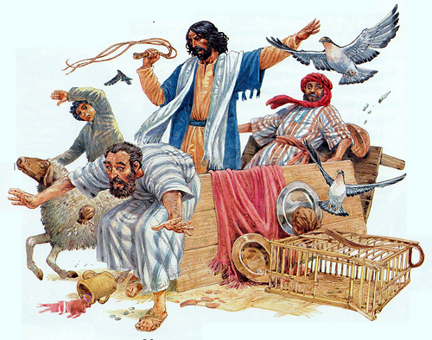

Slide 13
Why the anger?
Notes:
Seems so out of character.
Franky Schaeffer, son of Francis, wrote Time for Anger. Political activist 1982
Context: first century money matters.

Slide 14
First tithe to the Leviim, Cohenim
Second tithe for family celebration in Yerushaliyim except third and sixth year given to poor.
Notes:
Description of how to manage the second tithe…

Slide 15
^{Dvarim 14.22-26} "But if the distance [to Yeruashalayim] is too great for you, so that you are unable to transport it [wheat, goats, etc.], because the place where ADONI chooses to put his name is too far away from you; then, when ADONI your God prospers you,

Slide 16
^{Dvarim 14.22-26} you are to convert it into money, take the money with you, go to the place which ADONI your God will choose, and exchange the money for anything you want -

Slide 17
^{Dvarim 14.22-26} - cattle, sheep, wine, other intoxicating liquor, or anything you please - and you are to eat there in the presence of ADONI your God, and enjoy yourselves, you and your household.
Notes:
Intoxicating liquor!??
Quite normative to have money changers and sales of Temple sacrifices.

Slide 18
What maintains the sanctuary? ^{Shmot/Ex 30.12-15} "When you take a census of the people of Isra'el and register them, each, upon registration, is to pay a ransom for his life to ADONI, to avoid any breakout of plague among them during the time of the census.
Notes:
in the Misnah is a whole treatise called "Shekalim", in which an account is given of the time and manner of collecting this ransom money, and for what uses, and who were obliged to pay it, and who not; on the first of Adar (or February) they proclaimed concerning the payment of it, on the fifteenth the tables were set for that purpose, and on the twenty fifth the proper persons sat in the sanctuary to receive it. Had to be paid in Tyrian coinage, since no idolatrous pix.

Slide 19
^{Shmot/Ex 30.12-15} Everyone subject to the census is to pay as an offering to ADONI half a shekel [one-fifth of an ounce of silver]- by the standard of the sanctuary shekel (a shekel equals twenty gerahs).

Slide 20
^{Shmot/Ex 30.12-15} Everyone over twenty years of age who is subject to the census is to give this offering to ADONI - the rich is not to give more or the poor less than the half-shekel when giving ADONI's offering to atone for your lives.
Notes:
Remember Daveed’s census and the plague.
And the coins were from all over the Empire, but had to be converted to Tyrian coinage: no idolatrous images.

Slide 21
First tithe to the Leviim, Cohenim
Second tithe for family celebration in Yerushaliyim except third and sixth year given to poor.
Half shekel for Temple maintenance
Required money exchange.

Slide 22
Why the anger?
Context:
Scriptures quoted by
Messiah the King

Slide 23
Mattityahu (Matthew) 21:13
אָמַר לָהֶם: "הֵן כָּתוּב, 'בֵּיתִי בֵּית-תְּפִלָּה יִקָּרֵא', אַךְ אַתֶּם הוֹפְכִים אוֹתוֹ לִמְעָרַת פָּרִיצִים."
He said to them, "It has been written, 'My house will be called a house of prayer.' But you are making it into a den of robbers!"
Notes:
People in those days memorized scripture. No other way to retain. He quoted a phrase, hearers thinking a chapter.
Yeshayahu/Isaiah,
then Yermiyahu/Jeremiah

Slide 24
^{Yeshayahu/Is 56.6-8} “And the foreigners who join themselves to ADONI to serve him, to love the name of ADONI, and to be his workers, all who keep Shabbat and do not profane it, and hold fast to my covenant, I will bring them to my holy mountain

Slide 25
^{Yeshayahu/Is 56.6-8} and make them joyful in my house of prayer; their burnt offerings and sacrifices will be accepted on my altar; for my house will be called a house of prayer for all peoples.” Adonai ELOHIM says, he who gathers Isra'el's exiles:

Slide 26
^{Yeshayahu/Is 56.6-8} “There are yet others I will gather, besides those gathered already.”
Notes:
Passion to have the Temple as a house of prayer: praise, reading, study concomitant. Under porches.
For all nations. All nations. Poor example to help Gentiles? Back to Garden.
NOT a political uprising since He left Temple w/o organizing followers. Just a statement to the Cohanim/Saducees, and all observers. Prophets given to symbolic actions. Ezk paraylzed. Dug in wall. Jeremiah’s wife died,
Similar here to the Qumran DSS community, believed the Temple corrupt.

Slide 27
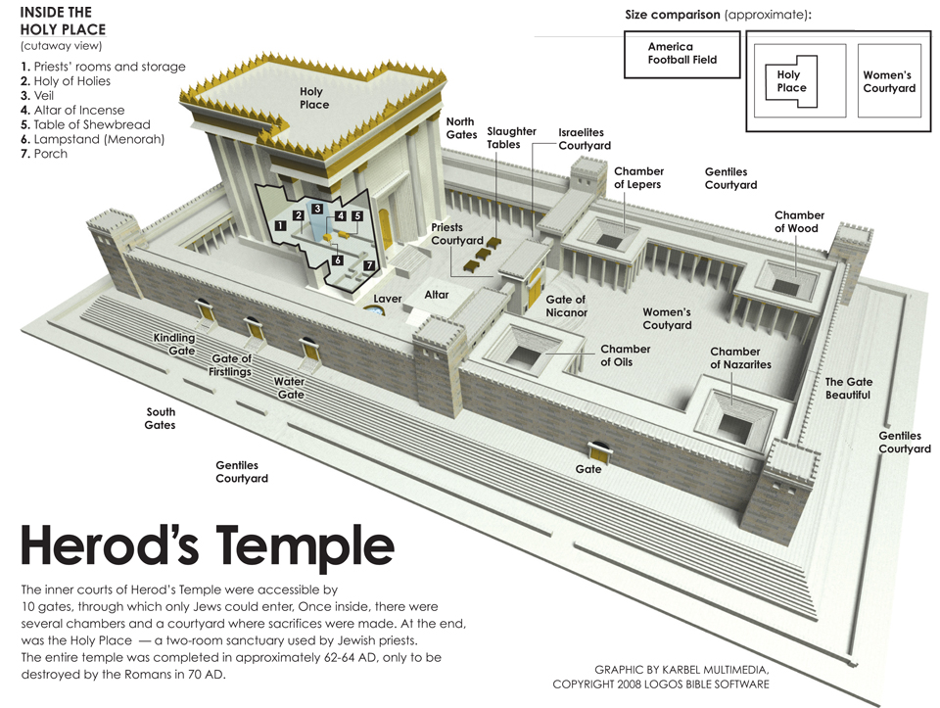

Slide 28
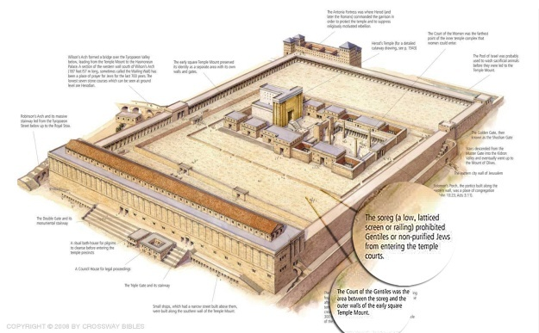
סוֹרָגSoreg
Notes:
Limit of attendance for Gentiles and ritually unclean [haven’t been immersed in mikveh]
Porches for rabbis to teach their talmidim/disciples.

Slide 29
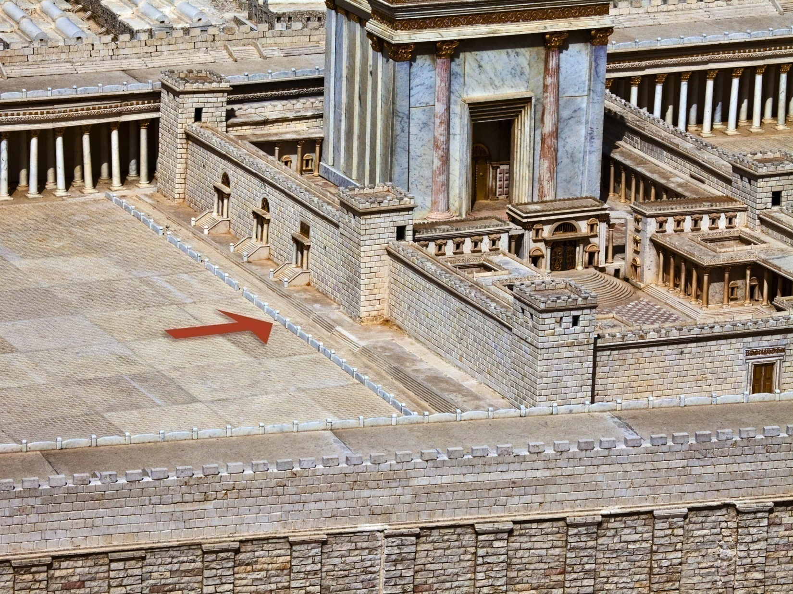
סוֹרָגSoreg
Notes:
Limit of attendance for Gentiles and ritually unclean [haven’t been immersed in mikveh]
Stone with inscription from the soreg. Two like this, one in Turkish museum Ankara, this is Israel Museum Jerusalem.

Slide 30
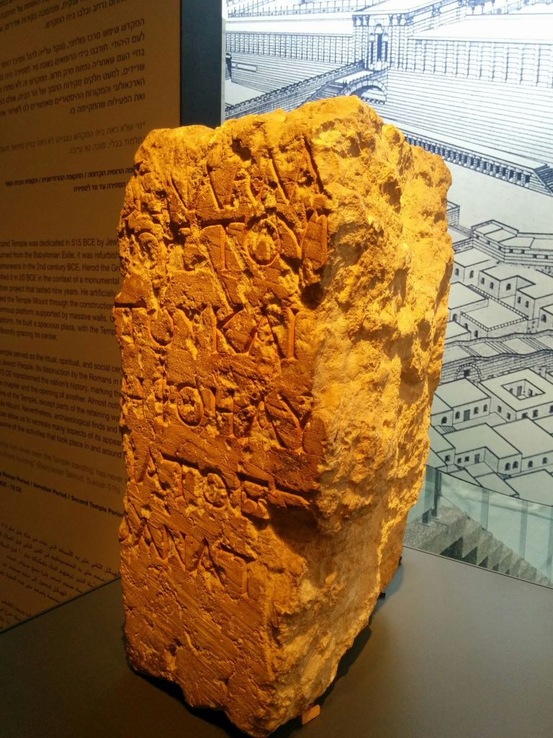
No foreigner may
enter within the
balustrade around
the sanctuary and
the enclosure. Who-
ever is caught, on
himself shall he put
blame for the death
which will ensue.
Notes:
https://www.timesofisrael.com/ancient-temple-mount-warning-stone-is-closest-thing-we-have-to-the-temple/
Yeshua knew salvation of Israel was for all the world. Grieved at poor example of exclusion.

Slide 31
Mattityahu (Matthew) 21:13
אָמַר לָהֶם: "הֵן כָּתוּב, 'בֵּיתִי בֵּית-תְּפִלָּה יִקָּרֵא', אַךְ אַתֶּם הוֹפְכִים אוֹתוֹ לִמְעָרַת פָּרִיצִים."
He said to them, "It has been written, 'My house will be called a house of prayer.' But you are making it into a den of robbers!"
Notes:
Context from Yermiyahu/Jer…

Slide 32
^{Yermiyahu/Jer 7.8-11} Look! You are relying on deceitful words that can't do you any good. First you steal, murder, commit adultery, swear falsely, offer to Ba'al and go after other gods that you haven't known.

Slide 33
^{Yermiyahu/Jer 7.8-11} Then you come and stand before me in this house that bears my name and say, 'We are saved' - so that you can go on doing these abominations! Do you regard this house, which bears my name, as a cave for bandits? I can see for myself what's going on," says ADONI.
Notes:
Some ancient temples were indeed a refuge of thieves.
Edersheim Life and Times of…the Messiah pp 368-372

Slide 34
^{T’hillim 141.2} Let my prayer be like incense set before you, my uplifted hands like an evening sacrifice.
Notes:
Here is the pattern of the Temple worship.
And power over enemies… not scripture…aphocryphal Bk. Macc.

Slide 35
^{1 Maccabees 7.37-43} ”You chose this house to be called by your name, and to be for your people a house of prayer and supplica-tion. Take vengeance on this man and on his army, and let them fall by the sword; remem-ber their blasphemies, and let them live no longer.”

Slide 36
^{1 Maccabees 7.37-43} Now Nicanor went out from Jerusalem and encamped in Beth-horon, and the Syrian army joined him. Judas encamped in Adasa with three thousand men. Then Judas prayed and said, "When the messengers from the king spoke blasphemy, your angel went out and struck down

Slide 37
^{1 Maccabees 7.37-43} one hundred eighty-five thousand of the Assyrians. So also crush this army before us today; let the rest learn that Nicanor has spoken wickedly against the sanctuary, and judge him

Slide 38
^{1 Maccabees 7.37-43} according to this wickedness.“ So the armies met in battle on the thirteenth day of the month of Adar. The army of Nicanor was crushed, and he himself was the first to fall in the battle.
Notes:
Back to Yeshua’s scripture…

Slide 39
Mattityahu (Matthew) 21:13
אָמַר לָהֶם: "הֵן כָּתוּב, 'בֵּיתִי בֵּית-תְּפִלָּה יִקָּרֵא', אַךְ אַתֶּם הוֹפְכִים אוֹתוֹ לִמְעָרַת פָּרִיצִים."
He said to them, "It has been written, 'My house will be called a house of prayer.' But you are making it into a den of robbers!"

Slide 40
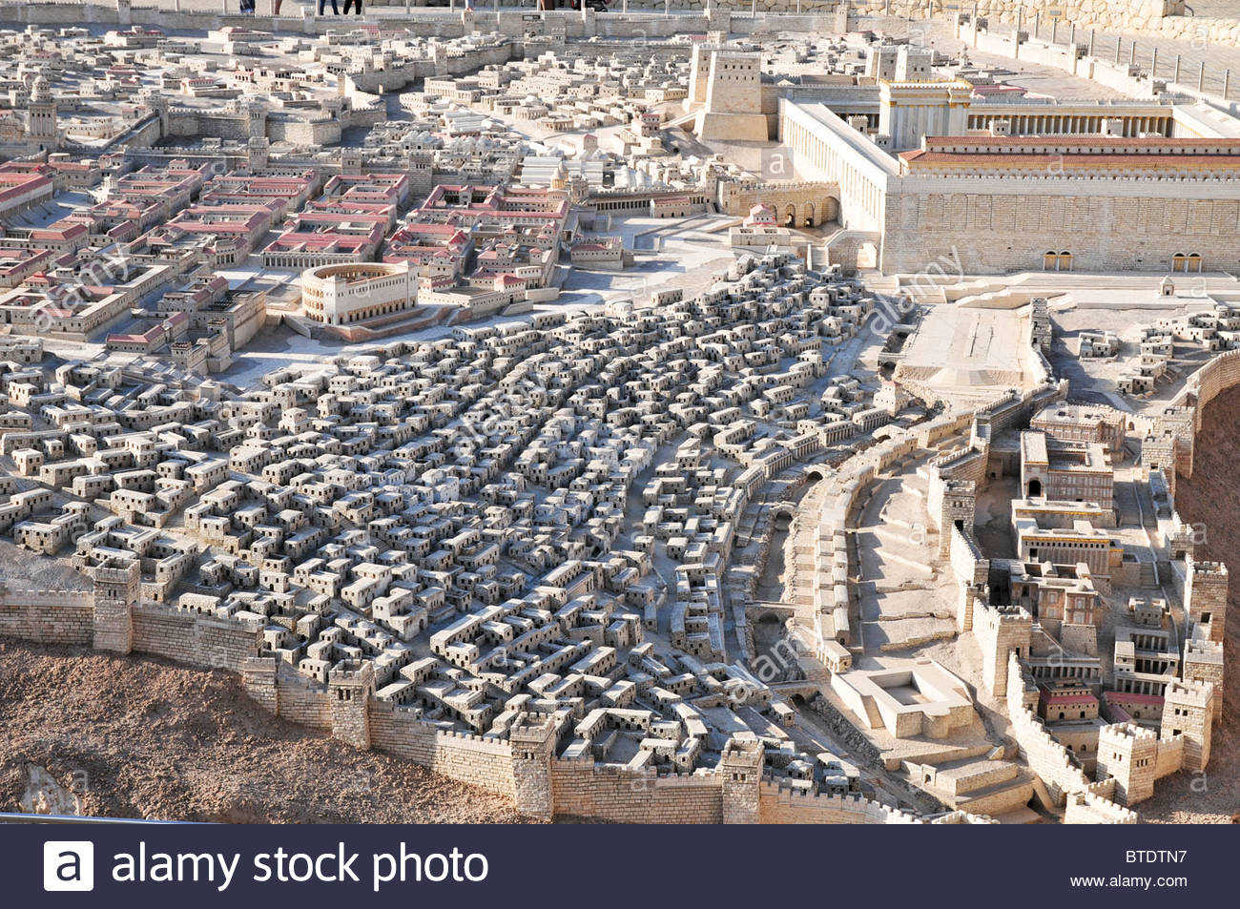
Commercial zone
Notes:
israel-jerusalem-israel-museum-model-of-jerusalem-in-the-late-second-BTDTN7
https://www.google.com/search?q=Second+temple+models&safe=active&source=lnms&tbm=isch&sa=X&ved=0ahUKEwjM_7fZ5oDXAhUB0YMKHR7aCyYQ_AUICigB&biw=1282&bih=884#imgdii=gEU_yAUrHa-mCM:&imgrc=Dko-JRhpAtwr2M:
See Robinson’s Arch?

Slide 41
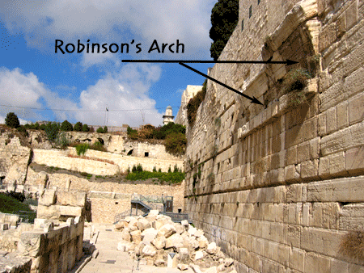
shops

Slide 42
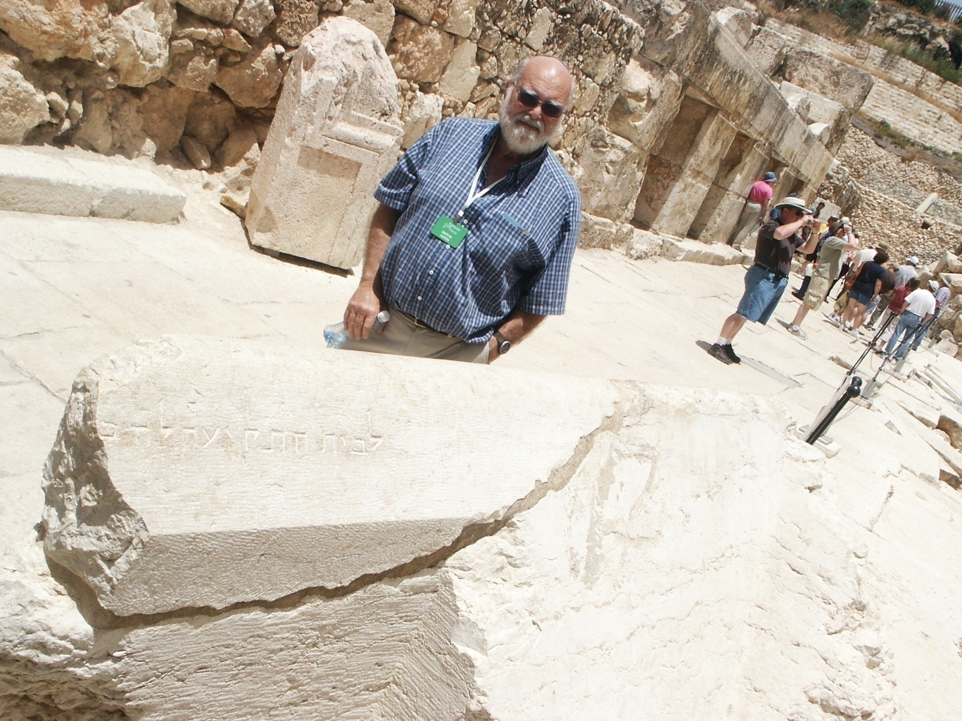
Notes:
See the shops on the left behind this venerable pilgrim and worshiper

Slide 43
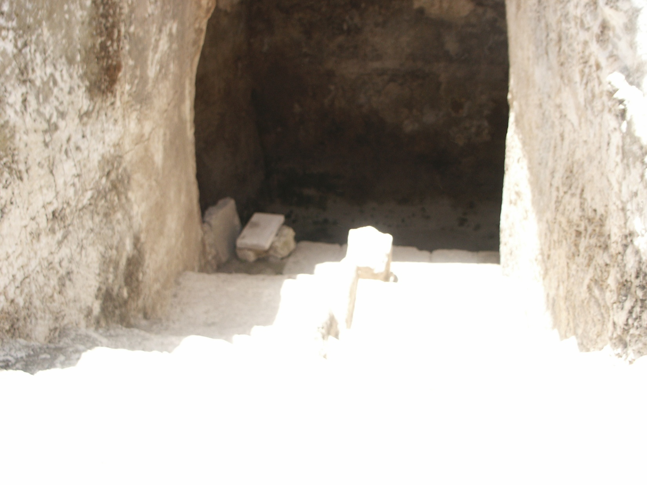
Mikveh / Immersion pool
on this street

Slide 44
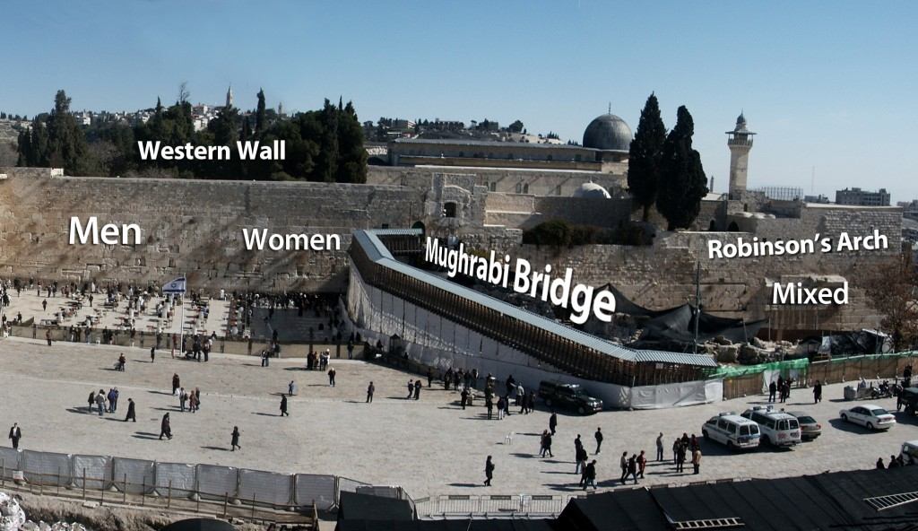
Notes:
Later law to keep trade out of Temple Plaza. Streets to west just shown, and throughout city.

Slide 45
Soreg סורג
Notes:
According to David Flusser, after Yeshua they thought to ban such transactions from the Temple Mount Plaza, but Yeshua was NOT alone in loathing the contamination.

Slide 46
^{Malakhi 3.1-3} “Look! I am sending my messenger to clear the way before me; and HaAdon, whom you seek,
will suddenly come to his temple.
Yes, the messenger of the covenant, in whom you take such delight — look! Here he comes,”
says Adonai-Tzva’ot.
Notes:
Prophetic role, cleasning His Father’s house of leaven, just before Pesakh

Slide 47
^{Malakhi 3.1-3} But who can endure the day when he comes?
Who can stand when he appears?
For he will be like a refiner’s fire,
like the soap maker’s lye.
He will sit, testing and purifying the silver; he will purify the sons of Levi, refining them like gold and silver,so that they can bring offerings to Adoni uprightly.

Slide 48
^{Zekh 14.20-21} In that day “Holy to Adoni” will be inscribed on the bells of the horses and the pots in House of Adoni will be like the sacred bowls in front of the altar. In fact every pot in Jerusalem and in Judah will be Holy to Adoni-Tzva’ot,

Slide 49
^{Zekh 14.20-21} ^{s}o that everyone who comes to sacrifice will take them, and cook in them. In that day there will no longer be a Canaanite [merchant,
וְלֹא-יִהְיֶה כְנַעֲנִי עוֹד Canaanites, especially Phoenicians were merchant traders] in the House of Adoni-Tzva’ot
Notes:
Mal 3 read on the Great Shabbat, Shabbat HaGadol, just before Pesakh. Yeshua was fulfilling this NOW.

Slide 50
Why the anger, lesson for us?
Lack of focus on worship.
Lack of integrity.
Exclusion of newcomers/ Gentiles.
Notes:
1. Put away your smart phones. Focus thoughts on thanksgiving, praise, dance, study, entering in. How many stay for classes, come for Tuesday night Teerosh? Intense corporate prayer!
2. Transparent life of honesty, humility, transparency.
3. Have you invited anyone, befriended anyone, served anyone? Outside your comfort zone. My trip to New York. Can’t say I dramatically shared, but as I could. Oxana’s concert tonight, invited any Jewish or non-Jewish people? Calling Jews and those of the Nations to their covenantal identity in Messiah!!
Prayer now…

Slide 51
Mattityahu (Matthew) 21:13
אָמַר לָהֶם: "הֵן כָּתוּב, 'בֵּיתִי בֵּית-תְּפִלָּה יִקָּרֵא', אַךְ אַתֶּם הוֹפְכִים אוֹתוֹ לִמְעָרַת פָּרִיצִים."
He said to them, "It has been written, 'My house will be called a house of prayer.' But you are making it into a den of robbers!"

