Slide 1
To easily follow these notes, log on to our Wifi
Wifi: mycci01
p/w: ancientquail060
Go to OrHaOlam.com
Click on downloads, messages, 2017

Slide 2
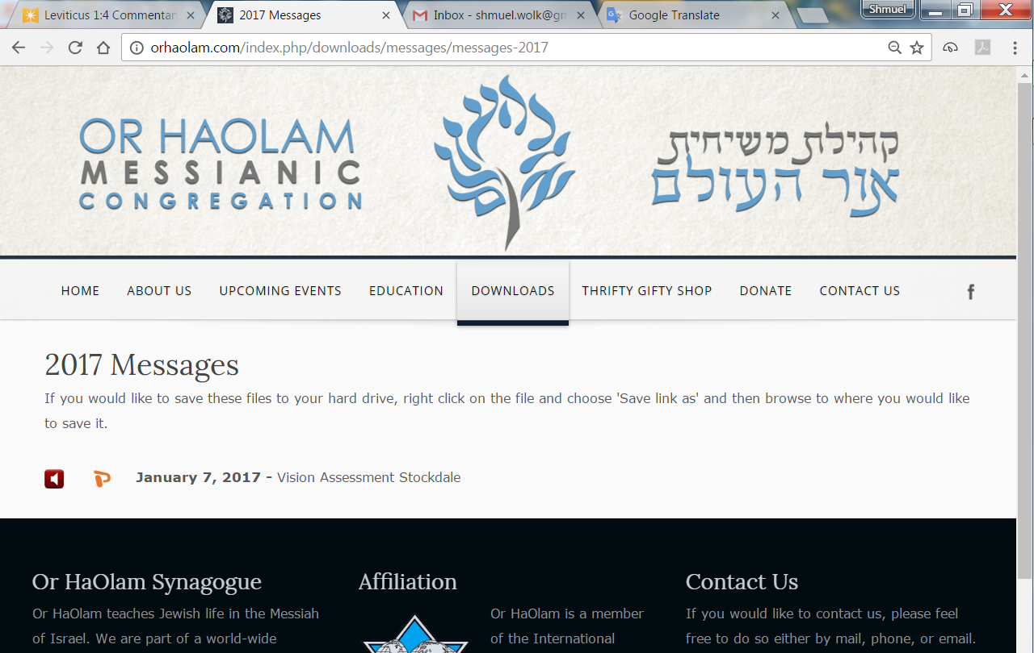

Slide 3
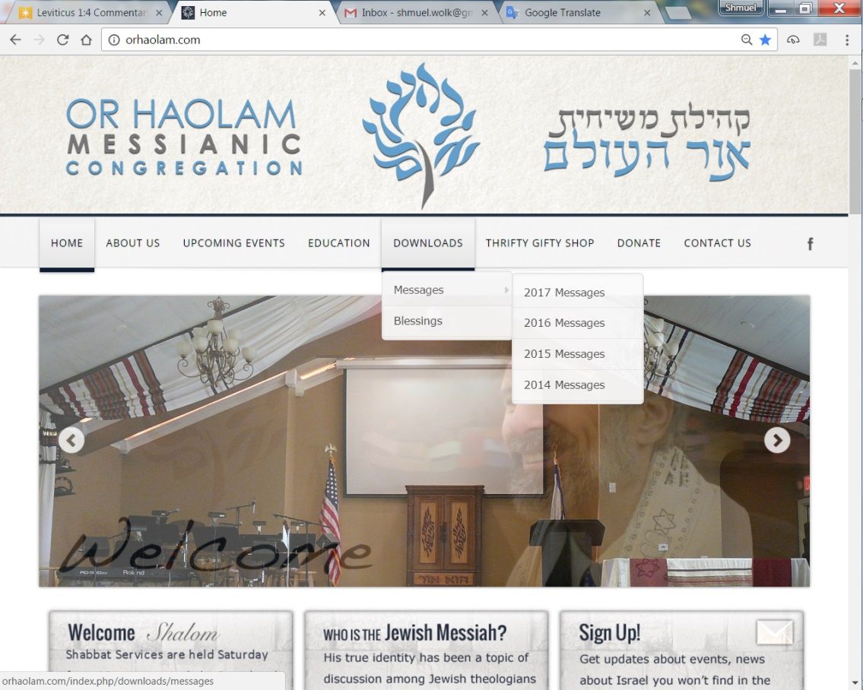
Downloads\messages\
2017 Messages

Slide 4

Notes:
Just go to OrHaOlam.com

Slide 5
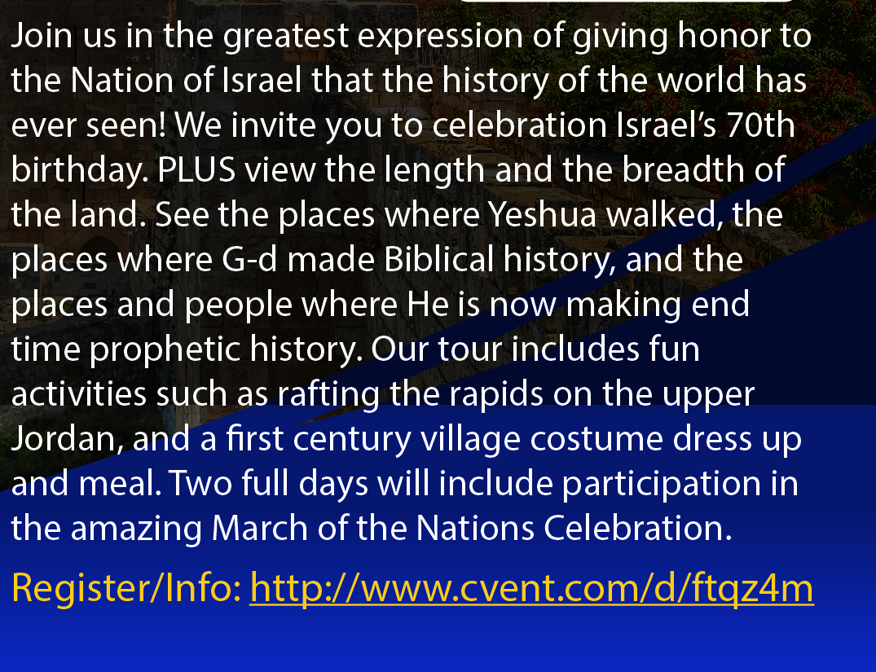
Notes:
Just go to OrHaOlam.com
Correction: air fare is from Kanas City, MCI. Previously said erroneously, from NY

Slide 6
Good News from Israel

Slide 7
Israelis Live 10 Years Longer Than In 1970: Thanks to a more healthful lifestyle, better economic situation, improved education and a more advanced medical system, the Israeli life expectancy has increased by 10.3 years since 1970 – from 71.8 years to 82.1 years in 2015.
Notes:
Barry & Batya Segal Newsletter November 15, 2017
78.74 years (2015)

Slide 8
Men with bachelor’s degrees lived an average of 7.5 years longer than men with much less formal education,
comparable for women was five years.
Notes:
Barry & Batya Segal Newsletter November 15, 2017

Slide 9
More good News from Israel
Notes:
Would you like to see the fundamental difference between men and women?

Slide 10
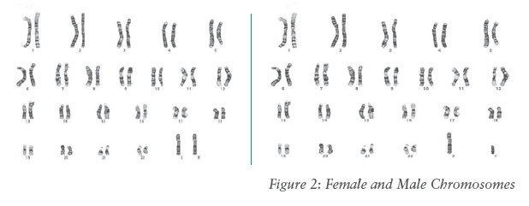
XX female XY male
In every one of your 40 trillion cells
Notes:
A photograph of chromosomes.
Only males have the shorter Y chromosome. If you are a father of daughters, then you only have contributed X chromosomes to your offspring.
All the pair separate for conception, and each parent contributes one.
XY vs XX difference effects many chromosomes.

Slide 11
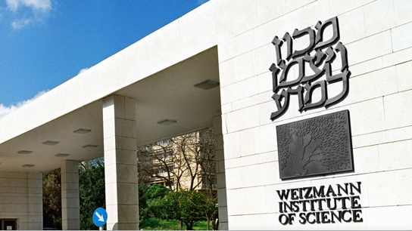

Slide 12
Geneticists at the Weizmann Institute of Science, one of the world's leading scientific institutes, recently published a study showing just how many biological differences there are between the male and female of our species.
Notes:
http://www.israeltoday.co.il/NewsItem/tabid/178/nid/32827/Default.aspx

Slide 13
They eventually found around "6,500 genes with activity that was biased toward one sex or the other in at least one tissue, adding to the already major biological differences between men and women."
Notes:
http://www.israeltoday.co.il/NewsItem/tabid/178/nid/32827/Default.aspx
Am I deriding people with gender uncertainty? No, No, No. I just am saying that there IS gender. It’s not fluid. There is healing for gender dysphoria, although it’s illegal to say this in California.

Slide 14
Good news from Israel, despite all her enemies.
What about us and our difficulties?
Hanukkah lesson?
Today’s parasha…

Slide 15
^{Beresheet/Gen 41.8} [Pharaoh] sent and called for the fortune-telling priests of Egypt and all its wise men and Pharaoh told them his dream. But no one could interpret them for Pharaoh…
Notes:
Story of fellow jail inmate, forgot promise to Joseph.

Slide 16
^{Beresheet/Gen 41.14-15} Pharaoh sent and called for Joseph. So they quickly fetched him from the pit. He shaved, changed his clothes, and came to Pharaoh. Then Pharaoh said to Joseph, “I dreamed a dream and there’s no one to interpret it.

Slide 17
^{Beresheet/Gen 41.15-16 TLV} I heard about you—it’s said that you can listen to a dream to interpret it.”
Then Joseph answered Pharaoh saying, “It’s not within me. God will answer with shalom for Pharaoh.”

Slide 18
^{Beresheet/Gen 41.29-31 TLV} [Joseph said] Seven years of abundance are about to come in the whole land of Egypt. Then seven years of famine will come up after them and all the abundance in the land of Egypt will be forgotten and the famine will consume the land.

Slide 19
^{Beresheet/Gen 41.29-31 TLV} So the abundance in the land will be unknown because of the famine that follows, for it will be a very oppressive famine.

Slide 20
All he was asked to do
was to interpret the dream.
However, he didn’t stop talking.

Slide 21
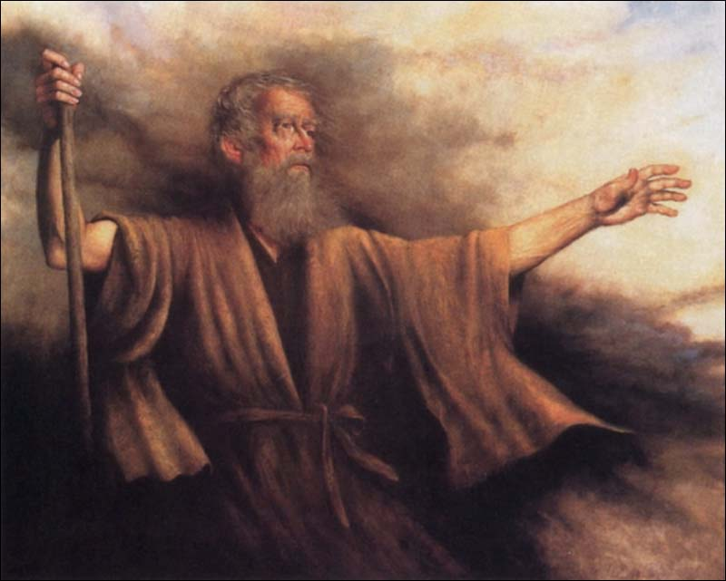
B’resheet בְּרֵאשִׁית
(Genesis) 41:33-34, 38
מִקֵּץ (from) Mikketz (At the end)

Slide 22
B’resheet (Genesis) 41:33
ג כִּי שֵׁם יְהוָה אֶקְרָא ס הָבוּ גֹדֶל לֵאלֹהֵינוּ׃
ג כִּי שֵׁם יְהוָה אֶקְרָא ס הָבוּ גֹדֶל לֵאלֹהֵינוּ׃
וְעַתָּה יֵרֶא פַרְעֹה אִישׁ נָבוֹן וְחָכָם וִישִׁיתֵהוּ עַל-אֶרֶץ מִצְרָיִם׃
"Therefore, Pharaoh should look for a man both discreet and wise to put in charge of the land of Egypt.

Slide 23
B’resheet (Genesis) 41:34
ג כִּי שֵׁם יְהוָה אֶקְרָא ס הָבוּ גֹדֶל לֵאלֹהֵינוּ׃
ג כִּי שֵׁם יְהוָה אֶקְרָא ס הָבוּ גֹדֶל לֵאלֹהֵינוּ׃
יַעֲשֶׂה פַרְעֹה וְיַפְקֵד פְּקִדִים עַל-הָאָרֶץ
Pharaoh should do this, and he should appoint supervisors over the land

Slide 24
B’resheet (Genesis) 41:34
ג כִּי שֵׁם יְהוָה אֶקְרָא ס הָבוּ גֹדֶל לֵאלֹהֵינוּ׃
ג כִּי שֵׁם יְהוָה אֶקְרָא ס הָבוּ גֹדֶל לֵאלֹהֵינוּ׃
וְחִמֵּשׁ אֶת-אֶרֶץ מִצְרַיִם בְּשֶׁבַע שְׁנֵי הַשָּׂבָע׃
to receive a twenty percent tax on the produce of the land of Egypt during the seven years of abundance…

Slide 25
B’resheet (Genesis) 41:38
ג כִּי שֵׁם יְהוָה אֶקְרָא ס הָבוּ גֹדֶל לֵאלֹהֵינוּ׃
ג כִּי שֵׁם יְהוָה אֶקְרָא ס הָבוּ גֹדֶל לֵאלֹהֵינוּ׃
וַיֹּאמֶר פַּרְעֹה אֶל-עֲבָדָיו הֲנִמְצָא כָזֶה אִישׁ אֲשֶׁר רוּחַ אֱלֹהִים בּוֹ׃
Pharaoh said to his officials, "Can we find anyone else like him? The Spirit of God lives in him!"
Notes:
He interpreted more than asked. Saw need and considered it.
Is our mode to look for needs that we can fill? Not do everything, but everything we can.
Above and beyond the call of duty.

Slide 26
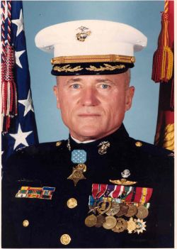
1st Lieutenant
Wesley L. Fox
Congressional Medal
of Honor
Date of Issue:
March 2,1971
Notes:
http://www.cmohs.org/recipient-detail/3284/fox-wesley-l.php

Slide 27
For conspicuous gallantry and intrepidity at the risk of his life above and beyond the call of duty while serving as commanding officer of Company A, in action against the enemy in the northern A Shau Valley…
Notes:
http://www.cmohs.org/recipient-detail/3284/fox-wesley-l.php
There is a theme in scripture about doing, giving, loving, service, above and beyond the call of duty!

Slide 28
^{Philemon 21} Having confidence in your obedience, I write to you, knowing that you will do even more than what I say.

Slide 29
^{Yn 14.21} He who has My command-ments and keeps them is the one who loves Me. He who loves Me will be loved by My Father, and I will love him and reveal Myself to him.”

Slide 30
^{T’hillim/Ps 119.10-14} I seek you with all my heart; don’t let me stray from your
mitzvot. I treasure your word in my heart, so that I won’t sin against you. Blessed are you, Adoni! Teach me your laws. I proclaim with my mouth all the rulings you have spoken. I rejoice in the way of your instruction more than in any kind of wealth.

Slide 31
^{Phil. 3.12} I press on if only I might take hold of that for which Messiah Yeshua took hold of me.

Slide 32
Do more than asked or required.
Notes:
A giver mentality. Do we look to give, emotionally, socially, spiritually, financially, gastronomically?
Relates to Hanukkah? you’ll see shortly.
Introduce reading from Matityahu

Slide 33
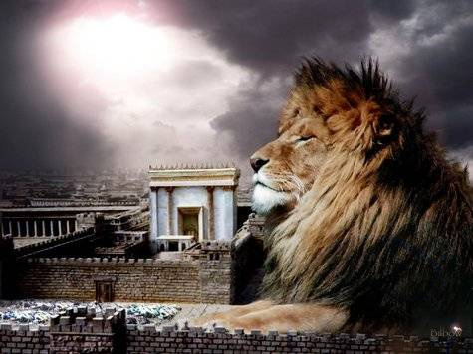
מַתִּתְיָהוּ Mattityahu
(Matthew) 22:11-14
Notes:
Last week, King’s passion to FILL His house, his banquet party.

Slide 34
Mattityahu (Matthew) 22:11
כְּשֶׁבָּא הַמֶּלֶךְ לִרְאוֹת אֶת הַמְסֻבִּים רָאָה שָׁם אִישׁ שֶׁאֵינֶנּוּ לָבוּשׁ בִּגְדֵי חֲתֻנָּה.
"Now when the king came in to look at the guests, he saw there a man who wasn't dressed for a wedding; so he asked him,

Slide 35
Mattityahu (Matthew) 22:12
אָמַר אֵלָיו, 'חָבֵר, אֵיךְ בָּאתָ לְכָאן בְּלִי בִּגְדֵי חֲתֻנָּה?' הַלָּה הֶחֱרִישׁ.
'Friend, how did you get in here without wedding clothes?' The man was speechless.
Notes:
Edersheim Life and Times ii 429 seems reasonable to infer garments were supplied by the palace.
Invitation given to people on street corners, no dress up time.
Man made no excuse.
Many scriptures about given wedding garments.

Slide 36
^{Gal 3.27} For all of you who were immersed in Messiah have clothed yourselves with Messiah.
^{Rev 6.11} Then a white robe was given to each of them, and they were told to rest a little while longer, until the number of their fellow servants was complete.

Slide 37
^{Rev. 3.18} I advise you to buy from Me gold refined by fire so that you may be rich, and white clothes so that you may dress yourself and so the shame of your nakedness will not be revealed

Slide 38
^{Rev 19.7-8} For the wedding of the Lamb has come, and His bride has made herself ready, She was given fine linen to wear, bright and clean! For the fine linen is the righteous deeds of the kedoshim [set apart & sealed.”]

Slide 39
^{Eph. 4.22-24} You must strip off your old nature, because your old nature is thoroughly rotted by its deceptive desires; and you must let your spirits and minds keep being renewed, and clothe yourselves with the new nature
Notes:
Clothing metaphors.

Slide 40
^{Eph. 4.22-24} created to be godly, which expresses itself in the righteousness and holiness that flow from the truth.
Notes:
Clothing metaphors.

Slide 41
^{Yeshayhu/Isaiah 61:10} I will rejoice greatly in Adonai. My soul will be joyful in my G-d. For He has clothed me with garments of salvation, He has wrapped me in a robe of righteousness— like a bridegroom wearing a priestly turban, like a bride adorning herself with her jewels.
Notes:
How does that apply to us, here and now?
Our supernatural garment…

Slide 42
^{Ro 8.14-17} For all who are led by the Ruach Elohim, these are sons of God. For you did not receive the spirit of slavery to fall again into fear; rather, you received the Spirit of adoption, by whom we cry, “Abba! Father!”

Slide 43
^{Ro 8.14-17} The Ruakh Himself bears witness with our spirit that we are children of God. And if children, also heirs—heirs of God and joint-heirs with Messiah—if indeed we suffer with Him so that we may also be glorified with Him.

Slide 44
^{Ro 8.28-29} Now we know that all things work together for good for those who love God, who are called according to His purpose. For those whom He foreknew He also predestined to be conformed to the image of His Son

Slide 45
^{2 Cor.13.5} Examine yourselves to see whether you are in the life of trust. Test yourselves. Don’t you realize that Yeshua the Messiah is in you?

Slide 46
Put two themes together:
Do more than required
Have the garment of righteousness.
Notes:
Do more than asked, with supernatural joy, because of the power of the Ruakh

Slide 48
Mattityahu (Matthew) 22:13
אָמַר הַמֶּלֶךְ לַמְשָׁרְתִים, 'קִשְׁרוּ אֶת יָדָיו וְרַגְלָיו
Then the king said to the servants, 'Bind him hand and foot,
Notes:
He who had no wedding garment.
Us…doing religion in our own strength, without the presence of Yeshua in the Ruakh.

Slide 49
Mattityahu (Matthew) 22:13
וְהַשְׁלִיכוּהוּ אֶל הַחֹשֶׁךְ הַחִיצוֹן; שָׁם יִהְיוּ הַיְלָלָה וַחֲרוֹק הַשִּׁנַּיִם'.
and throw him outside in the dark!' In that place people will wail and grind their teeth,

Slide 50
Mattityahu (Matthew) 22:14
הֵן רַבִּים הַקְּרוּאִים וּמְעַטִּים הַנִּבְחָרִים."
for many are invited, but few are chosen."
Notes:
Edersheim, Life and Times ii 430
The call comes to all; but it may be outwardly accepted, and a man may sit down to the feast, and yet he may not be chosen to partake of the feast, because he has not the wedding garment of the empowering, transforming grace.
We have a culture of doing, giving, with the joy of the Ruakh??? But all? I saw a sneak peak of the Hanukkah drama: 8 cylinders high performance.

Slide 51
Put themes together:
Do more than required
Have the garment of righteousness = Messiah.
How does this relate to Hanukkah?

Slide 52
Context of Hanukkah. 168 BCE.
Theologians talk of the 400 silent years between the prophet Malakhi, and the appearance and power of Yokhanan, John the Immerser.
They weren’t so silent.

Slide 53
Haggai, Zechariah, and Malachi received from the Prophets; and the men of the Great Synagogue received from Haggai, Zechariah, and Malachi.
Notes:
https://en.wikipedia.org/wiki/Great_Assembly

Slide 54
Knesset HaGdola כְּנֶסֶת הַגְּדוֹלָה‎ “The Great Assembly,” which according to Jewish tradition was an assembly of 120 scribes, sages, and prophets, in the period from the end of the Biblical prophets to the time of the development of Rabbinic Judaism – about two centuries ending c. 200 BCE.
Notes:
https://en.wikipedia.org/wiki/Knesset
Almost to the time of Hanukkah events

Slide 55
It comprised such prophets as Haggai, Zechariah, Malachi (who is Ezra), Daniel, Hananiah, Mishael, Azariah, Nehemiah b. Hachaliah, Mordechai and Zerubabel b. Shaaltiel, among others
Notes:
https://en.wikipedia.org/wiki/Great_Assembly

Slide 56
Among the developments in Judaism that are attributed to them are the fixing of the Jewish Biblical canon, including the books of Ezekiel, Daniel, Esther, and the Twelve Minor Prophets;
Notes:
https://en.wikipedia.org/wiki/Great_Assembly

Slide 57
the introduction of the Feast of Purim; and the institution of the prayer known as the "Shemoneh 'Esreh" as well as the synagogal prayers, rituals, and benedictions.
Notes:
https://en.wikipedia.org/wiki/Great_Assembly

Slide 58
שִׁמְעוֹן הַצַּדִּיק הָיָה מִשְּׁיָרֵי כְנֶסֶת הַגְּדוֹלָה. הוּא הָיָה אוֹמֵר, עַל שְׁלשָׁה דְבָרִים הָעוֹלָם עוֹמֵד, עַל הַתּוֹרָה וְעַל הָעֲבוֹדָה וְעַל גְּמִילוּת חֲסָדִים:
Shimon the Righteous was from the last survivors of the Great Assembly. He would say, "On three things the world stands: on the Torah, on the [Temple] service and on acts of lovingkindness."
Notes:
https://www.sefaria.org/Pirkei_Avot.1.5?lang=bi&with=all&lang2=en
He is someone known only to us through rabbinic writings, that we could really relate to.
Moreover, there were huge and powerful literay movements, producing…

Slide 59
Apocrypha
1 Esdras
2 Esdras
Tobit
Judith
Rest of Esther
Wisdom
Ecclesiasticus (aka ben Sirach)
Baruch
Epistle of Jeremy
Song of the Three Children
Story of Susanna
The Idol Bel and the Dragon
Prayer of Manasses
1 Maccabees
2 Maccabees
Notes:
https://en.wikipedia.org/wiki/Biblical_apocrypha

Slide 60
Pseudepgrapha
Apocalypse of Abraham
Apocalypse of Moses
Letter of Aristeas
Martyrdom and Ascension of Isaiah
Joseph and Aseneth
Life of Adam and Eve
Lives of the Prophets
Ladder of Jacob
Jannes and Jambres
History of the Captivity in Babylon
History of the Rechabites
Eldad and Modad
History of Joseph
Odes of Solomon
Prayer of Joseph
Prayer of Jacob
Vision of Ezra
Notes:
https://en.wikipedia.org/wiki/Biblical_apocrypha
Not determined to be divinely inspired like the Tanakh, but useful.

Slide 61
Now there was also a young rebel Jewish cohen, priest who married a Samaritan, went down to Samaria, and in rebellion against the Jewish laws, built a temple on Mount Gerizim that became a rival of the temple in Jerusalem.
Notes:
http://www.templemount.org/0240.html

Slide 62
Also during this time, in Egypt, under the reign of one of the Ptolemies, the Hebrew scriptures were translated for the first time into another language, in about 284 B.C. A group of 70 scholars was called together by the Egyptian king to make a translation of the Hebrew scriptures
Notes:
http://www.templemount.org/0240.html

Slide 63
Book by book they translated the Old Testament into Greek. When they had finished, it was given the name of the Septuagint, which means 70, because of the number of translators. This became the Greek version of the Hebrew Bible
Notes:
http://www.templemount.org/0240.html

Slide 64
From it many of the quotations in the Messianic Scriptures/New Testament are derived. That is why New Testament quotations of Old Testament verses are sometimes in different words -- because they come from the Greek translation.
Notes:
http://www.templemount.org/0240.html

Slide 65
The Mishnah [~200 CE] is not a code of Jewish law; it is a study book of law. As the Mishnah itself describes, ‘Why are the opinions of the minority included with the opinions of the majority even though the law is not like them? So that a later court can examine their words and rely upon them?’ ^{Mishnah Eduyot 1:3}
Notes:
https://www.myjewishlearning.com/article/mishnah/
Written after Yeshua, but records much older material. Simon the Just, the Tsadik.

Slide 66
Most passages in the Mishnah contain a dispute between different rabbinic sages. When does one begin the morning prayers? How does one treat produce that may or may not have had the priestly gifts separated from it?
Notes:
https://www.myjewishlearning.com/article/mishnah/

Slide 67
How does one constitute a Jewish marriage? What are the limitations of the liability of someone who watches another’s property? Can cheese and meat be on the same table?
Notes:
https://www.myjewishlearning.com/article/mishnah/
So there was a LOT of spiritual stuff happening. I person could be pre-occupied with just getting by. Staying out of trouble. Avoid the Greeks. Then it got worse.

Slide 68
Put themes together:
Do more than required
Have the garment of righteousness = Messiah.
Much spiritual activity between Malakhi and Yokhanan.
How does this relate to Hanukkah?

Slide 69
In 171 B.C. Antiochus invaded Egypt and once again Israel was caught in the nutcracker of rivalry. Israel is the most fought-over country in the world, and Jerusalem is the most captured city in all history. It has been pillaged, ravished, burned and destroyed more than 27 times in its history.
Notes:
http://www.templemount.org/0240.html

Slide 70
While Antiochus was in Egypt, it was reported that he had been killed in battle, and Jerusalem rejoiced. The people organized a revolt and overthrew Menelaus, the pseudo-priest.
Notes:
http://www.templemount.org/0240.html

Slide 71
When report reached Antiochus that Jerusalem was delighted at the report of his death, he organized his armies and swept like a fury back across the land, falling upon Jerusalem with terrible vengeance.
Notes:
http://www.templemount.org/0240.html

Slide 72
He overturned the city, regained his power, and guided by the treacherous Menelaus, intruded into the very Holy of Holies in the temple itself. Some 40,000 people were slain in three days of fighting during this terrible time. When he forced his way into the Holy of Holies, he destroyed the scrolls of the Torah and, to the absolute horror of the Jews,
Notes:
http://www.templemount.org/0240.html

Slide 73
took a sow and offered it upon the sacred altar. Then with a broth made from the flesh of this unclean animal, he sprinkled everything in the temple, thus completely defiling and violating the sanctuary.
Notes:
http://www.templemount.org/0240.html

Slide 74
Daniel the prophet had said the sanctuary would be polluted for 2300 days. (Dan. 8:14) In exact accordance with that prophecy, it was exactly 2300 days -- six and a half years -- before the temple was cleansed.
Notes:
http://www.templemount.org/0240.html

Slide 75
Antiochus decided by 167 BCE to do an enforced Hellenization of the Jews. He outlawed Jewish religious rites and traditions kept by observant Jews and ordered the worship of Zeus as the supreme god (2 Maccabees 6:1–12)
Notes:
Some Jewish people LOVED the Hellenization. Competition among the successors of Alexander the Great’s world empire.
Most just tried to get by, not make trouble.
https://en.wikipedia.org/wiki/Antiochus_IV_Epiphanes
http://www.jewishvirtuallibrary.org/jsource/judaica/ejud_0002_0002_0_01155.html

Slide 76
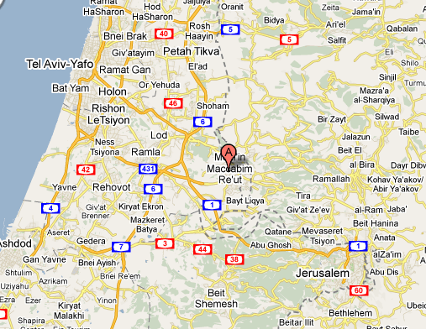
Notes:
Hwy 1 also called Shaar haGai
גַּיְא שער ה‎ or באב אל-ואד Bab El Wad
Matthias family sometimes → Jerus
One day though they were shocked to find that the Temple gold leaf had been ripped from the walls, the tapestries torn down, all plundered and sold for profit by the Syrians. Upon the Jewish altar they had build an altar to the Greek god, Zeus.
Syrian officers came to Modin. 166 BCE

Slide 77
^{1 Macabees 2.15-28} The king's officers... came into the city Modin, to make them sacrifice. And when many of Israel came unto them, Mattathias also and his sons came together.
Notes:
ie sacrifice a pig
from Apocrypha: additional ancient Jewish books, NOT Scripture
This one in Heb orig, Greek surviving

Slide 78
^{1 Macabees 2.15-28} Then answered the king's officers, and said to Mattathias on this wise, You are a ruler, and an honorable and great man in this city, and strengthened with sons and brethren: Now therefore come first, and fulfill the king's command, like as all the heathen have done,

Slide 79
^{1 Macabees 2.15-28} and the men of Judah also, and such as remain at Jerusalem: so shall you and thy thy house be in the number of the king's friends, and you and your children shall be honored with silver and gold, and many rewards.

Slide 80
^{1 Macabees 2.15-28} Then Mattathias answered and spake with a loud voice, Though all the nations that are under the king's dominion obey him, and fall away every one from the religion of their fathers, and give consent to his commandments: Yet will I and my sons and my brethren walk in the covenant of our fathers.
Notes:
Us also. Purpose of Messianic Judaism is COVENANT
He could have just gotten by.

Slide 81
^{1 Macabees 2.15-28} God forbid that we should forsake the law and the ordinances. We will not hearken to the king's words, to go from our religion, either on the right hand, or the left. Now when he had left speaking these words,

Slide 82
^{1 Macabees 2.15-28} there came one of the Jews in the sight of all to sacrifice on the altar which was at Modin, according to the king's commandment.
Notes:
Compliant.
What can it hurt?
Let’s don’t make trouble. Ralph Beren Jewish humor there were these two Jewish men standing before a firing squad in Czarist Russia. Their crime? Being Jewish. So the Cossack captain [Ive forgiven Cossack, Poles] heading the firing squad looks at Abie and Yankele and shouts, “Jews, take off your hats.” Abie takes off his hat. But Yankele says, “No, I won’t take off my hat.” So Abie leans over to Yankele and whispers, “Yankele, don’t make trouble.”

Slide 83
^{1 Macabees 2.15-28} Which thing when Mattathias saw, he was inflamed with zeal, and his reins trembled, neither could he forbear to show his anger according to judgment: wherefore he ran, and slew him upon the altar.

Slide 84
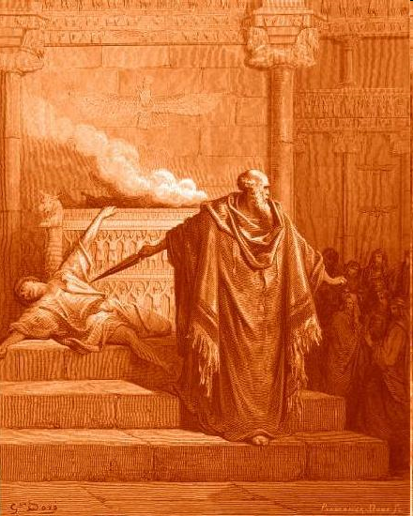
Notes:
Best photo we have sepia
This guy was about to sacrifice a pig on the altar.

Slide 85
^{1 Macabees 2.15-28} Also the king's commissioner, who compelled men to sacrifice, he killed at that time, and the altar he pulled down. And Mattathias cried throughout the city with a loud voice, saying, Whosoever is

Slide 86
^{1 Macabees 2.15-28} zealous of the law, and maintaining the covenant, let him follow me. So he and his sons fled into the mountains, and left all that ever they had in the city.
Notes:
That’s the question yet today, slightly amplified. Who is zealous for scripture, and the covenant of death and resurrection of the Messiah, follow me!
Who wants to just do minimums: prayer, service, giving, caring.

Slide 87
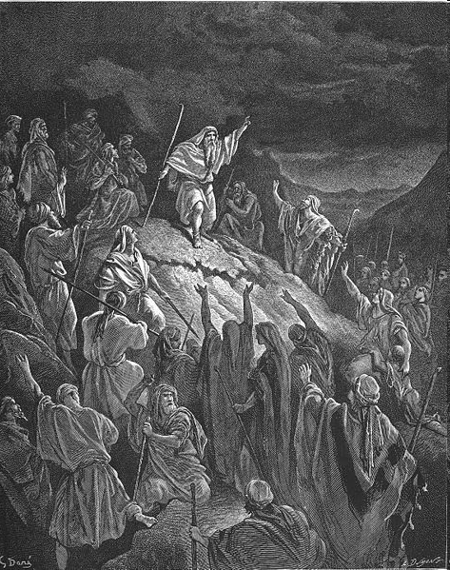
Mattathias exhorts the mountain
hidden Jewish refugees
Notes:
Tremendously outnumbered, weapons inferior.
Just had to do what was right.

Slide 88
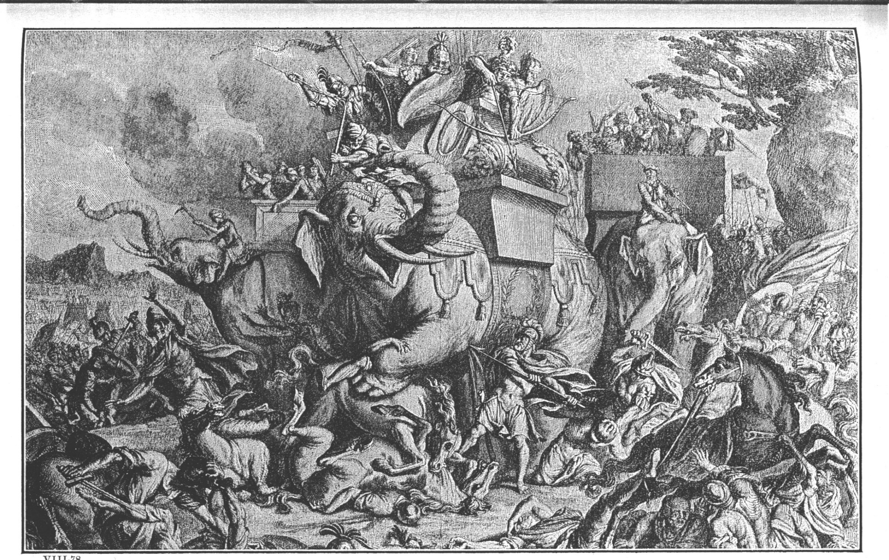
Elazar 162 BCE

Slide 89
Lysias, the commander-in-chief of the Seleucid army, along with 60,000 infantrymen and 5000 cavalry, encountered Judah, who had a force of only 3000 poorly equipped rebels, in the town of Emmaus, 7 miles from Jerusalem.

Slide 90
Judah managed to gather together another 7000 rebels. He prayed to God for strength and deliverance ^{(I Maccabees 4:30-33)}, and God answered!
Notes:
Judah then determined to enter Jerusalem and liberate the city, and also to purify the Temple
166 to 164 to liberate Jerusalem
Liberation Jerusalem, cleansed the Temple. Enacted Holiday ~Sukkot
That’s what Hanukkah is about. Military victory. Eight days of oil lamp later recorded. May be true, not really essential.
Ever other situations like that?

Slide 91
^{Dan. 11.35} the people who know their God will stand firm and prevail. Those among the people who have discernment will cause the rest of the people to understand.
Notes:
Wisdom. Likely first guerilla warfare in history.
What opposition do you face? What will be the price for us to maintain worship. How are we dedicated to the living God?

Slide 92
If there had been no Hanukkah, there would be no Messiah’s Birth or Birthday. Knowledge of God, through the Bible, would have been lost.
Redemption, salvation, would not have happened as we know it.

Slide 93
Put themes together:
Do more than required
Have the garment of righteousness = Messiah.
Much spiritual activity between Malakhi and Yokhanan.
Hanukkah is a time of WHOLEHEARTED dedication
Notes:
Caring, giving, building

Slide 94
Judah and the Macabbes did MORE than required. They didn’t just survive, they reconstituted the Hebrew nation and worship!
They did it in the ‘fog of war’
Zeal, boldness of the Ruakh
Faith against all odds

Slide 95
We are a people in Hanukkah mode.

Slide 96
Do we look for ways to serve, beyond the minimums?
Look for people to visit with or cluster with our friends?
Is wedding garment, the flame of G-d’s presence real in your life, so that death is not dreadful?
Notes:
I got a sneak preview of the Hanukkah drama. It’s amazing. Vicki and cast really worked this hard. Way above and beyond the call of duty. Lawncare! Menorah
Invite friends, Jewish friends. Bring LOTS of food.
Spiritual taker or giver. Prayer, Ruakh. We are fighting against a culture, for survival.

