Slide 1
To easily follow these notes, log on to our Wifi
Wifi: mycci01
p/w: ancientquail060
Go to OrHaOlam.com
Click on downloads, messages, 2017

Slide 2
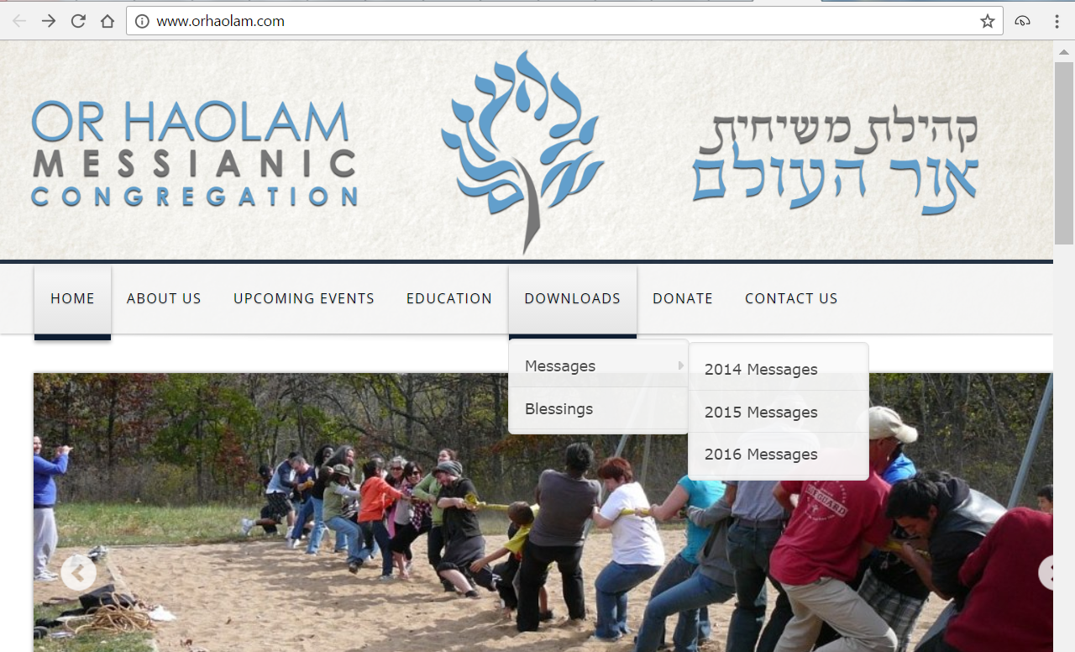
Notes:
Sukkot campout ~2012

Slide 3
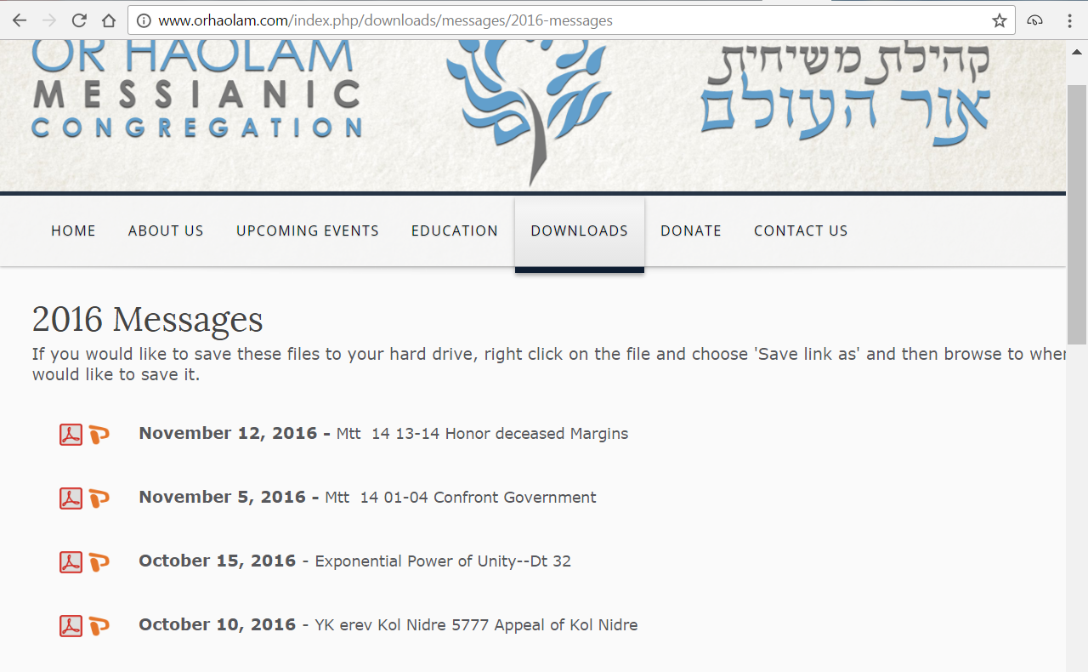
Notes:
This one should be the only one for 2017.
Before we forget about Hanukkah, I want to deeply thank...
Rabbi’s Conf taught us a new way to light the Hanukkah Menorah

Slide 4
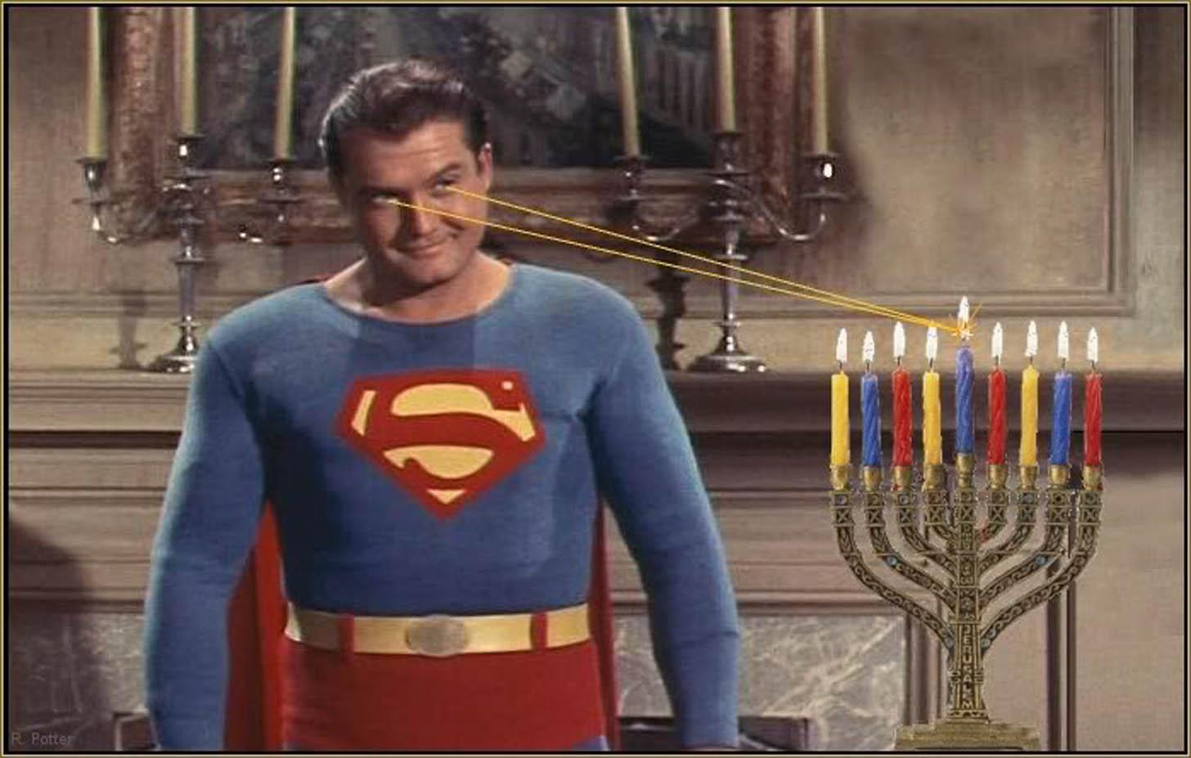
Notes:
Transition: Serious and gripping story that illustrates the message.

Slide 5
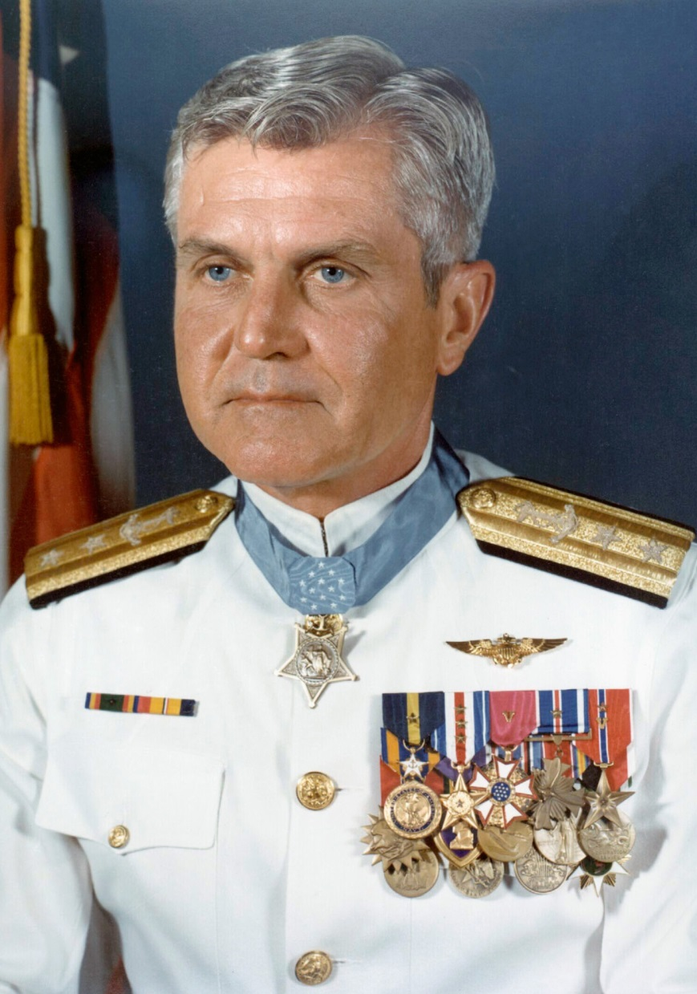
Rear Admiral
James Stockdale in
full dress white
uniform
Dec. 23, 1923 – July 5, 2005

Slide 6
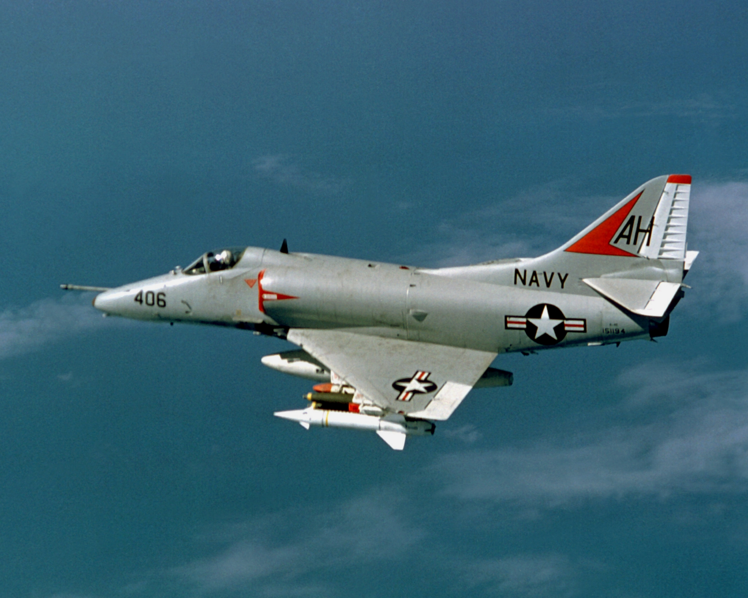
Douglas A-4 Skyhawk
Notes:
Vietnam era fighter / bomber, top speed of more than 670 miles per hour (1,080 km/h). The aircraft's five hardpoints support a variety of missiles, bombs and other munitions. It was capable of carrying a bomb load equivalent to that of a World War II-era Boeing B-17 bomber, and could deliver nuclear weapons. Skyhawks played key roles in the Vietnam War
https://en.wikipedia.org/wiki/Douglas_A-4_Skyhawk

Slide 7
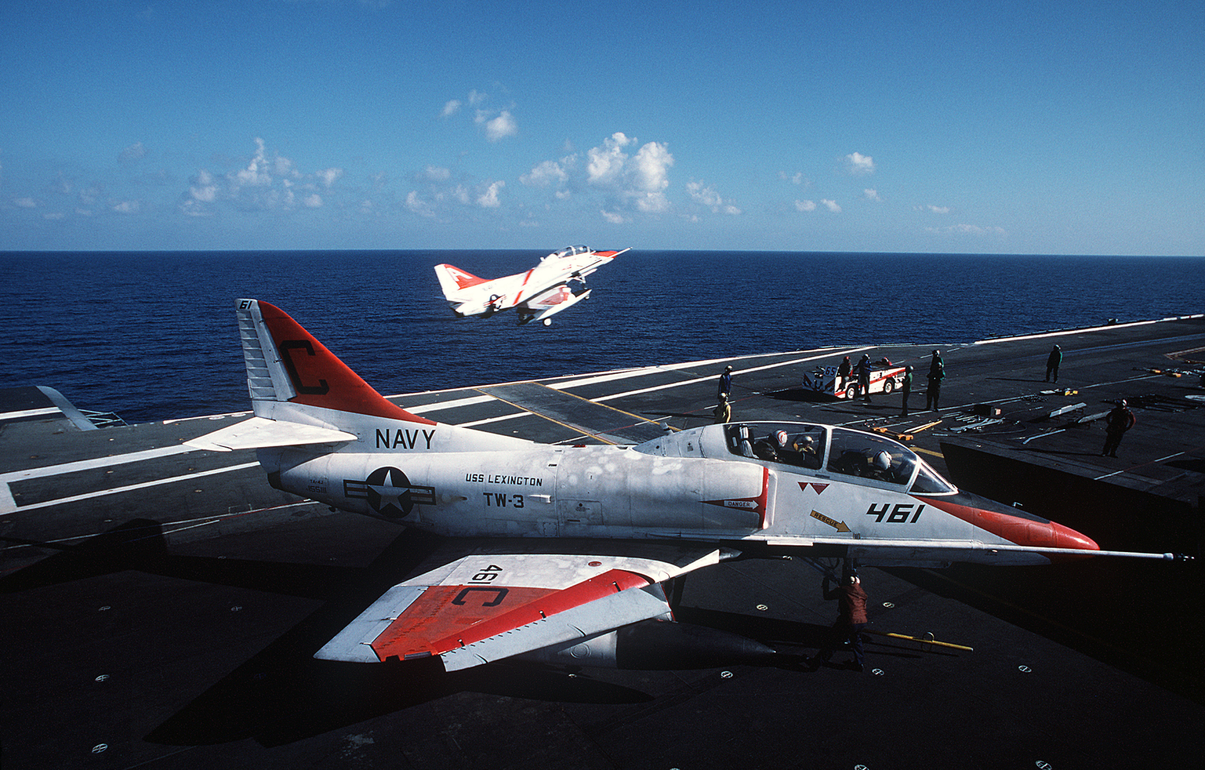
A U.S. Navy A-4 Skyhawk
on the deck of USS Lexington
Notes:
https://en.wikipedia.org/wiki/Douglas_A-4_Skyhawk
Jan Fields used to be that flight deck officer

Slide 8
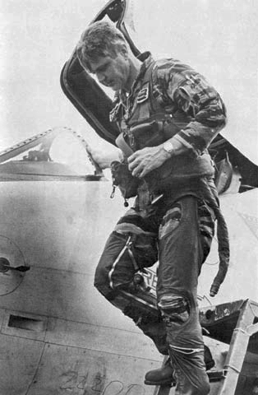
Stockdale exiting his A-4
fighter-bomber weeks before
becoming a POW on Sept. 9, 1965
Notes:
https://en.wikipedia.org/wiki/James_Stockdale
On 9 September 1965, while flying from USS Oriskany on a mission over North Vietnam, Stockdale ejected from his Douglas A-4 Skyhawk, which had been struck by enemy fire and completely disabled. He parachuted into a small village, where he was severely beaten and taken prisoner.

Slide 9
Stockdale was held as a prisoner of war in the Hoa Lo prison (the infamous "Hanoi Hilton") for the next seven and a half years. As the senior Naval officer, he was one of the primary organizers of prisoner resistance. Tortured routinely and denied medical attention.
Notes:
https://en.wikipedia.org/wiki/James_Stockdale

Slide 10
Stockdale created and enforced a code of conduct for all prisoners which governed torture, secret communications, and behavior. In the summer of 1969, [4 years POW] he was locked in leg irons in a bath stall and routinely tortured and beaten.
Notes:
https://en.wikipedia.org/wiki/James_Stockdale

Slide 11
When told by his captors that he was to be paraded in public, Stockdale slit his scalp with a razor to purposely disfigure himself so that his captors could not use him as propaganda. When they covered his head with a hat,
Notes:
https://en.wikipedia.org/wiki/James_Stockdale

Slide 12
he beat himself with a stool until his face was swollen beyond recognition. When Stockdale was discovered with information that could implicate his friends' "black activities", he slit his wrists so they could not torture him into confession.
Notes:
https://en.wikipedia.org/wiki/James_Stockdale

Slide 13
Stockdale was released as a prisoner of war on February 12, 1973 during Operation Homecoming. His shoulders had been wrenched from their sockets, his leg shattered by angry villagers and a torturer,
Notes:
https://en.wikipedia.org/wiki/James_Stockdale

Slide 14
and his back broken. On March 4, 1976, Stockdale received the Medal of Honor.

Slide 15
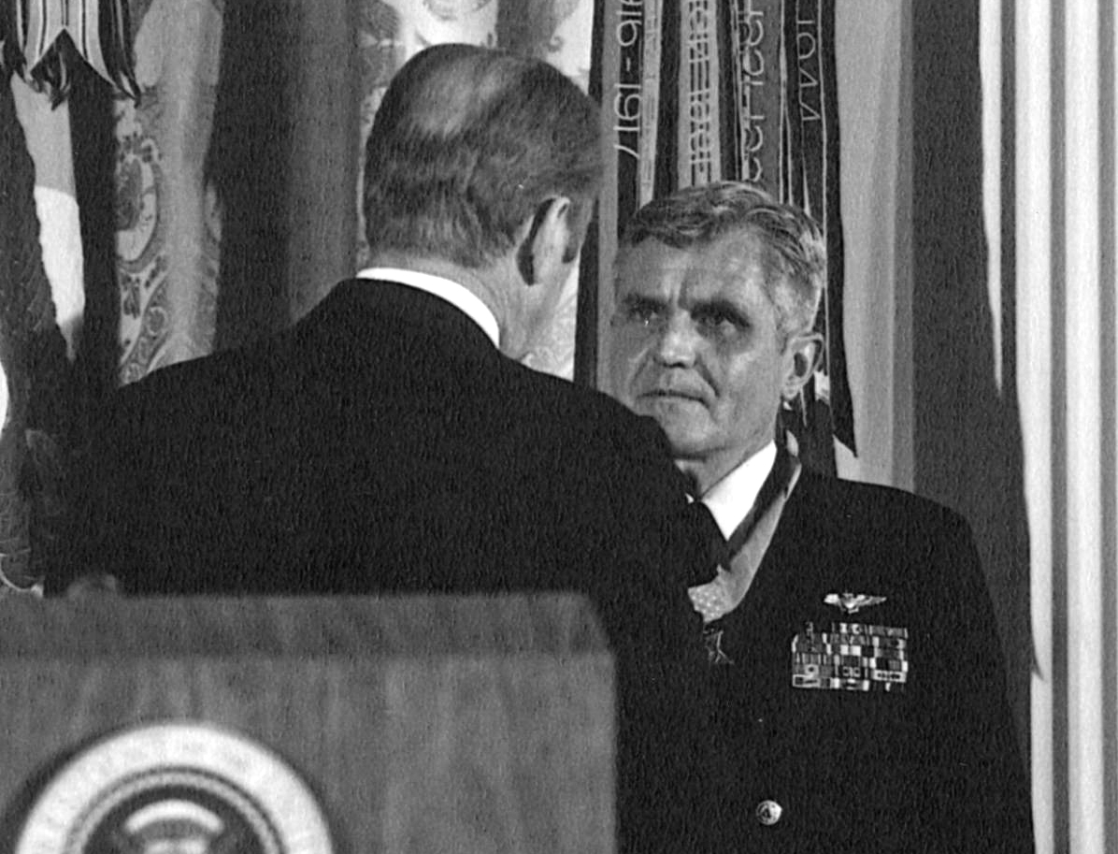
Pres. Gerald Ford presents
the Medal of Honor to
Stockdale at the White House
on 4 March 1976.
Notes:
A real American hero.

Slide 16
In a business book by James C. Collins called Good to Great, there is a conversation with Stockdale.
“I never doubted not only that I would get out, but also that I would prevail in the end and turn the experience into the defining event of my life, which, in retrospect, I would not trade.”
Notes:
http://ndoherty.com/stockdale-paradox/
Never doubted his future. Faith?

Slide 17
Stockdale Paradox
When Collins asked who didn't make it out of Vietnam, Stockdale replied:
Oh, that's easy, the optimists. Oh, they were the ones who said, 'We're going to be out by Christmas.' And Christmas would come, and Christmas would go.
Notes:
http://ndoherty.com/stockdale-paradox/

Slide 18
Stockdale Paradox
Then they'd say, 'We're going to be out by Easter.' And Easter would come, and Easter would go. And then Thanksgiving, and then it would be Christmas again. And they died of a broken heart.
Notes:
http://ndoherty.com/stockdale-paradox/

Slide 19
Stockdale then added:
This is a very important lesson. You must never confuse faith that you will prevail in the end—which you can never afford to lose—with the discipline to confront the most brutal facts of your current reality, whatever they might be.
Notes:
http://ndoherty.com/stockdale-paradox/
Lots applications here: faith in the face of reality. Not a gloss on reality. Faith in his destiny, his calling. Our calling?

Slide 20
Did Yeshua have a “faith that [he] will prevail in the end,” despite the “most brutal facts”?
Prophet Yeshayahu/Isaiah…

Slide 21
^{Yeshayahu/Is 50.6-7} I offered my back to those who struck me, my cheeks to those who plucked out my beard; I did not hide my face from insult and spitting. For Adonai Elohim will help. This is why no insult can wound me

Slide 22
^{Yeshayahu/Is 50.6-7} This is why I have set my face like flint, knowing I will not be put to shame.
Notes:
faith in the face of reality

Slide 23
^{Lk 9.51} Now it came to pass, when the time had come for Him to be received up, that He steadfastly set His face to go to Jerusalem.

Slide 24
^{Mes Jews/Heb 12.1-2} Let us also get rid of every weight and entangling sin. Let us run with endurance the race set before us, focusing on Yeshua, the initiator and perfecter of faith.

Slide 25
^{Mes Jews/Heb 12.1-2} For the joy set before Him, He endured the execution on a stake as a criminal, disregarding its shame; and He has taken His seat at the right hand of the throne of God

Slide 26
Where are our faces set?
“faith that will prevail in the end,” despite the “most brutal facts”?
What is our congregational vision?
Not visions → division.
Why are we here?
Where are we going, or trying to go?
Notes:
Divided vision can work for a while in synergy and mentoring, but ultimately we must bless and release you to follow your vision/calling.
Not that we’re getting there so quickly, or apparently at all. But believing, trusting, purposing!
‘faith in the face of reality’
What about your specific call, hopefully within the congregational vision I’m about to articulate.

Slide 27
Important to take inventory. End of every year businesses used to close for several days for any sales.
Notes:
Maybe now computerized inventory and scanners. Still have to somehow physically count.
We need to account, spiritual inventory.

Slide 28


Slide 29
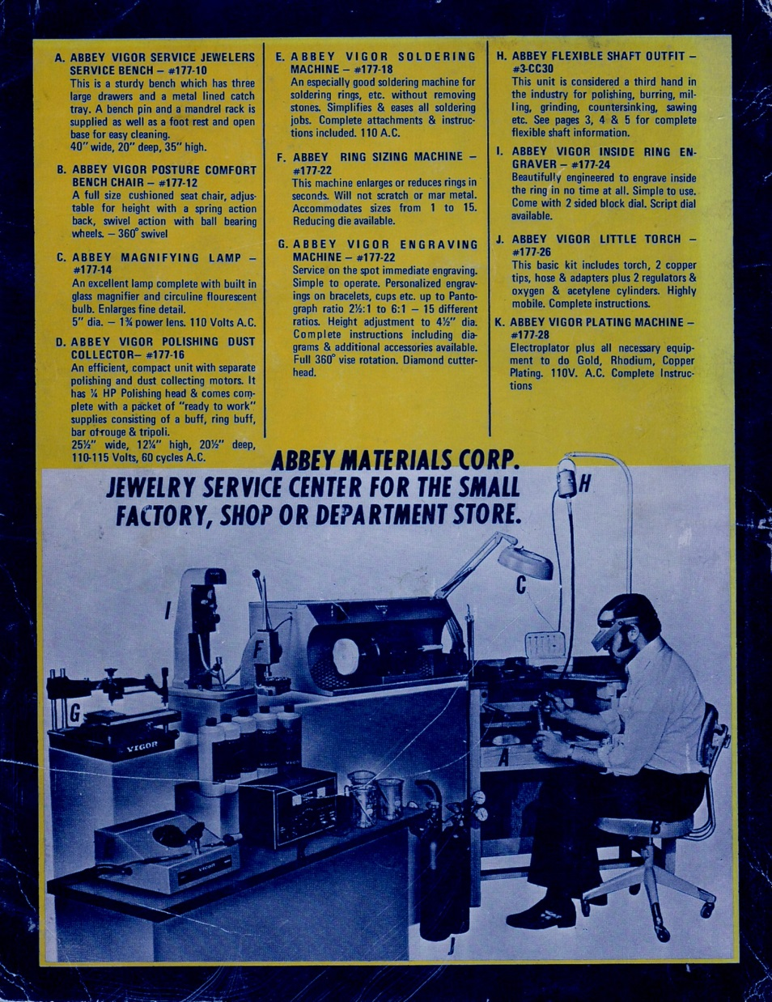

Slide 30
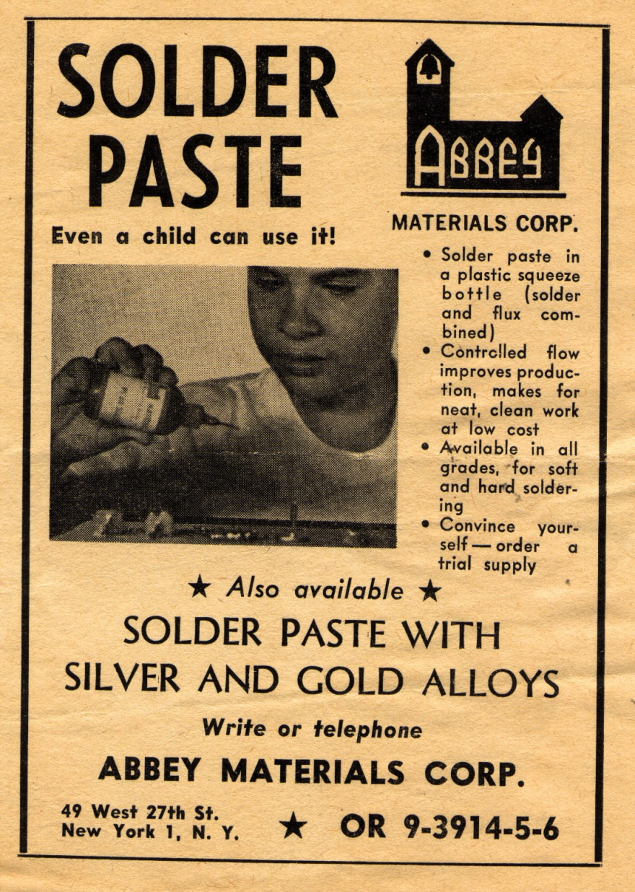

Slide 31
for several days count every tweezer, file, buffing wheel, machine, chemical…etc.
Or HaOlamnik inventory…

Slide 32
Where are our faces set?
“faith that will prevail in the end,” despite the “most brutal facts”?
What is our congregational vision?
Not visions → division.
Why are we here?
Where are we going, or trying to go?

Slide 33
Working to bring Jewish people, and those grafted in, to their covenantal identity in Messiah. Implies:
Salvation through the Atonement of the Messiah. Personal faith in the atoning death and resurrection of Yeshua. It’s all about the King.
Notes:
This is where my face is set. Not just cerebral affirmation, but personal...

Slide 34
^{Mes Jews/Heb 6.19-20} We have this hope as an anchor of the soul, both firm and steady—a hope that enters the inner place behind the curtain. Yeshua has entered there as a forerunner on our behalf, having become Kohen Gadol “forever, according to the order of Melchizedek.”

Slide 35
^{Mes Jews/Heb 7.25} Therefore He is also able to save completely those who draw near to God through Him, always living to make intercession for them.
Notes:
Maybe you have sins, anger, porn...Can be forgiven and cleansed!! Family issues, emotional issues, bitterness. By confession to G-d, search the Word for wisdom, confession to people/mentors. Sozo, Life Model, marriage helps, etc.

Slide 36
Covenantal identity of Jewish people, not replacement;
Restoration to Torah lifestyle;
Restoration/survival of the nation of Israel.
Notes:
Jews and Nations one in Messiah: art, this building as expression. Logo in front soon!
Liturgy, holidays, dance, Shabbat, food
Prayer on Tues. About Jan 15 Paris Conf.

Slide 37
[Covenantal identity, so Jewish believers don’t assimilate. ^{Ro 11.15} For if their casting Yeshua aside means reconciliation for the world, what will their accepting him mean? It will be life from the dead!]
Notes:
That is, our success in sharing LIFE in Messiah with our Jewish people will have a dynamic to change all peoples!!
Spin off effects on every ill in society. Life from the dead. We are doing the MOST important work, if we are building the Kingdom in Israel and the Nations.

Slide 38
Stockdale:
Faith that you will prevail in the end — which you can never afford to lose
Notes:
Is G calling you the be part, whether Jewish or of the Nations, part of the spiritual restoration of Israel!!
At the Rabbi’s Conf...

Slide 39
Make Messianic Judaism great again!
Started as a revival movement among 1000’s youth.
Pioneers = halutzim חלוצים warriors
Notes:
Something really radical I had heard of, but much more at Conference.
I need to do some name dropping of our leaders. Many of you will recognize names. If not, check them out, or take my word for it.

Slide 40
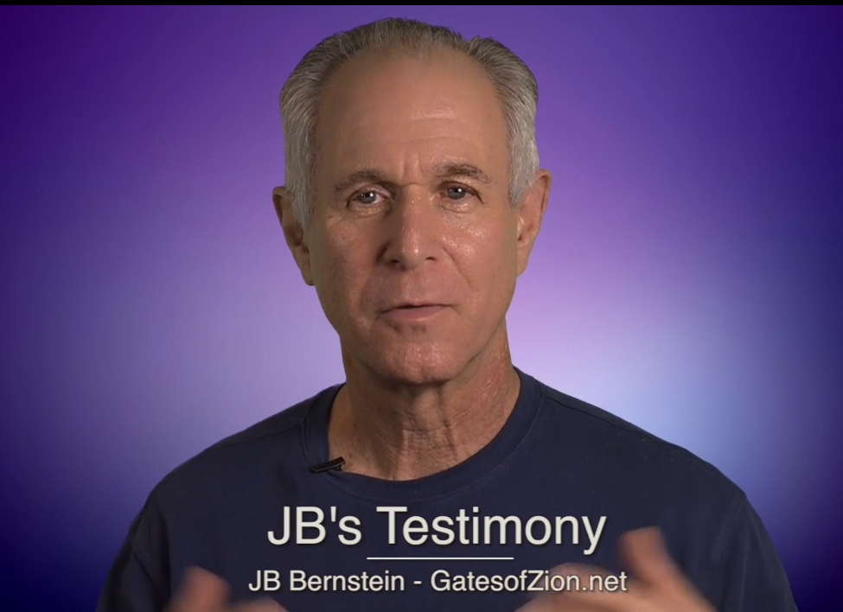
Notes:
http://www.gatesofzion.net/new
Jeff Bernstein, has spoken here some years ago.

Slide 41
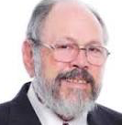
I have known Jeff
Bernstein for over 30
years. I know of no one
who shares a deeper
passion for our people, the Jewish people to come into a saving relationship to the Messiah Yeshua.
Notes:
http://www.gatesofzion.net/content.cfm?id=9027
Dan Juster, leading theologian and spokesman for the Messianic movement. Many profound & powerful books.

Slide 42
JB's understanding of
our people and how to communicate the
message of Messiah with them
is brilliant. He is very perceptive at effective outreach.
Notes:
http://www.gatesofzion.net/content.cfm?id=9027
Fasten your seatbelts for what comes next. Fulfilling vision of Or HaOlam, but hazards.

Slide 43
Amazing things are happening through Jeff Bernstein. Up to 5 Jewish salvations / day at Judah Hungerman's cong in Sarasota, FL. But, deficient in discipleship. Stewart Winograd is working with them.
Notes:
https://bethmessiahfla.com/index.php?submenu=home&src=
And other places.
Stewart most of you know is on our Board of Directors, and in the fivefold Ephesian model of leadership, is our ‘Apostle’ Doesn’t like the term, too grandiose. Breakthrough guy: Minsk, Holocaust Survivors, Israeli trekkies in Himalayas. Knows Bernstein well for many years. Willing to help us see this happen here, but not overwhelmingly.
If we have one/ year it’s wonderful.

Slide 44
Stewart is willing to work this at Or HaOlam. Jonathan Bernis also connected Hungerman's to Peter van der Steur to help develop Jewish discipleship materials. I spoke to Jeff extensively by phone. I think great things are coming our way.

Slide 45
Make Messianic Judaism great again!
Started as a revival movement among 1000’s youth.
Pioneers = halutzim חלוצים warriors

Slide 46
Working to bring Jewish people, and those grafted in, to their covenantal identity in Messiah. Implies:
Salvation through the Atonement of the Messiah. Personal faith in the atoning death and resurrection of Yeshua. It’s all about the King.

Slide 47
As Matityahu, the founder of the Macabbes proclaimed, ‘He that is for G-d and for the covenant, follow me.’
Hearts open for renewal, revival, outreach?

