Slide 1
To easily follow these notes, log on to our Wifi
Wifi: mycci01
p/w: ancientquail060
Go to OrHaOlam.com
Click on downloads, messages, 2017

Slide 2
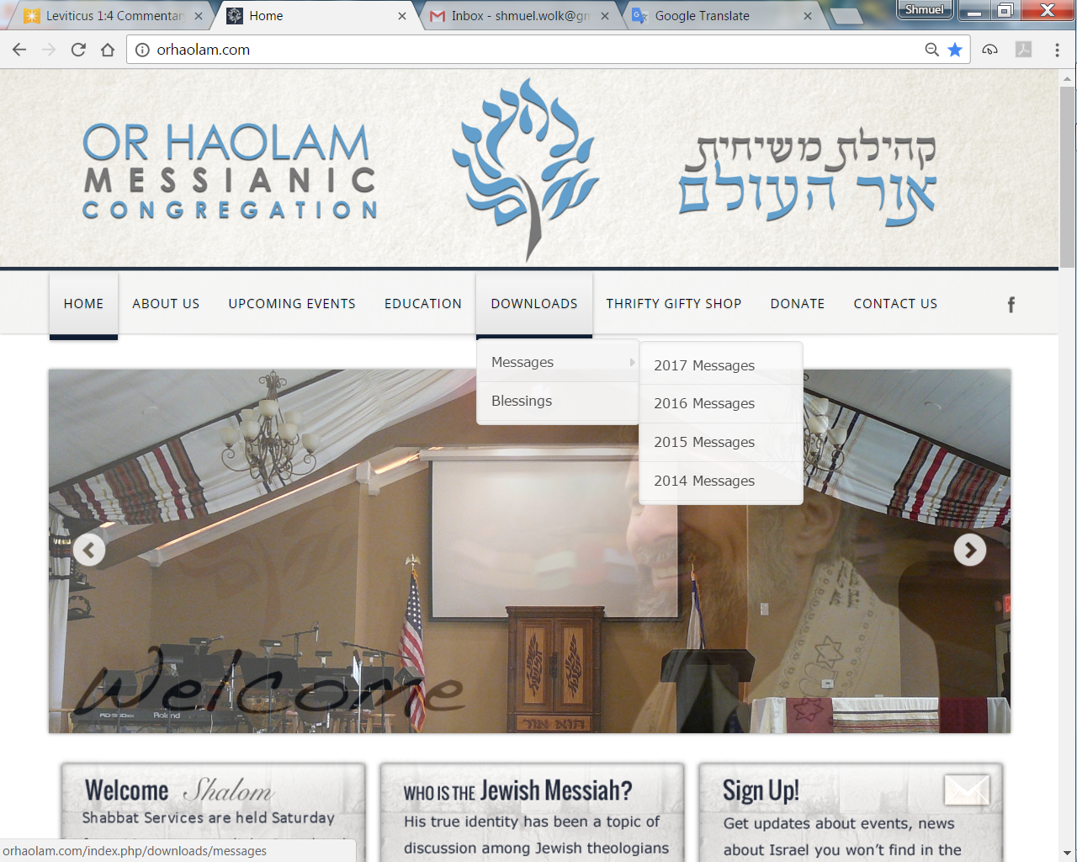
Downloads\messages\
2017 Messages

Slide 3
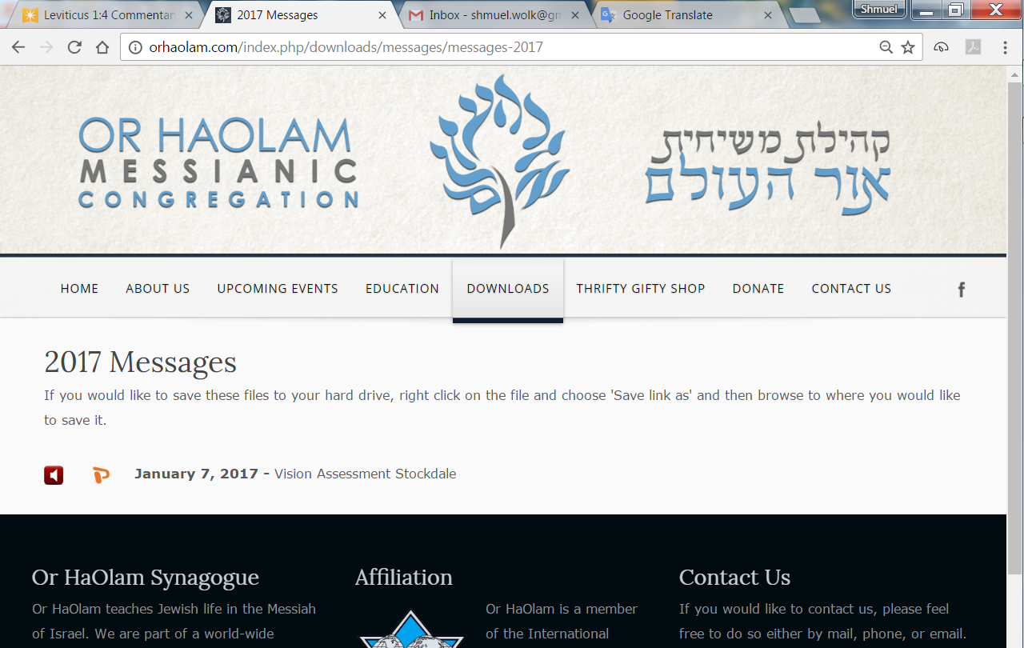

Slide 4

Why do Jedi's like Fake News?
They like wishing everyone “May the farce
be with you!"
Cassie Maslowski

Slide 5


Slide 6
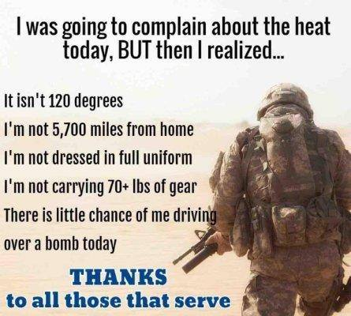

Slide 7
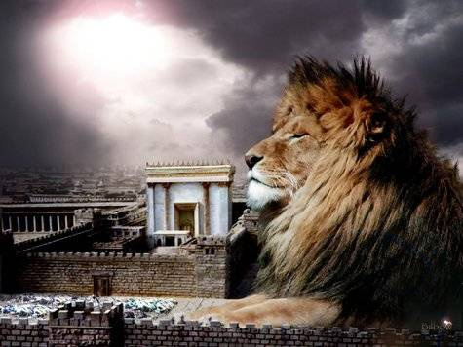
מַתִּתְיָהוּ Mattityahu
(Matthew) 16:18-20
Notes:
Last week we considered...What?
Divine Messiah. Kefa/Peter’s revelation of that reality.

Slide 8
Mattityahu (Matthew) 16:18
וְגַם אֲנִי אוֹמֵר לְךָ כִּי אַתָּה כֵּיפָא וְעַל הַצּוּר הַזֶּה אֶבְנֶה אֶת קְהִלָּתִי
I also tell you this: you are Kefa," [which means 'Rock,'] "and on this rock I will build my Community,
Notes:
Some relations to rock and Kefa. What?

Slide 9
He was given this as a nickname by Yeshua,
^{Yn 1.42} Looking at him, Yeshua said, “You are Shim‘on Bar-Yochanan; you will be known as Kefa. (The name means “rock.”)”
Why given? Not a common name.
Notes:
Without א in Hebrew rocks
Jeremiah 4:29 HEB: וּבַכֵּפִ֖ים עָל֑וּ NAS: and climb among the rocks;

Slide 10
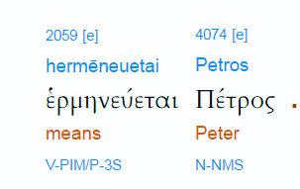
Yn 1.42
Notes:
http://biblehub.com/interlinear/john/1.htm

Slide 11
He [Peter] is also the "Apostle of the Apostles", an honor 3rd-century theologian Hippolytus of Rome gave him, and first pope of the Roman Catholic Church, ordained according to Catholic teaching by Yeshua in the "Rock of My Church" dialogue in Matthew 16:18 Really?
Notes:
https://en.wikipedia.org/wiki/Saint_Peter

Slide 12
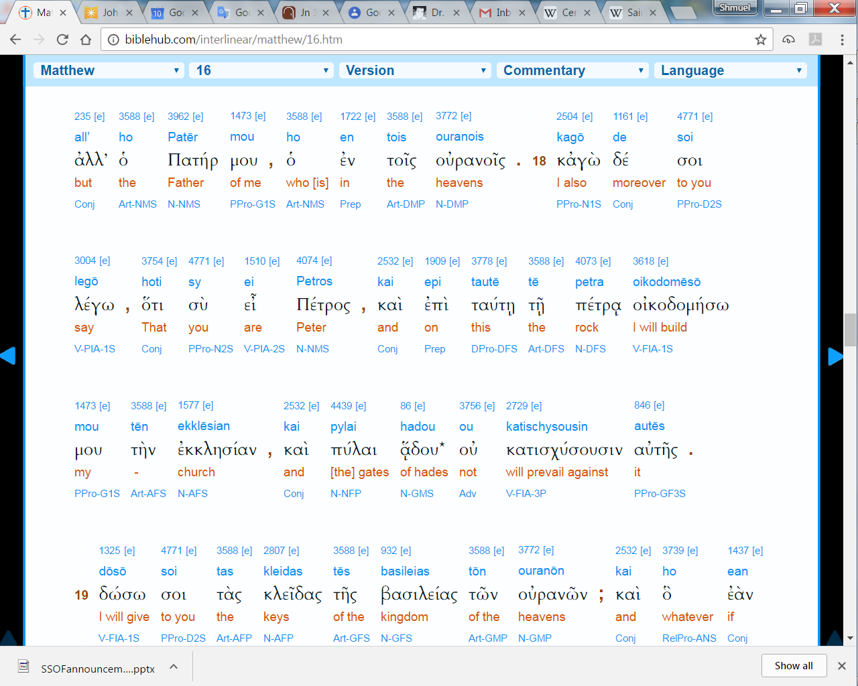
Note: petros and petra

Slide 13
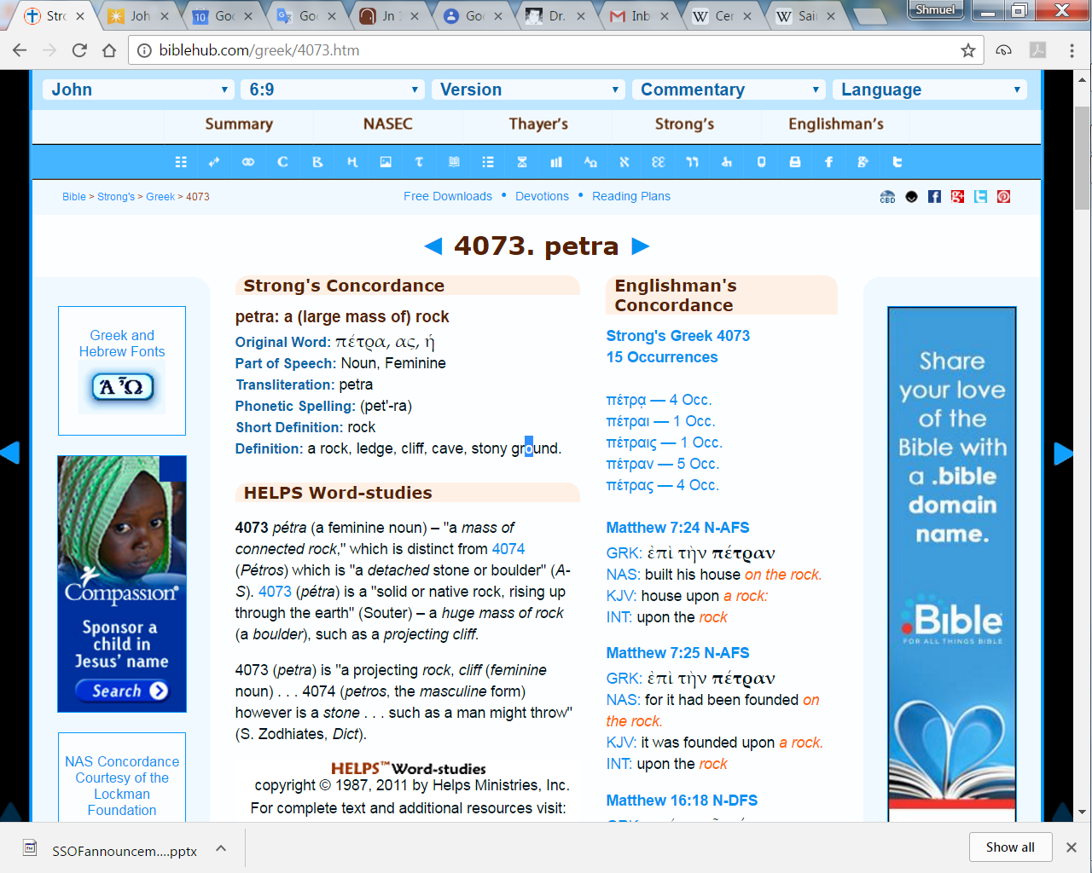
Significant difference masculine
& feminine form of Peter

Slide 14
Kefa is not the absolute rock, but his confession of the divine Messiah does make him a stalwart.

Slide 15
Prominent leader
^{1 Cor 1.12} I say this because one of you says, “I follow Sha’ul”; another says, “I follow Apollos”; another, “I follow Kefa”; while still another says, “I follow the Messiah!”

Slide 16
^{Gal. 2.9} Ya‘akov, Kefa and Yochanan, the acknowledged pillars of the community,
^{1 Kefa/Pet 1.1} From: Kefa, an emissary of Yeshua the Messiah

Slide 17
^{Eph.2.20} You have been built on the foundation of the emissaries and the prophets, with the cornerstone being Yeshua the Messiah himself.
Notes:
A cornerstone of a building is an important part of construction as it is the first stone to be set and determines the position of all the pieces to be laid afterwards. Cornerstones have been part of building since the Great Pyramids.

Slide 18
^{Yesha/Is 51.1-2} “Listen to me, you pursuers of justice, you who seek Adoni: consider the rock from which you were cut, the quarry from which you were dug — consider Avraham your father

Slide 19
Human leaders are foundational:
^{1 Cor. 11.1} Try to imitate me, even as I myself try to imitate the Messiah.
My integrity, your integrity is our foundational inventory.
Notes:
Google on «Fallen Evangelical leaders» the list is rife. Some may be media accusations, but right in this city are some notable disasters: crash and burn.

Slide 20
Mattityahu (Matthew) 16:18
וְגַם אֲנִי אוֹמֵר לְךָ כִּי אַתָּה כֵּיפָא וְעַל הַצּוּר הַזֶּה אֶבְנֶה אֶת קְהִלָּתִי
I also tell you this: you are Kefa," [which means 'Rock,'] "and on this rock I will build my Community. [?]
Implies kingdom delay
Notes:
Essenses were very apocalyptic, yet had this self description.,

Slide 21
God expects us to be in submission to an eldership to whom were are accountable so that we might be taught and grow into the likeness of the Messiah. I know of no one who professes faith who has ever gotten very far in this without congregational life. For in the ups and downs of life together in a congregation,
Notes:
Asher Intrater
http://reviveisrael.org/i-do-not-need-to-be-in-a-congregation/

Slide 22
in forgiving, submitting, and serving, we grow. We need congregational life to fulfill the Biblical demand to be conformed to Yeshua. We need congregation to grow in character. We need a congregation to grown in our exercise of the gifts of the Spirit .We need a congregation to bring regular corporate worship before God.
Notes:
Asher Intrater
http://reviveisrael.org/i-do-not-need-to-be-in-a-congregation/

Slide 23
This is both our responsibility as part of his corporate Temple and as part of intercessory responsibility as his priesthood. We need a congregation so we might be taught and mentored by those who have attained what we have not yet attained. This includes everything from marriage and family life, to personal devotion. Plus, the Bible says that God has given five kinds of gifted people, apostles, prophets, evangelists, pastors and teachers to equip us for the work of
Notes:
Asher Intrater
http://reviveisrael.org/i-do-not-need-to-be-in-a-congregation/

Slide 24
ministry (Eph. 4:11ff). But they cannot equip us if we are not in congressional life and submitted to their gifting to equip us. We need a congregation to fulfill God’s command and to walk in the fear of God and to be assured of his blessing. If we are in known disobedience here, we cannot expect His blessing on our lives.
Notes:
Asher Intrater
http://reviveisrael.org/i-do-not-need-to-be-in-a-congregation/

Slide 25
There is another application to a significant issue of Messianic identity
Theological / covenantal issue inside the wrapper of terminology
approach presenting truth
apply with forgiveness and love
terminology?
Identity

Slide 26
Two Hebrew words for community or gathering, or us, here in this room, and universal:
עֵדָה Edah community
קָהָל Kahal congregation, gathering of the community

Slide 27
into LXX Greek Septuagint: Hebrew content in Greek packaging
עֵדָה Edah is usually translated sunagoge [synagogue]
קָהָל Kahal usually ekklesia [congregation, community, church?]

Slide 28
no major difference in the words
no particularly Jewish connotation to sunagoge עֵדָה Edah
no particularly non-Jewish connotaion to קָהָל Kahal usually ekklesia [congregation, community, church?]

Slide 29
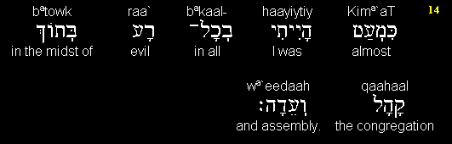
Prov 5.14
I was almost in all evil in the midst of the congregation and assembly.
Notes:
parallelism

Slide 30

Nu 1.18

Slide 31
^{Beresheet/Gen 1.9} Let the waters below the heaven be gathered /sunagogen
^{Matityahu 13.47} The Kingdom of Heaven is like a net thrown into the lake, that gathered/sunagogen all kinds of fish.

Slide 32
^{Acts 7.38} the assembly/ekklesia in the wilderness, accompanied by the angel that had spoken to him at Mount Sinai
^{Yaakov 2.2} Suppose a man comes into your synagogue wearing gold rings and fancy clothes
^{Yaakov 5.14} Is someone among you ill? He should call for the elders of the congregation.

Slide 33
English packaging of Greek rendering of Hebrew thought:
1525
William Tyndale translates ekklesia as “community”

Slide 34
never uses the word “church”
1535 Luther’s German translation never used the word “church” rather “gemeinde” community

Slide 35
1611 KJV King James of England
head of the Church of England
divine right of kings to rule
gave rules to KJV translators
rule #3 “Ecclesiastical Words to be kept” in stead of the
Notes:
This can be offensive to some. P 66 Copernicus and the Jews, Dan Gruber

Slide 36
“scrupulosity of the Puritans” [Tyndale]
mandated “church” for ekklesia
validates James’ rule over church
Notes:
This can be offensive to some. P 66 Copernicus and the Jews, Dan Gruber

Slide 37
Implications of the word “church”
Is it still just “assembly?”
cf “mosque” substituted ~ alien and foreign concept to Israel
Church Age theology
Notes:
Gruber Copernicus p 68 This is why the word church is just a bit foreign to Jewish believers.

Slide 38
Implications of the word “church”
possibly from Greek
  “kuriakon” house of the L-rd
  not the sense of ekklesia קָהָל Kahal / community or gathering

Slide 39
possibly from Latin kirk / circle, circus, not the sense of ekklesia קָהָל Kahal / community or gathering
concept:
scriptures speak of body of Messiah, commonwealth of Israel,

Slide 40
community of believers in the Jewish Messiah and King
“church” is a group by terminology disconnected from the Jewish people
However, there is one major Jewish directed misuse of the term synagogue...

Slide 41
^{Rev. 3.9} . . .the synagogue of Satan, those who call themselves Jews but aren’t–on the contrary, they are lying – see, I will cause them to come and prostrate themselves at your feet, and they will know that I have loved you.
Notes:
Gruber, 69 «Some church father pointed used these verses to refer to all Jews and incite hatred

Slide 42
^{Rev 2.9} To the angel of the Messianic Community in Smyrna, write: ‘Here is the message from the First and the Last, who died and came alive again: I know how you are suffering and how poor you are (though in fact you are rich!), and I know the insults of those who call

Slide 43
^{Rev 2.9} themselves Jews but aren’t – on the contrary, they are a synagogue of the Adversary.

Slide 44
common, metaphorical interpretation: that Yochanan is talking about Jews who reject Yeshua as the Messiah
literal understanding that these are non-Jews who lie and say they are Jews but in fact are Gentiles.
Notes:
Ephraimites, Hebrew roots.

Slide 45
Metaphorical interpretation gave this verse a virulently anti-Semitic significance.
over the centuries Jews have had the epithet “synagogue of Satan” hurled at them by Christians who thought they understood the Bible.

Slide 46
Conclusion: the kingdom of Messiah is made up of the assembly of
  Jews who’ve received the New Covenant G-d made with Israel and Judah in Jer 31
  non-Jews grafted into this covenant with Israel Ro 11

Slide 47
  word ‘church’ is not a translation of anything in scripture
  word “church” has implications of the government of European kings and bishops, without Jews
Notes:
End of rabbi trail.

Slide 48
Mattityahu (Matthew) 16:18
וְשַׁעֲרֵי שְׁאוֹל לֹא יִגְבְּרוּ עָלֶיהָ.
and the gates of Sh'ol will not overcome it.
Notes:
Sometimes is seems like the gates are. Darkness is resisting the light. Broken families, generational failures.

Slide 49
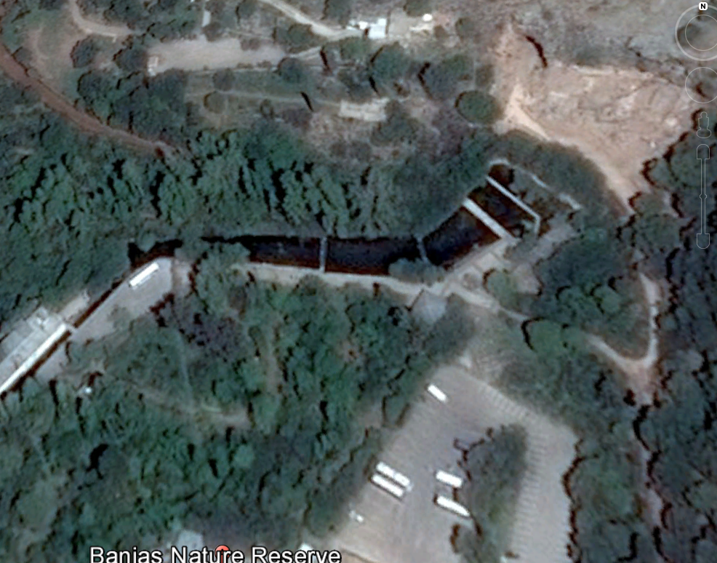
Gates of Hell
Notes:
Google earth
On tour you can walk among these foot bridges. Great place to praise, pray, and picnic!

Slide 50
Mattityahu (Matthew) 16:19
אֶתֵּן לְךָ אֶת מַפְתְּחוֹת מַלְכוּת הַשָּׁמַיִם וְכָל מַה שֶּׁתֶּאֱסֹר עַל הָאָרֶץ יִהְיֶה אָסוּר
בַּשָּׁמַיִם,
I will give you the keys of the Kingdom of Heaven. Whatever you prohibit on earth will be prohibited in heaven, "

Slide 51
Mattityahu (Matthew) 16:19
וְכָל מַה שֶּׁתַּתִּיר עַל הָאָרֶץ יִהְיֶה מֻתָּר בַּשָּׁמַיִם."
and whatever you permit on earth will be permitted in heaven."

Slide 52
Authority
Sanhedrin 5a types of סמיכה.
יורה יורה ידין ידין
Yaroh yaroh yadin yadin
Judging you shall judge and teaching you shall teach
Notes:
http://judaism.stackexchange.com/questions/38703/yoreh-yoreh-vs-yadin-yadin
These two semicha 'tracks' cover different areas of halakah: Yoreh Yoreh covers areas that deal with the day to day questions that rabbis might receive, such as questions on kashrut or taharat hamishpacha. Most programs of Yoreh Yoreh also include study of the laws of Shabbat and Mourning. It's traditionally associated with the second section of Tur/Shulchan Arcuh, "Yoreh Deah".
Yadin Yadin covers the type of knowledge that one would need to adjudicate cases between individuals- either in monetary or marital laws. This is traditionally associated with "Choshen Mishpat" and "Even HaEzer", the areas of Shulchan Aruch that deals with monetary and marital laws, respectively.

Slide 53
^{Ro 8.22-27} We know that until now, the whole creation has been groaning as with the pains of childbirth; and not only it, but we ourselves, who have the firstfruits of the Spirit, groan inwardly as we continue waiting

Slide 54
^{Ro 8.22-27} eagerly to be made sons — that is, to have our whole bodies redeemed and set free. It was in this hope that we were saved...Similarly, the Spirit helps us in our weakness; for we don’t know how to pray the way we should.

Slide 55
^{Ro 8.22-27} But the Spirit himself pleads on our behalf with groanings too deep for words; and the one who searches hearts knows exactly what the Spirit is thinking, because his pleadings for God’s people accord with God’s will.

Slide 56
^{Yeshayahu/Is 66.7-13} Before going into labor, she gave birth; before her pains came, she delivered a male child. Who ever heard of such a thing? Who has ever seen such things? Is a country born in one day? Is a nation brought forth all at once?
Notes:
https://www.thattheworldmayknow.com/gates-of-hell-article

Slide 57
^{Yeshayahu/Is 66.7-13} For as soon as Tziyon went into labor,she brought forth her children. “Would I let the baby break through and not be born?” asks Adonai. “Would I, who cause the birth, shut the womb?” asks your God.
Notes:
https://www.thattheworldmayknow.com/gates-of-hell-article

Slide 58
^{Yeshayahu/Is 66.7-13} Rejoice with Yerushalayim! Be glad with her, all you who love her! Rejoice, rejoice with her, all of you who mourned for her; so that you nurse and are satisfied by her comforting breast,
Notes:
https://www.thattheworldmayknow.com/gates-of-hell-article

Slide 59
^{Yeshayahu/Is 66.7-13} drinking deeply and delighting in the overflow of her glory. For Adonai says, “I will spread shalom over her like a river, and the wealth of nations like a flooding stream;
Notes:
https://www.thattheworldmayknow.com/gates-of-hell-article

Slide 60
^{Yeshayahu/Is 66.7-13} you will nurse and be carried in her arm and cuddled in her lap. Like someone comforted by his mother, I will comfort you; in Yerushalayim
you will be comforted.”
Notes:
https://www.thattheworldmayknow.com/gates-of-hell-article

Slide 61
Mattityahu (Matthew) 16:20
אָז הִזְהִיר אֶת תַּלְמִידָיו שֶׁלֹּא יְסַפְּרוּ לְאִישׁ כִּי הוּא הַמָּשִׁיחַ.
Then he warned the talmidim not to tell anyone that he was the Messiah.
Why? Warfare and death to self, they weren’t ready for.

Slide 62
Are we ready?
Are we the secondary Rock?
Are we part of community?
Do we understand English terminoloy of church?
Are we exercising the authority of the kingdom?
Notes:
https://www.thattheworldmayknow.com/gates-of-hell-article

Slide 63
Mattityahu (Matthew) 16:20
אָז הִזְהִיר אֶת תַּלְמִידָיו שֶׁלֹּא יְסַפְּרוּ לְאִישׁ כִּי הוּא הַמָּשִׁיחַ.
Then he warned the talmidim not to tell anyone that he was the Messiah.
Why? Yeshua gives us TIME: grow, rest, strengthen, work.

Slide 64
Treasures of His glory...
Notes:
https://www.thattheworldmayknow.com/gates-of-hell-article

