Slide 1
To easily follow these notes, log on to our Wifi
Wifi: mycci01
p/w: ancientquail060
Go to OrHaOlam.com
Click on downloads, messages, 2017

Slide 2
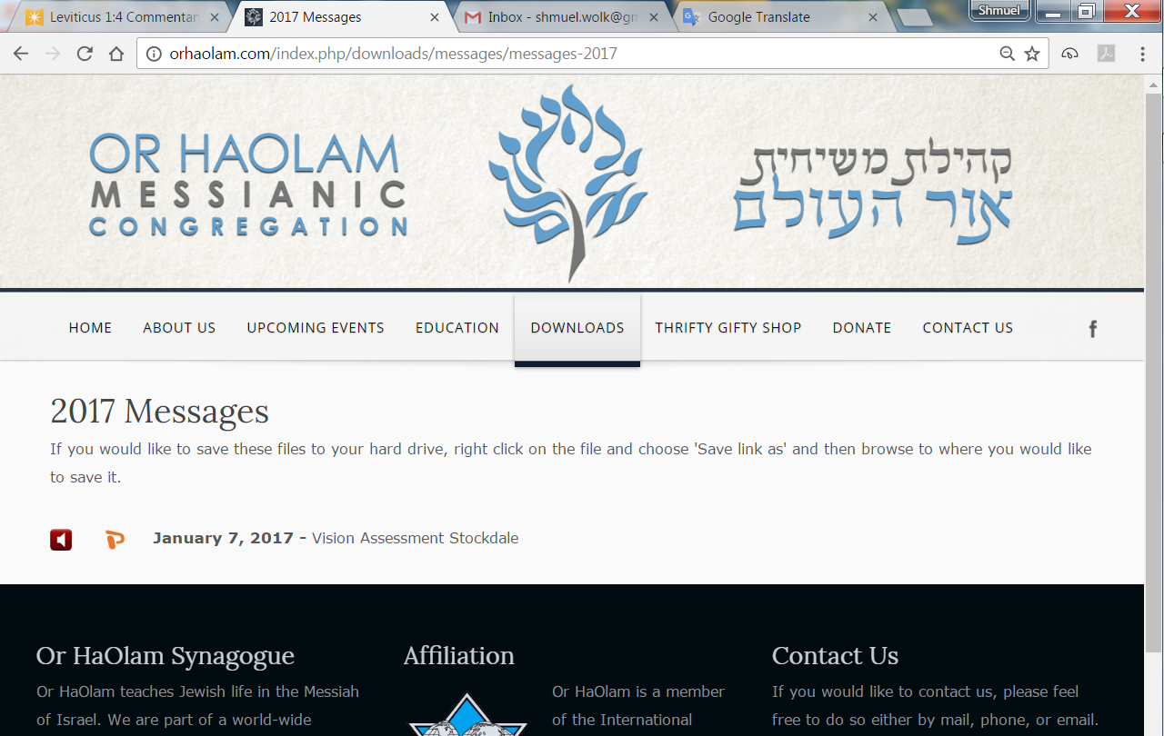

Slide 3
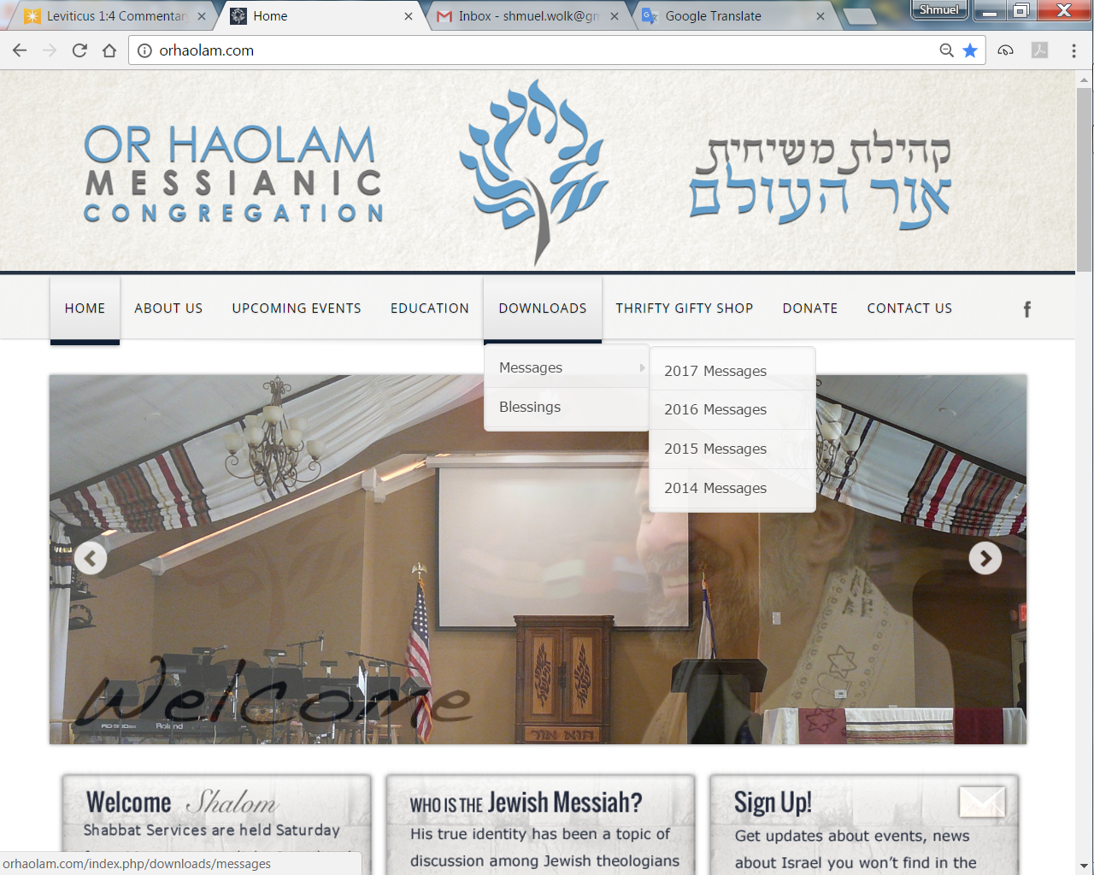
Downloads\messages\
2017 Messages
Notes:
Pres. Trump understands what is truly hindering peace in the Middle East Arab/Israeli sphere.

Slide 4
Trump at joint White House press conference with Netanyahu: Palestinians must stop teaching hate: The Palestinians “have to get rid of some of the hate they are taught from a very young age” before a peace deal with Israel can be reached, USA President Donald Trump said on Wed. 15 Feb. 2017.
Notes:
Barry & Batya Segal (Algemeiner)

Slide 5
“They’re taught tremendous hate,” Trump stated at a joint White House press conference with visiting PM Netanyahu. “I’ve seen what they’re taught. It starts at a very young age and it starts in the schoolroom. They have to acknowledge Israel; they’re going to have to do that.”
Notes:
Barry & Batya Segal (Algemeiner)
This is the real reason there is no peace, no two states. Bit of background:

Slide 6
Khartoum Resolution of September 1, 1967 After the Six Day War, when the Israelis gained control of the Golan, the West Bank, including Jerusalem, and Gaza, Levi Eshkol then Prime Minister offered all the territory back in exchange for recognition and peace. Two states were available then.
Notes:
[https://en.wikipedia.org/wiki/Khartoum_Resolution]

Slide 7
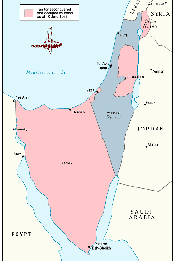

Slide 8
However, the response of the Khartoum Resolution of September 1, 1967 of Egypt, Syria, Jordan, Lebanon, Iraq, Algeria, Kuwait, and Sudan, was famous for containing (in the third paragraph)
Notes:
[https://en.wikipedia.org/wiki/Khartoum_Resolution]

Slide 9
what became known as the “Three No's:”
No peace with Israel,
No recognition of Israel,
No negotiations with it.
Notes:
[https://en.wikipedia.org/wiki/Khartoum_Resolution]
They only wanted the destruction of Israel.
Now:
End of Two State Solution?
End of guaranteed Two State solution without PA renouncing destruction.
Palestinians have previously been assured of a state without commitment to peace.
Tumultuous world, but now to eternal verities that undergird our lives. Two weeks ago:

Slide 10
Mattityahu (Matthew) 16:16
עָנָה שִׁמְעוֹן כֵּיפָא וְאָמַר: "אַתָּה הַמָּשִׁיחַ, בֶּן-אֱלֹהִים חַיִּים!"
Shim`on Kefa answered, "You are the Mashiach, the Son of the living God.’’
Divine Messiah
Notes:
Numerous evidence two weeks ago.
Divine Messiah. Pause, deep breath as contemplate.
Application...

Slide 11
I also tell you this: “You are Kefa, ” [which means `Rock’]
“and on this rock I will build my Community, and the gates of Sh'ol will not overcome it.”
This rock = Divine Messiah.
Mattityahu (Matthew) 16:17-18

Slide 12
Applications of Kingdom:
We are the secondary Rock.
We are part of community.
We understand terminology
‘community’ ≠ ‘church.’
We exercise the authority of the kingdom.
Notes:
https://www.thattheworldmayknow.com/gates-of-hell-article
Rock like integrity
Community on the Rock
Community ≠ church. Church is not a Bible word. I am aware that may sound weird or offensive.
We are authoritative in the Kingdom.
This was taught by Yeshua to his talmidim, then..

Slide 13
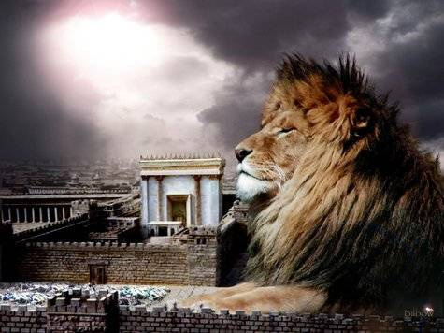
מַתִּתְיָהוּ Mattityahu
(Matthew) 16:21-22
Notes:
They had some grasp of Divine King and Kingdom

Slide 14
Mattityahu (Matthew) 16:21
מֵאוֹתָהּ עֵת הֵחֵל יֵשׁוּעַ לְהַבְהִיר לְתַלְמִידָיו כִּי עָלָיו לָלֶכֶת לִירוּשָׁלַיִם וְלִסְבֹּל הַרְבֵּה
From that time on, Yeshua began making it clear to his talmidim that he had to go to Yerushalayim and endure much suffering
Notes:
Why start then? Anathema to the human spirit to take strength, be encouraged, in suffering.
They grasped, at least somewhat, His Deity, their authority in the Kingdom Ruakh/Spirit. Sort of on a mountaintop and able to view the valley ahead. Deep valley. Sort of precipice.
Deity might → rulership
We assume Y came to die for atonement. They didn’t. Mindset of many Jewish people:

Slide 15
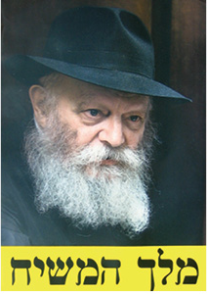
Melekh
HaMashiakh
“King Messiah”
seen all over
Israel,
particularly
Jerusalem
Notes:
Menachem Mendel Schneerson
Equate King and Messiah in many Jewish minds.

Slide 16
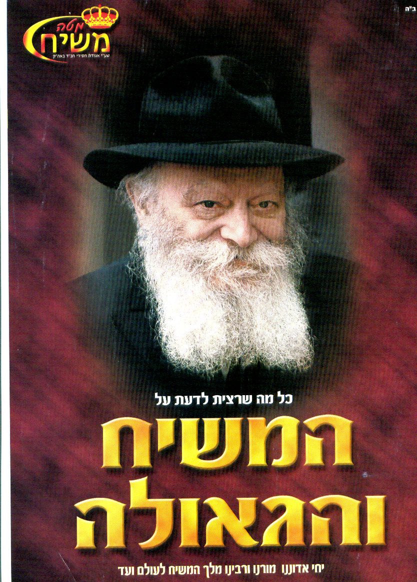
Staff of Messiah
“All that you ever
wanted to know
about the Messiah
and the redemp-
tion. May he live, our lord, teacher,
rabbi king messiah forever and ever.”
Notes:
Translation on right.
Similar in Yeshua’s day…

Slide 17
^{Yn 6.14-15} When the people saw the miracle he had performed, they said, “This has to be ‘the prophet’ who is supposed to come into the world.” Yeshua knew that they were on the point of coming and seizing him, in order to make him king; so he went back to the hills again. This time he went by himself.
Notes:
“The prophet”??

Slide 18
^{D’varim/Dt.18.15 -18} Adoni will raise up for you a prophet like me from among yourselves, from your own kinsmen… You are to pay attention to him…I will put my words in his mouth,
Notes:
Expected that Prophet, thought Y was.

Slide 19
^{D’varim/Dt.18.15 -18} and he will tell them everything I order him. Whoever doesn’t listen to my words, which he will speak in my name, will have to account for himself to me.
Notes:
The people thought Yeshua was this Dt. 18 prophet.

Slide 20
Mattityahu (Matthew) 16:21
מֵאוֹתָהּ עֵת הֵחֵל יֵשׁוּעַ לְהַבְהִיר לְתַלְמִידָיו כִּי עָלָיו לָלֶכֶת לִירוּשָׁלַיִם וְלִסְבֹּל הַרְבֵּה
From that time on, Yeshua began making it clear to his talmidim that he had to go to Yerushalayim and endure much suffering
Notes:
As if they’d come to a peak, from which He could show them the valley.
Go to Yerushalayim.

Slide 21
Yerushalayim
^{T’hillim/Ps 122.1-2} I was glad when they said to me, “The house of Adoni! Let’s go!” Our feet were already standing at your gates, Yerushalayim.
Notes:
Yerushalayim place of joy. Intoxicating joy. Jerusalem syndrome.

Slide 22
Yerushalayim
^{T’hillim/Ps 125.1-2} Those who trust in Adoni are like Mount Zion—
it cannot be moved, but endures forever. As the mountains are around Jerusalem, so Adoni is all around His people, both now and forever.
Notes:
Jerusalem, chief joy, would be place of excruciating suffering. Contrasting drama in words.

Slide 23
Mattityahu (Matthew) 16:21
מֵאוֹתָהּ עֵת הֵחֵל יֵשׁוּעַ לְהַבְהִיר לְתַלְמִידָיו כִּי עָלָיו לָלֶכֶת לִירוּשָׁלַיִם וְלִסְבֹּל הַרְבֵּה
From that time on, Yeshua began making it clear to his talmidim that he had to go to Yerushalayim and endure much suffering
Notes:
Not totally unique for Messiah to START kingdom with much suffering. So, even Schneerson died, some are expecting him to return!

Slide 24
There are parallel Talmudic references to the “birth pangs” or “travail” of the Messiah (Sanhedrin 98b and Shabbat 118a). These are based on Hebrew Scripture prophecies of suffering before the coming of the Messiah.
Notes:
https://jewsforjesus.org/newsletter-jan-1994/the-birth-pangs-of-the-messiah

Slide 25
The time is likened to the ordeal of childbirth. When a woman begins to have birth pangs, it means that things are not going to get easier, only much harder. Joy lies ahead, but first comes the painful part.
Notes:
https://jewsforjesus.org/newsletter-jan-1994/the-birth-pangs-of-the-messiah
Michael Brown, Answering Jewish Objections, vol 2.220-231
Suffering…

Slide 26
Mattityahu (Matthew) 16:21
מִידֵי הַזְּקֵנִים וְרָאשֵׁי הַכֹּהֲנִים וְהַסּוֹפְרִים
at the hands of the elders, the head cohanim and the Torah-teachers;

Slide 27
G-d delights to honor leaders
Sent Moshe to ask Pharaoh
Purim: prayed for King Akhashverosh to reverse decree
Free will essence of love
Notes:
G could have just killed Pharaoh.
G could have just killed Haman.
We loved working with Jewish community leaders. Six days they sponsored MoR!

Slide 28
endure much suffering
at the hands of the elders
the head cohanim
Notes:
Grk. presbuteros, which primarily carries the idea of ruling authority, leadership or acting in an official capacity. Here the term refers to members of the Sanhedrin who came from the most influential and wealthy lay families in Jerusalem (Lane 532). BlaineRobinson.com
The "chief priest" would be Caiaphas, the high priest, but the plural noun would include former high priests and holders of the priestly offices of higher rank in the Temple, altogether some fifteen to twenty persons. Saw the redemptive sacrifices. BlaineRobinson.com

Slide 29
at the hands of the elders
the head cohanim
and the Torah-teachers, Sofrim
סופרים from ספר
Notes:
Maybe Yeshua had a special hope for these to understand and receive Him.
Grk. grammateus refers to a specialist in Jewish legal matters. In Israelite culture a scribe was a legal scholar and a teacher of the Torah. The word grammateus occurs 65 times in the Mes. Scriptures, 60 of which are in Matthew—Luke. In all but one passage the term occurs in the plural form. The term always has its Jewish meaning of one learned in Torah, a rabbi or ordained theologian.
BlaineRobinson.com

Slide 30
In ancient Israel the art of writing was preserved as a craft by certain families, such as the Kenites dwelling at Jabez (1Chr 2:55). An ancient scribe's appearance with a writing case on his lap is mentioned in Ezekiel 9:2
Notes:
http://www.blainerobison.com/bible2/marknotes01.htm#scribes

Slide 31
^{Ro 3.1-2} Then what advantage has the Jew? What is the value of being circumcised? Much in every way! In the first place, the Jews were entrusted with the very words of God.
Notes:
This is the MAIN legacy of the Jewish people. Conveying the Word from generation to generation, until they could safely put the Word on the Internet and the cloud for safe storage and universal accessibility.
Romans for Empire,
Spartans for military,
Athenians for math and logic,
Phoenicians traders,
Chinese for food, etc.
Jews for literacy starting with the Word → all words, knowledge. So SCRIBES central to our identity. Wonder about start up nation?
I think Y was a lover of the Word!! Are we??

Slide 32
Mattityahu (Matthew) 16:21
וּלְהֵהָרֵג וּבַיּוֹם הַשְּׁלִישִׁי לָקוּם.
and that he had to be put to death; but that on the third day, he had to be raised to life.
Notes:
Put to death by Romans = Execution stake, cross, was the most scandalous form of criminal execution; even the term sounded terrible to ancient hearers
Keener p 431
Third day??

Slide 33
Mattityahu (Matthew) 16:22
לָקַח אוֹתוֹ כֵּיפָא לַצַּד וְהֵחֵל לִגְעֹר בּוֹ בְּאָמְרוֹ: "חָלִילָה לְךָ, אֲדוֹנִי. אַל יִהְיֶה הַדָּבָר הַזֶּה לְךָ!"
Kefa took him aside and began rebuking him, "Heaven be merciful, Lord! By no means will this happen to you!"
Notes:
Just told Kefa, “You are Kefa, upon this rock”
Kefa was the secondary rock.
Took Him aside, “Rabbi, this is over the top. Let’s have balance…”

Slide 34
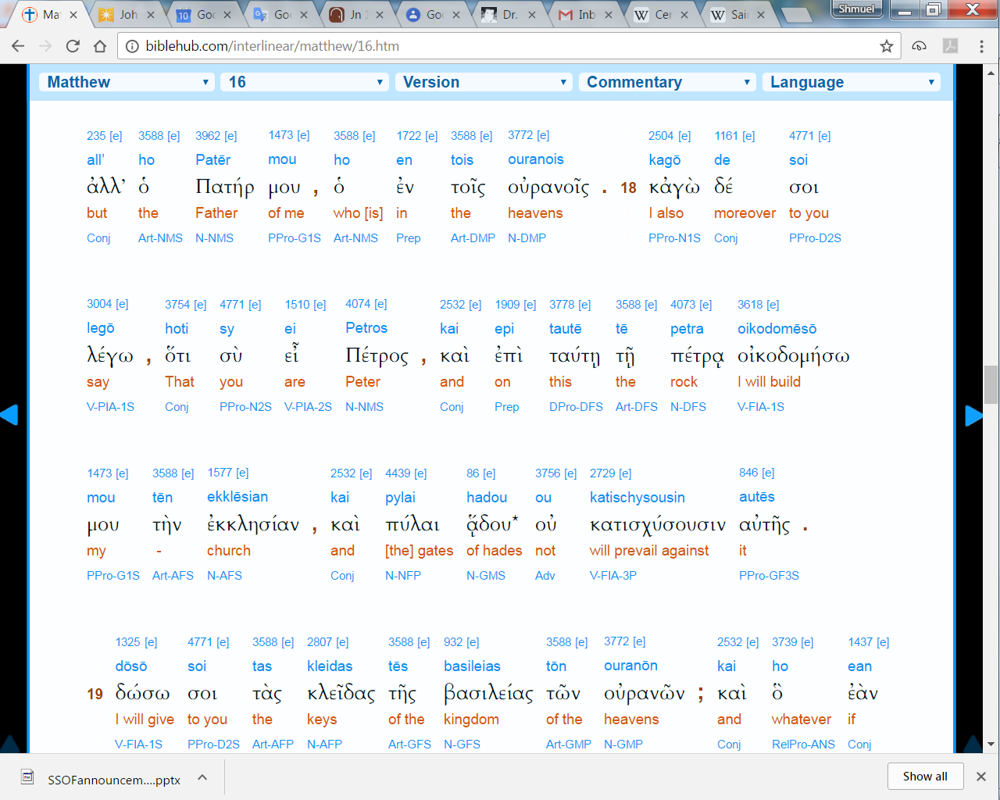
Note: petros and petra

Slide 35
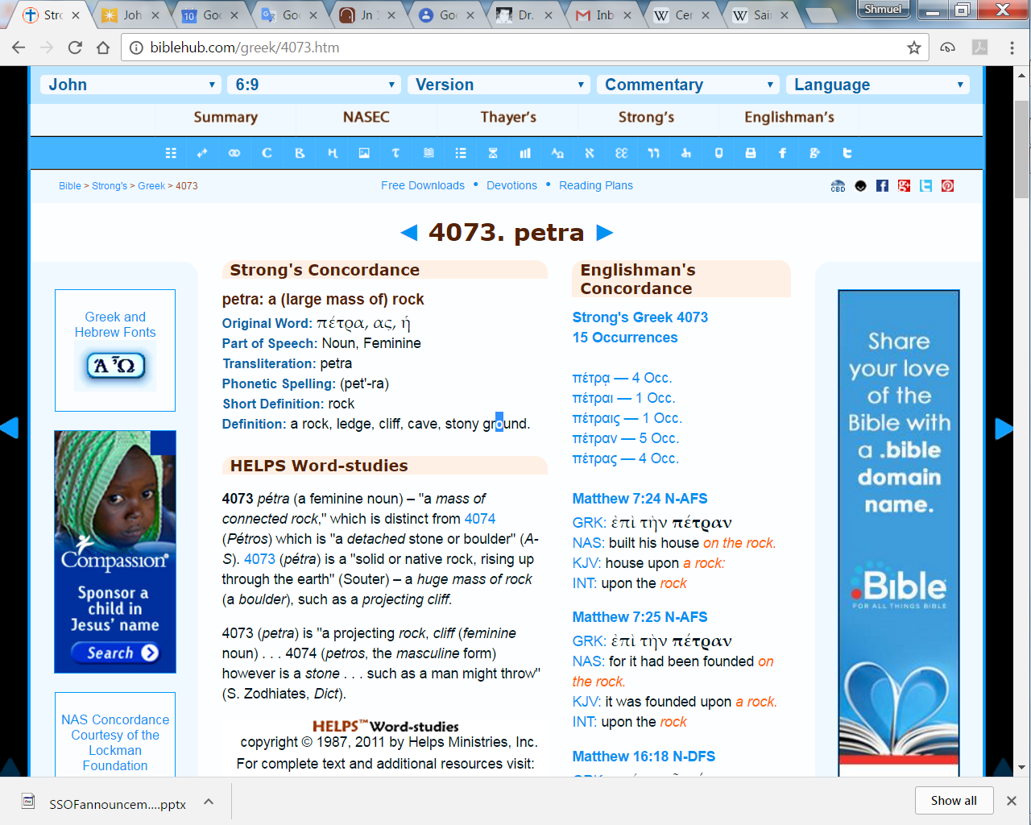
Significant difference masculine
& feminine form of Peter
Notes:
You are a boulder...complement, part of the rock face, and..on this rock strata...
“Chip off the old block”

Slide 36
Mattityahu (Matthew) 16:22
לָקַח אוֹתוֹ כֵּיפָא לַצַּד וְהֵחֵל לִגְעֹר בּוֹ בְּאָמְרוֹ: "חָלִילָה לְךָ, אֲדוֹנִי. אַל יִהְיֶה הַדָּבָר הַזֶּה לְךָ!"
Kefa took him aside and began rebuking him, "Heaven be merciful, Lord! By no means will this happen to you!"
Notes:
Just told Kefa, “You are Kefa, upon this rock”
Kefa was the secondary rock.
Rebuking Yeshua! Vehement LXX language. Way overstepped! “interrupted”
Correcting a teacher rare in that culture. [Not today!] Disciples followed their teacher. Literally walked behind.
Basically advocating Kingdom without atonement, without suffering.

Slide 37
But Yeshua turned his back on Kefa, saying, “Get behind me, Satan! You are an obstacle in my path, because your thinking is from a human perspective, not from God’s perspective!”
Mattityahu (Matthew) 16:23
Notes:
Disciples literally followed teacher, walking behind. Apparently, this WAY out of this order. Y put him back in his place!
This is the view of the enemy, HaSatan, to achieve the kingdom, without suffering, atoning suffering.

Slide 38
^{Mtt 4.8-10} Once more, the Adversary took him up to the summit of a very high mountain, showed him all the kingdoms of the world in all their glory, and said to him,

Slide 39
^{Mtt 4.8-10} “All this I will give you if you will bow down and worship me.”
“Away with you, Satan!” Yeshua told him, “For the Tanakh says, ‘Worship Adoni your God, and serve only him.’”
Notes:
We’re not going to get it without suffering. Rejection…

Slide 40
Mattityahu (Matthew) 16:21
וּלְהֵהָרֵג וּבַיּוֹם הַשְּׁלִישִׁי לָקוּם.
and that he had to be put to death; but that on the third day, he had to be raised to life.
Apparently NOT Kefa’s plan of victory.
No bee line. Death to self.
Notes:
Some current examples of suffering before success, [not equivalent to Y]

Slide 41
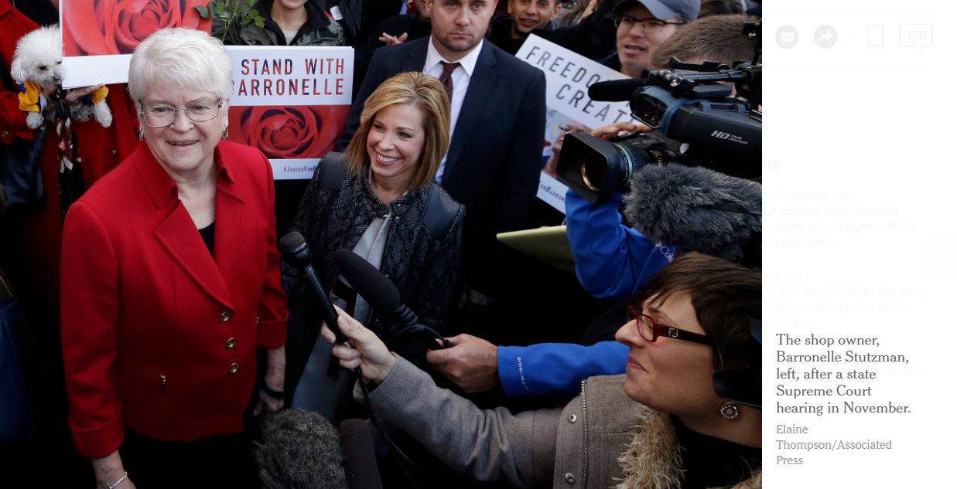
Cake decorator convicted of
discrimination for refusing to
make cake for gay wedding.
Notes:
https://www.nytimes.com/2017/02/16/us/florist-discrimination-gay-couple-washington-court.html?_r=0
Washington State Supreme Court Feb. 16, 2017
Ms. Stutzman and her lawyers, using dictionary definitions of “art” as well as expert testimony regarding her creativity and expressive style, argued for a broad reading of protected speech that encompassed her “unique expression,” crafted in “petal, leaf and loam.” Ms. Stutzman herself, the court said, contradicted the argument that wedding flowers were a statement when she said in a deposition that providing flowers for a wedding between Muslims would not necessarily constitute an endorsement of Islam, nor would providing flowers for an atheist couple endorse atheism.
Stand for righteousness?

Slide 42
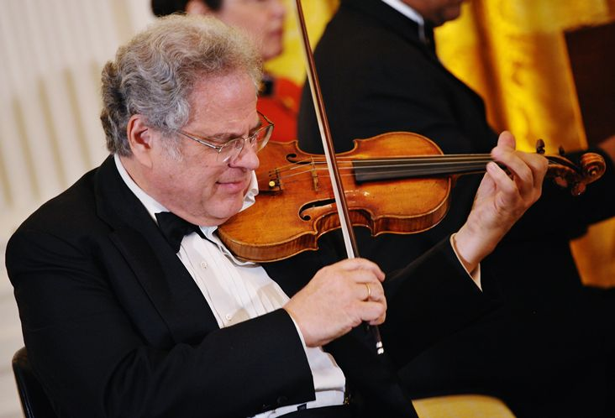
Izhak Perlman יצחק פרלמן
Notes:
born August 31, 1945) is an Israeli-American violinist, conductor, and pedagogue. Over the course of his career, Perlman has performed worldwide, and throughout the United States, in venues that have included a State Dinner at the White House honoring Queen Elizabeth II, and a Presidential Inauguration, and he has conducted the Detroit Symphony Orchestra, and the Westchester Philharmonic. In 2015, he was awarded the Presidential Medal of Freedom.

Slide 43
Israel makes list of best countries for families: A new report by InterNations lists the nineteen best countries to raise a family listed Israel third, just behind Finland and the Czech Republic. The UK and USA were not on the list.
Notes:
With all the trauma and suffering.

Slide 44
Each country was rated based on safety, cost of living, childcare availability and affordability, quality of education, and healthcare. Israel was listed in the top three countries, coming in just behind

Slide 45
Finland and the Czech Republic. Just behind Israel, in places four and five, were Austria and Sweden. (Arutz-7)

Slide 46
Once a colonist, Isaac Potts, who had sided with the British, caught George Washington crying out to God for victory in the midst of the war. “‘Such a prayer I never heard from the lips of man. I left him alone praying.”
Notes:
http://www.maozisrael.org/site/News2?abbr=maoz_&page=NewsArticle&id=11101&news_iv_ctrl=-1

Slide 47
Potts felt the power of this prayer and ran home and told his wife, “We’re on the side of George Washington. I’m changing, I’m changing sides because we’re going to win this.”
Notes:
http://www.maozisrael.org/site/News2?abbr=maoz_&page=NewsArticle&id=11101&news_iv_ctrl=-1

Slide 48
When Washington was trapped and all seemed lost, he told his men that they would cross the East River. As dawn came, the British ships would surely see them. But a fog descended upon Washington and his men and the revolution continued
Notes:
http://www.maozisrael.org/site/News2?abbr=maoz_&page=NewsArticle&id=11101&news_iv_ctrl=-1

Slide 49
Those present all record in their journals that the fog was not on the Manhattan side or the Long Island side, just over them. Yes, God had a plan for America.
Notes:
http://www.maozisrael.org/site/News2?abbr=maoz_&page=NewsArticle&id=11101&news_iv_ctrl=-1

Slide 50
According to award-winning author, Timothy Ballard, one of the founding fathers, John Witherspoon, a Presbyterian minister prophesied, “We will win this war because the Grand Artist will utilize the elements.”
Notes:
http://www.maozisrael.org/site/News2?abbr=maoz_&page=NewsArticle&id=11101&news_iv_ctrl=-1

Slide 51
“Somewhere Over the Rainbow” was written by Yip Harburg, the son of Russian Jewish immigrants who lived in New York. The music was written by Harold Arlen, a cantor’s son.
Notes:
http://www.jewishjewels.org/news-letters/sweet-16/

Slide 52
Together, the two men reached deep into their immigrant Jewish roots to write a prophetic song about Jewish survival, just as the Holocaust was beginning in 1939.
Notes:
http://www.jewishjewels.org/news-letters/sweet-16/

Slide 53
Somewhere over the rainbow,
Way up high.
There’s a land that I heard of
Once in a lullaby.
Somewhere over the rainbow,
Skies are blue.
Notes:
http://www.jewishjewels.org/news-letters/sweet-16/
The singers of the lullaby: Jewish mothers. Jewish people.
The Land in the song: Israel.

Slide 54
And the dreams that you dare to Dream really do come true.
Someday I’ll wish upon a star, And wake up where the clouds Are far behind me.
Notes:
http://www.jewishjewels.org/news-letters/sweet-16/
The dream: Next year in Jerusalem.

Slide 55
Where troubles melt
Like lemon drops,
Away above the chimney tops, That’s where you’ll find me.
Somewhere over the rainbow, Bluebirds fly.
Birds fly over the rainbow.
Why, then, oh why can’t I?
Notes:
http://www.jewishjewels.org/news-letters/sweet-16/
The chimney tops: the Holocaust.
Birds fly over the rainbow: The Jews who could escape the Holocaust.

Slide 56
The Land in the song: Israel.
The singers of the lullaby: Jewish mothers.
The dream: Next year in Jerusalem.
The chimney tops: the Holocaust. Birds fly over the rainbow: The Jews who could escape the Holocaust.
Notes:
http://www.jewishjewels.org/news-letters/sweet-16/

Slide 57
A dream come true: Less than 10 years after “Somewhere Over the Rainbow” was first published, the State of Israel was reborn.
Notes:
http://www.jewishjewels.org/news-letters/sweet-16/

Slide 58
Conclusion:
No Kingdom without death, “birthpangs of Messiah” khevlei Mashiakh חבלי משיח
Place of glory, people of glory, leaders, all may disappoint.
3rd day resurrection.
Notes:
Resurrection power for all of us! Come and take!

