Slide 1
To easily follow these notes, log on to our Wifi
Wifi: mycci01
p/w: ancientquail060
Go to OrHaOlam.com
Click on downloads, messages, 2017

Slide 2
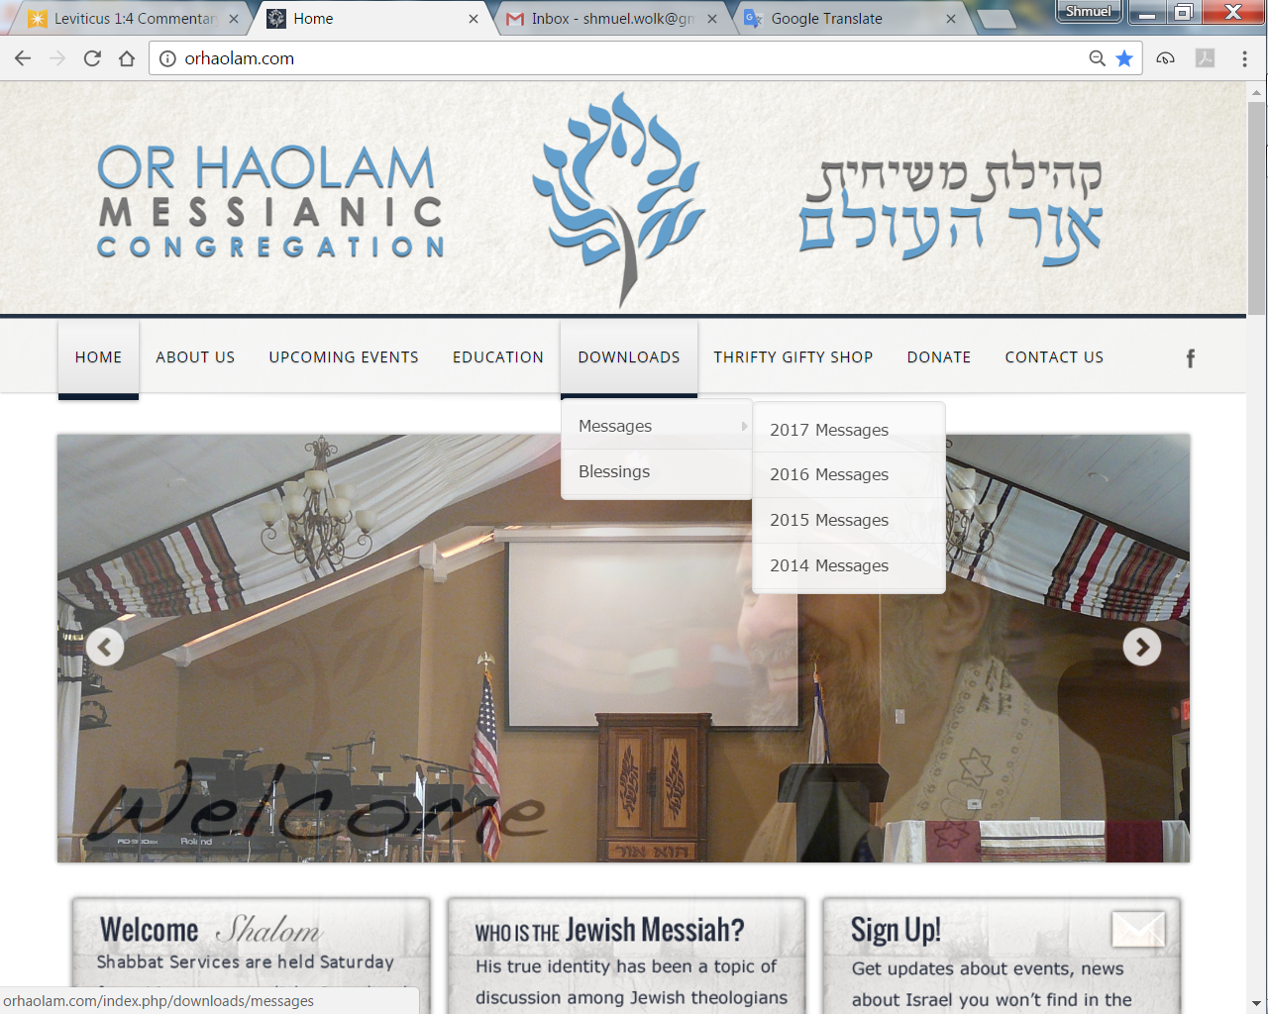
Downloads\messages\
2017 Messages

Slide 3
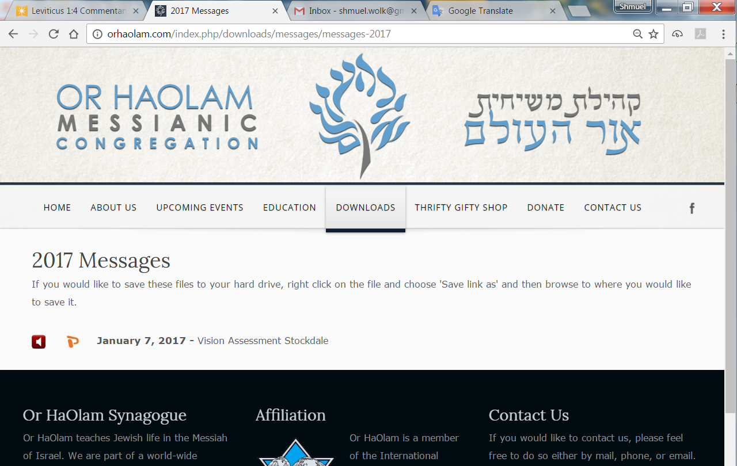

Slide 4
Paraprosdokians (Winston Churchill loved them) are figures of speech in which the latter part of a sentence or phrase is surprising or unexpected; frequently humorous.
1. Where there's a will, I want to be in it.
2. The last thing I want to do is hurt you. But it's still on my list.

Slide 5
3. Since light travels faster than sound, some people appear bright until you hear them speak.
4. If I agreed with you, we'd both be wrong.

Slide 6
5. We never really grow up, we only learn how to act in public.
6. War does not determine who is right - only who is left.
7. Knowledge is knowing a tomato is a fruit . . . Wisdom is not putting it in a fruit salad.
Notes:
Kathleen nee Steele Eltrich

Slide 7
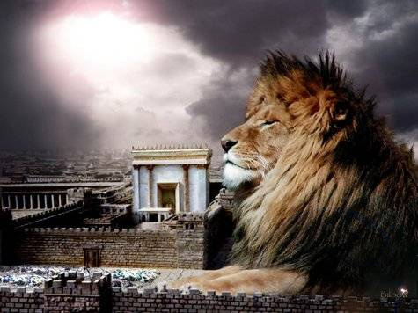
מַתִּתְיָהוּ Mattityahu
(Matthew) 16:13-16
Notes:
Start with a little tour, fly in

Slide 8
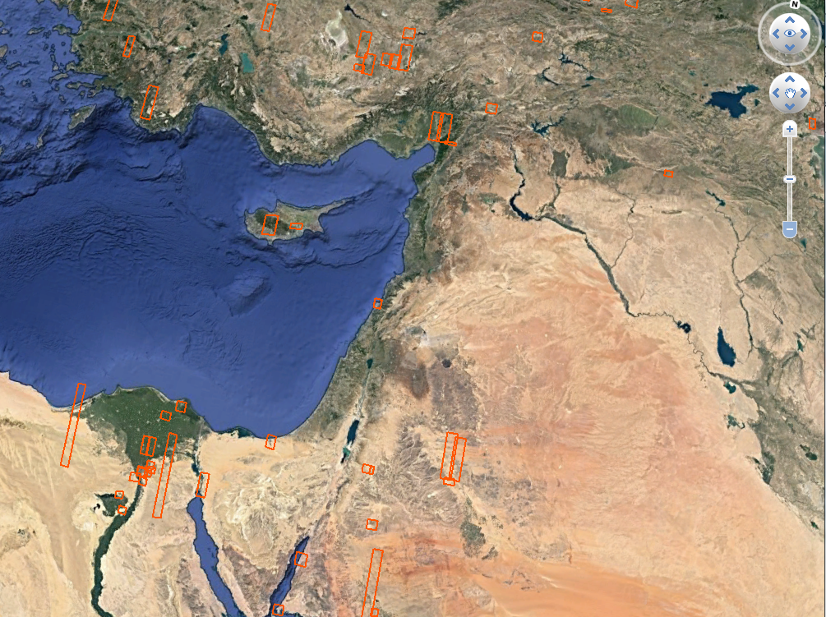
Notes:
Google earth

Slide 9
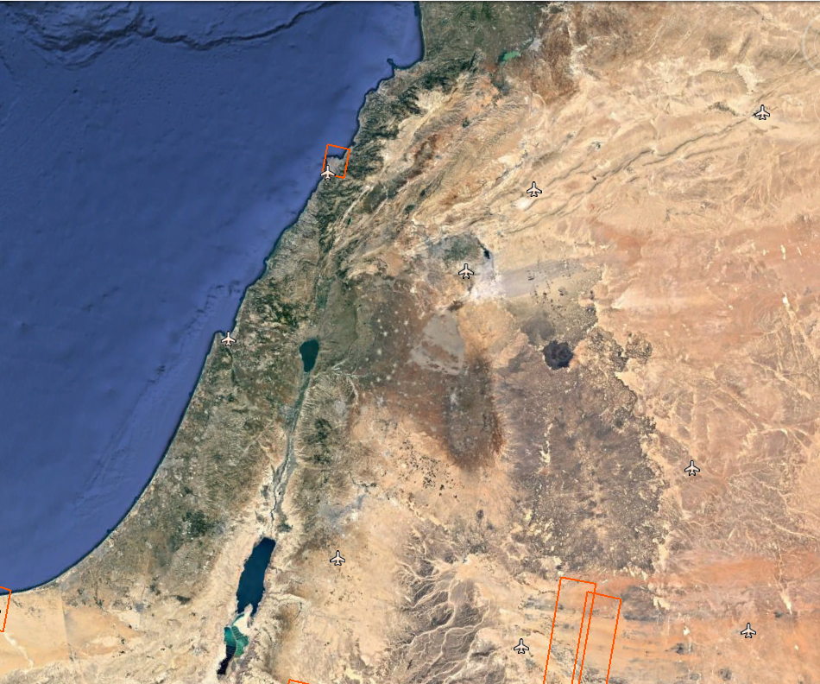
Notes:
Google earth next is a big zoom in, north of Yam Kinneret, Sea of Galilee

Slide 10
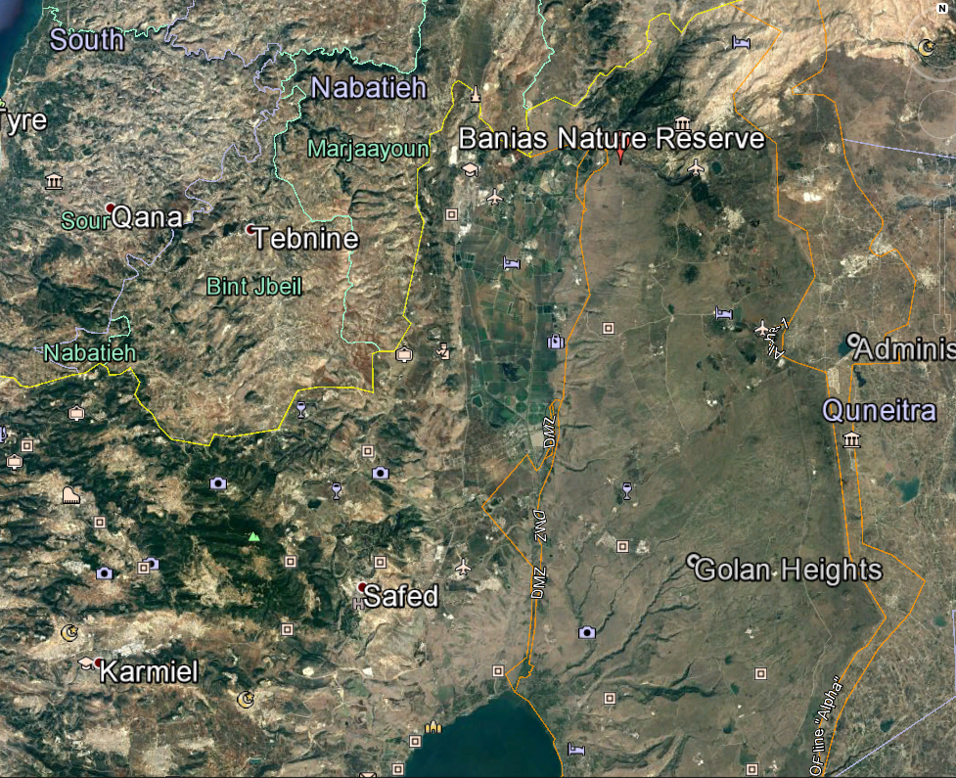
Notes:
Google earth northeasternmost corner of Israel High Galil, next to Kiryat Shmonah [airplane] called Kiryat Ketusha for Ketusha rockets from Lebanon, Hezbulloh. Note Banias Nature Reserve. Arab name of the place.

Slide 11
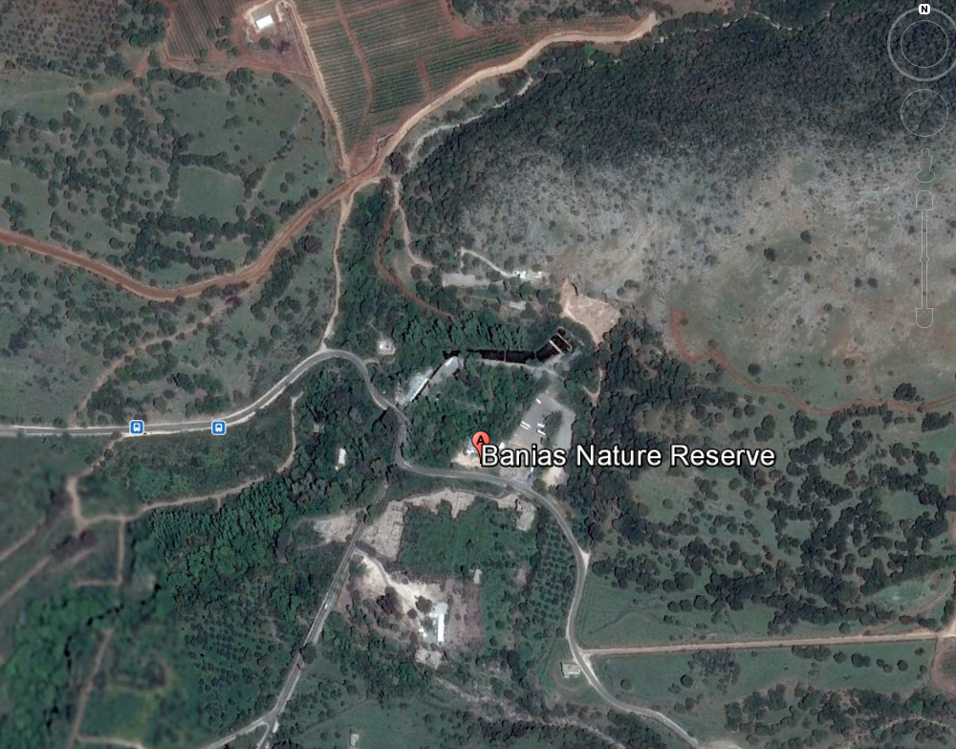
Notes:
Google earth

Slide 12
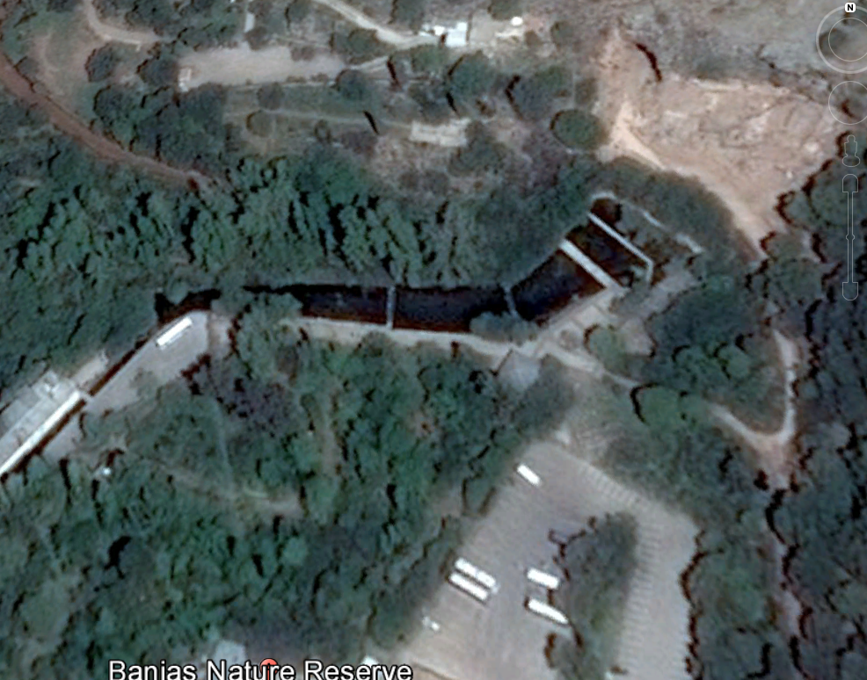
Notes:
Google earth. Note the cave at the top of the screen. Was the source of the Jordan previously. Still near it.

Slide 13
Mattityahu (Matthew) 16:13
כְּשֶׁבָּא יֵשׁוּעַ אֶל סְבִיבוֹת קֵיסַרְיָה שֶׁל פִילִיפּוֹס
When Yeshua came into the territory around Caesarea Philippi
Notes:
25 miles north, and 1700 feet elevation from Yam Kinneret, Sea of Galilee.

Slide 14
The northeastern area of Israel became a center for Baal worship. In the nearby city of Dan, Israelite king Yerovam built the high place that eventually led the Israelites to worship false gods. Eventually, worship of the baals was there, “lords”
Notes:
https://www.thattheworldmayknow.com/gates-of-hell-article
The Hebrew word for husband is baal. Baali = my husband. Baal ha bayit → balabuster = lady of the house in Yiddush. Matriarchal Master. Baal Zevuv = Lord of the flies.

Slide 15
Baal= = בַּעַל lord
The Hebrew word for husband is baal. Baali בַּעַלי = my husband.
Baal ha bayit →balabuster = lady of the house in Yiddush. Matriarchal Mistress.
Baal Zevuv = Lord of the flies. Beelzebub.
Notes:
One lady re ‘baali’ my husband, false god

Slide 16
Hosea suggests and Jeremiah graphically depicts the debauchery and excesses that developed in the worship of Ba‘al. Because of the sexual overtones of Ba‘al worship, it was easy to use the metaphor of adultery or prostitution to describe the problem
Notes:
http://www.crivoice.org/baal.html

Slide 17
Baal worship was replaced with worship of Greek fertility gods, the Greek god, Pan. The Greeks named the city Panias in his honor. Arabs can’t pronouce “p” so Panias became Banias. Common name till today.
Notes:
https://www.thattheworldmayknow.com/gates-of-hell-article

Slide 18
When Romans conquered the territory, Herod Philip rebuilt the city and named it after himself. In the cliff that stood above the city, local people built shrines and temples to Pan.
Notes:
https://www.thattheworldmayknow.com/gates-of-hell-article

Slide 19
Gates of Hell
Notes:
Google earth
On tour you can walk amon these foot bridges. Great place to praise, pray, and picnic!

Slide 20
To the pagan mind the cave at Caesarea Philippi created a gate to the underworld, where fertility gods lived during the winter. They committed detestable acts to worship these false gods. It stood at the base of a cliff where spring water flowed at one time.
Notes:
https://www.thattheworldmayknow.com/gates-of-hell-article

Slide 21
In order to entice the return of their god, Pan, each year, the people of Caesarea Philippi engaged in horrible deeds, including prostitution and sexual interaction between humans and goats.
Notes:
https://www.thattheworldmayknow.com/gates-of-hell-article

Slide 22
Caesarea Philippi was like a red-light district in their world and devout Jews would have avoided any contact with the despicable acts committed there.
It was a city of people eagerly knocking on the doors of hell.
Notes:
https://www.thattheworldmayknow.com/gates-of-hell-article

Slide 23
Mattityahu (Matthew) 16:13
כְּשֶׁבָּא יֵשׁוּעַ אֶל סְבִיבוֹת קֵיסַרְיָה שֶׁל פִילִיפּוֹס שָׁאַל אֶת תַּלְמִידָיו: "מָה אוֹמְרִים הָאֲנָשִׁים עַל בֶּן-הָאָדָם, מִי הוּא?"
When Yeshua came into the territory around Caesarea Philippi, he asked his talmidim, "Who are people saying the Son of Man is?"

Slide 24
Mattityahu (Matthew) 16:14
הֵשִׁיבוּ: "יֵשׁ אוֹמְרִים, 'יוֹחָנָן הַמַּטְבִּיל'; אֲחֵרִים אוֹמְרִים, 'אֵלִיָּהוּ'; וַאֲחֵרִים -- 'יִרְמְיָהוּ אוֹ אֶחָד מֵהַנְּבִיאִים'."
They said, "Well, some say Yochanan the Immerser, others Eliyahu, still others Yirmeyahu or one of the prophets."
Notes:
All powerful men of G-d

Slide 25
Mattityahu (Matthew) 16:15
שָׁאַל אוֹתָם: "וְאַתֶּם מָה אוֹמְרִים, מִי אֲנִי?"
"But you," he said to them, "who do you say I am?"
Notes:
That is also a question for each of us. Who is Yeshua?

Slide 26
Mattityahu (Matthew) 16:16
עָנָה שִׁמְעוֹן כֵּיפָא וְאָמַר: "אַתָּה הַמָּשִׁיחַ, בֶּן-אֱלֹהִים חַיִּים!"
Shim`on Kefa answered, "You are the Mashiach, the Son of the living God.’’
Divine Messiah
Notes:
How did he get that?

Slide 27
"Shim`on Bar-Yochanan," Yeshua said to him, "how blessed you are! For no human being revealed this to you, no, it was my Father in heaven.
Mattityahu (Matthew) 16:17-18
Notes:
Revelation, but not just Ruakh, also the Word, insight.

Slide 28
^{Mishlei/Prov 30.4} Who has gone up to heaven and come down? Who has cupped the wind in the palms of his hands? Who has wrapped up the waters in his cloak? Who established all the ends of the earth? What is his name, and what is his son's name?

Slide 29
^{Daniel 7.13} "I kept watching the night visions, when I saw, coming with the clouds of heaven, someone like a son of man. He approached the Ancient One and was led into his presence.

Slide 30
^{Zekharyah 4.6-7} "This is the word of ADONI to Z'rubavel: 'Not by force, and not by power, but by my Spirit,' says ADONI-Tzva'ot. 'What are you, you big mountain? Before Z'rubavel you will become a plain and he will put the capstone in place, as everyone shouts, "It's beautiful! Beautiful!"'

Slide 31
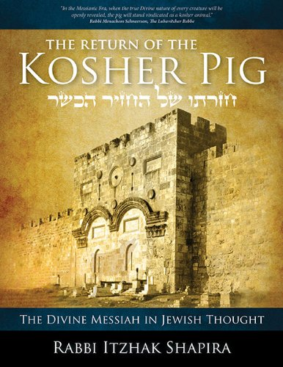
Notes:
Great book. A bit complex history and rabbinic reading, but the BEST on the divine Messiah. Tsakhi’s own struggle.

Slide 32
Quotes Rabbi Do Iszhak Abarbanel, a Portuguese Jewish statesman, philosopher, Bible commentator, and financier.
Born: 1437, Lisbon, Portugal
Died: 1508, Venice, Italy
Notes:
https://en.wikipedia.org/wiki/Isaac_Abravanel
Jews expelled from Portugal 1497

Slide 33
According to R. Abarbanel, the mountain that becomes a plain is the Messiah, who similarly...

Slide 34
^{Yeshayahu/Is 2.4} He will judge between the nations and arbitrate for many peoples. Then they will hammer their swords into plow-blades and their spears into pruning-knives; nations will not raise swords at each other, and they will no longer learn war.

Slide 35
That is, no one but a supernatural, divine Person could straighten out humanity as a whole.
Notes:
Three proofs from the Hebrew scriptures that the Messiah is divine.

Slide 36
"Shim`on Bar-Yochanan," Yeshua said to him, "how blessed you are! For no human being revealed this to you, no, it was my Father in heaven.
Mattityahu (Matthew) 16:17-18

Slide 37
How blessed you are!
Blessed = joyful
Our Divine Redeemer is adequate to overcome
All our sin.
All our opposers.
All difficulties in His kindgom.
Notes:
Divine Messiah is a source of praise, joy, celebration. Tell Him so every now and then.
Story from about 8 years ago. Many of you have heard, but illustrates importance of this.

Slide 38
In November of 2009 I received a phone call from Rabbi Herbert Mandl of Kehilath Yisrael Synagogue. He said, ‘Hi this is Herbie Mandl. Alan Cohen and I would like to have coffee with you.’

Slide 39
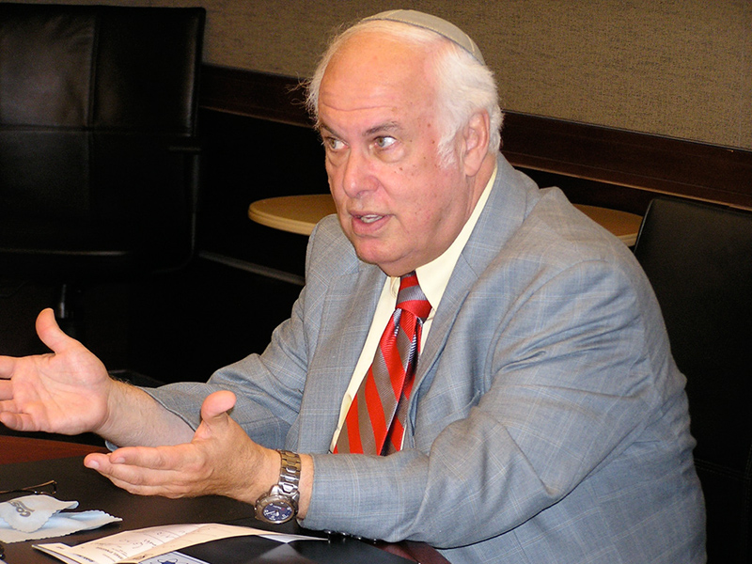
Notes:
Senior Rabbi of Kehilath Israel since 1977 and became Rabbi Emeritus in 2012. He has served on many commissions, boards and committees in the Jewish, civic and community. In his continuing academic pursuits, he was honored by the Vatican by allowing him to do research in the Vatican Library in 2013. Only rabbi to have done so.

Slide 40
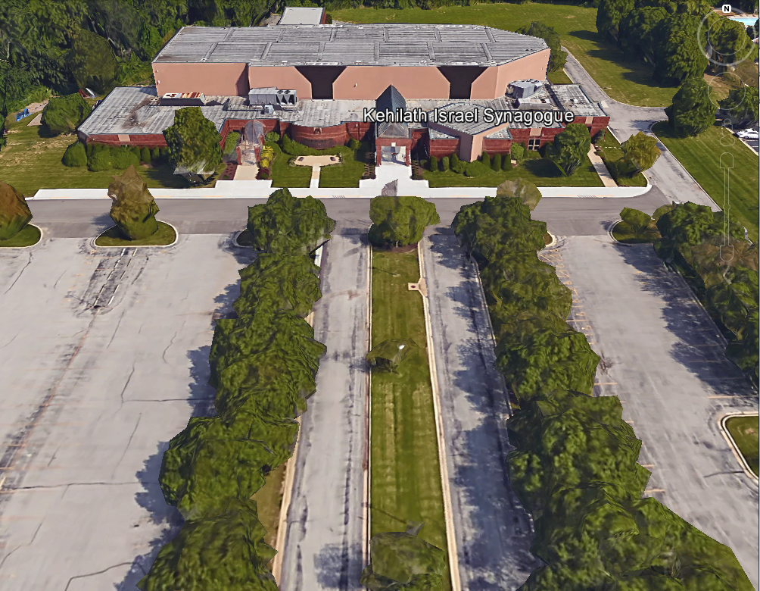
Notes:
Google earth 105th and Conser, Overland Park. It’s a bit bigger than our lovely place.

Slide 41
Wednesday, Dec. 2, 2009 10 a.m. visit with Herb Mandl and Alan Cohen Jewish Community Relations Bureau Am Jewish Committee, Rabbi Emeritus of Beth Shalom.
AC: There have been various interactions between you and the Jewish population of KC, at times of funerals, news events, etc.
Notes:
[This is an approximate reconstruction of our conversation, but done only a few hours after. The concepts are correct. The phraseology is close.]

Slide 42
People refer to you as rabbi, and it seems inappropriate since you are outside the normative definition, in terms of your belief in Jesus as divine Messiah. What people call you in your own circles is your business, but in the media and community you are not a rabbi by normative standards.
Notes:
They say the Greek name of the Messiah. I’m using it since quoting Mandl and Cohen.
Actually I bristled a bit, internally here. The word ‘rabbi’ is not copyrighted.
Divine Messiah is what made me NOT a rabbi, in their eyes.

Slide 43
SW: In the history of Judaism there have been many groups that were viewed as unacceptable to the pale of Jewish legitimacy. A cousin of mine in Tel Aviv has traced our lineage directly to Rabbi Elimelech Weisblum of Lizhensk [one of the great founding Rebbes of the Hasidic movement].
Notes:
That’s maybe why we have a LOT of dance here. Men’s, front, back, line, choreography, and one ballerina! Hasidic ancestry in your rabbi.

Slide 44
The Hasids were not accepted by mainstream Judaism for a while. So, are we.
AC: It’s true that the Misnagdim jailed some of the early Hasidic leaders. However, that was over matters of practice,
Notes:
Misnagdim = opposers.

Slide 45
NOT the issue of the deity of Jesus or a rabbi.
SW: actually, Hasids recently have written that Schneerson represents the divine presence and …
HM: I know and I find that scary.
SW: you find it scary but to us it’s a comfort that it’s not so unJewish to consider the Messiah to be divine.
Notes:
Note this if you are in conversations with Orthodox Jewish people.

Slide 46
SW: Concerning the title of ‘rabbi’ there really isn’t any other title that works. ‘Pastor’ doesn’t fit, ‘priest’ certainly doesn’t work. ‘Congregational leader’ we tried for a while, but it’s just too clumsy. We had our own hesitations at using the term ‘rabbi’ because of the words of the Messiah
Notes:
Where Yeshua says, “Don’t be called rabbi.” In context, also “Don’t be called father.”

Slide 47
but His injunction was really based on the fact that we shouldn’t take the title without adequate preparation and qualification.
HM: What about ‘spiritual leader?’

Slide 48
SW: It’s also just too clumsy to use in conversation. My smikha [ordination] is not from any Christian organization. It’s from the Intrnatl Alliance of Messianic Congregations and Synagogues.
HM: probably all Jews. I don’t know if that makes it better or worse.

Slide 49
SW: actually, mostly Jewish men from New York, if that matters. [maybe that’s not so, I thought later.]
AC: [at length] Since the 4th century, Constantine at the Council of Nicea, declared the deity of Jesus and that the whole Roman Empire was Christian.

Slide 50
This has been a watershed dividing point between Jews and Christians. Rabbis have not accepted you
SW: Rabbis have not accepted us, and the church hasn’t accepted us as continuing to be Jews

Slide 51
We weren’t recognized as Jews from either side. That’s most of the reason why the Messianic population disappeared from history: isolation and opposition.

Slide 52
BUT, we represent a restoration of that early community of faith in the Jewish Messiah.
AC: I’ve noticed that some Christians today don’t seem comfortable with Messianics identifying themselves as Jews. Since the 4th century there has been this separation. This has been the normative understanding of Jewish and rabbi. The deity issue has been the divider.
Notes:
Then I had a Ruakh/Spirit brainstorm…

Slide 53
SW: Before the 4th century there were rabbis who were Messianic, probably. Yeshua Himself was called ‘rabbi.’ Paul/Shual may have been called a rabbi. [Was a Parush, therefore a rabbi] He certainly believed in the deity of the Messiah.
AC: It’s just not been normative since the 4th century.

Slide 54
SW: What if I labeled myself a ‘first century rabbi’? It would require a bit of explanation, but that would be just fine. I’m saying this tentatively, and sort of facetiously, but what about it?

Slide 55
AC and HM [were taken by surprise, and didn’t really have an answer.] We don’t know what to say, and of course we’d have to consult with many others.

Slide 56
SW: I don’t’ think I’d mind the restriction at all, but I’d also have to consult with a national, international movement. But, it’s a start. I could put it on my business card. However, if we bought into this qualification, would you guys introduce me as “a first century rabbi’?

Slide 57
AC and HM: Well, I don’t know where this will go, but I’m glad we had this dialogue.
Both retired. It didn’t go anywhere.

Slide 58
But, what was that 4th Century event?
The First Council of Nicaea was a council of Christian bishops convened in the Bithynian city of Nicaea (now Iznik, Bursa province, Turkey) by the Roman Emperor Constantine I in CE 325.

Slide 59
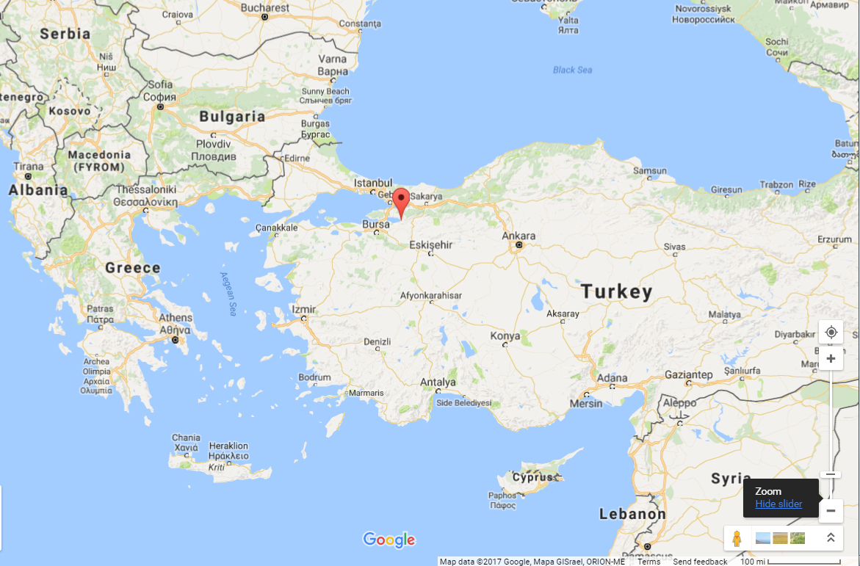
3rd C Council Nicea
Notes:
Incredibly spendid gathering place, overwhelmed many visiting ministers. Good access Roman roads.

Slide 60
The Council declared that the Son was true God, co-eternal with the Father and begotten from His same substance, arguing that such a doctrine best codified the Scriptural presentation of the Son.
Notes:
https://en.wikipedia.org/wiki/First_Council_of_Nicaea

Slide 61
This was an appropriate authoritative decision.
However, some decisions from Nicea 325 CE not so great.
Notes:
https://www.thattheworldmayknow.com/gates-of-hell-article

Slide 62
Easter was henceforward to be a Sunday in a lunar month chosen according to Christian criteria—in effect, a Christian Nisan—not in the month of Nisan as defined by Jews.
Notes:
https://en.wikipedia.org/wiki/First_Council_of_Nicaea

Slide 63
The letter written by the Emperor Constantine announcing the results of the Council: It was declared to be particularly unworthy for this, the holiest of all festivals, to follow the custom [the calculation] of the Jews, who had soiled their
Notes:
http://www.kesherjournal.com/index.php?option=com_content&view=article&id=135&Itemid=

Slide 64
hands with the most fearful of crimes, and whose minds were blinded . . . We ought not, therefore, to have anything in common with the Jews . . . and consequently, in unanimously adopting this mode,
Notes:
https://www.thattheworldmayknow.com/gates-of-hell-article

Slide 65
we desire, dearest brethren, to separate ourselves from the detestable company of the Jews.
Notes:
https://www.thattheworldmayknow.com/gates-of-hell-article
Major impetus to Christian anti-Semitism, and replacement theology at the spirit of Nicea. Moreover, the Nicene creed says nothing about the covenantal identity of Israel. It’s a non-issue. That might be OK, but Israel is a great negation in Constantine’s mindset.

Slide 66
Worst of all...
Notes:
https://www.thattheworldmayknow.com/gates-of-hell-article

Slide 67
Christians were no longer persecuted by the pagans. Instead, Christians persecuted others (including other Christians) with a zeal and a vengeance that would shock the pagans.
Notes:
http://messianicfellowship.50webs.com/nicea.html

Slide 68
More Christians were killed (by other Christians!) in the first century after the Council of Nicea than had been killed by pagans in the century before Nicea.
Notes:
http://messianicfellowship.50webs.com/nicea.html

Slide 69
Constantine, only one year after convening the Council of Nicea, had his own son (Crispus) put to death. Later he suffocated Fausta (his wife) in an overheated bath.
Notes:
http://messianicfellowship.50webs.com/nicea.html

Slide 70
Then he had his sister's son flogged to death and her husband strangled.
It was also during the reign of Constantine that the cross became a sacred symbol in Christianity.
Notes:
http://messianicfellowship.50webs.com/nicea.html

Slide 71
4th century Nicean codification of deity of Yeshua. A good thing. Peter/Kefa’s revelation publicized.

Slide 72
I also tell you this: “You are Kefa, ” [which means `Rock’]
“and on this rock I will build my Community, and the gates of Sh'ol will not overcome it.”
This rock = Divine Messiah.
Mattityahu (Matthew) 16:17-18

Slide 73
Gates were defensive structures in the ancient world. By saying that the gates of hell would not overcome, Yeshua suggested that those gates were going to be attacked. Standing as they were at a literal "Gate of Hades," the disciples may have been
Notes:
https://www.thattheworldmayknow.com/gates-of-hell-article

Slide 74
overwhelmed by Yeshua‘s challenge. They had studied under their rabbi for several years, and now he was commissioning them to a huge task: to attack evil, and to build the congregation on the very places that were most filled with moral corruption.
Notes:
https://www.thattheworldmayknow.com/gates-of-hell-article

Slide 75
Yeshua presented a clear challenge with his words at Caesarea Philippi: He didn't want his followers hiding from evil: He wanted them to storm the gates of hell.
Notes:
https://www.thattheworldmayknow.com/gates-of-hell-article

Slide 76
Gates of Hell
Notes:
Google earth
On tour you can walk amon these foot bridges. Great place to praise, pray, and picnic!

Slide 77
What are the ‘gates of hell in your life?’
Sensuality
Bitterness
Pride
Opposers
Conflicts
Notes:
Unsaved family. Unsaved co-workers. Arguments. Family difficulties.

Slide 78
I also tell you this: “You are Kefa, ” [which means `Rock’]
“and on this rock I will build my Community, and the gates of Sh'ol will not overcome it.”
This rock = Divine Messiah.
Mattityahu (Matthew) 16:17-18

