Slide 1
Or HaOlam online Survey!
Today: Hour of prayer after service
Today: Jong Kim Q&A after that, 1:30 p.m.
mañana 9:30 am Men’s Meeting
mañana 4 p.m. Anna Herzog Memorial
Mar. 20 Monday, Dahlia Aderet mitzvah volunteer!
Mar. 22 Wed. 7pm Rivka Hare Fundraiser
Mar. 25, Sat. 1:30 pm Passover Seder class.,
Mar. 25, Sat. 1:30 pm Spanish service
Mar. 25, Sat. 6:30 pm Souls on Fire, 20s 30s,
Mar. 26, Sun., 6:30pm Ted Pearce concert for MoR
Apr. 5 Sonia movie premiere sold out
April 8, Sat. Bob Mendelsohn
May 7 MoRKC 1:30, 3:00, 6:00
May 16 to 25 MoR Israel tour

Slide 2
To easily follow these notes, log on to our Wifi
Wifi: mycci01
p/w: ancientquail060
Go to OrHaOlam.com
Click on downloads, messages, 2017

Slide 3
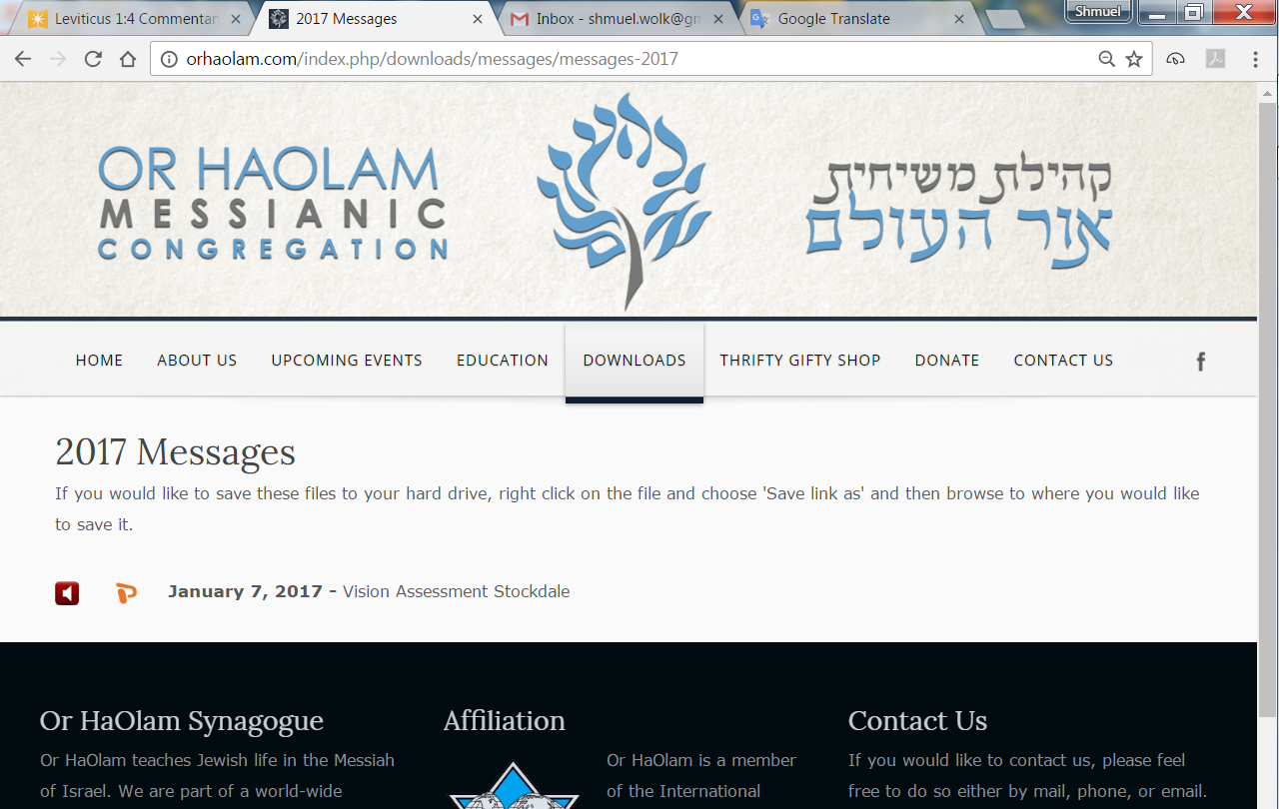

Slide 4
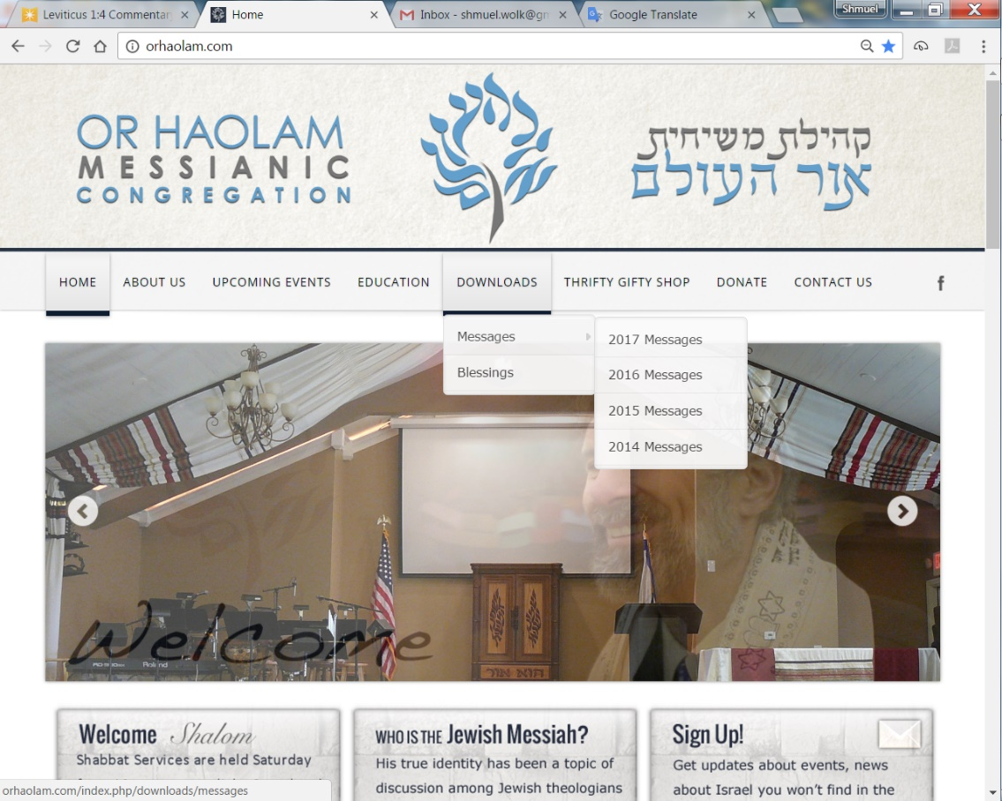
Downloads\messages\
2017 Messages
Notes:
Pres. Trump understands what is truly hindering peace in the Middle East Arab/Israeli sphere.

Slide 5
The water pistol
When my three-year-old son opened the birthday gift from his grandmother, he discovered a water pistol... He squealed with delight and headed for the nearest sink.
I was not so pleased.

Slide 6
The water pistol
I turned to mom and said, “I'm surprised at you. Don't you remember how we used to drive you crazy with water guns?"
Mom smiled and then replied...
"I remember!!"
Notes:
Next from Lori Wilson

Slide 7
Never talk to pi.
He'll go on forever.
Pi π
3.1415926535897932384626433832795028841971693993751058…
Our granddaughter, born on PI day. Birthday last Tuesday…
Notes:
From Lori Wilson
Once, when I was trying to remember my granddaughter’s birthday, my son Daniel said, “Dad how could you NOT remember. She’s a PI day baby!”

Slide 8
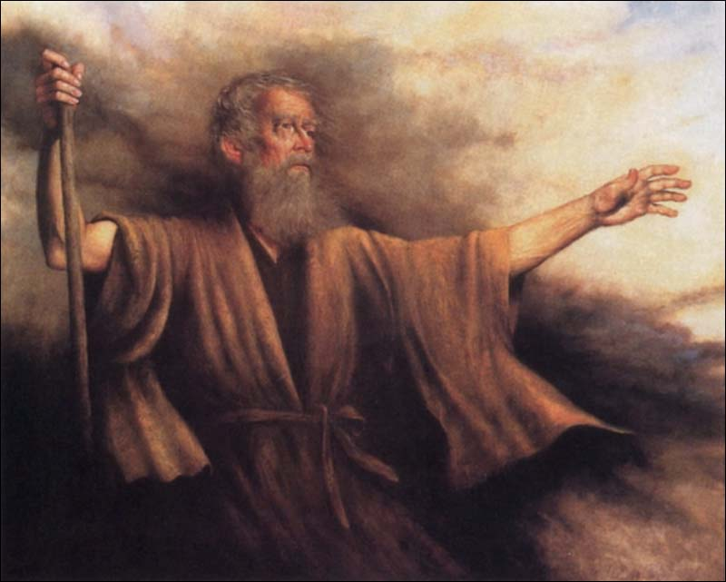
Sh’mot שְׁמוֹת
(Exodus) 30:11-14
(from) Ki Tisa / When you take כִּי תִשָּׂא

Slide 9
Half-Shekel atonement?
Notes:
In this seemingly obscure commandment is
A LOT of foundational theology
A LOT of Jewish history

Slide 10

Sh’mot (Exodus) 30:11
יְיָ
Adoni
Notes:
Likely most common Hebrew phrase in Torah.

Slide 11
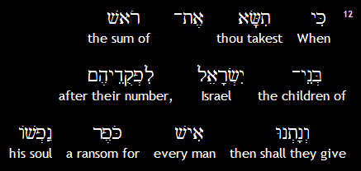
Sh’mot (Exodus) 30:12a
Notes:
Same root as
כִּפֵּר פ' פיעל to grant atonement, to forgive
An atonement!!????
The anti-Messianic teachers, Tovia Singer, Michael Skobac, etc., say there are many forms of atonement. Blood sacrifice not essential. Yeshua not needed. Consider the basis of their argument, starting above.

Slide 12
^{Nu 31.48-50} The officers in charge of the thousands who fought … approached Moshe and said to him, “Your servants have counted all the soldiers under our command, and not one of us is missing. We have brought an offering for Adoni

Slide 13
^{Nu 31.48-50} what every man has obtained in the way of gold jewelry — armlets, bracelets, signet rings, earrings and belts — to make atonement for ourselves before Adoni.”
לְכַפֵּר עַל-נַפְשֹׁתֵינוּ,
Notes:
Restitutionary atonement for the depredations and corruptions of war. Who knows what happened in the rage of battle and siege.

Slide 14
^{Nu 17.11} Moshe said to Aharon, “Take your fire pan, put fire from the altar in it, lay incense on it, and hurry with it to the assembly to make atonement for them, because anger has gone out from Adoni, and the plague has already begun!” Intercession
Notes:
Intercessory atonement

Slide 15
^{T’hillim 51.16-19} Rescue me from the guilt of shedding blood, God, God of my salvation! Then my tongue will sing about your righteousness — Adoni, open my lips; then my mouth will praise you.

Slide 16
^{T’hillim 51.16-19} For you don’t want sacrifices, or I would give them; you don’t take pleasure in burnt offerings. My sacrifice to God is a broken spirit.
Repentance and contrition as atoning sacrifice.

Slide 17
^{Hoshea 14.2-3} Return, Isra’el, to Adoni your God, for your guilt has made you stumble. Take words with you, and return to Adoni; say to him, “Forgive all guilt, and accept what is good;
we will pay instead of bulls
[the offerings of] our lips.
Notes:
Prayer instead of sacrifice?

Slide 18
^{Mishlei/Prov.16.6} Grace and truth atone for iniquity, and people turn from evil through fear of Adoni
Notes:
Many forms of atonement. So, do we really need the blood sacrifice of the Temple then, of the Lamb Yeshua now??
Anti-Messianic teachers say no. Are they right?

Slide 19
Various forms of atonement in scripture NOT mutually exclusive
Repentance and contrition
Prayer
Grace and truth [righteous life]
Blood sacrifice
Intercession
Restitution
Notes:
When we come to Yeshua, we need indeed to be in repentance and contrition, prayer, grace and truth in our living, restitution for wrong, intercession in our lifestyle. His sacrifice, without all that, is not really applied!
You may say, “I don’t think all that stuff is necessary. I prayed the sinner’s prayer, and I’m eternally saved.”
Scripture says, “No. You receive Him and in Him a lifestyle of Messiah likeness.”
A bit like Sacred Namers. If I have the right Name, I’m pleasing G-d. No, if have right LIFE. Hallowed by thy Name means lifesyle of honoring G-d in Yeshua.

Slide 20
^{1Kefa/Peter 1.18-19} You should be aware that the ransom paid to free you from the worthless way of life which your fathers passed on to you did not consist of anything perishable like silver or gold; on the contrary,

Slide 21
^{1Kefa/Peter 1.18-19} it was the costly bloody sacrificial death of the Messiah, as of a lamb without defect or spot

Slide 22
Sh’mot (Exodus) 30:12a
Notes:
was prototypical, symbolic, of the ransom price of souls by Messiah, which is not silver or gold, but his precious blood, his life, himself, which is given as an offering and sacrifice to God, in the room and stead of his people;

Slide 23
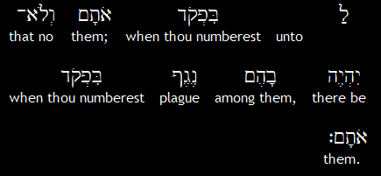
Sh’mot (Exodus) 30:12b
יְיָ
Adoni,
Notes:
Ever happen?

Slide 24
^{2 Sam 24.1-15} The anger of ADONI blazed up against Isra'el, so he moved David to act against them by saying, "Go, take a census of Isra'el and Y'hudah." The king said to Yo'av the commander of the army, who was with him, "Go systematically through all the tribes of Isra'el,
Notes:
Anger of Adoni? Apparently saw something in King David’s, Daveed HaMelekh’s, heart, needed to be tested, and Daveed failed the temptation.

Slide 25
^{2 Sam 24.1-15} from Dan to Be'er-Sheva; and take a census of the population; so that I can know how many people there are." Yo'av said to the king, "May ADONI your God add to the people a hundredfold, no matter how many there are; and may the eyes of my lord the king see it. But why does my lord the king take pleasure in doing this?"

Slide 26
^{2 Sam 24.1-15} However, the king's word prevailed against Yo'av and the army officers. So Yo'av and the army officers went out from the king's presence to take a census of the people of Isra'el… But after he had taken the census, David was conscience-stricken.
Notes:
Why conscience stricken?
Half shekel not collected
1,570,000 people x $3.85/half shekel = $6,500,000
Previously taught on this in March 16, 2001. No commentator got it then.
Best commentator now [John Gill] “he began to see the pride and haughtiness of his heart; his vanity and confidence in the creature, which led him to it; aggravated by doing it without seeking to know the mind of God, and without giving him his due, the half shekel, according to the law”

Slide 27
^{2 Sam 24.1-15} David said to ADONI, "I have greatly sinned in what I have done. But now, ADONI, please! Put aside your servant's sin, for I have done a very foolish thing." When David got up in the morning, this word of ADONI came to the prophet Gad,

Slide 28
^{2 Sam 24.1-15} David's seer: "Go and say to David that this is what ADONI says: 'I am giving you a choice of three punishments. Choose one of them, and I will execute it against you." Gad came to David and told him; he said: "Do you want seven years

Slide 29
^{2 Sam 24.1-15} of famine in your land? or do you want to flee before your enemies for three months while they pursue you? or do you want three days of plague in your land? Think about it, and tell me what to answer the one who sent me."

Slide 30
^{2 Sam 24.1-15} David said to Gad, "This is very hard for me. Let us fall into the hand of ADONI, because his mercies are great, rather than have me fall into the hand of man."

Slide 31
^{2 Sam 24.1-15} So ADONI sent a plague on Isra'el from that morning until the end of the specified time; 70,000 of the people died between Dan and Be'er-Sheva.
Notes:
Rest of the story…angel of death over Jerusalem, Ornan’s threshing floor. Purchased it and animals for sacrifice, and became the Temple mount.

Slide 32
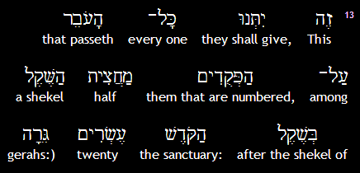
Sh’mot (Exodus) 30:13a

Slide 33
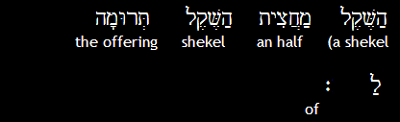
Sh’mot (Exodus) 30:13b
יְיָ
Adoni.

Slide 34
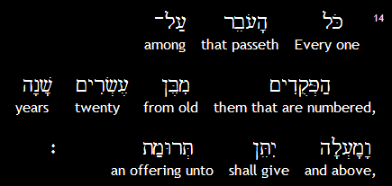
Sh’mot (Exodus) 30:14
יְיָ
Adoni.
Notes:
Rest of section…

Slide 35
^{Shmot/Ex 30.15-16} The rich is not to give more or the poor less than the half-shekel when giving Adoni’s offering to atone for your lives. לְכַפֵּר עַל-נַפְשֹׁתֵיכֶם
You are to take the atonement money from the people of Isra’el and use it for the service in the
Notes:
the price was set so low, that the poorest man might be able to pay it: and even Maimonides Hilchot Shekalim, c. 1. sect. 1. says, if he lived on alms, he was to beg it of others, or sell his clothes from off his back to pay it. [John Gill commentary]
This shows the equality of the redeemed and ransomed of the Lord; for though some sins and sinners are greater than others, and some are redeemed from more sins than others, yet all sins being infinite, as committed against an infinite God
precious blood of Messiah, the Son of God, an infinite and divine Person; hence all the ransomed ones have the same faith, righteousness, salvation, and eternal life:

Slide 36
^{Shmot/Ex 30.15-16} tent of meeting
so that it will be a reminder of the people of Isra’el before Adoni to atone for your lives.”
לְכַפֵּר עַל-נַפְשֹׁתֵיכֶם
Notes:
Maintenance of the Mishkan/Tabernacle and later the Temple. So, came to be called the Temple tax.
As sinners, that their lives were forfeited. John Gill
Later Jewish history…

Slide 37
^{2 K 12.4-5} Y'ho'ash said to the cohanim, "All the funds for sacred purposes which are brought to the house of ADONI - the half-shekel tax, the taxes on persons in a man's household, and all the offerings anyone voluntarily brings
Notes:
David ~1000 BCE
Y’hosash ~856 BCE, 150 years after David.

Slide 38
^{2 K 12.4-5} to the house of ADONI - the cohanim are to receive from whoever personally makes contributions to them; and they are to use these funds to repair the damaged parts of the house, wherever damage is found.

Slide 39
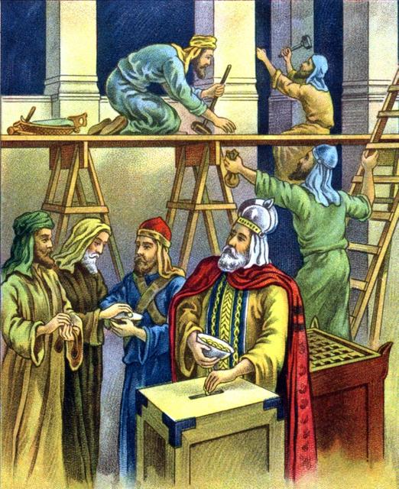

Slide 40
In later centuries, the half-shekel was adopted as the amount of the Temple Tax, even without a census, although in Nehemiah 10:33–34 the tax is given as a third of a shekel.
Notes:
https://en.wikipedia.org/wiki/Temple_tax

Slide 41
^{Nekhemiah 10.33-34} “We will impose on ourselves a yearly tax of one-third of a shekel [one-seventh of an ounce of silver] for the service of the house of our God, for the showbread, for the regular grain offering,
Notes:
Who gave Nekhemiah authority to change scripture? Not a census, so Shmot/Ex 30 didn’t exactly apply.

Slide 42
^{Nekhemiah 10.33-34} for the regular burnt offering, for [the offerings] on Shabbat, on Rosh-Hodesh, at the designated times and at other holy times, for the sin offerings to make atonement for Israel, and for all the work connected with the house of our God.”
Notes:
Carried down to Yeshua’s time…

Slide 43
^{Mtt 17.24-27} When they came to K'far-Nachum, the collectors of the half-shekel came to Kefa and said, "Doesn't your rabbi pay the Temple tax?"
Notes:
Not the Roman tribute, with the image of Caesar on it. Different tax, different story
Israeli half shekel

Slide 44
^{Mtt 17.24-27} "Of course he does," said Kefa.
When he arrived home, Yeshua spoke first.
"Shim`on, what's your opinion? The kings of the earth -- from whom do they collect duties and taxes?

Slide 45
^{Mtt 17.24-27} From their sons or from others?" "From others," he answered. "Then," said Yeshua, "The sons are exempt. But to avoid offending them -- go to the lake,

Slide 46
^{Mtt 17.24-27} throw out a line, and take the first fish you catch. Open its mouth, and you will find a shekel. Take it and give it to them for me and for you."
I.e., two half shekels, on for Kefa/Peter, one for Yeshua.
Notes:
Archeology about the significance of this…

Slide 47
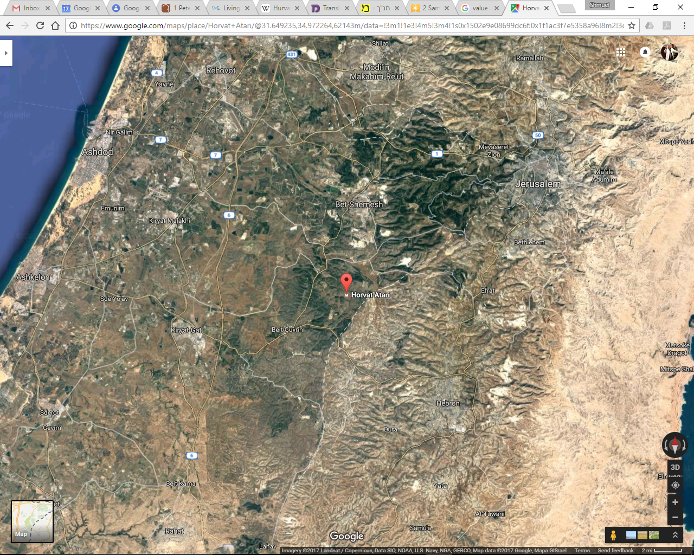
Hurvat Itri
Notes:
Middle of Judean hills, southwest of Jerusalem

Slide 48
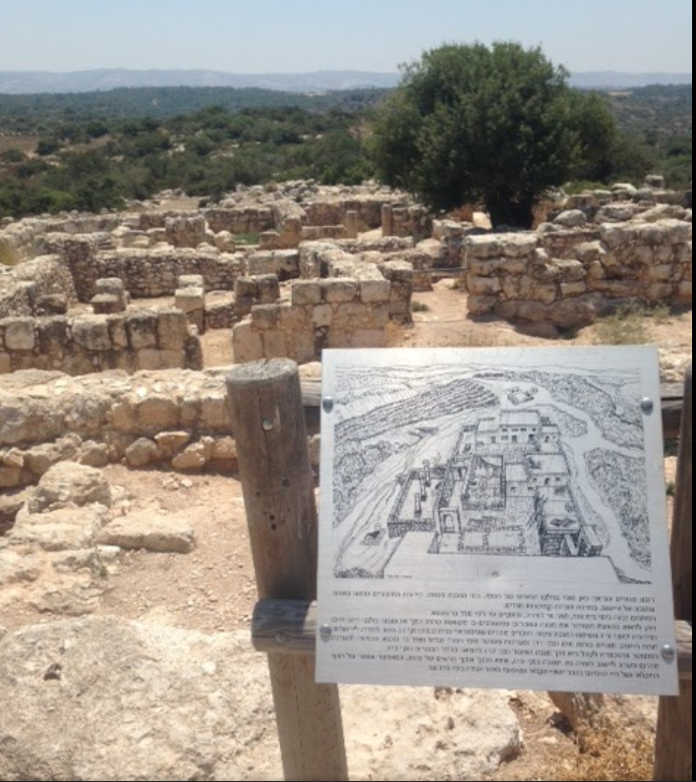
Hurvat Itri, ruins of Itri,
From 135 CE Second revolt
Notes:
Apparently from 135 CE: formidable wall formations, with massive stones, which led Israeli archaeologist, Boaz Zissu, to believe that it may have been one of the fifty strongholds in Judea destroyed by Hadrian during the second Jewish revolt (the Great Revolt).
https://en.wikipedia.org/wiki/Hurvat_Itri

Slide 49
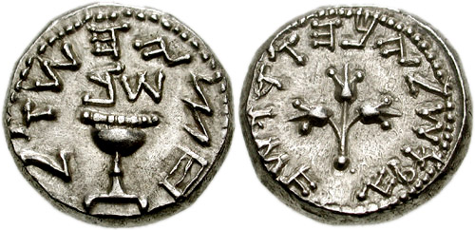
The half-Shekel coin discovered
in Hurvat Itri $3.85 Ag
Notes:
Archaeological excavations conducted at Hurvat Itri in Israel from 1999 to 2001 by Boaz Zissu and Amir Ganor of the Israeli Antiquities Authority (IAA) have yielded important finds, the most-prized of which being a half-Shekel coin minted in the 2nd century CE, upon which are embossed the words "Half-Shekel" in paleo-Hebrew (Hebrew: חצי השקל‎), and which same coin possesses a silver content of 6.87 grams [$3.85] https://en.wikipedia.org/wiki/Shekel#Collection_of_the_half-Shekel and a bronze coin with a date-palm tree and the inscription, "El'azar the Priest," on its obverse side, and a cluster of grapes with the inscription, "Year One of the Freedom of Israel," on its reverse side
https://en.wikipedia.org/wiki/Hurvat_Itri

Slide 50
After the return under Nehemiah, Jews [all throughout] the Diaspora continued to pay the Temple tax. Josephus reports that at the end of the 30s CE "many tens of thousands" of Babylonian Jews guarded the convoy taking the tax to Jerusalem ^{(Ant. 18.313).}
Notes:
https://en.wikipedia.org/wiki/Temple_tax
Continued in Yeshua’s day, into Roman times. You may have thought this was an obscure Torah command, became a key to Jewish identity.

Slide 51
The first Roman attempt to halt payments of the tax was made long before the Jewish War on account of customs controls. The Senate had forbidden the export of gold and silver, but the Jews of Italy continued to pay the Temple tax.
Notes:
https://en.wikipedia.org/wiki/Temple_tax

Slide 52
In 62 BCE L. Valerius Flaccus, governor of the province of Asia, issued an edict forbidding the Jews of his province from sending the tax to Jerusalem. After the destruction of the Temple in Jerusalem in CE 70,
Notes:
https://en.wikipedia.org/wiki/Temple_tax

Slide 53
new Roman tax was imposed for taxation of the Jews, the Fiscus Judaicus diverted into imperial coffers.
Notes:
https://en.wikipedia.org/wiki/Temple_tax

Slide 54
The tax was initially imposed by Roman Emperor Vespasian as one of the measures against Jews as a result of the First Roman-Jewish War of 66–73 AD (first Jewish revolt) (Josephus BJ 7. 218; Dio Cassius 66.7.2).
Notes:
https://en.wikipedia.org/wiki/Fiscus_Judaicus

Slide 55
The tax was imposed on all Jews throughout the empire, not just on those who took part in the revolt against Rome. The tax was imposed after the destruction of the Second Temple in 70 AD in place of the levy (or Tithe) payable by Jews towards the upkeep of the Temple.
Notes:
https://en.wikipedia.org/wiki/Fiscus_Judaicus

Slide 56
The amount levied was two denarii, equivalent to the one-half of a shekel that observant Jews had previously paid for the upkeep of the Temple of Jerusalem (Exodus 30:13). The tax was to go instead to the Temple of Capitoline Jupiter, the major center of ancient Roman religion.
Notes:
https://en.wikipedia.org/wiki/Fiscus_Judaicus

Slide 57
The fiscus Iudaicus was a humiliation for the Jews. In Rome, a special procurator known as procurator ad capitularia Iudaeorum was responsible for the collection of the tax. Only those who had abandoned Judaism were exempt from paying it.
Notes:
https://en.wikipedia.org/wiki/Fiscus_Judaicus

Slide 58
While the tax paid for the Temple of Jerusalem was payable only by adult men between the ages of 20 and 50, the fiscus Iudaicus was imposed on all Jews, including women, children, and elderly—and even Jewish slaves.
The tax was continued even after the completion of the reconstruction of the Capitoline temple for its upkeep.
Notes:
https://en.wikipedia.org/wiki/Fiscus_Judaicus

Slide 59
Domitian, who ruled between 81 and 96 AD, expanded the fiscus Iudaicus to include not only born Jews and converts to Judaism, but also on those who concealed the fact that they were Jews or observed Jewish customs. Suetonius relates that
Notes:
https://en.wikipedia.org/wiki/Fiscus_Judaicus

Slide 60
when he was young an old man of 90 was examined to see whether he was circumcised.
Domitian applied the tax even to those who merely "lived like Jews.“
De-incentivize Torah observance!
Notes:
https://en.wikipedia.org/wiki/Fiscus_Judaicus

Slide 61
It did not take long for Christians to petition the Emperor to distinguish the Christians for the purpose of the payment of the fiscus Iudaicus. As the tax only applied to practising Jews, if they could be recognised as a separate religion, they would escape the impost.
Notes:
https://en.wikipedia.org/wiki/Fiscus_Judaicus
So, if you ever wondered what happened to the Ancient Messianic Jewish movement, taxation was another stroke against us!

Slide 62
The tax was revived in the Middle Ages in 1342 under the name of Opferpfennig by the [German] Holy Roman Emperors. The Opferpfennig tax was introduced in 1342 by Emperor Louis IV the Bavarian, who ordered all Jews above the age of 12 and possessing 20 gulden to pay one gulden annually for protection.
Notes:
https://en.wikipedia.org/wiki/Fiscus_Judaicus
Thought “protection” tax was a Mafia idea.

Slide 63
The practice was justified on the grounds that the Germanic Holy Roman Emperor, as the legal successor of the [Italian] Roman emperors, was the rightful recipient of the Temple tax which Jews paid to the Romans after the destruction of the Second Temple. The Opferpfennig was collected on Christmas day.
Notes:
https://en.wikipedia.org/wiki/Fiscus_Judaicus
Shmot/Ex 30 in force till 1300’s, but as a mockery!

Slide 64
Atonement of European history by deep repentance
Notes:
Introduction Jong Kim and Alan Armfield, recently got back from March of Life Conference in Tubingen, Germany. Like them to give a 10 minute report, then Q&A after prayer time, 1:30 p.m.

Slide 65
A STORY OF GOD’S REDEMPTION IN
TUBINGEN, GERMANY
For behold, the darkness shall cover the earth,
And deep darkness the people;
But the LORD will arise over you,
And His glory will be seen upon you.
NKJ Isaiah 60:1-2

Slide 66
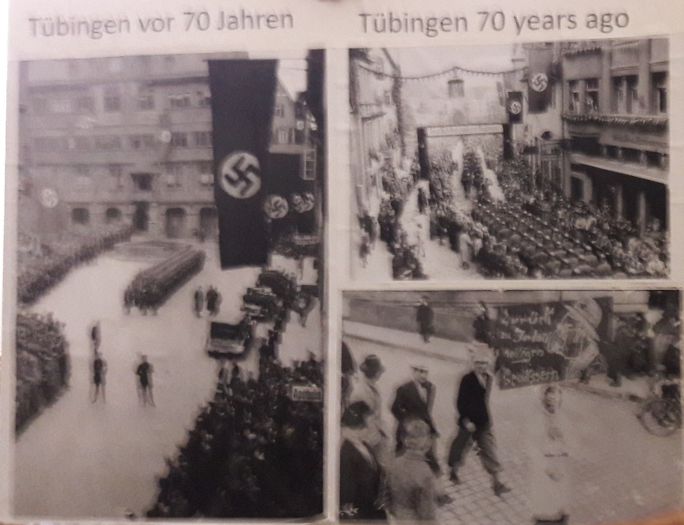
7-
Nazi Center, Tubingen 70 years ago

Slide 67
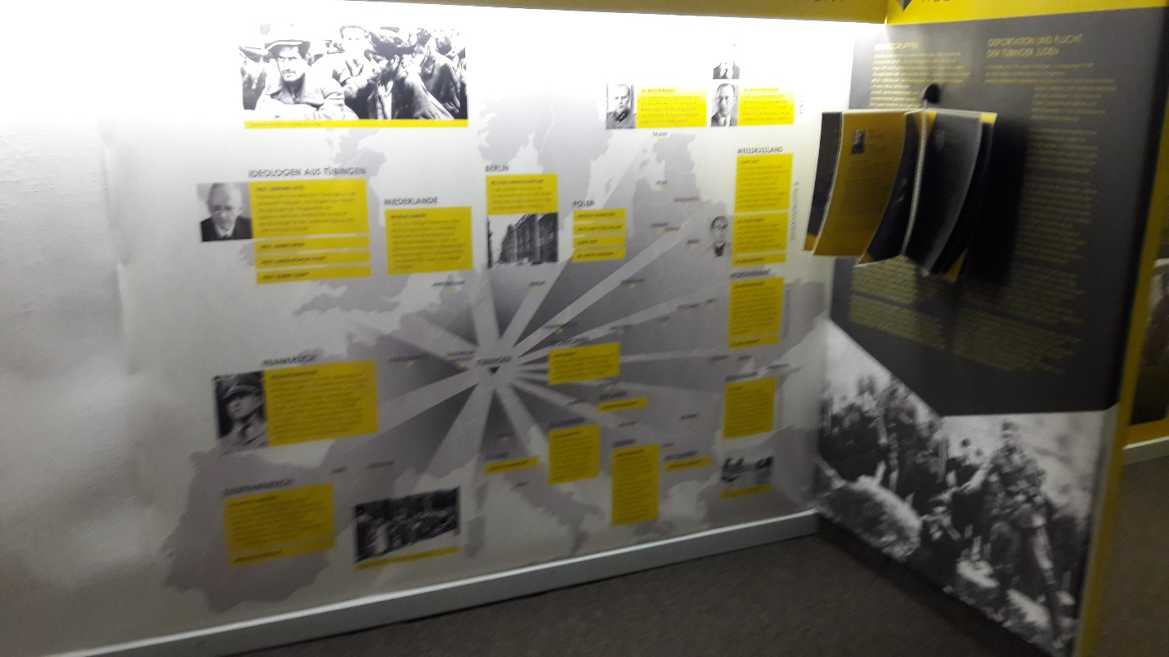
FROM TUBINGEN, NAZI IDEOLOGY SPREADS

Slide 68
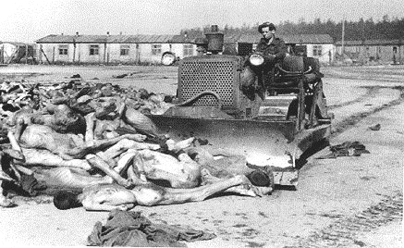
RESULTS OF NAZI IDEOLOGY

Slide 69
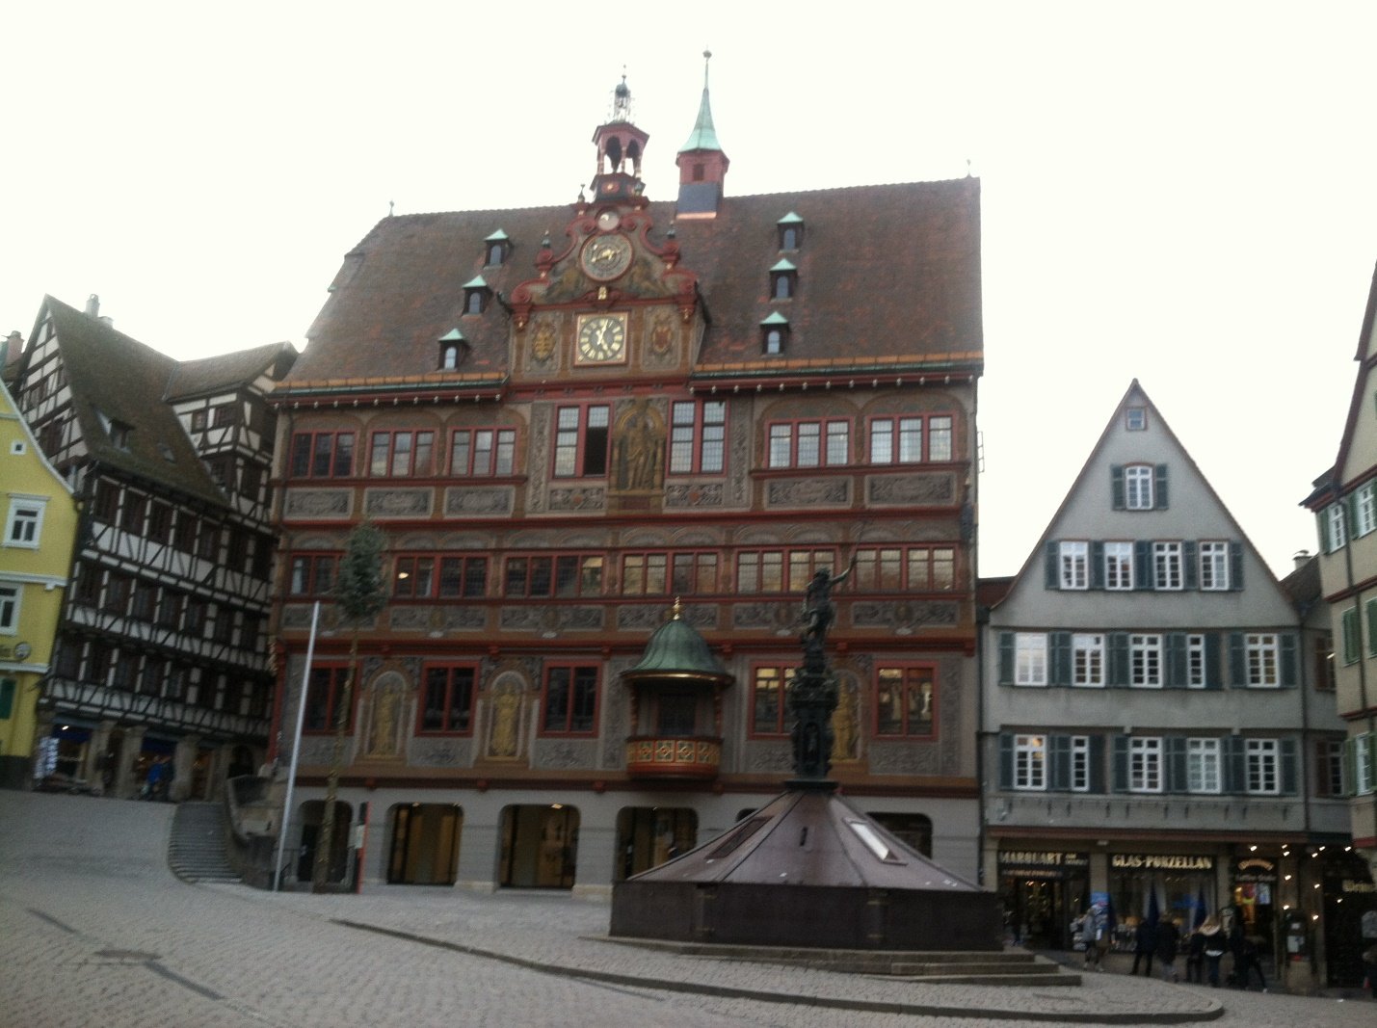

Slide 70
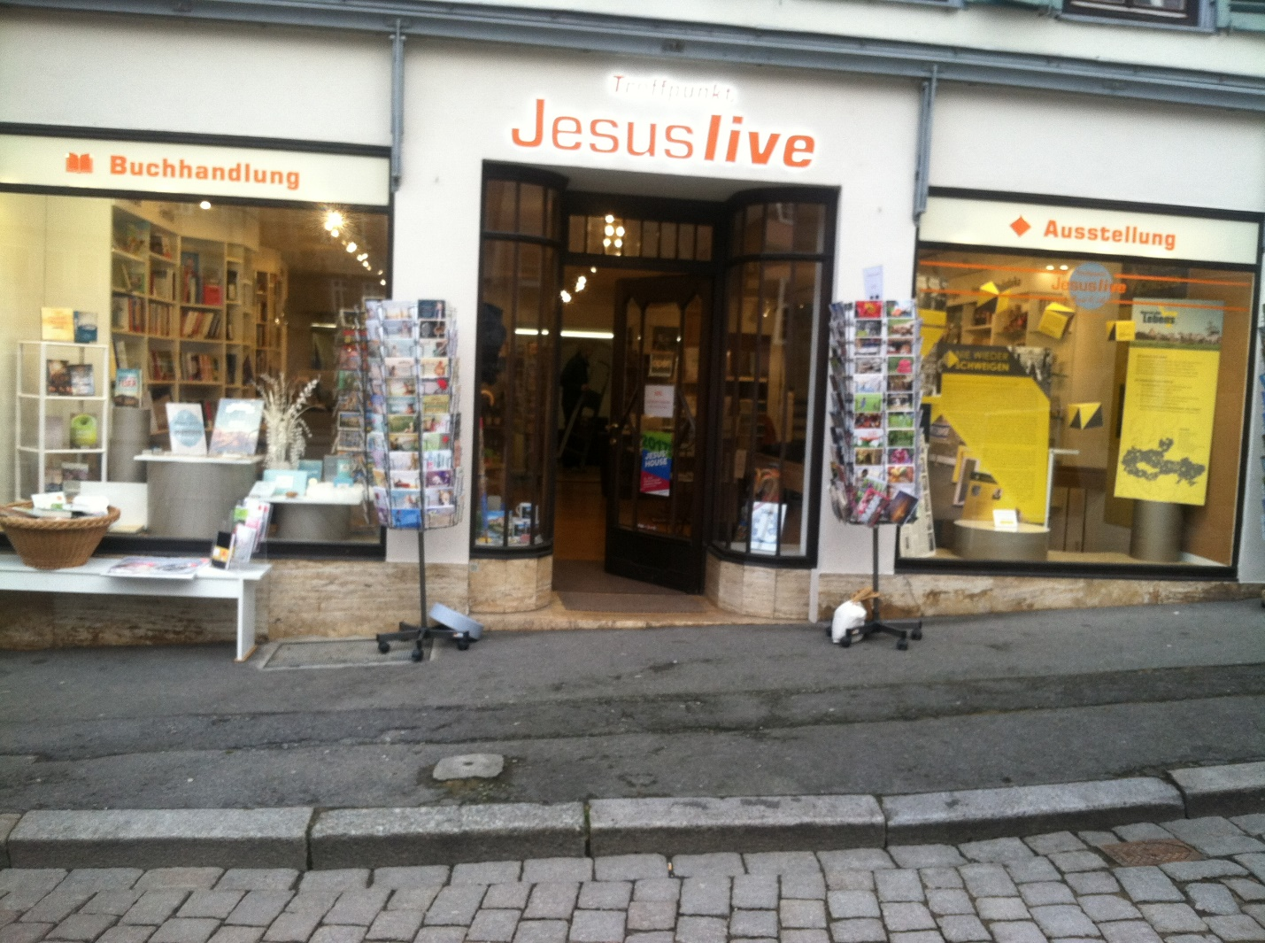
Jesus Live Christian bookstore and March of Life museum

Slide 71
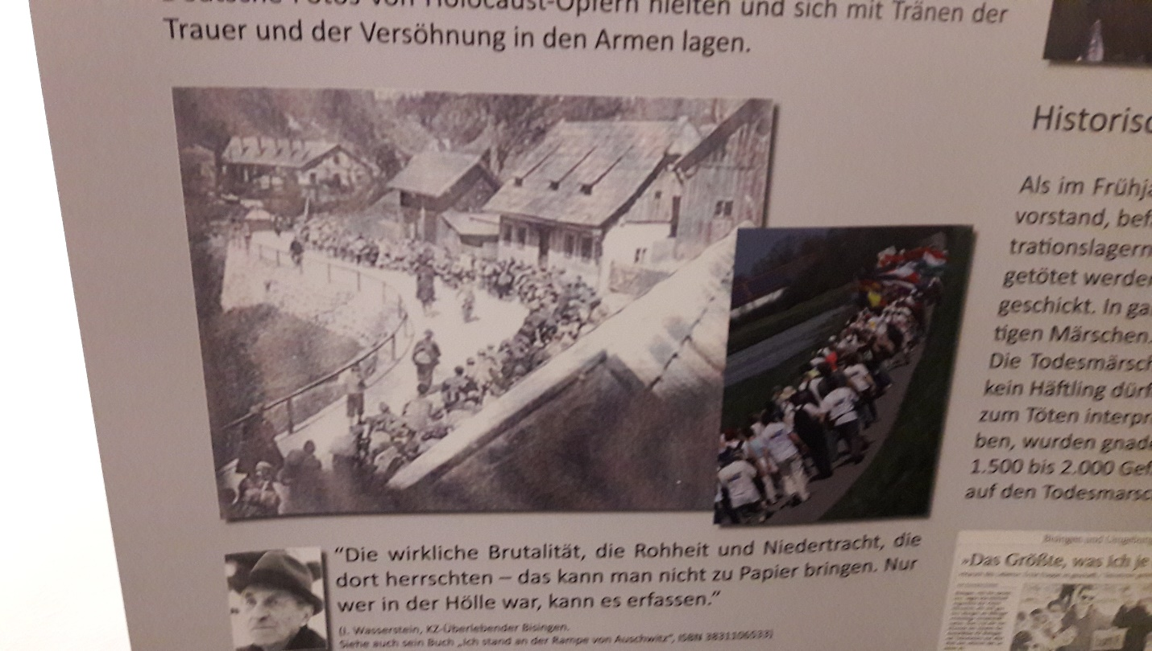
M
March of death in 1945 and March of Life in 2007

Slide 72
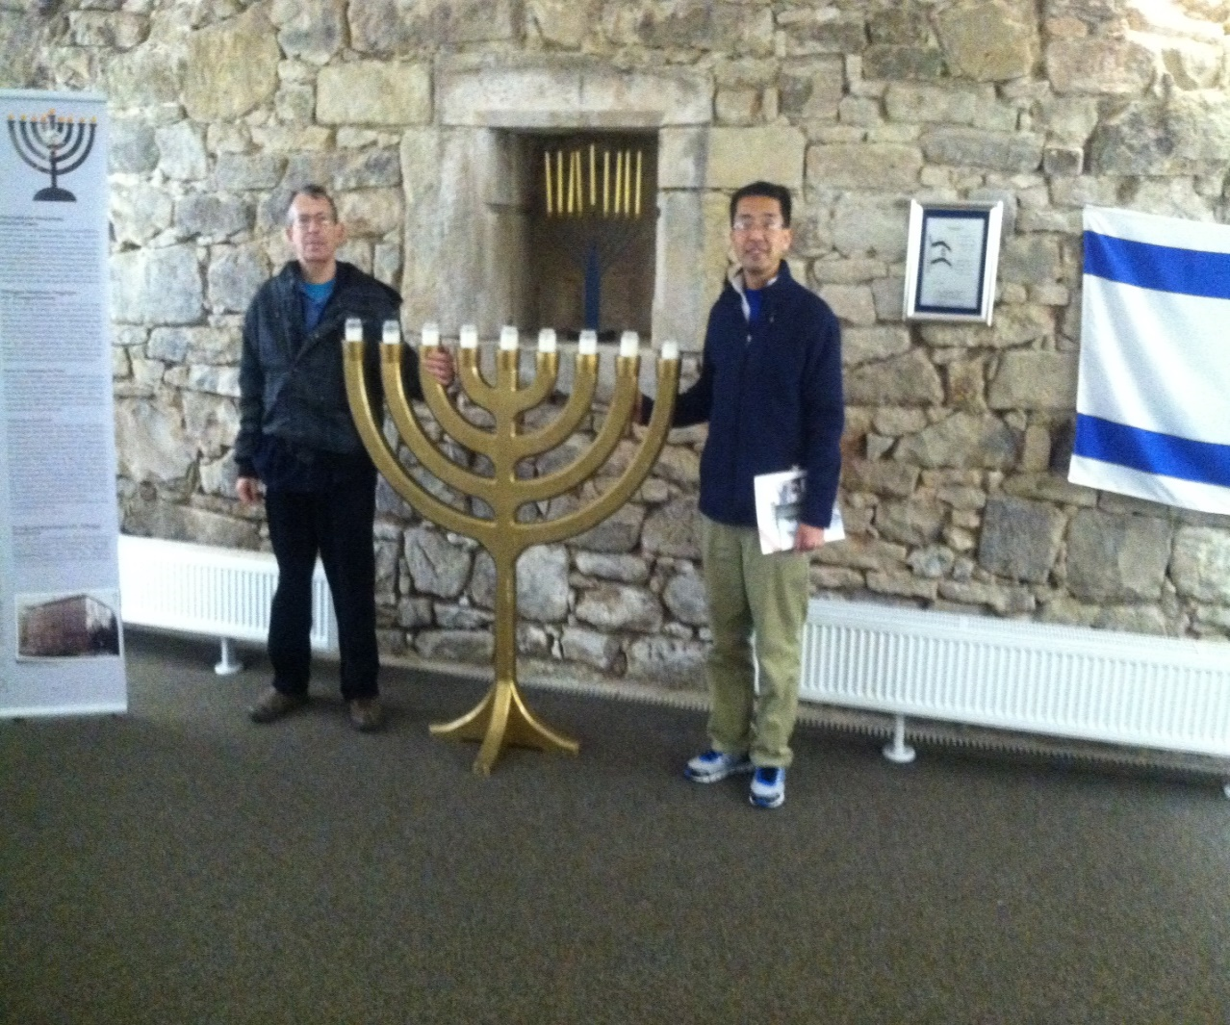

March of Life Museum

Slide 73
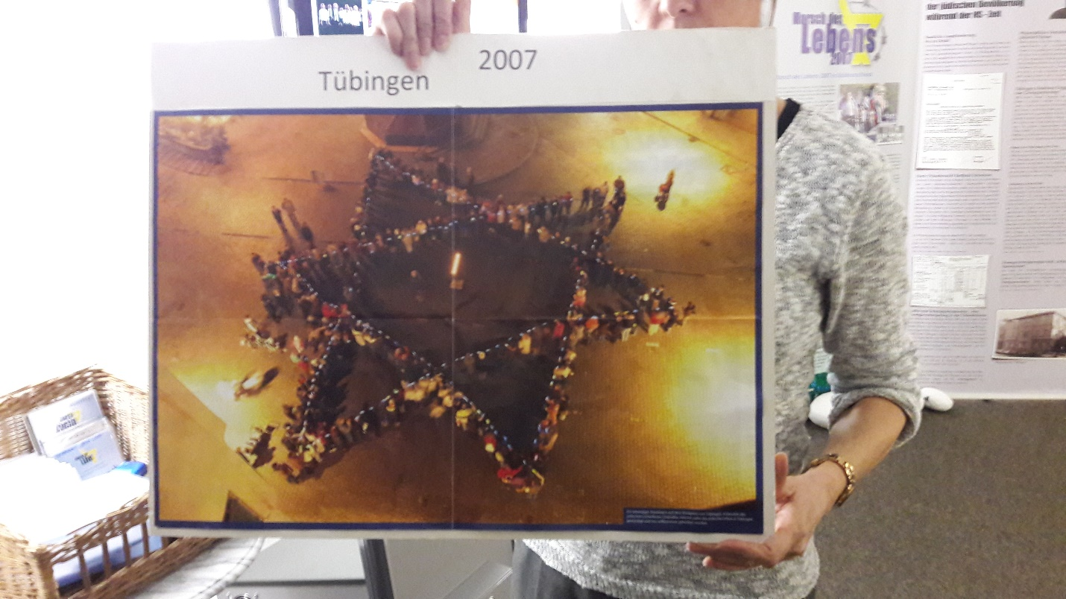
Nazi Descendants celebrating Hanukkah Tubingen, 2007

Slide 74
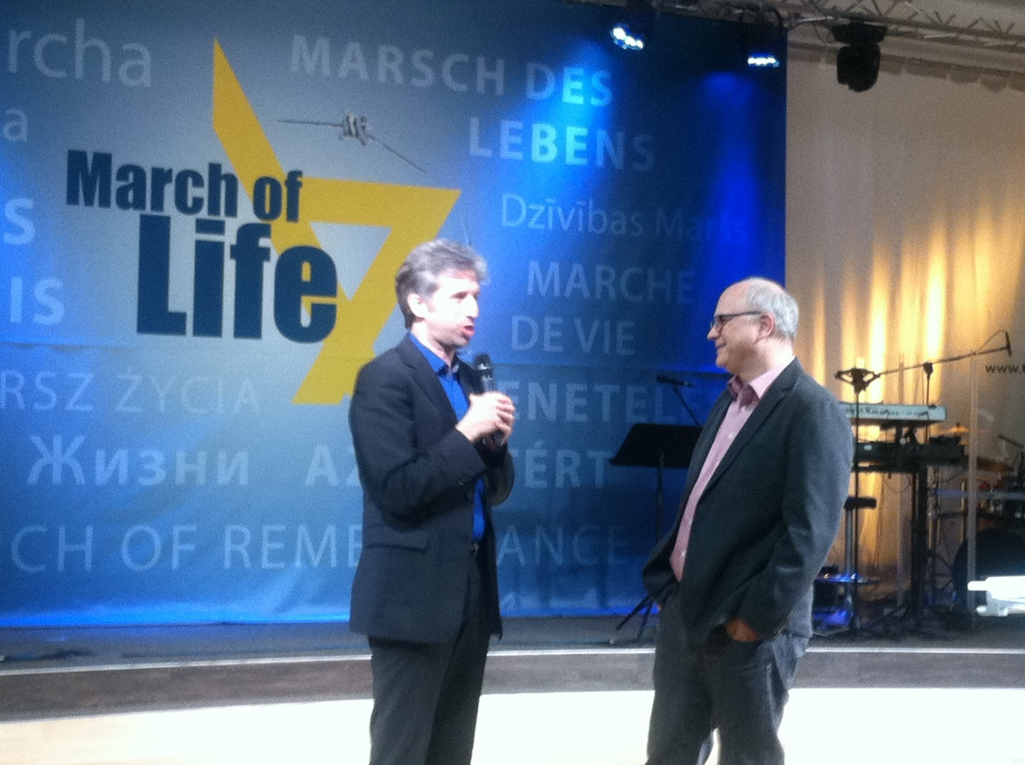
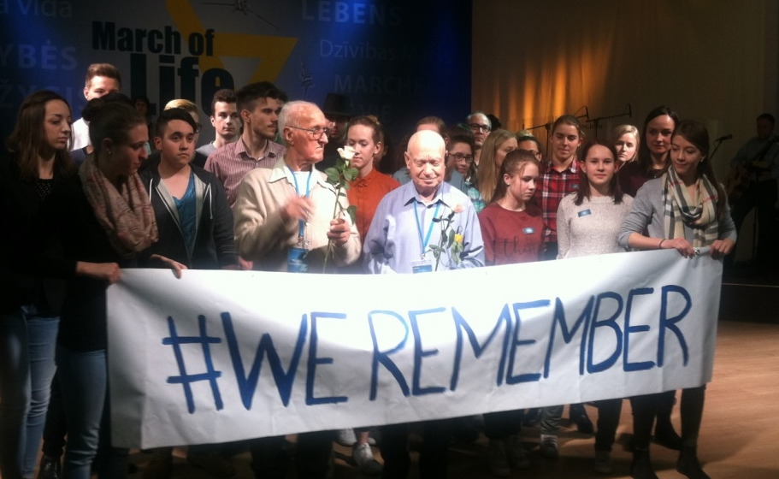
Mayor of Tubingen. His father is Jewish

Slide 75
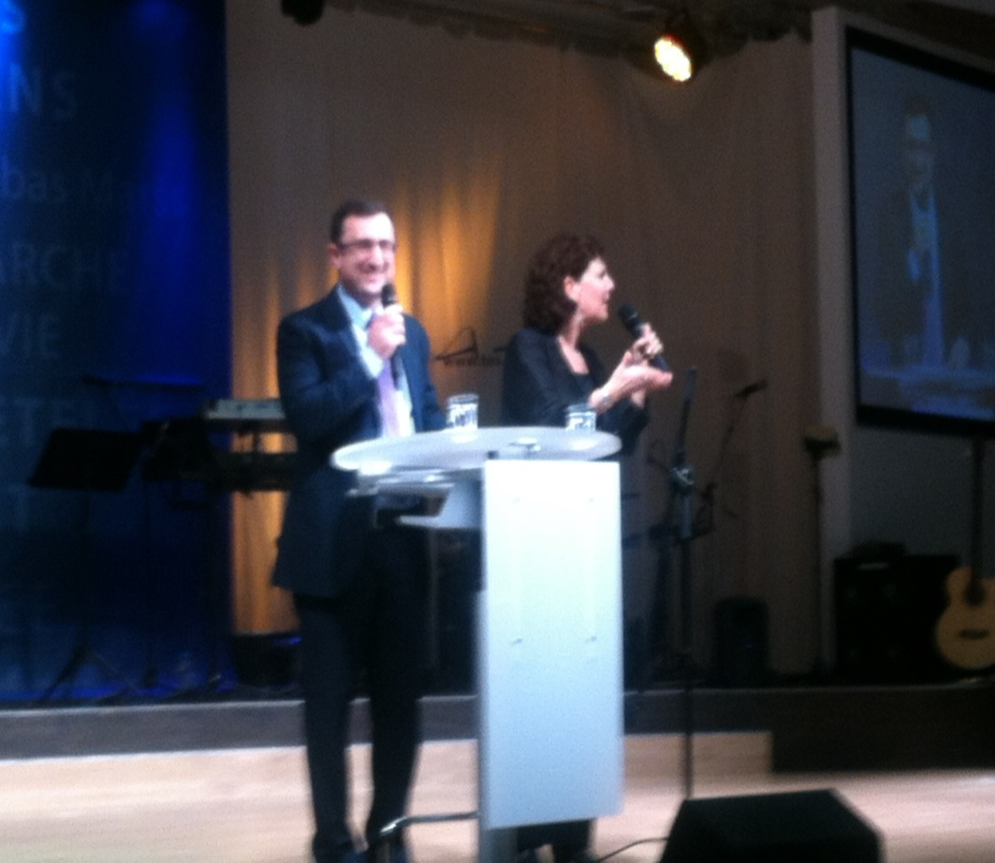
Robert Ilatov, Knesset member at the conference.

Slide 76
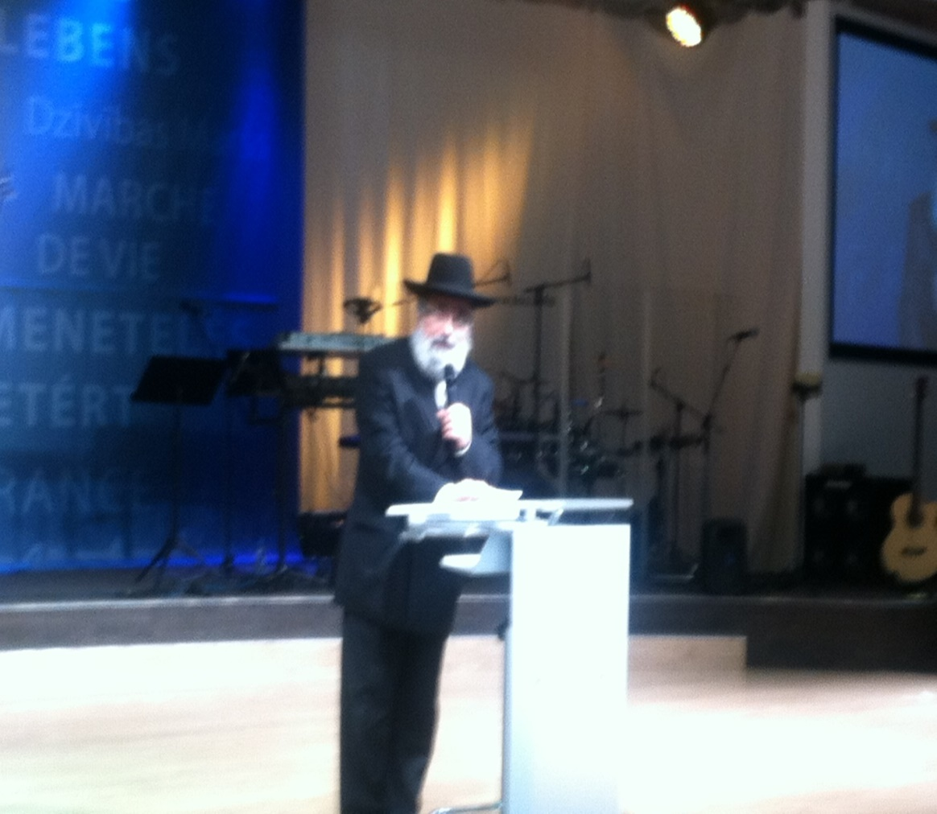
Rabbi of Southern Germany spoke at the conference in Tubingen.

Slide 77

German youth stand with Jewish Holocaust surviors.

Slide 78
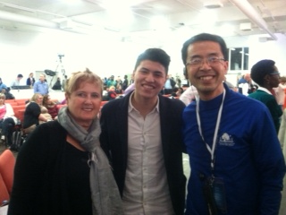
One New Man in Messiah: A Jewish Holocaust descendant and Palestinian Youth.

Slide 79
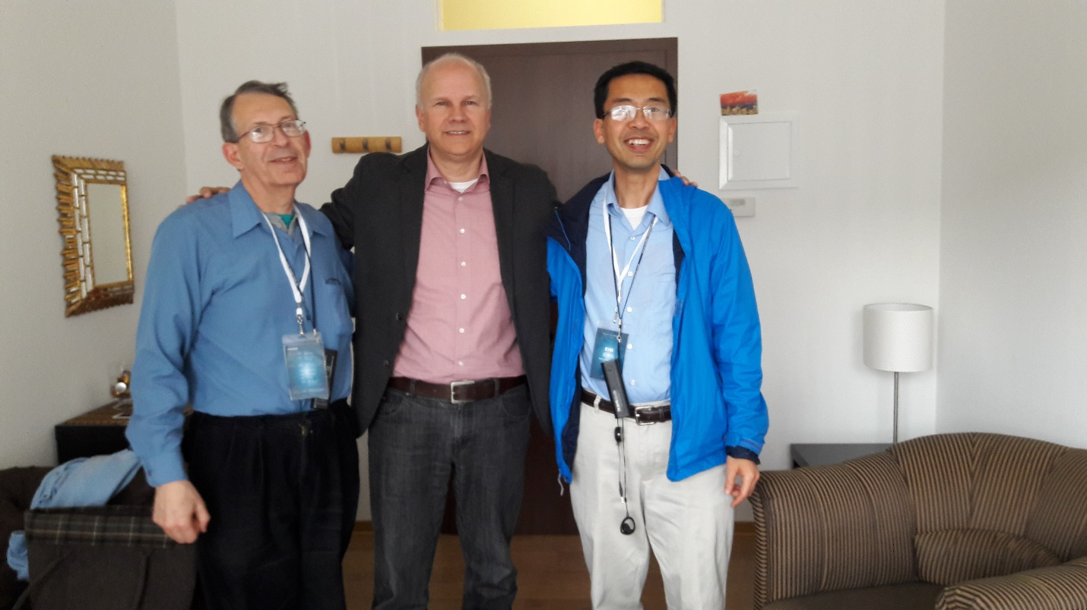
Pastor Jobst Bittner, Father of March of Life

Slide 80
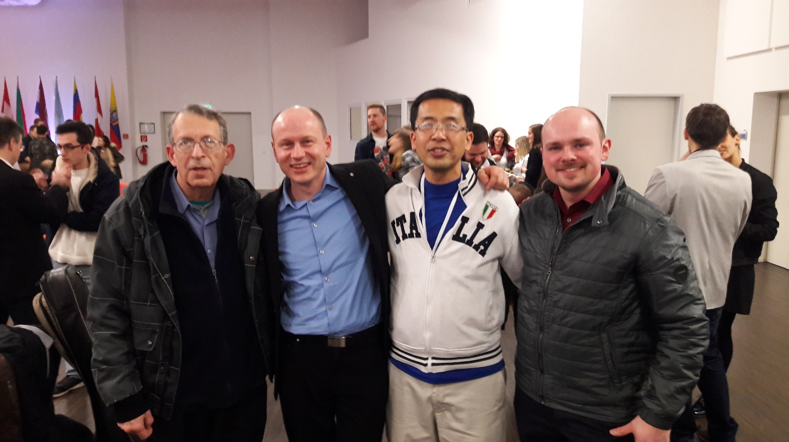
We prayed with Descendants of Nazis
In TOS Church’s 24/7 House of Prayer

Slide 81
How can we partner with G-d now?
1. BREAK THE VEIL OF SILENCE IN OUR LIVES.
2. PRAY WITH US FOR BREAKTHROUGH IN OUR CITY
Sundays 8pm-9pm.
40 days of prayer and fasting for March of Remembrance 3/29-5/7.
12 hour (8am to 8pm) prayer vigil at the March of remembrance.

Slide 82
How can we partner with G-d now?
2. JOIN THE MARCH OF REMEMBRANCE & MARCH OF LIFE/NATIONS.
March of Remembrance: May 7^{th,} 2017, Overland Park Convention Center.
March of Life in Israel: May 16-25, 2017.
March of Nations in Jerusalem: May 13-15, 2018.

Slide 83
Various forms of atonement in scripture NOT mutually exclusive
Repentance and contrition
Prayer
Grace and truth [righteous life]
Blood sacrifice
Intercession
Restitution
Notes:
When we come to Yeshua, we need indeed to be in repentance and contrition, prayer, grace and truth in our living. His sacrifice, without all that, is not really applied!

