Slide 1
To easily follow these notes, log on to our Wifi
Wifi: mycci01
p/w: ancientquail060
Go to OrHaOlam.com
Click on downloads, messages, 2017

Slide 2
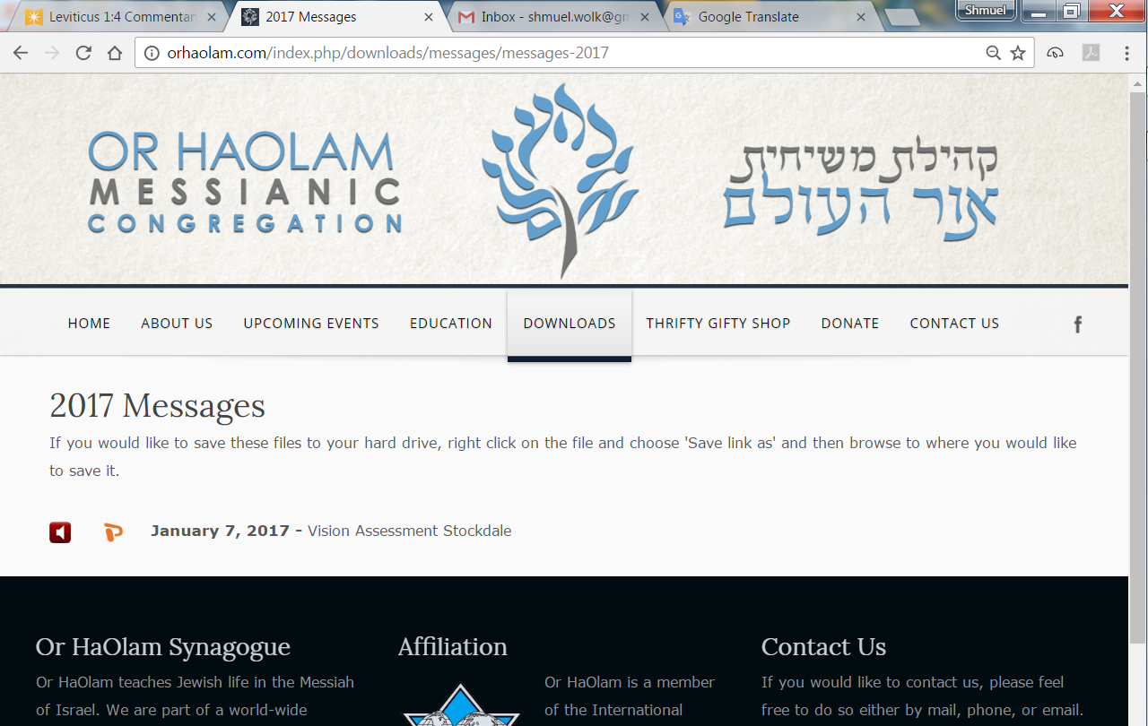

Slide 3
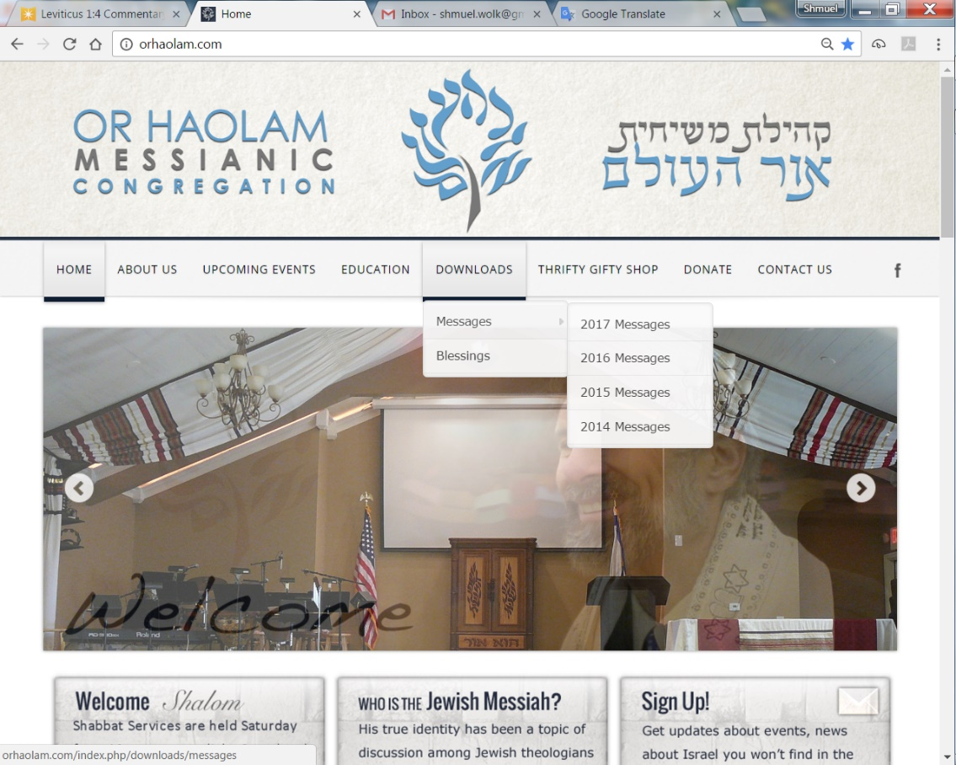
Downloads\messages\
2017 Messages
Notes:
Rivka 10 minute or less report

Slide 4
Dad's trick
“Oh, I sure am happy to see you," the little boy said to his grandmother on his mother's side. "Now maybe daddy will do the trick he has been promising us."
The grandmother was curious. "What trick is that?" She asked.

Slide 5
Dad's trick
"I heard him tell mommy that he would climb the walls if you came to visit," the little boy answered.

Slide 6
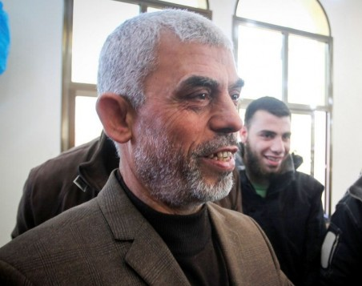
Yahya Sinwar, the new leader
of Hamas in the Gaza Strip
Notes:
Yahya Sinwar, the new leader of Hamas in the Gaza Strip, attends the opening of a new mosque in the southern Gaza city of Rafah on February 24, 2017. (Abed Rahim Khatib/Flash90)
http://www.timesofisrael.com/hamass-gaza-chief-vows-to-liberate-all-of-palestine/?elqTrackId=896470bf2f874294b665f011668af858&elq=14be95d218b143c286aeac0f53c488f8&elqaid=27966&elqat=1&elqCampaignId=16910

Slide 7
Speaking at an event marking the anniversary of the death of Hamas founder Ahmed Yassin, who was killed in an Israeli airstrike in 2004 in Gaza City, Yahya Sinwar said Hamas would not allow the State of Israel to exist on even a “morsel” of land.
Notes:
http://www.timesofisrael.com/hamass-gaza-chief-vows-to-liberate-all-of-palestine/?elqTrackId=896470bf2f874294b665f011668af858&elq=14be95d218b143c286aeac0f53c488f8&elqaid=27966&elqat=1&elqCampaignId=16910

Slide 8
He is considered hawkish even within Hamas, [and was elected leader] and opposes any compromise in its policies regarding the Palestinian Authority and Israel. Even from prison, he was one of the main opponents of the Gilad Shalit exchange deal that saw him
Notes:
http://www.timesofisrael.com/hamass-gaza-chief-vows-to-liberate-all-of-palestine/?elqTrackId=896470bf2f874294b665f011668af858&elq=14be95d218b143c286aeac0f53c488f8&elqaid=27966&elqat=1&elqCampaignId=16910

Slide 9
freed because he regarded the terms, one Israeli soldier for 1,027 prisoners, as a surrender to Israel’s conditions.
Notes:
http://www.timesofisrael.com/hamass-gaza-chief-vows-to-liberate-all-of-palestine/?elqTrackId=896470bf2f874294b665f011668af858&elq=14be95d218b143c286aeac0f53c488f8&elqaid=27966&elqat=1&elqCampaignId=16910

Slide 10
One of the commandments mentioned in the Torah is the commandment to observe the Shabbat.
וְאַתָּה דַּבֵּר אֶל בְּנֵי יִשְׂרָאֵל לֵאמֹר: אַךְ אֶת שַׁבְּתֹתַי תִּשְׁמֹרוּ כִּי אוֹת הִוא בֵּינִי וּבֵינֵיכֶם לְדֹרֹתֵיכֶם לָדַעַת כִּי אֲנִי ה' מְקַדִּשְׁכֶם
Notes:
www.ulpanor.com
office@ulpanor.org
Jerusalem: 02-561-1132
Tel Aviv: 03-566-1493 New York: 516-252-4914

Slide 11
"And you, speak to the People of Israel saying: But My Sabbaths you shall keep because it is a sign between Me and you for generations to know that I am G-d Who sanctifies you." (31:13)
Shabbat is a day of rest for the soul and for the body. It is customary on Shabbat to learn a lot of Torah and so to give spiritual sustenance to a person's soul. Passover class
Notes:
www.ulpanor.com
office@ulpanor.org
Jerusalem: 02-561-1132
Tel Aviv: 03-566-1493 New York: 516-252-4914

Slide 12
People also have the practice to sleep a little during the day, because the word "Shabbat"שבת is an acronym for:
שַׁבָּת - "שֵׁנָה בְּשַׁבָּת תַּעֲנוּג"
"Sleep on Shabbat is a Delight."
Notes:
www.ulpanor.com
office@ulpanor.org
Jerusalem: 02-561-1132
Tel Aviv: 03-566-1493 New York: 516-252-4914

Slide 13

Notes:
www.ulpanor.com
office@ulpanor.org
Jerusalem: 02-561-1132
Tel Aviv: 03-566-1493 New York: 516-252-4914

Slide 14
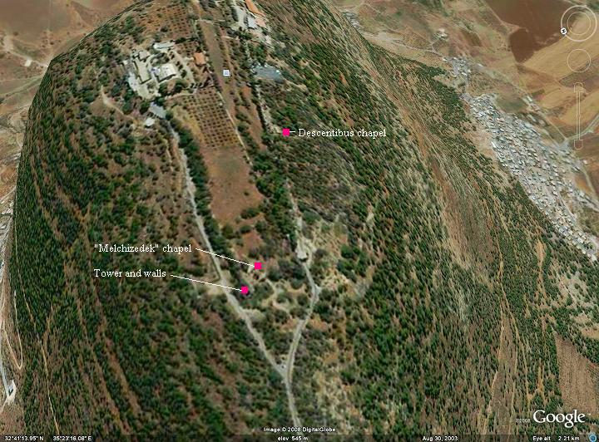
Notes:
Mtt. 16.24-28 Yeshua's Followers Execution stake
Feb. 25, 2017 5777
14
Plateau on top, but fort in Yeshua’s day. Har Tavor, Mt. Tabor.
^{Ju 4.4-14} D'vorah, a woman and a prophet, the wife of Lapidot, was judging Isra'el at that time… She sent for Barak the son of Avino'am, from Kedesh in Naftali, and said to him: "ADONAI has given you this order: 'Go, march to Mount Tavor, and take with you 10,000 men from the people of Naftali and Z'vulun. Barak summoned Z'vulun and Naftali to come to Kedesh. Ten thousand men followed him, and D'vorah went up with him. Sisra was informed that Barak the son of Avino'am had gone up to Mount Tavor…D'vorah said to Barak: "Get going! This is the day when ADONAI will hand Sisra over to you! ADONAI has gone out ahead of you!" So Barak went down from Mount Tavor with 10,000 men following him. Quick review three weeks ago…

Slide 15
^{Mtt 17.1-3} Yeshua took Kefa, Ya‘akov and his brother Yochanan and led them up a high mountain privately. As they watched, he began to change form — his face shone like the sun, and his clothing became as white as light. Then they looked and saw Moshe and Eliyahu speaking with him.
Notes:
Divine revelation/intimacy, ~Holy of Holies. Revelation that everyone craves. Vision that Anna is now delighting in seeing.

Slide 16
^{Yeshayahu 33.14-17} The sinners in Tziyon are frightened; trembling has seized the ungodly. "Who of us can live with the devouring fire? Who of us can live with eternal burning?" He whose life is right and whose speech is straight, he who scorns getting rich by extortion,

Slide 17
^{Yeshayahu 33.14-17} he who shakes his hands free of bribes, stops his ears against talk of bloodshed and shuts his eyes against looking at evil…

Slide 18
^{Yeshayahu 33.14-17} Your eyes will see the king in his beauty, they will gaze on a land stretching into the distance.

Slide 19
Mattityahu (Matthew 17.5b)
Then they looked and saw Moshe and Eliyahu speaking with him…And a voice from the cloud said, “This is my Son, whom I love, with whom I am well pleased. Listen to him!” Shma שמע
Notes:
Mtt. 16.24-28 Yeshua's Followers Execution stake
Feb. 25, 2017 5777
19
Told to ignore, relatively, Moshe and Eliyahu.

Slide 20
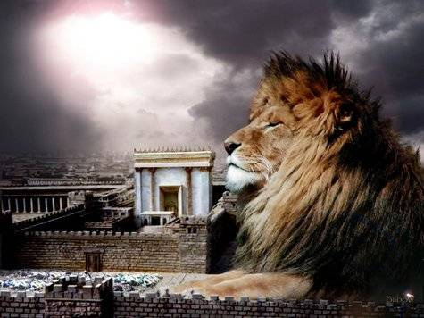
מַתִּתְיָהוּ Mattityahu
(Matthew) 17:10-13
Notes:
So, they had the glorious vision, but had questions..

Slide 21
^{Mtt. 17.9} As they came down the mountain, Yeshua ordered them, “Don’t tell anyone what you have seen until the Son of Man has been raised from the dead.”
Notes:
Y knew minds were churning, and seemed to say, let’s process this.

Slide 22
Mattityahu (Matthew) 17:10
שְׁאָלוּהוּ הַתַּלְמִידִים: "מַדּוּעַ זֶה אוֹמְרִים הַסּוֹפְרִים כִּי אֵלִיָּהוּ צָרִיךְ לָבוֹא תְּחִלָּה?"
The talmidim asked him, "Then why do the Torah-teachers say that Eliyahu must come first?"

Slide 23
Where did they get that?
First Hebrew scriptures
= Tanakh.
Second Rabbinic writings, done later but likely thinking contemporary to Yeshua.
Notes:
Rabbinic writings are useful for background, context, history. Useful, but NOT Word of G-d!
We’ve never had a split, but did lose some people over that issue.

Slide 24
Hebrew scriptures
Some Eliyahu/Elijah by name
Some by role as acknowledged in the Messianic scriptures

Slide 25
First ^{Yeshayahu /Is 40.1-3} “Comfort, comfort My people,” says your God. Speak kindly to the heart of Jerusalem and proclaim to her that her warfare has ended, that her iniquity has been removed.
Notes:
First prophetic reference to Yokhanan
It begins with comforts, and holds on and ends with them; which consolations, Kimchi observes, are what should be in the times of the Messiah;

Slide 26
^{Yeshayahu /Is 40.1-3} For she has received from Adoni’s hand double for all her sins. A voice cries out in the wilderness,
“Prepare the way of Adoni.”
קוֹל קוֹרֵא בַּמִּדְבָּר Kol koray ba-midbar
פַּנּוּ דֶּרֶךְ יְיָ; Panu derekh Adoni
Notes:
Israeli idiom now for hopeless cause.
קוֹל קוֹרֵא בַּמִּדְבָּר Kol koray ba-midbar

Slide 27
^{Yn 1.22-23} So they said to him [Yokhanan/John], “Who are you? — so that we can give an answer to the people who sent us. What do you have to say about yourself?” He answered in the words of Yesha‘yahu the prophet,

Slide 28
^{Yn 1.22-23} “I am The voice of someone crying out: ‘In the desert make the way of Adoni straight!’”
קוֹל קוֹרֵא בַּמִּדְבָּר Kol koray ba-midbar
  פַּנּוּ דֶּרֶךְ יְיָ; Panu derekh Adoni

Slide 29
Second ^{Malakhi 3.22-24 [4.4-6]} “Remember the Torah of Moshe my servant, which I enjoined on him at Horev, laws and rulings for all Isra’el. Look, I will send to you Eliyahu the prophet before the coming of the great and terrible Day of Adoni.
Notes:
Second prophetic reference to Yokhanan

Slide 30
^{Malakhi 3.22-24 [4.4-6]} He will turn the hearts of the fathers to the children and the hearts of the children to their fathers; otherwise I will come and strike the land with complete destruction.”

Slide 31
^{Lk 1.16-17} He will turn many of the people of Isra’el to Adoni their God. He will go out ahead of Adoni in the spirit and power of Eliyahu to turn the hearts of fathers to their children and the disobedient to the wisdom of the righteous, to make ready for Adoni a people prepared.”
Notes:
Zekhariah/Zacharias the Cohen acknowledges that his son is not a literal reincarnation of Eliyahu, but in the spirit and power of him.

Slide 32
Third ^{Malakhi 3.1} “Look! I am sending my messenger to clear the way before me; and the Lord, whom you seek, will suddenly come to his temple. Yes, the messenger of the covenant, in whom you take such delight —
Notes:
Third prophetic reference to Yokhanan

Slide 33
^{Malakhi 3.1} look! Here he comes,”
says Adoni-Tzva’ot.

Slide 34
^{Mtt.11.9-10} Nu, so why did you go out? To see a prophet! Yes! and I tell you he's much more than a prophet. This is the one about whom the Tanakh says, `See, I am sending out my messenger ahead of you; he will prepare your way before you.'

Slide 35
Rabbinic writings, done later, thinking possibly contemporary with Yeshua.

Slide 36
First ^{Seder Olam Rabba, p. 45, 46.}``that in the second year of Ahaziah, Eliyahu was hid; nor will he appear, till the Messiah comes; then he will appear, and will be hid a second time; and then will not appear, till Gog and Magog come.''
Notes:
Written later, but thinking earlier
. Tradition considers it to have been written about 160 CE by Yose ben Halafta.
סדר עולם רבה‎‎, "The Great Order of the World") is a 2nd-century CE Hebrew language chronology detailing the dates of biblical events from the Creation to Alexander the Great's conquest of Persia. It adds no stories beyond what is in the biblical text, and addresses such questions as the age of Isaac at the binding and the number of years that Joshua led the Israeliteshttps://en.wikipedia.org/wiki/Seder_Olam_Rabbah

Slide 37
Second Trypho the Jew, possibly = R. Tarphon, disputing with Justin Martyr, tells him ^{Dialog. cum Tryph. p. 226} that the Messiah, “shall not know himself, nor have any power, till Eliyahu comes, and anoints him, and makes him known to all.”
Notes:
155-167 Later writings, based on earlier thinking
https://en.wikipedia.org/wiki/Dialogue_with_Trypho

Slide 38
Third ^{T. Bab. Erubin, fol. 43. 2.} `before the coming of the son of David,
(יבוא אליהו לבשר) , "Eliyahu will come to bring the good news" of it.''
Notes:
Babylonian Talmud, compiled around 500, but thinking earlier

Slide 39
Fourth Maimonides observes,
Hilch. Melacim, c. 12. sect. 2. “that there are of their wise men that say, (שקודם ביאת המשיח יבוא אליהו) that before the coming of the Messiah, Eliyahu shall come.”

Slide 40
Mattityahu (Matthew) 17:11
הֵשִׁיב יֵשׁוּעַ וְאָמַר: "אֵלִיָּהוּ אָמְנָם יָבוֹא וְיָשִׁיב אֶת הַכֹּל,
He answered, "On the one hand, Eliyahu is coming and will restore all things;
Notes:
Yeshua seemed to be OK with uncertainty, paradoxical truth. Tevye.
Future
Could be one of the two witnesses in Revelation 11.

Slide 41
^{Rev 11.3-6} “Also I will give power to my two witnesses; and they will prophesy…dressed in sackcloth.”…If anyone tries to do them harm, fire comes out of their mouth and consumes their enemies…They have the authority to shut up the sky, so that no rain falls during the period of their prophesying.
Notes:
Signature actions of Eliyahu.

Slide 42
Mattityahu (Matthew) 17:12
אֲבָל אוֹמֵר אֲנִי לָכֶם שֶׁאֵלִיָּהוּ כְּבָר בָּא וְלֹא הִכִּירוּהוּ אֶלָּא עָשׂוּ בּוֹ כִּרְצוֹנָם;
on the other hand, I tell you that Eliyahu has come already, and people did not recognize him but did whatever they pleased to him.

Slide 43
Mattityahu (Matthew) 17:12
אֲבָל אוֹמֵר אֲנִי לָכֶם שֶׁאֵלִיָּהוּ כְּבָר בָּא וְלֹא הִכִּירוּהוּ אֶלָּא עָשׂוּ בּוֹ כִּרְצוֹנָם; כָּךְ גַּם בֶּן-הָאָדָם עָתִיד לִסְבֹּל מִיָּדָם."
In the same way, the Son of Man too is about to suffer at their hands."
Notes:
Eliyahu has come, and done his task, faced his end. What task: Comfort, prepare the way, turn hearts
Yeshua: My end is similar and soon.

Slide 44
Mattityahu (Matthew) 17:13
אָז הֵבִינוּ הַתַּלְמִידִים כִּי עַל יוֹחָנָן הַמַּטְבִּיל דִּבֵּר אֲלֵיהֶם.
Then the talmidim understood that he was talking to them about Yochanan the Immerser.

Slide 45
Jewish expansion of Eliyahu’s role as protector
Notes:
What task: Comfort, prepare the way, turn hearts. Based on Shmot/Ex 14

Slide 46
^{Shmot/Ex 12.42} This was a night when ADONI kept vigil to bring them out of the land of Egypt, and this same night continues to be a night when ADONI keeps vigil for all the people of Isra'el through all their generations.
Notes:
G-d kept vigil on the first Seder, He keeps vigil EVERY Passover.
Interpreted that the final redemption will be at the same time as the first redemption. Final redemption in Messiah.

Slide 47
The Torah describes the night of Passover as leil shimurim, a “guarded night.” It is the night when long ago G‑d protected the Jews from the plague which slew all the Egyptian firstborn,
Notes:
http://www.chabad.org/holidays/passover/pesach_cdo/aid/504495/jewish/Why-Is-Elijah-the-Prophet-Invited-to-the-Seder.htm#footnote1a504495

Slide 48
and the night when G‑d’s protection over His chosen nation is most apparent. Opening the door expresses our trust in G‑d’s protection.
Notes:
http://www.chabad.org/holidays/passover/pesach_cdo/aid/504495/jewish/Why-Is-Elijah-the-Prophet-Invited-to-the-Seder.htm#footnote1a504495

Slide 49
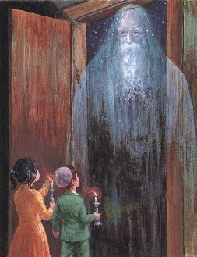
"Eliyahu Hanavi"
by Zalman
Kleinman
Notes:
http://www.chabad.org/holidays/passover/pesach_cdo/aid/504495/jewish/Why-Is-Elijah-the-Prophet-Invited-to-the-Seder.htm#footnote1a504495
What task: Comfort, prepare the way, turn hearts

Slide 50
So, Eliyahu comes in a spirit of protection, but also rebuke, calling to repentance, correction, as precursor to Deliverance.

Slide 51
^{Eph 1.3-6} Praised be ADONI, Father of our Lord Yeshua the Messiah, who in the Messiah has blessed us with every spiritual blessing in heaven. In the Messiah he chose us in love before the creation of the universe to be holy and without defect in his presence.
Notes:
But how does He get us to be holy and without defect. Do we have defects. Eliyahu came to prepare the way. What does G send to prepare us?

Slide 52
^{Eph 1.3-6} He determined in advance that through Yeshua the Messiah we would be his sons - in keeping with his pleasure and purpose - so that we would bring him praise commensurate with the glory of the grace he gave us through the Beloved One.
Notes:
What does G-d send to prepare us?
He usually sends us what we don’t want MOST, since it the center of our weakness.

Slide 53
^{Iyov/Job 3.25-26} For the thing I feared has overwhelmed me, what I dreaded has happened to me. I have no peace, no quiet, no rest; and anguish keeps coming."

Slide 54
^{Iyov/Job 3.25-26} ^{GW} What I fear most overtakes me. What I dread happens to me.
^{MSG} The worst of my fears has come true, what I've dreaded most has happened.

Slide 55
^{Iyov/Job 3.25-26} ^{CEB} for the thing I feared has overwhelmed me, what I dreaded has happened to me. have no peace, no quiet, no rest; and anguish keeps coming.“
^{Iyov/Job 3.25-26} ^{GNT} Everything I fear and dread comes true.

Slide 56
We are designed to live in joy.
^{1Thes. 5.16-18} Always be joyful. Pray regularly. In everything give thanks, for this is what God wants from you who are united with the Messiah Yeshua.

Slide 57
^{Ro 8.28-29} Furthermore, we know that God causes everything to work together for the good of those who love God and are called in accordance with his purpose; because those whom he knew in advance,

Slide 58
^{Ro 8.28-29} he also determined in advance would be conformed to the pattern of his Son, so that he might be the firstborn among many brothers.
Notes:
He usually sends us what we don’t want MOST, since it the center of our weakness.

Slide 59
The important thing about life is how we react. Our tikkun, תיקון soul correction in Messiah is what makes us grow in Him.
If our calling, tikkun, is to show forgiveness, we will be hurt. Embrace it in praise in Yeshua!
Notes:
Our tikkun, our Eliyahu.

Slide 60
If our calling, tikkun, is to show love, we will be rejected. Embrace it in praise in Messiah! “How can I grow?”
If our calling is to show approval, we’ll get disrespect. Embrace it in the Ruakh.
Notes:
These can be viewed as our personal Eliyahu, preparing the way for Messiah in our lives.

Slide 61
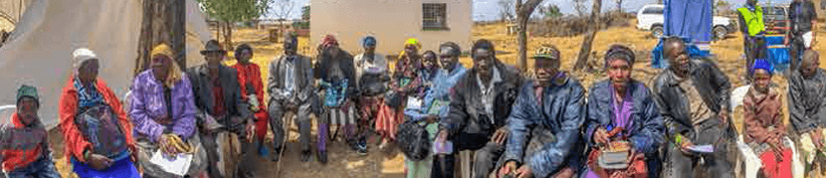
If your calling, tikkun, is generosity, you’ll have financial reversals. Live in gratitude. Cf. Spirit of entitlement. Masvingo story.

Slide 62
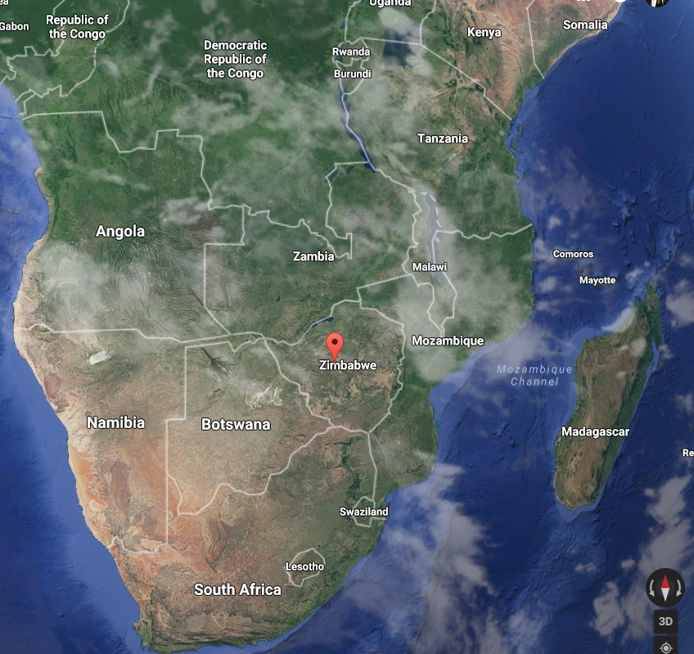

Slide 63
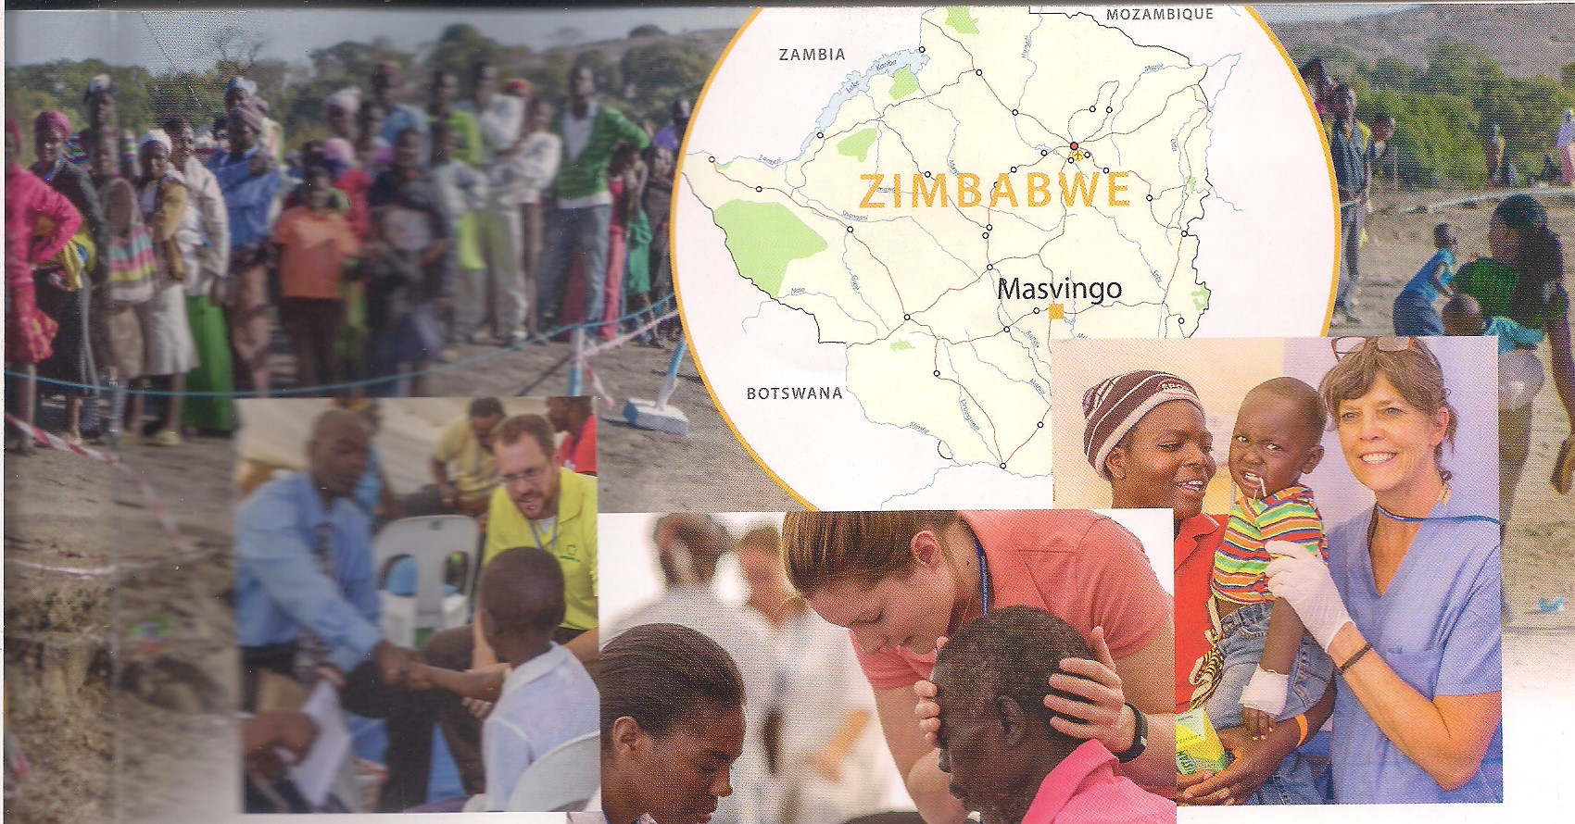
Notes:
http://www.jewishvoice.org/media/publications/articles/their-hearts-were-glad-masvingo-medical-clinic.html
Jewish Voice Jonathan Bernis, medical mission

Slide 64
The staff and volunteers had already seen countless people in previous days, and they knew the line would once again be lengthy when the clinic’s doors opened at daybreak. However, they weren’t prepared for what they saw at 3:30 in the morning as their flashlights scanned the outer perimeter of the clinic.
Already, an estimated 1,000 people who desperately needed free medical and dental care were queued outside, ready to receive the compassion and care of Yeshua through our staff and volunteers.
Notes:
http://www.jewishvoice.org/media/publications/articles/their-hearts-were-glad-masvingo-medical-clinic.html

Slide 65
Recognizing some familiar faces, the volunteers concluded that many of the people they were looking at had been there the day before but weren’t able to make it to the front of the line by the time the clinic closed. Instead, they spent the night outside.
Notes:
http://www.jewishvoice.org/media/publications/articles/their-hearts-were-glad-masvingo-medical-clinic.html

Slide 66
Rather than walking home and re-walking the many miles to get back, it was evident these masses had chosen to spend the last 20 hours in the clinic’s perimeter to retain their place in line so they would hopefully be seen today—the clinic’s last day.
Notes:
http://www.jewishvoice.org/media/publications/articles/their-hearts-were-glad-masvingo-medical-clinic.html

Slide 67
Unlike Western culture, where sleeping on an airfilled mattress with a sleeping bag to serve as a human placeholder for the latest tech product or the best seats at a sporting or music event is viewed as little more than an adventure, these hurting souls had spent the night in almost-freezing temperatures.
Notes:
http://www.jewishvoice.org/media/publications/articles/their-hearts-were-glad-masvingo-medical-clinic.html

Slide 68
Instead of sleeping bags to keep them warm or soft grass to lie on, many of the people slept on ice-cold granite outcroppings that had collected the evening’s bitter temperature. Jack Zimmerman recounts, “It broke our hearts to see the poverty and devastation… the images of what we saw transcends words.”
Notes:
http://www.jewishvoice.org/media/publications/articles/their-hearts-were-glad-masvingo-medical-clinic.html

Slide 69
Jack goes on, “Our hearts are to treat and minster to everyone within our reach. How can we feel that we’ve completed our work when we have to turn people away, especially women and babies?”
Notes:
http://www.jewishvoice.org/media/publications/articles/their-hearts-were-glad-masvingo-medical-clinic.html

Slide 70
But that didn’t deter the level of care and compassion in the hearts of the volunteers. Jack recalls one particular interaction that final day when the healing of Yeshua was present.
A young man who was weak and unable to walk on his own reached the front of the line. He was led by volunteers who’d quickly assessed that he was blind.
Notes:
http://www.jewishvoice.org/media/publications/articles/their-hearts-were-glad-masvingo-medical-clinic.html

Slide 71
After a thorough examination, it was determined that the blind man’s vision couldn’t be aided with the equipment on hand, but the physician who examined him felt confident that a procedure could be performed to restore the young man’s sight in nearby Harare.
Notes:
http://www.jewishvoice.org/media/publications/articles/their-hearts-were-glad-masvingo-medical-clinic.html

Slide 72
Although the amazing news of restored vision was one to be celebrated, the day was now drawing to an end, and the volunteers knew they had hard news to deliver to the crowd still waiting to be seen: the clinic would soon be closing for another year.
It was a heartbreaking moment as the volunteers prepared the announcement, but instead of the anticipated mass disappointment from those still waiting in line, something remarkable occurred.
Notes:
http://www.jewishvoice.org/media/publications/articles/their-hearts-were-glad-masvingo-medical-clinic.html

Slide 73
There was applause. It’s one of the ways the Lemba express their gratitude.
The volunteers had expected the possibility of an angry unsettling stemming from a sense of abandonment, but that’s a Western mindset
Notes:
http://www.jewishvoice.org/media/publications/articles/their-hearts-were-glad-masvingo-medical-clinic.html

Slide 74
where it’s more common than not to expect pandemonium when a store sells out of an item before it can be purchased by the masses. Shoppers who had camped out for hours so they could be in line when the stores opened certainly don’t applaud when they’re turned away.
Notes:
http://www.jewishvoice.org/media/publications/articles/their-hearts-were-glad-masvingo-medical-clinic.html

Slide 75
The concerned minds of the JVMI staff and volunteers were quieted by the applause. Jack says that he believes “everyone in that line was clapping because they knew that even though they wouldn’t receive what they needed that day, they knew we loved them enough to come out and do whatever we could to help.”
Notes:
http://www.jewishvoice.org/media/publications/articles/their-hearts-were-glad-masvingo-medical-clinic.html

Slide 76
The applause was their way of saying that although they never made it to the front of the line, they were thankful for our presence ... their hearts were glad and their souls rejoiced (Psalm 16:9).
Notes:
http://www.jewishvoice.org/media/publications/articles/their-hearts-were-glad-masvingo-medical-clinic.html

Slide 77
If our calling, tikkun, is orderly service, we will have a lot of lazy sloppy people to love and cheer. Embrace it in praise in Messiah! “How can I grow?”
Nourish your soul in the Word and prayer and praise and dance, and celebrate your tikkun. Faith

Slide 78
The important thing about life is how we react. Our tikkun, תיקון soul correction in Messiah is what makes us grow in Him.
What is your Eliyahu? Your difficult portal to growth in Messiah. Embrace it with praise!

Slide 79
Mattityahu (Matthew) 17:12
אֲבָל אוֹמֵר אֲנִי לָכֶם שֶׁאֵלִיָּהוּ כְּבָר בָּא וְלֹא הִכִּירוּהוּ אֶלָּא עָשׂוּ בּוֹ כִּרְצוֹנָם;
On the other hand, I tell you that Eliyahu has come already, and people did not recognize him but did whatever they pleased to him.
Notes:
We like to try to destroy our correction. Make them respect me.

Slide 80
Mattityahu (Matthew) 17:12
אֲבָל אוֹמֵר אֲנִי לָכֶם שֶׁאֵלִיָּהוּ כְּבָר בָּא וְלֹא הִכִּירוּהוּ אֶלָּא עָשׂוּ בּוֹ כִּרְצוֹנָם; כָּךְ גַּם בֶּן-הָאָדָם עָתִיד לִסְבֹּל מִיָּדָם."
In the same way, the Son of Man too is about to suffer at their hands."

