Slide 1
To easily follow these notes, log on to our Wifi
Wifi: mycci01
p/w: ancientquail060
Go to OrHaOlam.com
Click on downloads, messages, 2017

Slide 2
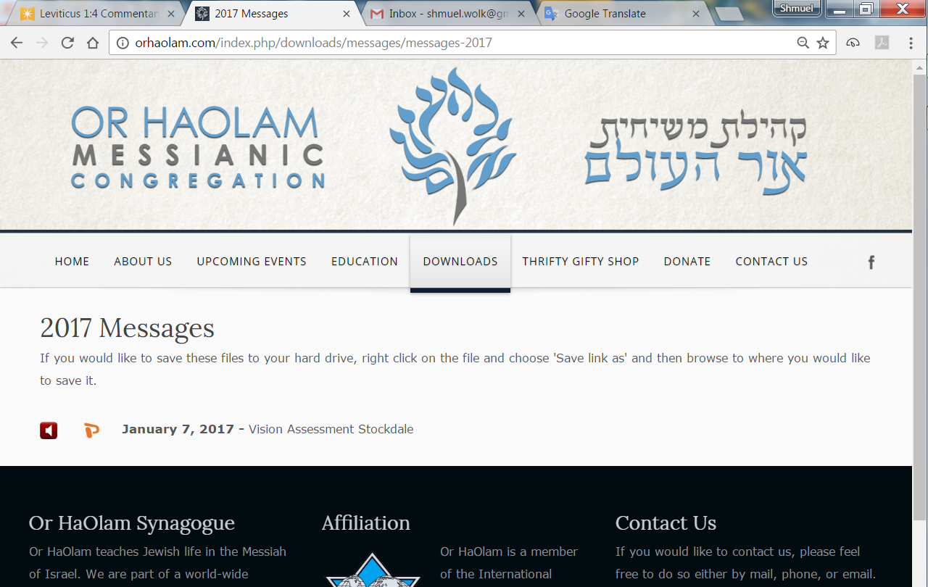

Slide 3
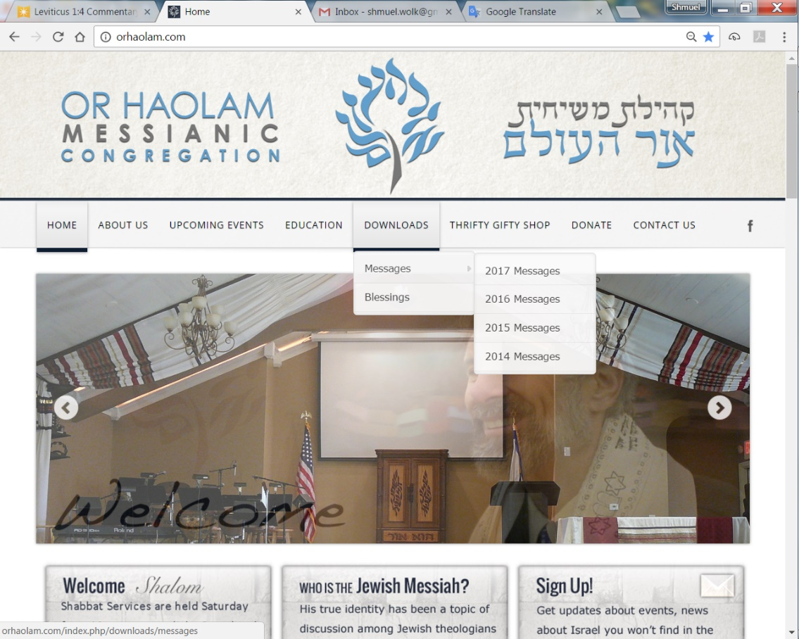
Downloads\messages\
2017 Messages
Notes:
Pres. Trump understands what is truly hindering peace in the Middle East Arab/Israeli sphere.

Slide 4
New version of counting the ‘Omer

Slide 5
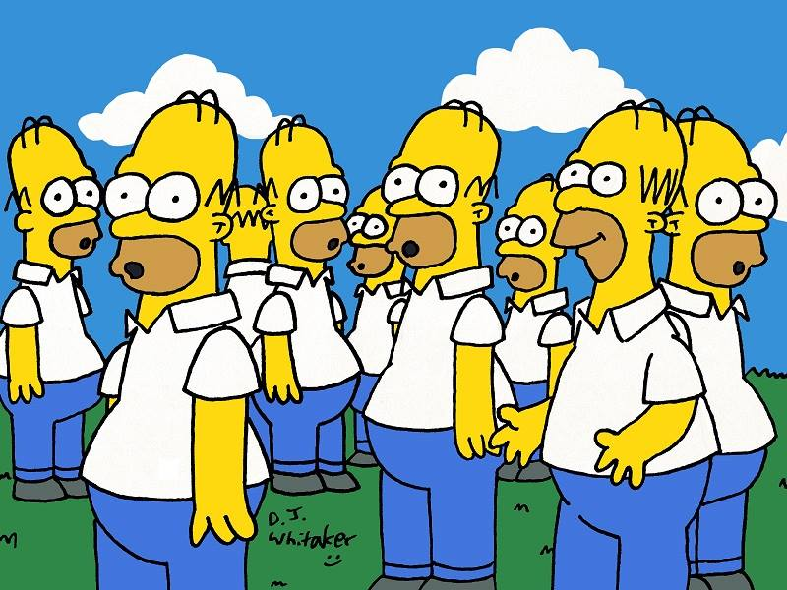
New version of counting the ‘Omer
Notes:
Homer Simpson 9 of him
Review of Israeli religious demographics, then Spring Holidays

Slide 6
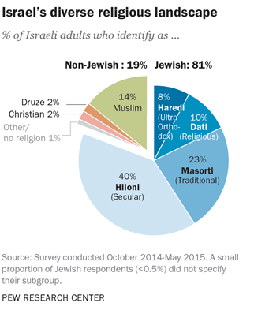
Notes:
http://www.pewforum.org/2016/03/08/israels-religiously-divided-society/
Note Hiloni חלוני largest subgroup Seculars, 40%
Masorti = traditional = Reform, Conservative, what you’ll see most of if you got to the Israel Ind Day event next month, instead of first Teerosh.

Slide 7
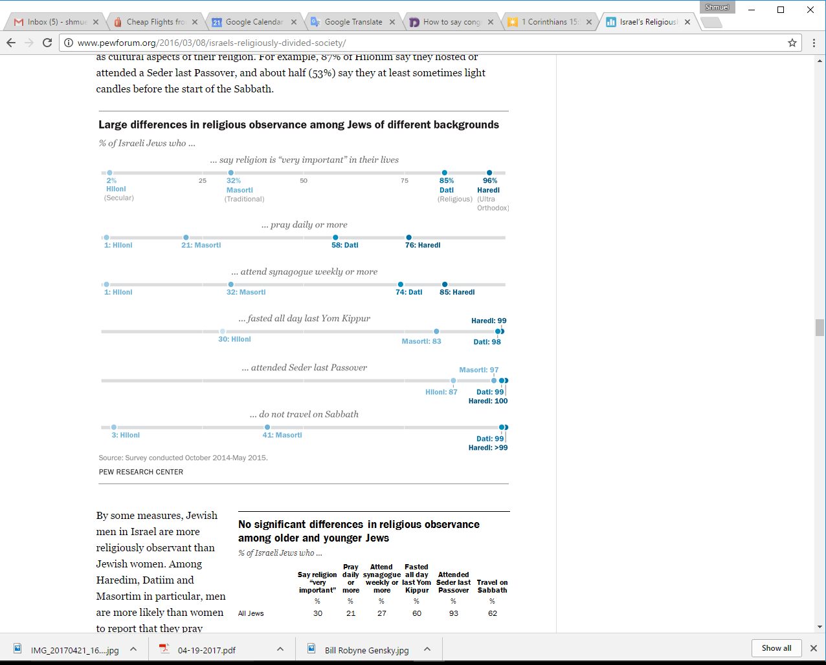
http://www.pewforum.org/
2016/03/08/israels-religiously-
divided-society/
Notes:
http://www.pewforum.org/2016/03/08/israels-religiously-divided-society/
Note especially the Hiloni=secular 40% population, Largest subgroup
Passover is the MOST kept part of Judaism. Last thing to be dropped if people are assimilating.

Slide 8
Vayikra/Lev 23 Spring holidays.
Pesakh = matzah vss. 5-8
First fruit Sheaves of the harvest vss 9-14 (barley)
Notes:
Many of us, hopefully most Or HaOlamniks, had Passover Seders, and celebrated the Exodus from Egypt via the lamb, and the Exodus from sin and guilt via the Lamb. Major event, last thing that is dropped when a Jewish person is assimilating.
Next: first fruit barley harvest
Since I had no idea what a sheaf of grain exactly was, maybe you don’t either.

Slide 9

Notes:
https://www.google.com/search?q=sheaf+definition&safe=active&rlz=1C1CHBF_enUS734US734&espv=2&source=lnms&tbm=isch&sa=X&ved=0ahUKEwimyIeUi7jTAhVC5YMKHYrkAhgQ_AUIBigB&biw=1160&bih=813#safe=active&tbm=isch&q=sheaf+definition&chips=q:sheaf%20definition,g_1:barley&imgdii=0-dIsU_VdTCgsM:&imgrc=k_vlR_h7iJUHUM:

Slide 10
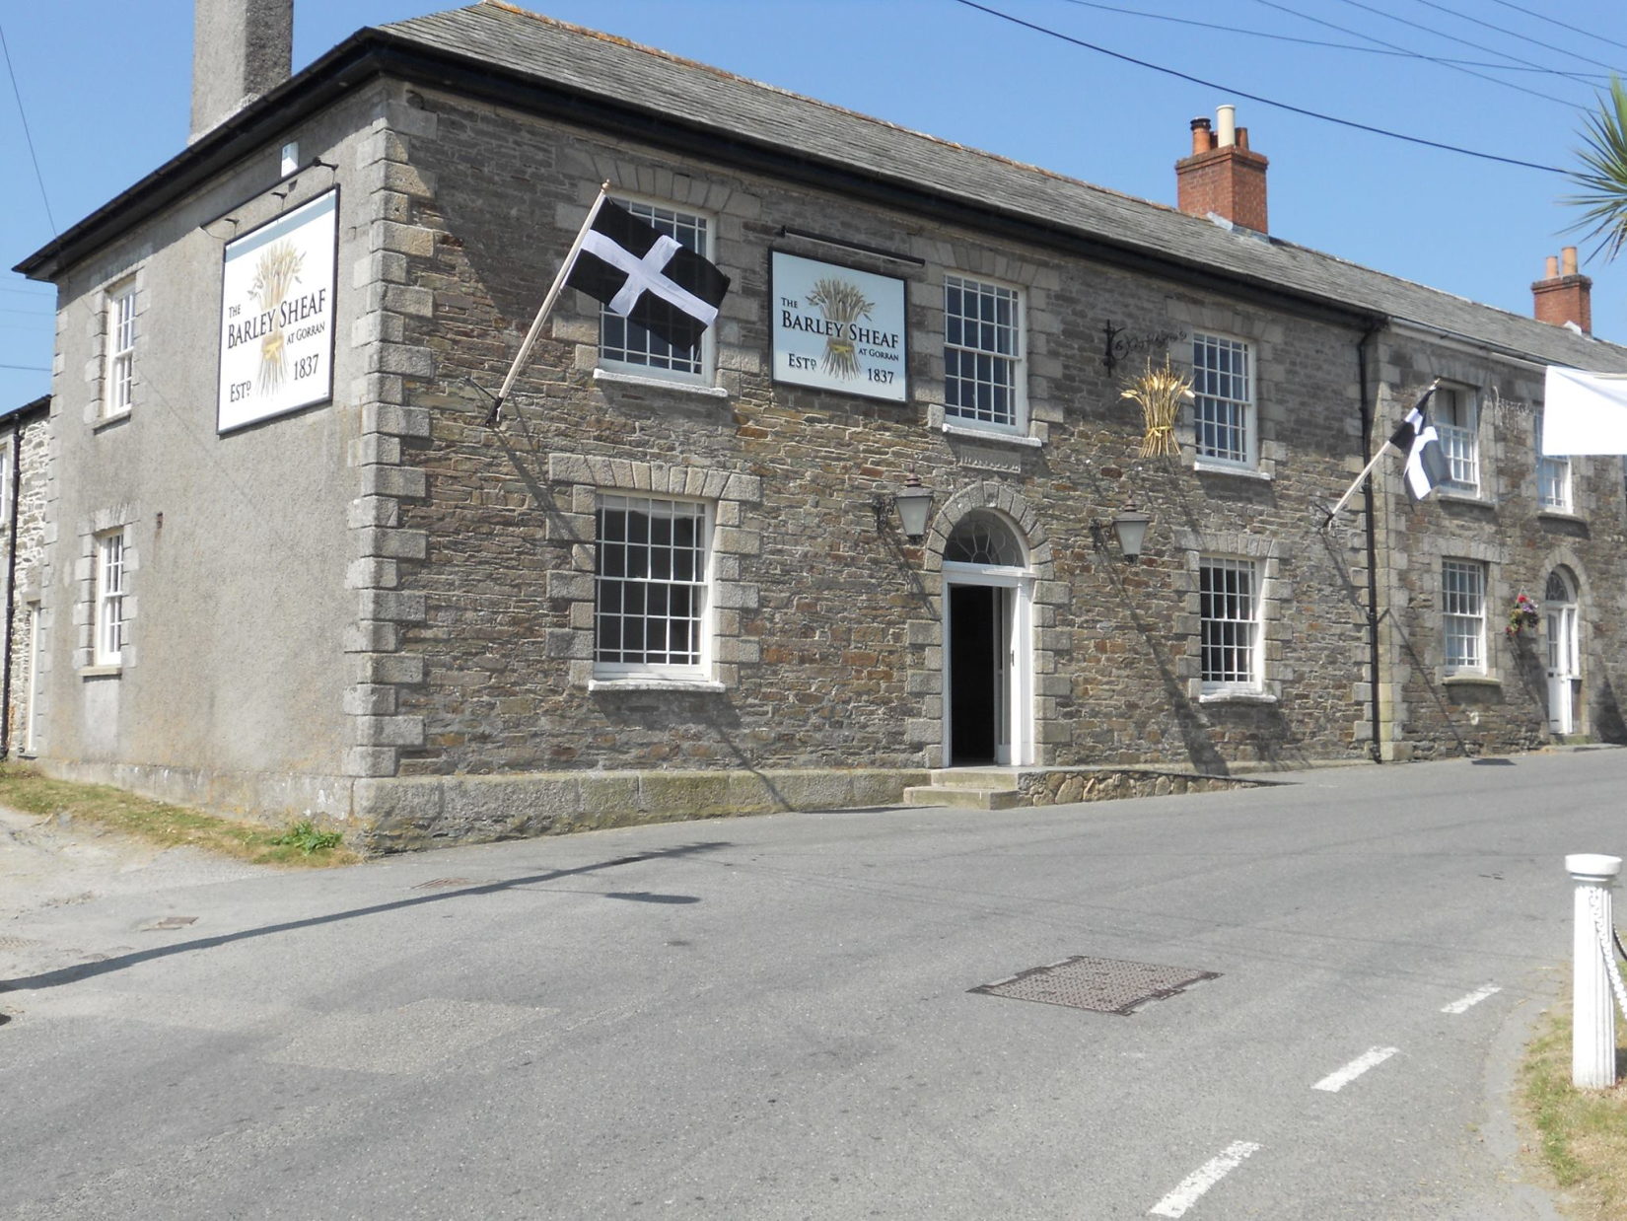
Notes:
https://www.facebook.com/The-Barley-Sheaf-at-Gorran-169947733042287/
This tastefully refurbished village pub serves fine Cornish ales & delicious locally sourced food. Regular live music events and weekly quiz night (Tues)

Slide 11
Vayikra/Lev 23 Spring holidays.
Counting of the Days of the Omer vss 15-16
Shavuot/ Weeks/ 50/ Pentecost vss. 17-21(Firstfruits of the wheat) [May 30, all night study and dairy fest]
Notes:
Back to the one right after Passover, firstfruit sheaf of barley [doesn’t say ‘barley’ in scripture, but that is the first grain to come up in the Middle East. Wheat is later. Mentioned that it was destroyed in the plagues of Egypt, but the wheat was OK, since later.]

Slide 12
First fruit Sheaves of the harvest Vayikra/Leviticus 23. 9-14 (barley)
Not on the chart above
No liturgy in any Siddur/prayer book or Makhzor [Holiday prayer book], though 6 verses in Torah!
No one stays off work.
Not at all observed in traditional Judaism
Notes:
What about us, Messianics?

Slide 13
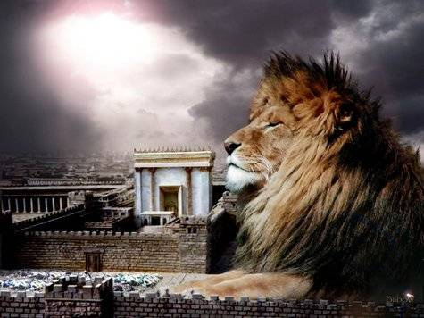
1 Corinthians 15:1-3

Slide 14
1 Corinthians 15:1
אַחַי, אֲנִי מַזְכִּיר לָכֶם אֶת הַבְּשׂוֹרָה שֶׁהִשְׁמַעְתִּי לָכֶם, בְּשׂוֹרָה אֲשֶׁר גַּם קִבַּלְתֶּם אוֹתָהּ וְגַם עוֹמְדִים אַתֶּם בָּהּ;
Now, brothers, I must remind you of the Good News which I proclaimed to you, and which you received, and on which you have taken your stand,

Slide 15
1 Corinthians 15:2
בְּאֶמְצָעוּתָהּ אַתֶּם גַּם נוֹשָׁעִים, אִם מַחֲזִיקִים אַתֶּם בַּדָּבָר שֶׁבִּשַּׂרְתִּי לָכֶם -- שֶׁאִם לֹא כֵן, לַשָּׁוְא הָיְתָה אֱמוּנַתְכֶם.
and by which you are being saved — provided you keep holding fast to the message I proclaimed to you. For if you don't, your trust will have been in vain.
Notes:
שָׁוְא
falsehood, futility ; (literary) vanity, emptiness

Slide 16
1 Corinthians 15:3
מָסַרְתִּי לָכֶם בָּרֹאשׁ וּבָרִאשׁוֹנָה מַה שֶּׁגַּם קִבַּלְתִּי, שֶׁהַמָּשִׁיחַ מֵת בְּעַד חֲטָאֵינוּ, לְפִי הַכְּתוּבִים;
For among the first things I passed on to you was what I also received, namely this: the Messiah died for our sins, in accordance with what the Tanakh says; [Where?]
Notes:
Most English versions “scriptures”
That is, He is the Passover Lamb

Slide 17
Not too difficult to find in Tanakh, Hebrew scriptures, where Messiah died for our sins, is the Passover Lamb:

Slide 18
^{Yeshayahu/Is 53 6-8} We all, like sheep, went astray; we turned, each one, to his own way; yet ADONI laid on him the guilt of all of us. Though mistreated, he was submissive - he did not open his mouth.

Slide 19
^{Yeshayahu/Is 53 6-8} Like a lamb led to be slaughtered, like a sheep silent before its shearers, he did not open his mouth. After forcible arrest and sentencing, he was taken away; and none of his generation protested
Notes:
Lamb imagery → Passover Lamb

Slide 20
^{Yeshayahu/Is 53 6-8} his being cut off from the land of the living for the crimes of my people, who deserved the punishment themselves.

Slide 21
^{Daniel 9.26} And after the sixty-two weeks Messiah shall be cut off, but not for Himself;
Notes:
Are other translations of the verse.
Back to Corinthian Letter summary of our core doctrine

Slide 22
1 Corinthians 15.4
and he was buried; and he was raised on the third day, in accordance with what the Tanakh says;
Where???
Notes:
That is, He is the first fruit sheave of the barley harvest.
Two issues to find in the Tanakh:
He was raised from the dead
He was raised on the third day.

Slide 23
1 Corinthians 15.19-22
But the fact is that the Messiah has been raised from the dead, the firstfruits of those who have died.
Notes:
Paul/Shaul thinks Messiah is this firstfruit sheaf.
This IS and important celebration to US as believers in Yeshua as Messiah, and there is a place for it in the Levitical cycle.

Slide 24
^{T’hillim/Ps 16.8-11} I always set ADONI before me; with him at my right hand, I can never be moved; so my heart is glad, my glory rejoices, and my body too rests in safety; for you will not abandon me to Sh'ol, you will not let your faithful one see the Abyss.
Notes:
Quoted by Kefa on Shavuot/Pentecost
Important to get understand of verse as in mind of original writer and hearers. Why rabbinics so valuable.
^{Apud Kimchi in v. 9.} “no worm or maggot should have power over him;” which is not true of David, nor of any but the Messiah.
Easy one. More? Says “scriptures”

Slide 25
^{Hoshea 6.1-3} Come, let us return to ADONI; for he has torn, and he will heal us; he has struck, and he will bind our wounds. After two days, he will revive us; on the third day, he will raise us up; and we will live in his presence.
Notes:
the Targum comes nearer the sense of it, which paraphrases the words thus, “he will quicken us in the days of consolation which are to come, and in the day of the resurrection of the dead he will raise us up.”
Evidence for both resurrection and third day.

Slide 26
Bereshit Rabba, sect. 56. fol. 49. 3.The Jewish writers take a particular notice of the third day
^{Beresheet/ Gen 22.4-5} On the third day, Avraham raised his eyes and saw the place in the distance. Avraham said to his young men, "Stay here with the donkey. I and the boy will go there, worship and return to you."
Notes:
Three days, Avraham considered Yitskak dead, but to be resurrected, and return.

Slide 27
Bereshit Rabba, sect. 56. fol. 49. 3.The Jewish writers take a particular notice of the third day
^{Beresheet/ Gen42.16-19} Send one of you, and let him bring your brother. Meanwhile, you will be kept in custody. This will prove whether there is any truth in what you say. Otherwise, as Pharaoh lives, you are certainly spies."
Notes:
All of them in custody and one goes back.

Slide 28
^{Beresheet/ Gen42.16-19} Then he put all of them together in prison for three days. On the third day, Yosef said to them, "Do what I say, and stay alive, for I fear God. If you are upright men, let one of your brothers remain

Slide 29
^{Beresheet/ Gen42.16-19} incarcerated in the prison you're being kept in, while you go and carry grain back to relieve the famine in your homes.
Notes:
Reversed. One jailed and rest go back. Three days to think his way to mercy.
So, there is a saying in the Talmud…

Slide 30
^{Mattanot Cehunah in ib}. “God does not leave the righteous in distress more than three days.”

Slide 31
^{Shmot/Ex 19.14-16} Moshe went down from the mountain to the people and separated the people for God, and they washed their clothing. He said to the people, "Prepare for the third day; don't approach a woman." On the morning of the third day,

Slide 32
^{Shmot/Ex 19.14-16} there was thunder, lightning and a thick cloud on the mountain. Then a shofar blast sounded so loudly that all the people in the camp trembled.
Notes:
1 Cor 7.5 fast from sexual intimacy. Third day revelation.

Slide 33
^{Yeshayahu 26.19} Your dead will live, my corpses will rise; awake and sing, you who dwell in the dust; for your dew is like the morning dew, and the earth will bring the ghosts to life.
Notes:
Not all the dead. This is a chapter on Judgment, but
20 Come, my people, enter your rooms, and shut your doors behind you. Hide yourselves for a little while until the wrath is past. 21 For see! ADONAI emerges from his place to punish those on earth for their sin. Then the earth will reveal the blood shed on it and no longer conceal its slain.

Slide 34
^{T’hillim/Ps 110.1} A psalm of David: ADONI says to my Lord, “Sit at my right hand, until I make your enemies your footstool.”
Notes:
Quoted 22x in the Messianic scriptures
``Says R. Joden, in the name of R. Khiyah, in time to come the holy blessed God will cause the king Messiah to sit at his right hand; as it is said, "the Lord said unto my Lord" Midrash Tillira in Psal. xviii. 35. apud Galatin. de Cath. ver. arcan. l. 8. c. 24. ''And the same says, R. Berachiah, in the name of R. Levi, elsewhere R. Moses Hadarsan in Gen. xviii. 1. apud ib.

Slide 35
^{T’hillim/Ps 110.1} A psalm of David: ADONI says to my Lord, “Sit at my right hand, until I make your enemies your footstool.”
Notes:
And, says, another of their writers R. Isaac Arama in Gen. xlvii. 6. spud ib. l. 3. c. 17.F9 Zohar in Num. fol. 99. 2. & Raya Mehimna, in ib. in Gen. fol. 37. 3. we do not find any man, or prophet, whose birth was prophesied of before the birth of his father and mother, but Messiah our righteousness; and of him it is intimated, "from the womb of the morning" i.e. before the womb of her that bore thee was created, thy birth was prophesied of: and this these words respect, "before the sun, his name is Yinnon", ( Psalms 72:17 ) i, e. before the creation of the sun, the name of our Messiah was strong and firm, and he shall sit at the right hand of God; and this is what is said, "sit at my right hand.“ ''In some writings of the Jewish people, the "Adon" or Lord, to whom these words are spoken, is interpreted of Messiah ben Joseph, whom they make to sit at the right hand of Abraham
Speculation David sitting there (Tovia Singer) Eliezer

Slide 36
^{T’hillim/Ps 110.7} He will drink from a stream as he goes on his way; therefore he will hold his head high.
Notes:
Down, then lifted up head, can be read as death, then resurrection.

Slide 37
^{Yehoshua/Josh 2.16} She told them, "Head for the hills, so that the pursuit party won't get their hands on you; and hide yourselves there for three days, until the pursuers have returned. After that, you can go on your way."
Notes:
Jarchi and Kimchi, observe that she had this by the revelation of the Holy Ghost,

Slide 38
^{Yonah 1.15-17} Then they picked up Yonah and threw him into the sea, and the sea stopped raging. Seized with great fear of ADONI, they offered a sacrifice to ADONI and made vows. ADONI prepared a huge fish to swallow Yonah;

Slide 39
^{Yonah 1.15-17} and Yonah was in the belly of the fish for three days and three nights.
Notes:
that is, one whole natural day, consisting of twenty four hours, and part of two others; the Jews having no other way of expressing a natural day but by day and night; and to this the antitype answers; namely, So it’s figured by the Orthodox for Shiva.

Slide 40
^{Ezra 8.15-16} I assembled them by the river that runs to Ahava, and we camped there three days. I reviewed the people and the cohanim but found no L'vi'im there. So I sent for Eli'ezer…who were leaders

Slide 41
^{Ezra 8.15-16} who were men of discernment...so that they would bring us men to minister in the house of our God.

Slide 42
^{Thillim/Ps 68 18-20} After you went up into the heights, you led captivity captive, you took gifts among mankind, yes, even among the rebels, so that Yah, God, might live there. Blessed be Adonai! Every day he bears our burden,

Slide 43
^{Thillim/Ps 68 18-20} does God, our salvation. (Selah) Our God is a God who saves; from ADONAI Adonai comes escape from death.

Slide 44
^{Isaiah 25.7-8} On this mountain he will destroy the veil which covers the face of all peoples, the veil enshrouding all the nations. He will swallow up death forever. Adoni ELOHIM will wipe away the tears from every face,
Notes:
the Jewish writers interpret Gloss. in T. Bab. Sanhedrin, fol. 94. Misna, Moed Katon, c. 3. sect. 9. Midrash Kohelet, fol. 61. 2.it of the future state, when those that live again shall die no more, and there will be no death; and of the days of the Messiah, when the dead will be raised
Zohar in Gen. fol. 73. 1. Shemot Rabba, sect. 20. fol. 131. 4.

Slide 45
^{Isaiah 25.7-8} and he will remove from all the earth the disgrace his people suffer. For ADONI has spoken.

Slide 46
^{Hoshea 13-14.15} Should I ransom them from the power of Sh'ol? Should I redeem them from death? Where are your plagues, death; where is your destruction, Sh'ol?
Notes:
Quoted by Shaul later in 1 Cor 15.55

Slide 47
^{1 Cor 15.54-57} When what decays puts on imperishability and what is mortal puts on immortality, then this passage in the Tanakh will be fulfilled: "Death is swallowed up in victory. "Death, where is your victory? Death, where is your sting?"

Slide 48
^{1 Cor 15.54-57} The sting of death is sin; and sin draws its power from the Torah; But thanks be to God, who gives us the victory through our Lord Yeshua the Messiah!

Slide 49
So, there are many Hebrew scripture that speak of the resurrection of Messiah, some poetically, mystically, but well understood. Several on the third day resurrection.

Slide 50
1 Corinthians 15.4
He was buried; and he was raised on the third day, in accordance with what the Tanakh says;
Notes:
That is, He is the first fruit sheave of the barley harvest.

Slide 51
Application to us of this assured resurrection:
Certainty of faith in Messiah
Certainty of our future life
Carefulness of practice
Celebration of praise

Slide 52
Certainty of Faith:
  The above proves that the death resurrection of Messiah is foretold in the Hebrew scriptures.
  For historical and other proofs/evidence of the resurrection, see

Slide 53
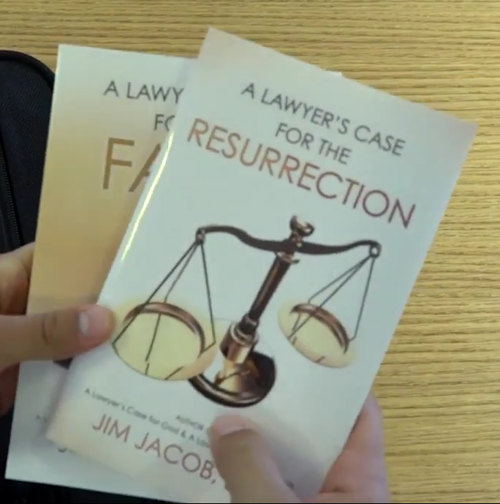
JimJacobBooks.com

Slide 54
2. Our certainty of future as believers

Slide 55
1 Corinthians 15.19-22
But the fact is that the Messiah has been raised from the dead, the firstfruits of those who have died. For since death came through a man, also the resurrection of the dead has come through a man.
Notes:
This IS and important celebration to US as believers in Yeshua as Messiah, and there is a place for it in the Levitical cycle.

Slide 56
1 Corinthians 15.19-22
For just as in connection with Adam all die, so in connection with the Messiah all will be made alive.

Slide 57
1 Corinthians 15.23
But each in his own order: the Messiah is the firstfruits; then those who belong to the Messiah, at the time of his coming;

Slide 58
3. Our carefulness of practice
Notes:
If we are eligible for resurrection, how should we then live?

Slide 59
^{1 Thes 4.13-14} Now, brothers, we want you to know the truth about those who have died; otherwise, you might become sad the way other people do who have nothing to hope for.

Slide 60
^{1 Thes 4.13-14} For since we believe that Yeshua died and rose again, we also believe that in the same way God, through Yeshua, will take with him those who have died.

Slide 61
^{1 Thes 3.12-13} May God our Father and our Lord Yeshua direct our way to you. And as for you, may the Lord make you increase and overflow in love toward each other, indeed, toward everyone, just as we do toward you;

Slide 62
^{1 Thes 3.12-13} so that he may give you the inner strength to be blameless, by reason of your holiness, when you stand before God our Father at the coming of our Lord Yeshua with all his angels.
Notes:
I don’t want there to be anything doubtful, in my life, when I’m gone, for people to fret over.
A bit of practical holy living guidance, that’s been reviled lately…

Slide 63
The Billy Graham Rule has taken a bit of beating recently, after a Washington Post profile revealed that Vice President Mike Pence follows a version of the rule. It’s set off a fierce debate over whether the rule safeguards marriages from adultery, harms women in the church, or is just plain sexist.

Slide 64
But most reports have neglected to mention that there’s not just one Billy Graham rule. There are four. They deal with money, sex, power, and lies and were part of something known as

Slide 65
the Modesto Manifesto. Set up in the 1940s, the rules were meant to keep Graham and his organization away from the pitfalls that have taken down American celebrity preachers.

Slide 66
Operate with financial transparency.
Avoid even the appearance of sexual immorality.
Avoid criticizing other pastors and congregations.
Be painstakingly honest in all publicity.

Slide 67
4. Our celebration life of praise

Slide 68
Don Finto
I'm glad I can't remember many of the circumstances, but I do remember that some years back, I was so troubled about a lot of things, that all night long I kept crying out to God, "Help!"
Notes:
https://mail.google.com/mail/u/0/#search/revive+israel/15b90f4fb33e924a

Slide 69
Don Finto
However, I never got into the throne room! All night long, my thoughts were on myself, my problems, and my needs.
Notes:
https://mail.google.com/mail/u/0/#search/revive+israel/15b90f4fb33e924a

Slide 70
Don Finto
We do not "enter His gates," crying, "Help!" We do not even enter His gates confessing our sins. We do not even know what sins to confess until we get before Him.
Notes:
https://mail.google.com/mail/u/0/#search/revive+israel/15b90f4fb33e924a

Slide 71
Don Finto
We enter His gates with thanksgiving and praise (see Psalm 100). This may be difficult at first, but then we get to enter in to the glory of Who God is, What Yeshua has done for us
Notes:
https://mail.google.com/mail/u/0/#search/revive+israel/15b90f4fb33e924a

Slide 72
Don Finto
the work of His Spirit in our lives, and become lost in a sea of hope and trust. We are again aware of His goodness, His mercy, His love, and His forgiveness.
Notes:
https://mail.google.com/mail/u/0/#search/revive+israel/15b90f4fb33e924a

Slide 73
1 Corinthians 15.19-22
But the fact is that the Messiah has been raised from the dead, the firstfruits of those who have died. For since death came through a man, also the resurrection of the dead has come through a man.
Notes:
This IS and important celebration to US as believers in Yeshua as Messiah, and there is a place for it in the Levitical cycle.

Slide 74
Application to us of this assured resurrection:
Certainty of faith in Messiah
Certainty of our future life
Carefulness of practice
Celebration of praise

