Slide 1
To easily follow these notes, log on to our Wifi
Wifi: mycci01
p/w: ancientquail060
Go to OrHaOlam.com
Click on downloads, messages, 2017

Slide 2
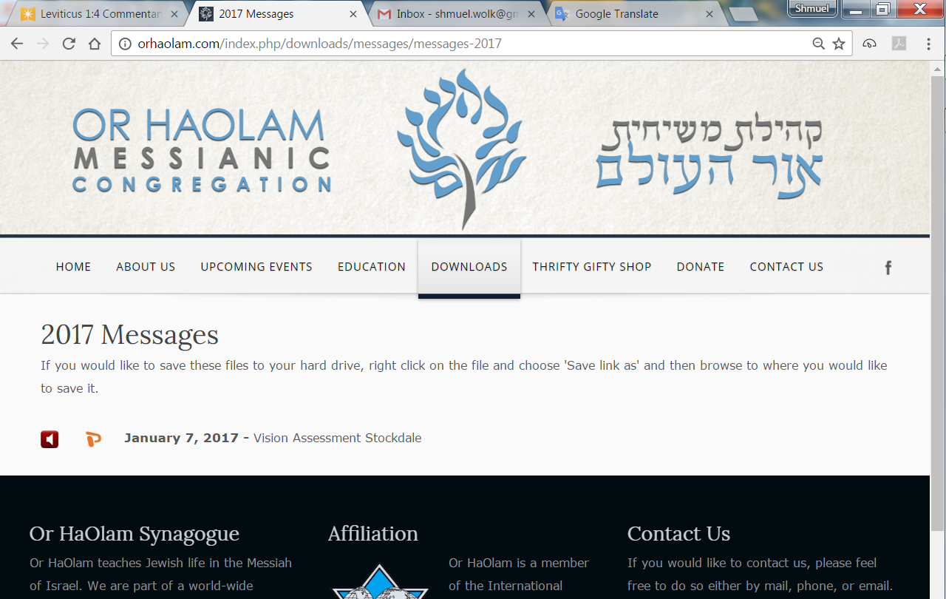

Slide 3
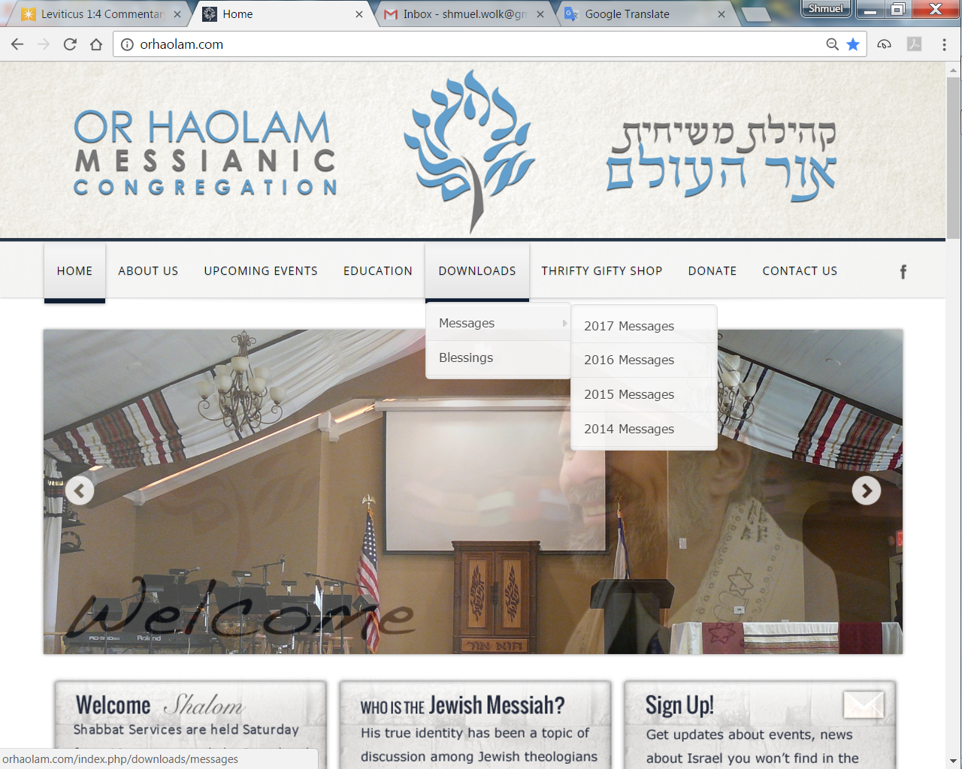
Downloads\messages\
2017 Messages

Slide 4
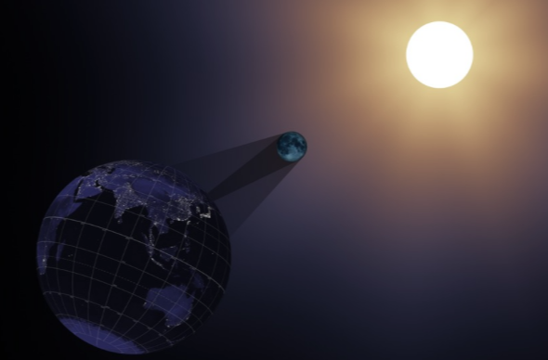
Total Solar Eclipse
Aug 21, 2017
Notes:
Penumbra → partial eclipse
umbra = totality, small shadow
Every 400 years given location

Slide 5

Shelter #20 at Claybrook
Email admin@orHaOlam.com
if you’re going
Notes:
Need a game and a food coordinator.

Slide 6
9 picnic tables
1 large grill and 2 small grills
20 amp service
Water hydrant 25 yards from shelter
Restroom with flush toilets 120 yards from shelter.
Close to Jesse James Farm Museum
21211 Jesse James Farm Rd.,
Kearney, MO 64060

Slide 7

Mother’s Day May 14
Notes:
http://www.drjamesdobson.org/#

Slide 8
The modern holiday of Mother's Day was first celebrated in 1908, when Anna Jarvis held a memorial for her mother at St Andrew's Methodist Church in Grafton, West Virginia. St Andrew's Methodist Church now holds the International Mother's Day Shrine.
Notes:
https://en.wikipedia.org/wiki/Mother%27s_Day

Slide 9
Her mother, Ann Reeves Jarvis, had been a peace activist who cared for wounded soldiers on both sides of the American Civil War, and created Mother's Day Work Clubs to address public health issues.
Notes:
https://en.wikipedia.org/wiki/Mother%27s_Day

Slide 10
By 1911 all US states observed the holiday, with some of them officially recognizing Mother's Day as a local holiday, the first being West Virginia, Jarvis' home state, in 1910.
Notes:
https://en.wikipedia.org/wiki/Mother%27s_Day

Slide 11
In 1914, Woodrow Wilson signed a proclamation designating Mother's Day, held on the second Sunday in May, as a national holiday to honor mothers.
Notes:
https://en.wikipedia.org/wiki/Mother%27s_Day
An entirely scriptural idea

Slide 12
^{Eph 6.2-3 quoting Shmot/Ex 20.} “Honor your father and mother” - this is the first commandment that embodies a promise – “so that it may go well with you, and you may live long in the Land.”
Notes:
Idolatry and disrespect for the Name precede this in the Aseret HaDibrot, עשרת הדברות the Ten Commands, and have negative consequences attached. This is the first with positive consequences.
It is the fifth commandment in the decalogue, it is reckoned by the Jewish commentators Devarim Rabba, sect. 6. fol. 241. 3 the weightiest of the weightiest commands of the law; and the reward bestowed on it, is length of days.
So, I want to build this concept of honoring mothers, and start by picturing it, in graphics and verbally.

Slide 13
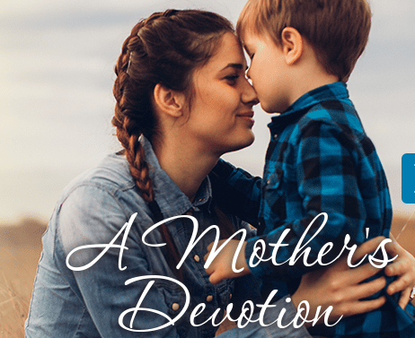
Notes:
http://www.drjamesdobson.org/#

Slide 14

Notes:
And a word picture…

Slide 15
^{Mishlei/Prov 31.26}
פִּיהָ פָּתְחָה בְחָכְמָה;
וְתוֹרַת חֶסֶד, עַל-לְשׁוֹנָהּ.
She opens her mouth with wisdom — a lesson of kindness is on her tongue.
Notes:
Literally, the Torah of kindness, teaching of kindness. Her words are the epitome of kindness. Yes? Let’s explore.

Slide 16
The moment a child is born, the mother is also born. She never existed before. The woman existed, but the mother, never. A mother is something absolutely new.
Notes:
http://www.withaspin.com/2013/02/12/birth-of-a-mother-a-transformation/
One woman writes:

Slide 17
Before I became a mom, I never felt my heart break into million pieces when I couldn’t stop a cry, or that someone so small can have such profound influence on me, or could make me feel so important.
Notes:
http://www.withaspin.com/2013/02/12/birth-of-a-mother-a-transformation/

Slide 18
The love, the joy, the magic. I never imagined I would love being a mom until I became one. I am astonished at nature’s grace and thank the Almighty each day for the miraculous decision that I made.
Notes:
http://www.withaspin.com/2013/02/12/birth-of-a-mother-a-transformation/

Slide 19
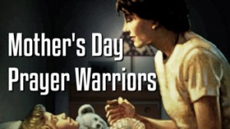
Notes:
Power of a Mother’s Prayers and heart.
The Power of a Praying Woman
Book by Stormie Omartian
Exemplified in scripture by one mother and grandmother team. We don’t know anything about the dad in this story.

Slide 20
^{2 Tim. 1.5-6} I recall your sincere trust, the same trust that your grandmother Lois and your mother Eunice had first; and I am convinced that you too now have this trust.

Slide 21
^{2 Tim. 1.5-6} For this reason, I am reminding you to fan the flame of God's gift, which you received through s'mikhah [laying on of hands] from me.
Notes:
Fan the flame…evidently imparted from his mom and grandma!

Slide 22
^{Mishlei/Prov 31.26}
פִּיהָ פָּתְחָה בְחָכְמָה;
וְתוֹרַת חֶסֶד, עַל-לְשׁוֹנָהּ.
She opens her mouth with wisdom — a lesson of kindness is on her tongue.
Notes:
This description goes along with the Omer counting fast I’ve been speaking of for a few weeks…fasting from words of unkindness.
Again!? Yes, it fits this prototype mom image.

Slide 23
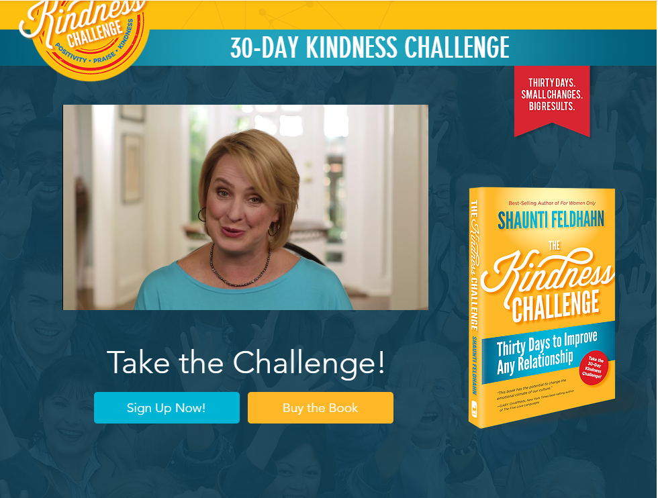
jointhekindnesschallenge.com/
Notes:
http://www.jointhekindnesschallenge.com/
Here is the summary. Pick a target person. Maybe a spouse, congregant, neighbor, co-worker, son/daughter, parent, etc.

Slide 24
Say nothing negative/negatively about your person—either to them or about them to somebody else. (If you must provide honest, negative feedback to or about a colleague or child for vital reasons, be constructive, helpful and encouraging, without a negative tone.)
Notes:
Shaunti Feldhahn: Kindness Challenge

Slide 25
Every day (or as often as possible), find one thing positive that you can sincerely praise or affirm about your person and tell them, and tell someone else. (i.e. Tell your mother-in-law, "Thanks for being willing to watch the kids last night
Notes:
Shaunti Feldhahn: Kindness Challenge "Purposeful praise is the antidote to the human tendency to focus on what we don't have rather than what we do. It is the prescription for becoming content and happy no matter our situation." –The Kindness Challenge

Slide 26
while we were at that meeting," and then tell your husband the same thing. Without bringing up that she let the kids stay up way too late again.)
Notes:
Shaunti Feldhahn: Kindness Challenge

Slide 27
Every day (or as often as possible), do one small act of kindness or generosity for your person.
Notes:
Shaunti Feldhahn: Kindness Challenge

Slide 28
President Theodore Roosevelt said, “When all is said, it is the mother, and the mother only, who is a better citizen than the soldier who fights for his country. The successful mother, the mother who does her part in rearing and training aright the boys and girls
Notes:
(in Encyclopedia of 7,700 Illustrations, by Paul Tan [Assurance Publishers], p. 845).
https://bible.org/seriespage/lesson-11-influence-godly-mothers-2-timothy-15-314-17

Slide 29
who are to be the men and women of the next generation, is of greater use to the community, and occupies, if she only would realize it, a more honorable as well as more important position than any man in it.
Notes:
(in Encyclopedia of 7,700 Illustrations, by Paul Tan [Assurance Publishers], p. 845).
https://bible.org/seriespage/lesson-11-influence-godly-mothers-2-timothy-15-314-17

Slide 30
The mother is the one supreme asset of the national life. She is more important, by far, than the successful statesman, or businessman, or artist, or scientist”
Notes:
(in Encyclopedia of 7,700 Illustrations, by Paul Tan [Assurance Publishers], p. 845).
https://bible.org/seriespage/lesson-11-influence-godly-mothers-2-timothy-15-314-17
James Dobson tells the following story of the influence of a mother in nature:

Slide 31
Horrendous fires ravaged Yellowstone National Park in June 1988. Birds and ground creatures fled for their lives as flames raced through the forest. One of those birds was a little mother who had laid her eggs in a bush at the base of a tree.
Notes:
https://mail.google.com/mail/u/0/#inbox/15bf77619cfe86e1

Slide 32
After the fires had been extinguished, a park ranger found her charred body still on the nest. She had remained on her eggs as she burned. They survived. She did not.
Notes:
https://mail.google.com/mail/u/0/#inbox/15bf77619cfe86e1

Slide 33
Notes:
http://www.drjamesdobson.org/#

Slide 34
^{Mishlei/Prov 31.26}
פִּיהָ פָּתְחָה בְחָכְמָה;
וְתוֹרַת חֶסֶד, עַל-לְשׁוֹנָהּ.
She opens her mouth with wisdom — a lesson of kindness is on her tongue.
Notes:
Two lessons:
Moms: live up to this.
All of us have Mom’s. Remember and treasure these words.

Slide 35
So the kind words of a mother are the spiritual milk and lifeblood of healthy development.
Ladies, pray to have this!
But, what if…

Slide 36
her inner Cruella DeVille comes out.
Notes:
Shaunti Feldhan Kindness Challenge

Slide 37


Slide 38
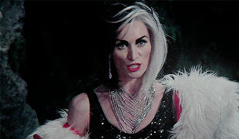
Notes:
Beautiful, powerful, but not so ideal.

Slide 39
How do we honor the mothers and wives who seem to be not always, or often, or barely ever, of exemplary nurturing speech?

Slide 40
^{1 Cor 13.7 NKJV} Love…bears all things, believes all things, hopes all things, endures all things.
^{CJB} Love always bears up, always trusts, always hopes, always endures.

Slide 41

Notes:
47, 48-49, 51, 52, 56, 58
I was discipled by John Wesley. Listen to these words of warmth and life:

Slide 42
John Wesley’s commentary: “Love bears all things.” Whatever evil the lover of mankind sees, hears, or knows of any one, he mentions it to none; it never goes out of his lips, unless where absolute duty constrains to speak.

Slide 43
John Wesley’s commentary: “Believes all things” - Puts the most favourable construction on everything, and is ever ready to believe whatever may tend to the advantage of any one character.

Slide 44
John Wesley’s commentary: And when it can no longer believe well, it hopes whatever may excuse or extenuate the fault which cannot be denied. Where it cannot even excuse, it hopes God will at length give repentance unto life.

Slide 45
John Wesley’s commentary: Meantime it endures all things - Whatever the injustice, the malice, the cruelty of men can inflict. He can not only do, but likewise suffer, all things, through the Messiah who strengthens him.

Slide 46


Slide 47
^{Yaakov [Jas.] 1:19} Therefore, my dear brothers, let every person be quick to listen but slow to speak, slow to get angry;
Notes:
Before you react with hurt, or continue to remember with wounding, consider what other construction could be put on your Mom’s/wife’s words.

Slide 48
^{Mishlei/Prov 31.26}
פִּיהָ פָּתְחָה בְחָכְמָה;
וְתוֹרַת חֶסֶד, עַל-לְשׁוֹנָהּ.
She opens her mouth with wisdom — a lesson of kindness is on her tongue.
This is a prayer statement, as well as a description.

Slide 49
^{Mark 11.22-25} And Yeshua answered, saying to them, “Have faith in God! Amen, I tell you, if someone says to this mountain, ‘Be taken up and thrown into the sea,’ and does not doubt in his heart but trusts that what he says is happening, so shall it be for him.

Slide 50
^{Mark 11.22-25} For this reason I say to you, whatever you pray and ask, believe that you have received it, and it will be yours. Whenever you stand praying, if you have anything against anyone, forgive him, so that your Father in heaven may also forgive you your transgressions.”
Notes:
By the power of the death and resurrection of Messiah, we believe when we can’t see.

Slide 51
Honor good words.
Believe the BEST for the questionable words.
Trust for Yeshua to establish better words in their mouth!

